Slide 1
Novel Diagnostics update
06/09/21
M. Marchevsky (LBNL)

Slide 2
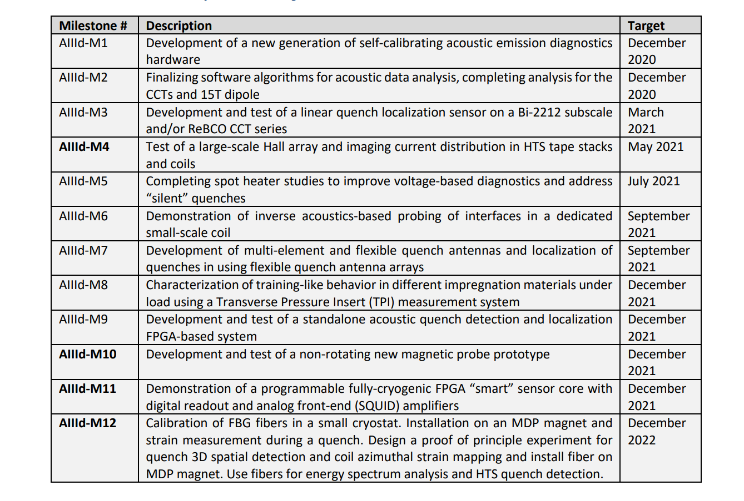
Diagnostics milestone table
Next generation acoustic hardware (LBNL)
Acoustic data analysis completed for 15 T (LBNL), CCT4 and subscale 2 – in progress (LBNL). New ML algorithms for quench precursors (FNAL)
In progress, new developments (LBNL)
Hall array hardware built, tested on CORC (LBNL)
Talks in progress at FNAL for implementing these studies
TBD (LBNL)
MQXFA QA built and delivered, warm bore tube QA structures are ready as well (FNAL). CCT subscale antennas (LBNL)
New tests with matrimid and organic resins mixed with high-Cp ceramics are planned at FNAL
Non-FPGA portion was built and tested (LBNL, BNL). Upgrade to FPGA TBD towards the target date
TBD (LBNL, FNAL) – likely early 2022
New DAQ boards, performance characterized for various cryo-parts. One channel cryo-system to be tested by the end of 2021 (LBNL)
Progress with early tests. Modifications to vertical test facility to integrate fibers. (FNAL, BNL)

Slide 3
Key questions
How do we resolve and properly identify mechanical and electromagnetic disturbances in SC Nb3Sn magnets [2,3] and understand the physics of the training process?
How do we non-invasively localize weak points and interfaces where mechanical disturbances that cause premature quenching are taking place? Can we manipulate those interfaces in situ to improve magnet performance?
How do we achieve a reliable and minimally invasive quench detection and localization capability for HTS [4-7] and hybrid HTS/LTS [8] magnets? Can we practically realize a new paradigm of HTS magnet operation where quenching can be avoided altogether through an early detection?
How do we resolve current sharing patterns and stress-driven defect accumulation in HTS coils and cables to ensure their long-term operational stability and quenching resilience?
Can we advance magnetic field measurements to the next level using arrays of miniature magnetic sensors combined with computationally-advanced field reconstruction algorithms?
Can we drastically simplify diagnostics instrumentation while making it more efficient and reliable by using cryogenic electronics, in particular FPGAs and quantum sensors?

Slide 4
Diagnostics WG: general activities
WG meetings
Acoustic data: comparing energy release in 15 T and the CCT subscales (S. Krave, MM)
Quench antenna development (J. di Marco, R. Teyber)
Hall arrays results for CORC (R. Teyber)
TFDR for quench detection (G.S. Lee)
HFM Workshop
https://indico.cern.ch/event/1012691/contributions/4291386/attachments/2227282/3773134/Advanced%20testing%20for%20HFM.pdf
Advanced testing for HFM (cern.ch)
New diagnostics group members:
Geon Seok LEE (postdoc) - quench detection with RF and acoustics

Slide 5
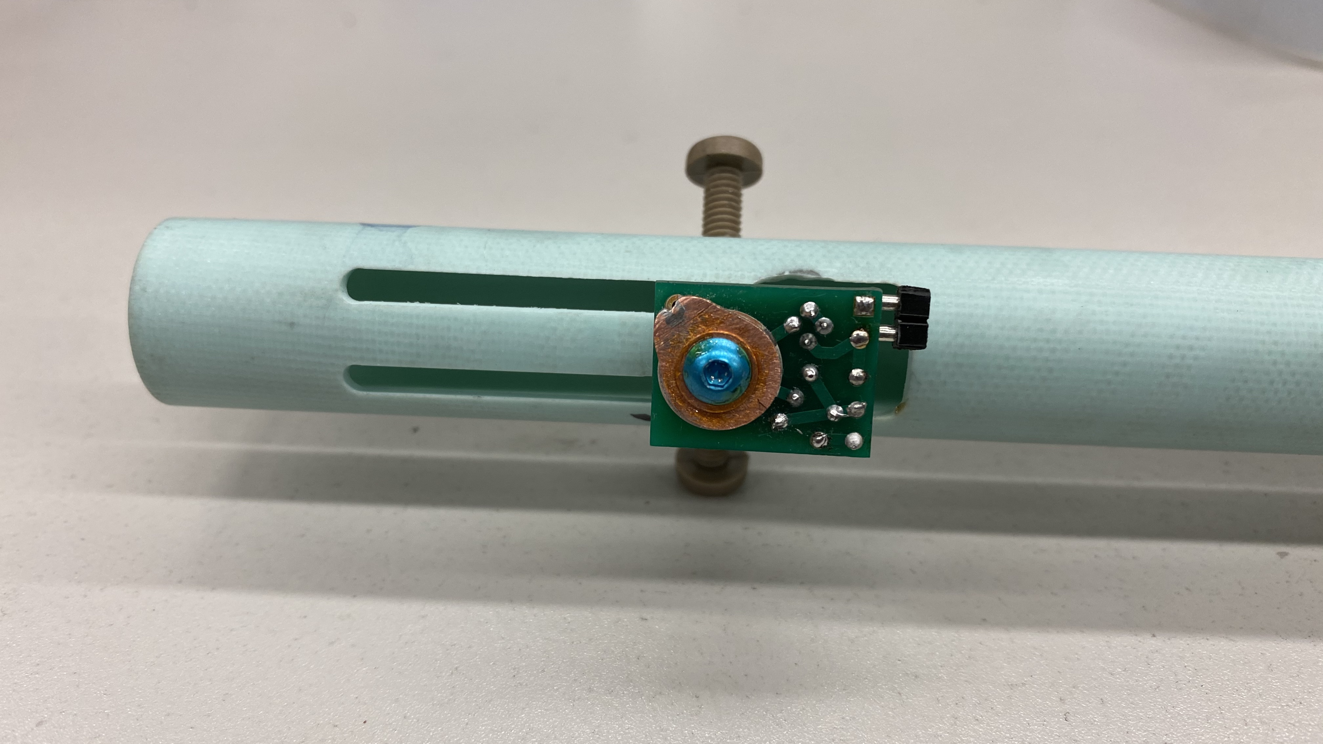
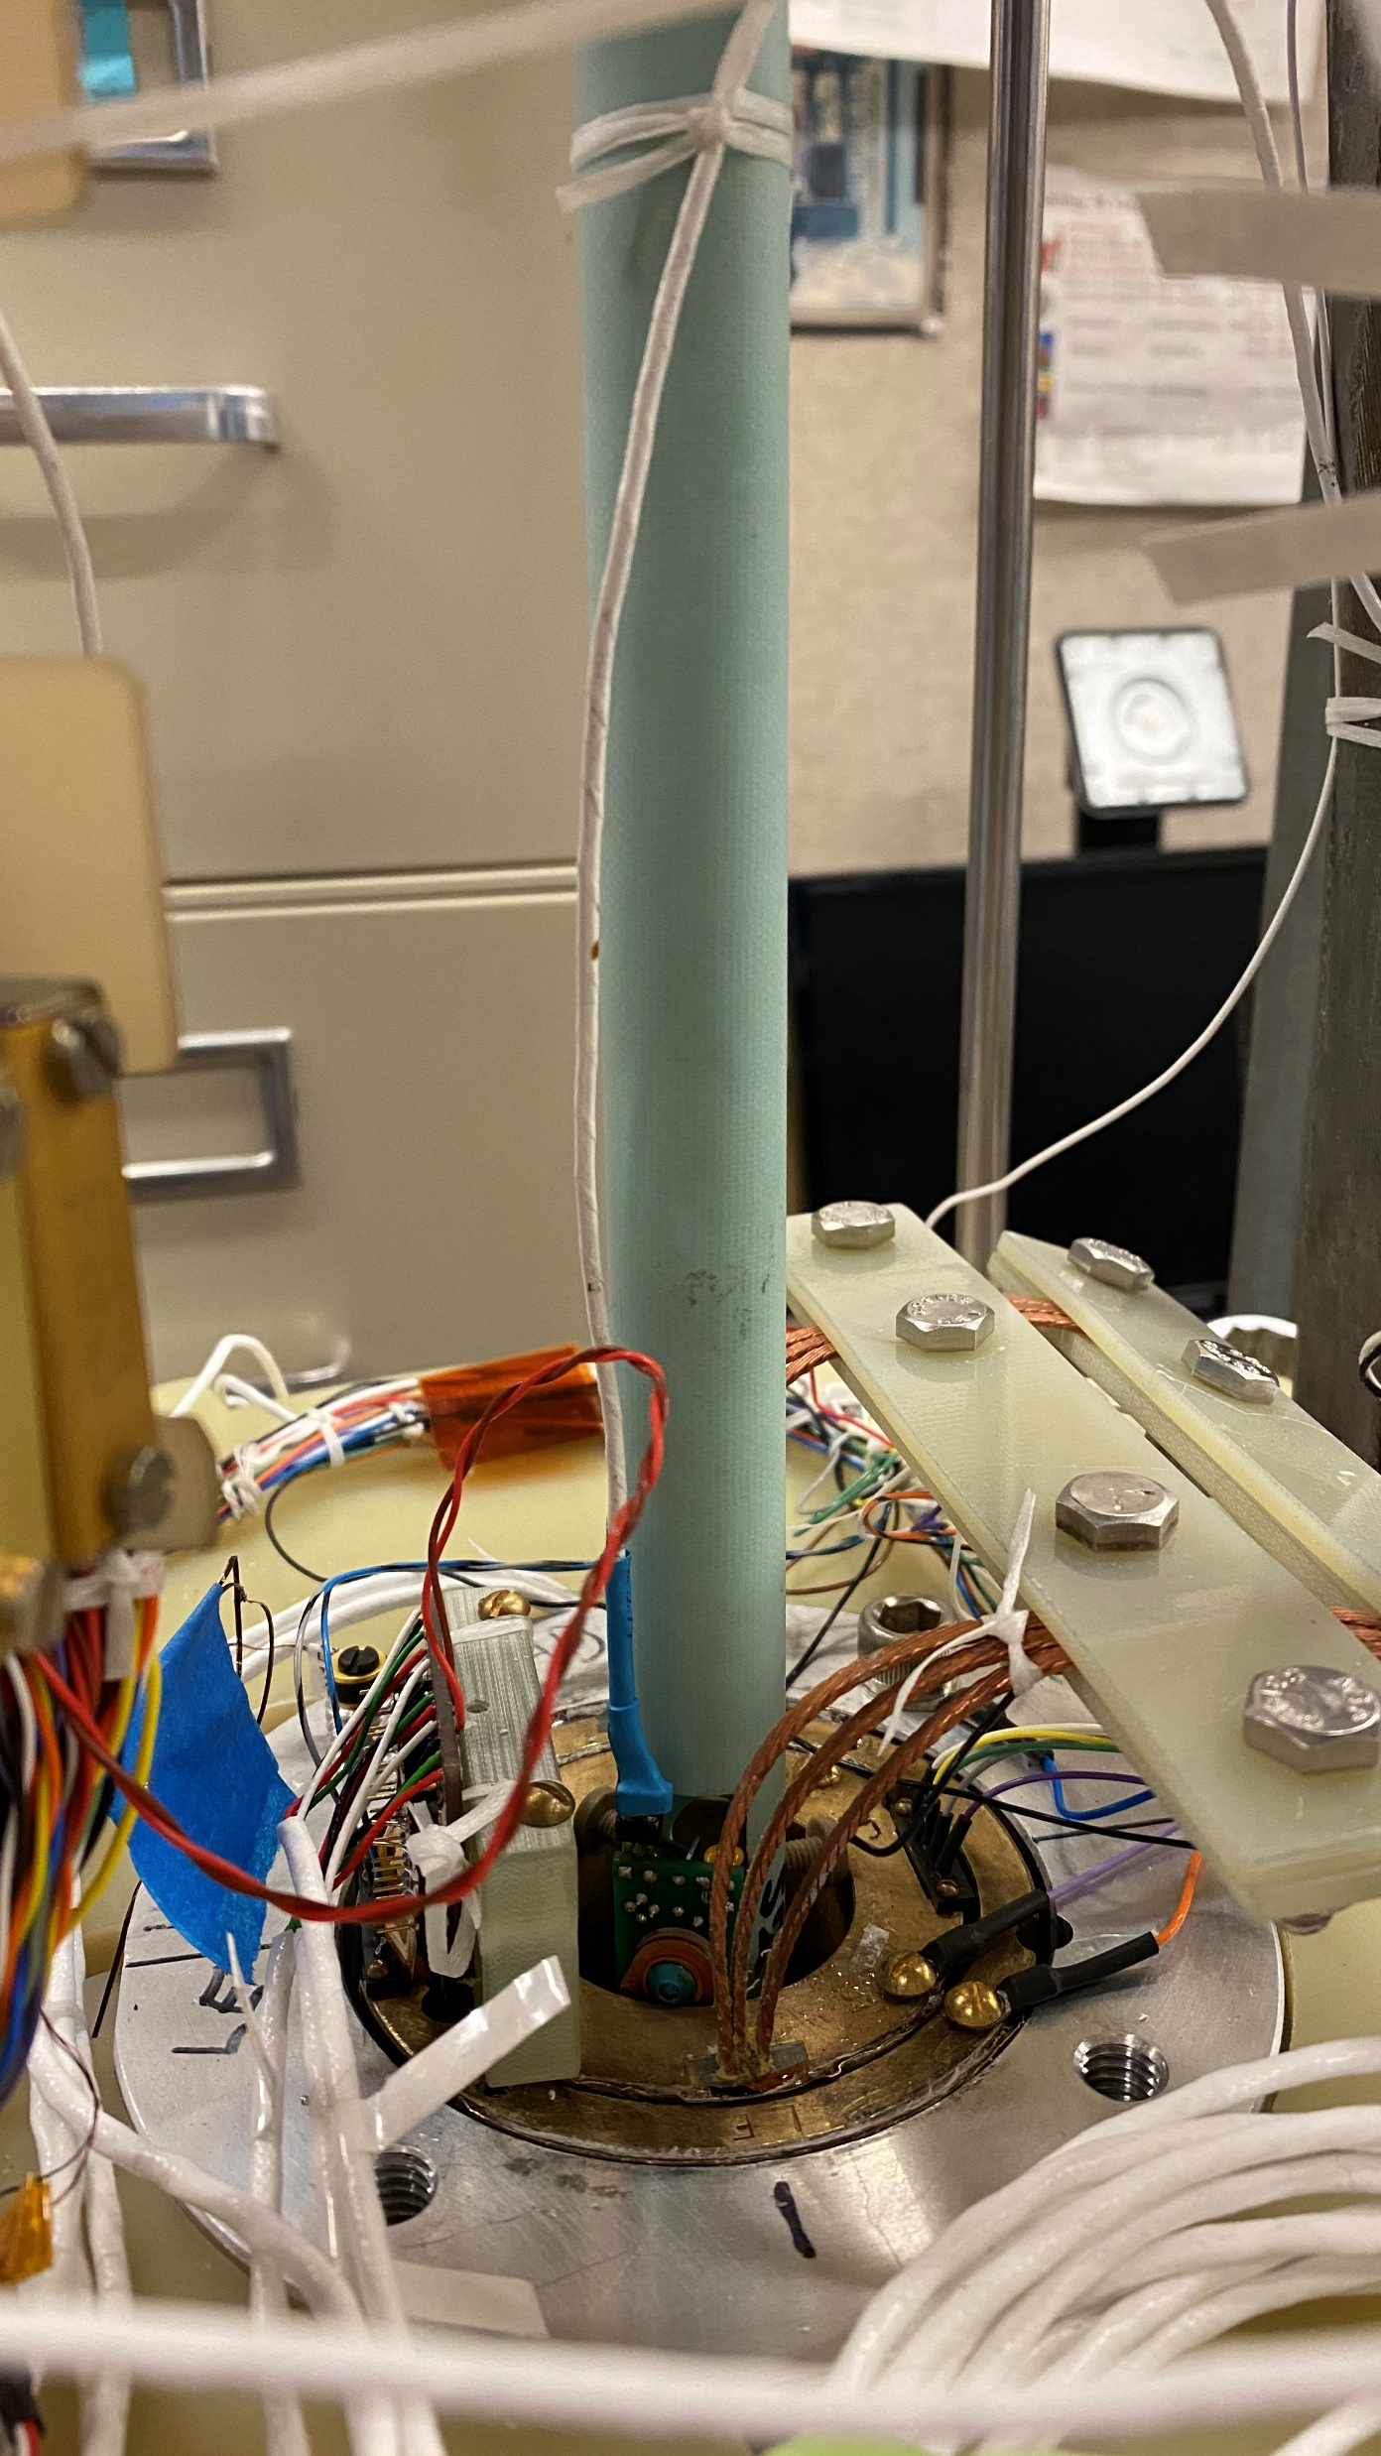
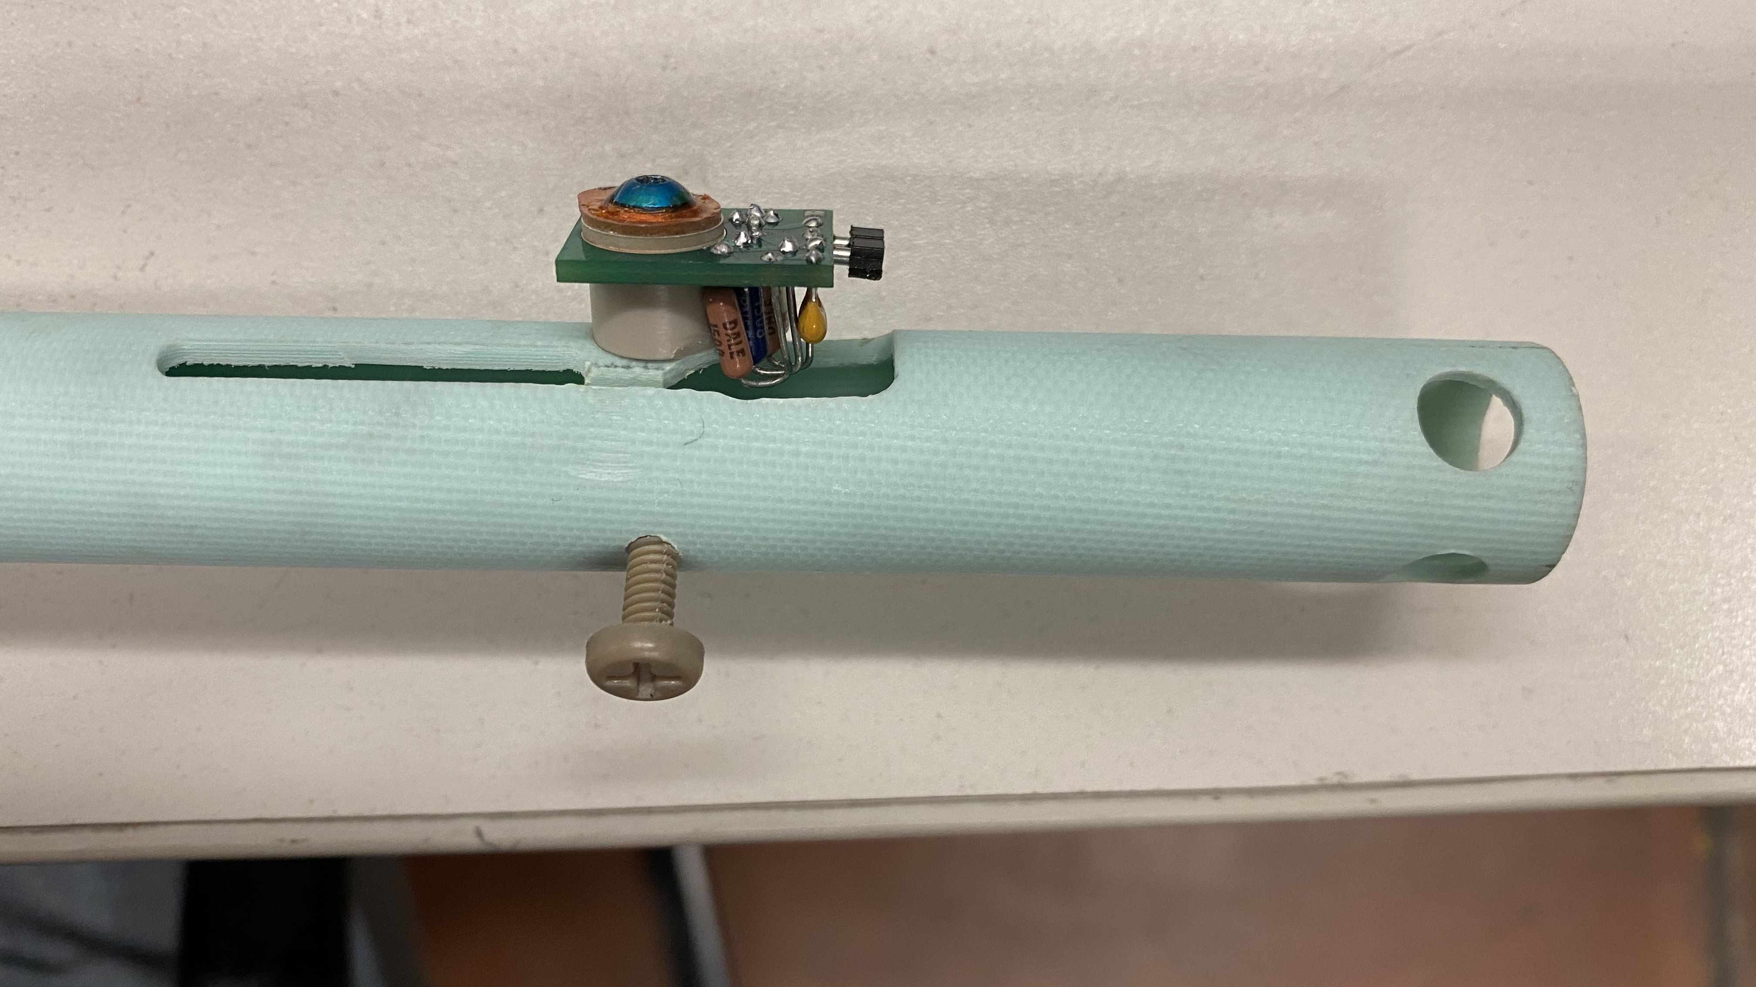
Acoustic mounts for CCT subscales
Acoustic mount approach works well for CCT subscales allowing for quick and reproducible installation of acoustic instrumentation

Slide 6
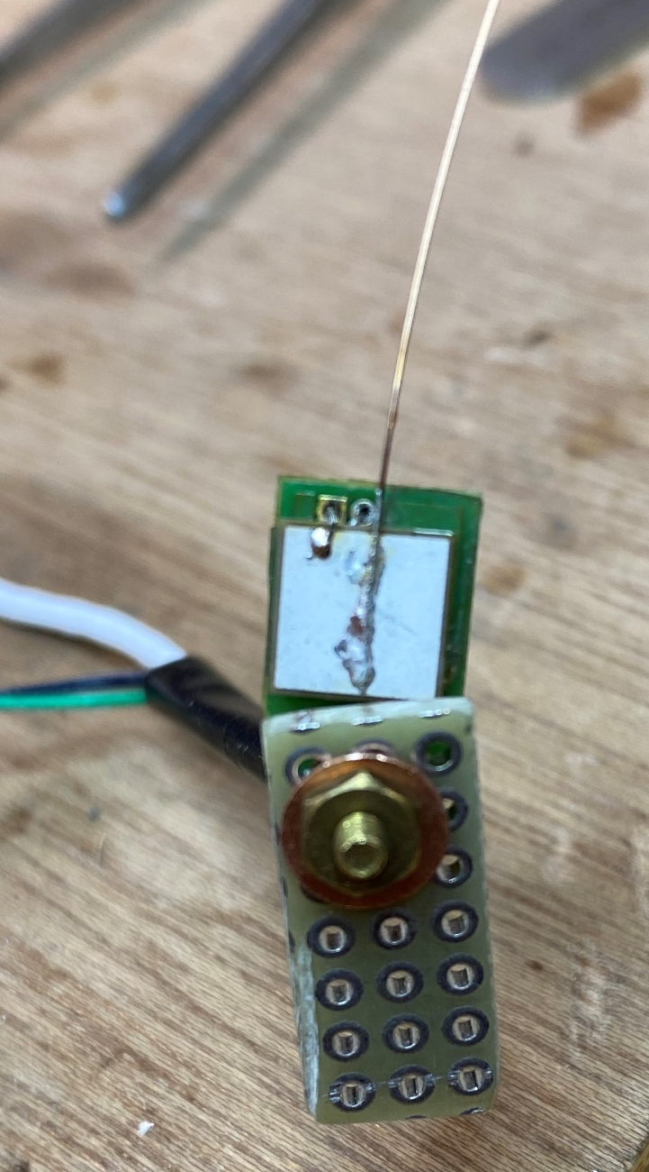
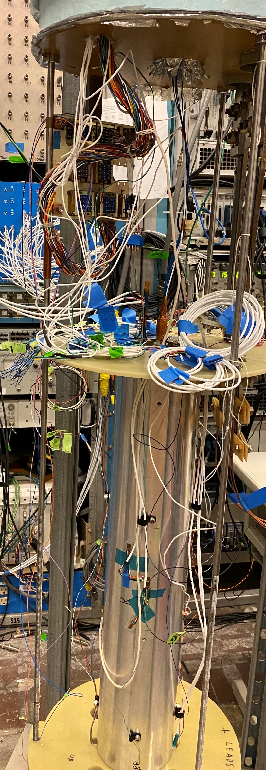
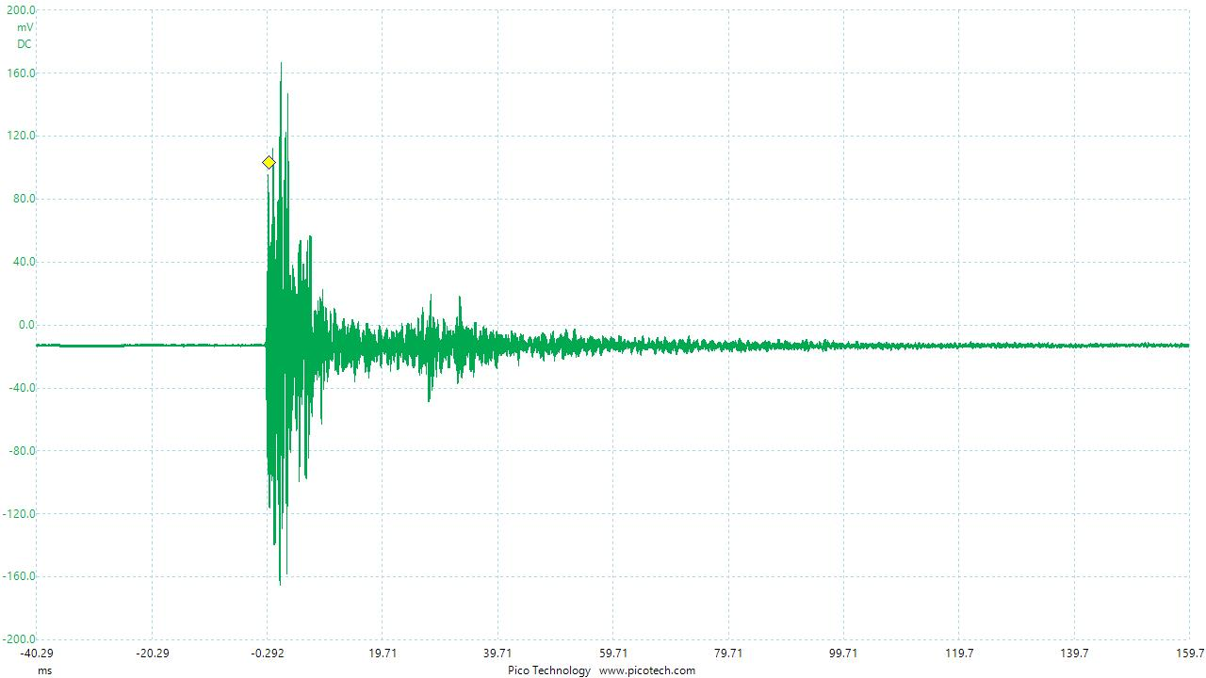
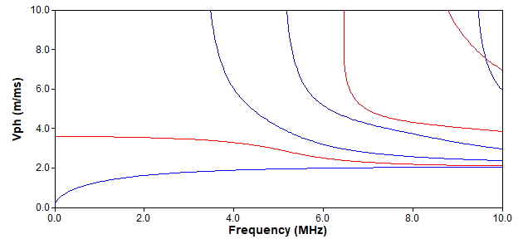
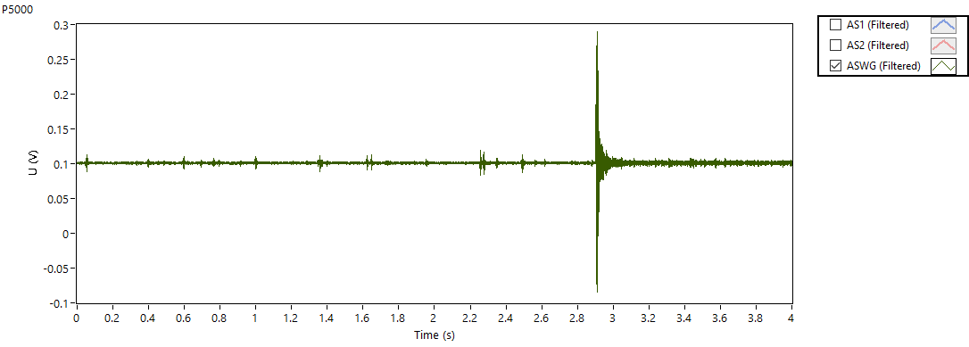
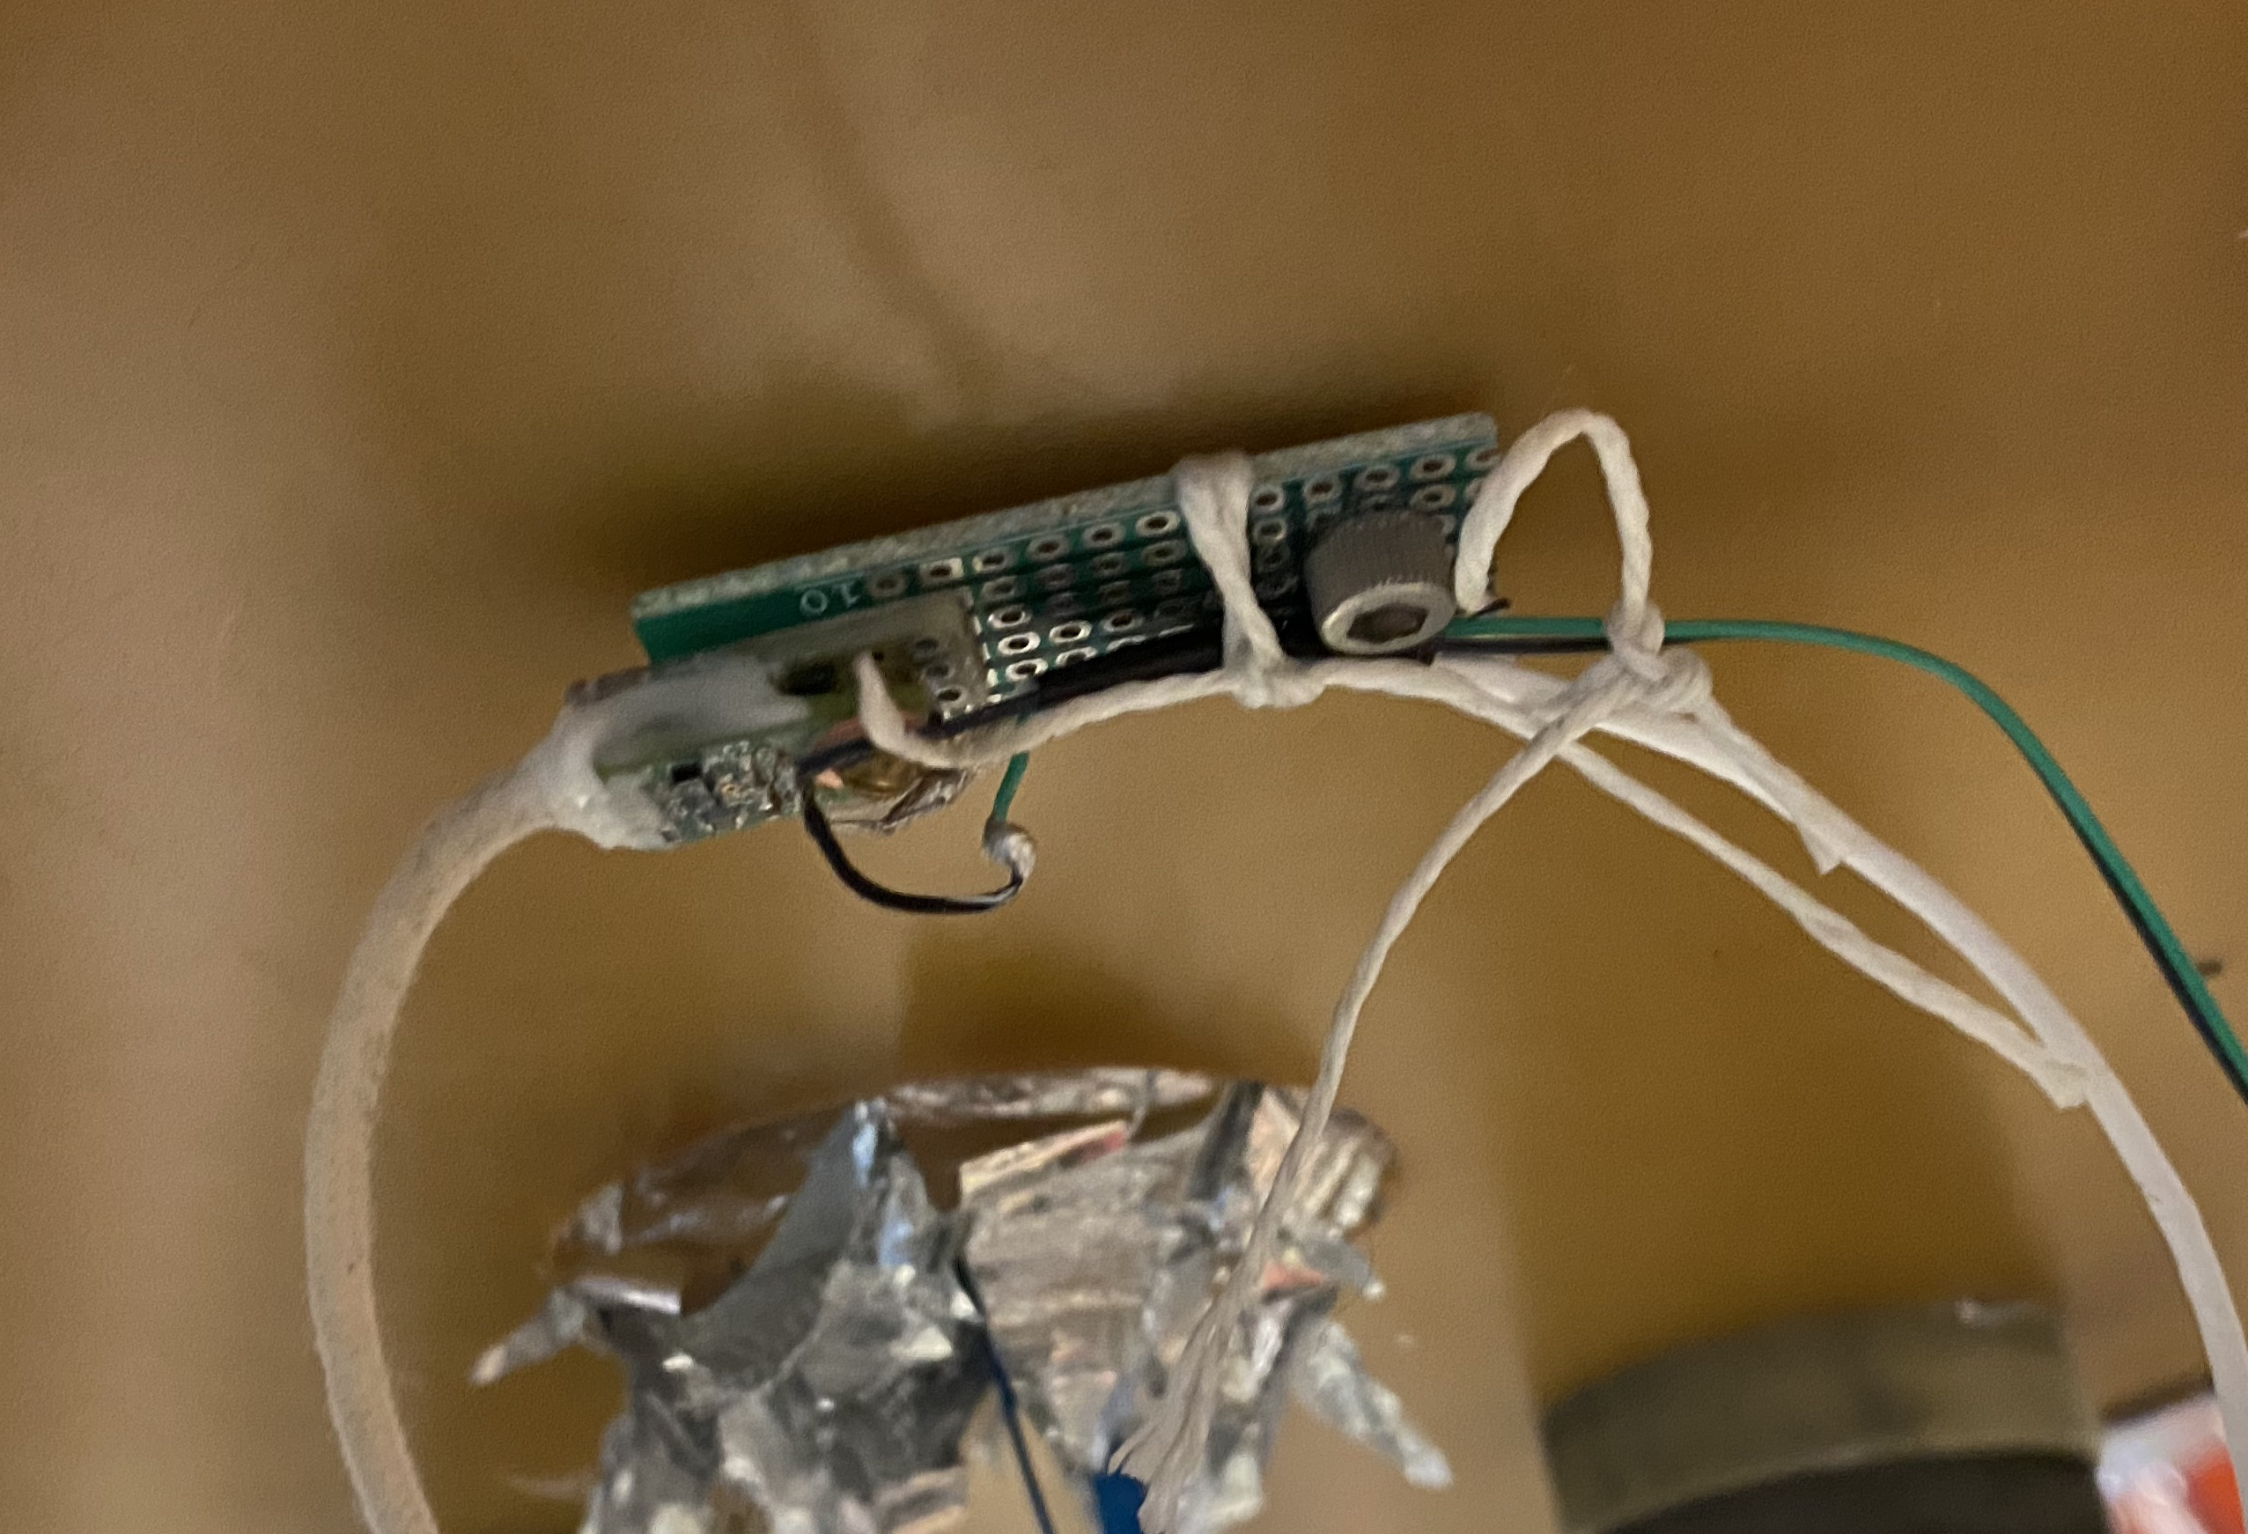
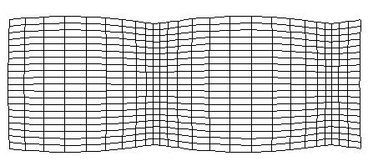
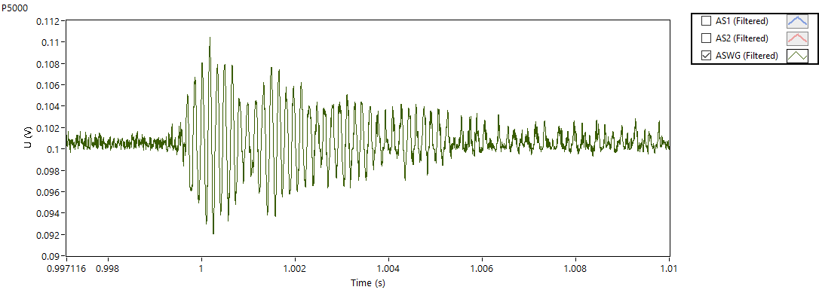
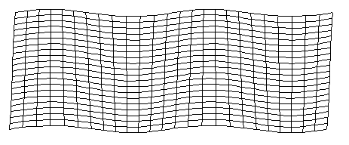
Acoustic waveguide concept
4.2 K tests, liquid helium level at ∼5” above the top of the magnet
0.009” wire
(waveguide)
Dispersion plot for traveling acoustic waves in a 0.4 mm diam. brass rod
Gen 2
sensor
Piezo-
element
Board mounted on the cryostat header
G10 plate
Tapping with a metal tool on the cryostat
Quench
L(0,1) mode
Waveguide wire in a sleeve
F(1,1) mode
AEs during ramping to a quench

Slide 7
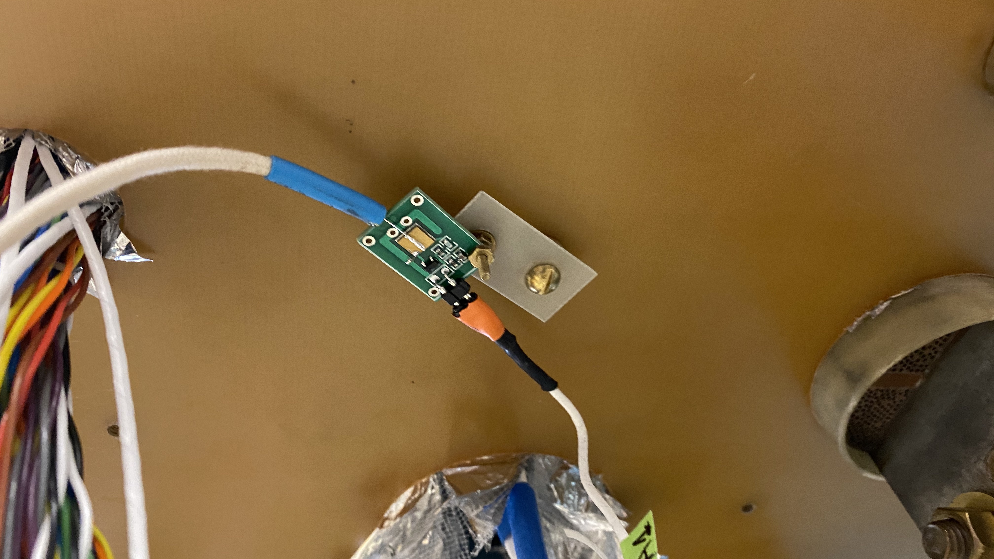
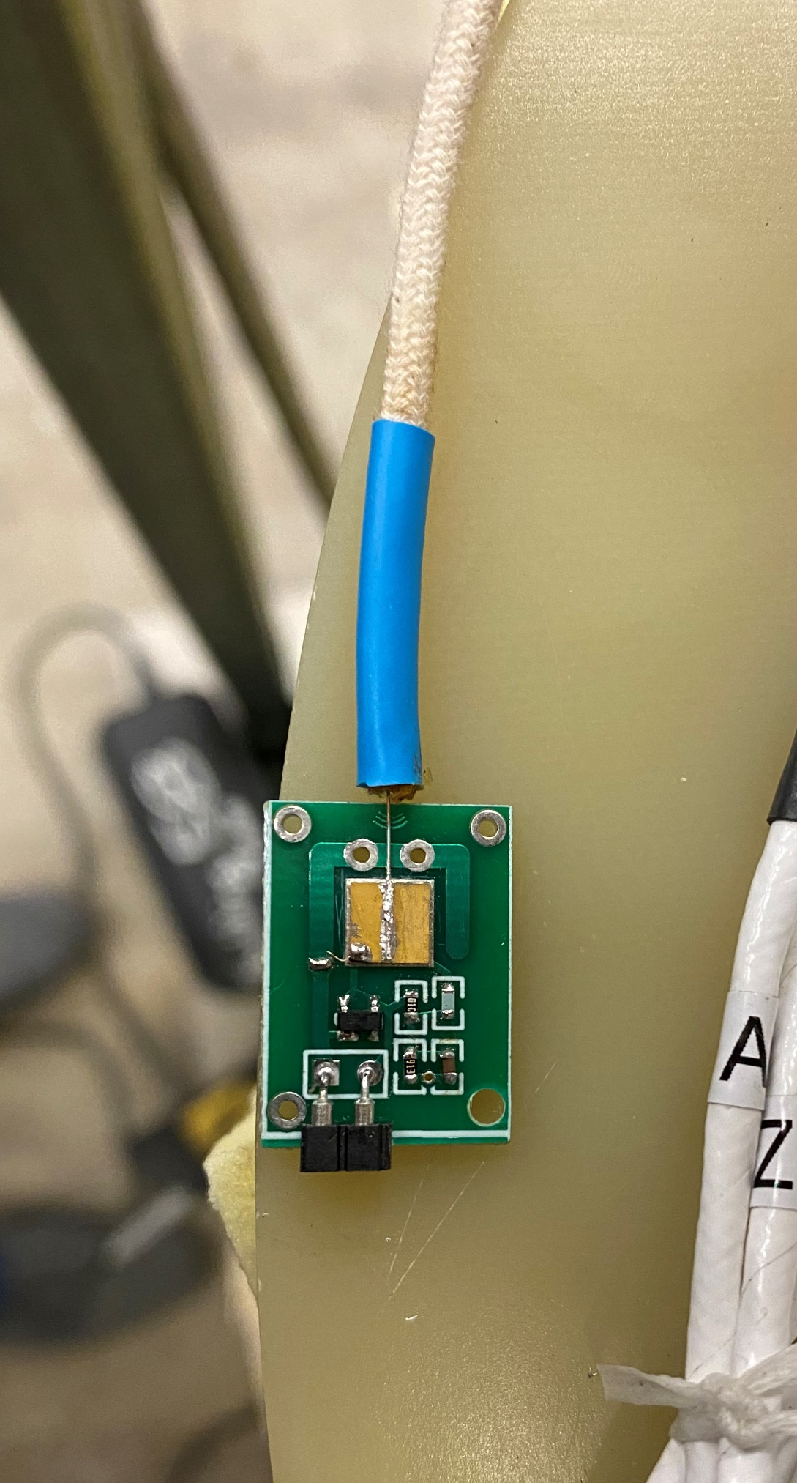
WG sensor arrays
WG wire
New design: the entire sensor is one low-profile soldered board, including the piezo.
It can be installed away from the magnet; acoustic signal is fed from the magnet by a waveguide wire
Enables multiple sensors being integrated in a single board, probing specific locations inside the magnet that otherwise are impossible to reach with standard diagnostics
Can be easily converted in a linear quench detector by attaching a pulser piezo at the opposite end of the waveguide

Slide 8
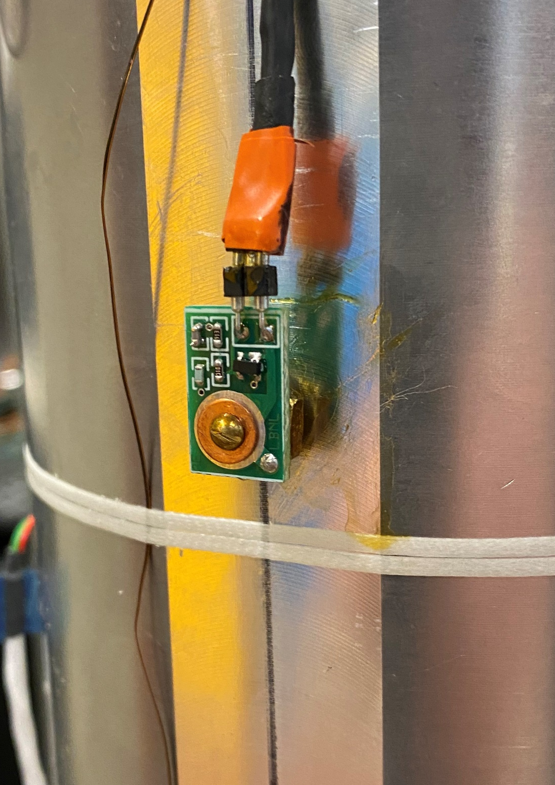
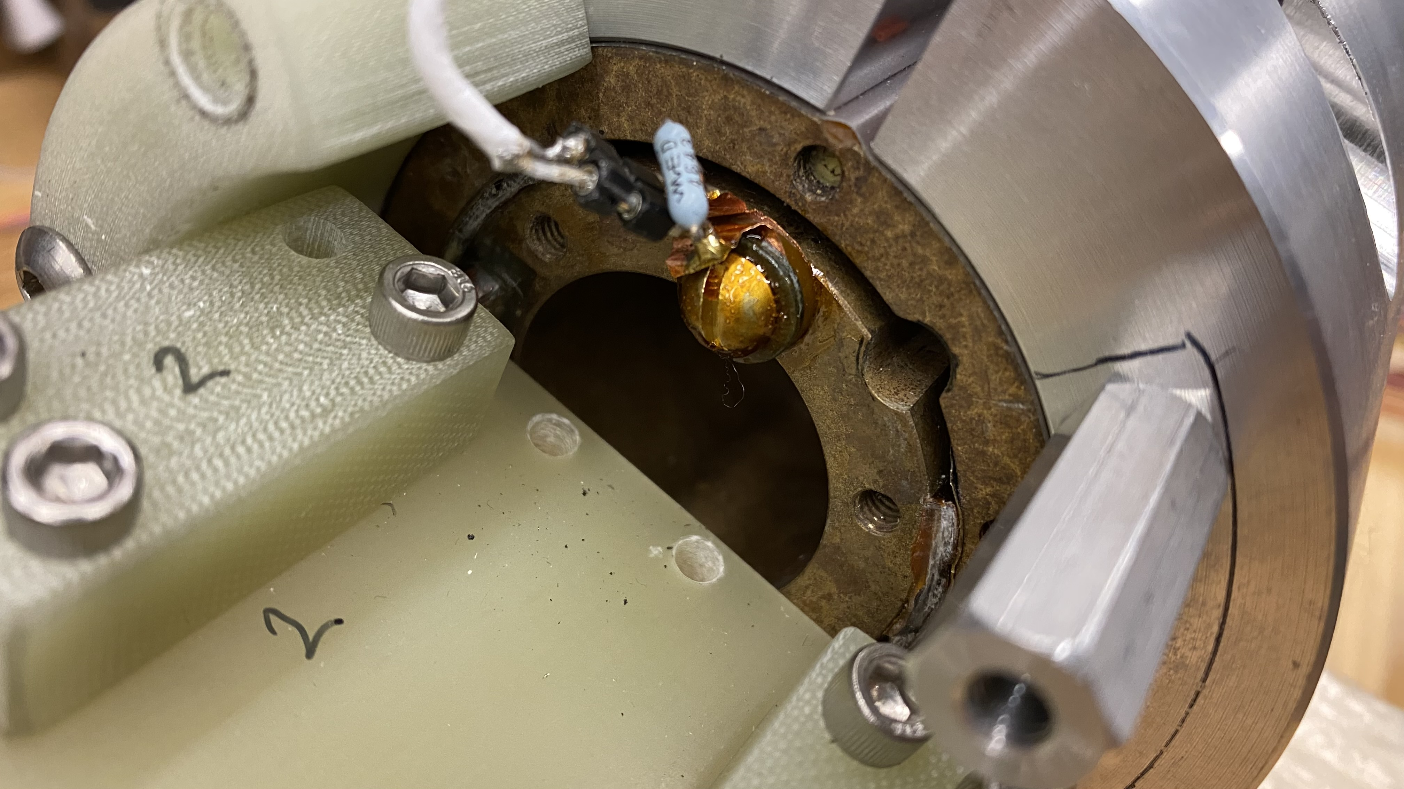
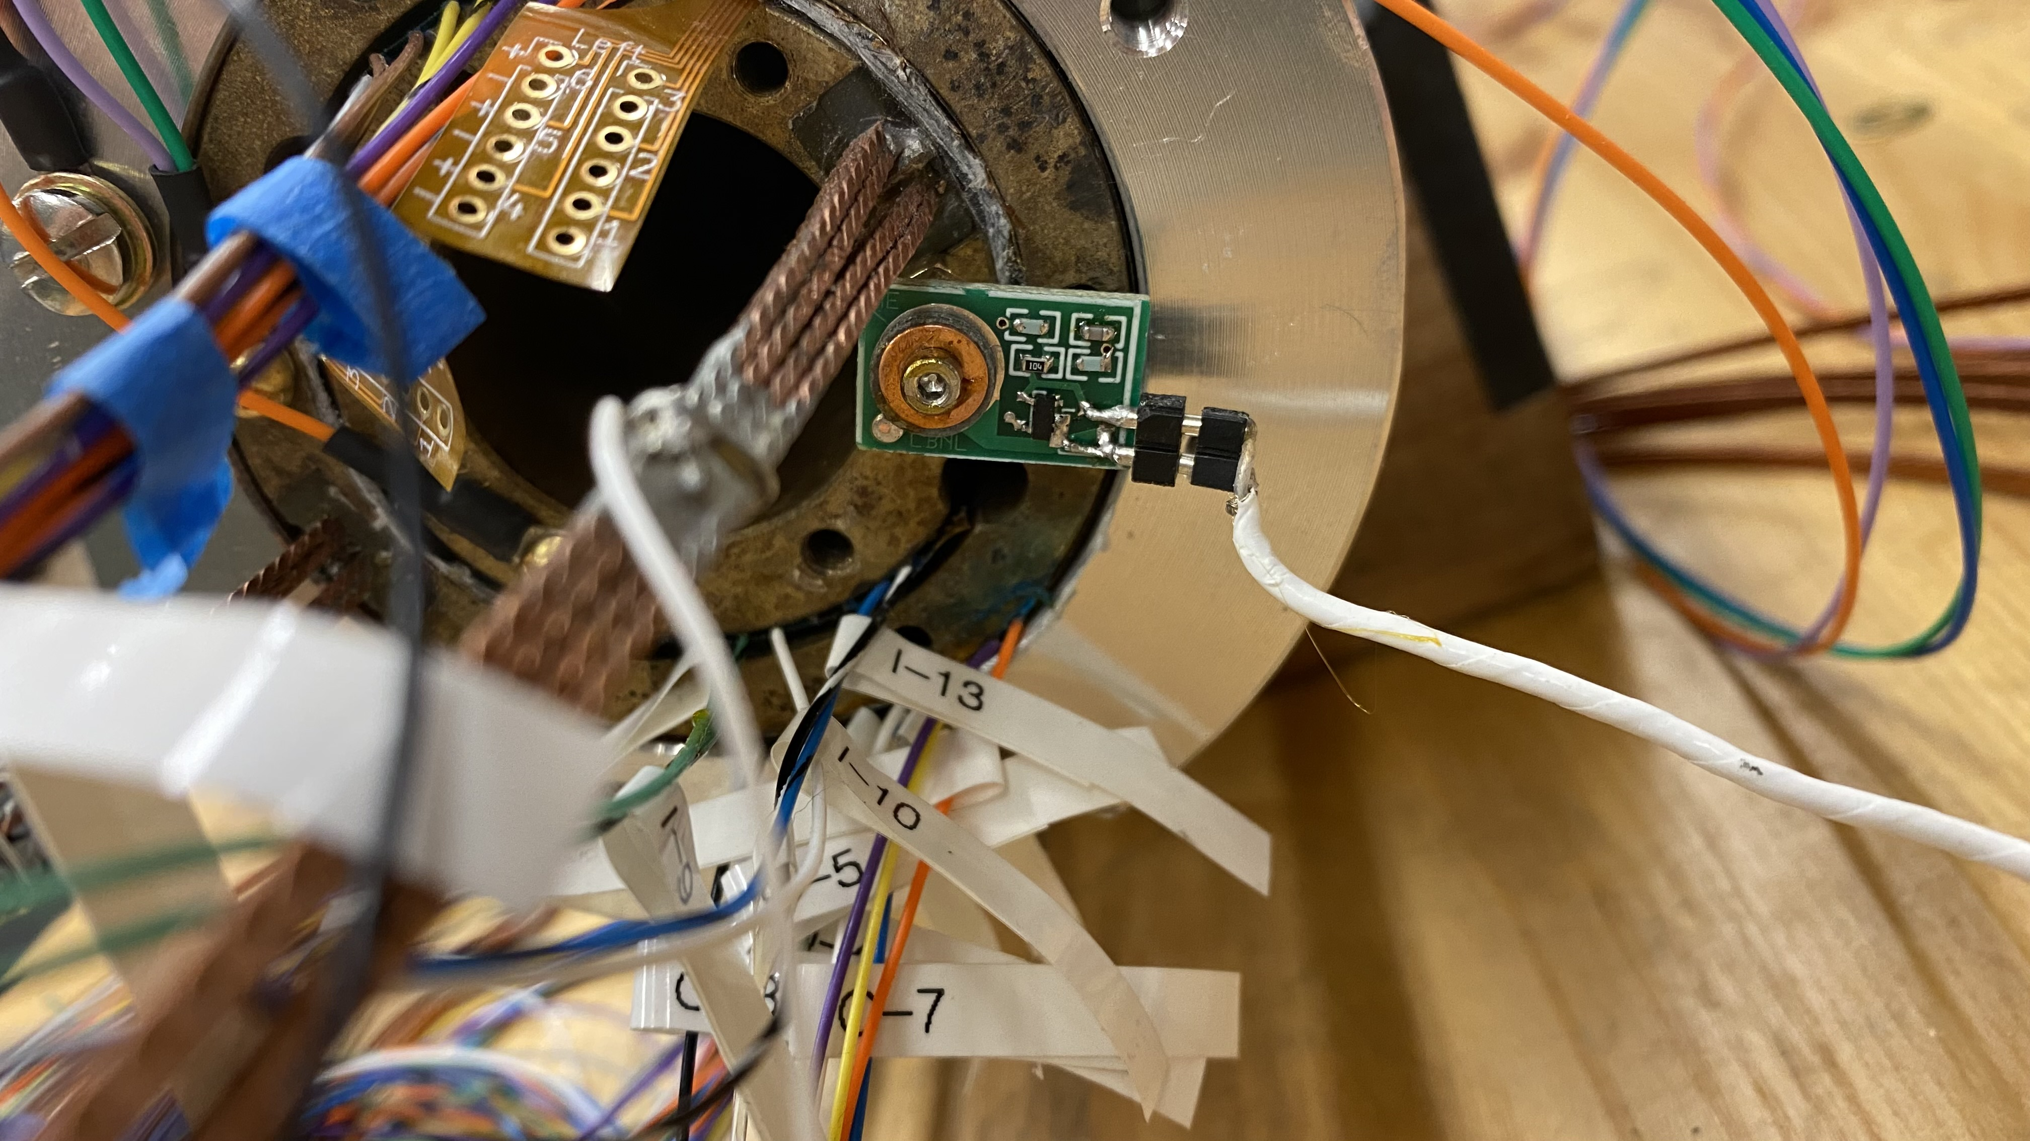
Original 2-wire sensor re-design
2/3 the size of the original sensor
M2 mounting screw
< 5 mm thickness (including the piezo-element)
Better high-frequency response
Same familiar 2-wire interfacing, fully compatible with old interface and powering hardware
Pulser and sensor installed on the BIN5 magnet for quench detection studies

Slide 9
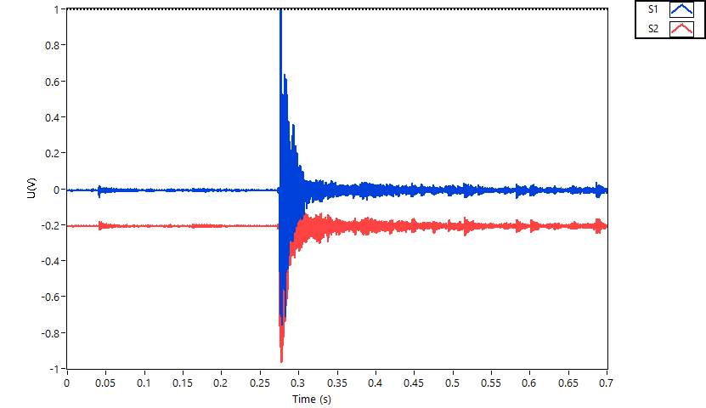
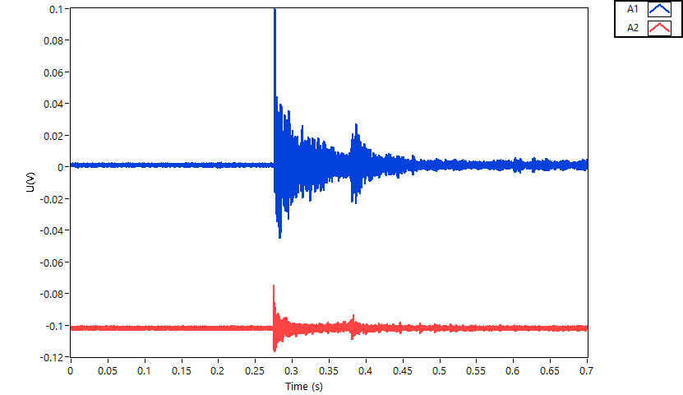
CCT sub 3 comparative sensor test
Original sensors on the in-bore mount
WG sensor
Original – re-design
Quench in CCT sub 3 monitored with old and new style acoustic sensors

Slide 10
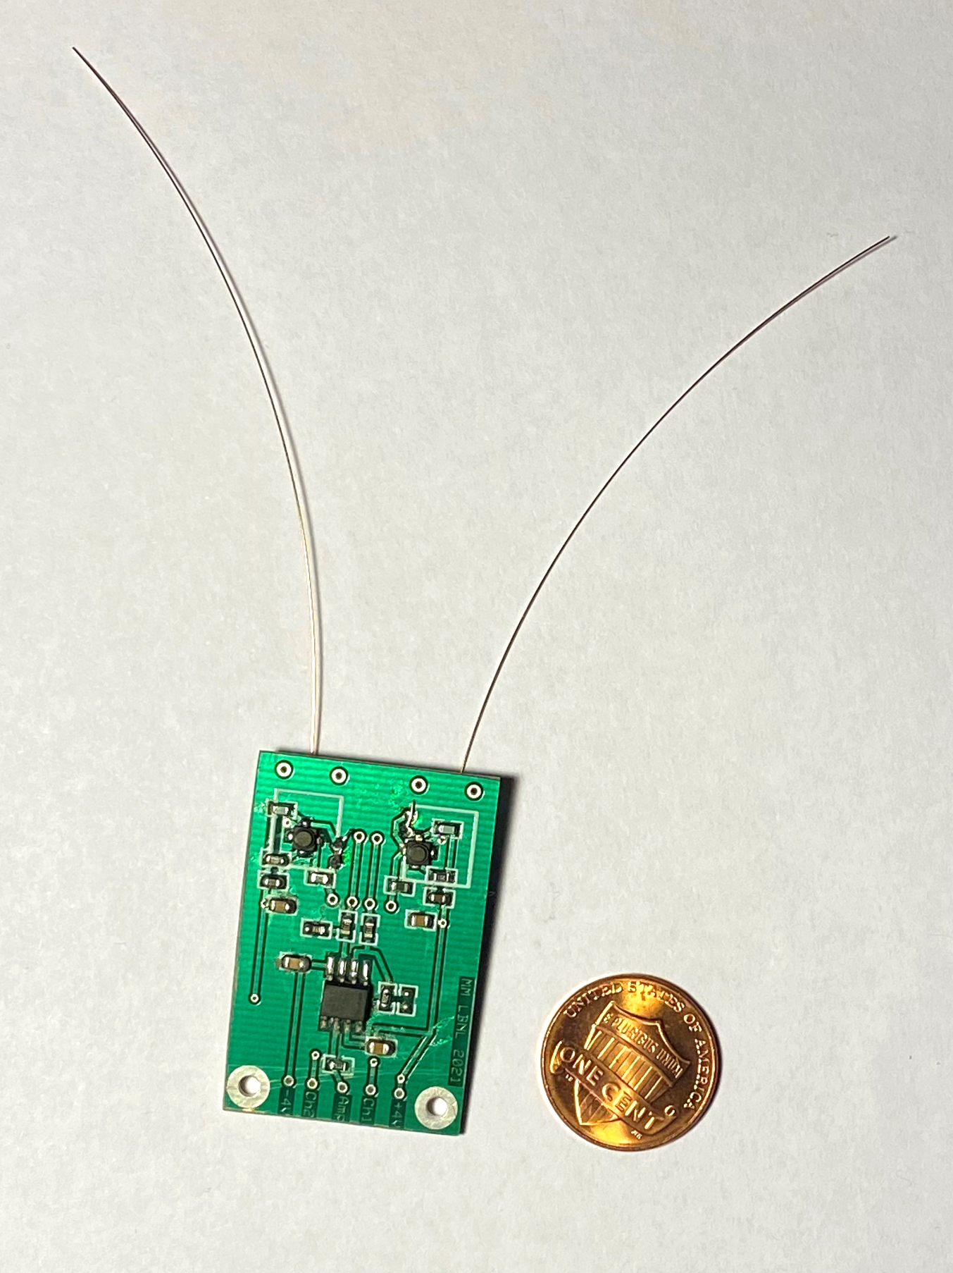
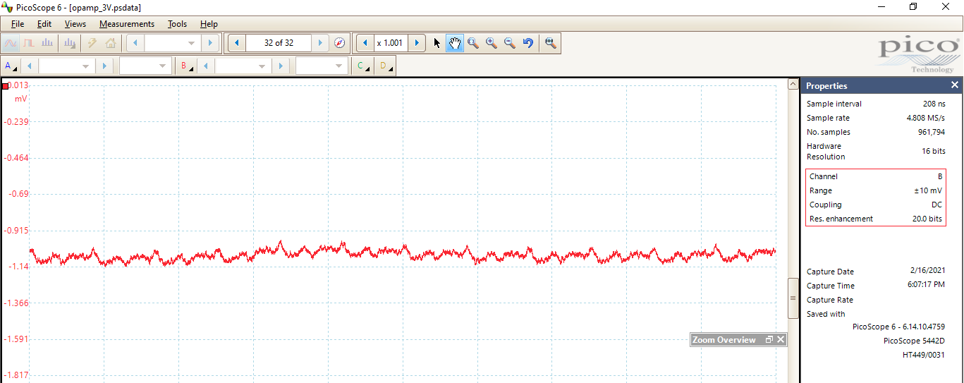
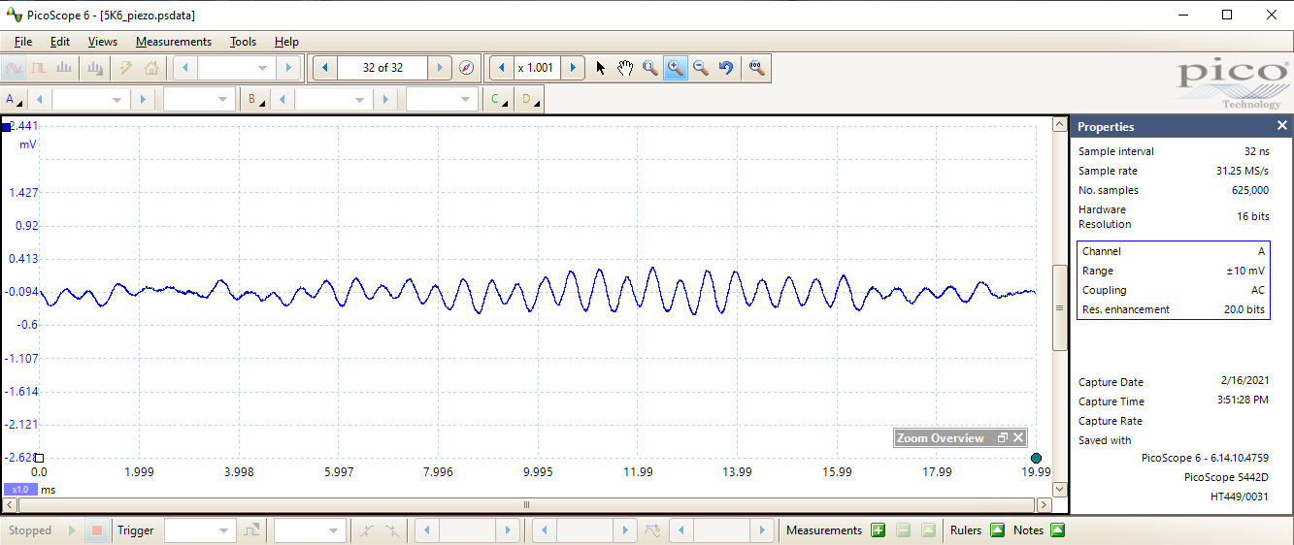
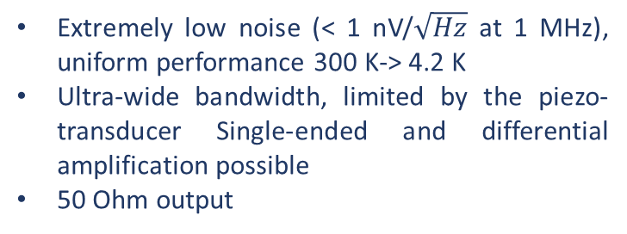
New cryo-electronics development
Extremely low noise (< 1 nV/$\sqrt{Hz}$ at 1 MHz), uniform performance 300 K-> 4.2 K
Ultra-wide bandwidth, limited by the piezo-transducer Single-ended and differential amplification possible
50 Ohm output
New cryogenic amplifiers based on GaAs JFETs and latest generation low-power op-amps have been developed at LBNL and tested at 4.5 K:
“Universal tap” board
Amp 1
Diff. op-amp
(gain 100)
Amp 2
Cryostat vibrations due to a working pump
Acoustic amplifier examples

Slide 11
Measuring current re-distribution with a Hall sensor array
Normally, current sharing can be studied by measuring voltage drop across individual tapes in the cable. Alternatively one can measure magnetic field re-distribution.
Side view
I
Current deviation from the “median path” will create additional local modulation of the magnetic field that can be monitored with the Hall sensor array
Hall sensor array
ExoCable©
Top view
I
Hall sensor array

Slide 12
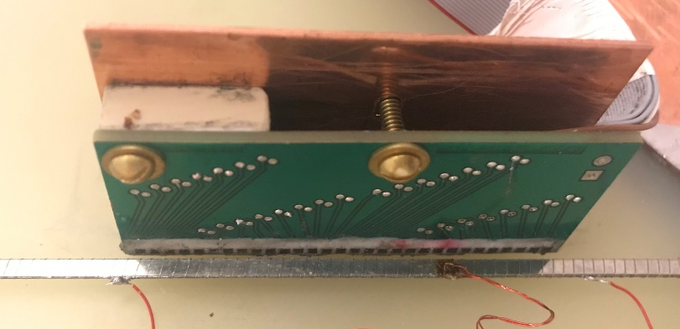
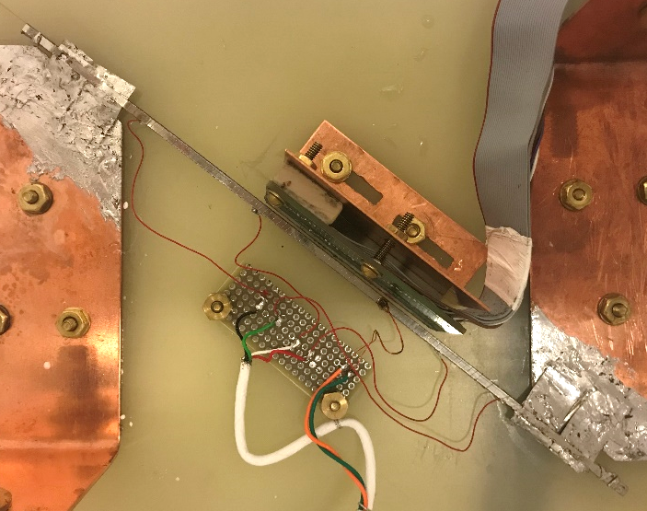
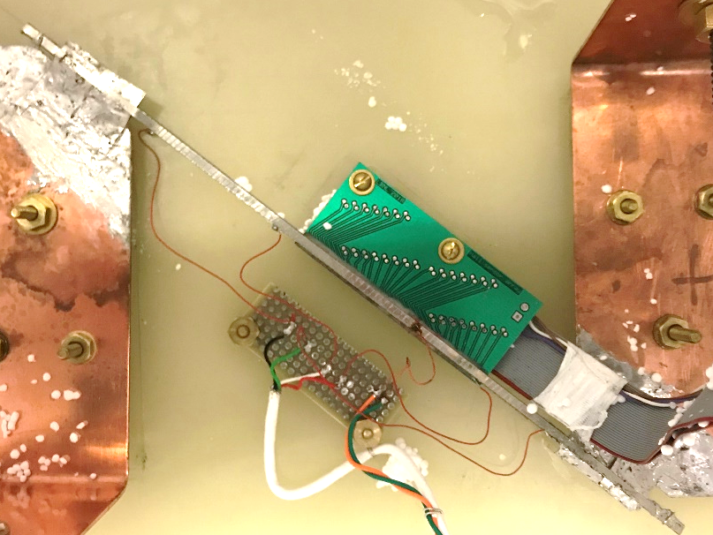
Experimental setup for measuring current distribution in stacks
Parallel field configuration
Perpendicular field configuration

Slide 13
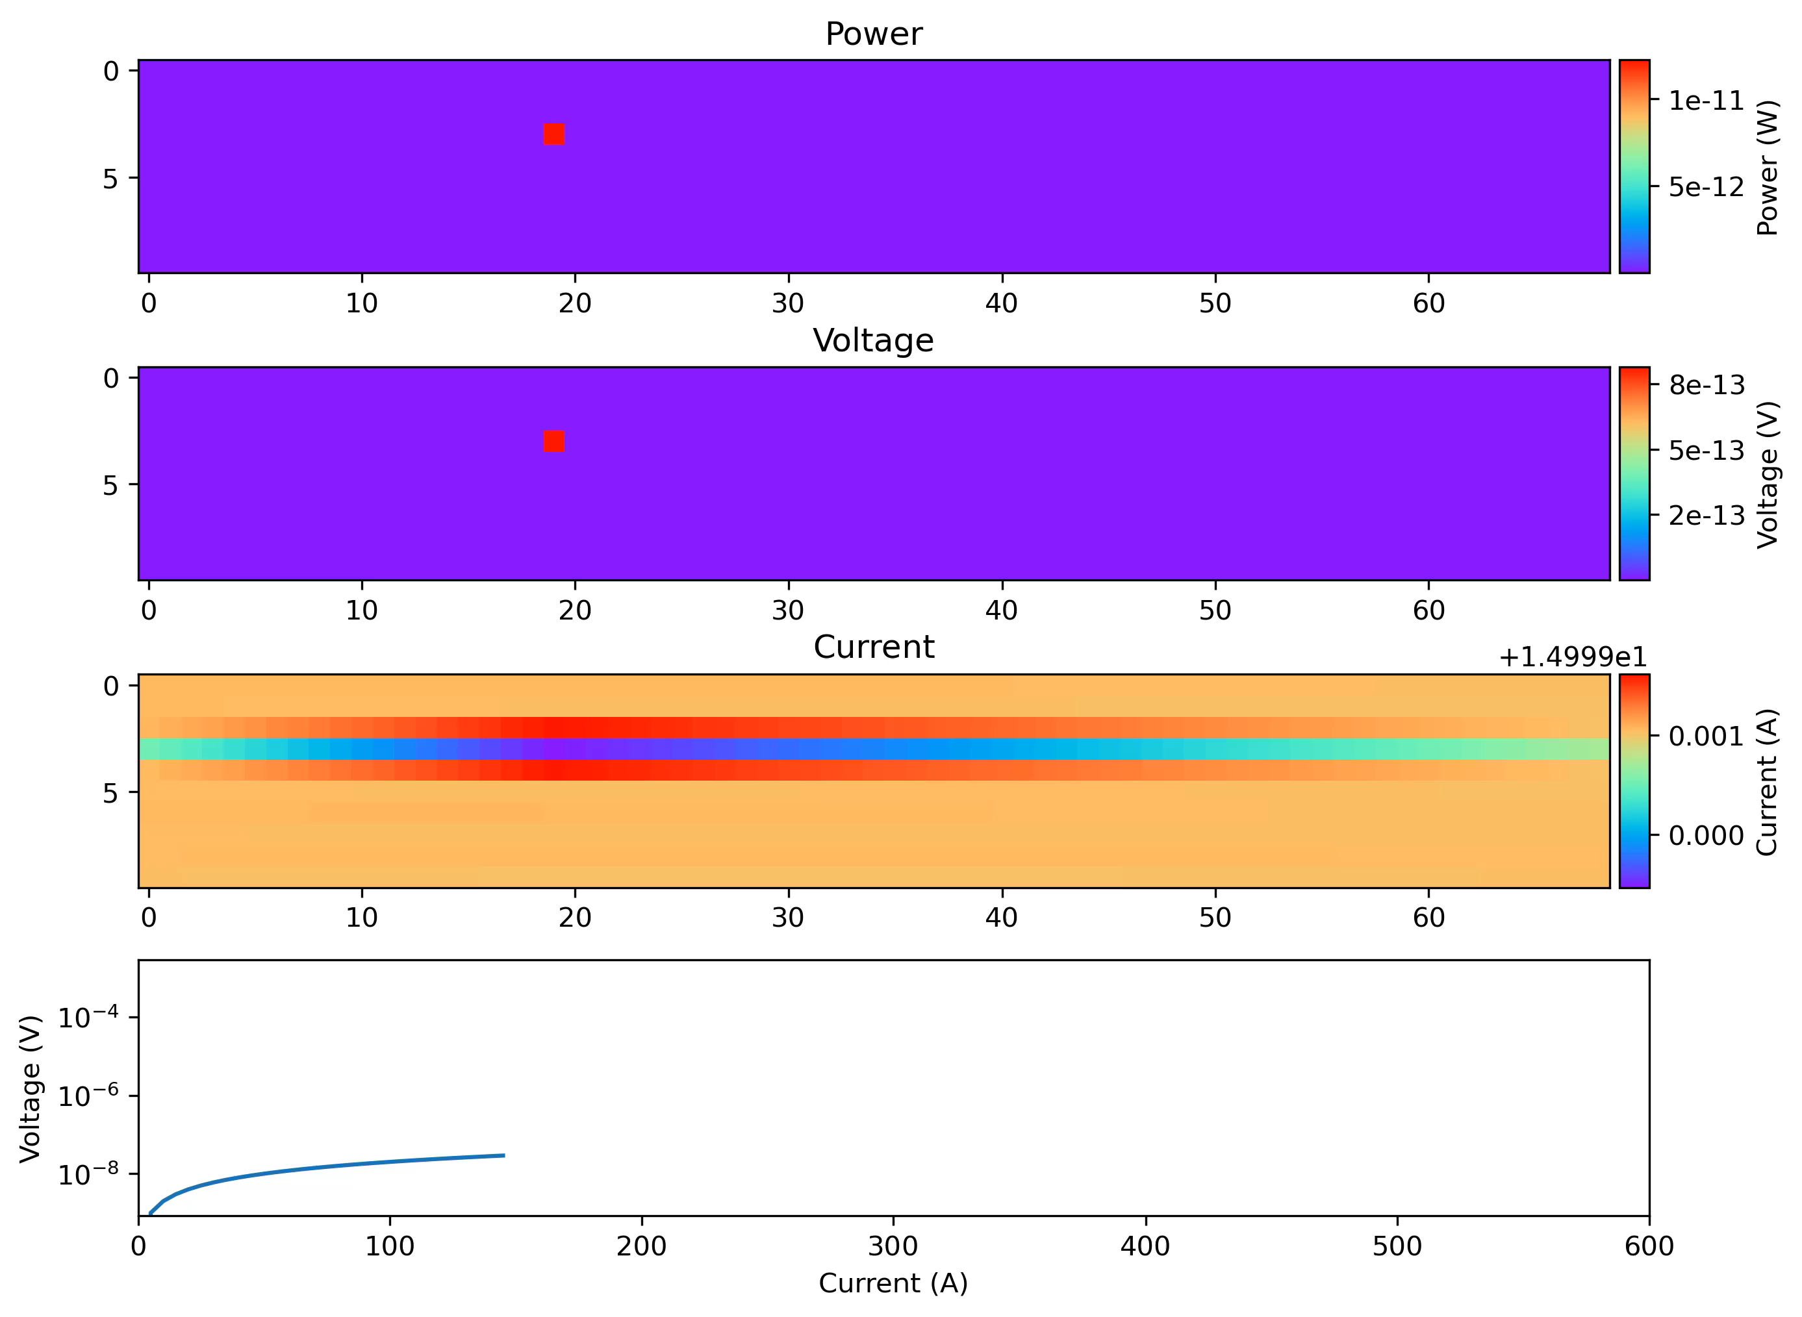
Simulation of HTS tape stacks using network modeling in LTSpice
10 x 70 matrix (10 tapes in a stack, “70 cm” length)
I_{c} = 50 A; 5% random variation
R_{cs} = 20 nΩ; 5% random variation
R_{term} = 1 nΩ
n = 20
Two pre-defined “bad spots”:
I_{c}(3,19) = 30 A
I_{c}(7,55) = 40 A
Ramping from 150 A to 600 A, step 5 A
LTSpice calculate the entire ramp at once (single call)

Slide 14
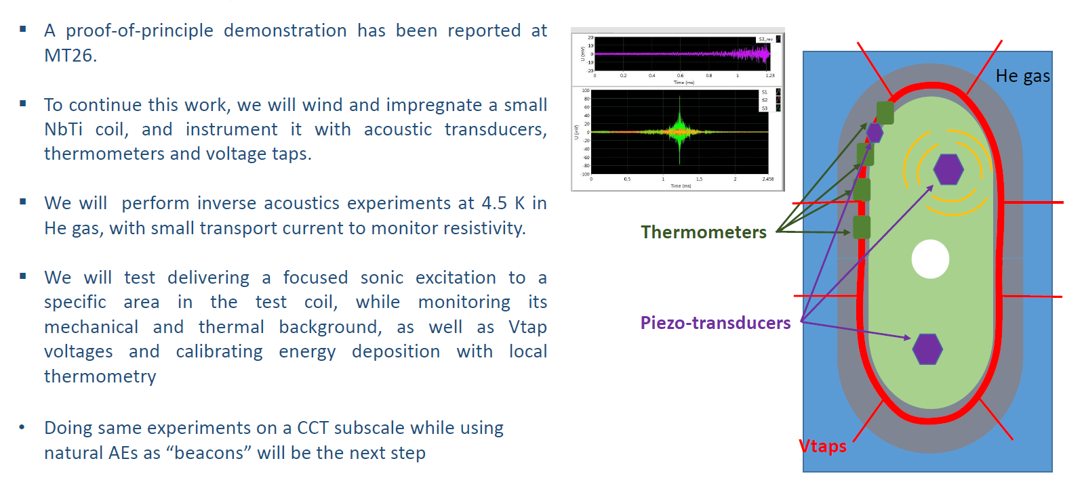
Experiments of inverse acoustics

