Slide 1
MDP Diagnostics Update
Quench Antennas & Hall Scanner
MDP Weekly meeting
June 9, 2021

Slide 2
Outline
Brief overview of quench antennas
  Comparison of thick and thin spar quench locations
Brief status update of cable scanner
We have been actively working on Hall arrays for SBIR phase 2
  Progress not presented today

Slide 3
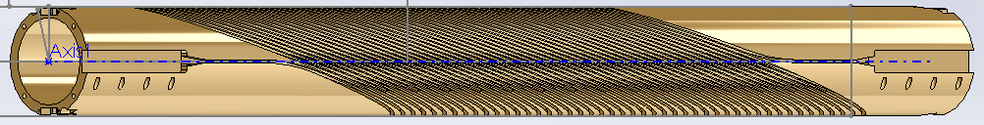
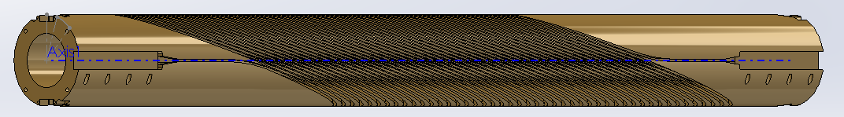
Quench Antenna - Introduction
Maxim recently gave MDP update on LBNL quench antenna results
  In-bore “cloverleaf” quench antenna
  Inter-layer flexible quench antenna
    Motivated by recent FNL + BNL quench antenna development (MQXF)
Two subscale tests have been completed (with thermal cycles)
  Thin spar (baseline – “thin tube”) – higher normal stresses
  Thick spar (“thick tube”) – higher shear stresses

Slide 4
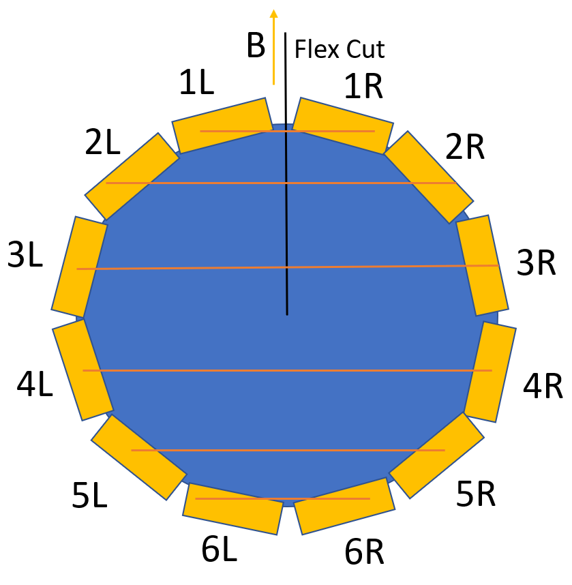
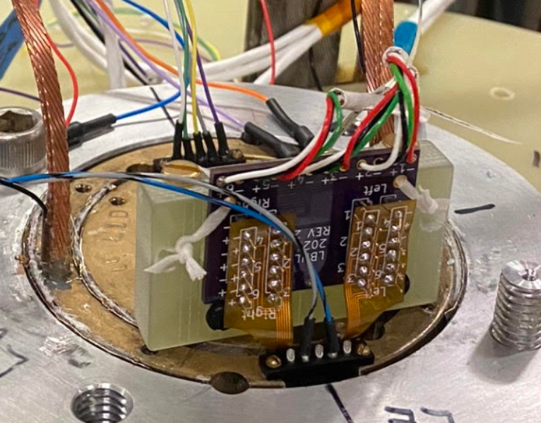
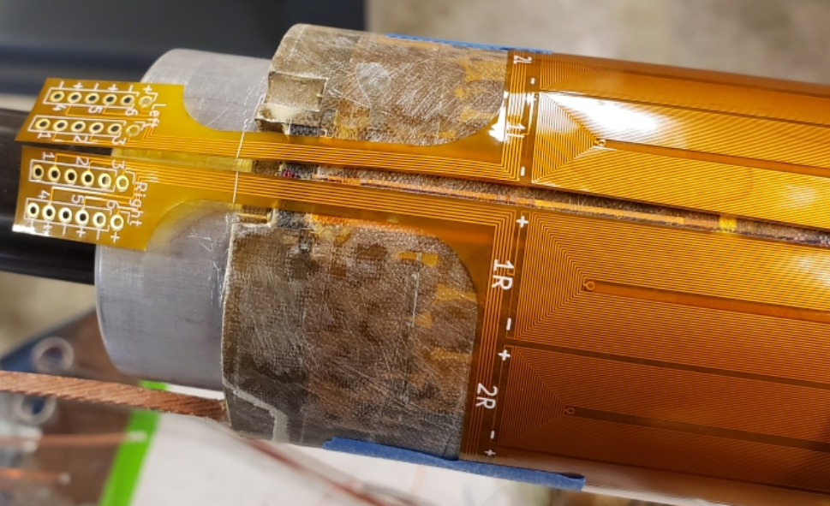
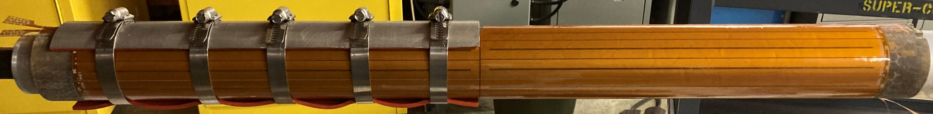
Quench Antenna - Methods
Mandrels wrapped in flex PCB antenna arrays
  Scripted / automated generation of antenna arrays
    Don’t hesitate to reach out if you want to use the tool
  Low cost – two ~$60-75 sheets per magnet test
Dipole (Left-right) bucking of each coil
  One sheet covers half of magnet

Slide 5
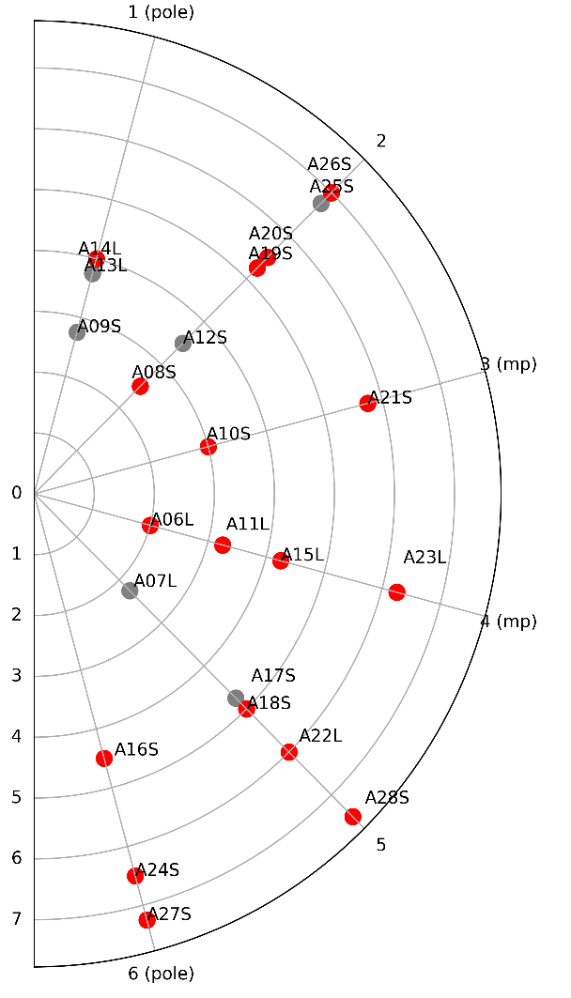
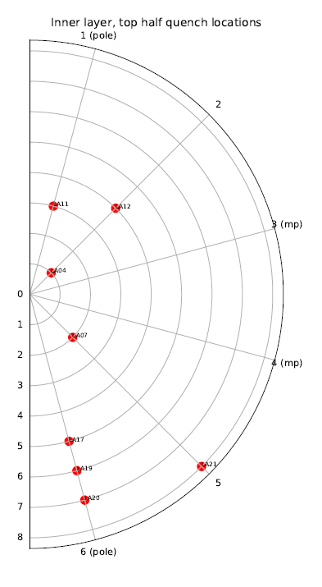
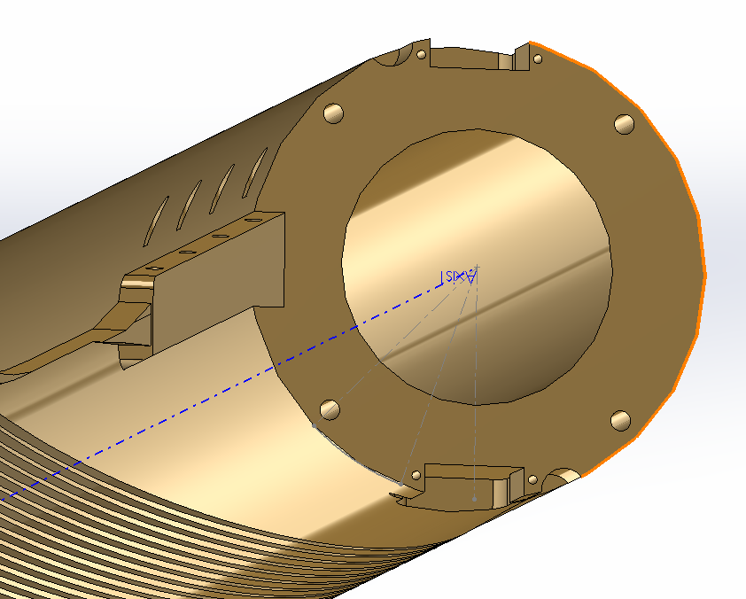
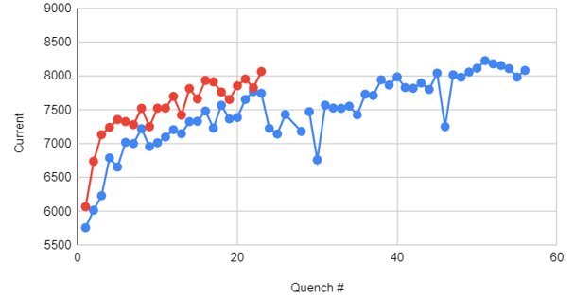
Quench Antenna – Test Comparison
Left: thin spar, full magnet
  Inner layer = red
Right: thick spar, lead half of magnet
  Inner layer only
Lack of midplane quenches in thick spar!
Thin spar (SUB2)
Thick spar (SUB3)
Thick spar
Thin spar

Slide 6
Quench Antenna – Current / Next Steps
In recent test, simultaneously acquired quench antennas with two DAQ systems
  Continuously streamed ramps
  A slower speed (25 KHz), cleaner system (Yokogawa 16 bit)
  A faster speed (250 KHz) system (NI 16 bit)
    NI system concurrently measured two in-bore acoustic sensors – explore if some activity is magnetic-only or vibration-only
Currently working to instrument Bin5 test with quench antennas
  Goal is to continuously monitor activity during ramp (shouldn’t quench)
    Although forces will be lower, see how types of quench antenna signals compare with Nb3Sn / CCT signals
Need to allocate time to analyze most recent test
I would argue that the flexible quench antennas have provided good value with relatively low cost and effort

Slide 7
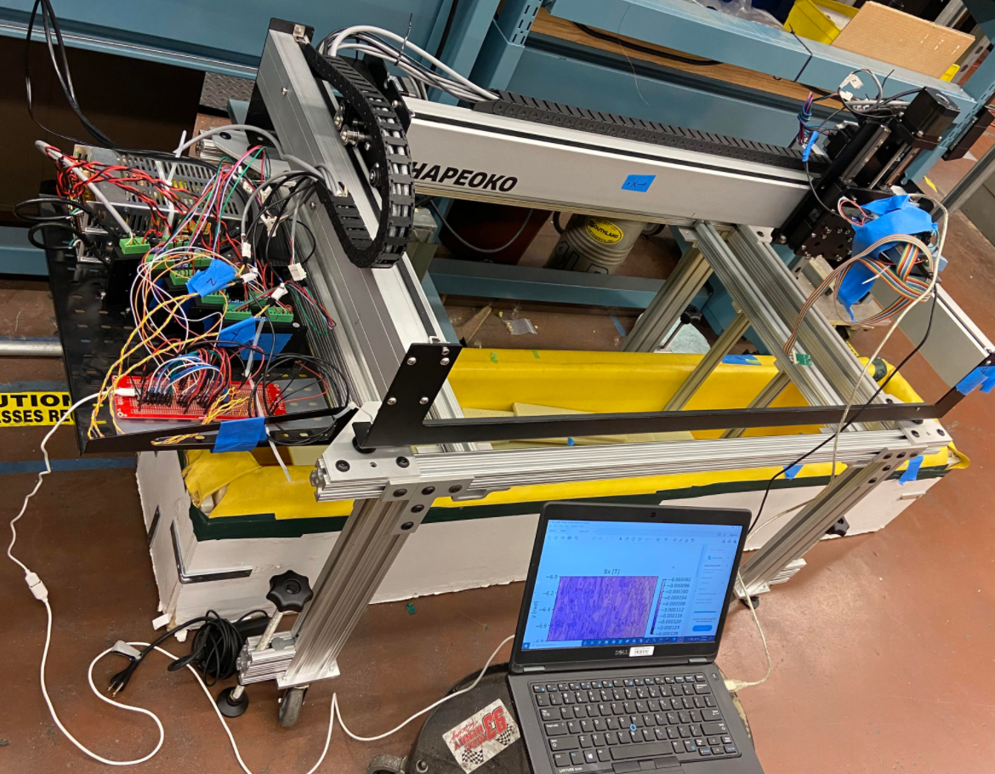
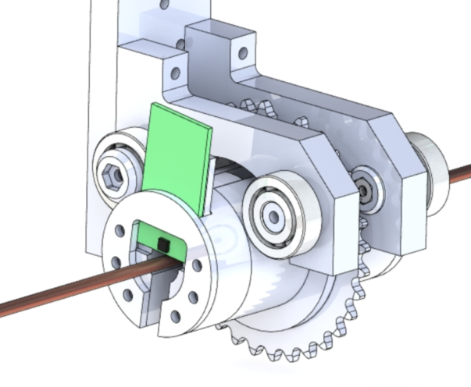
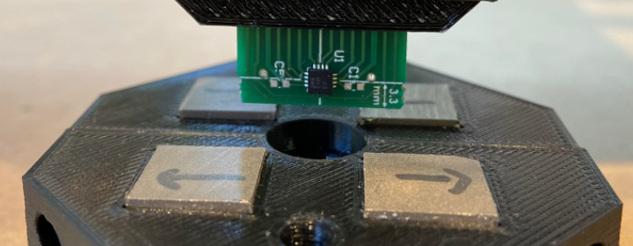
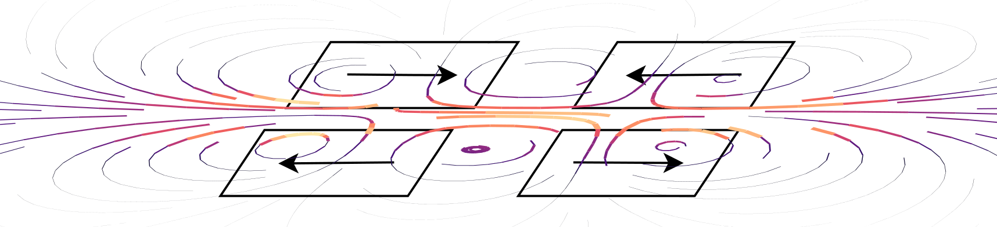
Cryogenic HTS Cable Scanner
Working on a rotary cryogenic field mapper for HTS cables (see MDP collab meeting)
  (1) Improve understanding of static & dynamic cable phenomena
  (2) Serve as cable QA (identify / map weak points in cable)
  (3) Feed data into existing current recreation techniques
Rotary implementation will have to wait until next fiscal year
  Cryogenic Hall probe scanners and current recreation exist in literature – main novelty lies in applying techniques to cable
For now, commission apparatus with cartesian scans over tapes with defects, small test windings and old racetrack coils - hope to do first cryogenic tests early next week!
Technique adapted from submitted manuscript - Inverse Biot-Savart Optimization for Superconducting Accelerator Magnets

Slide 8
Conclusion
Thanks for listening!

