Slide 1



Electromagnetic Probes for RHIC BES:
What can be learned?
Ralf Rapp
Cyclotron Institute +
Dept of Phys & Astro
Texas A&M University
College Station, USA
Online Workshop on
RHIC Beam Energy Scan and Beyond
16.+17. Aug. 2021

Slide 2
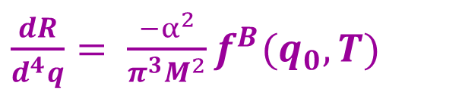
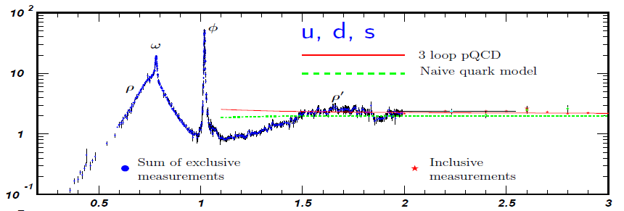
1.) Intro: EM Spectral Function to Probe Fireball
Thermal Dilepton Rate
Im Π_{em}(M,q;μ_{B},T)
e⁺e⁻ → hadrons
ρ
Im Π_{em}(M) / M²
e⁺ e⁻
e⁺ e⁻
M [GeV]
Hadronic Resonances
- change in degrees of freedom
- restoration of chiral symmetry
Continuum
- temperature
q₀,q → 0 limit: transport coefficient (EM conductivity)
Total yields: fireball lifetime

Slide 3
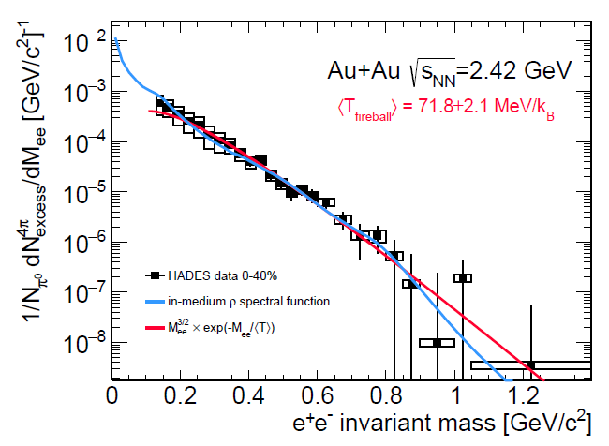
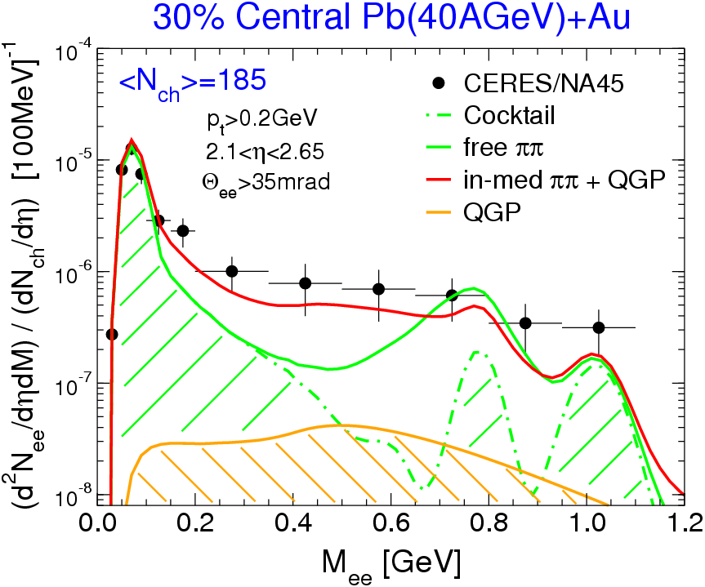
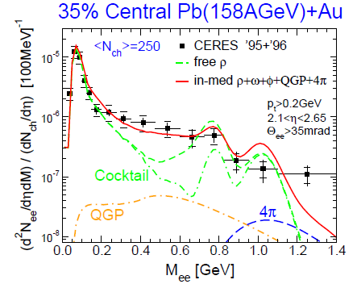
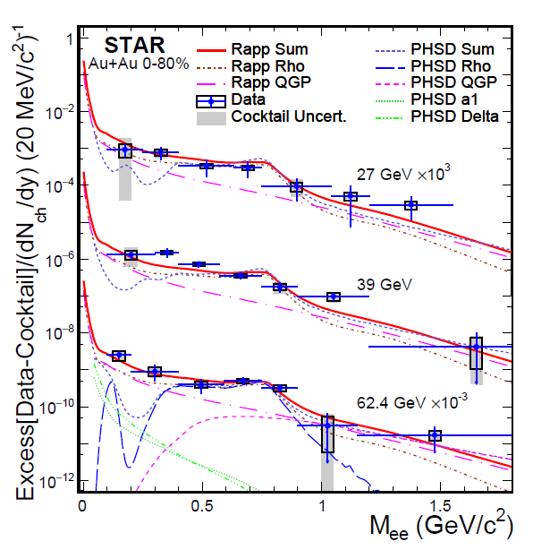
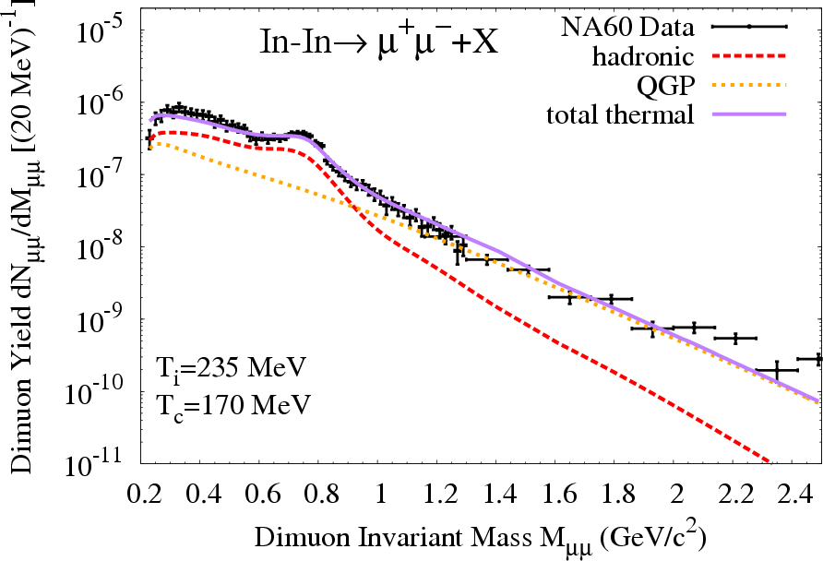
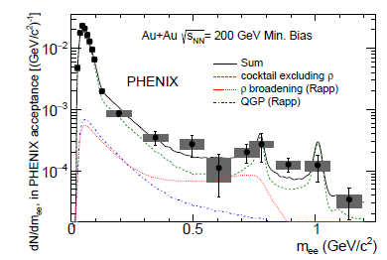
1.2 Dilepton Measurements in Heavy-Ion Collisions
<N_{ch}>=120
Robust description across collisions energies:
QGP + hadronic radiation with melting ρ resonance

Slide 4

1.3 NA60 Dimuons at SPS (√s=17.3 GeV)
Integrate rates over thermal fireball:
Excess Radiation Spectrum
e⁺
e⁻
-
High mass:
QGP thermometer
T_{slope} ~ 200 MeV
q q
ρ
Low mass:
ρ-meson melting,
fireball lifetime

Slide 5
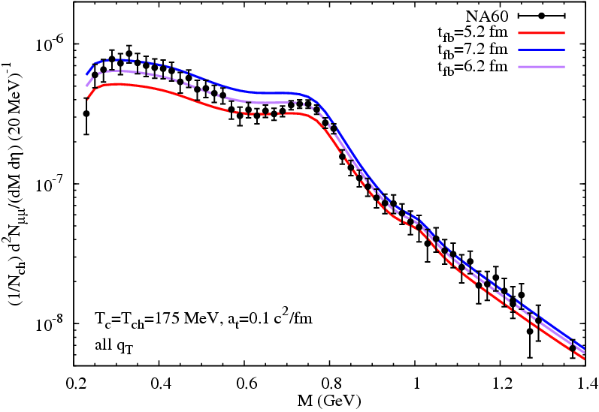
1.4 Sensitivity of NA60 Dimuons to …
… ρ-Meson Line Shape … Lifetime of the Fireball
In-In N_{ch}>30
Baryonic medium effects ρ-meson melting
First “explicit” measurement of interacting-fireball lifetime

Slide 6
Outline
1.) Introduction
2.) Baseline Results
• Spectral + Excitation Functions
3.) 1st-Order Transition
• Early Estimates
• HADES Energy
• Excitation Fct. around √s ~ 5 GeV
4.) Conclusions

Slide 7
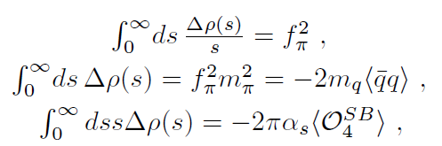
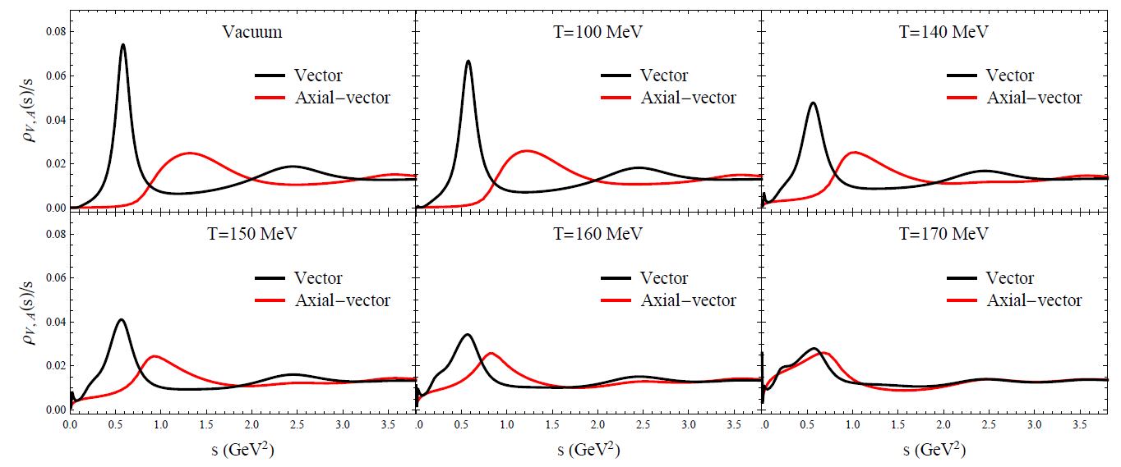
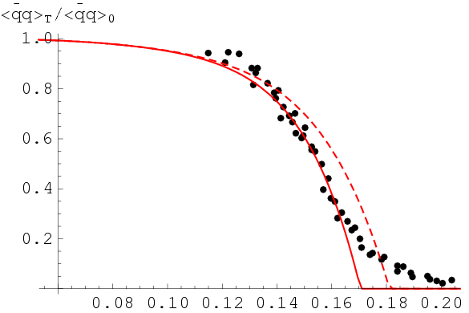
2.1 Vector Spectral Function + Lattice QCD (μ_{B}=0)
QCD+Weinberg sum rules
Axial/-Vector Spectral Functions
Δρ = ρ_{V} -ρ_{A}
[Weinberg ’67, Das et al ’67,
Kapusta+Shuryak ‘94]
⇒
[Hohler +RR ‘13]
Infer approach to chiral restoration
Chiral mass splitting “burns off”, resonances melt (also π-σ, N-N*)
How is chiral restoration realized at high μ_{B}?

Slide 8
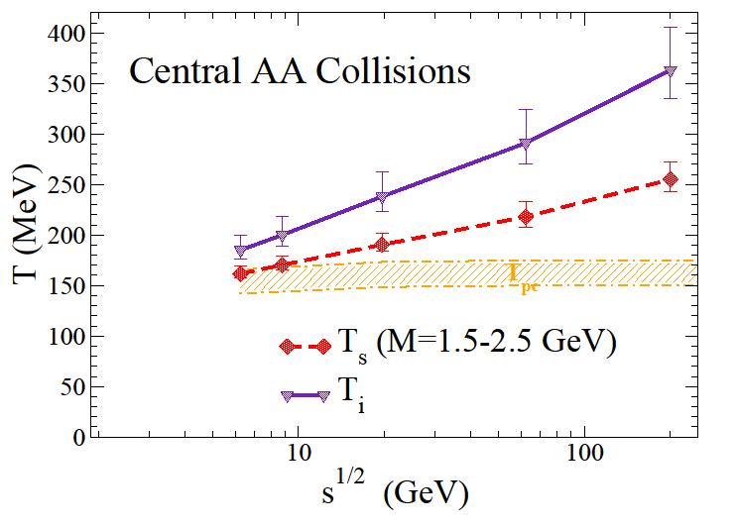
2.2 Fireball Temperature
Hadron Production Intermediate-Mass Dilepton Slopes
[STAR ‘17]
Unique “early” temperature measurement (no blue-shift!)
T_{slope} approaches T_{init} toward lower energies
1st-order “plateau” around √s ~ 5 GeV ?

Slide 9
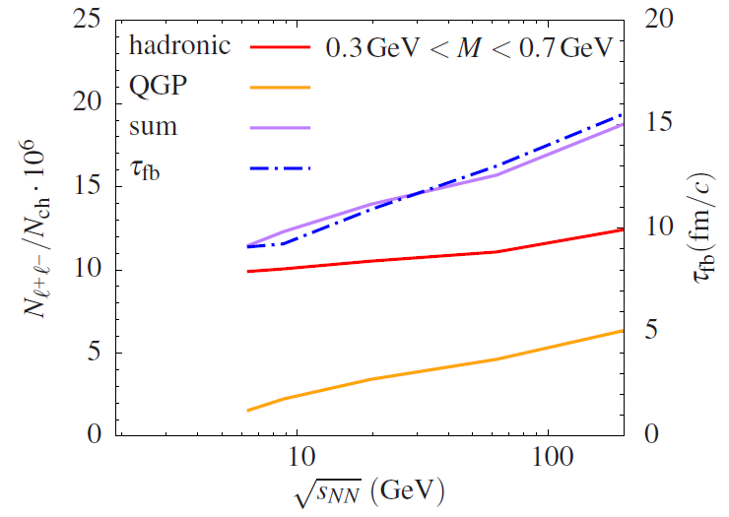
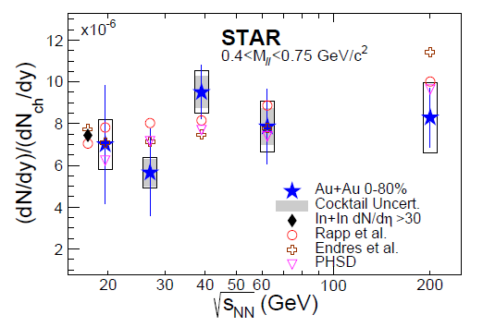
2.3 Fireball Lifetime
Excitation Function of Low-Mass Dilepton Excess Yield
[RR+van Hees ‘14]
[STAR ‘18]
Low-mass excess tracks lifetime well (medium effects!)
Tool for critical point search?

Slide 10
Outline
1.) Introduction
2.) Baseline Results
• Spectral + Excitation Functions
3.) 1st-Order Transition
• Early Estimates
• HADES Energy
• Excitation Fct. around √s ~ 5 GeV
4.) Conclusions

Slide 11
3.1 Early Dilepton Study of 1st-Order Transition
Hydrodynamics with generic equation of state
[Hung+Shuryak ‘94]
Long-lived mixed phase if fireball starts out near softest point
Divide yield by N_{ch} by 3-volume to exhibit maximum in lifetime

Slide 12
3.2 First-Order Transition at HADES Energies
Hydrodynamics for Au+Au(2.4GeV)
[Seck et al ’20]
Implement “strong” 1st-order transition into CMF/PNJL
model by increasing scalar quark couplings [Steinheimer et al ‘17]
Different evolution models describe HADES π spectra

Slide 13
3.2.2 Dilepton Emission with 1st-Order Transition
Good agreement hydro-no-PT and UrQMD
Factor 2 increase in low-mass yield from
longer lifetime + higher temperature
[Seck et al ’20]

Slide 14
3.3 First-Order Transition around √s_{NN} ~ 5 GeV
Fireball model (HRG/lQCD) with latent heat:
suppress P_{HRG} by x_{s} < 1 for T_{c} > T > T_{chem}
Reduce transverse acceleration by r = τ_{mix}/τ_{FB}
Constrain thermal freezeout by recovering proton slope parameters
Slower expansion → enhanced lifetime

Slide 15
3.3.2 Dilepton Emission with 1st-Order Transition I
Fireball Lifetime Excitation Function
Clear signature in low-mass yield due to lifetime increase

Slide 16
3.3.3 Dilepton Emission with 1st-Order Transition II
“Caloric Curve”
No strong signature in temperature
(T_{c} drops with μ_{B})

Slide 17
4.) Conclusions
ρ melting: hadron → parton transition, compatible with chiral
restoration (evaporate chiral mass splitting)
Baryon-driven medium effects → lower collision energies
Excitations functions
- low-mass radiation “measures” fireball life
→ sensitive to extended mixed phase
- intermediate-mass radiation: track T_{c} (decreases with μ_{B})
Electric conductivity: very-low mass + momentum O(100 MeV)

Slide 18
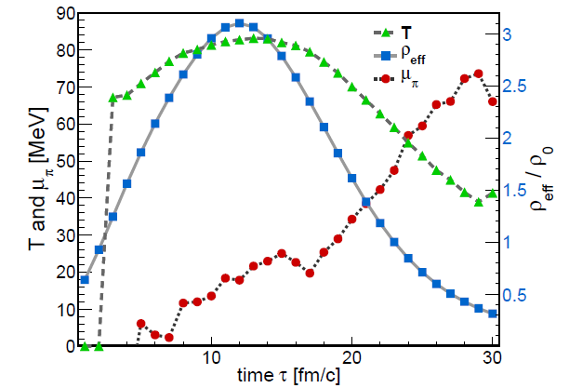
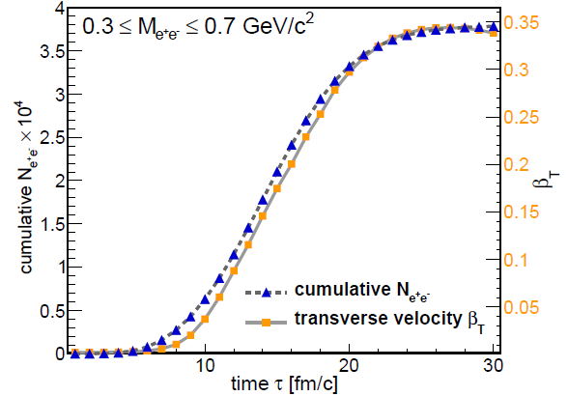
4.4 Dileptons at HADES: Coarse Graining
Coarse-graining of hadronic transport to
→ extract thermodynamic variables
→ convolute with thermal dilepton rate
Temperature + Baryon Density Dilepton Yield vs. Nucleon Flow
[Huovinen et al. ’02,
Endres et al ’15,
Galatyuk et al ‘16]
Au-Au
(1.23AGeV)
build-up of collectivity ↔ EM radiation ↔ “thermal” fireball
fireball lifetime “only” τ_{fb} ~ 13 fm/c

Slide 19
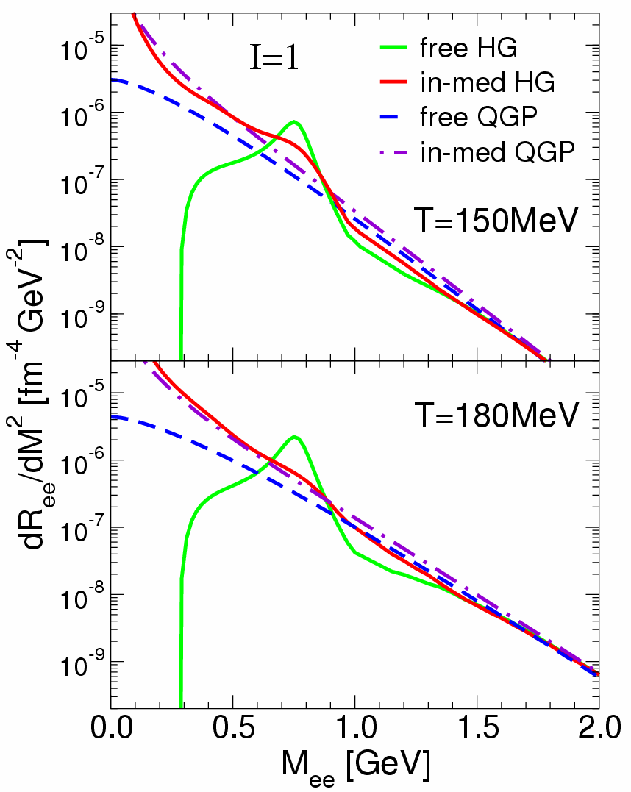
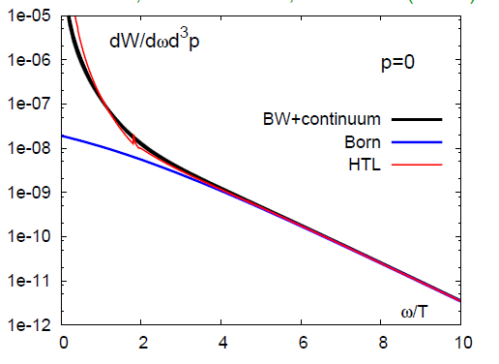
2.2 Dilepton Rates and Degrees of Freedom dR_{ee} /dM² ~ ∫d³q/q₀ f ^{B}(q₀;T) Im Π_{em} /M²
ρ-meson resonance “melts”
spectral function merges into
QGP description
Direct evidence for transition
hadrons → quarks + gluons
-
[qq→ee]
[HTL]
dR_{ee}/d⁴q 1.4T_{c} (quenched) q=0
[Ding et al ’10]
[RR,Wambach et al ’99]

Slide 20
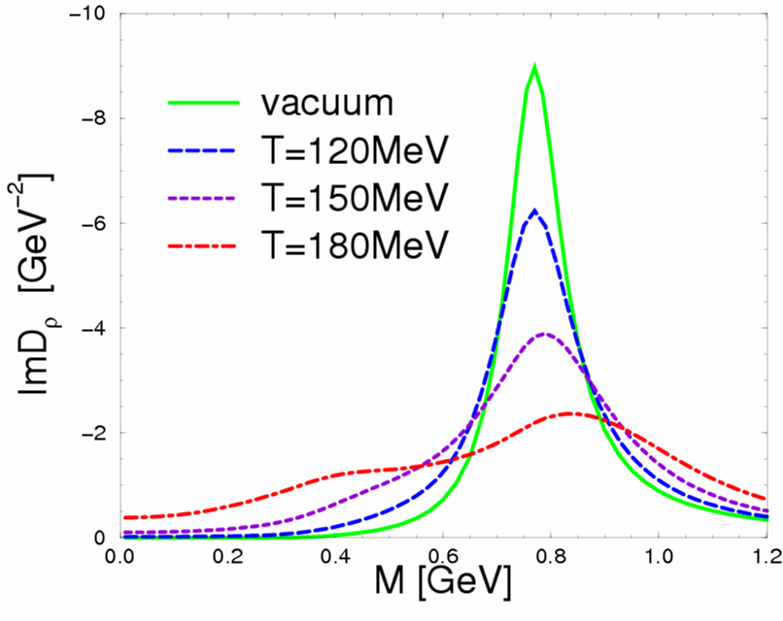
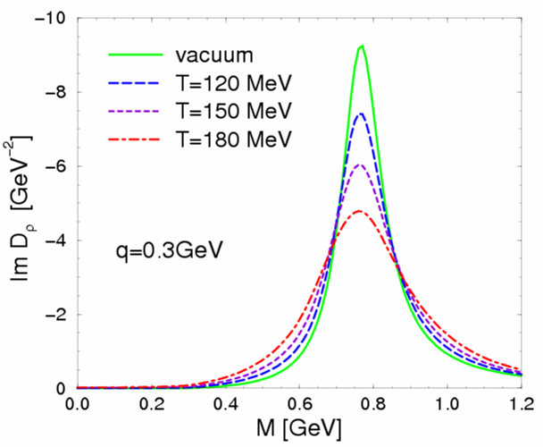
2.1 In-Medium ρ-Meson Spectral Functions
D_{ρ} (M,q;μ_{B},T) = 1 / [M² – (m_{ρ}⁽⁰⁾)² - Σ_{ρππ} - Σ_{ρB} - Σ_{ρM} ]
Hot + Dense Matter
Hot Meson Gas
ρ_{B}/ρ₀
0
0.1
0.7
2.6
μ_{B} =330MeV
[RR+Wambach ’99]
[RR+Gale ’99]
ρ-meson “melts” in hot/dense matter
baryon density ρ_{B} more important than temperature

Slide 21
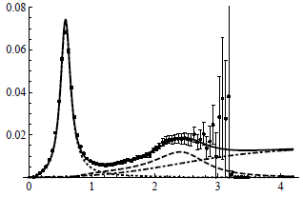
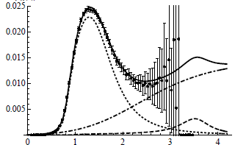

3.1 QCD + Weinberg Sum Rules
[Hatsuda+Lee’91,
Asakawa+Ko ’93,
Leupold et al ’98, …]
ρ
a₁
Δρ = ρ_{V} -ρ_{A}
[Weinberg ’67, Das et al ’67;
Kapusta+Shuryak ‘94]
accurately satisfied in vacuum
In Medium:
condensates from hadron resonance gas,
constrained by lattice-QCD
T [GeV]

Slide 22
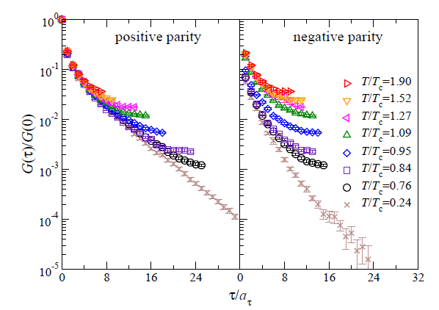
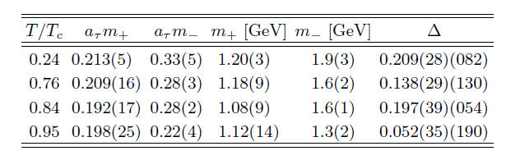
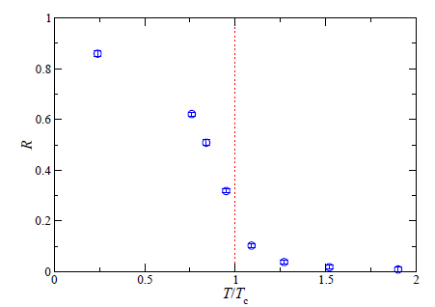
3.2 Lattice-QCD Results for N(940)-N*(1535)
Euclidean Correlator Ratios Exponential Mass Extraction
“Nucleon”
“N*(1535)”
R = ∫(G⁺-G⁻)/(G⁺+G⁻)
[Aarts et al ‘15]
also indicates M_{N*}(T) → M_{N} (T) ≈ M_{N}^{vac}

Slide 23
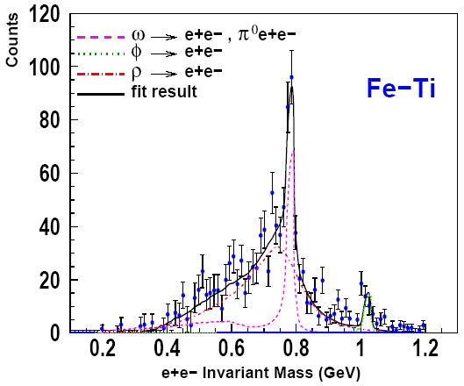
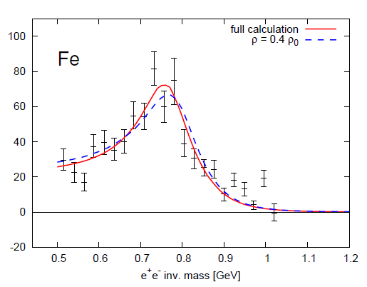
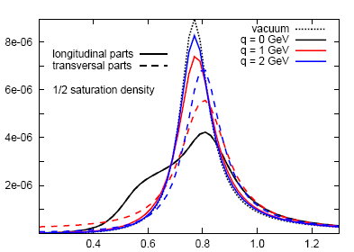
4.1 Nuclear Photoproduction: ρ Meson in Cold Matter
γ + A → e⁺e⁻ X
extracted
“in-med” ρ-width
Γ_{ρ} ≈ 220 MeV
e⁺
e⁻
E_{γ}≈1.5-3 GeV
γ
ρ
[CLAS+GiBUU ‘08]
Microscopic Approach:
+
in-med. ρ spectral fct.
product. amplitude
Fe - Ti
full calculation
fix density 0.4ρ₀
ρ
γ
N
[Riek et al ’08, ‘10]
M [GeV]
ρ-broadening reduced at high 3-momentum; need low momentum cut!

Slide 24
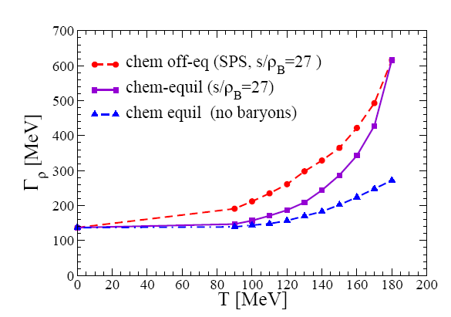
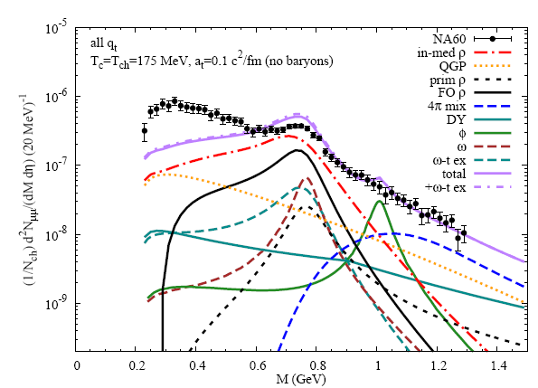
4.1.2 Sensitivity to Spectral Function
In-Medium ρ-Meson Width
M_{μμ} [GeV]
avg. Γ_{ρ} (T~150MeV) ~ 370 MeV ⇒ Γ_{ρ} (T~T_{c}) ≈ 600 MeV → m_{ρ}
driven by (anti-) baryons

Slide 25
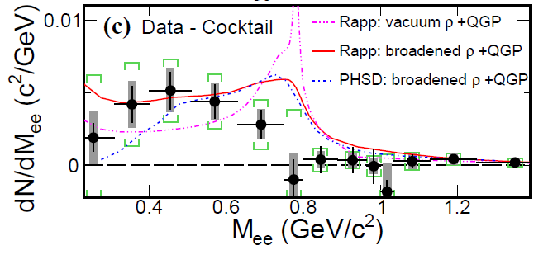
4.1 Prospects I: Spectral Shape at μ_{B} ~ 0
STAR Excess Dileptons
[STAR ‘14]
rather different spectral shapes compatible with data
QGP contribution?

Slide 26
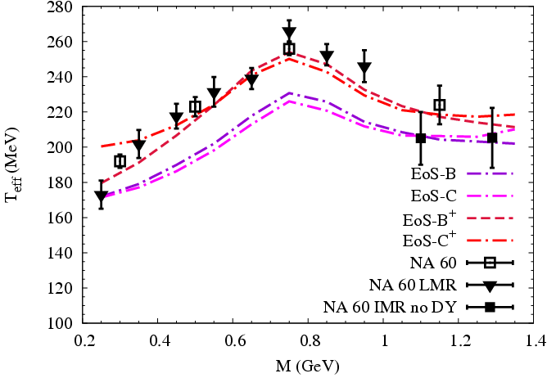
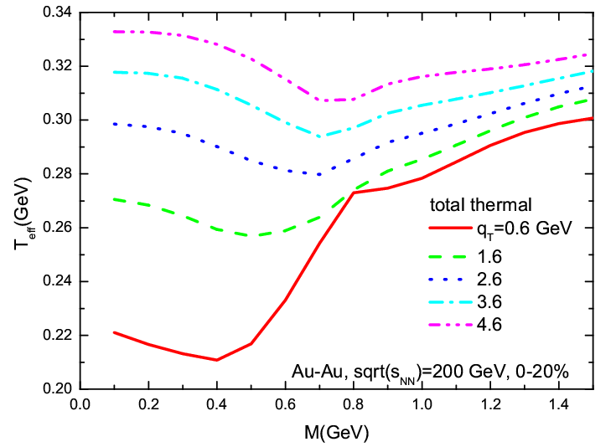
4.5 QGP Barometer: Blue Shift vs. Temperature
SPS RHIC
QGP-flow driven increase of T_{eff} ~ T + M (β_{flow})² at RHIC
high p_{t}: high T wins over high-flow ρ’s → minimum (opposite to SPS!)
saturates at “true” early temperature T₀ (no flow)

Slide 27
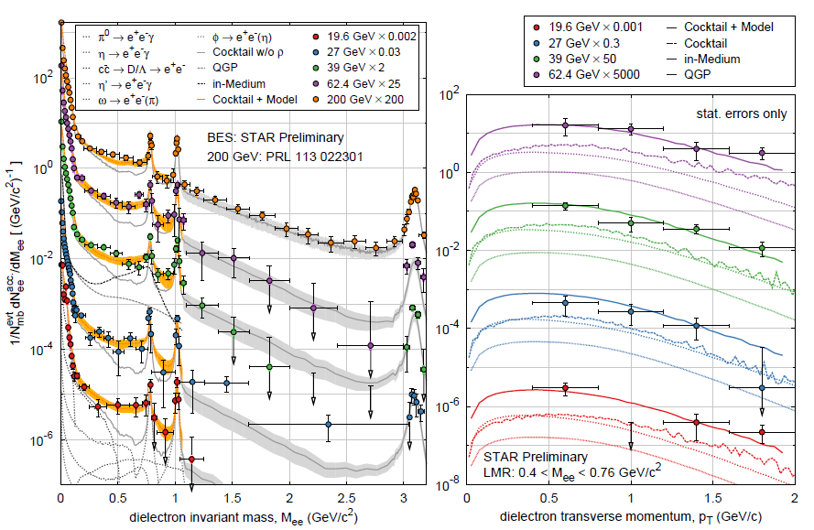
2.3 Low-Mass e⁺e⁻ Excitation Function: 20-200 GeV
P. Huck et al. [STAR],
QM14
compatible with predictions from melting ρ meson
“universal” source around T_{pc}

Slide 28
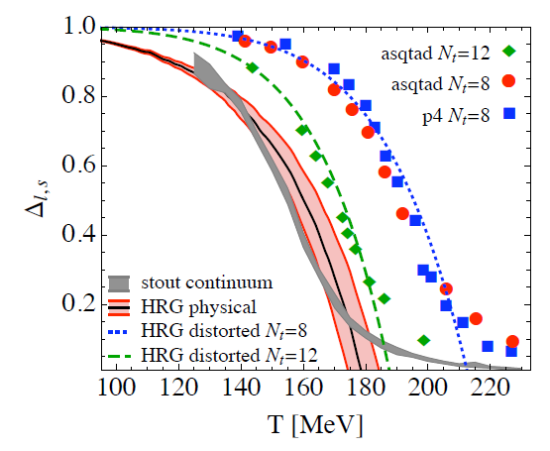
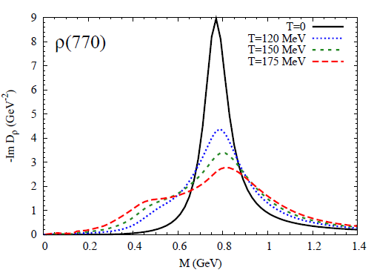

2.2 Chiral Condensate + ρ-Meson Broadening
- -
⟨⟨qq⟩⟩ / ⟨qq⟩₀
effective hadronic theory
-
Σ_{h} = m_{q} ⟨h|qq|h⟩ > 0 contains quark core + pion cloud
= Σ_{h}^{core} + Σ_{h}^{cloud} ~ + +
matches spectral medium effects: resonances + pion cloud
resonances + chiral mixing drive ρ-SF toward chiral restoration
>
ρ
Σ_{π}
>
Σ_{π}

