Slide 1
CCT6 preliminary analysis and next steps
Lucas Brouwer, Mariusz Juchno, Diego Arbelaez, Paolo Ferracin (for the CCT Team)
6/15/2021

Slide 2
CCT6 is a Large Aperture, 12-13 T Nb₃Sn Magnet for Hybrid Testing
CCT R&D goal d) “Demonstration of bore field up to 13 T in a 120-mm aperture in a four-layer Nb₃Sn CCT model magnet”

Slide 3
Outline
Initial Analysis Goals – outline for this talk
short-sample field vs. cable size at 4.5 K and 1.9 K
preliminary cable selection and 2D cross section
2D mechanical analysis with a rigid boundary
initial steps towards 3D modeling

Slide 4
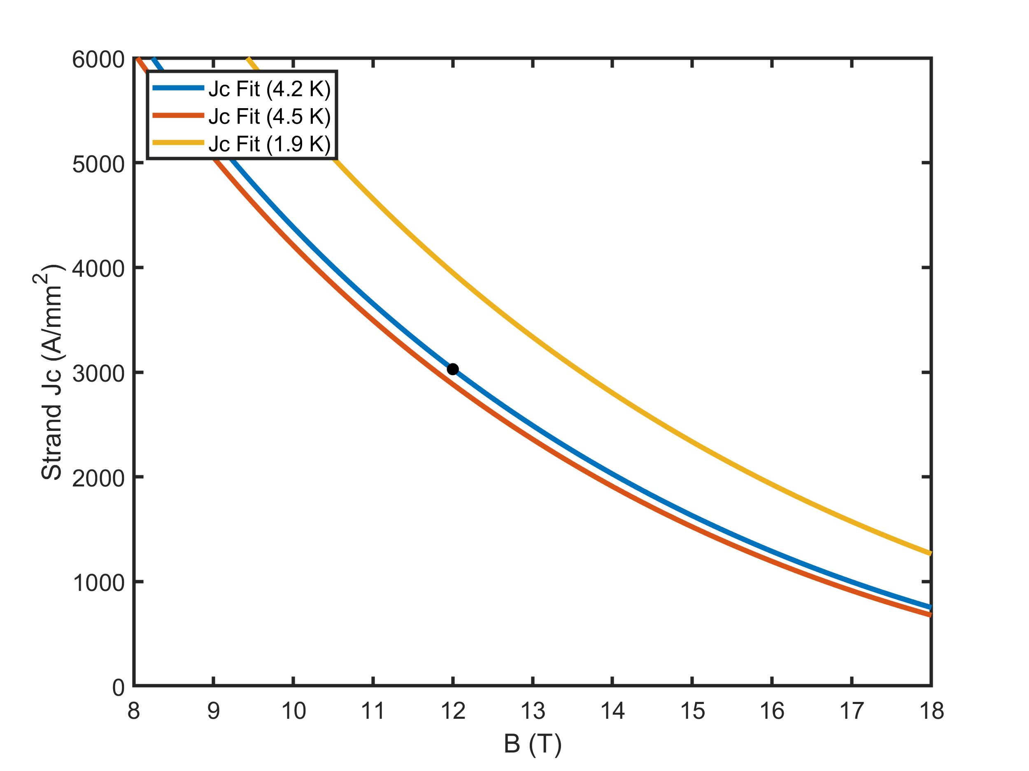
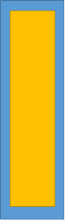
CCT6 Initial Design Assumptions
Assumptions
120 mm clear bore diameter
four layers
insulation and channel design is based on CCT5
Jc = 3000 A/mm^2 @4.2 K, 12 T
cable
ins. + gap of 300 μ per side

Slide 5
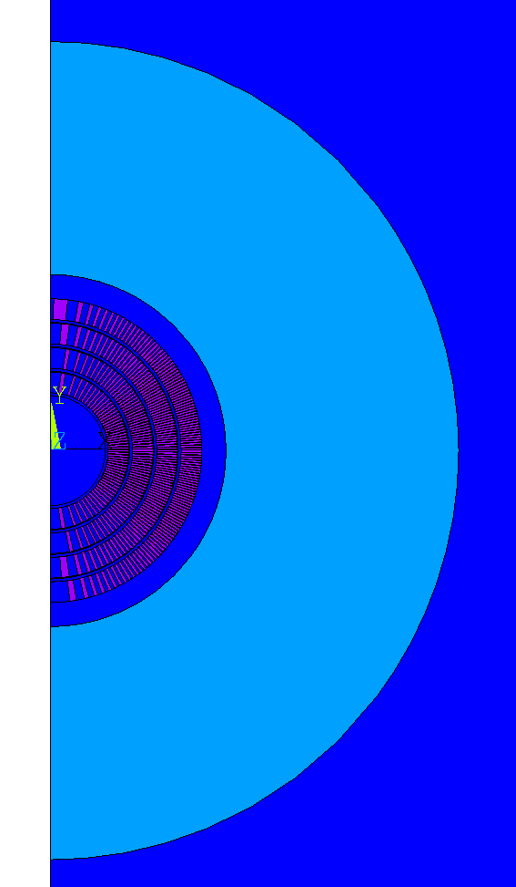
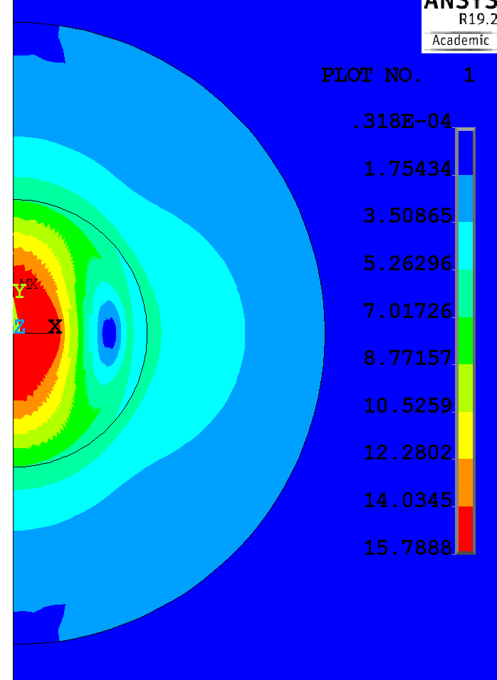
A 2D magnetic model is used for scaling studies
Assumptions
10” of iron close to the outer coil
5% rise of field at conductor due to 3D effects not captured by this model*
3 mm spar + 1 mm radial gap between layers
short-sample is with respect to round wire Jc
This model allows for quick study of short-sample fields attainable for a variety of cables
*based on past 4+ CCT layer designs

Slide 6
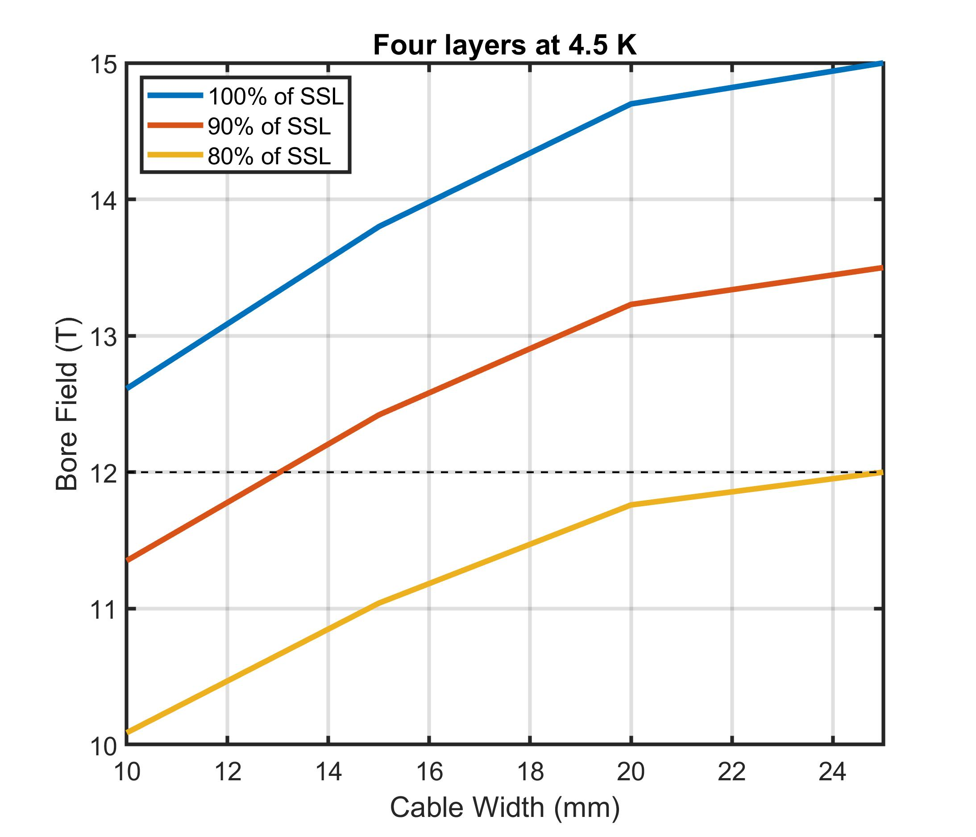
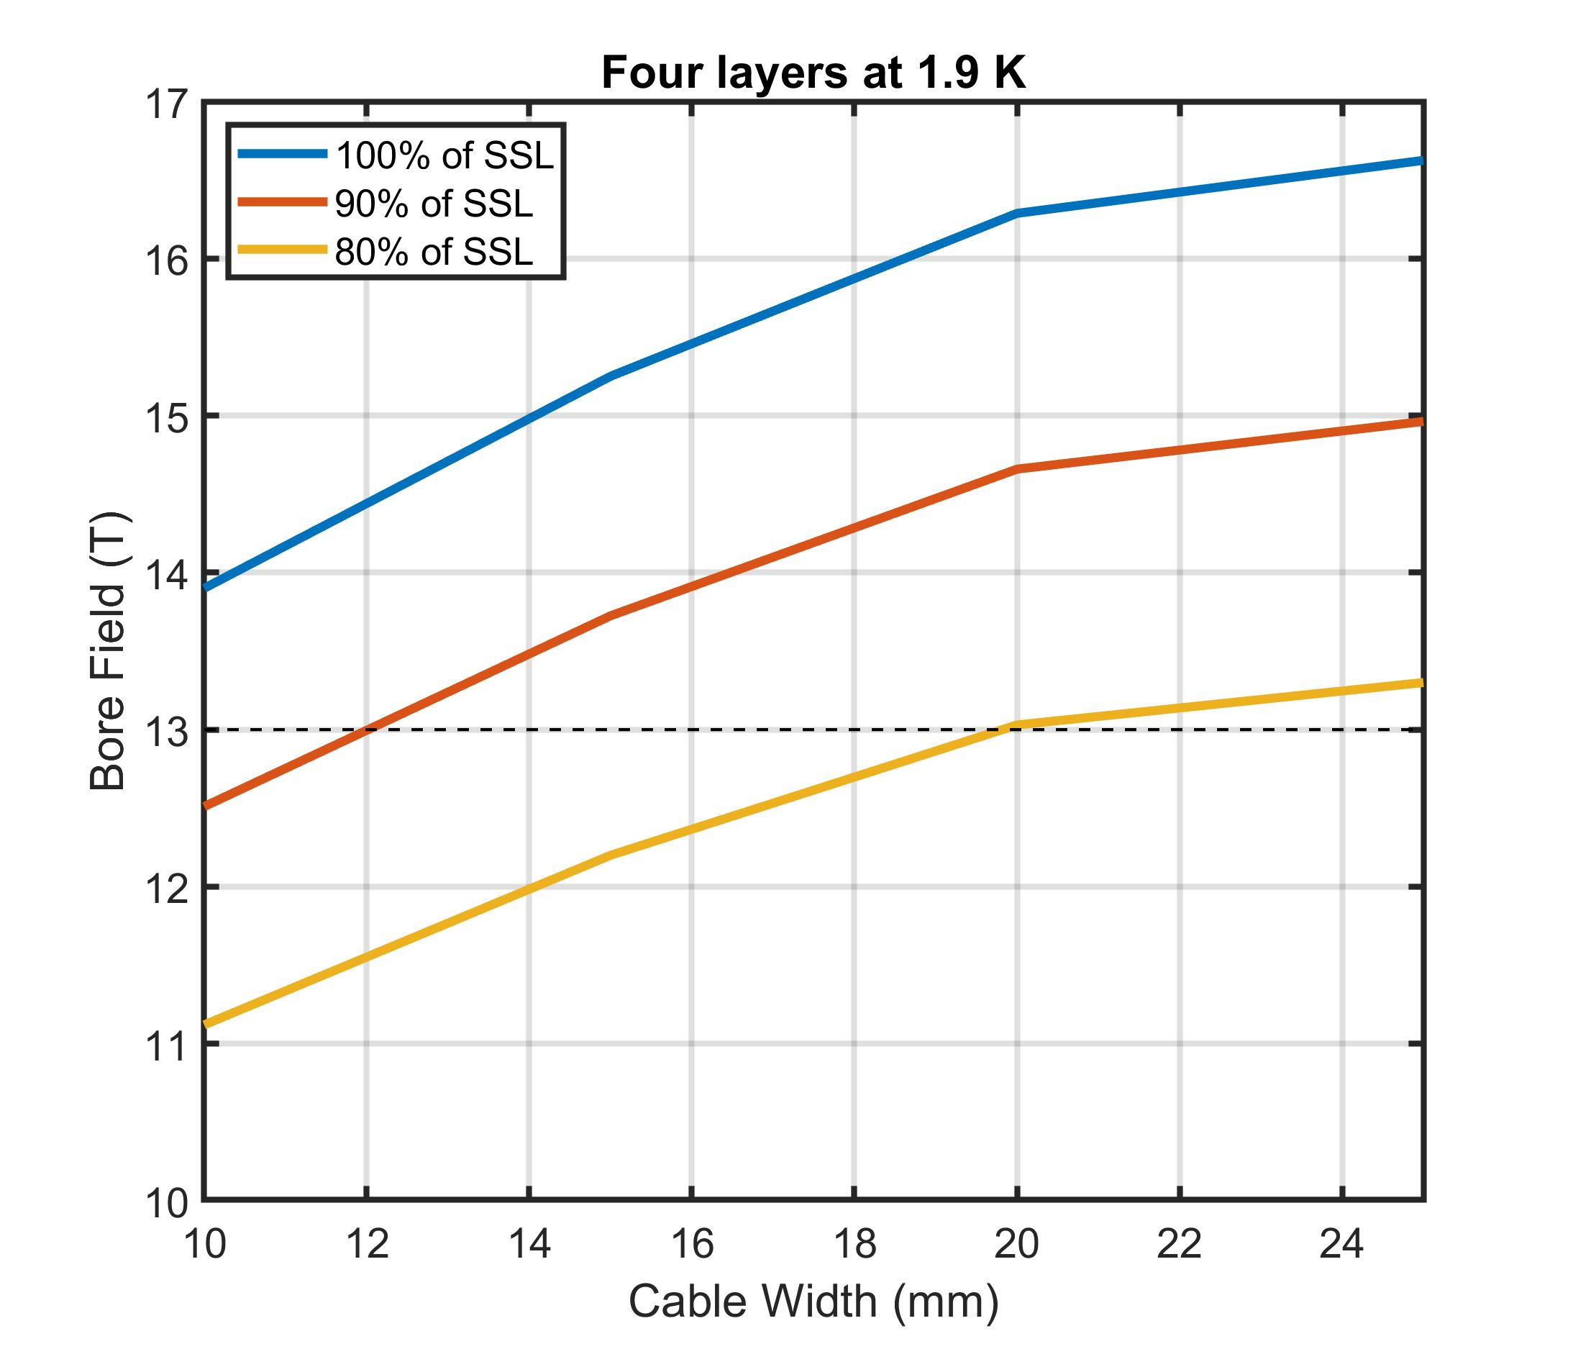
Short-Sample vs. Cable Width for 0.85 mm strand
Choice of a large cable (20-25 mm) targets 12 T at 4.5 K and 13 T at 1.9 K ( at 80% of SSL)
Assumptions for scaling study: 0.85 mm strand, non-cu fraction of 0.46

Slide 7
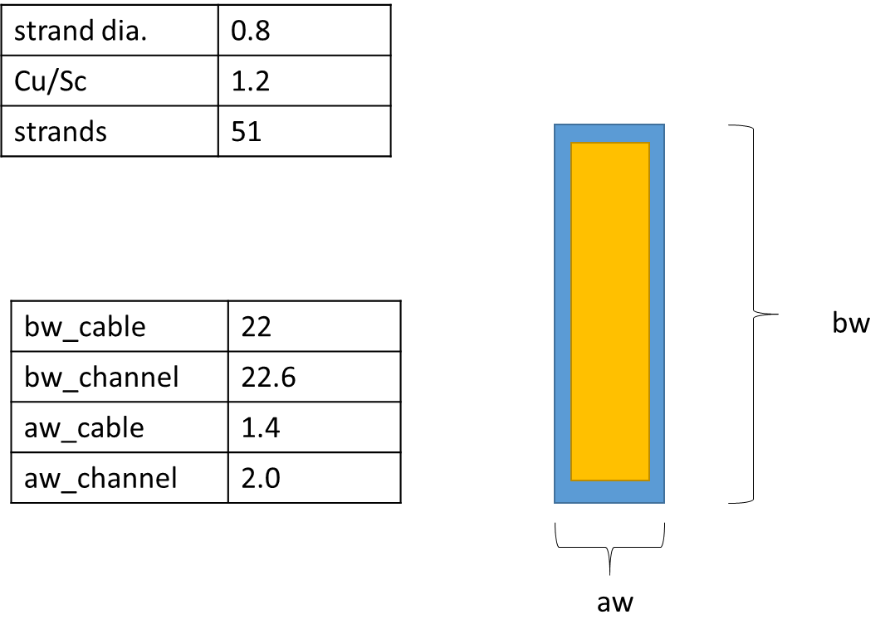
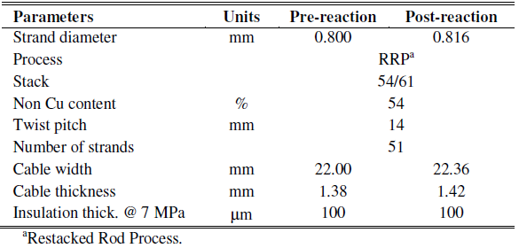
Explore CCT6 design using existing LD1 cable
Ref. P. Ferracin et al., IEEE TASC 22(2), 2012

Slide 8
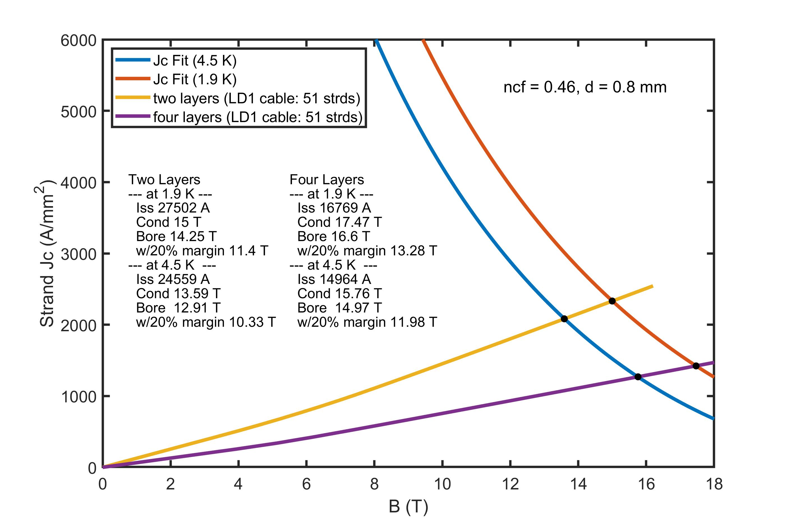
Four layers with LD1 cable leads to 12 T at 4.5 K and 13 T at 1.9 K (at 80% of SSL)
Four Layers @ SSL
 | 4.5 K | 1.9 K
current | 15.0 kA | 16.8 kA
B_cond | 15.8 T | 17.5 T
B_bore | 15.0 T | 16.6 T
Four Layers @ 80 % of SSL
 | 4.5 K | 1.9 K
current | 12.0 kA | 13.4 kA
B_cond | 12.6 T | 14.0 T
B_bore | 12.0 T | 13.3 T

Slide 9
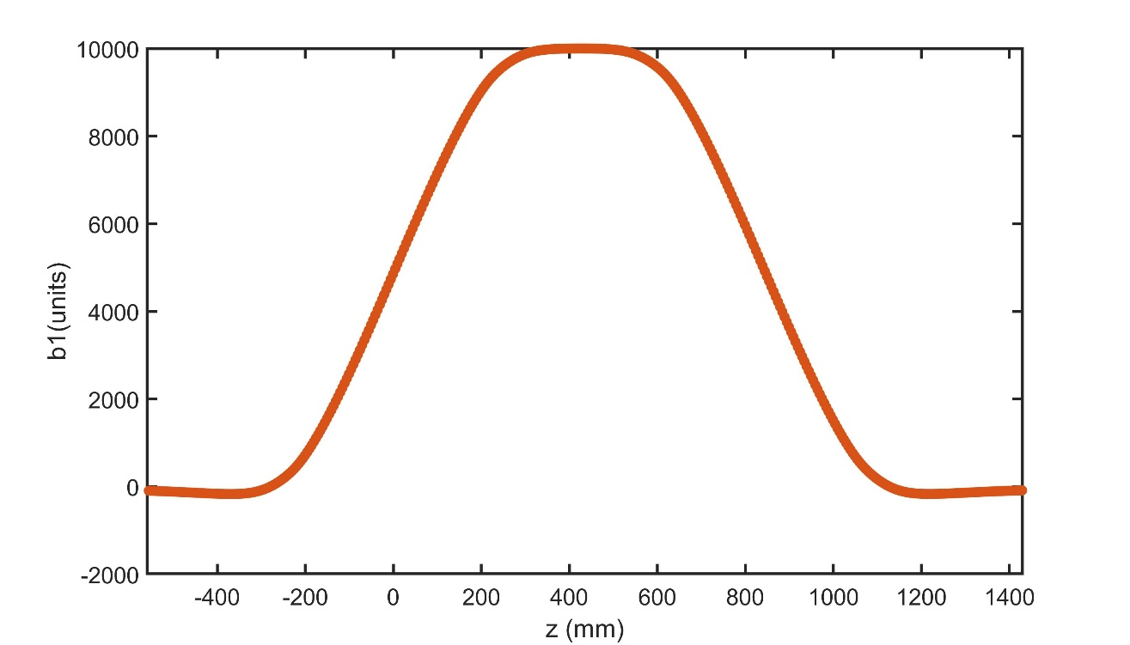
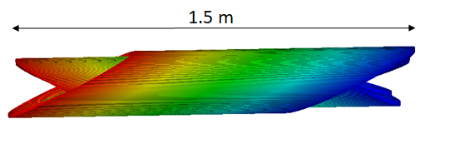
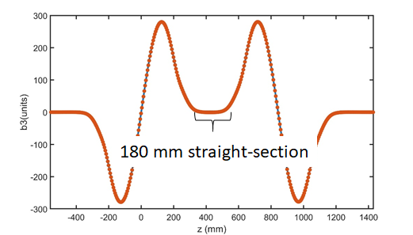
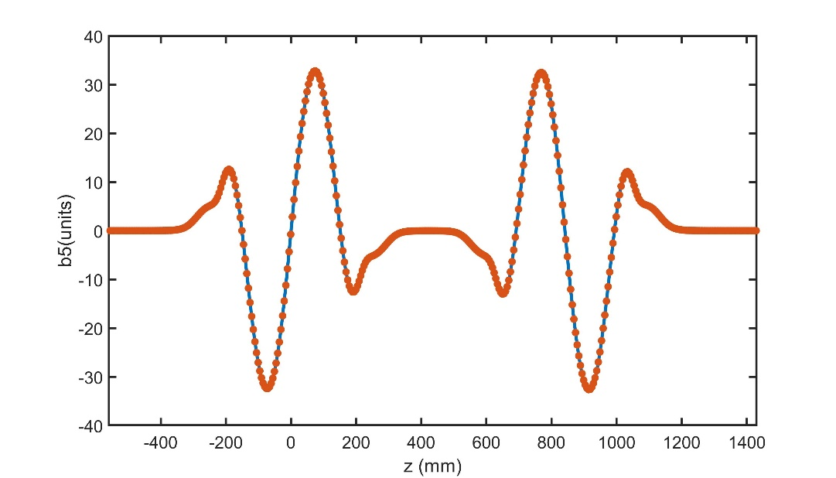
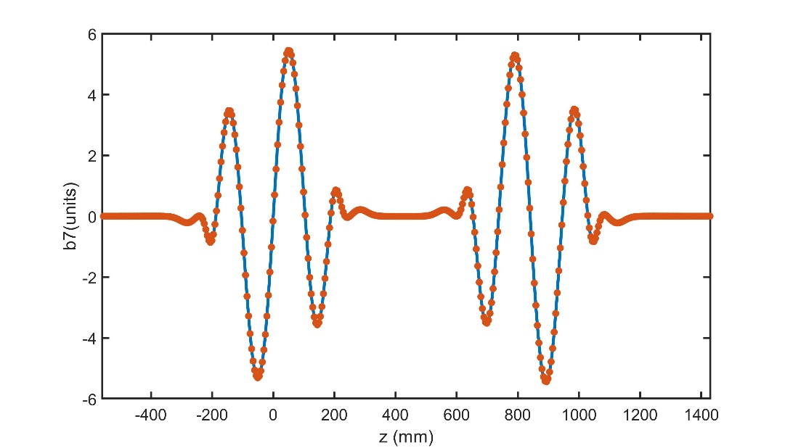
Coil physical length to magnetic straight-section length is important for testing HTS inserts
dipole
b3
b5
b7

Slide 10
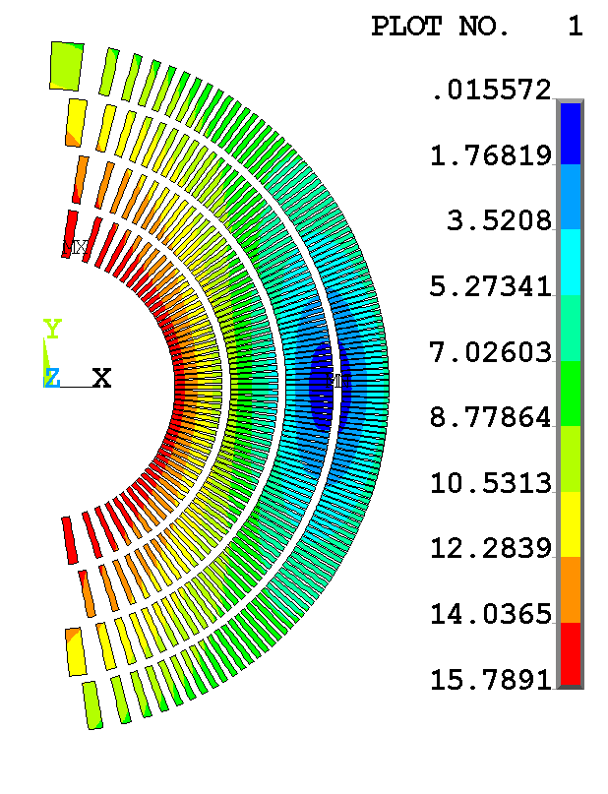
Stored Energy and Conductor Use for LD1 Cable (51 strands)
stored energy is 5.1 MJ/m (15.0 kA: 4.5 K short-sample)
without grading, requires ~720 m of cable and ~36 km of strand
Layer | tilt angle (deg) | turns | cable length (m) | strand length (km)
1 | 18 | 100 | 106 | 5.4
2 | 18 | 100 | 144 | 7.3
3 | 25 | 150 | 211 | 10.7
4 | 25 | 150 | 255 | 13.0

Slide 11
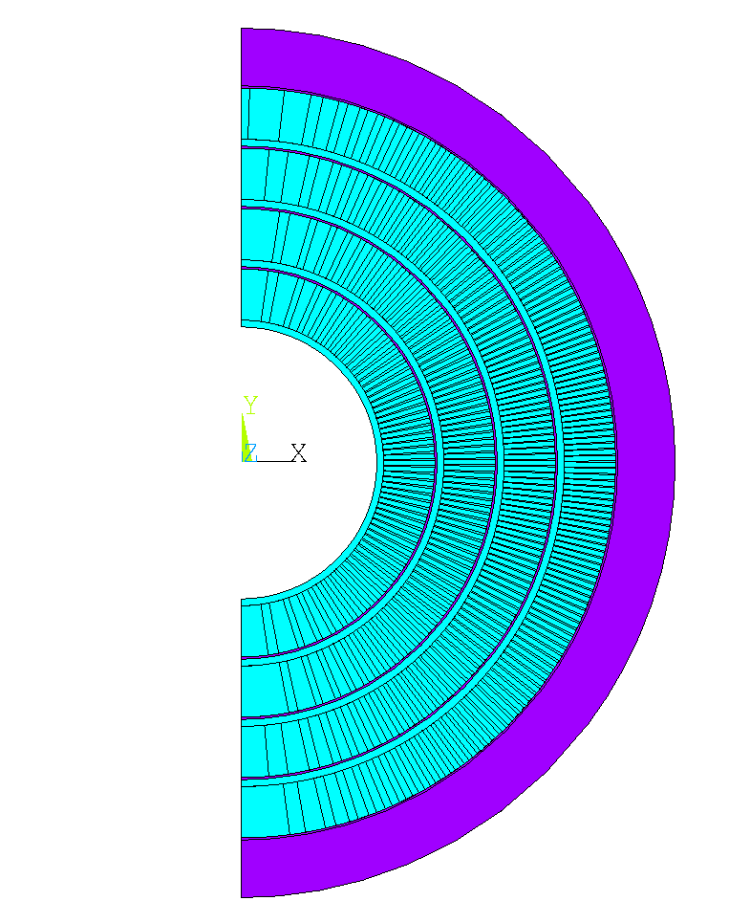
ANSYS model for stress estimation with an idealized structure
Artificially stiff shell
Pre-compression applied using fixed radial displacement on outside of the shell
Load steps (2D - plane stress)
  apply fixed radial displacement on rigid shell
  apply Lorentz forces at ~80% of 4.5 K short-sample
    four layers: 12.0 kA, 12.0 T bore field
Study the case of pre-compression up to the point of no conductor azimuthal tension during powering (all Lorentz force induced tension shifted into compression)
CCT layers with perfect sliding contact and “shims” extended to 90 degrees

Slide 12
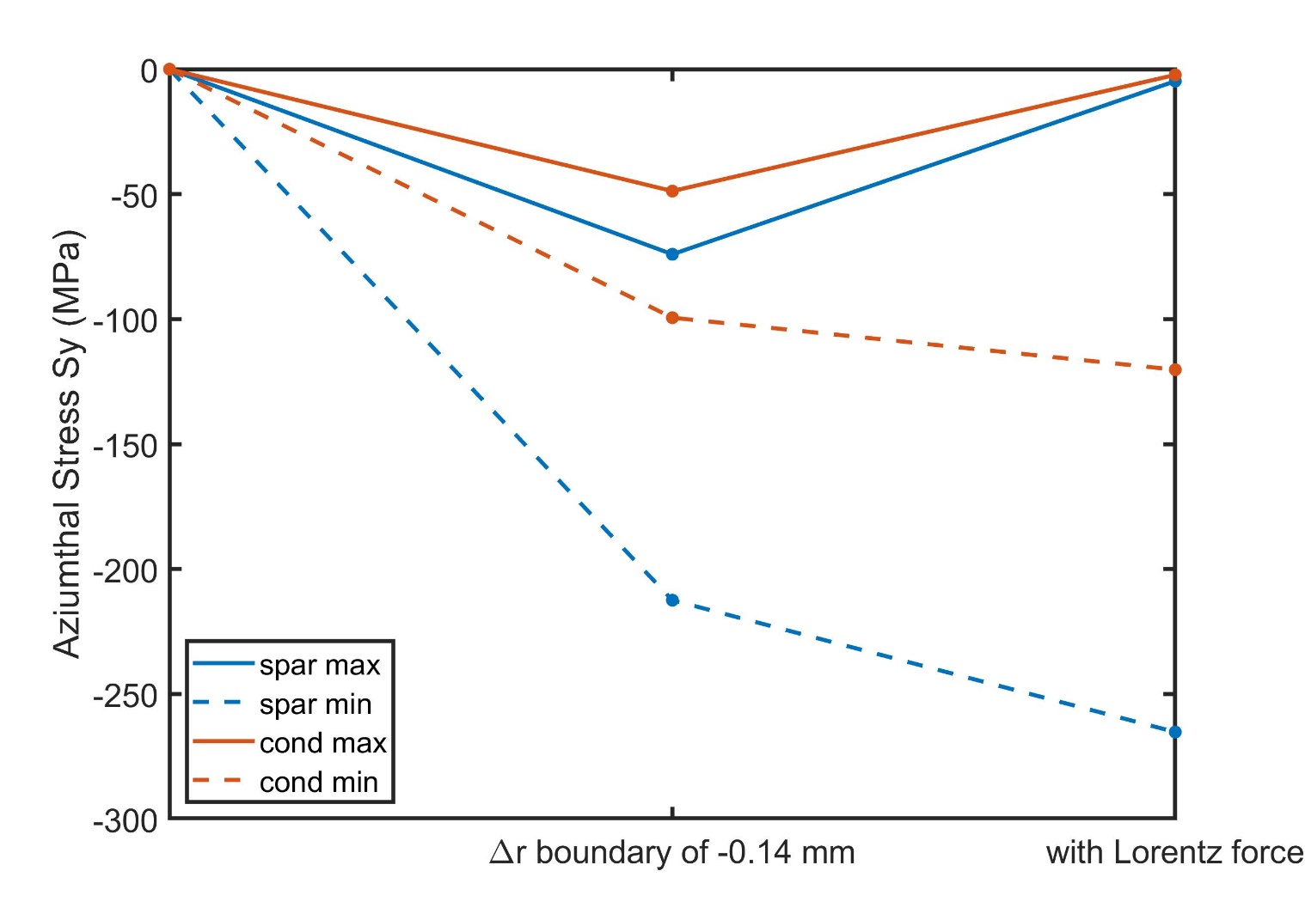
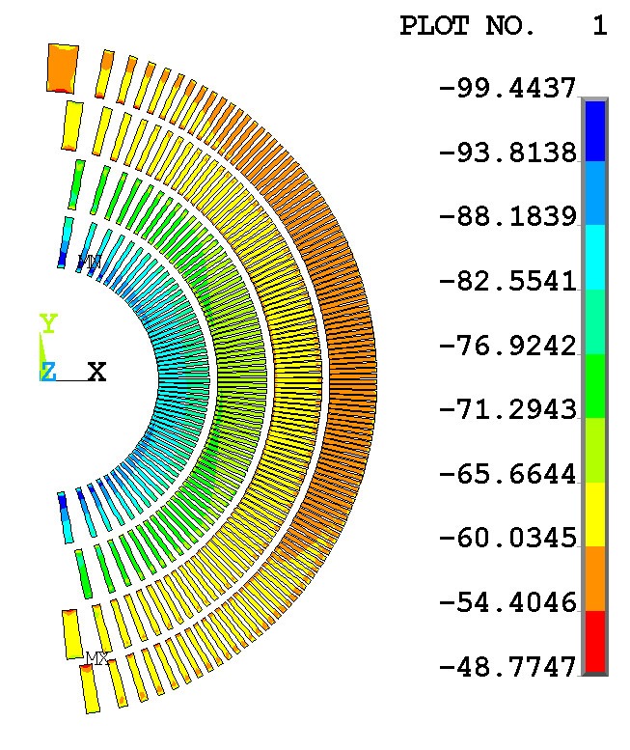
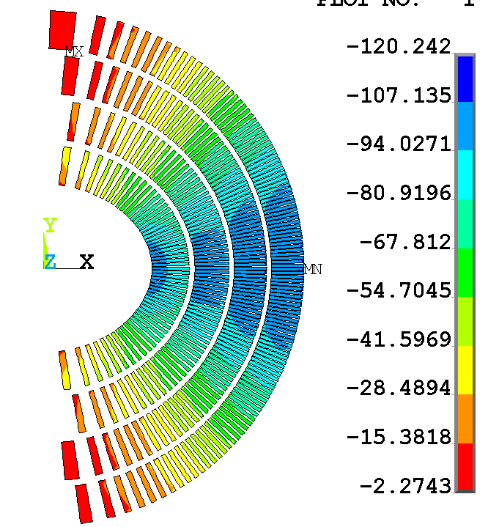
A rigid boundary with pre-stress gives a 2D estimate of peak conductor azimuthal stress of order 120 MPa
boundary is brought in 0.14 mm to keep coil barely in compression at 12.0 kA, 12.0 T bore field
after prestress
prestress+LF
Peak spar -265 MPa
Conductor +0/-120 MPa

Slide 13
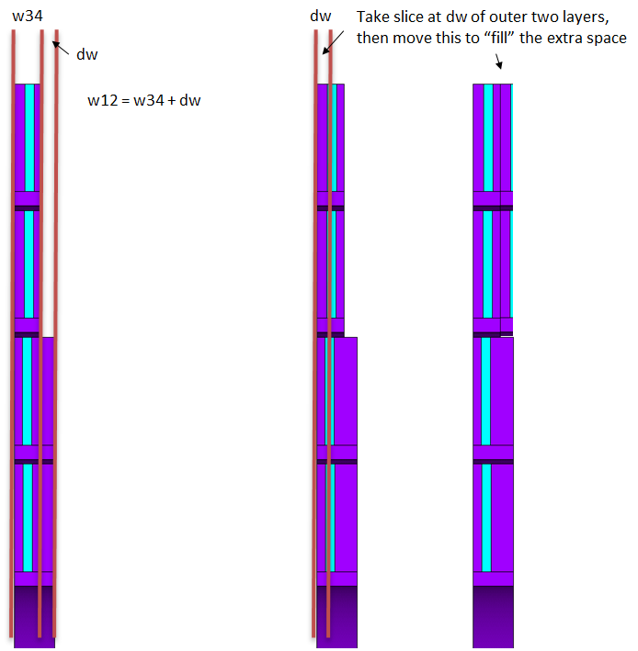
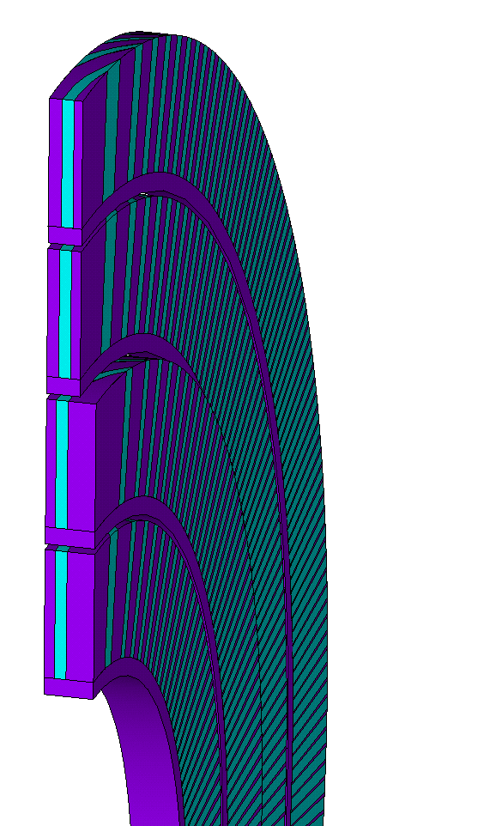
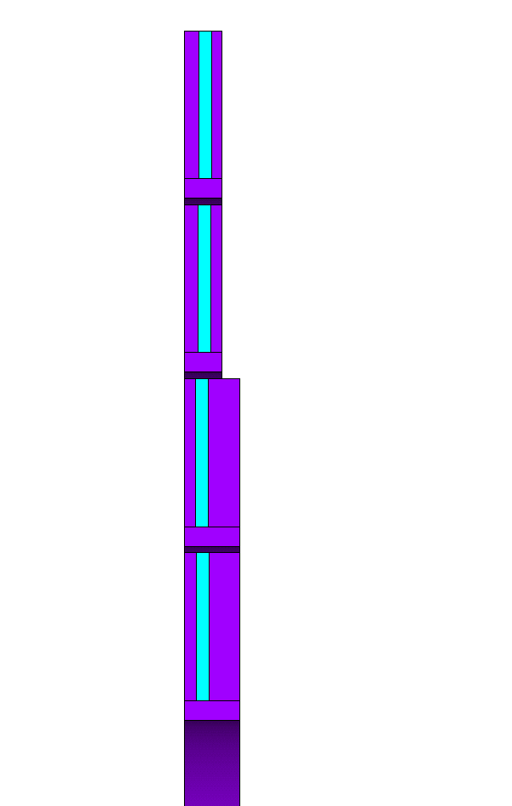
Initial steps towards 3D modeling
Pitch layer 1,2: 8.414 mm
Pitch layer 3,4: 5.679 mm

Slide 14
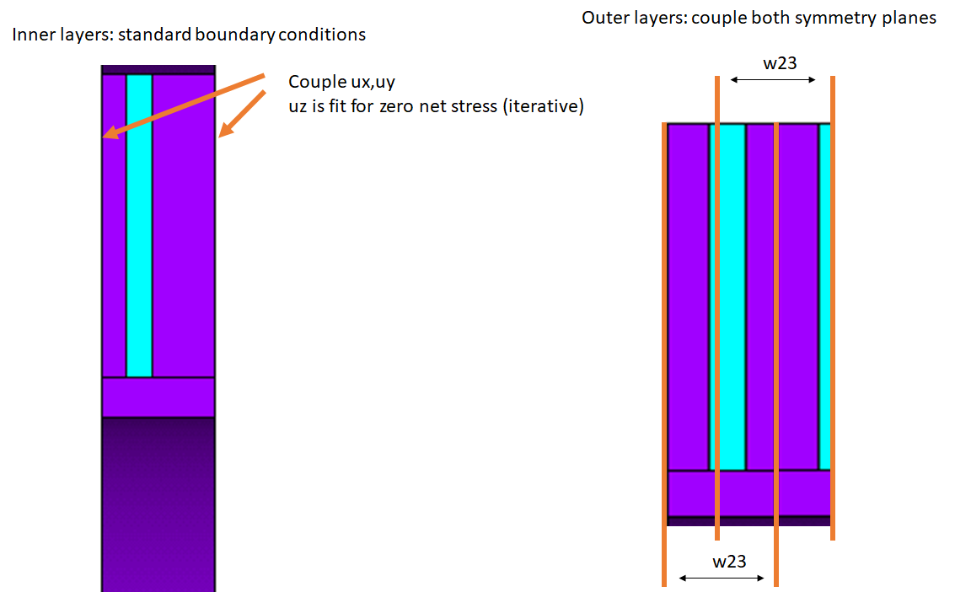
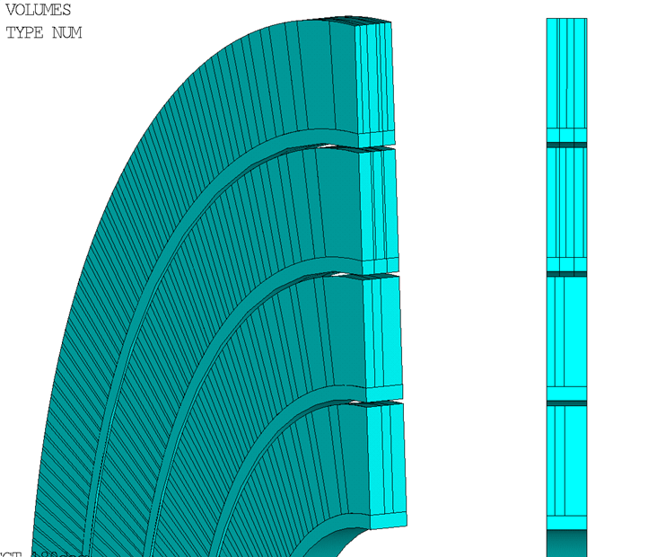
Initial steps towards 3D modeling

Slide 15
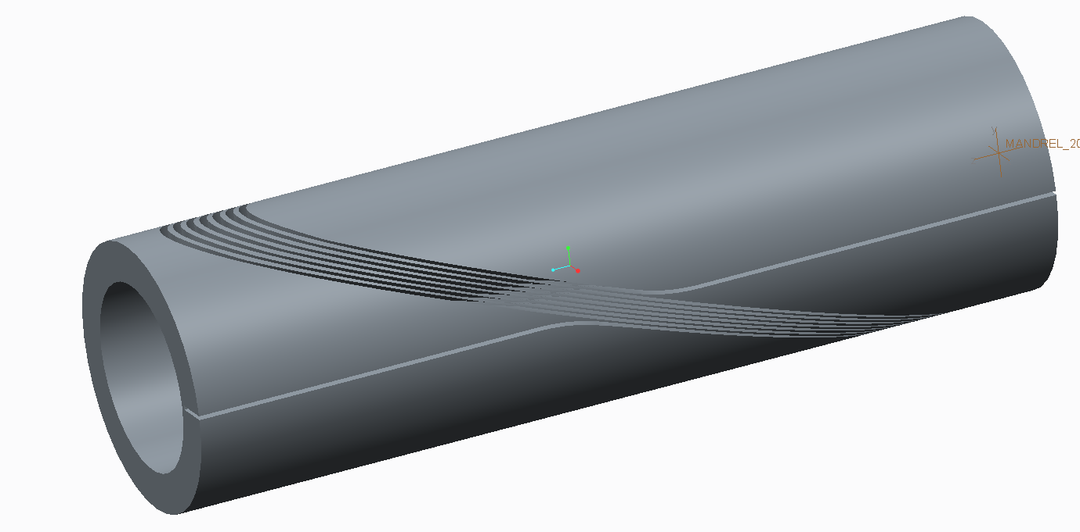
Future Work to Complete the Design of CCT6
To be studied through prototyping
feasibility of machining deep channels
winding demonstration with wide cable
reaction gap needed at pole
To be studied through modeling
seven-turn wind and reaction test mandrel
2D models
Initial optimization of structure (keys, shim angle, etc.)
HTS Insert coupling (SSL, structure, quench protection)
First study of de-bonding
3D normal and shear at cable channel interface
de-bonding with 3D shear
Final, 3D optimization of structure
3D models

