Slide 1
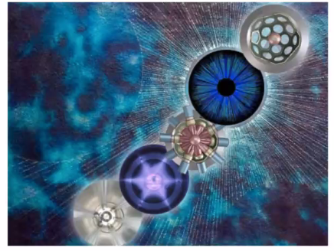

Isospin Dependence of NN Correlations
and
the Reduction of the Single-particle Strength in Atomic Nuclei
Augusto O. Macchiavelli

Slide 2
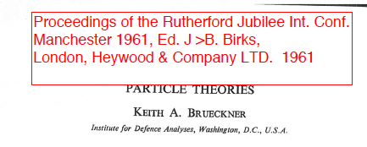
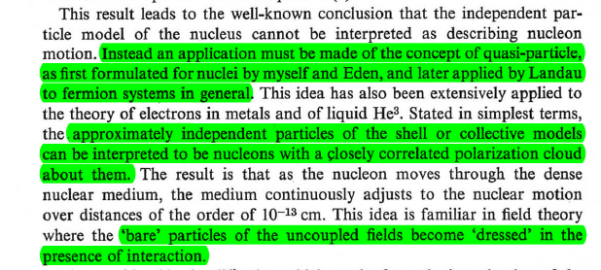

Slide 3
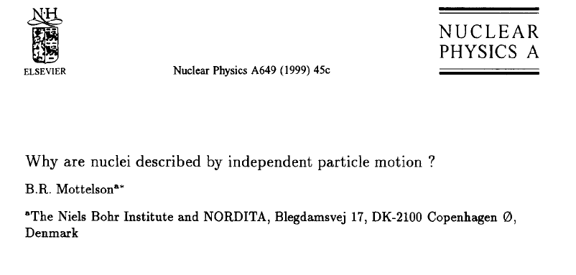

Slide 4
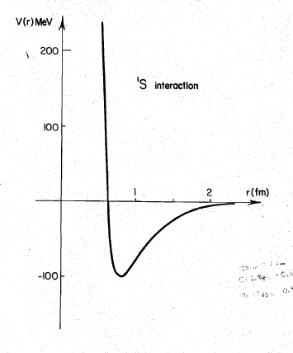
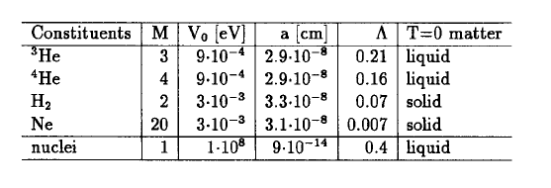
“Quantality Parameter”
Fermi Liquid → quasiparticles

Slide 5
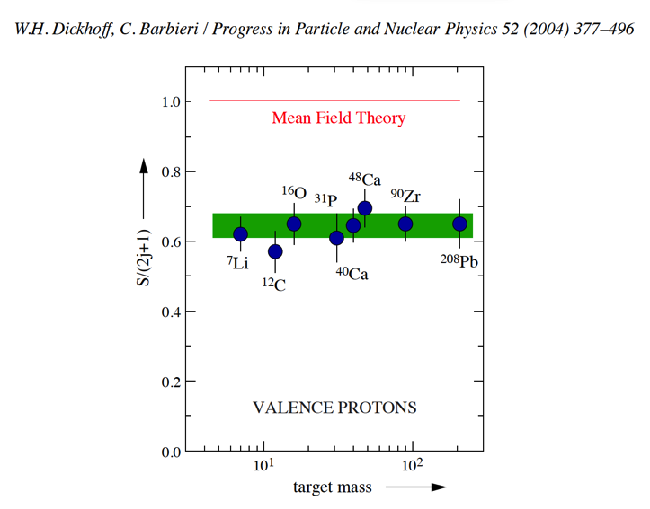
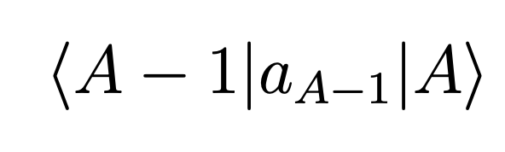
Long Range
Short Range
2
Correlations between nucleons modify the mean-field approximation and are thought to be the reason for the quenching of SF observed in (e,e′p), (p,2p) and transfer reactions.
About 30% – 40% of the nucleons participate in NN correlations, which are distinguished into long-range (LRC) and short-range (SRC).

Slide 6
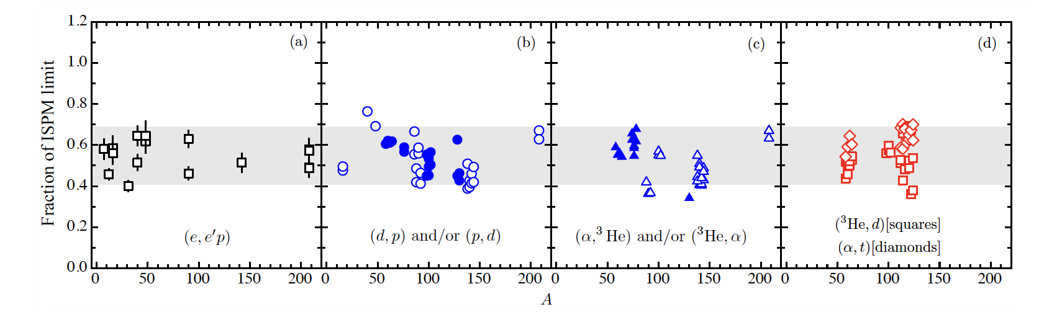
B. P. Kay, J. P. Schiffer, and S. J. Freeman.
Quenching of cross sections in nucleon transfer reactions.
Phys. Rev. Lett., 111:042502, Jul 2013.

Slide 7

On the meaning of spectroscopic factors

Slide 8



On the meaning of spectroscopic factors
NSD Theory
Augusto,

Slide 9
On the meaning of spectroscopic factors
NSD Theory
Yes, Volker
Augusto,

Slide 10
On the meaning of spectroscopic factors
NSD Theory
Yes, Volker
Augusto,
We feel you just don’t appreciate what the theorists have to say !
σ = S σ_{sp}

Slide 11
Our Motivation

Slide 12
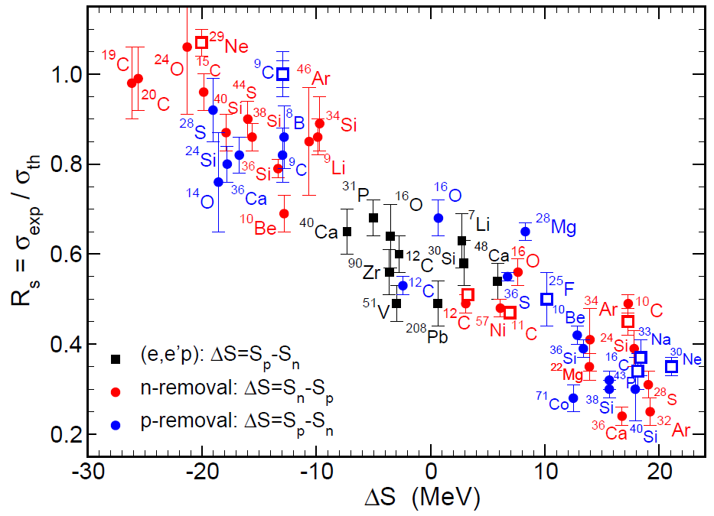
Data today – 2021 update
J. A. Tostevin and A. Gade, Phys. Rev. C 103, 054610 (2021)
Courtesy of A. Gade
Figure: Open symbols are data taken at 240 MeV/u are ²⁹Ne-1n, ²⁵F-1p, ¹⁶C-1p, ³⁰Ne-1p, and ³³Na-1p and at 1.6 GeV/u ⁹C-1p, ¹²C-1n, ¹¹C-1n and ¹⁰C-1n

Slide 13




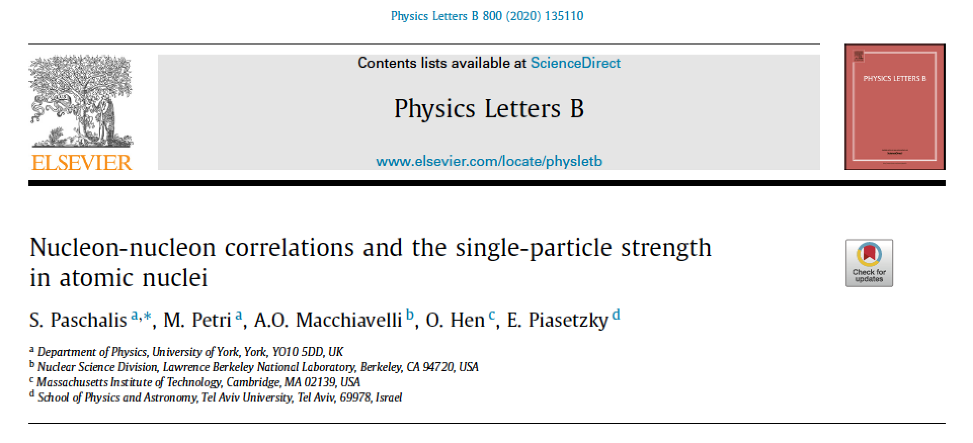

Slide 14
The questions we addressed:
What are the individual contributions of LRC and SRC to the observed depletion (quenching of SF)?
What is the isospin dependence of these contributions, and how do they compete in very asymmetric nuclei?
What did we do?
A phenomenological approach, in the spirit of Brueckner and Mottelson’s Fermi liquid

Slide 15


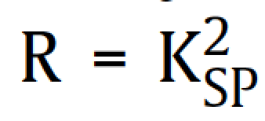
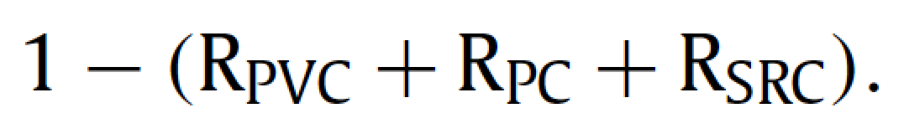
single-particle
configuration
Long-range
correlations
Short-range
correlations
Particle-vibration
coupling
Pairing
correlations
SURFACE
Missing strength
R = total single-particle Quenching Factor
represents the probability to find a nucleon in the pure single-particle configuration

Slide 16
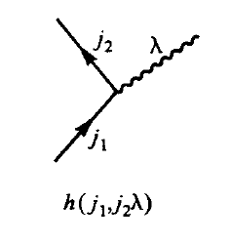
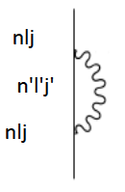
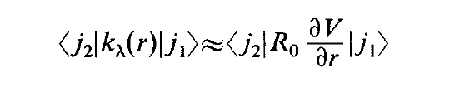


LRC Dressed nucleons
Particle Vibration Coupling
λ
Phonon
Radial coupling matrix element
~
|nlj > = A |nlj > + B |phonon> x |n’l’j’> + …

Slide 17

LRC Dressed nucleons
Pairing Vibrations
0p0h
Unperturbed gs
2p2h
4p4h
|gs > = A |0p0h> + B |2p2h> + … (small)
B ~ Matrix element / Energy
B ~ GΩ/ 2hbarW₀ = Δ/hbarW₀

Slide 18
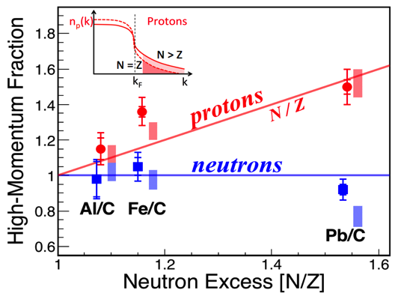
SRC: Quantitative information from JLAB
minority
M. Duer et al., Nature 560 (2018) 617

Slide 19
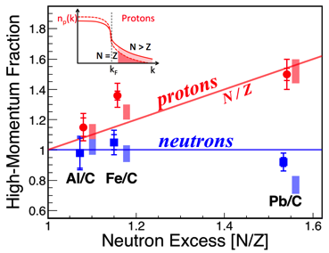
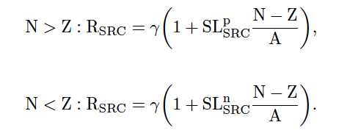
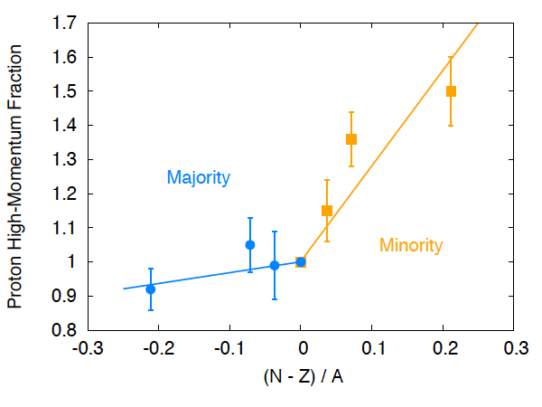


SRC

Slide 20
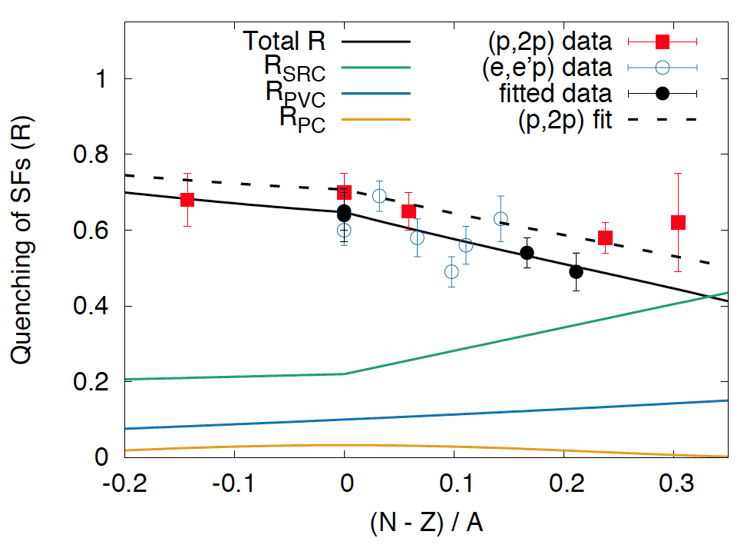
Our results
γ ≈22
α ≈10
β ≈3

Slide 21
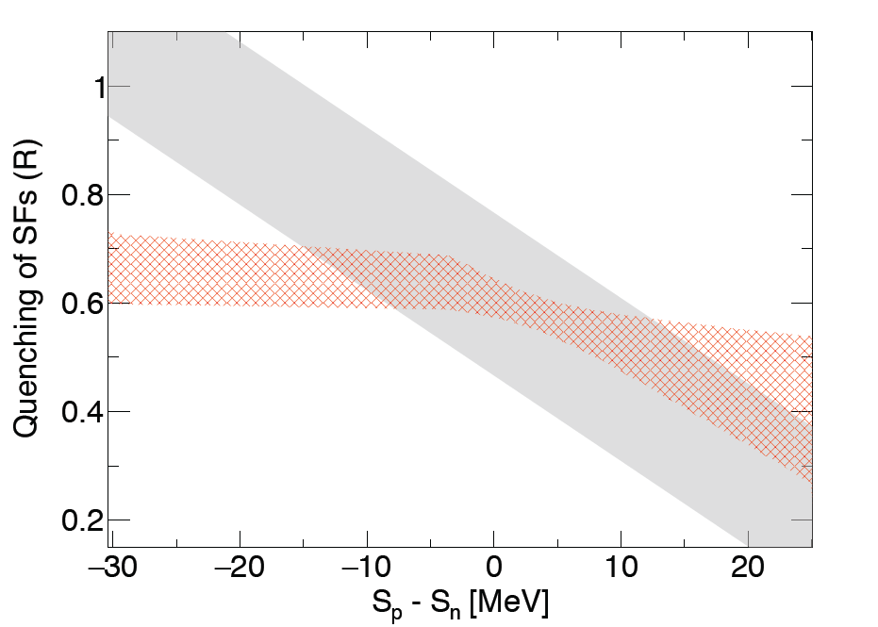
Our results in a Gade/Tostevin plot
(converting A,Z,N → S_{n} and S_{p})

Slide 22
Ongoing work

Slide 23
NP1912-RIBF170R1
Proton Removal and Lifetimes in the Ca Isotopes: Spectroscopy and Reaction Studies
Spokespersons:
Heather L. Crawford, Lawrence Berkeley National Laboratory
Marina Petri, University of York
Stefanos Paschalis, University of York

Slide 24
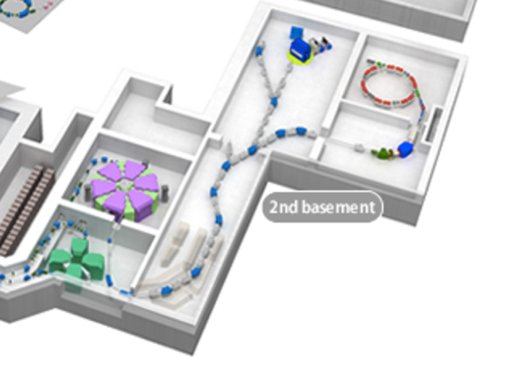
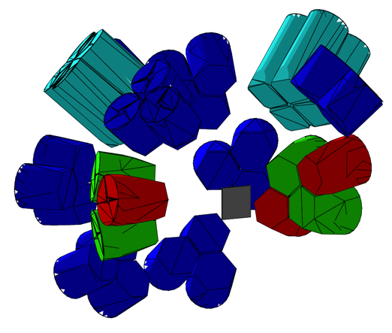
Successfully Run in December 2020. Data analysis in progress.
Studies proton knockout (heavy-ion induced) and (p,2p) reactions from the
^{38,48,54}Ca isotopes produced from a ⁷⁰Zn primary beam
Direct comparison of heavy-ion induced knockout and (p,2p) to help constrain
quenching contributions (reaction vs. nucleon correlations)
HiCARI configuration with eight MiniBall clusters, two tracking detector clusters,
and two super clovers
Solid C and CH₂ targets
ZDS
BigRIPS

Slide 25
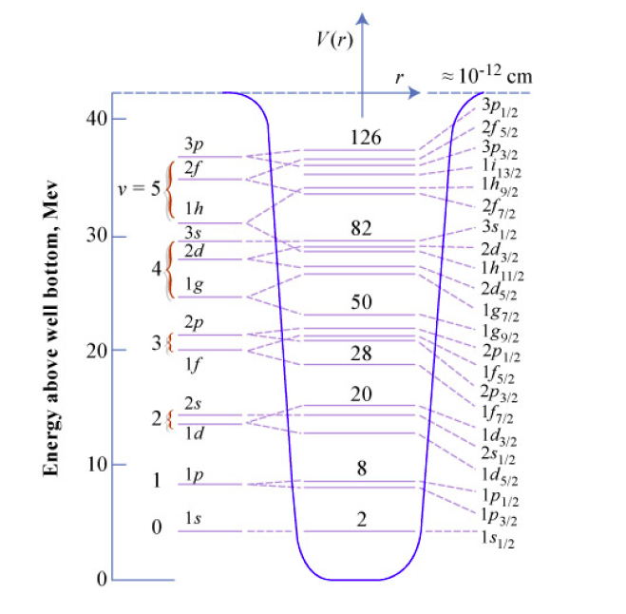
How do the IPM particles get dressed by the SRC?

Slide 26
How do the IPM particles get dressed by the SRC?
Quasi-deuteron
p
h
“d”
p
|qp > ~ 80% |p> + 20% |h > x |qd > ????

Slide 27
How do the IPM particles get dressed by the SRC?
Quasi-deuteron
(p,pd) reaction studies
R3B @ GSI
M. Petri, S. Paschalis, AOM
Isao Tanihata @ RCNP
|qp > ~ 80% |p> + 20% |h > x |qd > ????

Slide 28
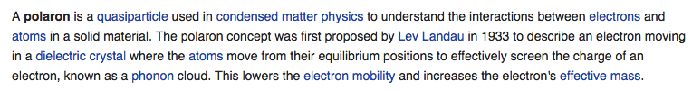

Slide 29

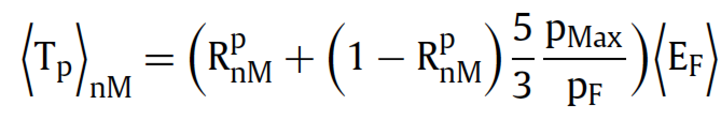
Interesting to consider the limit:
Quasi-proton (nuclear polaron) in neutron matter
LRC (Surface) → 0
~ 3 times that of a Fermi gas
M*/M ~ 0.54

Slide 30
Conclusions
We derived simple phenomenological parametrizations for the combined effects of SRC, PVC, and PC that were used in an analysis of published data from electron scattering experiments
Our analysis consistently shows that ~ 20% of the missing strength observed in the region of N ≈ Z can be attributed to SRC, in agreement with reported expectations
We showed how the missing strength evolves with (N − Z)/A
Speculation on a quasi-proton (nuclear polaron) in the limit of neutron matter, A → ∞ and (N-Z)/A → 1, proton R ~ 0.2
Possible effects on the charge radius of neutron-rich Ca’s
and spin content of N=Z ground states.
How about effective charges?

Slide 31
Acknowledgments
Many Thanks to
M. Petri and S. Paschalis
University of York
H.L. Crawford, R. M. Clark, P. Fallon, I. Y. Lee,
C. M. Campbell, and M. Cromaz

Slide 32
Thank you !

Slide 33
Other aspects

Slide 34
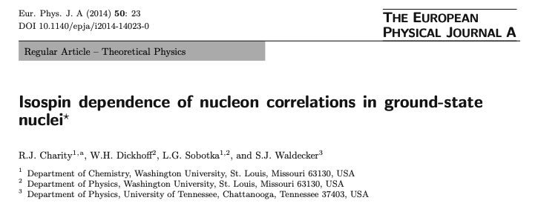
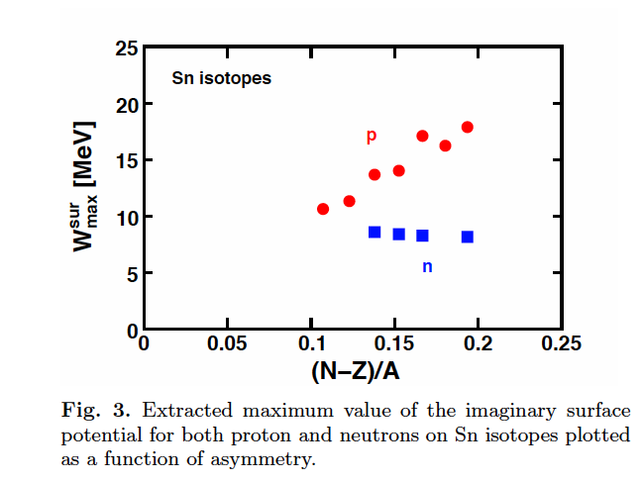

Slide 35
n
p
R/R(N=Z)
Our fit vs. DOM fit of W ^{surf} _{max}
W^{surf,max} /W ^{surf,max} (N=Z)

Slide 36
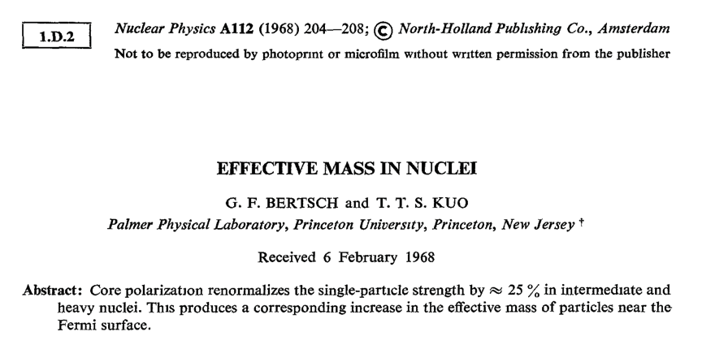
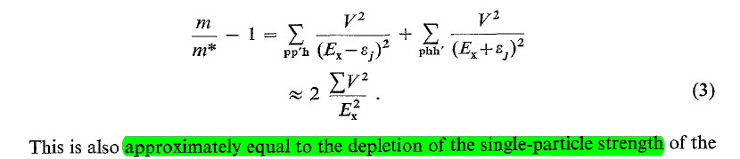
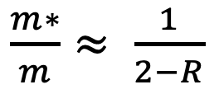
$\frac{m∗}{m}≈ \frac{1}{2−R}$

Slide 37
Effective Mass
Bao-An Li, Bao-Jun Cai, Lie-Wen Chen, and Jun Xu
Progress in Particle and Nuclear Physics 00 (2018) 1–109
Bao-An Li
n p
m*/m
(N-Z)/A

Slide 38
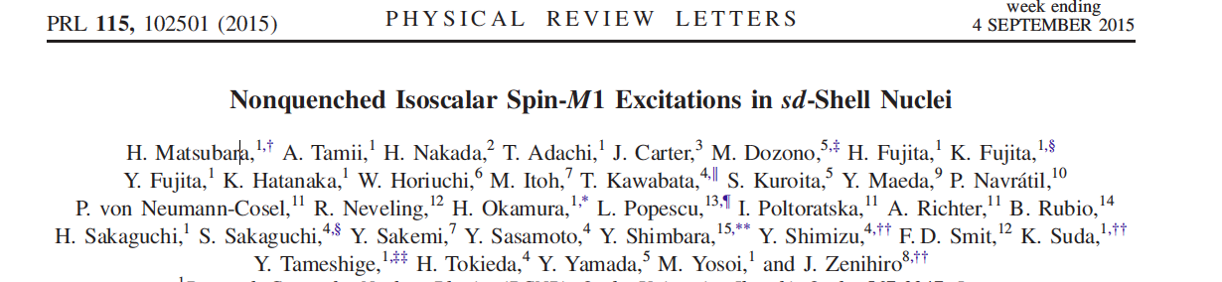

Slide 39
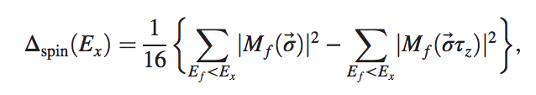

IS
IV
Measured by (p,p’) inelastic scattering near zero degree

Slide 40
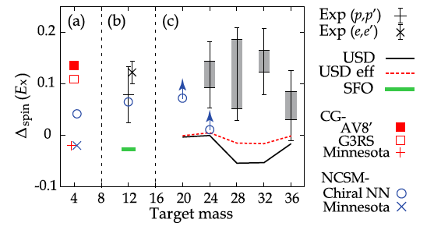
SRC ?

