Slide 1

Impact on Momentum and Angular Resolution of All-Si Tracker with Seven Disks Per Side
Drew Palmer
University of California, Berkeley
7/6/21

Slide 2
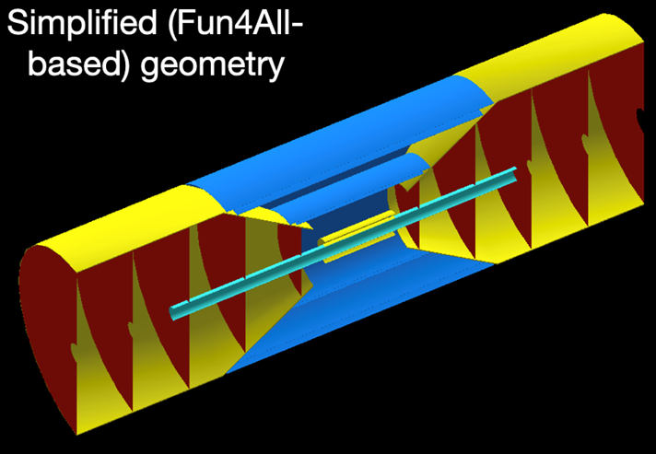
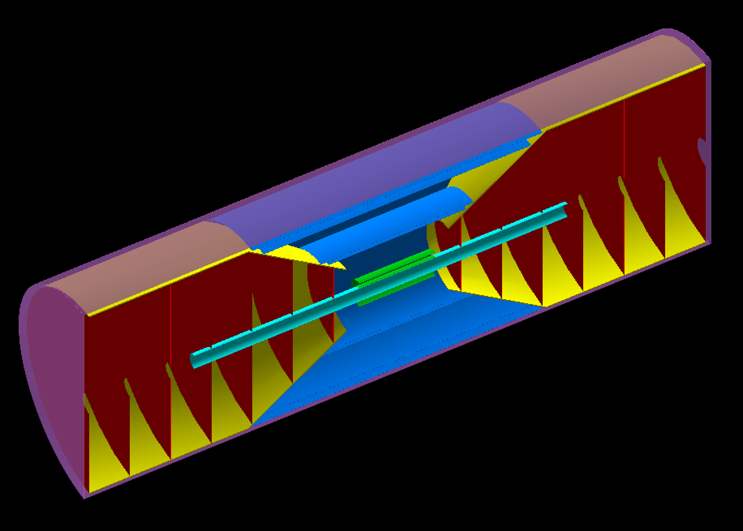
Five vs Seven Disk Simplified Geometry
Comparing ratios of momentum and theta resolution as a function of eta and momentum
Comparing between new seven disk geometry and old five disk geometry
Beast 3.0T and the sPHENIX 1.4T map
VS

Slide 3
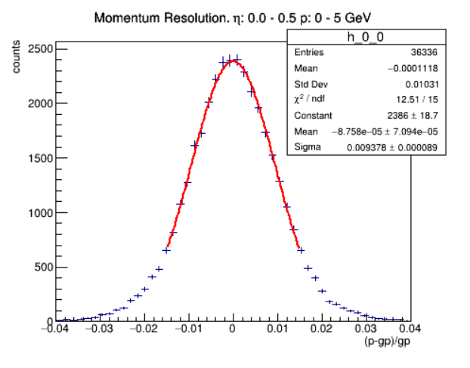
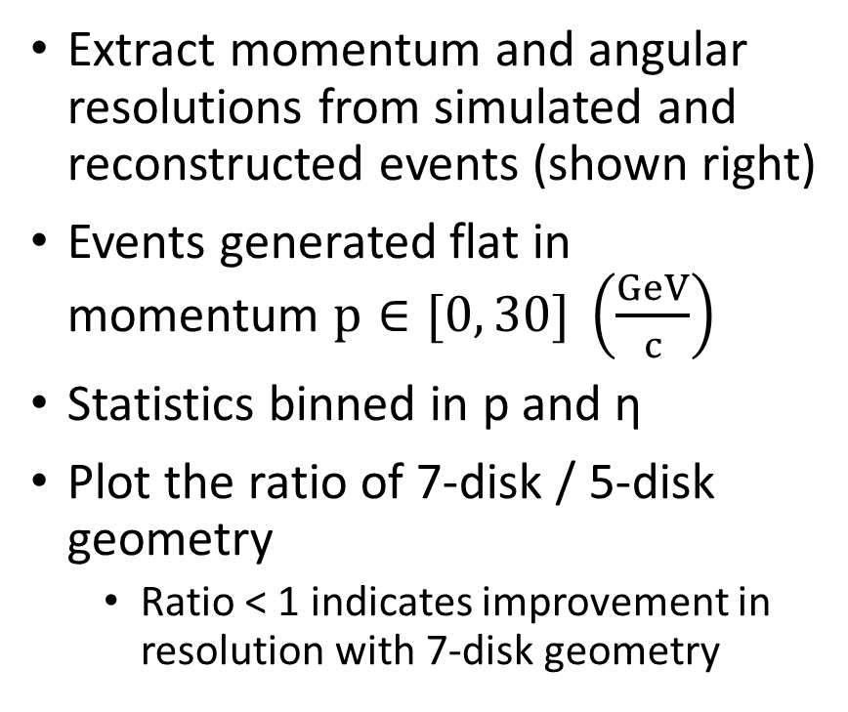
Methods
Extract momentum and angular resolutions from simulated and reconstructed events (shown right)
Events generated flat in momentum $p∈[0, 30] \left(\frac{GeV}{c}\right)$
Statistics binned in p and η
Plot the ratio of 7-disk / 5-disk geometry
Ratio < 1 indicates improvement in resolution with 7-disk geometry
Example Momentum Resolution Plot

Slide 4
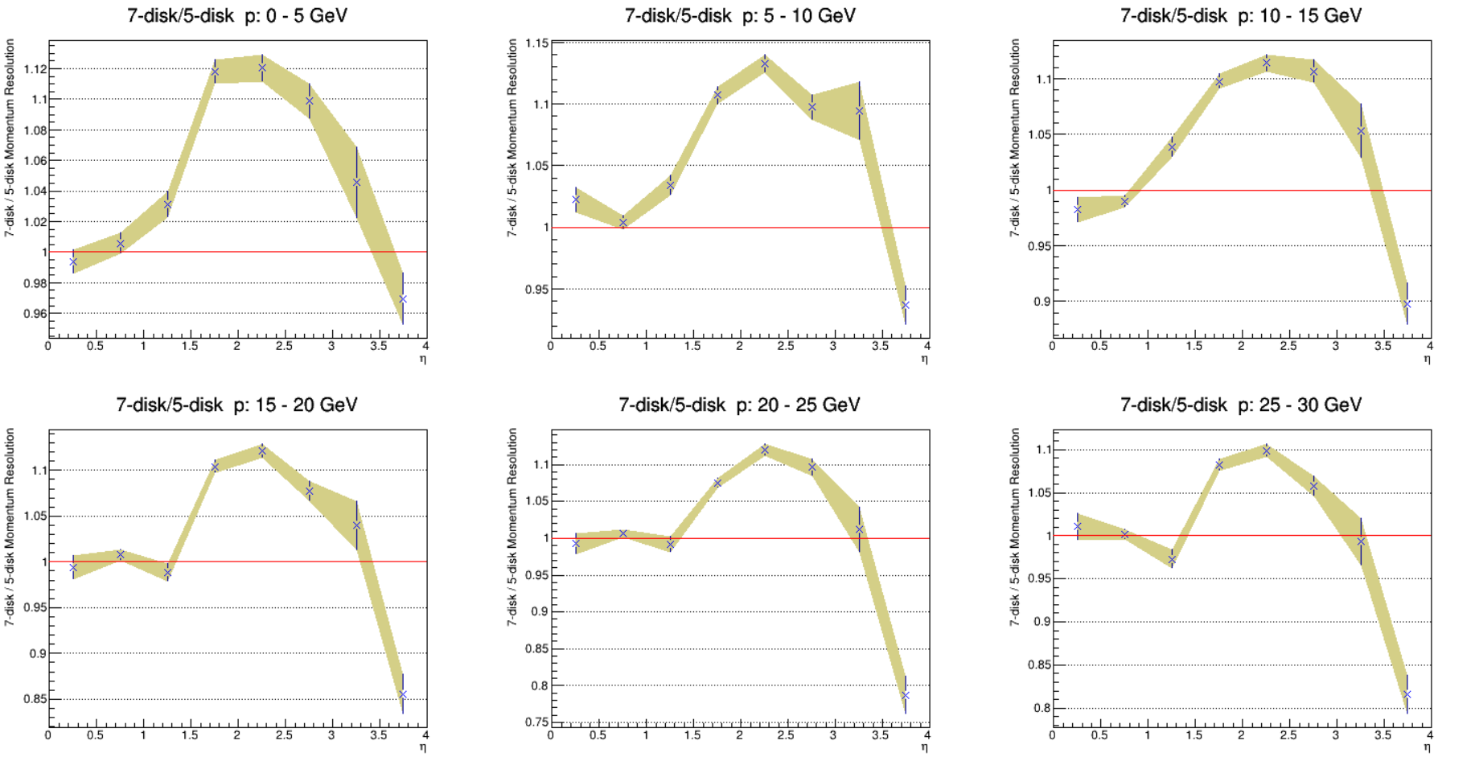
Beast 3.0T Momentum Resolution Comparison

Slide 5
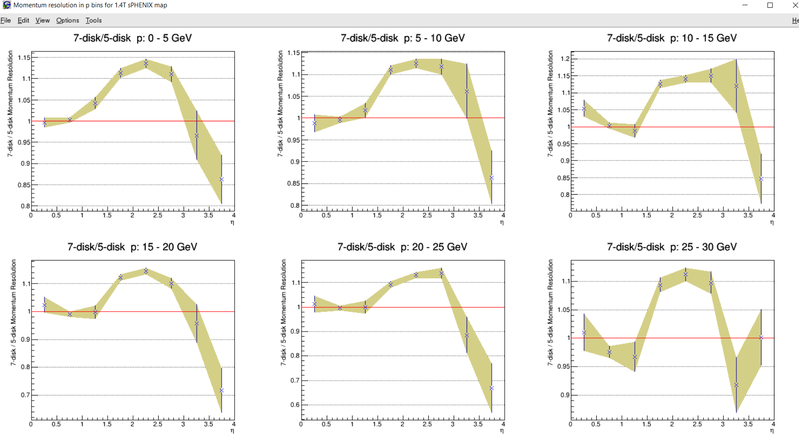
sPHENIX 1.4T Momentum Resolution Comparison

Slide 6
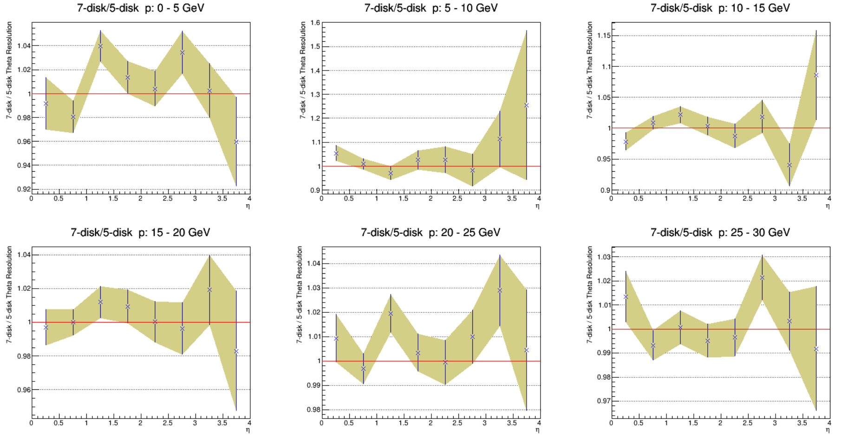
Beast 3.0T Theta Resolution Comparison

Slide 7
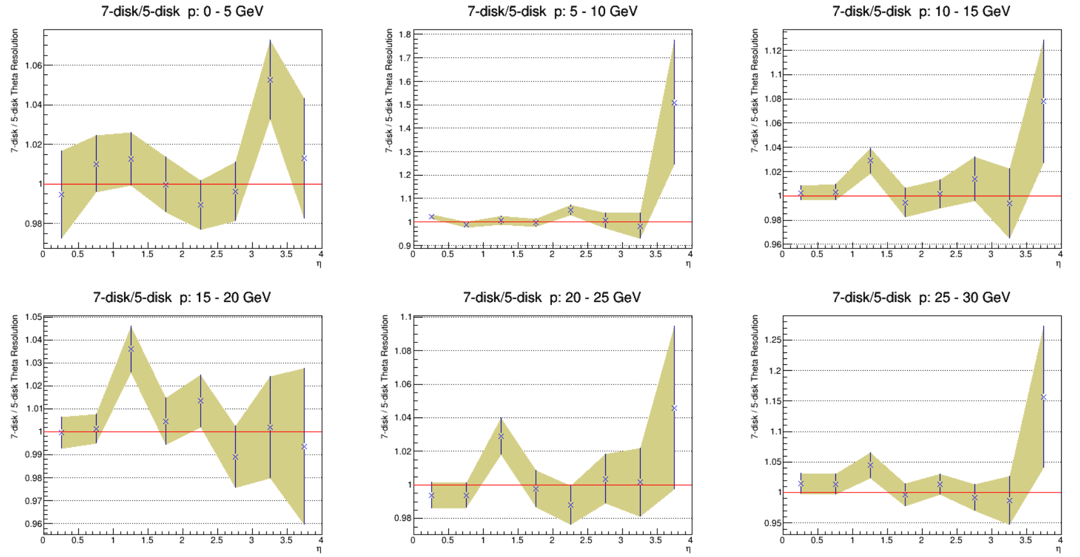
sPHENIX 1.4T Theta Resolution Comparison

Slide 8
Conclusions and Next Steps
Based of these results it is probably not worth the extra cost to add two disk layers per side
The momentum resolution advantage of adding more disks comes at high pseudorapidity η > 3.5
There is no significant advantage in angular resolutions
Next Steps
Study the phi resolution
Generate more statistics to probe high pseudorapidity region

