Slide 1

Fast-Turnaround Technology R&D for
Stress-Managed Coil Blocks
B. Auchmann (CERN/PSI), A. Brem (PSI), M. Daly (PSI), D. Martins Araujo (PSI)
Technical Mtg with US-MDP, July 6th, 2021.
Work supported by the Swiss State Secretariat for Education, Research and Innovation SERI.

Slide 2

LTS Technology Questions
2020
2021
2022
2023
2024
2025
2026
2027
ESPP Update
ESPP Update
1
2
3
CHART1
CHART2
CHART3
European Strategy for Particle Physics Update 2020:
Europe, together with its international partners, should investigate the technical and financial feasibility of a future hadron collider at CERN with a centre-of-mass energy of at least 100 TeV.
Application for support of the Swiss Accelerator Research and Technology Initiative (2018)
CHART, the Swiss Center for Accelerator Research and Technology, was founded to support the […] Future Circular Collider (FCC) at CERN and the development of advanced accelerator concepts in Switzerland beyond the existing technology.
Now is the time to pursue fast-turnaround technology R&D
in order to find the most promising designs as well as materials
and processes that will make the designs work.
Design, Materials, and Process R&D go hand in hand
and validate or disqualify each other.
In 2022, we must start building demonstrator magnets.
How can we implement a wide enough yet quickly
narrowing innovation funnel to bring new ideas into
our Nb₃Sn accelerator-magnet R&D?
Design
Materials
Processes

Slide 3
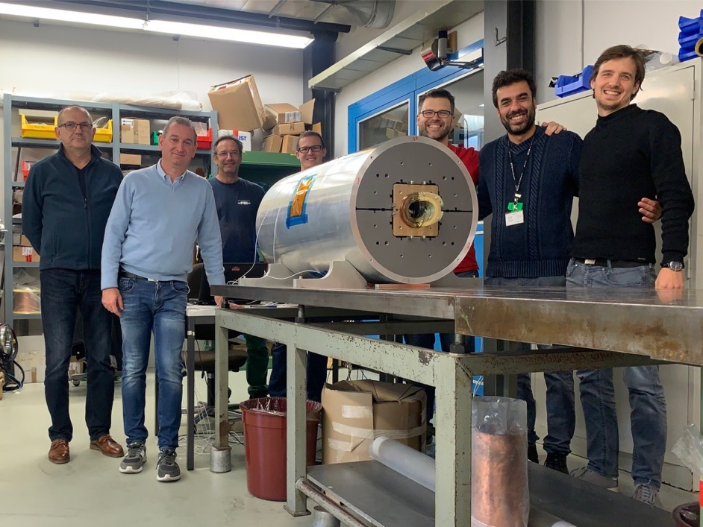
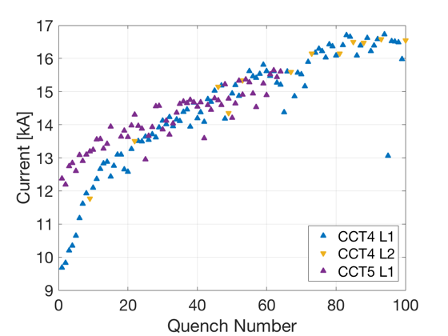
CHART MagDev and Stress Management
By the end of 2019, PSI built, with material support from
LBNL, a CCT demonstrator magnet.
While testing has been much delayedby the COVID-19
and a He-liquifier problem, we expect extensive training
due to bonding and cracking issues.
To study this fundamental technology issue, we devised
the BOX (BOnding eXperiment) and implemented it in
collaboration with the University of Twente.
  Conductor length: 1 m
  Sample preparation time: ~2 weeks
  Turnaround time incl. shipping and testing:4-6 weeks
  Preparation of multiple samples in parallel
  Sample cost incl. testing of 6’000 CHF (~6’600 USD)
  10 samples successfully built and tested.
  Surprise result with Parafin wax BOXes.
Courtesy D. Arbelaez, LBNL.

Slide 4
Michael Daly – the BOX program

Slide 5
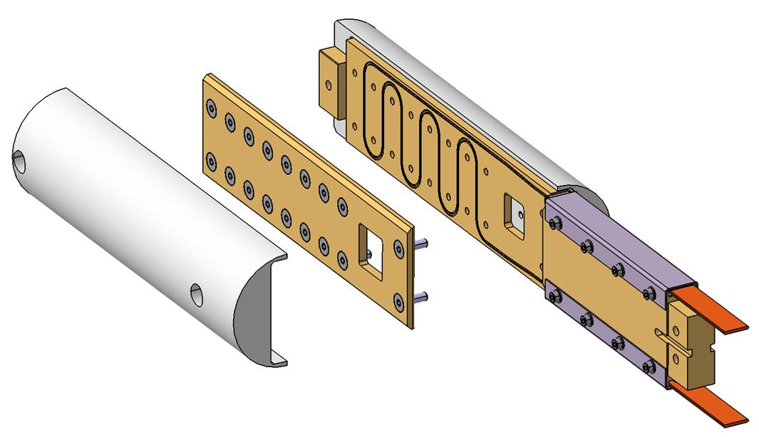
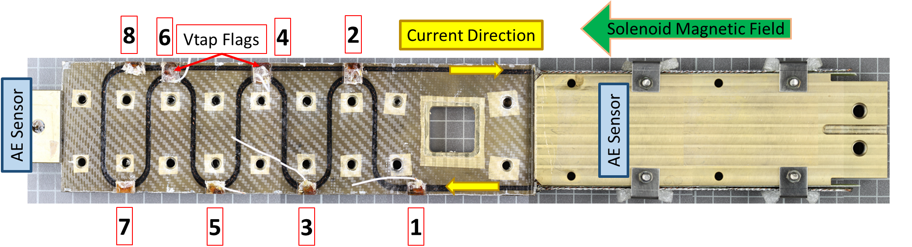
BOX Sample: Summary
Straight Sections where high forces expected (each 35.5 mm in length)
Key Test Parameters
Solenoid Field | 7.5 T
Target Current | > 23 kA
Ramp rate | 200 A/s
Forces | > 170’000 N/m
Temperature | 4.2 K
79 mm
To Transformer
470 mm
Face Plate
20 mm

Slide 6
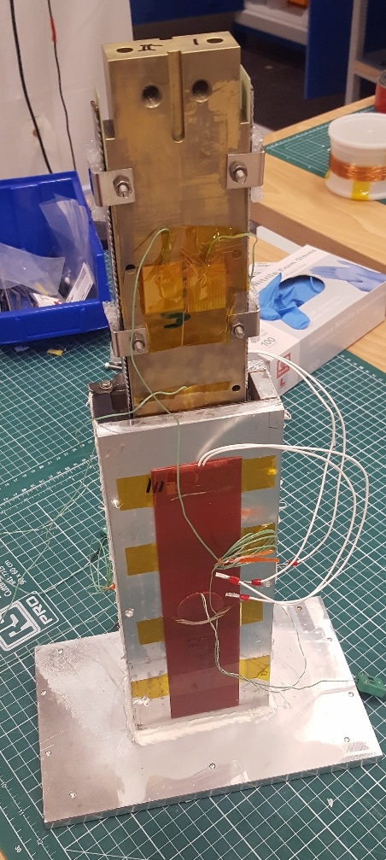
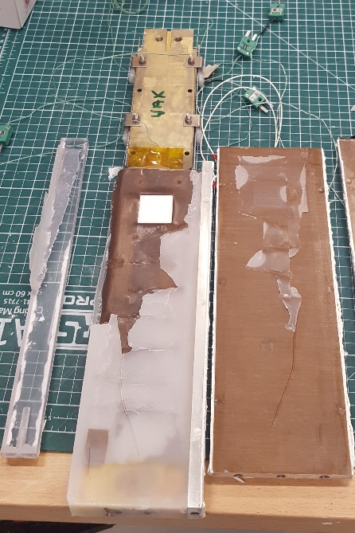
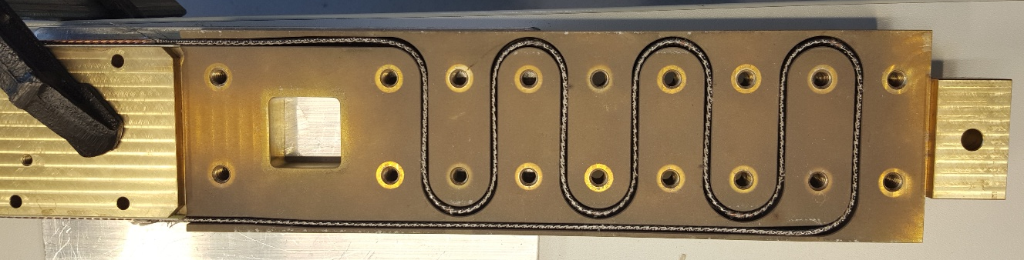
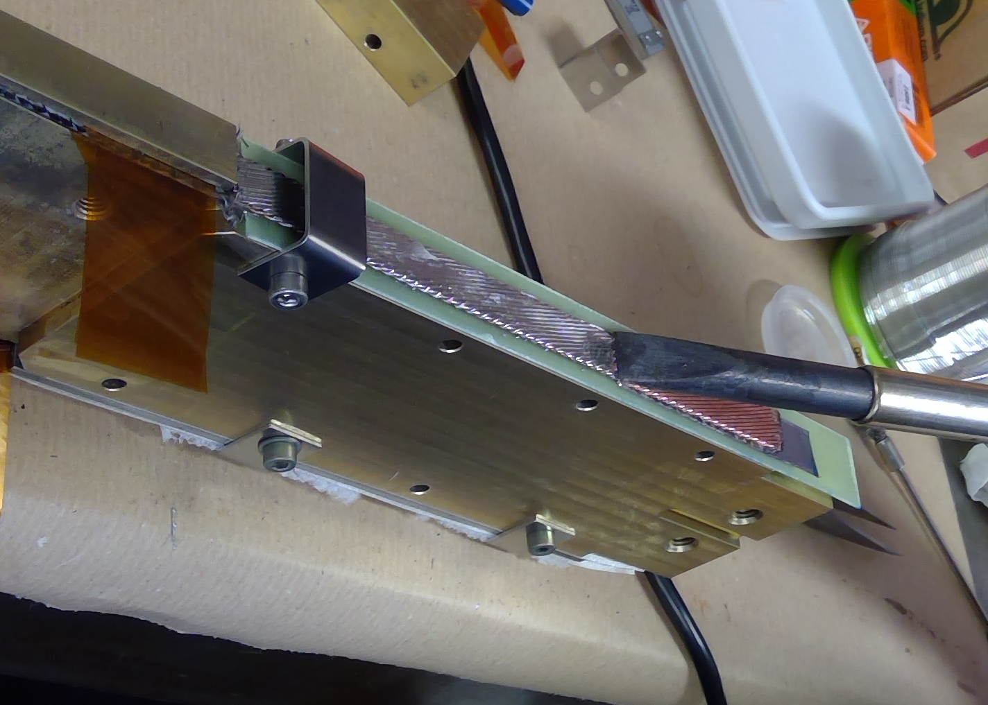
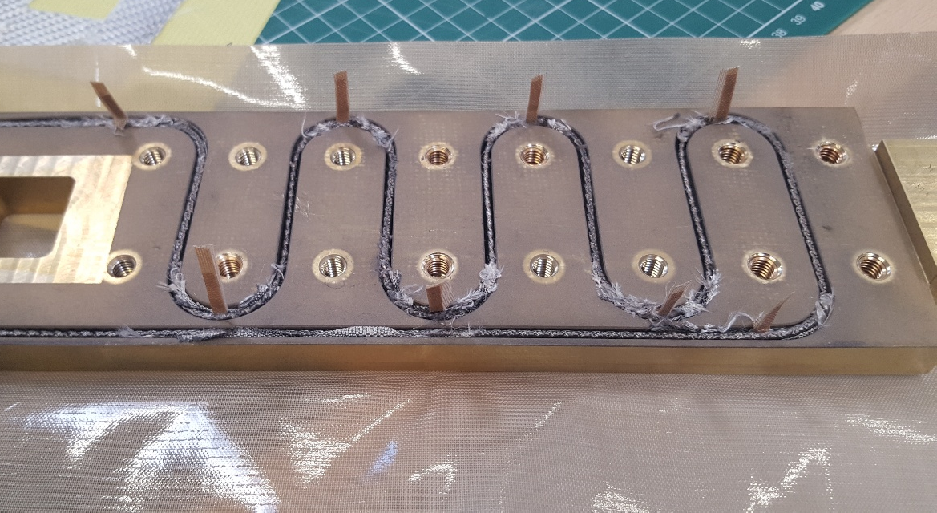
BOX Production
Winding
Prior to reaction (No face plate)
Post reaction (No face plate)
BOX in Impregnation container
BOX demoulding post impregnation (in this case Wax)
Pre-tinning of leads
Vtaps and Teflon tape wrapping prior to impregnation

Slide 7
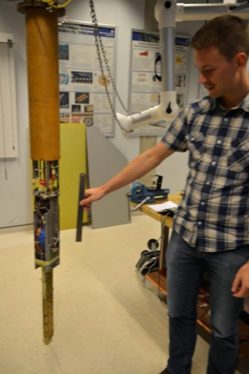
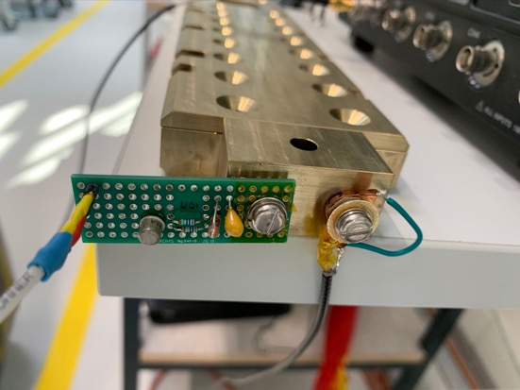
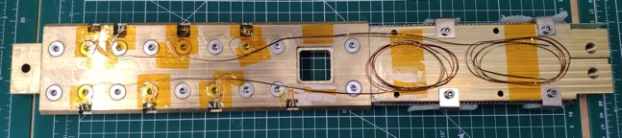
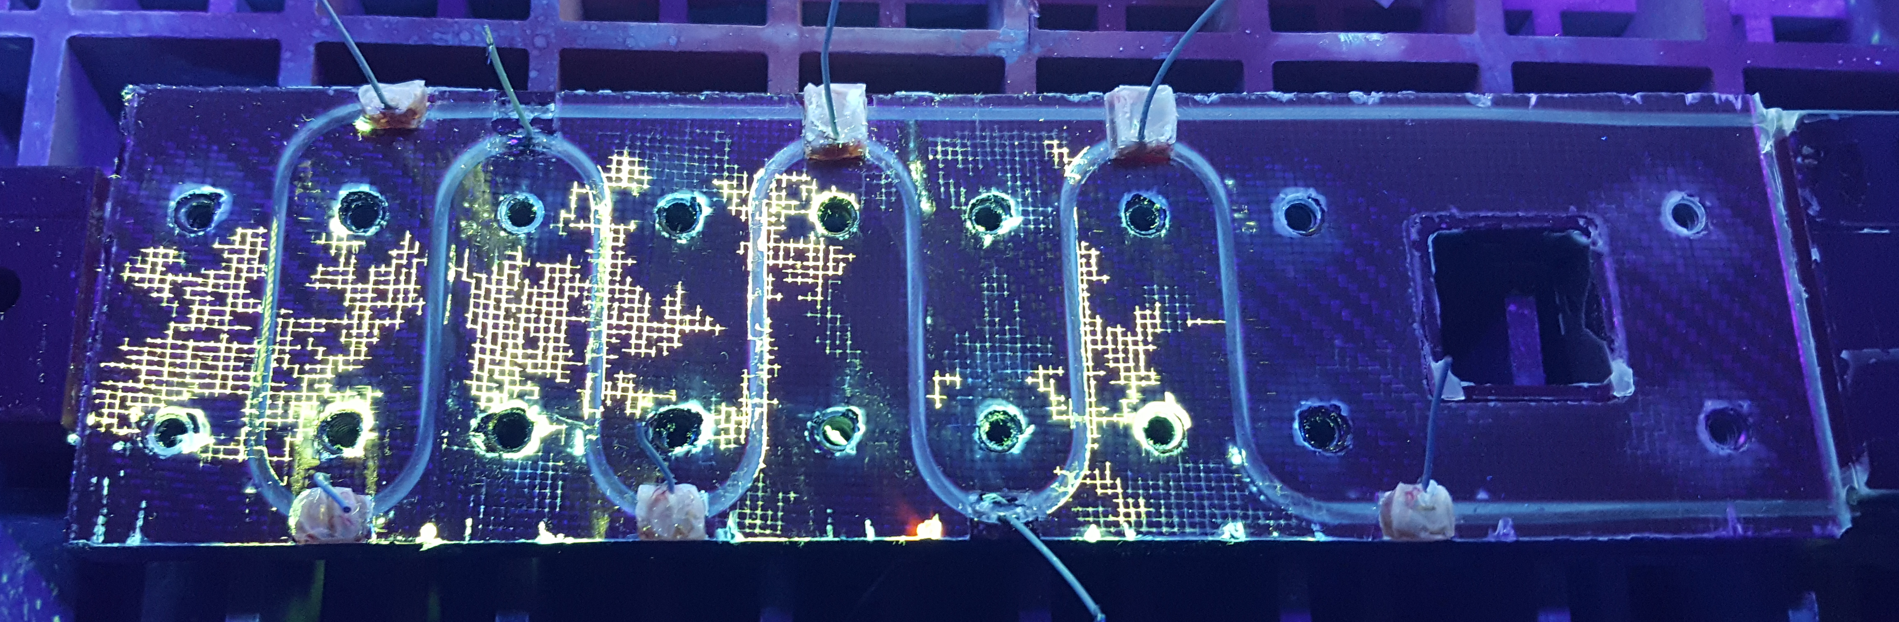
BOX Samples
9 BOX samples tested until now (x7 Nb3Sn and x2 NbTi)
Some are representative of PSI’s CD1 CCT magnet with some small variations:
  With/without MICA, some cleaning of fibreglass sizing, sand blasting…
  Formers: Alu-bronze, anodised aluminium, stainless steel.
  Impregnations systems: CTD101K, Mix61, MY750, CTD701X, Paraffin Wax…
Intrumentation & Analytics:
  Acoustic sensors similar to LBNL’s – Maxim’s AE design (1 to 2 sensors)
  Vtaps to identify quenching segments
  Wave analysis, V-I Measurements,
  Post-mortem analysis i.e. Dye penetrant searching for cracks/delamination
BOX1
AE sensor
Dye penetrant

Slide 8
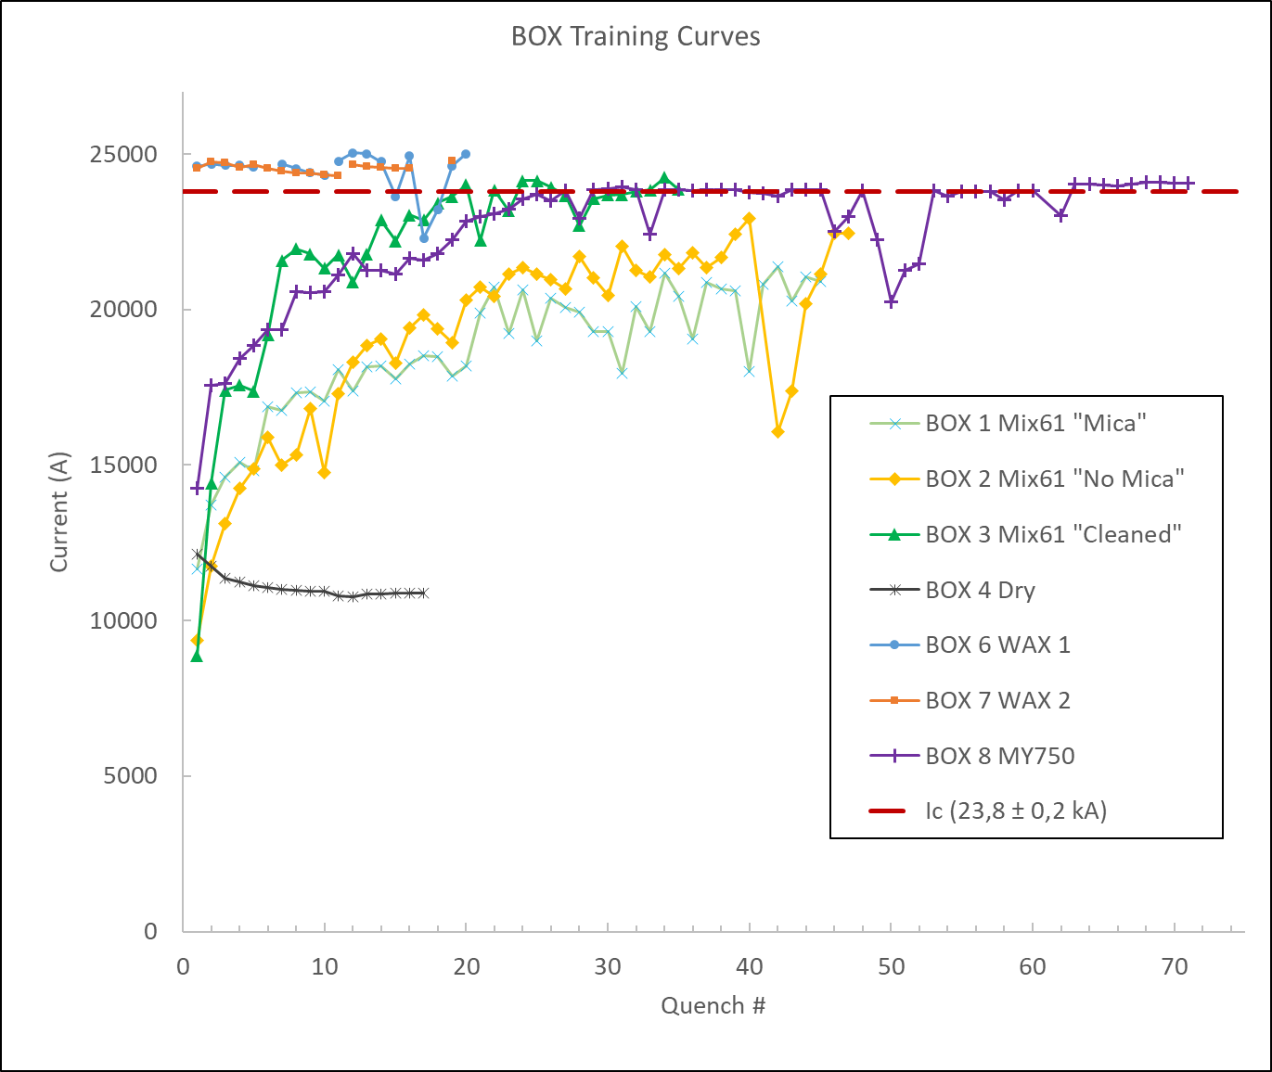
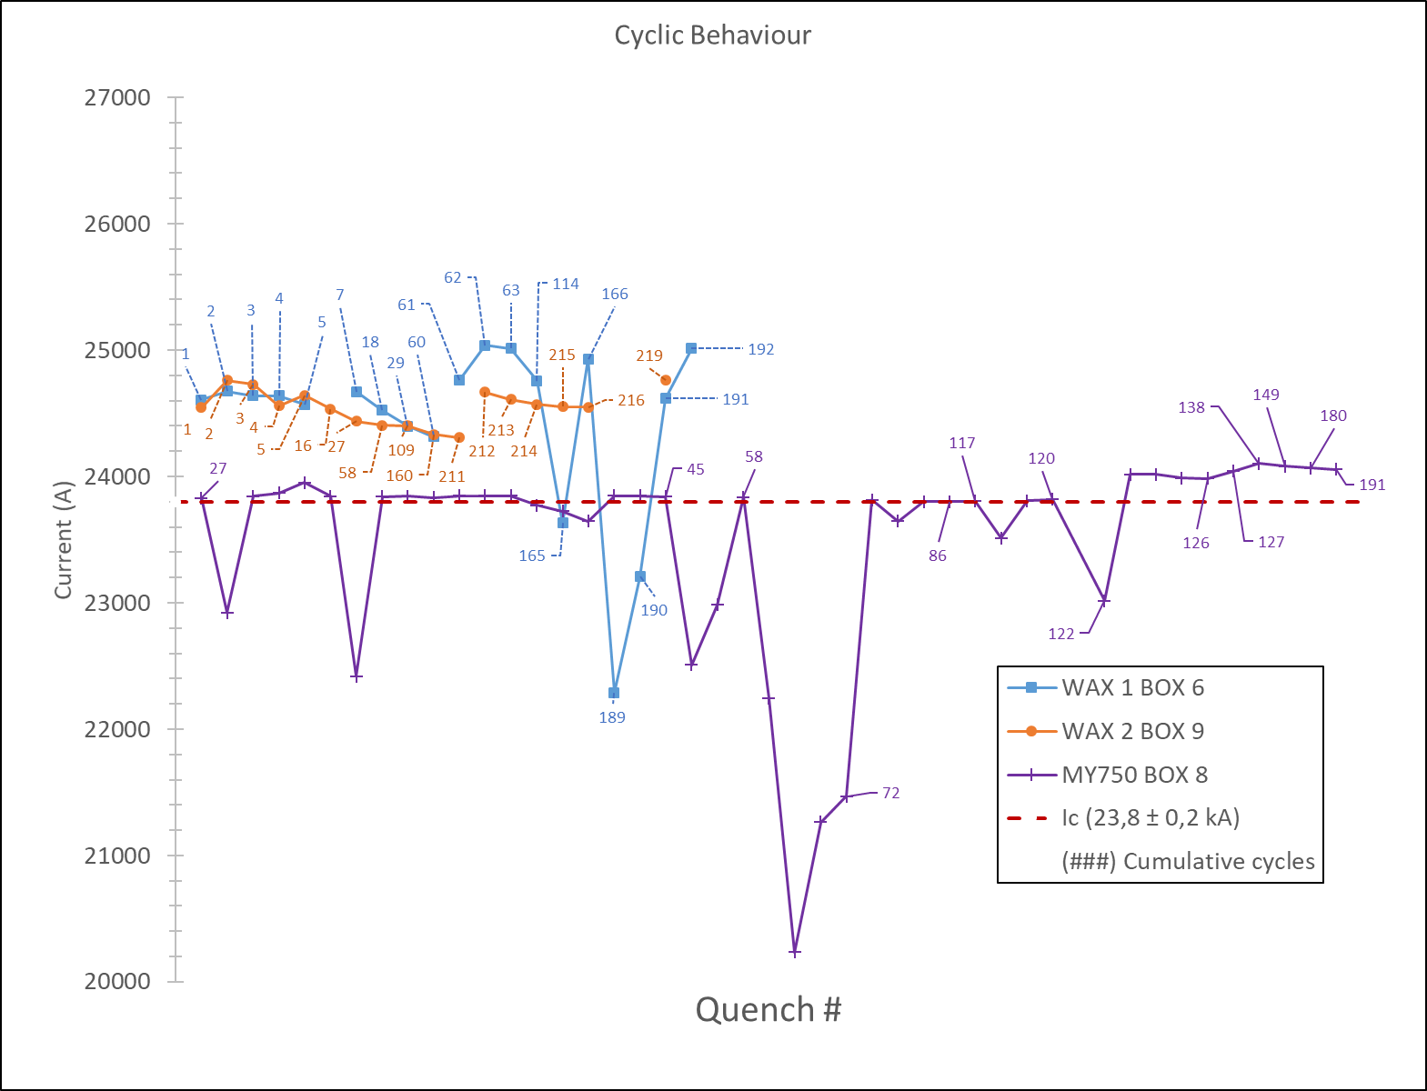
Recent Nb3Sn results
Analysed behaviour:
  Training quenches to reach Ic.
  Cyclic behaviour and fatigue
  Conductor Degradation (V-I measurements)
  Thermal cycle & memory
  Current reversal

Slide 9
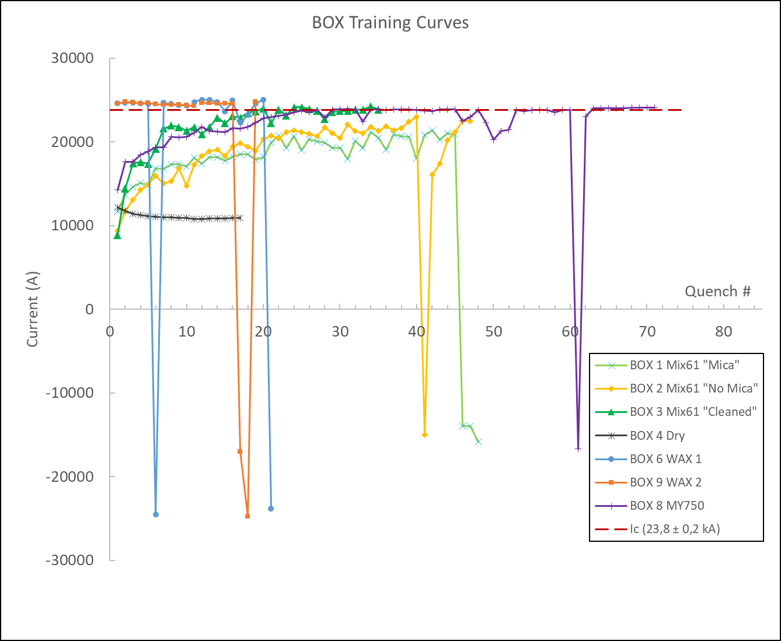
Recent Nb3Sn results
Analysed behaviour:
  Training quenches to reach Ic.
  Cyclic behaviour and fatigue
  Conductor Degradation (V-I measurements)
  Thermal cycle & memory
  Current reversal

Slide 10
Back to Bernhard

Slide 11
CCT Pros and Cons for a 15-m-long FCC Main Dipole
Design:
  Mechanical support of each turn
  → reduced coil stress and avoidance of stress-induced degradation.
  Easy field quality (on paper).
  Ideally suited for LTS/HTS hybrid magnets due to easy stacking of heterogeneous layers.
  Simpler external mechanical structure → more iron between the apertures and better magnetic separation → less cross-talk.
  Hope to fix training: getting one turn “right”, the entire magnet would work; no discontinuities towards the end regions
Fabrication:
  Simple and safe coil-manufacturing process; little tooling needed; coil always protected by former.
Instrumentation and protection:
  Efficient CLIQ protection as every turn is a high-field turn.
  Co-winding of instrumentation (fibers, wires, etc.) is supposedly easy.
Design:
  Every turn must be glued to metal surfaces; delamination would preclude good performance.
  Reduced efficiency by winding angle, rib thickness, and spar thickness.
  Check FQ variation along z-axis due to lack of control on turn position.
  Some axial strain on cable in every turn.
  No radial pre-compression possible.
Fabrication:
  Tricky winding on small ID with wide cable.
  Difficult to obtain reliable insulation.
  Difficult to keep cable in groove on small IDs.
  Interplay between former and cable during reaction.
Instrumentation and protection
  No heater protection possible.
Scaleup:
  Involved former manufacturing; cost and time consuming; difficult to scale to 15 m.
  Difficult assembly for long magnets – assembly gaps reduce performance.

Slide 12
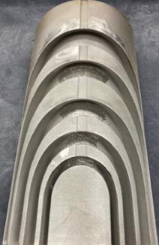
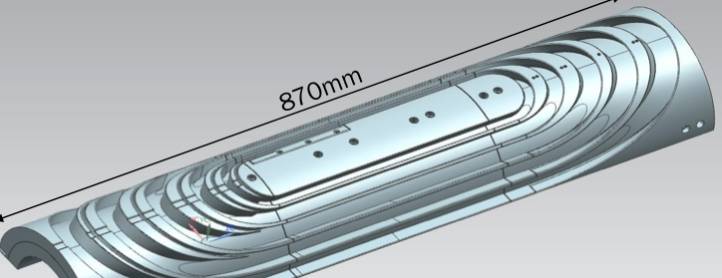
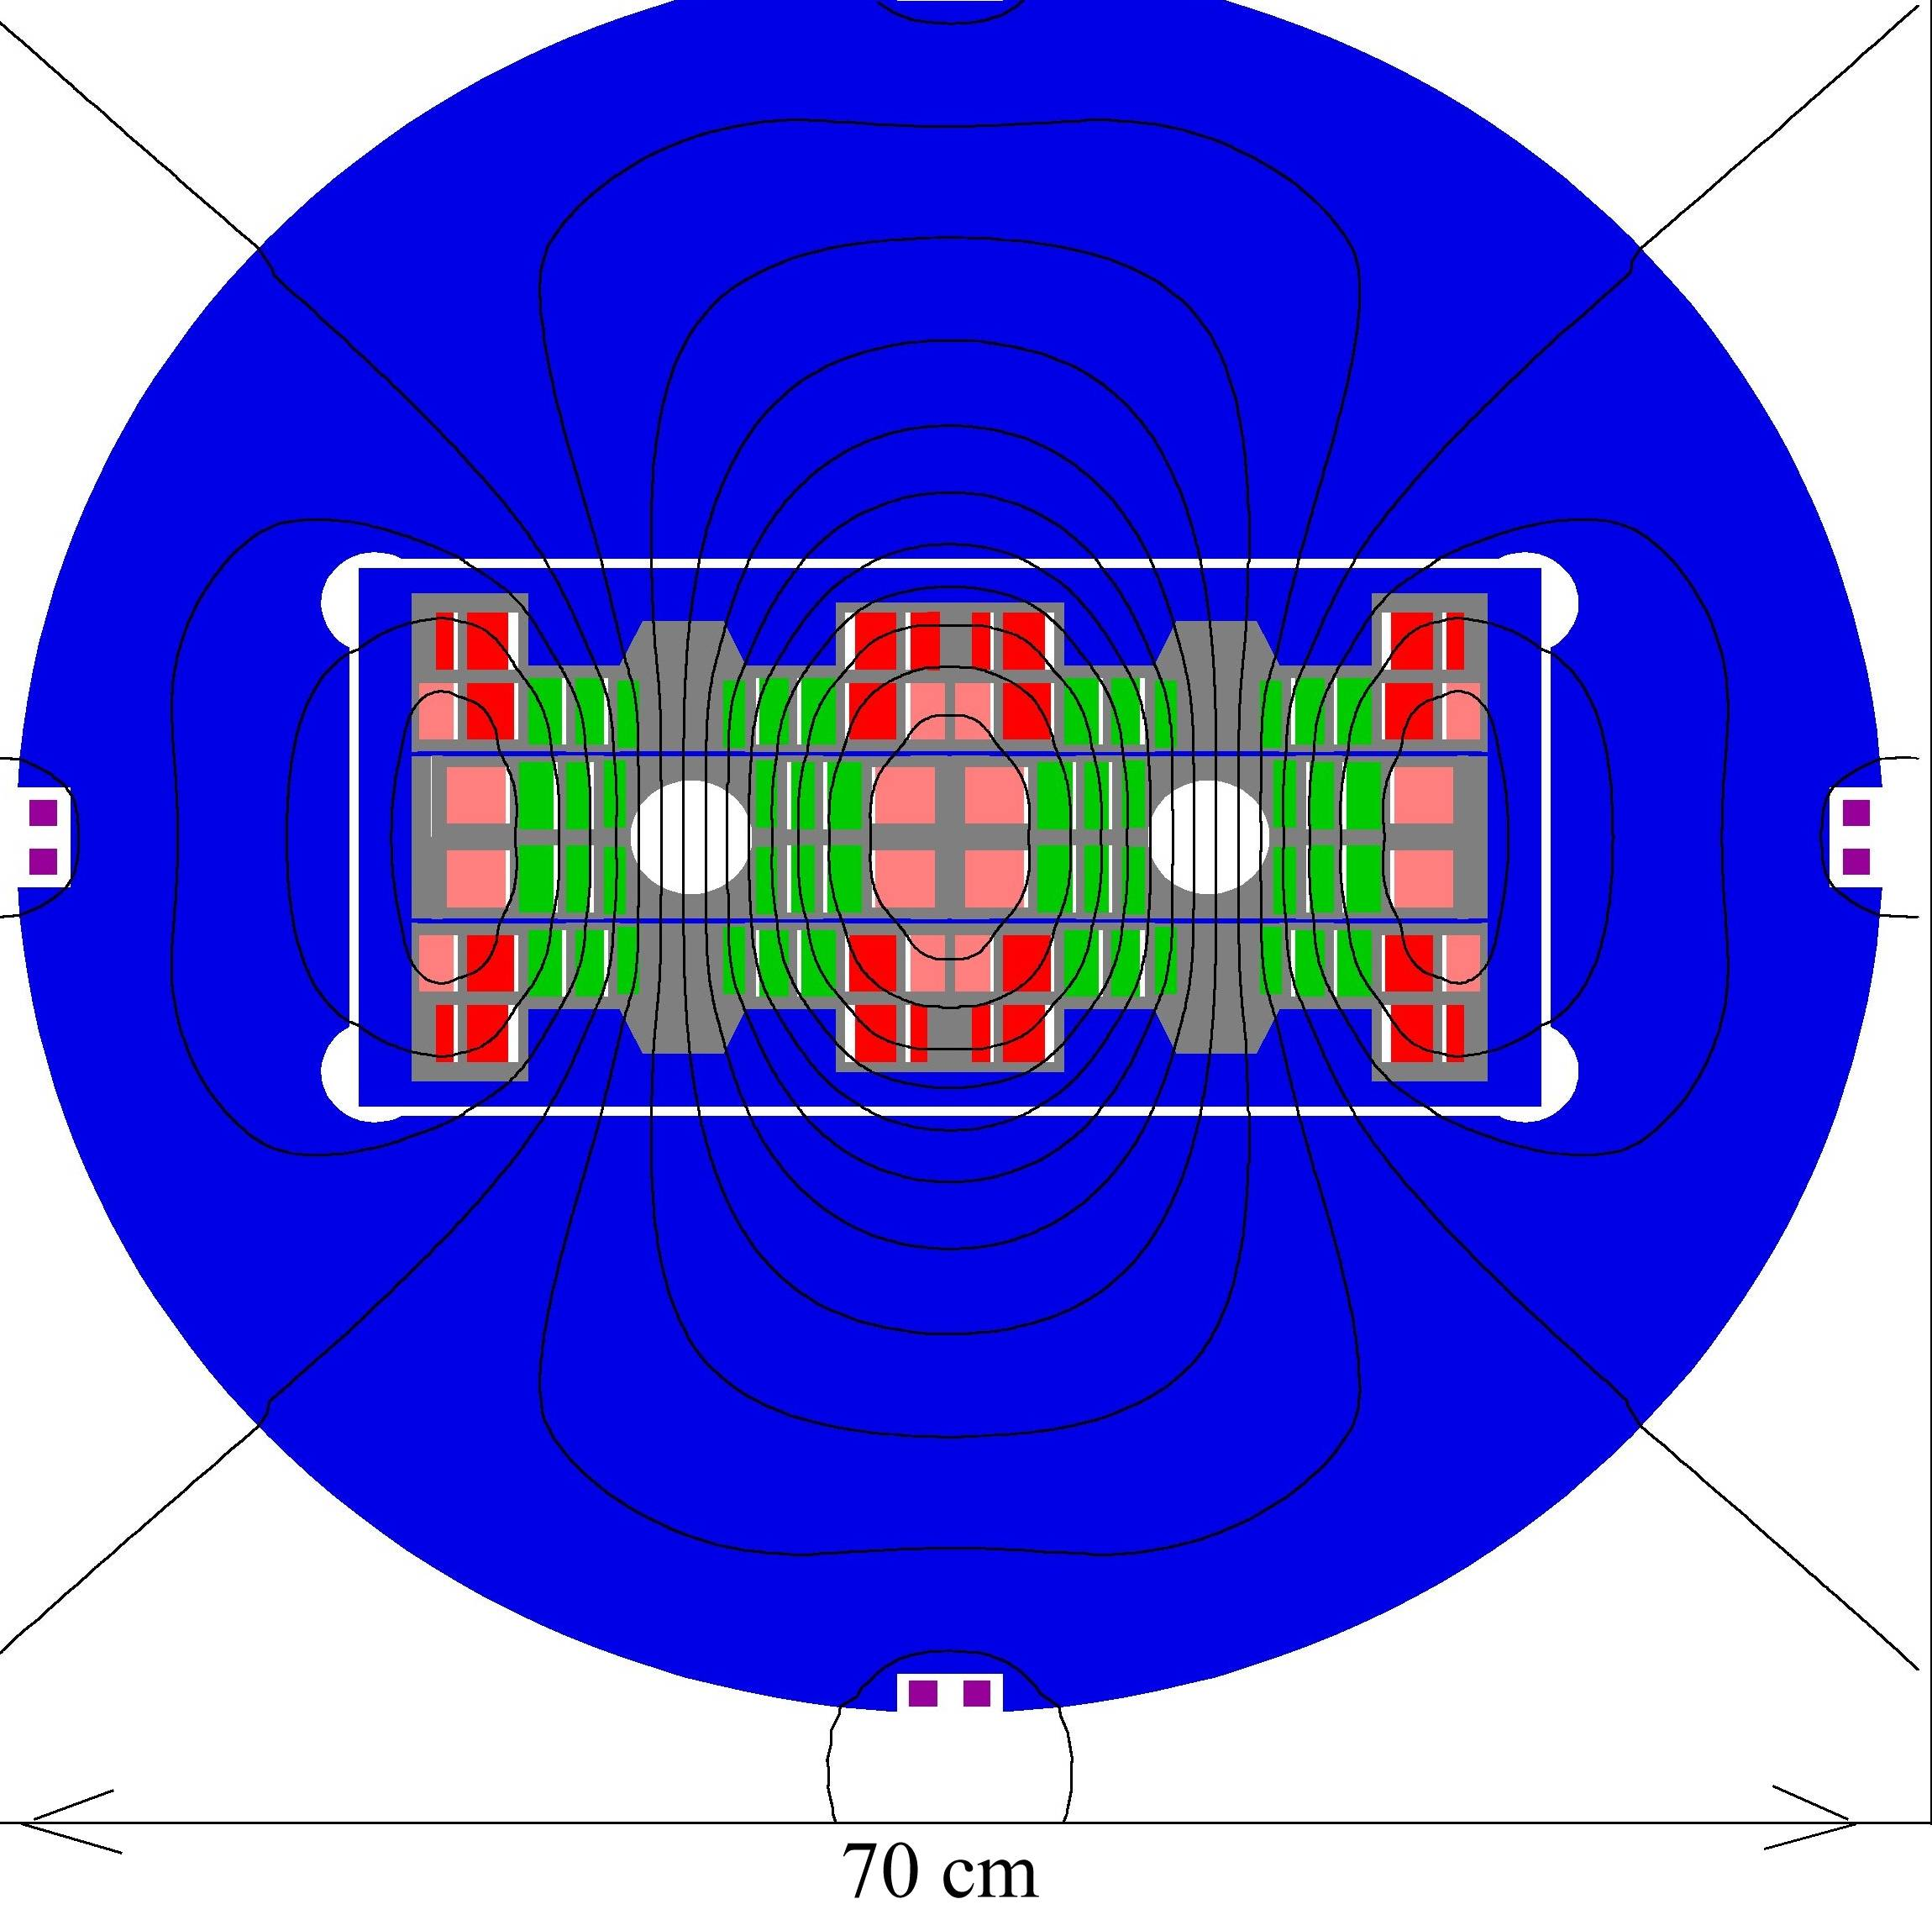
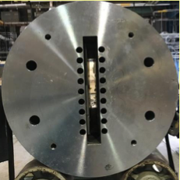
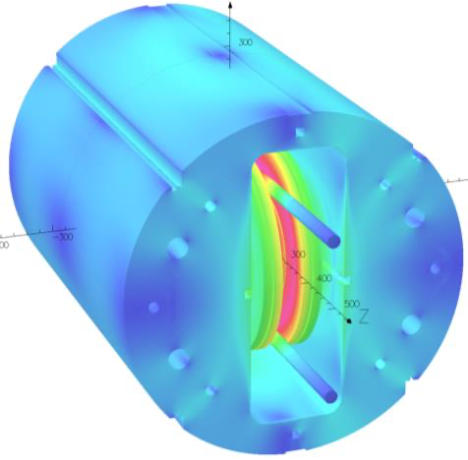
How About Stress-Management of Coil Blocks?
If there is a material-process combination that drastically reduces training in stress-manged magnets, then this should be explored for stress-management concepts other than CCT.
  S. Zlobin et al. SM-CT
  P. McIntyre et al. LHC Energy Tripler
How to test technologies that were successfully pre-
screened with BOX for SM coil blocks?
  Option A: build flast-racetrack magnets like the
  LBNL/CEA SD01 or CERN SMC.
    Costly in development time, material, testing.
  Option B: use the unique common-coil dipole magnet
  DCC017 at BNL as a background-field facility for a
  BigBOX test of a stress-managed coil block.

Slide 13
Douglas Martins Araujo – BigBOX design study

Slide 14
Agenda
Insert coil and DCC017
Conceptual design study
  Parameters
  Self-field contribution
  Total field
  Forces and average stress
Critical curve, load line and margin
Iron-pole introduction – 3D modelling
Next steps and questions

Slide 15
Insert coil and DCC017 cross-section
Insert coil and DCC017
  We are considering to wind on the hard-way bend direction to get transversal pressure
D. Martins Araujo

Slide 16
Insert coil and DCC017 cross-section
Insert coil 3D view
View from leads side
  The layer-jump is on the ends to keep the straight section flat
  14 turns in this picture
  Unit length of 15 m
360 mm
25 mm
260 mm
D. Martins Araujo

Slide 17
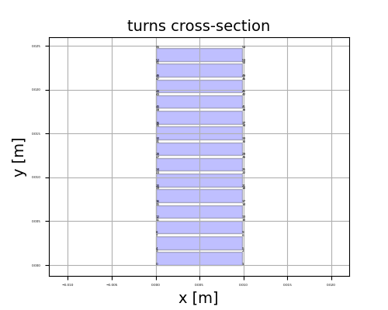
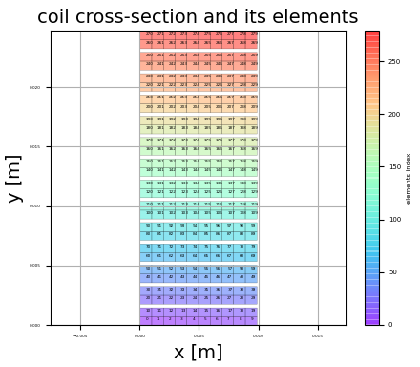
Conceptual design study
Parameters used on the first check
  number of turns: 14
  cable bare width: 9.85 mm
  cable bare thickness: 1.48 mm
  insulation thickness: 155.0 μm
  electrical current: 10 kA
  background field of 10 T on the x direction
14 turns representation
Meshing
  One element per strand
D. Martins Araujo

Slide 18
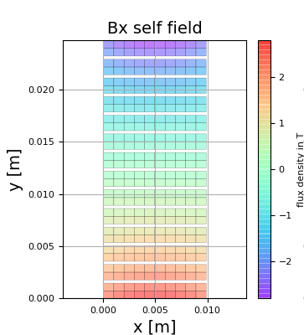
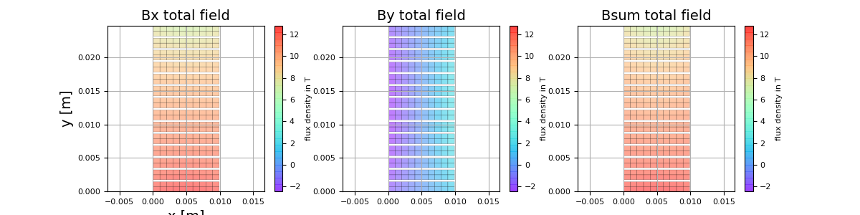
Conceptual design study
Self-field contribution
  Peak of 2.8 T
Total field contribution
  Peak of 12.8 T
D. Martins Araujo

Slide 19
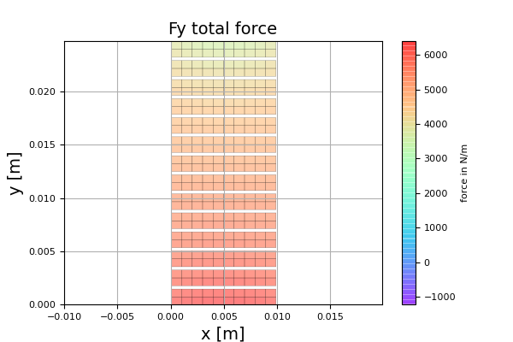
Conceptual design study
Vertical Force distribution
  Average stress of 142 MPa
Forces
  Are higher on towards the turn on the bottom
Stress
  Are higher towards the turn on the top
D. Martins Araujo

Slide 20
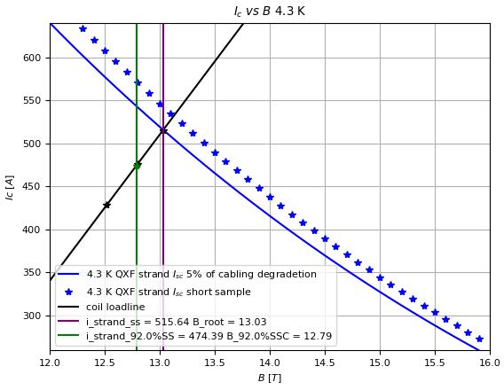
Conceptual design study
Critical curve, load line and margin
Critical curve, load line and margin
Critical curve
  5% of degradation due to cabling
  4.2 K
I_op of 10 kA
  8% of margin
  Bpeak = 12.8 T
D. Martins Araujo

Slide 21
Conceptual design study
Stress and margin cases
  The peak of stress occurs where the margin is bigger
Bpeak = 7.2 T
Margin = 8%
D. Martins Araujo

Slide 22
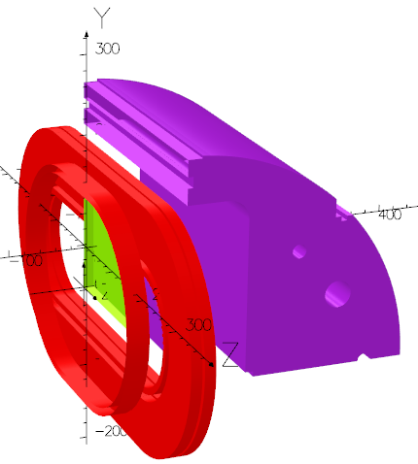
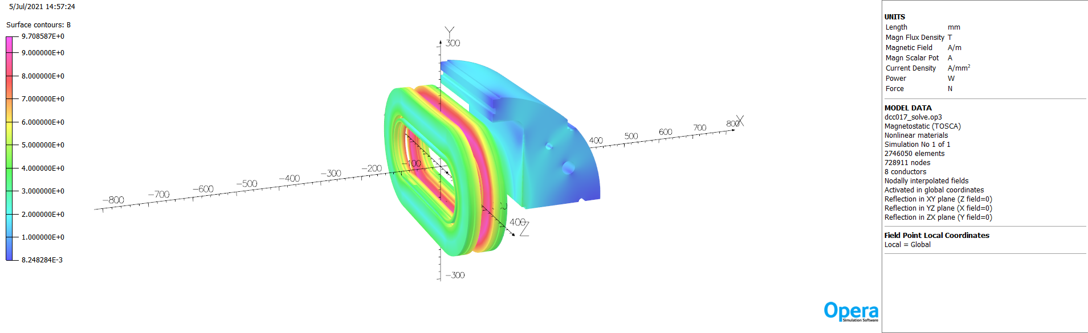
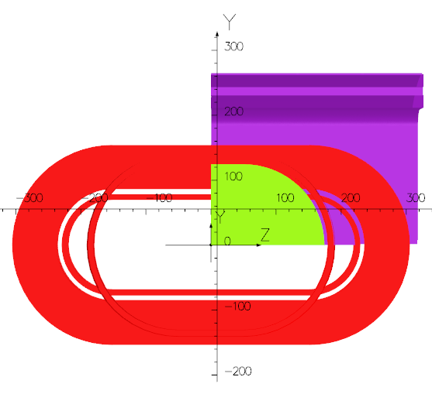
3D magnetic models – Preliminary results
With BNL Opera model
  Common coils Jeng = 425 A/mm²
  Common coil peak field Bpeak = 9.7 T
  Aperture Field B0 = 9.15 T
Test coil introduction
  Coil test with iron pole in green
D. Martins Araujo

Slide 23
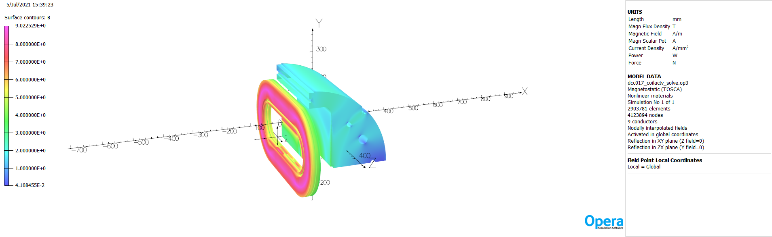
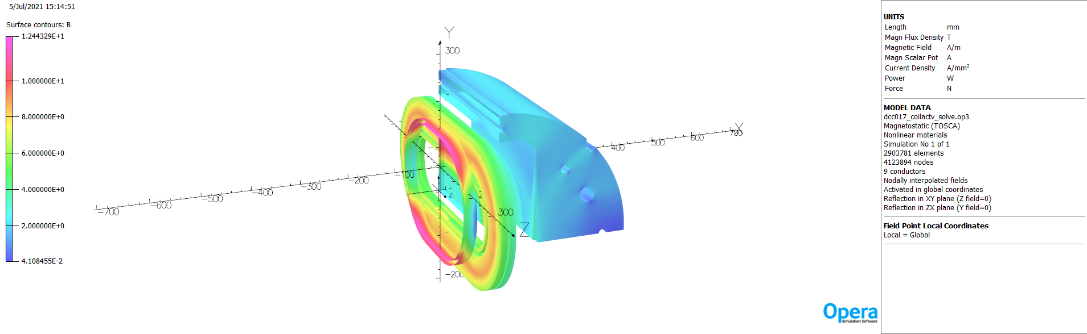
3D magnetic models – Powering the test coil
  Test coil, Jeng = 547 A/mm² (10 kA)
  Common coil peak field Bpeak = 9.0 T
  Test coil peak field BTCpeak = 12.4 T
D. Martins Araujo

Slide 24
3D magnetic models – Designs comparaison
  Magnetic analysis summary
Coil type | Test coil deactivated | Powering the test coil
 | Common coil peak field in T | Common coil peak field in T | Test coil peak field in T
With iron | 9.7 | 9.0 | 12.4
No iron | 9.7 | 9.3 | 11.7
D. Martins Araujo

Slide 25
Next steps & Questions
Cable trials
  Winding ability study (hard-way bend direction)
  Mechanical integration on DCC017
  Instrumentation
Modelling
  Mechanical 3D modelling
  Transversal stress gradient along the coil
  Shell
  Iron pole / iron shell
  Operating current
  A higher current would allow us to reach short sample / have a more compact coil
  SC transformer
D. Martins Araujo

Slide 26
Back to Bernhard

Slide 27
What questions need addressing?
For a given technology (impregnation material, surface preparation, etc.),
  What is the training performance related to de-bonding and cracking?
  What are the limiting stress levels?
  Or similarly, how many turns can we place per SM slot?
We foresee a limited series of tests, with surely
  BigBOX1, max. number of turns, CTD101K,
  BigBOX2, max. number of turns, paraffin wax,
  BigBOX3, CTD701X if BOX test is successful (later this week!)
  Possibly a reproducibility check.
And optionally
  BigBOXn, reduced number of turns if needed,
  BigBOXn+1 alternative low-K1c material, after respective successful BOX test,
  Etc.

Slide 28
Beyond BOX and BigBOX
Solutions that have been validated by BOX and BigBOX are ripe for implementation in mirror magnets and technology demonstrator dipoles.
CHART2/MagDev at PSI intends to propose an R&D roadmap based on SM-CT to an international review committee in November ‘21.
Upon approval, we would proceed to build mirror magnets and a demonstrator in the 12-T range until 2024, in close collaboration with US-MDP and FNAL in particular.

Slide 29
End

Slide 30
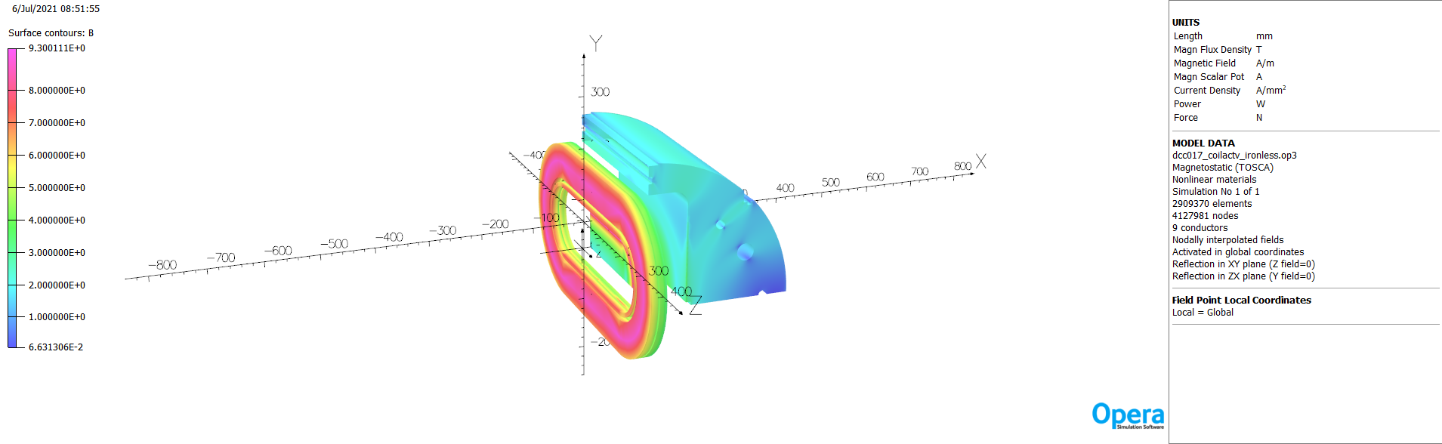
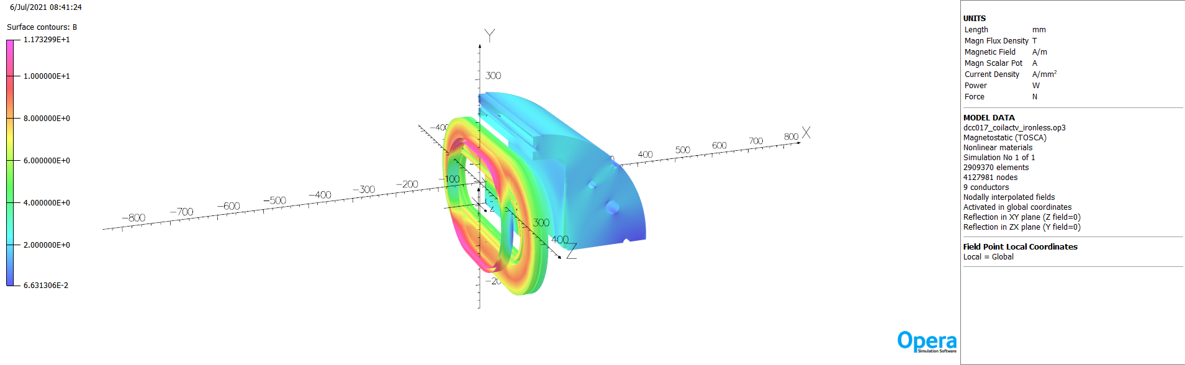
3D magnetic models – Active test coil
  Test coil, Jeng = 547 A/mm² (10 kA)
  Common coil peak field Bpeak = 9.3 T
  Test coil peak field BTCpeak = 11.7 T
D. Martins Araujo

Slide 31
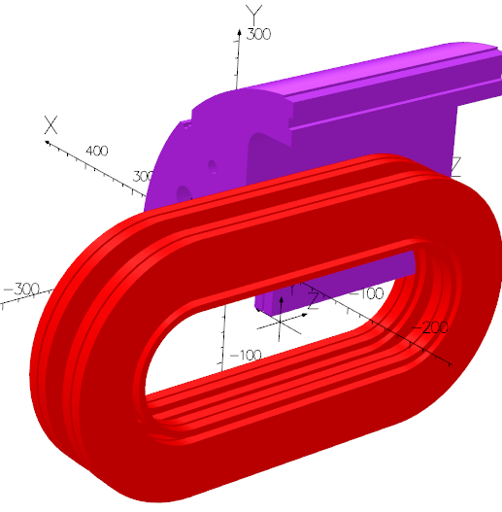
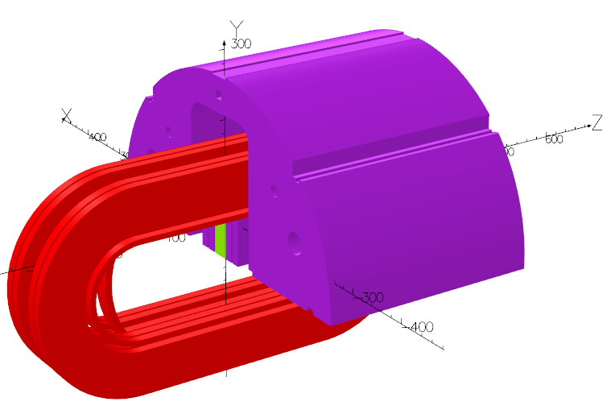
3D magnetic models – Symmetry
  DCC017
With coil test
D. Martins Araujo

