Slide 1
Summary of the plans for
CCT5-Bin5c and CCT6-BiCCT1 hybrids
Presenter: Laura Garcia Fajardo
MDP meeting on design of a 20 T hybrid magnet and comparative analysis
06/29/2021

Slide 2
CCT5-BIN5c hybrid
Preparation of BIN5c

Slide 3
Plans for BIN5c
Tests of BIN5c
Test each coil (IL and OL) separately at 77 K
Test the assembled magnet in standalone configuration:
At 77 K (to verify that no damaged was done to the coils during the assembly)
At 4.2 K in our 15” cryostat
Test the hybrid magnet BIN5c/CCT5 at 4.2 K
We need to ensure compatibility between these tests in terms of the instrumentation, assembly and alignment of the coils

Slide 4
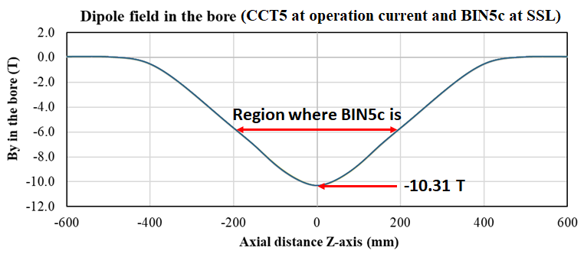
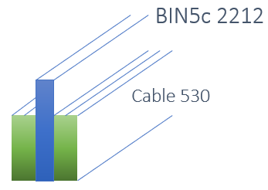
Preparation of BIN5c for standalone and hybrid tests
Key points:
CCT5 is an already existing Nb₃Sn CCT magnet producing 8 T at 80% of its SSL
BIN5c is a Bi-2212 CCT magnet to be tested in standalone configuration
CCT5 and BIN5c were designed independently to prove Nb3Sn CCT technology and Bi-2212 CCT technology respectively
The structure of BIN5c has been designed to be compatible with CCT5 for the hybrid test
CCT5 is 1 m long and BIN5c is 39 cm long
The splices will be made with Nb-Ti in the following configuration:
The splices are in the ~6 T region of CCT5
Therefore, we chose four Nb-Ti_530 cables per joint, in contact with to LHe to ensure good heat dissipation in a 30 cm long splice, at 4500 A

Slide 5
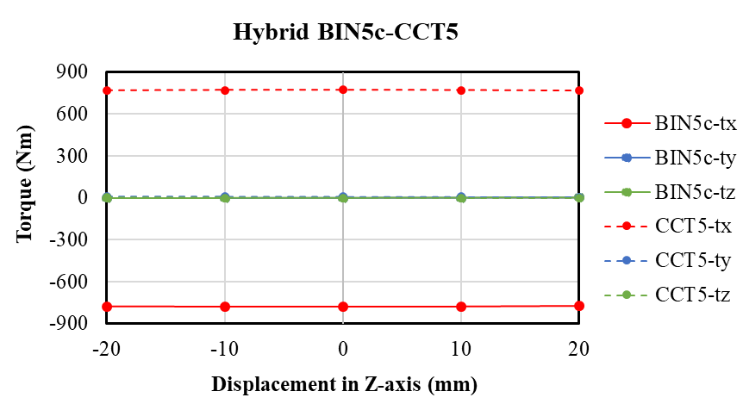
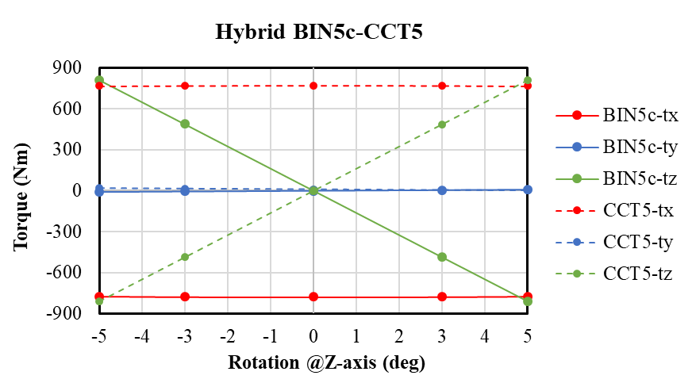
Torque in the hybrid CCT5-BIN5c magnet
The only misalignment that influences the torque is the rotation about the z-axis
There is always a torque about the x-axis between the magnets (even in the perfectly aligned position)
The torque can be handled by assembling the magnets using end supports (no need for contact in the midplane between the magnets)

Slide 6
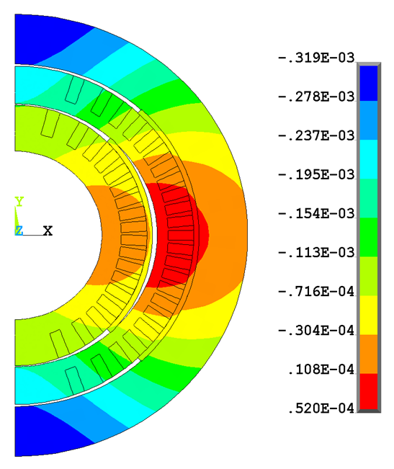
Radial displacement of BIN5c coils inside CCT5
Radial displacement of BIN5c (m) under the background field of CCT5
BIN5c coils are impregnated independently
The assembly of the magnet consists of smart shims placed between the coils, and between outer coil and the Al shell, spanning +/- 45 deg from the midplane
The assembly of BIN5c inside CCT5 will rely on end supports only
Since the mandrels of BIN5c were designed for standalone test only (to prove the Bi-2212 CCT technology), the inner layer is too stiff for avoiding the gap in the midplane during the hybrid test

Slide 7
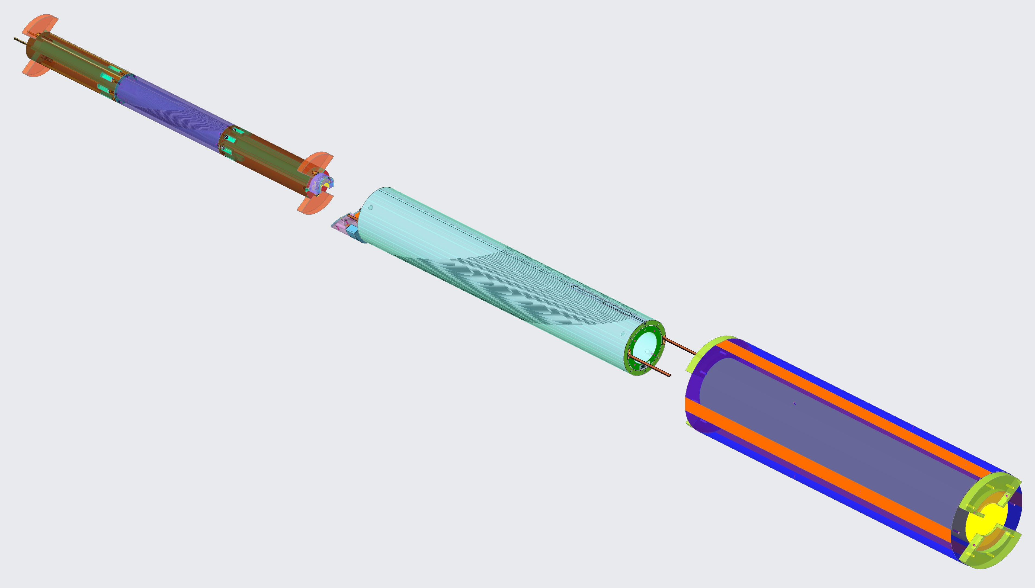
Additional preparation of BIN5c to account for the hybrid test
For the hybrid test, extension tubes will be installed at the ends of BIN5c to match the length of CCT5
The voltage tap wires and Nb-Ti leads will be guided through the lead-end extension tube towards the header of the cryostat
Nb-Ti cables will also be guided through the other extension tube for the installation of the layer jump
BIN5c
Assembly of BIN5c inside CCT5
CCT5
Extension tube at the lead-end
CCT5 aluminum shell
Extension tube at the layer jump-end

Slide 8
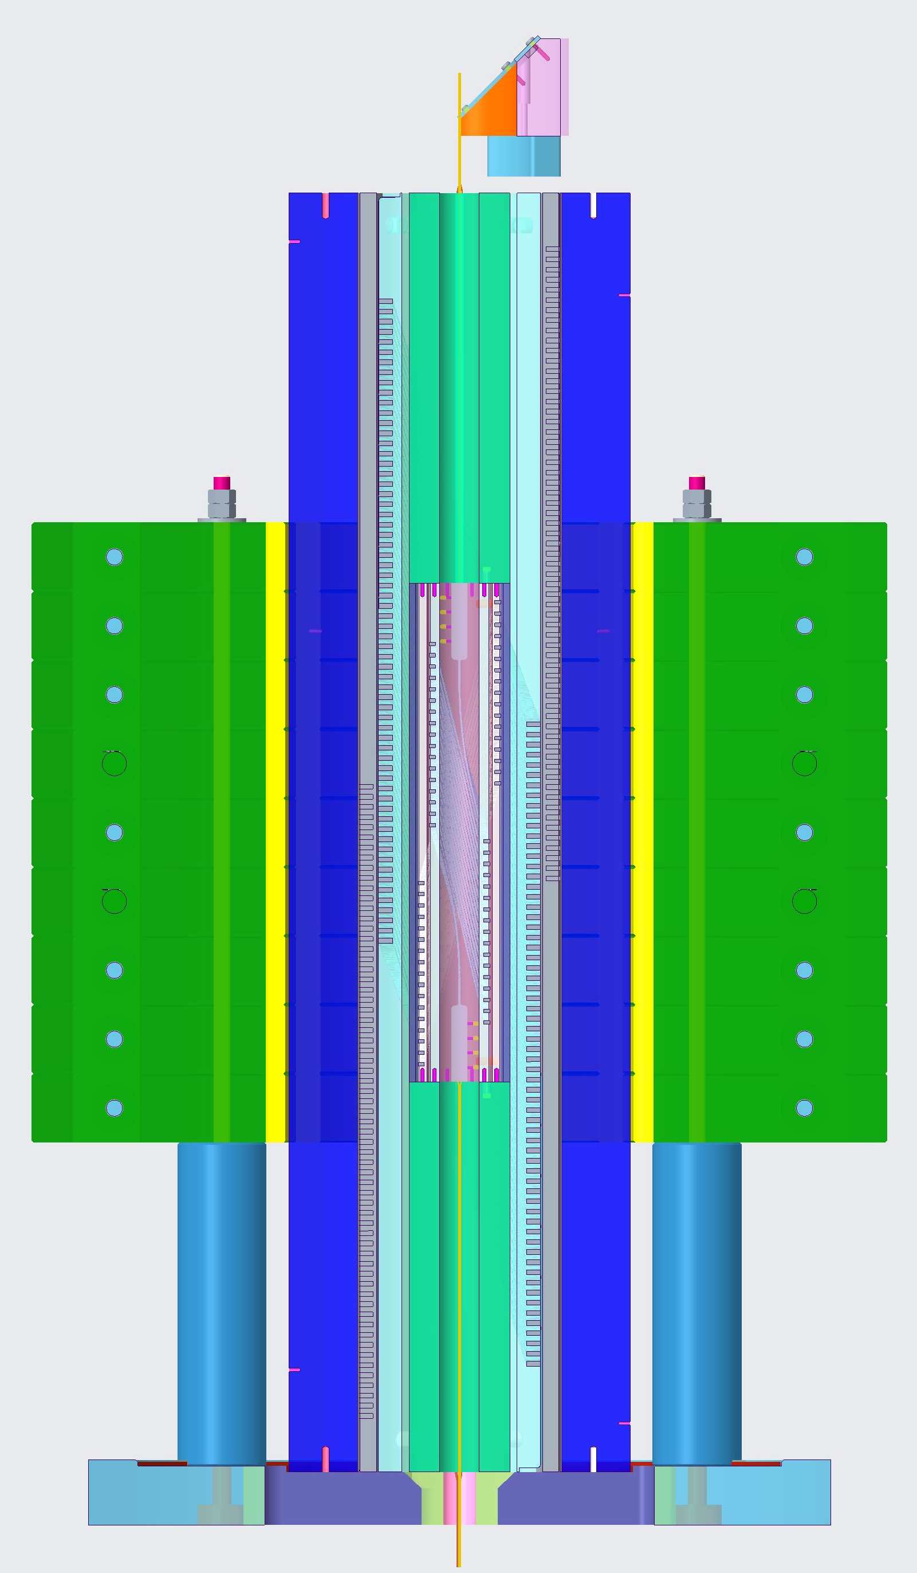
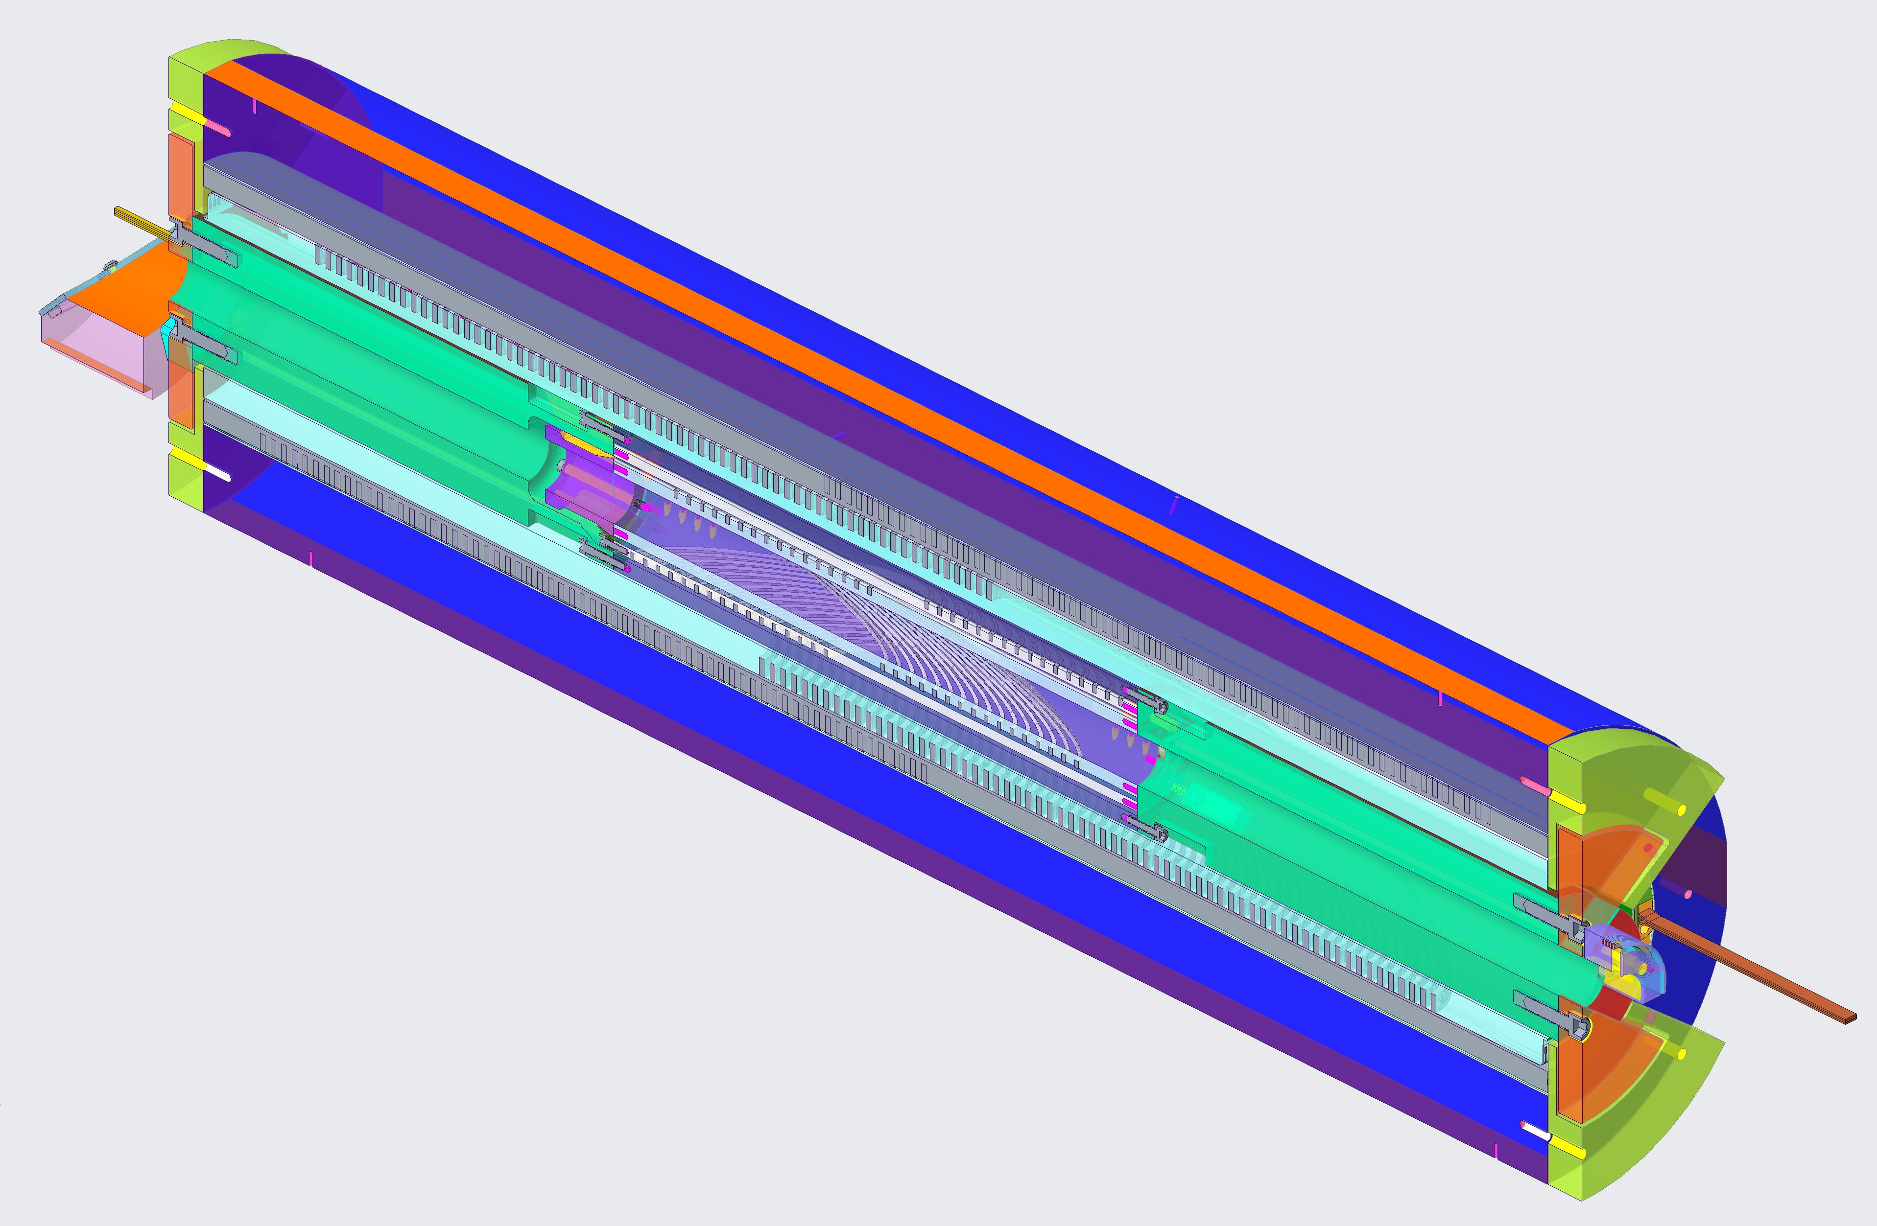
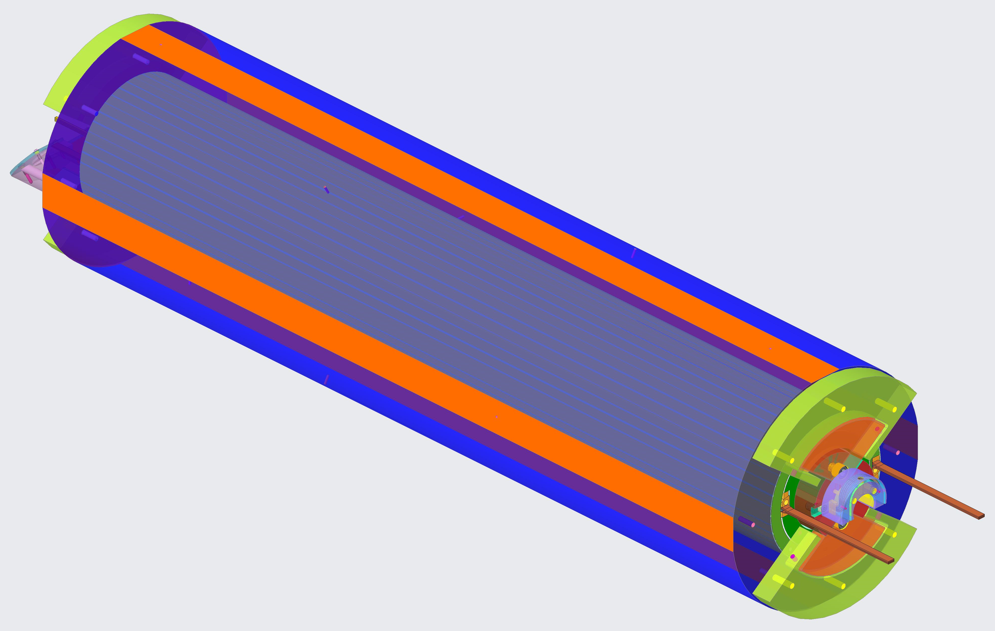
Additional preparation of BIN5c to account for the hybrid test
Layer jump of CCT5
Leads and voltage tap wires of BIN5c will come out from the bore of CCT5
End supports
BIN5c
Iron yoke
The layer jump of BIN5c will be in this region
Layer jump of BIN5c

Slide 9
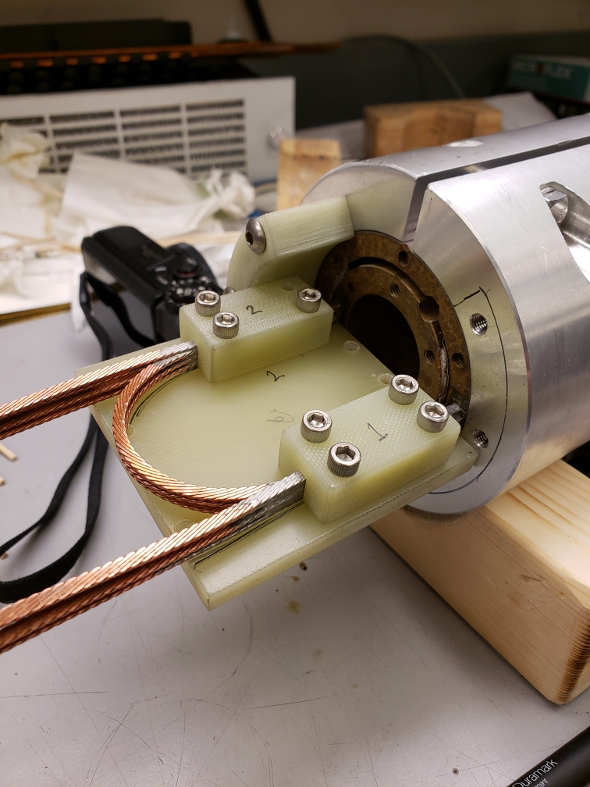
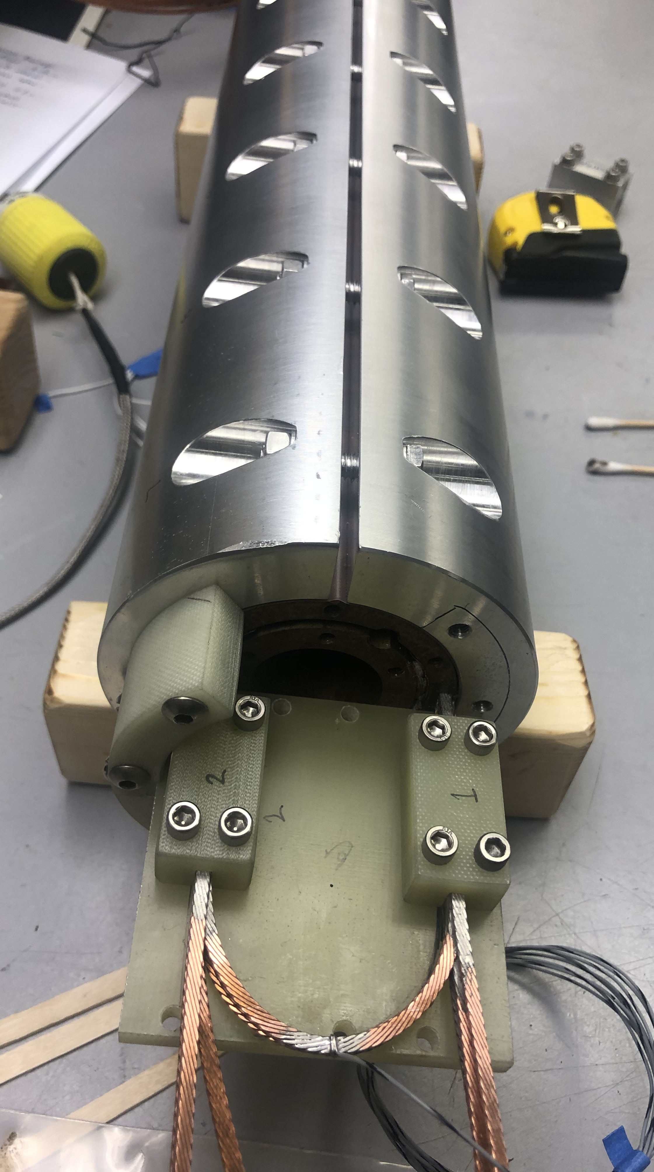
Differences in the setup for the standalone test
Since the standalone test of BIN5c will be done in our 15” cryostat, the extension tubes will not be used (because the whole setup would not fit). Therefore, the layer jump will be dismounted and re-soldered for the hybrid test
In addition, a split shell will be used for easier assembly and the installation of the instrumentation
Split aluminum shell
Layer jump

Slide 10
Summary of key points for the hybrid magnet CCT5-BIN5c
The length of BIN5c (smaller than CCT5) is in accordance with the size of the OP furnace Deltech at FSU. Therefore we need additional structure to match the length of CCT5 (for easier assembly), and we need to adapt the splices of BIN5c to the high background magnetic field of CCT5
Because CCT5 and BIN5c were not designed with the hybrid test in mind, the hybrid design is not optimal in terms of stresses
The next insert and outsert magnets should be designed with the hybrid test in mind to avoid incompatibilities in the structure and stresses

Slide 11
CCT6-BiCCT1 hybrid
Preliminary analysis

Slide 12
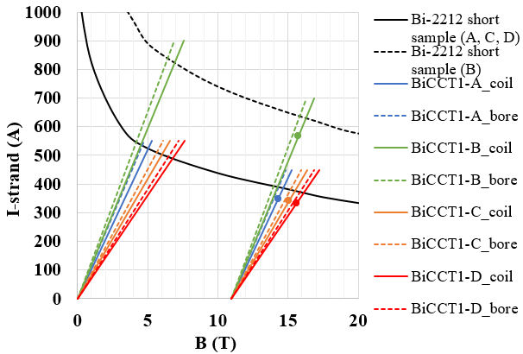
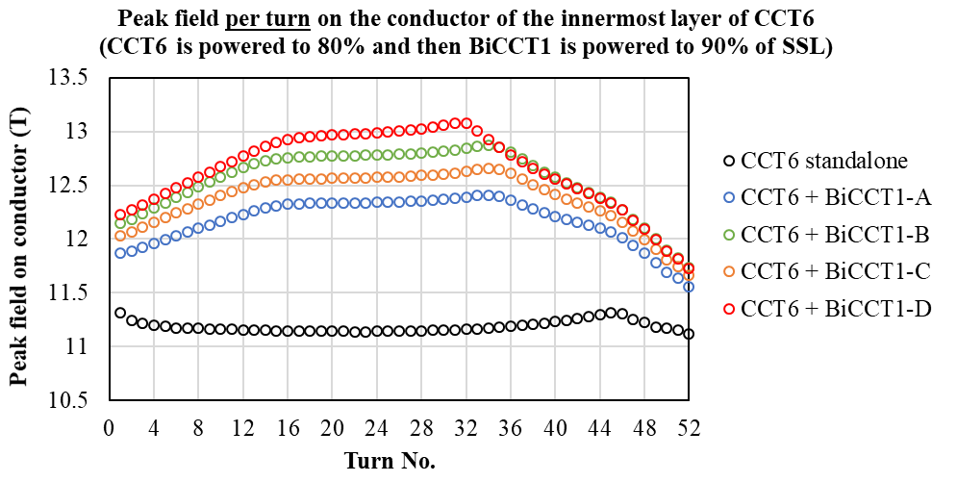
Design options for BiCCT1
Scaling study: Design parameters of Bi-2212 CCT, two layer dipole, 0.8 m long
BiCCT1-A to D are designed to fit inside CCT6: a four-layer, 120 mm bore Nb₃Sn CCT dipole that is under design
Parameter | BiCCT1-A | BiCCT1-B | BiCCT1-C | BiCCT1-D
Bore diameter (mm) | 50 | 40 | 40 | 40
Outer diameter (mm) | 99.8 | 101.7 | 101.7 | 110.4
Cable size (mm²) | 7.8 x 1.44 | 10.077 x 1.86 | 10.077 x 1.44 | 12.25 x 1.44
No. strands | 17 | 19 | 23 | 28
Strand diameter (mm) | 0.8 | 1 | 0.8 | 0.8
No. of turns | 48 | 38 | 46 | 42
Electromagnetic challenges of these designs:
Increasing the field in the insert increases the peak field in the outsert
The working point of the outsert should be kept under a safe limit to avoid quenches when powering the insert
Therefore, we might not be able to reach a high background field with the outsert
Loadlines
This plot represents the half of CCT6
BiCCT-A is the best candidate so far since we have the 17-strand cable fabricated for at least one magnet
Bore field produced by CCT6 at 80% SSL
BiCCT1 at 90% SSL

Slide 13
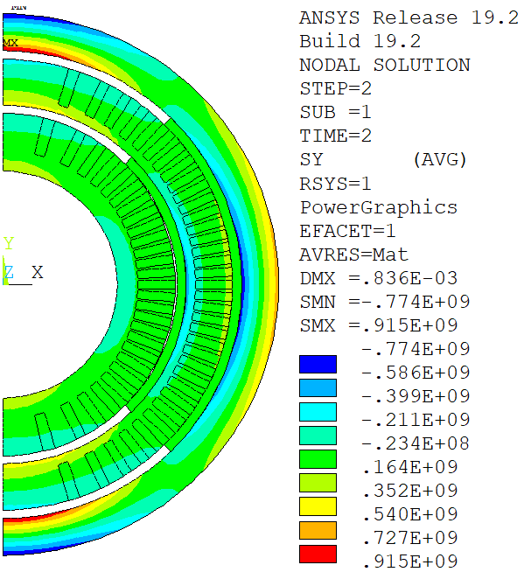
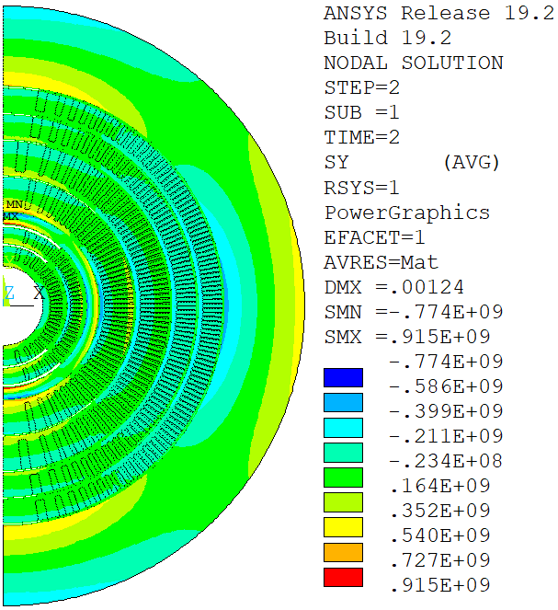
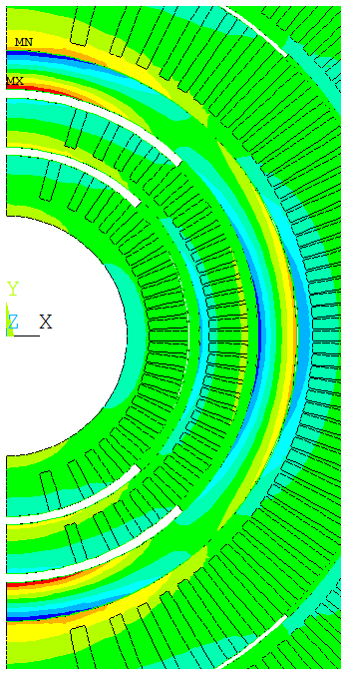
BiCCT1-A (V1) ➔ Azimuthal stress, no shim between insert and outsert
We want to reduce the stress

Slide 14
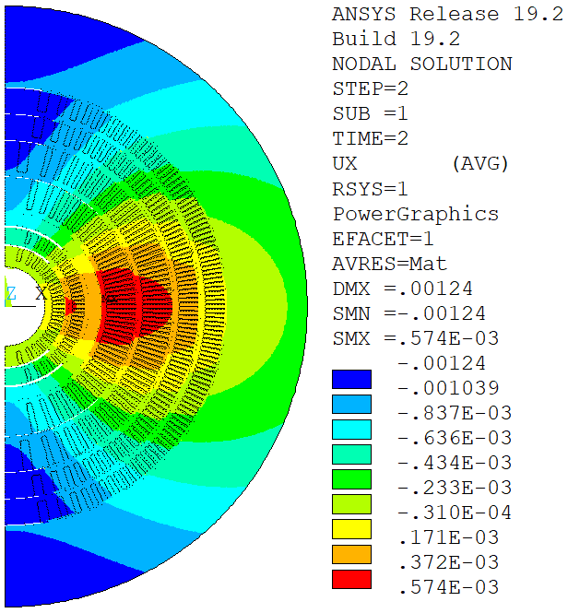
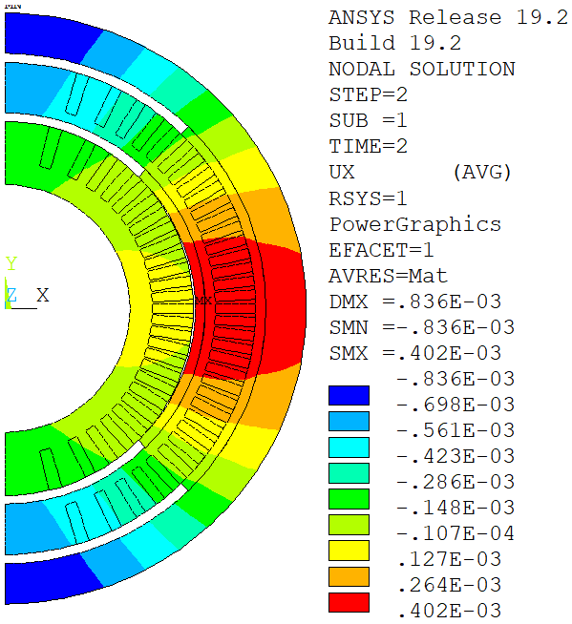
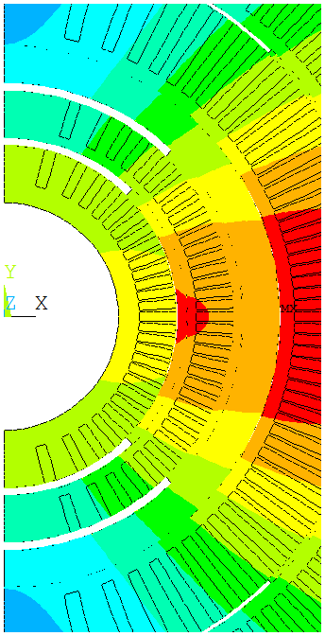
BiCCT1-A (V1) ➔ Radial displacement, no shim no shim between insert and outsert
We want to avoid this gap

Slide 15
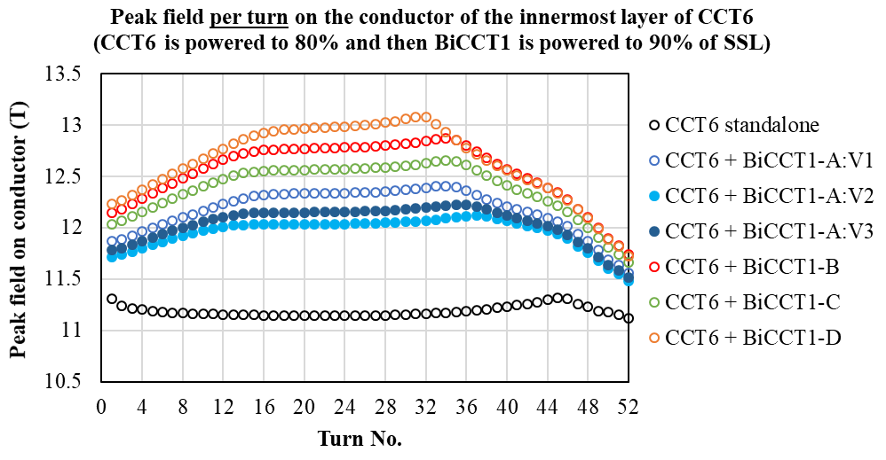
Design modifications BiCCT1A for decreasing the stress and avoiding the gap at the midplane
Different options for BiCCT1-A (17 strands, 0.8 mm diameter strand)
In order to reduce the stress in the insert and avoid the gap in the midplane between the inner and outer layer during hybrid operation, several versions of BiCCT1A (v2-v4) were studied
v2-v4 modifications consist of reducing the bore diameter from 50 to 40 mm to have more space for structural material, and change the spar thickness of the inner and outer layer to change the stiffness of the mandrels and remove the gap in the midplane
Parameter | BiCCT1-A:V1 | BiCCT1-A:V2 | BiCCT1-A:V3 | BiCCT1-A:V4
Bore diameter (mm) | 50 | 40 | 40 | 40
Outer diameter (mm) | 99.8 | 89.8 | 94.8 | 94.8
Spar thickness L1 (mm) | 4.5 | 4.5 | 6 | 4.5
Spar thickness L2 (mm) | 2 | 2 | 3 | 4.5
No. of turns | 48 | 51 | 49 | 49

Slide 16
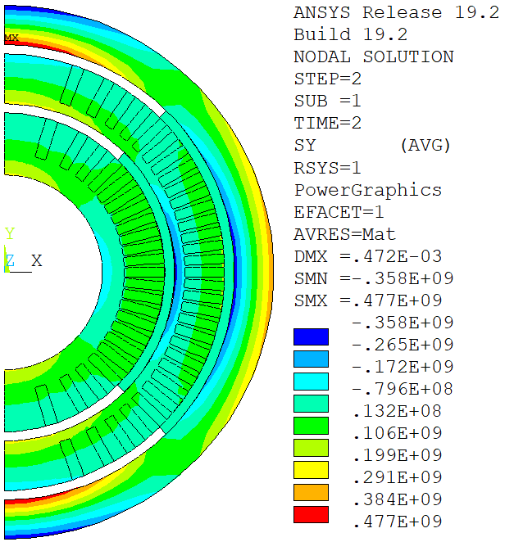
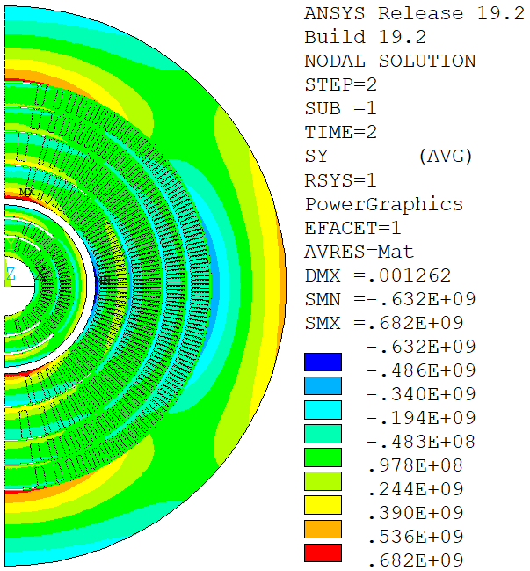
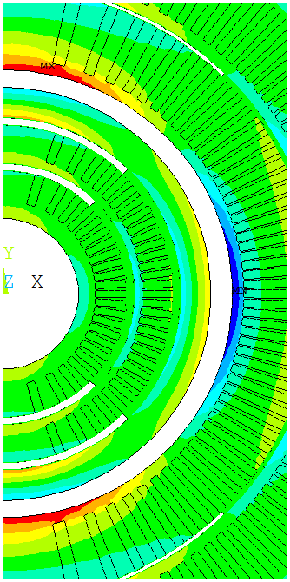
BiCCT1-A: V2 ➔ Azimuthal stress, no shim no shim between insert and outsert

Slide 17
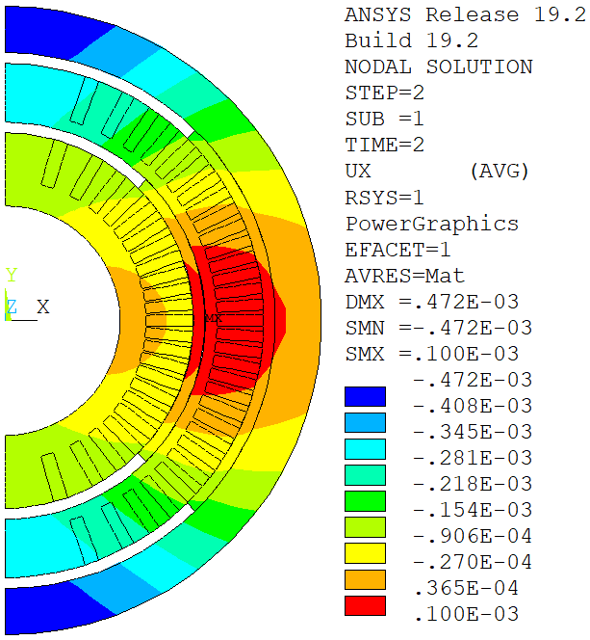
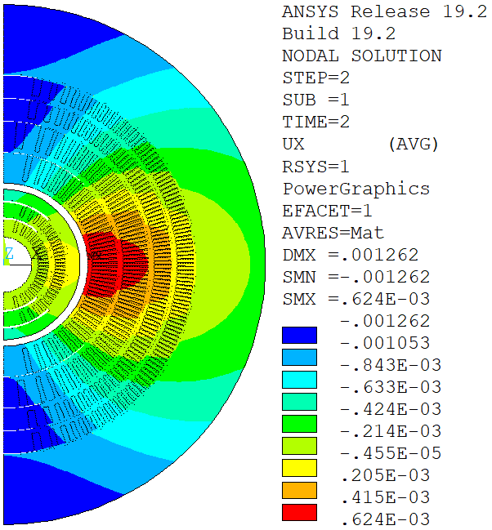
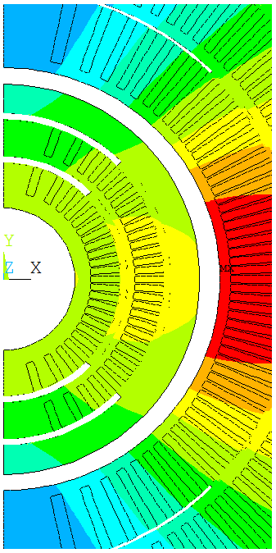
BiCCT1-A: V2 ➔ Radial displacement, no shim no shim between insert and outsert

Slide 18
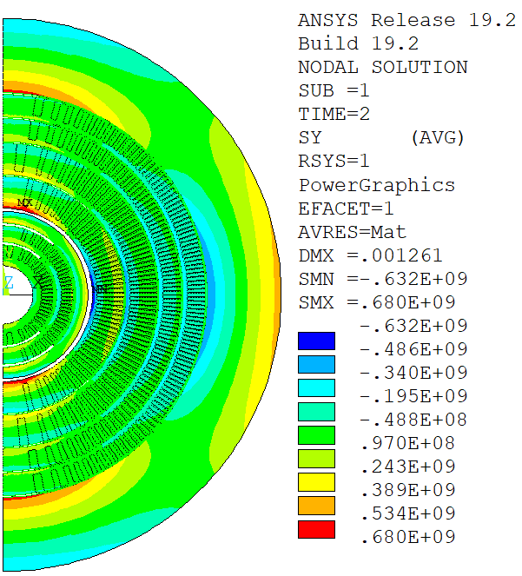
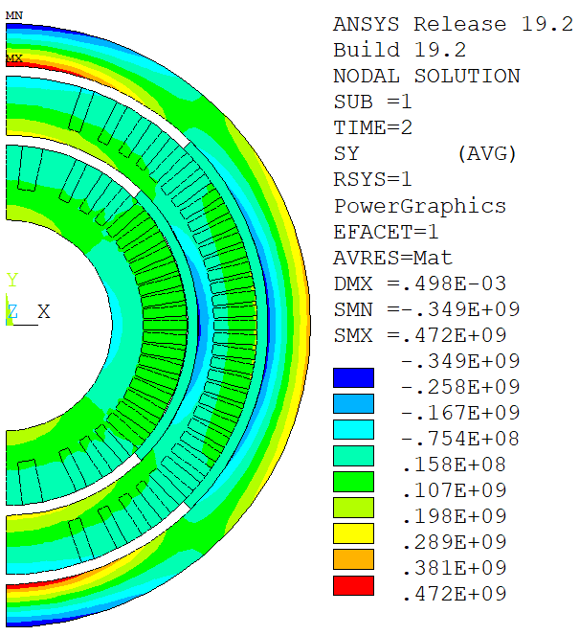
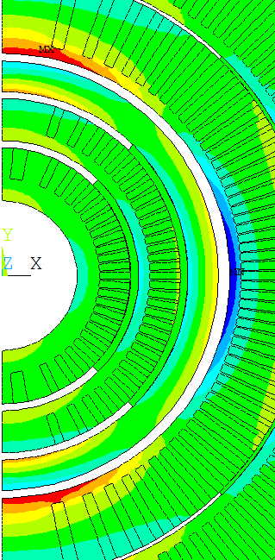
BiCCT1-A: V3 ➔ Azimuthal stress, no shim no shim between insert and outsert

Slide 19
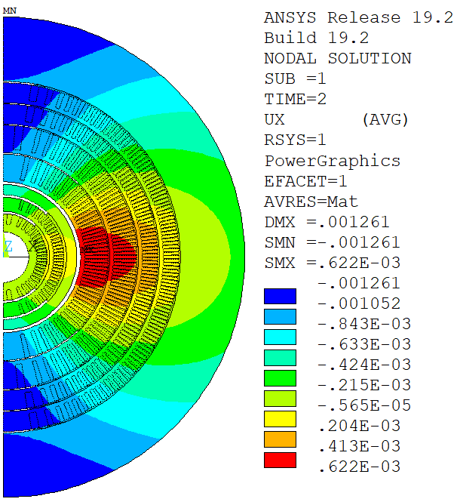
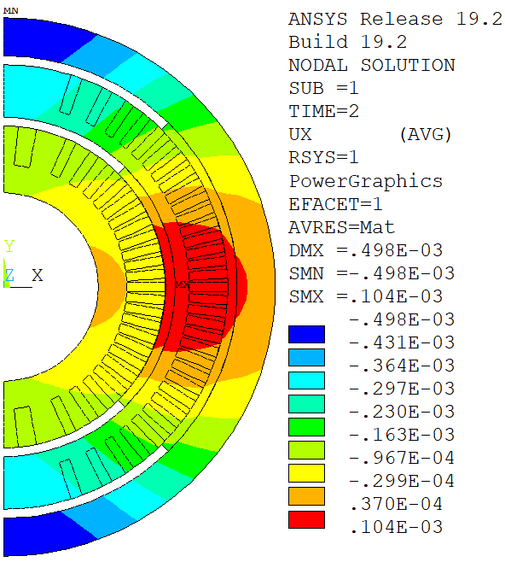
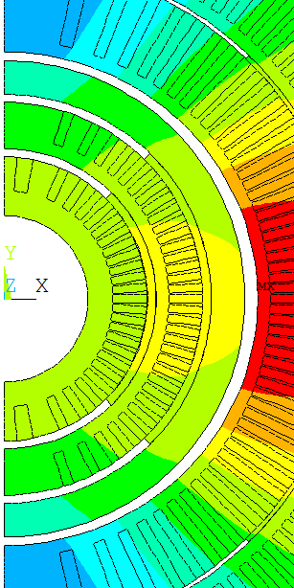
BiCCT1-A: V3 ➔ Radial displacement, no shim no shim between insert and outsert

Slide 20
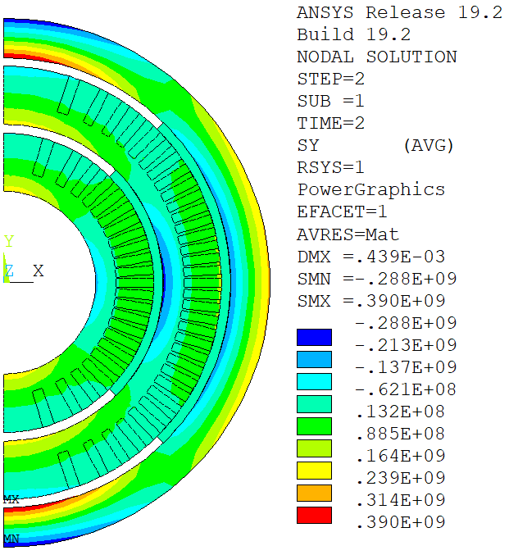
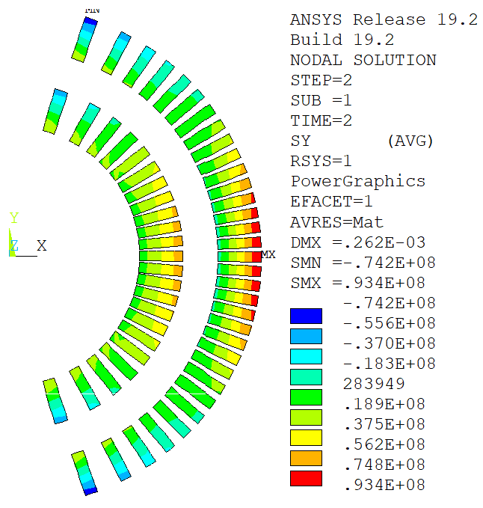
BiCCT1-A: V4 ➔ Azimuthal stress, no shim no shim between insert and outsert (this is the selected BiCCT1 design)

Slide 21
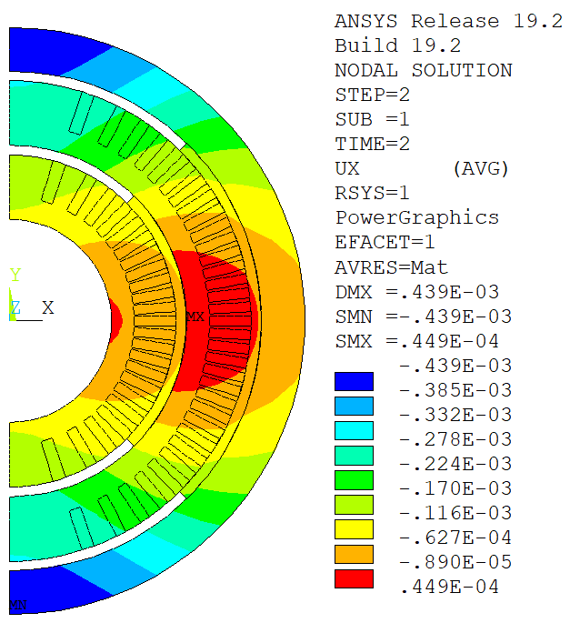
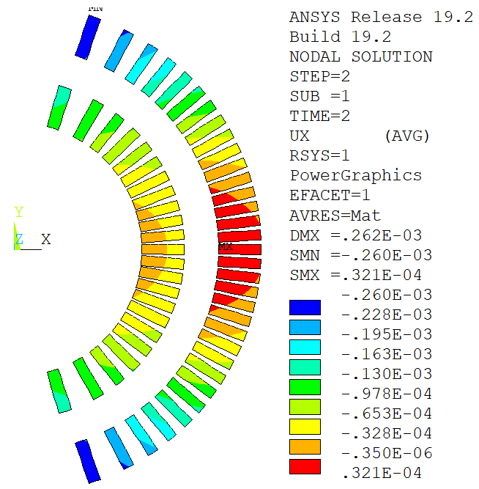
BiCCT1-A: V4 ➔ Radial displacement, no shim no shim between insert and outsert (this is the selected BiCCT1 design)

Slide 22
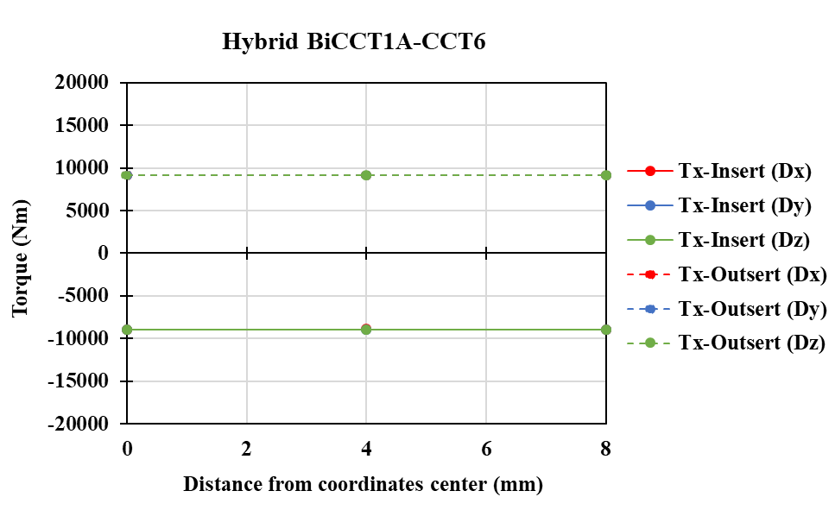
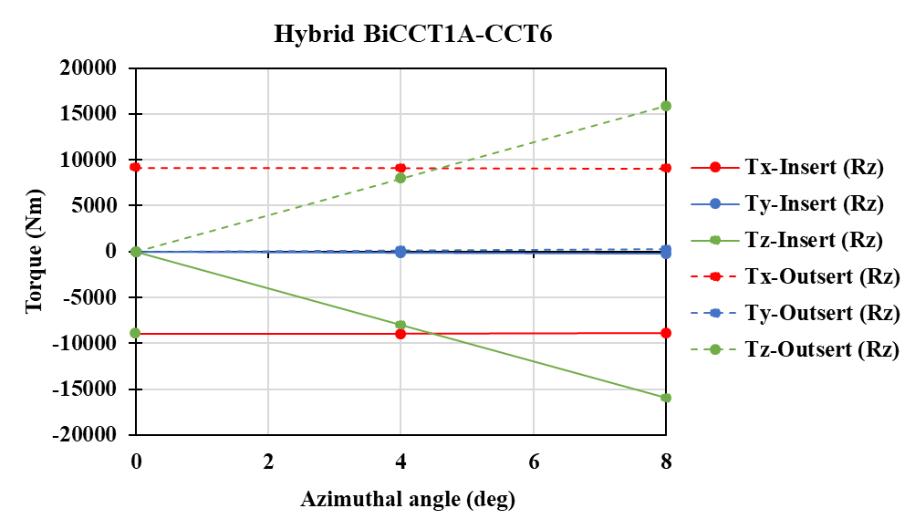
Torque in the hybrid CCT6-Bi-CCT1 (A-v4) magnet
Like in the CCT5-BIN5c hybrid, the only misalignment that influences the torque is the rotation about the z-axis
Like in the CCT5-BIN5c hybrid, there is always a torque about the x-axis between the magnets (even in the perfectly aligned position)
In the BiCCT1A-CCT6 hybrid, Tx is more than 10 times larger than in the CCT5-BiCCT1 hybrid (end supports will probably not be enough to assemble the magnets and counteract the torque)

Slide 23
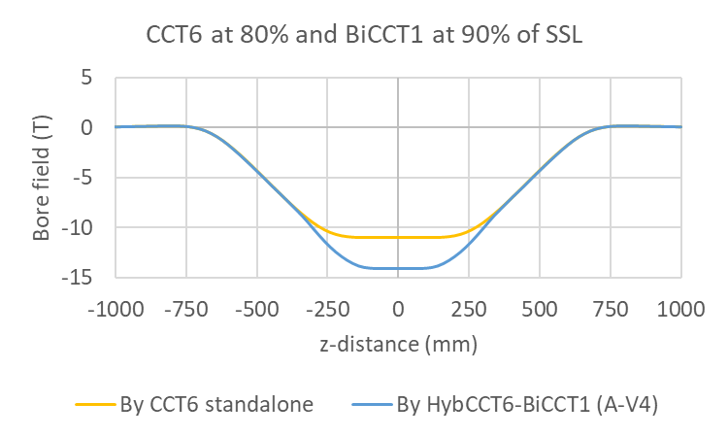
Background field of CCT6 at the splice region of BiCCT1
With this scenario, it is possible to use Nb-Ti splices for BiCCT1
If the design of CCT6 changes, or if BiCCT1 is intended to be tested inside another outsert, we might need to use Nb₃Sn splices (which would introduce additional challenges in the fabrication process)
We are already planning to fabricate BiCCT1, whereas CCT6 is still under design ➔ is it convenient for the Bi-2212 team to plan so far in the future?
Region where BiCCT1 is

Slide 24
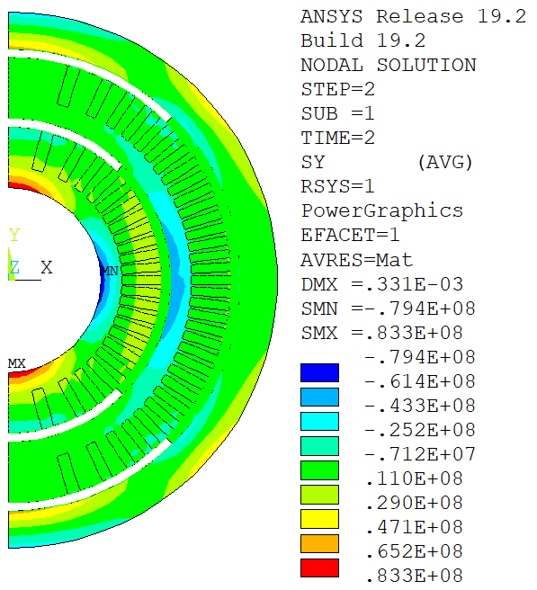
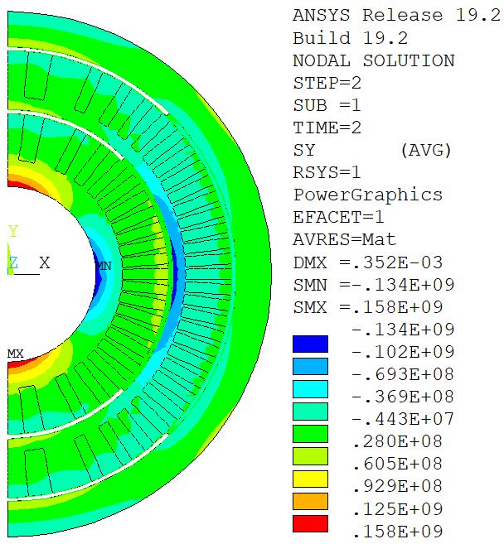
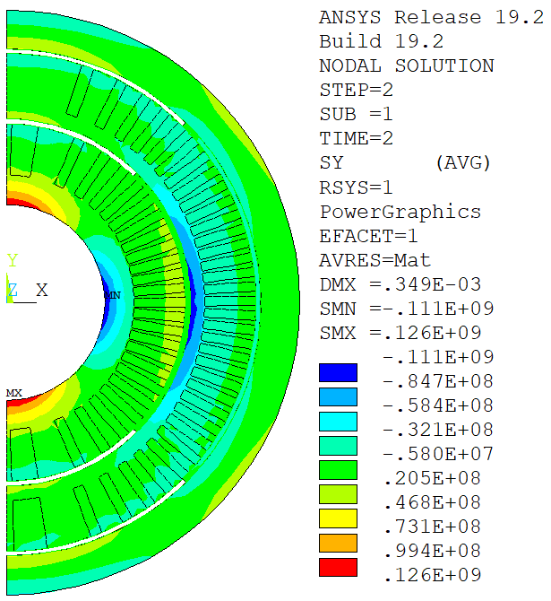
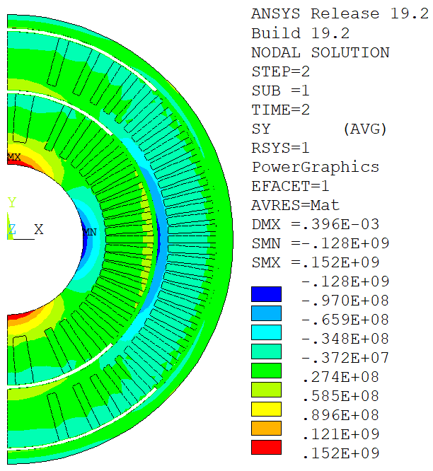
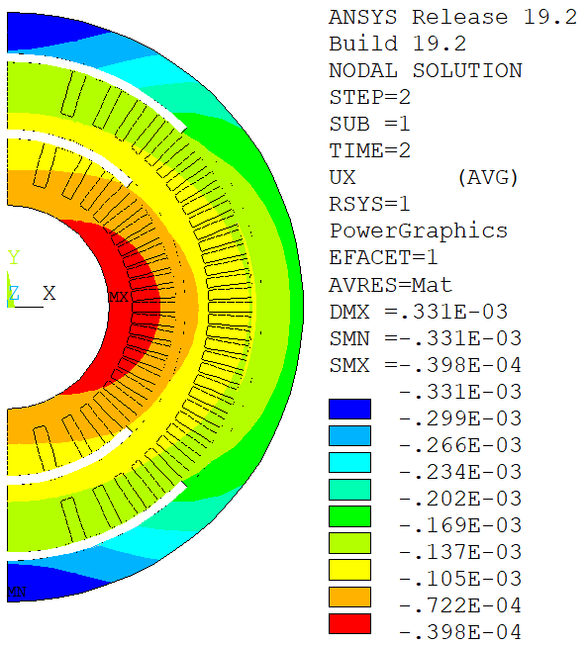
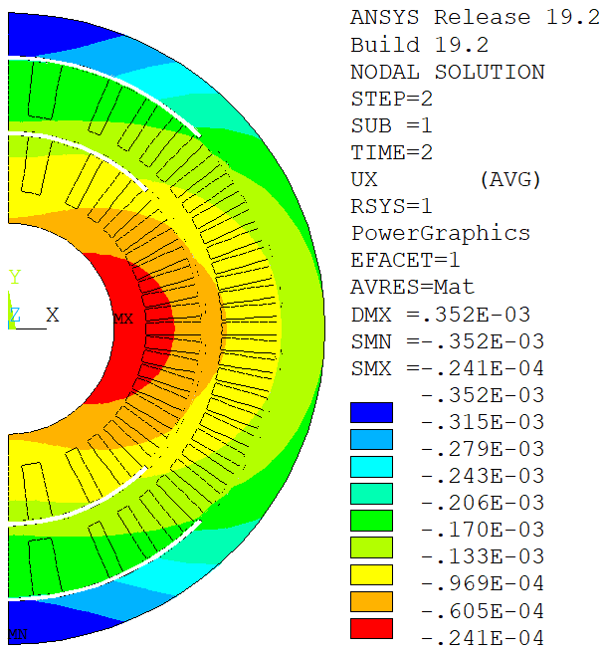
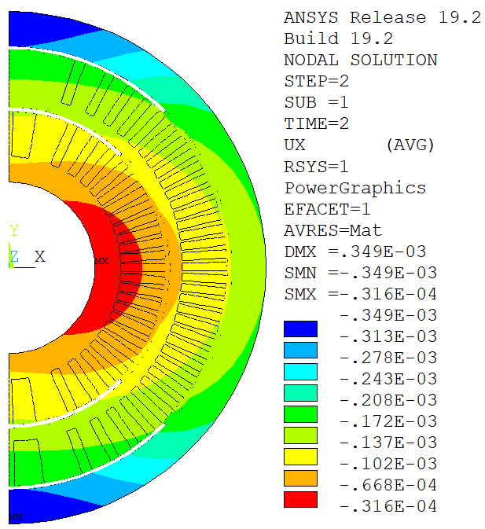
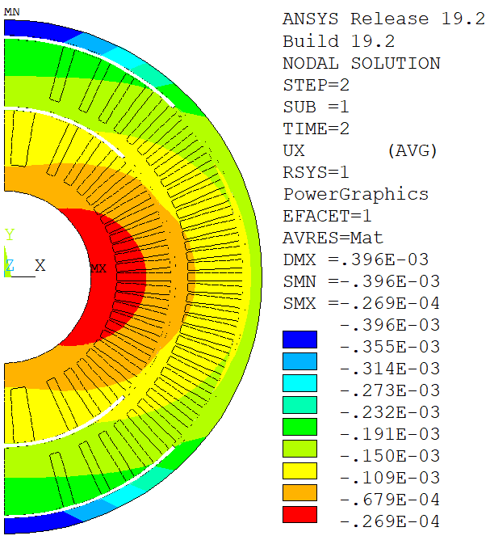
Azimuthal stress and radial displacement of the scaling options, no shim no shim between insert and outsert
BiCCT1 standalone
BiCCT2-B standalone
BiCCT2-C standalone
BiCCT2-D standalone

Slide 25
Summary of key points for the hybrid magnet CCT6-BiCCT1
A high field insert like BiCCT1, with the conductors close to the outsert, will increase the peak field of the outsert and the outsert will not be able to produce the desired bore field
If the outsert is intended to be a test magnet for different inserts, the best approach is to decouple the magnets mechanically (otherwise different pre-compression will be needed for different inserts, with the risk of damaging the outsert). However, a solution for handling the torque is needed
For decoupling the magnets, the insert’s structure should withstand the Lorentz force by itself ➔ more space needed for structural material (either increase the bore size of the outsert or decrease the bore size of the insert)
Decreasing the insert’s bore from 50 to 40 mm provides more flexibility in the design of a decoupled magnet
The fabrication of a hybrid magnet requires close collaboration between the teams involved

