Slide 1
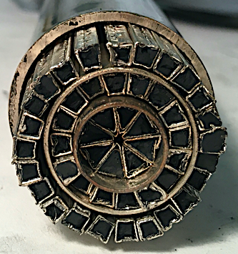
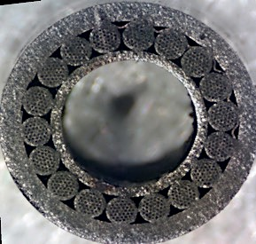
Wire, Cable, and Magnet R&D at Texas A&M and ATC
Textured-powder Bi-2212 with LAR ~ 1:1 (SBIR DE-SC0021688)
Nb₃Sn cable-in-conduit (SBIR DE-SC0021688)
Conformal REBCO winding for 18 T dipole
Tim Elliott^{1,2}, Gareth May, Peter McIntyre^{1,2}, and Christian Ratcliff², and John Rogers²
¹Accelerator Technology Corp. and ²Texas A&M University
MDP Aug 2021
p-mcintyre@tamu.edu

Slide 2
Textured-powder Bi-2212
We are developing a new method to fabricate Bi-2212/Ag wire using textured-powder cores – funded by SBIR DE-SC0021688.
The objective is to reduce the LAR of Ag in multi-filament wire from 3:1 for OPIT to 1:1, to reduce cost while retaining wire performance.
Bi-2212 fine powder is loaded with a Ag wrap and compressed to form a textured-powder (TP) bar:
The TP bars are then assembled into a symmetric multi-filament billet.
The billet is extruded and drawn to fine-wire.

Slide 3
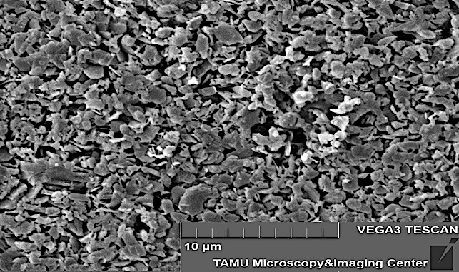
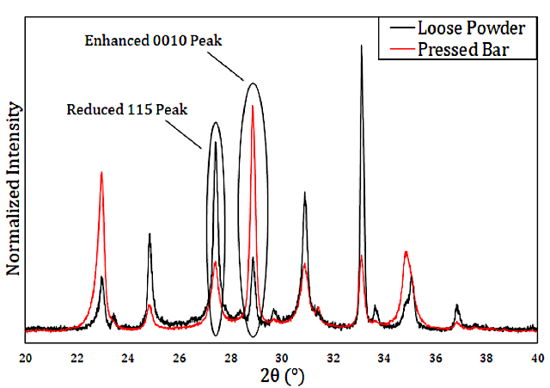
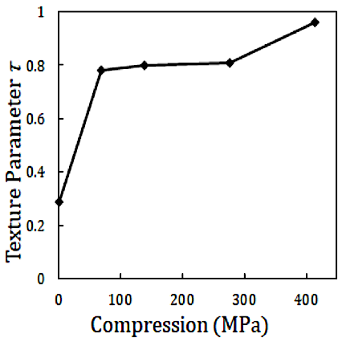
Bi-2212 is micaceous
Each grain in Bi-2212 fine powder has a plate-like morphology in which its c-axis thickness is 50x less than its a-b dimensions:
The powder particles align face-on to the direction of compression, so it is feasible to produce a high texturing among the powder particles:
Texture factor:
XRD:

Slide 4
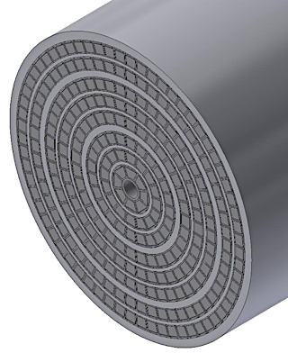
TP Bi-2212 has low shear modulus in the a-b plane
As with mica, a textured powder of Bi-2212 flows
with low modulus under shear in the a-b plane.
Our objective is to achieve a flow modulus under
extrusion and drawing that is comparable to Ag, so
that the bars in a billet will reduce conformally.
Assemble a symmetric array of TP:
Use tetrahedral bars, and chose # bars and bar size in each layer so that all bars have ~same cross-section area.
Bar forming: The cavity in the female die is lined with a 50 mm Ag foil strip cladding. The top flaps of silver foil are folded over.
The foil-clad bar is uniaxially compressed to 200 MPa. The silver provides a slip-plane between the powder and the walls of the die. After compression, the TP bar releases readily from the die and is nearly hermetically sealed on its side surfaces.

Slide 5
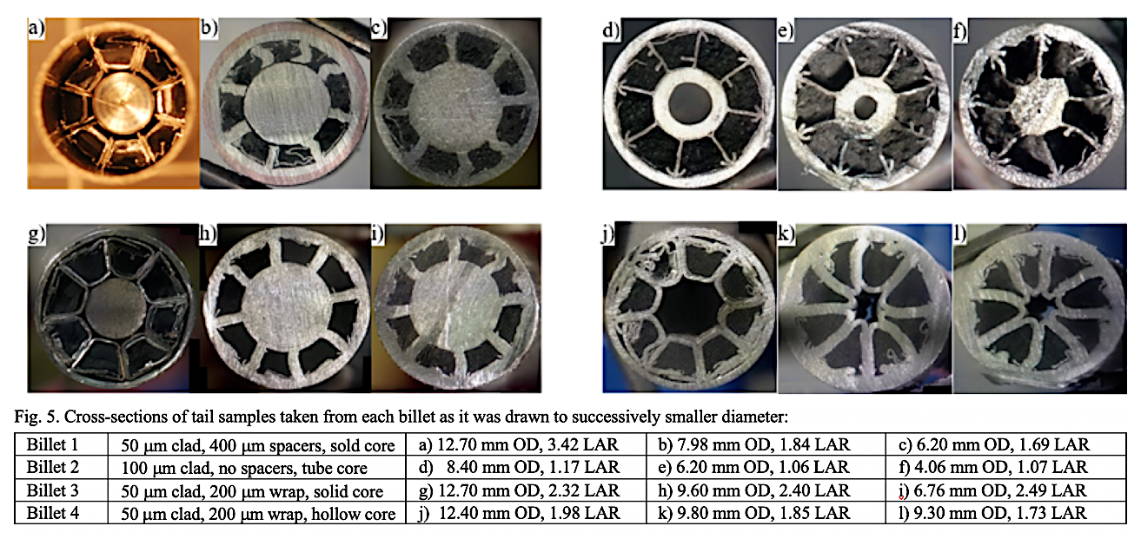
Single-layer billet experiments
Experimental billets were made using solid core, tube core, no core.
With a hollow tube core, the Bi-2212 bars drew down conformally with the Ag-alloy sheath tube wrappings – the LAR was preserved.
This result demonstrates that the plastic deformation modulus of the TP Bi-2212 bars is close to that of the Ag structure – a key condition for stable extrusion and drawing.
But the core remained a challenge – when the hole disappeared, the solid core reduced more slowly than the bars.

Slide 6
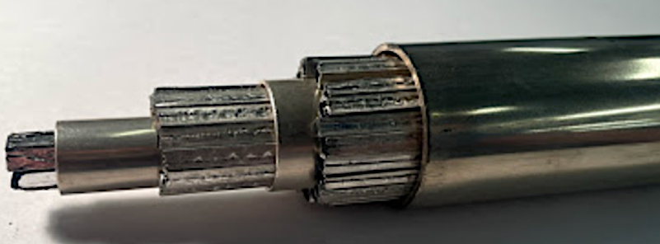
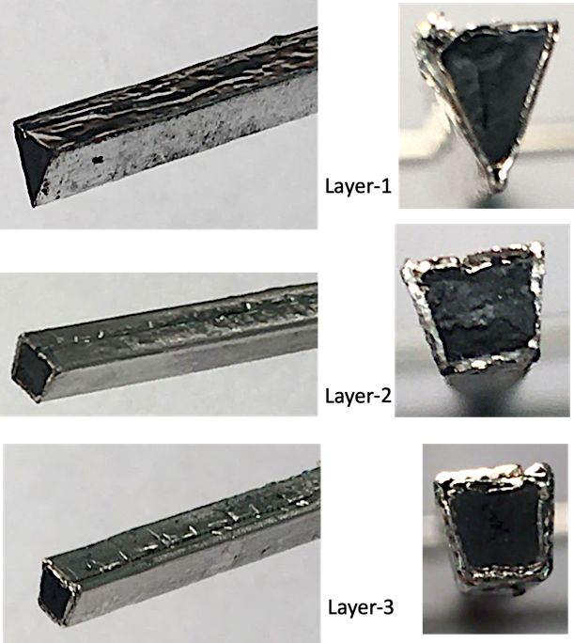
Use triangular bars in the core
A solid core does not reduce with the bars; an empty core de-stabilizes the bars so that they deform; a hollow tube core works well until the hole is fllled during drawing, then becomes a solid core.
So we fabricated a triangular bar for the core that provides the ~same mix of Bi-2212 and Ag in the core and in the layers:
This is a work in progress. Billets are being drawn at TAMU, extruded at Ames Lab.

Slide 7
Update summary
We have demonstrated that we can extrude and draw a multi-sub-element TP Bi-2212/Ag billet and preserve LAR.
We have assembled a 3-layer billet with TP bars in core and will soon conduct drawing and extrusion experiments.
Plans thereafter are to do process development of OP heat treatment of multi-filament wire with ~50 μm cores, measure Ic(B) for the wire, and evaluate wire made with powder from Nexans, MetaMateria, and nGiMat.

Slide 8
Down the road…. Can TP Bi-2212/Ag wire survive cabling?
The reduced LAR of Ag may make Rutherford cable susceptible to damage from cornering stress.
Once wire is developed, we will provide samples to LBNL to cable.
We have successfully fabricated SuperCIC using Bi-2212:
SuperCIC provides stress management within the cable, may provide better support with less Ag.
2-layer SuperCIC made using Bi—2212 wires: a) cross-section showing the layers of over-wrap foils; b) blow-up detail showing strands in both layers.

Slide 9
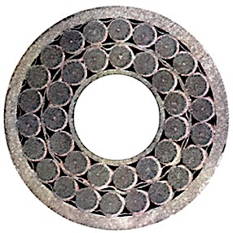
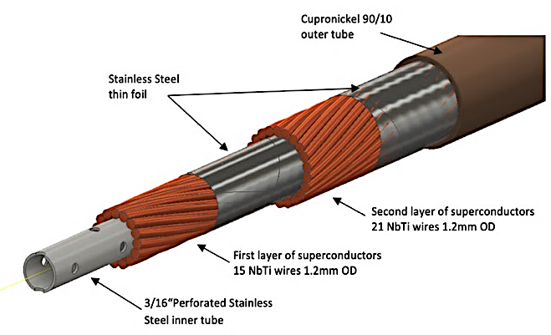
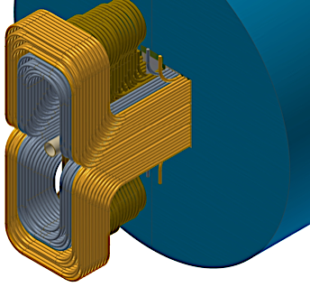
2. Nb₃Sn cable-in-conduit
ATC and TAMU have developed a NbTi cable-in-conduit for use in superconducting magnets.
It provides stress management at the cable level, internal flow of cryogen within the cable, and ability to form small-radius flared ends with support to all wires.

Slide 10
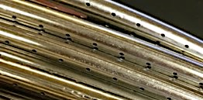
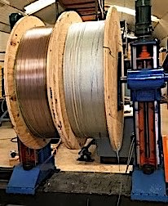
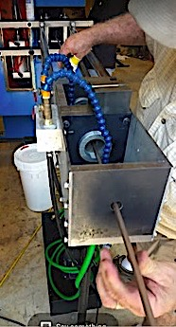
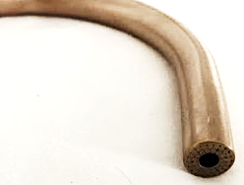
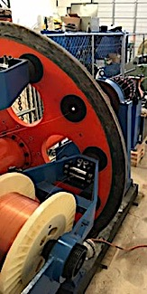
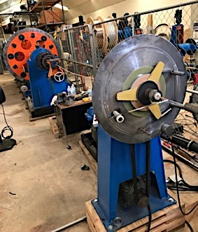
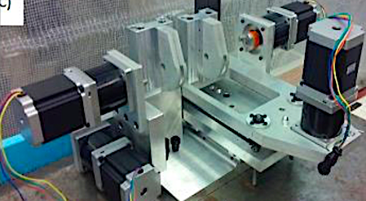
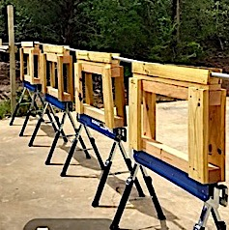
ATC has developed a manufacturing process to make SuperCIC in 150 m lengths
a
f
e
b
c
d
Fabrication of SuperCIC: a) perforated center tube; b) cable superconducting wires onto center tube, c) apply foil over-wrap; d) pull straight 150 m cable through sheath tube with loose fit; repeat b-d for the second layer; e) draw sheath tube onto cable.
TAMU has developed robotic bend tooling to make 8 cm-radius bends

Slide 11
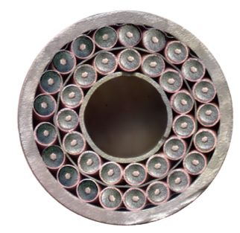
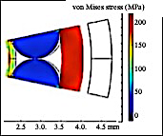
ATC, TAMU, and HyperTech have developed short-length fabrication of SuperCIC using tube-process Nb₃Sn
The perforated center tube is made of 316 SS, the sheath tube is made of aluminum bronze.
SuperCIC provides stress management at the cable level. The center tube deflects elastically as each wire is compressed against it, so the wires are immobilized (so they cannot move under Lorentz forces), but they are protected from strain by the elastic support from the center tube.

Slide 12
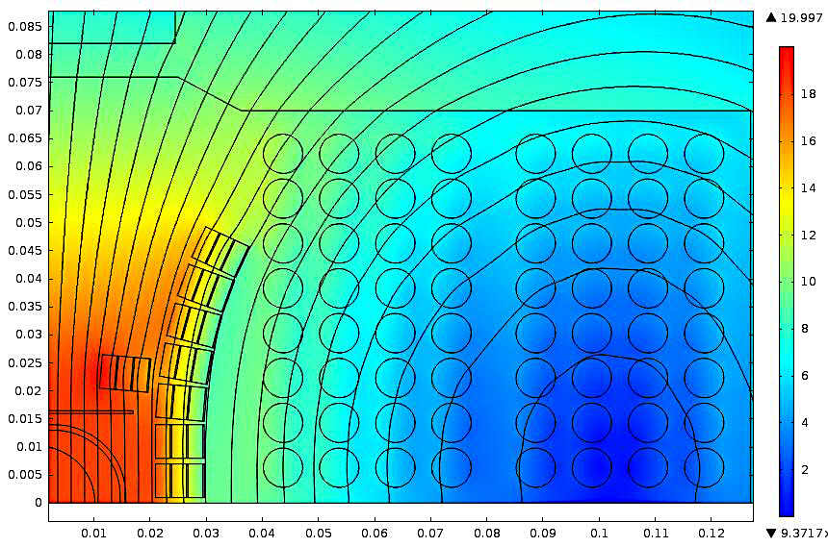
Nb₃Sn SuperCIC for an 18 T hybrid dipole
ATC is funded under SBIR DE-SC0021688 to develop Nb₃Sn SuperCIC for the outsert winding of an 18 T hybrid dipole:
Fabricate short-lengths of single-layer Nb₃Sn SuperCIC, heat-treat, test short-sample limit.
Fabricate few-turn winding, test in background field.

Slide 13
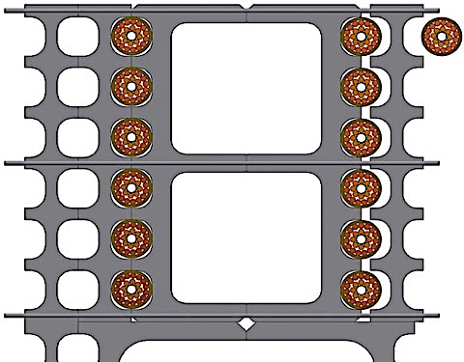
Structural support in SuperCIC outsert
Plymouth tube fabricates near-net-size extrusions using T16Al4V.
Support structure is an assembly of interlocking Ti extrusions. The SuperCIC cable is insulated with ceramic coating and S-glass sock, wound into groove in Ti-channel:
Simulated von Mises stress in the windings and Ti support matrix at 18 T:

Slide 14
Update summary
This project has just begun.
ATC is modifying the SuperCIC cabling line to accommodate low-tension feeds for the Nb₃Sn wire spools, tuning cabling parameters to optimize cable.
Fabricate short-length SuperCIC segments using HQ-spec RRR wire.
Heat-treat Nb₃Sn SuperCIC @ATC
Evaluating options for cold-testing short segments of single-layer cable: 17T @ 12.2 T, 5 K.

Slide 15
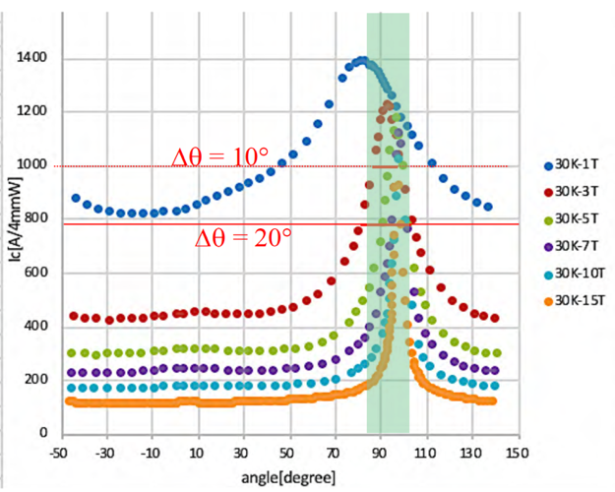
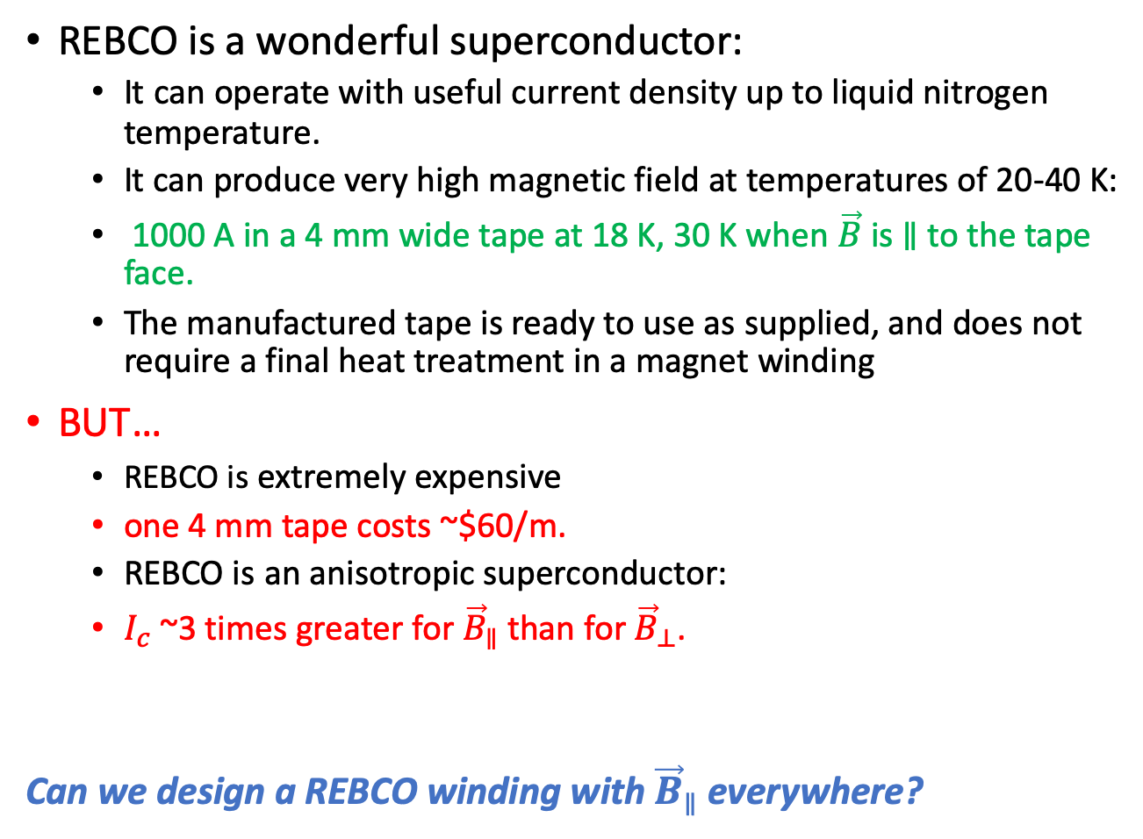
3. Conformal REBCO windings for insert windings of high-field dipoles
REBCO is a wonderful superconductor:
It can operate with useful current density up to liquid nitrogen temperature.
It can produce very high magnetic field at temperatures of 20-40 K:
1000 A in a 4 mm wide tape at 18 K, 30 K when $\vec{B}$ is $∥$ to the tape face.
The manufactured tape is ready to use as supplied, and does not require a final heat treatment in a magnet winding
BUT…
REBCO is extremely expensive
one 4 mm tape costs ~$60/m.
REBCO is an anisotropic superconductor:
$I_{c}$~3 times greater for ${\vec{B}}_{∥}$ than for ${\vec{B}}_{⊥}$.
Can we design a REBCO winding with ${\vec{B}}_{∥}$ everywhere?

Slide 16
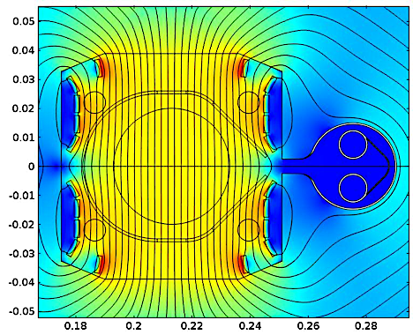
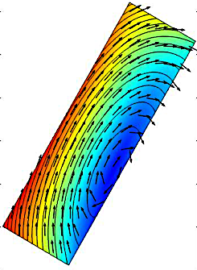




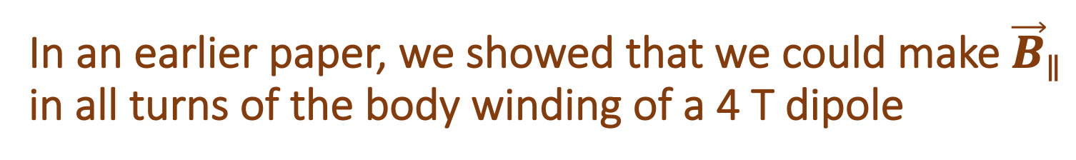
In an earlier paper, we showed that we could make ${\vec{B}}_{∥}$ in all turns of the body winding of a 4 T dipole
Each turn is positioned with its face parallel to $\vec{B}$.
Each layer of the winding forms a curving current sheet – conformal winding.
Because each layer follows the contours of $\vec{B}$, the conformal condition is preserved for all values of $\left|B\right|.$
B(T)
B(T)
This raises 3 questions:
Could the conformal condition be preserved for a high-field hybrid dipole (steel saturation)?
Could the conformal condition be preserved in the flared ends of a dipole?
Could a multi-tape winding be oriented everywhere with ${\vec{B}}_{∥}$ yet be ramped with current sharing?

Slide 17

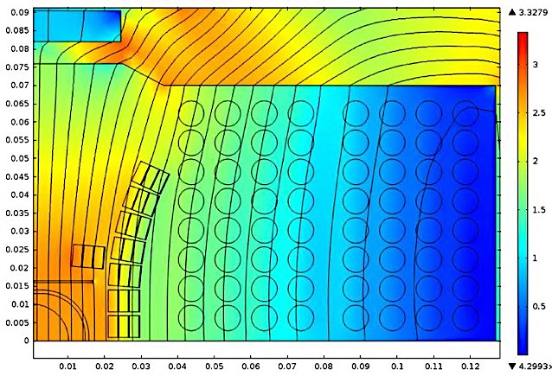
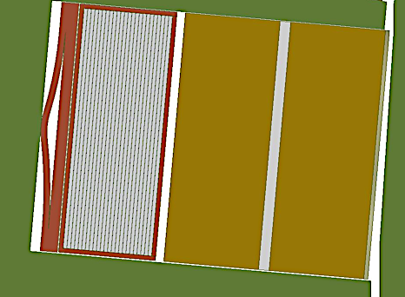
18 T hybrid dipole – body field
B(T)
REBCO sub-winding uses flat cable containing 24 6-mm tapes, 4 layers gives ~5 T in the dipole.
Nb₃Sn sub-winding uses cable-in-conduit (CIC) containing 15 0.8 mm wires, gives ~13 T in the dipole.
18.3 T bore field at short-sample. Current limit ~equal in REBCO, Nb₃Sn sub-windings.
Steel flux plate helps to maintain homogeneity over 10:1 dynamic range.
Curved boundary of REBCO is optimized for high field, but departs from optimum at lower field.
17.5 kA
B(T)
1.75 kA

Slide 18
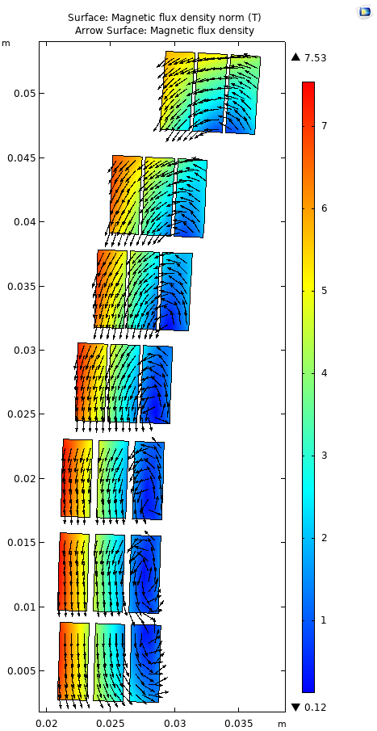
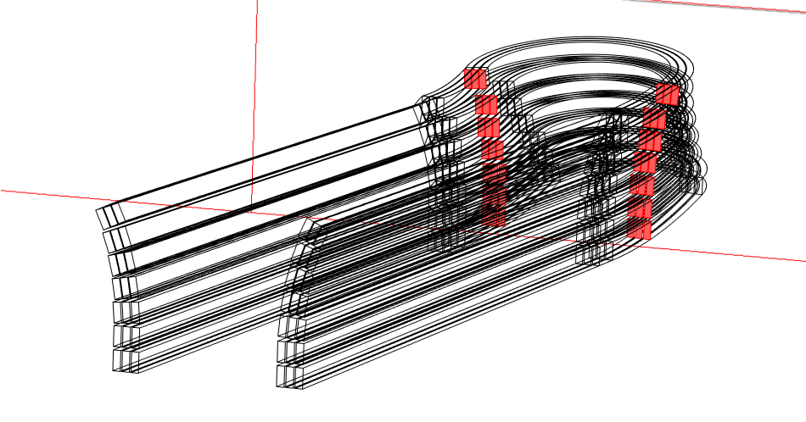
Flared-end REBCO sub-winding
We are evaluating two geometries for the flared-end windings of REBCO tape-stack cables:
Minimum flare angle to clear beam tube:
Field distribution in cross-section slice at 30º point of the flared end:

Slide 19
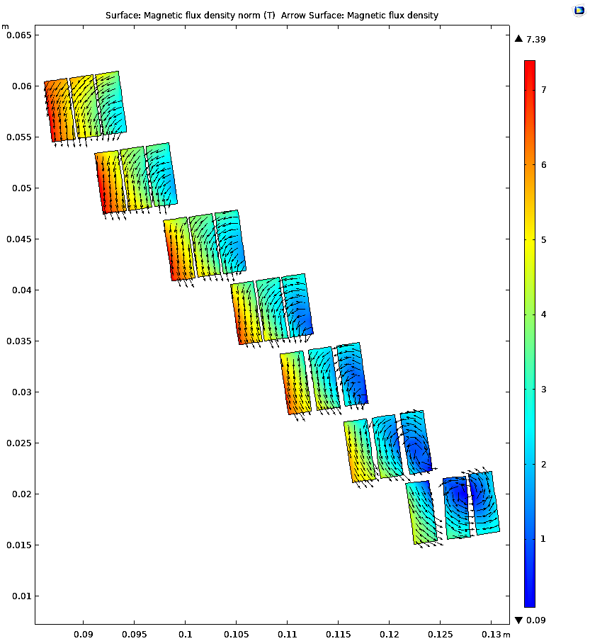
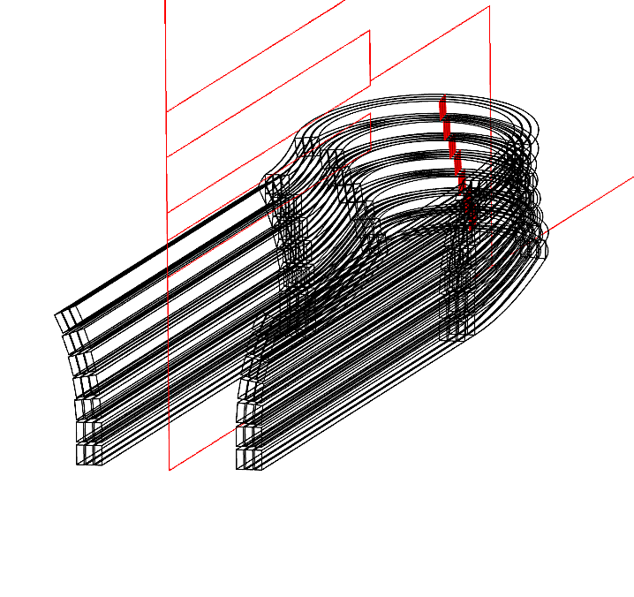
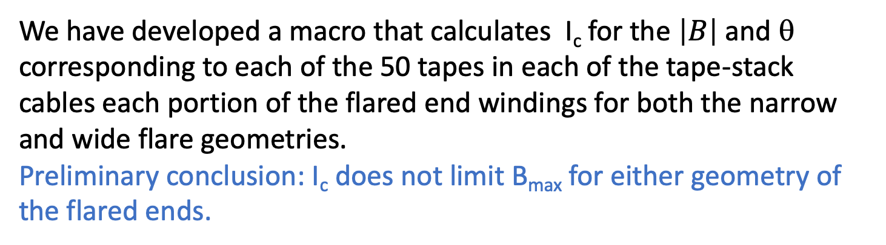
Mid-plane of the flared end:
We have developed a macro that calculates I_{c} for the $\left|B\right|$ and θ corresponding to each of the 50 tapes in each of the tape-stack cables each portion of the flared end windings for both the narrow and wide flare geometries.
Preliminary conclusion: I_{c} does not limit B_{max} for either geometry of the flared ends.

Slide 20
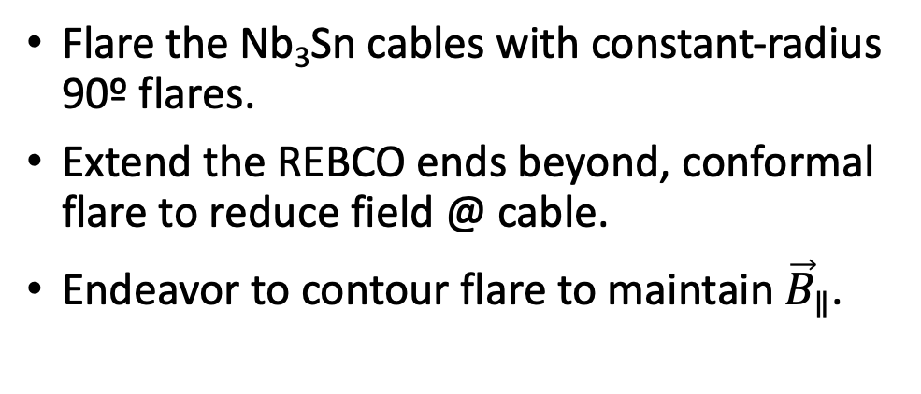
Wide-flare ends
Flare the Nb₃Sn cables with constant-radius 90º flares.
Extend the REBCO ends beyond, conformal flare to reduce field @ cable.
Endeavor to contour flare to maintain ${\vec{B}}_{∥}$.
x-z 45º cut
y-z mid-plane
x-y cut @ middle of CIC flare

Slide 21
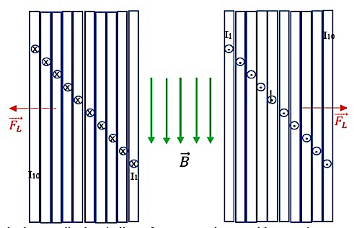
Current-sharing in a REBCO cable
When current is ramped in a cable containing wires in contact, Lorentz force pushes current towards the outside of the winding at all locations.
Unless the cable is twisted or transposed, this force tends to concentrate current and cause per-mature quench.
As current in the outermost tape approaches critical current, that tape develops a non-zero electric field, which pushes additional current to the next-inner tape.
This process repeats as each tape reaches its capacity, and produces a set of voltage spikes.
But for REBCO, the I/V transition is gentle and can provide a domain of dynamic stability.

Slide 22
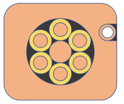
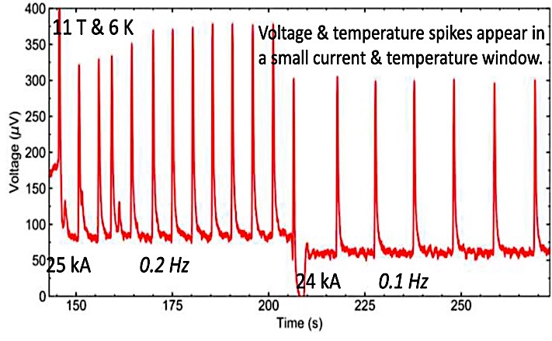
Ten Kate et al. observed this in a large test winding, even with a CIC of twisted CORC cables, because of isolation of bundles in the leads:
As current in the outermost tape approaches critical current, that tape develops a non-zero electric field, which pushes additional current to the next-inner tape.
This process repeats as each tape reaches its capacity, and produces a set of voltage spikes.
But for REBCO, the I/V transition is gentle and can provide a domain of dynamic stability.
Voltage spikes associated with successive stages of current-sharing in the testing of a REBCO CIC conductor:
T. Mulder et al., Development of ReBCO-CORC conductors and their magnet technology at CERN’, ICMC 2019

Slide 23
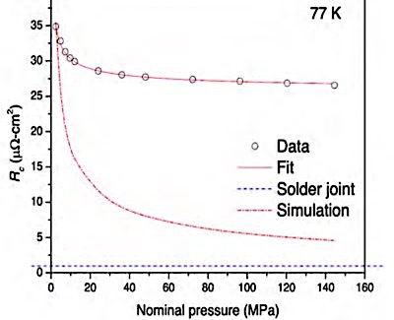
Flux creep, enhanced current-sharing: dynamic stability as current is ramped
Current-sharing relies critically upon the face-face contact resistance between tapes.
We developed a laminar spring that provides S₀~1 MPa of uniform compression in a flat-profile package, and sustains it through a stack of 24 tapes.
steel flux return
inner structure
J. Lu et al., ‘Contact resistance between two REBCO tapes under load and load-cycles’, https://arxiv.org/ftp/arxiv/papers/1701/1701.00447.pdf
outer structure
Lu et al. found that 1 MPa compression produces 35 μΩ-cm² contact resistance between Cu-clad faces of REBCO tapes.
REBCO exhibits flux creep and flux flow. With sufficiently good tape-tape transport the dynamics for current transfer should provide stability as current is ramped.
F. Trilaugh et al., ‘Essential material knowledge and recent model developments for REBCO-coated conductors in electric power systems’, Materials 14, 1892 (2021)

Slide 24
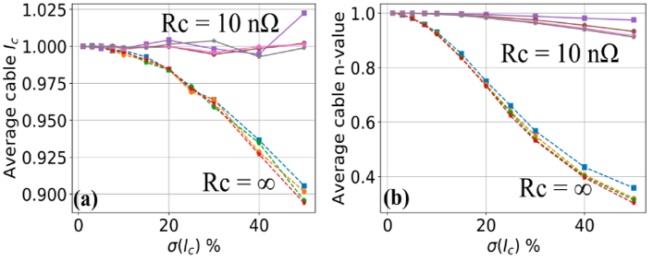
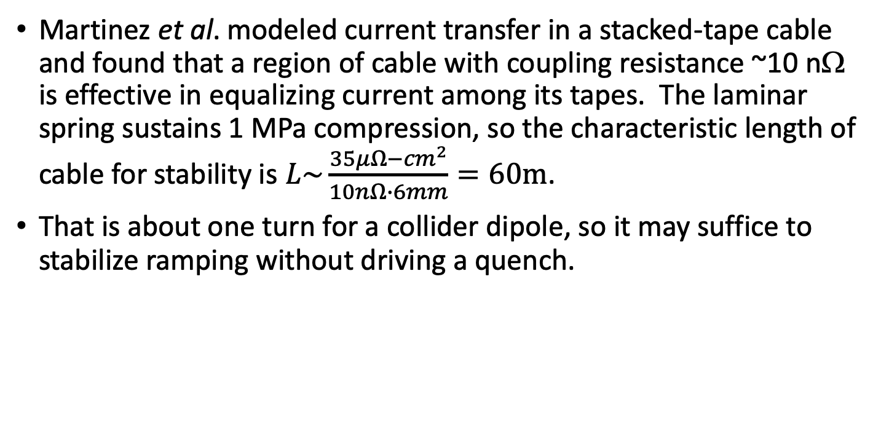
We are developing a multi-physics model of current sharing and dynamics during ramp
Average cable parameters as a function of Ic variation for different numbers of tapes: a) cable I_{c}; b) n value.
A.C.A. Martinez et al., ‘Electric-circuit model on the inter-tape contact resistance and current sharing for REBCO cable and magnet applications’, IEEE Trans. Appl. Superconduct. 30, 4, 2972215 (2020).
Martinez et al. modeled current transfer in a stacked-tape cable and found that a region of cable with coupling resistance ~10 nΩ is effective in equalizing current among its tapes. The laminar spring sustains 1 MPa compression, so the characteristic length of cable for stability is $L\sim \frac{35μΩ−{cm}^{2}}{10nΩ∙6mm}=60m$.
That is about one turn for a collider dipole, so it may suffice to stabilize ramping without driving a quench.

Slide 25
Future plans: magnetic modeling
We are undertaking a systematic study of the 3-D magnetics of the 18 T dipole to determine what is the most effective geometry to preserve conformal geometry in the body and ends.
We are developing a multi-physics model of current dynamics in the REBCO winding as the dipole current is increased. The model will be used to predict the dynamics of current transfer and voltage spikes that should be produced. Effects of heat transfer, stress management, and quench criteria will be studies.

Slide 26
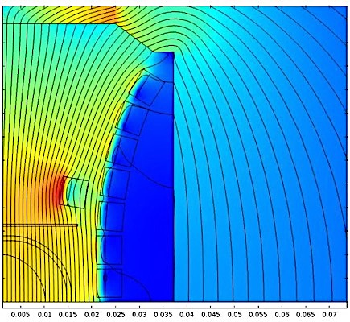
Future plans: build/test a progression of sub-scale model dipoles
 | TAMU4 | TAMU5 | TAMU6 | TAMU7
Bore field @ 4.2K short-sample | 2.7 | 8.3 | 10.9 | 18.3 | T
Cable current (windings in series) | 15.5 | 20 | 15.5 | 15.5 | kA
REBCO: #tapes/cable x #cables/shell x #shells | 5x16x1 |  | 25x 16 x 3 | 25x 16 x 3
Nb₃Sn CIC: #wires/CIC x #cables/layer x #layers |  | 17x 16 x 4 | 17x 16 x 4 | 17x 16 x 8
B_{max} in REBCO, CIC | 2.8 | 9.2 | 12.0 | 18.5, 11.8 | T
Sextupole @ full field, injection field |  | 44 | 46 | 27, 35 | units
Total conductor cost in 1m dipole | 16 | 31 | 249 | 310 | K$
TAMU4: Single-shell REBCO sub-winding, to be built by ARL.
TAMU5: 4-layer Nb₃Sn SuperCIC sub-winding, to be built by ATC
TAMU7: 8-layer Nb₃Sn outsert, to be built by TAMU and ATC.

Slide 27
Update summary
REBCO inserts offer great benefit for dipoles of 16-24 T.
REBCO is ruinously expensive, and the conventional design methodology of twisted cables to homogenize current distribution during ramping limits the current capacity to ~1/3 of what a REBCO tape can support when aligned with the field at conductor.
We are developing a conformal winding strategy that could preserve that full current capacity, and a structured cable design that could provide optimum Intertape resistance for current-sharing.
The strategy is related to the NI strategy that provides excellent stability in stack-of-pucks solenoids.
This is a work in progress – we are developing the 3-D magnetics to preserve the conformal geometry in the flared ends, and we are developing the multi-physics modeling of current sharing during ramping.

