Slide 1
CCT6 3D Periodic Model Results
Lucas Brouwer
7/2/2021

Slide 2
2D model properties
conductor bonded in channel (shared mesh)
change angle of outer layer to match pitch (more efficient)
12.2 T Lorentz forces (@ 11 kA)
plane stress
conductor E = 25 Gpa
shims are full 360 deg with 0.2 friction sliding
rigid boundary is applied by radial displacement condition on an aluminum shell with E = 350 GPa
Load steps
cooldown + bring in rigid boundary radially
Lorentz forces

Slide 3
3D model properties
conductor bonded in channel (shared mesh)
change angle of outer layer to match pitch (more efficient)
~12.2 T Lorentz forces (@ 11 kA)
conductor E = 25 Gpa
shims are full 360 deg with 0.2 friction sliding
rigid boundary is applied by radial displacement condition on an aluminum shell with E = 350 Gpa
dz fit for each “layer” using iterative process (sum fz = 0)
Load steps
cooldown + bring in rigid boundary radially
Lorentz forces

Slide 4
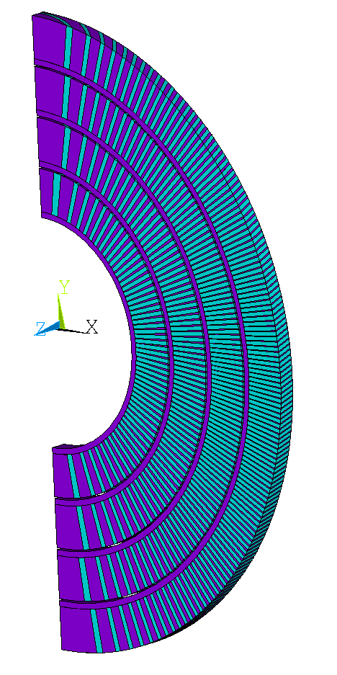
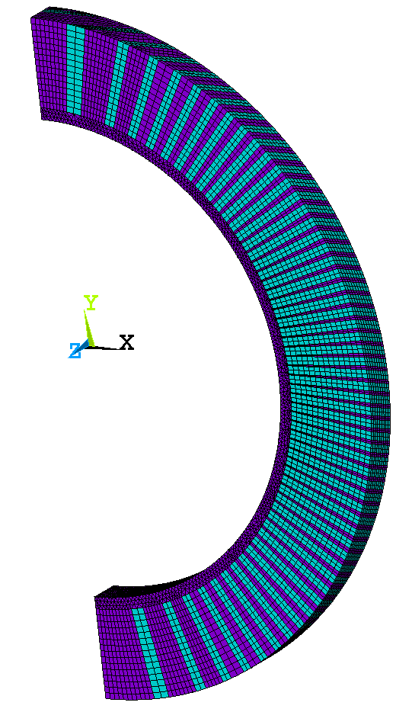
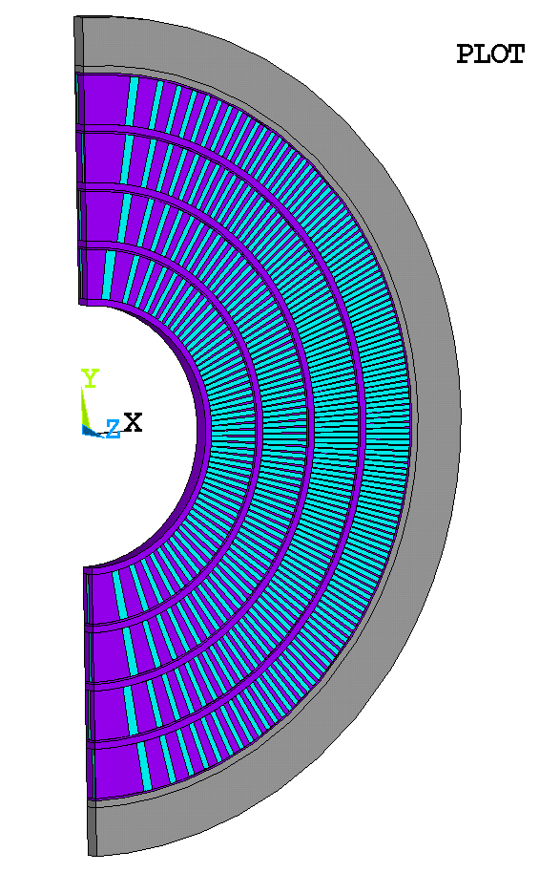

Slide 5
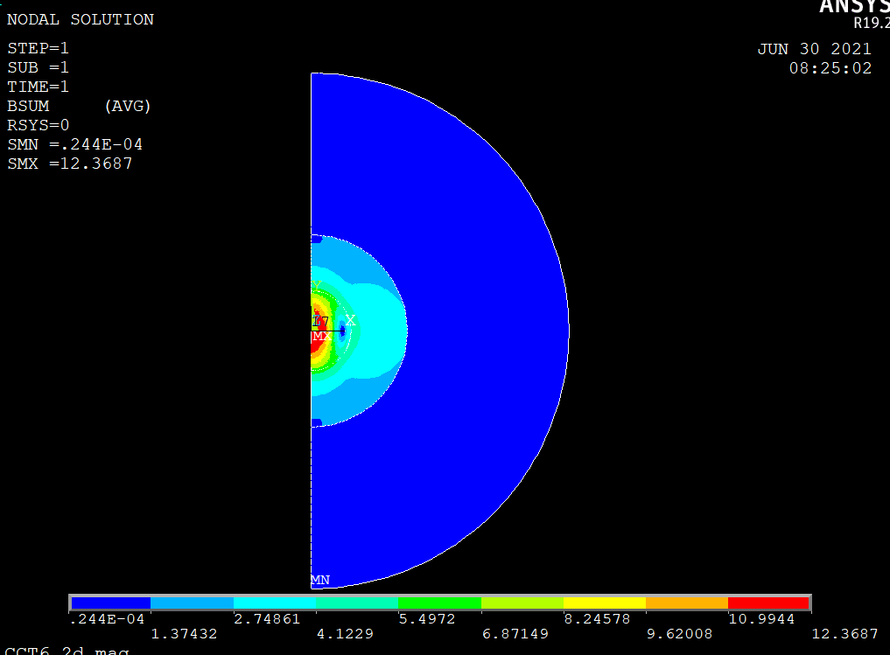
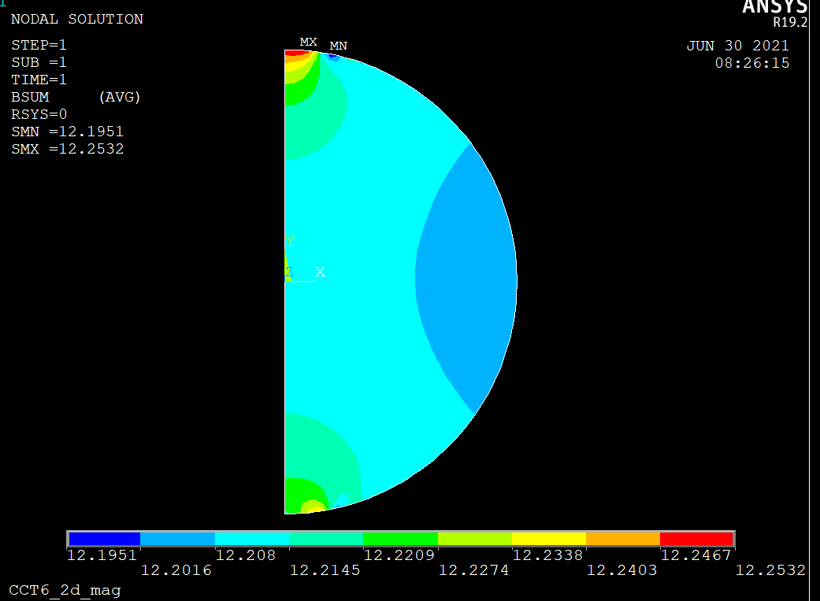
ANSYS 2D Model at 11 kA gives ~12.2 T

Slide 6
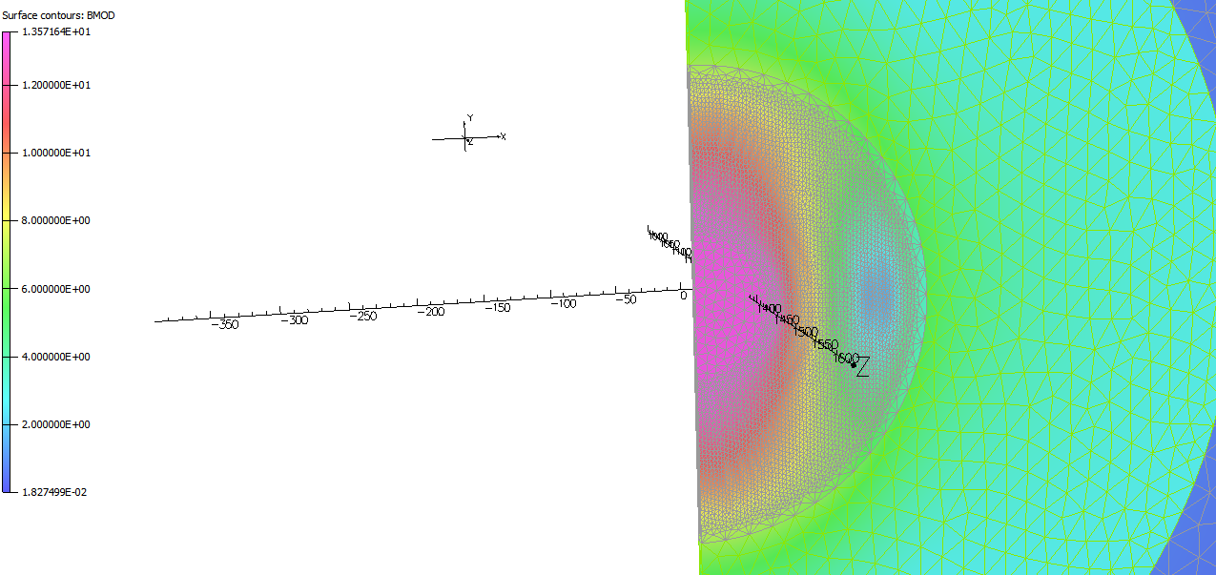
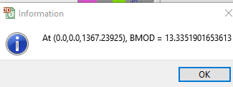
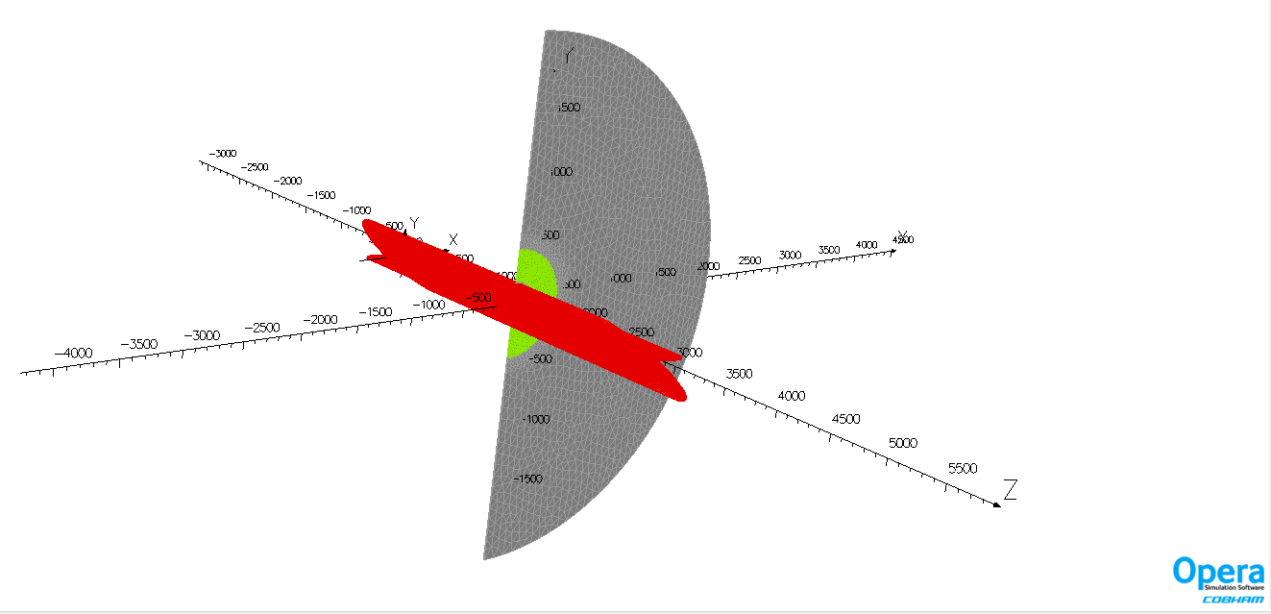
Opera 3D Model at 12 kA gives ~13.4 T
Scale forces from 12 kA to 11 kA (~12.3 T)
Fscale,11*11/(12*12)

Slide 7
Compare the net force between 2D and 3D
 | Net Force in kN |  |  |  |  | Net Force in MN/m
 | layer1 | layer2 | layer3 | layer4 |  | layer1 | layer2 | layer3 | layer4 | total
x-3D-QI | 25.8 | 26.1 | 19.77 | 8.62 |  | 3.066398218 | 3.102054 | 2.349716774 | 1.02451 | 9.54268
y-3D-QI | -2.5 | -4.78 | -12.78 | -16.8 |  | -0.29713161 | -0.56812 | -1.518936792 | -1.99672 | -4.3809
z-3D-QI | 9.7 | -11.94 | 13 | -13.1 |  | 1.152870648 | -1.4191 | 1.545084373 | -1.55697 | -0.2781
x-2D-QI |  |  |  |  |  | 3.2 | 3 | 2.48 | 0.85 | 9.53
y-2D-QI |  |  |  |  |  | -0.22 | -0.67 | -1.38 | -2.16 | -4.43
z-2D-QI |  |  |  |  |  | 0 | 0 | 0 | 0 | 0
Total is almost exactly the same in x,y

Slide 8
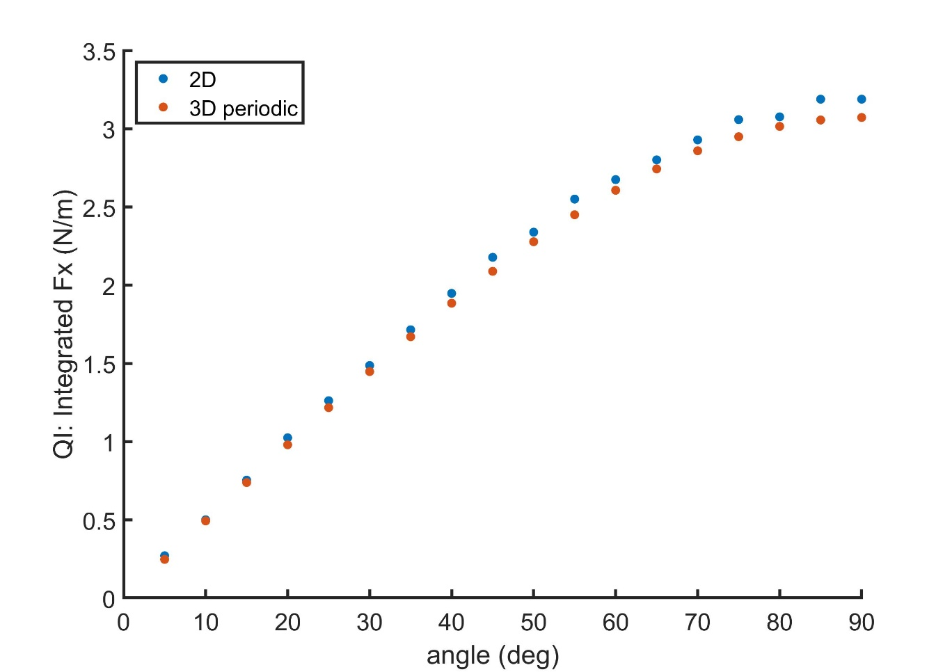
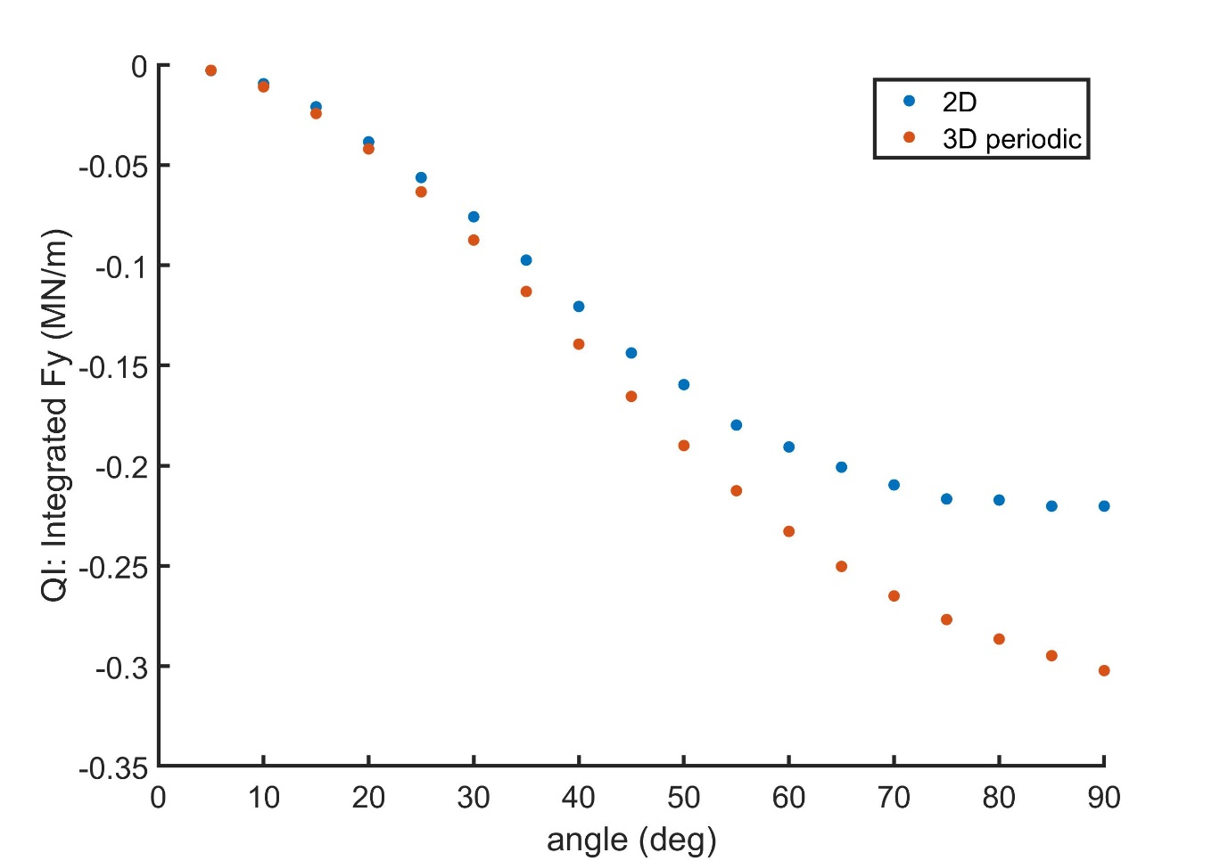
Compare net force vs. angle
Just use layer1 as an example

Slide 9
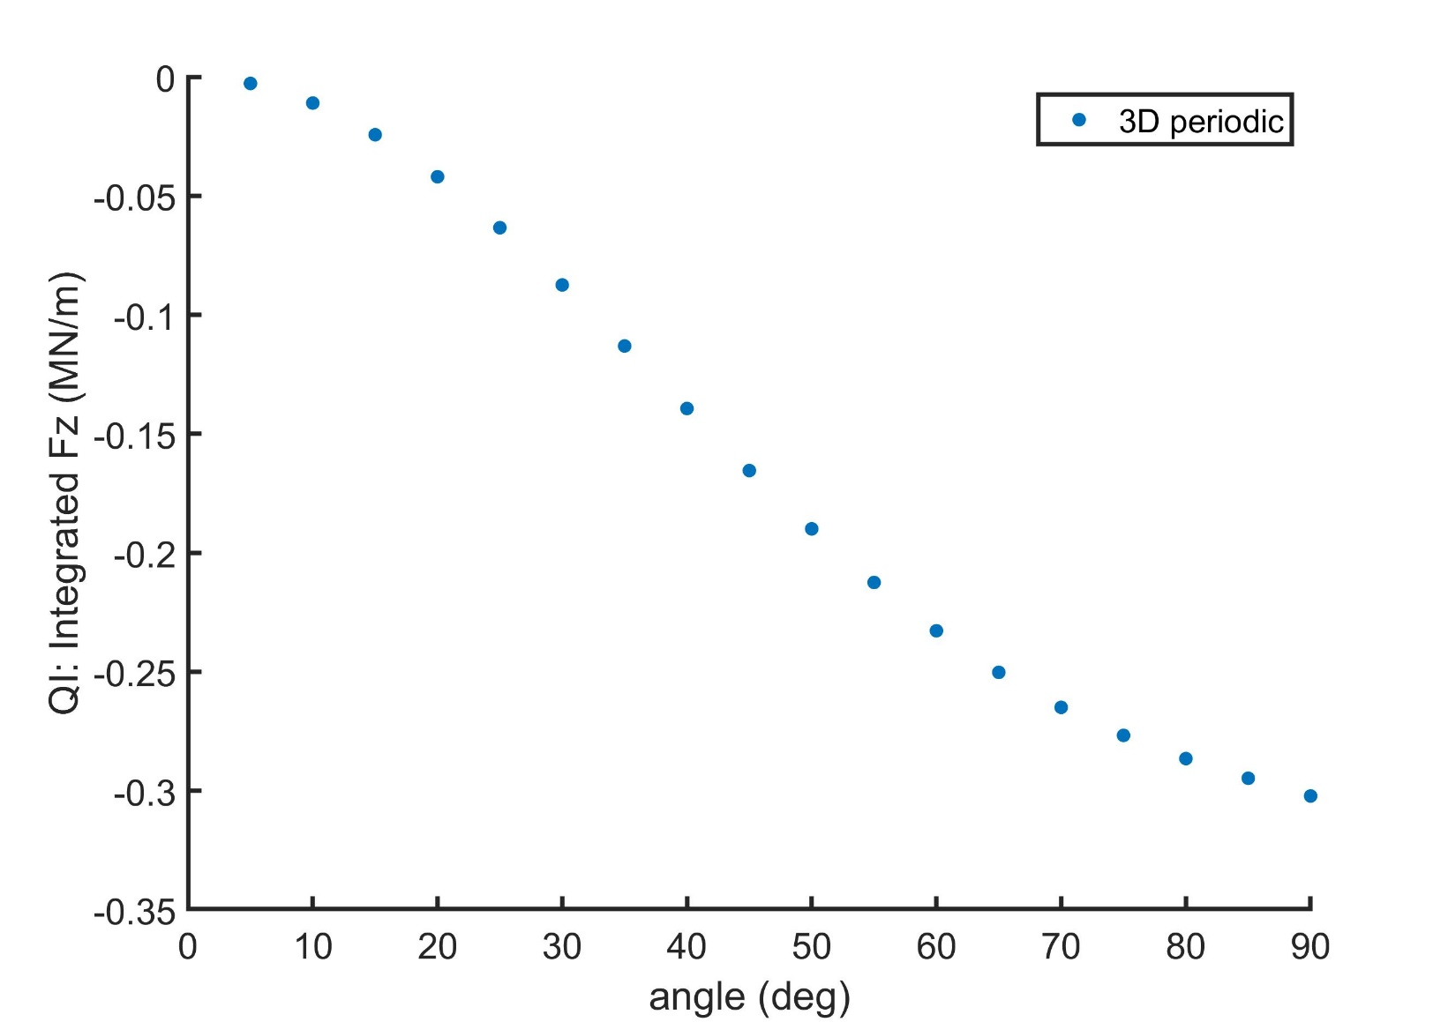
Compare net force vs. angle
Just use layer1 as an example

Slide 10
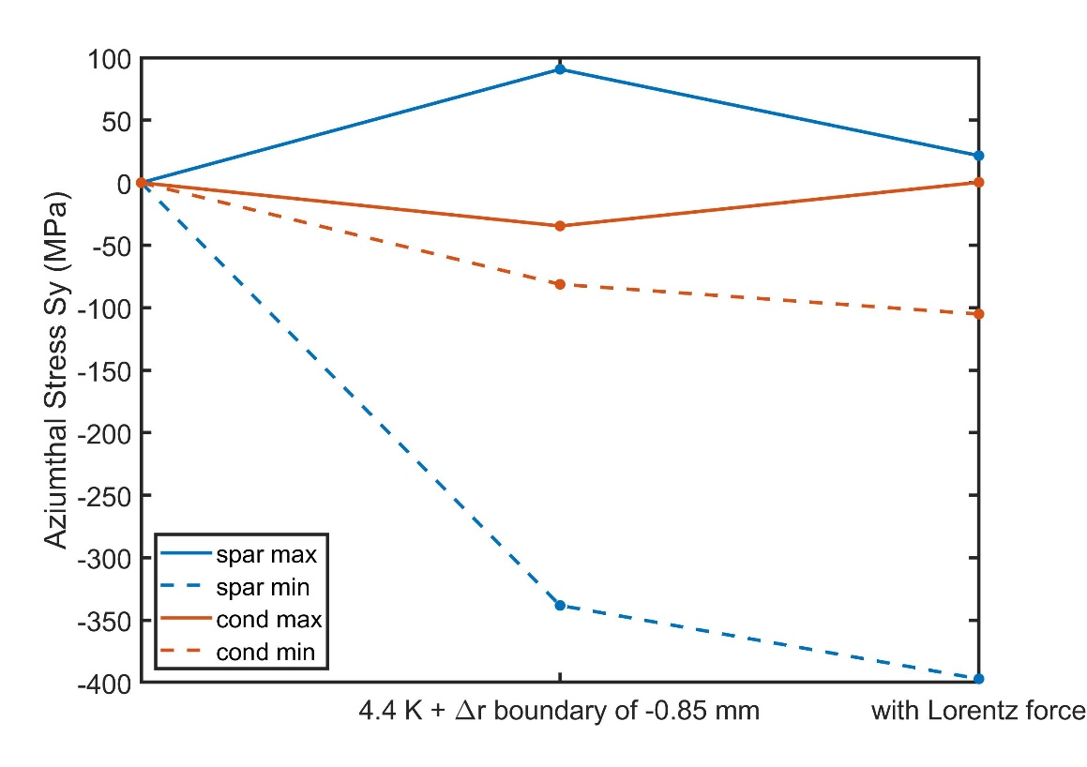
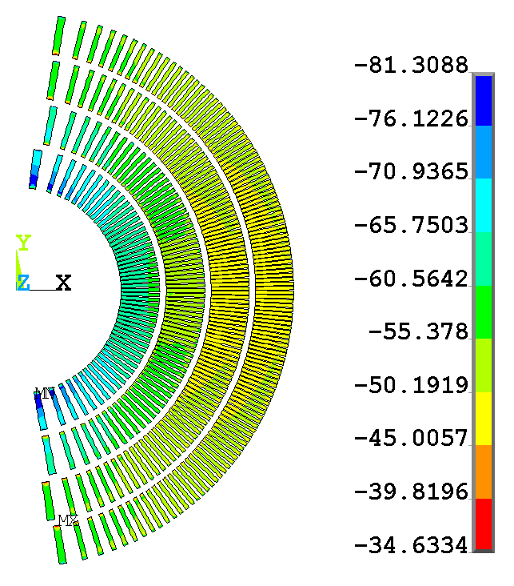
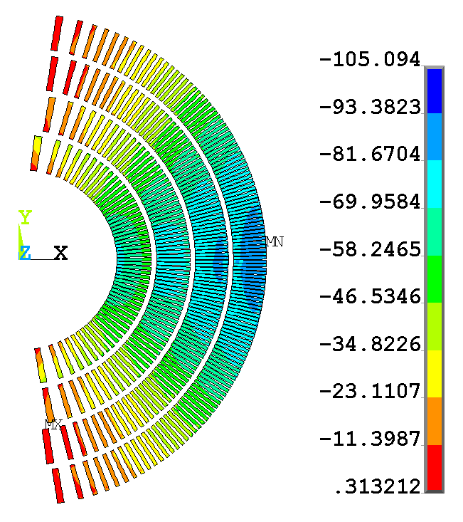
Bring in outer boundary by -0.85 mm to keep entire coil in azimuthal tension after cooldown + Lorentz force

Slide 11
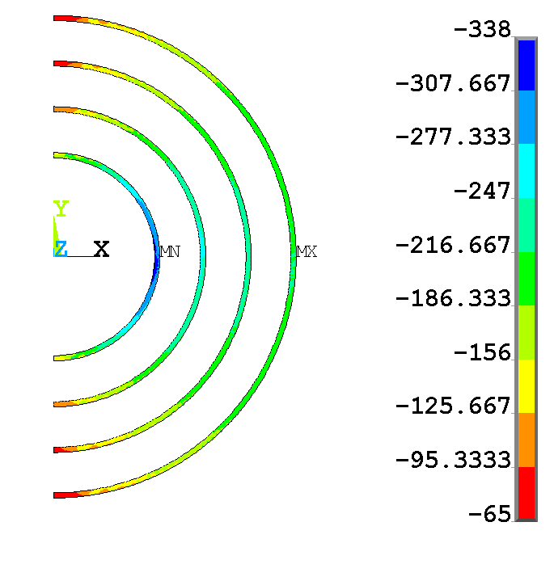
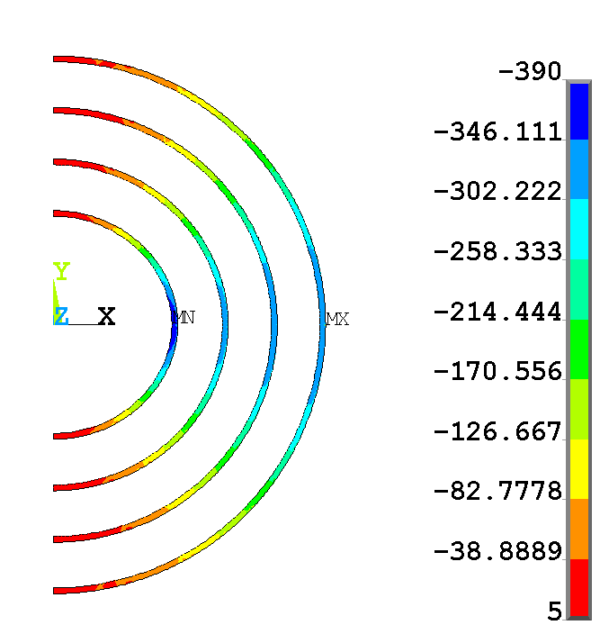
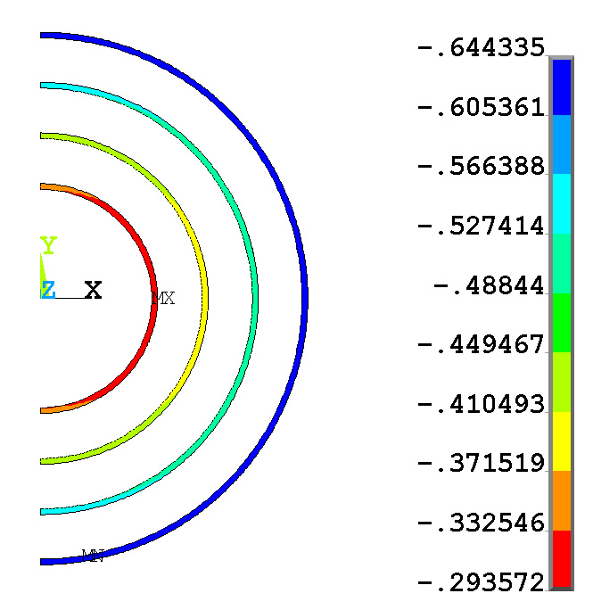
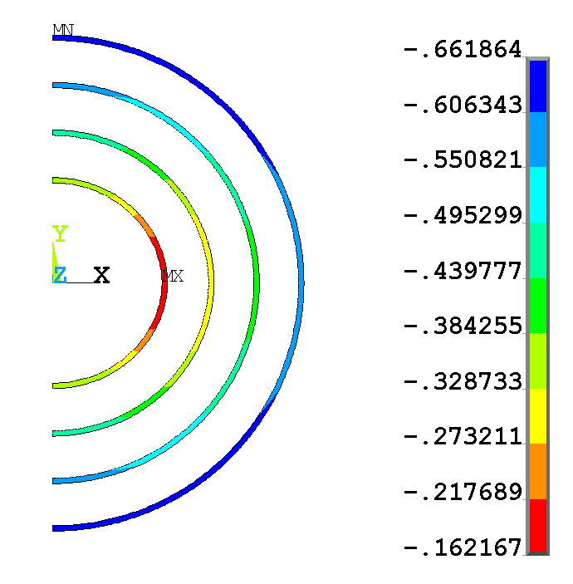
Sy (MPa)
Sy (MPa)
2D Spar Stress / Displacement
1st column is cooldown+radial boundary
2nd column is with Lorentz forces
ux (mm)
ux (mm)

Slide 12
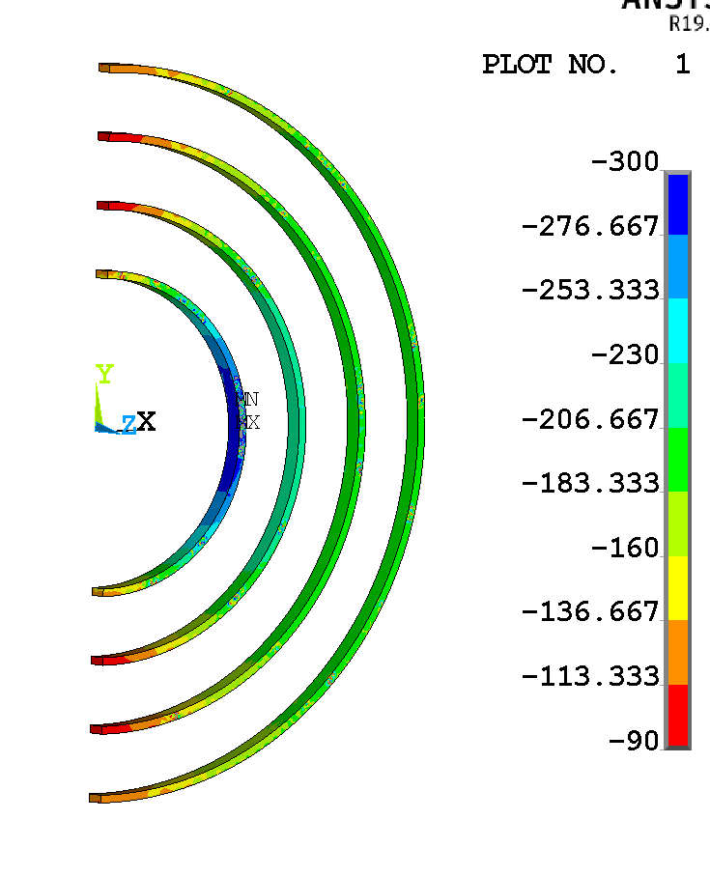
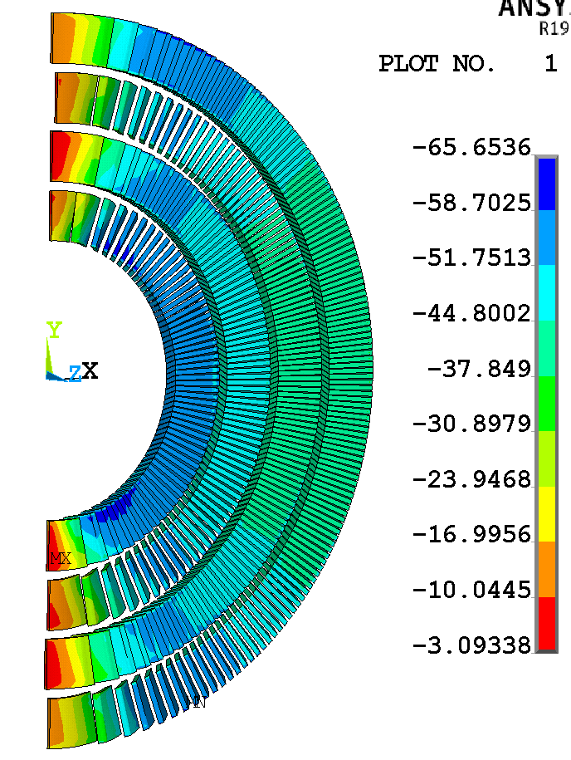
Cooldown + boundary Sy (MPa)

Slide 13
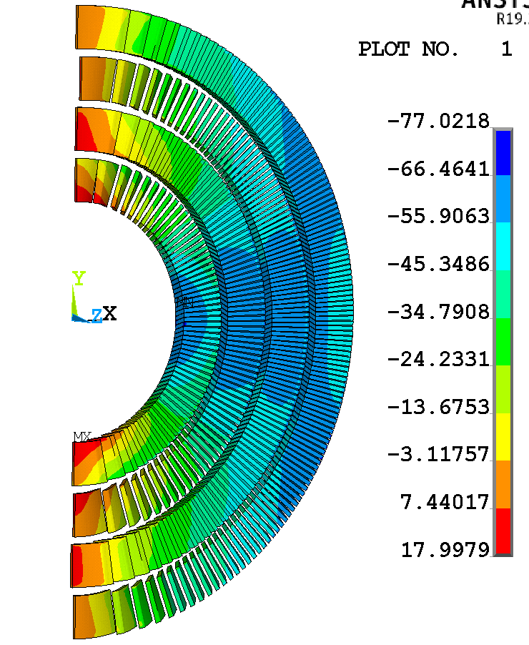
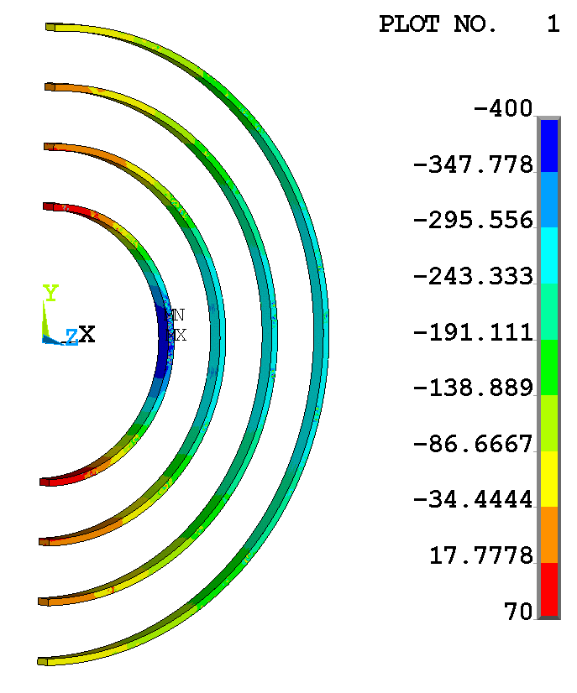
With Lorentz forces Sy (MPa)

Slide 14
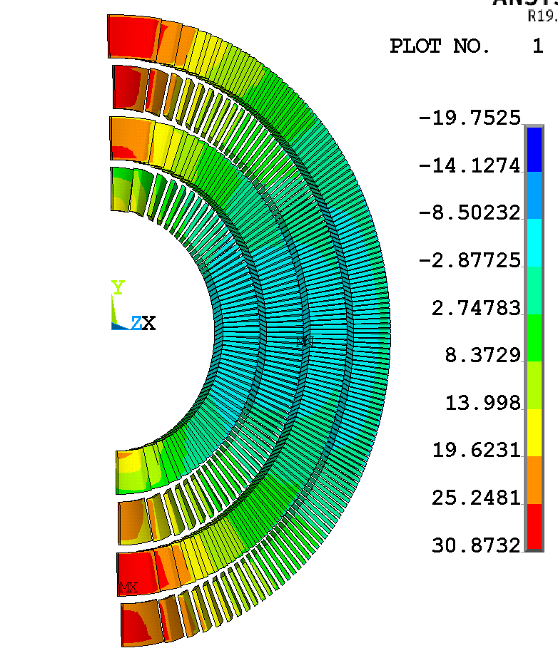
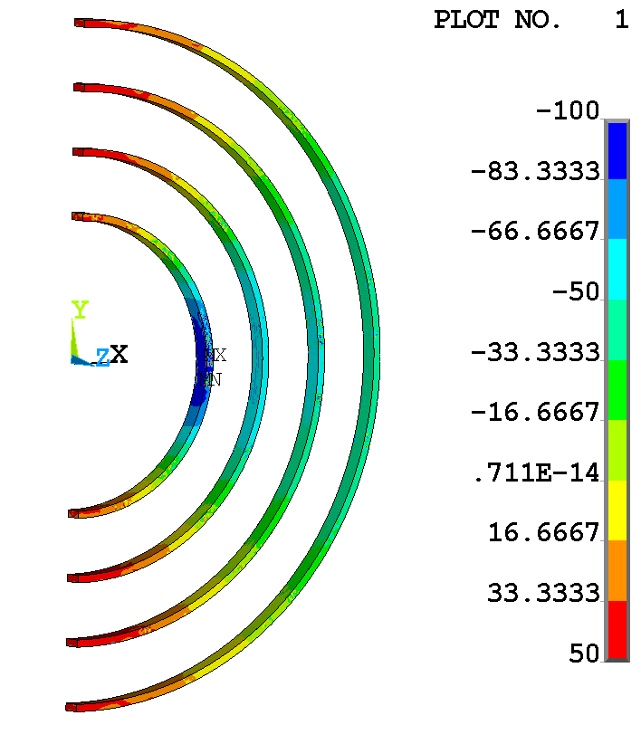
With Lorentz forces Sz (MPa)

Slide 15
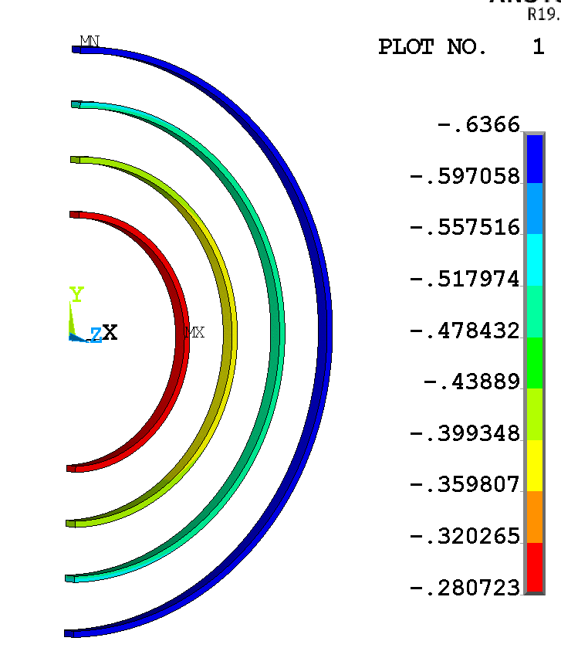
Cooldown + boundary - ux (mm)
2D
3D

Slide 16
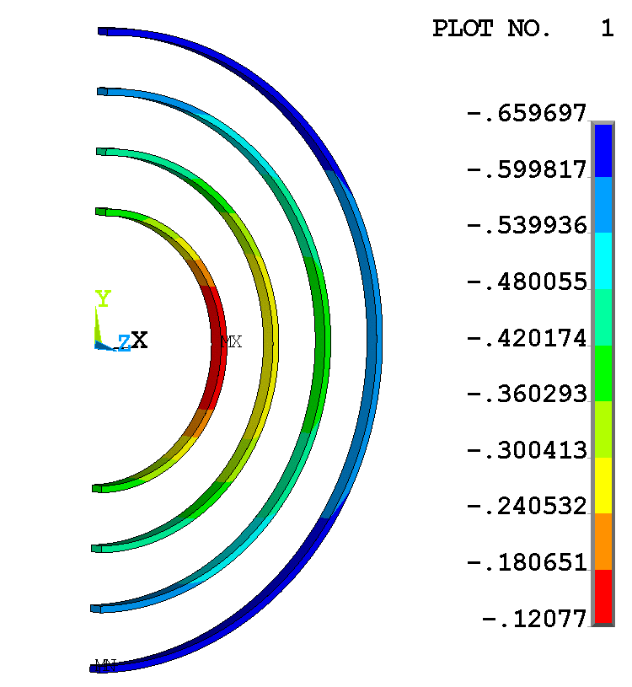
With Lorentz forces - ux (mm)
2D
3D

Slide 17
Cooldown + boundary - Sy (MPa)
3D
2D

Slide 18
With Lorentz forces - Sy (MPa)
3D
2D

Slide 19
Cooldown + boundary - Sy (MPa)
3D
2D

Slide 20
With Lorentz forces - Sy (MPa)
2D
3D

Slide 21
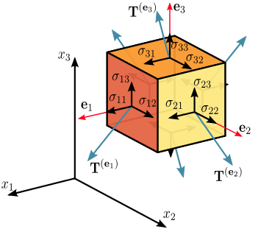
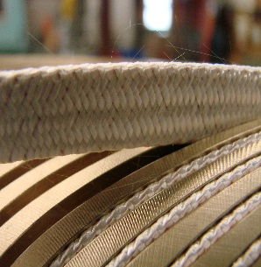
Local cable frame
y
x: tangent (along cable)
y: radial (along broad face)
z: bi-normal (along thin edge)
x
Thin Face (y-const)
Syz
Syx
Broad Face (z-const)
Szy
21
Szx

Slide 22
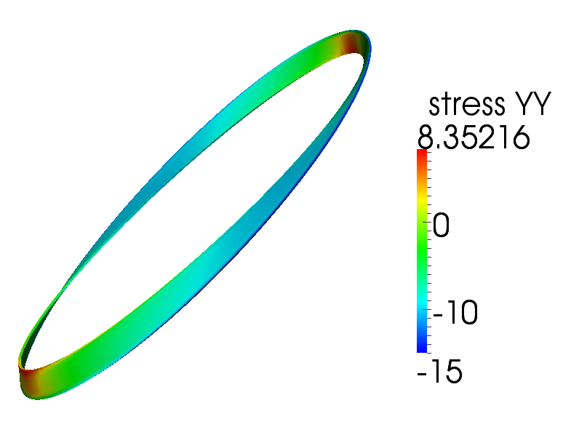
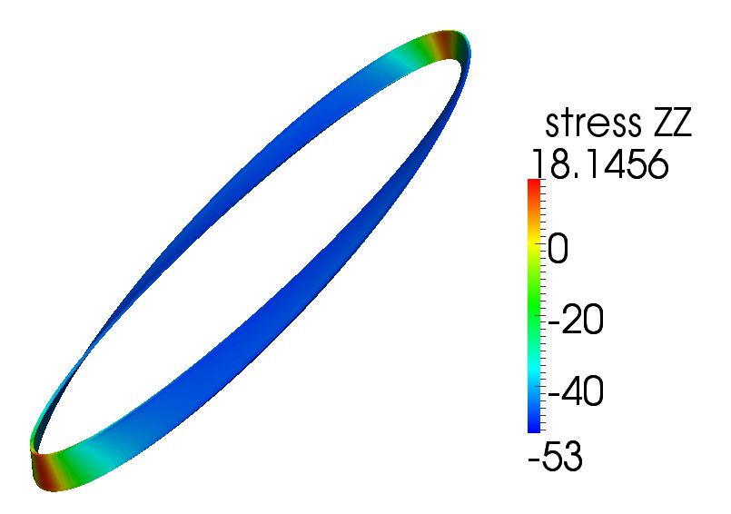
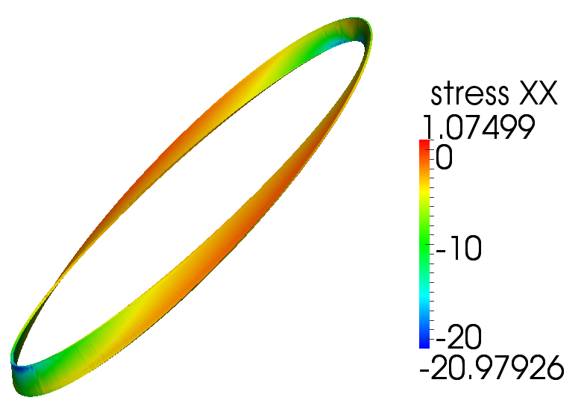
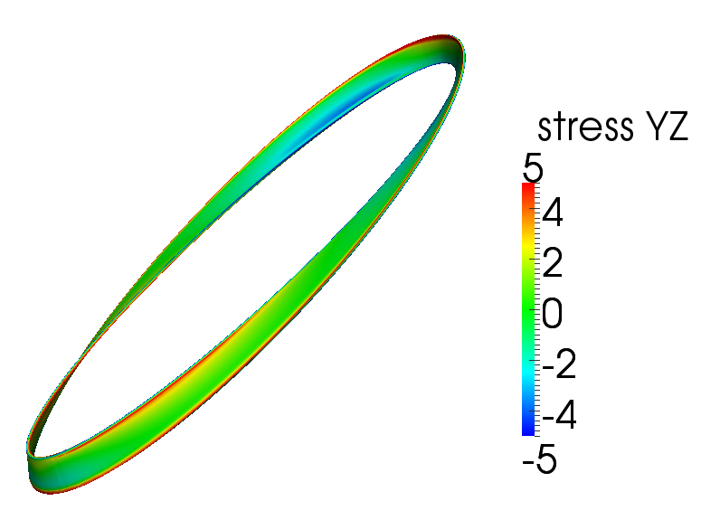
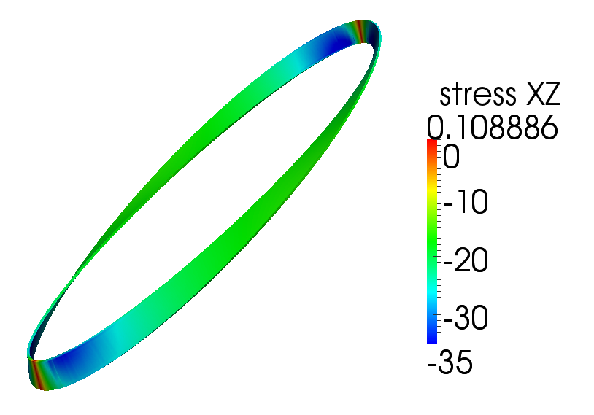
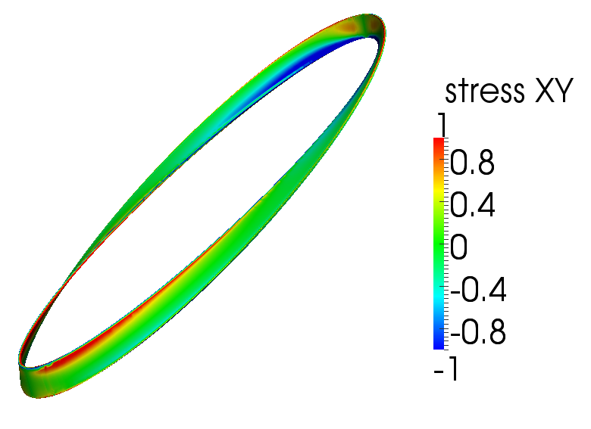
Initial stress state (cooldown with boundary)
x: tangent (along cable)
y: radial (along broad face)
z: bi-normal (along thin edge)
results are reflected to make it easier to view ID/OD

Slide 23
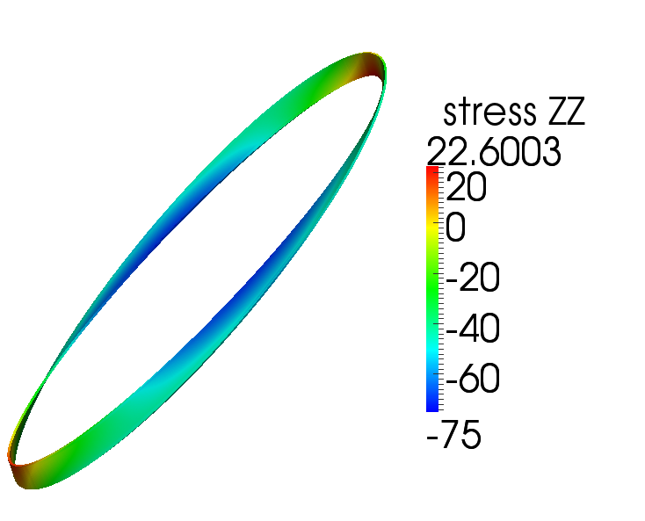
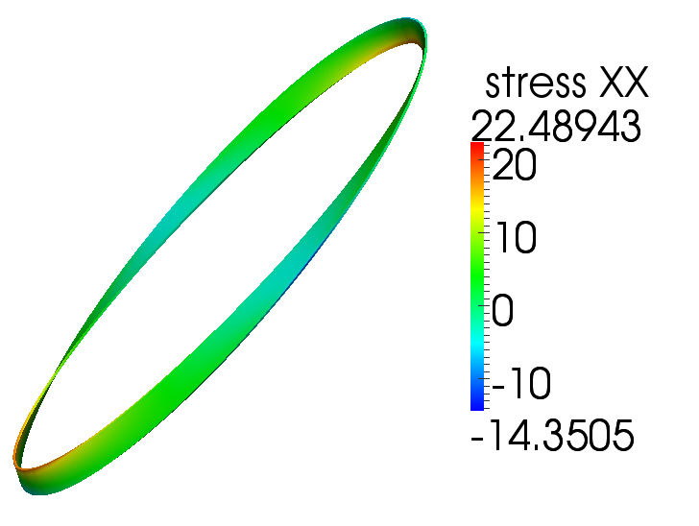
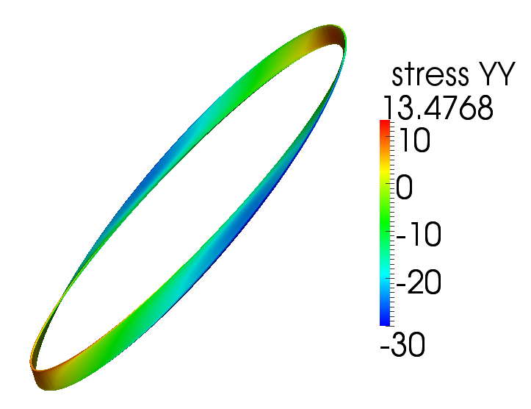
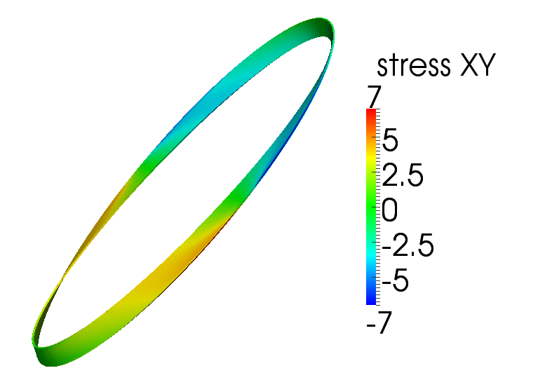
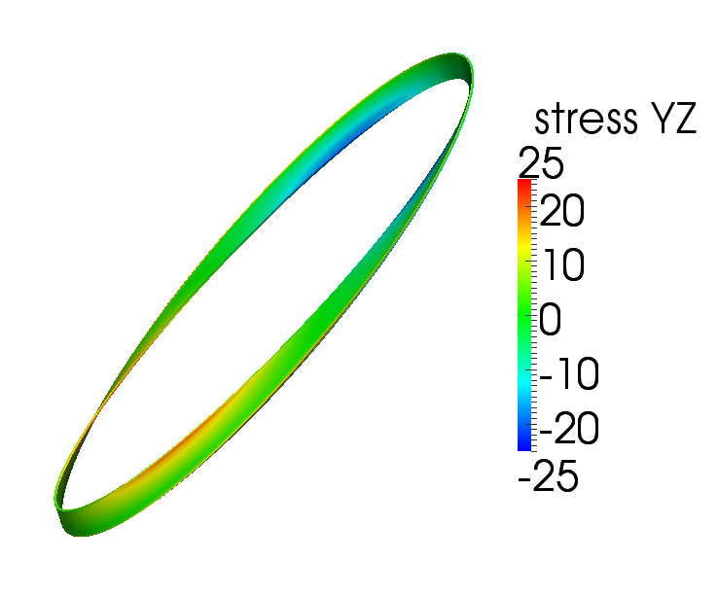
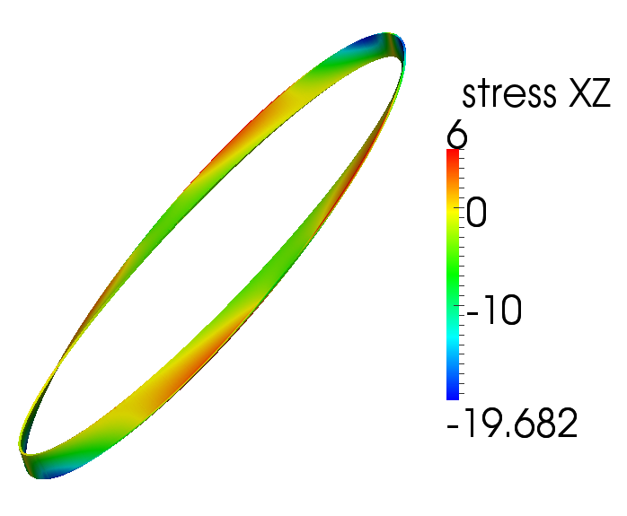
Final stress state (cooldown + Lorentz forces)
x: tangent (along cable)
y: radial (along broad face)
z: bi-normal (along thin edge)
results are reflected to make it easier to view ID/OD

Slide 24
Cooldown
Operation

Slide 25
Cooldown
Operation

Slide 26
Cooldown
Operation

Slide 27
Cooldown
Operation

Slide 28
Cooldown
Operation

Slide 29
Cooldown
Operation

Slide 30
Backup / more details

