Slide 1
Update on Costheta cross section
V. Marinozzi
07/13/2021

Slide 2
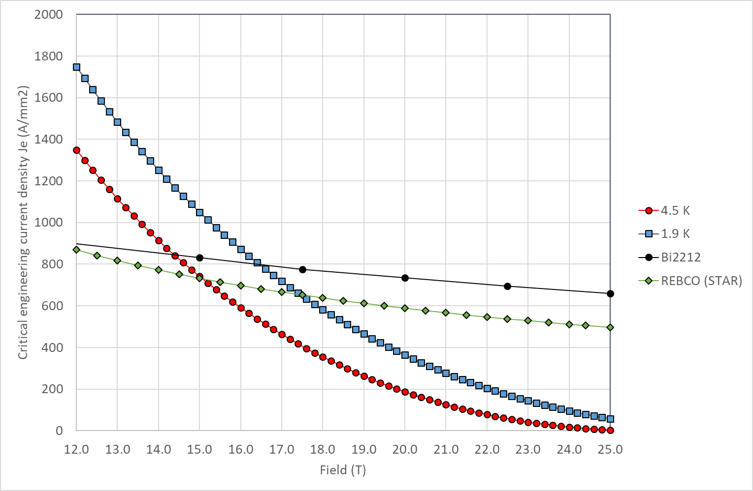
Critical current
Still using linear approximation in the peak field zone
Jc in SC obtained by scaling Jc engineering from Paolo slides
J_{c} for Nb₃Sn: 1928 A/mm² @16 T, 1.9 K
J_{c} for Bi2212: 2944 A/mm² @20 T, 1.9 K

Slide 3
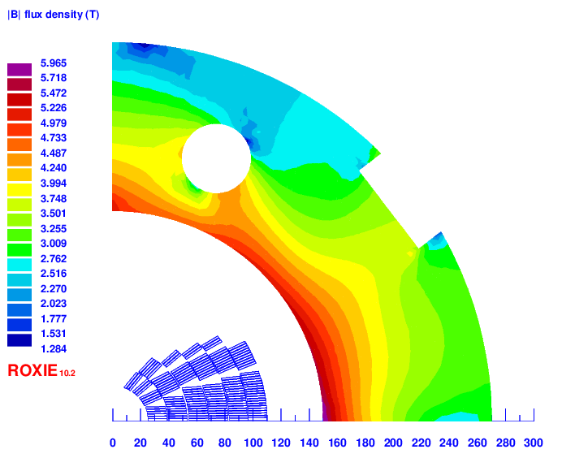
Iron yoke

Slide 4
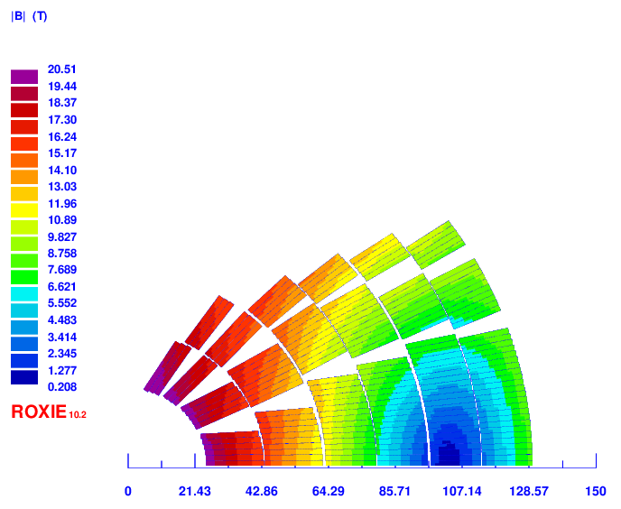
Baseline classic costheta (size optimized): v9f
4 layer HTS, 2 layer LTS
Strands: 0.8 mm, 40 – 35 – 30
Cable width: 18.35 – 16.06 – 13.3 mm
Stabilizer/Superconductor: 3 – 3 – 1
Coil width: 100 mm
Current: 11120
Peak field: 20.51 – 16.02 – 12.69 T
Margin: 83.4 – 84.1 – 75.5 %
J_{cu} on LTS: 1229 A/mm²
Peak azimuthal Lorentz force: 156/145 MPa (LTS/HTS)

Slide 5
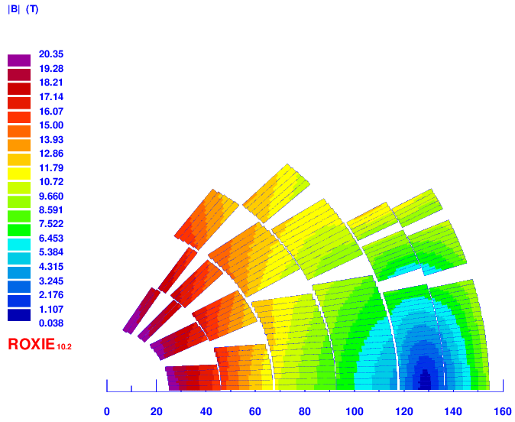
Baseline classic costheta (HTS optimized): v11d
2 layer HTS, 4 layer LTS
Strands: 0.9/1.1/0.8 mm, 40 – 40– 40
Cable width: 20.65 –24.38 – 17.73 mm
Stabilizer/Superconductor: 3 – 1 – 1.5
Coil width: 129 mm
Current: 13610
Peak field: 20.35 – 15.96 – 11.96 T
Margin: 81.5 – 84.4 – 78.0 %
J_{cu} on LTS: 1128 A/mm²
Peak azimuthal Lorentz force: 105/152 MPa (LTS/HTS)

Slide 6
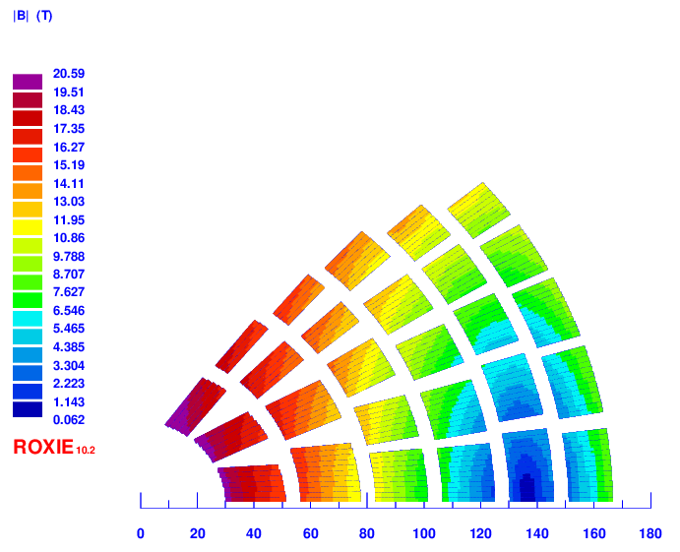
SMCT-like with 5 mm rings: v12e
4 layer HTS, 2 layer LTS
Strands: 0.8 mm, 46 – 40 – 35
Cable width: 21.1 – 18.35– 15.51 mm
Stabilizer/Superconductor: 3 – 3 – 1.2
Coil width: 136 mm
Current: 11900 A
Peak field: 20.59 – 16.24 – 13.6 T
Margin: 79.9 – 80.7 – 83.1 %
J_{cu} on LTS: 1240 A/mm²

Slide 7
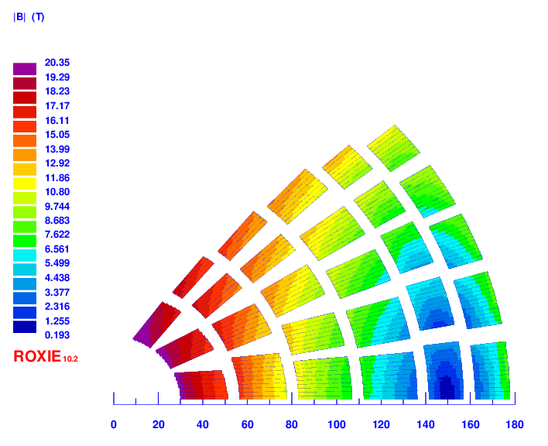
SMCT-like with 5 mm rings: v13c
2 layer HTS, 4 layer LTS
Strands: 0.8 mm, 46 – 54 – 35
Cable width: 21.1 – 23.9– 15.51 mm
Stabilizer/Superconductor: 3 – 1 – 1.2
Coil width: 148 mm
Current: 11900 A
Peak field: 20.36 – 15.7 – 13.06 T
Margin: 75.8 – 85.3 – 78.8 %
J_{cu} on LTS: 1240 A/mm²

Slide 8
Next steps
Iron: 25 mm from last turn, 250 mm thick
Field quality
Quench protection studies
Common coil, hear from Ramesh

Slide 9
Cross sections

Slide 10
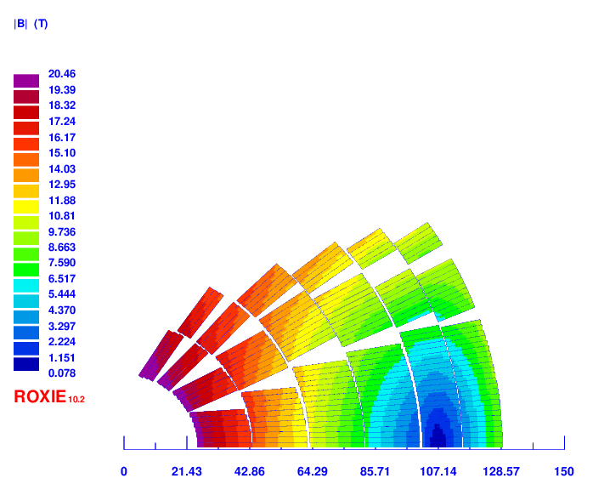
v2

Slide 11
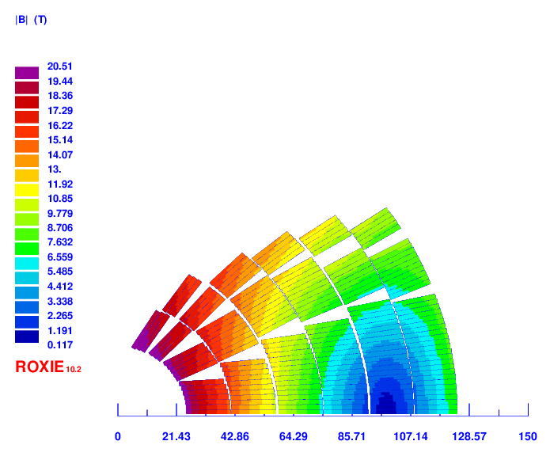
v3

Slide 12
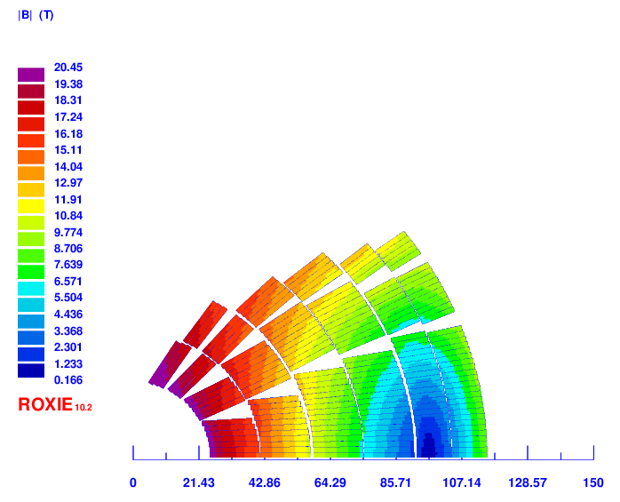
V4

Slide 13
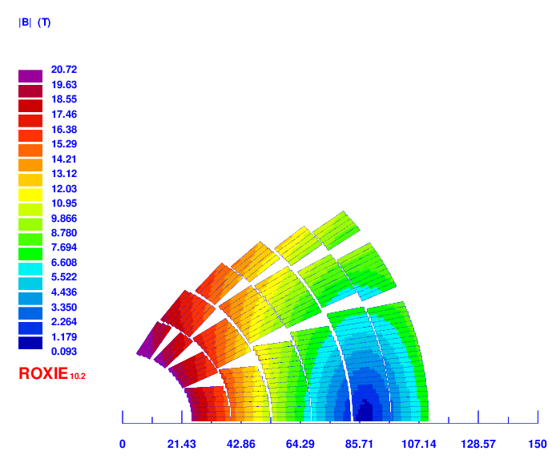
v5

Slide 14
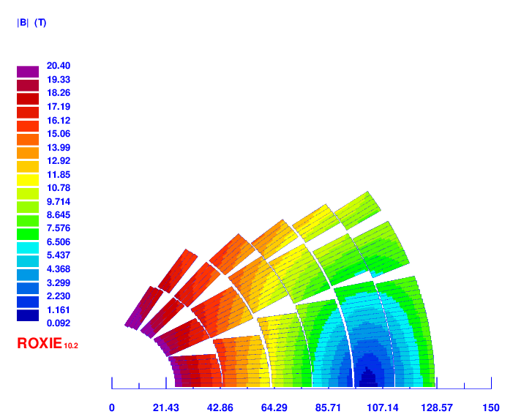
v6

Slide 15
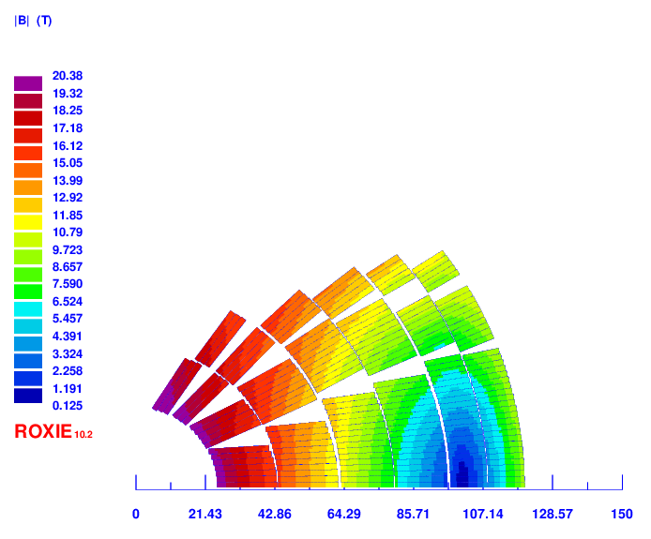
v8

Slide 16

v9

Slide 17
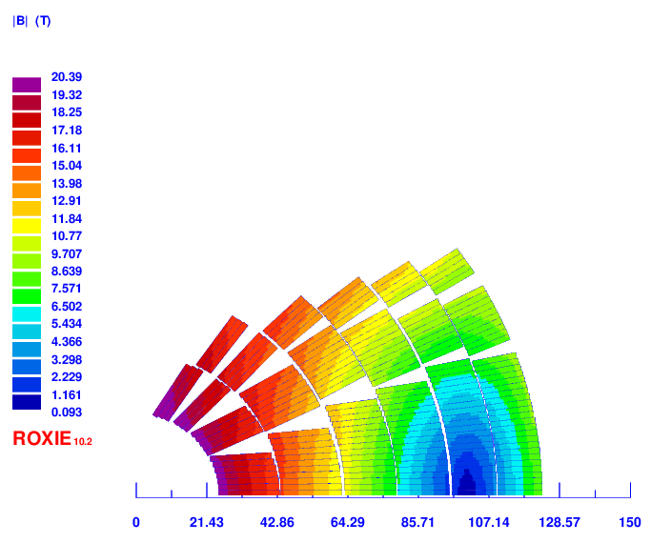
v10

Slide 18
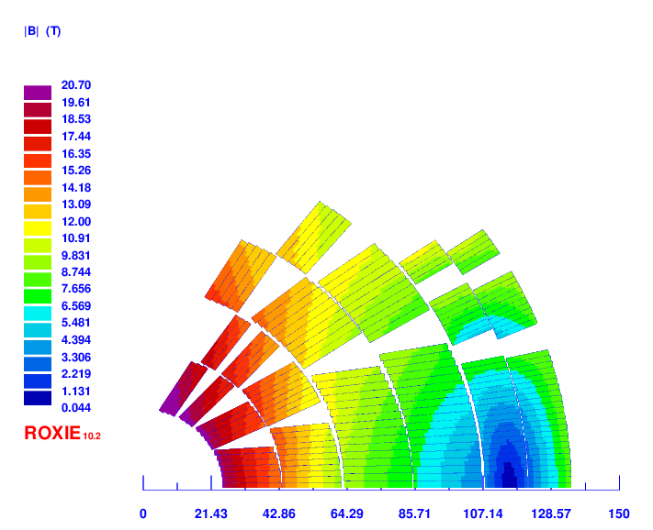
v11

