Slide 1
Status Report on the CORC Coil Program
Ramesh Gupta, BNL
September 1, 2021

Slide 2
Contents
Status of the preparation of MDP test for “in-field quench studies of a long CORC cable” in the background field of common coil dipole
A possible opportunity of more complete HTS coil studies thanks to the opening offered by the upcoming USMDP PSI test

Slide 3
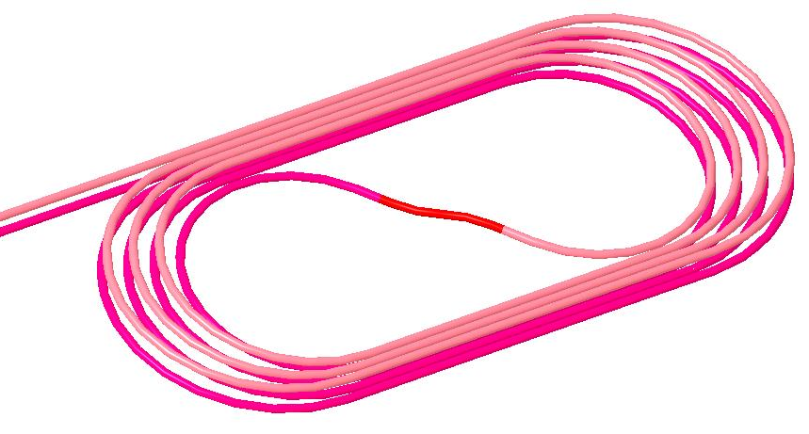
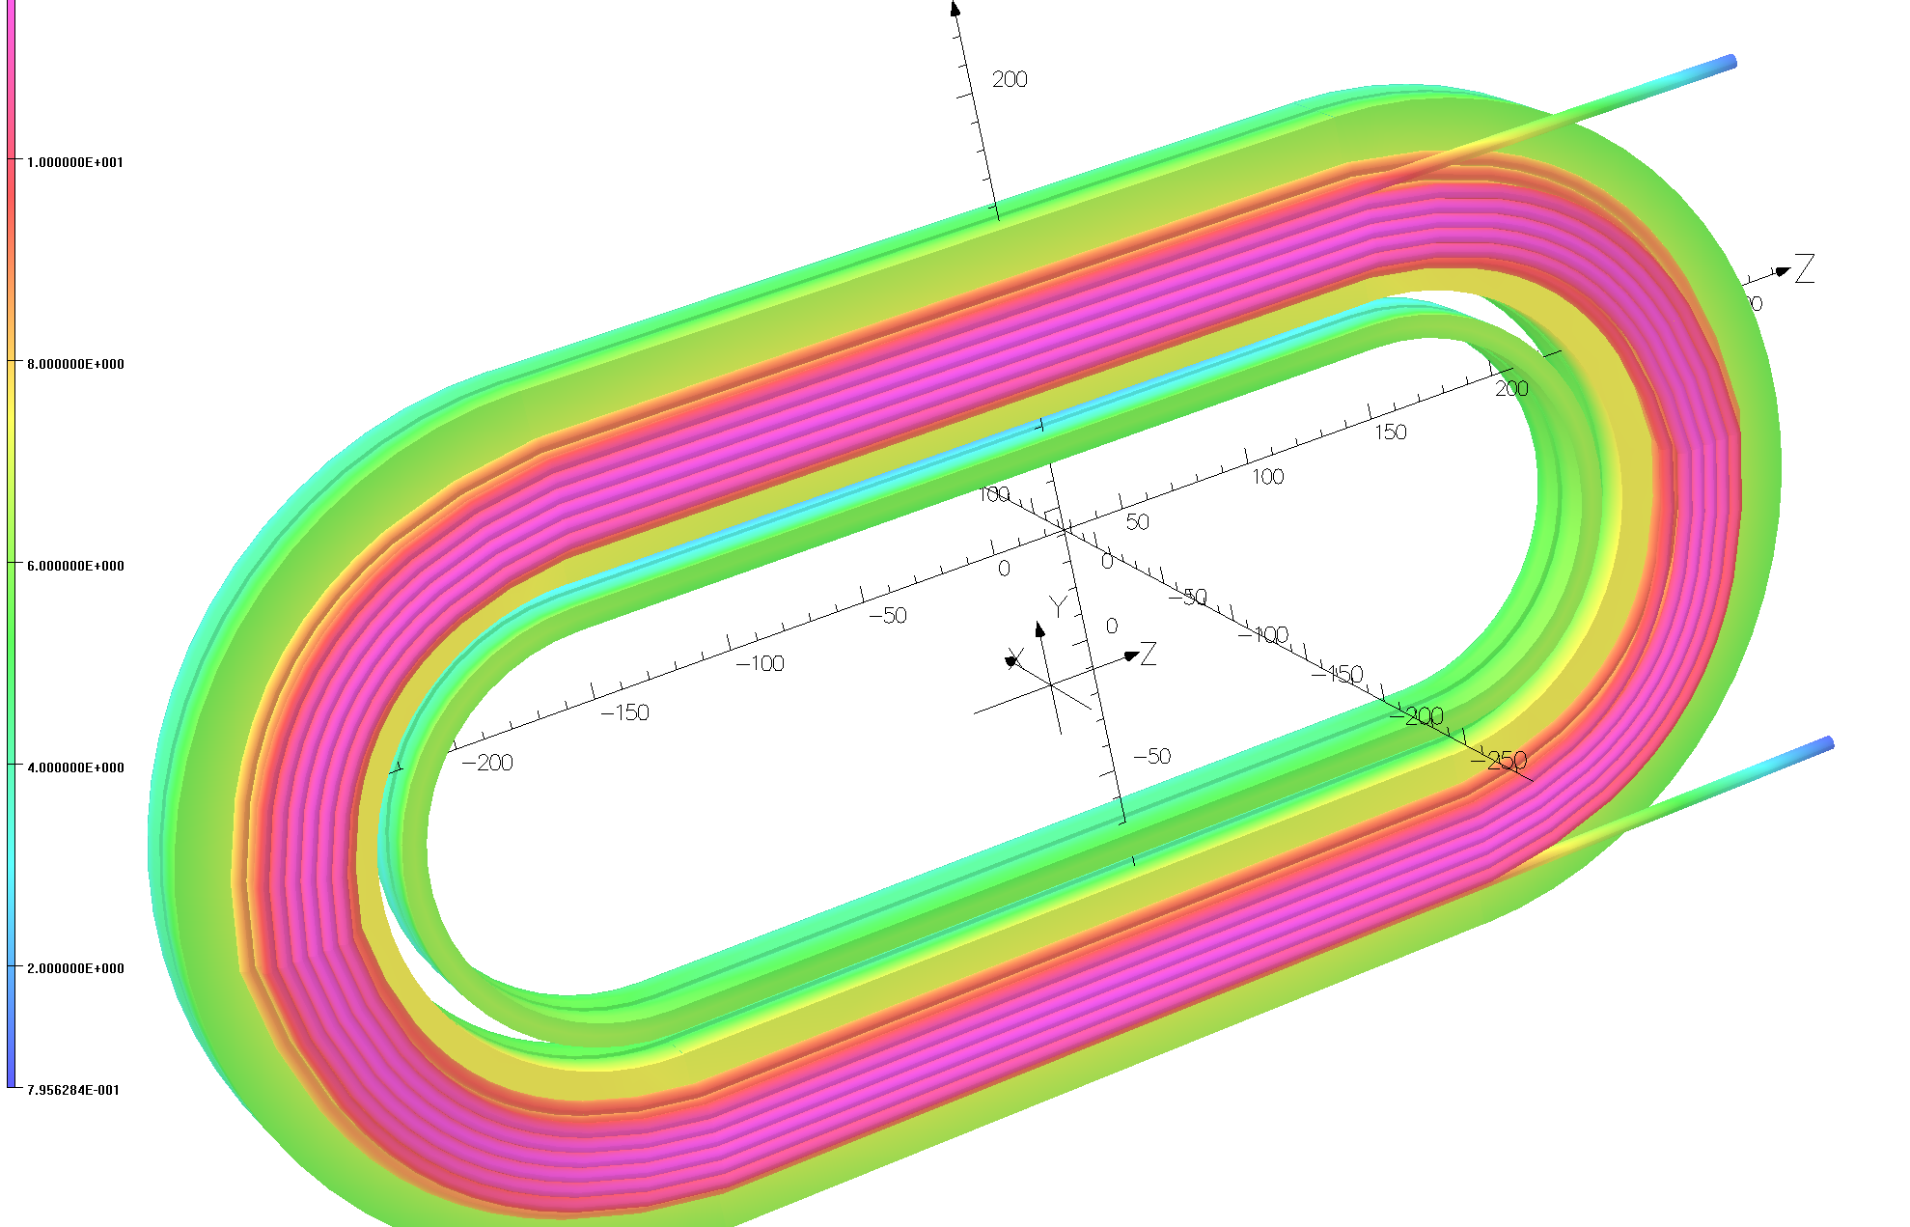
High Level Goals/Plans/Tasks
Two Related R&D programs. Magnet Design Program (MDP) and Small Business Technology Transfer (STTR)
MDP: “In-field quench studies of a long CORC cable” in the background field of common coil dipole via one 8-turn HTS coil (S-turn in to flip the polarity)
STTR: “Demonstration of a high field HTS/LTS hybrid dipole” with two sets of double pancake coils made with 6+8 turns (total 28 turns) of CORC cable
MDP:
Quench studies & technology demo
(10.7 T with
10 T from LTS)
STTR:
High field Demo
(13-14 T with
10 T from LTS)

Slide 4
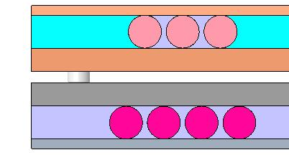
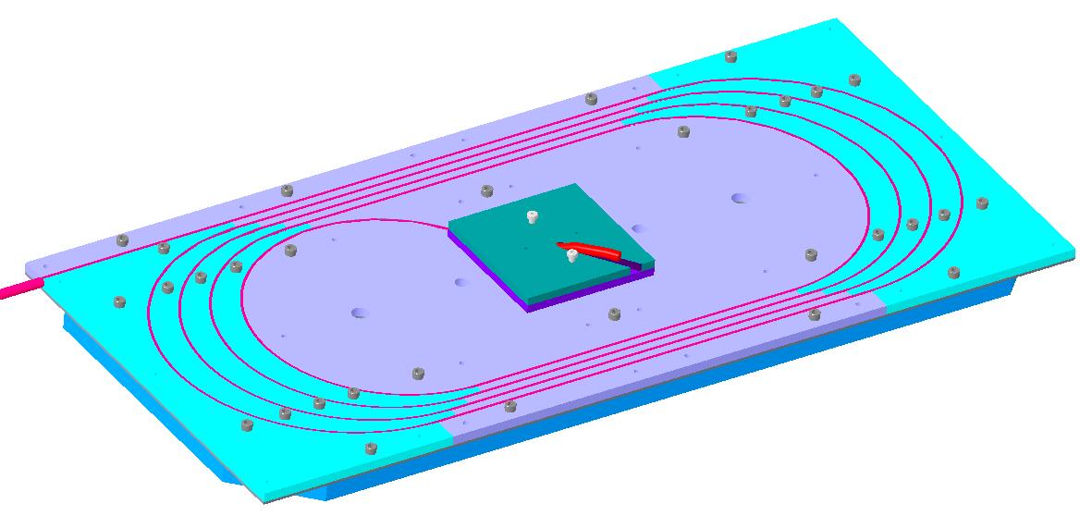
Status of MDP CORC Program (1)
Design work complete a while ago
All parts obtained several months ago
Parts were shipped from BNL to ACT for them
view them
make a practice cable
do initial winding test
Provide feedback
ACT recommended tighter tolerances
Some parts sent back to vendor
Corrected parts received and sent to ACT
New parts meet ACT expectations

Slide 5
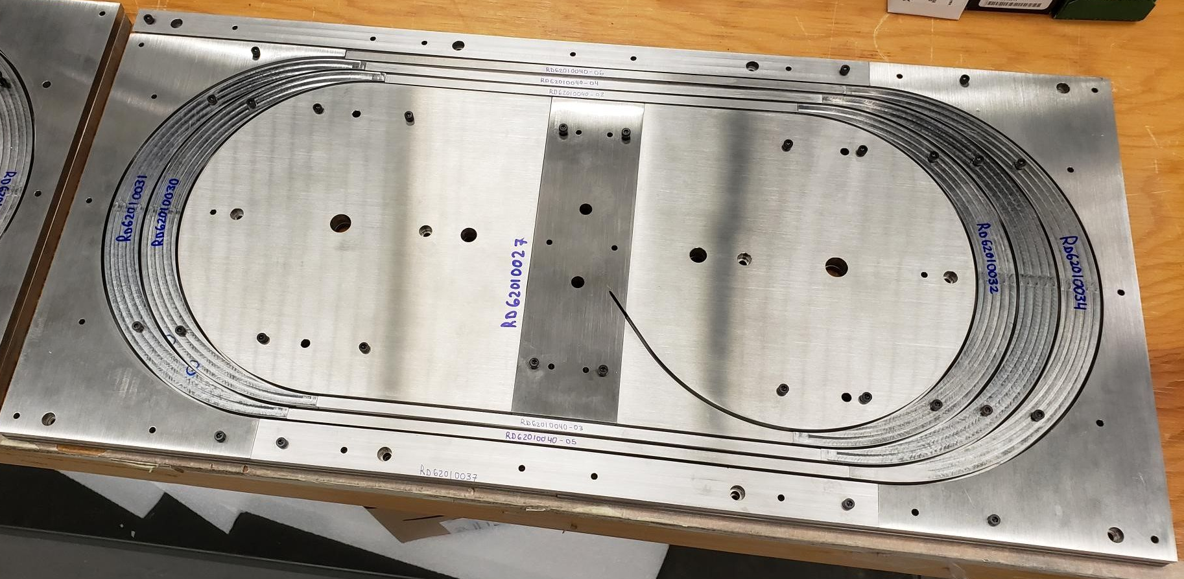
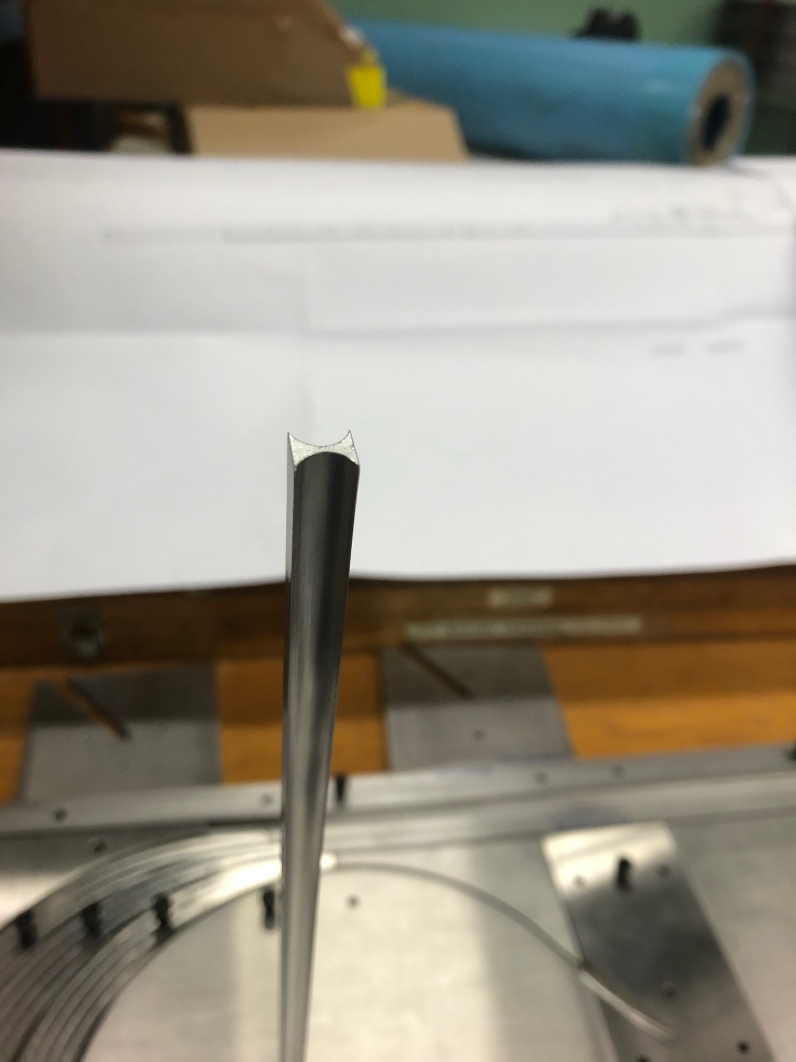
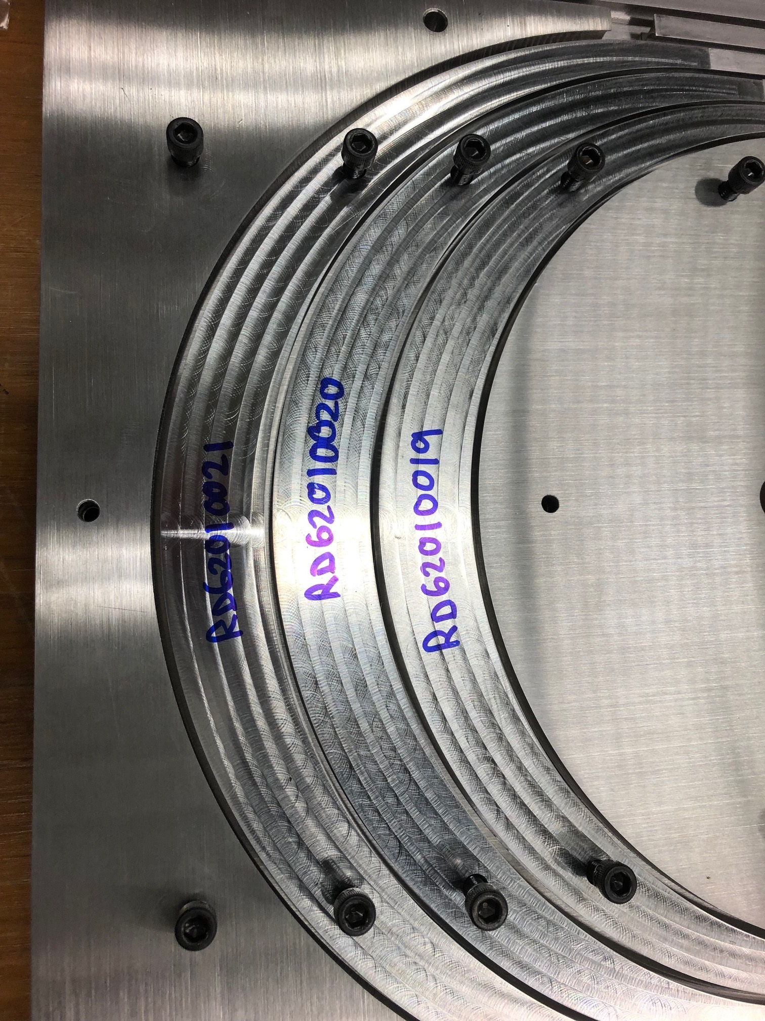
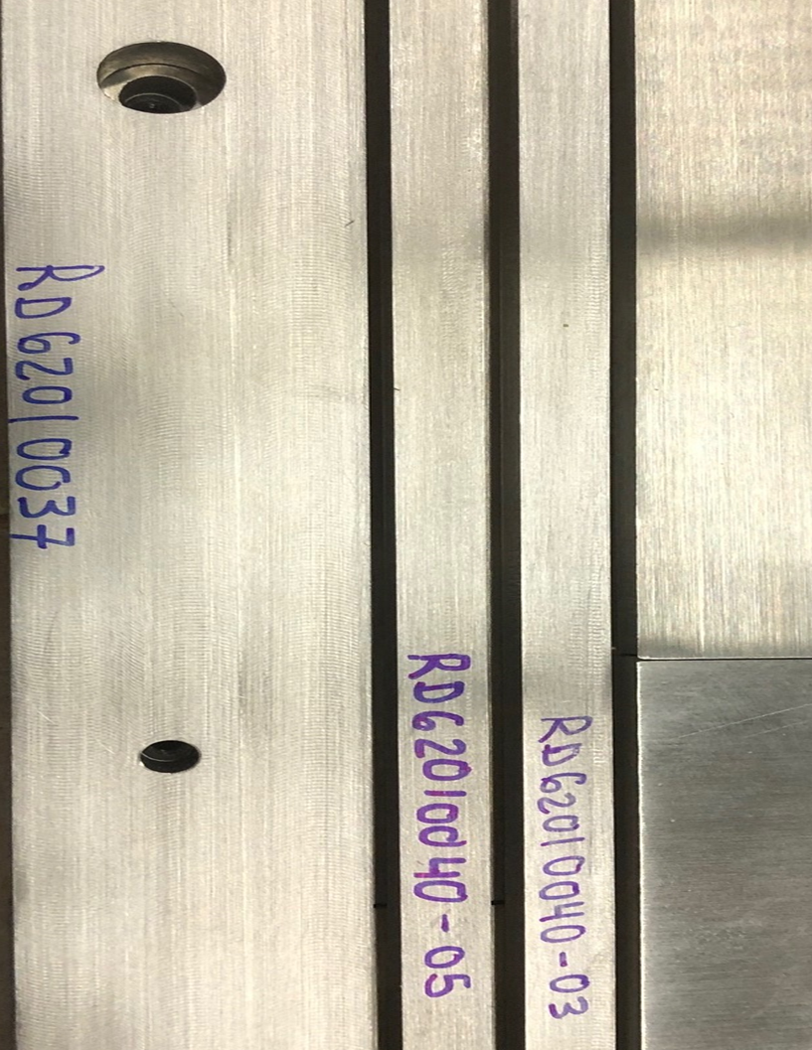
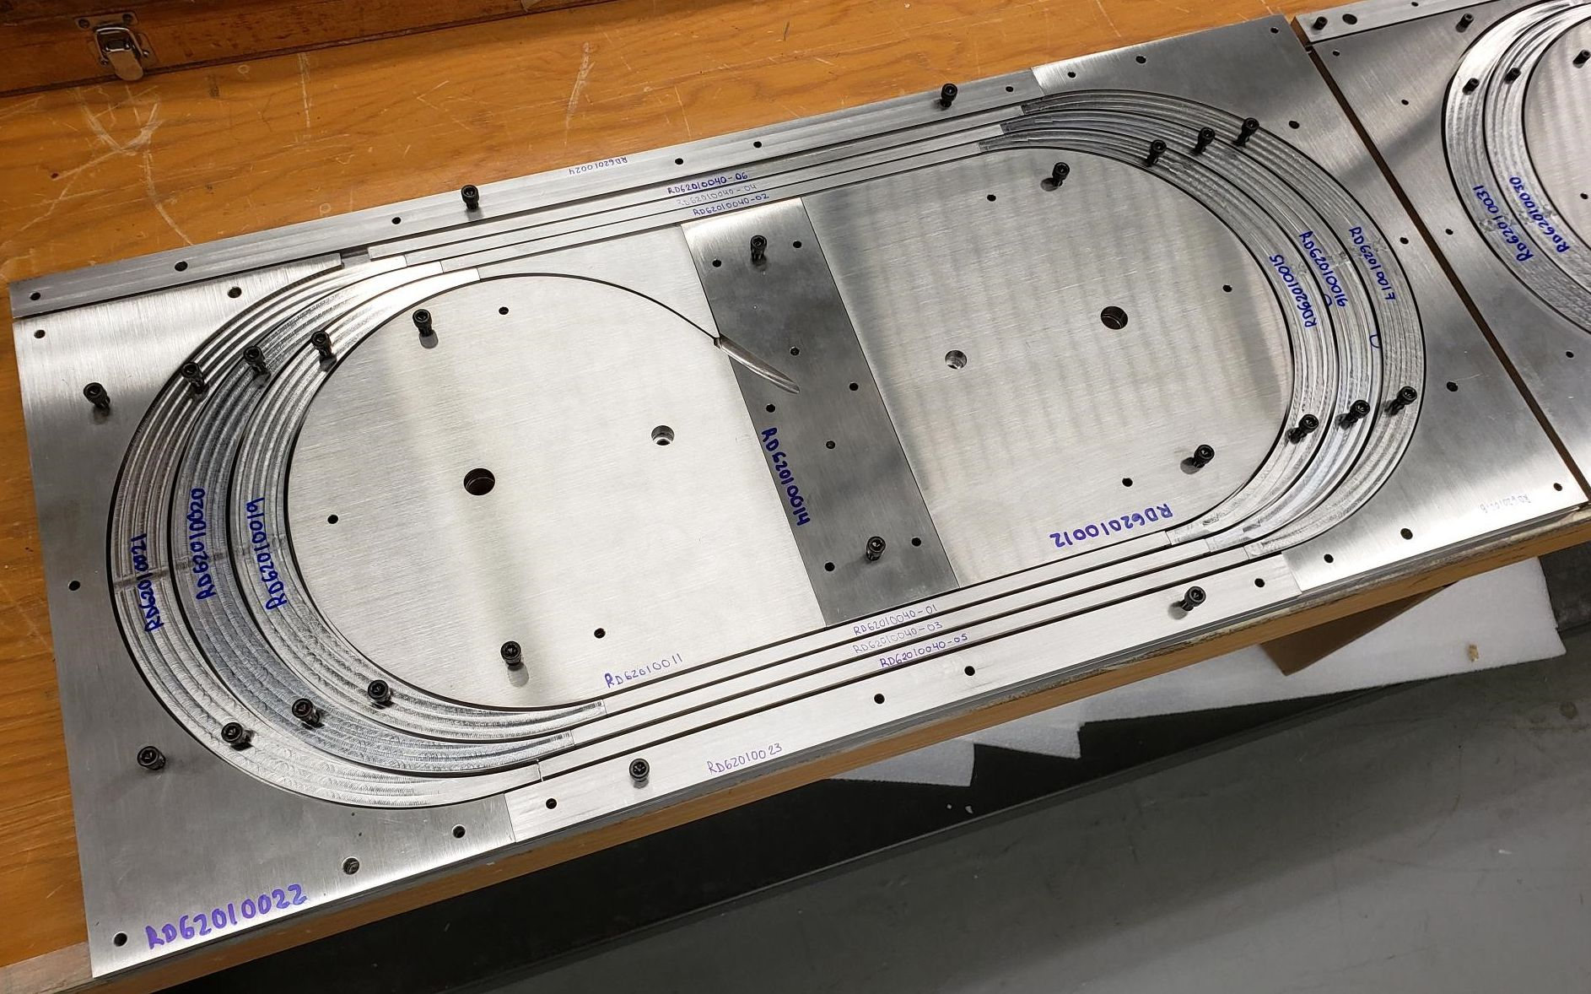
A Few Coil Structure Parts

Slide 6
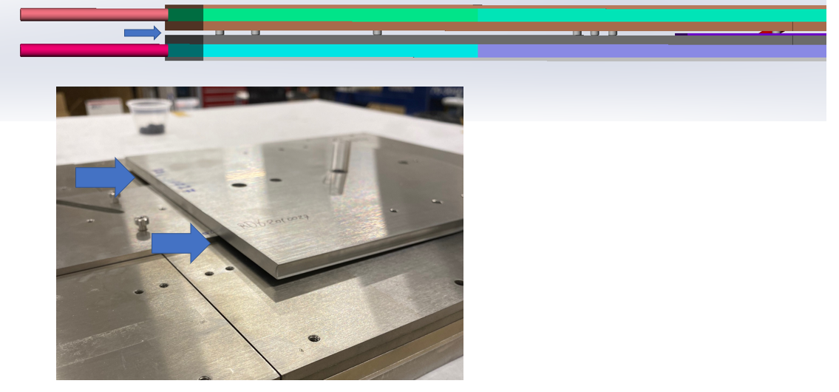
Status of MDP CORC Program (2)
Regular discussion continues between BNL and ACT, and between BNL and MDP collaborators, and with all parties combined
ACT will be doing initial test winding by hand in a couple of weeks
ACT will send the practice cable and the coil parts back to BNL in about a month
BNL will wind the practice coil on universal coil winder under tension.
Details to be worked out (significant work)
Real cable in a few months
Test expected in six months after that

Slide 7
A Possible Opportunities to Continue HTS Scientific Studies without Scheduling a New Test

Slide 8
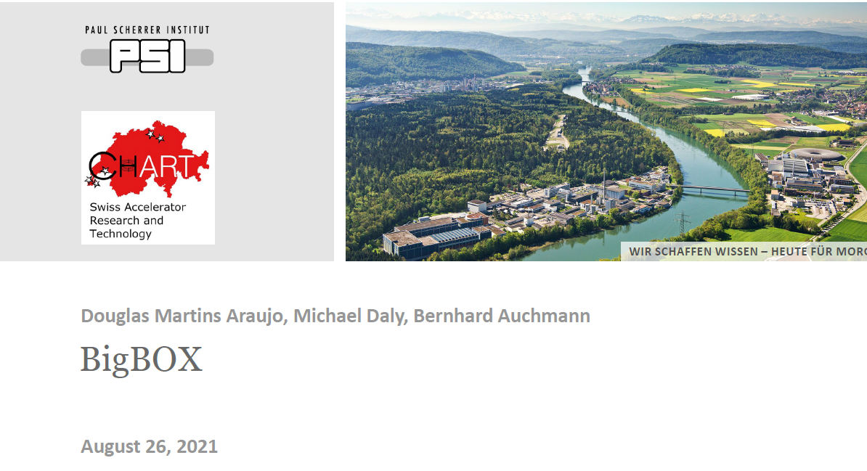
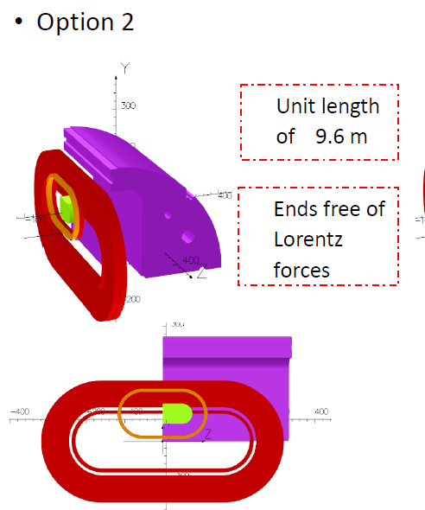
An Upcoming MDP Test (12/21)
Only 1 of the 2 apertures of the common coil dipole is being used
(aperture is a terrible thing to waste)

Slide 9
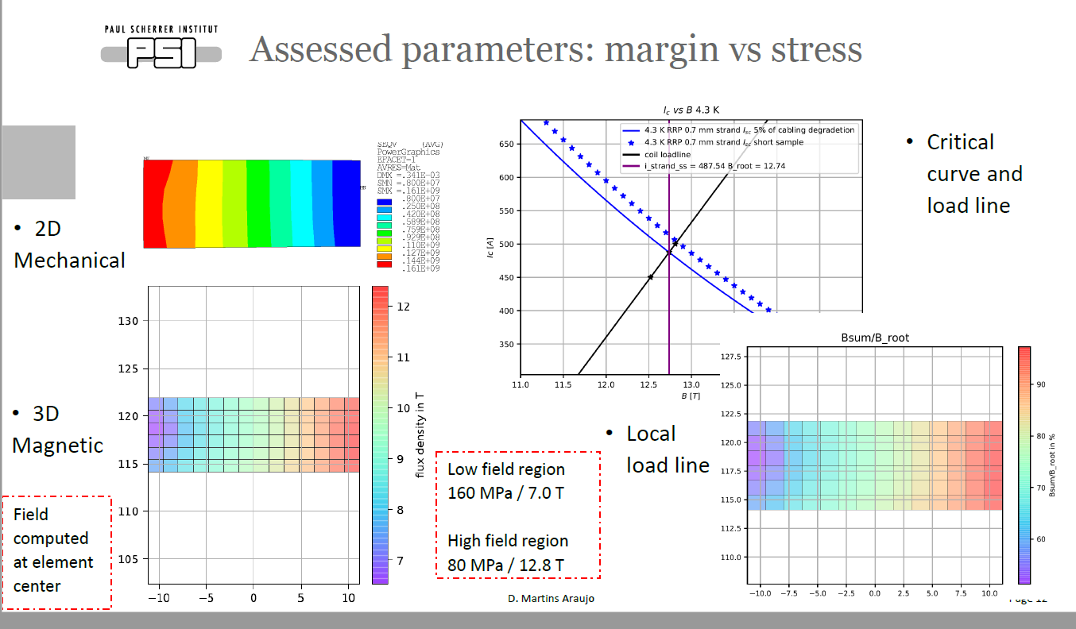
Possible Opportunity in the 2nd Aperture
During the last HTS/LTS hybrid test (Feb 2020), we didn’t have a bipolar power supply. Therefore, we couldn’t carry out complete hysteric cycle for the magnetization studies.
Now, it is getting ready under US-Japan program
Last time, the test was limited by LTS coil.
Now, we have a better idea of how to overcome that
Why not explore this opportunity in one aperture to see if we can learn more

Slide 10
Summary and Discussion
Even though MDP test for “in-field quench studies of a long CORC cable” in the background field of common coil dipole is delayed by ~3 months, we continue to make good progress
There is a good possible opportunity of carrying out useful experimental studies for HTS/LTS hybrid dipole
A personal opinion: Given the limited number of tests coming up every year in MDP and given the very limited knowledge of HTS/LTS coil interaction and of HTS magnetization, we should use all possible opportunity available, as long as there is a good scientific case

Slide 11
Acknowledgement
This presentation benefited from the discussions with and direct contributions from the following colleagues:
ACT: Danko van der Laan, Jeremy Weiss
ASC: Ernesto Bosque, Lance Cooley
BNL: Anis Ben Yahia, Michael Anerella, Jesse Schmalzle, Piyush Joshi, …
FNAL: Vadim Kashikhin, Vito Lomardo
LBNL: Xiaorong Wang, Maxim Martchevsky, Reed Teyber, Steve Gourlay
… and more

Slide 12
EXTRA SLIDES

