Slide 1
Update on the REBCO magnet development
Vadim Kashikhin, Vito Lombardo
September 1, 2021

Slide 2
REBCO magnet development
The project’s objective is to address the U.S. MDP goal #2: “Develop and demonstrate an HTS accelerator magnet with a self-field of 5 T or greater, compatible with operation in a hybrid HTS/LTS magnet for fields beyond 16T.” This is achieved through a series of steps:
  Short sample studies to determine the bending degradation;
  Initial COMB magnet demonstration (proof of principle) with a CORC® cable made of average-performance REBCO tapes;
  Performance demonstration to reach 5 T self field goal in the HTS accelerator magnet using the CORC® cable made of pre-sorted (high Je) REBCO tapes;
  Demonstration of the hybrid HTS/LTS magnet operation using a Nb₃Sn coil outsert;
  Studies of the magnet parameter space to determine suitable designs and conductor requirements to reach 10 T standalone field and 5 T insert field.
Driving questions for area IIb REBCO magnets to be addressed:
  What performances and architectures should the conductor have? How can we make magnets using these conductors?
  What is the maximum dipole field a REBCO magnet can generate? What is the long-term conductor and magnet performance under cycling Lorentz loads?
  What is the magnet performance? How does it quench? How can one protect the magnet during a quench? What is the field quality of REBCO accelerator magnets?
  How can we characterize the transport performance for long conductors?

Slide 3
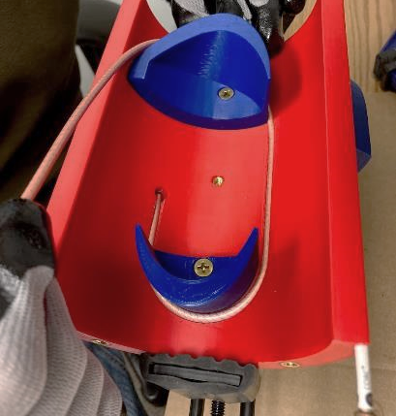
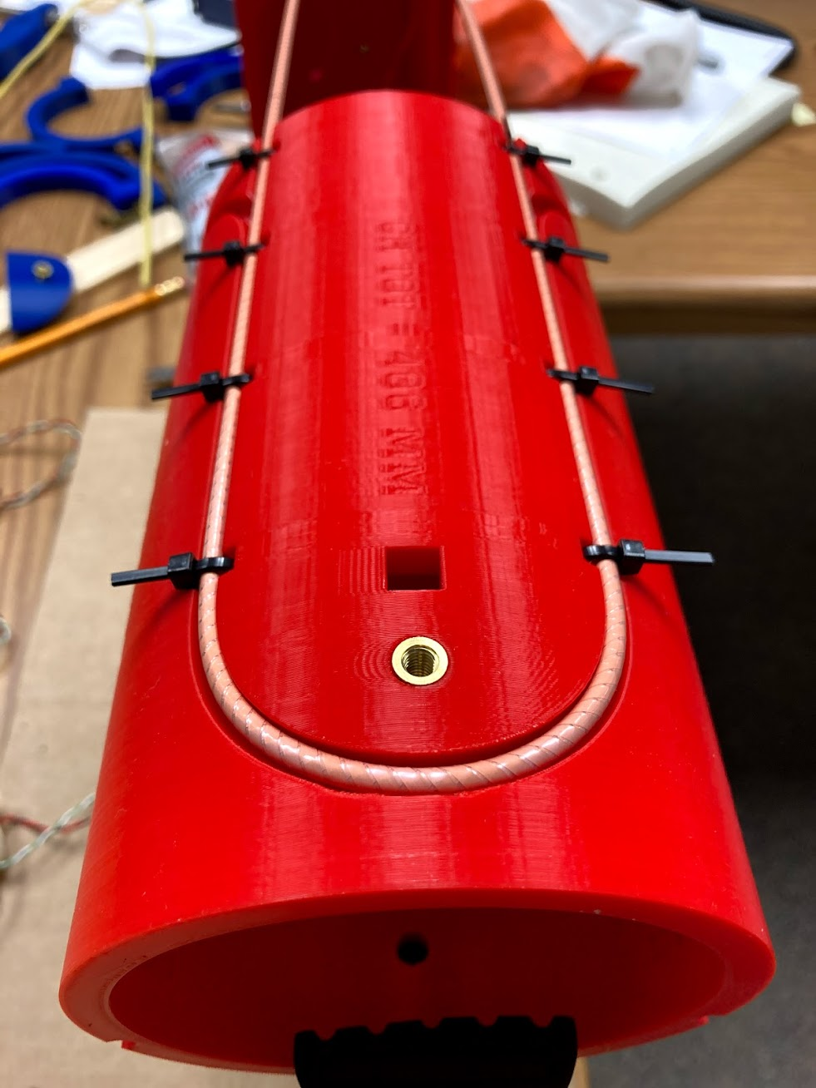
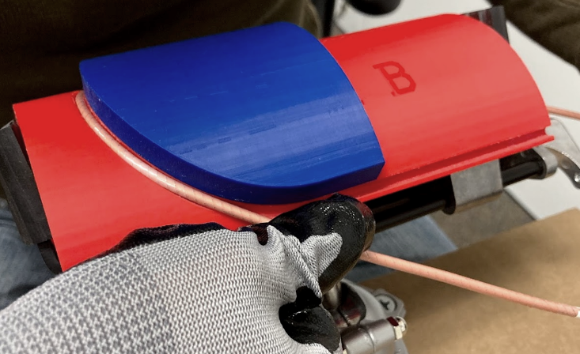
Revised support design
52 mm
57 mm
Single bend on the outer surface instead of 3 bends on the inner and outer surfaces.

Slide 4
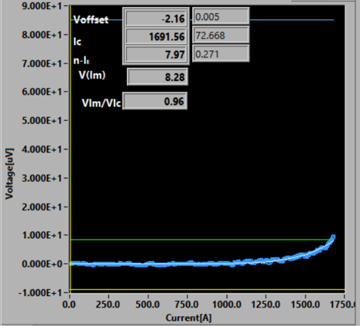
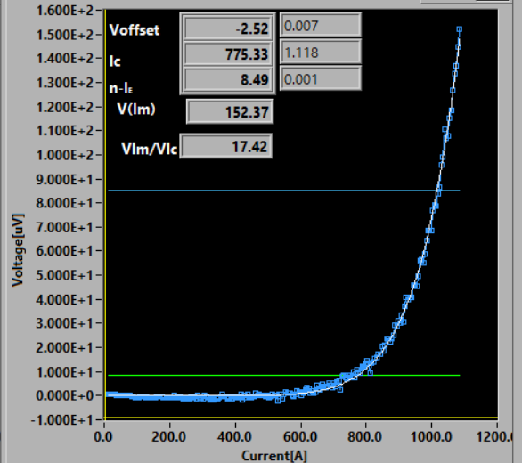
Typical I_{c} retention before and after bending
1st set of tests
2nd set of tests
I_{c} retention increased from 49% to 54% (after the self-field correction).
Improvement, but not as much as expected based on ACT and LBNL data for relevant bending diameters.
Why?

Slide 5
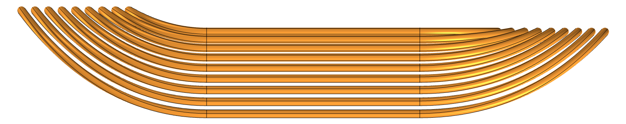
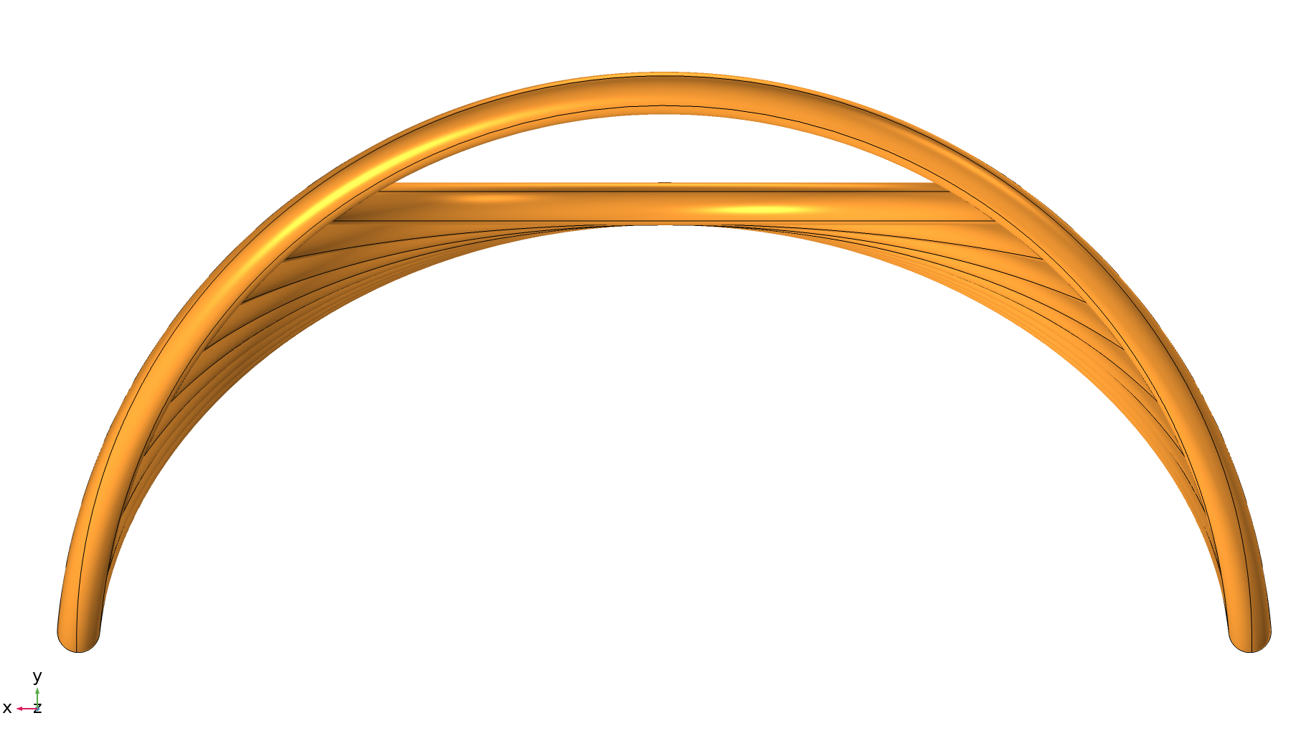
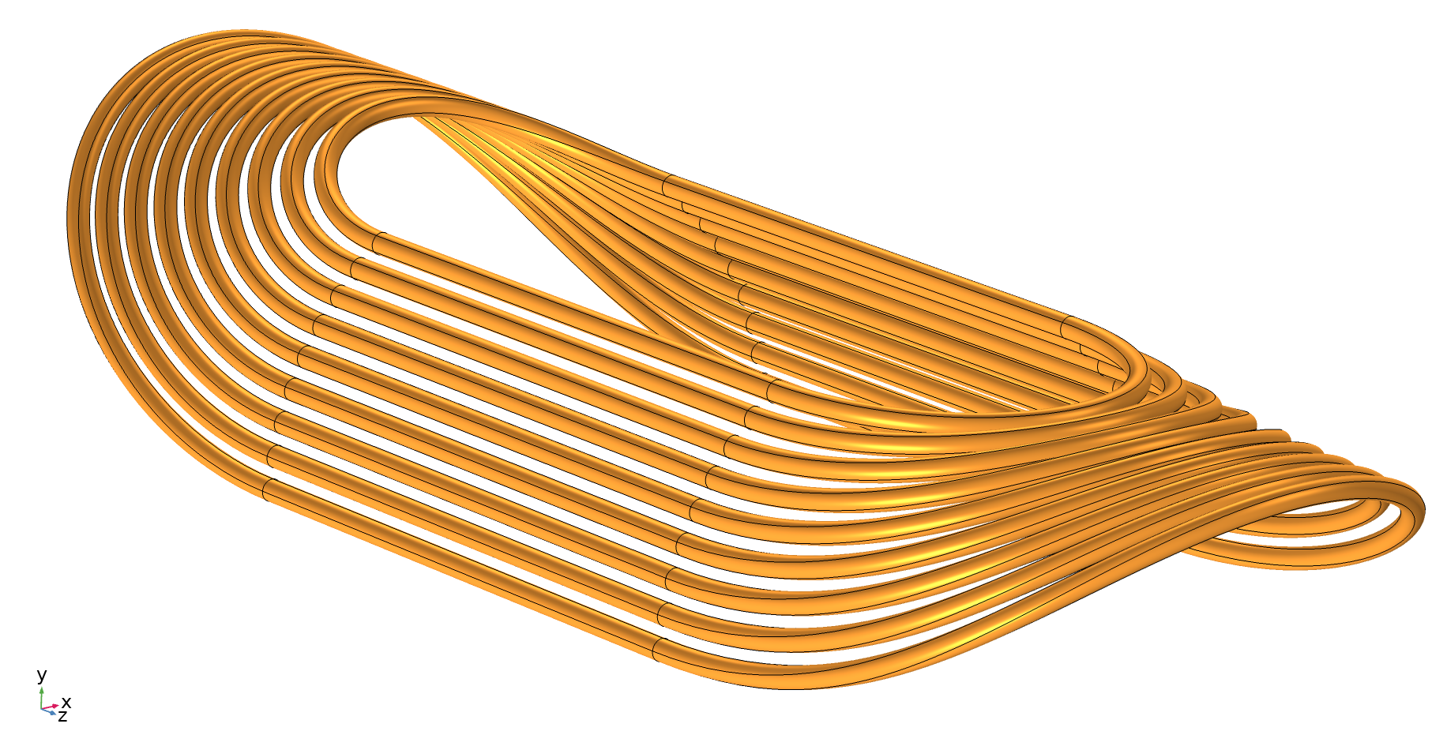
Traditional and alternative coil end design
Flattened end
(allows to reduce the maximum
bending strains by ~10%)
Traditional end

Slide 6
New issue – lubricant drying
The vendor for the CORC cables (ACT) identified an issue associated with drying the anti-friction lubricant used in the cable production.
All CORC cable samples used for bending studies were produced ~3 years ago. It was confirmed that the lubricant has dried in this samples and no longer has anti-friction properties:
  It appears to be the main reason of the premature I_{c} degradation during bending observed during the cable winding into the COMB structures;
  ACT is continuing this investigation and looking at alternative lubricants that should have a longer shelf-life.
We already have 20 m of CORC cable for the first model. It is likely affected.
  Will need to be re-lubricated before use.

Slide 7
New test results (courtesy of ACT)
Studies performed by ACT on a 3-year old CORC cable:
Removed the insulation, soaked cable in lubricant, and applied a slight vacuum to insure penetration into the sample.
Bent the cable to progressively smaller diameters and saw a minimal degradation (94 % I_{c} retention at 50 mm!).
This is compared to a similar 3-year old 30-tape CORC cable that was bent without re-lubrication and only retained 72 % I_{c} at a 90 mm bend.

Slide 8
Short-term plans (after the R&D funding is resumed)
ACT re-lubricated another 3-year old CORC cable and wound it into the “nominal” COMB structure provided by FNAL (3 bends at 57 mm pole diameter) – see next slide. The structure with the sample is scheduled to arrive at FNAL today.
Test the re-lubricated CORC cable in liquid nitrogen:
  We expect to see a significant performance improvement comparing to the previous results. In this case, there will be no need in the alternative flattened end design.
  If the performance is worse than expected – proceed with the flattened end design for the first model.
Make the solid models of the COMB structure and other magnet components. Have the engineering design review. Initiate the parts procurement.
Fabricate and test the first model (standalone in LN₂ and LHe):
  The CORC cables will need to be sent to ACT for re-lubrication just prior to the coil winding.

Slide 9
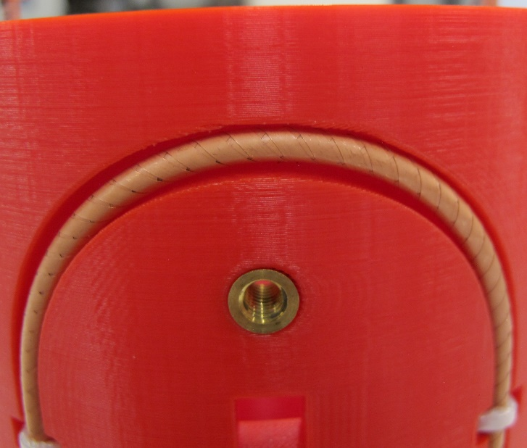
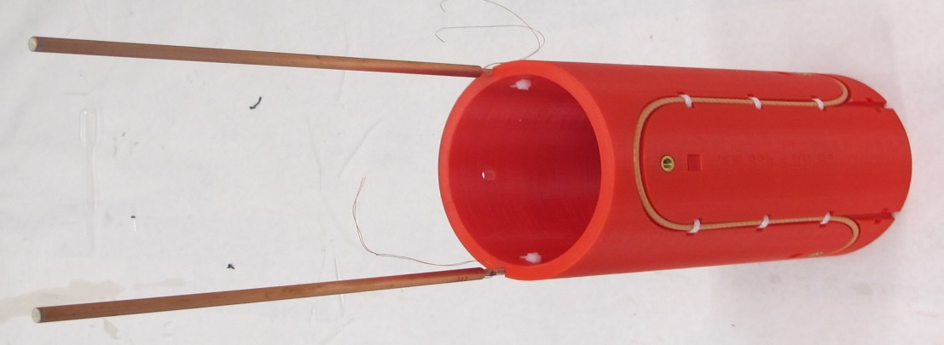
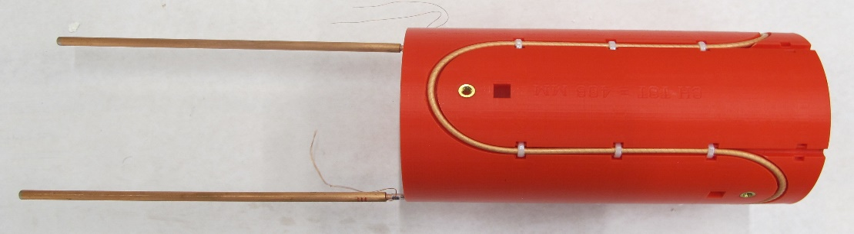
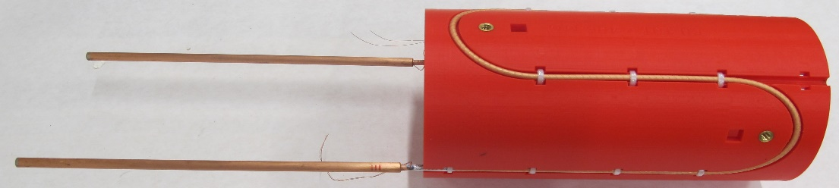
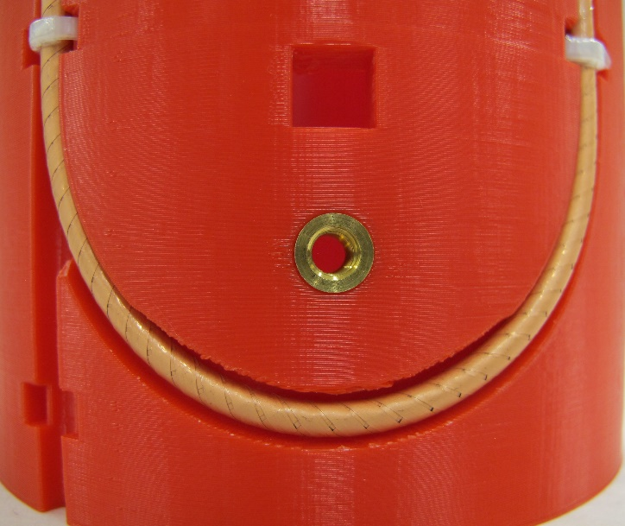
New short sample (produced by ACT)

Slide 10
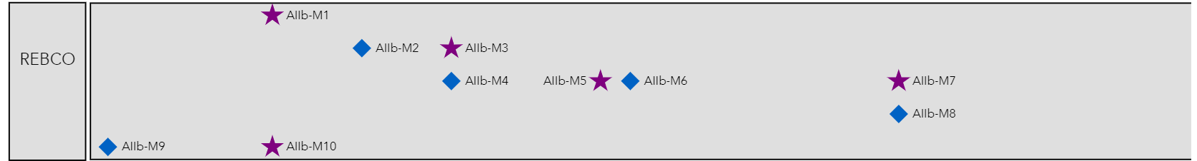
REBCO magnet milestones
Test subscale common coil
[Part 1]
Test C3
[Part 3]
Complete COMB insert test
Demonstrate COMB performance
Complete 8 T REBCO dipole design study
[All three parts]
Demonstrate COMB
[Part 2]
1 T @ 8 T CCT5
8 T stand-alone
CORC quench study at 10 T common coil [Part 1]
Commission hybrid test platform (CCT5)
120 mm aperture, 10 – 12 T Nb₃Sn magnet
Hybrid test platform at FNAL
Impact of Lorentz forces at 14 T solenoid (ASC/NHMFL)
[Part 3]

Slide 11
Resource needs for FY22
Period | Task | Personnel (hours) | M&S (k$)
FY22 | Design of COMB coil structures and parts procurement | 100 (e) 200(d) | 50
 | Fabrication of 2 COMB dipole coils with HTS CORC® cable and support structure | 130 (e) 300(t) | 0
 | Test of COMB dipole in LN₂ in IB3 | 80 (e) 30(t) | 1
 | Test of COMB dipole in LHe in VMTF | 90 (s) 40 (e) 100(t) | 10
 | Assembly of the COMB dipole coils with the outer Nb₃Sn coils from the 15-T dipole and support structure | 300 (e) 400(t) | 5
 | Procurement of high-performance CORC® cable for the next model |  | 85
 | Total | 90 (s) 650 (e) 830 (t) 200 (d) | 151
Personnel: hours specified by categories – engineers (e), scientists (s), designers/drafters (d), technicians (t).
M&S: does not include the overhead.

