Slide 1
We focused on c3 since last update in May 2021
We are ready to make the subscale c3
3-turn version of c3 to practice and prepare for the full scale c3
We have a plan on how to make it
Expect to start winding in November, if
Receive conductors from ACT in September/October after addressing the lubricant issue [also see Vadim’s slides]
Receive mandrels in November assuming funding will be available in October

Slide 2
We have a plan on how to make the subscale C3
Wind with Winding Machine Mark #2
First test with real conductor
Use Stycast to constrain the conductor and bond all the layers
Stycast can flow through a radial gap of 0.010” or 254 µm

Slide 3
Growing pain: challenges in the C3 order
SuperPower is able to meet the minimum I_{c} requirement that was specified for the first time
350 A at 4.2 K, 6 T to provide margin to reach 5 T dipole field for c3
ACT received 73% of total tape order
67% of the received tapes meet the I_{c} spec
Some of the tapes that meet the I_{c} spec show weak mechanical performance
Unexpected I_{c} degradation after winding into CORC®
Excellent opportunity to address these challenges now

Slide 4
c3 needs in FY22
$200 k M&S, without overhead
$35 k: conductors for the subscale c3
$40 k: subscale c3 mandrels and other hardware
$60 k: full-scale c3 mandrels
$25 k: LHe to test sub- and full-scale c3
$40 k: contingency
1.5 - 2 FTE effort to make and test the sub- and full-scale c3

Slide 5
Backup slides

Slide 6
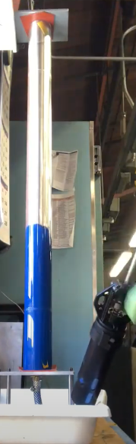
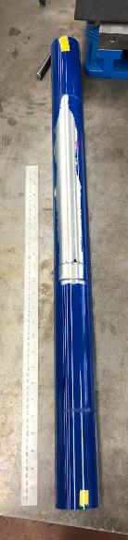
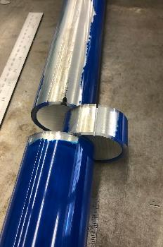
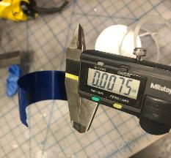
Experiments show that we may use Stycast 2850 MT to fill the gap between c3 layers
Radial gap
It is necessary to fill the gap between c3 layers to reduce the stress on conductors at 5 T
CTD 528 can work
Test flow Stycast through a radial gap between the ID of an acrylic tube and the OD of an aluminum pipe
To be tested again with a pair of aluminum bronze tubes with the actual c3 radial gap of 0.0225” nominal
0.020”
~ 0.010”
0.040”

Slide 7
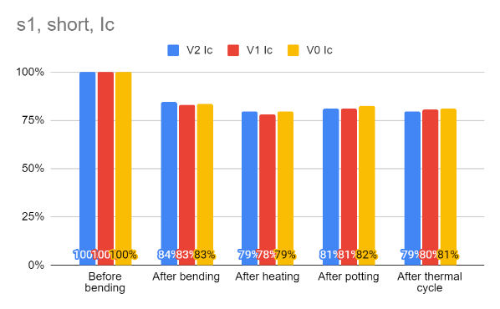
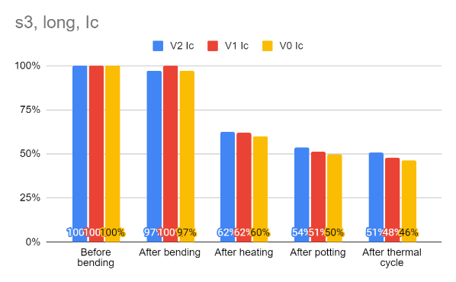
Vacuum pressure impregnation needs more study
We impregnated two sets of CORC® wires with FSU Mix-61 epoxy
Heating seems a common cause for the I_{c} degradation in both experiments with all four samples
Collaboration with J. Stern and L. Chiesa from Tufts University and D. van der Laan and J. Weiss from ACT

