Slide 1
SBIR/STTR sub-topic proposals (MSD/FNAL)
Stoyan Stoynev
MDP meeting
15 September 2021

Slide 2
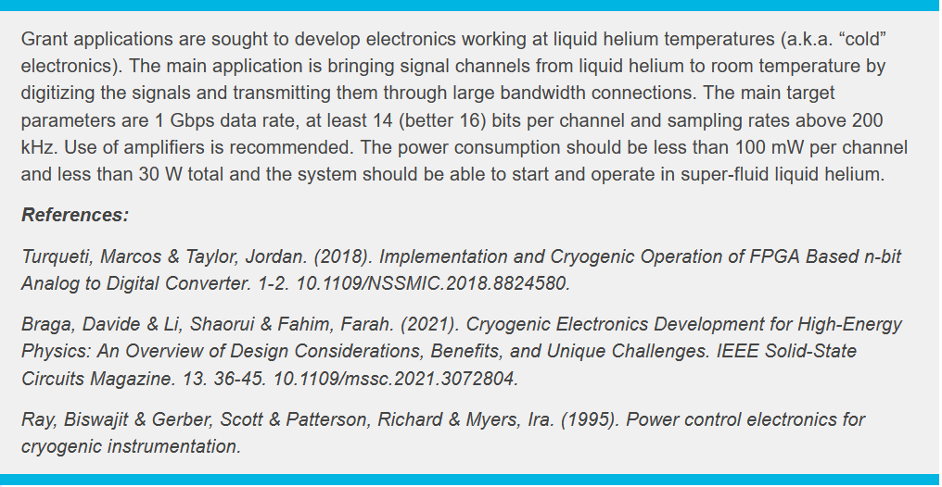
Sub-topics
“Cold” electronics

Slide 3
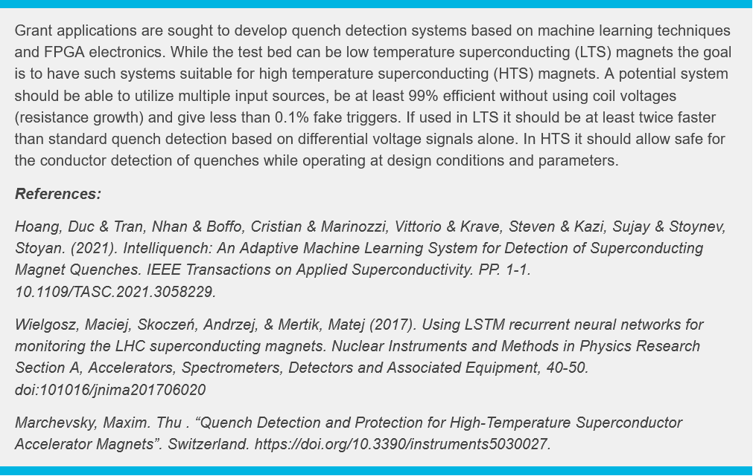
Sub-topics
Machine learning
for quench detection

Slide 4
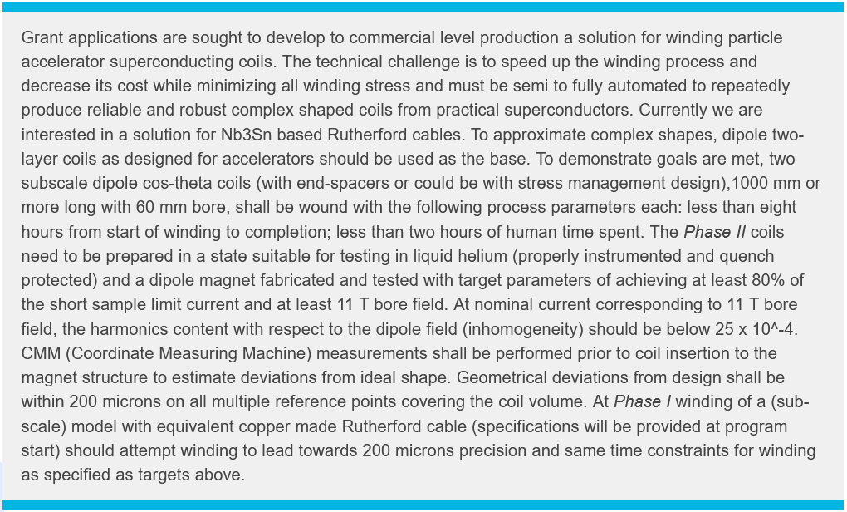
Sub-topics
Cost-effective LTS coil/magnet
fabrication, starting with coil winding
The caveat is that there is already a small business interested (Infinity Physics) and we tried to see what
can satisfy both us and them. If accepted, I expect DOE will change its narrative, but the text is clear on intentions.

Slide 5
Sub-topics
Historically, superconducting magnets have been manufactured using round strands, either as single wire or in cable form. The tape form factor of the next generation ReBCO high temperature superconductors introduced new challenges in coil manufacturing. However, this carries a considerable development potential of innovative winding schemes and automated processes using multi degree of freedom winding machines. A proposal submitted under this topic shall focus on the development of a fully automated device that allows winding of complex 3D shaped coils out of tape conductor while retaining tension and precise positioning at 10 micrometer level. Integration of on-line geometry measurement, electrical insulation and wet winding could be also considered.
Winding HTS magnets
The caveat is that there is already a small business interested (Infinity Physics) and we tried to see what
can satisfy both us and them. If accepted, I expect DOE will change its narrative, but the text is clear on intentions.
(Cristian B.)

Slide 6
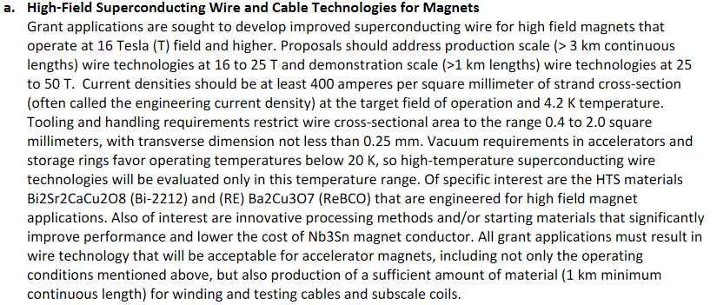
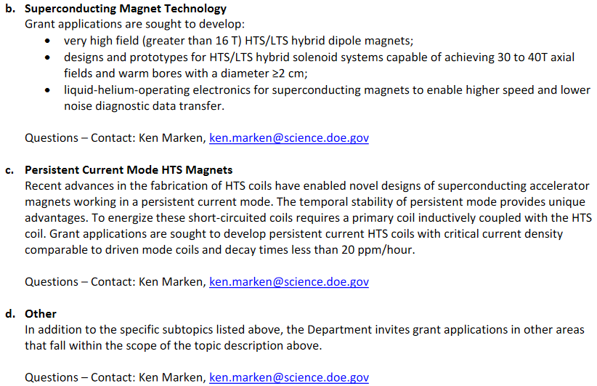
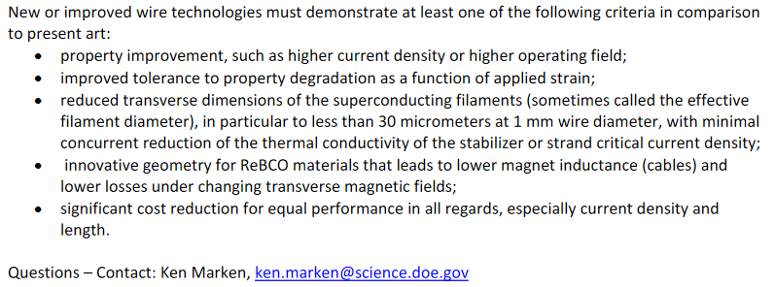
Sub-topics
FY21

