Slide 1
MDP Technical Meeting #15
20 T hybrid magnet and comparative analysis
P. Ferracin, G. Ambrosio, E. Barzi, L. Cooley, R. Gupta, V. Kashikhin, V. Marinozzi, I. Novitski, B. Yahia, A. Zlobin
US Magnet Development Program

Slide 2
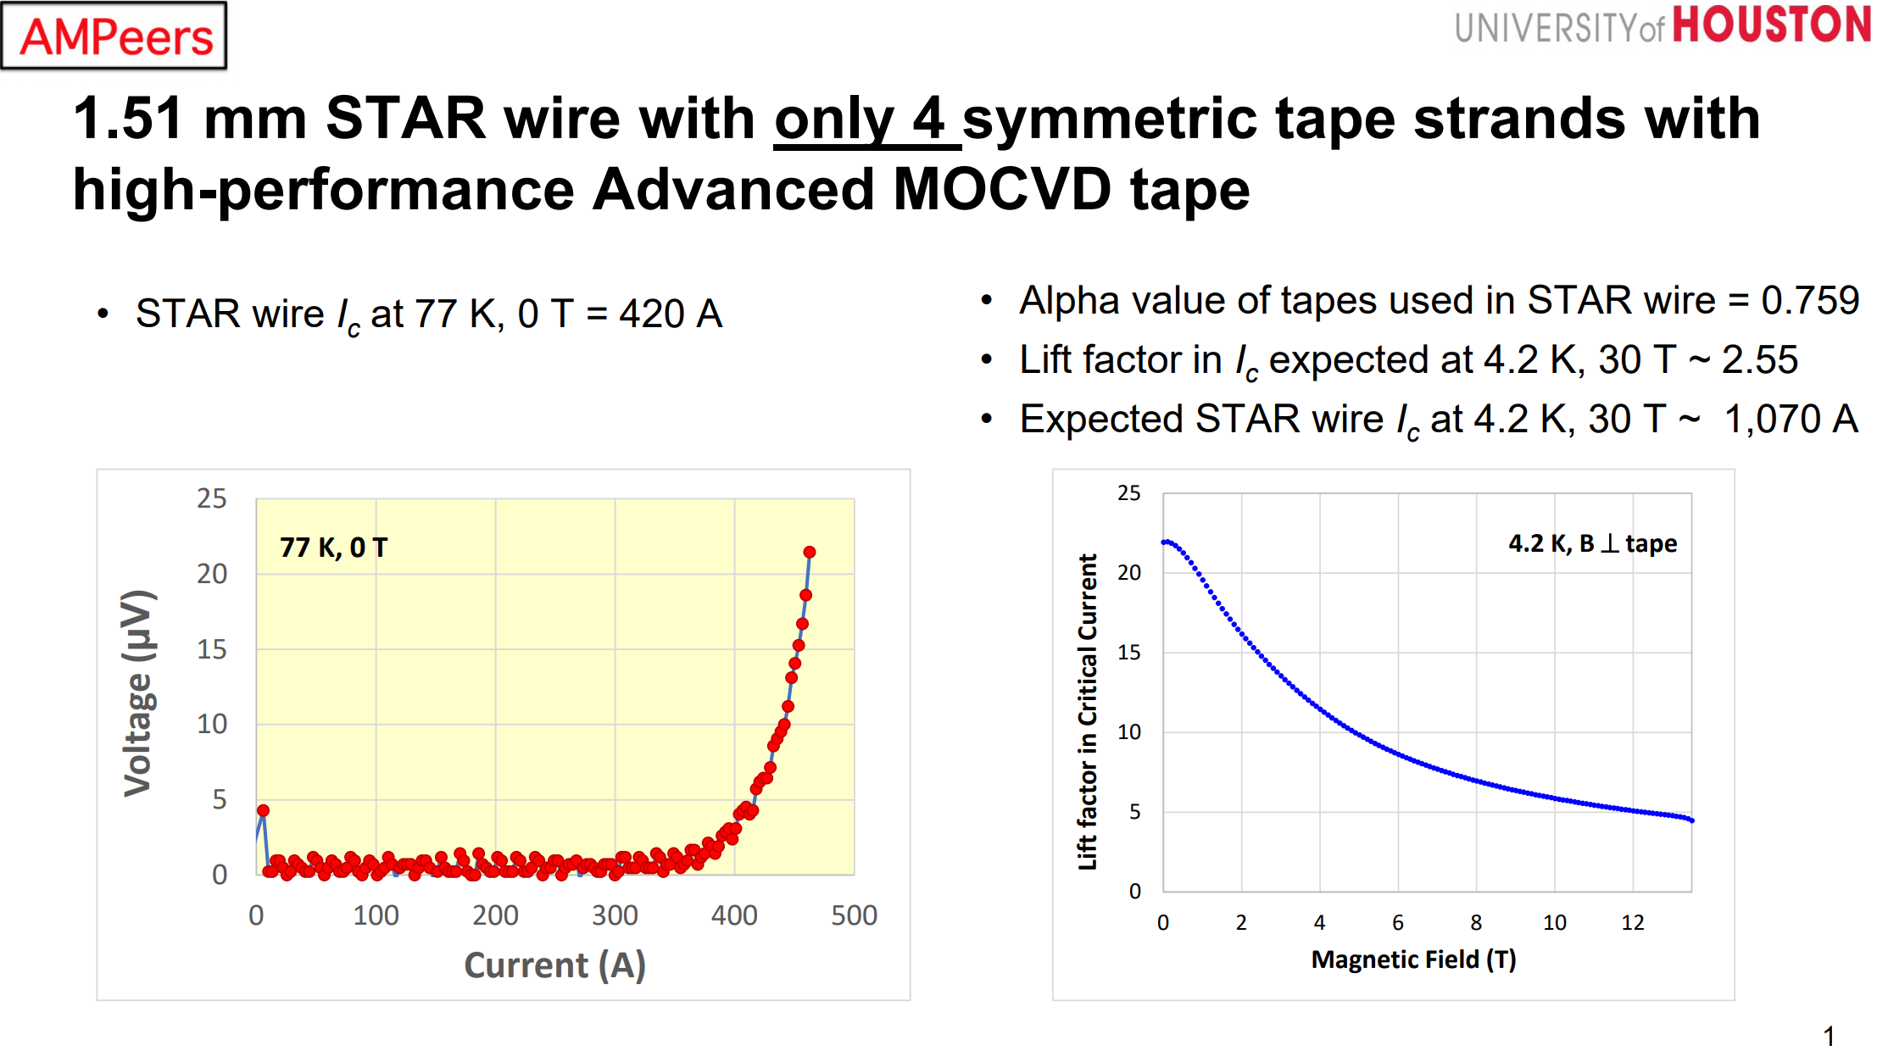
STAR wire recent data

Slide 3
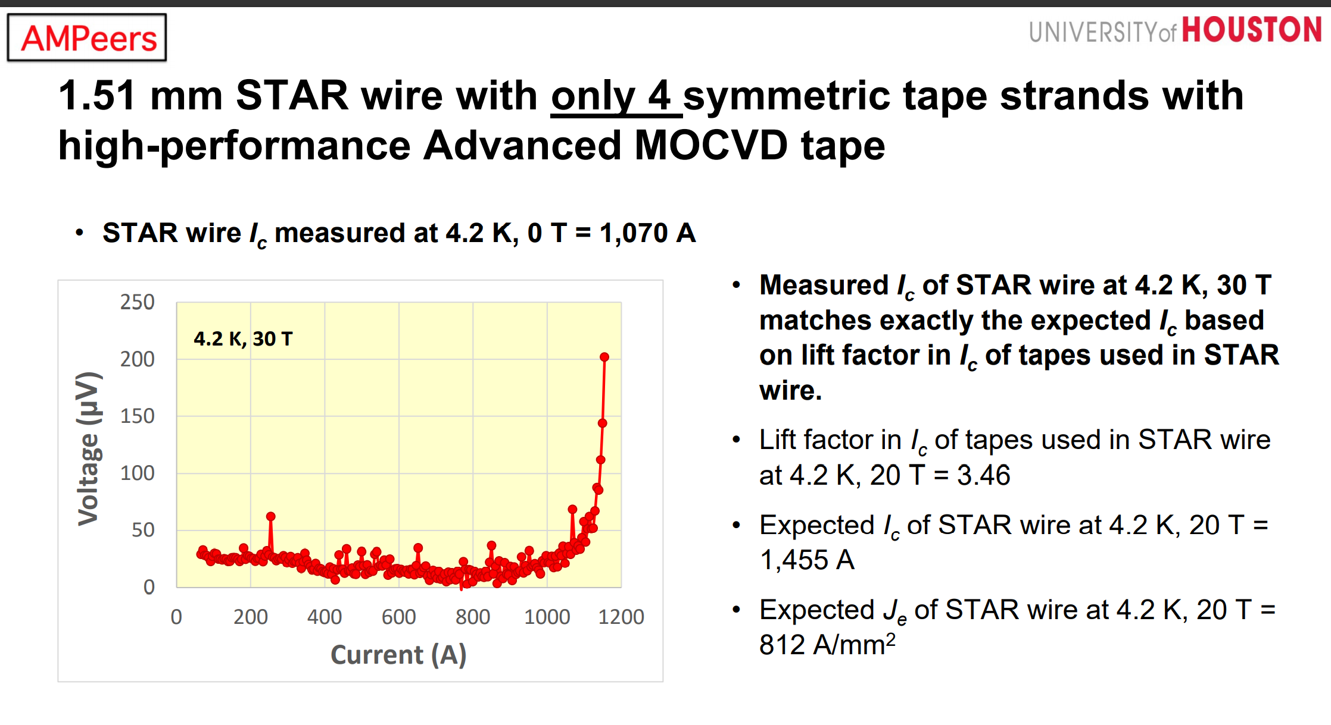
STAR wire recent data

Slide 4
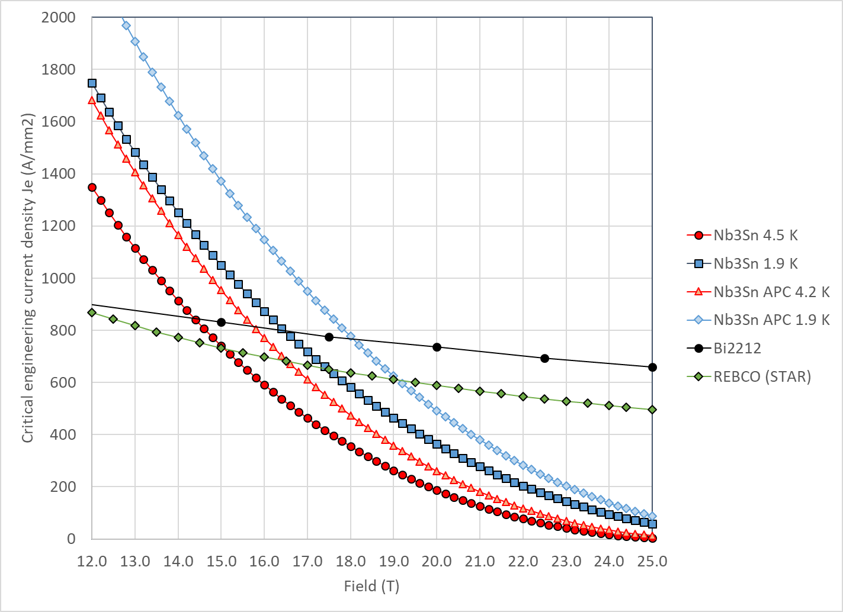
Previous plot

Slide 5
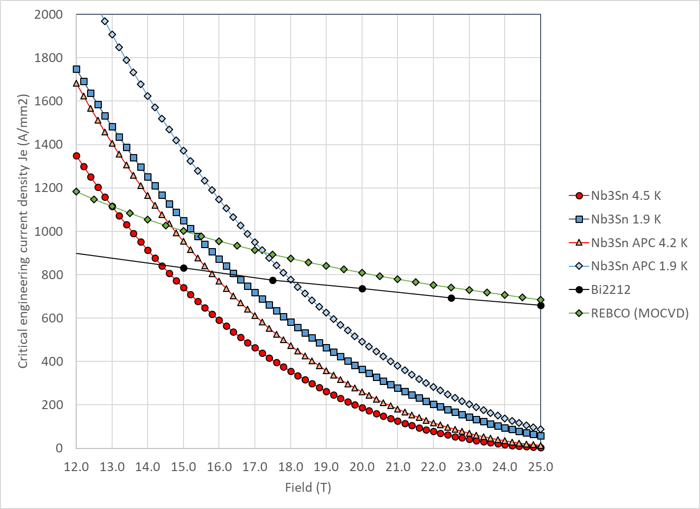
Updated plot

