Slide 1
Status of the program – progress towards MDP milestones
Presentation to the MDP TAC
Soren Prestemon
For the MDP HTS Team

Slide 2
Guidance to the Technical Advisory Committee
The purpose of the meeting is to update the TAC on MDP progress since the last Collaboration meeting and on MDP strategy
Feedback is appreciated on all fronts, most importantly the TAC’s perspective on:
  MDP coordination, cooperation and operation – i.e. are we efficient and effective
  Observations and impressions of potential impact of developments
  Strategy on engagement in community planning and in international collaboration

Slide 3
Recap of our MDP vision
Maintain and strengthen US Leadership in high-field accelerator magnet technology for future colliders
Focus on the four primary goals identified in the the original MDP Plan
  Explore the performance limits of Nb₃Sn accelerator magnets, with a focus on minimizing the required operating margin and significantly reducing or eliminating training
  Develop and demonstrate an HTS accelerator magnet with a self-field of 5T or greater, compatible with operation in a hybrid HTS/LTS magnet for fields beyond 16T
  Investigate fundamental aspects of magnet design and technology that can lead to substantial performance improvements and magnet cost reduction
  Pursue Nb₃Sn and HTS conductor R&D with clear targets to increase performance and reduce the cost of accelerator magnets
Further develop and integrate the teams across the partner laboratories and Universities for maximum value and effectiveness to the program
Identify and nurture cross-cutting / synergistic activities with other programs to more rapidly advance progress towards our goals

Slide 4
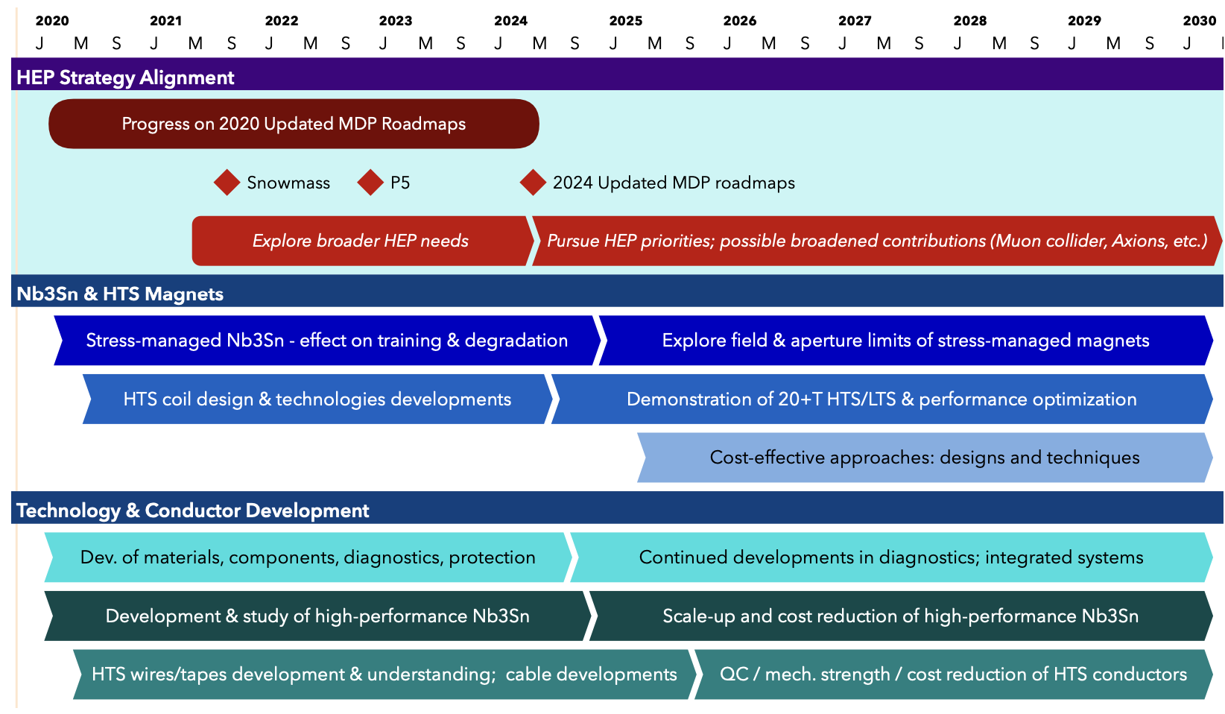
US MDP 2020 roadmaps – long range
Continue alignment with physics community needs
Focus on “stress-management” as well as hybrid HTS/LTS magnet technology
Continue to invest in the “science of magnets” and in improved conductors

Slide 5
Program roadmap – 2020 Detailed Plan
Strategic priorities for the update plan:
  Probing stress management structures
  Hybrid HTS/LTS designs
  Understanding and impacting the disturbance-spectrum
  Advancing both LTS and HTS conductors, optimized for HEP applications
  A new technology element
  20T Hybrid Magnet Design & Comparative Analysis,
  is designed to prepare for future program goals

Slide 6
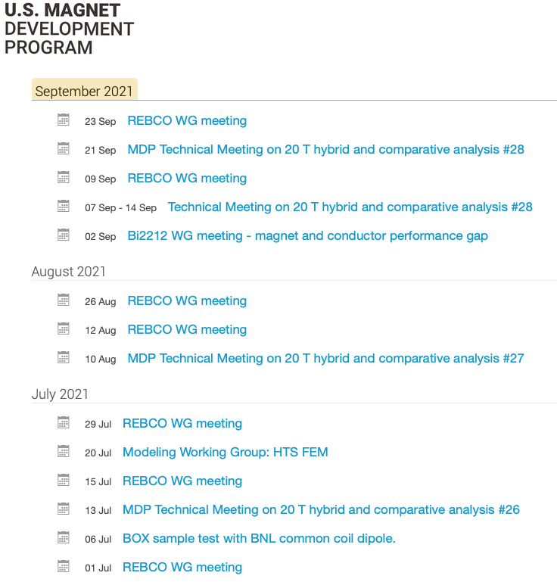
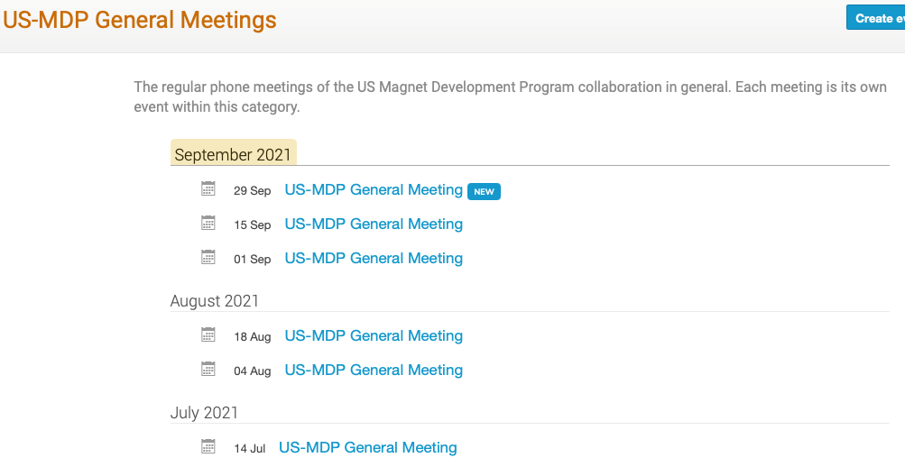
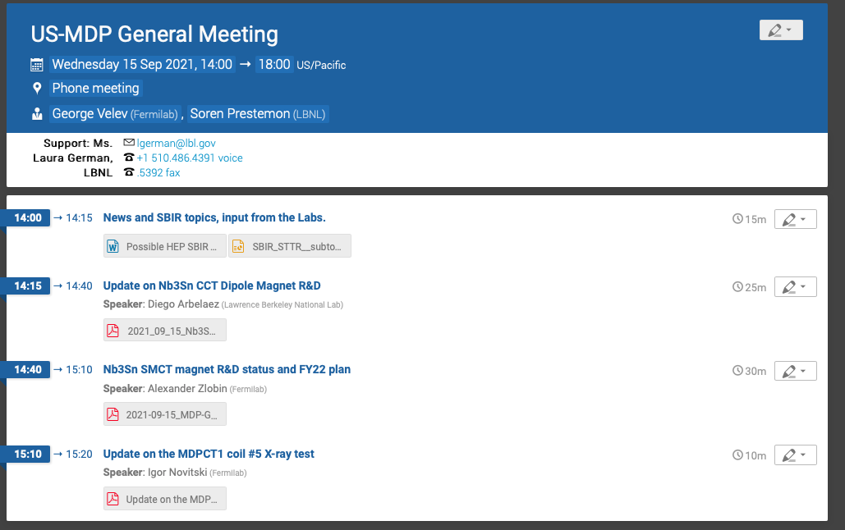
Program approach to collaboration and communication
MDP G7 meets regularly Tuesday 2/4/5pm
  GV and SP typically touch base Tuesday morning to set a basic agenda for the day’s G7 meeting, and review plans for next general meeting
  Meeting covers agenda but is then free-flowing – excellent attendance and communication
Technical coordinators set up “regular” Technical Meetings of technical areas
  Some “ad-hoc” technical meetings focus on specific collaborations
  Coordinators are empowered and able to create their own Indico page, and do so regularly
General meetings are now held bi-weekly
  Most meetings include an update on milestone and technical progress of one technical area
  A meeting can also include an invited presentation – internal or external – to MDP

Slide 7
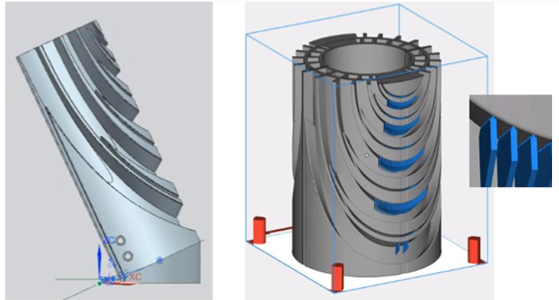
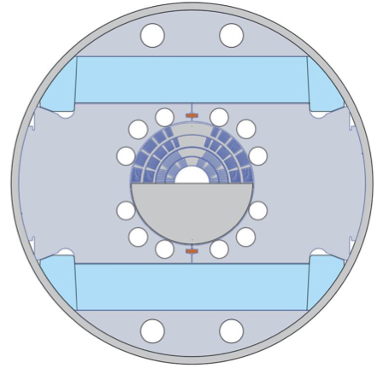
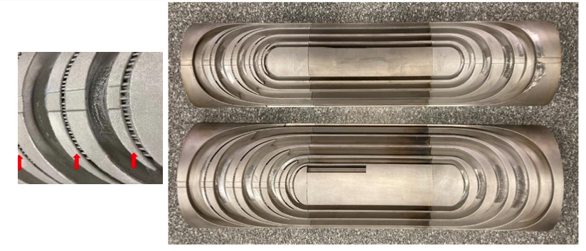
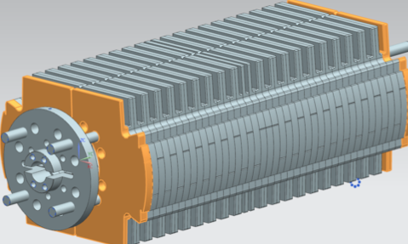
Nb₃Sn Stress-managed Cos-theta (SMCT) progress
Direct Laser Melting (DLM) by GE Additive
Mirror block fab starts in Oct.
Improvement to coil end support
– lessons learned from 15T
Resulting 316L parts - <3 months to deliver

Slide 8
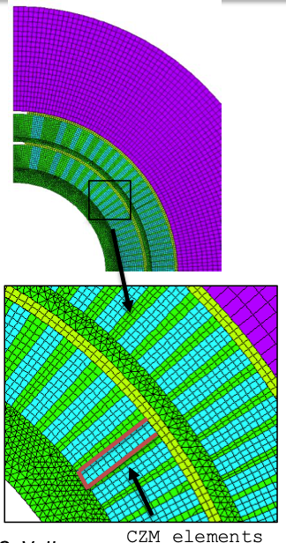
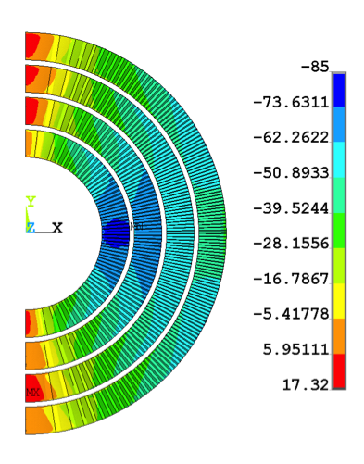
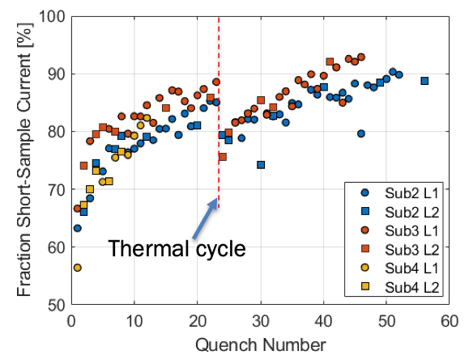
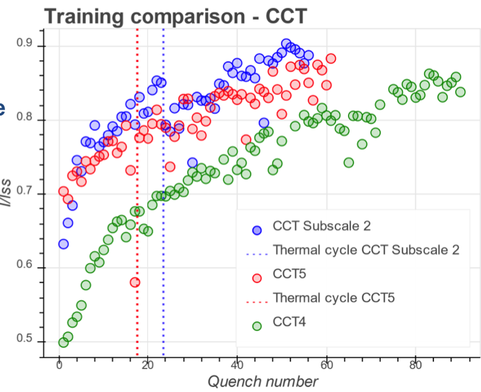
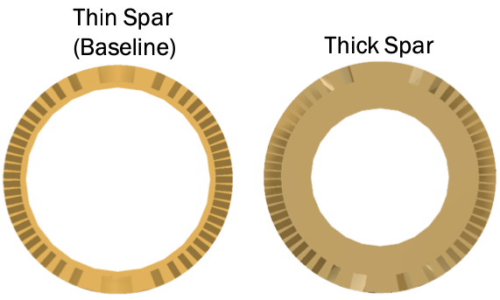
Nb₃Sn Canted Cos-theta (CCT) progress
Five subscale tests since January:
Sub2, + thermal cycle test
Sub3, + thermal cycle test
Sub4
“Cohesive Zone Modeling” underway
Lorentz forces at 12.2 T
stress
Feedback on thick/thin spars informs CCT6 design
Subscale reproduces training
Sub2 design
Sub3 design

Slide 9
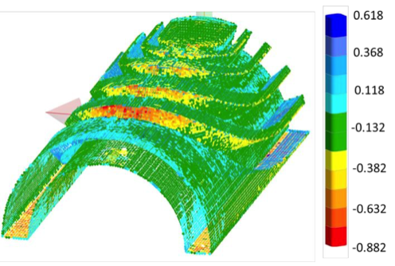
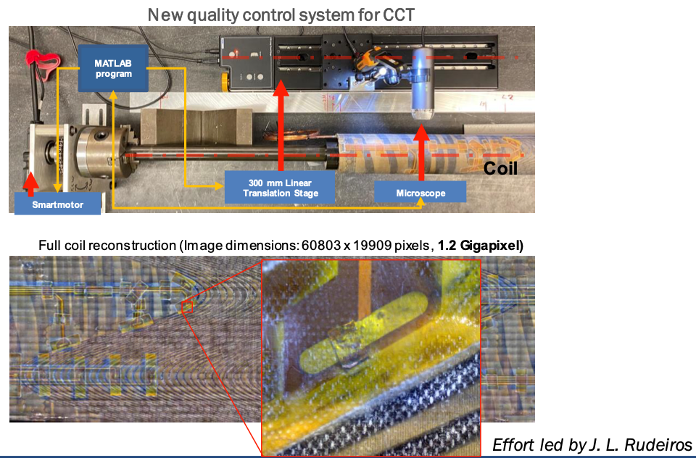
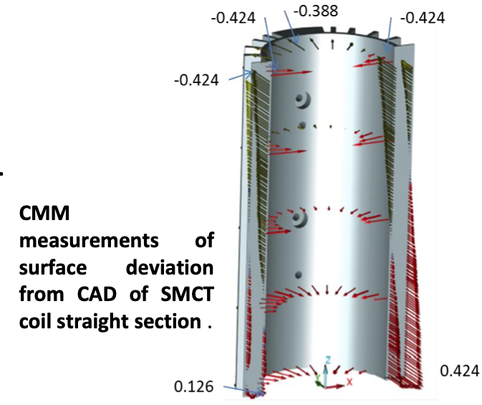
Advances in quality control are being applied
CMM surface deviation scans on SMCT parts provide feedback on Advanced Manufacturing process
In-house visual-microscope scanning of CCT surface provides QC of fabrication process
Automated laser-scanner
CT Scanning capability from industry also being explored
– should be available in coming months

Slide 10
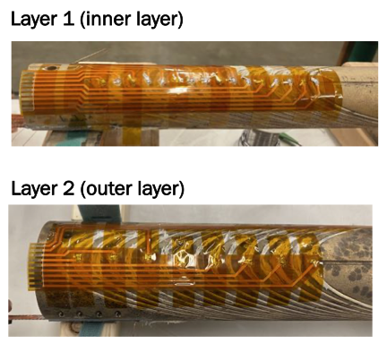
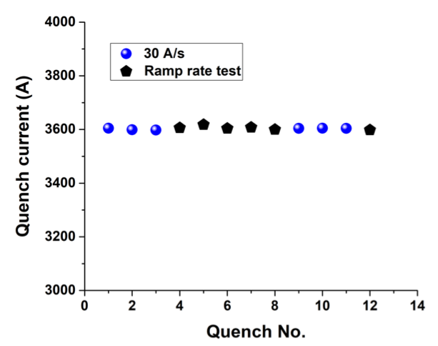
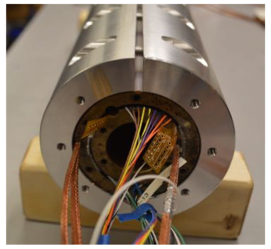
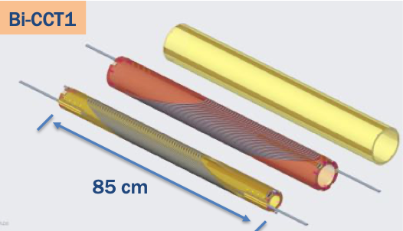
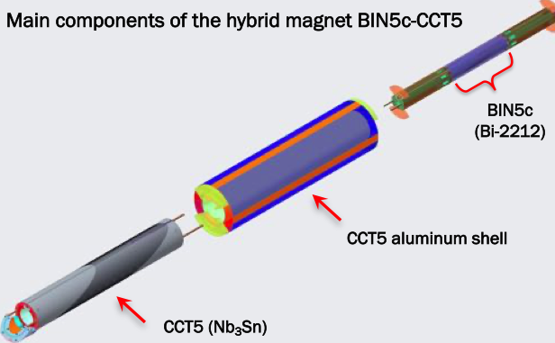
Bi2212 magnet development progress
Recent test of “Bin5c1”, first Bi2212 CCT dipole magnet
Extracted strand barrel samples planned, will be tested at FNAL. Discussions underway with CERN to have transverse pressure tests performed at Twente.
Wire (2.4km) just sent to FNAL to begin work

Slide 11
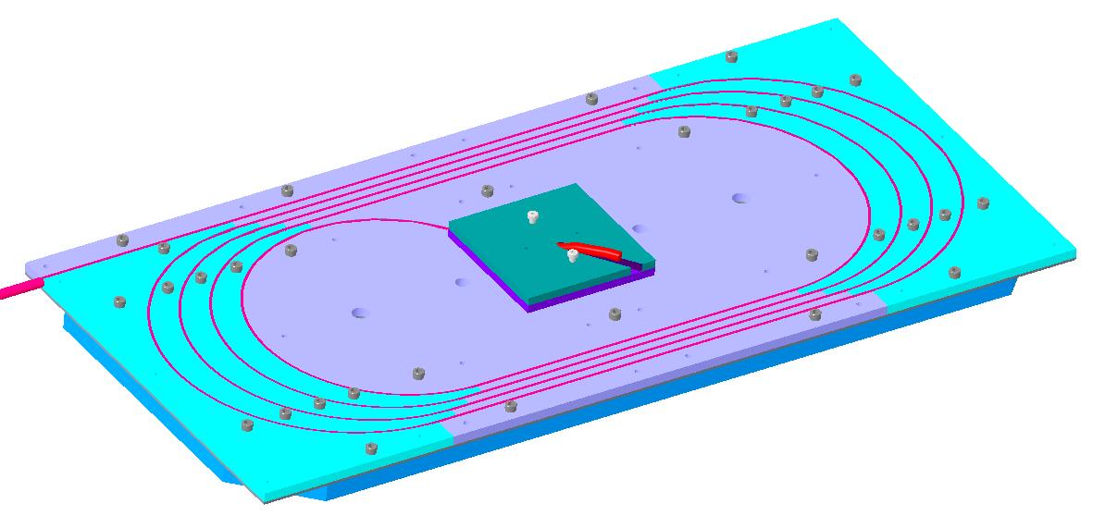
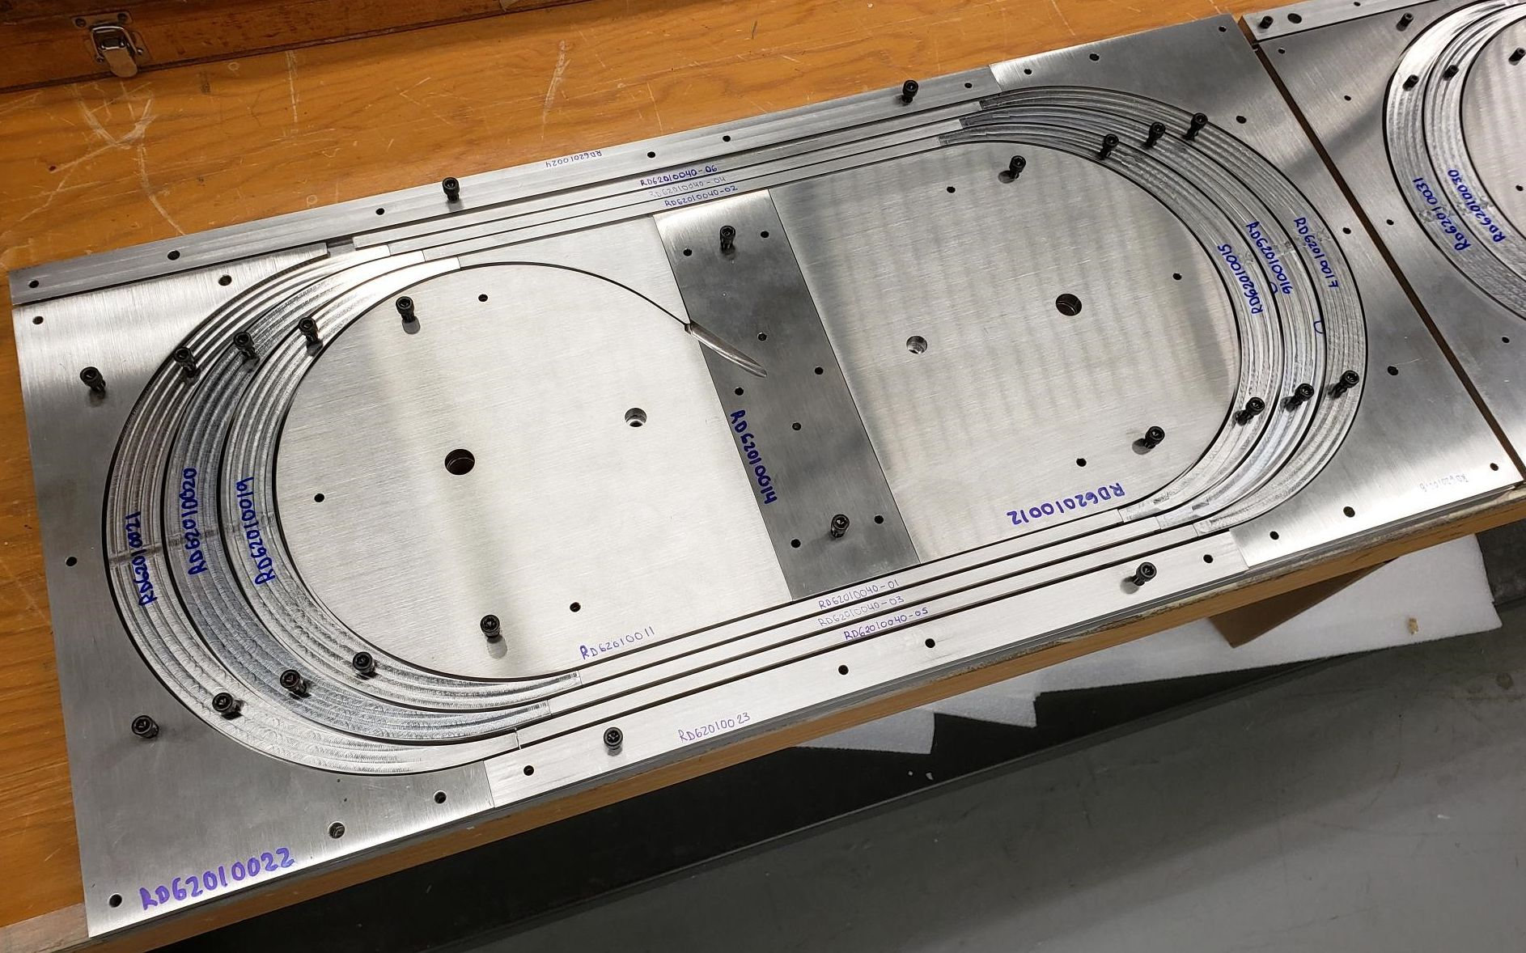
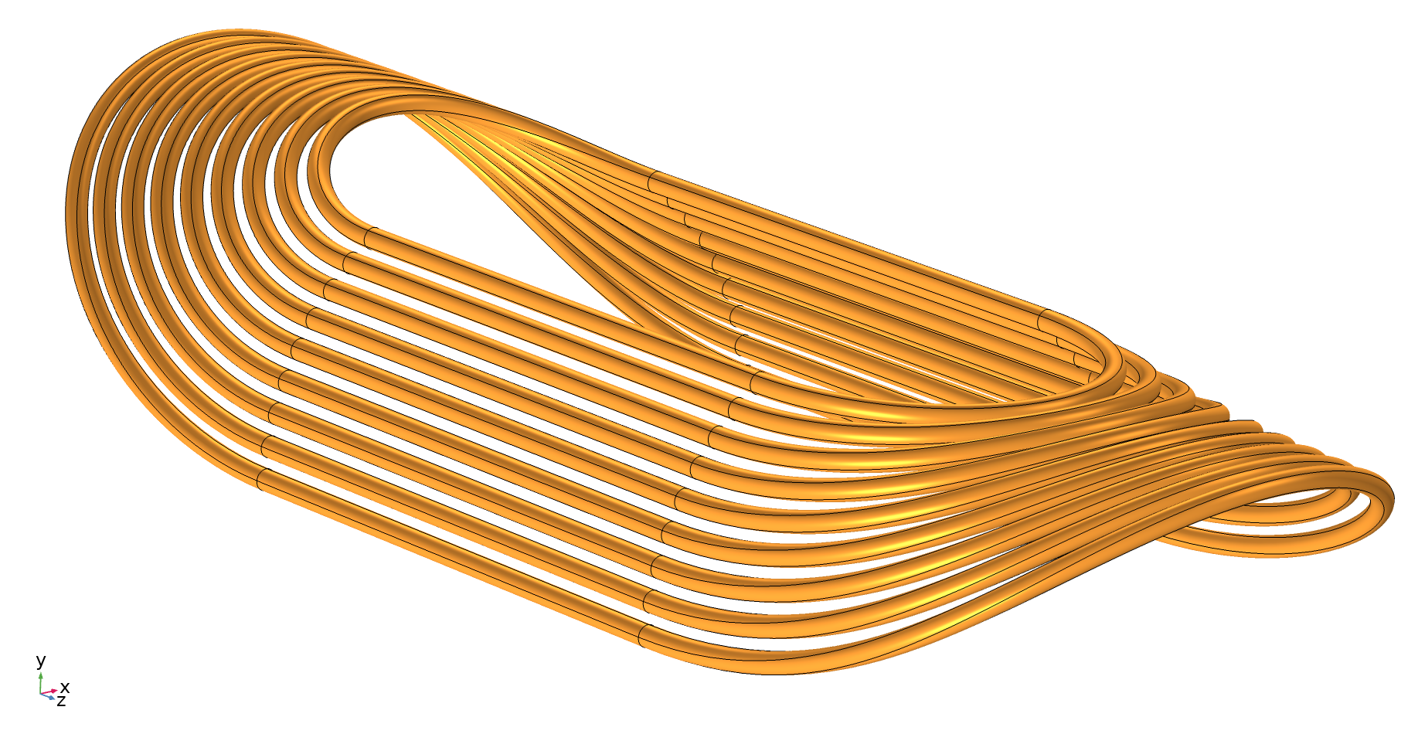
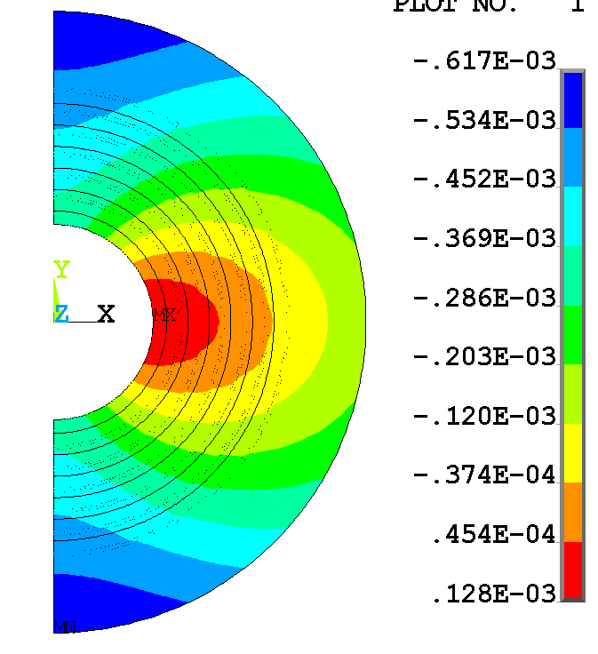
REBCO magnet progress
Vendor fab issues are delaying test
- BNL benefitting by fitting in a collaboration exp.
Steady progress; working with ACT to address strain sensitivity (e.g. lubricant issue, strain limits)
ACT received ~70% of C3 conductor; some mechanical issues with some wires
CORC for practice winding has been obtained
Practice winding before end of CY

Slide 12
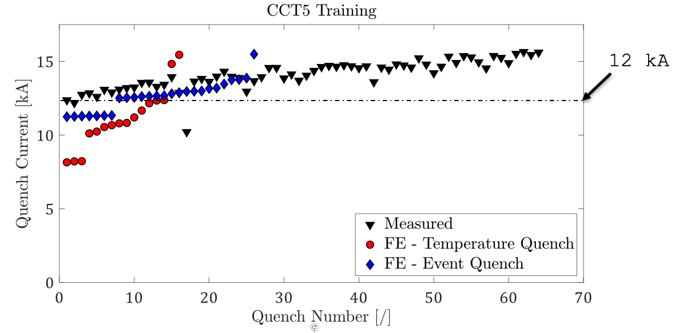
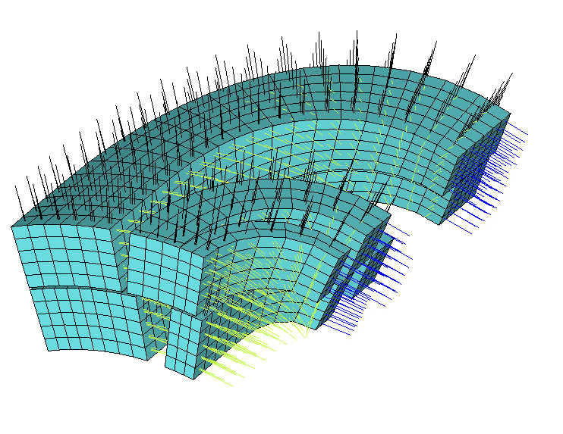
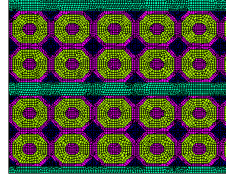
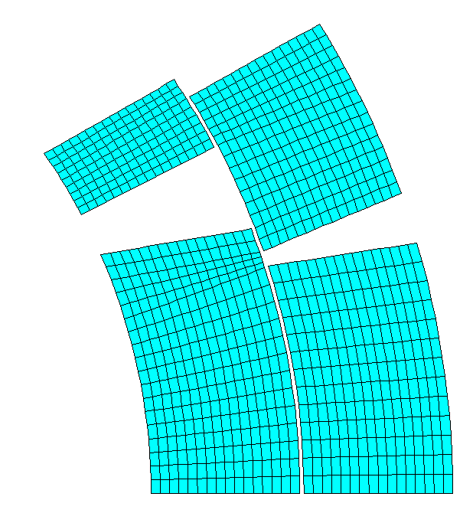
Progress towards modeling milestones
Will be presented at MT27
Need to validate CZM models in 3D
Strand Model
Building representative volume element (RVE) approach
leverages 10-stack experiments
Issues being addressed:
Correct element (material) coordinate system definition – a bit challenging in the ends
3D yielding limits
3D hardening criteria
Block ‘RVE’ Model

Slide 13
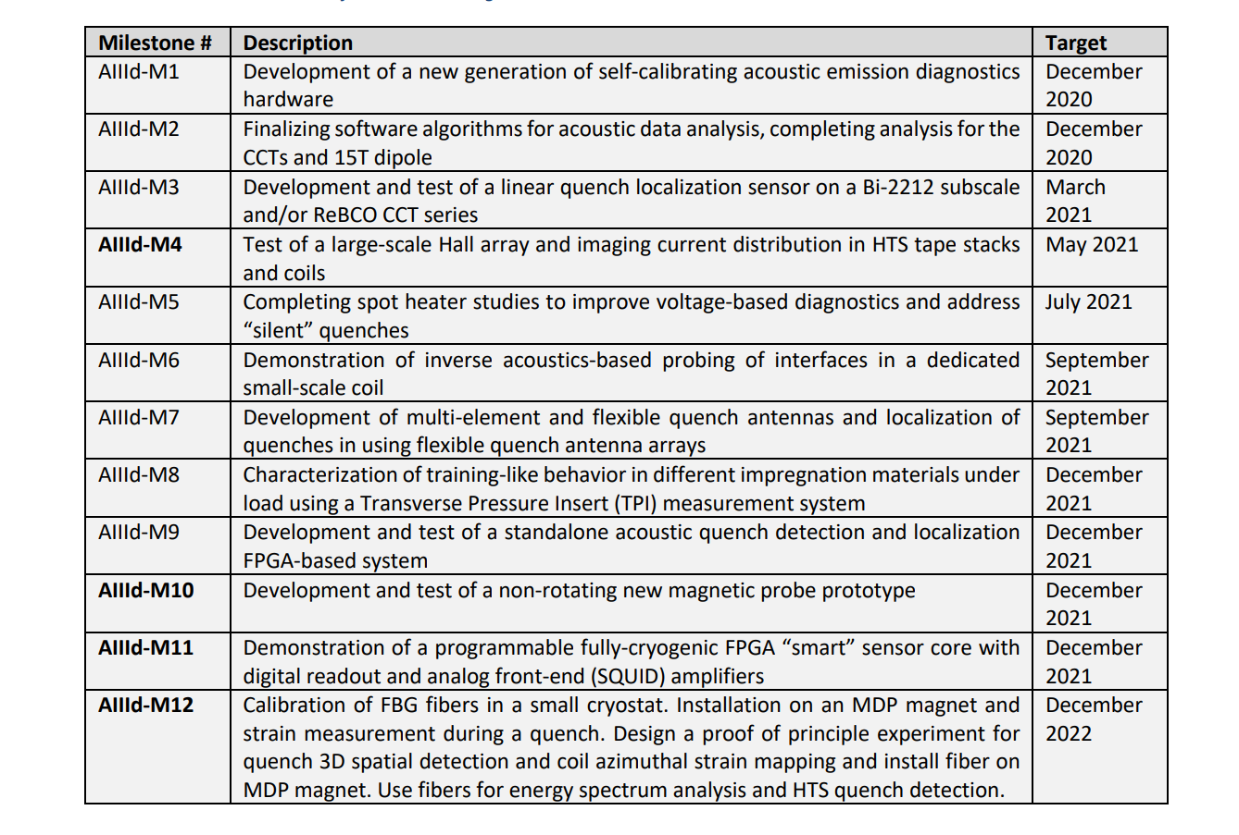
Significant progress on diagnostics – connected to magnet tests
Acoustic data analysis completed for 15 T (LBNL), CCT4 and subscale 2 – in progress (LBNL). New ML algorithms for quench precursors (FNAL)
In progress, new developments (LBNL)
Hall array hardware built, tested on CORC (LBNL)
Talks in progress at FNAL for implementing these studies
TBD (LBNL)
MQXFA QA built and delivered, warm bore tube QA structures are ready as well (FNAL). CCT subscale antennas (LBNL)
New tests with matrimid and organic resins mixed with high-Cp ceramics are planned at FNAL
Non-FPGA portion was built and tested (LBNL, BNL). Upgrade to FPGA TBD towards the target date
TBD (LBNL, FNAL) – likely early 2022
New DAQ boards, performance characterized for various cryo-parts. One channel cryo-system to be tested by the end of 2021 (LBNL)
Progress with early tests. Modifications to vertical test facility to integrate fibers. (FNAL, BNL)

Slide 14
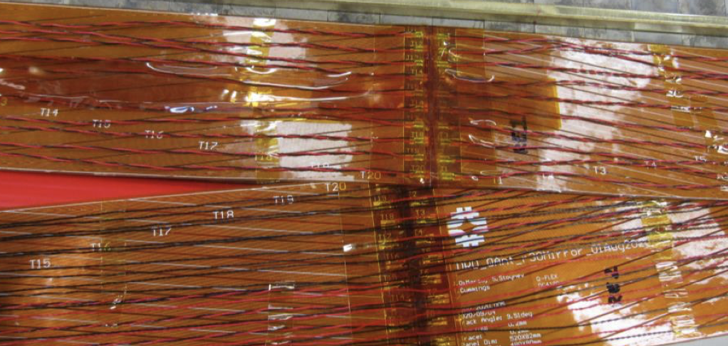
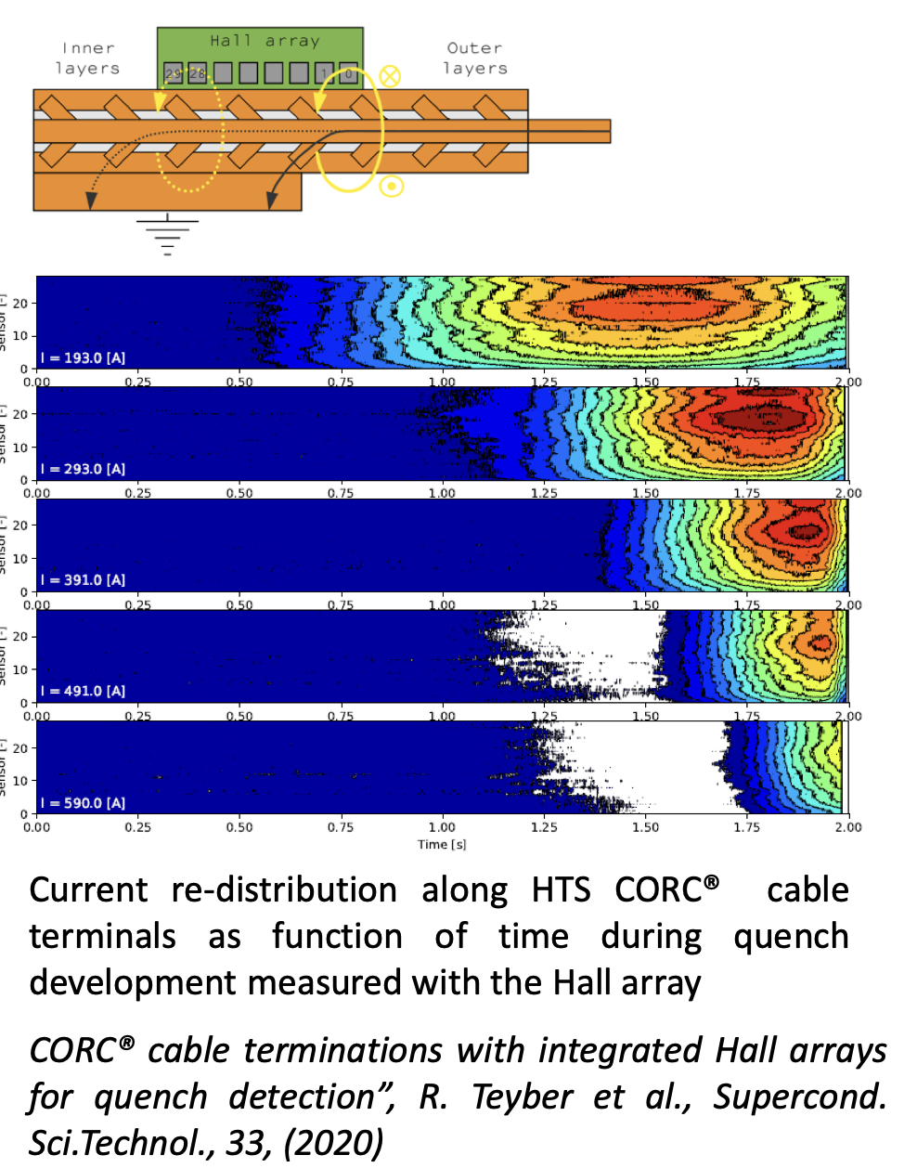
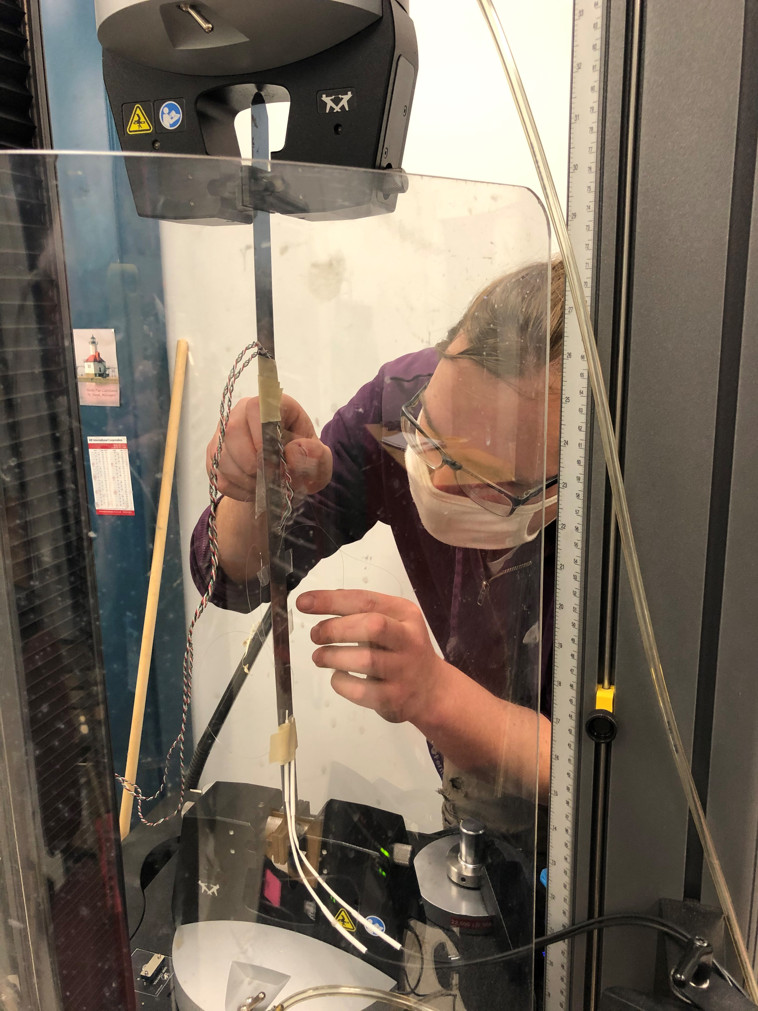
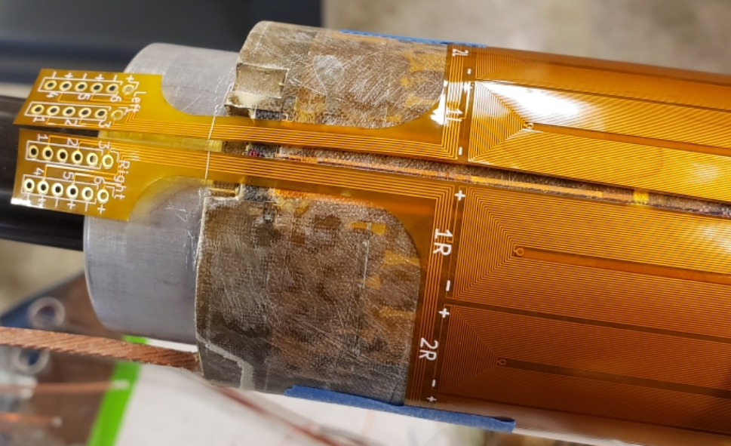
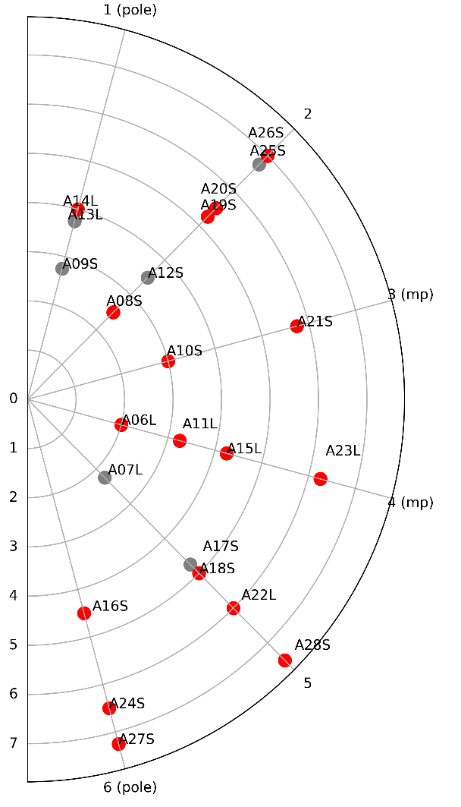
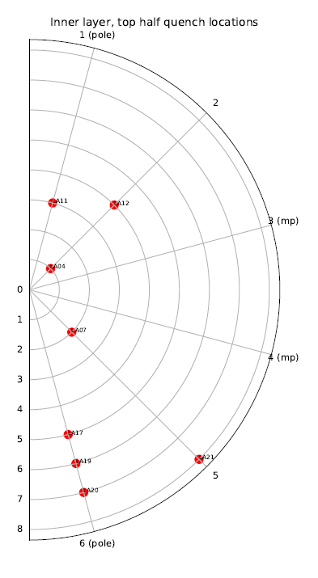
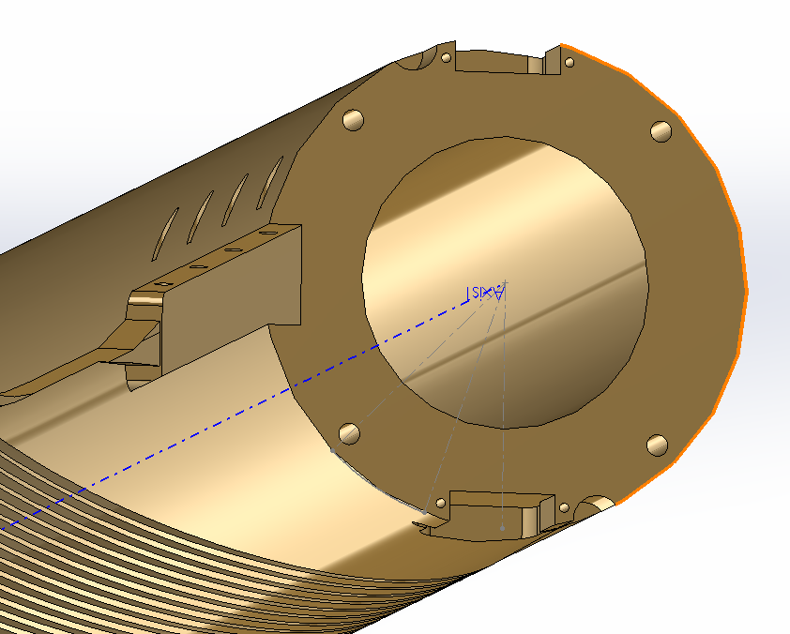
Examples of diagnostics developments
Flex-QA (flexible PCB quench antenna)
FBG fiberoptics – developing techniques
Hall array-based quench detection for HTS cables
Strain gauges
FBG sensors

Slide 15
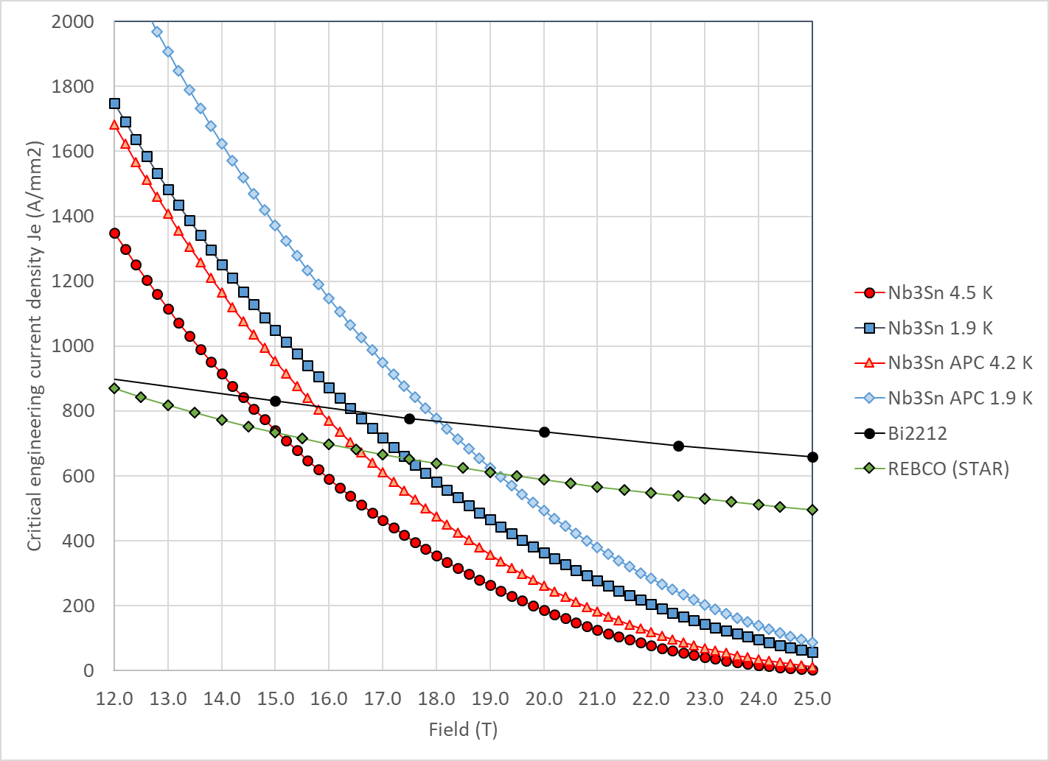
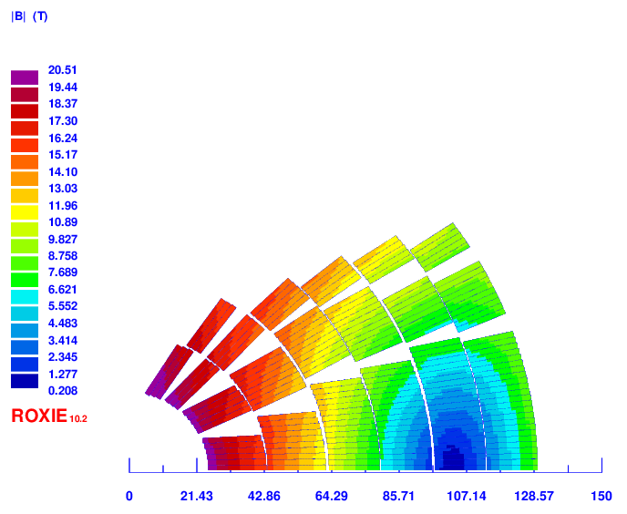
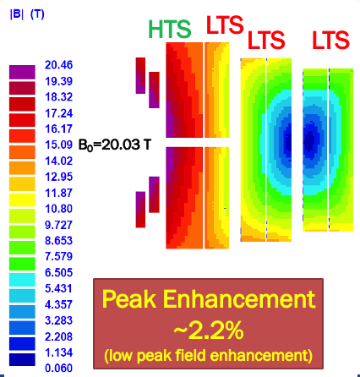
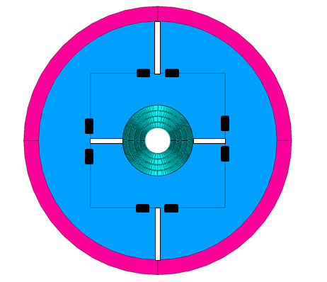
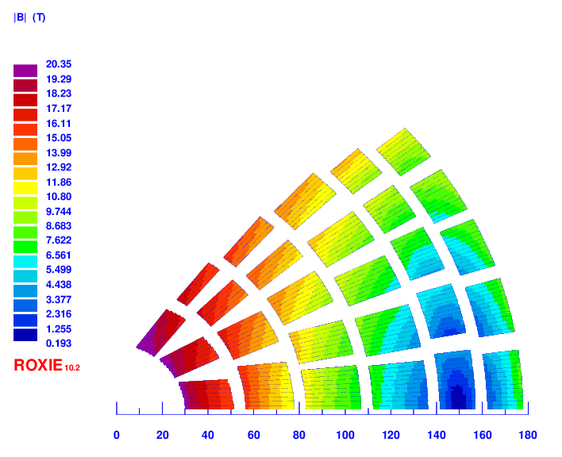
20 T hybrid magnet and comparative analysis
Team assumes for REBCO & Bi2212:
J_{e}(20T)= 740 A/mm^{2,} J_{o} = 500 A/mm²
Utility structure is being re-optimized for stress-managed designs

Slide 16
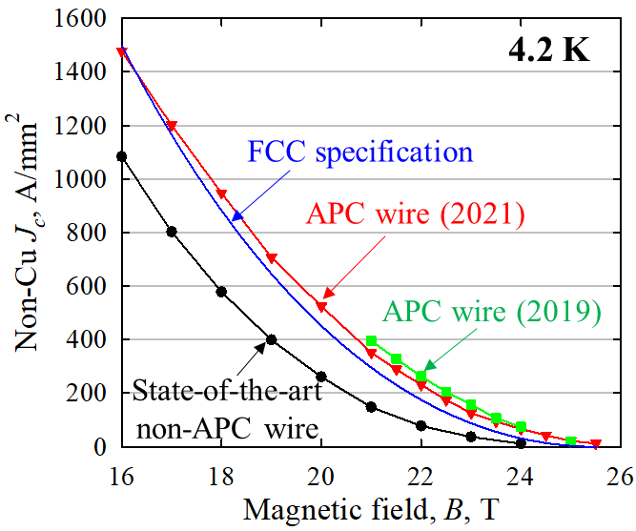
Conductor Procurement and R&D
In the past 12-month period (2020 Aug - 2021 Aug), CPRD placed three POs:
  LBNL PO 7544721 with BOST, with a value ~$287+$110 (in two phases, without burden) on Hf-doped Nb₃Sn
    The contract ran into some technical difficulties in phase I.
    It is pending a formal phase I closeout report and discussion on follow up proposals
  LBNL PO 7541135 with BOST, with a value ~$100k (without burden) on small Deff Nb3Sn strand by improving subelement roundness
    The contract is running behind schedule but is expected to complete end of 2021
  LBNL PO 7596379 with BOST on 2212, with a value ~$340k (without burden)
    It is being revised to minimize risk and to accelerate to meet magnet needs
2400 m of 0.8 mm Bi-2212 wire (billet PMM161111) was transferred from CPRD inventory to Fermilab to enable work on hybrid magnet
Experience from the 2212 procurement:
  Need to balance the Procurement and R&D goals and the magnet milestones
    Limited funding means we need to manage the risks accordingly
      may not always be able to achieve all the goals simultaneously

Slide 17
Engagement with industry
We work to identify SBIR partners aligned with MDP goals
2021 Phase I
Accelerator Technology Corp., College Station, TX | 77845-7158 | McIntyre, Peter | SBIR | Nb3Sn SuperCIC Outsert and REBCO Conformal Insert for an 18 T Collider Dipole
AMPEERS LLC, Houston, TX | 77059-3733 | Galstyan, Eduard | SBIR | Multi-Strand Transposed Cables of Round REBCO Wires for Accelerator Magnets
Advanced Conductor Technologies LLC, Boulder, CO | 80301-2385 | van der Laan, Danko | SBIR | Hybrid accelerator magnets based on dog bone shaped CORC® wire inserts for operation beyond 20 T
Cryomagnetics, Incorporated, Oak Ridge, TN | 37830-8011 | Minter, Stephen | STTR | Very High Field Superconducting Magnets Using REBCO
2021 Phase II
Engi-Mat Co., Lexington, KY | 40511-2637 | Bugaris, Daniel | SBIR | Bi2212 powder production with wide Tmax window for high field magnet applications
Solid Material Solutions, N. Chelmsford, MA | 50011-1061 | Otto, Alexander | SBIR | Advanced silver sheathed 2212/Ag wire for high field magnets
Cryomagnetics, Incorporated, Oak Ridge, TN | 37830-8011 | Minter, Stephen | STTR | Very High Field Hybrid Superconducting Magnet Using Bi-2212
2020 Phase I
AMPEERS, LLC | 77059-7705 | Kar, Soumen | SBIR | Low-cost Manufacturing of Round REBCO Wires for Accelerator Magnets
Hyper Tech Research, Inc. | 43228-2412 | PENG, XUAN | SBIR | Improved Stability of Nb3Sn Superconductor by Increasing Specific Heat
MetaMateria Technologies, LLC | 43228-1155 | Sengupta, Suvankar | SBIR | Multifilamentary high JE Bi2Sr2CaCu2Ox/Ag superconducting wires for high fields
Accelerator Technology Corp. | 77845-7158 | Sattarov, Akhdiyor | SBIR | Jelly-roll Fabrication of Textured-Powder Bi-2212/Ag wire
Particle Beam Lasers, Inc. | 75167-2807 | Gupta, Ramesh | STTR | Overpass/Underpass Coil Design for High Field Dipoles
2020 Phase II
Hyper Tech Research, Inc | 43228-2412 | Peng, Xuan | SBIR | A Novel Way to Dope Ti in Nb3Sn Conductor to Reduce A15 Grain Size and Improve non-Cu Critical Current at High Fields

Slide 18
Ongoing / planned international collaborations
International
Activity | MDP Relevance | Collaborating Institution | Contact(s) | MDP Contact | Tier Category | Start Date | End Date
Study of transverse loading on Rutherford cables in FRESCA II using 10mm cable with Hi-Lumi strands. | MDP Nb3Sn Program | CERN | Bernardo Bordini | Ian Pong | 3 | Dec-18 | N/A
Possible collaboration with PSI to jointly build a 4-layer SM-CT* | Nb3Sn dipole | PSI | Auchmann, B. | Zlobin, A. | 3 | TBD | TBD
CCT Development | Nb3Sn CCT | PSI | Auchmann, B. | Brouwer, L. | 1 |  | Ongoing
CCT Instrumentation | Nb3Sn CCT | PSI | Auchmann, B., Montenero, G. | Marchevsky, M. | 3 |  | Ongoing
Acoustic Sensor Development | Technology Development | CERN | Kirby, G. | Marchevsky, M. | 3 |  | Ongoing
APC Nb3Sn | Conductor Development | CERN | A. Ballarino | D. Larbalestier | 1 | 2018 | 2020
A Collaboration Framework To Advance High-Temperature Superconducting Magnets For Accelerator Facilities | Technology Development/HTS - HTS Magnet and Magterials R&D | KEK, Kyoto Univ. | T. Ogitsu), N. Amemiya | Shen, Gupta | 3 | 2018 | Ongoing
History and Documentation of Nb3Sn Magnet R&D | MDP Nb3Sn Program | EuroCirCol | Schoerling, D. | Zlobin, A. | 3 | 10-Jul | 11-Jul
Conceptual design of the Quadrupole magnets for high low luminosity interaction regions of FCC | Magnet design | CERN | Schoerling, D. | Velev, George | 1 | 3/18/19 | 12/31/22

Slide 19
Summary
MDP continues to grow stronger, leveraging the collaboration between the members
Significant progress towards major milestones - we are seeing inevitable schedule slippages, but these are being managed and minimized to the degree possible
  Some due to conductor supply chain
  Some simply due to limited resources (mainly funding, not staff)
  Very modest amount may be attributed to COVID
Investments in infrastructure are ongoing and/or being pursued to support MDP goals
  New Bi2212 furnace coming online now
  Continued improvements to testing capabilities at BNL’s 10T facility (e.g. higher current), additional liquefier being procured
  Ongoing progress on FNAL’s planned HTS Cable Test Facility / Hybrid Magnet Test Facility
  Hybrid header and extraction system upgrades at LBNL, liquefier upgrade
  The MDP team is focused and working hard on the milestones identified in the updated Roadmaps!
HEP, FES, ARPA-E, internal funds, etc.

