Slide 1
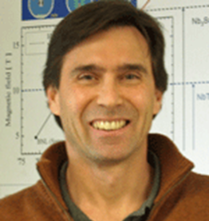
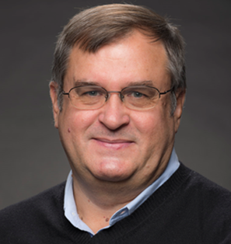
AF7: Accelerator Technology – Subgroup Magnets
Goal
Address the potential contributions of magnet technology to future HEP facilities, the R&D required to enable these opportunities, the time and cost scales of these efforts, and the needs for associated fabrication infrastructure and test facilities.
Conveners
Susana Izquierdo Bermudez
CERN
GianLuca Sabbi
LBNL
Alexander Zlobin
FNAL

Slide 2
AF7-Magnets: LoIs
50 LoIs: 5 from Asia, 11 from Europe, 34 from the US
Excel spreadsheet uploaded to https://indico.fnal.gov/category/1118/
 | Category | System | U.S. | EU | Asia
Machines | Hadron collider (FCChh, HE-LHC, SppC, etc.) | Arc D/Q/corr, IR Q/D, Misc. magnets | 9 | 2 | 1
 | Linear collider (ILC, CLIC, etc.) | IR, undulators, etc. | 1 | 1
 | Muon collider | SR and IR, muon production and cooling | 2 | 2
 | Lepton-hadron collider (LHeC, FCCeh, EIC, etc.) | SR and IR, other systems
 | High Intensity Proton Source | Fast cycling magnets |  | 2
 | Gamma-Gamma | Undulators | 1
 | Dark Matter, Detectors | Large aperture dipole detectors |  | 1 | 2
Materials and Technologies | Superconducting and structural materials | Wires, cables, insulation, magnetic materials | 9 | 1
 | Magnet technologies | Magnetic and mechanical structures, protection, fabrication, instrumentation, measurements and tests, cost | 8 | 1 | 1
 | Magnet cooling, accelerator cryogenics | Cryostat, heat transfer and removal, quench protection, cost |  | 1
 | Test Facilities | Magnets, cryogenics, instrumentation, test cost | 4

Slide 3
AF7/Magnets - Organization
The LoI input is organized under 6 themes (working groups):
Global collaboration (6 LoI)
High-field arc and IR magnets (15 LoI)
Conductor and cable (13 LoI)
Detector magnets (5 LoI)
Special magnets - solenoids, undulators etc. (7 LoI)
Test facilities and measurements/diagnostics techniques (4 LoI)
Main goals:
Provide a forum for presenting/discussing proposals
Coordinate writing of white papers, fostering potential collaboration across institutions (Labs, University, Industry) and geographical regions

Slide 4
AF7/Magnets - Schedule
Time frame | Main objectives | Specific activities/meetings
Now through November | Working group discussions and meetings to plan and start work on white papers | Review of regional roadmaps and test facility plans with area leaders (T1+T6) Organize meetings for larger WGs: T2: High-field arc and IR magnets T3: Conductor and cable Conveners facilitate/guide work of smaller WG (T4/detectors, T5/special magnets, T6/diagnostics)
December/January | Assess working group progress | Review and provide feedback on draft white papers
January-March | Finalize white papers | Collect by March 15 deadline
March-June | Draft topical group report and CSS preparations | General AF7/magnets meeting to present/discuss report and CSS plans
July-September | CSS and Final report | Incorporate CSS and AF feedback

Slide 5
US MDP LoIs
MDP 20 out of 50
3 – programmatic
4 - Nb3Sn magnets
3 – HTS and hybrid magnets
6 – technology/instrumentation
7 - conductor

