Slide 1
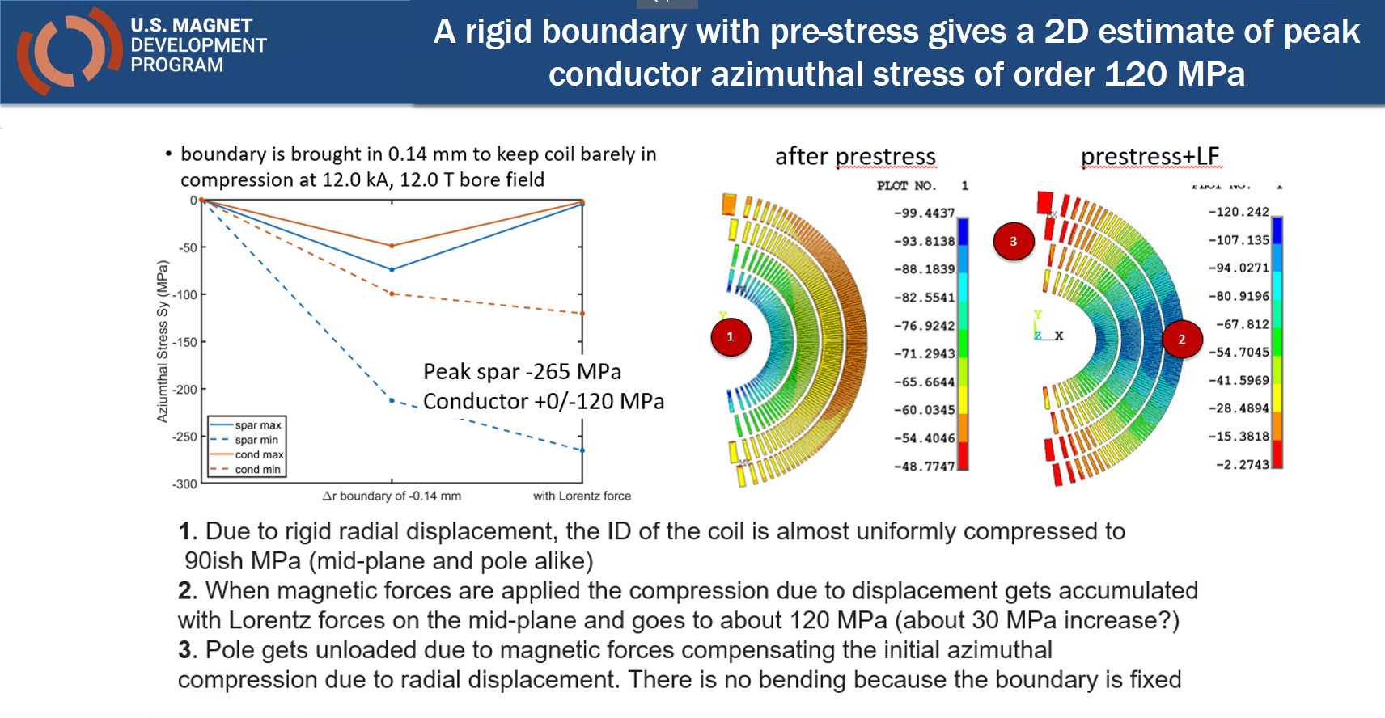
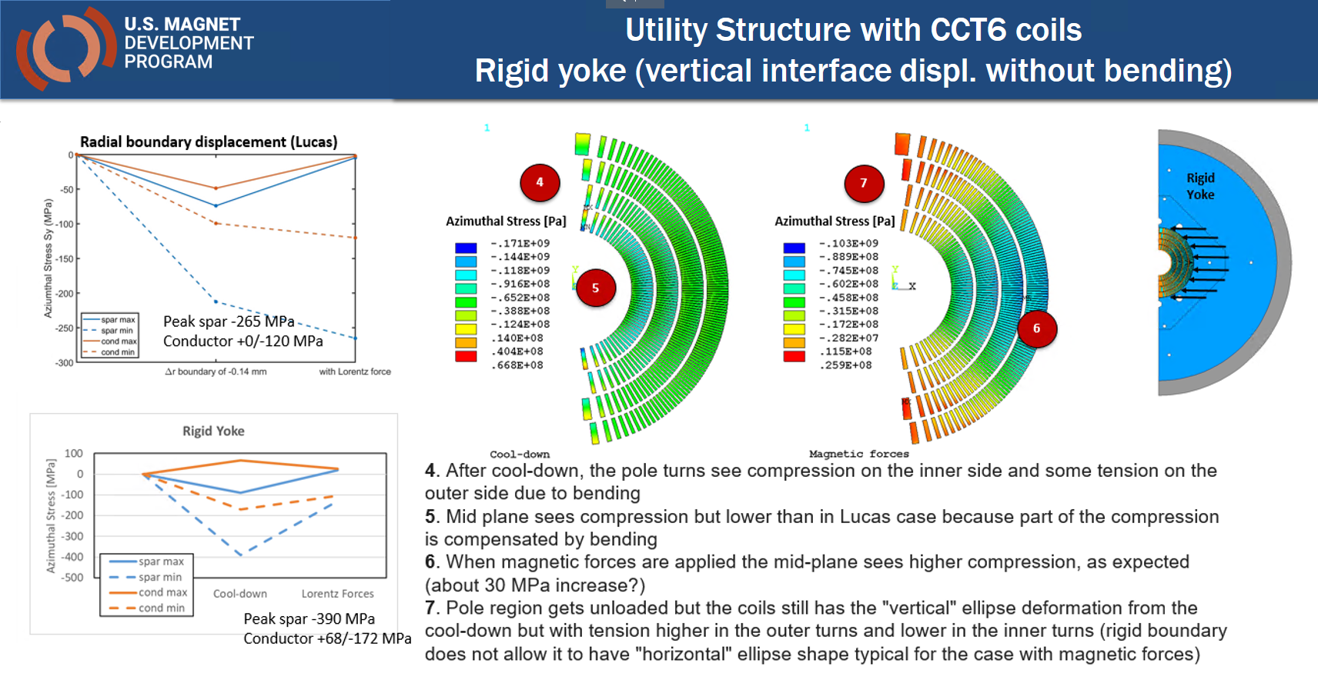
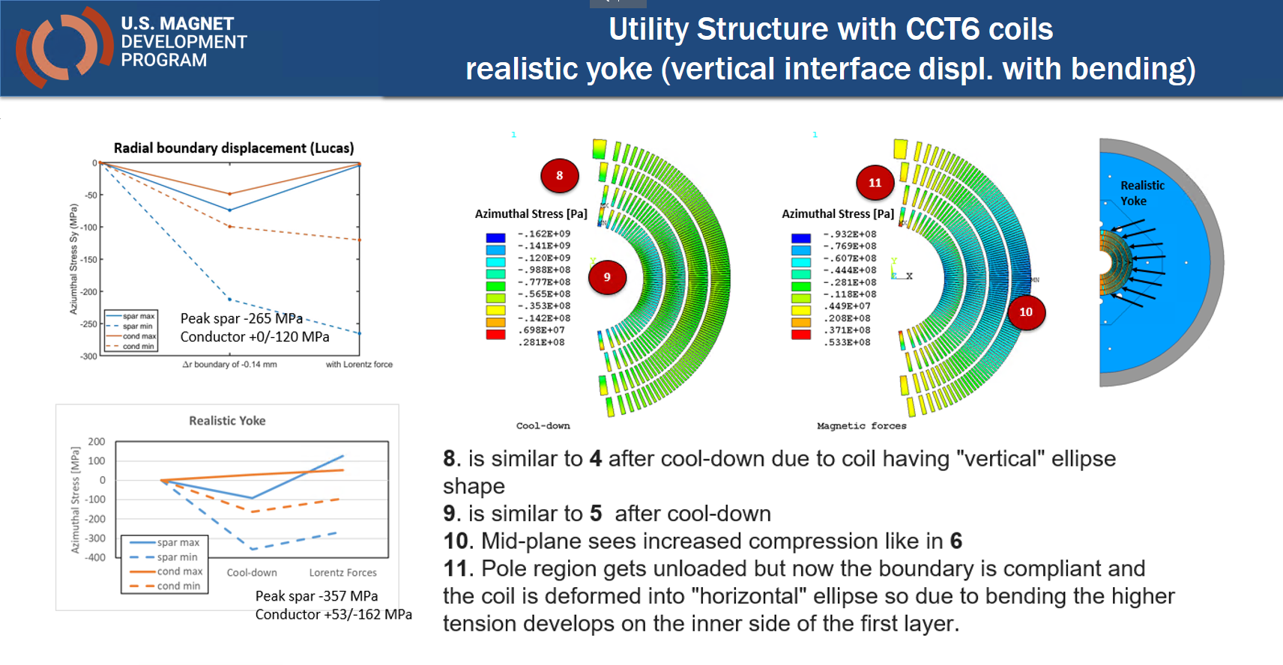
Testing various yoke-pad configurations
Past analysis
Fixed boundary displacement and ultra-rigid structure
Acceptable stress distribution but unrealistic structure
Realistic materials and open yoke/pad vertical interface
Risk of over-compression of pole region during cool-down (coil ovalization)
Tensile stress in the pole region to be investigated in 3D
Various yoke types motivation
Performed in the past for CT but not for CCT or SMCT
Goals
Control of deformation after cool-down
Minimizing tension when magnetic forces are applied
Using bladder-and-key structure

Slide 2
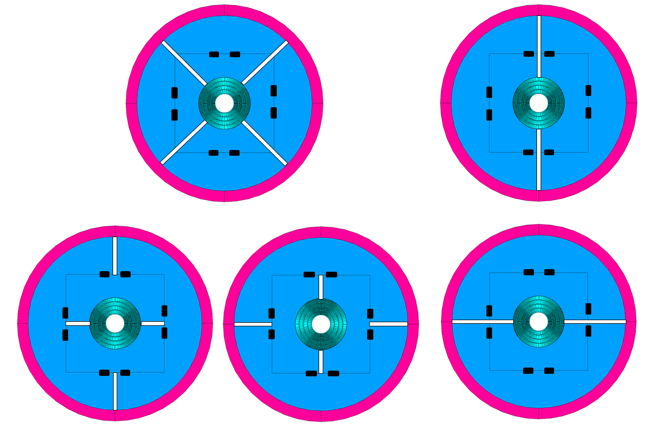
Various configurations Geometry and modeling
Model
Simplified model
Yoke/pad split into 8 pieces each
Various configuration obtained with boundary conditions and node coupling
Key between yoke/pad modeled with contact elements
Configurations
Quadrupole structure (MQXF-like)
Vertical split dipole structure
Horizontal split dipole structure
H-split yoke / V-split pad
V-split yoke / H-split pad
1
2
5
4
3

Slide 3
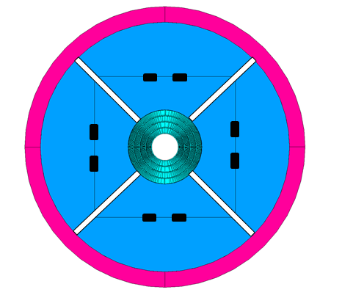
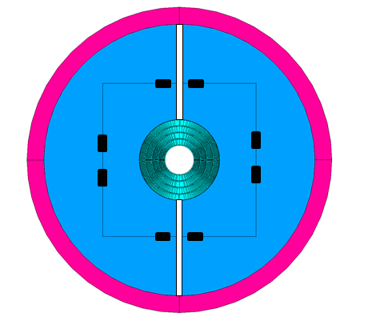
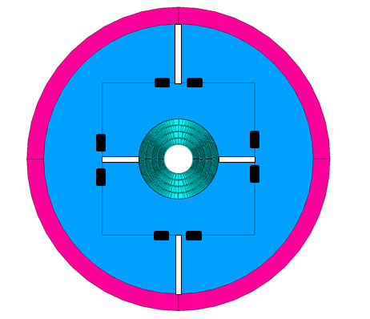
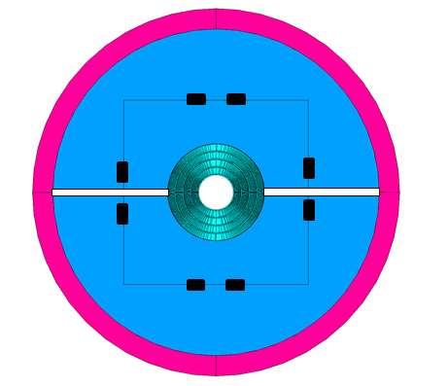
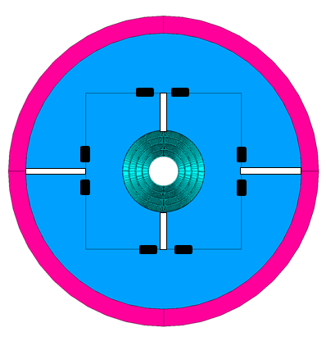
Various configurations Analysis summary
Quad structure
Good control over cooldown deformation
Lack of rigidity to counteract mag. forces
V-split dipole
Risk of high stress / deformation during cool-down
Some tension when magnetic forces applied
V-split yoke/H-split pad
Uniform radial deformation can be achieved after cooldown but ovalization needed to compensate for mag. forces
Higher overall structure rigidity
Lower tensile stress with hor. Interference
H-split yoke/V-split pad
A lot of similarities to the case above
Seems harder to control than the case above but it will be analyzed further
H-split dipole
Acceptable stress after cooldown but deformation contributes to magnetic forces stresses
No control over stress when magnetic forces applied

Slide 4
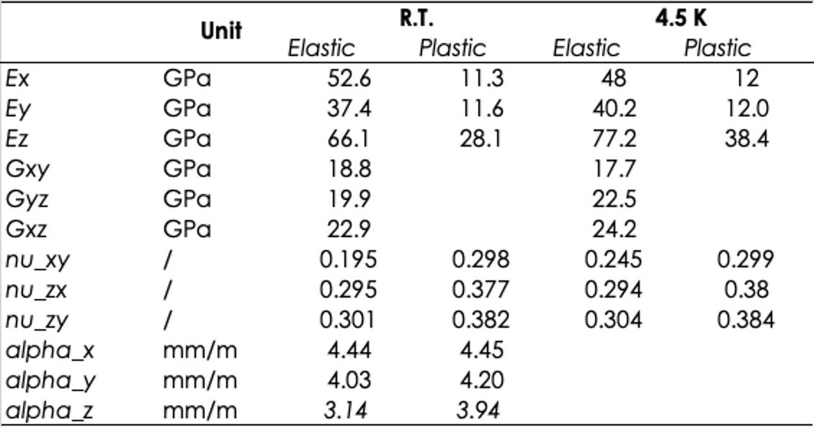
Updated conductor properties
Elastio-plastic properties from Giorgio Vallone
Based on MQXF cable modeling
Elastic material used for the initial optimization analysis
Average of elastic and plastic parameters from the table

Slide 5
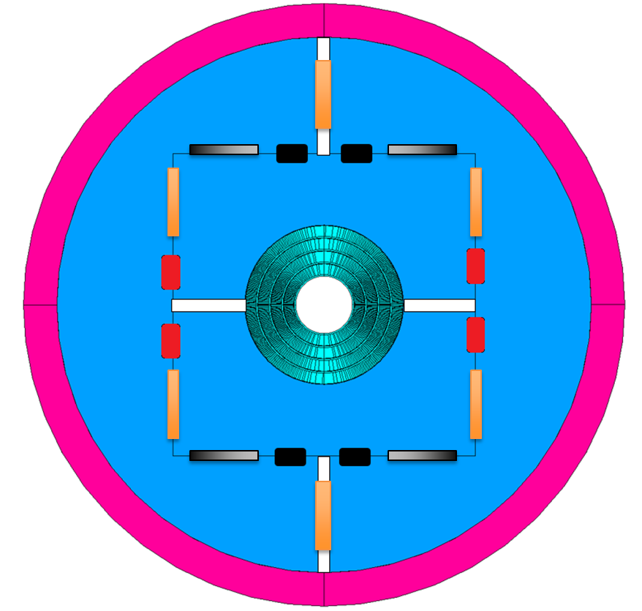
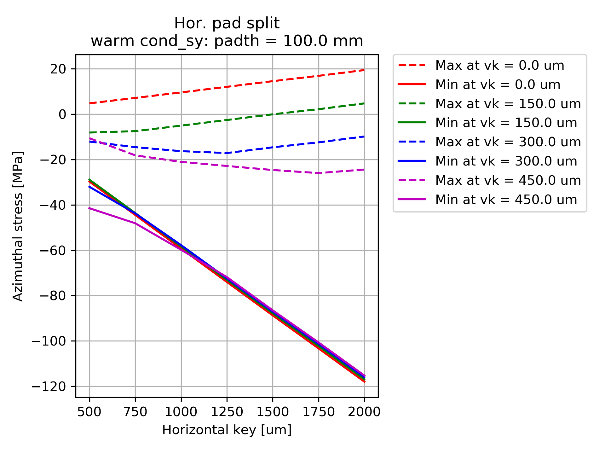
Analysis, parameters and example result plot
Analysis Steps
Room temperature preload
Cool-down
Magnetic forces
Varied parameters
Pad thickness
100, 125 and 150 mm
Vertical key interference
0 to 450 um
Horizontal key interference
500 to 2000 um

Slide 6
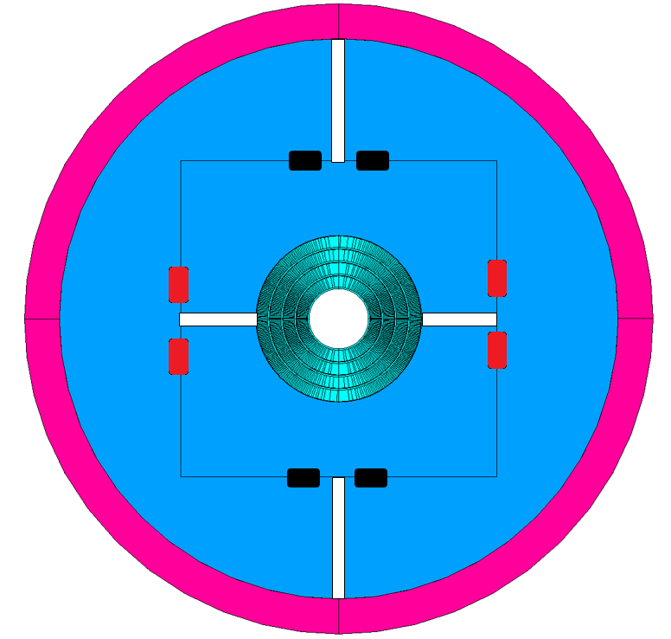
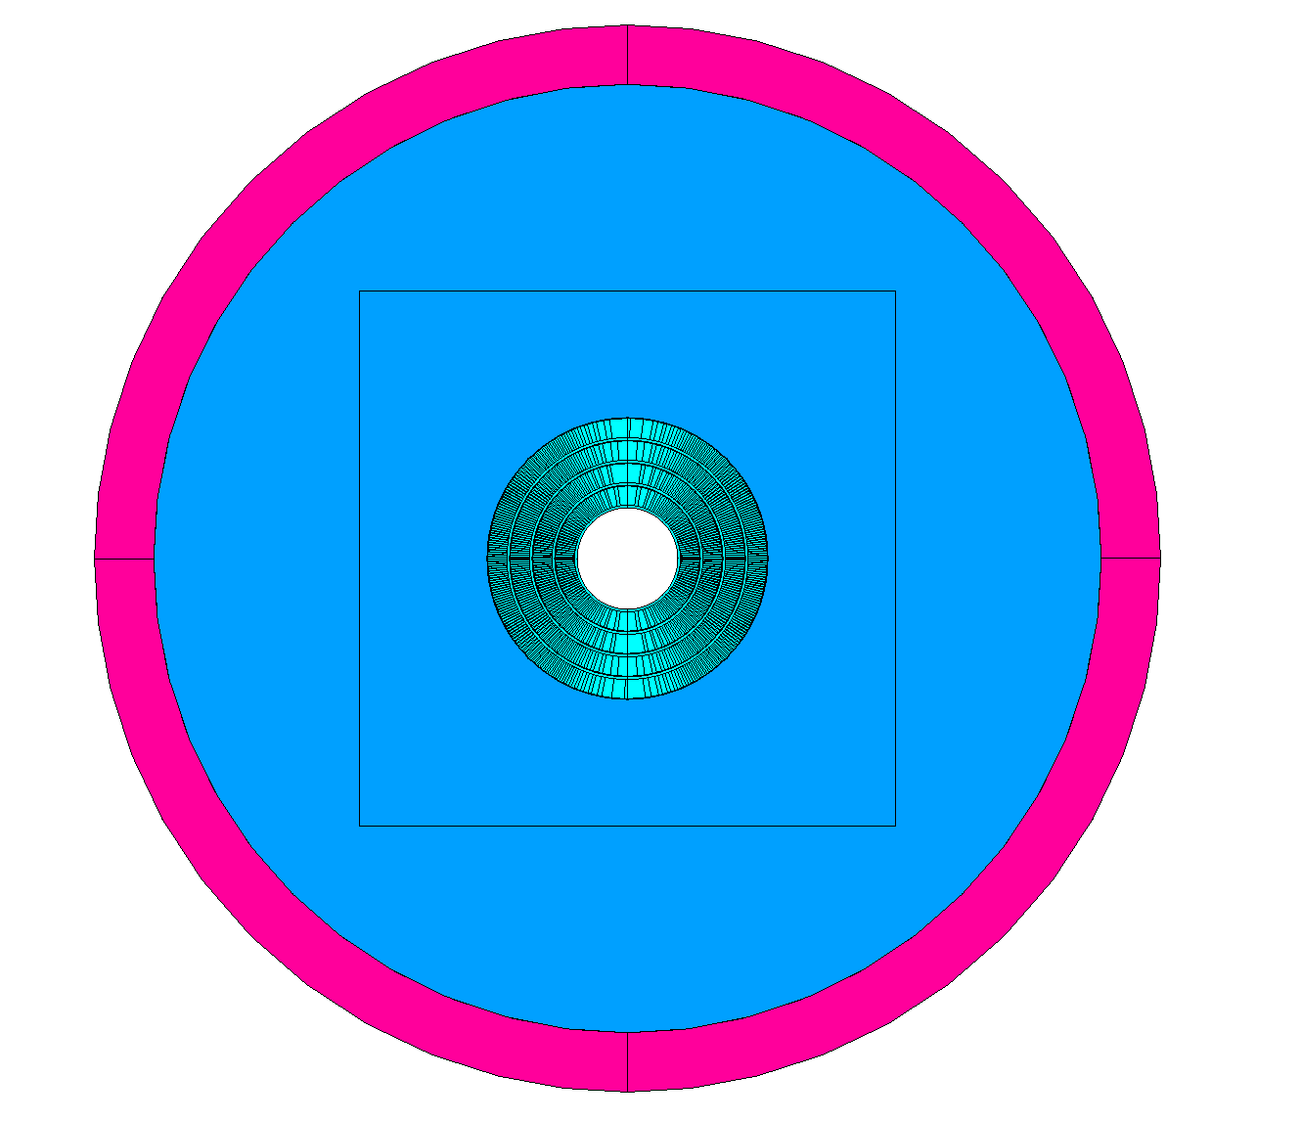
V-Split Yoke vs V-Split Yoke H-Split Pad V-Split Pad

Slide 7
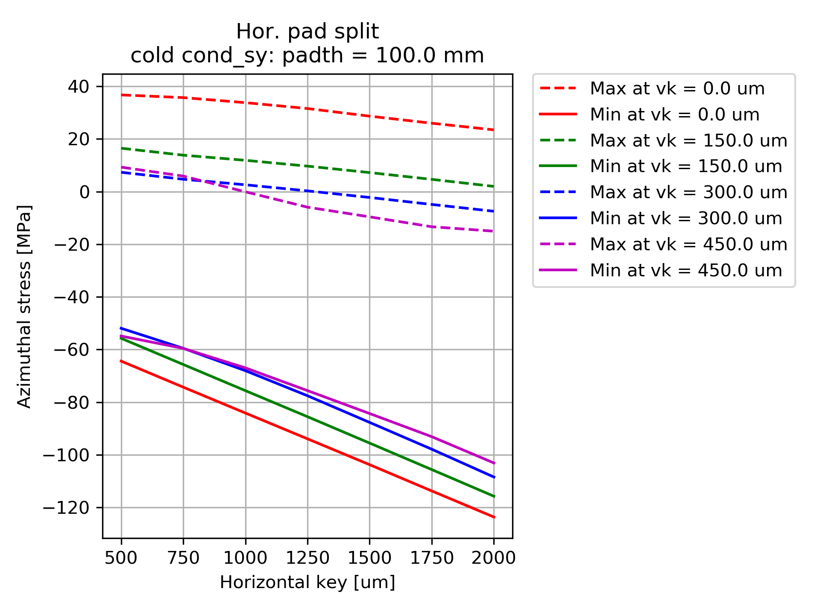
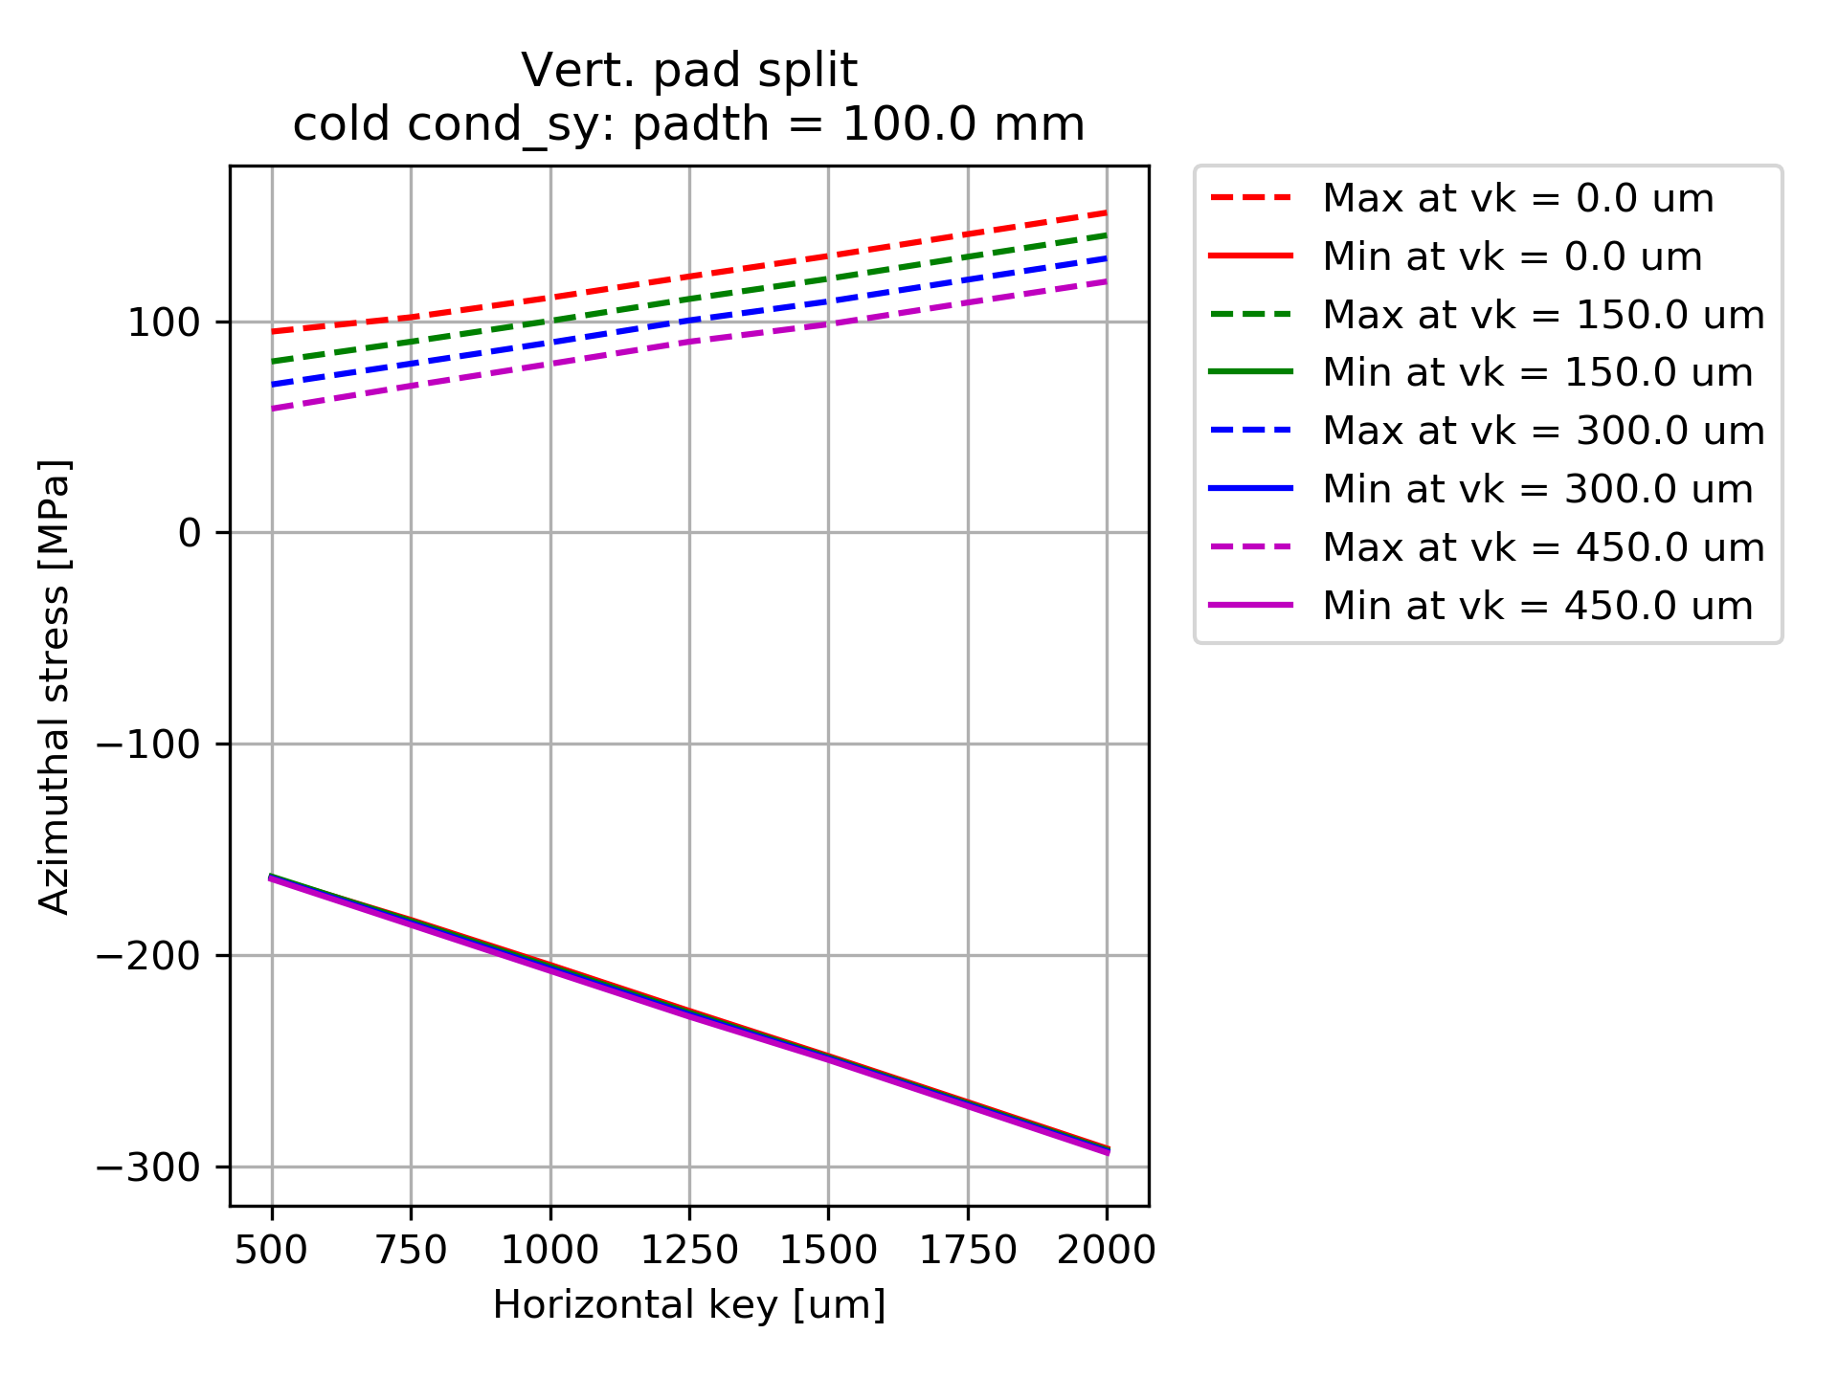
Conductor azimuthal stress Cool-down
Thinner (100mm) pad and 150um vertical gives the same benefits as thicker pad
Increasing horizontal key increases tensile stress.
Even 500um horizontal interference causes the compressive stress of ~150 MPa

Slide 8
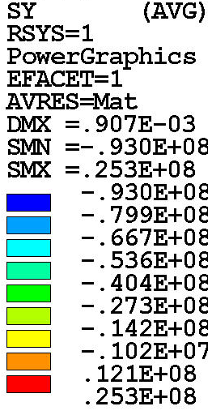
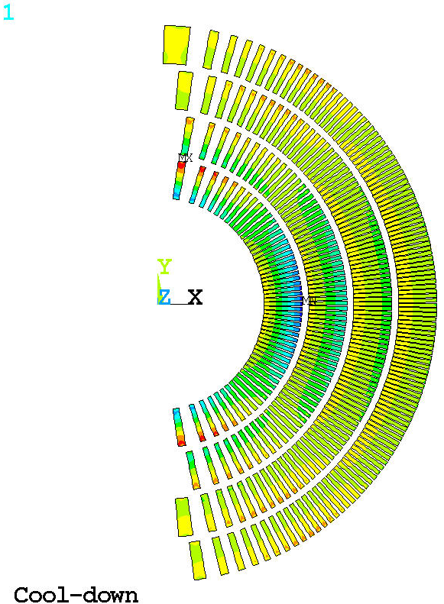
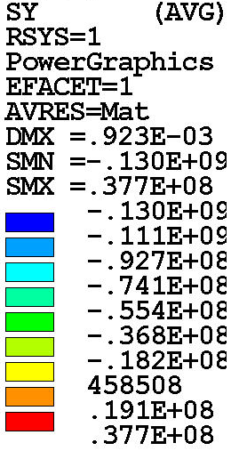
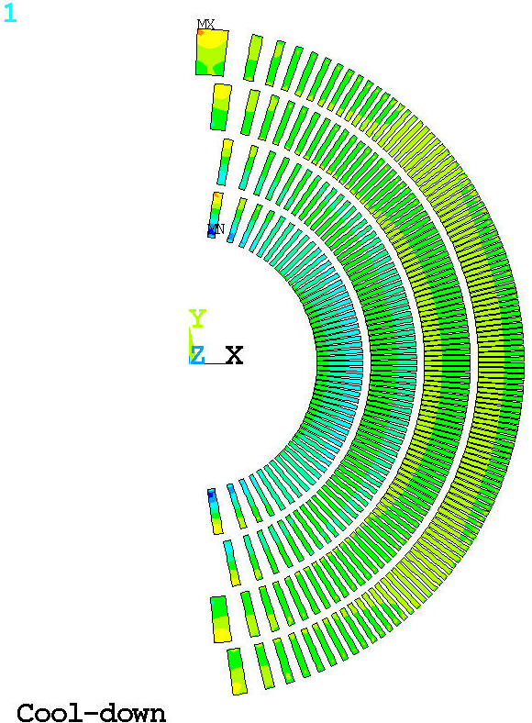
Conductor azimuthal stress Cool-down
Pad 100 mm
HK 1250 um
VK 100 um
Pad 100 mm
HK 250 um
VK 450 um
High compression on the mid-plane but <100MPa
High compression in pole turn but <125MPa

Slide 9
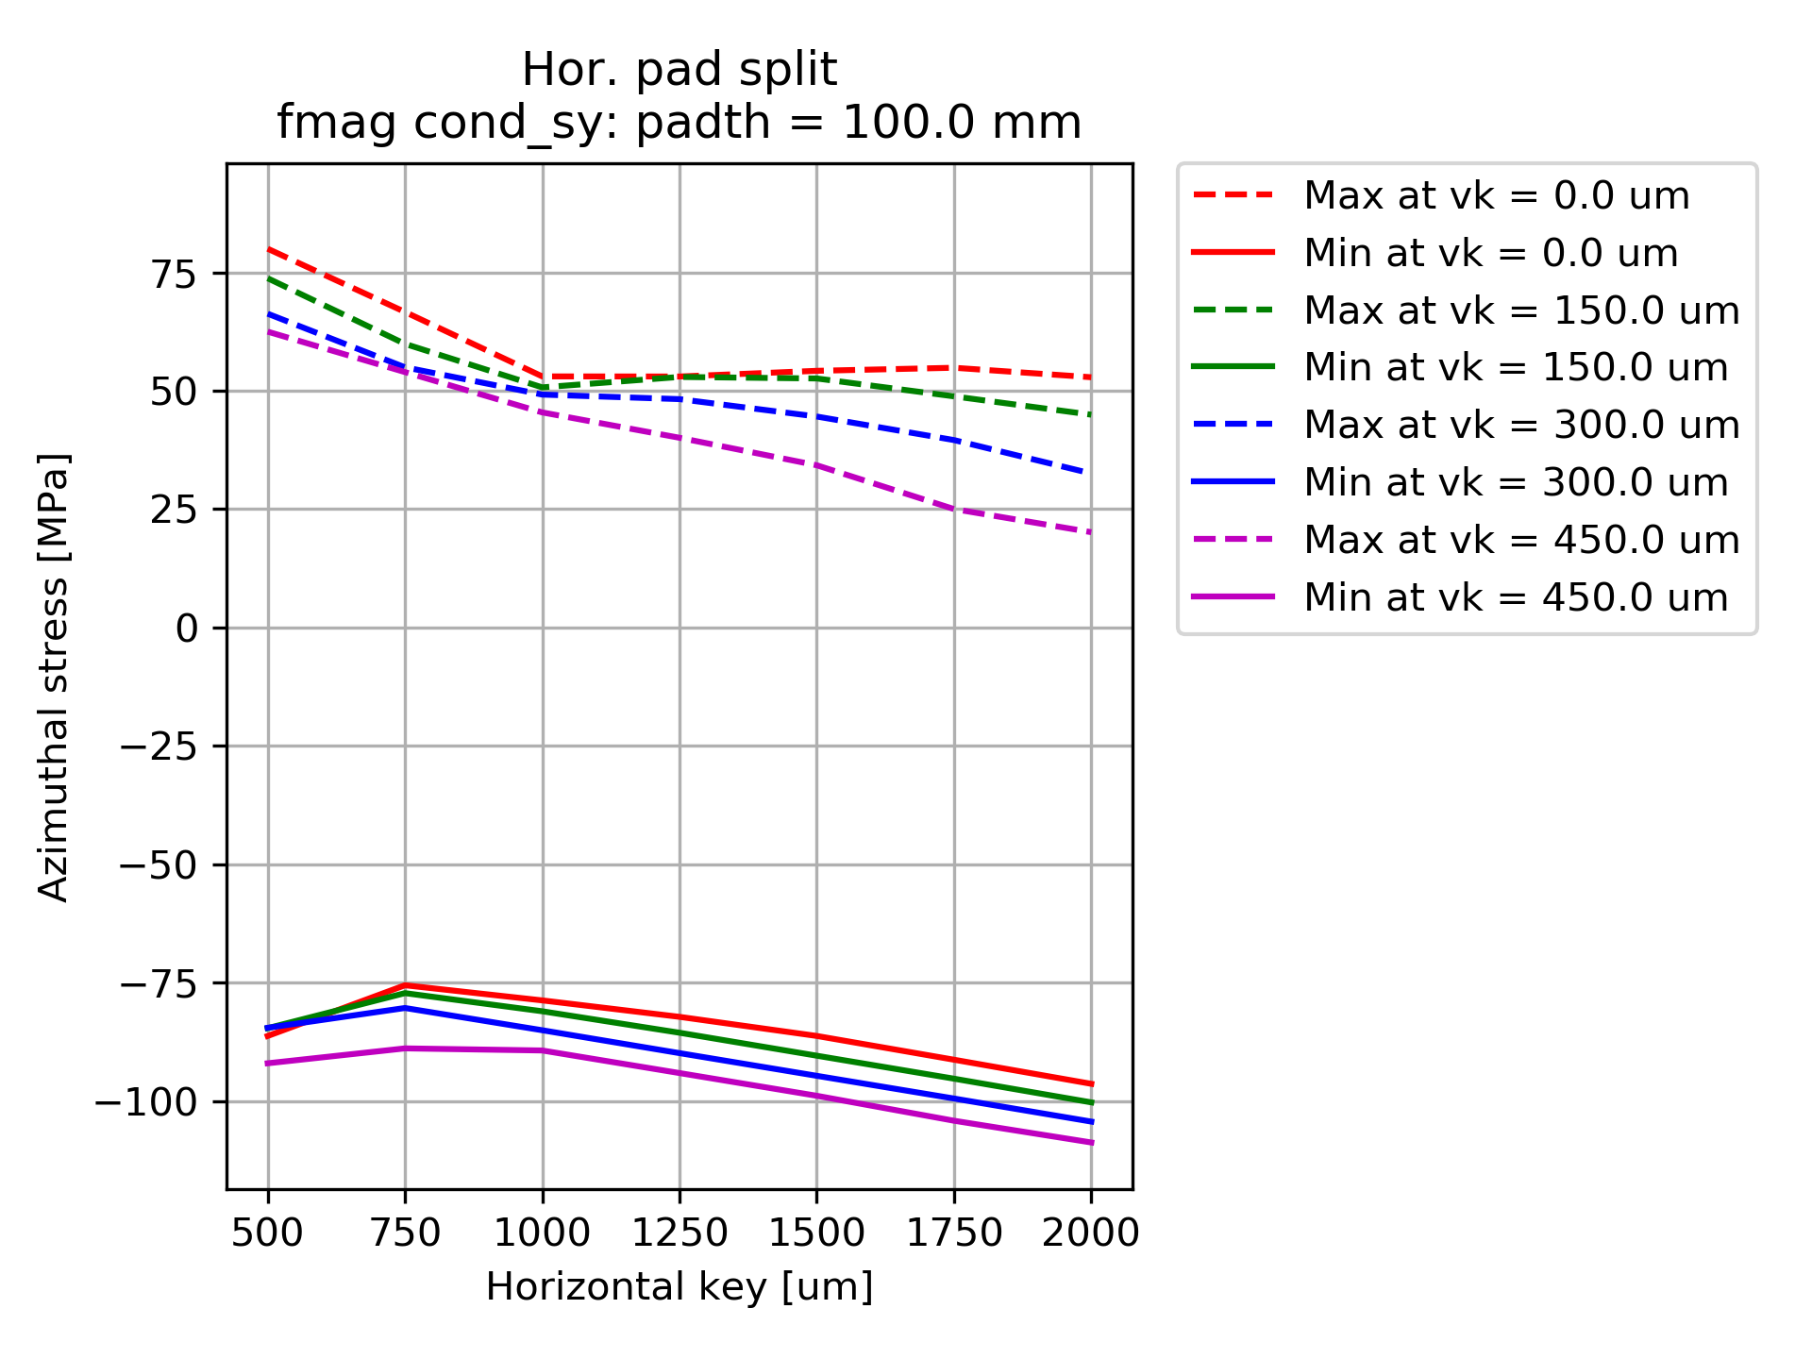
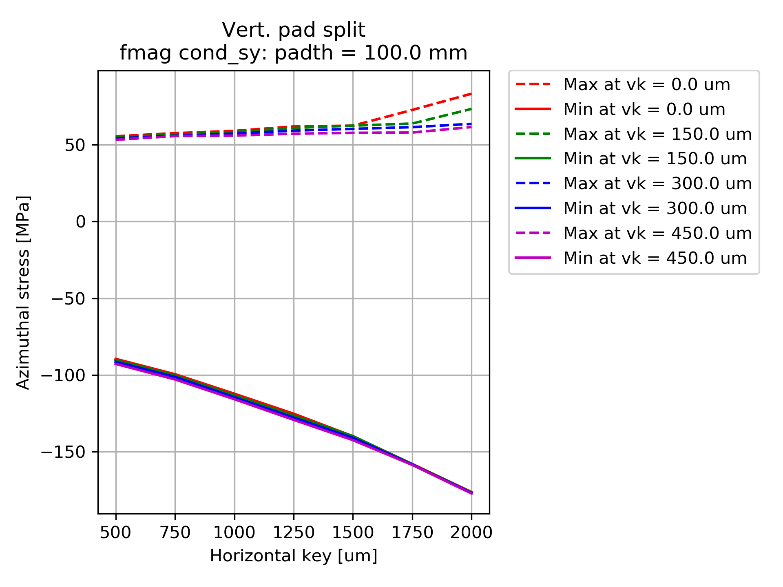
Conductor azimuthal stress Magnetic forces
Tensile stress does not show high sensitivity on pad thickness nor vertical interfacernce

Slide 10
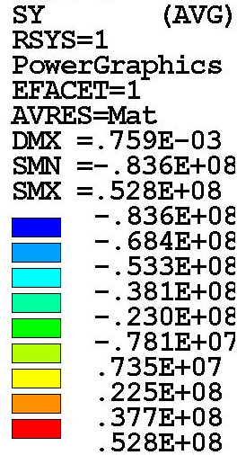
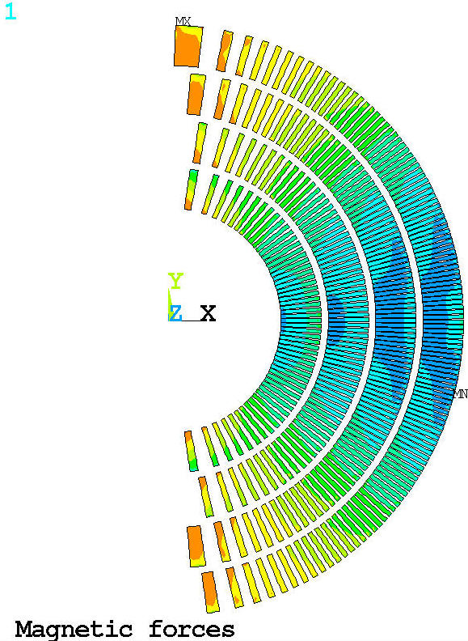
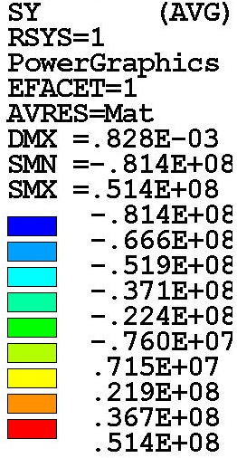
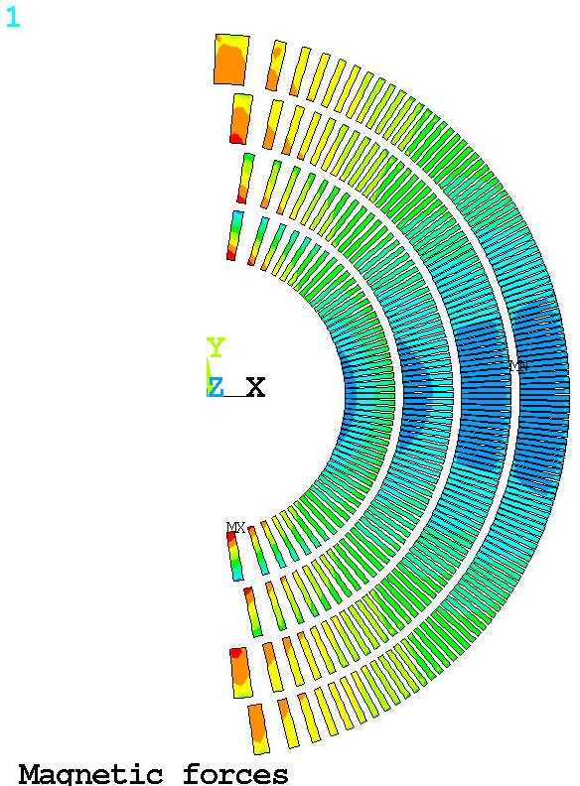
Conductor azimuthal stress Magnetic forces
Pad 100 mm
HK 1250 um
VK 100 um
Pad 100 mm
HK 250 um
VK 450 um

Slide 11
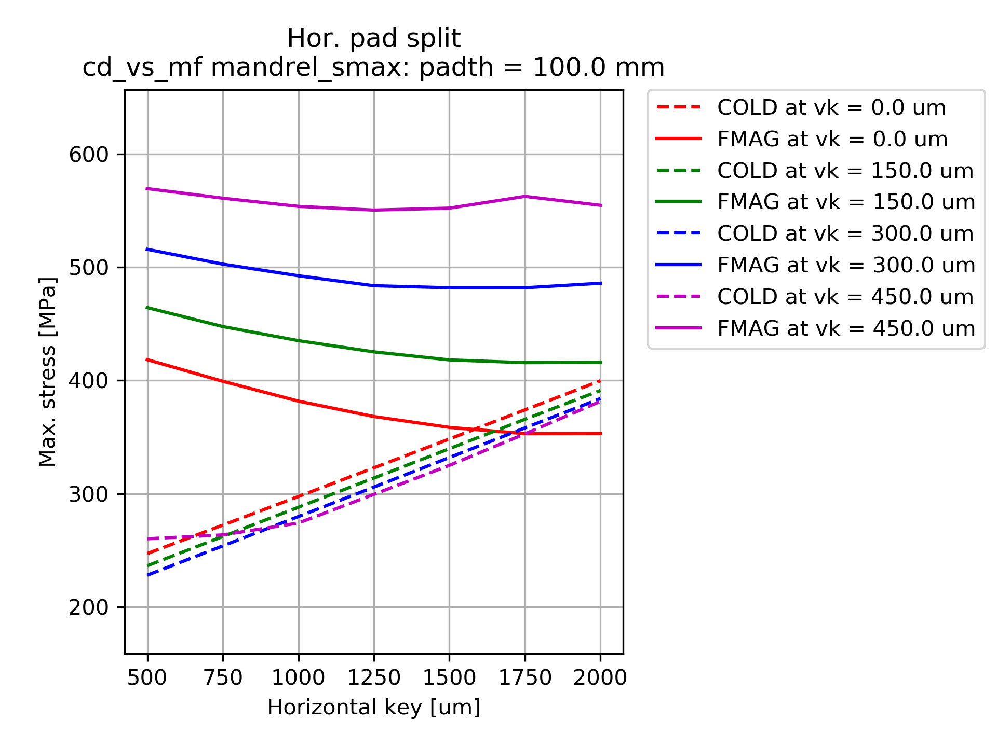
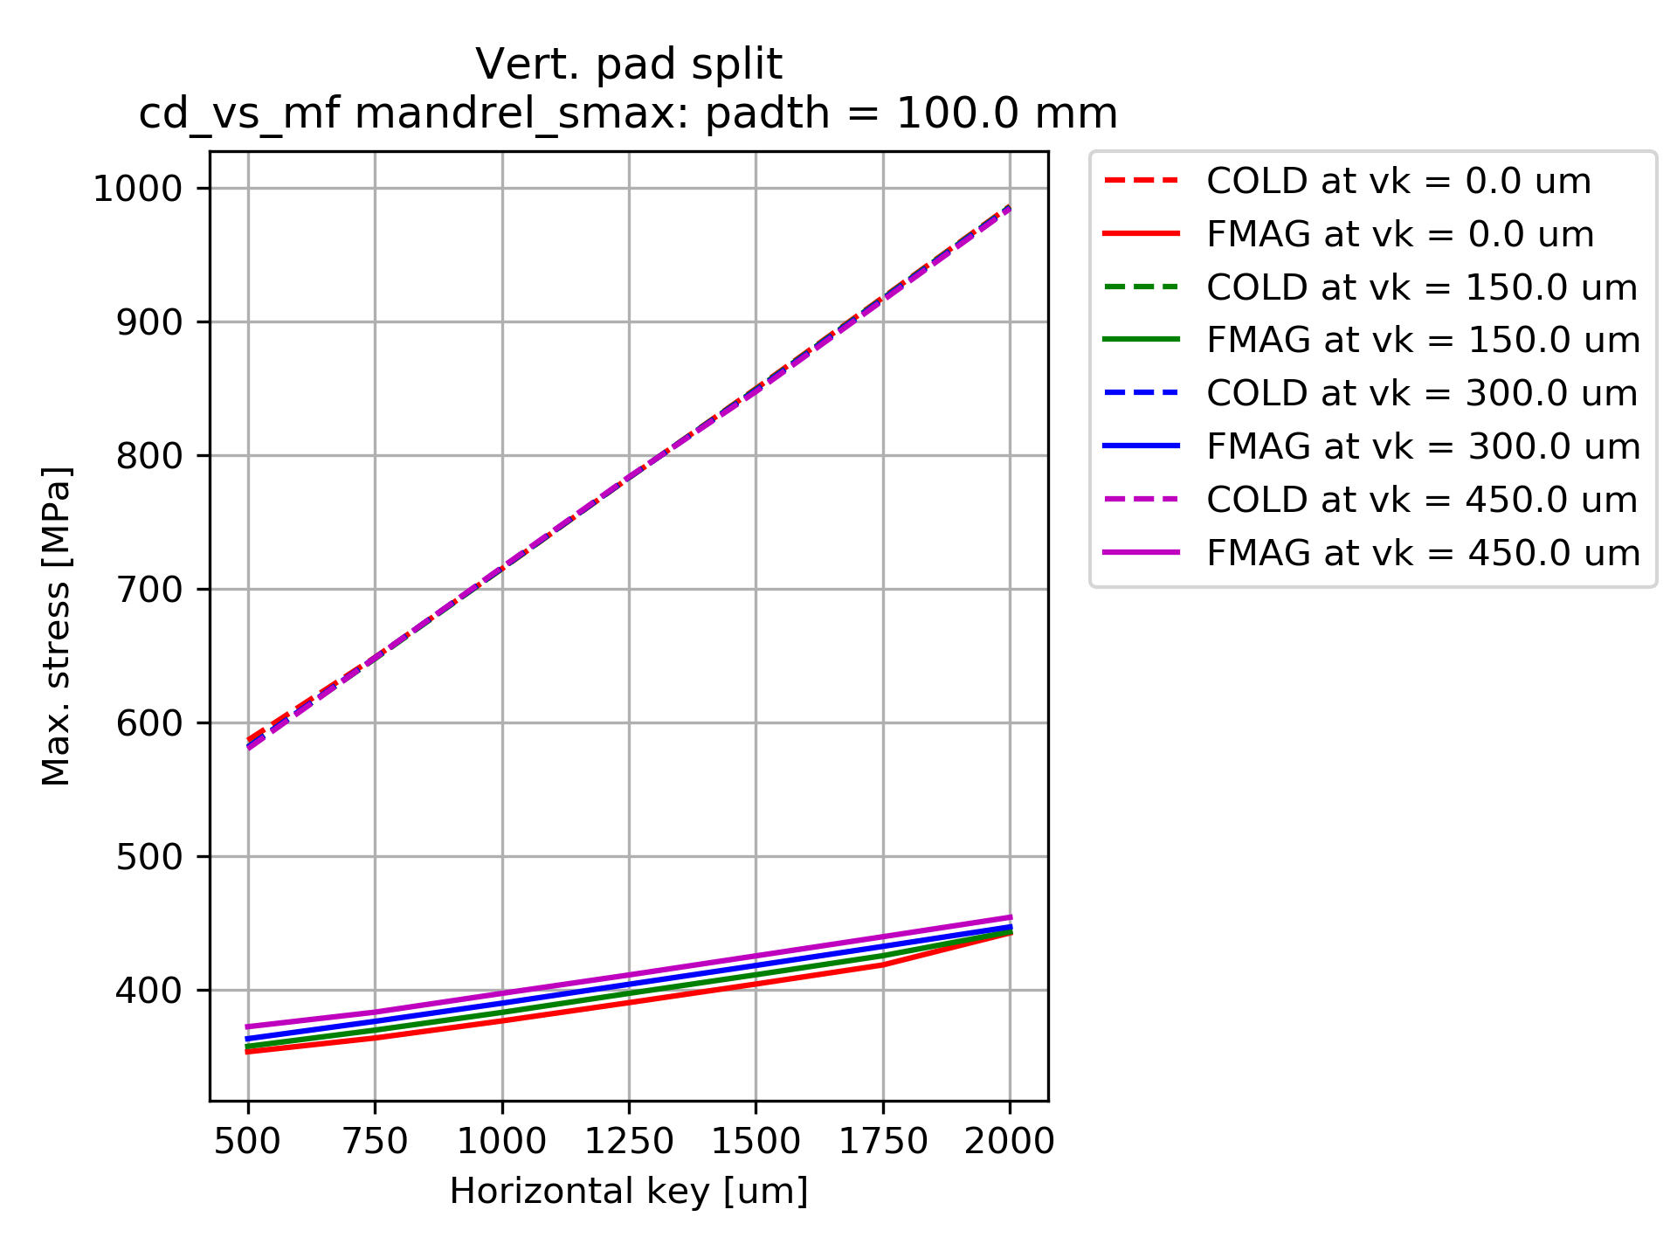
Mandrel stress Cool-down vs Mag. forces
Easier to achieve more balance mandrel stress
Much higher mandrel stress and deformation

Slide 12
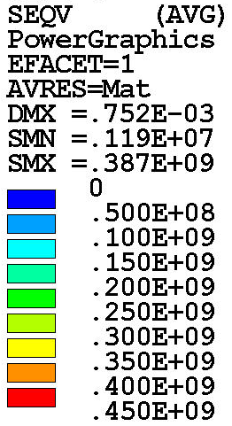
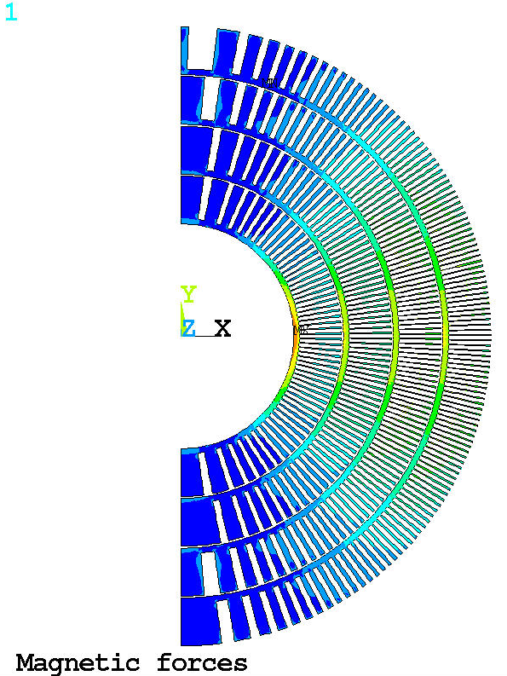
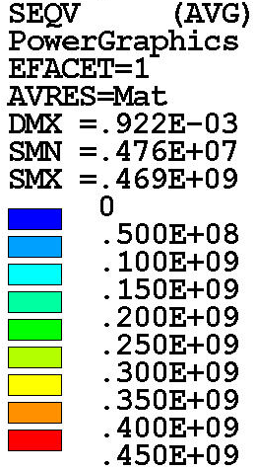
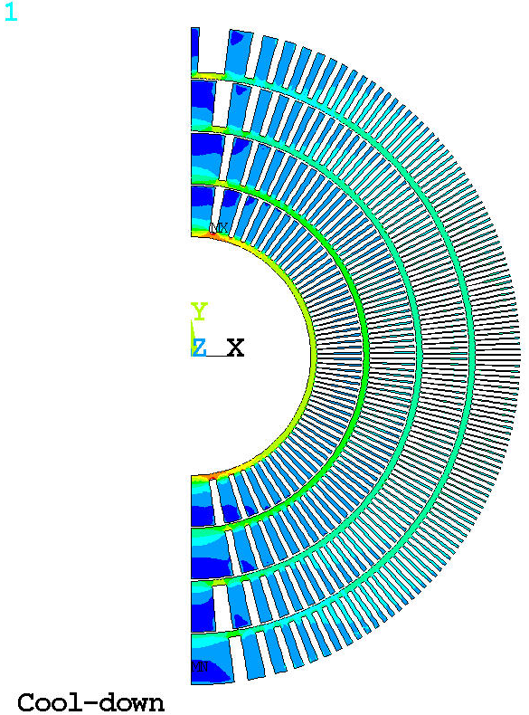
Mandrel
Pad 100 mm
HK 1250 um
VK 100 um
Pad 100 mm
HK 250 um
VK 450 um
RT < 234 MPa
CD < 330 MPa
MF < 387 MPa
RT < 177 MPa
CD < 412 MPa
MF < 469 MPa

Slide 13
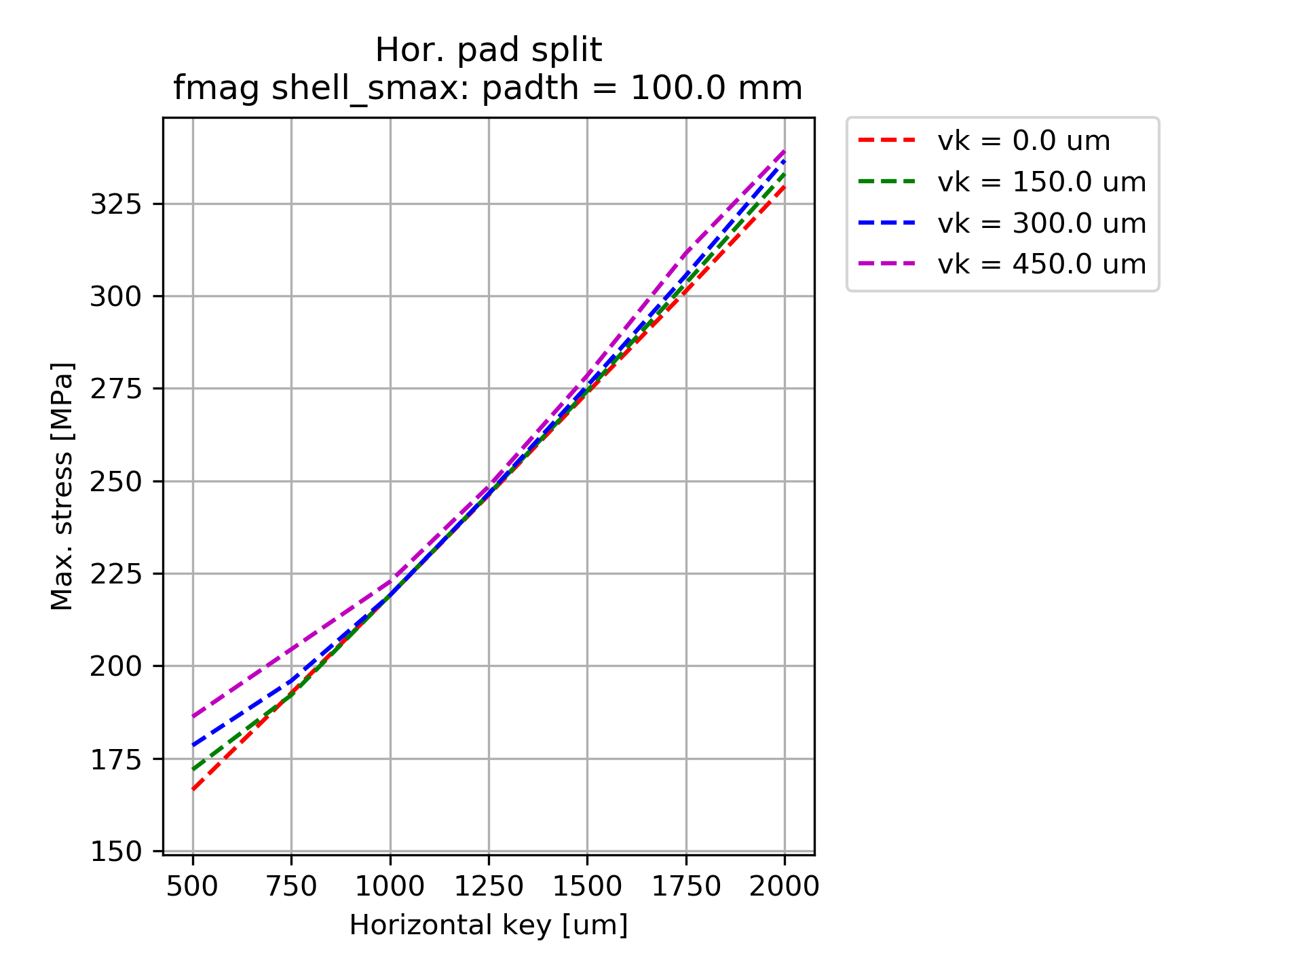
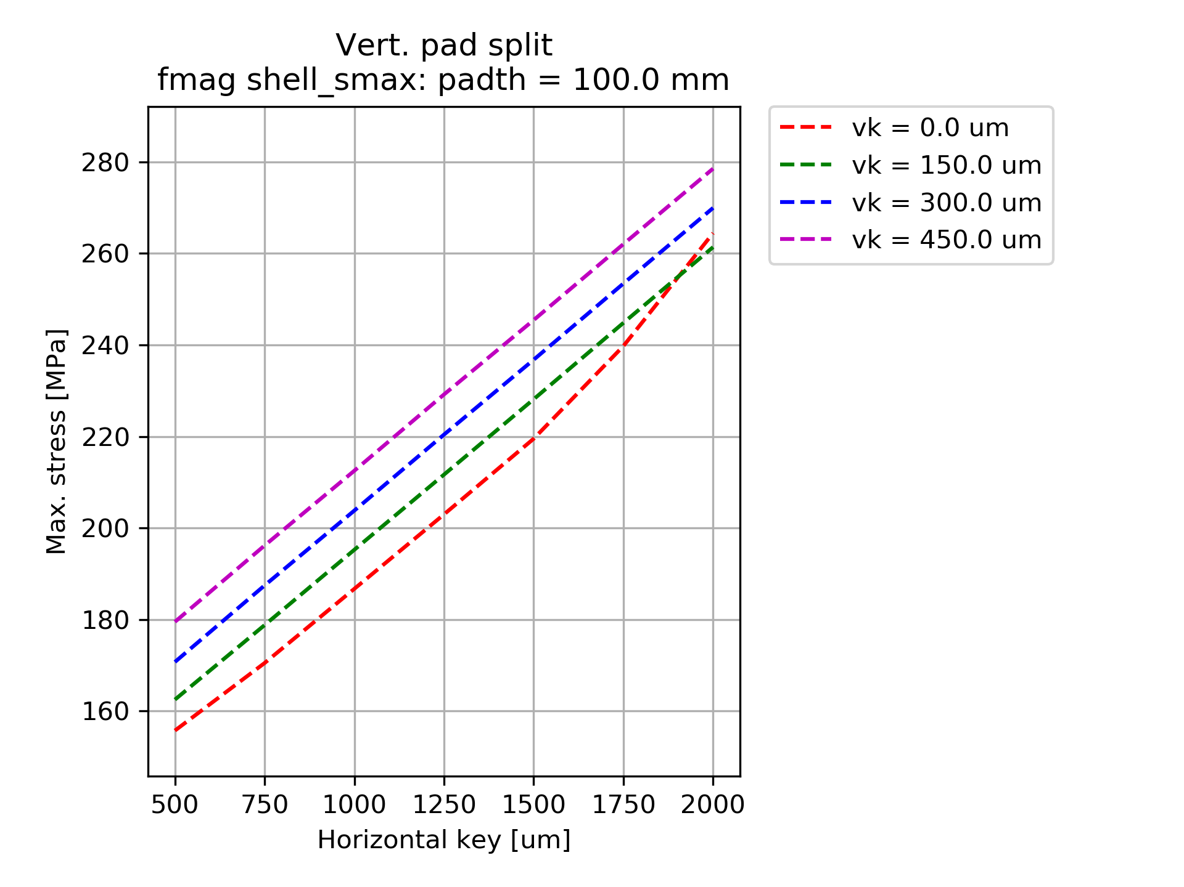
Shell Stress Magnetic forces
Stress in the shell below 300 MPa in both configuration

Slide 14
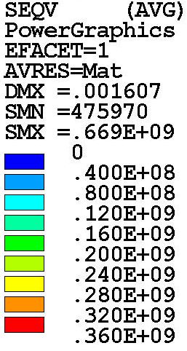
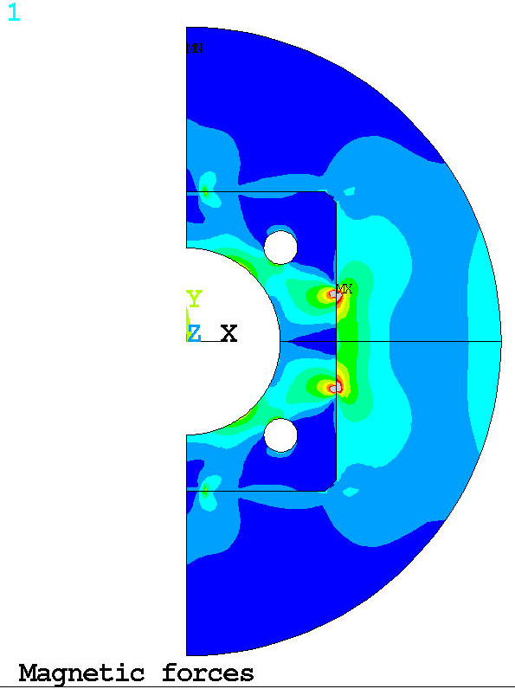
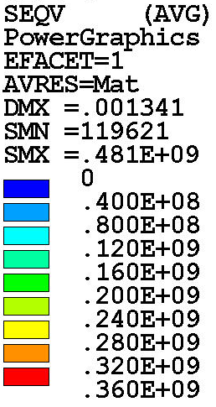
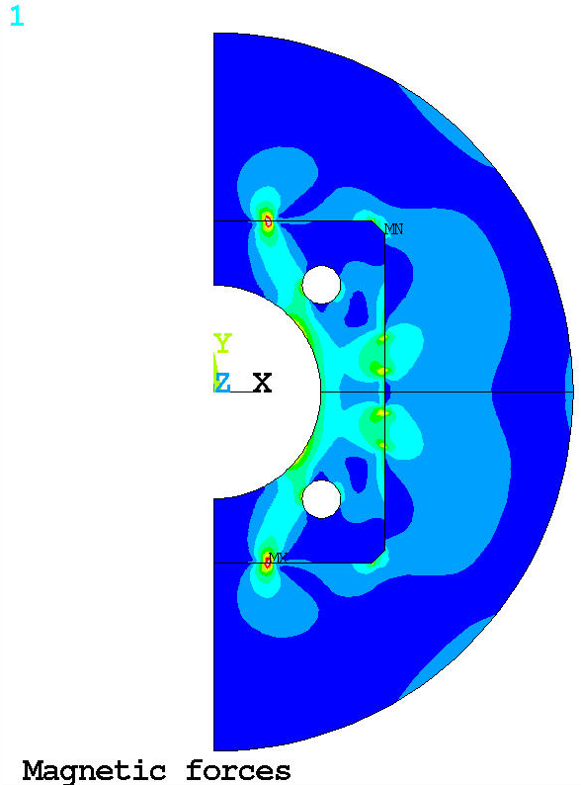
Structure
High local stresses in pre-load key corners

Slide 15
Summary and next steps
Symmetric pad/yoke interfaces allow to use the structure in two configuration
Unique set key interferences required for each configuration
Both configurations allow to minimize cool-down stress below ~100-130 MPa
Tension (local <40 MPa) still present in pole-turns in Magnetic Force case
Local high stress in the key corners
Further analysis
Conductor contact elements implemented but de-bonded causes convergence problems
Structure 3D model is ready to implement 3D conductor model (slice)
Case with graded LD1 & MQXF will be investigated next
Implementing SMCT coil geometry and performing geometry/preload evaluation

