Slide 1
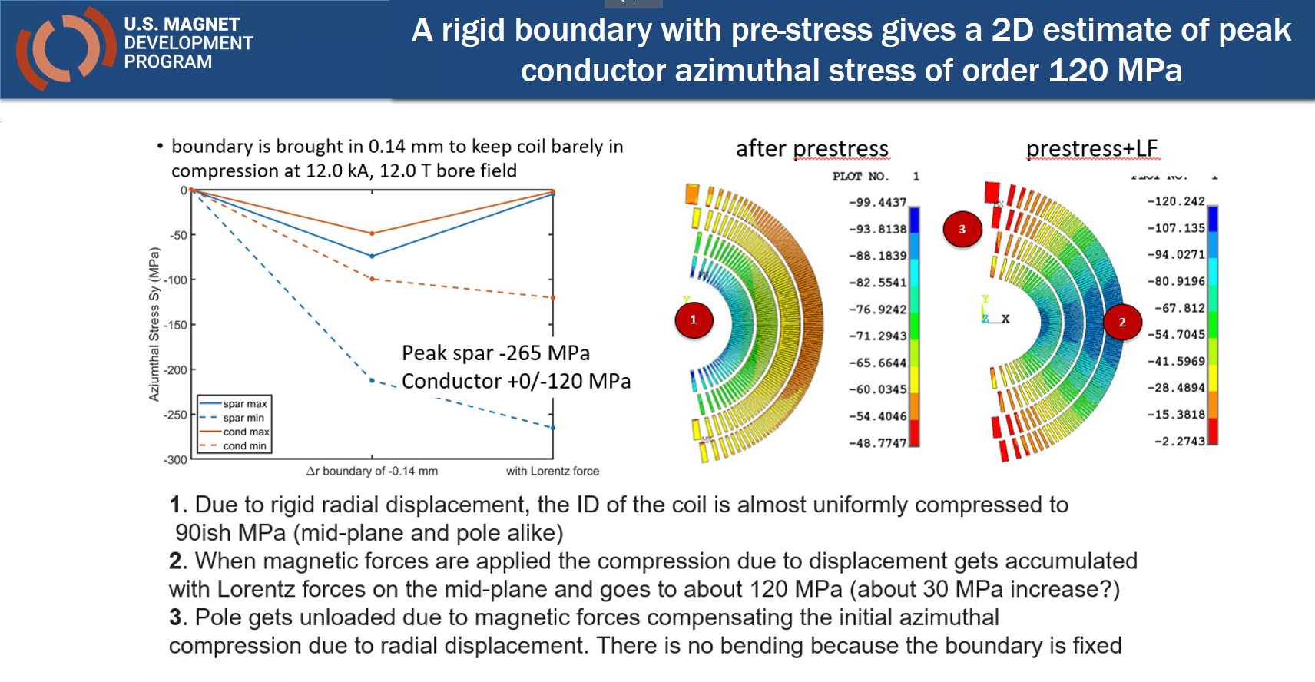
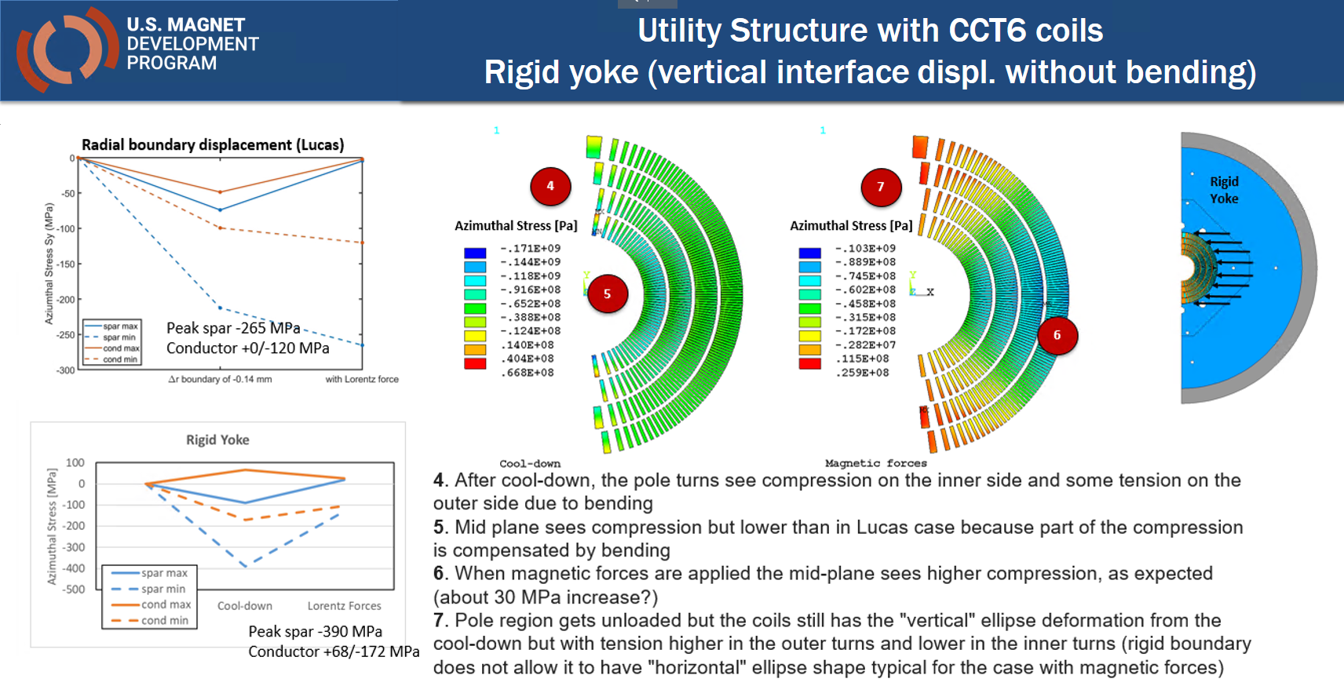
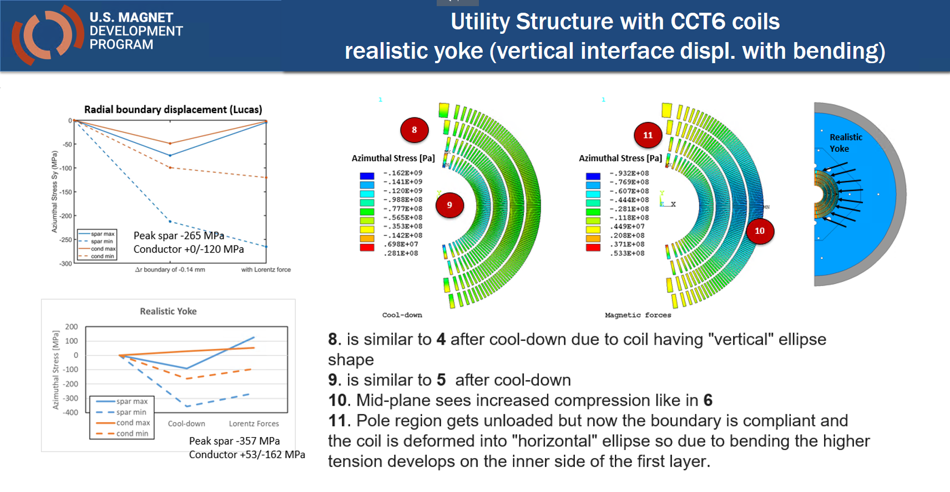
Testing various yoke-pad configurations
Past analysis
Fixed boundary displacement and ultra-rigid structure
Acceptable stress distribution but unrealistic structure
Realistic materials and open yoke/pad vertical interface
Risk of over-compression of pole region during cool-down (coil ovalization)
Tensile stress in the pole region to be investigated in 3D
Various yoke types motivation
Performed in the past for CT but not for CCT or SMCT
Goals
Control of deformation after cool-down
Minimizing tension when magnetic forces are applied
Using bladder-and-key structure

Slide 2
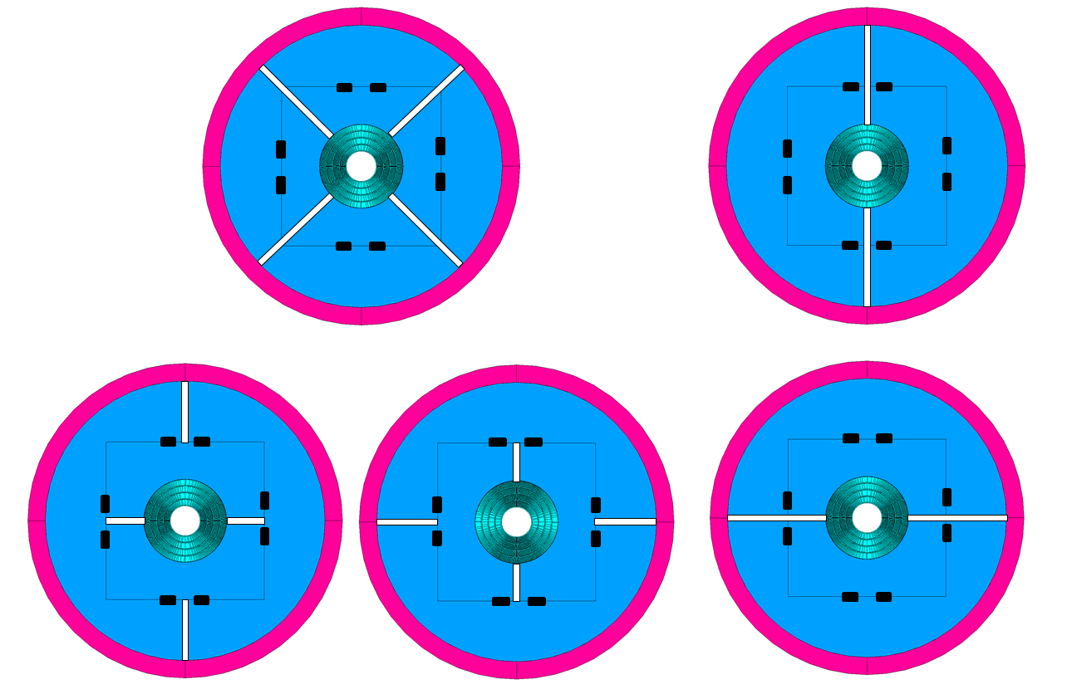
Various configurations Geometry and modeling
Model
Simplified model
Yoke/pad split into 8 pieces each
Various configuration obtained with boundary conditions and node coupling
Key between yoke/pad modeled with contact elements
Configurations
Quadrupole structure (MQXF-like)
Vertical split dipole structure
Horizontal split dipole structure
H-split yoke / V-split pad
V-split yoke / H-split pad
1
2
5
4
3

Slide 3
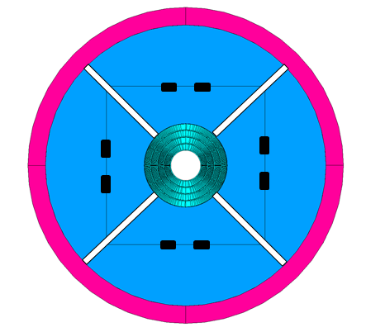
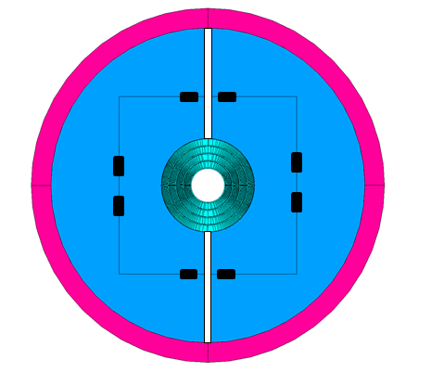
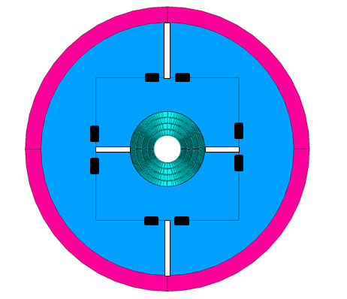
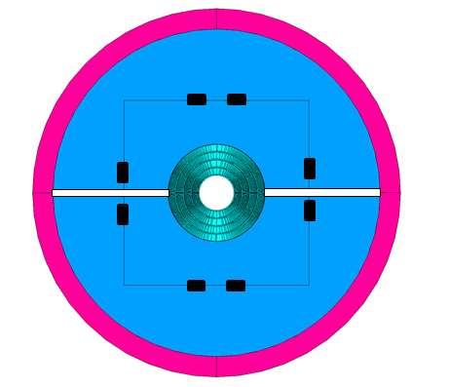
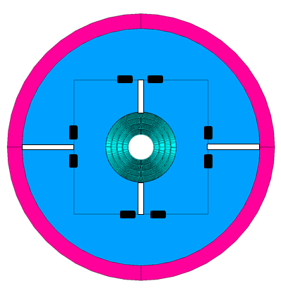
Various configurations Analysis summary
Quad structure
Good control over cooldown deformation
Lack of rigidity to counteract mag. forces
V-split dipole
Risk of high stress / deformation during cool-down
Some tension when magnetic forces applied
Closing pad-pad interface might be the only solution to cool-down stress
V-split yoke/H-split pad
Uniform radial deformation can be achieved after cooldown but ovalization needed to compensate for mag. forces
Higher overall structure rigidity
Lower tensile stress with hor. Interference
H-split yoke/V-split pad
A lot of similarities to the case above
Seems harder to control than the case above but it will be analyzed further
H-split dipole
Acceptable stress after cooldown but deformation contributes to magnetic forces stresses
No control over stress when magnetic forces applied

Slide 4
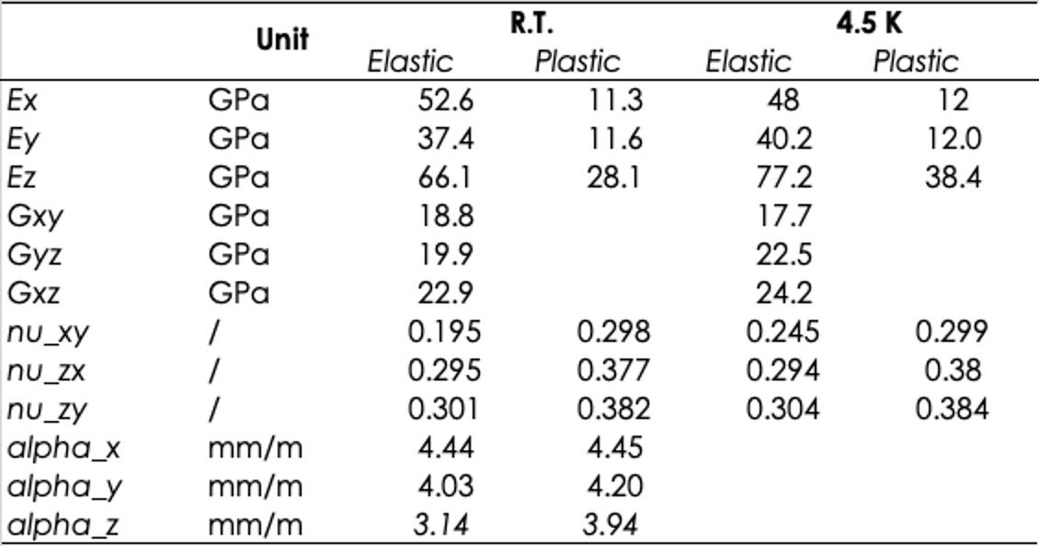
Updated conductor properties
Elastio-plastic properties from Giorgio Vallone
Based on MQXF cable modeling
Elastic material used for the initial optimization analysis
Average of elastic and plastic parameters from the table
 | UNIT | RT | 4.5K
Ex | GPa | 31.95 | 30.00
Ey | GPa | 24.50 | 26.10
Gxy | / | 18.8 | 17.7
nu_xy | / | 0.2465 | 0.272
alpha_x | mm/m | 4.445
alpha_y | mm/m | 4.115

Slide 5
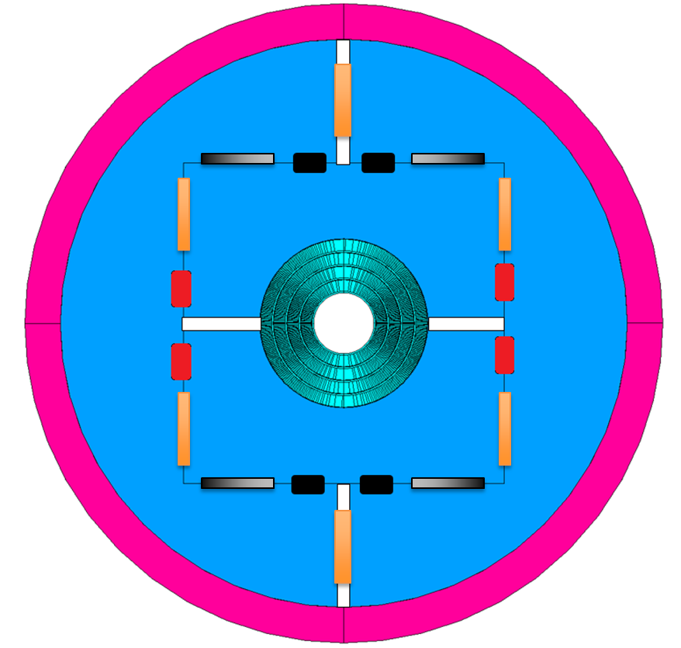
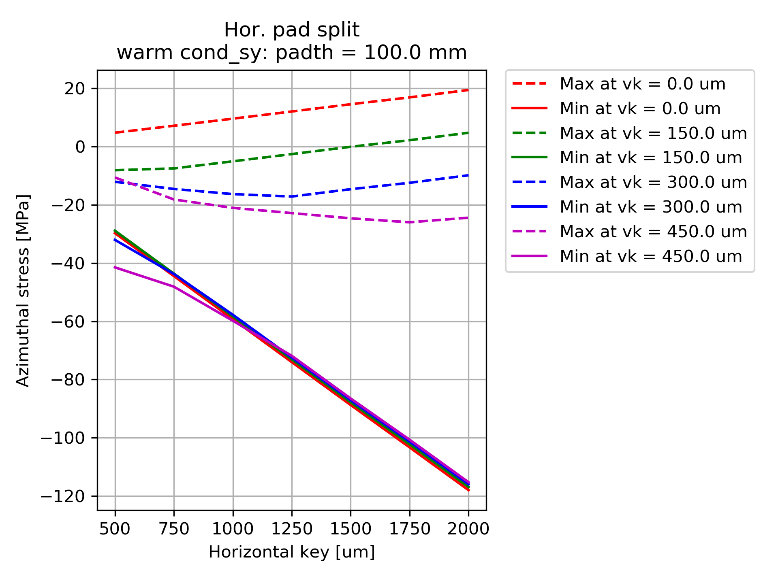
Analysis, parameters and example result plot
Analysis Steps
Room temperature preload
Cool-down
Magnetic forces
Varied parameters
Vertical key
Pad thickness
Horizontal key
Pad thickness
100, 125 and 150 mm
Bladders
Vertical key interference
0 to 450 um
Horizontal key interference
500 to 2000 um

Slide 6
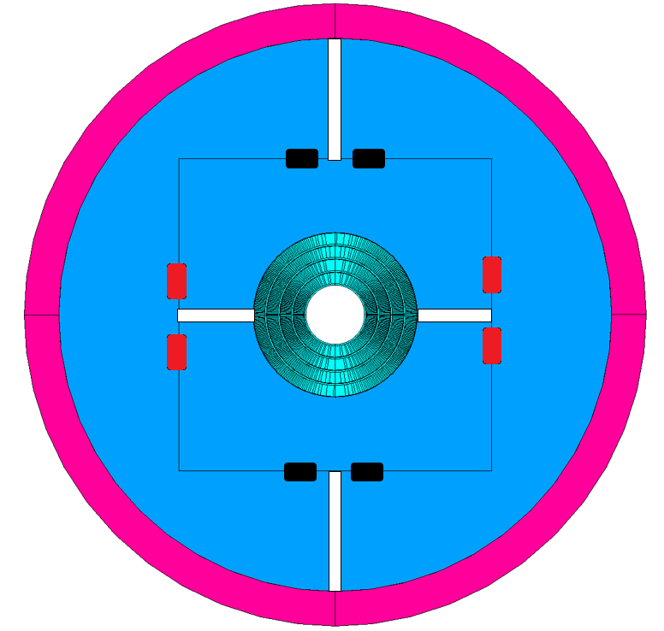
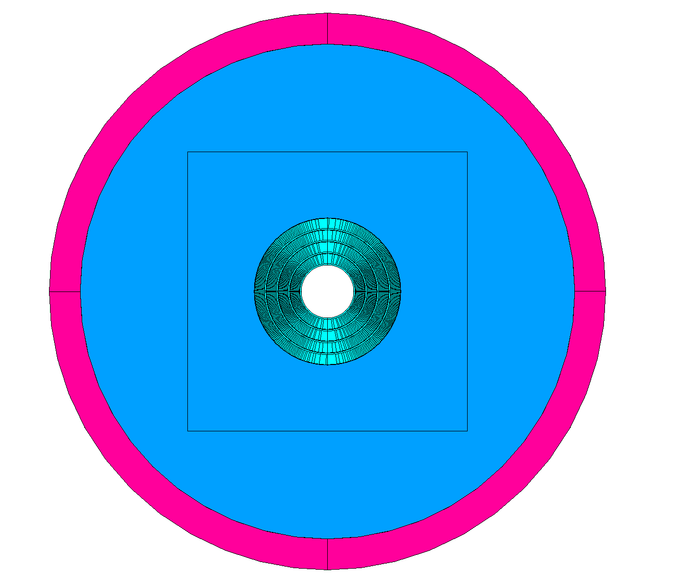
V-Split Yoke vs V-Split Yoke H-Split Pad V-Split Pad

Slide 7
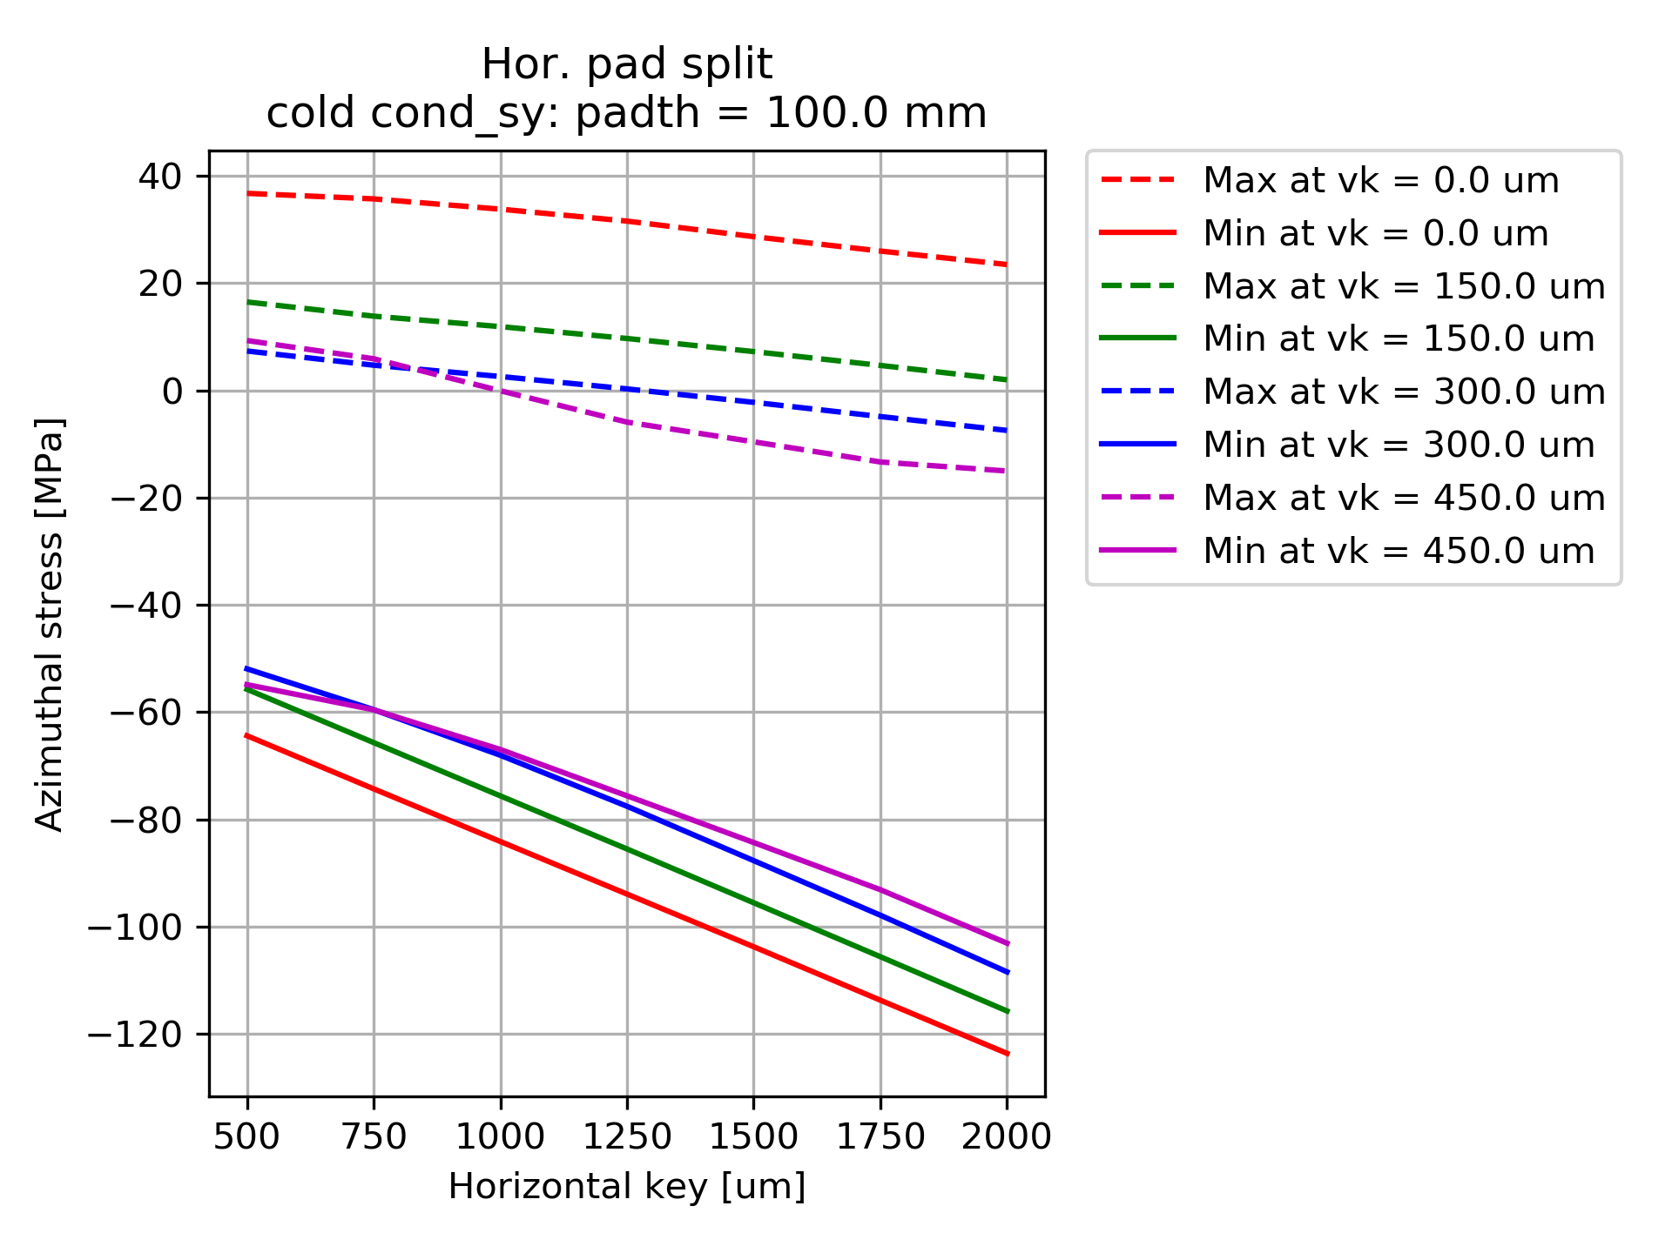
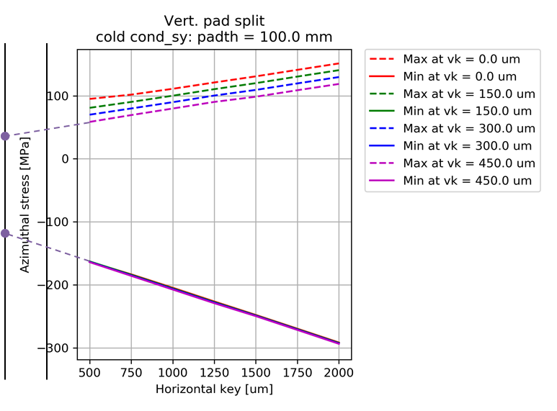
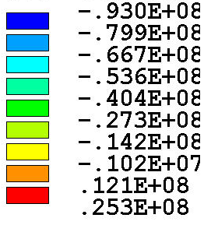
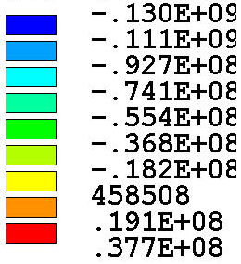
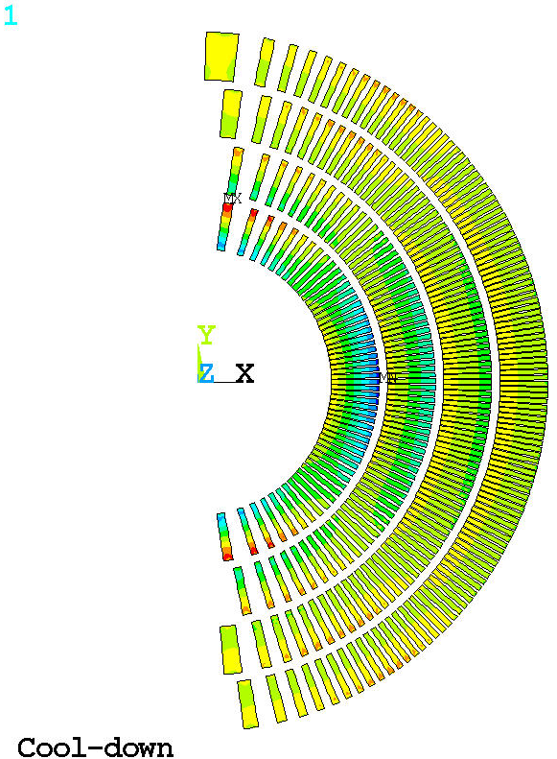
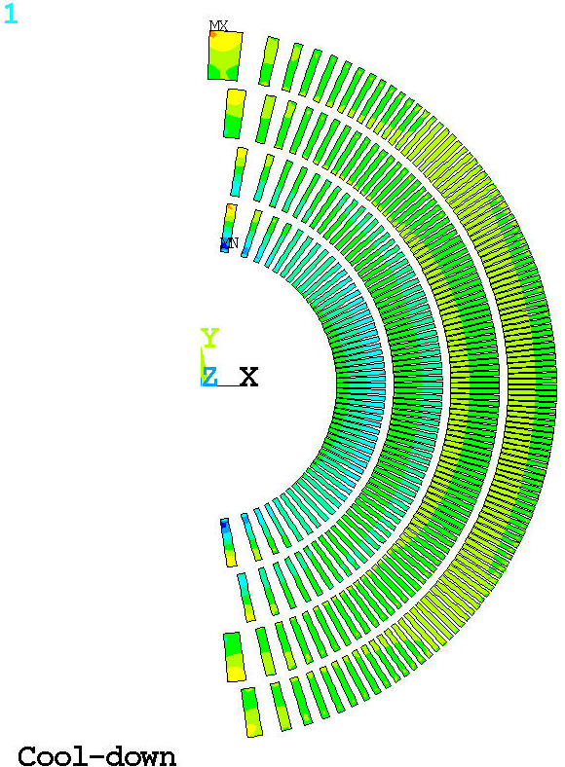
Conductor azimuthal stress Cool-down
Thinner (100mm) pad and 100-150um vertical gives the same benefits as thicker pad
Example case:
Compression on mid-plane <100 MPa
Pad 100 mm
HK 1250 um
VK 100 um
With pad gap open, even 500um horizontal interference causes the compressive stress of ~150 MPa
Example case
Compression <130 MPa
450 um vertical key very difficult to insert in such configuration
Pad 100 mm
HK 250 um
VK 450 um

Slide 8
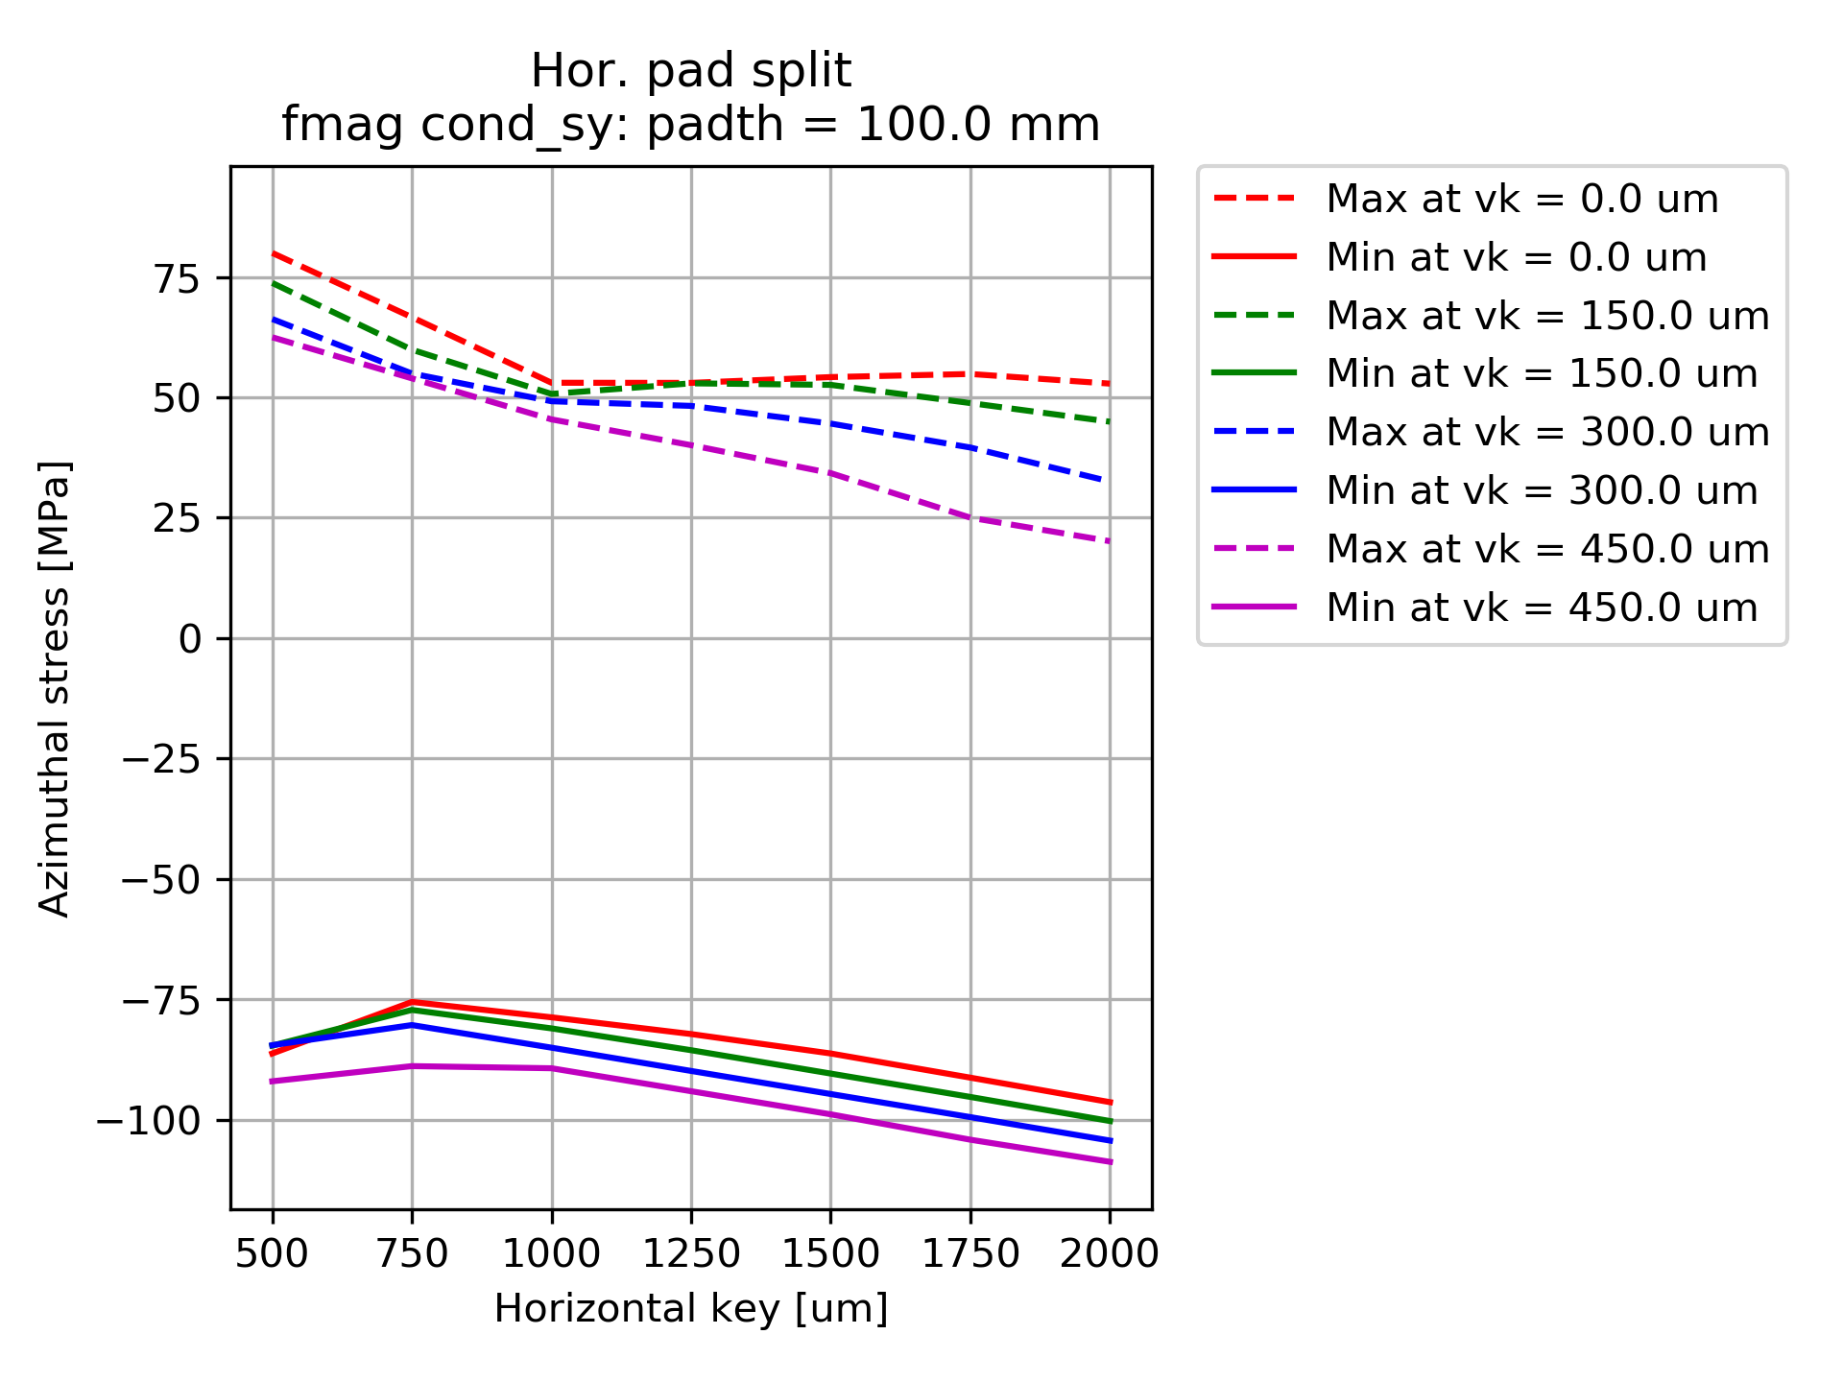
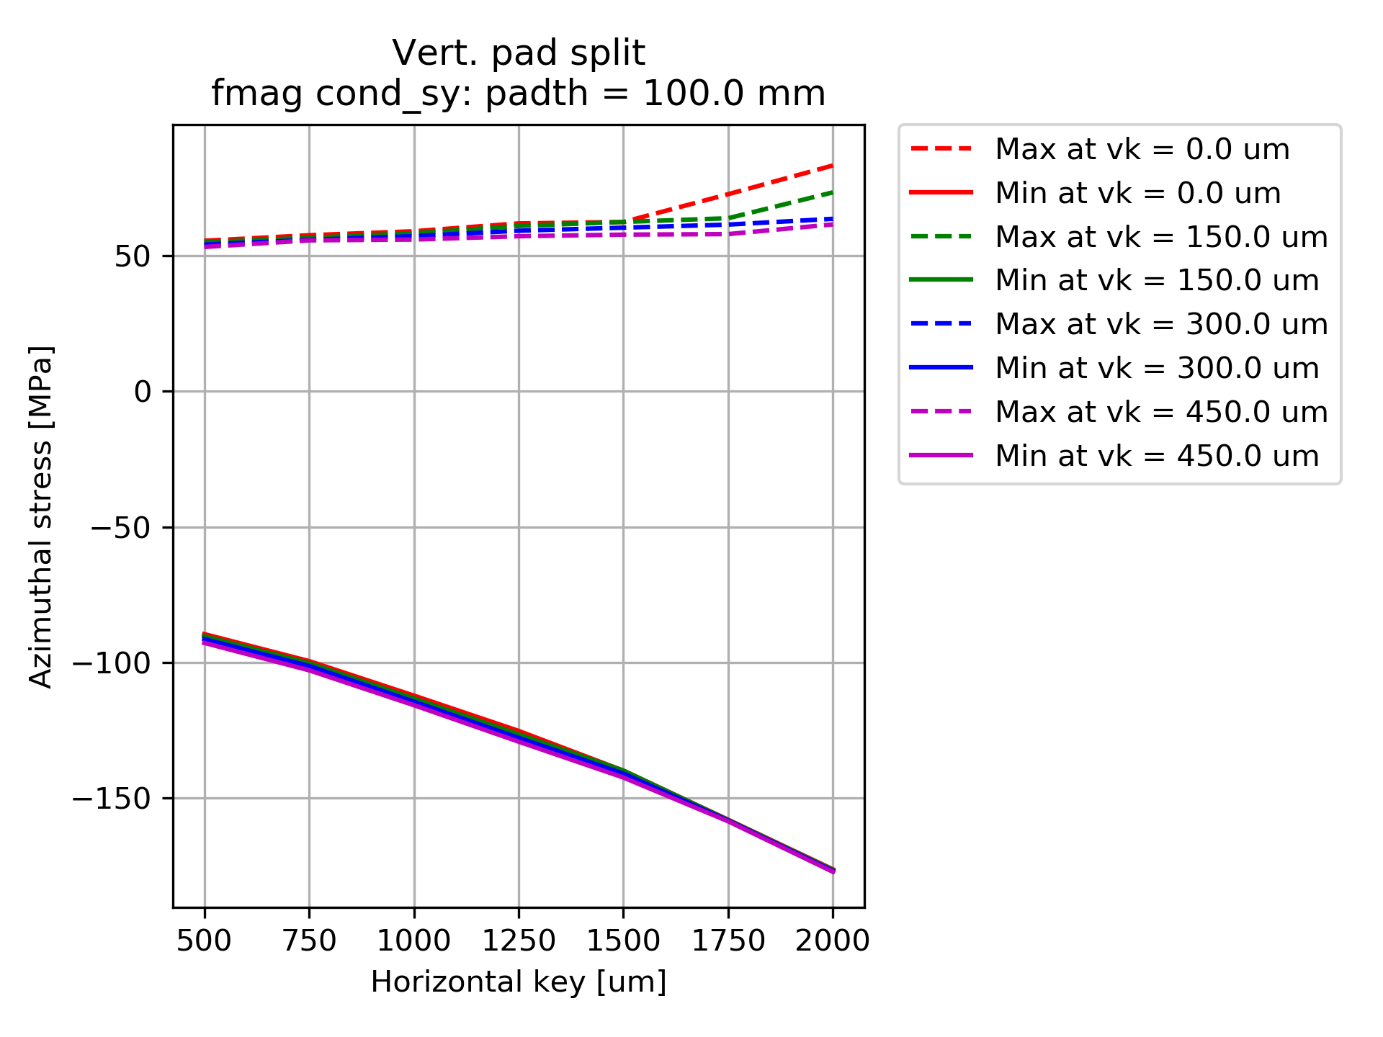
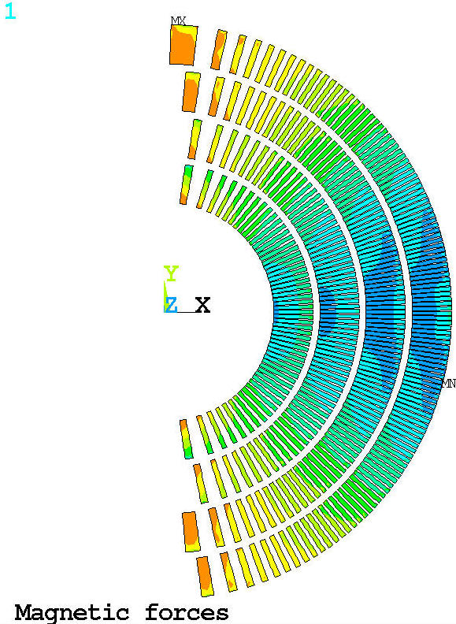
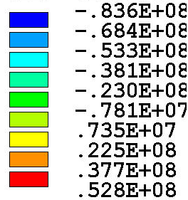
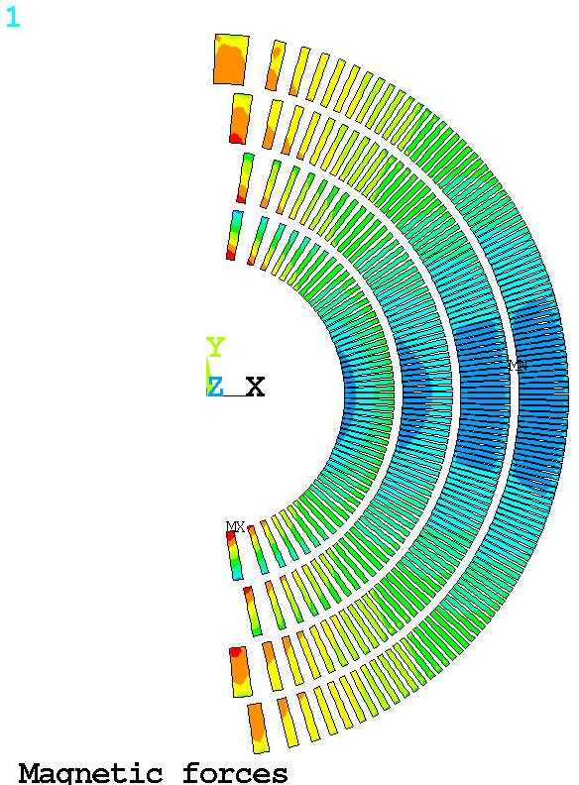
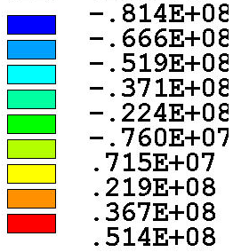
Conductor azimuthal stress Magnetic forces
Pad 100 mm
HK 1250 um
VK 100 um
Pad 100 mm
HK 250 um
VK 450 um
Corner artifacts
Example case
Stress range after excluding artifacts
+35 / -65 MPa
Tensile stress does not show high sensitivity on pad thickness nor vertical interfacernce

Slide 9
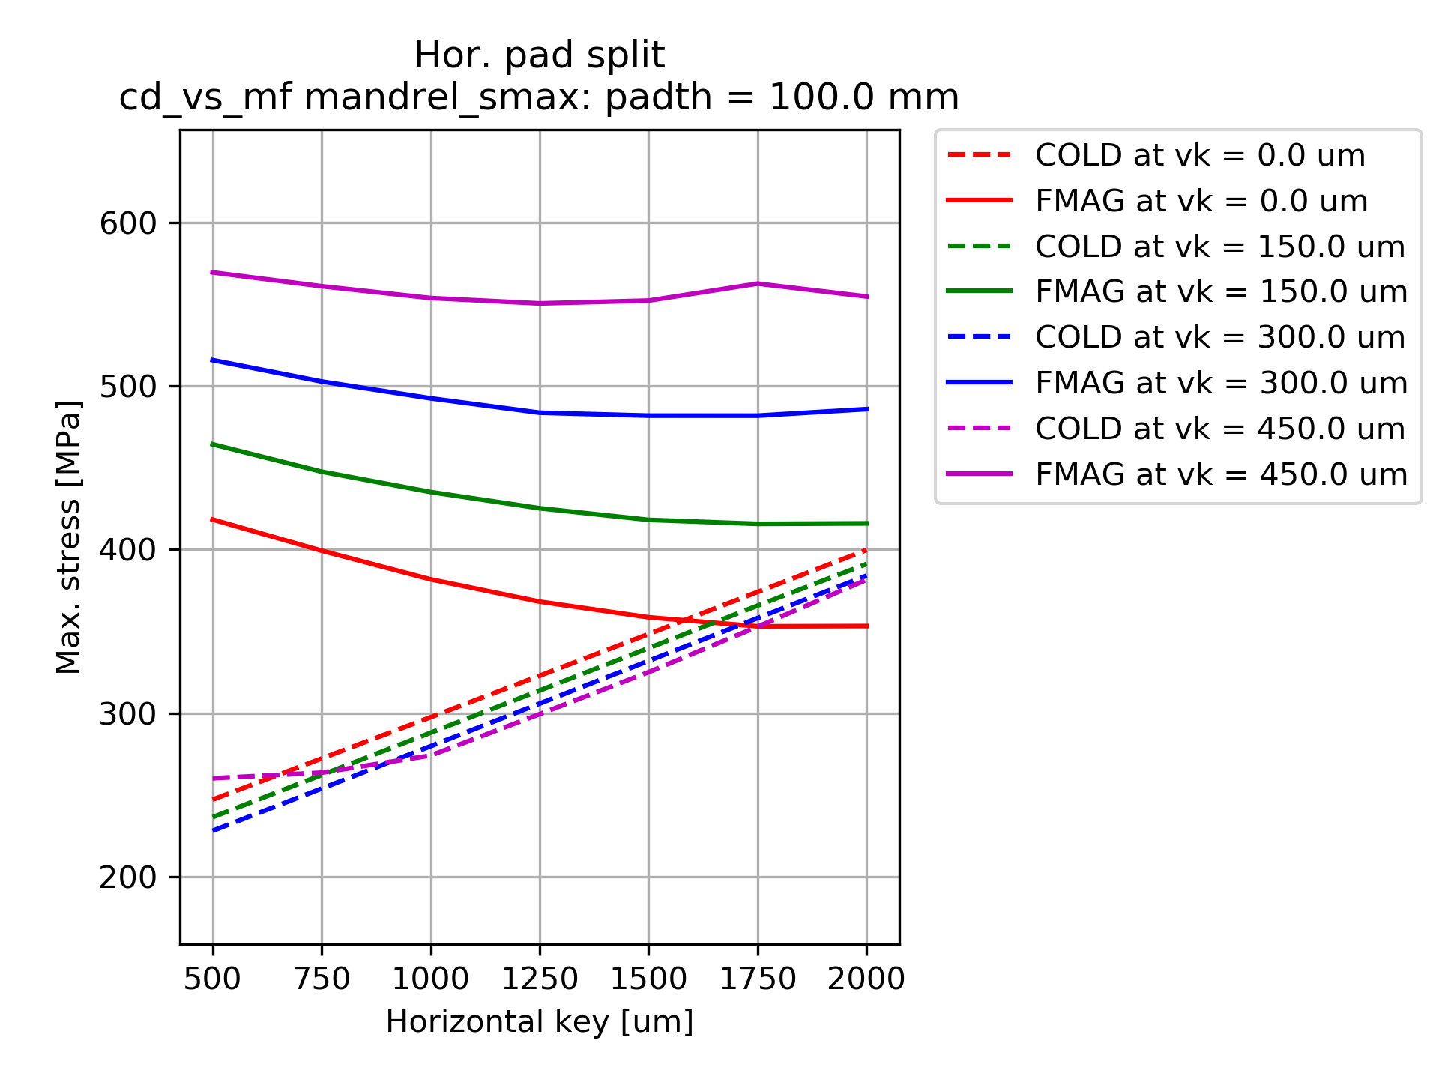
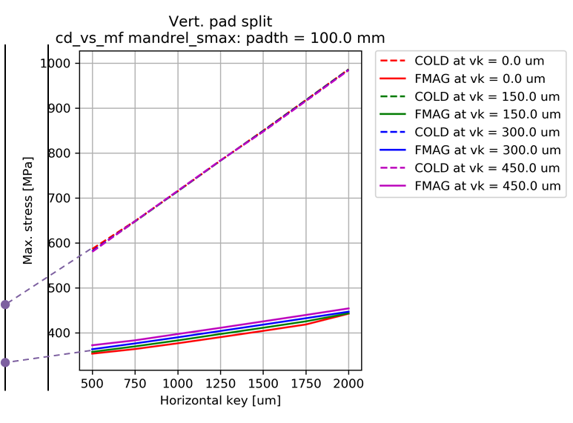
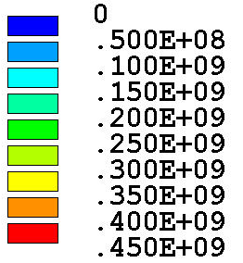
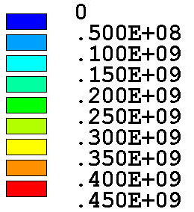
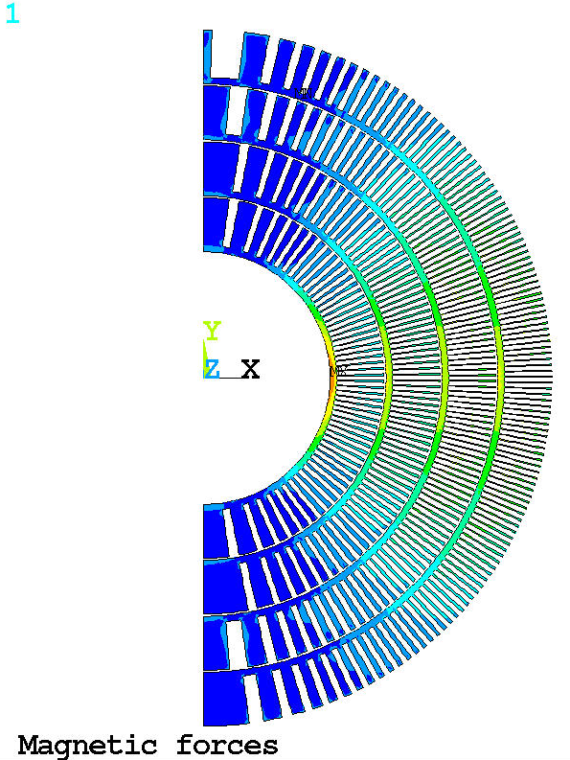
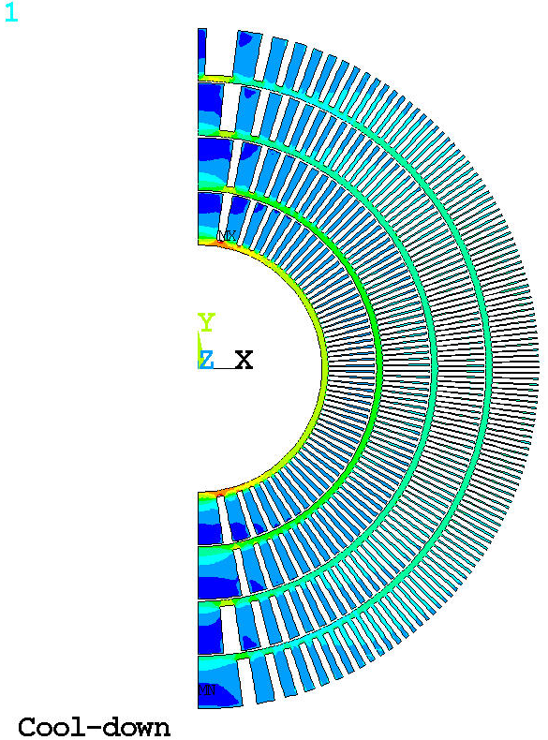
Mandrel stress Cool-down vs Mag. forces
Easier to achieve more balance mandrel stress/deformation
Example case
RT < 234 MPa
CD < 330 MPa
MF < 387 MPa
Pad 100 mm
HK 1250 um
VK 100 um
Much higher mandrel stress and deformation
Example case
RT < 177 MPa
CD < 412 MPa
MF < 469 MPa
Pad 100 mm
HK 250 um
VK 450 um
CERN measurement of Cu alloys (Rp0.2 at 4.5K)
CuAl10Ni5Fe4 C63000 nickel aluminum bronze 578 MPa
CuAl7Si, C64200 aluminum bronze 306 MPa
CuSn8P, C52100 phosphor bronze 247 MPa
CuSn5, C51000 phosphor bronze 315 MPa

Slide 10
Summary and next steps
Symmetric pad/yoke interfaces allow to use the structure in two configuration
Unique set key interferences required for each configuration
Both configurations allow to minimize cool-down stress below ~100-130 MPa
V-pad/V-yoke split structure: high vertical interference might not be possible
Tension (local <40 MPa) still present in pole-turns in Magnetic Force case
Local high stress in the key corners (structure, manageable)
Shell stress in the range of 200-300 MPa
Bladder operation analyzed for example cases
Further analysis
Conductor contact elements implemented but de-bonded causes convergence problems
Structure 3D model is ready to implement 3D conductor model (slice)
Case with graded LD1 & MQXF will be investigated next
Implementing SMCT coil geometry and performing geometry/preload evaluation
Closed pad-pad interface in V-pad/V-yoke split structure

Slide 11
Backup

Slide 12
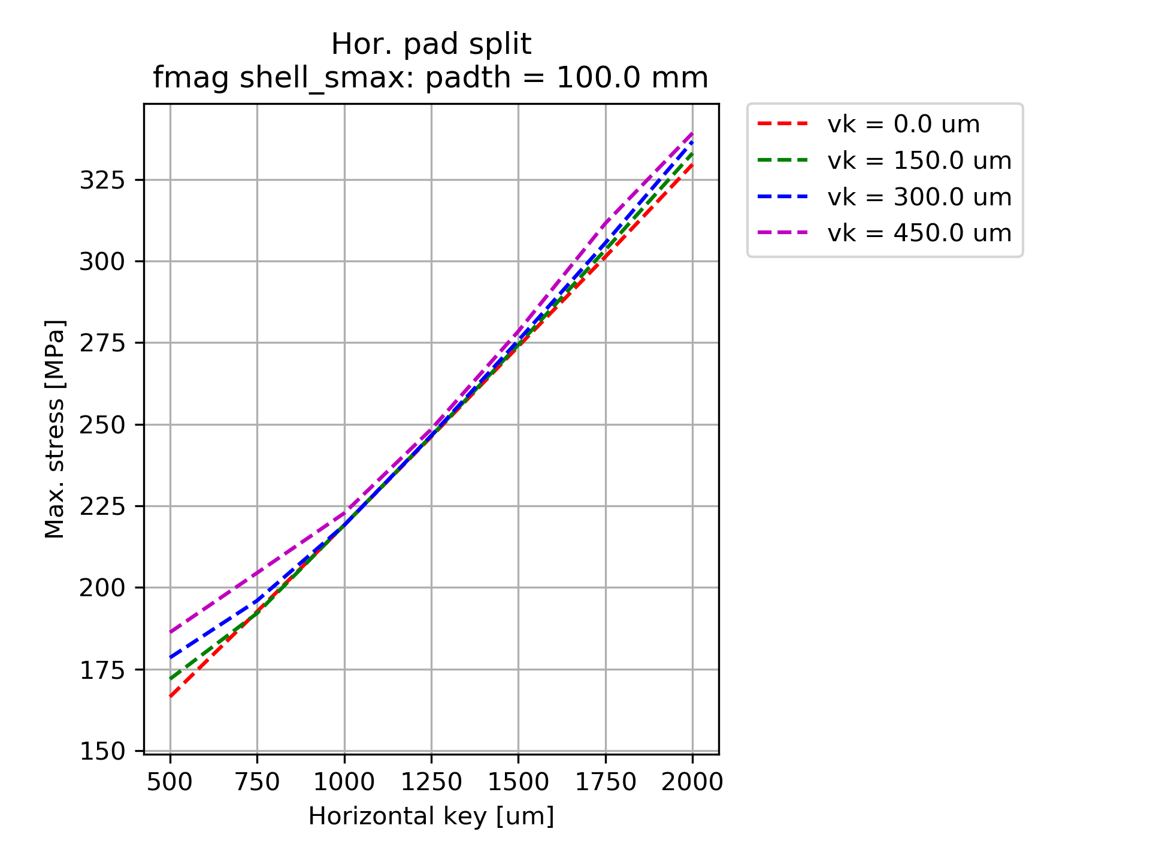
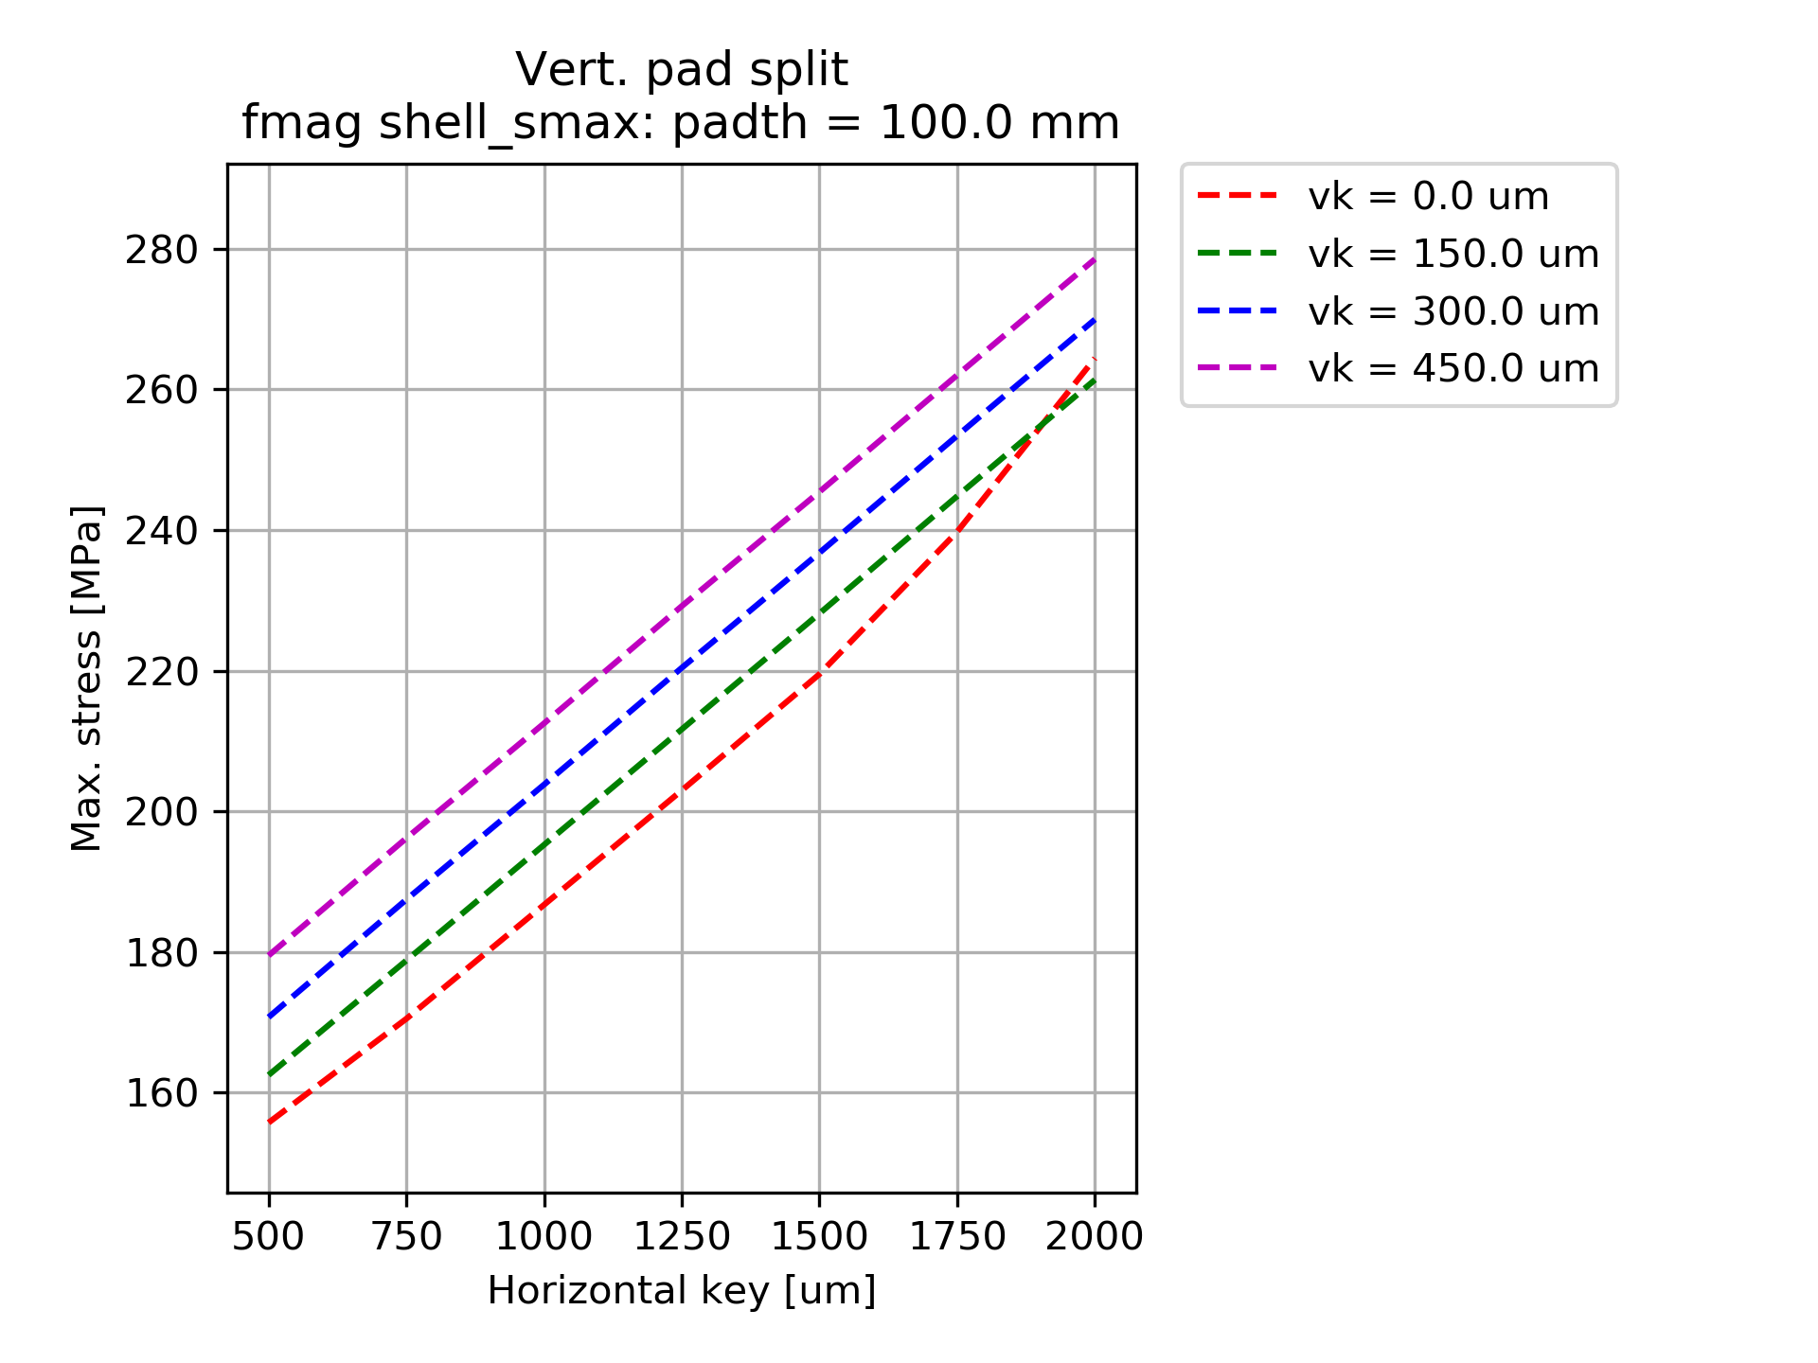
Shell Stress Magnetic forces
Stress in the shell below 300 MPa in both configuration

Slide 13
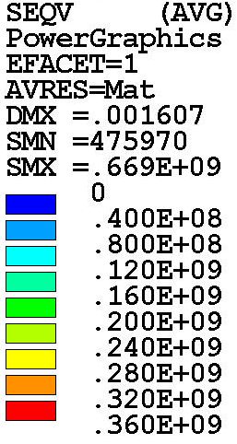
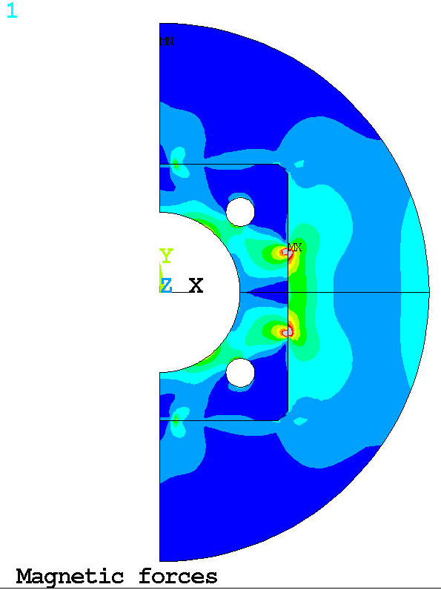
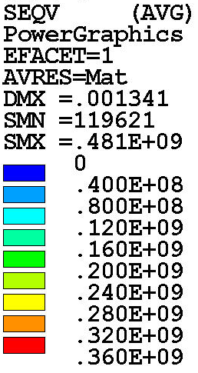
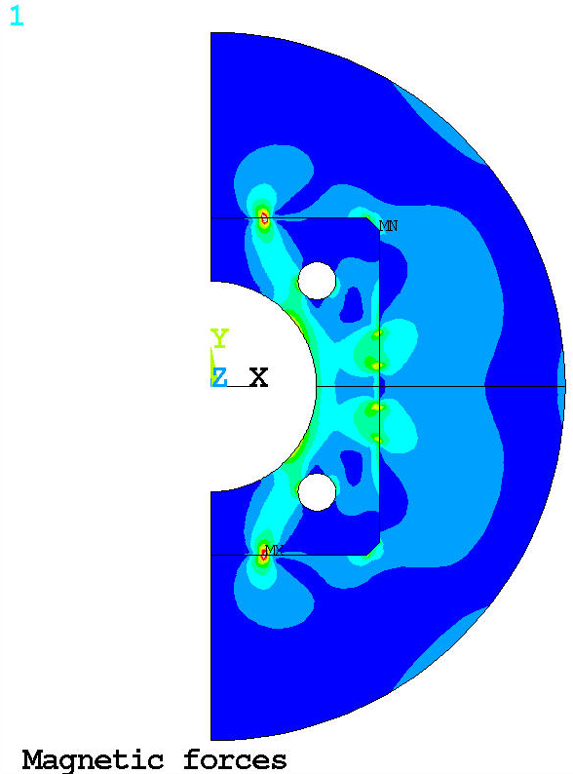
Structure
High local stresses in pre-load key corners

