Slide 1
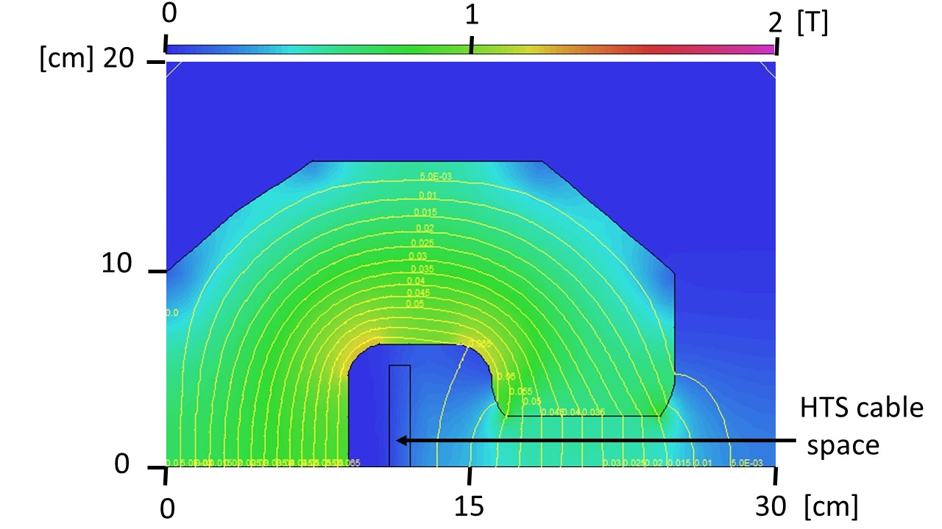
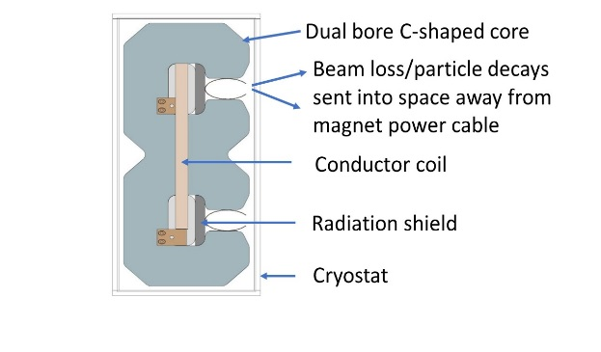
Rapid-Cycling HTS-Based Accelerator Magnet Henryk Piekarz, Steve Hays, Brad Claypool, Matt Kufer, Vladimir Shiltsev (Fermilab)
Magnet design
If conductor is formed as a very narrow structure extended
as much as possible in the vertical plane within magnet core
space it is exposed to a very minimal magnetic field
- High current density of superconductor facilitates forming
magnet power cable requiring very little space
Vertically wound current coil energizes two
vertical beam gaps
Beam losses and particle decays are emitted
away from the magnet current coil

Slide 2
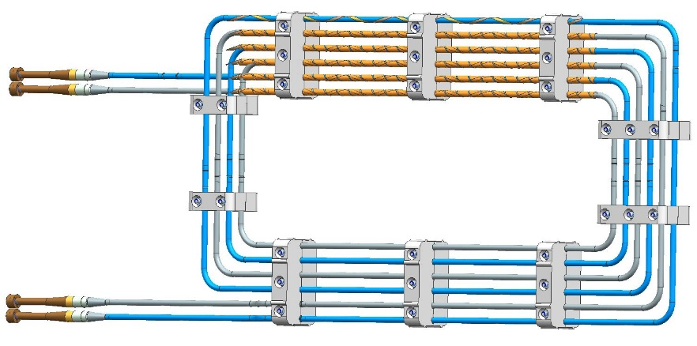
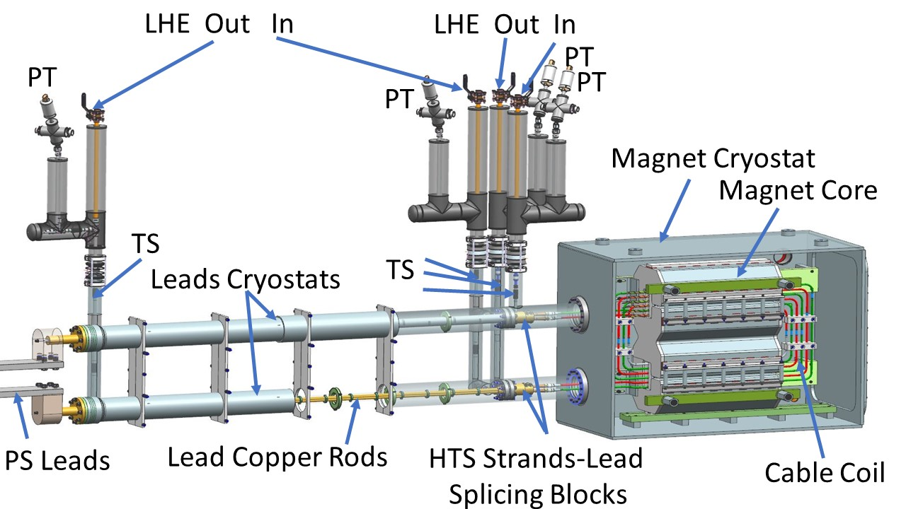
Magnet conductor coil
Magnet test set-up
- 3 turn conductor reduces energizing current and
with 2 sub-cables/turn makes very narrow structure
- 4 HTS strands (Super-Power, 2.5 mm x 0.1 mm) per
sub-cable are helically wound over cold pipe and
firmly held on pipe surface with a single layer of
0.1 mm x 12.5 mm Cu tape
Sub-cable T_{C} ~30 K @ 2 kA, T_{OPER} ~6 K provides safe temperature margin
- ABS printed holders keep power coil in place and
insulate from magnetic core
- 0.5 m long magnet features dual beam gaps: 100 mm (H) x 10 mm (V)
LHe Inlet/Outlet temperatures together with flow rate and pressures
are used to determine cryogenic power losses

Slide 3
HTS magnet mechanical and electrical properties
Mechanical properties of magnet HTS cable
Magnet electrical properties
Cable component | Volume [m³] | Mass [g] | Resistivity [Ω-m]
HTS strands
REBCO | 2.4 10 ⁻⁸ | 0.15 | -
Hastelloy C-276 | 12 10 ⁻⁷ | 10.7 | 1.2 10 ⁻⁶
Cu cap | 9.5 10 ⁻⁷ | 8.6 | 8 10 ⁻¹⁰
Ag cup | 9.5 10 ⁻⁸ | 1.0 | 1 10 ⁻¹⁰
Total | 22.5 10 ⁻⁷ | 20.5 | -
Strands support
Cryogenic pipe | 73 10 ⁻⁶ | 569 | 5 10 ⁻⁷
Copper tape | 15 10 ⁻⁶ | 107 | 8 10 ⁻¹⁰
Total | 88 10 ⁻⁶ | 676
Cable critical current @ 6.5 K | 6 kA
Cable critical current @ 30 K | 2 kA
Magnet critical current @ 30 K | 6 kA
Magnet resistance @ 6.5 K (Leads @ RT) | 340 µΩ
Magnet resistance @ 6.5 K (Leads @ <100 K> | 150 µΩ
Analysis indicates that power loss in the cable cryogenic pipes
constitutes ~ 90 % of all (hysteresis + eddy) cable power losses.
It is possible to reduce the pipe wall from 0.5 mm to 0.1 mm
for the Allowable Working Pressure of 30 bar.

Slide 4
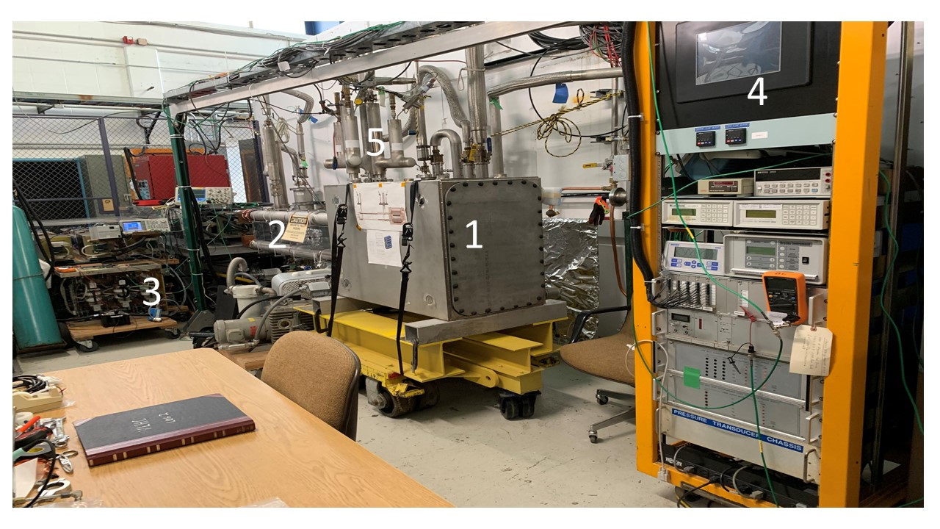
View of the HTS magnet test setup
1 – Magnet, 2- Current leads, 3- Power supply, 4 – Control electronics, 5- Liquid Helium flow lines

Slide 5
2019 Test - Nucl. Instr. & Meth. A 943, 162490
- Applied current: 0.65 kA (1.9 kA for magnet)
Maximum B field: 0.23 T
Maximum dB/dt: 12 T/s
Rep rate: 20 Hz
Power supply:1.5 V switcher cells.
S. Hays et al. for VLHC-LF magnet

Slide 6
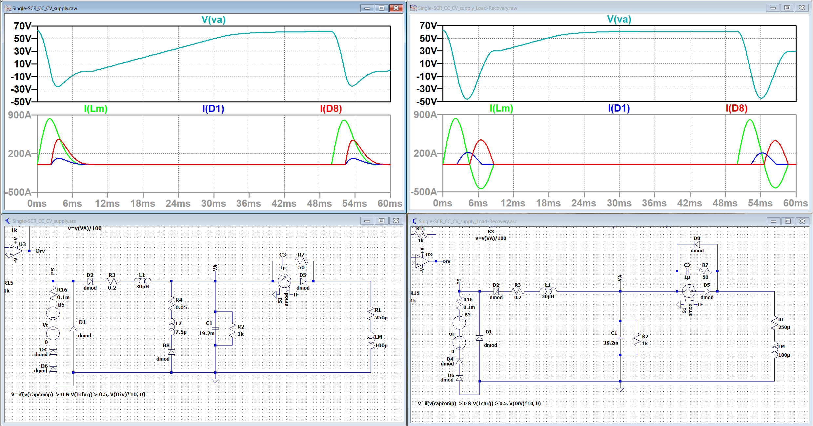
Power supply based on discharge capacitor bank – June 2021
Steve Hays, Bradley Claypool, Matthew Kufer
June 21/2021 test:
Capacitor bank: 20 x 960 µF
Maximum voltage: 80 V
I_{max} cable = 1000 A
I_{max} magnet = 3000 A
Rep rate _{max} = 10 Hz
Next test (???):
Maximum voltage: 160 V
I_{max} cable = 2000 A
I_{max} magnet = 6000 A
Rep rate _{max} = ???
Magnet current wave-form (light green color).
Current is measured using toroid transformer.

Slide 7
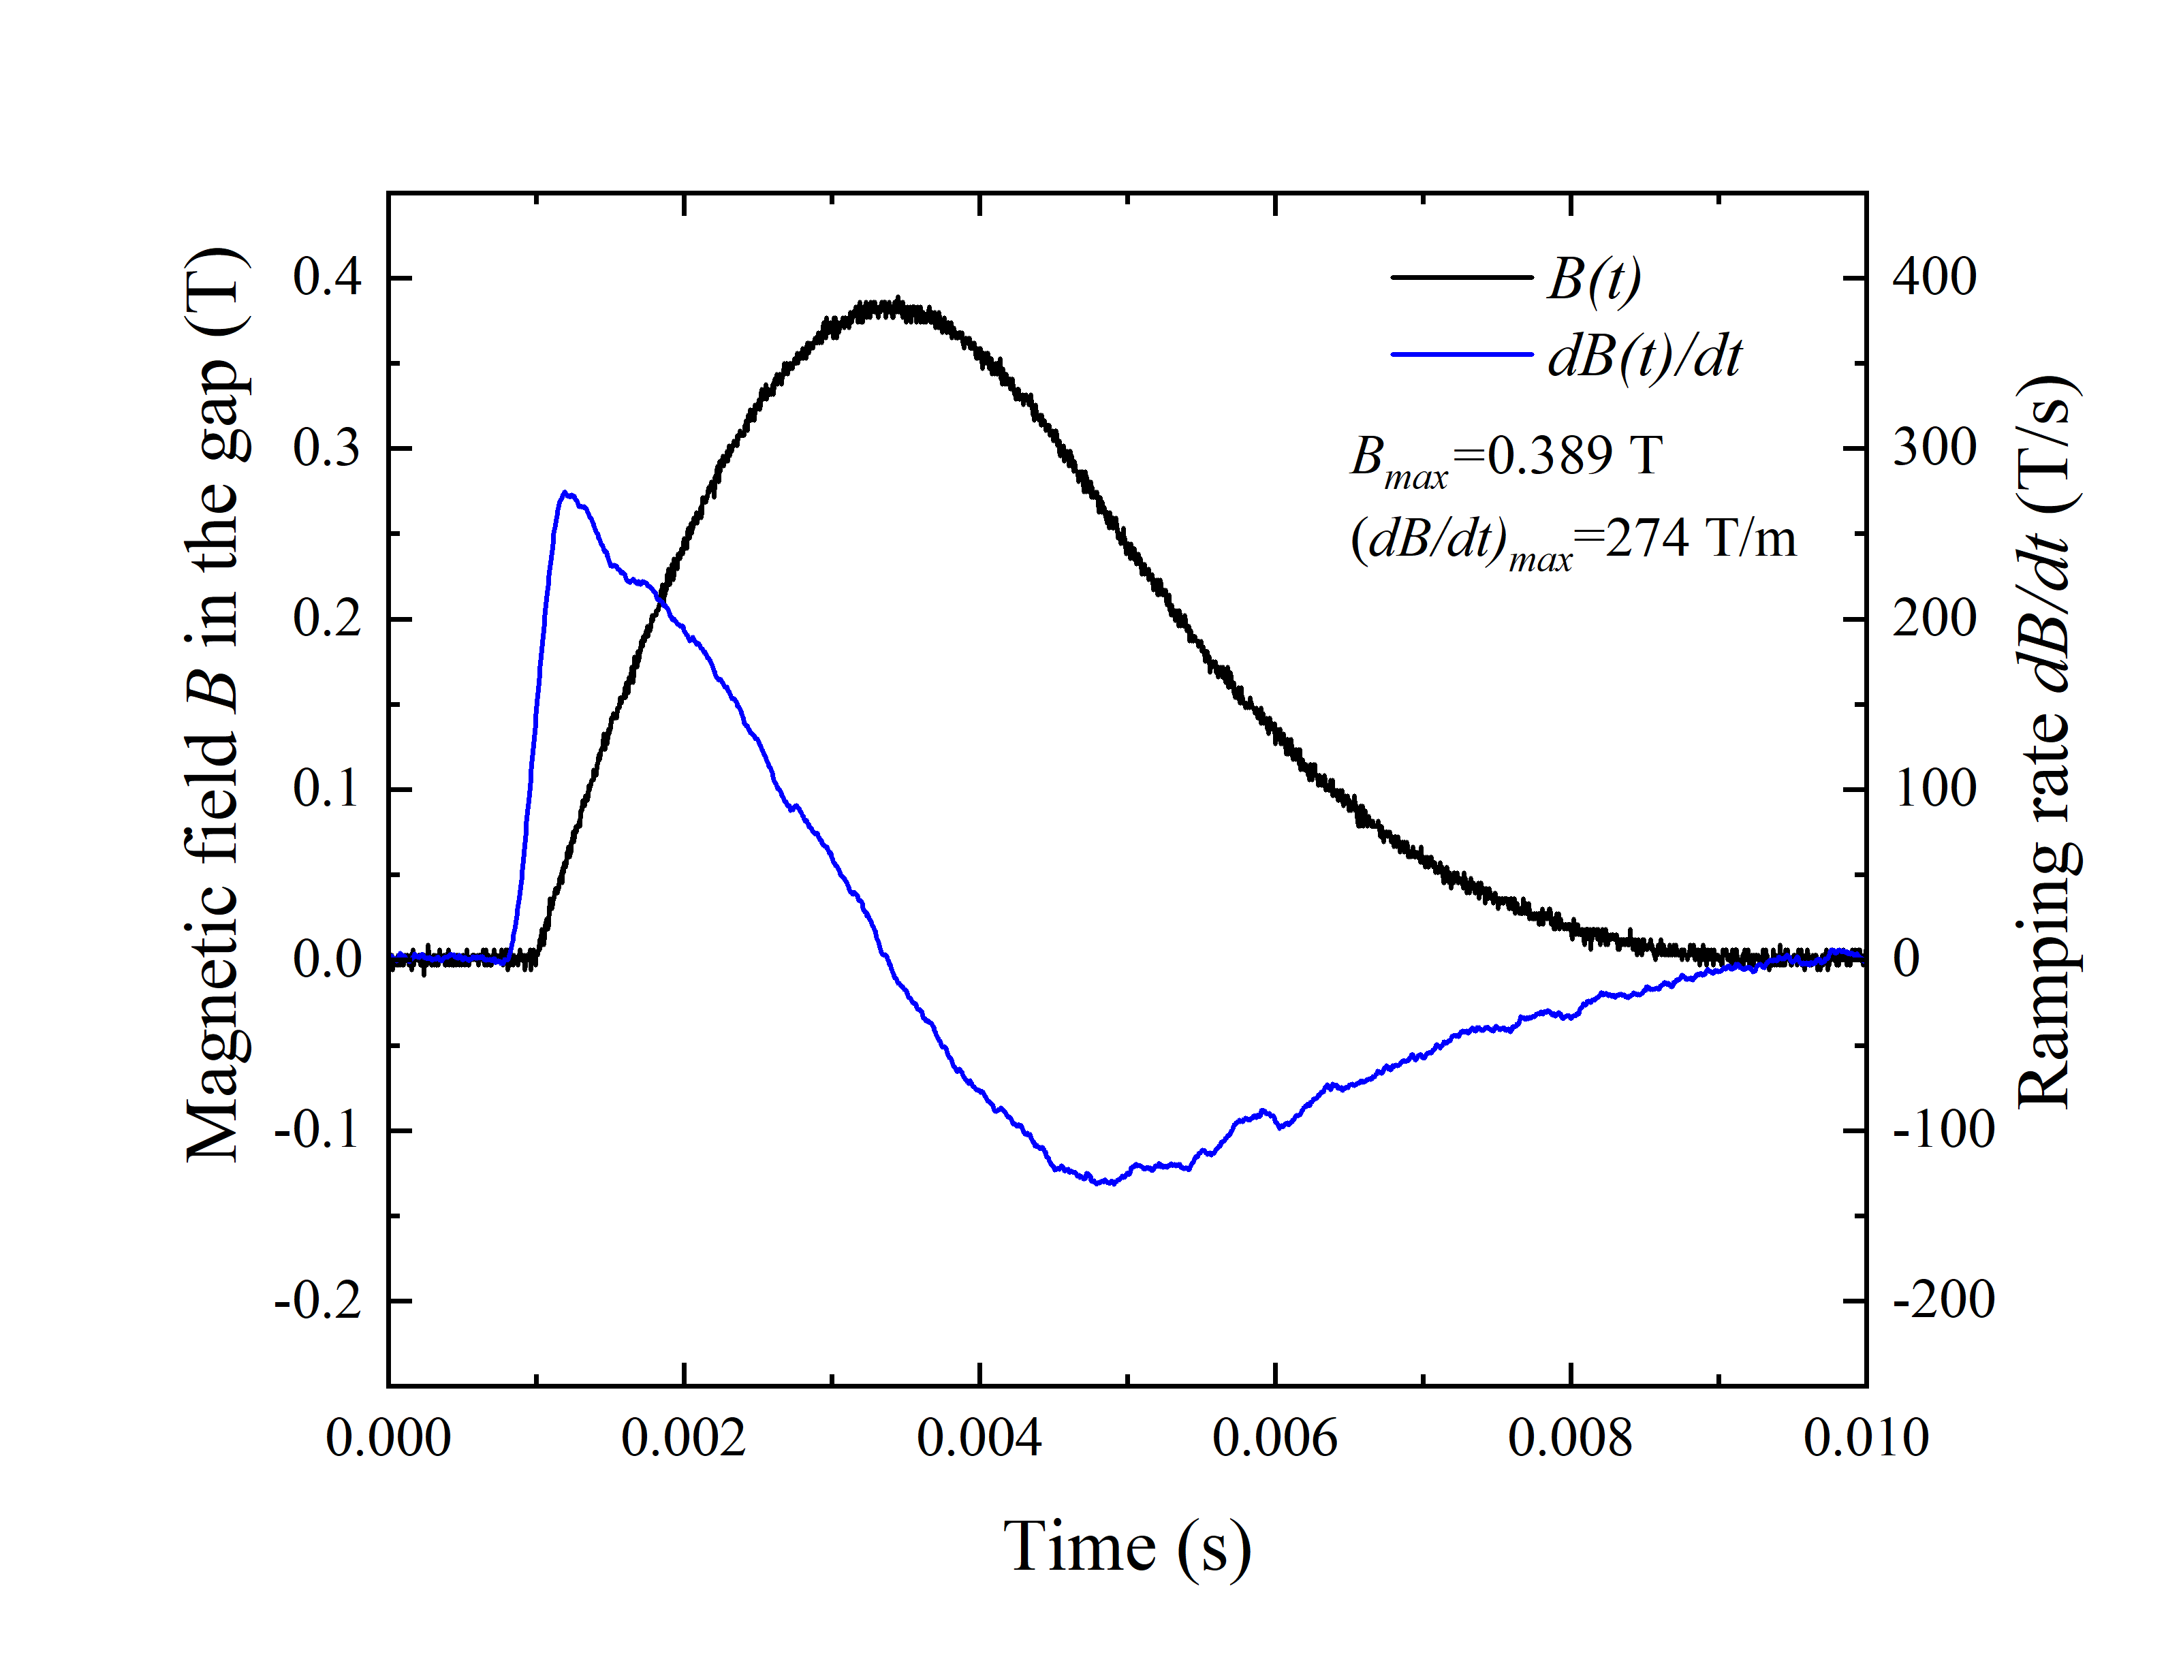
Power Tests with Gaussian Shaped B-field – June 2021
- Applied current: 1 kA (3kA in three turns)
Maximum B field: 0.39 T
Maximum dB/dt: 274 T/s
Avg. dB/dt: 160 T/s (0.39 T over 2.4 ms)
Maximum rep rate: 10 Hz
Gaussian shaped B-field - suitable for simultaneous acceleration of
µ⁺ µ⁻ beams in a dual bore magnet.
Long recovery time limits rep. rate.

Slide 8
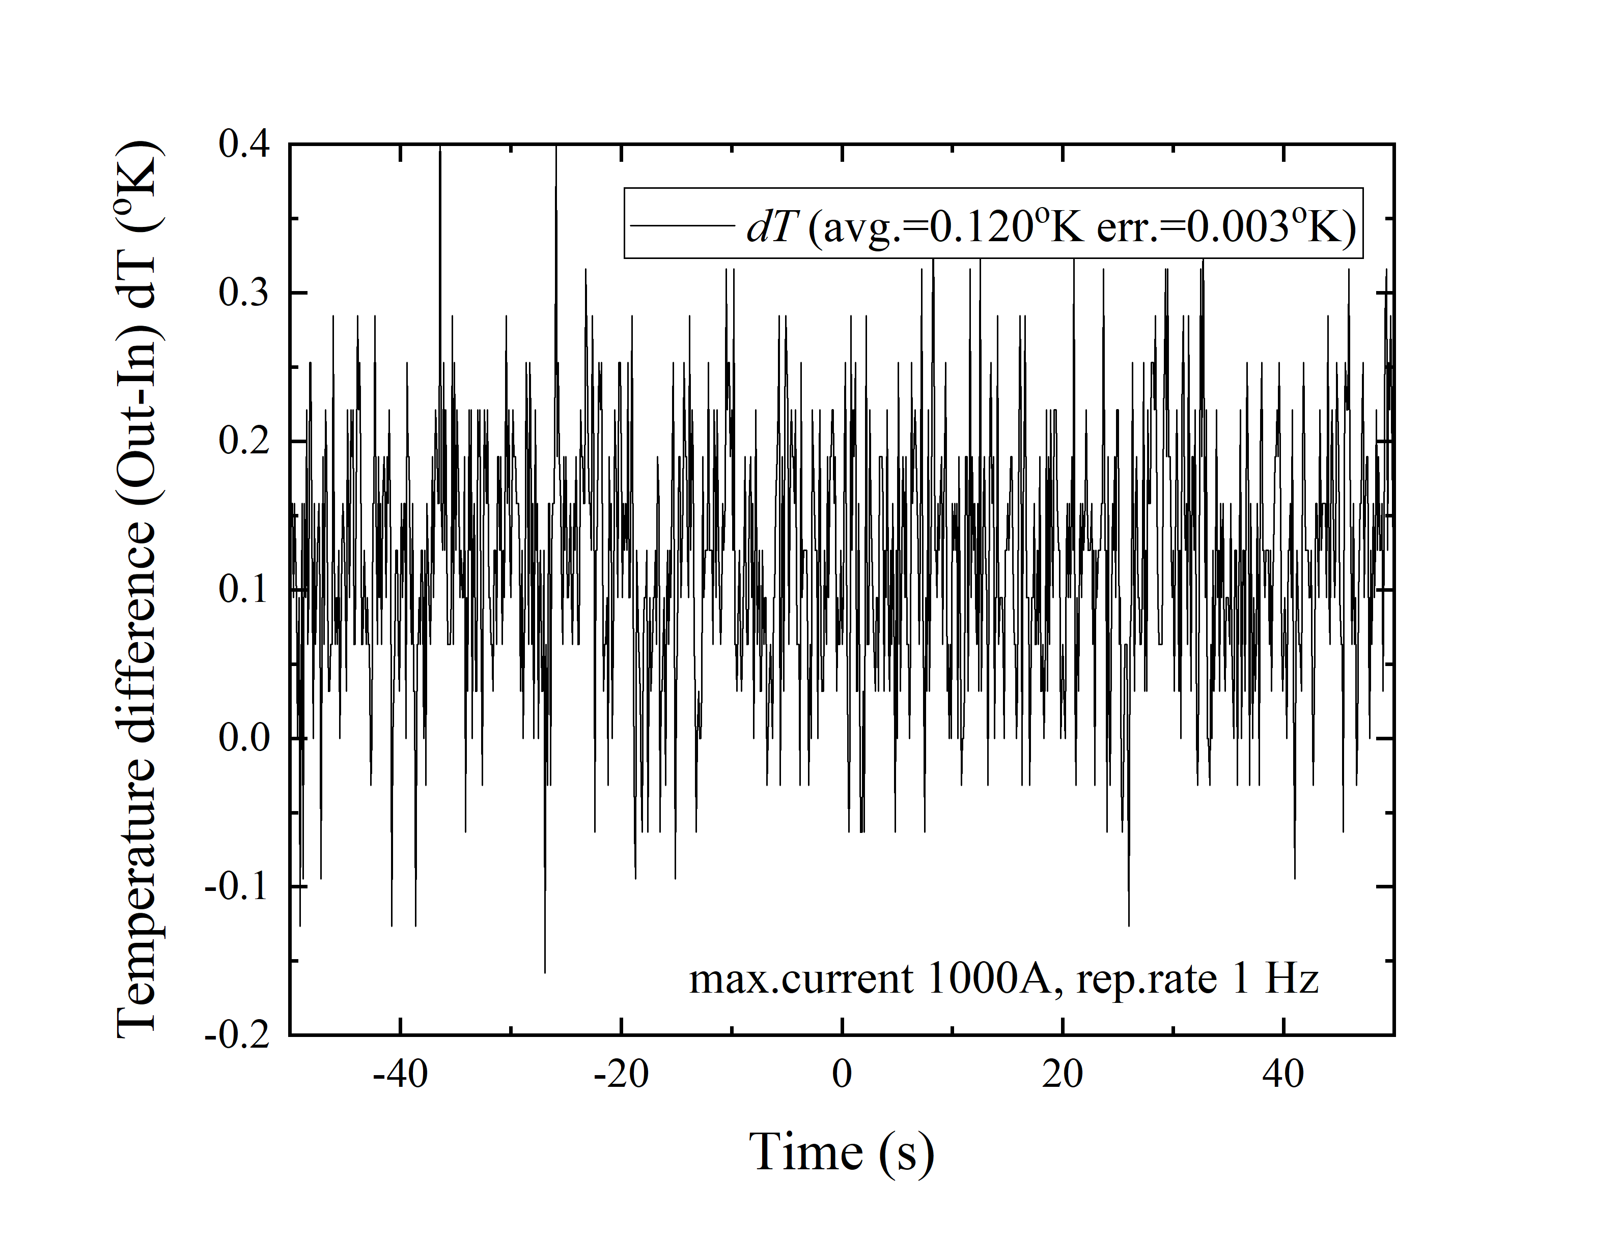
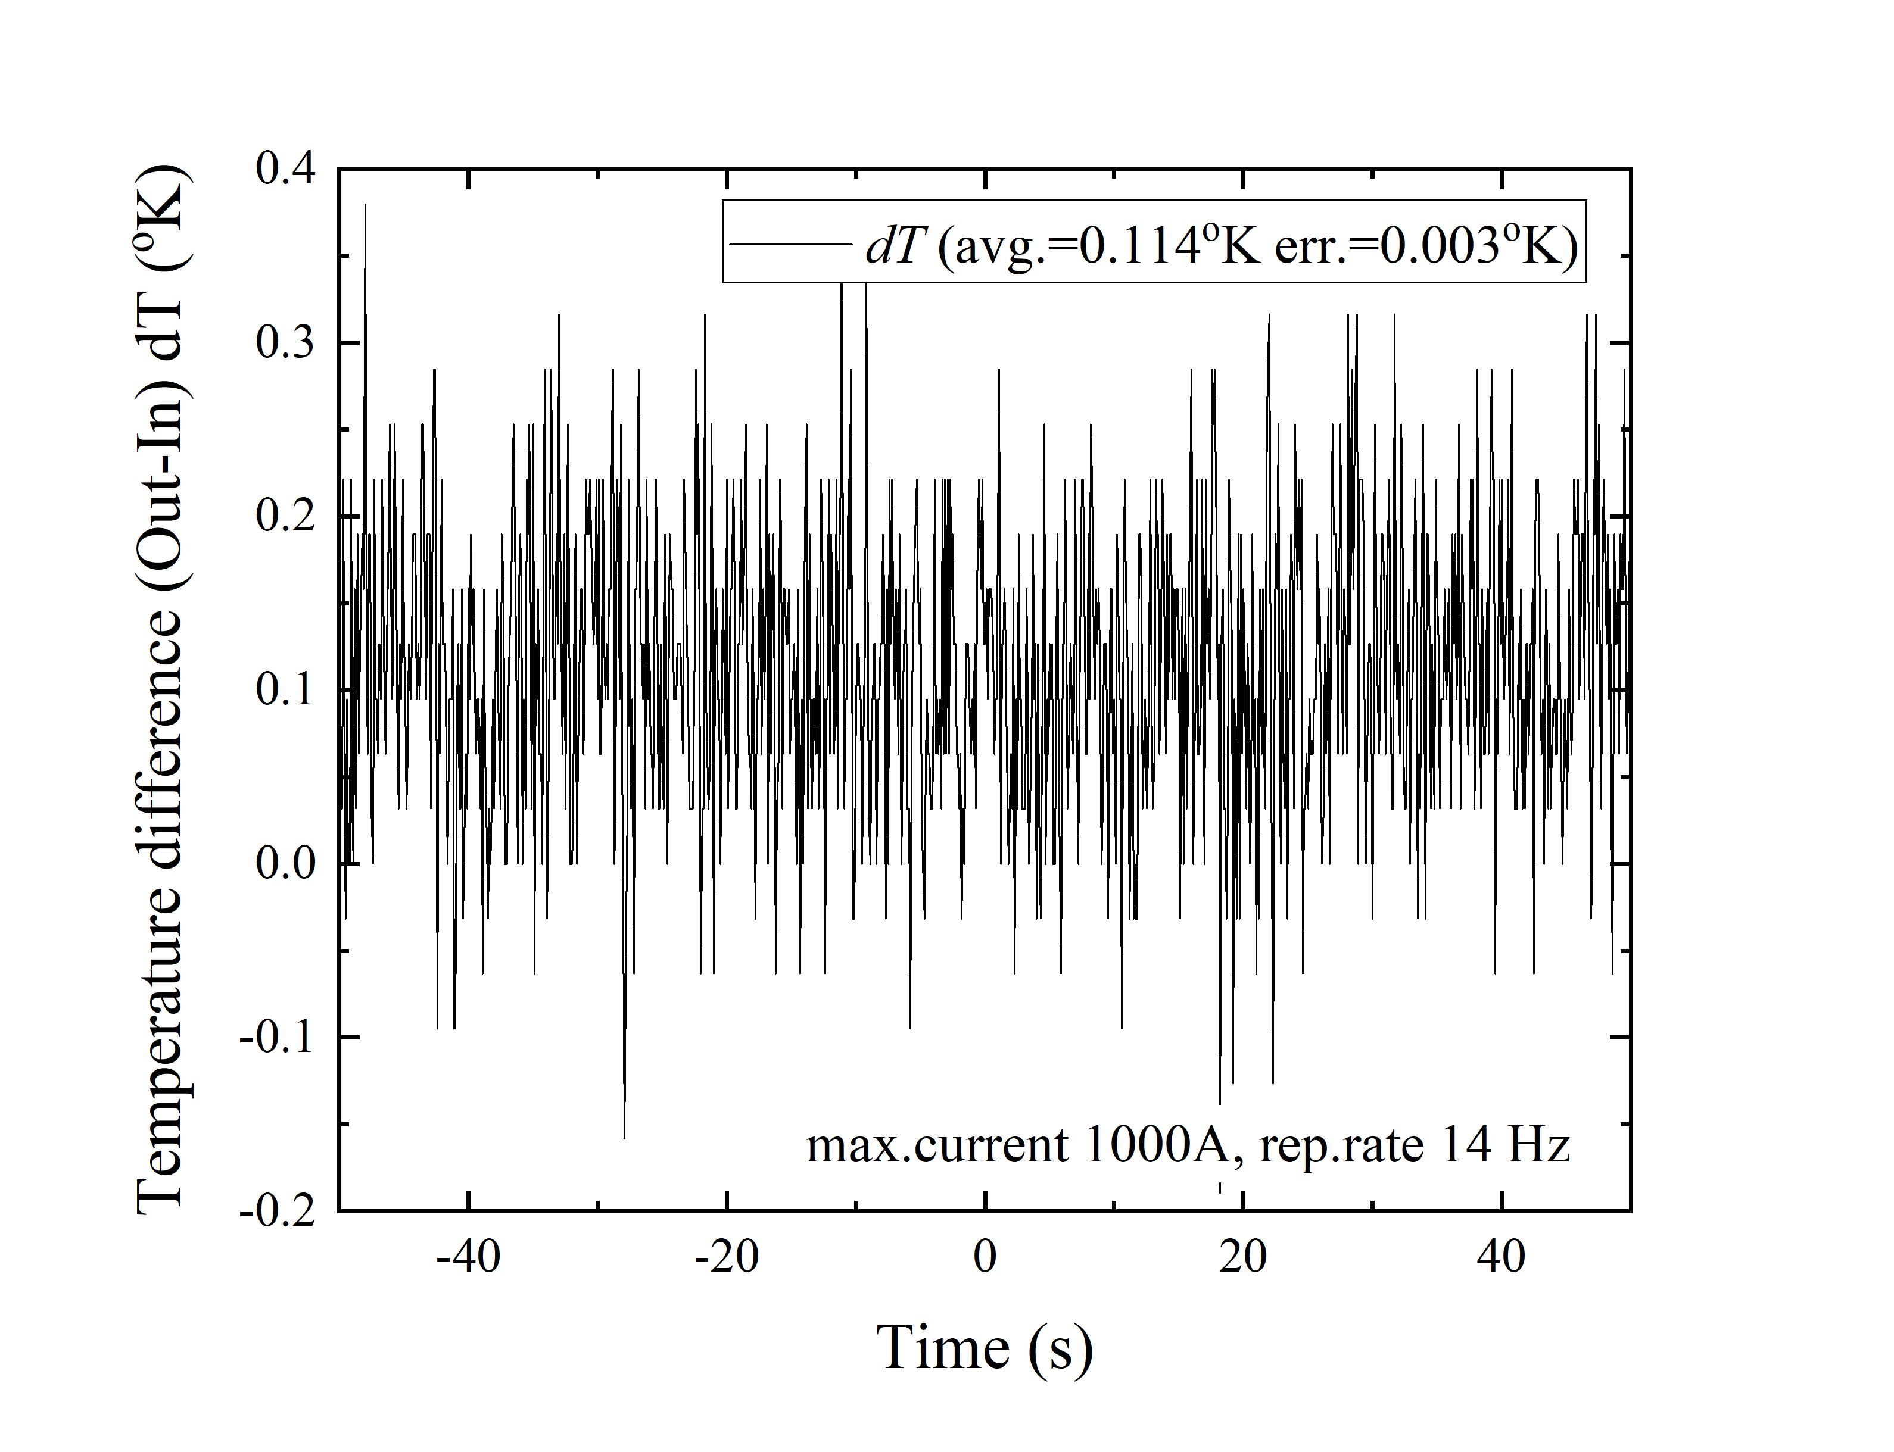
Measurements of conductor temperature
Temperature signals (#1 and #3, 25 mV/K) and pressure (#2).
Difference of “In” and “Out” helium temperatures measured at 1000A 1 Hz pulsing (a – left) and at 1000A 14 Hz magnet pulsing (b – right).
Precision of temperature measurements is about +/- 0.003 K which leads to the upper limit on HTS magnet cryogenic power loss of 0.1 W.
Helium pressure drop in cryogenic pipes may lead to the temperature drop (for ideal gas: Δ P/P => Δ T/T).
Methodical analysis, however, indicates possible pressure drop of only 543 Pa (0.08 Psi), hence 12 mK correction.

Slide 9
Power dissipated in Cu tape holding strands if magnet was not superconducting
HTS strands are wrapped with single layer of 12.5 mm x 0.1 mm Cu tape of 402 g mass and resistance of 230 10⁻⁴ Ω @ 6 K.
Magnet power cable is split into 2 sub-cables, each carrying medium current of 250 A over the 9 10⁻³ s power cycle time.
P _{Copper tape} = (250 A)² · 230 · 10⁻⁴ Ω · 9 10⁻³ s · 14 Hz = 181 W
With supercritical helium 6.5 K, 0.38 MPa, flow 1.2 g/s in each sub-cable pipe the temperature rise would be 39 K.
Temperature rise upper limit of ~ 0.1 K indicates that magnet was perfectly superconducting.

Slide 10
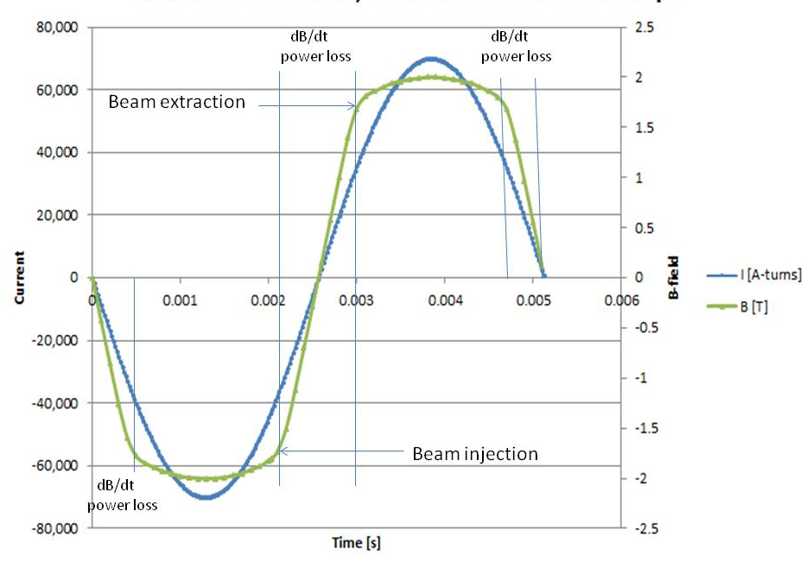
Possible application of HTS rapid cycling magnet for Muon Accelerator
Using the formulas from paper: “On the feasibility of a pulsed 14 TeV c.m.e. muon collider in the LHC tunnel”, 2018 JINST 13 T10003 by D. Neuffer and V. Shiltsev, we outline a possibility of a pulsed 7 TeV c.m.e muon collider (Parton energy 5 times of that of LHC) based on now being developed 2 T rapid cycling HTS magnets
in combination with the existing 8 T LHC magnets. The LHC cryogenic and power infrastructure will be reused.
Accelerator Parameter | LHC-D2
C [km] | 26.7
E _{max} [TeV] | 3.5
E _{inj} [TeV] | 0.45
B _{HF} [T] | 8.0
B _{PLS-max} [T] | 2.0
B _{PLS-linear} [T] | 1.7
L _{HF} [km] | 5.25
L _{PLS} [km] | 18.78
Π | 0.9
N _{turns} | 70
ΔE / turn [GeV] | 44
PLS _{current cycle} [ms] | 114
PLS _{beam acceleration ramp} [ms] | 6.3
dB _{PLS} /dt [T/s] | 270
f rep [Hz] | 8
Beam gap | 2 x (25 mm x 100 mm)
I _{PLS-max@25mm gap} [kA-turn] | 66
I _{magnet cable @ 20 K} [kA] | 24
N _{HTS strands} / cable | 24
Surahammar Steel, non-oriented Fe3%Si, 0.005” laminations, beam gap = 25 mm
With no changes to the magnet coil design the number of strands can be increased 6-fold allowing for 24 kA per cable @ 20 K.

