Slide 1
Interface Models for CCT Magnets
G. Vallone¹, E. Anderssen¹, D. Arbelaez¹, L. Brower¹, P. Ferracin¹, J. L. Rudeiros¹, S. Prestemon¹, T. Shen¹
¹Lawrence Berkeley National Laboratory
US-MDP Collaboration Meeting
13 October 2021

Slide 2
Outline
Introduction
CCT standard FE Models:
Bonded
Frictional
CCT interface debonding
CZM with nominal properties
CZM with reduced strength
Calibration on strain gauge data
Conclusion

Slide 3
Introduction
After studying CCT5 debonding during training, we focus on the the subscale magnets, as they offer new data that can be studied/compared to our models
Preliminary results from the subscale experiments suggest that the spar thickness has an impact on magnet training
Do we see / can explain this difference in/with our models?
Here we use FE model to study the differences between the two magnets (qualitative). Ideally, would like to predict/match the behavior starting from the measured interfaces’ properties (quantitative)
3 step process:
Bonded model, to evaluate tension/shear loads at the interfaces
Frictional model, to evaluate potential motion with failed interfaces
Cohesive model, to model progressive failure during training

Slide 4
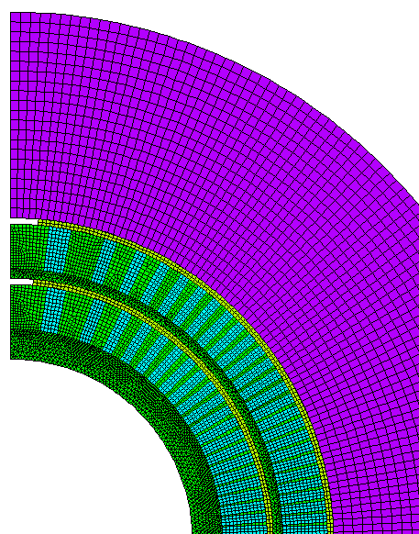
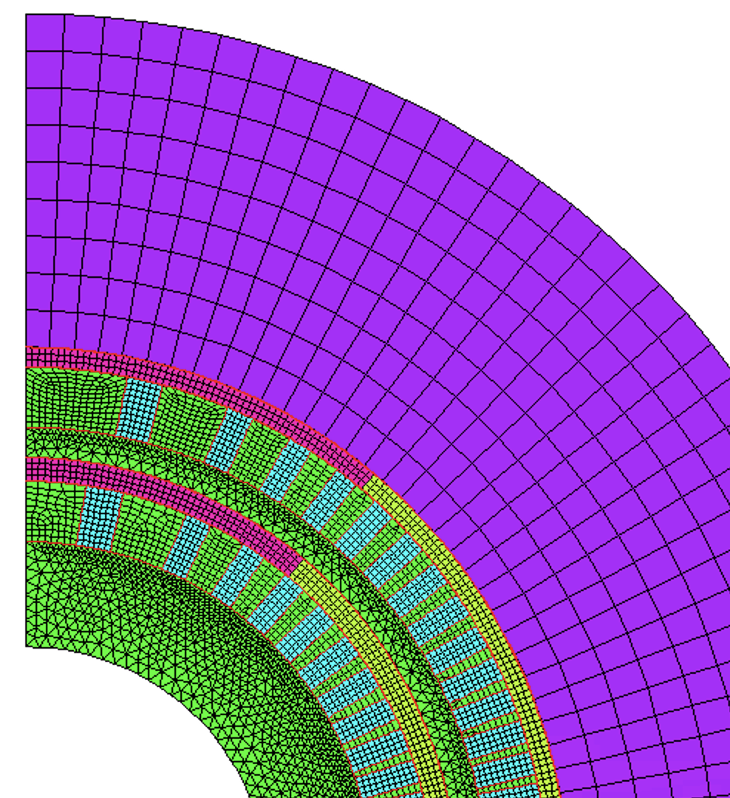
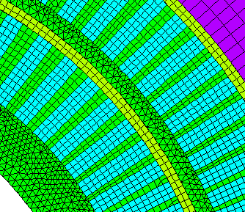
FE Model Description
Soft shims
CZM elements
Contact elements (bonded/frictional/CZM) around the cable (cable/spar, cable/rib)
With the ‘real’ shim configuration, in 2D the conductor flies away during powering
Old strategy: Shim ‘angle’ increased w.r.t. real value
Now: additional ‘soft’ shim. E = 1 GPa – convergence issues if softer than this
Elasto-plastic material model for the conductor, extracted from RVE models of the cable
For more information, see talk at MDP general meeting 23/06/2021
Load steps: 0: prestress, 1: cooldown, 2: power to final current - no ‘training’
Prestress (<1 MPa) added to improve convergence at cooldown start

Slide 5
Outline
Introduction
CCT standard FE Models:
Bonded
Frictional
CCT interface debonding
CZM with nominal properties
CZM with reduced strength
Calibration on strain gauge data
Conclusion

Slide 6
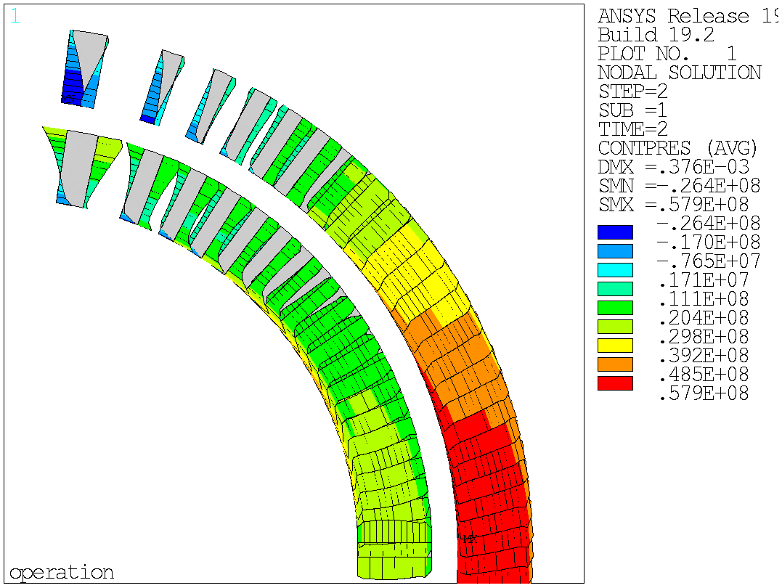
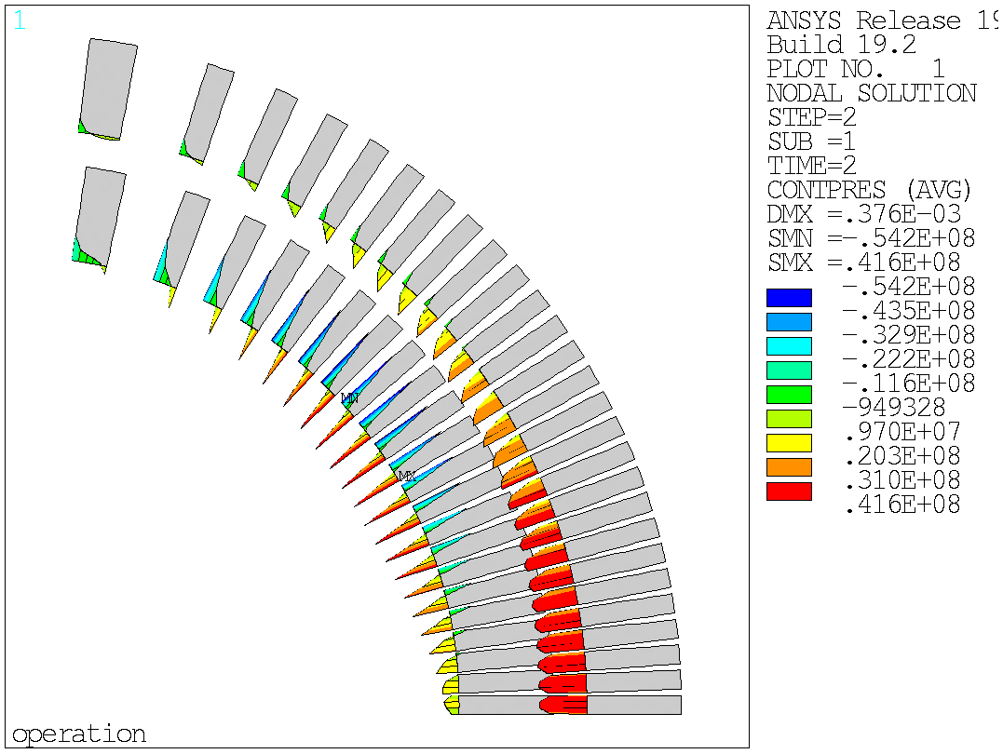
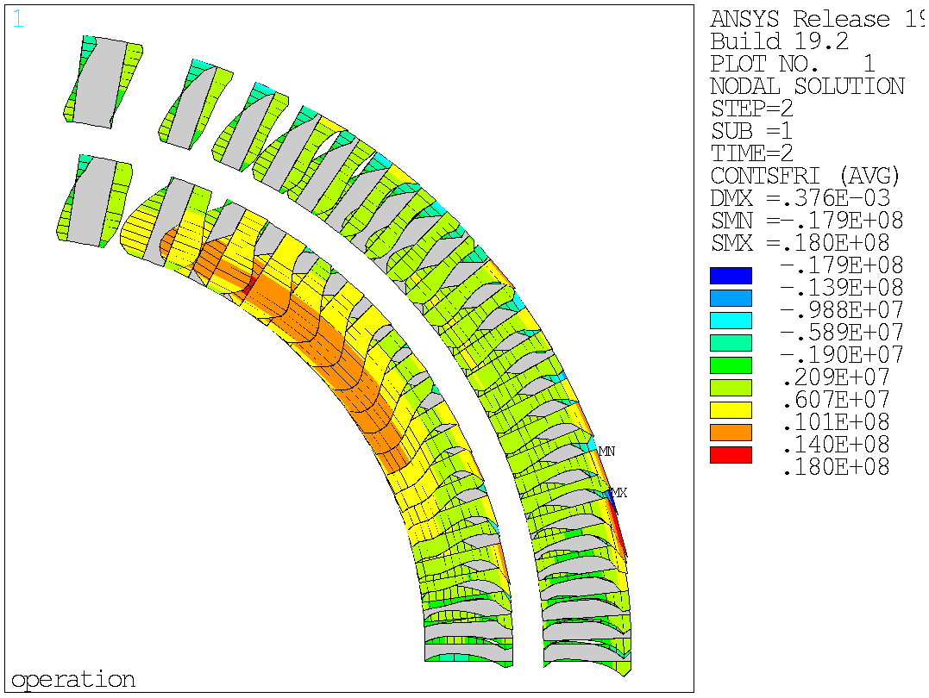
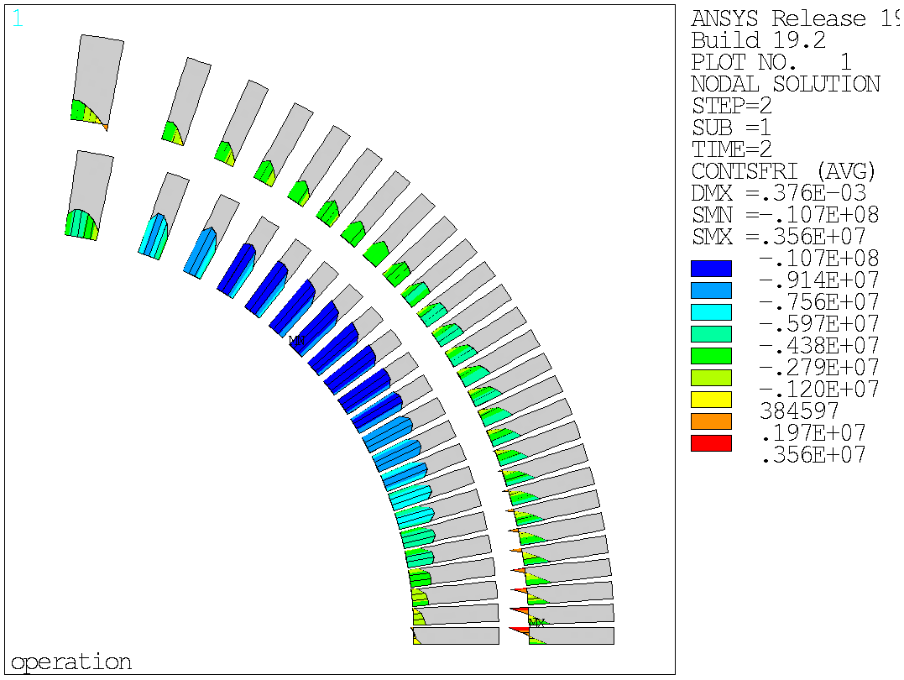
CCT5 – Bonded Model
FE 2D numerical model of CCT5 – bonded contacts
Normal contact status during powering:
Conductor/rib: 26 MPa max tension on the first turn
Conductor/spar: worst condition at ~45°with 54 MPa of tension
Shear contact status:
Conductor/rib: 18 MPa max shear stress on the outer layer
Conductor/spar: worst condition at ~45°with 10 MPa of shear stress at the interface

Slide 7
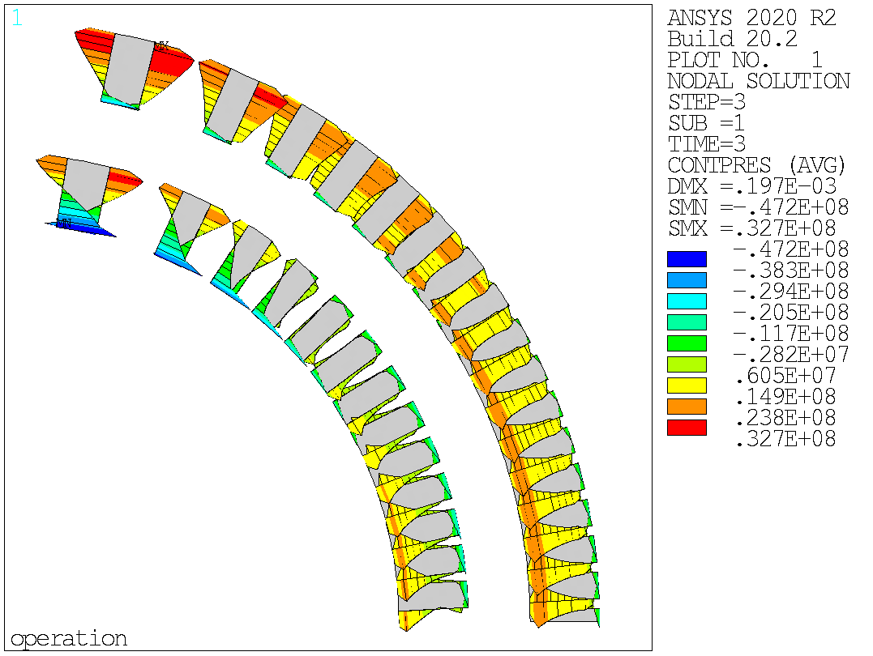
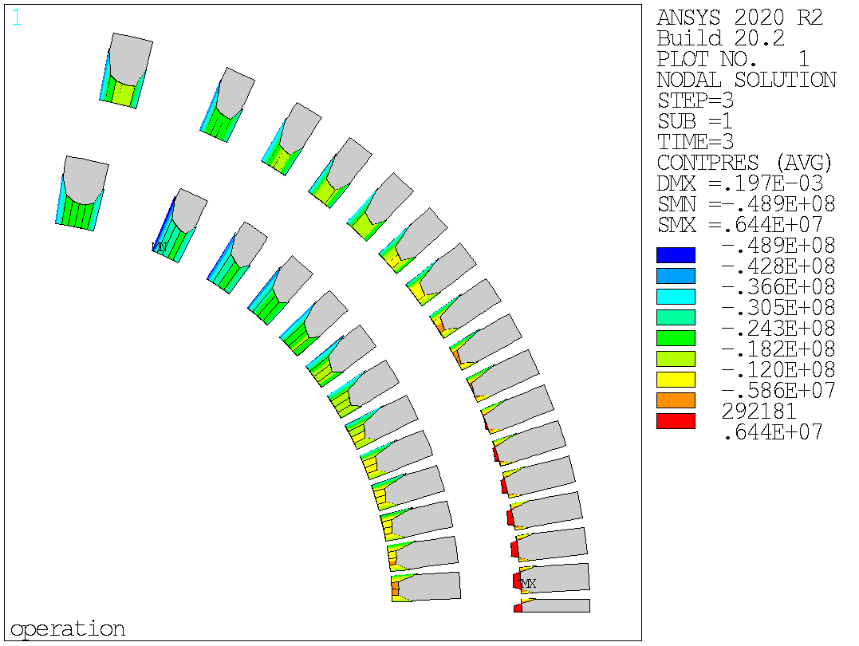
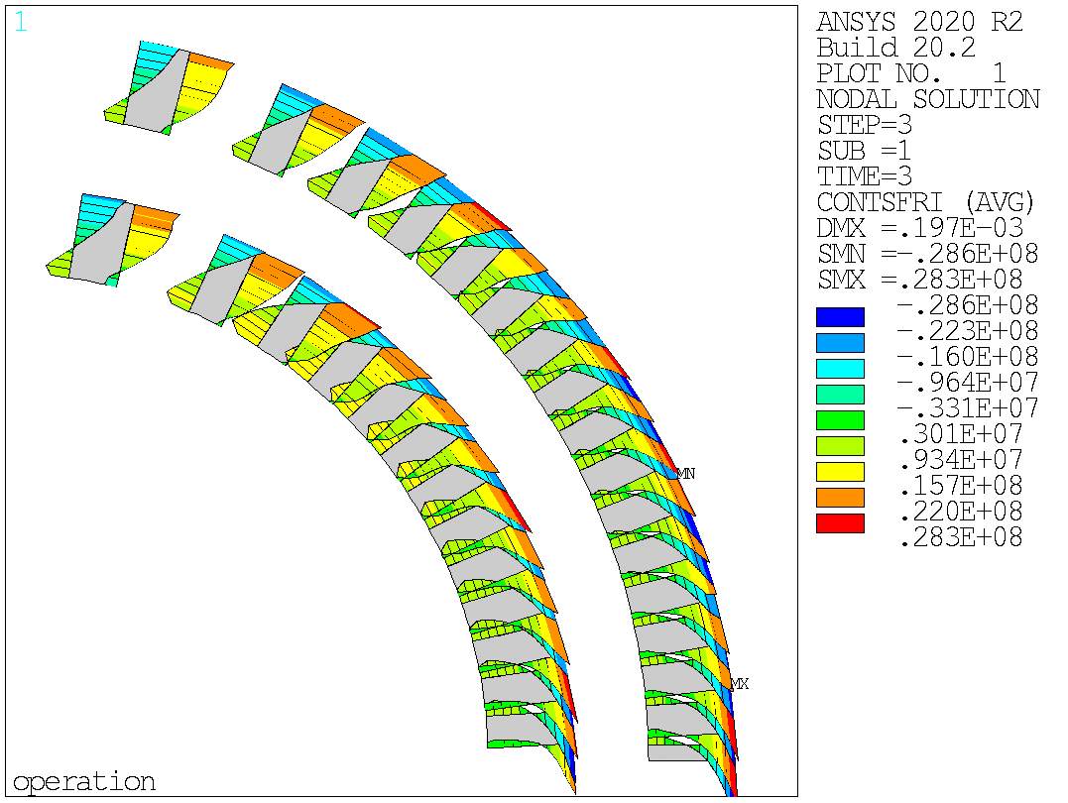
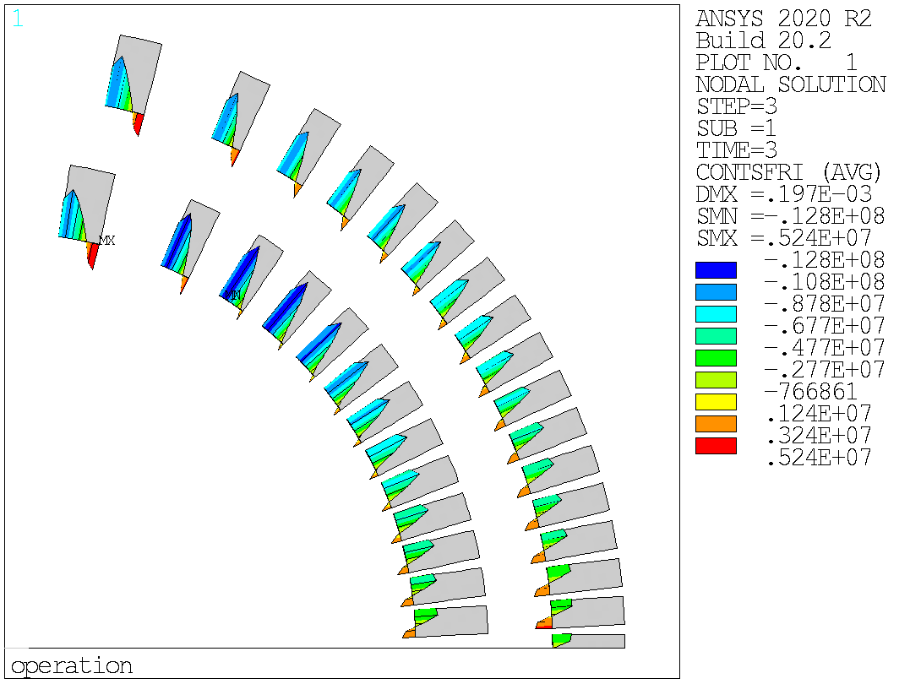
Subscale II – Bonded Model
FE 2D numerical model of Subscale II, 9 kA – bonded
Normal contact status during powering:
Conductor/rib: 47 MPa max tension on the first turn
Conductor/spar: 49 MPa max tension at ~60°
Shear contact status:
Conductor/rib: 28 MPa max shear, on the outer layer
Conductor/spar: 3 MPa max shear at ~60°

Slide 8
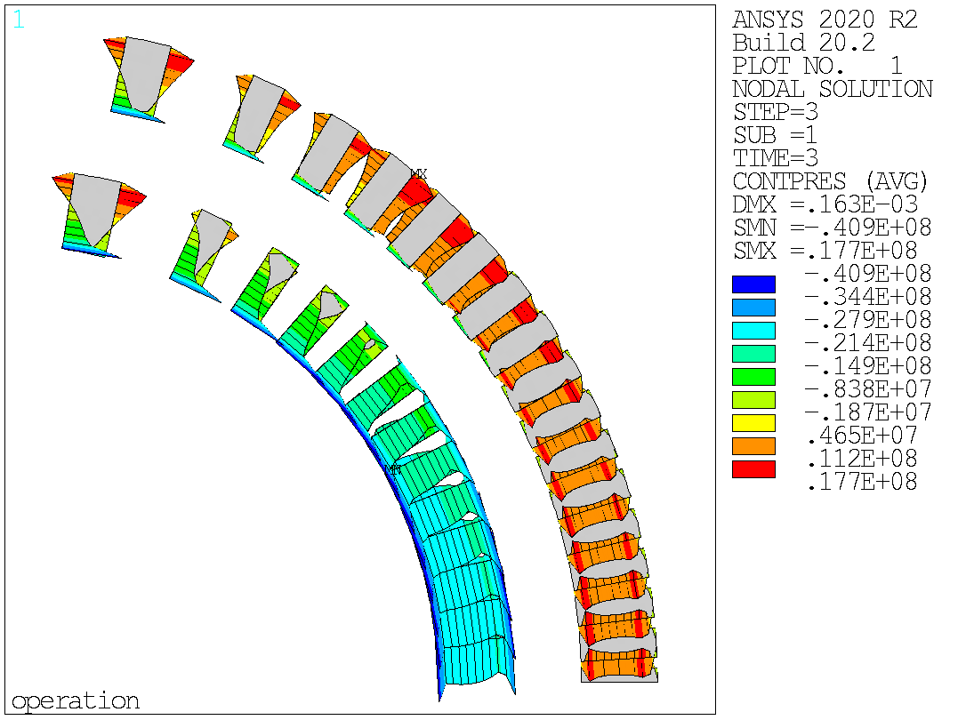
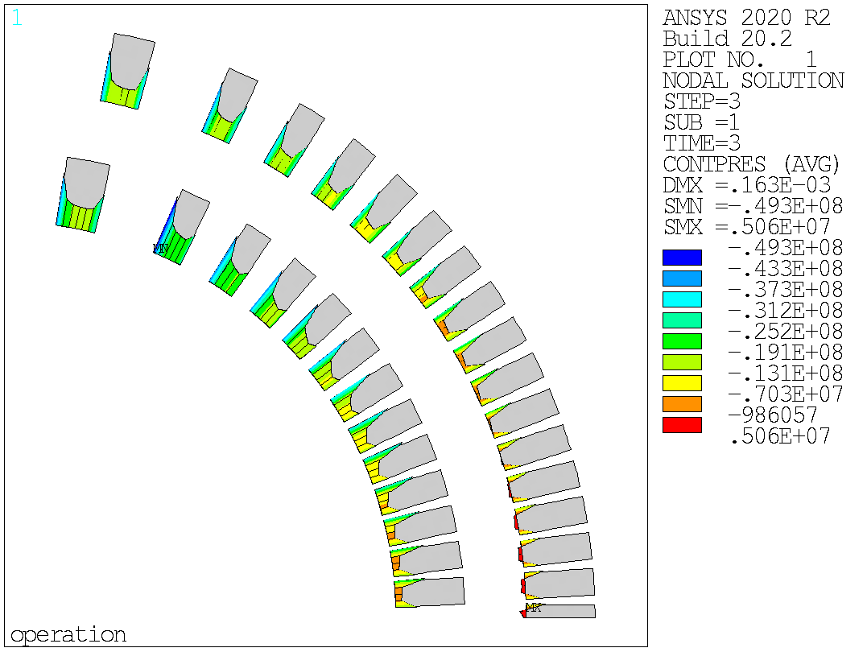
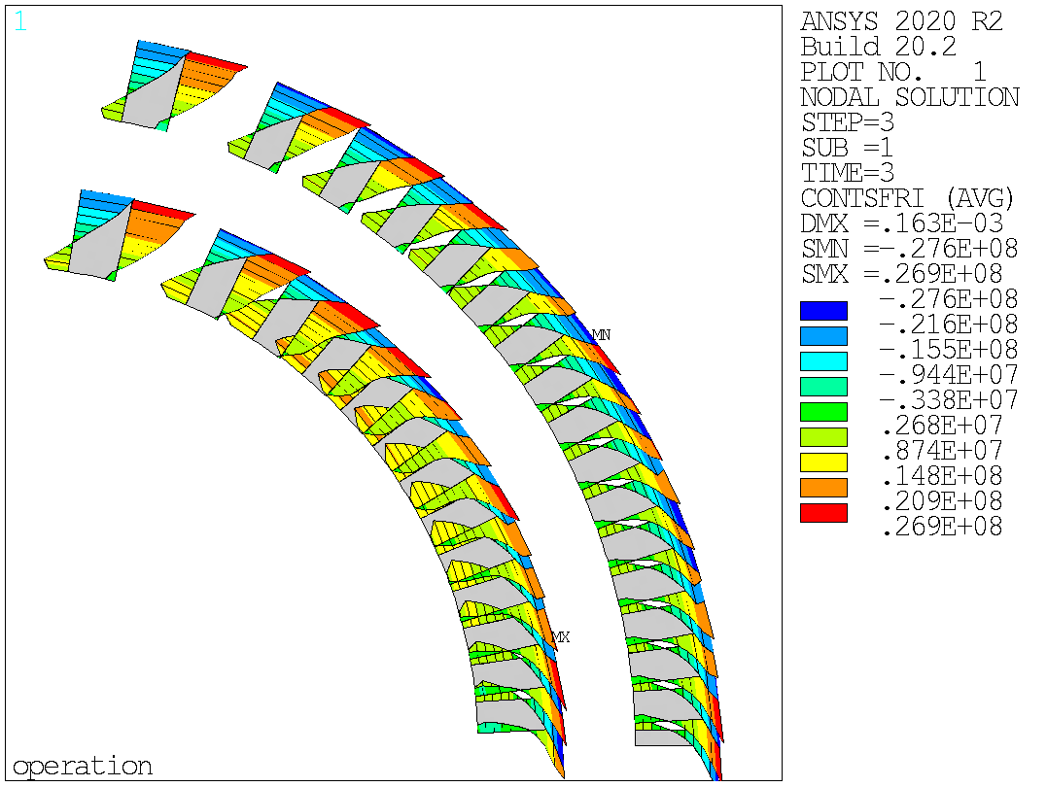
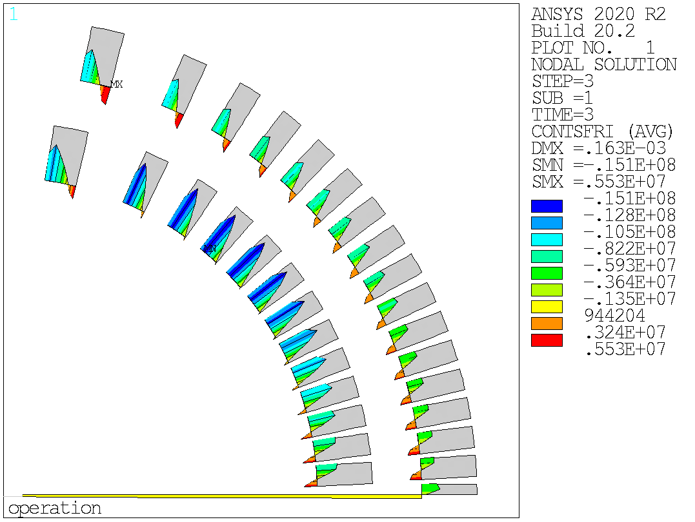
Subscale III – Bonded Model
FE 2D numerical model of Subscale III, 9 kA – bonded
Normal contact status during powering:
Conductor/rib: 41 MPa max tension on the inner radius
Conductor/spar: 49 MPa max tension at ~60°
Shear contact status:
Conductor/rib: 27 MPa max shear, on the outer layer
Conductor/spar: 15 MPa max shear at ~60°, inner layer

Slide 9
Bonded Model - Considerations
 | Normal |  | Shear
 | Rib | Spar | Rib | Spar
 | MPa | MPa | MPa | MPa
CCT 4/5 | 26 | 54 | 18 | 10
Subscale II | 47 | 49 | 28 | 3
Subscale III | 41 | 49 | 27 | 15
Peak stresses:
Subscale II and III interface loads are surprisingly similar!
Similar spar tension on CCT4/5 and Subscale models
Subscale magnets at 9 kA have higher tension and shear loads on the ribs
The average load or allowed displacement might be more important
Should be able to understand this from the detachment models

Slide 10
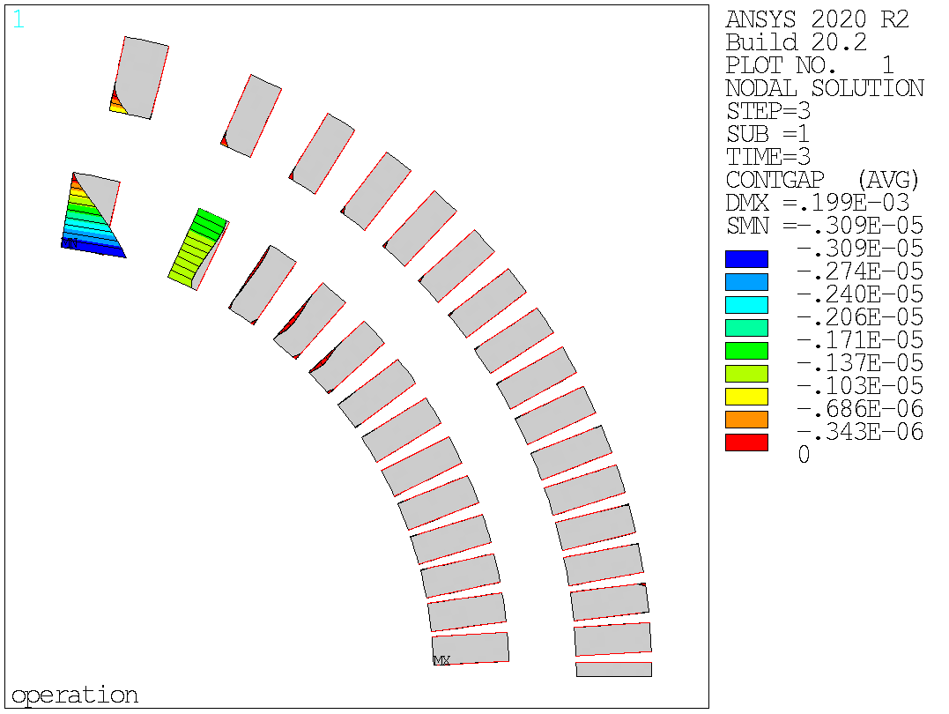
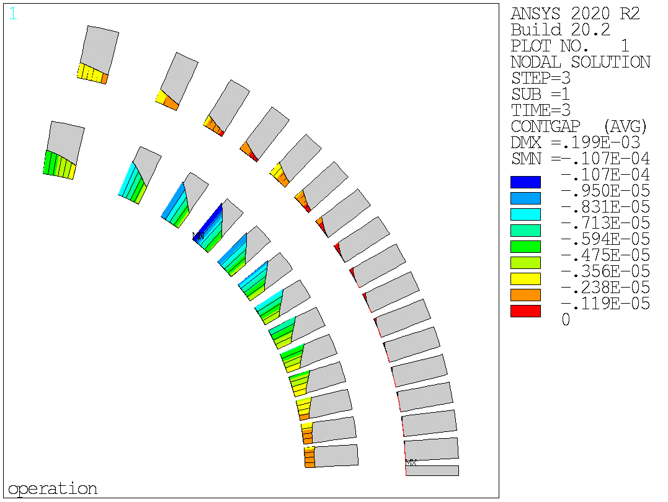
Subscale II – Frictional Model
FE 2D numerical model of Subscale II, 9 kA – 𝞵 = 0.2
Normal contact status during powering:
Conductor/rib: 3 um (!) max gap on the first turn
Inner turns and outer layer do not separate
What about the tension? The rib seems to follow the conductor…
Conductor/spar: 10 um max gap at ~60°
Shear contact status:
Conductor/rib: sliding
Conductor/spar: mostly detached

Slide 11
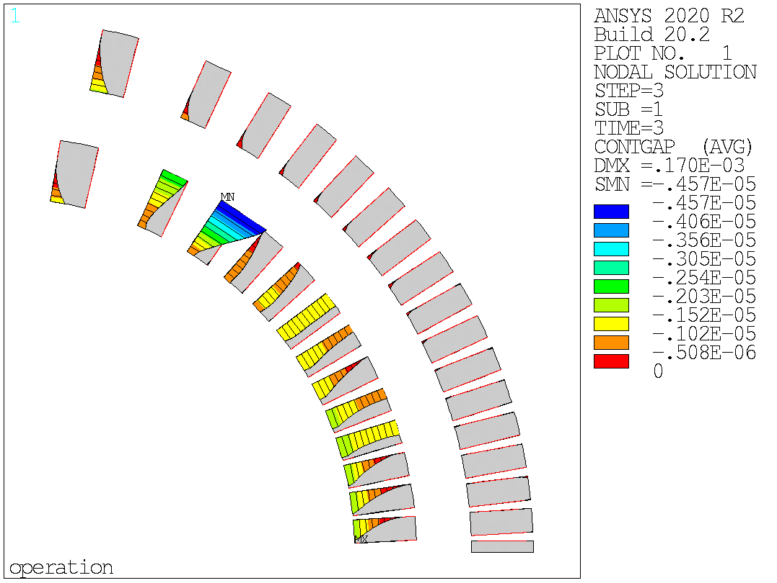
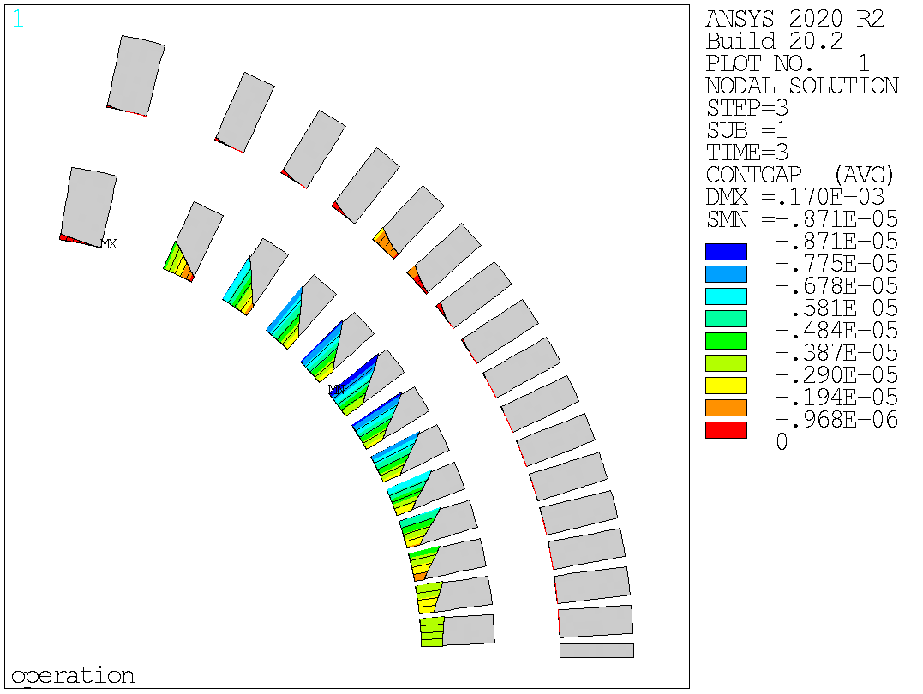
Subscale III – Frictional Model
FE 2D numerical model of Subscale II, 9 kA – 𝞵 = 0.2
Normal contact status during powering:
Conductor/rib: 5 um (!) max gap at ~60°
More turns separate -> the ribs do not follow the conductor now (stiffer spar)…
Conductor/spar: 9 um max gap at ~45°
Shear contact status:
Conductor/rib: sliding
Conductor/spar: detached

Slide 12
Frictional Model - Considerations
Thin
Thick
Peak displacement:
Not much difference (normal direction)
Significant difference in the opening at the rib/conductor interface

Slide 13
Outline
Introduction
CCT standard FE Models:
Bonded
Frictional
CCT interface debonding
CZM with nominal properties
CZM with reduced strength
Calibration on strain gauge data
Conclusion

Slide 14
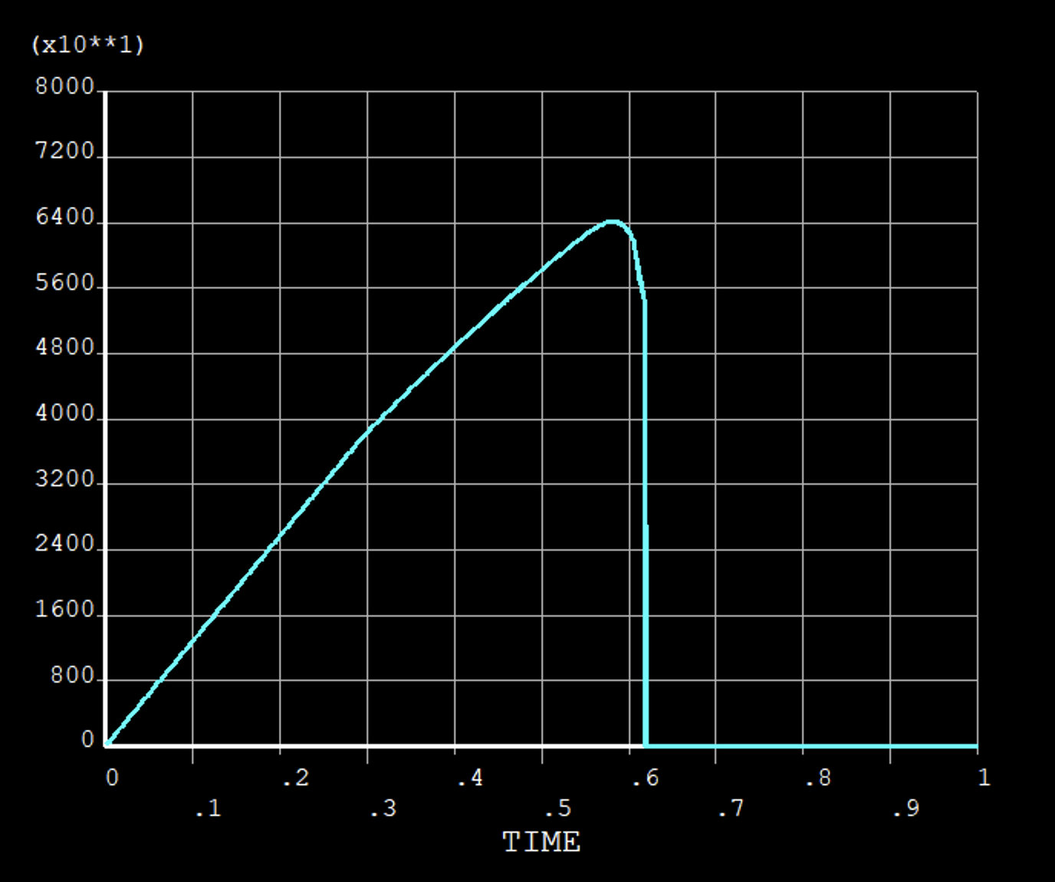
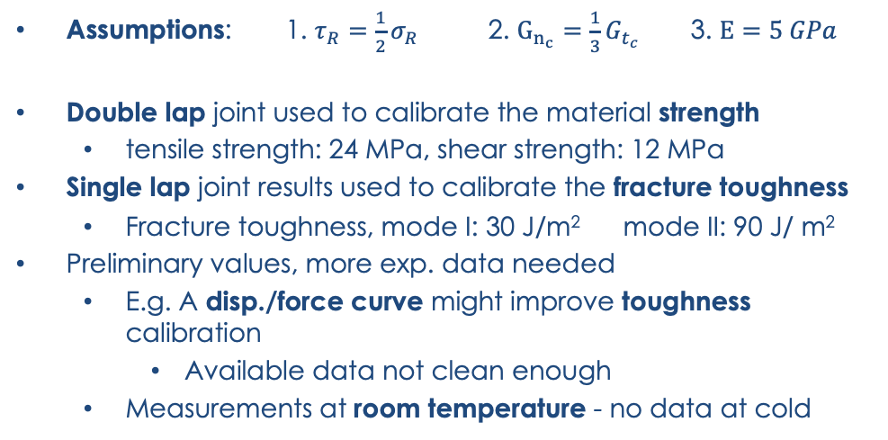
Interface Model Properties
DOUBLE LAP JOINT TEST
smax | Gcn | tmax | Gct | Fmax | Stress
MPa | J/m2 | MPa | J/m2 | N/m | N/mm2
10 | 200 | 10 | 600 | 97612 | 9.76
20 | 200 | 10 | 600 | 98746 | 9.87
20 | 200 | 20 | 600 | 193175 | 19.32
20 | 200000 | 10 | 600000 | 99584 | 9.96
70 | 200 | 35 | 600 | 312706 | 31.27
SINGLE LAP JOINT TEST
smax | Gcn | tmax | Gct | Fmax | Stress
MPa | J/m2 | MPa | J/m2 | N/m | N/mm2
20 | 200 | 10 | 600 | 92750 | 9.28
20 | 100 | 10 | 300 | 90749 | 9.07
20 | 50 | 20 | 150 | 87933 | 8.79
20 | 25 | 10 | 75 | 73215 | 7.32
24 | 50 | 12 | 150 | 100081 | 10.01
24 | 25 | 12 | 75 | 74081 | 7.41
24 | 30 | 12 | 90 | 81397 | 8.14
Assumptions: 1. $τ_{R}=\frac{1}{2}σ_{R}$ 2. $G_{n_{c}}=\frac{1}{3}G_{t_{c}}$ 3. $E=5 GPa$
Double lap joint used to calibrate the material strength
tensile strength: 24 MPa, shear strength: 12 MPa
Single lap joint results used to calibrate the fracture toughness
Fracture toughness, mode I: 30 J/m² mode II: 90 J/ m²
Preliminary values, more exp. data needed
E.g. A disp./force curve might improve toughness calibration
Available data not clean enough
Measurements at room temperature - no data at cold
G…

Slide 15
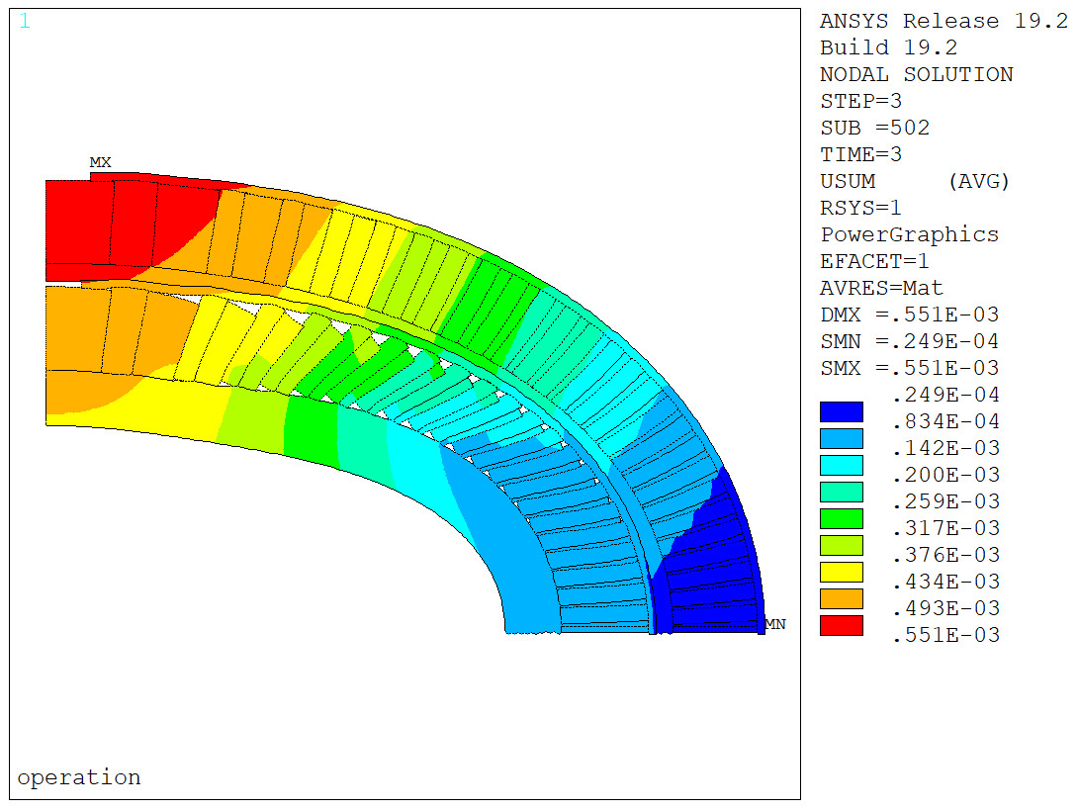
CCT5 – CZM Model - Damage
Some ‘small’ detachment after cooldown at the outer radius
This is what you might see looking at the coil after a test…
Almost no damage inside!
Significant damage on the inner layer – negligible on the outer layer
Most of the spar/cable interface failed (from ~20 to 75 deg approx.)
The rib/cable interface fails on both sides (completely on the side in tension)
Failure propagates slowly from the outer edge, then suddenly propagates at around 12 kA
Impossible to say if this would be one or multiple events in a real magnet
This is quite close to where most CCT5 quenches were… (more later)

Slide 16
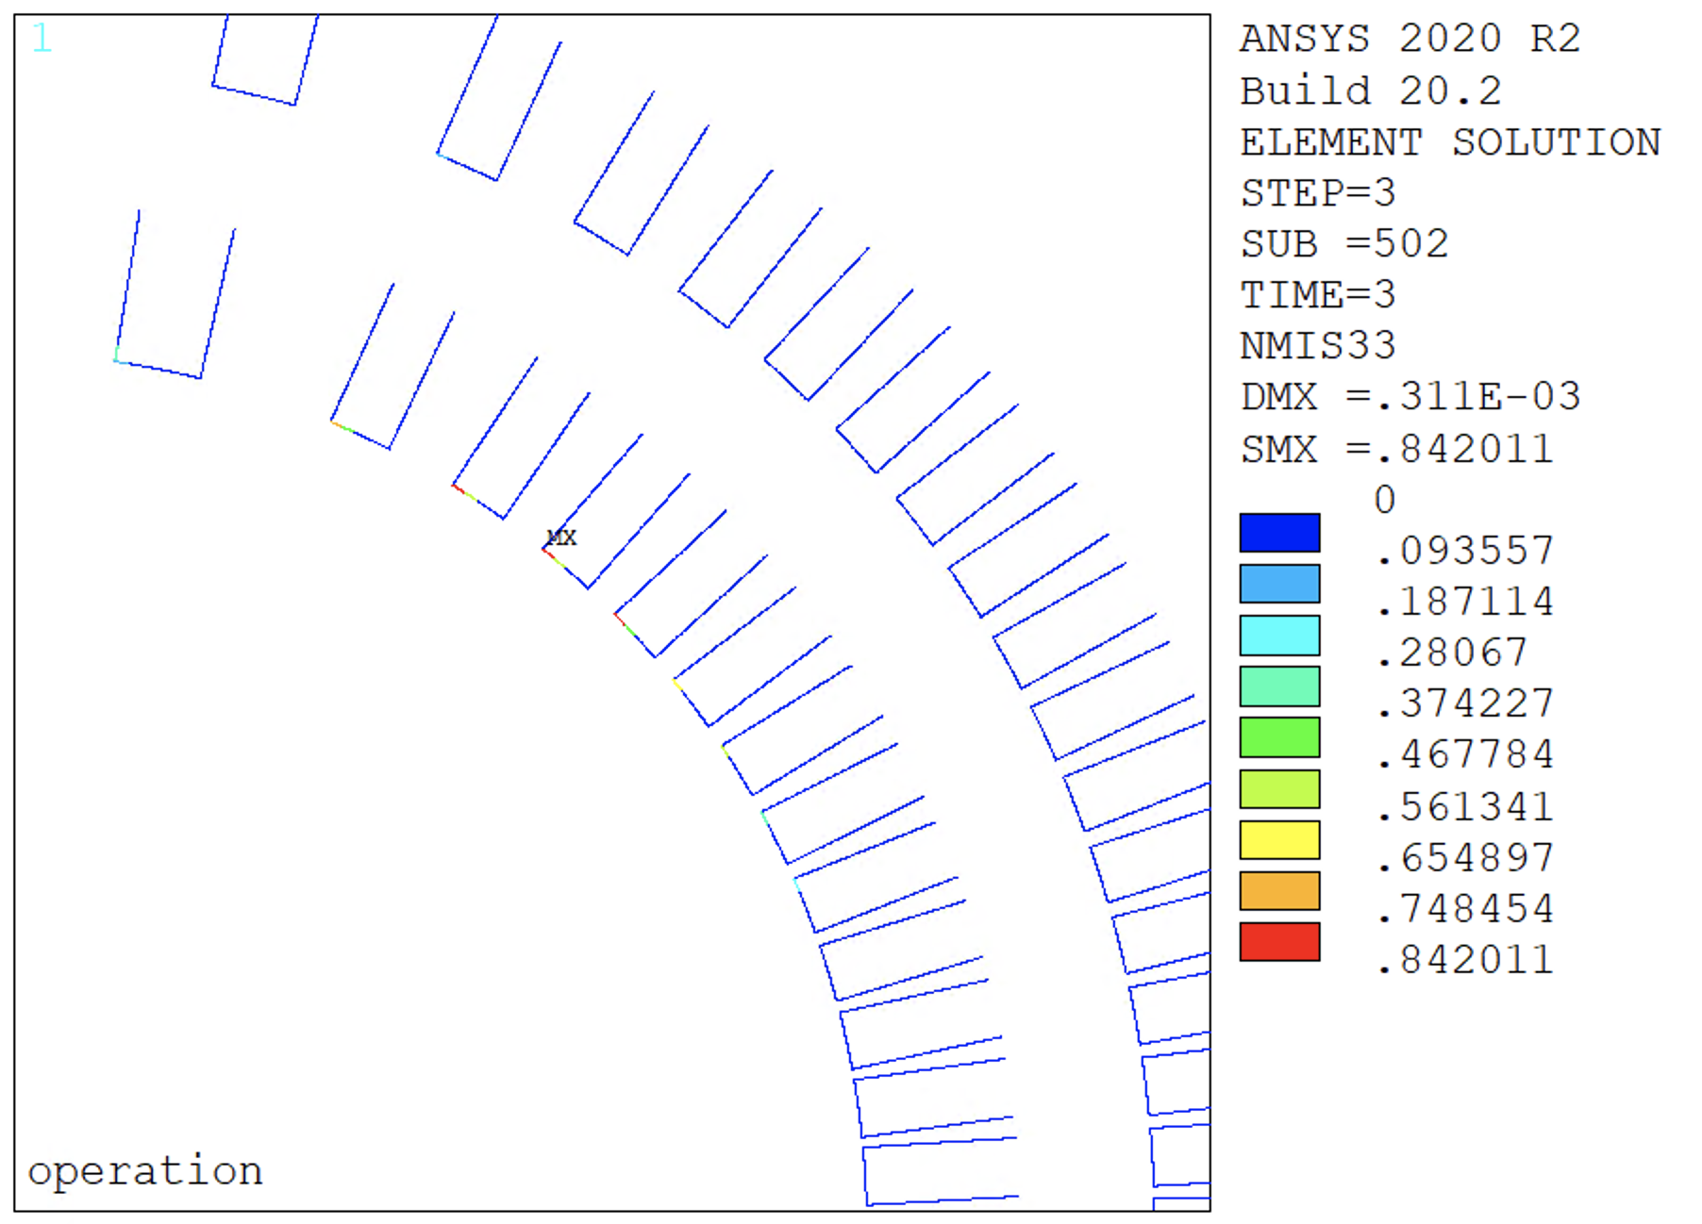
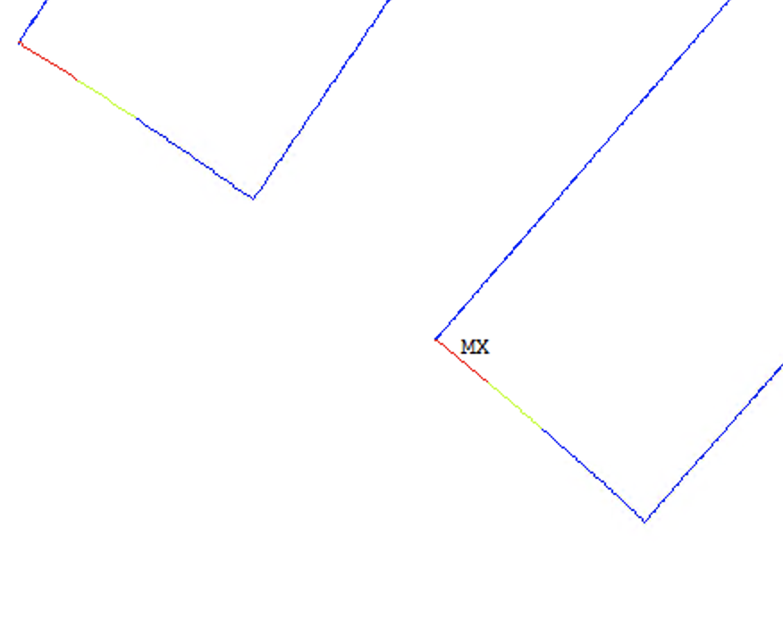
Subscale II – CZM Model - Damage
Less detachment… Interfaces on the verge of breaking
No damage after cooldown
No damage on the rib/conductor interface
Significant damage (~84% failed) on spar/conductor corners
No damage on the outer layer
But the max. tension was higher than the limit!
With the CZM model we usually add also the ‘glue layer’ stiffness (150 um). Therefore, contact elements are softer, reducing the peaks stresses

Slide 17
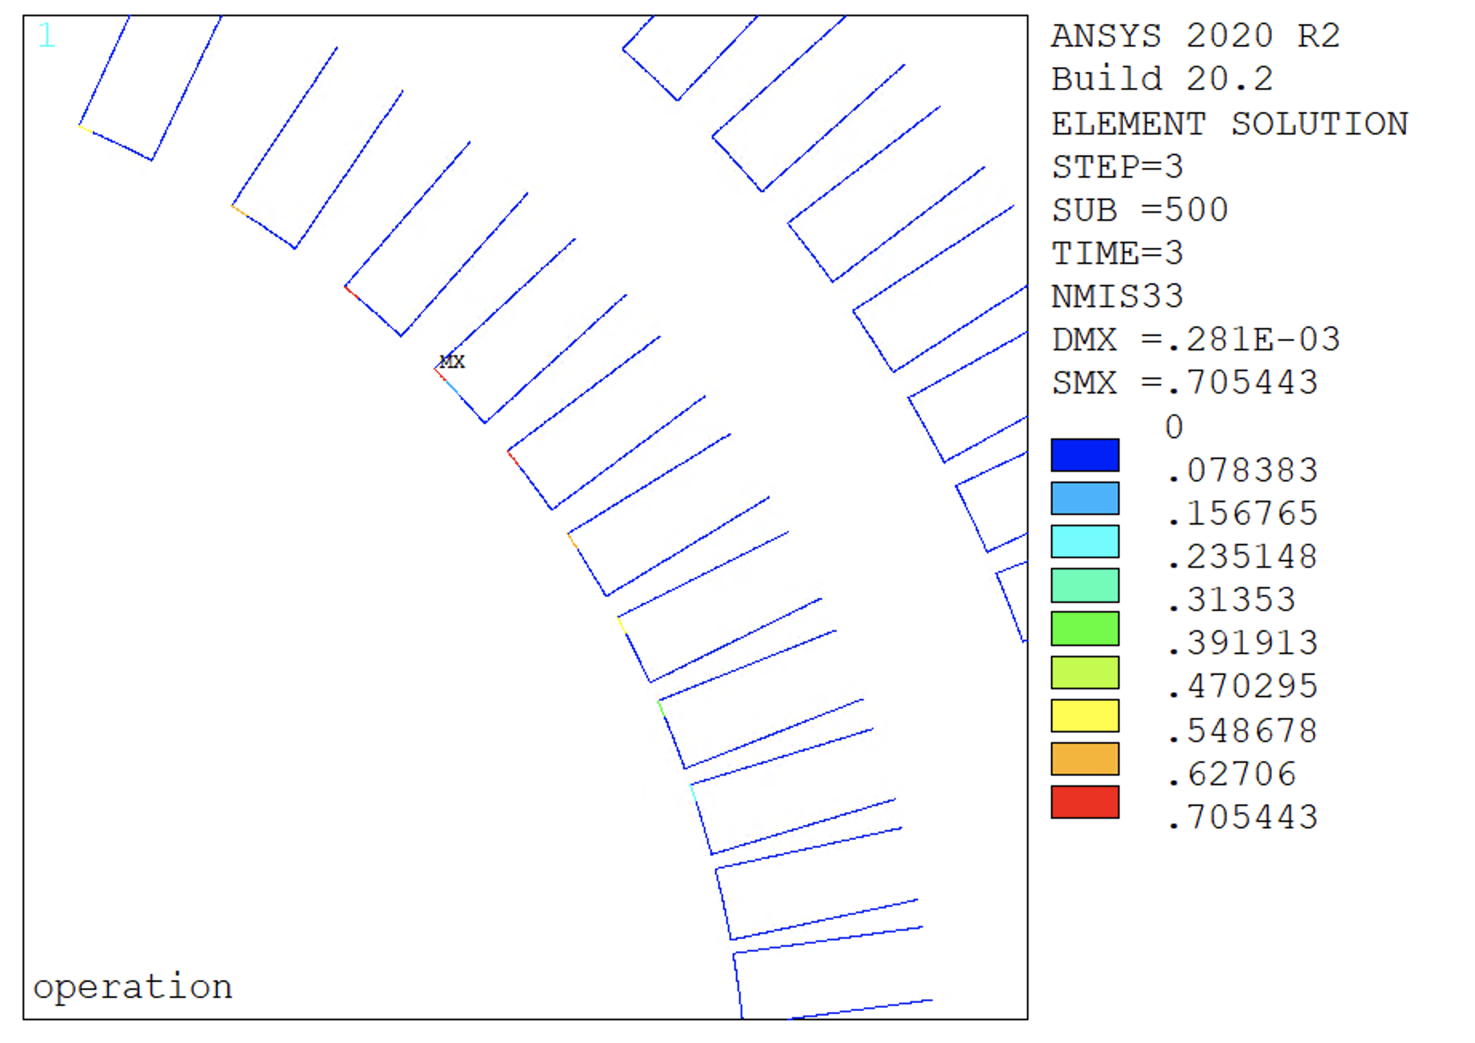
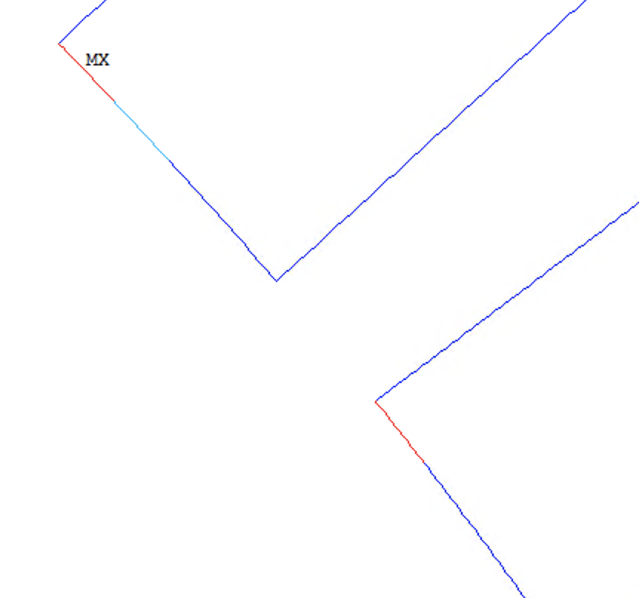
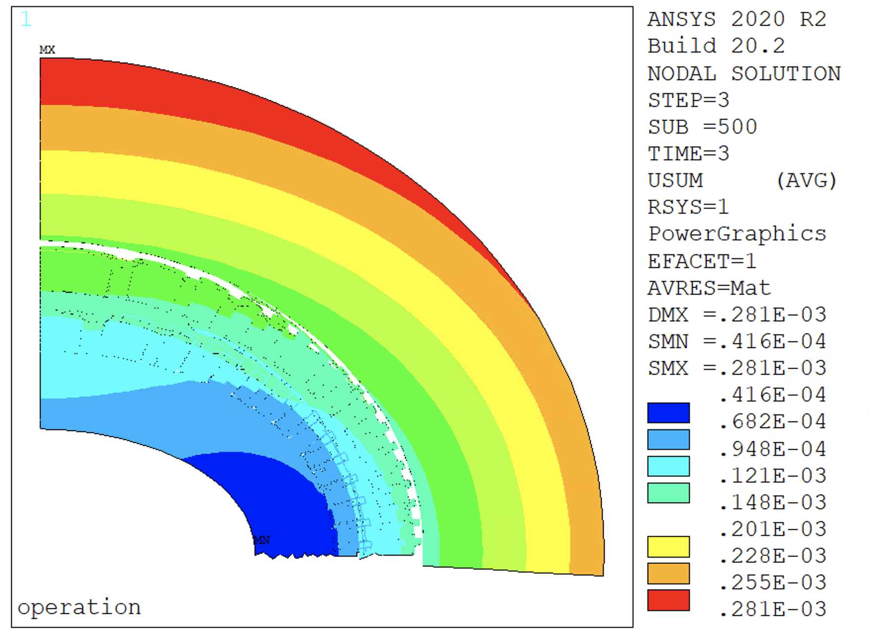
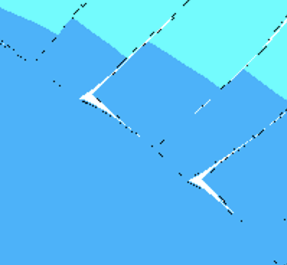
Subscale III – CZM Model - Damage
Less detachment… Interfaces on the verge of breaking
No damage after cooldown
No damage on the rib/conductor interface
Significant damage (~70% failed) on spar/conductor corners (a bit less than with the thin spar…)
No damage on the outer layer
By the way, this might be removed by a rounded corner design

Slide 18
Interface Properties Study
We are not very confident in the material properties for these interfaces
Measurement on their way…
What would happen if the strength was significantly lower?
For example (negligible strength):
Tensile strength: 2 MPa, shear strength: 1 MPa
Fracture toughness, mode I: 5 J/m² mode II: 10 J/ m²

Slide 19
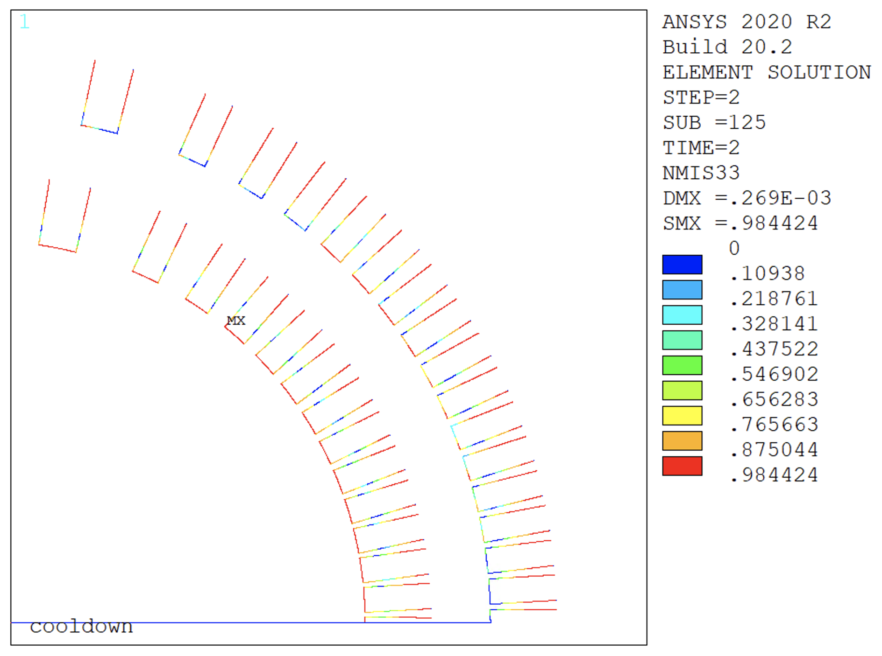
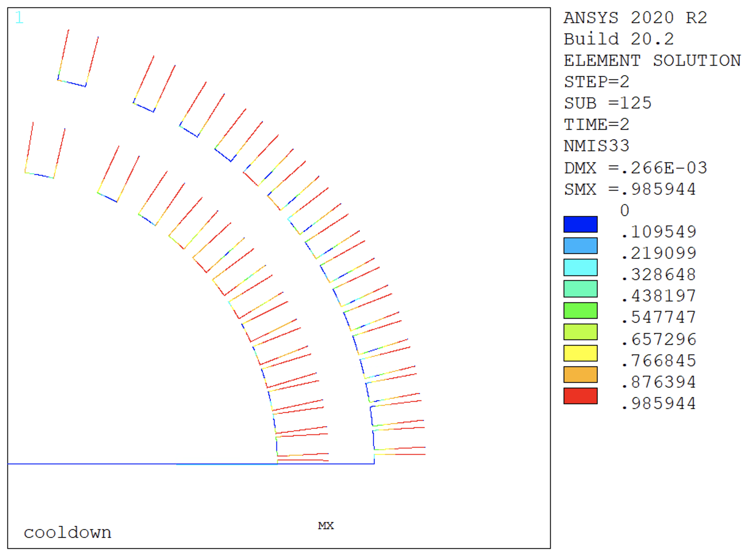
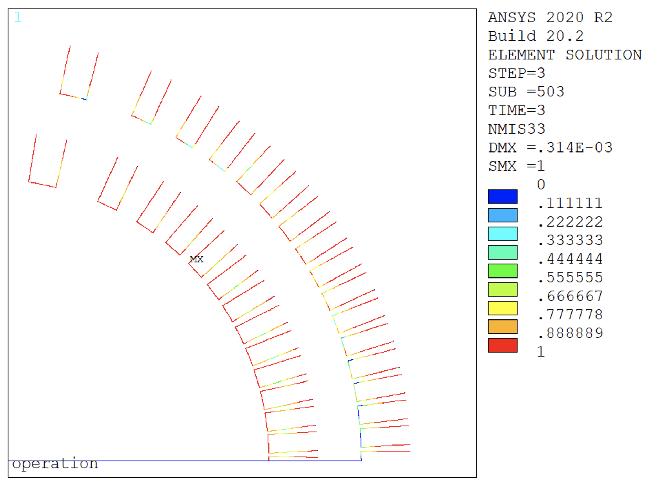
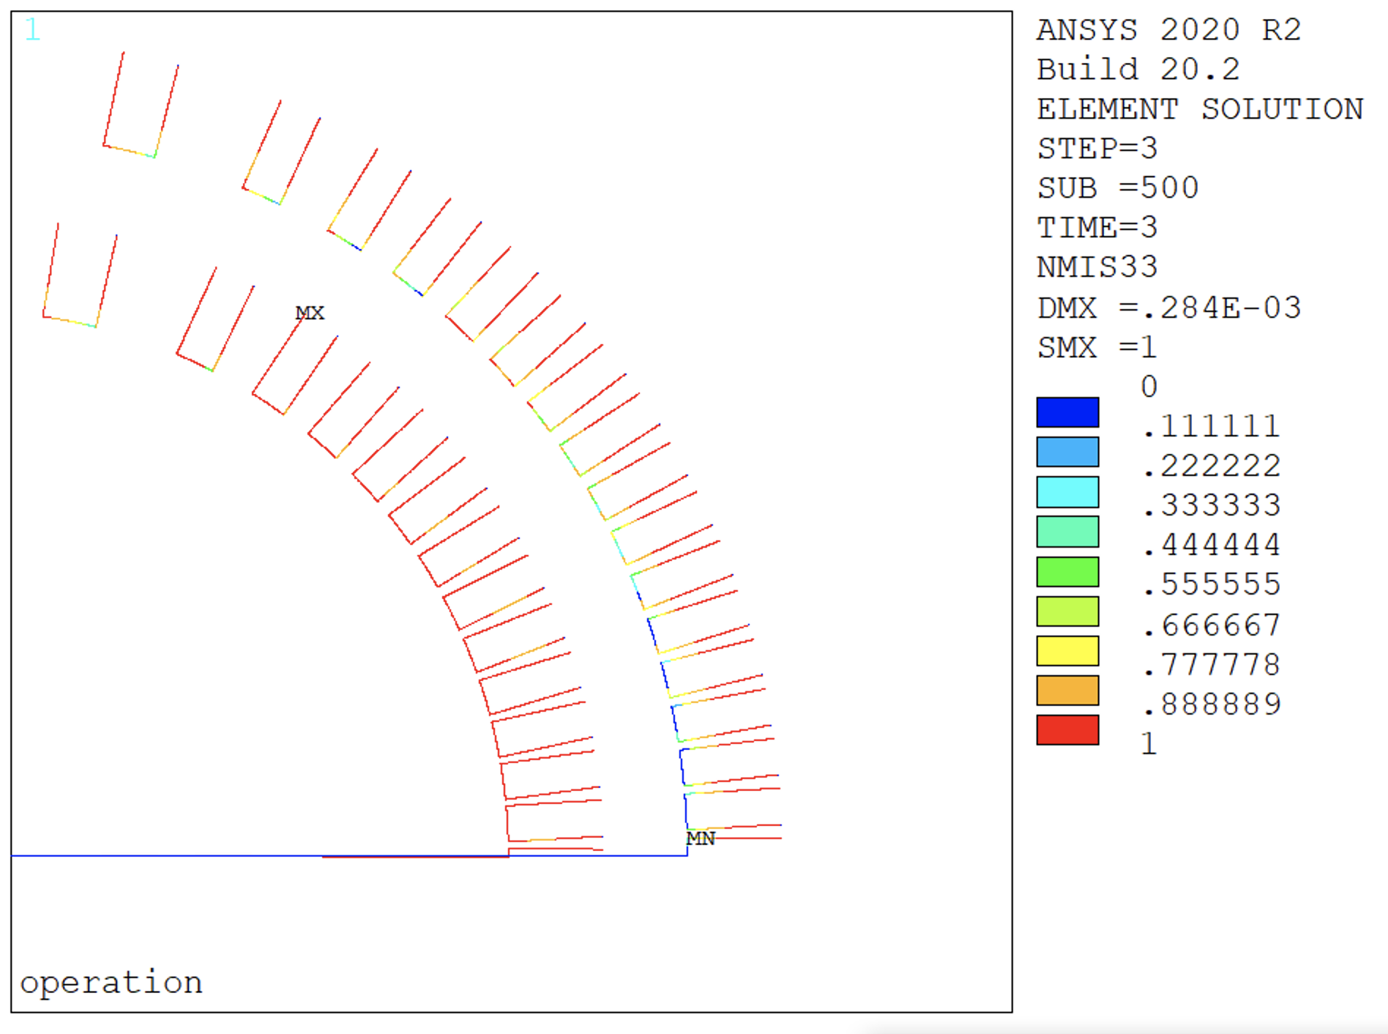
Subscale – CZM Model - Damage
Almost all the interfaces failed during powering:
Some strength left on some ribs and on the outer layer mid-plane
Widespread detachment already after cooldown
With this assumptions results are very close to the frictional model
Is this realistic?
Thin
Thick

Slide 20
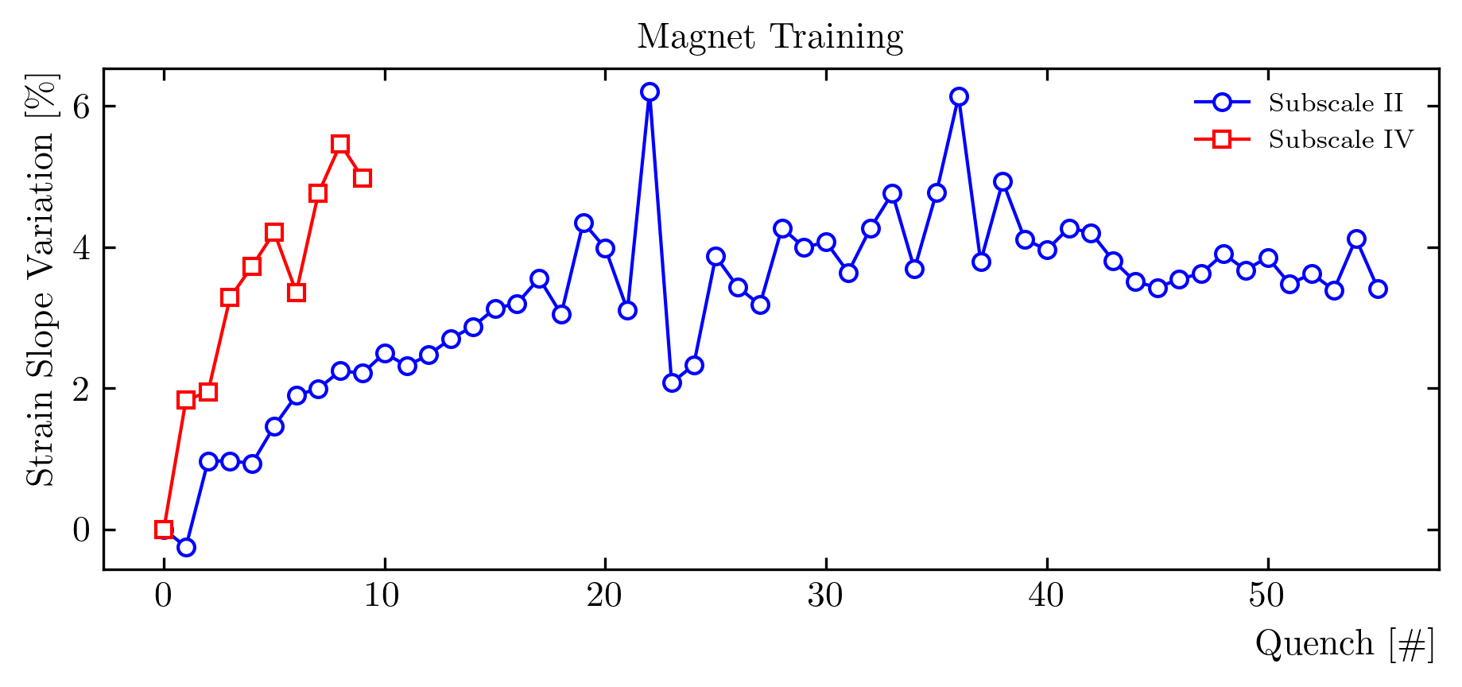
Strain Gauge Measurements
Strain gauge data shows a progressive reduction in stiffness ramp after ramp
Total variation around 4% at the end of the training for subscale II
Can we use these measurements to ‘calibrate’ the model?
Courtesy of J. L. Rudeiros

Slide 21
Material Model Calibration
Initial interface ’degradation’
Contact | pbond | RT | CD | 8 kA | Delta | Slope | Variation
 |  | ueps | ueps | ueps | ueps | ueps | /
Glued | / | -12 | 108 | 448 | 339 | 440 | /
Sliding | / | -12 | 123 | 501 | 378 | 490 | 11%
Debonding | 0.25 | -13 | 113 | 470 | 357 | 462 | 5%
Debonding | 0.5 | -13 | 109 | 461 | 352 | 457 | 4%
Debonding | 0.75 | -13 | 109 | 455 | 346 | 449 | 2%
measurements | / | 10 | 114 | 445 | 331 | 429 | /
Subscale II model results compared with strain gauge data – in general, good agreement
Glued model to sliding: 11% stiffness decrease
Debonding models are in the middle. Interface properties linearly scaled with a single parameter
To get a ~5% stiffness increase from the bonding model we need about half the strength of the interfaces w.r.t. the ‘ideal’ case measured
‘Calibrated’ model:
Tensile strength: 12 MPa, shear strength: 6 MPa. Fracture toughness, GIc: 15 J/m^{2 G}IIc: 30 J/ m²
~ half of the properties from preliminary measurements

Slide 22
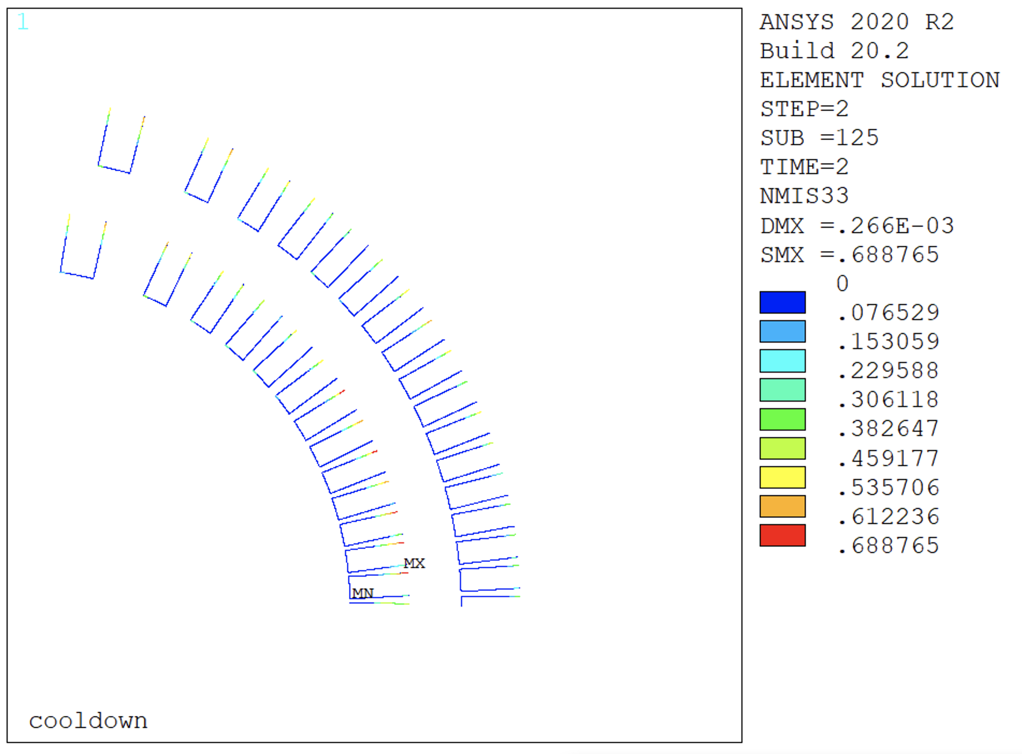
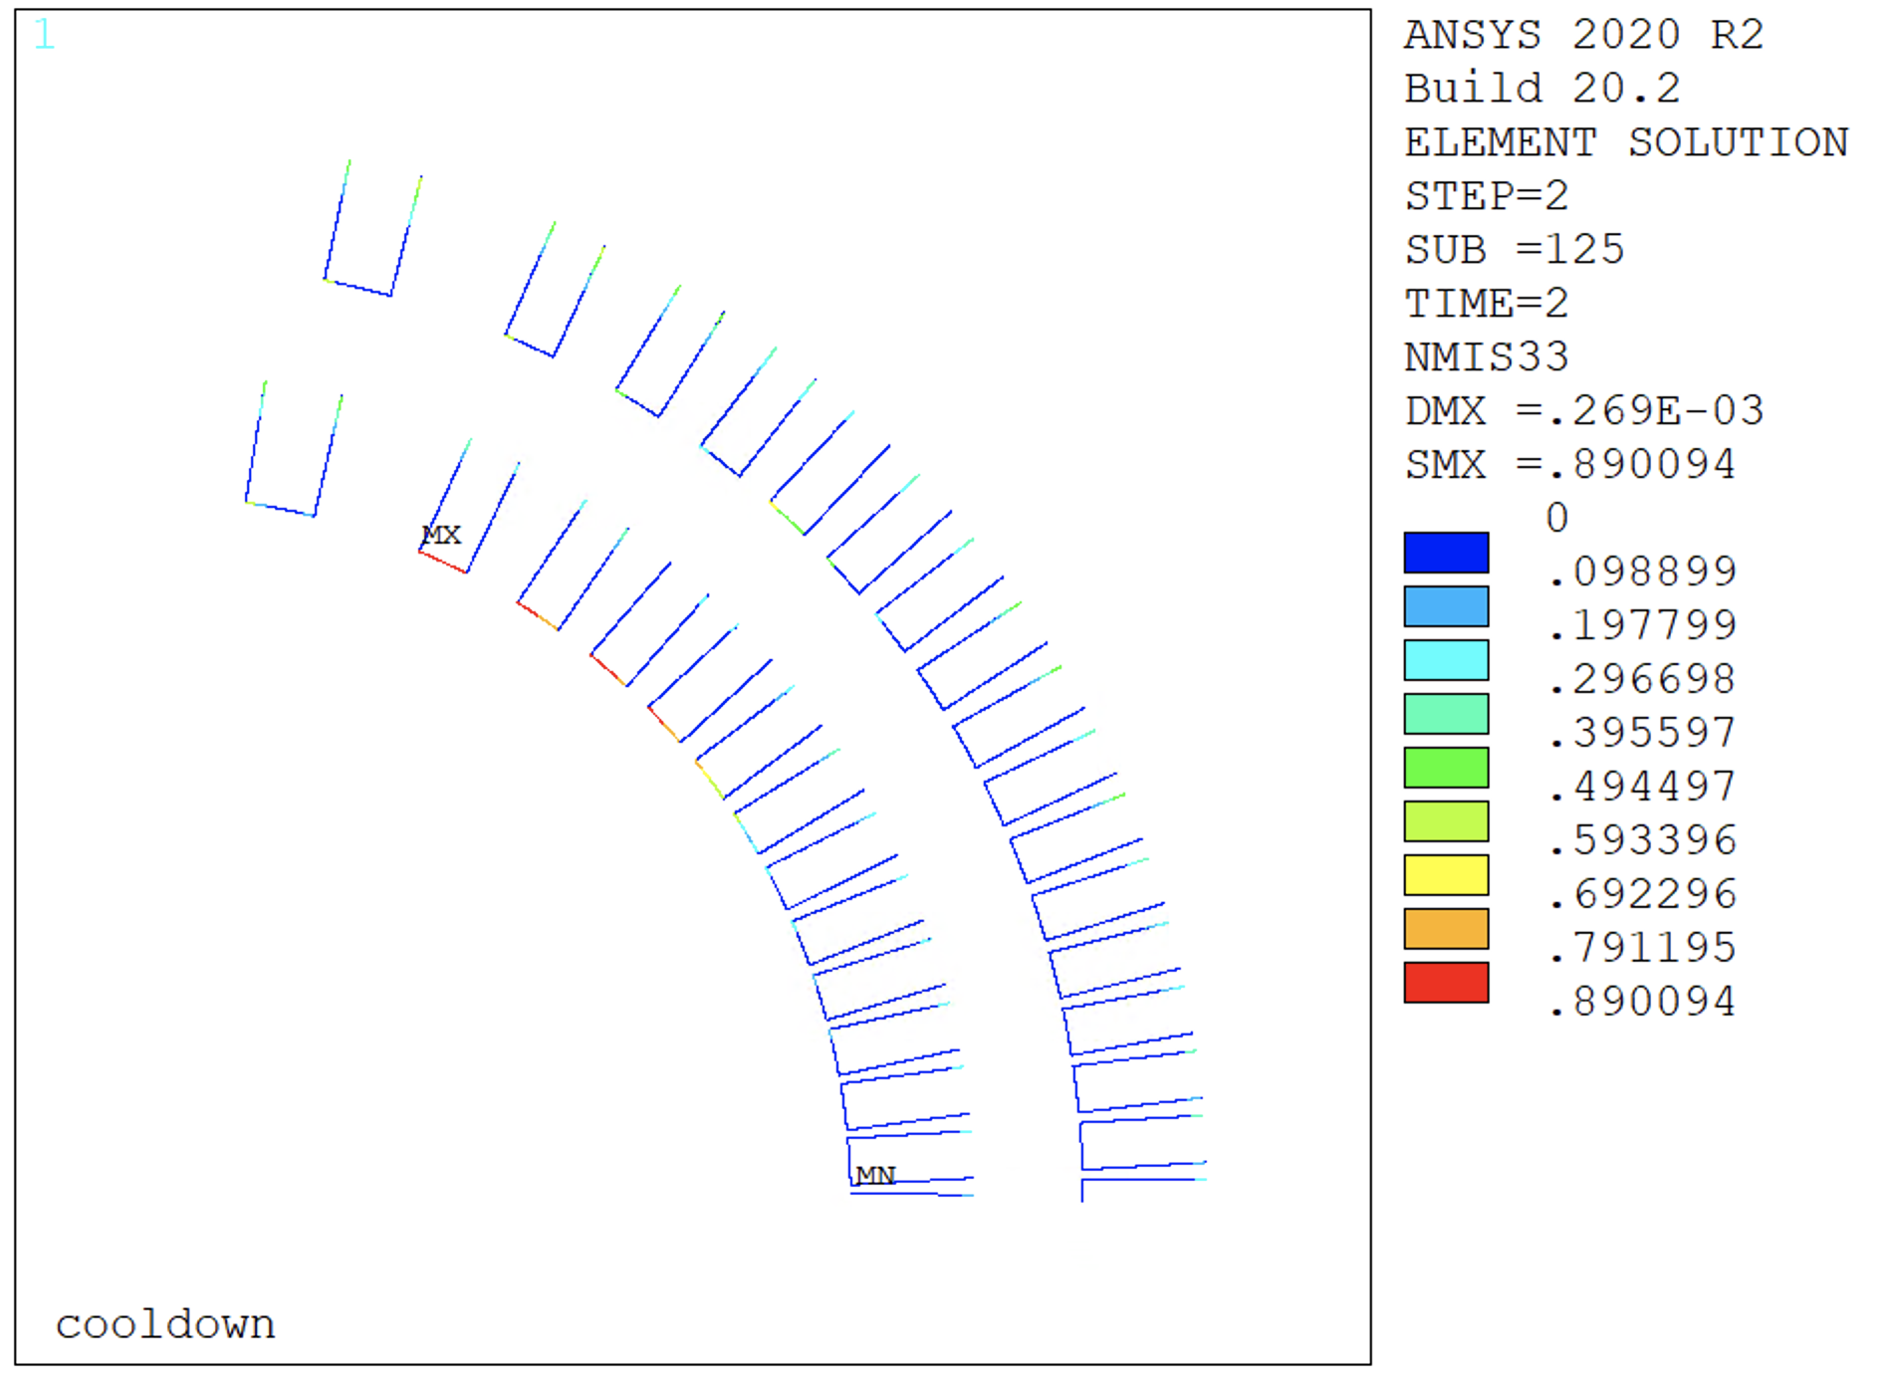
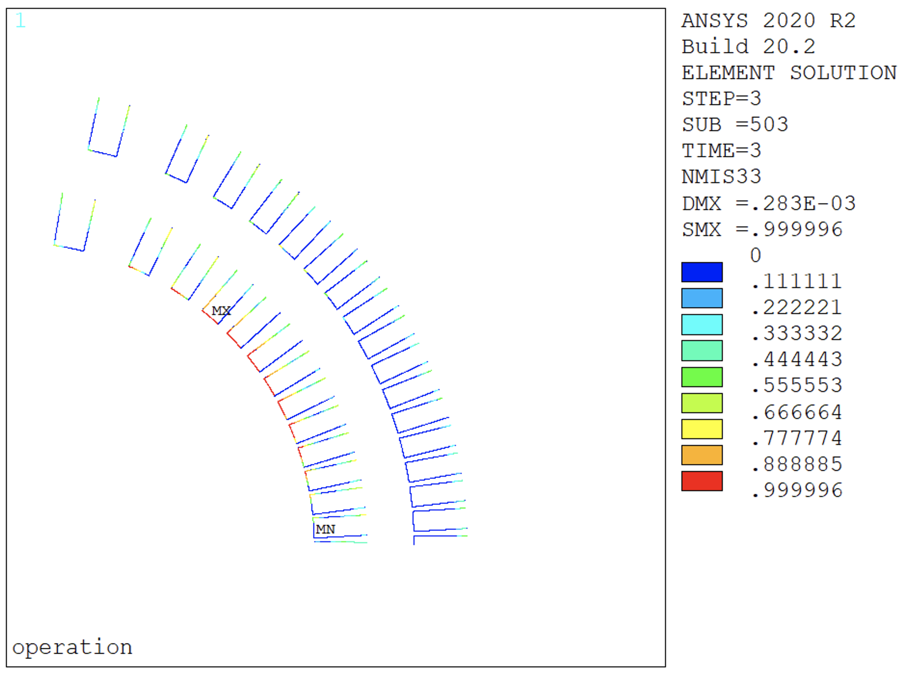
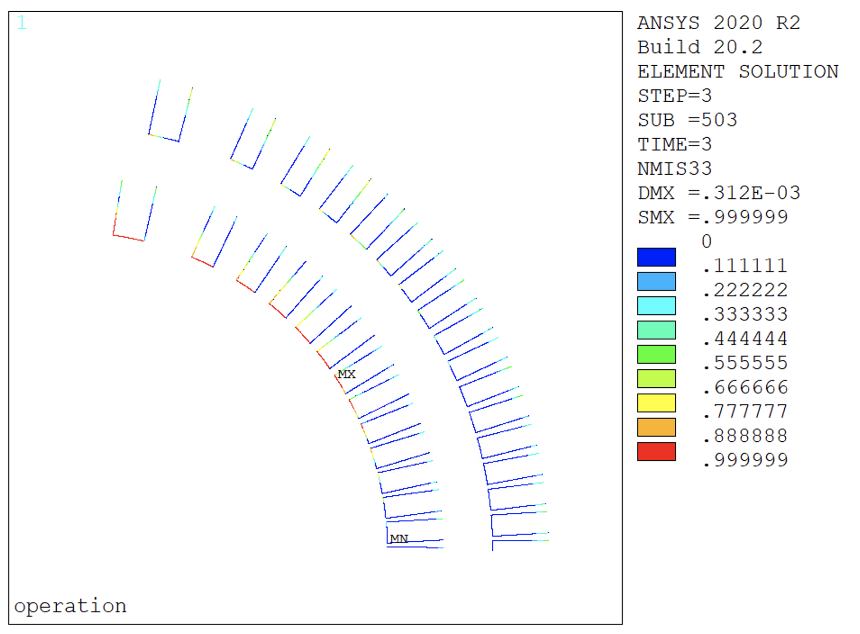
Subscale – CZM Model - Damage
Thin spar:
Initial detachment on the outer radius of both layers after cooldown
Full detachment on the spars and rib corners at 45°
Thick spar:
More interface damage after cooldown
Different debonding locations on the thick spar model (moved towards the pole)
This seems consistent with the results from quench antennas
Thin
Thick

Slide 23
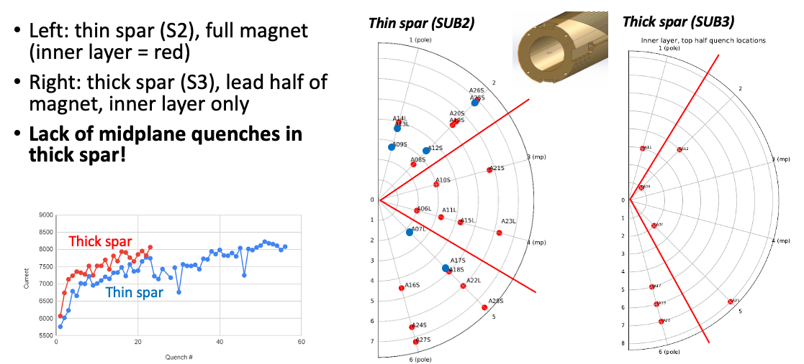
Quench Antenna Data
Courtesy of R. Teyber

Slide 24
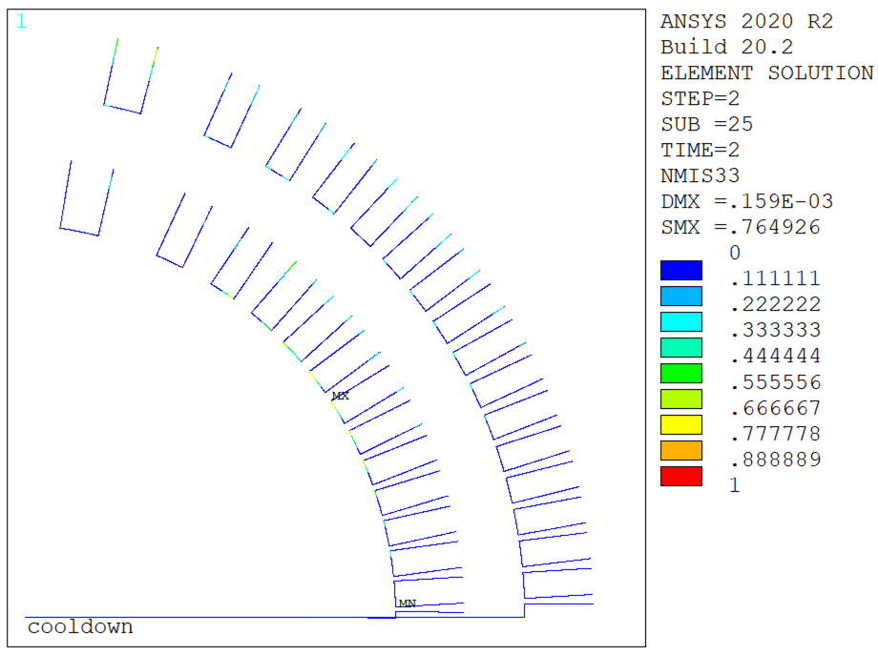
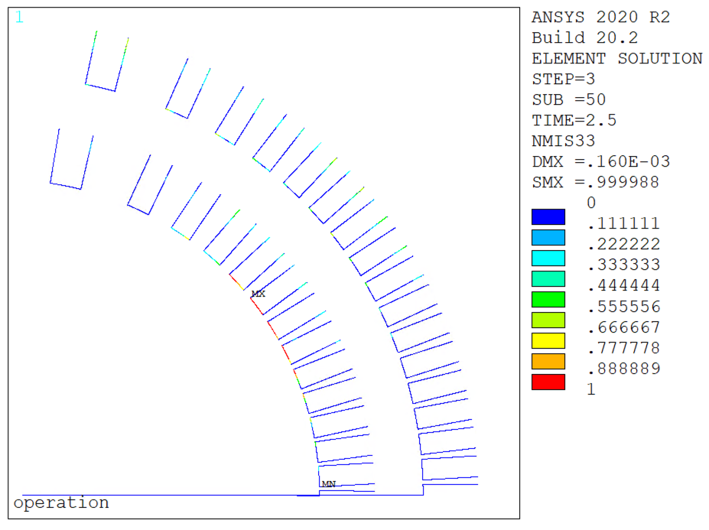
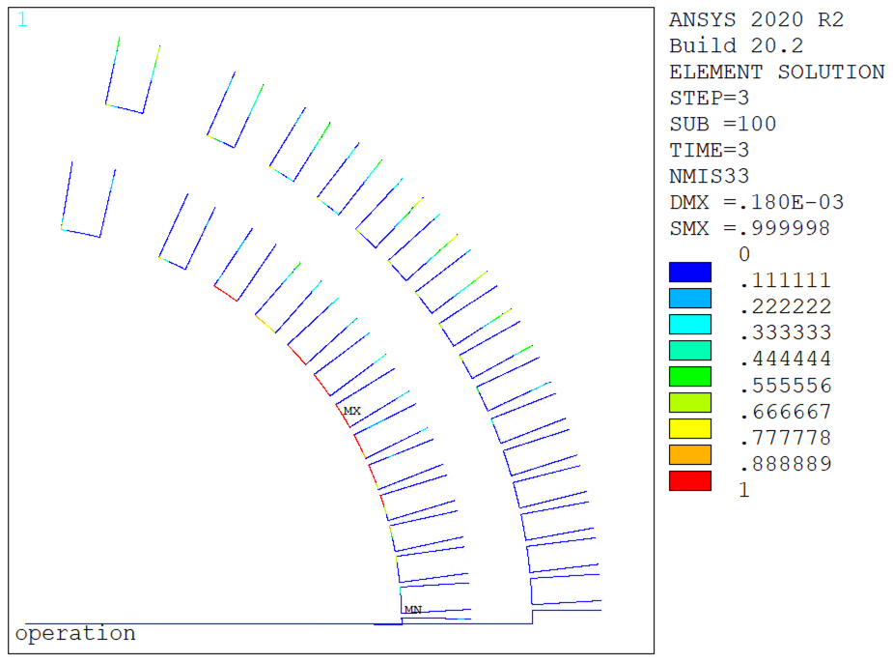
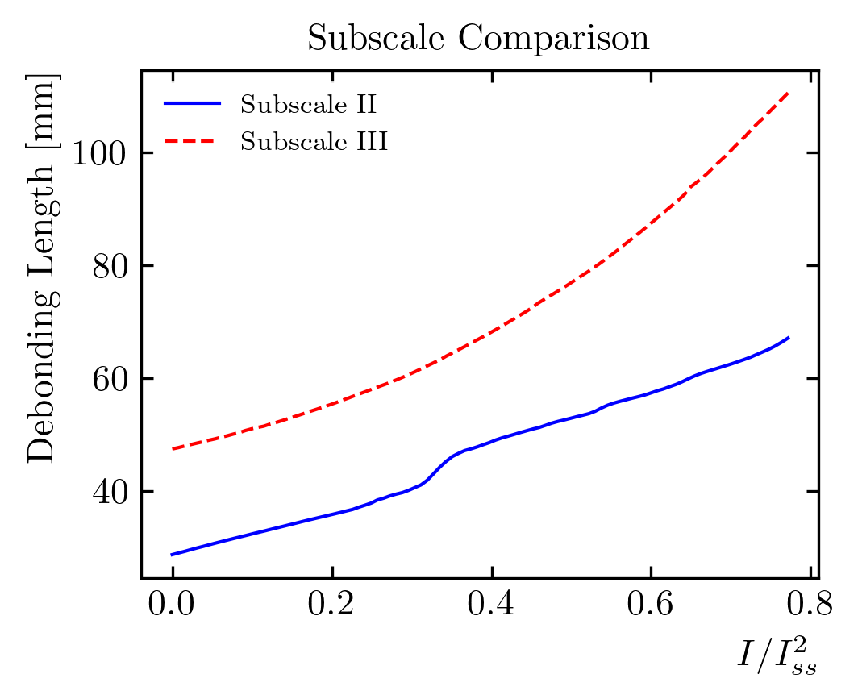
Work in Progress - Training Simulation
Training simulation properties shows the progressive failure of the interfaces
Total debonding length – very different behavior between the two magnets
Will correlate this data to a training plot as done for CCT5

Slide 25
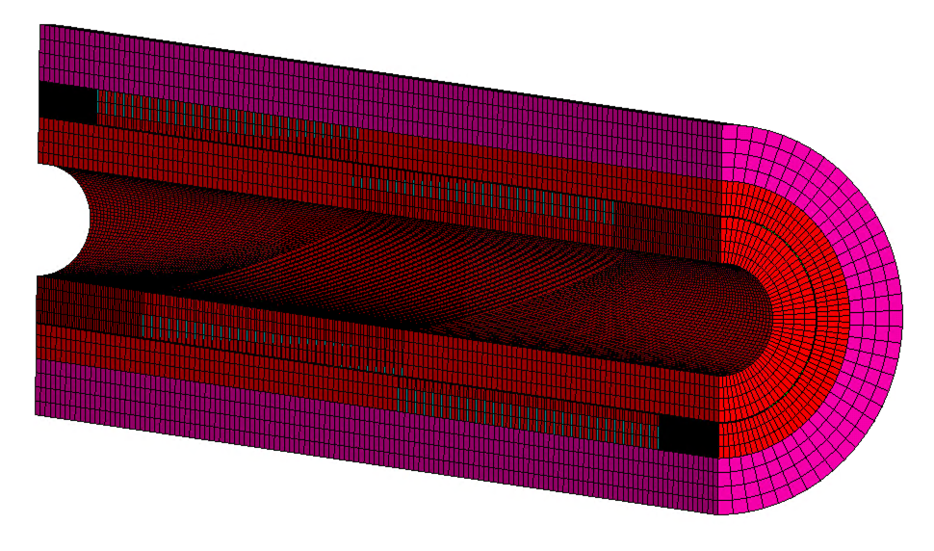
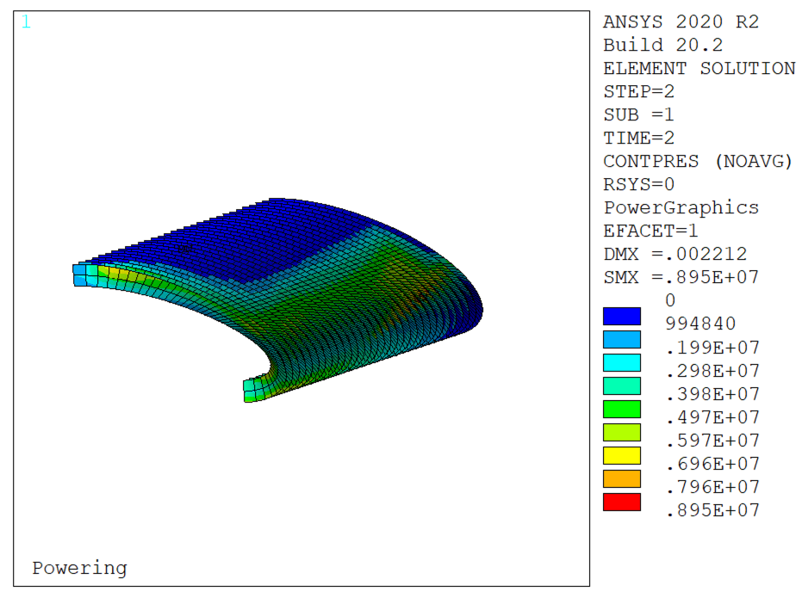
Work in Progress – 3D
We developed a 3D model with contacts around the coil (same assumptions as the 2D models just shown)
Once confident in the glued/sliding results, will move to a CZM model
We should be able to compare this model with the (planned) single turn 3D with periodic boundary conditions (validation)

Slide 26
Outline
Introduction
CCT standard FE Models:
Bonded
Frictional
CCT interface debonding
CZM with nominal properties
CZM with reduced strength
Calibration on strain gauge data
Conclusion

Slide 27
Conclusion & Next Steps
Key points:
Thick/Thin spar results not very different on the bonded and frictional models
Contact stresses at 9 kA close enough to CCT5 values
Thick spar opens more/larger gaps on the conductor/rib interfaces
The debonding model shows a different picture:
With the measured properties, debonding is limited to the spar/conductor interfaces in subscale magnets
The interface properties were calibrated on top of the sg measurements
Extensive debonding after calibration
Thick spar tends to debond in a different way. But results suggest that it does not debond ‘less’
Next steps:
Thick spar debonding model
Training simulation (post-processing available results)
Update interface properties (after measurements)
3D models

Slide 28
Questions?

Slide 29
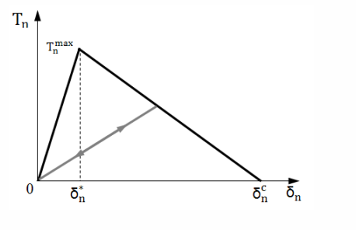
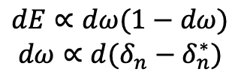
Quench Simulation
Released energy
$$dE∝dω(1−dω)$$
$$dω∝{d(δ}_{n}−δ_{n}^{∗})$$
Compare to fixed threshold
Compare to local T margin
Can we correlate the crack propagation to energy releases?
Crack energy released should be related (proportional) to the heat released (minus elastic waves…)
Difficult to say how much heat goes trough the conductor and how much trough the mandrel
Add temperature measurements in the future? Challenging at cryogenic temperature
A couple of simplified approaches:
Derivative of damage vs time proportional to the released energy?
Compute the local temperature margin
Compute the contact element energy change
Assume that the change in temperature is proportional (ok this would have been better with the enthalpy margin)
Event magnitude approach
The energy released by the crack is propagating to every location in the magnet (shocks?)
The limit should not be constant but decrease with the margin…
This study is only qualitative, and useful for comparison purposes

Slide 30
Training
12 kA
CCT5 training curve comparison (threshold calibrated). Results suggest that the ‘event quench’ mechanism might be predominant. Notes:
I am assuming that these events cause quenches, but this result does not prove it
We should compare the ‘crack propagation currents’ with measured AE events
Quenches could be distributed along the length – we need a 3D model!
Difficult to say if one ‘quench’ does not represent ‘multiple quenches’ in reality
Prestress model: apply ~250 MPa of azimuthal stress on the shell
Interface is still cracking, but the propagation is slower, and the released energy is below the threshold (no quenches…)

Slide 31
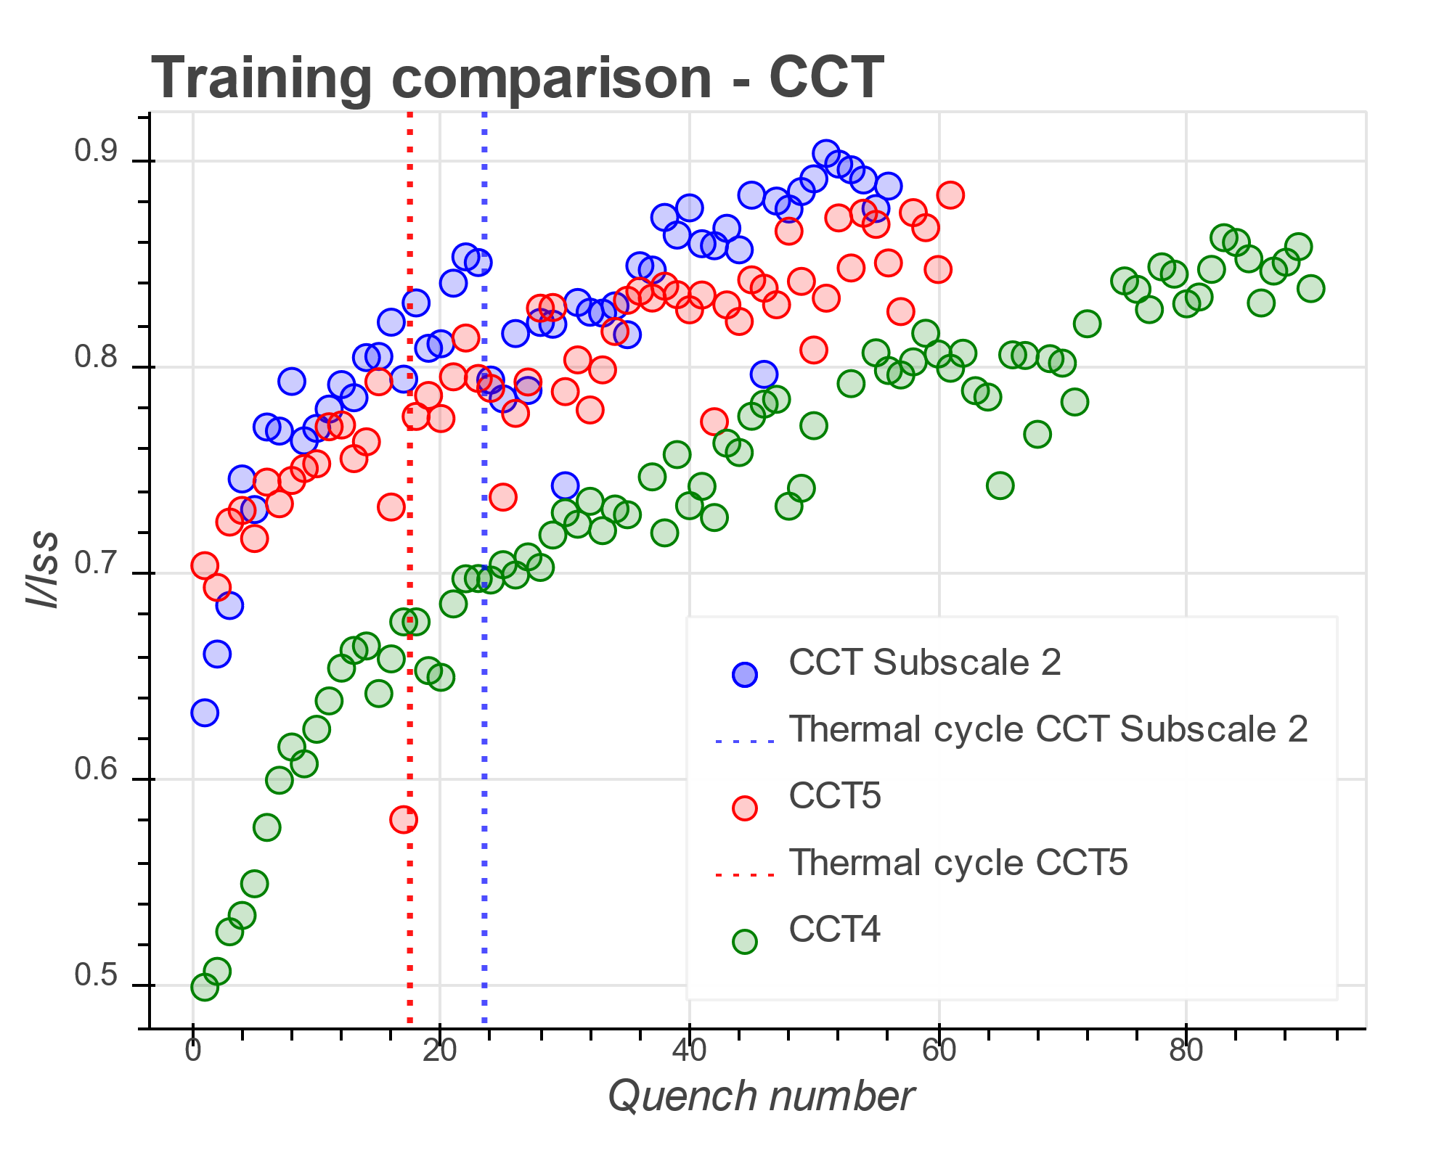
Extra

