Slide 2
HTS Test Facility Dipole Magnet Wire Specification Review
CERN Procurement Experience and Test Results
Simon C. Hopkins, Christian Barth, Marina Malabaila, Amalia Ballarino, Luca Bottura
CERN
simon.hopkins@cern.ch

Slide 3
Background
For HL-LHC, RRP® wire was procured with the 108/127 layout and a Cu/non-Cu of ~1.2
  Diameters of 0.7 and 0.85 mm
  Minimum non-Cu J_{c} of 2450 A/mm² at 4.22 K and 12 T
  Successfully produced and qualified in long lengths
In 2017, procurement was launched for four types of Nb₃Sn wire for CERN’s magnet development programme
  Magnet development towards 16 T designs for a proposed Future Circular Collider (FCC-hh), now continuing in CERN’s High Field Magnet programme
  Wire development for 16 T magnets targets a non-Cu J_{c} of 1500 A/mm² at 4.2 K and 16 T – but not commercially available
  As an interim step, the specification for wire procurement imposed a minimum J_{c} corresponding to HL-LHC procurement, but with targets to indicate that high J_{c} was prioritised
The wire design now proposed for TFD was procured at CERN in that broader context
  One spool was provided to LBNL for use in their TFD development cable
  This wire layout has not been cabled at CERN: this presentation focuses on procurement and test data for the wire only
Distribution of J_{c} performance at 4.2 K for wire types procured for HL-LHC

Slide 4
Procurement Approach
Target high performance without requiring R&D or associated costs:
  Specify a minimum non-Cu J_{c} comparable to the HL-LHC specification, with a target 15–20 % higher (comparable to the best material received)
  For wire intended for high field coils (1.0 and 1.1 mm diameter), specify a significantly lower Cu/non-Cu ratio (nominal 0.9), but with tolerance increased to ± 0.2
Sub-element diameter ≤ 60 µm
  No specific design mandated, but targeting ≥ 169 restack for high-field wires
  Relaxed to ≤ 65 µm to permit the same layout for 1.0 and 1.1 mm wires
Other requirements comparable to HL-LHC specification
B (T) | Minimum non-Cu J_{c} (A/mm²) at 4.22 K
 | Minimum | Target
12 | 2450 | 2800
15 | 1000 | 1200

Slide 5
Specification (as amended)
 |  | DEM-1.1 | ERMC-1 | ERMC-0.7 | DEM-0.7
Diameter (mm) |  | 1.1 | 1.0 | 0.7 | 0.7
Sub-element diameter (mm) |  | ≤ 65 | ≤ 60 | ≤ 60 | ≤ 60
Minimum I_{c} (A), 4.22 K* | 16 T | 475 | 395 | - | -
 | 15 T | 610 | 508 | - | -
 | 12 T | - | - | 430 | 315
Cu/non-Cu |  | 0.7 – 1.1 |  | 1.0 – 1.4 | ≥ 1.6
Twist pitch (mm) |  | 19 ± 3 (right handed screw)
RRR |  | > 150 (round), > 100 (rolled)
n-value |  | > 30
* For rolled samples, the minimum specified I_{c} is 95 % of the tabulated value

Slide 6
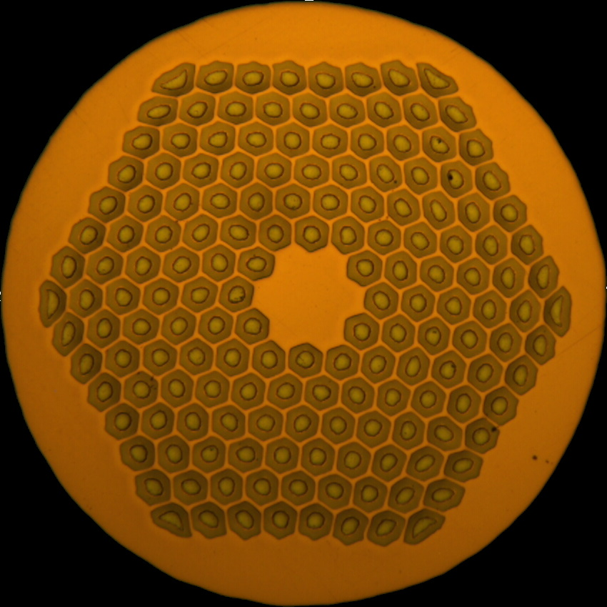
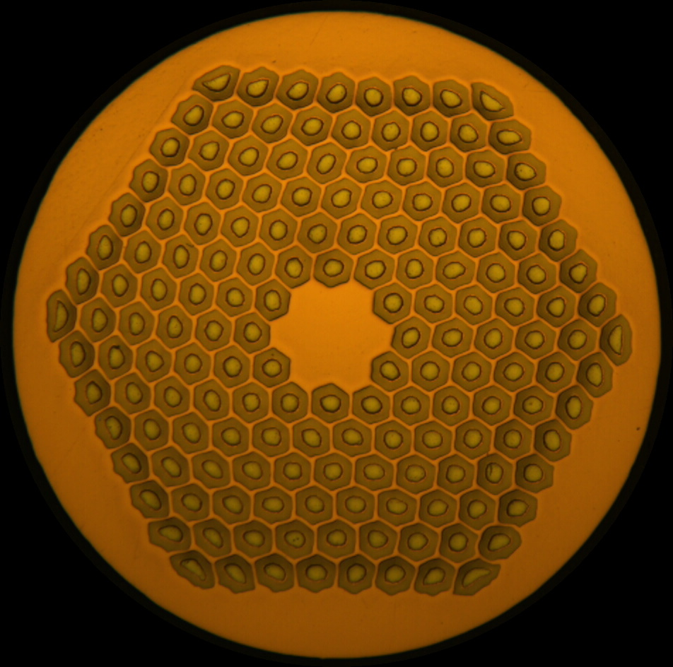
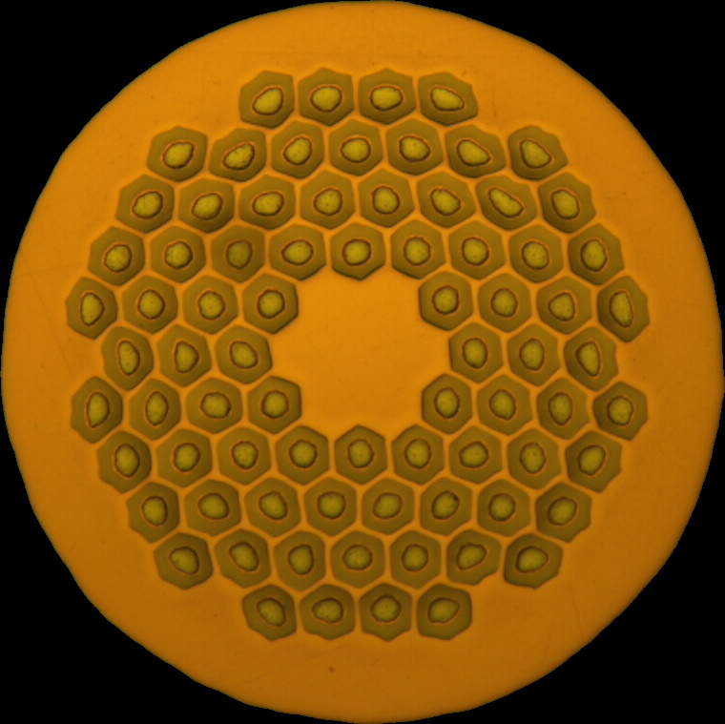
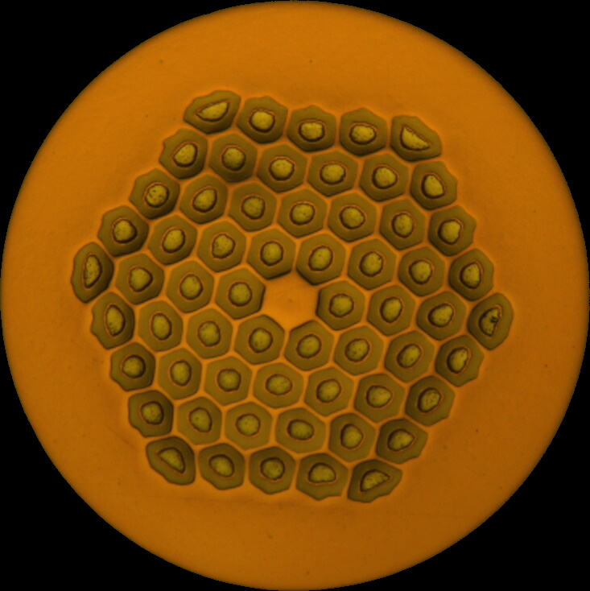
Wire Designs and Characteristics
High Field 162/169 | ERMC-1 | DEM-1.1
Low Field /91 | ERMC-0.7 | DEM-0.7
Diameter | 1.0 mm
Cu/non-Cu | 0.9 ± 0.2
I_{c} at 4.22 K, 16 T | ≥ 395 A
d_{sub-el} (nom.) | 58 μm
Diameter | 1.1 mm
Cu/non-Cu | 0.9 ± 0.2
I_{c} at 4.22 K, 16 T | ≥ 475 A
d_{sub-el} (nom.) | 64 μm
Wire of the same layout for comparison
The focus of this presentation
Diameter | 0.7 mm
Cu/non-Cu | 1.2 ± 0.2
I_{c} at 4.22 K, 12 T | ≥ 430 A
d_{sub-el} (nom.) | 54 μm
Diameter | 0.7 mm
Cu/non-Cu | 1.8 - 0.2
I_{c} at 4.22 K, 12 T | ≥ 315 A
d_{sub-el} (nom.) | 54 μm

Slide 7
Procurement Experience
Chronology
  Invitation to Tender (IT-4363) originally issued in October 2017
  For internal reasons, several rounds of revision took place, up to November 2018
  A contract (F716) was signed with Bruker OST on 30th January 2019
  Deliveries took place from October 2019 to May 2020
Basic observations
  Production was completed largely in accordance with the schedule
    Minor delays with the first batch (lower than expected yield for 1.0 mm wire, global helium shortages affecting testing) were caught up later
  Some minor nonconformities arose, but were successfully addressed
    No material rejected based on test data
    No nonconformities specific to the 162/169 layout

Slide 8
Nonconformities
Surface quality issues were identified for 17 of 129 spools
  Affected all four wire types (and also some contemporary HL-LHC material), not specifically the 162/169 layout
  Defects were classified into four categories with distinct causes
    Three of these factors were mechanical in nature: corrective and preventive actions have been implemented
      Only one of these has a known performance impact, and it is ordinarily detectable by eddy current inspection
    The fourth was related to local superficial oxidation of copper, which can be removed by electro-cleaning
The supplier engaged in a detailed evaluation process, implemented corrective and preventive actions, and was able to apply corrections to the majority of spools concerned with minimal material loss

Slide 9
Wire Characterisation
Supplier test data were required – in particular:
  ≥ 2 samples per billet (point and tail, plus first break): Cu/non-Cu, RRR and I_{c}
  ≥ 1 sample per billet: RRR and I_{c} of rolled samples
  Online diameter measurement and eddy current inspection
  Cu RRR, twist pitch, spring back, sharp bend and microscopy
CERN additionally performed acceptance tests
  At least the same frequency as supplier testing for Cu/non-Cu, RRR and I_{c}
  Typically more samples per billet and additional test conditions
The remaining slides concern only the 162/169 layout:
  Primarily 1.1 mm diameter wire (DEM-1.1), as proposed for TFD
  Where indicated, some comparison data for wire of the same layout at 1.0 mm diameter (ERMC-1)

Slide 10
Heat Treatment and Test Conditions
Heat treatment
  The supplier proposed a heat treatment of 210 °C 48 h, 400 °C 48 h, 665 °C 50 h for all wire types
  For 1.0 mm wire only it was established that this resulted in marginal RRR, and the final step was changed to 650 °C 50 h
  Some data are available for comparison of 650 °C, 665 °C and 680 °C heat treatments
Rolling
  Specification requirements after rolling were for 10 % rolling reduction
  CERN testing was primarily performed for 15 % rolling reduction
Test temperature
  All supplier cryogenic testing was performed at 4.2 K
  The majority of CERN testing was also at ~4.2 K, with a small number of tests at 1.9 K
Magnetic field
  Supplier testing was performed at 12–16 T, limited to ≥ 14 T for 1.1 mm diameter wire due to current limitations
  CERN testing was performed at 12–15 T

Slide 11
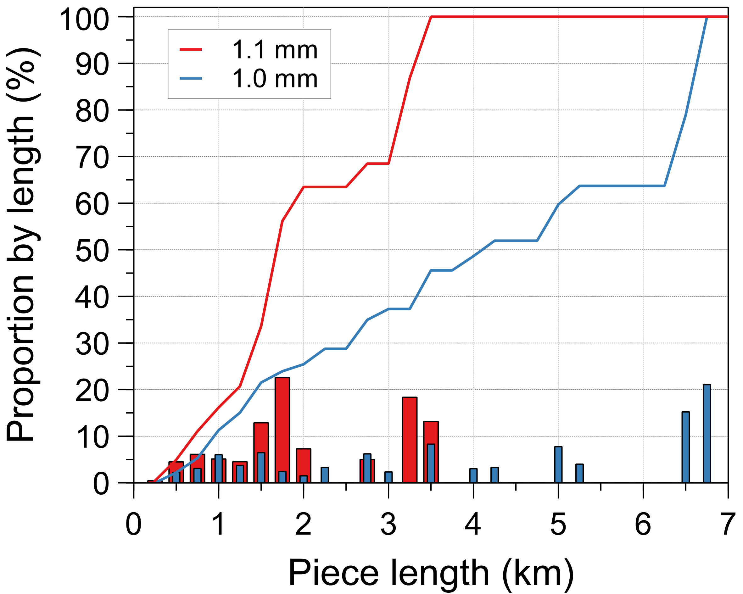
Piece Lengths
Piece lengths exceeded the specified minimum
  The supplier did not request acceptance of any shorter lengths (an option permitted by specification)
  At both diameters, the vast majority of piece lengths exceeded 1 km
Low yield in the first batch of 1.0 mm wire did not impact the majority of production
Diameter (mm) | Spools | Total Length (km) | Piece Length (m)
 |  |  | Min | Max | Mean
1.1 | 37 | 51.6 | 229 | 3493 | 1395
1.0 | 56 | 125.6 | 347 | 6713 | 2242
Distribution of piece lengths for wires of 162/169 layout
(lines: cumulative, bars: for 250 m length range up to the plotted value)

Slide 12
Cu/Non-Cu Ratio
The Cu/non-Cu was well controlled throughout production
  Mean value ~0.88 (cf. nominal 0.9)
  Range well within the ± 0.1 originally sought, as well as the ± 0.2 specification
Diameter (mm) | Supplier Data |  |  | CERN Data
 | Min | Max | Mean ± SD | Min | Max | Mean ± SD
1.1 | 0.865 | 0.910 | 0.887 ± 0.013 | 0.846 | 0.915 | 0.881 ± 0.019
1.0 | 0.830 | 0.925 | 0.881 ± 0.021 | 0.800 | 0.926 | 0.874 ± 0.022
Cu/non-Cu values for wires of 162/169 layout with diameters of 1.1 and 1.0 mm

Slide 13
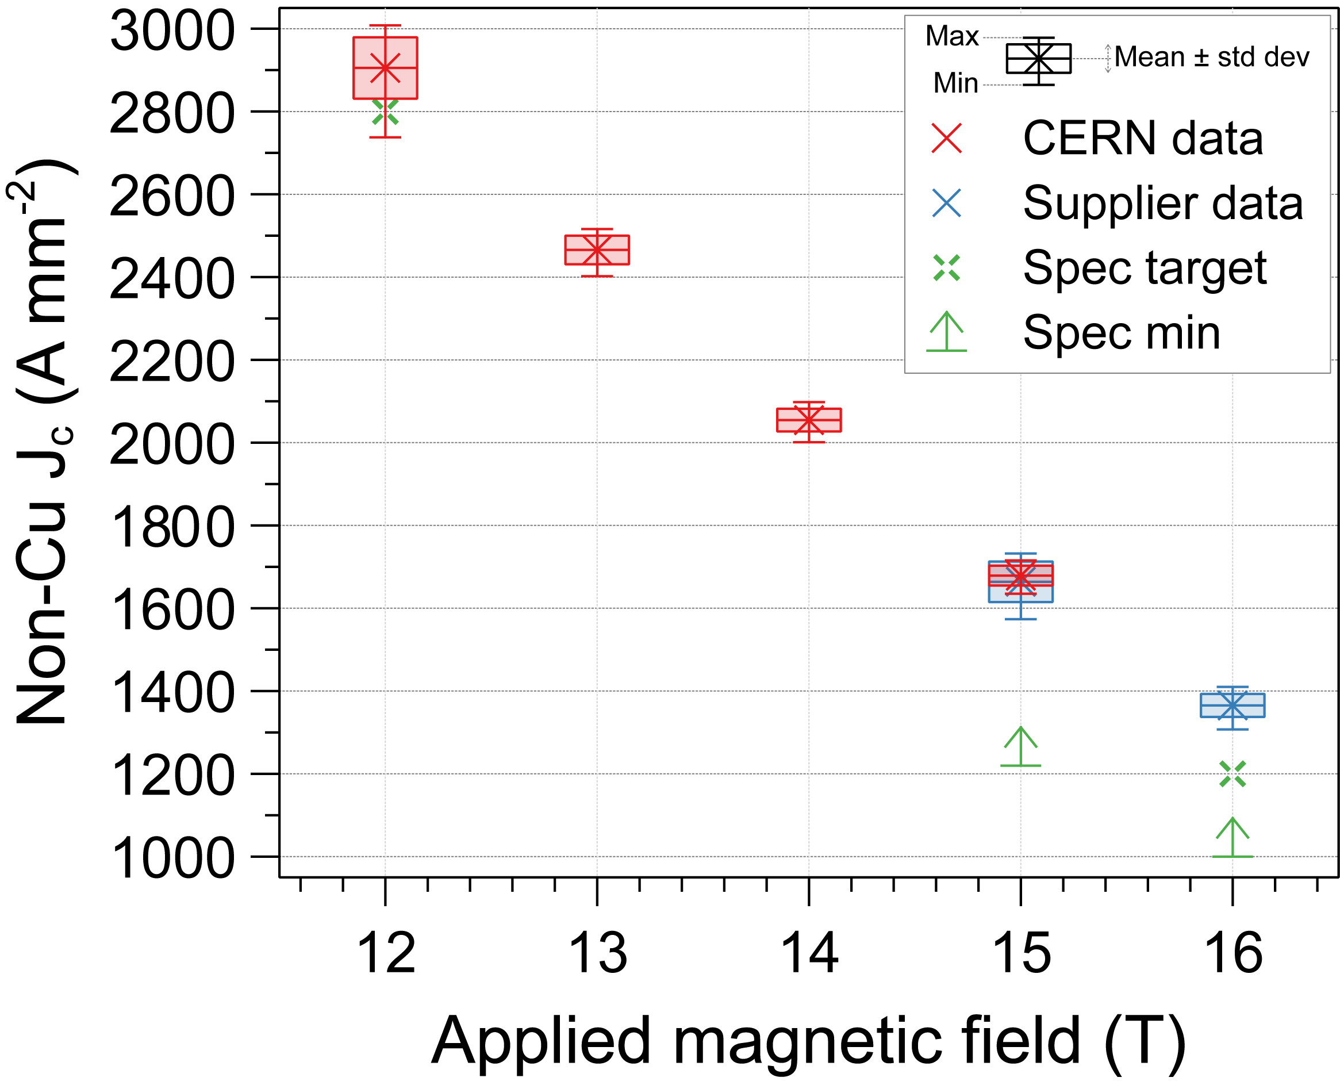
J_{c} Distribution
Critical current performance substantially exceeded the specification, and also the target J_{c} for 16 T
For 1.1 mm diameter wire, there is little overlap between CERN and supplier test conditions, but agreement is reasonable
J_{c} distribution for 1.1 mm wire (DEM-1.1) as measured by the supplier (nominally 4.2 K) and CERN (mean 4.26 K)
Standard 665 °C heat treatment; supplier Cu/non-Cu values used for consistency.

Slide 14
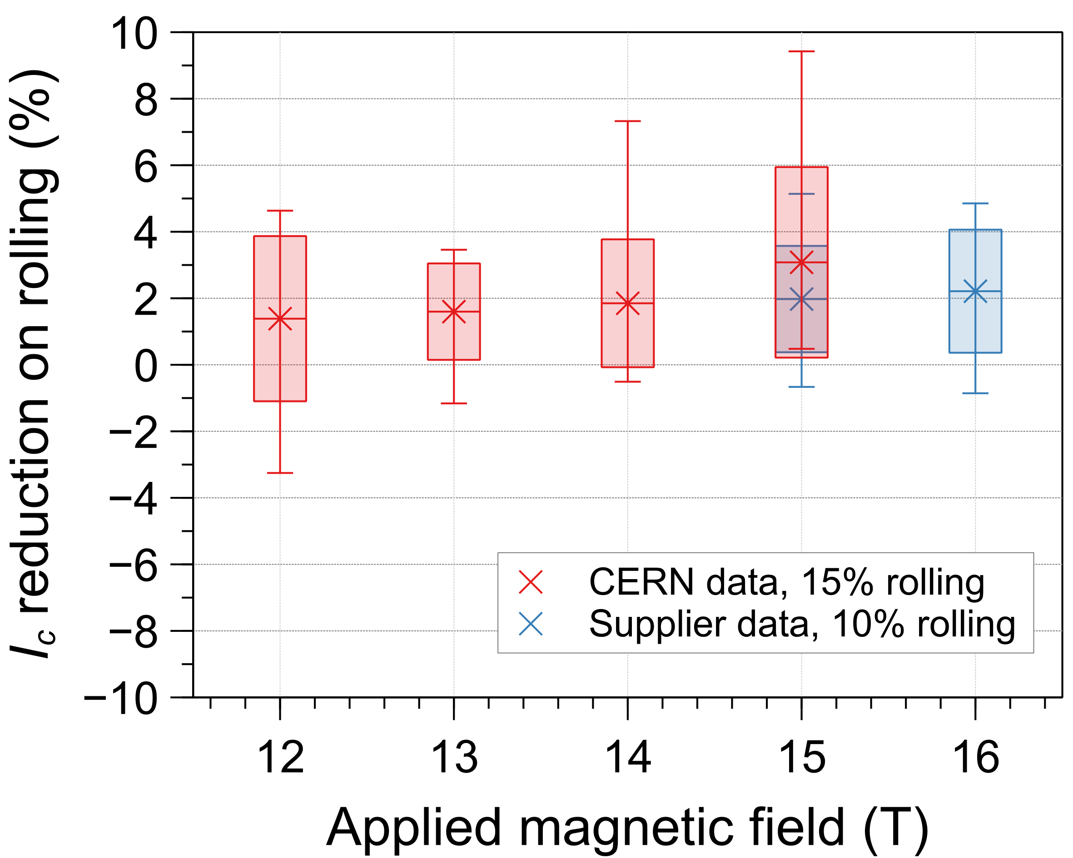
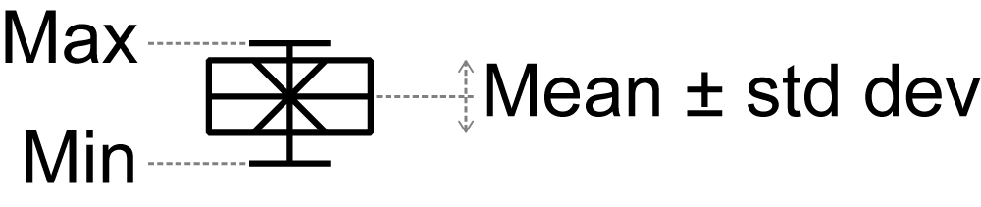
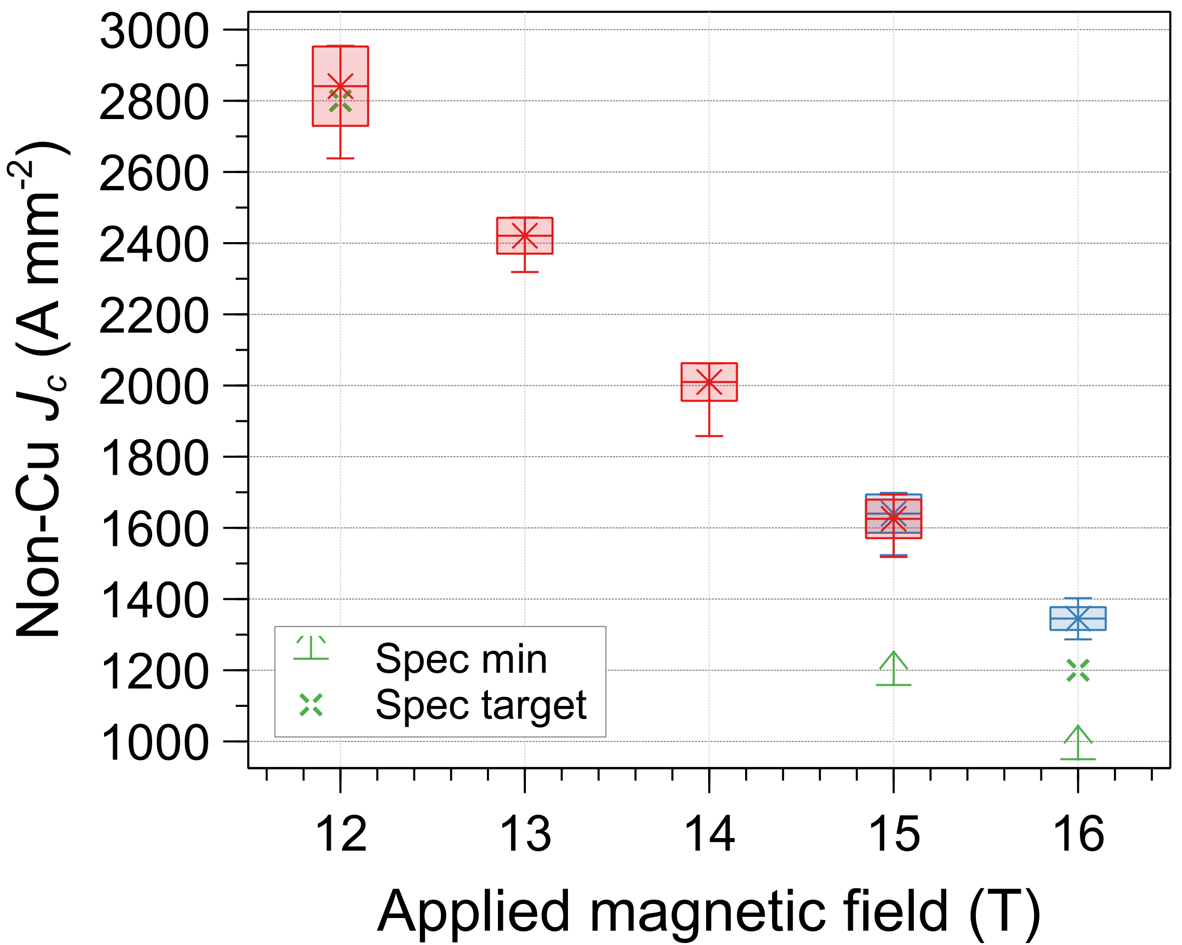
J_{c} Distribution: Rolled Samples
After 10–15 % rolling reduction:
  J_{c} remains above the target value, and hence comfortably in specification*
  I_{c} variability is slightly higher than for round samples
  The typical I_{c} reduction relative to round wire is ~2 %
J_{c} distribution at ~4.2 K of 1.1 mm wire (DEM-1.1) as measured after rolling with a 10 % (supplier) or 15 % (CERN) rolling reduction
Standard 665 °C heat treatment; supplier Cu/non-Cu values used for consistency.
* The I_{c} specification for rolled wire is 95 % that of round wire
Relative reduction in I_{c} at ~4.2 K after rolling with a 10 % (supplier) or 15 % (CERN) rolling reduction
Positive values indicate I_{c} reduction

Slide 15
RRR
For the standard 665 °C heat treatment, the RRR was comfortably in specification for all piece lengths:
  From CERN data, the mean reduction in RRR for a 15 % rolling reduction is 22.5 %
Rolling Reduction | Supplier Data |  |  | CERN Data
 | Min | Max | Mean ± SD | Min | Max | Mean ± SD
0 (round) | 172 | 296 | 220 ± 29 | 168 | 328 | 266 ± 39
10 % | 150 | 249 | 201 ± 33 | 163 | 341 | 246 ± 50
15 % | - | - | - | 141 | 265 | 203 ± 36
RRR values for round and rolled samples for DEM-1.1 (1.1 mm diameter wire)
Standard 665 °C heat treatment

Slide 16
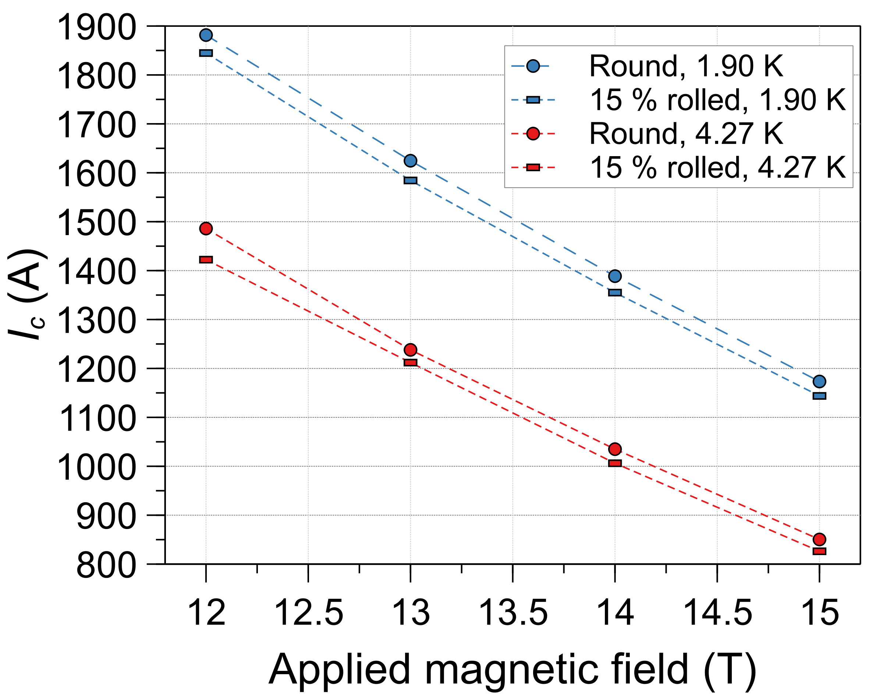
Temperature Scaling
Measurements at 1.9 K are currently available for only one spool
I_{c} for spool CO11S20234A02U at 1.9 K and 4.3 K
Standard 665 °C heat treatment

Slide 17
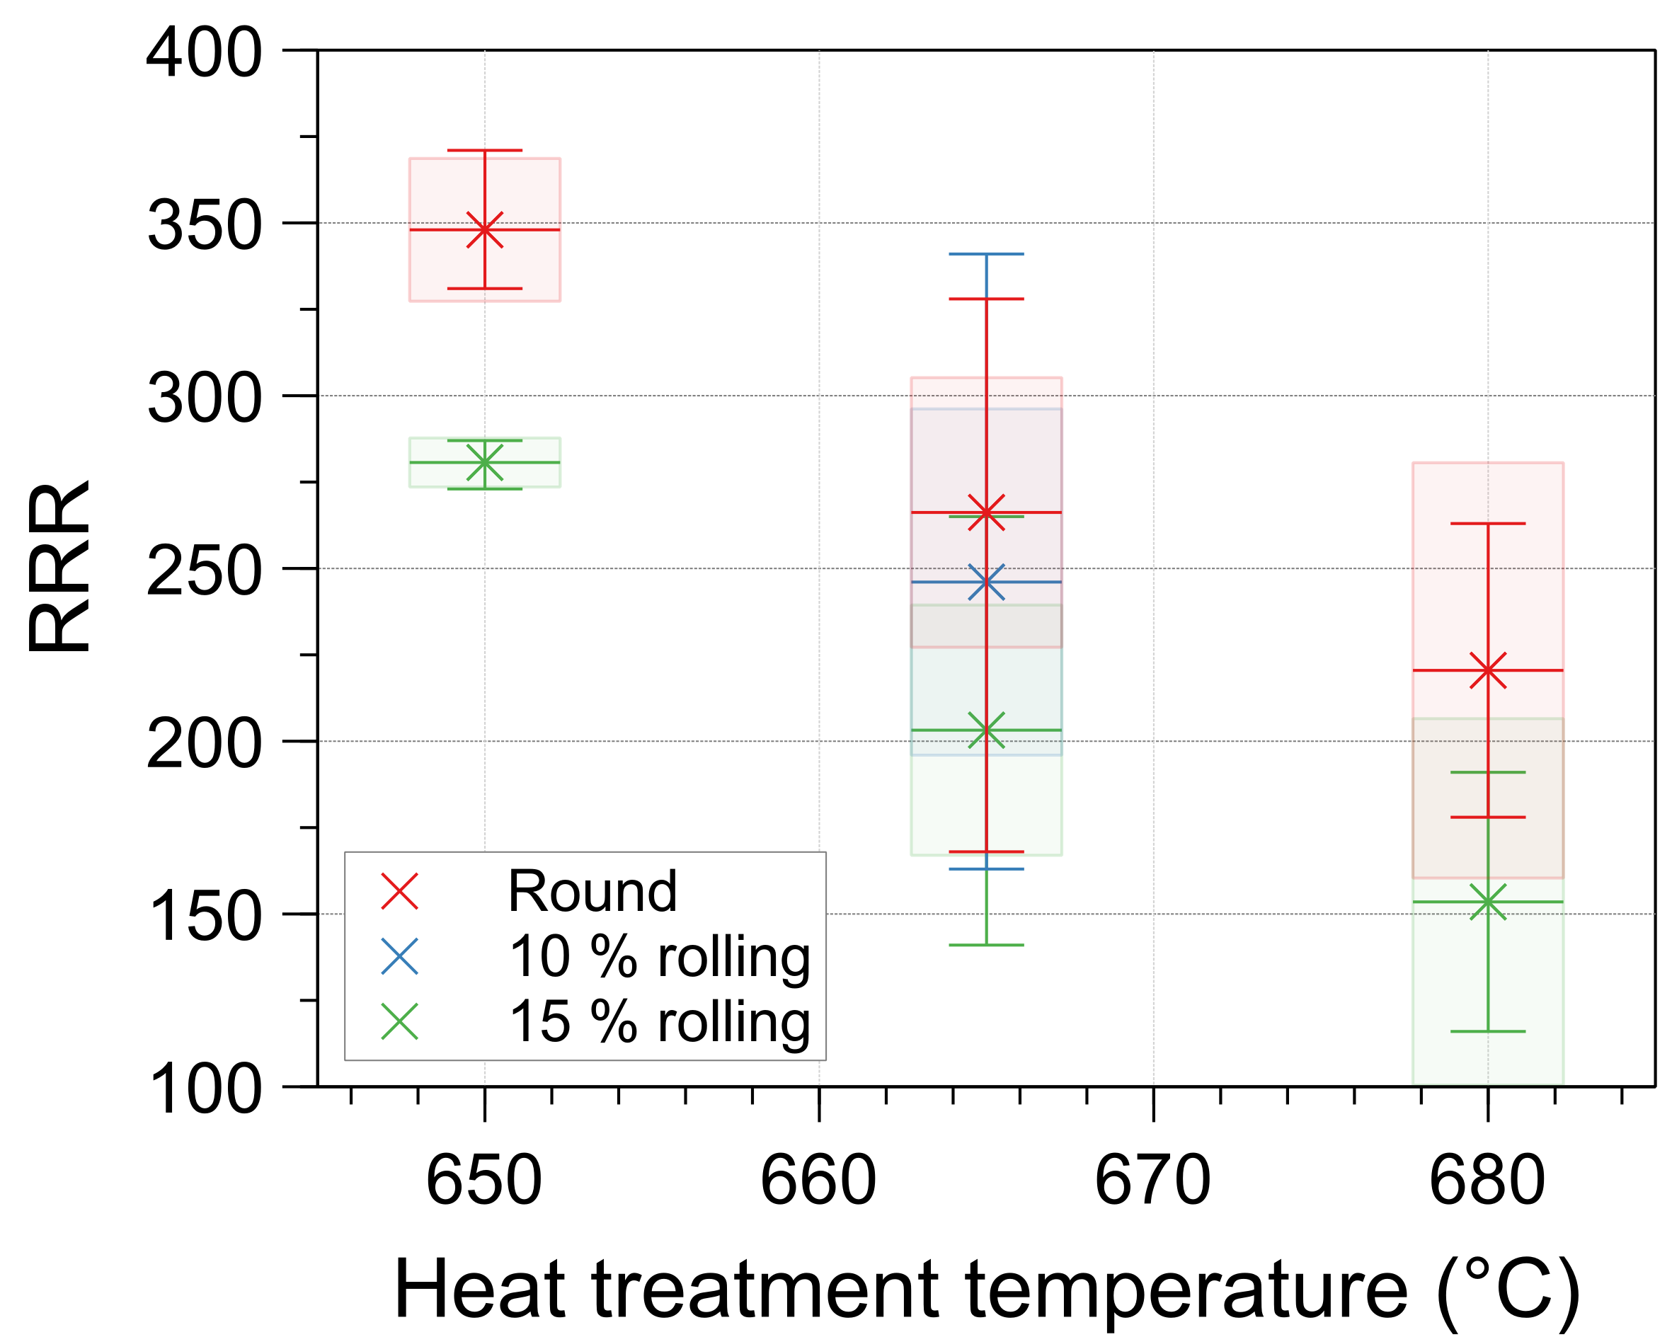
Heat Treatment Dependence (1)
Some measurements were also performed after heat treatments at 650 °C and 680 °C
  650 °C was performed for comparison with the 1.0 mm wire, for which this reduced temperature was necessary to ensure confirming RRR
  A small number of tests were performed at 680 °C, also with modified low-temperature heat treatment plateaus
As expected, RRR decreases significantly for increasing heat treatment temperature, but remained in specification for all tests
  The minimum RRR was 168 (round) and 116 (15 % rolled) across all tests
  The reduction in RRR on rolling is similar in magnitude for all heat treatment conditions
There are, however, insufficient results at 680 °C for a reliable statistical summary
RRR as a function of maximum heat treatment temperature for round and rolled samples of DEM-1.1 (1.1 mm diameter)

Slide 18
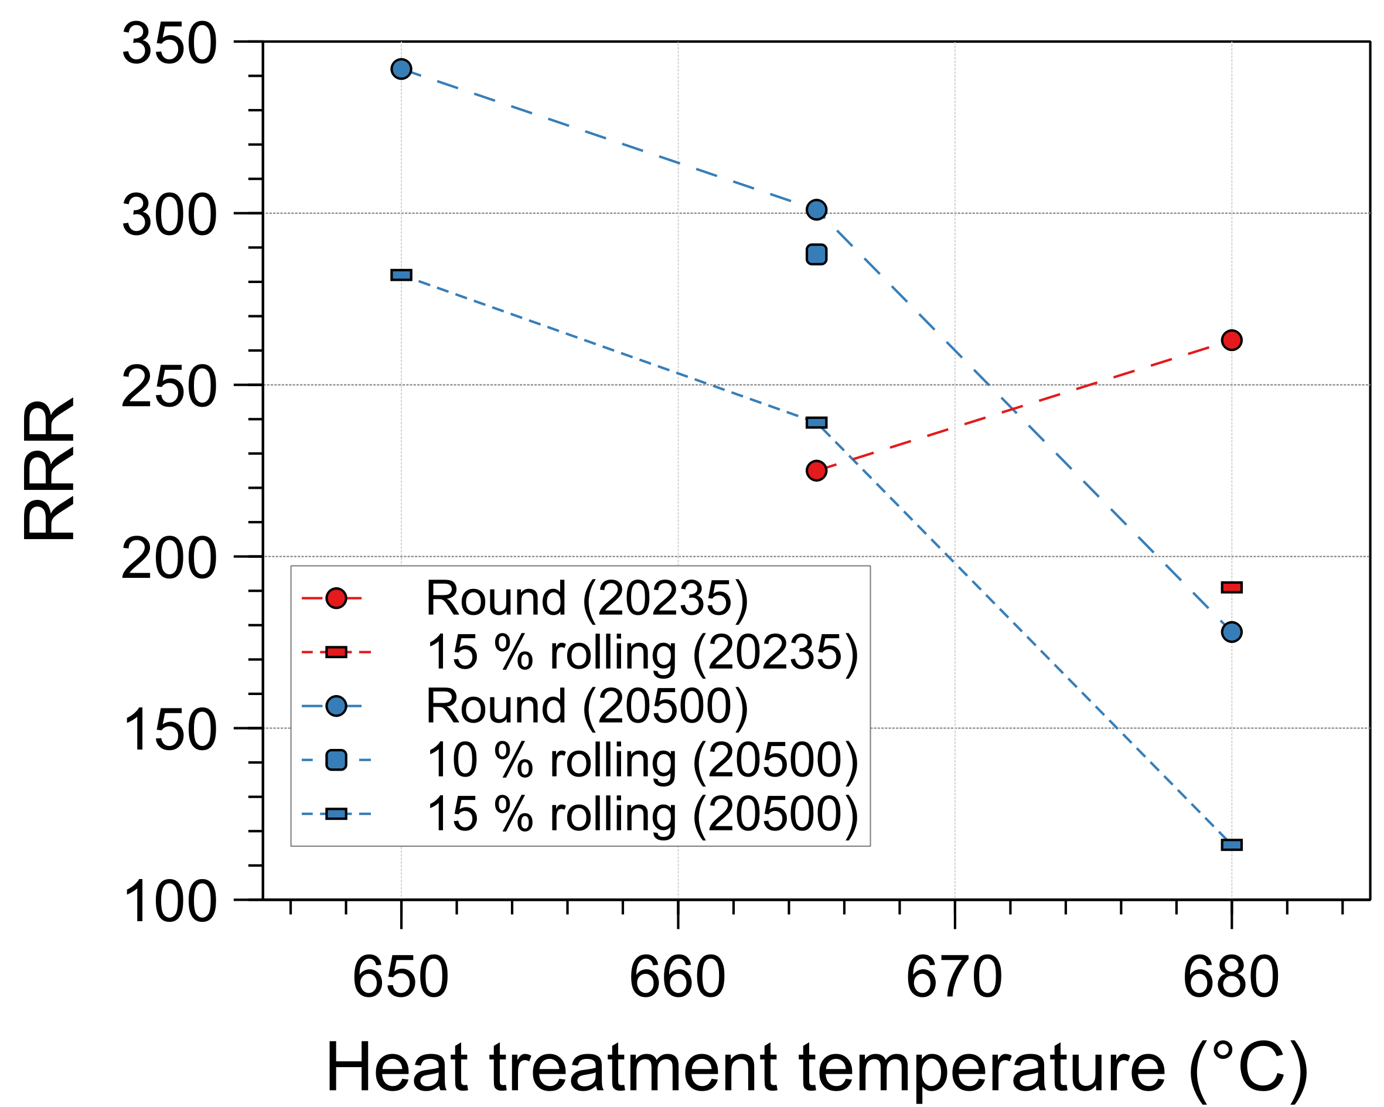
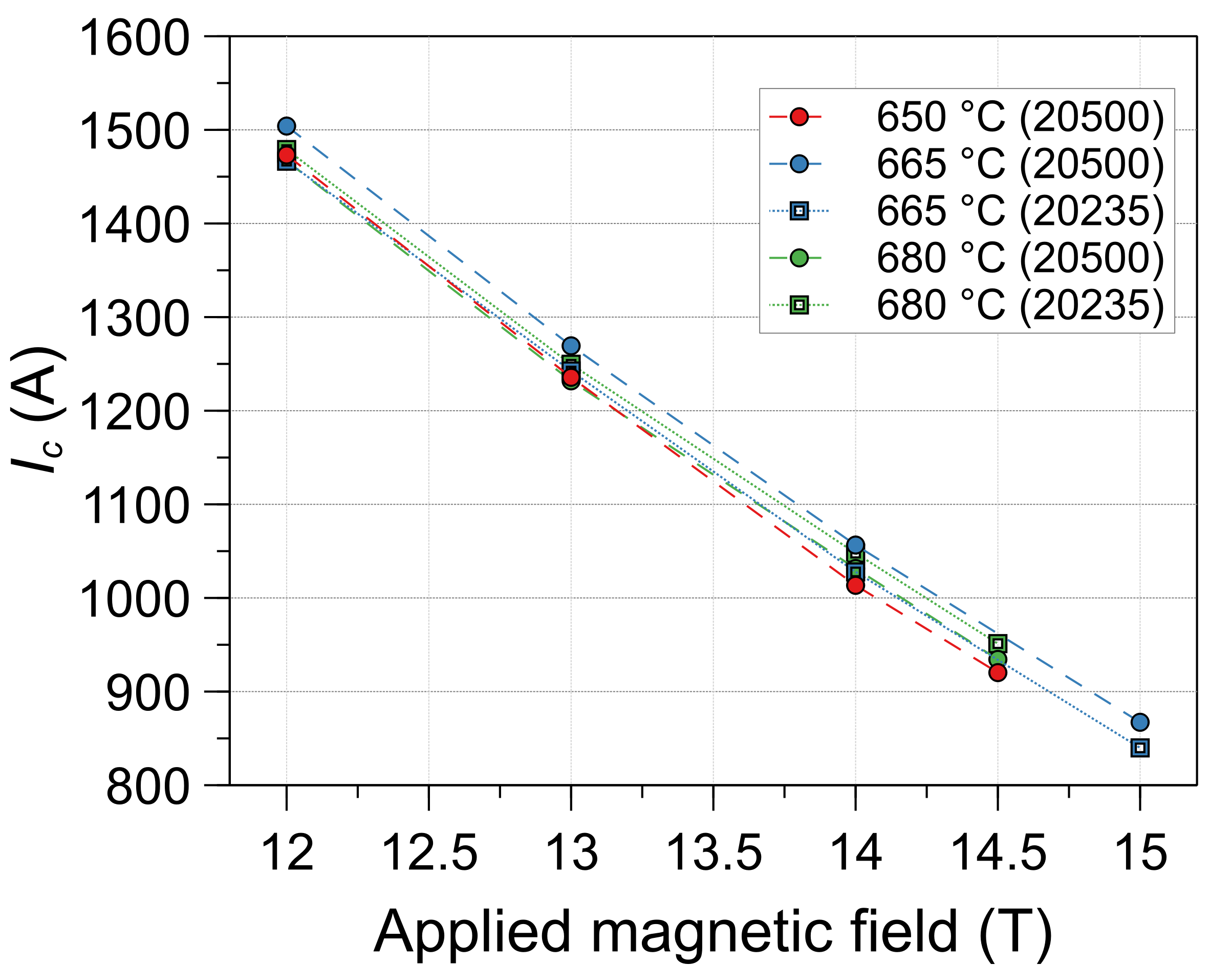
Heat Treatment Dependence (2)
For two spools, I_{c} and RRR data are available at all tested temperatures
  I_{c} and RRR are well balanced at 665 °C
  Reducing the temperature to 650 °C is not beneficial
  RRR decreased markedly for a higher temperature of 680 °C, without a significant/consistent I_{c} increase
Data at 680 °C are insufficient for a definitive conclusion, but it appears there is scope for heat treatment optimisation in the 665–680 °C range
Performance of two spools as a function of maximum heat treatment temperature
Left: RRR of round and rolled samples
Right: I_{c} (4.2 K) of round samples
Numbers in brackets indicate the billet number

Slide 19
Conclusions
An RRP® wire with 162/169 layout and a nominal Cu/non-Cu of 0.9 has been procured in two diameters to a specification targeting high J_{c}
Production was completed on schedule, with good yield and process control
  Average piece lengths significantly exceeded 1 km
  Cu/non-Cu was well controlled close to the design value of 0.9
Acceptance testing has been completed successfully
  51 km of the 1.1 mm diameter wire design proposed for TFD, processed with a 665 °C 50 h heat treatment, satisfied all acceptance criteria
    At 16 T, the minimum measured J_{c} exceeded the performance target of 1200 A/mm² (4.2 K), even after 15 % rolling reduction
  125 km of a 1.0 mm diameter wire of the same layout was produced with longer piece lengths, and met all acceptance criteria with a 650 °C 50 h heat treatment
Stability testing and cabling have not yet been performed at CERN

