Slide 1
HTS Test Facility Dipole Magnet Wire Specification Review
TFD Cable Packing Factor
Ian Pong (ipong@lbl.gov)
Algirdas Baskys (abaskys@lbl.gov)
Lawrence Berkeley National Laboratory

Slide 2
Development Cable Parameters
W12OL1302 – using the CERN wire CO11S20235A04U
Cable parameters (as-fabricated, before HT)
W12OL1302A (“1302-A”): 25.9 mm wide, 1.93 mm thick (at 14 MPa by CME)
W12OL1302B (“1302-B”): 25.9 mm wide, 1.91 mm thick (at 14 MPa by CME)
W12OL1302C (“1302-C”): 26.1 mm wide, 1.91 mm thick (at 14 MPa by CME)

Slide 3
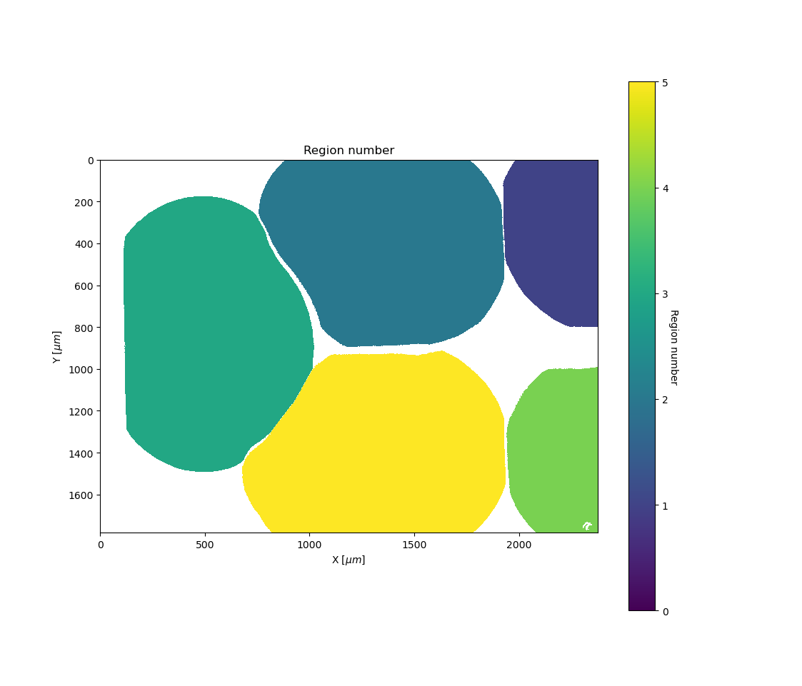
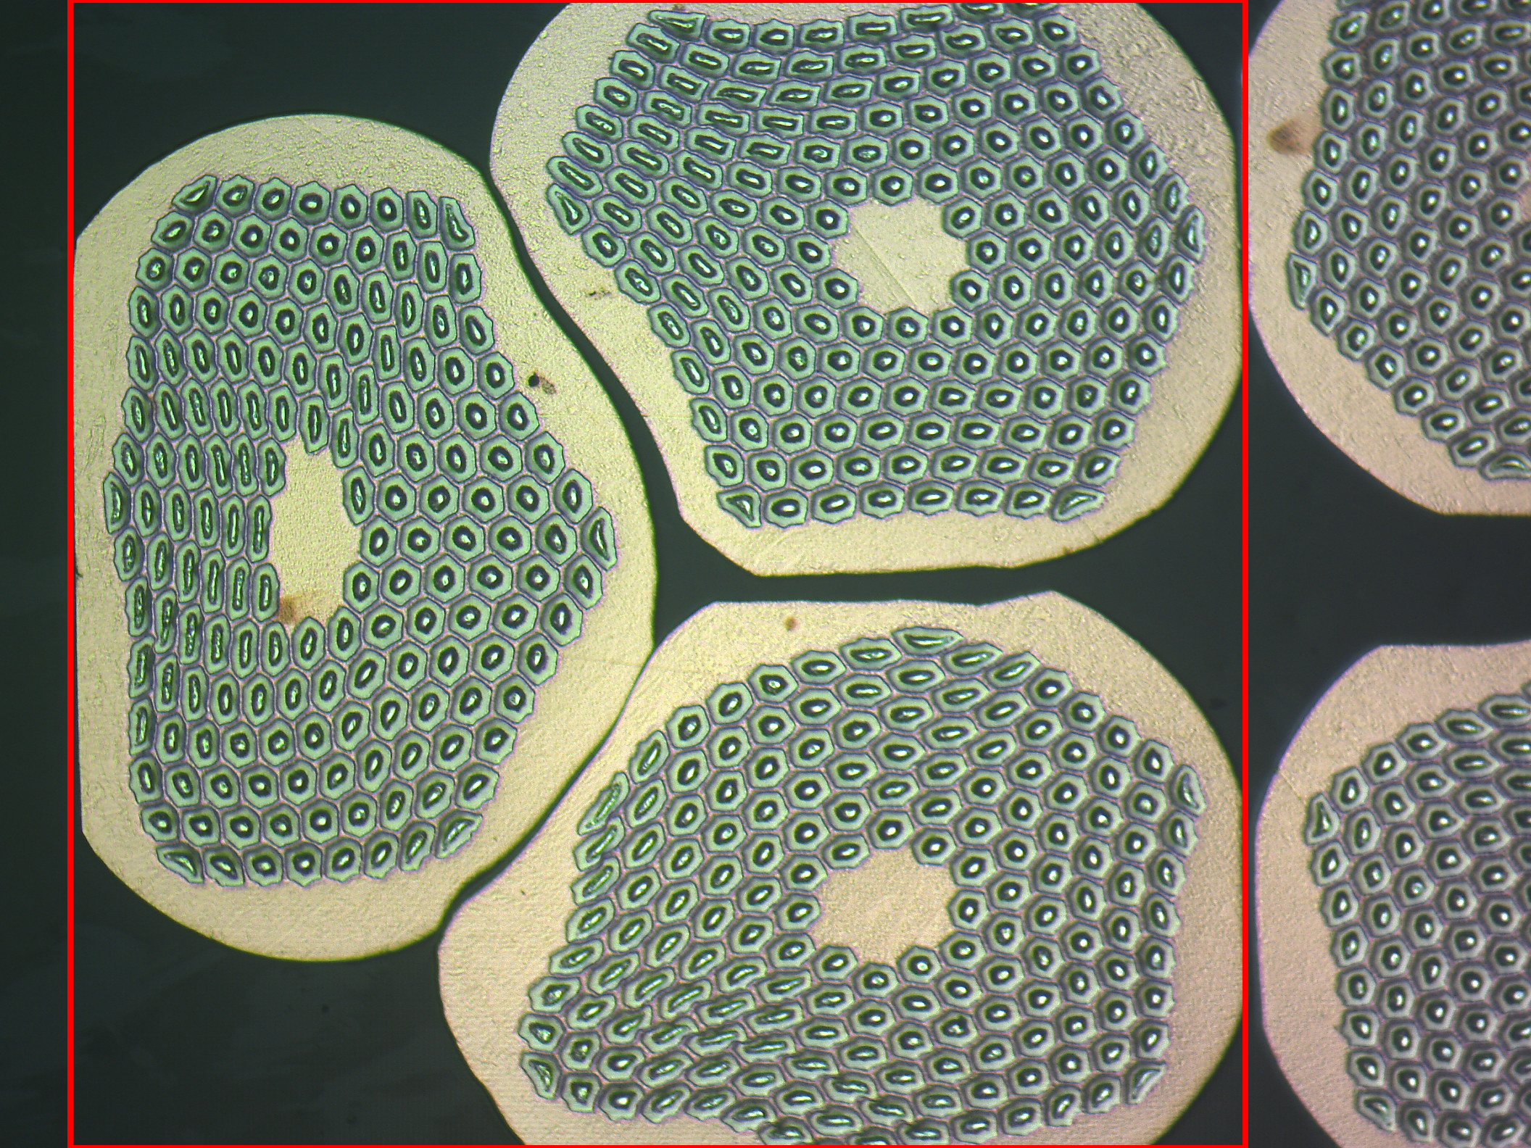
Packing Factor
RW diameter: 1.1 mm
Cable thickness: 1.91 mm → when top and bottom strands are directly on top of another, thickness reduction is ~13%
1.93 mm → ~12%
Cf. MQXFA: ~10%
At the triplet, the packing factor is ~82%

