Slide 1
Test Facility Dipole
Strain Effect on Magnet Critical Surface
G. Vallone, E. Anderssen, D. Arbelaez, P. Ferracin,
S. Prestemon, GL. Sabbi
TFD Wire Specification Review
28 October 2021

Slide 2
Outline
Introduction
FE models description
Strand parametrization
Critical current computation
Conclusion

Slide 3
Outline
Introduction
FE models description
Strand parametrization
Critical current computation
Conclusion

Slide 4
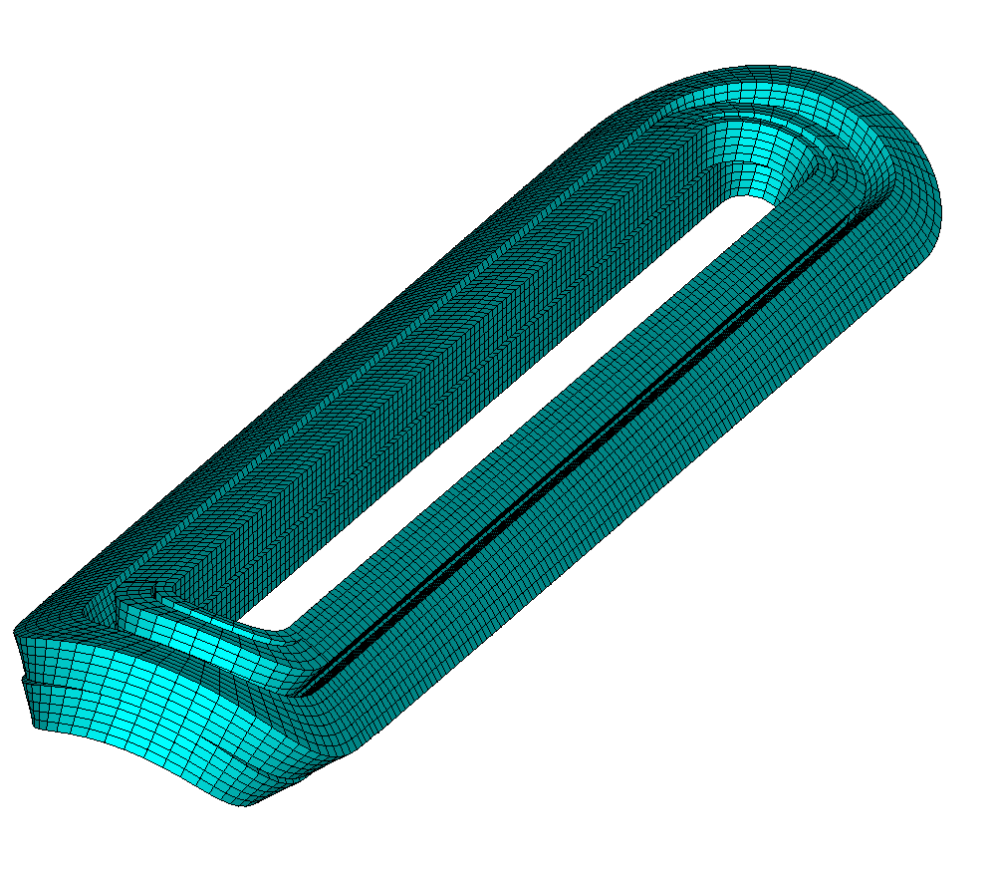
Introduction
We want to evaluate the magnet current limit including the impact of the applied strain on the critical surface
Traditional designs are based on empirical limits of the Von Mises equivalent stress, computed modelling (FEA) the coils as blocks of a homogeneous material

Slide 5
Methodology Overview
Procedure:
Measure the strand critical current as function of field, temperature and strain
Fit the exponential scaling law to the measurements
Create an electromagnetic and a mechanical model with a separate representation of the superconducting ‘regions’
Compute the current/field transfer function for all the superconducting regions
Extract the strain on every superconducting region as a function of the powering current
Compute the critical current for each strand using the exponential scaling law
Find the minimum powering current for which the critical current is crossed at any strand
More details on the methodology are available here:
Vallone, G., et al. "A methodology to compute the critical current limit in Nb3Sn magnets." SUST 34.2 (2020): 025002.

Slide 6
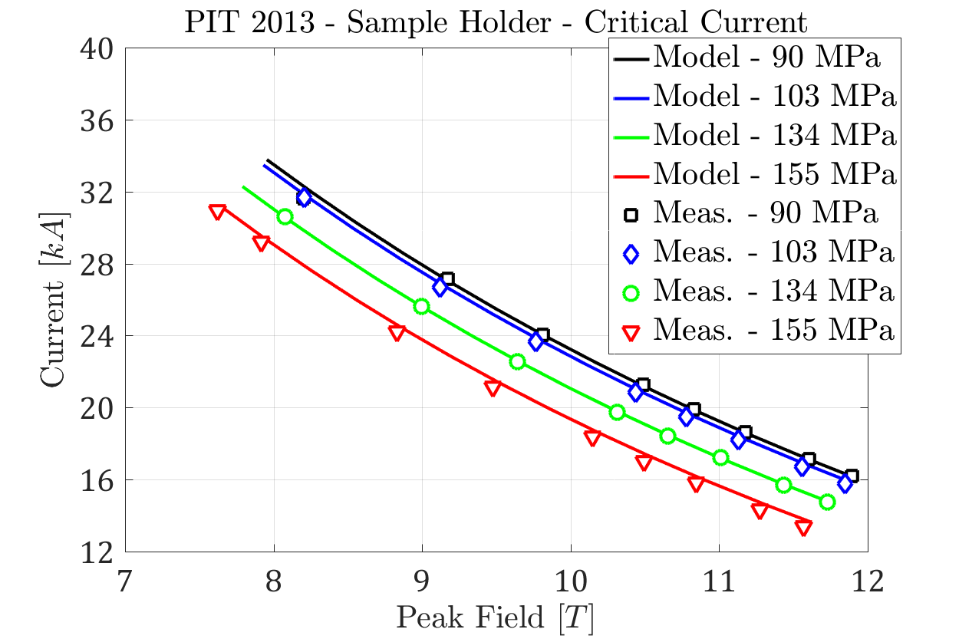
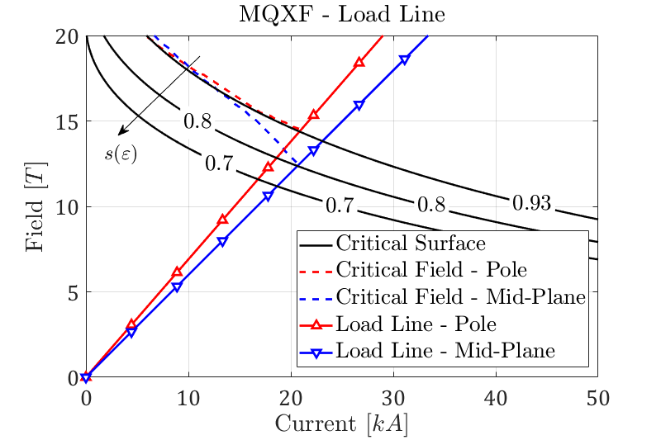
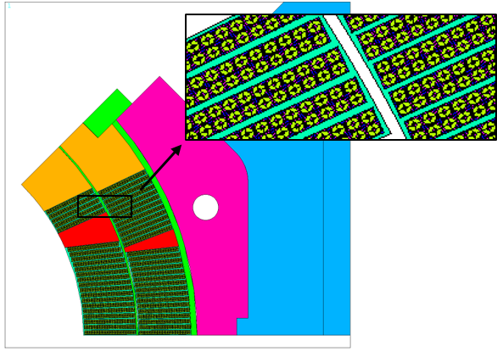
Methodology Background
The methodology was ‘calibrated’ on the CERN sample holder and tested on the MQXF magnet
Being based on the exponential scaling law, it allows to reproduce only the critical current reduction in the reversible region

Slide 7
Outline
Introduction
FE models description
Strand parametrization
Critical current computation
Conclusion

Slide 8
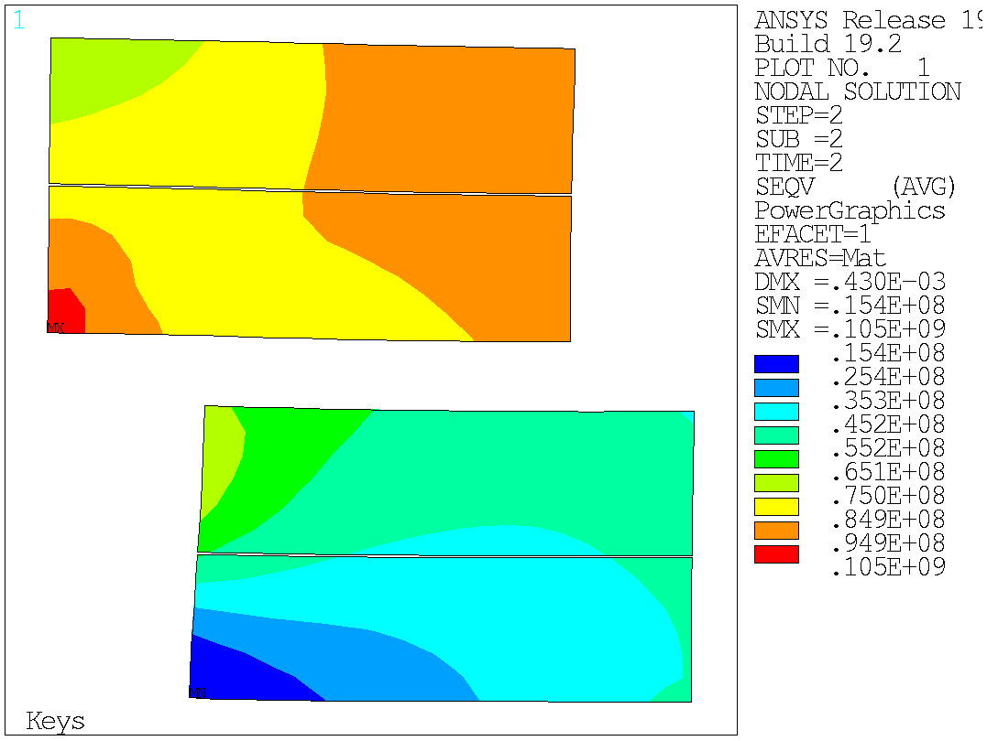
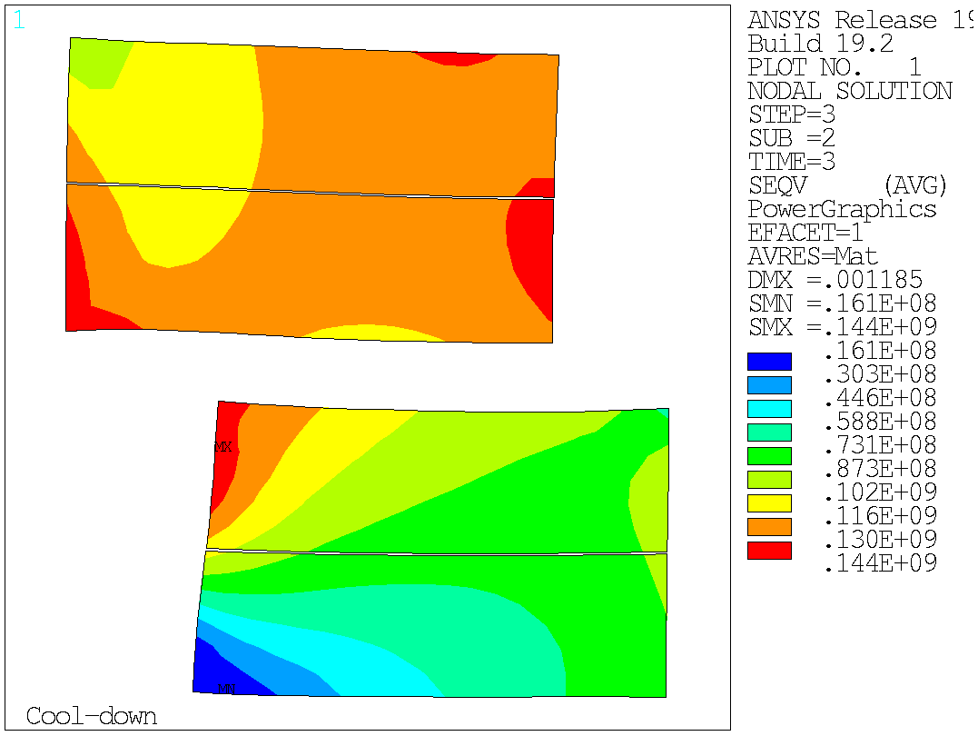
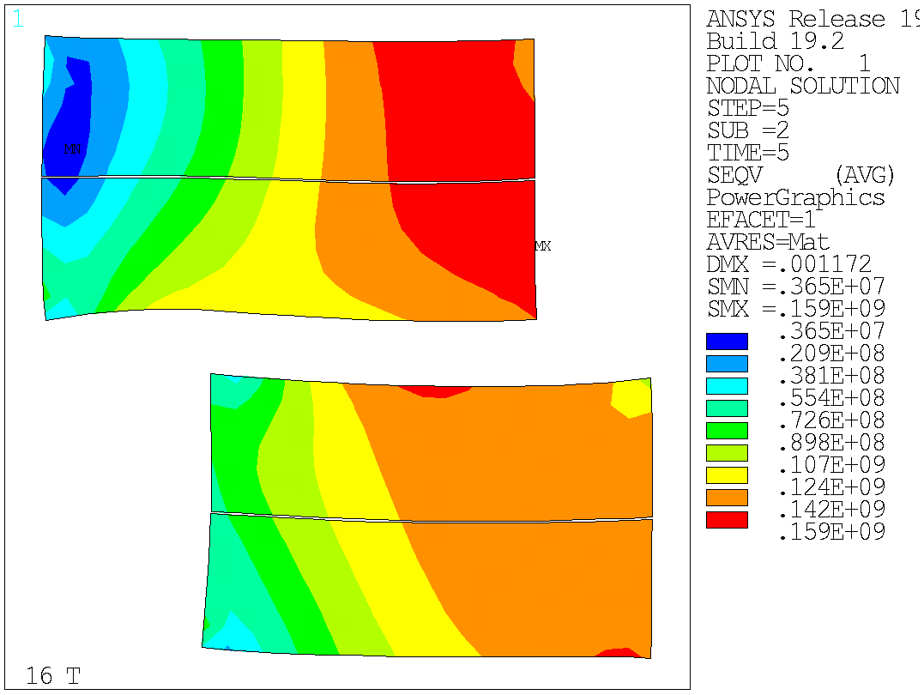
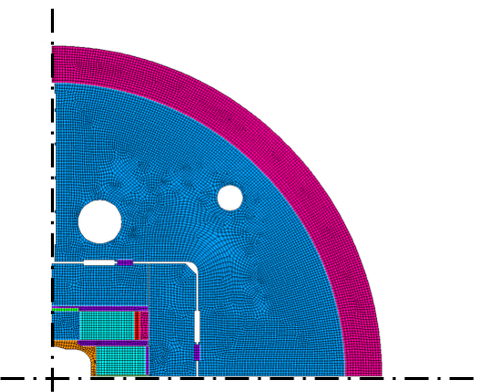
FE ’Block’ Model
Quadrant model with symmetry boundary conditions
Sliding contacts everywhere
Results with ‘full’ prestress to avoid detachment at 16 T
Coil block model shows a ‘reasonable’ stress on the conductor at all stages

Slide 9
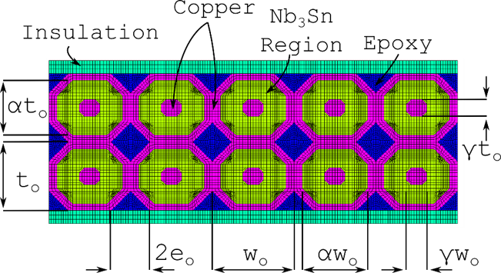
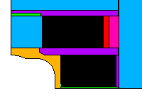
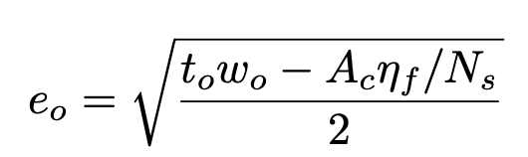
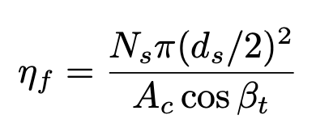
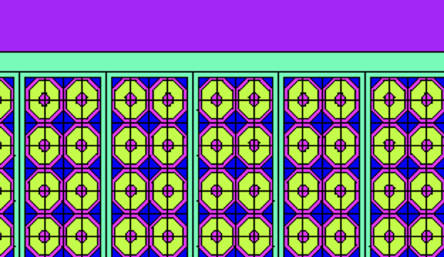
FE ‘Strand’ Model
Cable geometry from cable/strand parameters and micrography of strand/cable
The remaining modeling assumptions are the same as in the standard ‘block’ model

Slide 10
Outline
Introduction
FE models description
Strand parametrization
Critical current computation
Conclusion

Slide 11
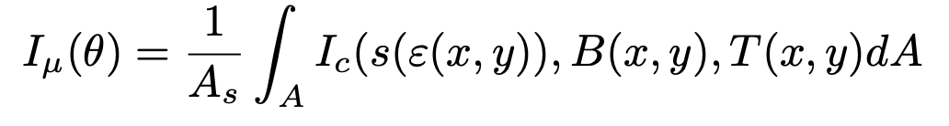
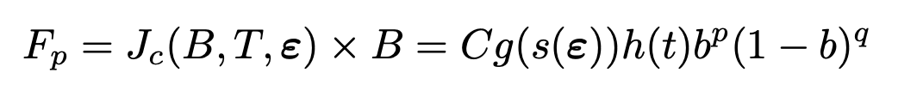
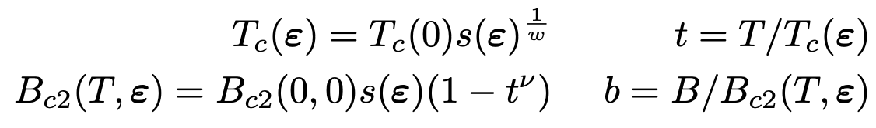
Critical Current on the Strands
The strand critical current is computed averaging the critical current over the strand area (perfect current redistribution within the strand):
The local critical current can be computed from the pinning force:
Where:
Bordini, B et al., An exponential scaling law for the strain dependence of the Nb3Sn critical current density. SUST (2014)

Slide 12
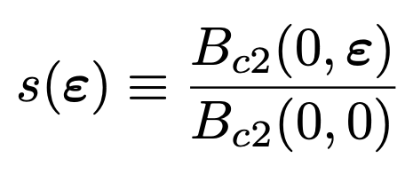
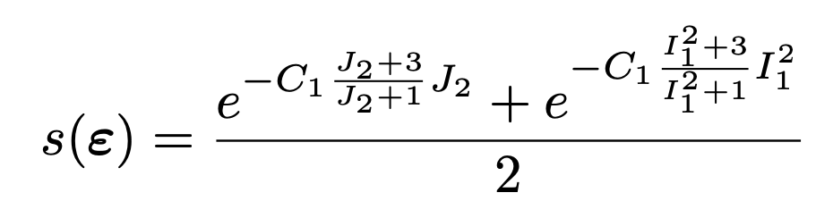
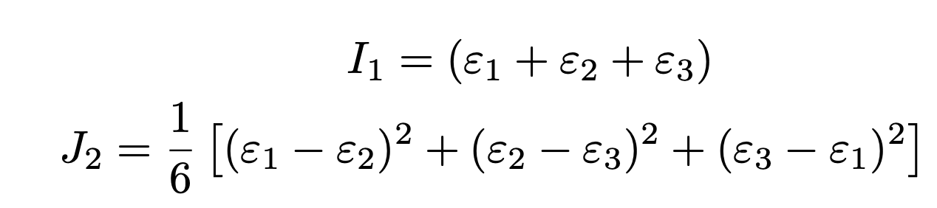
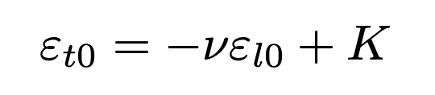

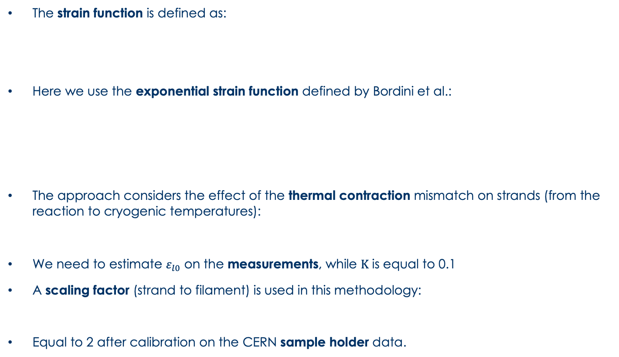
s(𝞮) - Exponential Scaling Law
The strain function is defined as:
Here we use the exponential strain function defined by Bordini et al.:
The approach considers the effect of the thermal contraction mismatch on strands (from the reaction to cryogenic temperatures):
We need to estimate $ε_{l0}$ on the measurements, while $K$ is equal to 0.1
A scaling factor (strand to filament) is used in this methodology:
Equal to 2 after calibration on the CERN sample holder data.

Slide 13
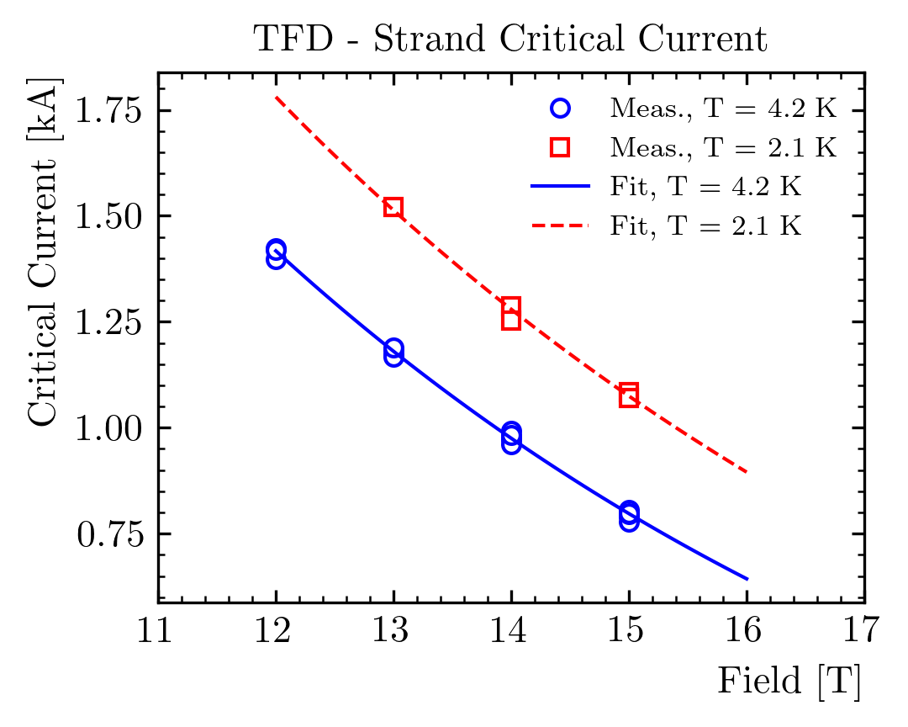
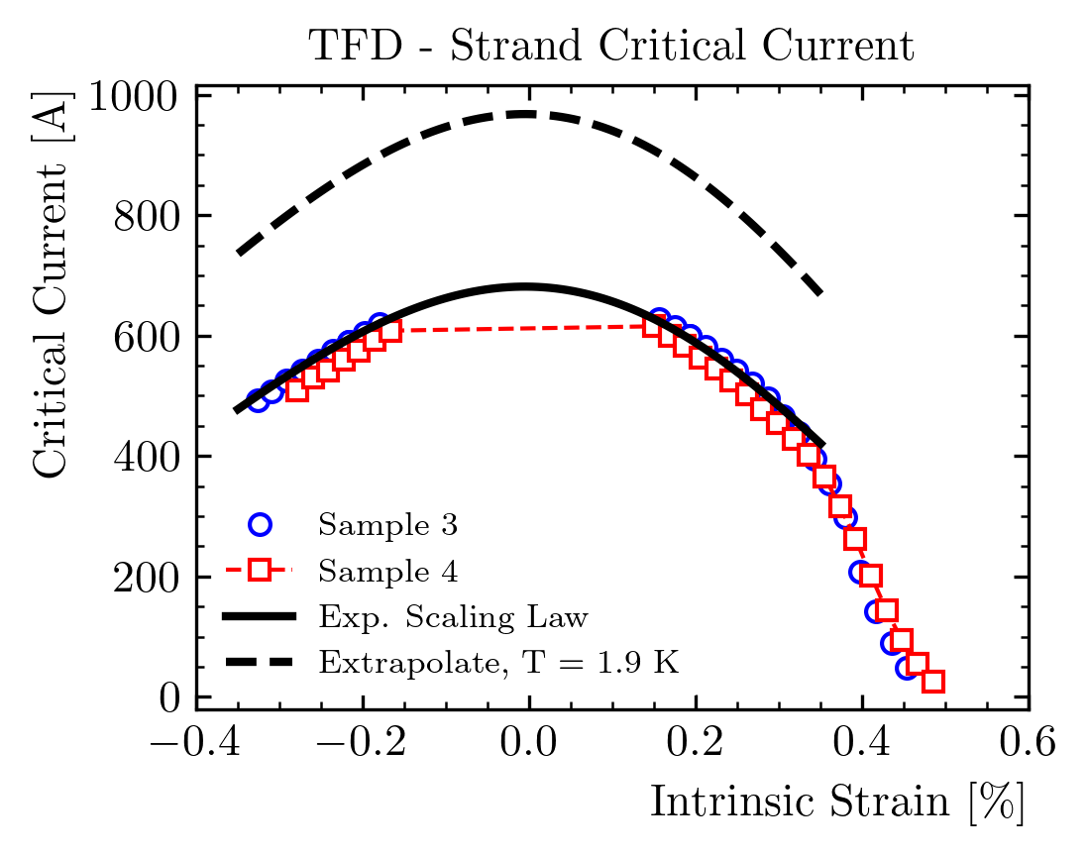
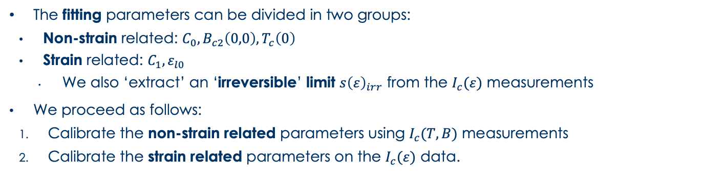
Fitting of the Strain Data
N. Cheggour talk
Data from CERN wire, 665°C reaction
See D. Turrioni talk
The fitting parameters can be divided in two groups:
    Non-strain related: $C_{0}, B_{c2}\left(0,0\right), T_{c}\left(0\right)$
    Strain related: $C_{1}, ε_{l0}$
      We also ‘extract’ an ‘irreversible’ limit $s{\left(ε\right)}_{irr}$ from the $I_{c}(ε)$ measurements
  We proceed as follows:
    Calibrate the non-strain related parameters using $I_{c}(T,B)$ measurements
    Calibrate the strain related parameters on the $I_{c}(ε)$ data.

Slide 14
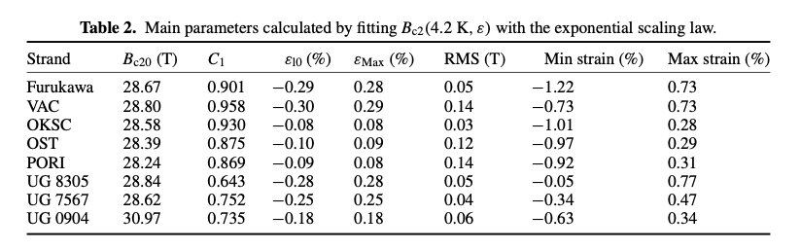
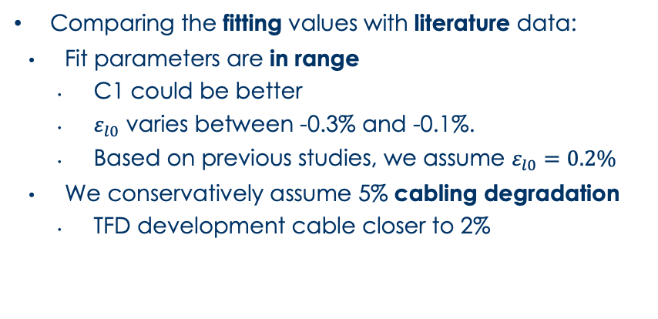
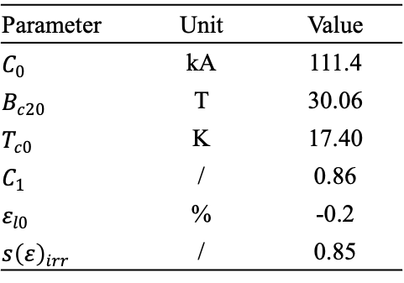
Fitting Results - Summary
Parameter | Unit | Value
$C_{0}$ | kA | 111.4
$B_{c20}$ | T | 30.06
$T_{c0}$ | K | 17.40
$C_{1}$ | / | 0.86
$ε_{l0}$ | % | -0.2
$s{\left(ε\right)}_{irr}$ | / | 0.85
Comparing the fitting values with literature data:
    Fit parameters are in range
      C1 could be better
      $ε_{l0}$ varies between -0.3% and -0.1%.
      Based on previous studies, we assume $ε_{l0}=0.2\%$
    We conservatively assume 5% cabling degradation
      TFD development cable closer to 2%
B. Bordini et al, SUST., 2014

Slide 15
Outline
Introduction
FE models description
Strand parametrization
Critical current computation
Conclusion

Slide 16
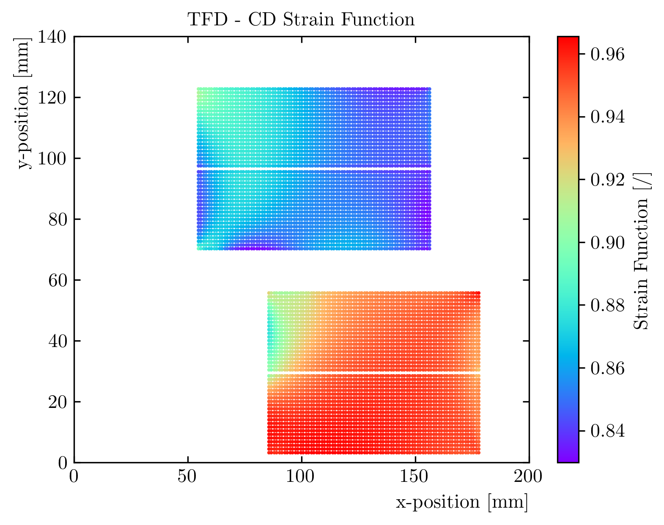
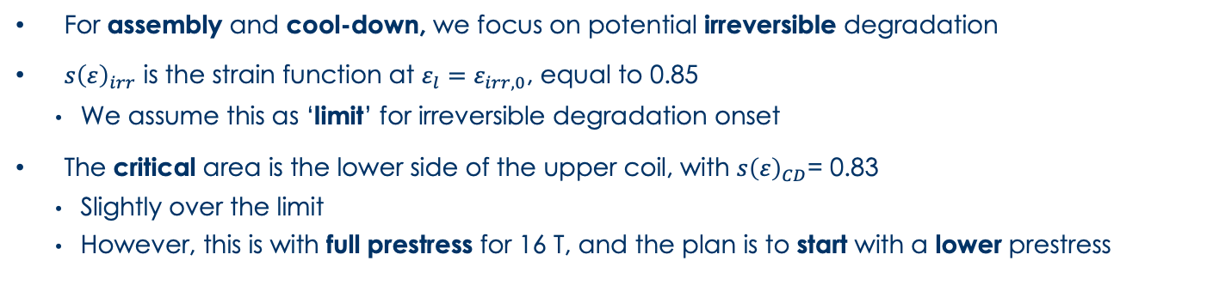
Results – Assembly + Cooldown
N. Cheggour talk
Critical
area
For assembly and cool-down, we focus on potential irreversible degradation
$s{\left(ε\right)}_{irr}$ is the strain function at $ε_{l}=ε_{irr,0}$, equal to 0.85
    We assume this as ‘limit’ for irreversible degradation onset
The critical area is the lower side of the upper coil, with $s{\left(ε\right)}_{CD}$= 0.83
    Slightly over the limit
    However, this is with full prestress for 16 T, and the plan is to start with a lower prestress
Notes:
TFD_contour_seps_cd.png

Slide 17
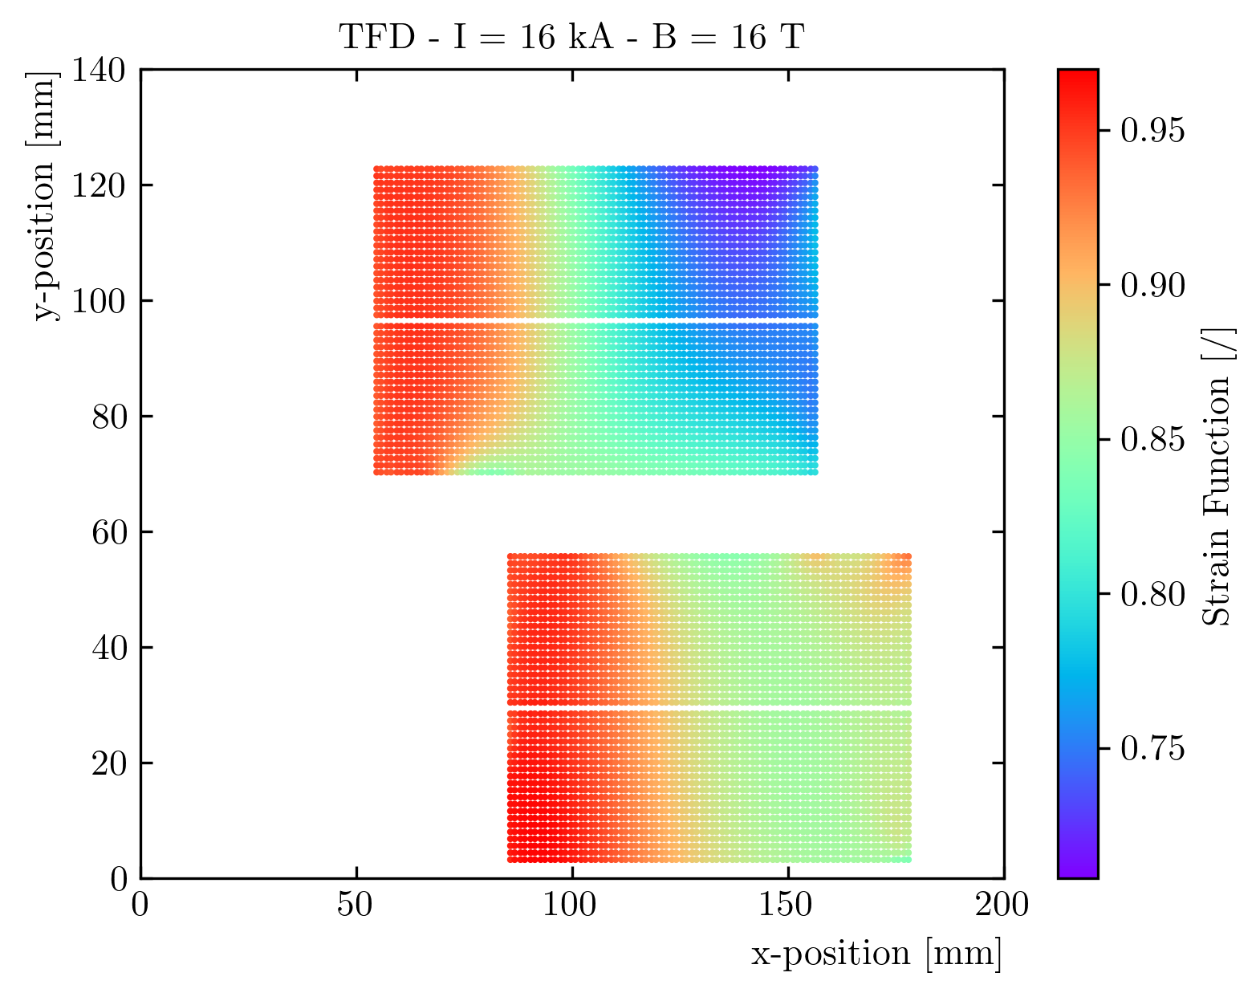
Strain Function During Powering (1)
Strain function at 16 T, averaged on each strand
    During powering, the pole turn unloads and the strain function is lower than ~0.9 only on the ‘low field’ region
  Next step is to evaluate the margin on each strand

Slide 18
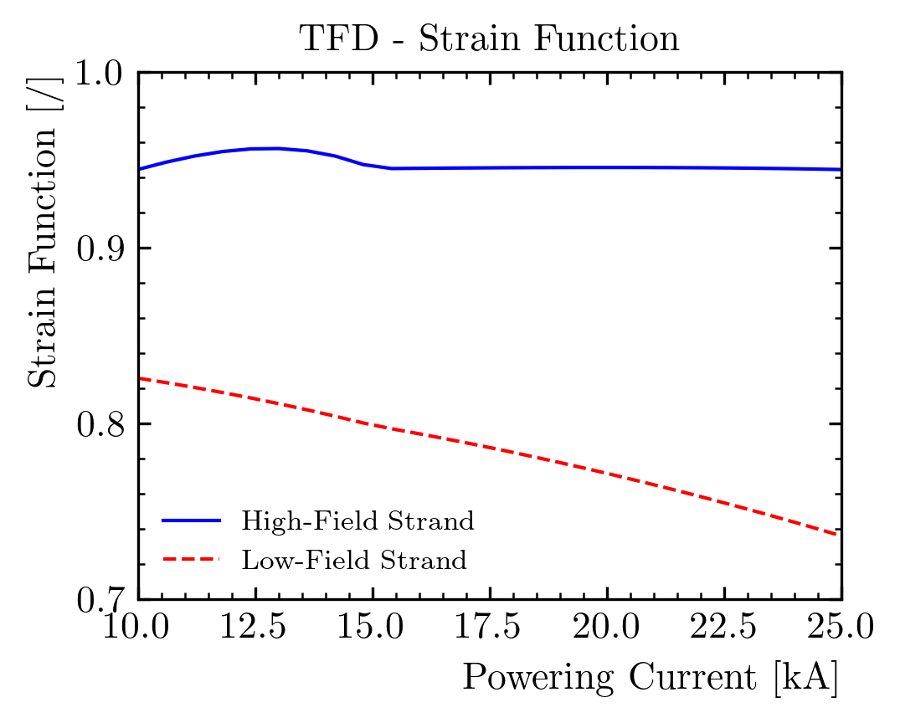
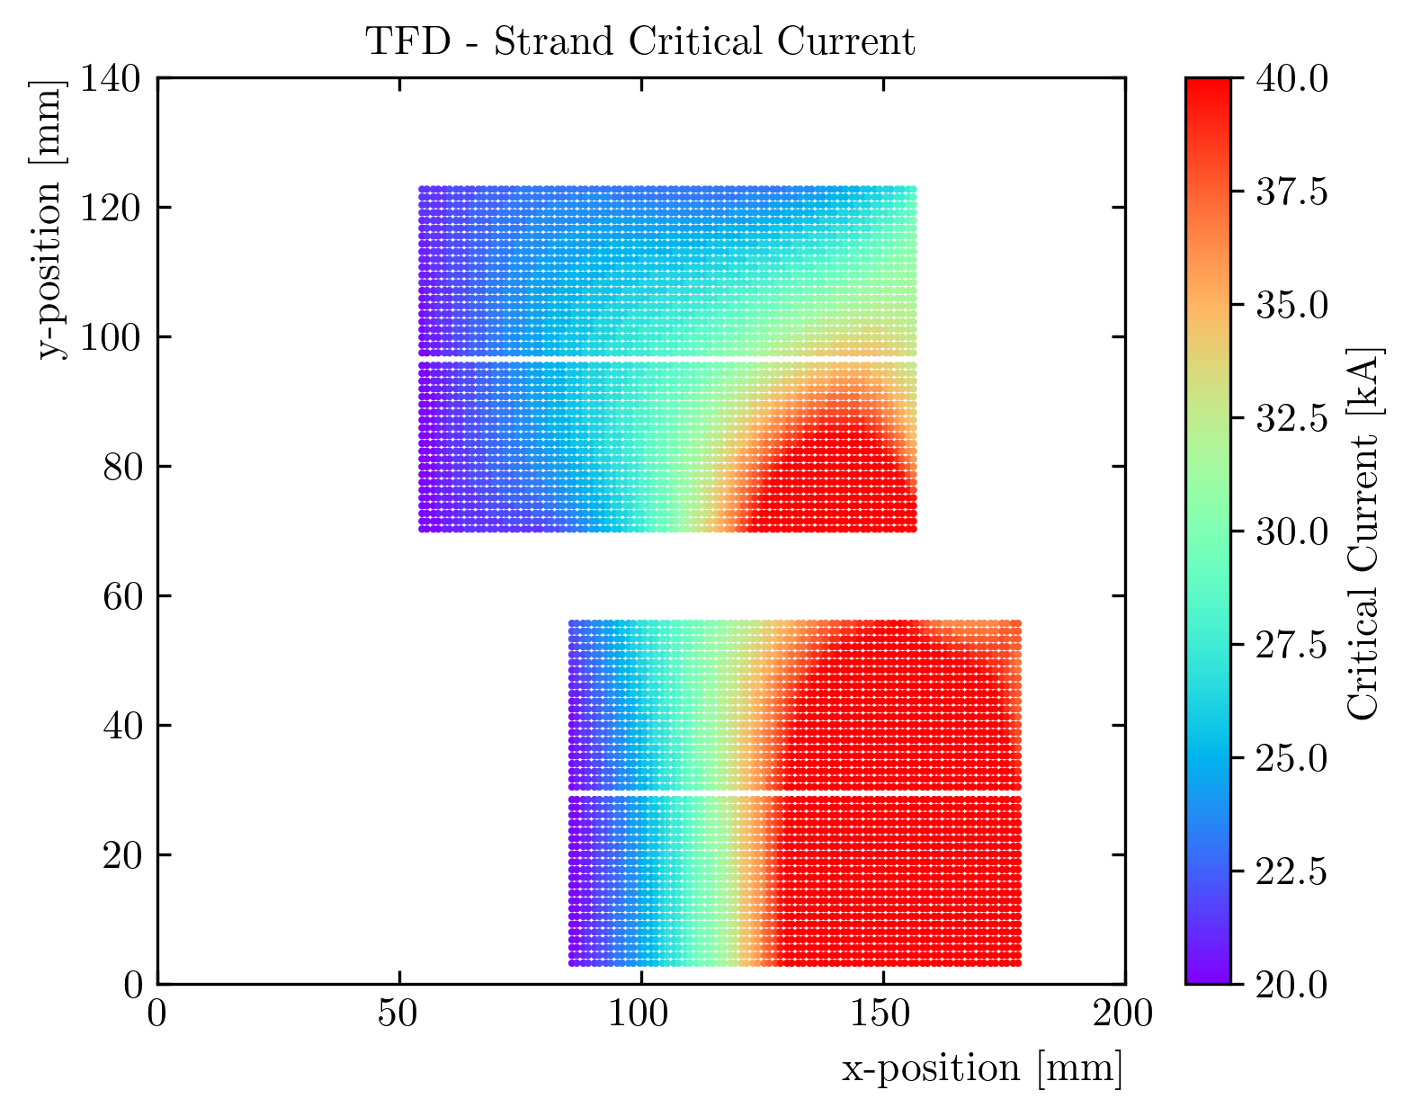
Strain Function During Powering (2)
Low field
High stress
High field
Low stress
Two regions of interest selected for further analysis:
    High field / low stress, on the outer coil pole turn (max field)
    A ‘dangerous’ area in the low field region, with high stress
The strain function on the high field region does not see a lot of variation after ~15 T
The strain function in the low field region sees a continuous reduction as the e.m. forces increase
Therefore, the margin on the pole turns is ~unchanged, while the LF region sees a reduction

Slide 19
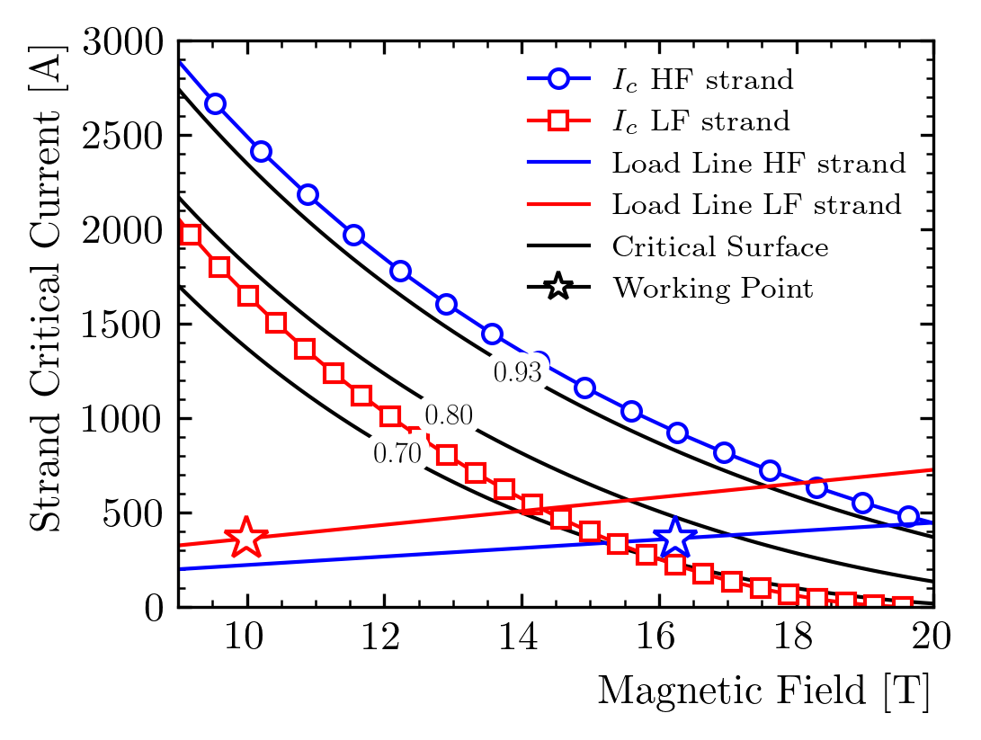
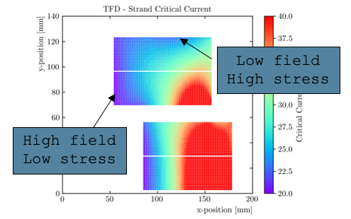
Critical Current Margin with Strain
At 16 T, the working point as a fraction of the critical current is:
    High field/low stress region: 39%
    Low field / high stress region : 24%. Neglecting the strain, this would be15%

Slide 20
Load Line Margin with Strain
We compute the short sample limit for each strand, as a function of field and strain
    Note, however, that the preload is not consistently increased to match our design criteria
    80% in the high field / low stress region
    57% in the low field / high stress region. This would be 15% with no strain effects.

Slide 21
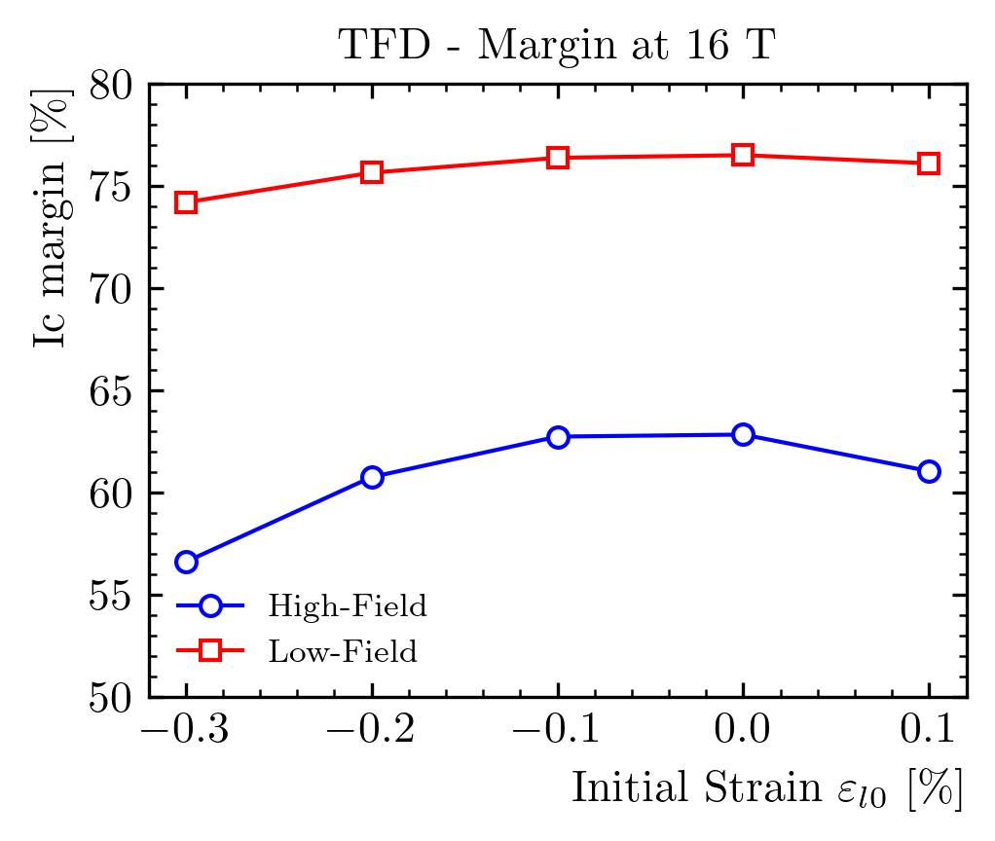
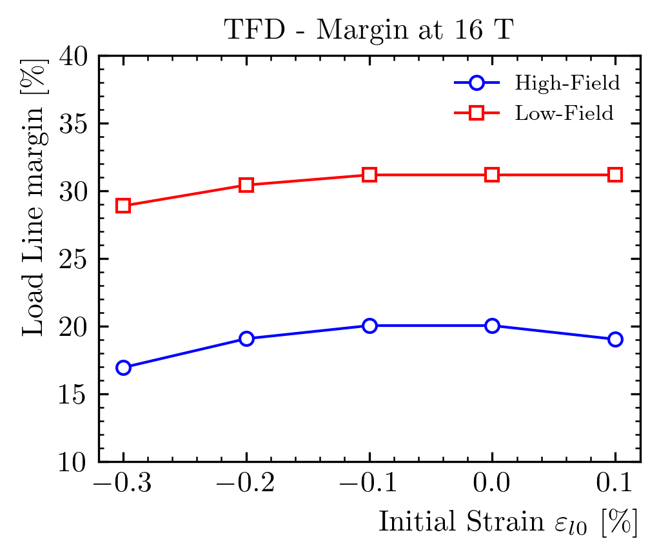
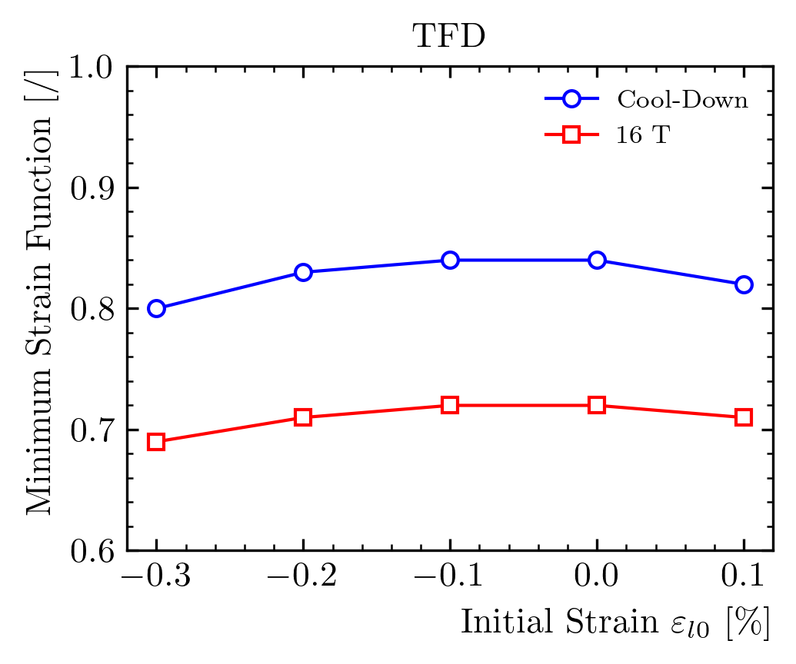
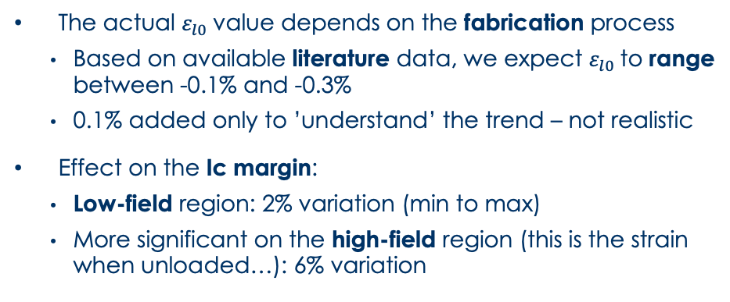
Effect of the ‘initial’ strain
The actual $ε_{l0}$value depends on the fabrication process
    Based on available literature data, we expect $ε_{l0}$to range between -0.1% and -0.3%
    0.1% added only to ’understand’ the trend – not realistic
Effect on the Ic margin:
    Low-field region: 2% variation (min to max)
    More significant on the high-field region (this is the strain when unloaded…): 6% variation

Slide 22
Outline
Introduction
FE models description
Strand parametrization
Critical current computation
Conclusion

Slide 23
Conclusion
The proposed methodology allows to consider the effect of the strain on the expected magnet performances
    The results suggest that the magnet can reach 16 T with sufficient margin
    The analysis will be repeated for the heat treatment at 680 C, as measurements show a larger strain ‘window’
After cooldown, TFD is close to irreversible degradation in the high field region
    This is with full prestress for unloading at 16 T
    The plan is to start with a lower prestress
At 16 T, the working point as a fraction of the critical current is:
    39% in the high field/low stress region
    24% in the low field / high stress region.
  Effect on the temperature margin to be evaluated

Slide 24
Back-up Slides

Slide 25
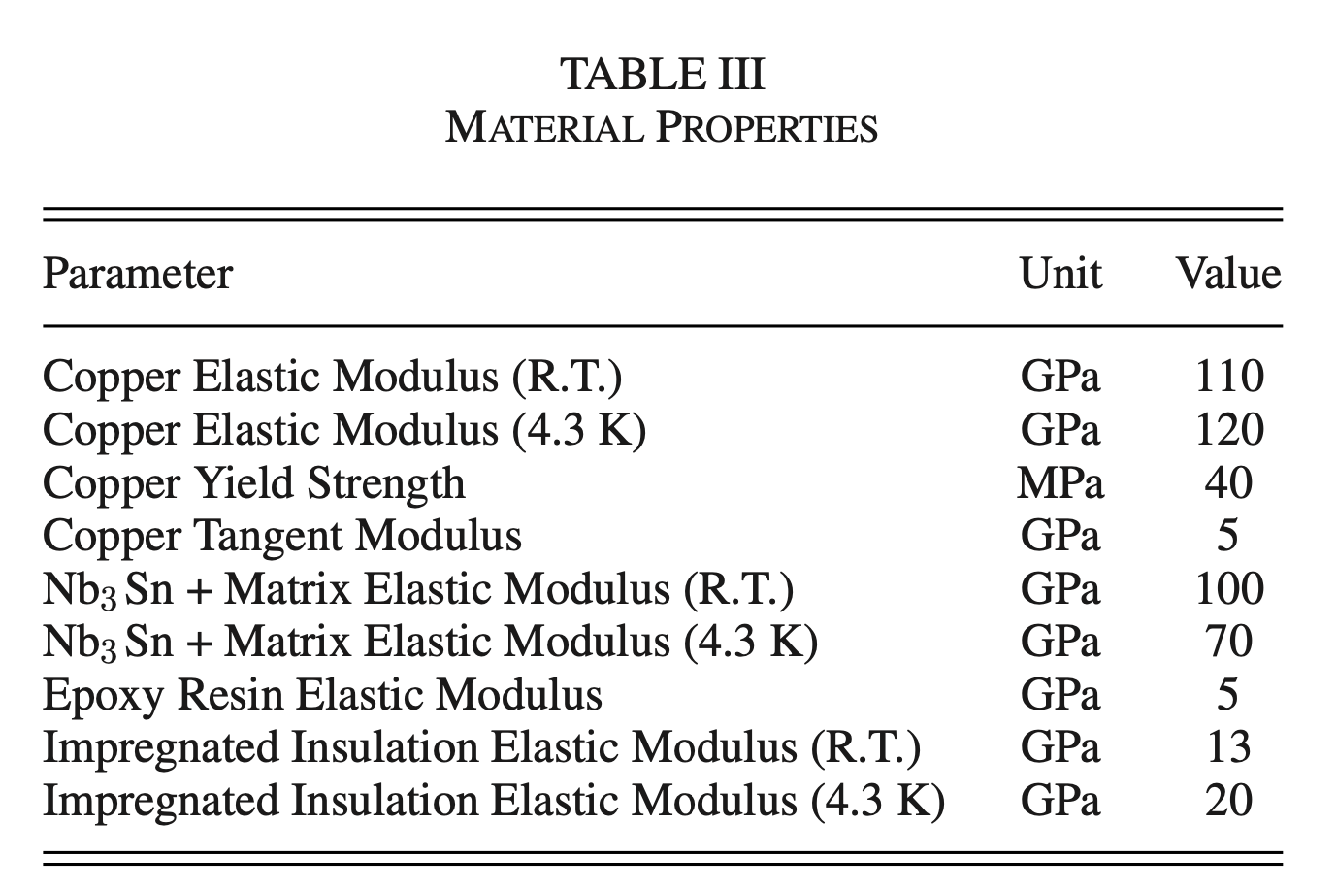
Material Properties
Material properties from literature

Slide 26
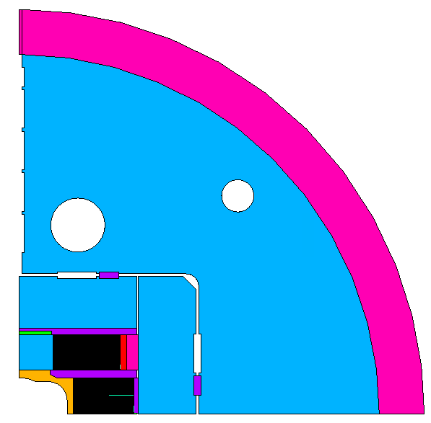
FE Model Geometry

Slide 27
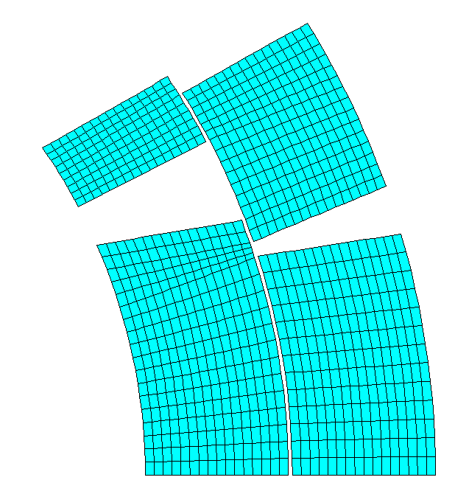
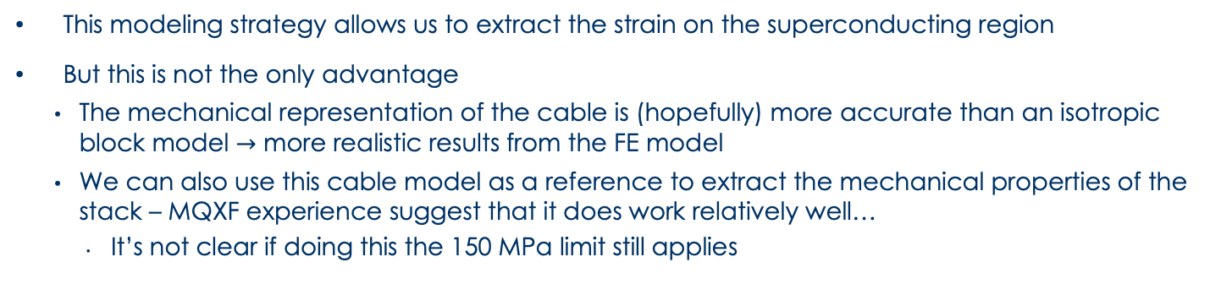
FE Modeling – Side Advantages
Block ‘RVE’ Model
This modeling strategy allows us to extract the strain on the superconducting region
But this is not the only advantage
    The mechanical representation of the cable is (hopefully) more accurate than an isotropic block model $→$ more realistic results from the FE model
    We can also use this cable model as a reference to extract the mechanical properties of the stack – MQXF experience suggest that it does work relatively well…
      It’s not clear if doing this the 150 MPa limit still applies

Slide 28
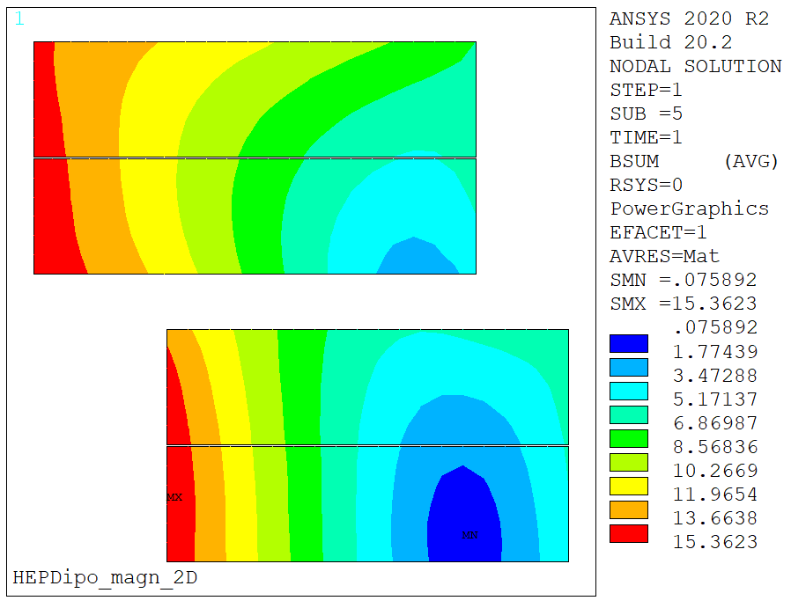
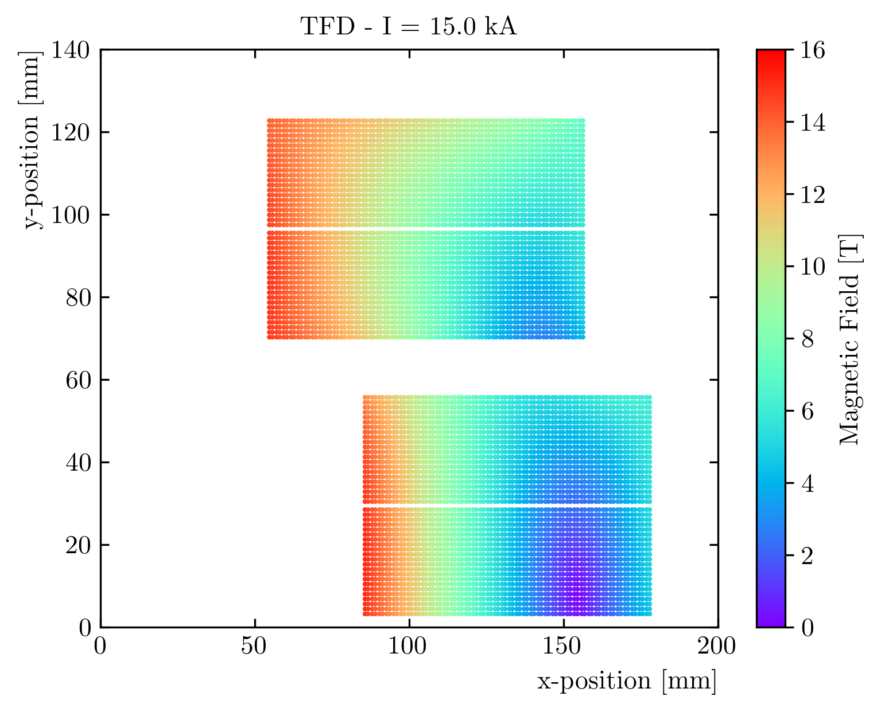
Results – Magnetic Field
Magnetic field in line with ‘standard’ 2D (and 3D) model results
    Peak field block model: 15.3 T
    Peak field strand model: 15.2 T

Slide 29
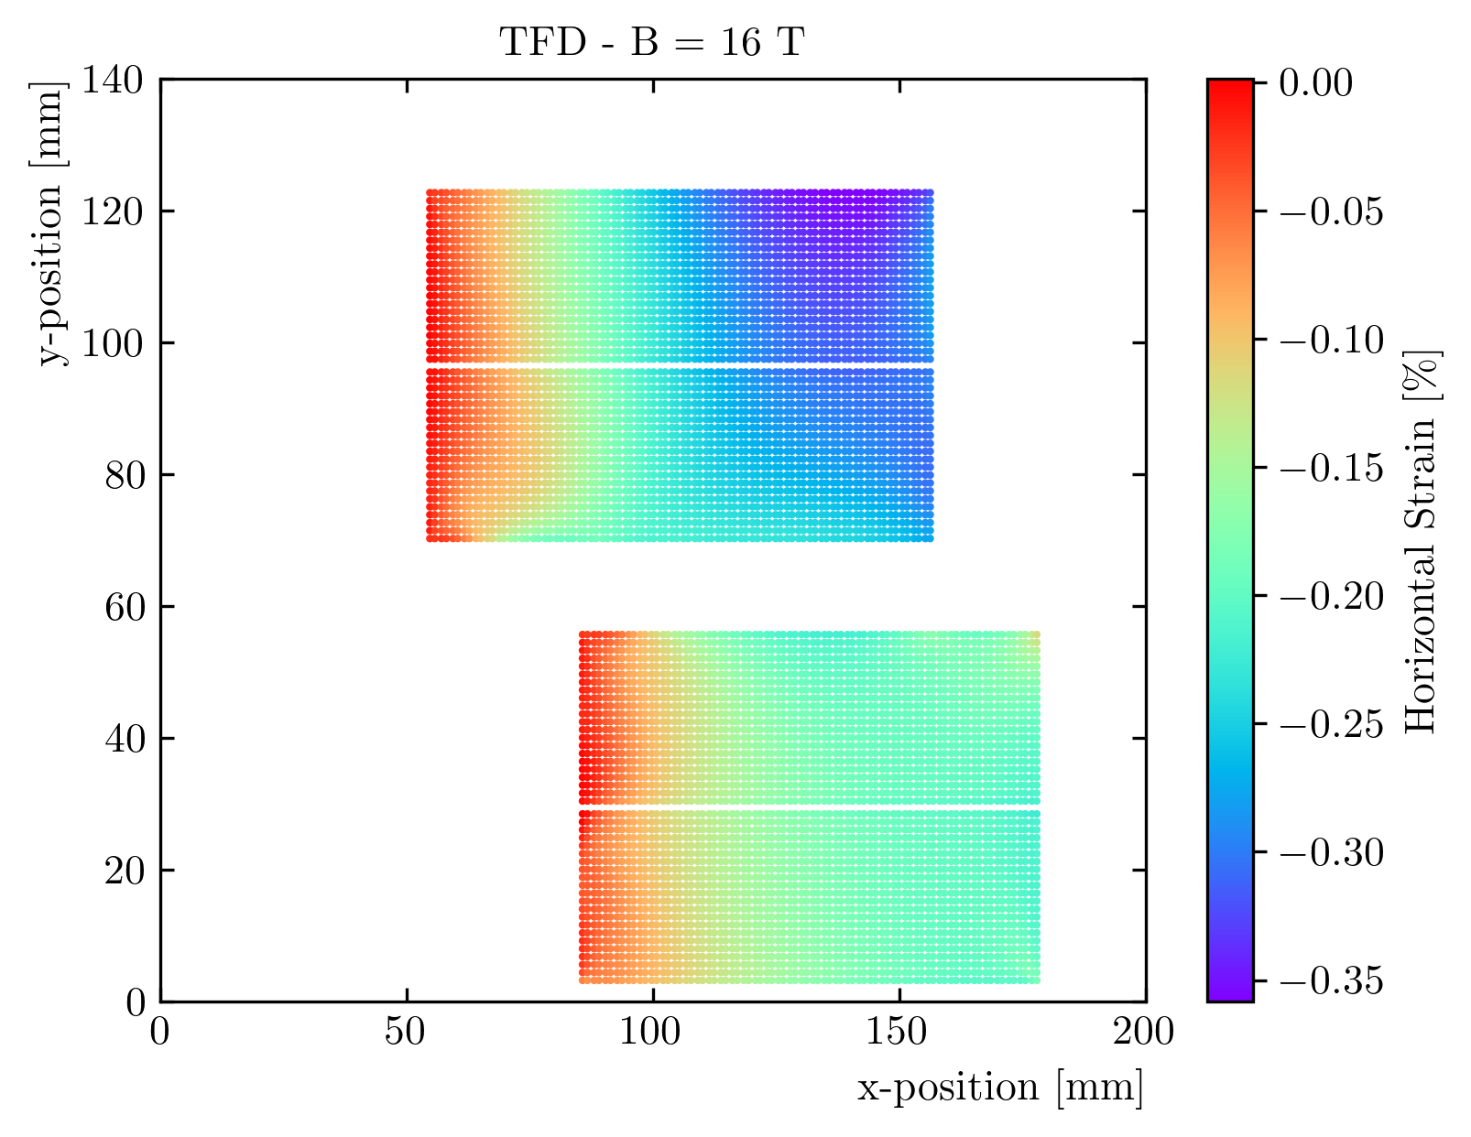
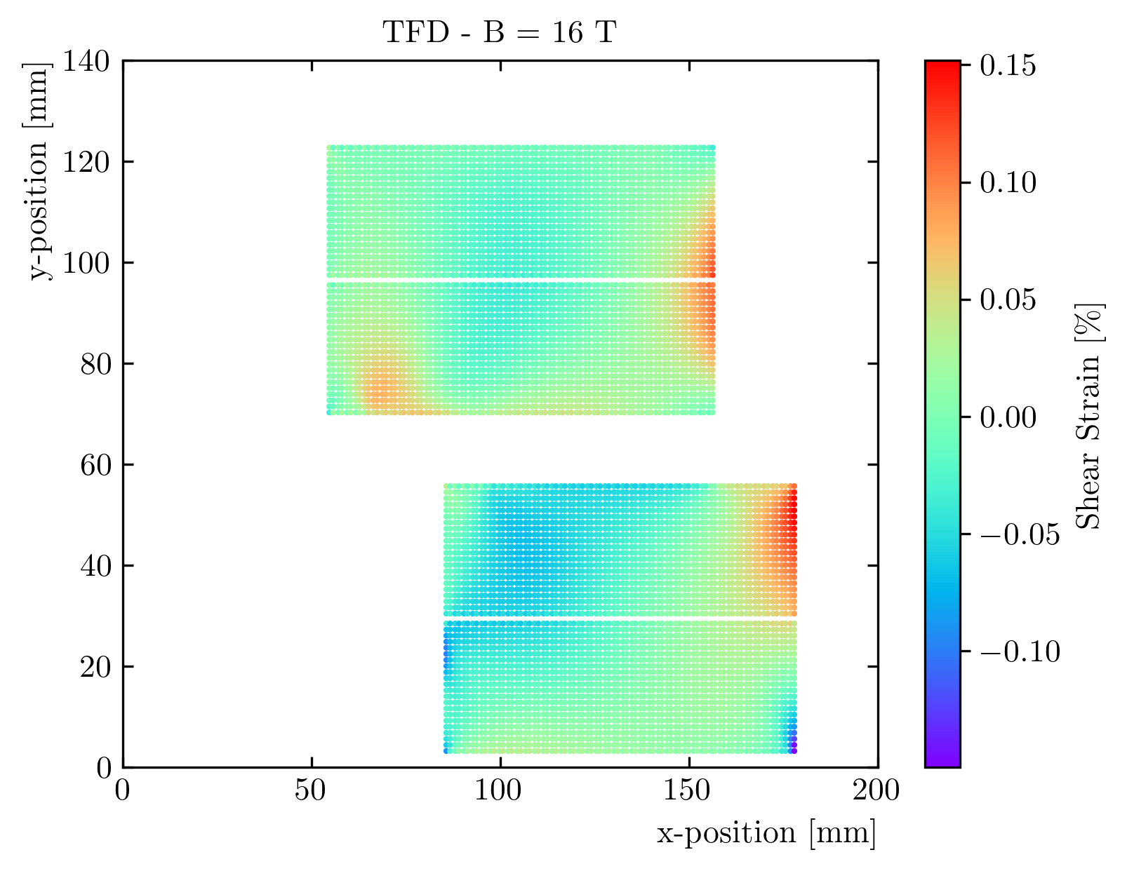
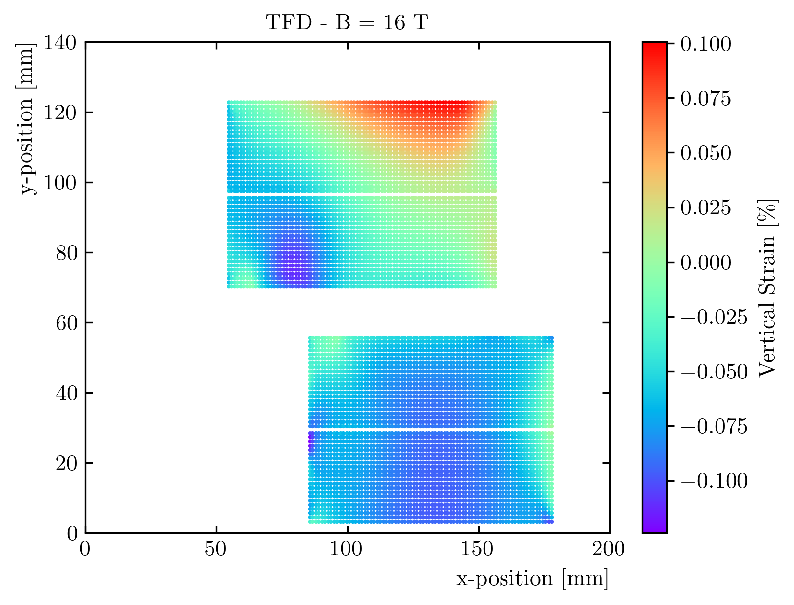
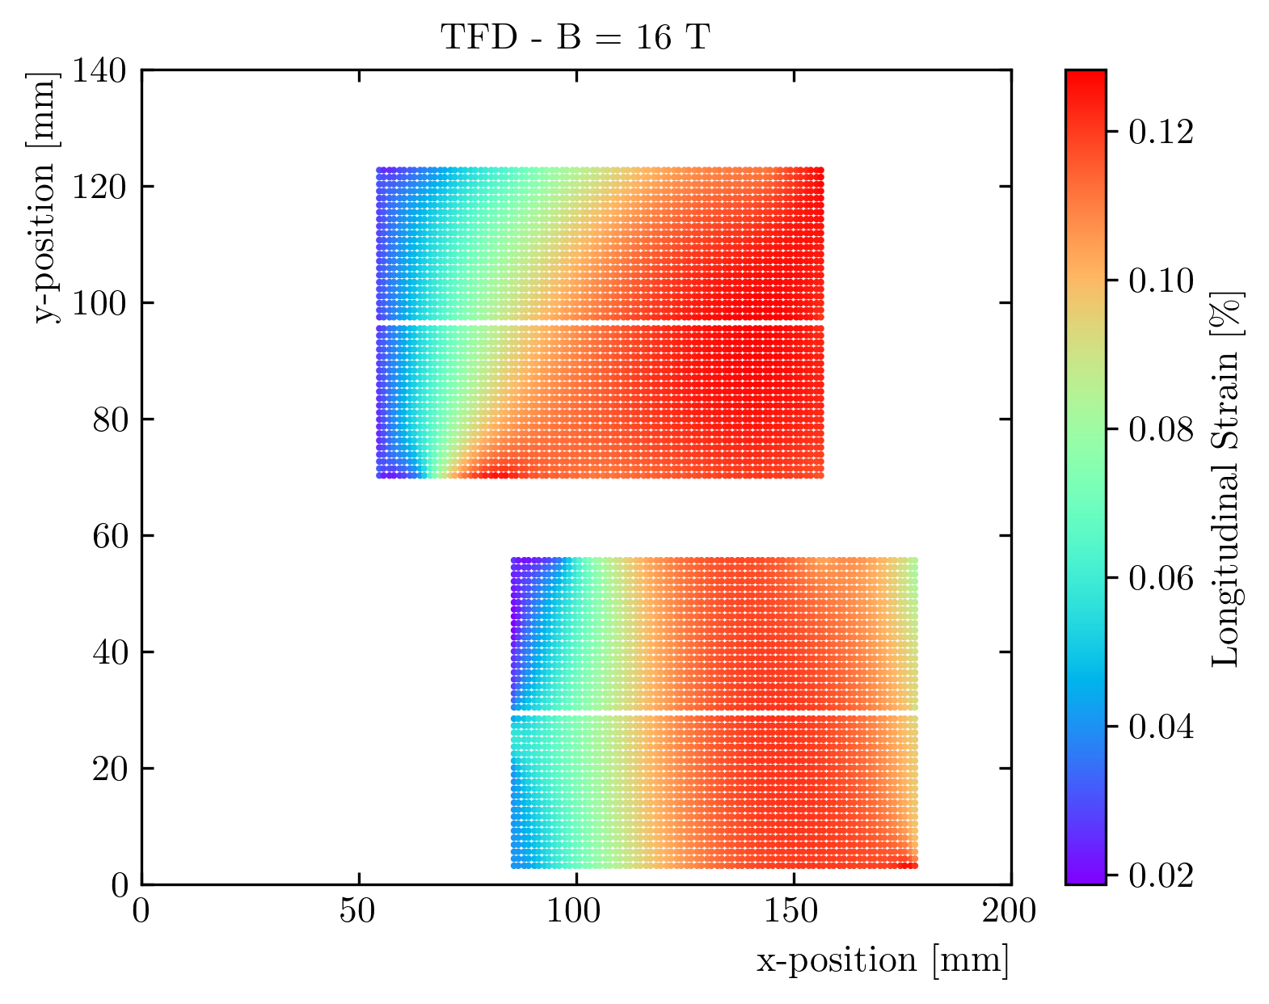
Results – Strain Maps - Powering

Slide 30
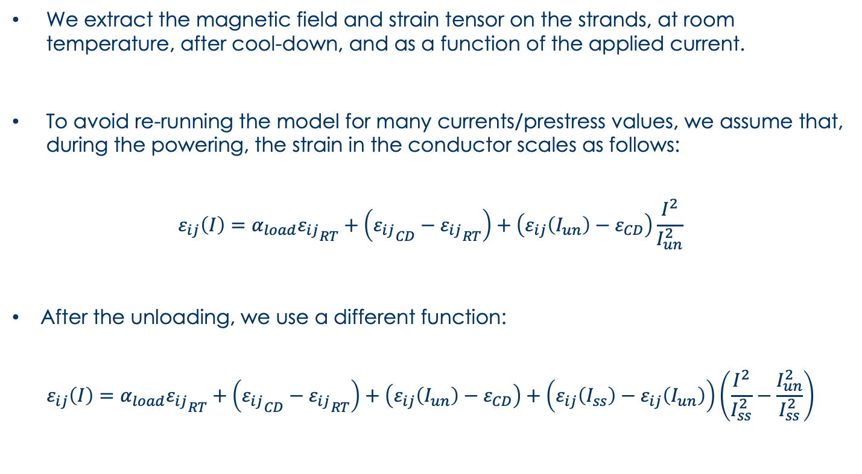
Post-Processing – Strain during ramps
We extract the magnetic field and strain tensor on the strands, at room temperature, after cool-down, and as a function of the applied current.
To avoid re-running the model for many currents/prestress values, we assume that, during the powering, the strain in the conductor scales as follows:
$$ε_{ij}\left(I\right)=α_{load}{ε_{ij}}_{RT}+\left({ε_{ij}}_{CD}−{ε_{ij}}_{RT}\right)+\left(ε_{ij}\left(I_{un}\right)−ε_{CD}\right)\frac{I^{2}}{I_{un}^{2}}$$
After the unloading, we use a different function:
$$ε_{ij}\left(I\right)=α_{load}{ε_{ij}}_{RT}+\left({ε_{ij}}_{CD}−{ε_{ij}}_{RT}\right)+\left(ε_{ij}\left(I_{un}\right)−ε_{CD}\right)+\left(ε_{ij}\left(I_{ss}\right)−ε_{ij}\left(I_{un}\right)\right)\left(\frac{I^{2}}{I_{ss}^{2}}−\frac{I_{un}^{2}}{I_{ss}^{2}}\right)$$

Slide 31
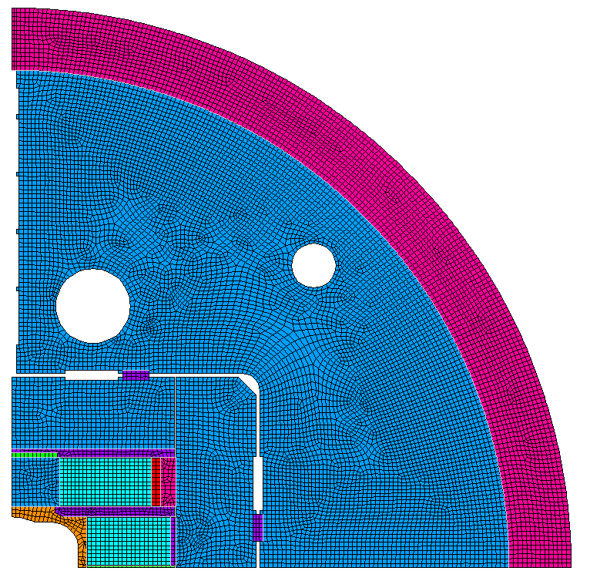
FE Block Model

Slide 32

Critical Current Reduction
Critical current with no strain (left) and with the strain (right)
    ‘Short sample’ current for each strand, computed from measurements
    Critical current for each strand, computing the strain as a function of current and field
As expected, the pole is unloaded at these currents, and the strain effect negligible
A reduction appears in the ‘low-field’ region
    Even with the strain effect, the current limit is still dictated by the pole region

Slide 33

Load Line with Ic Reduction
The strain function of the high field strand does not see a lot of variation after 15 T
The low field strand strain function sees a continuous reduction as the e.m. forces increase
Therefore, the updated short sample on the pole turns is ~unchanged, while the LF region sees a significant reduction
    This will also reduce the temperature margin (work in progress) in these locations
Low field
region
High field
region

Slide 34
Load Line with Ic Reduction

