Slide 1
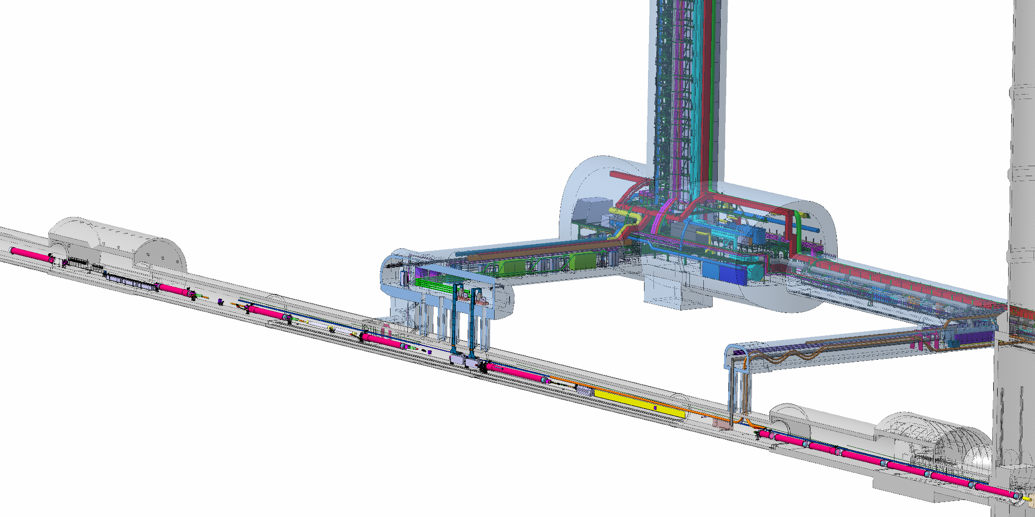
HL-LHC Project status: rebaseline, C&SR2 and other reviews
Lucio Rossi
Project Leader
LARP CM28 Joint HiLumi/LARP meeting
Napa, CA, 24 April 2017

Slide 2
Goal of High Luminosity LHC (HL-LHC) as fixed in November 2010
From FP7 HiLumi LHC Design Study application
The main objective of HiLumi LHC Design Study is to determine a hardware configuration and a set of beam parameters that will allow the LHC to reach the following targets:
A peak luminosity of L_{peak} = 5×10³⁴ cm⁻²s⁻¹ with levelling, allowing:
An integrated luminosity of 250 fb⁻¹ per year, enabling the goal of L_{int} = 3000 fb⁻¹ twelve years after the upgrade.
This luminosity is more than ten times the luminosity reach of the first 10 years of the LHC lifetime.
Ultimate performance established 2015-2016: with same hardware
and same beam parameters: use of engineering margins:
L_{peak ult} ≅ 7.5 10³⁴ cm⁻²s⁻¹ and Ultimate Integrated L_{int ult} ∼ 4000 fb⁻¹
LHC should not be the limit, would Physics require more…
Notes:
Ultimate : the pink box must substitute/overlap the blue one

Slide 3
Technical limits to lumi increase (Machine & Experiments)
Notes:
Change with new one

Slide 4
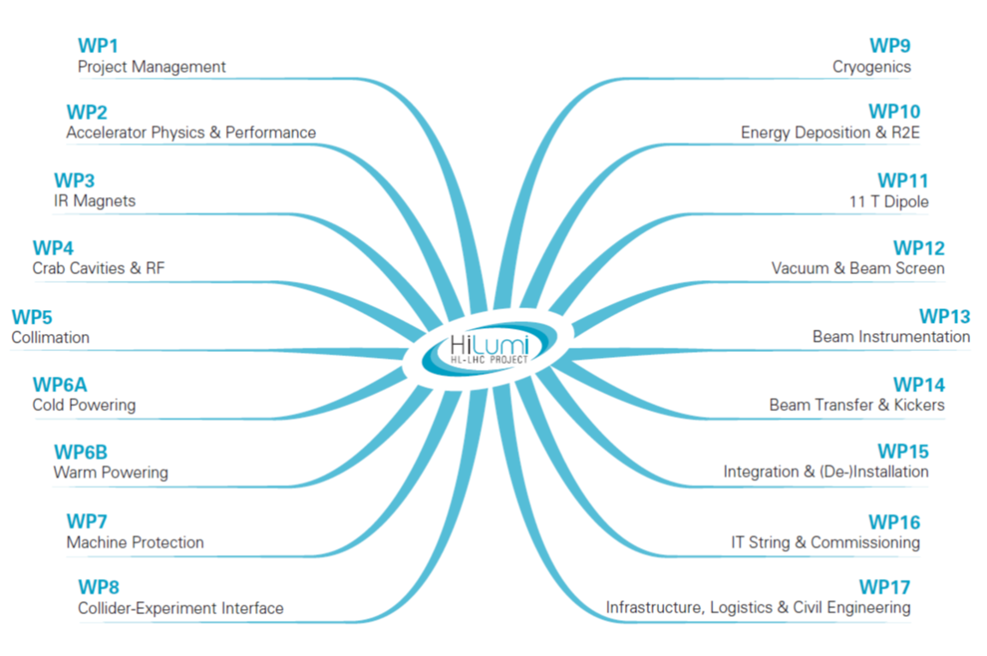
Project structure
Mr Circuit
Notes:
WP structure: similar but not perfect copy of group: MSC is in 3 WPs; same STI…; Cryo has its own WP but also task in WP3 and WP4 (SPS).
PUT CO as possible new WP

Slide 5
Notes:
Take out Consolidation form Beniamino charge

Slide 6
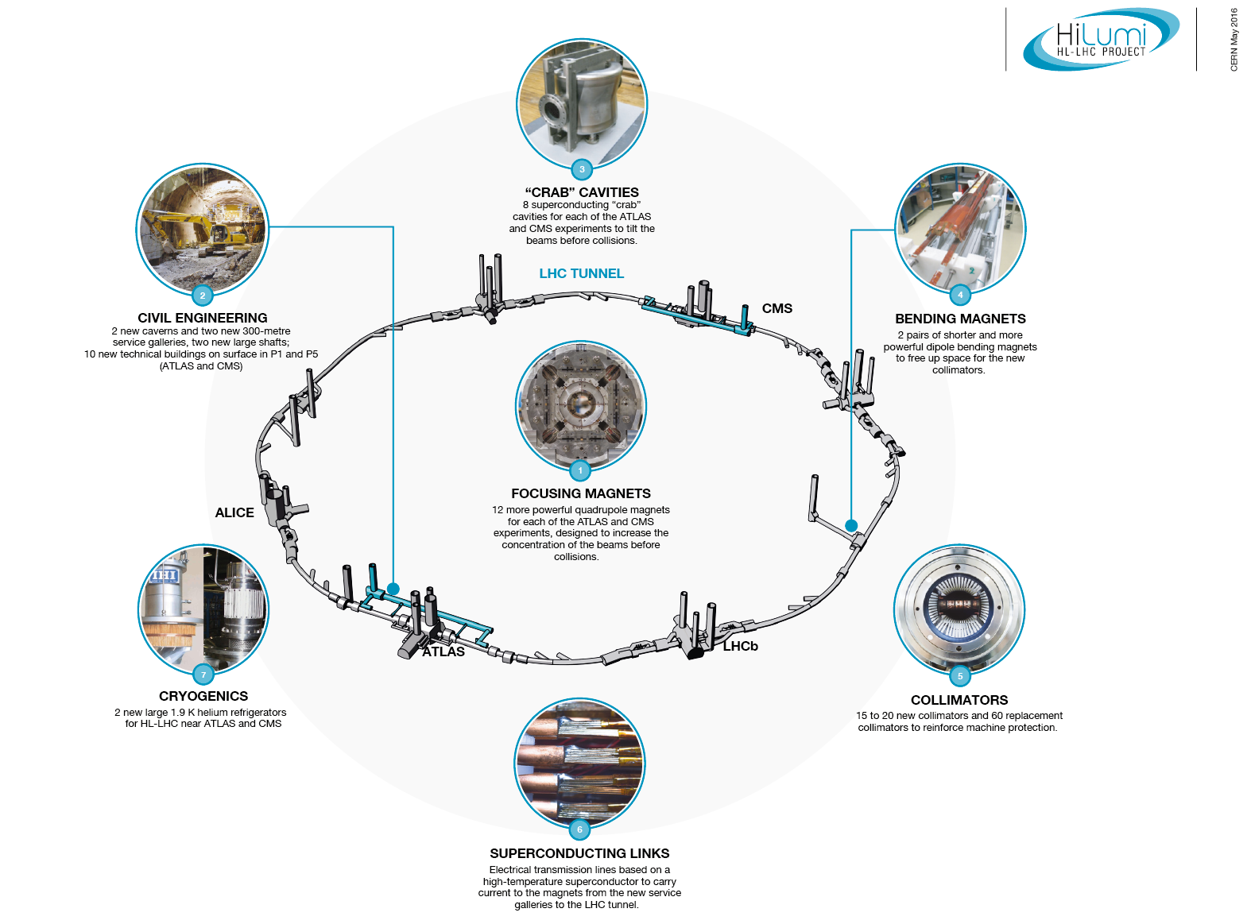
HiLumi LHC landmarks

Slide 7
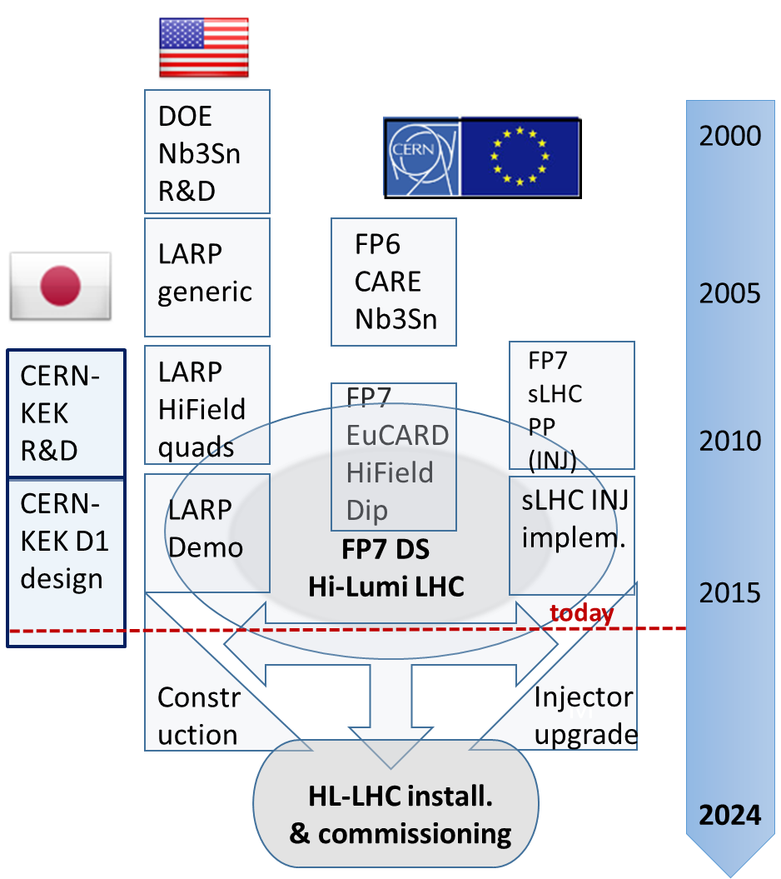
HiLumi & Collaborations: the long route
Beyond FP7:
CEA, INFN. UK
CIEMAT, Uppsala
Canada/Triumf?
China/IHEP?
Russia/BINP?

Slide 8
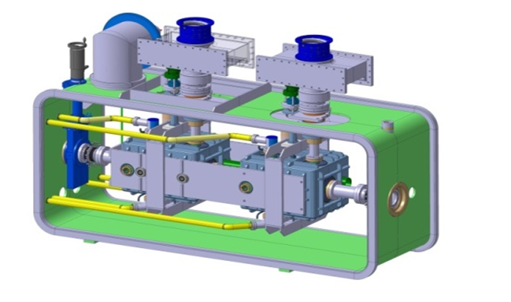
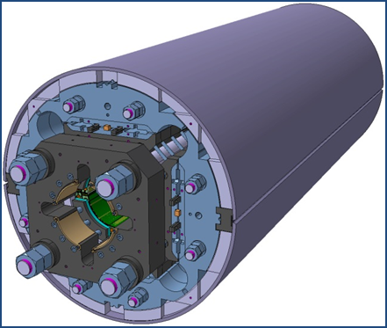
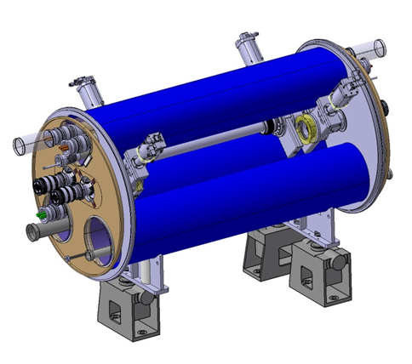
The largest HEP accelerator in construction
ATLAS
CMS
Dispersion Suppressor (DS) in P7
Matching Section (MS)
Interaction Region (ITR)
Modifications
In IP2: new DS collim. in C.Cryost.
In IP7 new DS collimation with 11 T
Change/new lay-out
TAXN
D2
CC
Q4
Correctors
Q5
Q5@1.9K in P6
New collimators
Complete change and new lay-out
TAXS
Q1-Q2a-Q2b-Q3
D1
All correctors
Heavy shielding (W)
Cryogenics, Protection, Interface, Vacuum, Diagnostics, Inj/Extr, Controls, new UG and surface infrastr.
> 1.2 km of LHC !!
Notes:
Put IR1 and IR5 over the grey Martching Section and ITR

Slide 9
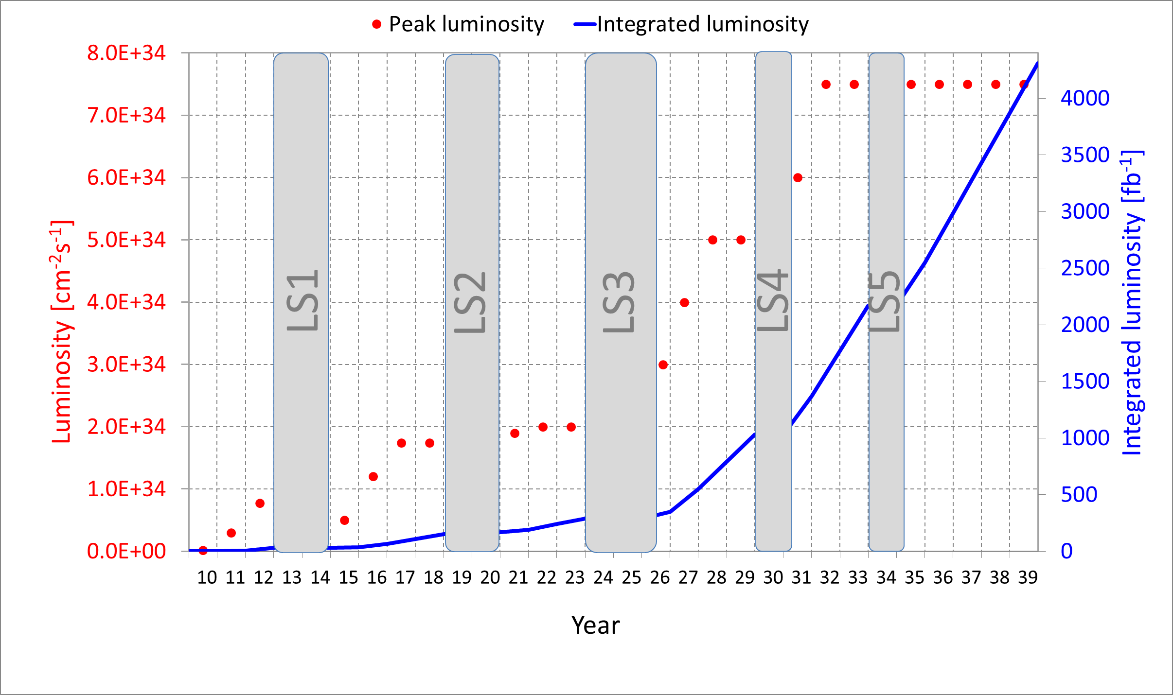
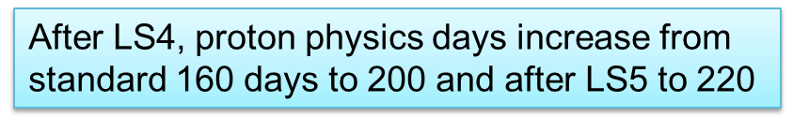
Luminosity profile: ULTIMATE

Slide 10
Rebaseline (triggered by extra cost of C.E.)
May 2016-Aug 2016
Crab Cavity: reduction of CC system from 4 to 2 cavities/beam-side ⇒ 16 CCs + 4 spares (vs. 32+8 previous). Impact on perfomance: visible but not dramatic – see later
    Revision of the power/CC and volume of the power conv.
Shifting installation of new MQYY as new Q4 (90 mm aperture) to after HL-LHC end (i.e. in LS4), if needed. HL will start using as Q4 the present 70 mm MQY modified for 1.9 K operation.
    Negligible impact on baseline performance (also because of CC reduction), but more pronounced for flat beams.
QPS for the MQXF maintaining all systems (QH_{out}, Qh_{inn}, (Qh_{intr}), and CLIQ) however with a minimal configuration with redundancy.
Notes:
Picture Paolo tunnel

Slide 11
Rebaseline
Reduction of TCLD (DS collimator in P7 from 4 to 2 per side). This entails no 11 T for LS3 (while keeping it for LS2). Reduction of TCTPM from 16+3 to 8+2
New integration layout for miniTAN of P8, more integrated with D2
New cryobox lay-out (with external distribution box)
Improved LSS vacuum layout (WP12) and partial manpower internalization via resource optimization.
Minimal reduction of Beam Diagnostics (WP13)
Modularity optimization of TCDS (WP14)
Powering the IPQs (Q6-Q5-Q4) from the RR, via existing EPCs, DFBLs (and links?)...
Notes:
Picture Paolo tunnel

Slide 12
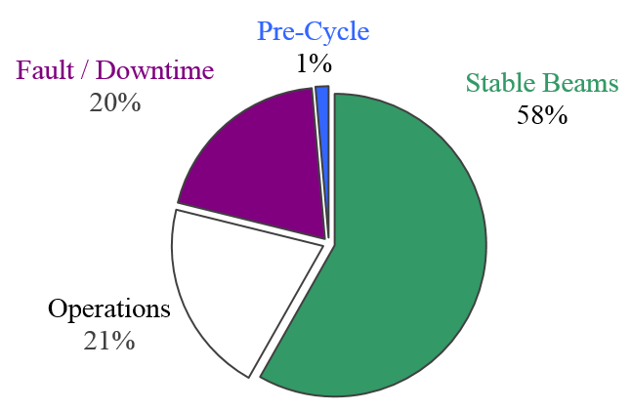
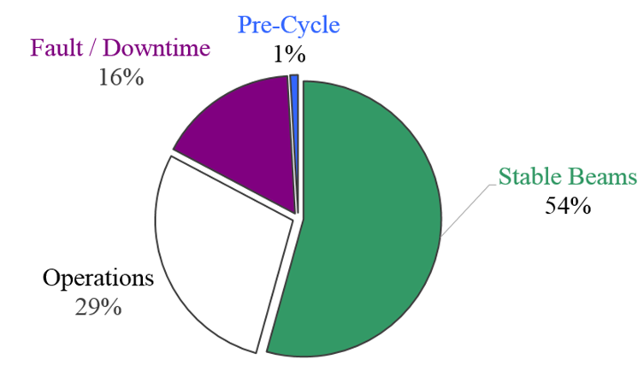
Rebaseline
Saving on the technical WPs: about 76 MCHF
Saving induced on WP17 : about 45 MCHF
Performance remains the same if:
  Efficiency increase to 50% for nominal
  Efficiency increase to 58% for ultimate…
Rebaseline approved by CERN manag. on 3 Aug ‘16 and endorsed by C&SR2 in Oct 2016 for COST-Planning.
TS1 – TS2
LHC 2016
TS2 – TS3

Slide 13
CMAC Jan 2017: technical examination of the rebaseline: Findings
All scope changes resulting from the re-baseline of Sept 2016 have been included in the physics model of the HL-LHC.
The performance of the present collimation scheme, while meeting baseline requirements, is challenged. Adding two hollow beam lenses are considered and would remove significant risk.
Electron cloud induced heat loads present one of the biggest challenges to the HL-LHC performance. Varying heat load by sector, various scrubbing techniques and a variety of other mitigation measures are under investigation.
Long range Beam-Beam compensation with wires is crucial.
Flat beam performance is essential to understand to mitigate risk of crab cavity performance.

Slide 14
CMAC Jan 2017: technical examination of the rebaseline: recommendations
The scope changes from the re-baseline in September of 2016, while increasing risks and narrowing margins in several areas, do not affect the ability to achieve the ultimate Luminosity goal of HL-LHC as far as we can assess.
Uncertainties in predicting the halo require large design margins for the collimators. Hollow electron lenses, a proven technology, can further mitigate this risk. The HL-LHC team should further evaluate (calculate and measure) the necessity and management might want to consider inclusion into the baseline, even at increased cost.
If electron cloud has a strong negative impact on emittance growth at injection only techniques which will allow e-cloud reduction will resolve the problem.

Slide 15
CMAC Jan 2017: technical examination of the rebaseline: recommendations - 2
Execute all necessary experiments, with and without beam, during CY17 which can impact major activities for LS2.
Define a strategy to either intrinsically reduce the heat load stemming from the e-cloud. In case that is not possible, evaluate the maximum possible heat load that could be cooled in the shield and develop a strategy to do that.
Charge question 5: Review the HL-LHC ability to reach the initial (unchanged) performance goals of 3000 fb-1 integrated luminosity (respectively 4000 fb-1 for the ultimate configuration), a mean pile-up of 140 (ultimate 200) and around 250 fb-1/year, taking into account decisions taken during the 2016 re-baselining exercise of the HL-LHC projet: see first statement under comments
  The revised LIU and HL-LHC design after re-baseline in Sept 2016 has been completely integrated and luminosity performance is NOT impacted. Risk in some areas has increased but is acceptable.

Slide 16
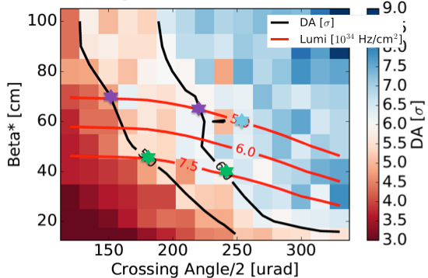
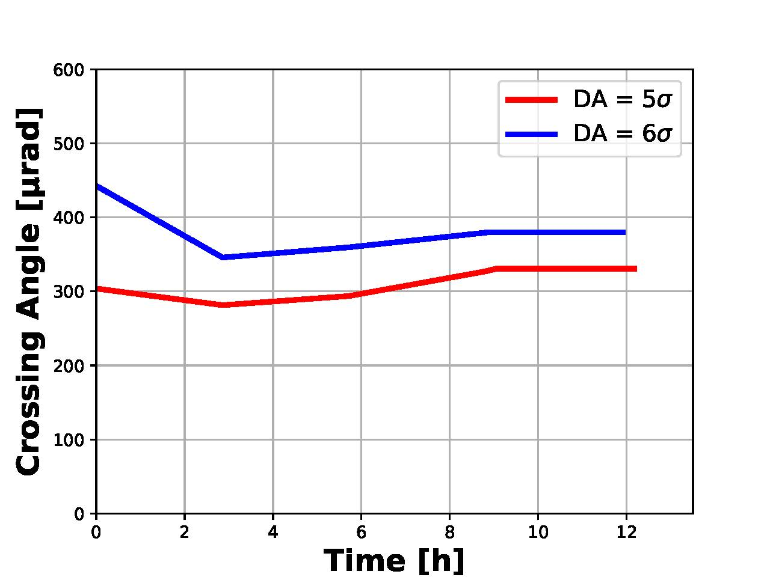
Performance optimization (WP2)
Baseline
Further optimization of the baseline scenario ongoing based on:
  Lessons learned during 2016 run
  Simulation work (with increasing detail) with parametric scans
Experience confirms need to guarantee dynamic aperture of 6 σ (beam sigmas!) with beam-beam to provide enough margin for:
  Minimum working point area with good lifetime to account for bunch-to-bunch tune differences from coherent effects and for impact of field quality
  Beam stabilization (octupoles and chromaticity) ➔ needed based on 2016 experience.
Margin for optimization exists:
  Crossing angle variation at constant DA during β* leveling → increased leveling time → increase in integrated luminosity (1-2 %); reduction of pile up density (10 – 15 %)
  Test of crossing angle variation in LHC in 2017
Nominal and ultimate scenario (2.2e11p/bunch).
Optimization
Baseline
N. Karastathis, Y. Papaphilippou, D. Pellegrini

Slide 17
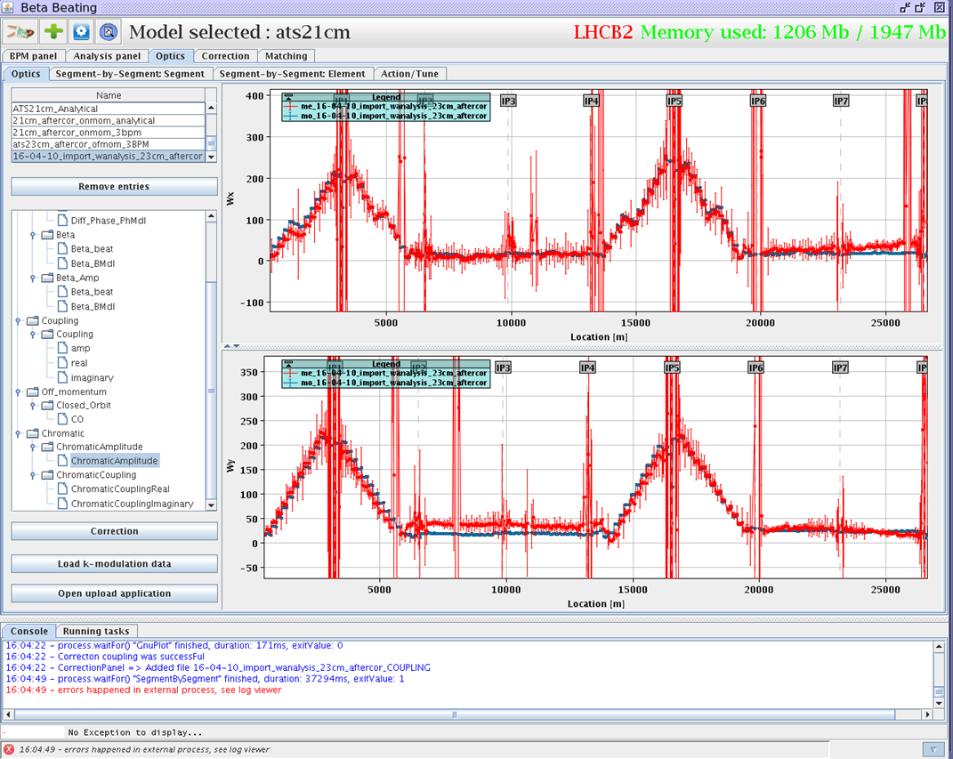
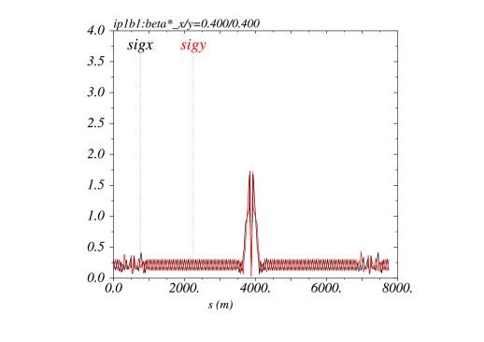
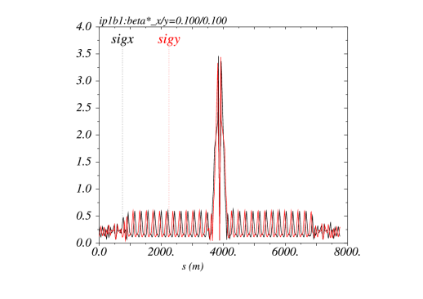
Achromatic Telescopic Squeezing (ATS) scheme
Small β* is limited by aperture but not only: optics matching & flexibility (round and flat optics), chromatic effects (not only Q’), spurious dispersion from X-angle,..
A novel optics scheme was developed to reach un-precedent β* w/o chromatic limit based on a kind of generalized squeeze involving 50% of the ring
(S. Fartoukh)
Recent successful MD in LHC.
We can push to β∗ ∼ 12 cm in HL-LHC (margins)
ATS will be anticipated this year in LHC!
Notes:
Slide 18 2015

Slide 18
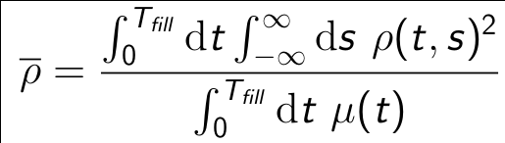
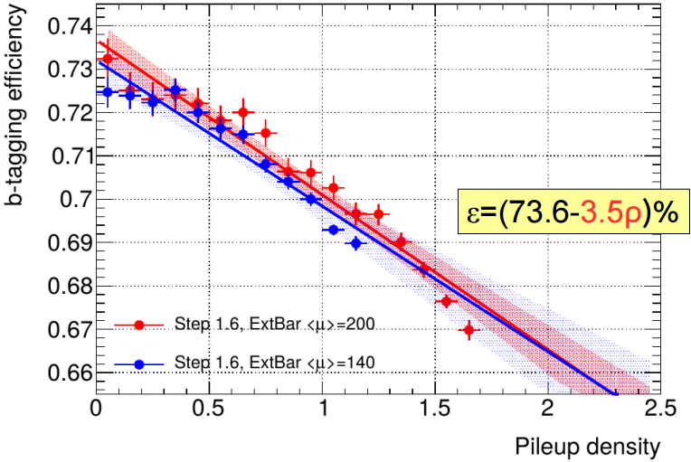
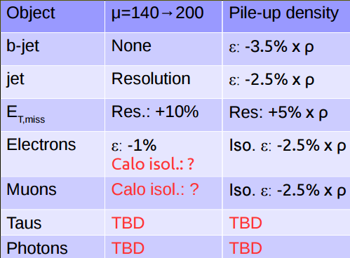
Experimental Data Quality WG
1st year!
Chairs: R. Tomas, B. Petersen, P. Azzi. Secretary: I. Efthymiopoulos
Effective pile-up density:
allows to estimate detector performance after parameterizing with sims:

Slide 19
Experimental Data Quality WG
The ultimate scenario with pile-up=200 has a penalty from pile-up density of only about 5%
The alternative with smallest effective pile-up density is 200 MHz (bunch length ~15cm). RMS luminous region is ~8cm, which is ok for the detector.
Precision timing is under investigation. It reduces dependency on pile-up density. CMS is considering the upgrade in the entire detector and ATLAS only in the forward region.

Slide 20
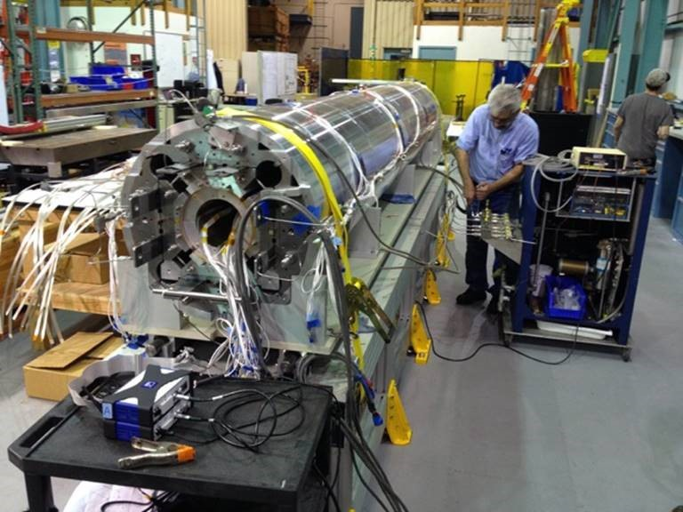
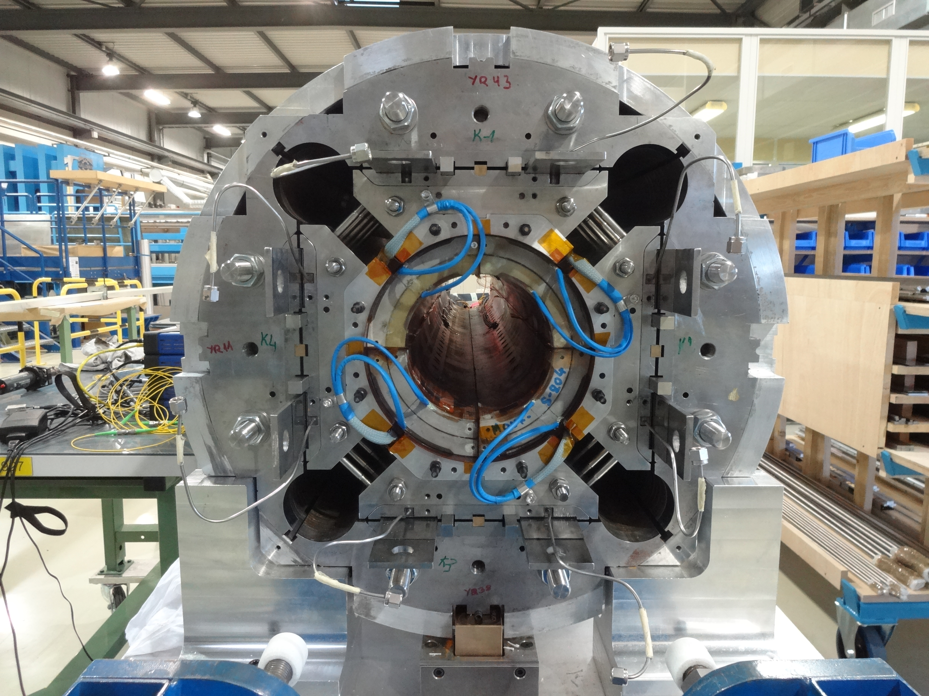
Inner Triplet and Nb3Sn technology
Procurement of the Nb3Sn is satisfactory: the issue causing six months delay has been solved – with minimal effect: good reactivity of thee company. Now production is well advancing, big order are being made. Price is under control.
The very good results of QXFS01 need to be repeated!
4 m-long first prototype by LARP
Finally a long magnet under test!
3rd model, QXFS05 near to be tested at CERN: first of PIT conductor (NB: old layout). 2nd QXF, QXFS03, to be understood and retested after re-assembly
Excellent progress but too slow!!!

Slide 21
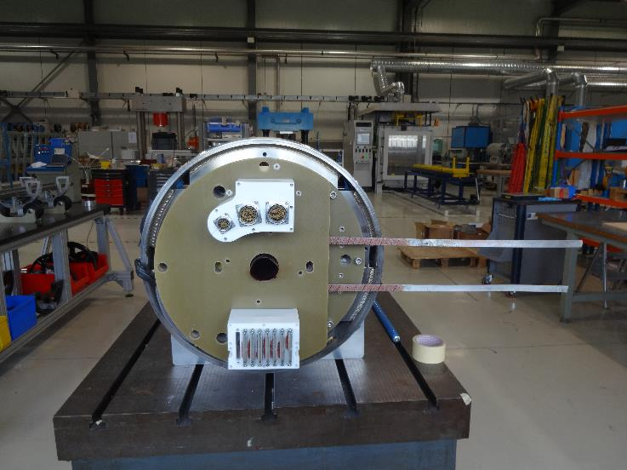
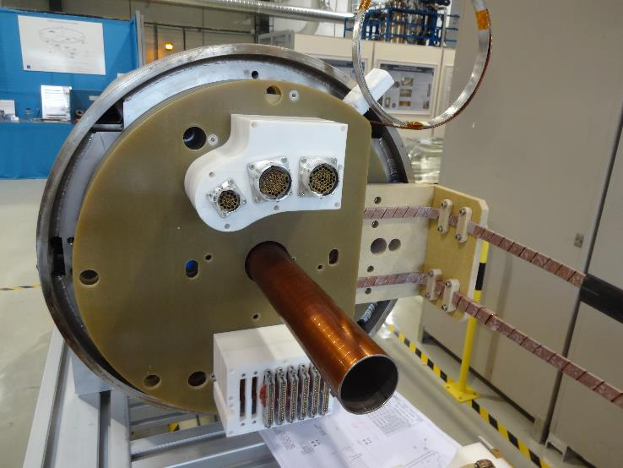
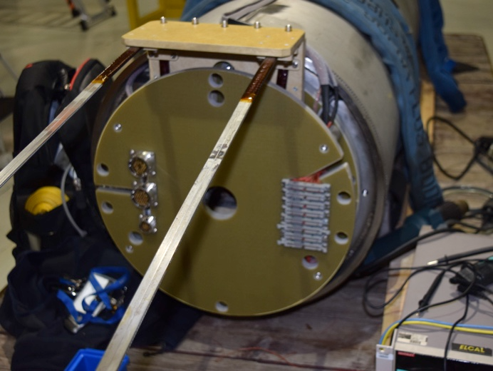
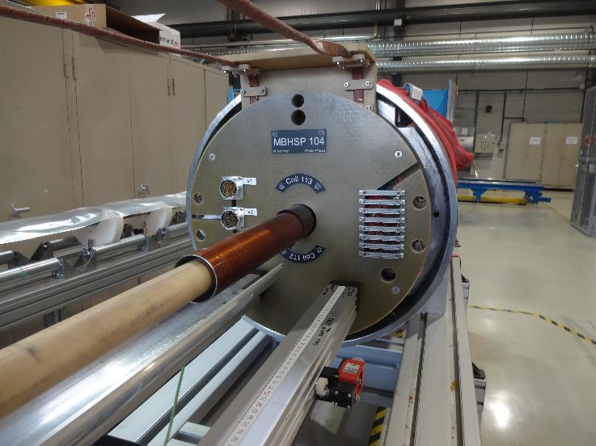
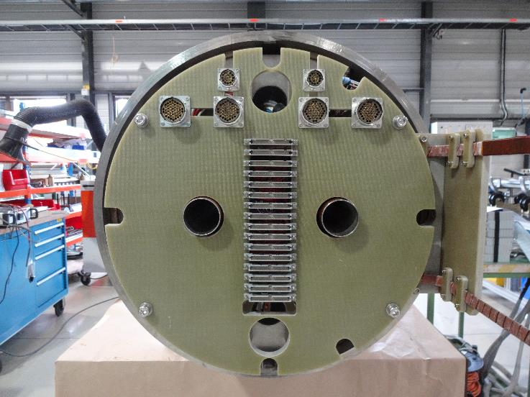
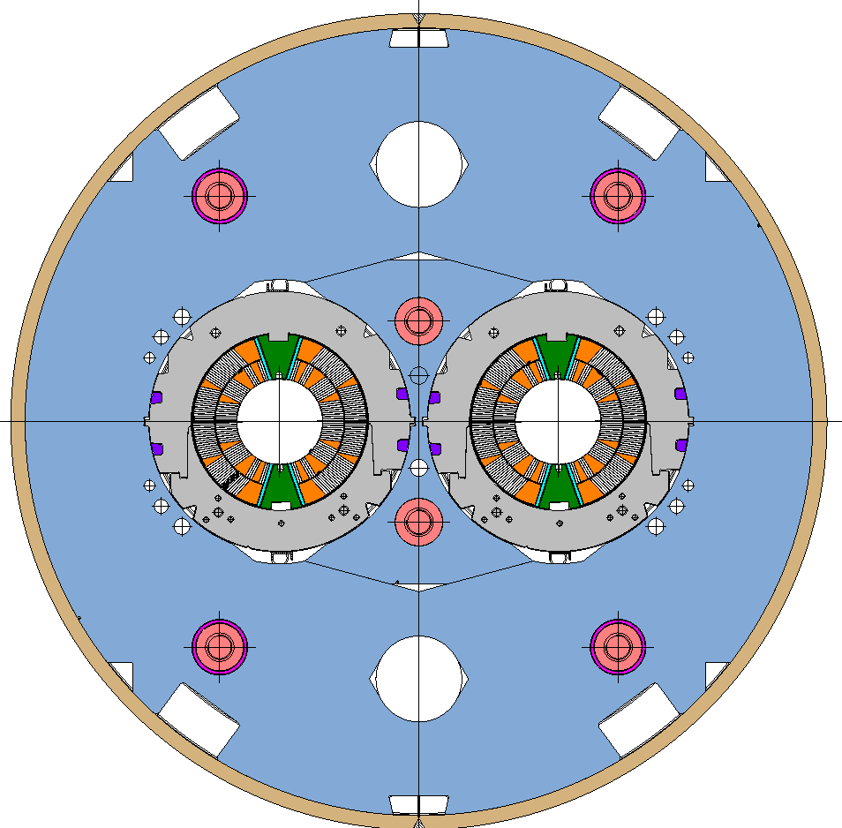
Nb3Sn technology: 11 T dipole (2 m models)
SP101
SP102
SP103
SP104
DP101
DP102 in construction (tests scheduled in Summer 2017)
SP106 in construction (interlayer QH)
Procurement of components for X-Section 2 initiated
SP105, not shown

Slide 22
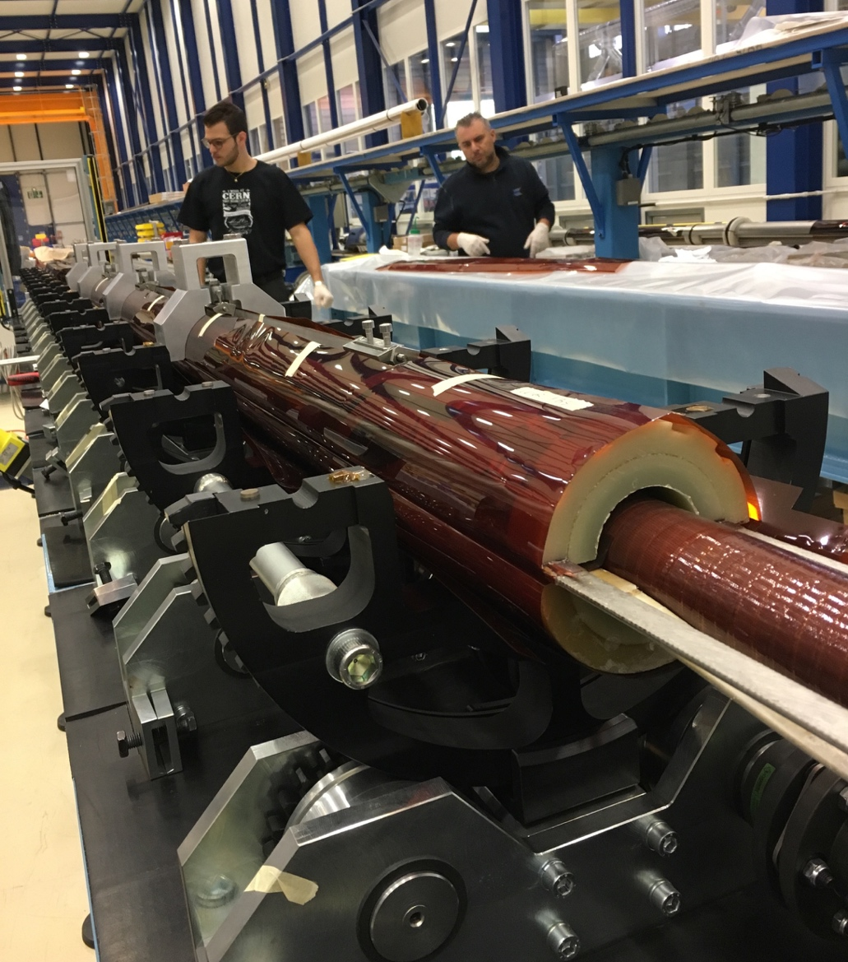
Nb3Sn technology: 11 T dipole 5.5 m prototype
Coil CR004 ready available
Coil CR005 impregnated this week (W17)
Coil CR006 reacted, preparation for transfer in impregnation mould on-going
Coil CR007 in winding / curing (1st layer cured in W17)
Collared coil with low grade CR001 & CR002 made with Fuji paper, now being reconstructed (collaring in W17).
It will me measured for geometry and field quality.
Two ½ yokes ready available
Shells available
Magnet on test bench in SM18 in the end of 2017

Slide 23
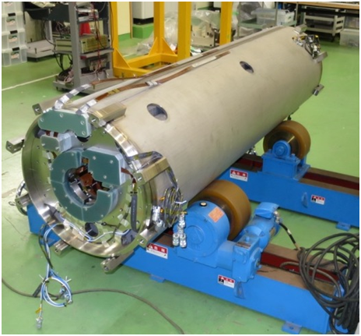
Milestone achievement for HiLumi:
D1 (dipole separation) for IP1 and IP5
It’s a resistive magnet in present LHC: will be superconducting in HL-LHC
Large aperture dipole (150 mm) operating at about 6 T
First test in red, not conform to expectation (long training, ultimate value not reached)
Re-assembled with corrections (+prestress): outstanding performance
Collaboration CERN-KEK
Manufactured and test at KEK

Slide 24

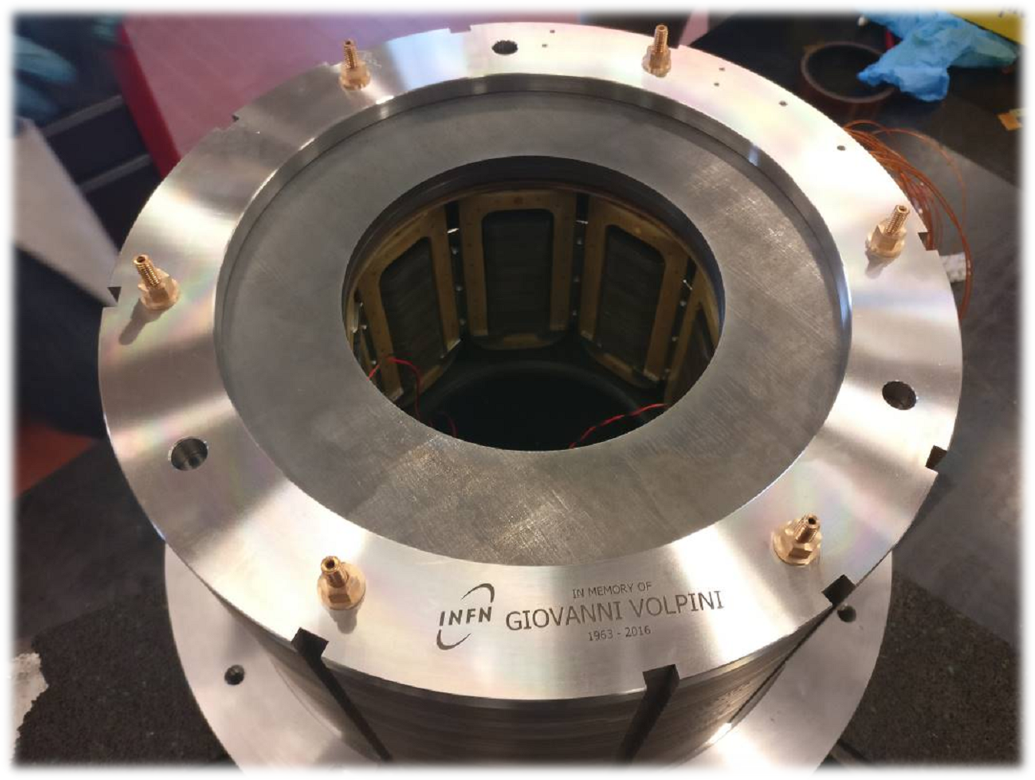
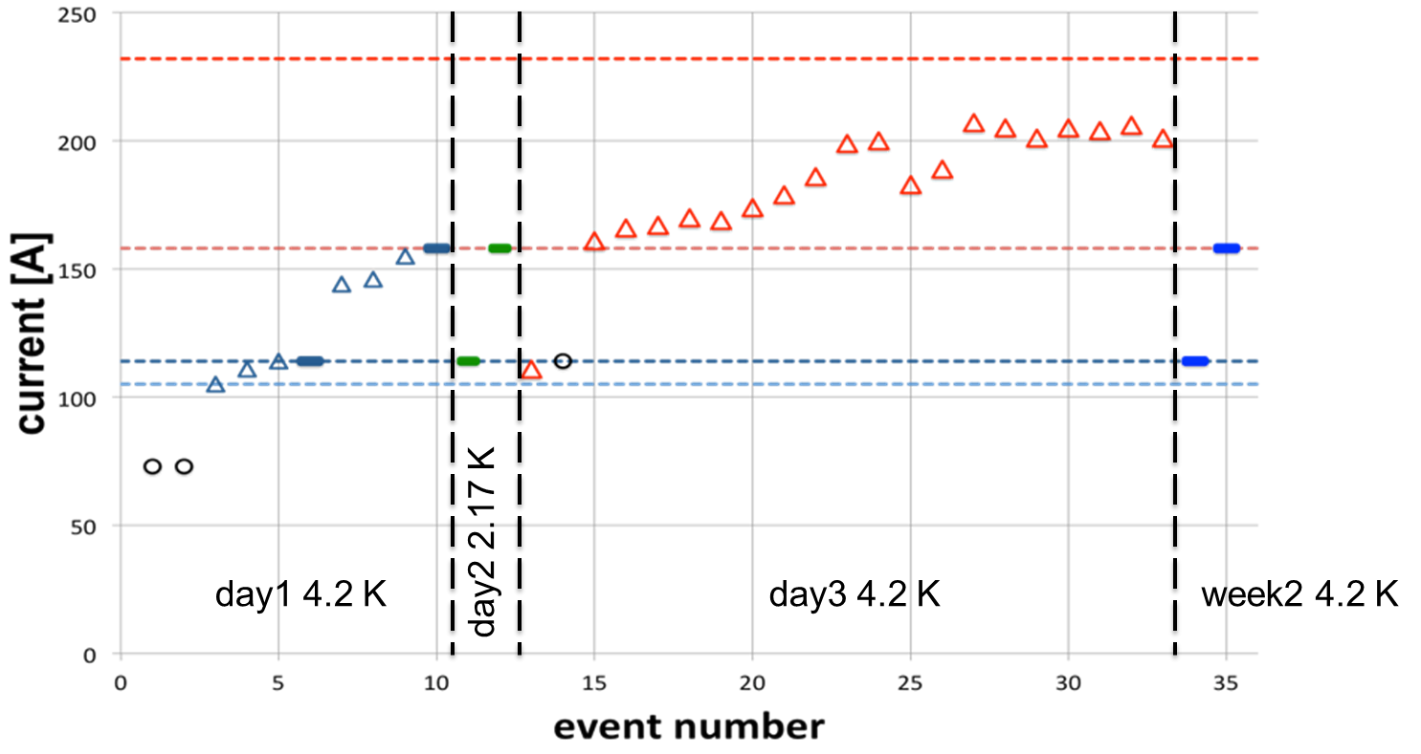
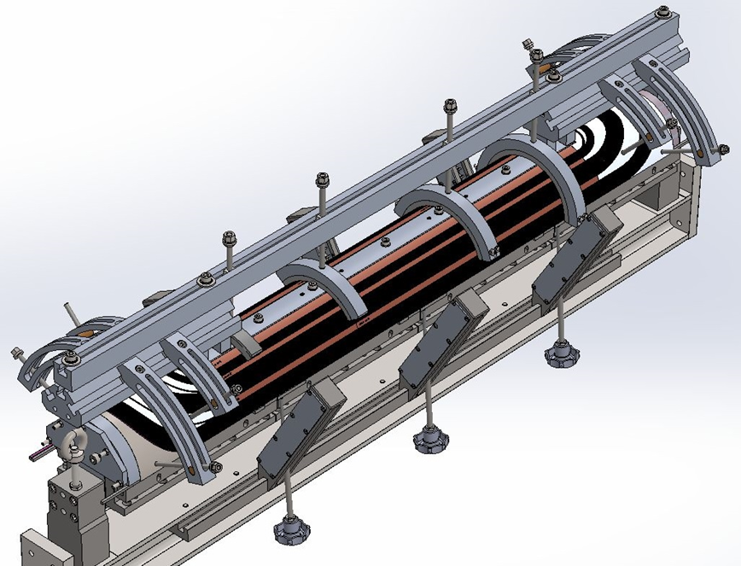
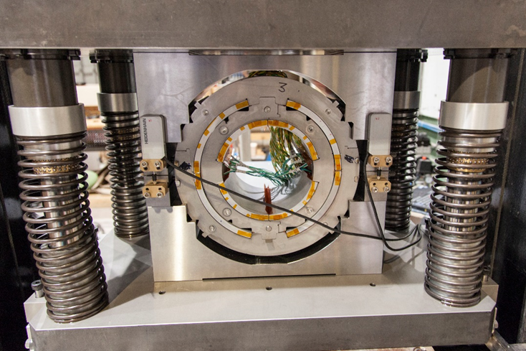

Progress in corrector magnets
Superferric Octupole @ INFN-LASA -Milano

Slide 25
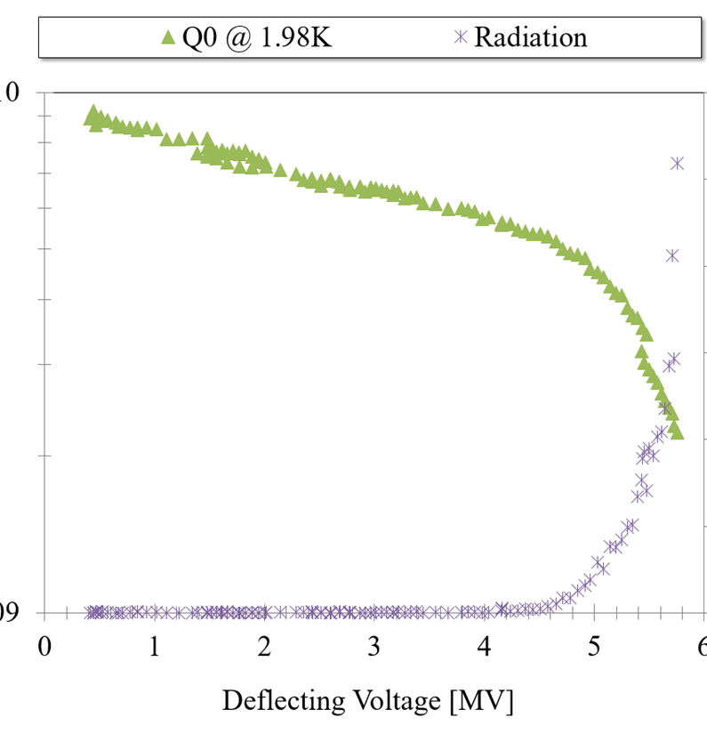
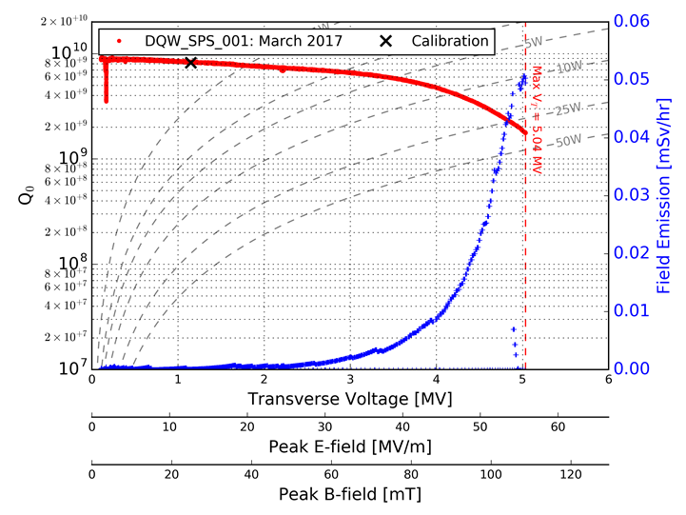


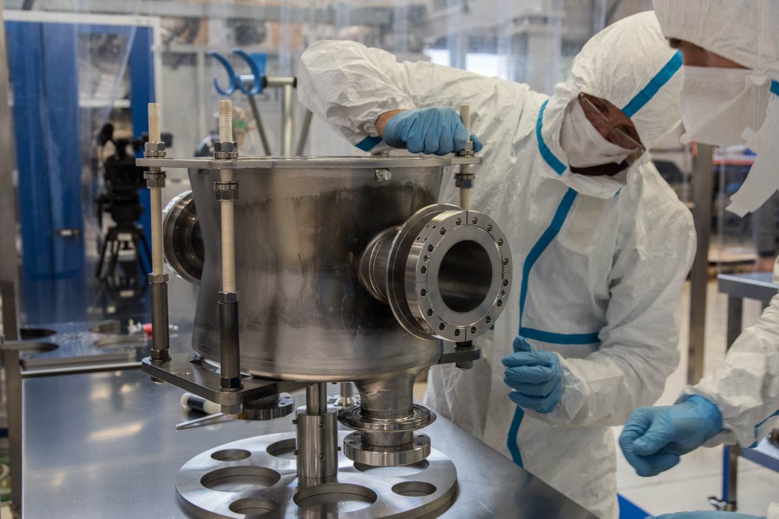
Milestone achievement for HiLumi:
SRF Crab Cavity first prototypes
Operating point
Operating point
CERN DQW
US-LARP DQW
In early 2017 four (naked) Crab Cavities were tested: all went well beyond the operating voltage of 3.4 MV
The US-LARP DQW (tested at JLab) went up to 5.4 MV
The CERN DQW (test at SM18) went up to 5.04 MV
The US-LARP RFD (tested at Jlab) reached 4.03 MV.
This is an outstanding result for the first prototypes.
Our schedule of CC testing in the SPS in 2018 is confirmed

Slide 26
CC International Review in April 2016:
Go AHEAD!
We recognize that both cavity designs (DQW and RFD) are mature, as demonstrated with initial Proof-of-Principle (PoP) prototypes and later with evolved prototypes for the SPS/LHC installation.
We concur with the plan to keep the CC development with two complementary designs, and agree with the concept of the CM design allowing common interfaces to HPRF and Cryogenics system.
The RFD design and prototype results are further impressive. The LARP development has been successful. The U.S. Accelerator Upgrade Project (AUP) scope is defined and a sound conceptual design exists. The AUP is in a good position to seek CD-1 approval through the expected CD-1 review in 2017
We strongly support the bunker CM test at SM18, planned with associated cryogenics qualification and integrated RF system checks to be done before the SPS test.
… (many suggestion on balance between SM18 and SPS tests)

Slide 27
WP5 – Collimation
First low impedance collimator prototype is inside the LHC!
E- lens: gun test at
CERN
and FNAL
Low impedance collimators with three different surfaces.
This autumn : technical review of the system with cost and integrability.

Slide 28
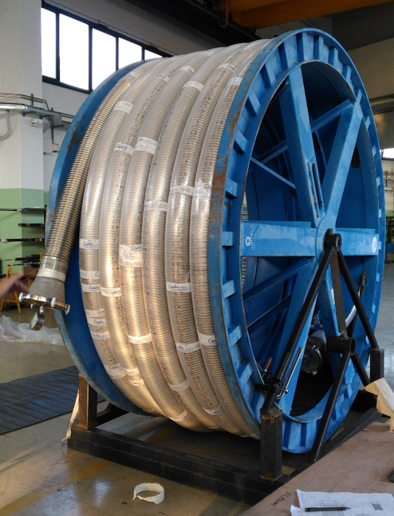
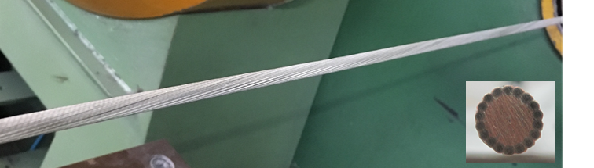
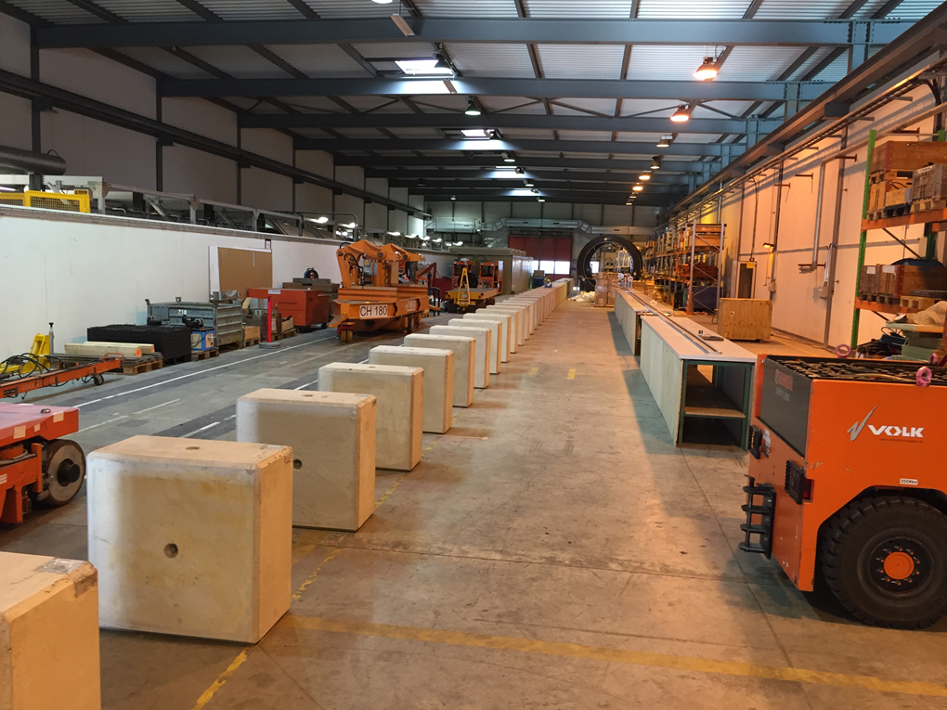
WP6 - Powering
First cable unit (6 kA)
Fir 60 m long flexible cryostat
Area in B.927 were the cable will be assembled into cryostat
Test with dummy cable in June, with SC cable in October
International Review in July

Slide 29
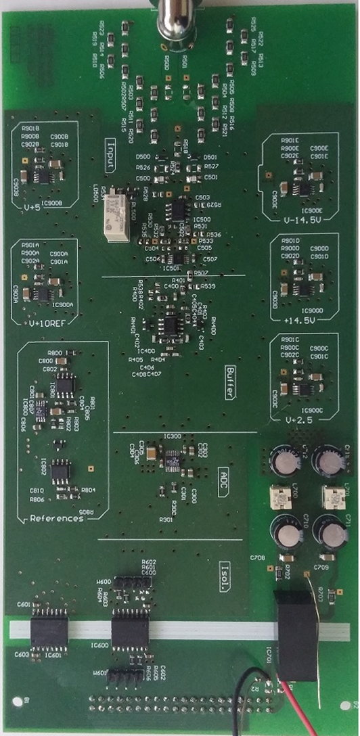
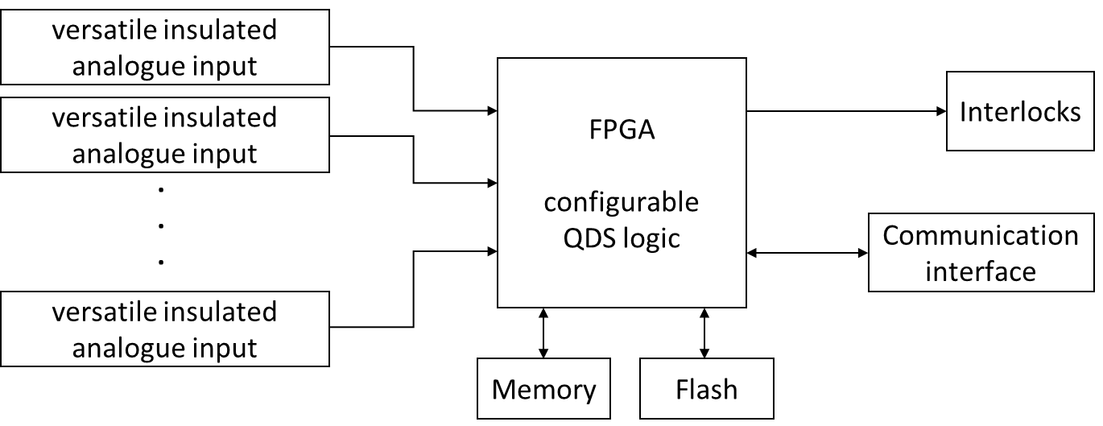
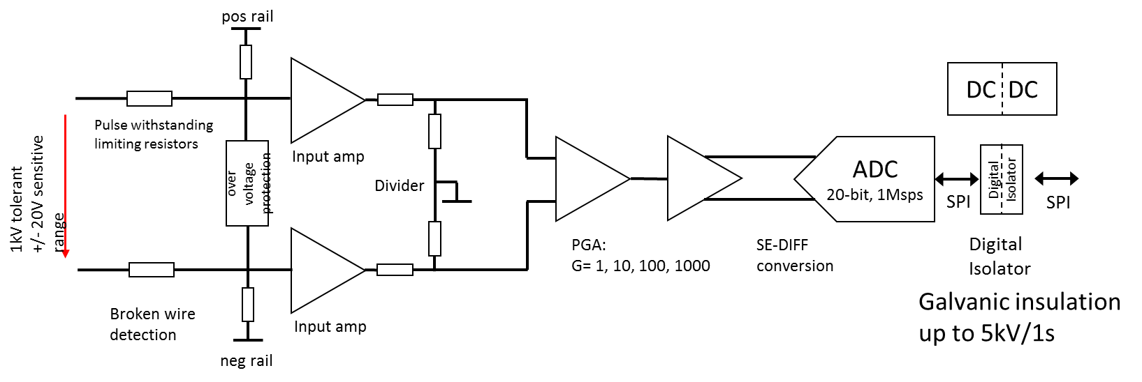
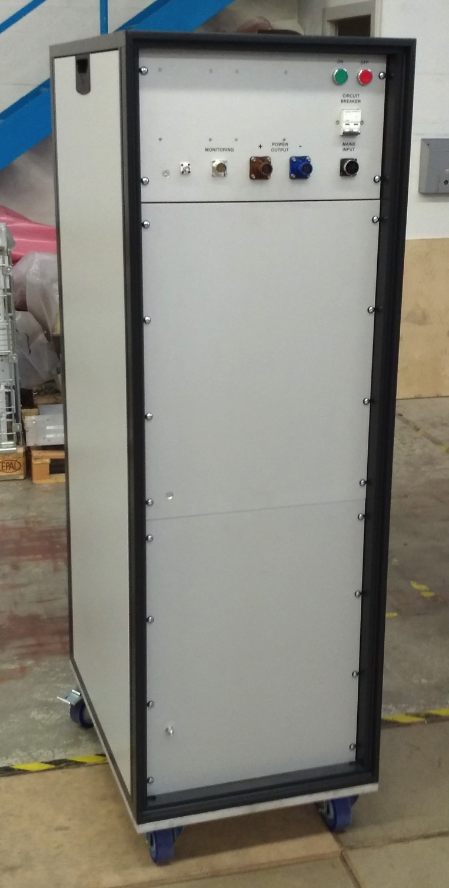
Quench Detection and Data Acquisition System
Prototype development advancing well :
  3 channel QDS prototype installed and operational in SM18.
  Measurements performed during 11T short model tests.
  Test results for mitigation of flux jumps promising.
  Full 8 channel prototype expected by Q4.2017.
Energy Extraction and Protection Systems
CLIQ-2 manufacturing
  Three new units completed, with multiple choices of capacitance between 10 and 50 mF (step 10 mF), and voltage from 0 to 1000 V (step 100 V).
CLIQ-3 specification for industrial version
  In final stage of preparation, call for tender will follow.
Energy Extraction systems’ development
  Design of an 1 kA IGBT-based EE model system → completed at 60%.
  Signed Addendum with Łodz for the development and manufacturing of a 2 kA prototype EE system based vacuum electro-mechanical switches → expected Q1.2018.

Slide 30
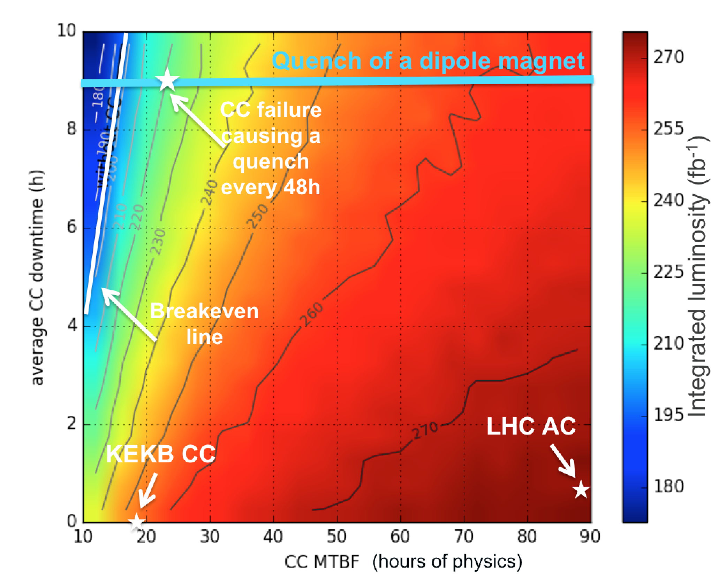
Availability studies
Simulate expected integrated luminosity achievable during HL-LHC runs with Monte Carlo models based on LHC experience.
  Required crab cavity system availability depending on failure modes and effects.
Improved failure tracking with Accelerator Fault Tracking (AFT) operational → feed-forward from current LHC.
  Extension to injector complex as of 2017.
  Monitoring of injector performance in view of HL-LHC parameters (e.g. LINAC 4 reliability run)
Development of system fault trees with system experts.
  Develop fault trees for technical infrastructure systems (collaboration with TIOC).

Slide 31
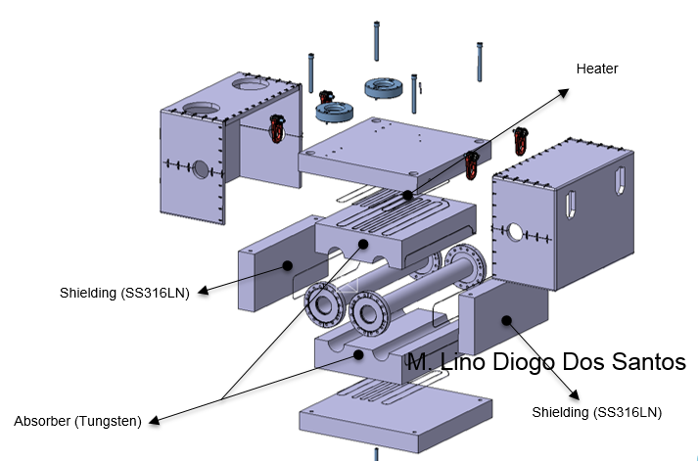
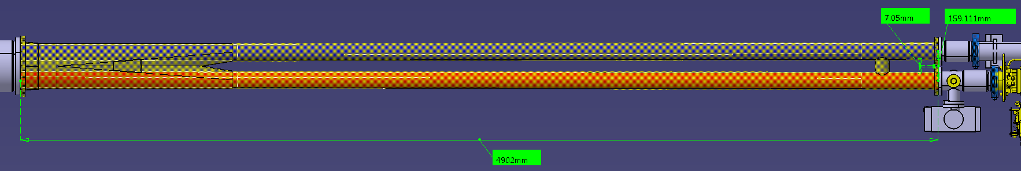
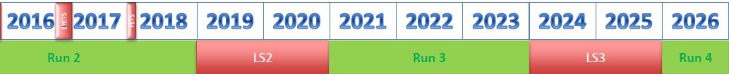
WP8 work progress: TAXN, TANB
Layout for protecting protecting P8 defined.
TANB design close to completion.
Y-chamber specification (P1 & P5) close to completion.
Collaboration with BINP being stablished (TAXN& TAXS)
P. Santos Diaz
TANB
TAXS, TAXN

Slide 32
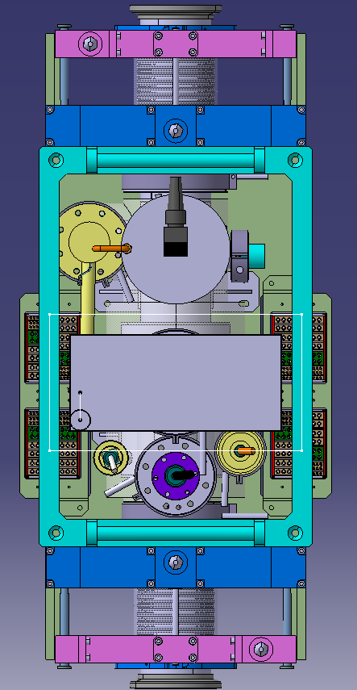
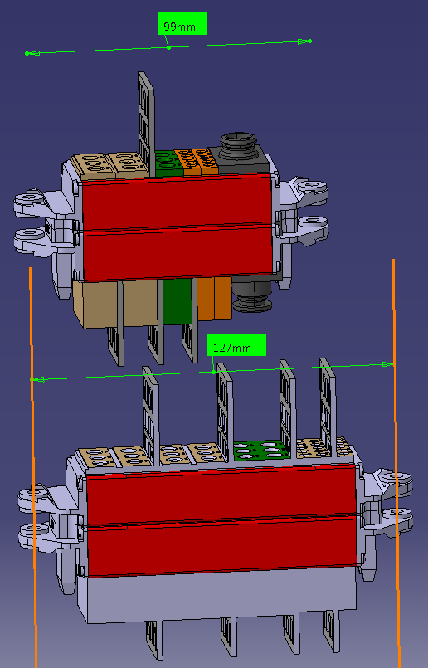
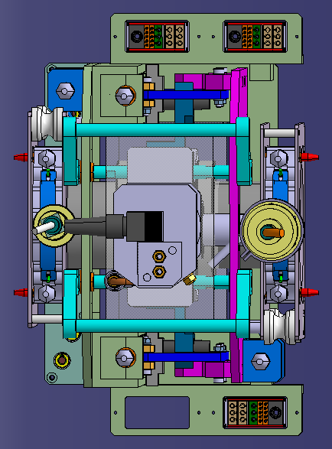
WP8 work progress: VAX
Vertical handling of 3 independent modules guided by columns. Services defined & integrated.Tendering automatic plug-in connectors.
L. Krzkempek, J. Perez Espinos, M. Lazzaroni, D. Brethoux

Slide 33




Development of beam screens with shielding
Beam screen and cold bore mechanical design completed:
Q2 – D1 beam screen assembly
Q1 beam screen / cold bore assembly
  Thermal mechanical models and simulations done:
Illustration of mechanical behaviour during a quench
Heat transfer from the tungsten absorbers to the cryogenic cooling tube
  Impact of CLIQ discharge under study.

Slide 34




Development of beam screens with shielding
  Characterisation tests and prototyping:
    Thermal tests ongoing with cryolab to assess the heat transfer performance:
      Heat transfer from the absorbers to the cryogenic cooling tube successfully done on short prototype
      Overall thermal behaviour to be tested on a 80 cm long cold bore/beam screen prototypes in Mid 2017
    First quench test foreseen in Summer 2017 with MQXF model
    CB prototypes produced, tolerances fixed end 2016
    First beam screen prototype produced, new beam screen prototypes being produced, tolerances to be frozen by end 2017/beginning 2018
Samples for heat transfer assessment
10 m long CB prototype
Beam screen/ cold bore prototype

Slide 35

Shape Memory Alloys (SMA) Connectors for UHV chambers
Development of new UHV connectors for room temperature vacuum system:
    Proof of concept done
    Design optimisation and implementation in accelerator environment in 2017 - 2019
Current system
New concept
Typical ConFlat flange
Proof of concept of SMA connectors for Ultra High Vacuum (UHV) chambers.
Mounting by heating above 100 °C
Leak Rate < 10⁻¹⁰ mbar·l·s⁻¹ at room temperature
Dismounting by cooling down to -50°C
    A compact, leak tight and easily mountable\dismountable connection system
    Possibility to use in high demanding areas (e.g. collimator areas, machine/detector interface)
    Possibility of remote controlling\activation

Slide 36


Preparing for LS2 equipment installation: detailed integration analysis started
11 T dipoles and TCLD installation at IP 7
TANB installation at IP 8

Slide 37


Working on feasibility for installation of equipment not still in HL baseline as the Hollow electron lenses
Distance from IP4: 42809 mm
Ventilation door
ADT
V.C Supports
HEL
D3
And of course a lot of work for the baseline!
DFB

Slide 38

WP17 Status
WP17.1: Civil engineering
  Preliminary design completed in December 2016
  Tendering design and contractual documents in progress with the objective to issue the Invitation to Tenders by end of July 2017.
  The adjudication of two contracts (1 for Point 1 and 1 for Point 5) foreseen in March 2018.

Slide 39
WP17 Status
WP17.2: Electrical distribution
  Rerouting of existing buried electrical networks at Point 1 done during the YETS’16-17
  Value-Engineering Review to be organized by end 2017
Existing electrical networks

Slide 40

WP17 Status
WP17.3: Cooling and ventilation
  International Value-Engineering Review Scheduled on 14-15 March 2017
  International Review Panel: Giovanni Dell Orco (ITER, Chair), Peter Röllig (ILK Dresden), Ugo Rotundo (INFN), Maurice Ball (FNAL) and Jiri Nožička (Czech Technical University in Prague)
    The panel agrees on the main design criteria according to the standard.
    The panel also acknowledges the validity of the modular design between P1 and P5

Slide 41

Preparing Industry for construction…
I. Bejar Alonso
About 240 participants, More than 120 form Industry!

Slide 42





The Inner Triplet region with in-kinds
Connection to LHC (UL)
Service gallery (UR)
SC Links
Q2a
Q1
TAXS
Q2b
CP
Q3
DFX
D1
DFM

Slide 43


The MS region with in-kinds
UA gallery
Service cavern
(BBLR)
Q4
Crab cavities
D2
Collimators
TAXN

Slide 44
Urgent actions in CERN-US collaboratins for HiLumi
Other in-kind contributions to HL-LHC magnets have not yet been approved and can endanger the overall schedule. It was not clear to the committee how risks and costs are shared between CERN and the contributor in each case. It is important that the project develop a “Plan B” for each case with clear decision milestones.
The committee recognizes and endorses the strategic and risk mitigation strategy of using two different suppliers for Nb3Sn wire.
Our scope (also in THIS LARP meeting): to help securing contribution through management actions but also by having a good and detailed agreement on deliverables with specifications.
Works hand in hands for procurement of conductors and whatever else is possible
To clarify the planning: if CERN receives all too late is difficult to avoid schedule of HL-LHC installation
C&SR2

Slide 45
Thanks to WPLs and other for providing material
Thanks to the many people that are working on the project

