Slide 1
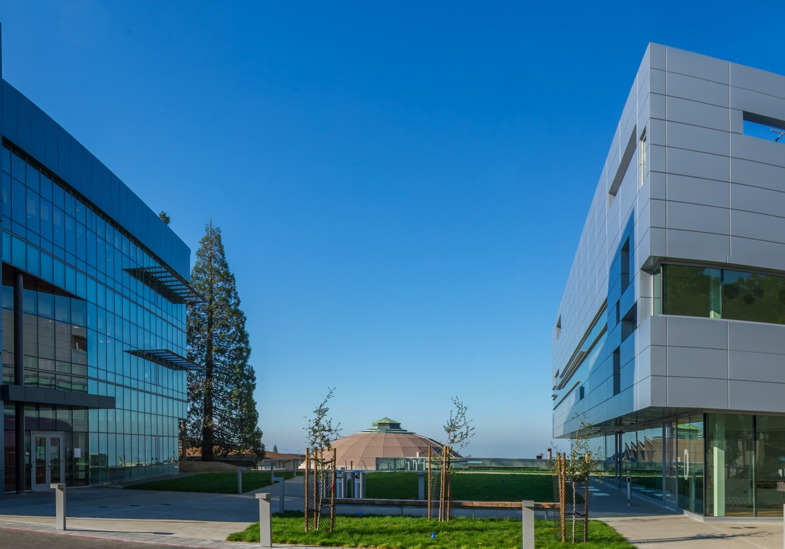
Welcome
Lawrence Berkeley National Laboratory
Joint LARP CM28/HiLumi Meeting
April 24-26, 2017
James Symons
Associate Laboratory Director, Physical Sciences
,

Slide 2
Lawrence’s Successful Legacy of Team Science
Ernest O. Lawrence founded Berkeley Lab in 1931
– the first of the National Labs –
and pioneered the
“team science” model

Slide 3
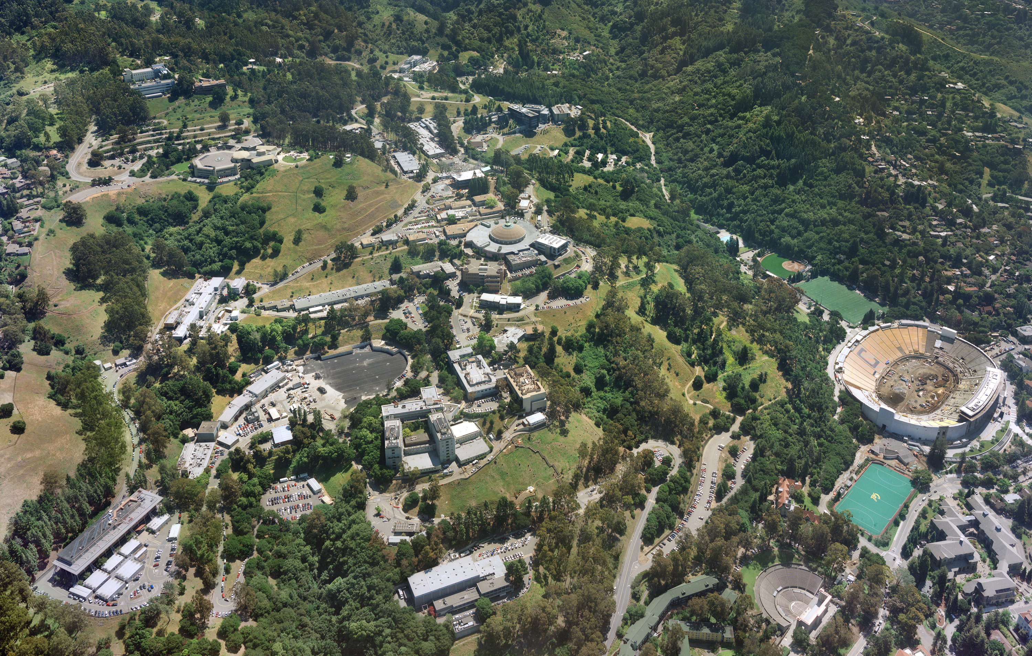

Team Science at
Lawrence Berkeley National Laboratory
Managed and operated by UC for the U.S. Department of Energy
232 University of California faculty on staff at LBNL
1805 Scientists and Engineers, ~$800M/year Budget
486 Postdocs, 263 Graduate Students
63 members of the National Academy of Sciences
(~3% of the Academy)
18 members of the National Academy of Engineering,

Slide 4
Berkeley Lab Organization

Slide 5
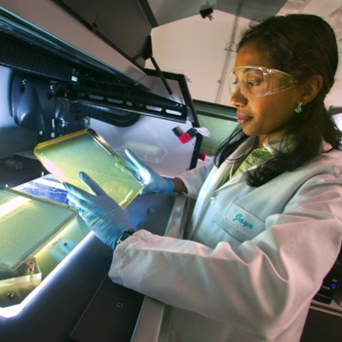
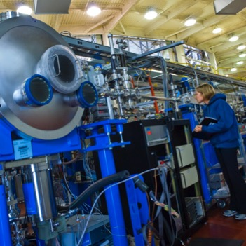
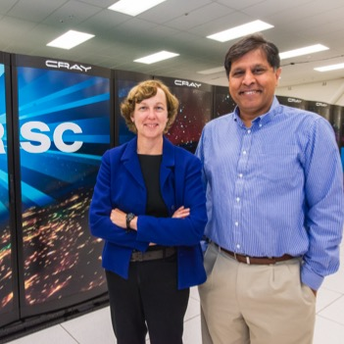
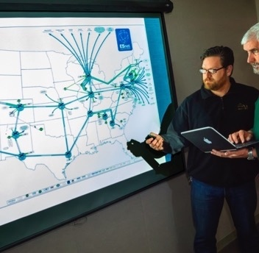
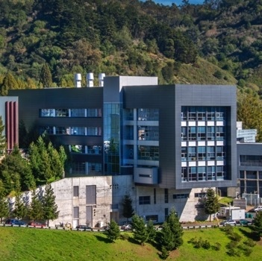
Berkeley Lab welcomes 10,000 Visiting Scientists Each Year to its National User Facilities
1,000 Users
2,443 Users
5,608 Users
The Joint Genome Institute
The Advanced Light Source
NERSC
240 Petabytes/yr.
616 Users
Energy Sciences Network
The Molecular Foundry

Slide 6
HiLumi-LHC AUP Project
The HL-LHC AUP project is a high priority for LBNL
Significant upgrades are being made to the Assembly Areas in preparation for quadrupole fabrication
We are proud to be part of a great team (FNAL, BNL, CERN,…)
Confident in the ability of the HL-LHC AUP collaboration to address any challenges and deliver for the LHC.

Slide 7
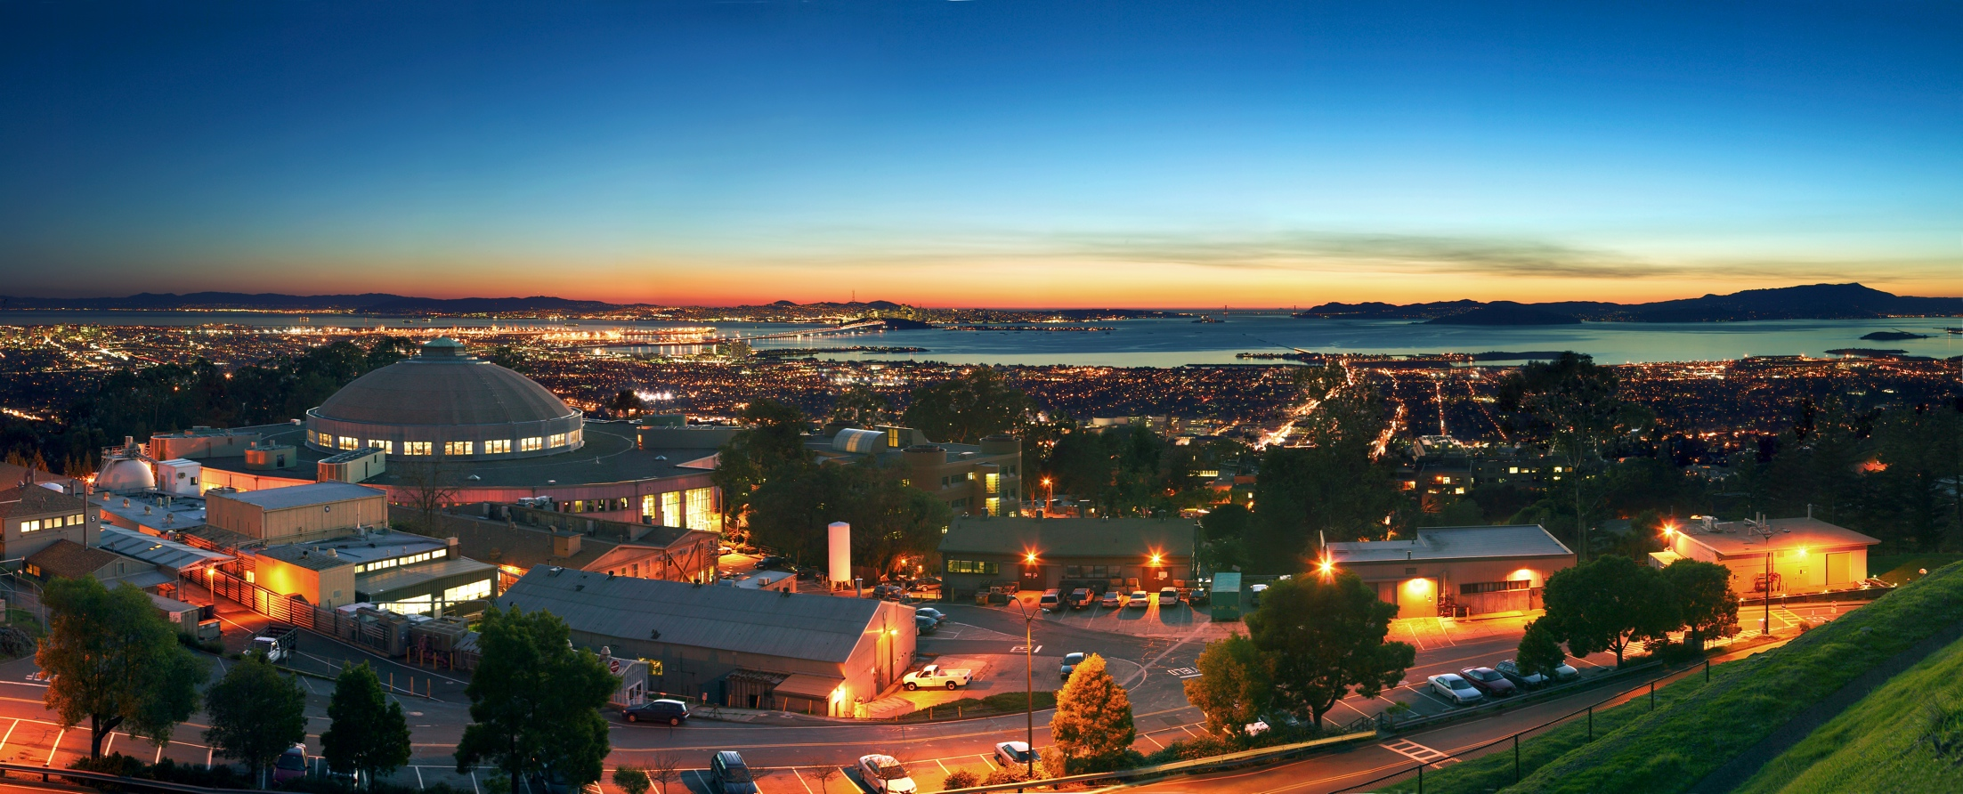
Thank You

