Slide 1
Status of the LHC
O. Brüning
With input from the Chamonix and Evian workshops from 2016 and 2017
and material from Mike Lamont
Joint LARP CM28 Collaboration meeting, Napa CA, April 26th, 2017

Slide 2
LHC Status: Outline
Operation in 2015:
Activities during LS1
Startup in 2015
Operation in 2016:
Status after YETS
Main achievements and performance milestones in 2016
Operation in 2017:
Status after EYETS
Plans for 2017
Training towards operation @ 7TeV:
Results from S34 and S45 training before EYETS 2016/2017

Slide 3
Operation in 2015
Main Goals and choices for 2015 and changes wrt RunI:
Magnet retraining after LS1
Beam energy increase to 6.5 TeV (from 4 TeV)
Change to operation with 25ns (from 50ns) ➔ 2244 bunches
  ➔ Operation with relaxed β∗ and large x-angle: 0.8m / 290μrad
Exploring of limits @ 6.5 TeV
Main observations from 2015:
Efficient re-training of magnets after LS1
LHC can operate efficiently with 25ns (30% SB and 70% AV)
Good transmission and emittance preservation through cycle
e-cloud scrubbing relatively slow ➔ change scrubbing strategy
Strong conditioning of UFOs
ULO
    ➔ Reached half of nominal luminosity

Slide 4
Dipoles – Re-training in tunnel
About 8x faster (as expected)
Only 1.3x faster
6.5 TeV + margin
Extrapolation to 7 TeV (12 kA) very tricky
Joint LARP CM28 Collaboration meeting, Napa CA, April 26th, 2017 Oliver Brüning CERN

Slide 5
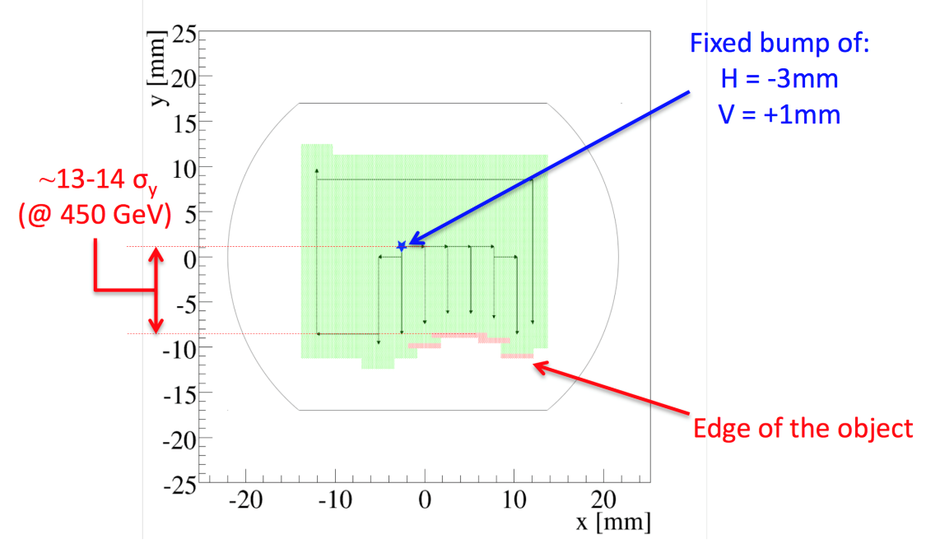
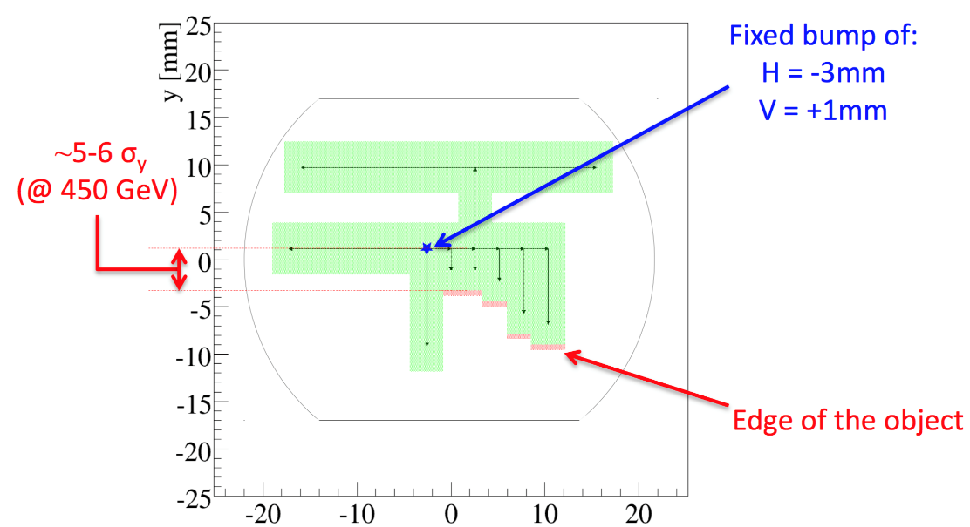
ULO
May 2015
M. Lamont @ 2016 Chamonix Summary
Aperture restriction deep in MB.C15R8.
3 ULO-induced quenches; BLM thresholds around 15R8 have been lowered so as to avoid quenches.
Vertical restriction not constant; horizontal restriction stable.
If the object moves further, there is room for increasing the orbit bump:
  from currently H = -3 mm, V = 1 mm
  we may increase to H = -6 mm, V = 3.5 mm
  and reduce margin to 10 σ in both planes at 450 GeV in the nearby quad.
D. Mirarchi
May 2015
15/11 and 10/12

Slide 6
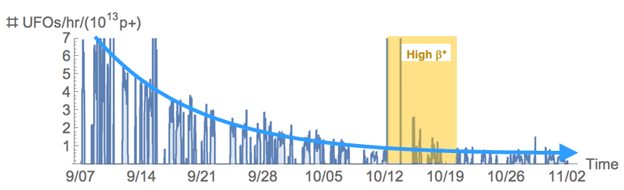
UFOs
Bernhard Auchmann
M. Lamont @ 2016 Chamonix Summary
An encouraging fall in normalized rates during 2015
UFO rates of ~10/h were stable over the last 3 weeks.
End of Conditioning?
BLMTWG proposes to continue to avoid dumping on UFOs as a strategy to maximize availability.
increase the short Running Sums (RS 1-6) by another factor 2, while reducing the longer Running Sums to conservative values.
In short: avoid dumping on UFOs all together as a strategy to maximize availability

Slide 7
Operation in 2016
Main Goals and choices for 2016 :
Intensity ramp-up: 2748 (➔2244) bunches with 1.2 10¹¹ ppb
Operation with squeezed β∗: 0.4m / 370μrad ➔ 280μrad (9.3σ)
Tight collimator settings: TCSG @ 8σ ➔ 7.5σ (Impedance!)
Operation with BCMS beams ➔ high brightness and small ε
Special runs and ion operation
Main observations from 2016:
Efficient operation with BCMS beams!!!
LHC can operate very efficiently with 25ns (> 60% SB)
Week 17 in April: SPS dump, PS power supply and Weasel
  ➔ Limited beam intensity for the rest of the year
Overall excellent machine understanding!
  ➔ Excellent optics model: 1% RMS β-beat, coupling 2 10⁻⁴
  ➔ Exceeded nominal L in June 2016 (1.4 10³⁴cm⁻²s⁻¹ Sept)
  ➔ Overall 49% in SB in spite of April problems
  ➔ Achieved 40fb⁻¹ thanks to high efficiency and BCMS

Slide 8
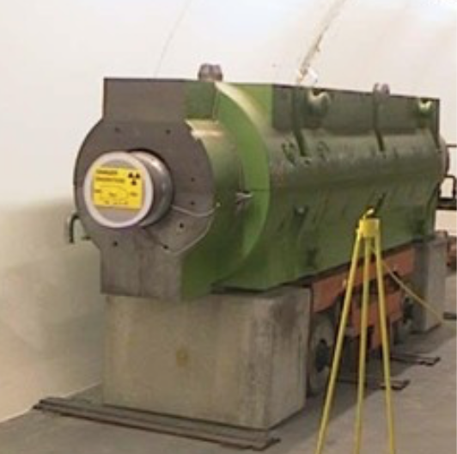
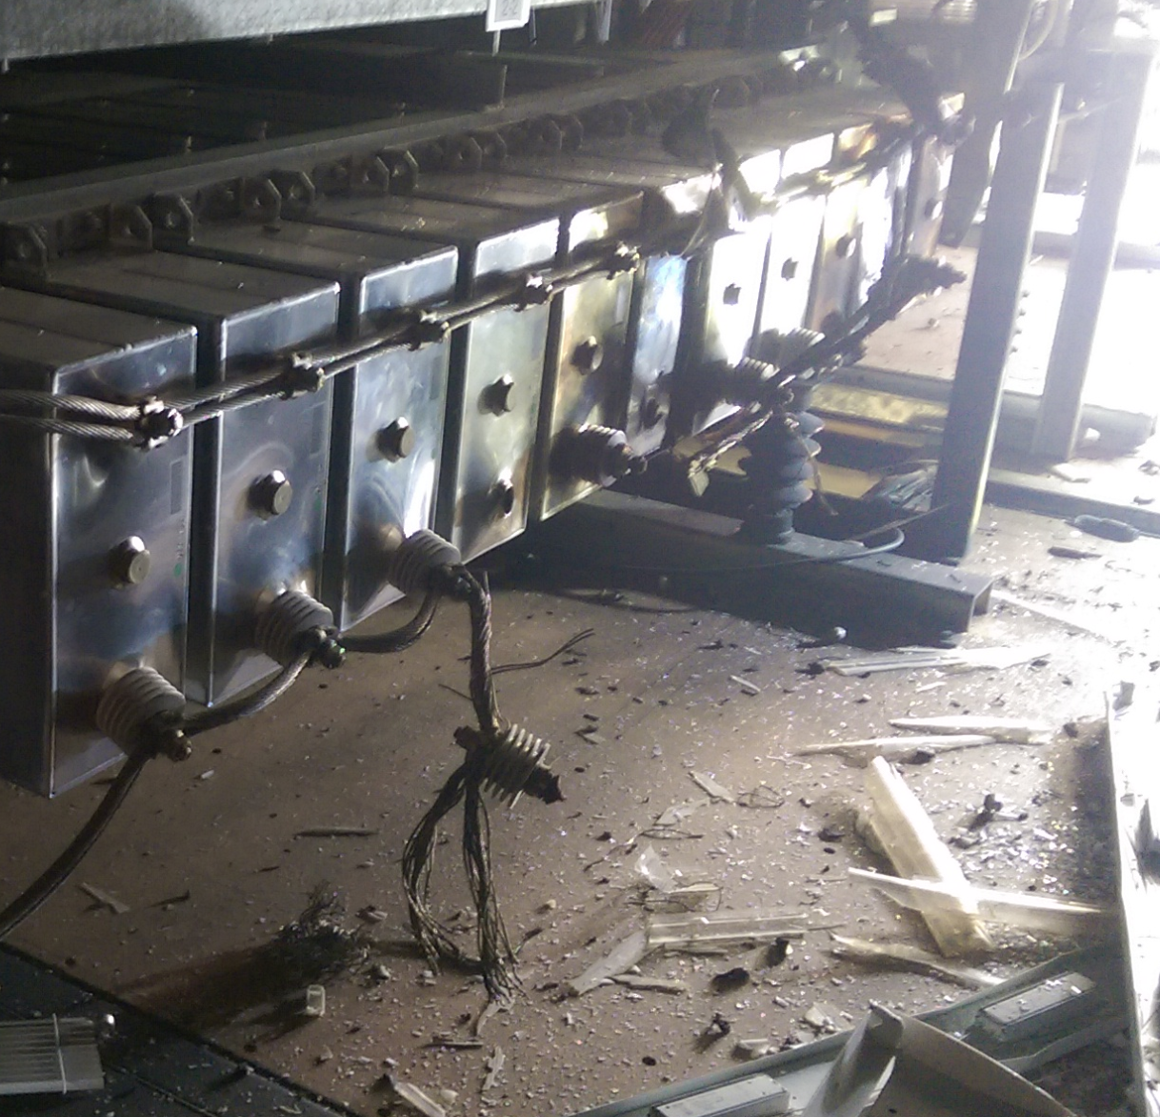
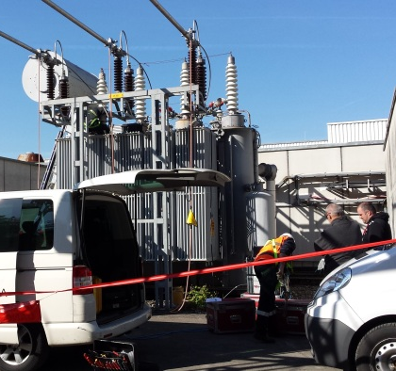

The startup: highs and lows
Beams back in the LHC on 25 March (Easter weekend, starts being a tradition…)
Very efficient setup with low intensity beams
  machine validated for β* = 40 cm in ~1 month
But then Week 17 came - just about to start operation with higher intensity:
  26 April: Vacuum leak in the SPS beam dump → limited beam intensity for the rest of the year ☹
  27 April: Serious breakdown in the PS main power supply (POPS)
  29 April “Weasel accident” at one of the 66 kV transformers feeding the LHC
G. Iadarola @ CERN Council 2017
8

Slide 9
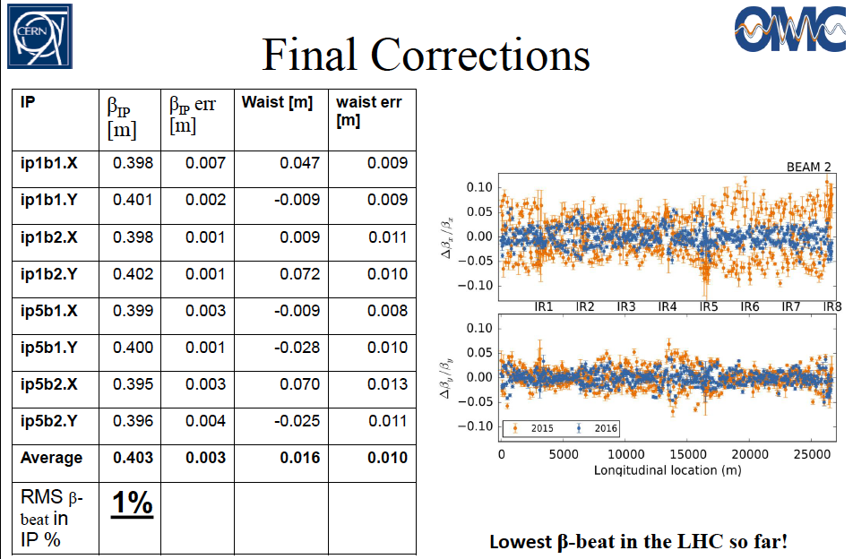
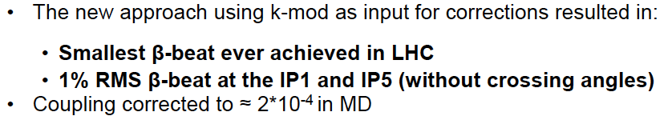
Exquisite knowledge of the machine++
M. Lamont @ Chamonix 2017

Slide 10
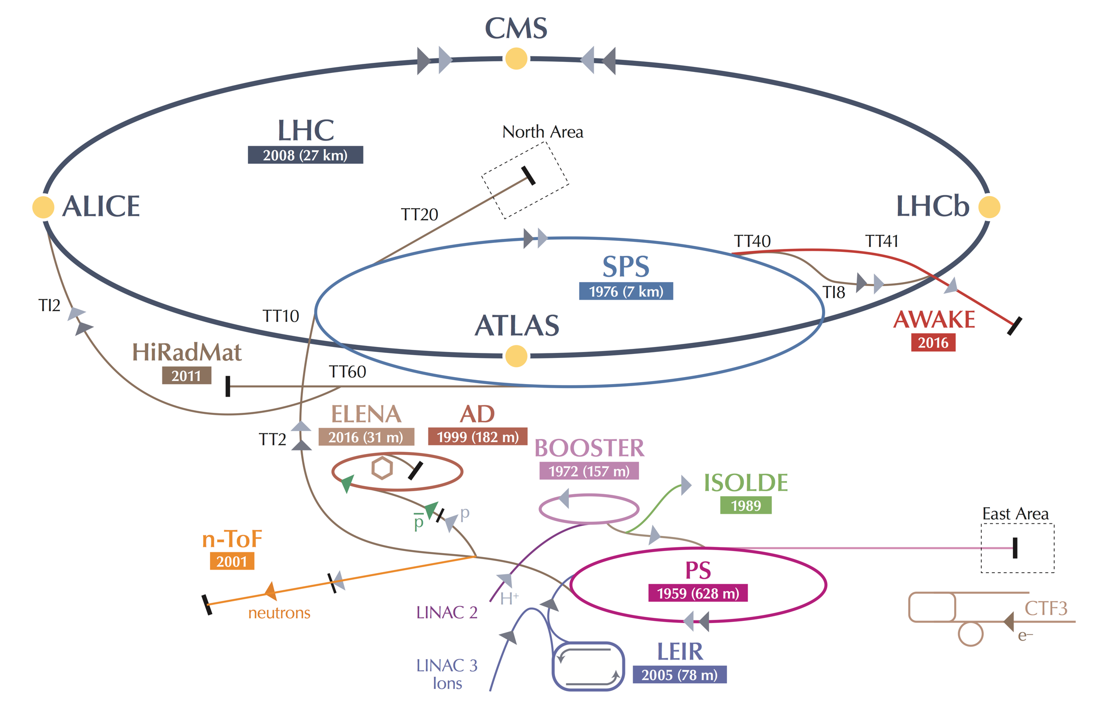
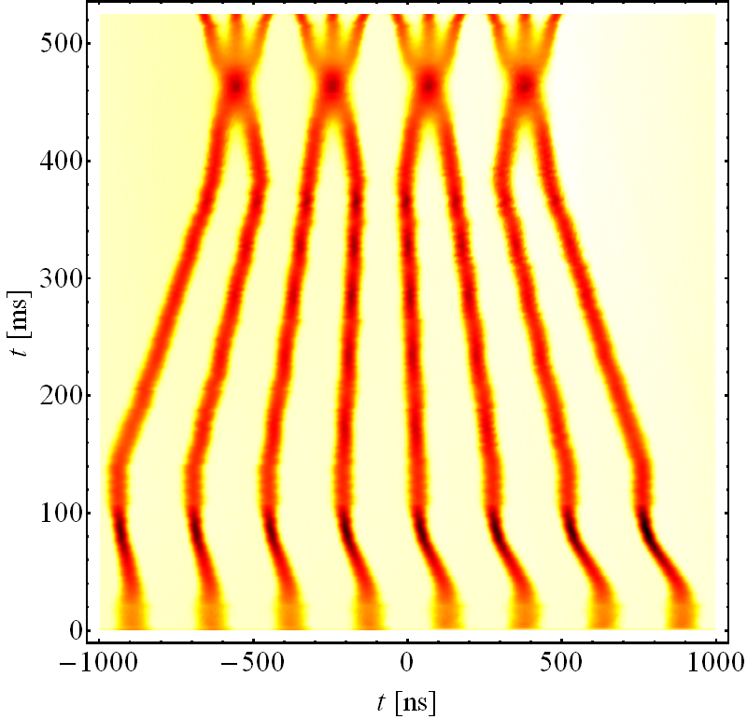
An extra boost from the injectors
A new production scheme – the “BCMS” - was put in place in the PS
RF cavities tuned at different frequencies play together to compress merge and split bunches
Beams ~30% brighter than standard scheme
The LHC performance fully relies on the performance of its injector complex
By itself one of the largest accelerator facility in the world with its own diverse and, for many aspects, unique physics program
E_{kin} = 2.5 GeV
G. Iadarola @ CERN Council 2017

Slide 11
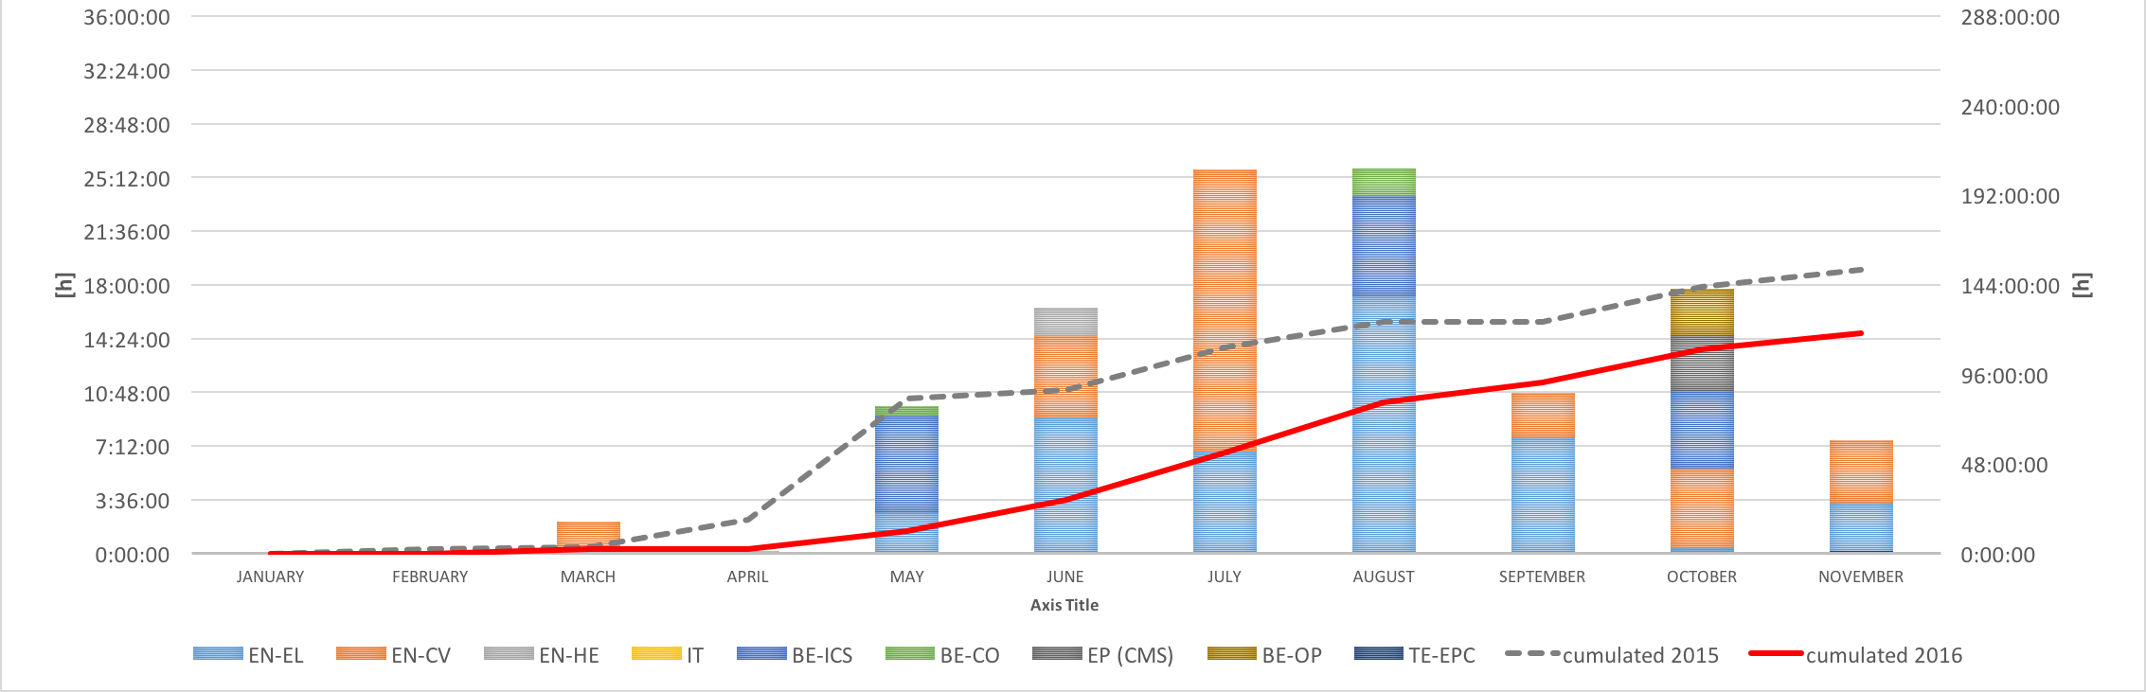
Pre-cycle 2%
2016 Availability
[4%]
[2015 - 25 ns Run]
Remarkable availability:
Increased operational efficiency
Enhanced system availability
New pre-cycle strategy
Downtime
26%
[31%]
Stable Beams
49%
Operation
23%
[33%]
[32%]
Downtime of technical infrastructures
30% less downtime in 2016 than 2015
Non-availability of beams from the injector complex is the largest source of LHC downtime
TS1 - TS2 : stable beams 58 %
TS2 - TS3 : stable beams 54 %

Slide 12
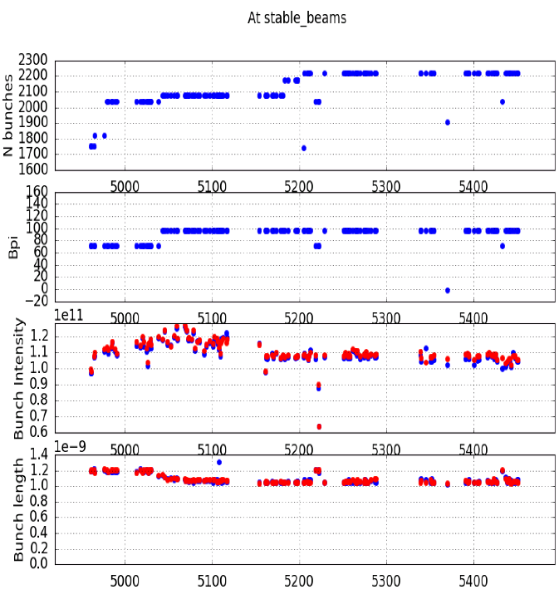
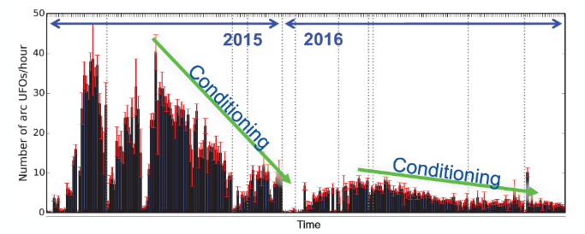
LHC Limitations
SPS beam-dump
  Nb of bunches per injection limited to 96
  Total number of bunches: 2200
LHC Injection kickers
  Outgassing from ceramic
  Bunch population limited to around 1.1 x 10¹¹
Electron cloud
  -Different heat load in the LHC sectors
  ➔ 2 classes of sectors?!
  -Still significant heat-load within cryogenic limits
  -Dynamics – well handled by cryogenics
  feed-forward
  ➔ no impact on operations in the
  present conditions
UFOs
  Frequency has happily conditioned down

Slide 13
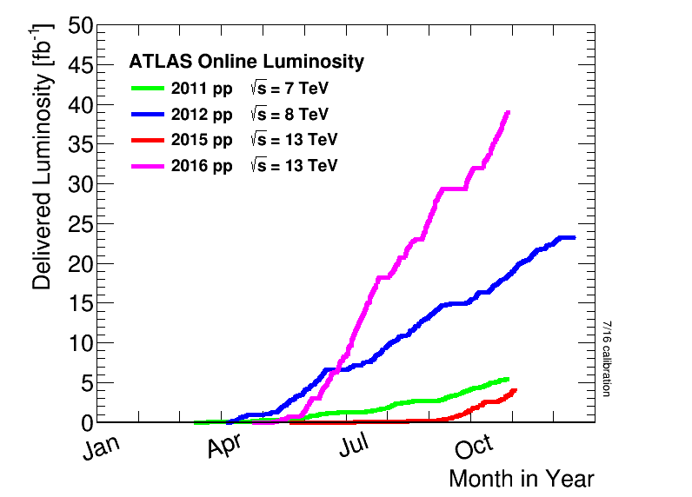
p-p physics – summing all up
Combination of high peak performance and excellent machine availability
→ quite impressive progression of the integrated luminosity
~40 fb⁻¹
for ATLAS and CMS
(2016 target was 25 fb⁻¹!)
More data in 2016 than in all previous years together!
G. Iadarola @ CERN Council 2017

Slide 14
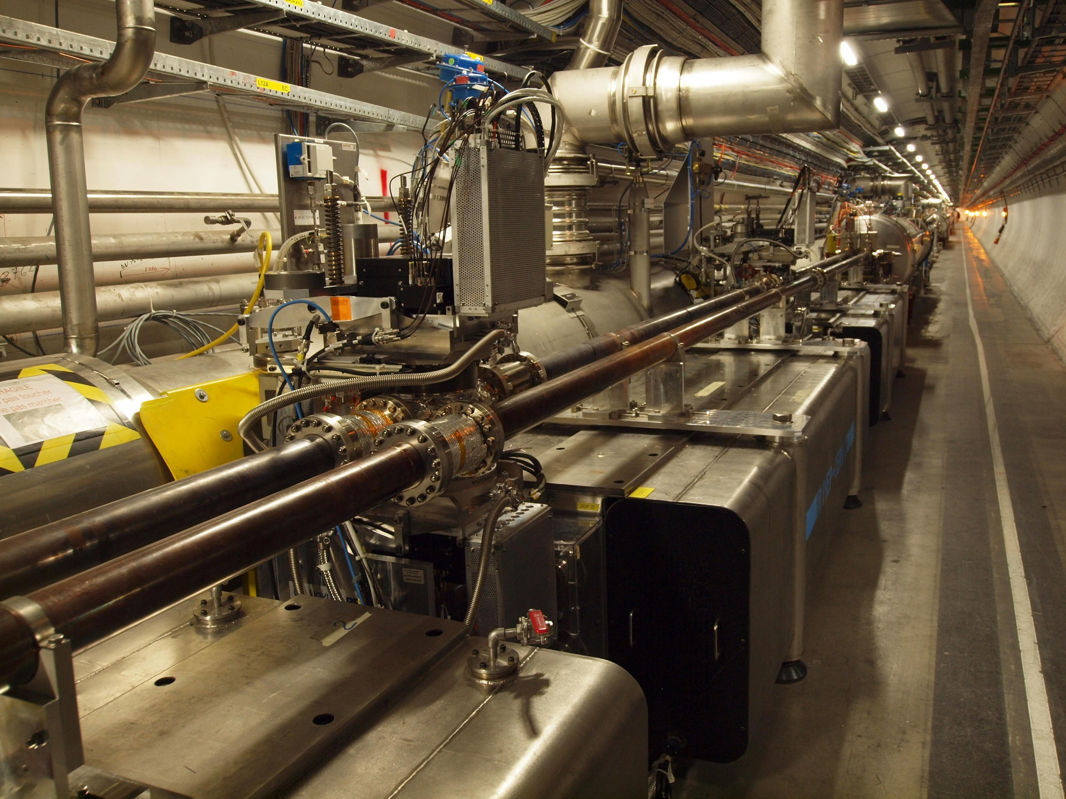
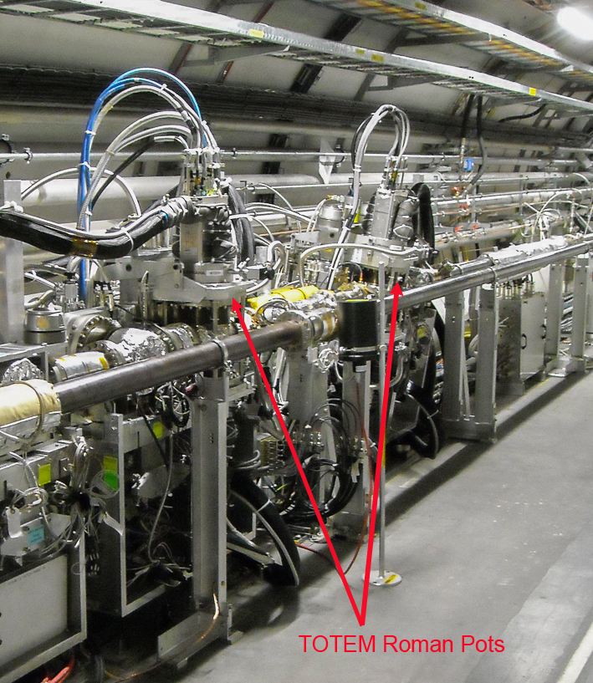
Special run at β* = 2.5 km
Special period for data collection by TOTEM and ATLAS/ALFA experiments
  Looking for small angle deviations (elastic p-p interactions)
ATLAS/ALFA Roman Pots
TOTEM Roman Pots
G. Iadarola @ CERN Council 2017

Slide 15
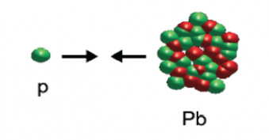
The final rush: proton-ion run
The last month of operation was devoted to proton-ion collisions
Very interesting regime for accelerator specialists: the two beams would naturally have different revolution periods!
Ambitious program with three different machine configurations to be carried out in exactly four weeks (including commissioning!)
  Performance of LHC and ion injectors well beyond expectation
Configuration | Goal
5 TeV p-Pb | ALICE | 700x10⁶ m.b. events
8 TeV p-Pb | ATLAS - CMS | 50 nb⁻¹
 | LHCb - ALICE | 10 nb⁻¹
 | LHCf | 9-12 h at 10²⁸ cm⁻²s⁻¹
8 TeV Pb-p | ATLAS - CMS | 50 nb⁻¹
 | ALICE - LHCb | 10 nb⁻¹
G. Iadarola @ CERN Council 2017

Slide 16
Operation in 2017
Main Goals and choices for 2017 :
Magnet exchange in EYETS ➔ on schedule!
Operation with ATS optics
Operation with BCMS beams ➔ high brightness and small ε
Further tightening of collimator settings
➔ potential to squeeze β* to 33cm
➔ could reach 1.7-1.8 10³⁴ cm⁻² s⁻¹ luminosity and
cryo cooling limit of triplet magnets in 2017

Slide 17
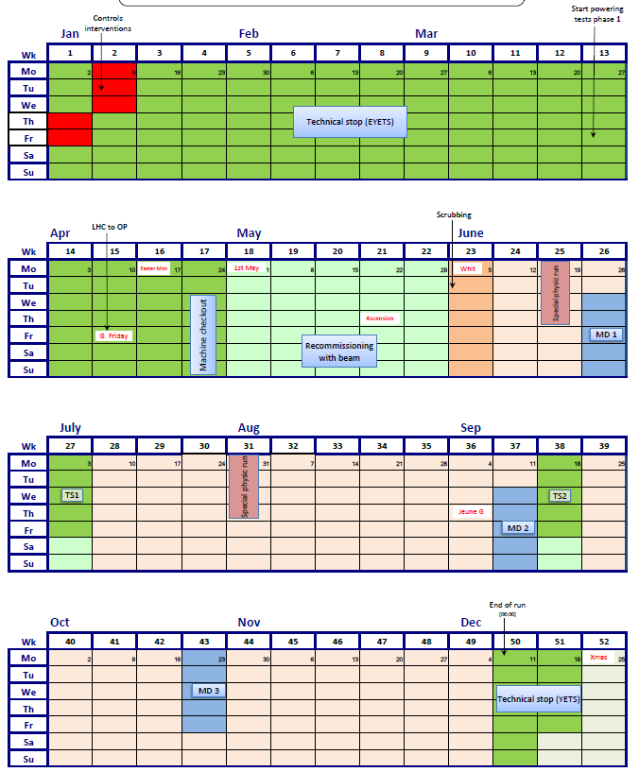
LHC schedule 2017
a new production year at 13 TeV
Goal 45fb⁻¹
keeping the LHC availability close to 50% (stable beams)
Initially 15 days of MD; later during 2017 according
integrated luminosity : + 3 days ?
Special runs: VdM scans, 5TeV reference, high β*, high β*@ low energy… and LHCC recommendations

Slide 18
Magnet Training Campaign before EYETS
Main Goals for Training:
Part of general study on ‘Full Energy Exploitation of the LHC’
  Part I: Operation at 7 TeV
  Part II: Operation at ultimate energy of 7.7 TeV
  Part II: Operation beyond ultimate energy by replacing some
  (e.g. 1/3) of the LHC magnets with 11T magnets
Provide better statistics across all magnet manufacturers for
  estimating the required time for training to 7TeV
Identify potential issues related to operating the LHC at 7 TeV
Main observations:
Statistical behavior of the magnet training
Will take 500 to 600 quenches to bring the machine to 7TeV
Multiple quenches at higher beam current (EM coupling)
Short to ground in magnet diode box during training

Slide 19
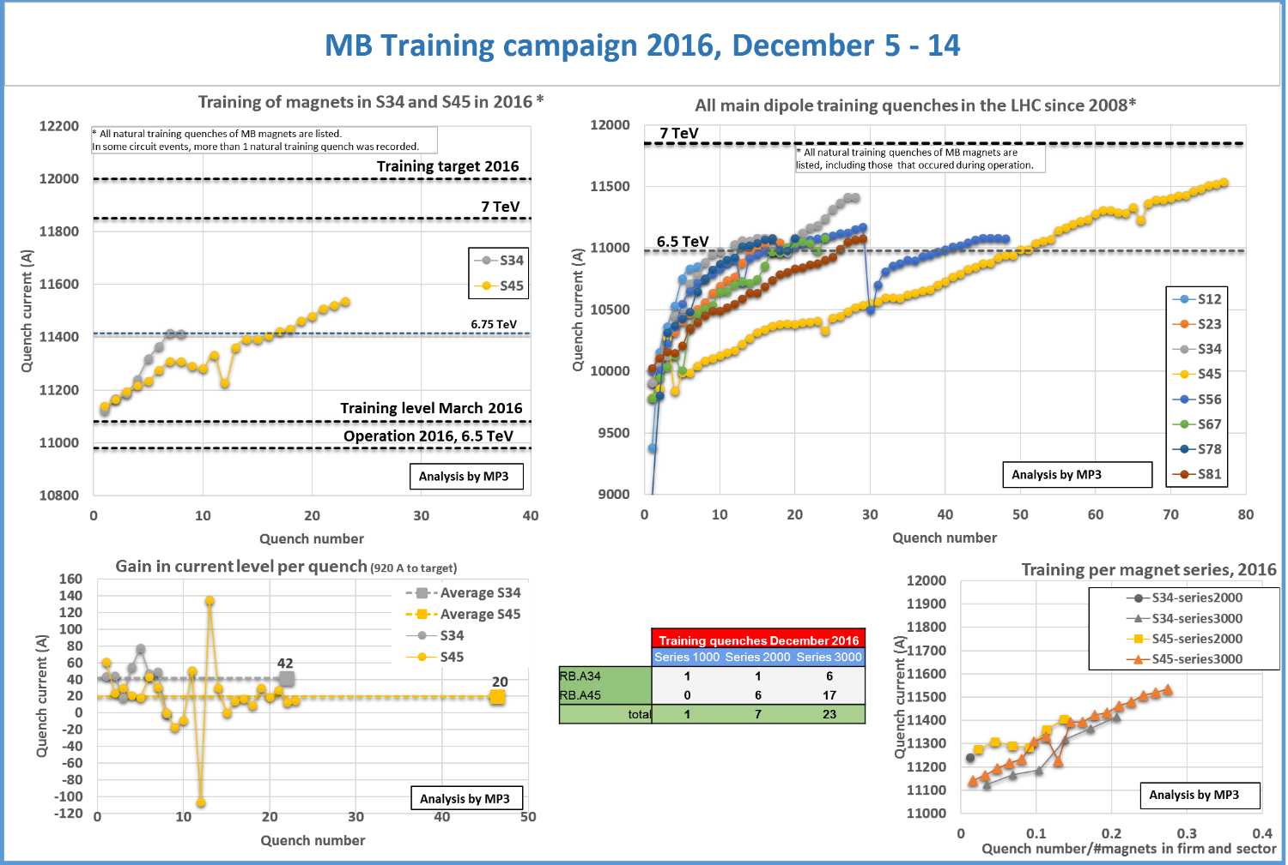

Slide 20
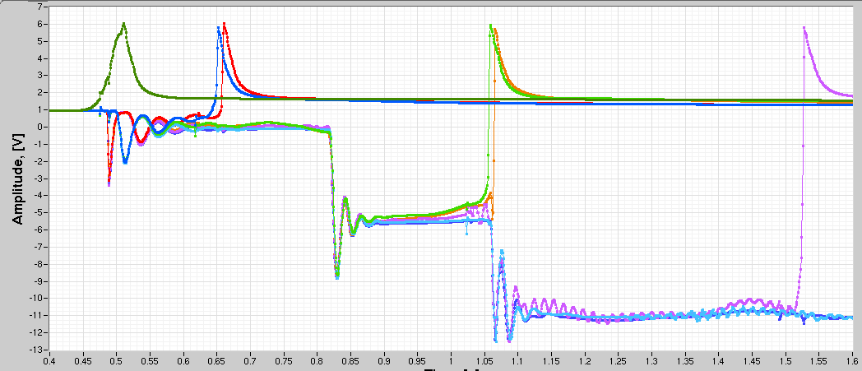
LHC Energy Exploitation Session
Observations from the training campaign:
Multiple magnet quenches during a given training quench event:
➔ Multiple training quenches and / or EM coupling (timescale < 1s)
+ heat propagation at lower current ➔ multiple quenches!!
➔ Possible cascade effect for quenches at higher magnet current!!!
Example: I=11521 A with 6 quenches triggered by nQPS and iQPS
Sandrine Le Naour @ Cham’17
A16R4
C16R4
B16R4
B17R4
C17R4
A17R4
Time scale 0.5s

Slide 21
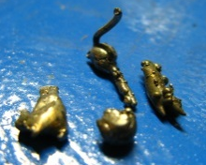
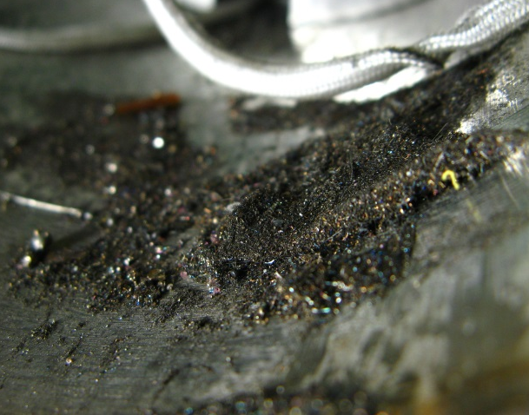
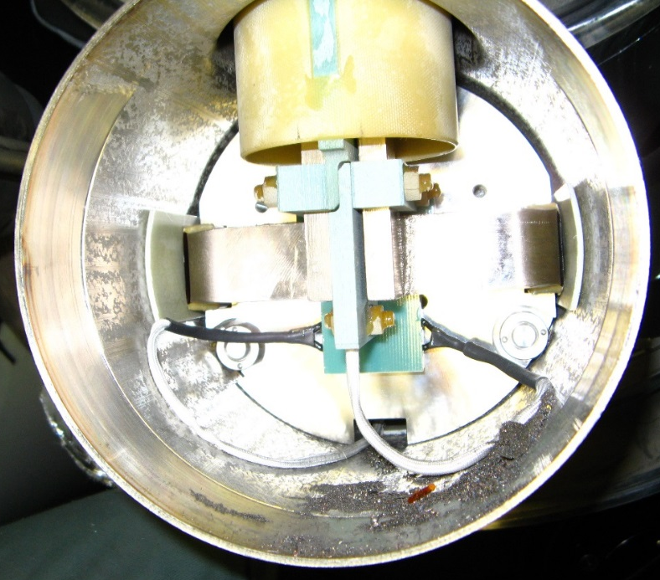
LHC Energy Exploitation Session
Mateusz Bednarek @ Cham 2017
Unforeseen Obstacles:
Short in the diode box following a training quench:
➔ released energy during quench at high
energy is capable of displacing debris that
has collected in the diode box
Second incident during training in ca. 252 quenches
(but had also 5-6 shorts before LS1)
Earth Fault Burner:
Solution exists and could by now remove a short twice
But there is no guarantee that this method will always work!!!
Risk Assessment:
Should one therefore cure this problem at the root cause?
➔ Systematic cleaning and insulation of the diode box!!!
➔ Intervention during LS2?

Slide 22
LHC Energy Exploitation Session
All magnets re-tested in SM18 did not show intrinsic limitations to
reach ‘ultimate’ field (including 26MBs from tunnel)
Statistical analysis of all training quenches:
95% of all quenches are 1st quenches (magnets quench only once)
Most training quenches in 3000 series
No correlation in the training before and after thermal cycle!
  ➔Statistical process with Gaussian tails
Expectation for 7TeV:
33% of 2000 series
~140 quenches
90% of 3000 series
~370 quenches
ca. 500 to 600 quenches
to reach 7 TeV
ca. 2 quenches / day
Total of 1 month / sector
Gerard Willering
@ Cham 2017
Performance estimates for first year operation after training:
20% - 30% integrated lumi loss if training before LS2
16% - 18% integrated lumi loss if training after LS2
  ➔ could be smaller if training could start during LS2!
Ezio Todesco @ Cham 2017
Strategy and planning:
➔ decided after Chamonix 2017 to stay at 6.5TeV until LS2
➔ evaluate possibility of ‘fixing’ diode problem during LS2
22

Slide 23
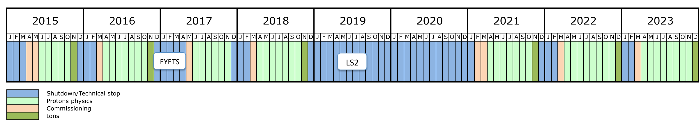
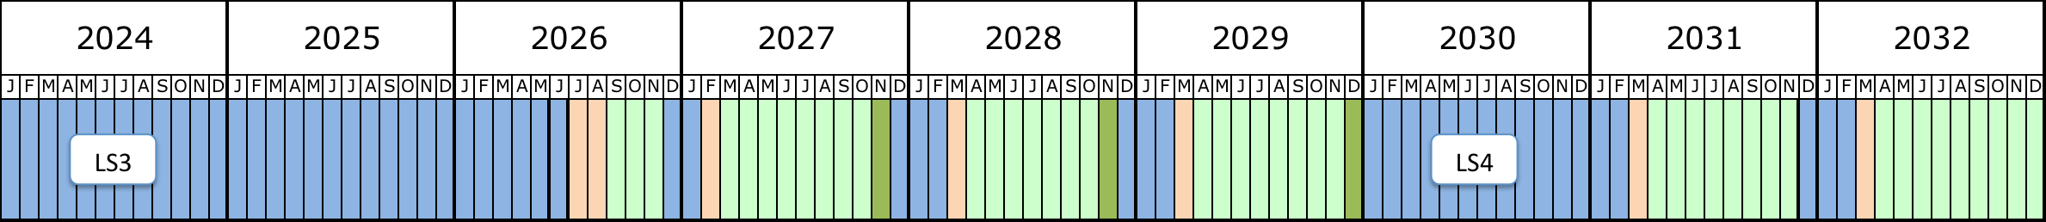
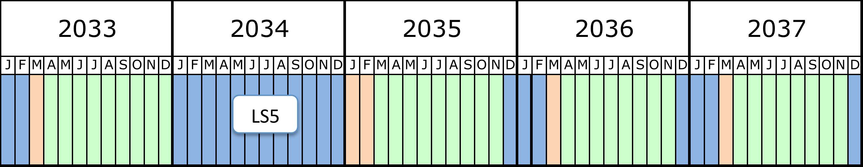
LHC Schedule:

Slide 24
End:

Slide 25
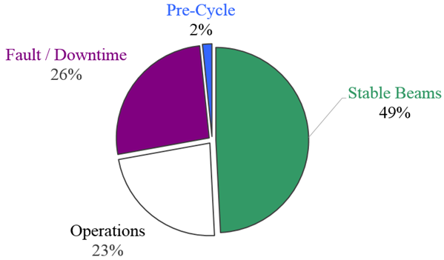
p-p physics – machine availability
2016 was characterized by unprecedented machine availability:
The machine was available for operation 72% of the time scheduled for physics
Overall Stable Beam efficiency of 49% (to be compared to 36% in 2012, and 30% for the short production period in 2015)
Possible thanks to:
Professionalism, commitment and attention to the details from all the different equipment groups
Solid understanding of the machine and beam behaviors
Continuous effort in fault and availability tracking
M. Lamont @ CERN Council 2017

Slide 26
2017 special runs ?
5 TeV pp reference run (for Pb-PB and p-Pb physics analysis)
  LHCC should recommend if to do at end of 2017 or end of 2018 just before the ion run
  LHCC should define the duration: 7-10 days or 4-5 days of stable days
  High β* run at low energy ( 900 GeV/2 TeV ?)
    (TOTEM and ATLAS(ALFA)
  - 2018 or Run 3 ?
  - To schedule 1 day of machine time in 2017 to investigate possibilities ?
  90 m-like β* run with maximum luminosity
    (TOTEM and ATLAS(ALFA)
  - LHCC: 2018 ? Duration : ∼1-2 weeks including setup

Slide 27
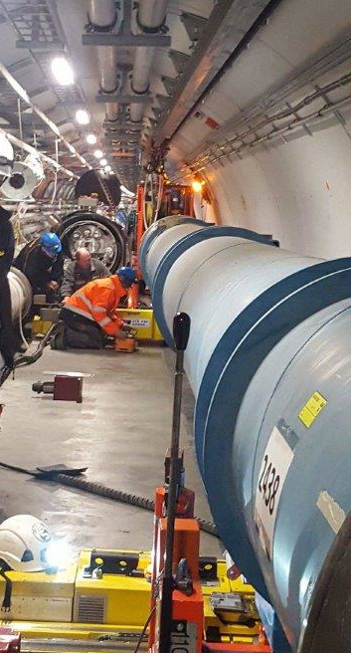
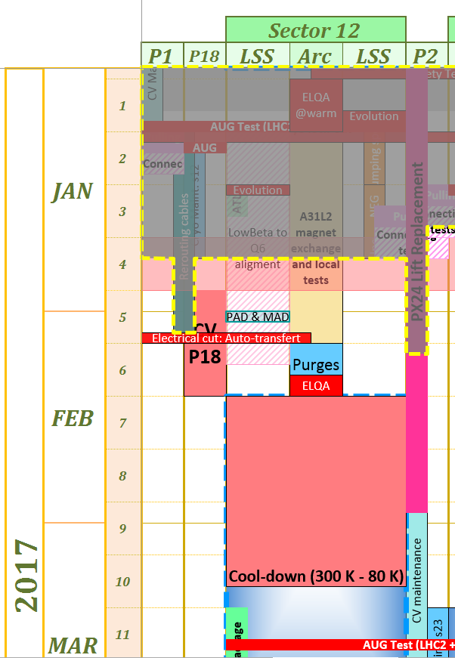
Activities on the critical path
A31L2 magnet exchange
The new A31L2 magnet was installed on 16th January
ElQA HV and AIV tests have been completed successfully
The 2nd RF ball test, the tomographies and endoscopies have been performed and no problem have been identified on the PIMs
The installation of the cryogenics instrumentation is in progress
Sector 1-2 Insulation leak tightness
Assuming no degradation during cool-down (factor ∼100 of margin in the worst case), all magnet leaks can be managed below vacuum level required (E-04 mbar).
Sector 1-2 QRL status
No mechanical intervention is foreseen on the QRL during the EYETS
Existing small leak can be easily pumped with standard pumping capacity for 2017 operation, without impact on the performance of the distribution line
Installation of A31L2 new magnet
Linear schedule for sector 1-2

