Slide 1


LARP and HL-LHC AUP in US and Goals for CM28
Giorgio Apollinari
Napa Valley, CA – Apr 24th – 26th, 2017

Slide 2

Content
Progress since Paris (November 2016)
LARP Progress in FY17 and Financials
Interaction(s) with Funding Agencies
FY18 and beyond
HL-LHC AUP Status
  Deliverables
  CD-1 Director and DOE Reviews
Goals for this Collaboration Meeting

Slide 3
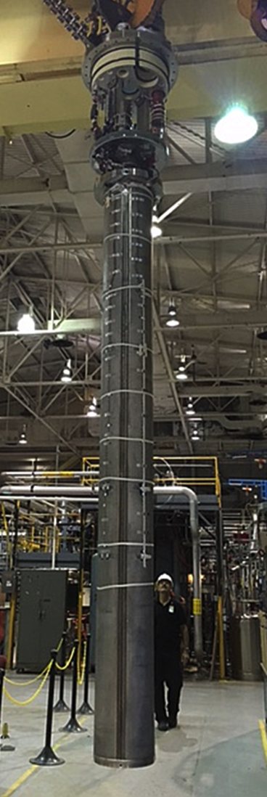
Progress since Paris
Successful Test of first long (4m) HL-LHC coil and commissioning of BNL Vertical Stand
Continued progress on 4 m MQXF-prototype acquisition (Strand, Coil Parts, Structure, etc) and assembly:
  Next big (LARP) challenge: Test of Long prototype #1 in Summer 2017
Successful tests (and reprocessing) of 3 NW cavities at JLAB
  Next big (LARP) challenge: Vendor Interactions for prototype RFD cavities
e-lens
  Test on CERN e-gun and simulations for HL-LHC
WBFS
  MD to resume shortly, simulations on efficient RF power use
Accelerator Physics
  Simulation on wire LR compensator for FY17 MD
To be reported in Plenary and Parallel Sessions

Slide 4
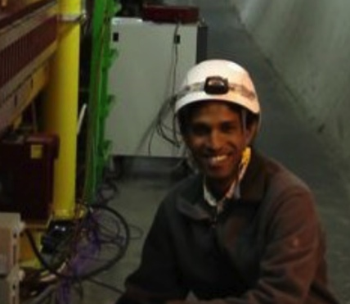
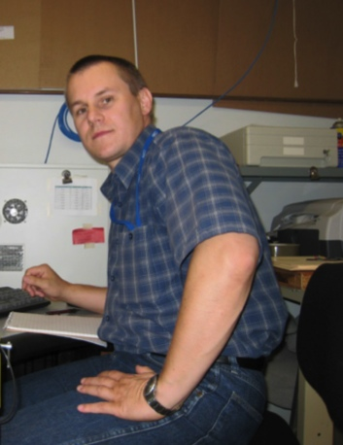

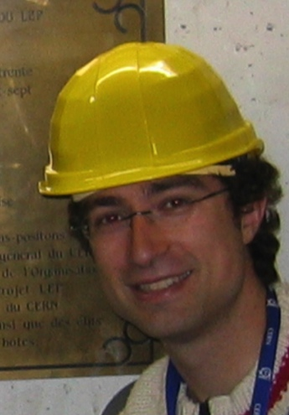

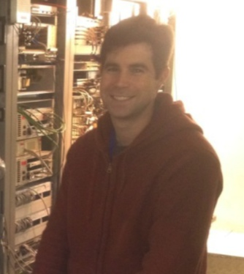
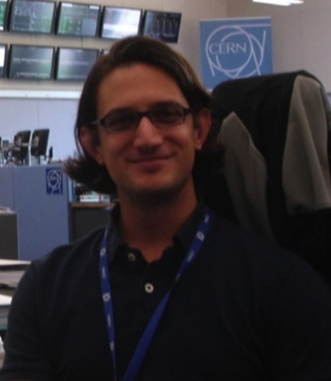

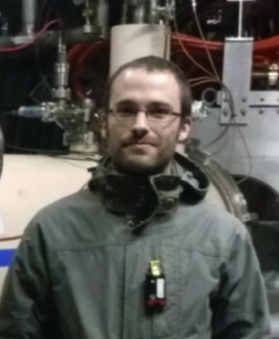


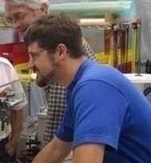
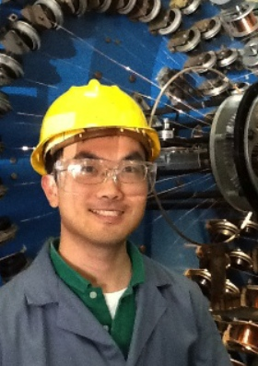
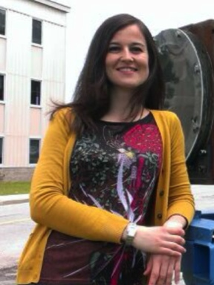

Toohig Fellowship
Extremely successful Fellowship program – Toohig Felloship - with several young Accelerator Scientist providing vital contributions to the LHC and field in general
R. Calaga – CERN
D. Bocian
Prof. HNINP
H. Felice – CEA
V. Previtali
Teacher, Geneve
J.Cesaratto
Phillips
R. Miyamoto – ESS
T. Mastoridis
Prof. CPU
S. White – ESRF
R. DeMaria –CERN
S. Verdu
BNL
T. Holik
FNAL
E. Ravaioli
LBL
M. Fitterer FNAL
I.Pong
LBNL
4

Slide 5
Evolution of FY14-FY17 Funding
 | FY14 | FY15 | FY16 |  | FY17
e-lens | 150 | 150 | 340 |  | 500
Acc. Systems | 592 | 150 | 149 |  | 130
Quad. Magnets | 7,854 | 10,500 | 11,428 |  | 13,157
Management | 1,485 | 1,375 | 1,445 |  | 1,635
Crab Cavities | 1,136 | 1,200 | 1,458 |  | 2,137
WBFS | 1,183 | 625 | 560 |  | 300*
Reserve |  |  |  |  | 641
Total | 12,400 | 14,000 | 15,380 |  | 18,500
In addition, received additional funding in FY17 to support ~300km of Nb₃Sn conductor procurement
Good support from funding agency !
  Clear shift of priorities in view of definition of US deliverables to HL-LHC.

Slide 6
LARP Future before Nov. ‘16
DOE Review of LARP on July 2016
We interpreted this comment to represent the “asymptotic” funding for LARP after FY20.
LARP/AUP transition needs (FY18-FY20) have been presented at the July ‘16 DOE Review and have not changed
 | FY18 | FY19 | FY20 | FY21
Magnet Prototypes | 8.9 M$ | 3.9 M$ | 1.0 M$ | 0 M$
HL-LHC RFD Prototypes | 1.8 M$ | 0.6 M$ | 0.6 M$ | 0 M$
Other (WBFS, e-lens, Accelerator Physics, Toohig Fellows, Scientific Support, etc.) | 3.0 M$ | 3.0 M$ | 3.0 M$ | 3.0 M$
TOTAL LARP | 13.7 M$ | 7.5 M$ | 4.6 M$ | 3.0 M$
 | FY18 | FY19 | FY20 | FY21
HL-LHC Acc. Upgrade Project (Dec ’23) | 17.4 M$ | 31.6 M$ | 35.8 M$ | 33.4 M$

Slide 7

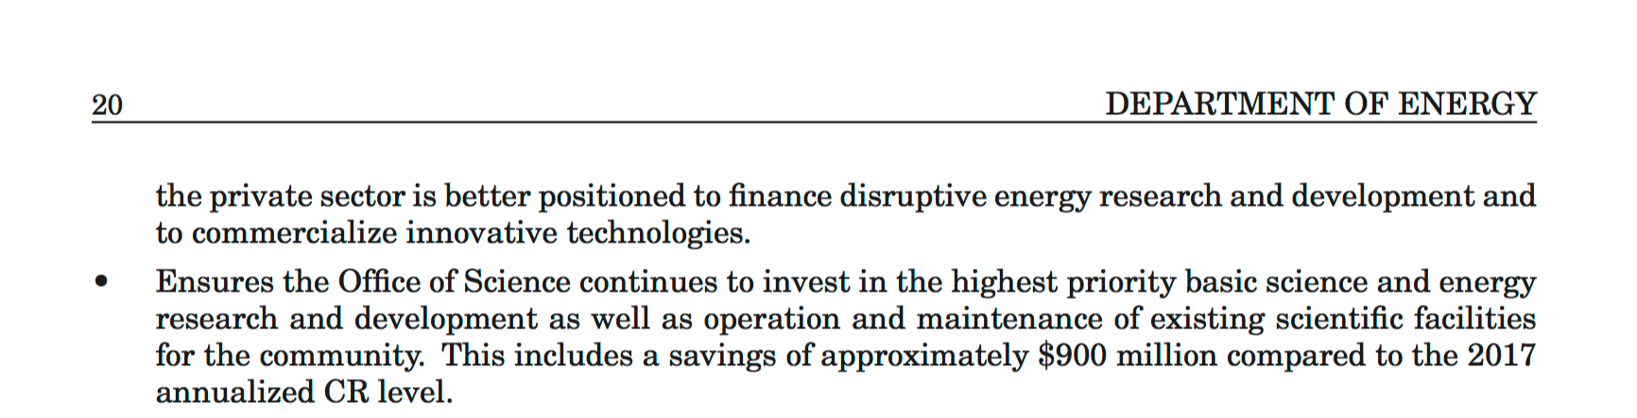
New Administration
~17% cut respect to 2017 annualized CR (i.e. 2016 budget)

Slide 8
Future Budget
Uncertainty on FY17 continuation
  Continuing Resolution (CR) through April
    Good scenario: FY17 (previous) Administration budget is endorsed
    Reasonable Scenario: CR continues to the end of the year (~FY16 funds). Hopefully P5 “prioritization” will protect to some extent LARP funding level from FY16 (15.4M$) to FY17(18.5M$)
    Other Scenarios: Government Shutdown, …
Uncertainty on FY18 (and beyond) funding levels
  DOE-HEP will provide funding levels in agreement with the WH budget.
    Hopefully P5 “prioritization” will protect to some extent LARP funding and, especially, HL-LHC AUP funding, levels
  Expect to receive FY18 LARP guidance and HL-LHC AUP funding profile (see next) by end of May ‘17.
  Congress will allocate FY18 Budget

Slide 9
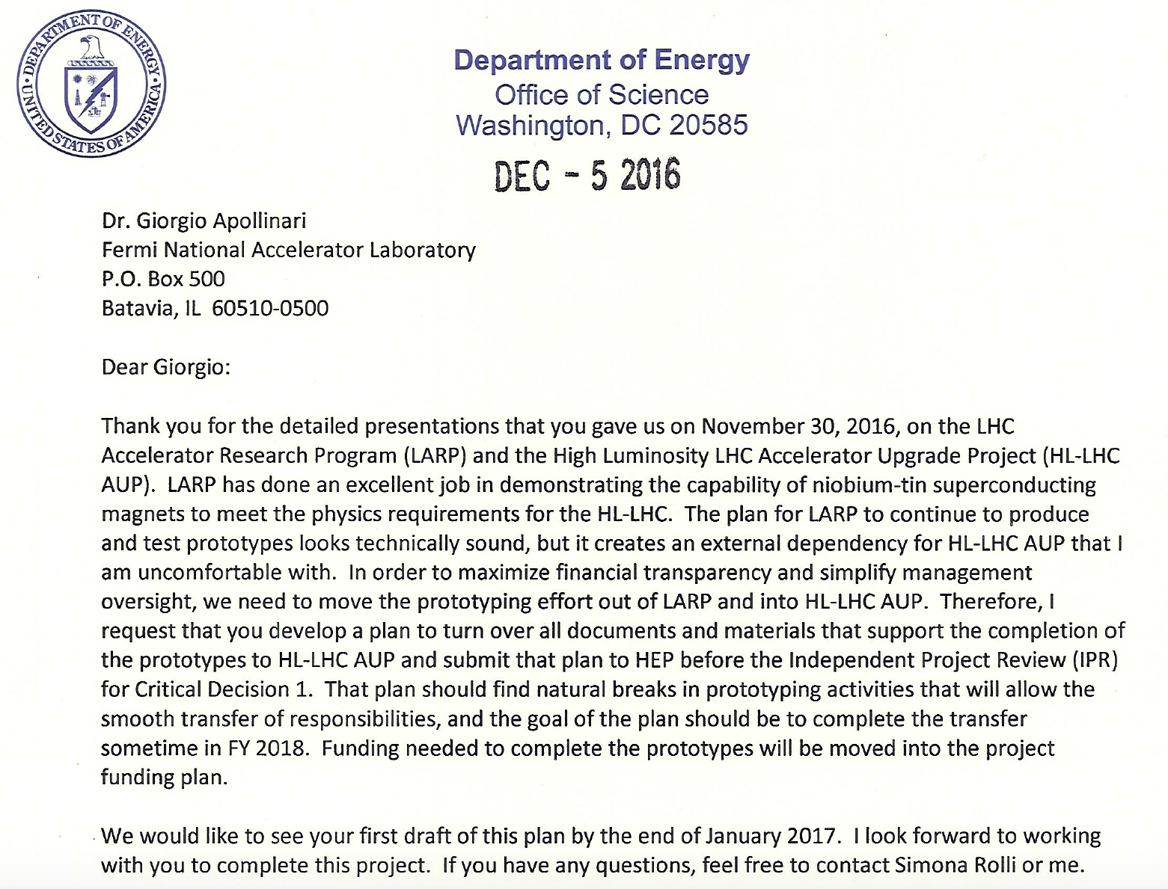
Letter Following DOE-HQ Visit (Nov. 30th, 2016)
Transfer MQXF and RFD prototypes from LARP to HL-LHC AUP

Slide 10
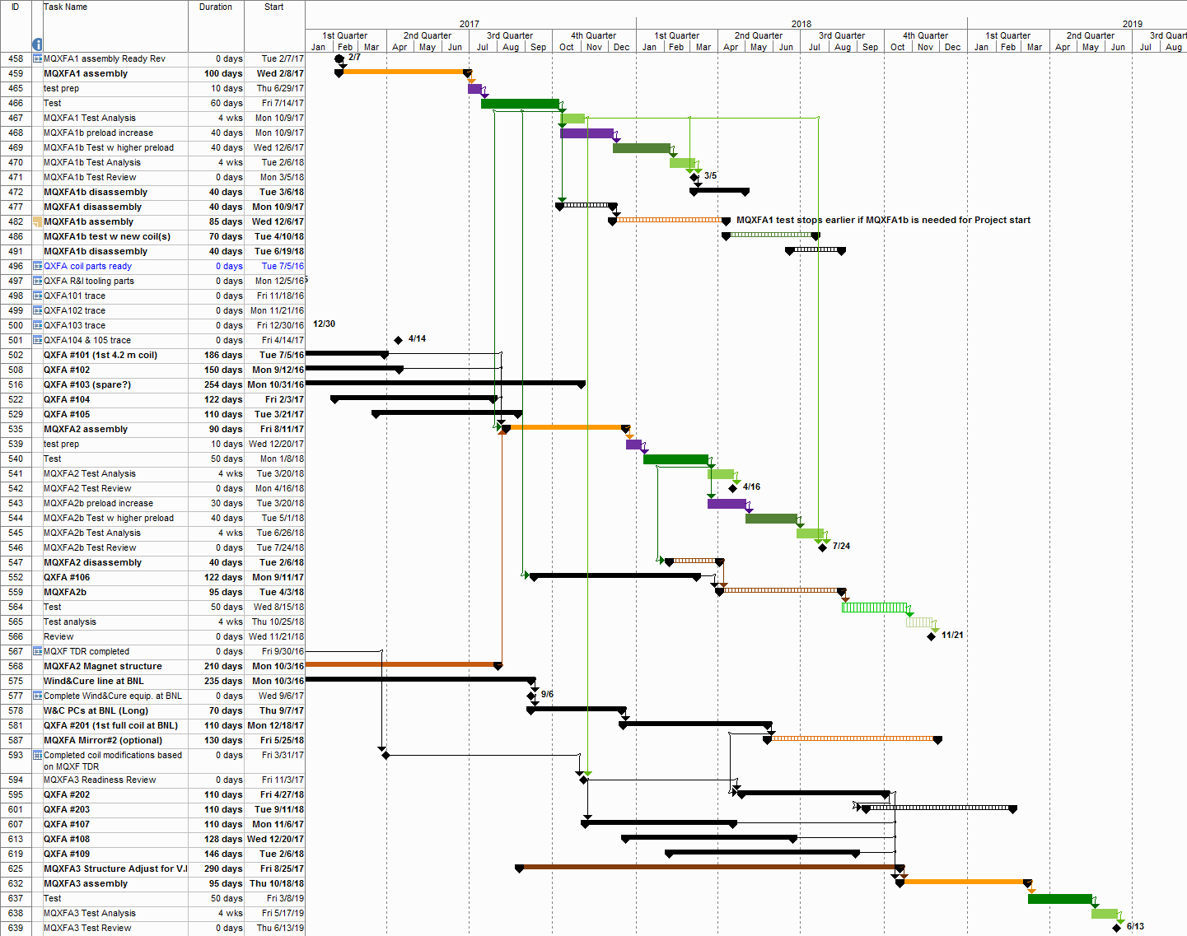
FY18
FY19
Test
Assembly
Test
MQXFA1
LARP
AUP
Coils
Assembly
Test
MQXFA2
Test
Cold Mass & Cryostat
BNL Coils
FNAL Coils
MQXFA3
Test
Assembly

Slide 11
LARP future after Nov ‘16
 | FY18 | FY19 | FY20 | FY21
Magnet Prototypes | 8.9 M$ | 3.9 M$ | 1.0 M$ | 0 M$
Crab Cavity HL-LHC Prototypes* | 1.8 M$ | 0.6 M$ | 0.6 M$ | 0 M$
Other (WBFS, e-lens, Accelerator Physics, Toohig Fellows, Scientific Support, etc.) | 3.0 M$ | 3.0 M$ | 3.0 M$ | 3.0 M$
TOTAL LARP | 13.7 M$ | 7.5 M$ | 4.6 M$ | 3.0 M$
From: LARP DOE Review
July 2016
Jan. 2017
All Prototypes in AUP
 | FY18 | FY19 | FY20 | FY21
Magnet after LARP-AUP Transition | 5.0 M$ | - | - | -
Crab Cavity after LARP-AUP Transition | - | - | - | -
Other (WBFS, e-lens, Accelerator Physics, Toohig Fellows, Scientific Support, etc.) | 3.0 M$ | 3.0 M$ | 3.0 M$ | 3.0 M$
TOTAL LARP | 8.0 M$ | 3.0M$ | 3.0 M$ | 3.0 M$
 | FY18 | FY19 | FY20 | FY21
HL-LHC Acc. Upgrade Project (Dec ’23) | 32 M$ | 39 M$ | 40 M$ | …

Slide 12

HL-LHC
Accelerator Upgrade Project

Slide 13
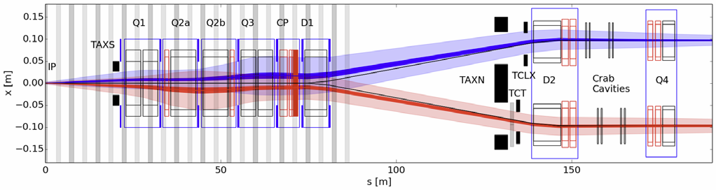
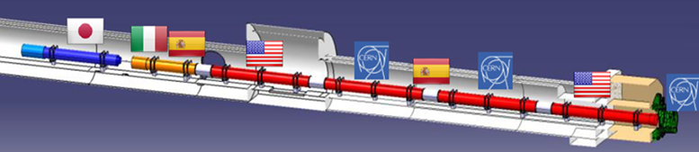
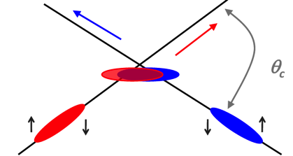
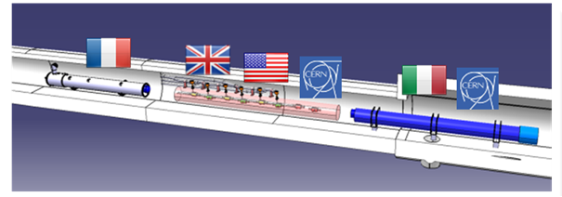
Possible U.S. contributions to HL-LHC
(in pictures)
Insertion Region layout from the IP to Q4
Large Aperture IR Quadrupoles:
From 70 mm MQXA/B to 150 mm MQXF
From NbTi to Nb₃Sn for higher field/gradient
Minimum β* from 0.55 m to 0.15 m
Compatible with 10x integrated luminosity
Crab cavities:
Deflect bunch at IP to collide head-on
Restore luminosity loss due to crossing angle
Requires compact superconducting cavities

Slide 14
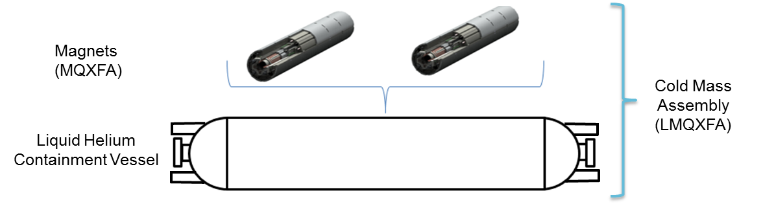
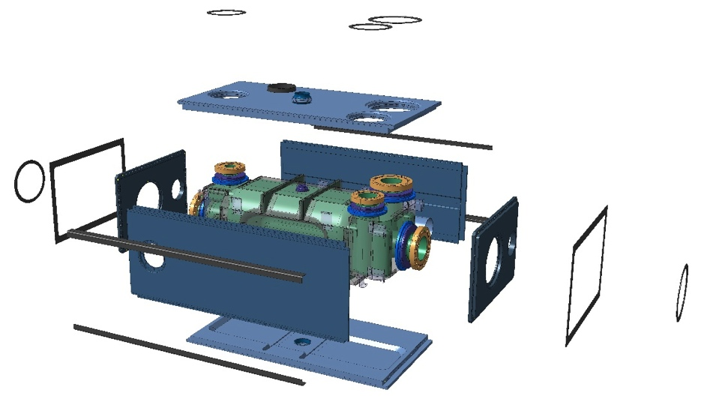
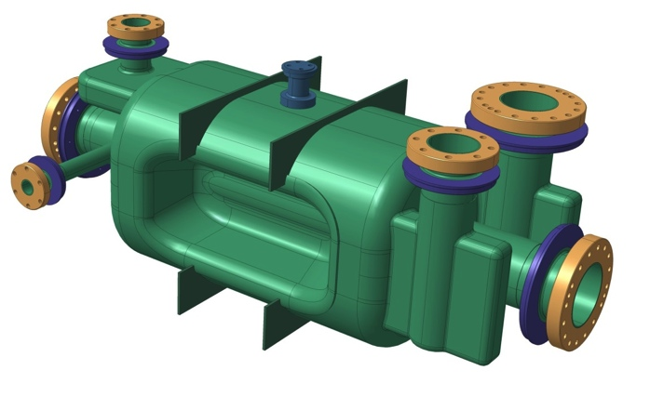



Possible U.S. contributions to HL-LHC
(in pictures)
Q1/Q3 Cryoassembly
Dressed RFD Cavity
V-HOM
RF Pickup
H-HOM

Slide 15
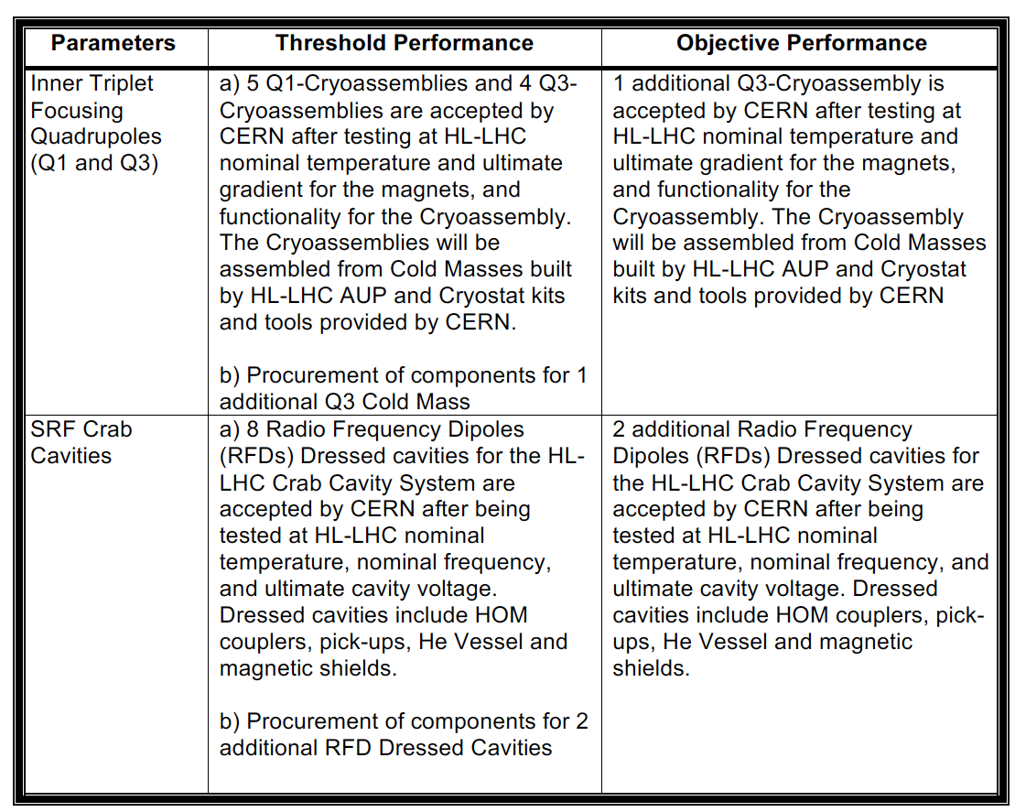
Possible U.S. contributions to HL-LHC
(in words)
At this time (pre-CD-1) the following deliverables are entertained for the US contribution to HL-LHC:
  From the PPEP Draft exchanged with AUP FPD
Delivery Date Needs (from CERN):
  Q1/Q3 Cryoassembly #1 at CERN by Late ’21
  Cryoassembly #8 at CERN by Summer ’24
  RFD Dressed Cavity #1 at CERN by Late ’22
  Dressed Cavity #8 at CERN by Summer-Fall ‘23
Slightly more than 50%
of the Q1/Q2a & b/Q3 Final Focusing Triplets of HL-LHC
50% of the total number
of Crab Cavities for
HL-LHC
CERN is also suggesting financial contribution to cavities built in Europe as Objective KPP (“Up-scope” Opportunity ?)

Slide 16
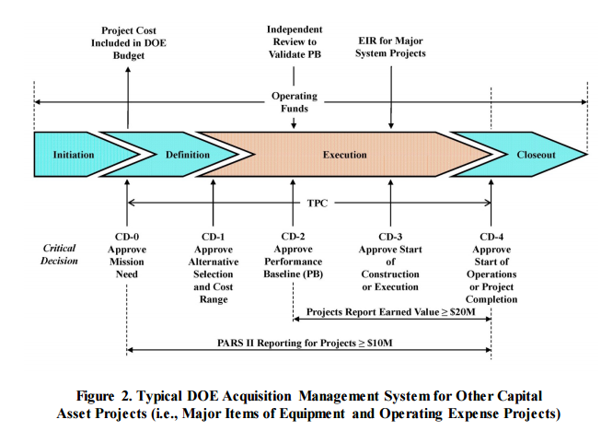
US HL-LHC AUP Project Status
Must follow DOE Order 413.3b:
We are here: next goal CD-1/CD-3a

Slide 17
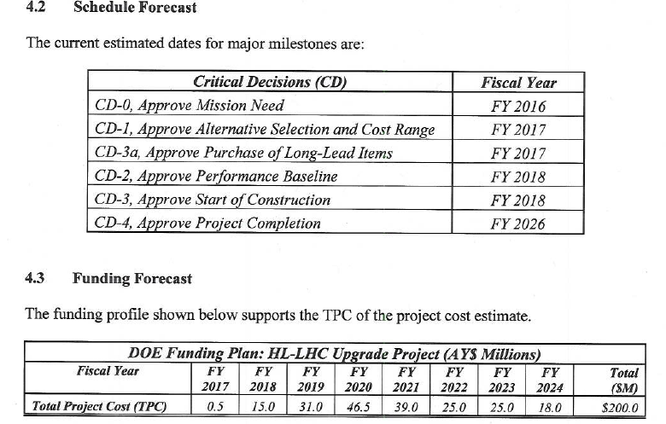
HL-LHC AUP: Funding Profile and Schedule at CD-0
Preliminary DOE TPC range is $180-250M in then-year dollars.

Slide 18
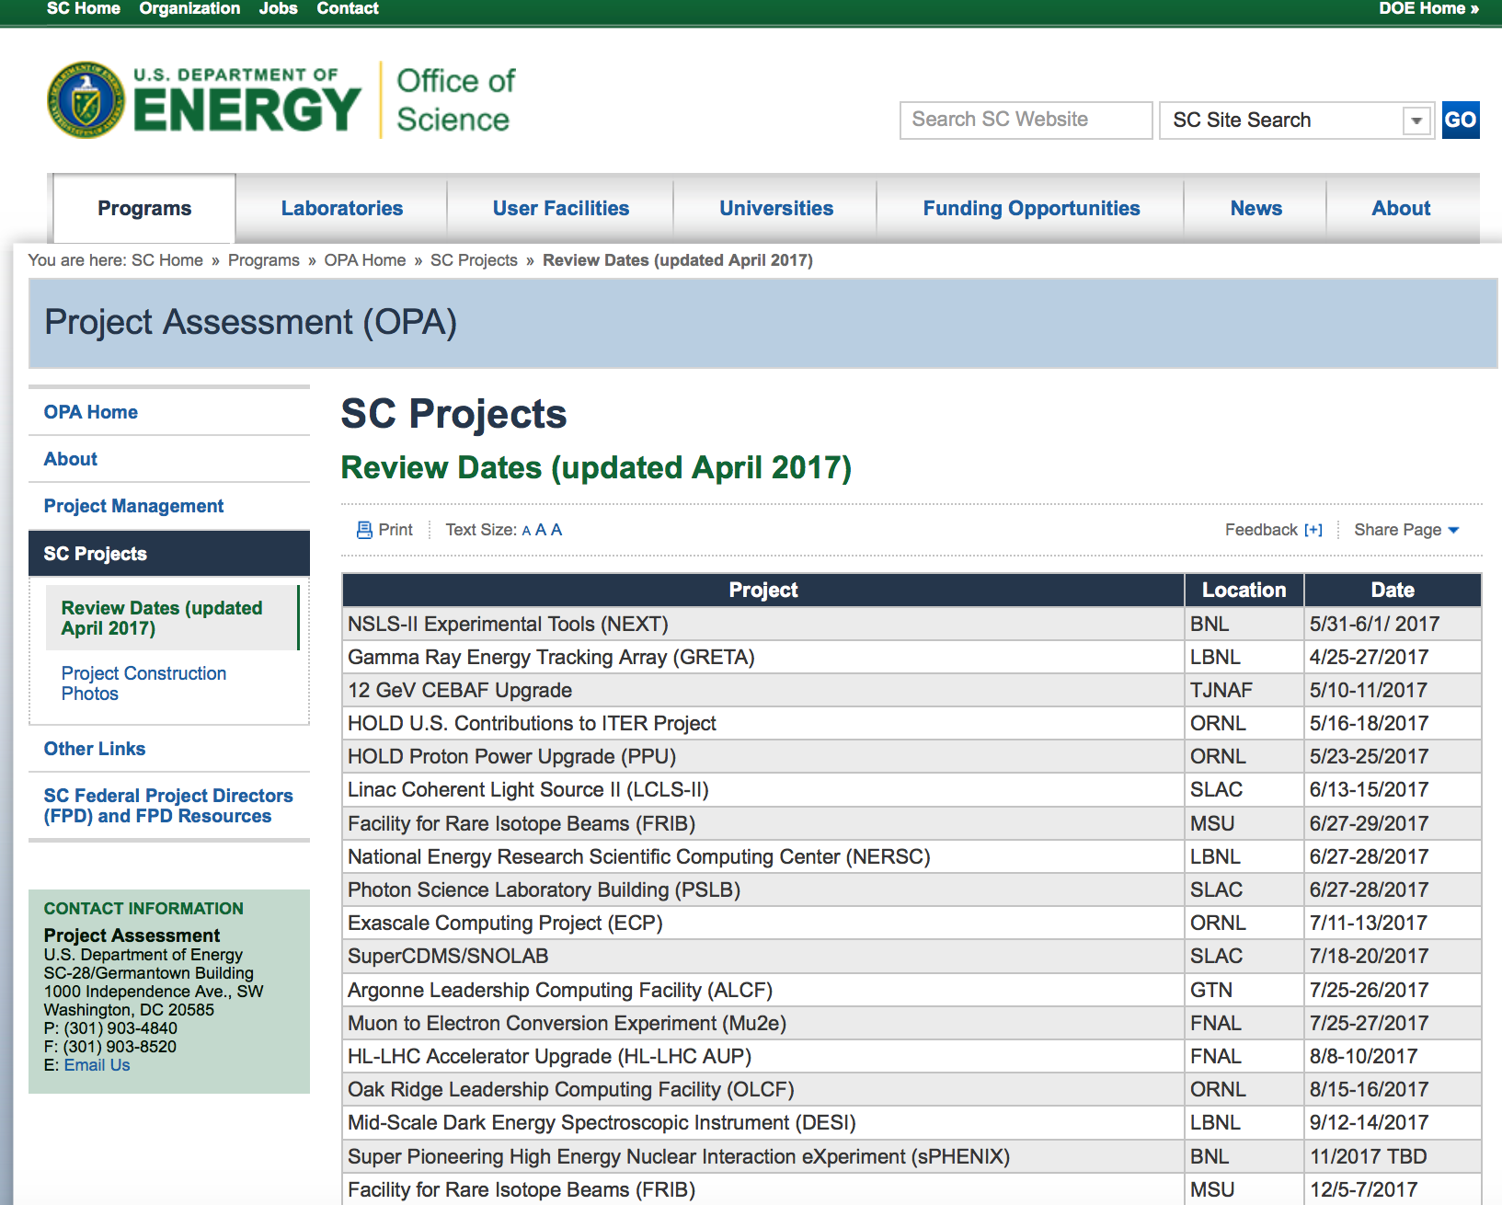
HL-LHC AUP CD-1/CD-3a Date
Took ~1 year and 3 trips to DOE-HQ to get on this schedule !

Slide 19
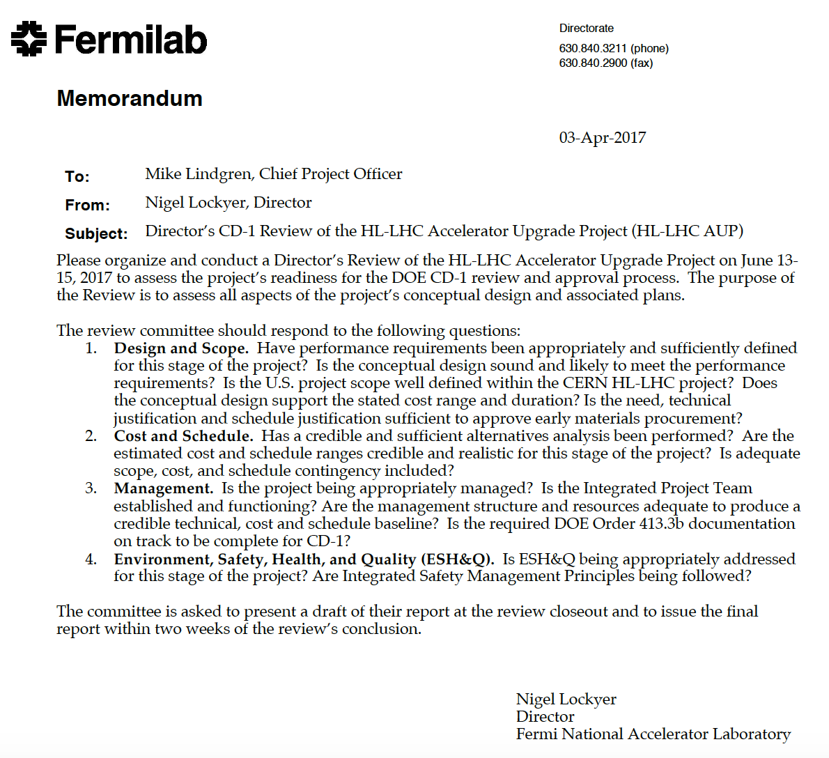
CD-1/CD-3a Preparation
CD-1 Director’s Review (June 13th – 15th ) in preparation of DOE CD-1 Review
  Imperative to pass Director’s Review with decent marks
  AUP PO will have to report to DOE-HQ outcome of Director’s Review by early July.
Imperative to address Director’s and CD-1 Review successfully for timely execution of the Project

Slide 20
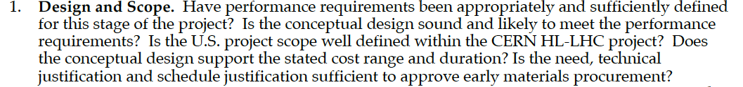
(Real) Goals of HiLumi/LARP CM28 !
Functional Requirement Specifications for all US deliverables is a must !
  Failure to leave this CM without at least WP agreement on the basic FRS would be a bad omen for a successful approval of HL-LHC AUP
Conceptual Design (including, where possible, Integration) must be discussed
  Interfaces Specification Documents (or plans to get to Interfaces Documentation before CD-2) need to be discussed and agreed upon at this CM.
  Materials/Parts exchange and/or approval

Slide 21
(Real) Goals of HiLumi/LARP CM28 !
US Project within CERN HL-LHC Endeavor
  Rely on Lucio/Oliver presentation abilities AND full agreement on KPPs (materials usage, parts from CERN, kits, tooling, etc).
Cost and Duration
  Address external dependencies (materials and tools from CERN)
  Formally requested by DOE to address external dependencies as milestones preceding US activities.
  All LARP/HL-LHC AUP L3 have done an exceptional job reviewing/scrubbing BOEs in the last month. Thank you ! Need to keep same intensity preparing for Director/DOE Review during month of May.

Slide 22
Transition to CD-2/CD-3b and CD-3
After a successful CD-1/CD-3a, our next effort will be to prepare for CD-2/CD-3b review in ~Spring-Summer 2018 assuming:
  Reasonable HL-LHC AUP budget profile
  Unchanged “Request by” date from CERN
CD-2 (baseline) and CD-3b (start coil/magnet production + RFD Materials procurement)
  Approve Performance Baseline
    Technical (final) Design baseline
    EVMS on monthly level

Slide 23
Conclusions
Good Progress in LARP !
HL-LHC AUP has seen evolvement since Paris:
  Prototypes in HL-LHC AUP
  Decrease of expected LARP support post-FY18
By far the most important part of my message:
  Finalization/Support/Integration of HL-LHC needs/requirements is a “must” at this Collaborations Meeting
    Functional Requirement Specification on all AUP deliverables
    Materials/Parts Approval
    Interfaces agreement (or plan to reach agreement on a reasonable timescale in next few 6-8 months)
    Agreement on KPPs
    Full disclosure/discussion of schedule, especially for external dependencies.

