Slide 1

HL-LHC Beam Physics in view of Recent Technical Achievements
Massimo Giovannozzi – CERN
On behalf of Accelerator and Beam Physics Group, WP2
Joint LARP CM28/HiLumi Meeting, Napa – 24- 26 April 2017

Slide 2
Outline
Introduction
Single particle beam dynamics
  Dealing with magnets’ field quality and real effects
Collective effects
  A quick look at crab cavities
Conclusions and outlook

Slide 3
Introduction
How Accelerator Physics studies follows technological advances
Revised design assumptions
Design assumptions
Reality
HL-LHC performance estimate
Revised HL-LHC performance estimate
The two estimates are different: how to control/minimise such a difference?

Slide 4
The assumptions
Design assumptions should be realistic
Include margins to cope with unforeseen events (the reality)
  Example: beam aperture is evaluated including tolerances on the beam parameters, mechanical properties, and alignment
Determine the sensitivity of the HL-LHC performance on individual parameters to define the correct priority of assumptions and guide hardware design
  Example: Dynamic aperture (DA) is determined varying the individual multipoles of the various magnet families -> Jacobian of DA
Include enough “correctors” in the layout
  Example:
    orbit correctors in matching section
    Non-linear correctors in triplet region

Slide 5
The reality - I
Reality enters in the form of
Measurements of hardware prototypes
  Deviations from expectations could lead to
    Design revision (if time and resources are available), e.g., change of cross section to act on multipoles
    Corrections a posteriori of the hardware performance, e.g., installation of magnetic shims, or magnet sorting
Beam measurements in the LHC, used as a test bed for HL-LHC design choices, e.g.
  The new ATS optics will be used for the 2017 LHC run

Slide 6
The reality - II
Beam measurements in the LHC that is used as a test bed for HL-LHC design choices, e.g.
  Experience gained with the LHC optics correction has guided
    The choices for the triplets powering, including the request for a “trim” on Q1A
    The request of accurate knowledge of magnetic centre position and of magnetic length
  Experience with the LHC non-linear correctors will be essential for mastering the corresponding HL-LHC magnets
    b3 and b4 corrections start to be mastered now and they will be used in operation for the first time in 2017!
    High-orders are still to be understood, but 2016 results are promising

Slide 7
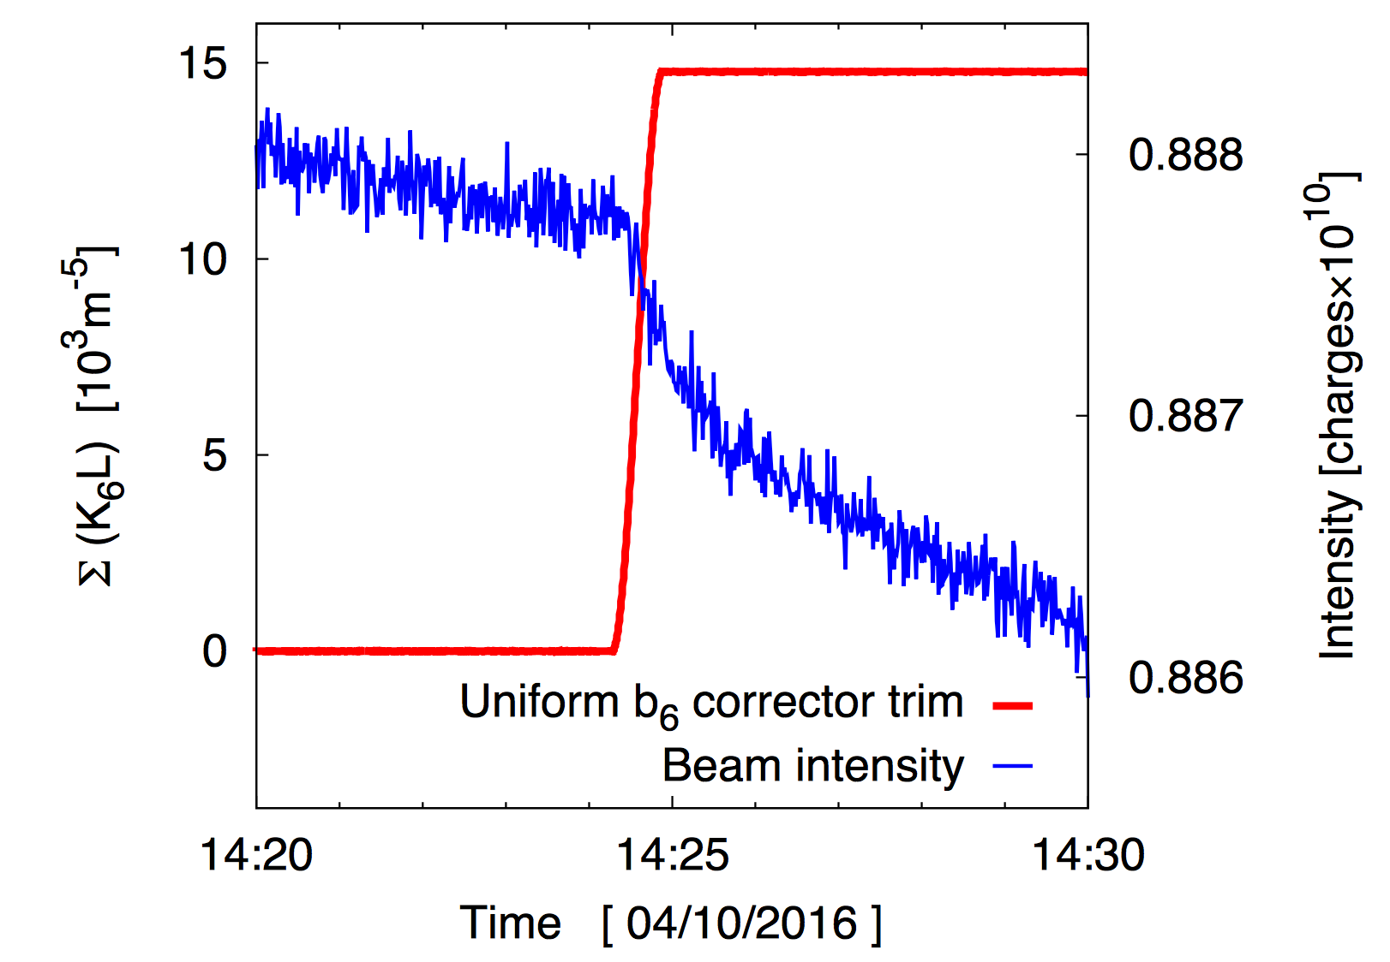
The reality - III
Impact on beam lifetime of b6 corrector in LHC
Courtesy E. Maclean

Slide 8
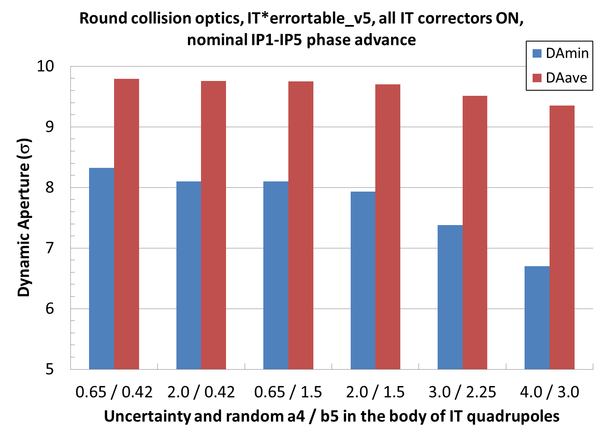
Other means to adapt to reality - I
Push the original functions of HL-LHC hardware elements to cope with the reality
  Use of a4 and b5 magnets to correct for observed larger-than-expected multipoles in the triplets.
Courtesy Y. Nosochkov
Very successful approach, but we might reach the maximum correctors’ strength

Slide 9
Other means to adapt to reality - II
Extend the original functions of HL-LHC hardware elements to cope with the reality
  Use of b3 and b5 magnets to correct for the corresponding multipoles of D2, thus making the field quality of D2 less critical for performance
    Some technical issues (single-aperture corrector for double-aperture magnet) can be overcome
    Preliminary results are encouraging for b3
    Improvement is still needed for b5

Slide 10
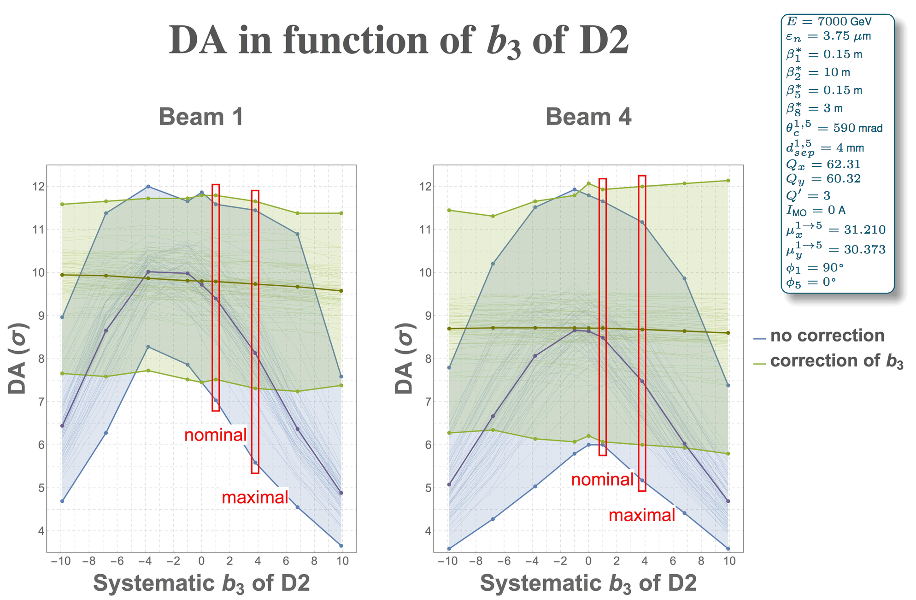
Other means to adapt to reality - III
Courtesy F. Van der Veken

Slide 11
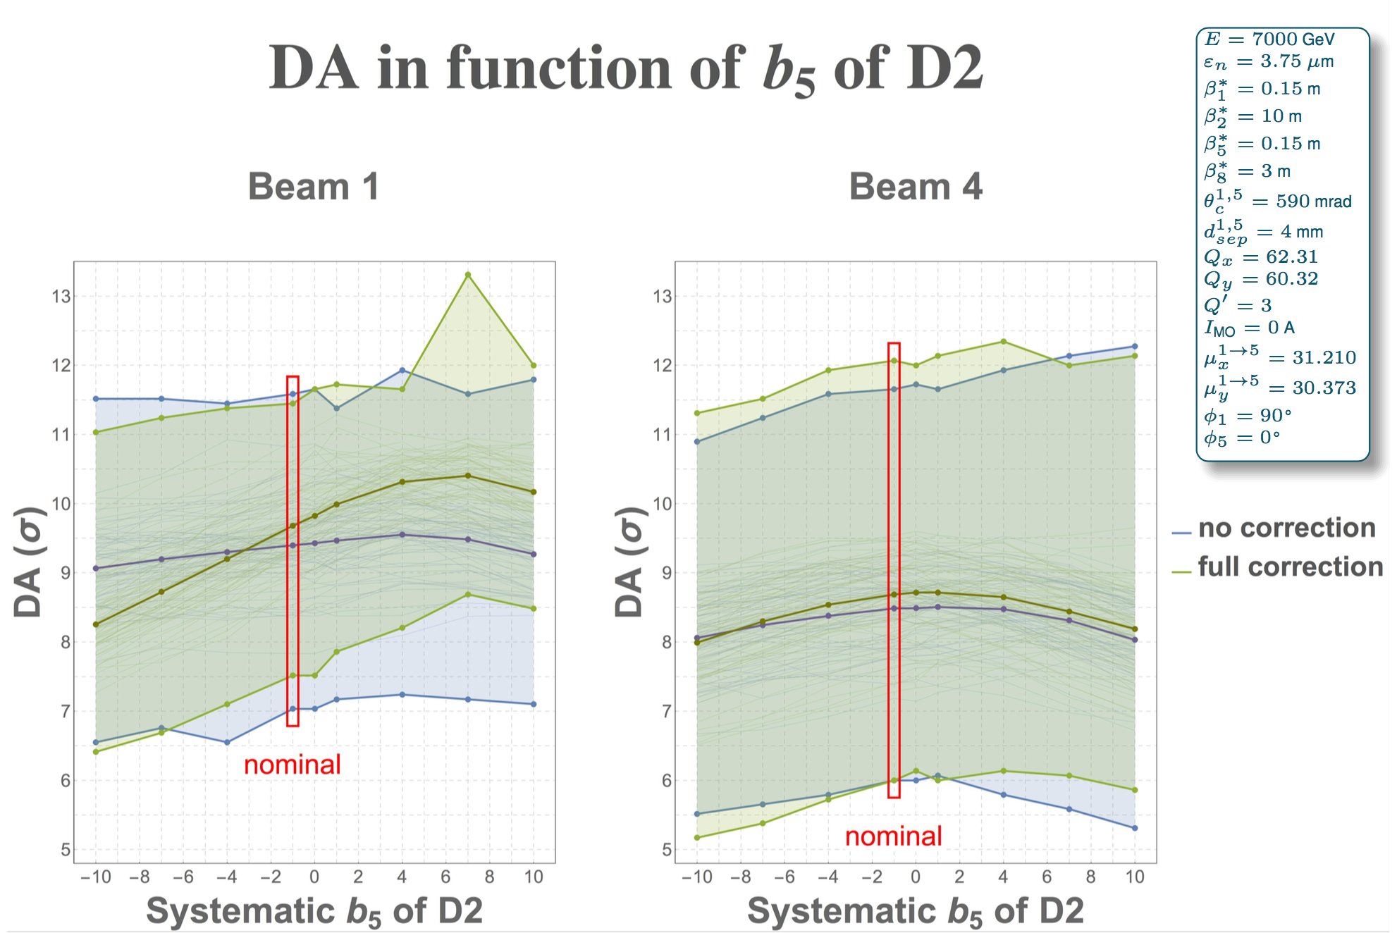
Other means to adapt to reality - IV
Courtesy F. Van der Veken

Slide 12
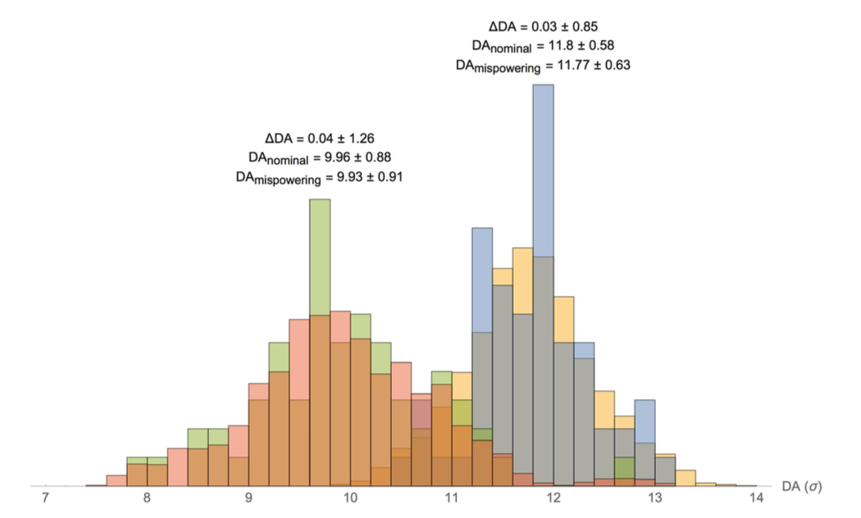
Other means to adapt to reality - V
The analysis can be pushed to consider finer detail to predict more accurately the performance
  Consider realistic effects affecting non-linear correctors
    Mispowering
    Mechanical misalignments
Courtesy F. Van der Veken
DA is computed using 60 realisations of magnetic errors.
64 configurations each representing a random mispowering of all non-linear correctors.
The distributions of DA averaged over angles is almost the same for the two cases.

Slide 13
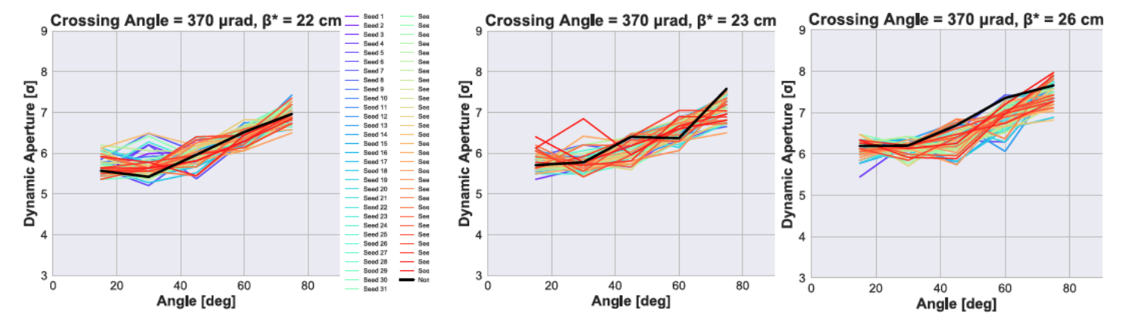
Other means to adapt to reality - VI
The analysis can be pushed to consider finer detail to predict more accurately the performance
  Consider the interplay between magnetic errors and beam-beam
Courtesy Y. Papaphilippou

Slide 14
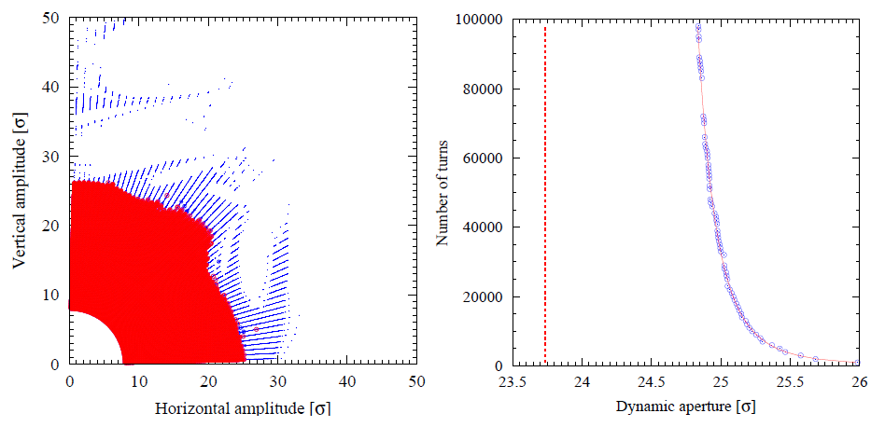
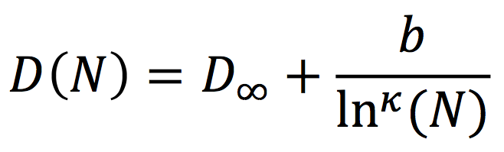
New concepts - I
A critical review of the concepts used so far is on going, aiming at proposing figure of merit(s)
  More predictive
  With closer link to physical observable(s)
Stable region for 10⁵ turns
Unstable region
Dynamic aperture
Well defined for numerical simulations
Heavy in terms of CPU-power
Not so well defined in terms of physical observables
A simple law describes the time evolution of DA
It can be used to extrapolate DA

Slide 15
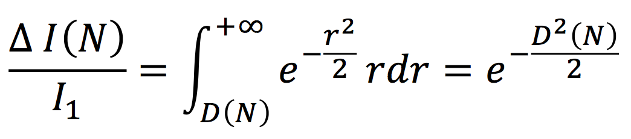
New concepts - II
Assuming that each particle with amplitude beyond D(N) is lost, it is possible to establish a link between losses and DA
Two direct applications
  Use of DA simulations to provide prediction of lifetime and beam losses
  A direct method to measure DA
For Gaussian beams

Slide 16
New concepts - III
Standard method to measure DA
  Kick the beam towards large amplitudes
  Observe sudden beam losses
Novel method to measure DA
  The beam is blown up gently to generate slow losses
  The DA is inferred by fitting the intensity evolution using the scaling law
It is clear that
  The standard method needs to impart large kicks -> not suitable for high-energy machines
  The standard method generates large losses -> not suitable for superconducting machines

Slide 17
New concepts - IV
Standard method to measure DA
E. H. Maclean et al., Phys. Rev. ST Accel. Beams 17, 081002 (2014)
Left: sketch of the standard method for DA measurement
Right: numerical simulations showing agreements between measurements and model.

Slide 18
New concepts - V
Novel method to measure DA
Outcome of the DA measurement with the novel method
Simulation (lines)
Measurements (markers)
Different configurations of the non-linear elements are tested.
Data from measurements at top energy in the LHC are also available.

Slide 19
A quick look at crab cavities - I
Two crab cavities/beam/IP side in combination with the low-impedance collimators
DQW cavities => Further work has been done to reduce the impedance of a remaining HOM at 920 MHz by a factor ~ 20 (new table from 21-10-2016 used)
Beam is stable for a current in the Landau octupoles (LOF) < ~ 300 A (maximum of 590 A), whatever the sign and even if the transverse tails would be cut down to ~ 3 σ
Courtesy E. Métral

Slide 20
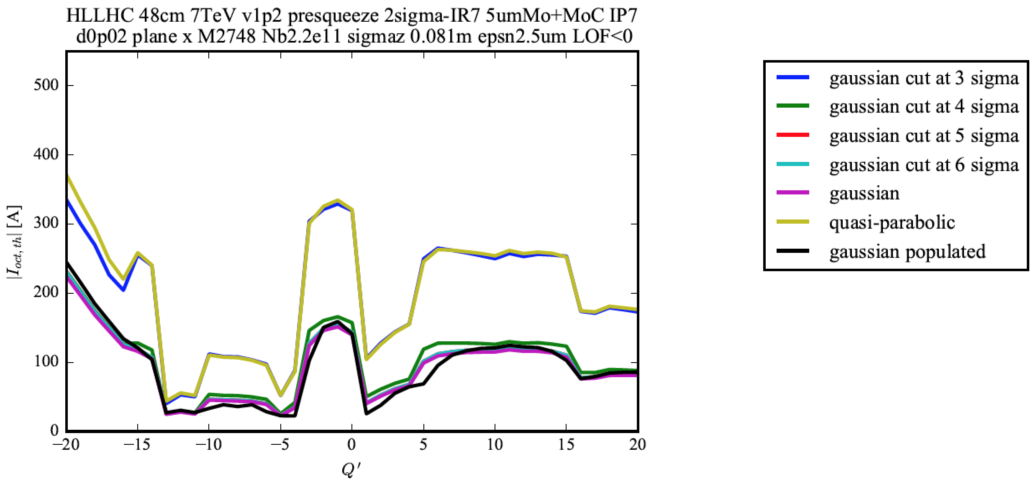
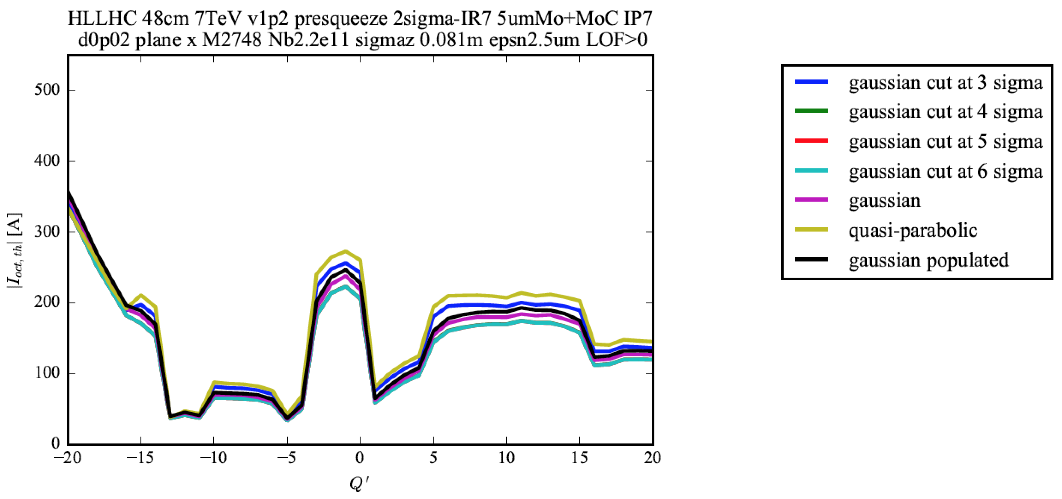

LOF < 0
Courtesy N. Biancacci
LOF > 0

Slide 21
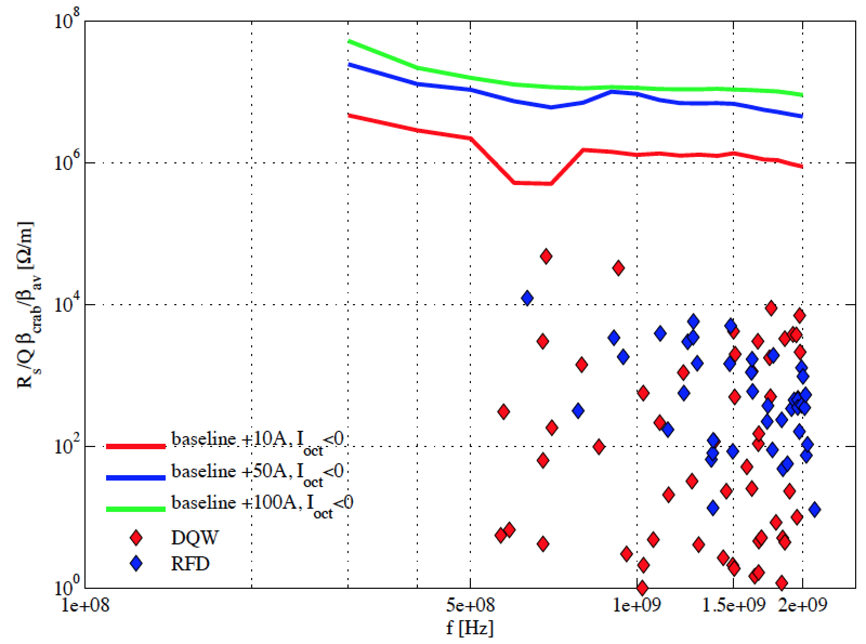
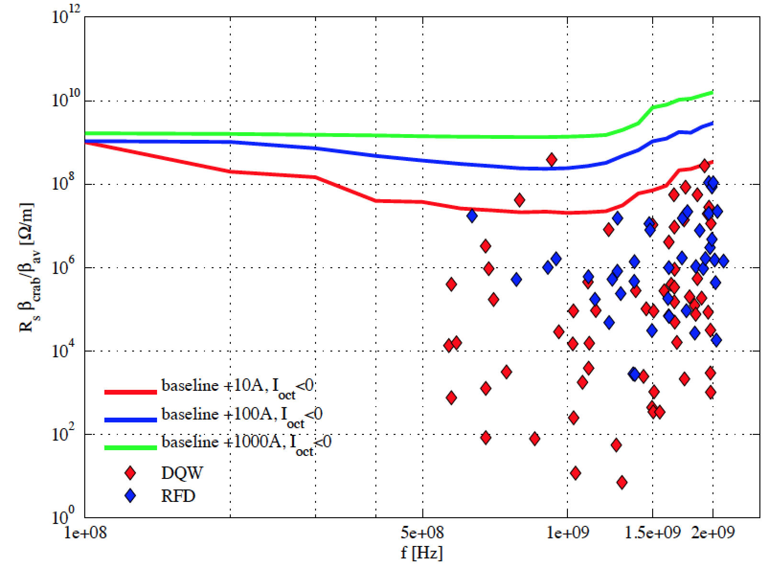
A quick look at crab cavities - II
HOM of the DQW and RFD crab cavities and corresponding single bunch thresholds for the increase of octupole current over the machine baseline
HOM of the DQW and RFD crab cavities and corresponding coupled bunch thresholds for the increase of octupole current over the machine baseline
Courtesy N. Biancacci
Mode at 920 MHz => Recommendation to try and damp it

Slide 22
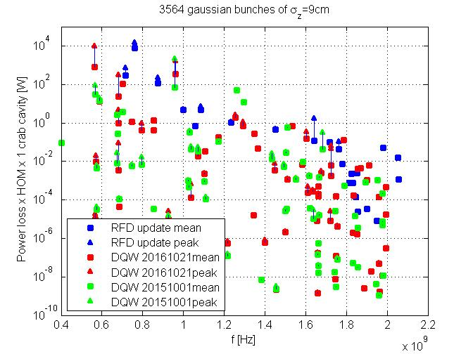
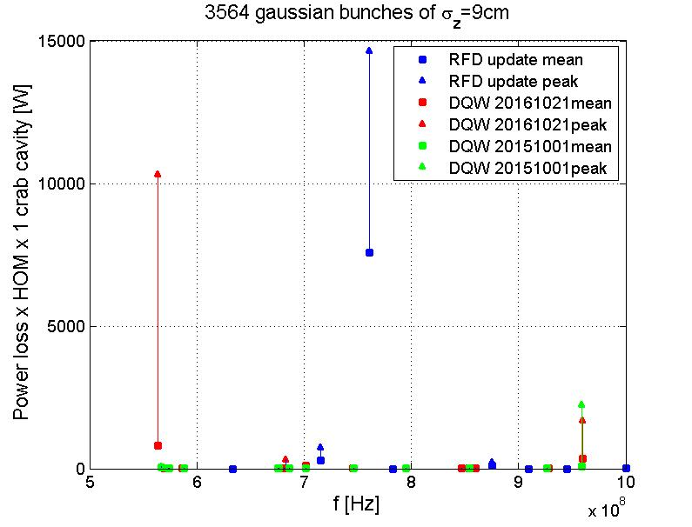
A quick look at crab cavities - III
Courtesy E. Métral
Critical modes if hit a beam line

Slide 23
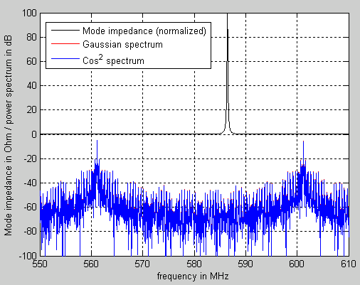
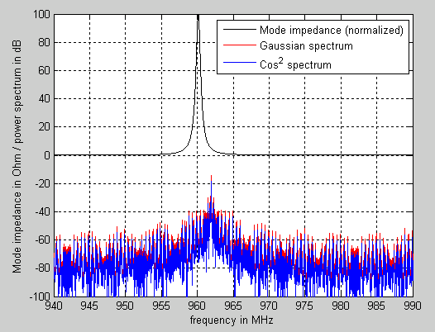
A quick look at crab cavities - IV
Courtesy E. Métral
Need the modes to be sufficiently far from a beam line (~ 5 MHz) to avoid kW of induced power

Slide 24
Conclusions and outlook
Beam physics is actively involved on several fronts to provide
  The best estimate of HL-LHC performance
  To ensure that the performance is at least preserved, with the evolution of the baseline and the technological achievements
The various activities cover
  Theory and simulations
  Beam experiments
Enough work for several years to come!

Slide 25
Thank you for your attention!

