Slide 1

HL-LHC Project at CERN / Europe
New Collaboration Framework
O. Brüning, Beniamino Di Girolamo and Lucio Rossi
26th April 2017 – Joint LARP CM28/HiLumi Meeting in Napa, CA USA

Slide 2
High Luminosity Work Packages after FP7 DS:

Slide 3
High Luminosity Project Office after FP7 DS:
Project Leader & Deputy
Project Definition & Strategy
Report to CERN Management and DHs
Report to Collaboration Board
Coordination technical WPs (2-14) & Collaborations
Safety officer
Budget Officer
Budget & its follow-up
Link to RC and to DAT
Project Office Manager
Coordination among officers, secretariat, interface with host states, General Planning Coordination, Safety follow up
KT, Outreach and Communication
Technical Infrastructure Officer
Civil Engineering
Impact & Environ. Studies
Electrical Distr. & CV
Access & Alarm
Logistics & link to Test Infra.
Consolidation & Operations
Configuration, Quality and Resource Officer
TDR Edition & Tech. Baseline
(PBS, interfaces, Tech. Specs, Technical documentation & ECR)
Quality and Risk management
Resource & Purchase Plan
Integration and Installation Officer
Integration study and layout
Lead (de-) installation
Survey

Slide 4
HL-LHC Technical Collaborations
Launched effort for building collaborations beyond the FP7:
  Continuation of collaboration that were started under FP7
  proposals for new in-kind contributions ‘k-contracts’
    ca. 50-50 cost sharing for deliverables plus resource
    contributions
Preparation of new general framework / collaboration contract
for the HL-LHC project: MoU
  Non-committing general agreement (no entry or annual fee!)
  Deliverables and commitments specified in dedicated
  addendums
See the detailed presentation by Beniamino at the HL-LHC annual meeting in Paris for more details

Slide 5
HL-LHC Technical Collaborations
New HL-LHC Collaboration Board:
  First meeting at the annual HL-LHC meeting in Paris in 2016
  Election of the new HL-LHC CB Chairperson:
    Rob Appleby, Manchester University, elected for 2 years
    The HL-LHC CB will meet once per year
        next meeting in Madrid hosted by CIEMAT
Existing Collaborations with in-kind contributions:
  9 MS & 5 NMS signed 5 MS and 3 NMS Under preparation
  several agreements include multiple deliverables & partners
  e.g. UK (7 partner & 4+ contributions) and
  USLARP (4 members + 2 partner & 5+ contributions)

Slide 6
Post FP7 HL-LHC Project Governance:

Slide 7
HL-LHC Collaboration Board: HLCB
Mandate:
The HL-LHC Collaboration Board [HLCB] is the official forum for information exchange and dialogue between the HL-LHC collaborators, the HL-LHC project management and the CERN management.
The HL-LHC Project Leader will inform the HLCB regularly about the situation of the project, including technical and financial aspects and the overall project schedule, and will make proposals for in-kind contributions and collaboration topics. The HL-LHC collaboration partners will report via the HLCB to the HL-LHC project management and the other collaboration partners about delivery schedule and progress of technical implementations of their contributions or changes in the expected performance scope and reach of their contributions. When needed, the HLCB will discuss measures to cope with technical or financial shortfall, as well with delay of deliverables from the collaboration partners and give advice and recommendations to the project management for the resolution of such issues
➔ The HLCB reports to the HL-LHC Project Leader.

Slide 8
HL-LHC Collaboration Board: HLCB
Organization:
'The chair of the Collaboration Board chairs the HLCB meetings and discussions between the HLCB members. The chair will also communicate any recommendations or advice from the HLCB to the HL-LHC project management’
The chair is appointed for a 2 year mandate but can be re-elected.
Composition:
HL-LHC Collaboration Board consists of one representative per collaborating institute of the HL-LHC project and ex-officio of the HL-LHC project management, i.e., HL PL, HL DPL and the HL Project Office Manager. The Director of the Accelerator and Technology Sector at CERN, or his/her representative, will also be ex-office member.
'Collaboration partners include laboratories and institutes who have either signed directly a HL-LHC collaboration agreement or are part of an overreaching general collaboration agreement and provide either significant in-kind contributions or studies and personnel for the HL-LHC project.'
Institutes that have signed the framework agreement but not a Collaboration agreement with an explicit contribution to HL-LHC can be invited as observers.
Each MoU signatory with explicit contribution has one representative

Slide 9
HL-LHC Collaboration Board
Members: 21
Observers: 10
Name | Institute/University
APOLLINARI, Giorgio | FNAL/LARP
APPLEBY, Rob | University of Manchester
BOOGERT, Stewart | Royal Holloway University
BORDRY, Frederick | CERN
BRUNING, Oliver | CERN
BURT, Graeme | University of Lancaster
EKELOF, Tord | University of Uppsala
GARCIA, Luis | CIEMAT
GOURLAY, Steve | LBNL
OGITSU, Toru | KEK
WHEELHOUSE, Alan | STFC
RATOFF, Peter | Cockcroft Institute
ROSSI, Lucio | CERN
ROLLI, Simona | DOE
TAVIAN, Laurent | CERN
VEDRINE, Pierre | CEA
WANDERER, Peter | BNL
WELSCH, Carsten | University of Liverpool
YANG, Yifeng | University of Southampton
ZOCCOLI, Antonio | INFN
RAUBENHEIMER, Tor | SLAC
Name | Institute/University
ABDOLVAND, Amin | University of Dundee
BARLOW, Roger | University of Huddersfield
BUGADOV, Julian | JINR
DELAYEN, Jean | ODU/JLAB
KARLSSON, Kenneth | LAPIN
KESTER, Oliver | TRIUMF
KULKA, Jan | AGH-UST
LEVICHEV, Eugeny | BINP
RIVKIN, Lenny | EPFL
SYNTFELD-KAZUCH, Agnieszka | NCBJ

Slide 10
New Collaboration Agreement
New multi party MoU [finished and ready for distribution] specifies explicitly for each partner institute the general link persons for the general, non-committing part of the agreement
-dynamic list of laboratory representatives
-dynamic list of contributions and deliverables
Collaboration partners will receive automatic updates of the membership list whenever a new partner signs the agreement
-transparent membership list
Concrete deliverables that imply commitment from the partner institutes are described in dedicated addendums
-safety link person
-technical expert

Slide 11
Status of MoU
Done a first round of circulation for Institution that expressed the will to sign or consider to sign
Needed a second reminder for the other Institutions to give feedback
MoU = Memorandum of Understanding
CA = Collaboration Agreement

Slide 12
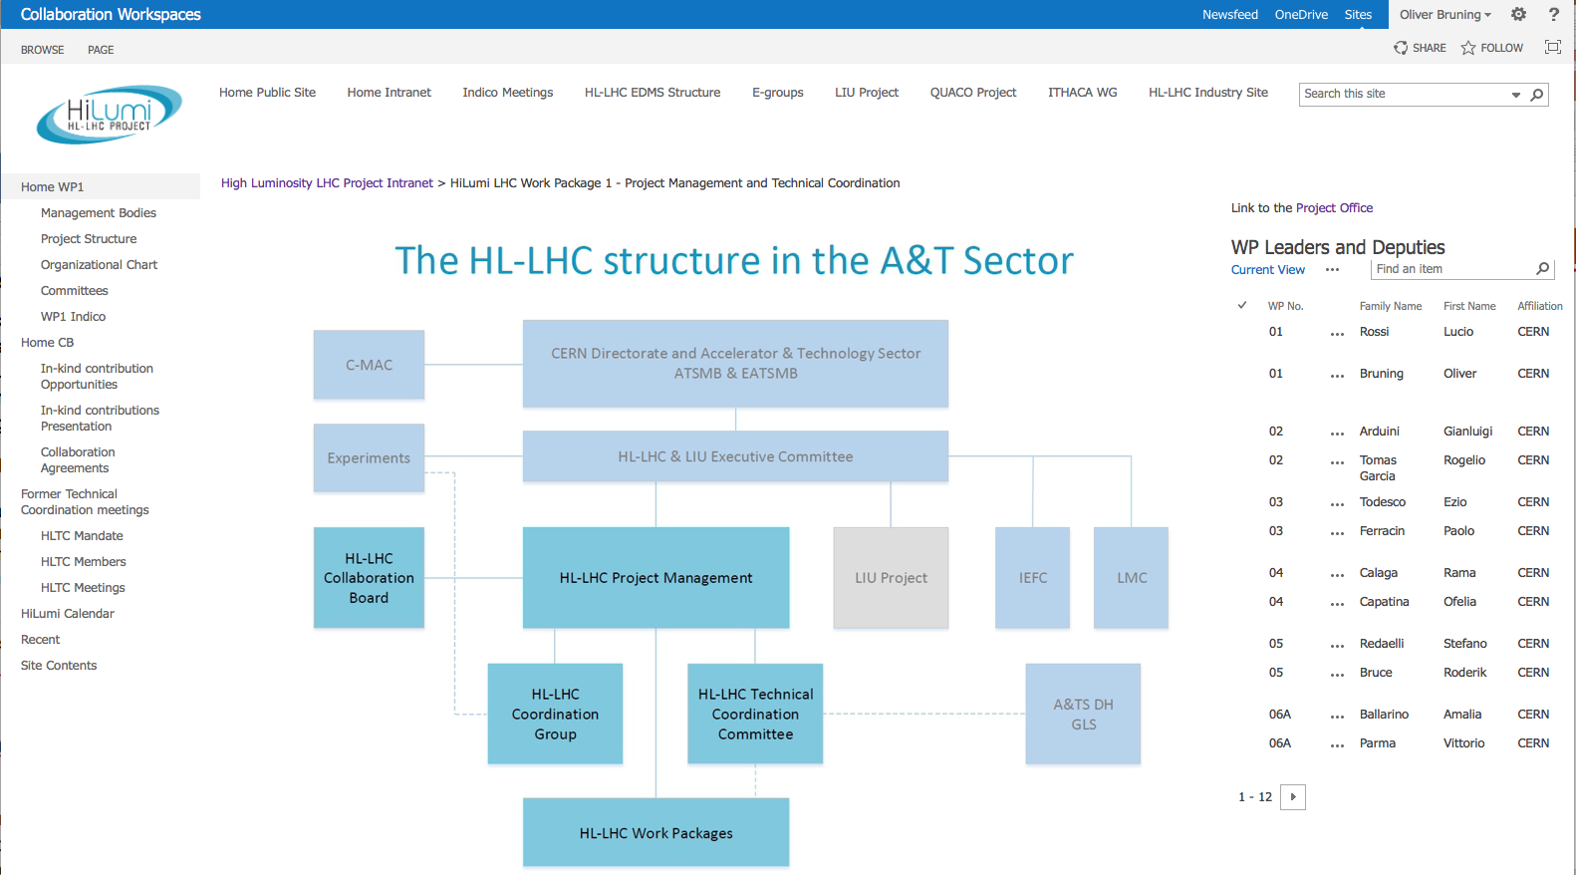
HL-LHC Intranet Page:
https://espace.cern.ch/HiLumi/WP1/default.aspx

Slide 13
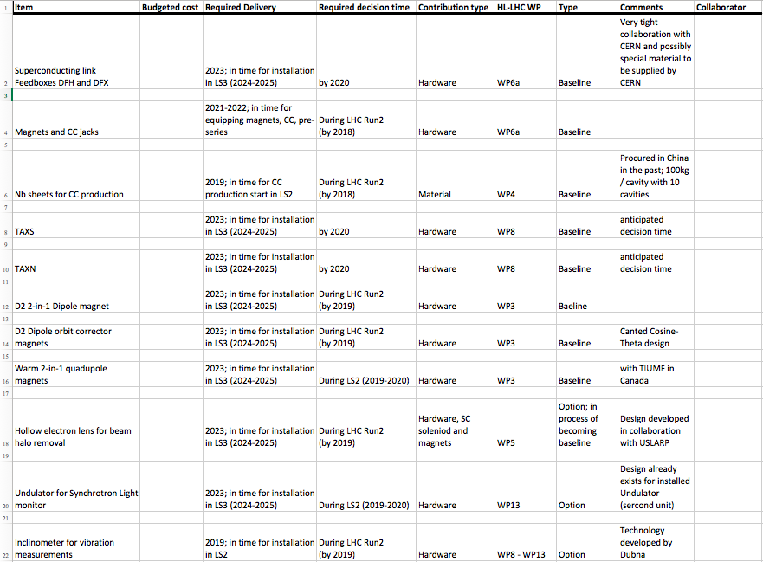
Excel Table for in-kind contributions:

Slide 14
Signed Member State Collaborations
France: Collaboration with CEA-Saclay
KE2275/TE/HL-LHC
(ca. 4.7 M€ CEA50%, CERN 50% + 2 MCHF Mat. Tool.)
-Construction of Fresca2 dipole magnet (Nb₃Sn large bore 13 T)
-Design and construction of Q4 quadrupole magnet short model
-HTS coil small insert
-Other technological studies for advanced superconductors
France: Collaboration with CEA-Saclay
KE2736/TE/HL-LHC, [CERN 169kCHF, CEA50%,CERN50%]
-Cryogenic studies
Spain: Collaboration with CIEMAT Madrid KE2292/TE/HL-LHC (ca. 0.72 M€, CIEMAT60%, CERN40%)
-Design and construction of: nested orbit corrector magnet prototype

Slide 15
Signed Member State Collaborations
Finland: University of Applied Sciences of Lapland
KE2491/EN/HL-LHC & KN2930 ADD2 & KE3134/TE/HL0LHC
(ca. 60kCHF for CERN)
-virtual visualization of underground areas of the LHC and HL-LHC
Sweden: Collaboration with Uppsala
KE 3082/TE/HL-LHC [2.3MCHF / CERN 0.85MCHF]
-Magnet and crab cavity measurements and tests
UK: Dundee University and Daresbury
KN3362/TE/HL-LHC [1.3MCHF / CERN 0.65MCHF] -Laser Engineered Surface Structures

Slide 16
Signed Member State Collaborations
Italy: Collaboration INFN (Milano & Genova)
KE2291/TE/HL-LHC (ca. 1.3 M€, INFN60%, CERN40%)
-Design and construction HO corrector magnets prototypes (five units)
-Engineering design of the D2 dipole magnet
Recently amended for duration until end 2018.
Italy: Collaboration INFN (Milano & Genova)
KN3083/TE/HL-LHC, KE3084, KE3085 (ca. 5.8 M€, INFN55%, CERN45%; ca 5.8 M€, INFN50%, CERN50%)
-Design and prototype of D2 dipole magnet
-Construction of HO correctors

Slide 17
Approved (under signature)
Member State Collaborations
UK: Collaboration with 7 partner institutes KN3295/GEN, KE3296,
3299/TE/HL-LHC, KE3297 & 3298/BE/HL-LHC, (ca. 7.5M£ 50/50)
-University Manchester [coordination; collimation; crab cavities]
-University Liverpool [crab cavities, diagnostics]
-University Huddersfield [collimation]
-Lancaster University [crab cavities]
-Royal Halloway University [collimation, diagnostics]
-University Southampton [cold powering]
-ASTEC/STFC [crab cavities]

Slide 18
Member State Collaborations in Preparation
France: Collaboration CEA Saclay KN3573 [ca. 6 MCHF 50/50]
- Q4 Quadrupole development
- High Field Magnet Technology and Material characterization
- Spare LHC quadrupoles
Spain: Collaboration CIEMAT Madrid KN3574 [ca. 14 MCHF 65/35]
- Construction of nested orbit corrector magnet for the series production
Italy: Collaboration INFN
- Crystal collimations [ca. 60 kCHF]
- Synchrotron radiation tests on beam screens [ca. 750 kCHF]

Slide 19
Member State Collaborations in discussion
Sweden: Uppsala
-Three-phase production of MBW cyanate-ester coils
Greece: National Technical University Athens
-Absorbers
-Beam Instrumentation
- SC Magnet assembly and measurements [under discussion]
[On hold]
Spain: CAN Seville
-Radiation tests
Poland: Wroclaw University of Technology [Project Associates]
-cryogenic engineering
-magnet test facility

Slide 20
Established Non-Member State Collaborations
US: LARP Collaboration with 3+ partner institutes:
BNL, FNAL, LBNL, SLAC, ODU, JLab
(≈ 70 M$ R&D + 200M$+ as in-kind)
-R&D for new Nb3Sn triplet quadrupole magnets
-R&D for Crab Cavities
-Rotatable Collimator R&D
-Feedback system R&D
-Hollow e-lens studies and technical design
-Production of ½ of the triplet magnets
-Production of RFD Crab Cavities (e.g.½ of the re-scoped Crab Cavities)
-Hollow electron lens (if funding permits) [under preparation]
Japan: Collaboration with KEK (about 20 MCHF)
-R&D on superconductor
-Design and production of new superconducting D1 dipole magnets

Slide 21
Established Non-Member State Collaborations
Russia: Collaboration with BINP (150 kCHF)
- amorphous Carbon coating characterization with synchrotron radiation
JINR: Collaboration with Dubna (12 kCHF)
- alignment and vibration measurement devices industrialisation
Georgia: Collaboration with GTU (about 10 kCHF)
- Models vs built verification for LHC elements for the HL-LHC integration

Slide 22
Non-Member State Collaboration in discussion
Georgia: Georgian Technical University
-mechanical constructions for Beam Instrumentation
-mechanical construction for the HL-LHC jacks
Canada: Collaboration with TRIUMF [7 MQW]
1 prototype, 4 magnets and 2 spares; industrial contract can be larger!
-refurbishment / construction of normal conducting quadrupole magnets
-beam dynamics and beam-beam interaction studies
Russia: BINP
-TAXS and TAXN absorbers Add 3 to P110 [ca. 3 MCHF 50/50]
-gun for electron lens test stand
-(Cavity couplers, normal conducting magnets)
JINR: Collaboration on alignment and vibration measurement devices production Add 2 to P123 [ca. 50 kCHF]

Slide 23
Non-Member State Collaboration in discussion
China: Beijing University of Technology
-high current cathodes development [ca. 20 kCHF]
China: IHEP Beijing
-HTS current leads
- CCT magnet

Slide 24
Table of relative contributions
(based on estimated Project budget values)

Slide 26
New Collaboration Agreement: general part
Version 25-8-16
MEMORANDUM OF UNDERSTANDING
FOR COLLABORATION IN THE HIGH LUMINOSITY LHC PROJECT
AT CERN
Between: The European Organization for Nuclear Research (“CERN”), an Intergovernmental Organization having its seat at Geneva, Switzerland, as the Host Organization of the High Luminosity LHC project (“HL-LHC Project”);
and: The institutes, laboratories, universities and their funding agencies and other signatories of this memorandum of understanding,
Hereafter “Participant” and collectively “Participants”
CONSIDERING:
That CERN, an Intergovernmental Organization, is a leading global laboratory in particle physics, providing for collaboration of a pure scientific and fundamental character, with participation by scientific institutes from all over the world;
That XXX wishes to contribute to the HL-LHC Project, which aims at maximizing the performance of the LHC accelerator by increasing its luminosity, and that XXX has internationally recognized experience in fields that are relevant to the HL-LHC Project;
That the Participants will derive mutual benefits from their collaboration in the HL-LHC Project,

Slide 27
New Collaboration Agreement
AGREE AS FOLLOWS:
Article 1
Purpose
1.1 This Memorandum of Understanding (“MoU”) establishes the framework for collaboration in the HL-LHC Project. The current description of the HL-LHC Project is provided in CERN’s EDMS system. The Participants shall use the results of their collaboration for non-military purposes only.
1.2 By signing this MoU, the signatory becomes a Participant in the HL-LHC Project, together with other Participants. A list of Participants and their Funding Agencies is set out in Annex 1. Except as agreed otherwise, this MoU is without prejudice to any agreement or arrangement between CERN and the signatory existing at the date of the latter’s accession to this MoU.
1.3 Except for Articles 5, 6, 7, 9 and this Article, which are binding and shall survive termination of this MoU, this MoU is not legally binding, and each Participant’s involvement in the HL-LHC Project is on a best-effort basis. This MoU does not constitute or imply any commitment of resources. Without prejudice to the provisions of this MoU, it is understood that each Participant’s involvement in the HL-LHC Project is governed by its internal policies and regulations and the laws to which it is subject.
Article 2
Contributions
2.1 A Participant may contribute in terms of funds, expertise, equipment, materials and other in-kind contributions, knowledge and other resources. Except as agreed otherwise, each Participant shall bear the cost of its contribution to the HL-LHC Project.
2.2 Each Participant’s contribution, including, where applicable, the required resources, the duration of the activities and any deliverables, milestones, acceptance procedures and other key elements shall be set out in an Addendum to this MoU, which shall be signed by authorized representatives of CERN as the Host Organization and the Participant concerned. It is understood that a single Addendum can cover collaboration across multiple scientific and technological domains. The Addendum shall be subject to the provisions of this MoU.
2.3 The Participants may, as between themselves, and with any other entity, enter into arrangements or agreements as may be necessary for the delivery of their contributions, provided their terms are consistent with the provisions of this MoU.

Slide 28
New Collaboration Agreement
Article 3
Ownership of in-kind contributions
3.1 Save as provided in Article 3.2, ownership of and all risks related to in-kind contributions provided under this MoU shall transfer to the receiving Participant upon their delivery, including associated documentation, or, as the case may be, successful completion of acceptance tests, whichever comes later.
3.2 Where an in-kind contribution is provided as a loan, ownership and risk shall remain with the lending Participant, except as the Participants concerned agree otherwise. They shall agree on the return and/or disposal of the contribution upon completion of the loan period.
Article 4
Collaboration Board
The mandate of the HL-LHC Collaboration Board is set out in Annex 2. Each Participant shall in accordance with applicable membership rules designate one representative in the Collaboration Board, whose name it shall notify to the HL-LHC Project Leader and who together shall be listed in Annex 3.

Slide 29
New Collaboration Agreement
Article 12
Co-ordination
A Participant shall for each Addendum appoint a Technical Coordinator and a Safety Correspondent, whose name and contact details shall be set out in the Addendum, who shall not necessarily be the same person as their representative on the Collaboration Board.
Article 13
Amendments
Any amendment to this MoU shall be made in writing, signed by and communicated to the authorized representatives of the Participants.
Annex1
List of Participants
Annex2
Mandate
Annex3
Representatives in the Collaboration Board and contributions of collaborating partners
Beniamino Di Girolamo
will go through the details of the
new HL-LHC MoU

Slide 30
Memorandum of Understanding (MoU)
The draft has been finalised integrating the comments that arrived within the deadline
A final version has been issued
It is composed by a fixed body where the only variable placeholders are the name of the Institute/Laboratory in two places
It has an evolving Annex 1 doing bookeeping of the signatories
It has a fixed Annex 2 with the Mandate of the Collaboration Board
It has an evolving Annex 3 with the composition of the Collaboration Board.

Slide 31
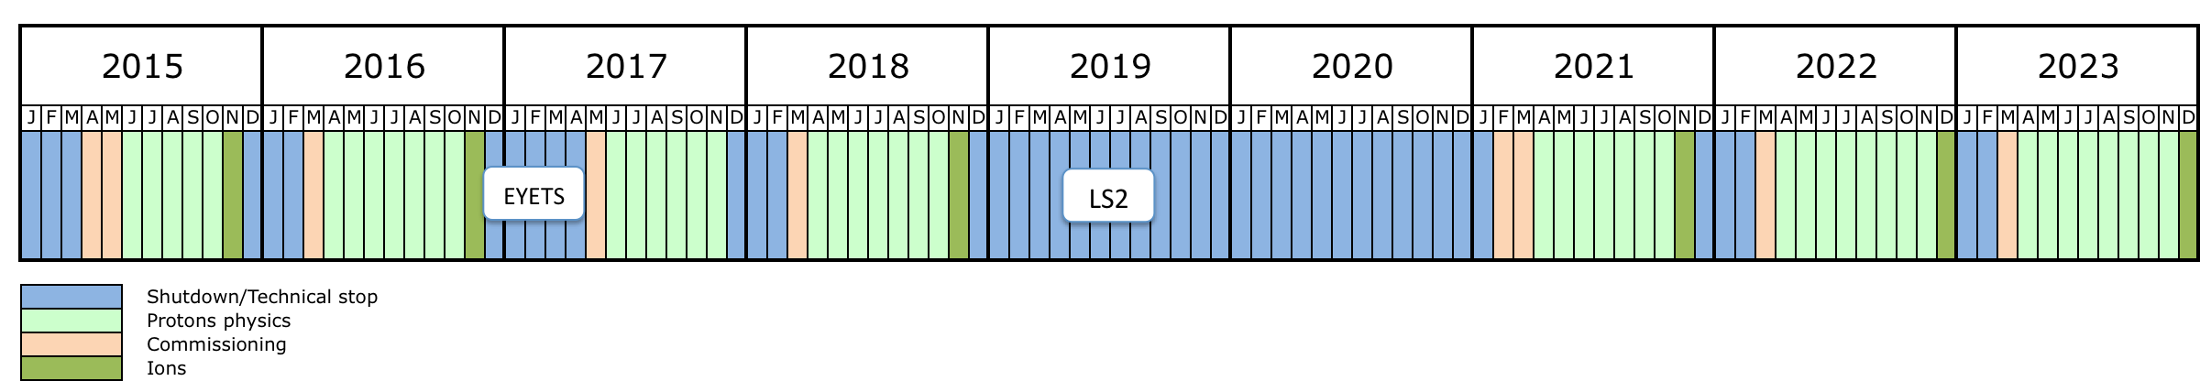
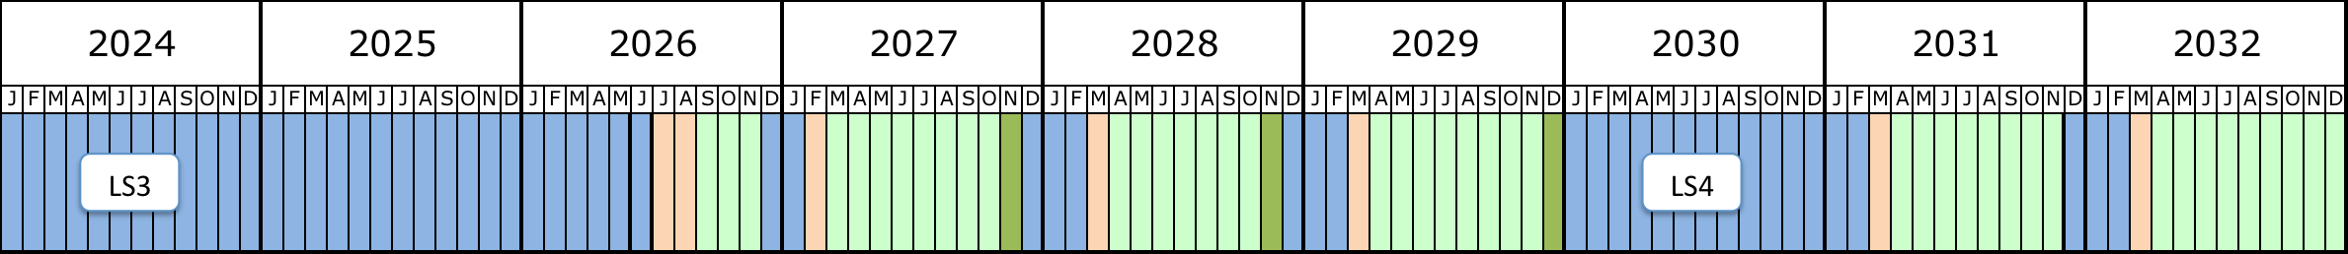
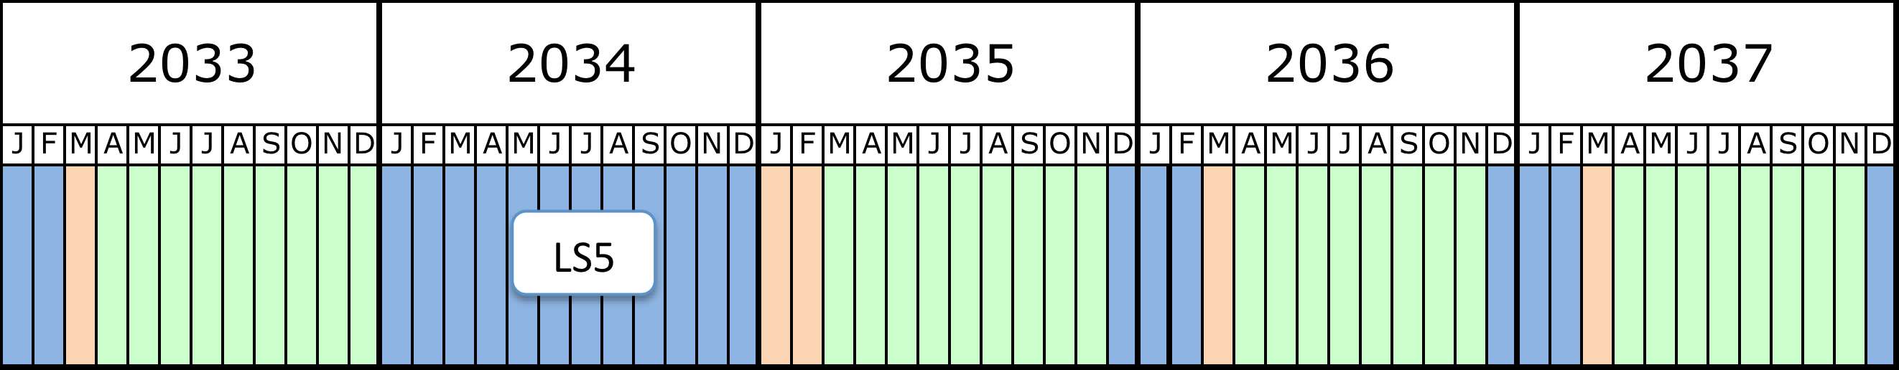
New Schedule: ➔ HL-LHC CE during LS2

