Slide 1
MDP Diagnostics update
(M7) Quench antennas, (M4) CORC network model and (M4) Scanner developments
October 27, 2021

Slide 2
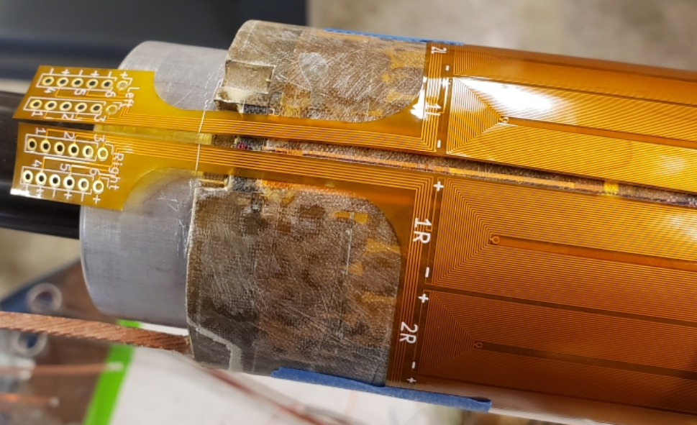
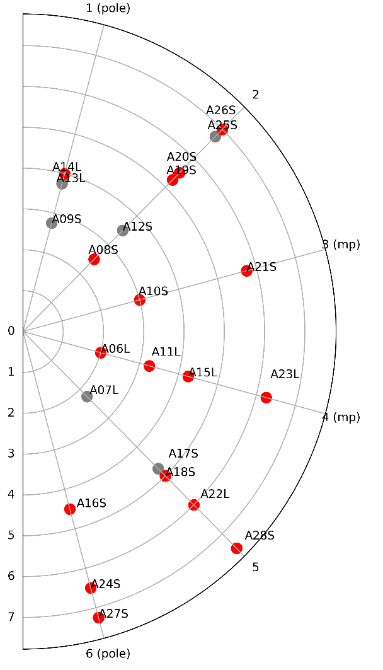
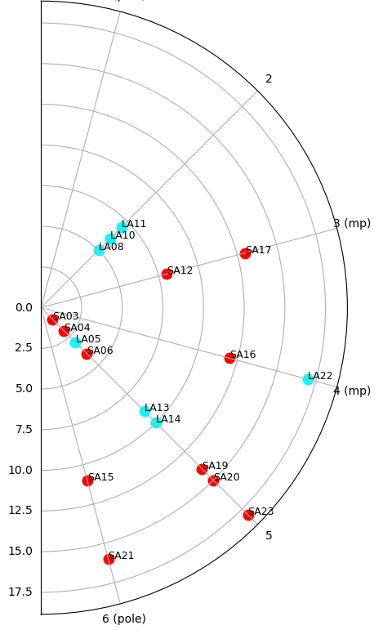
(M7) Quench Antennas
Scripted generation of antennas
Continuing to gather quench antenna data on magnet tests
  Sub 3 thermal cycle, Bi-2212 CCT, Sub 4
    Sub 3 thermal cycle – simultaneously gathered acoustics and quench antennas at high frequency
  Data analysis effort was paused due to funding, recently resumed
Feedback to magnet design
  (A) Identify quench locations in CCT magnets – provide direct feedback to magnet development
    See recent MDP talk by G. Vallone
  (B) Identify types of magnetic signatures – how they change during test, between magnets – and try to learn about the underlying mechanisms.
    Ongoing work – was paused due to funding constraints
(previously presented)
(new results)
Thin spar (SUB2)
Thick spar (SUB3)

Slide 3
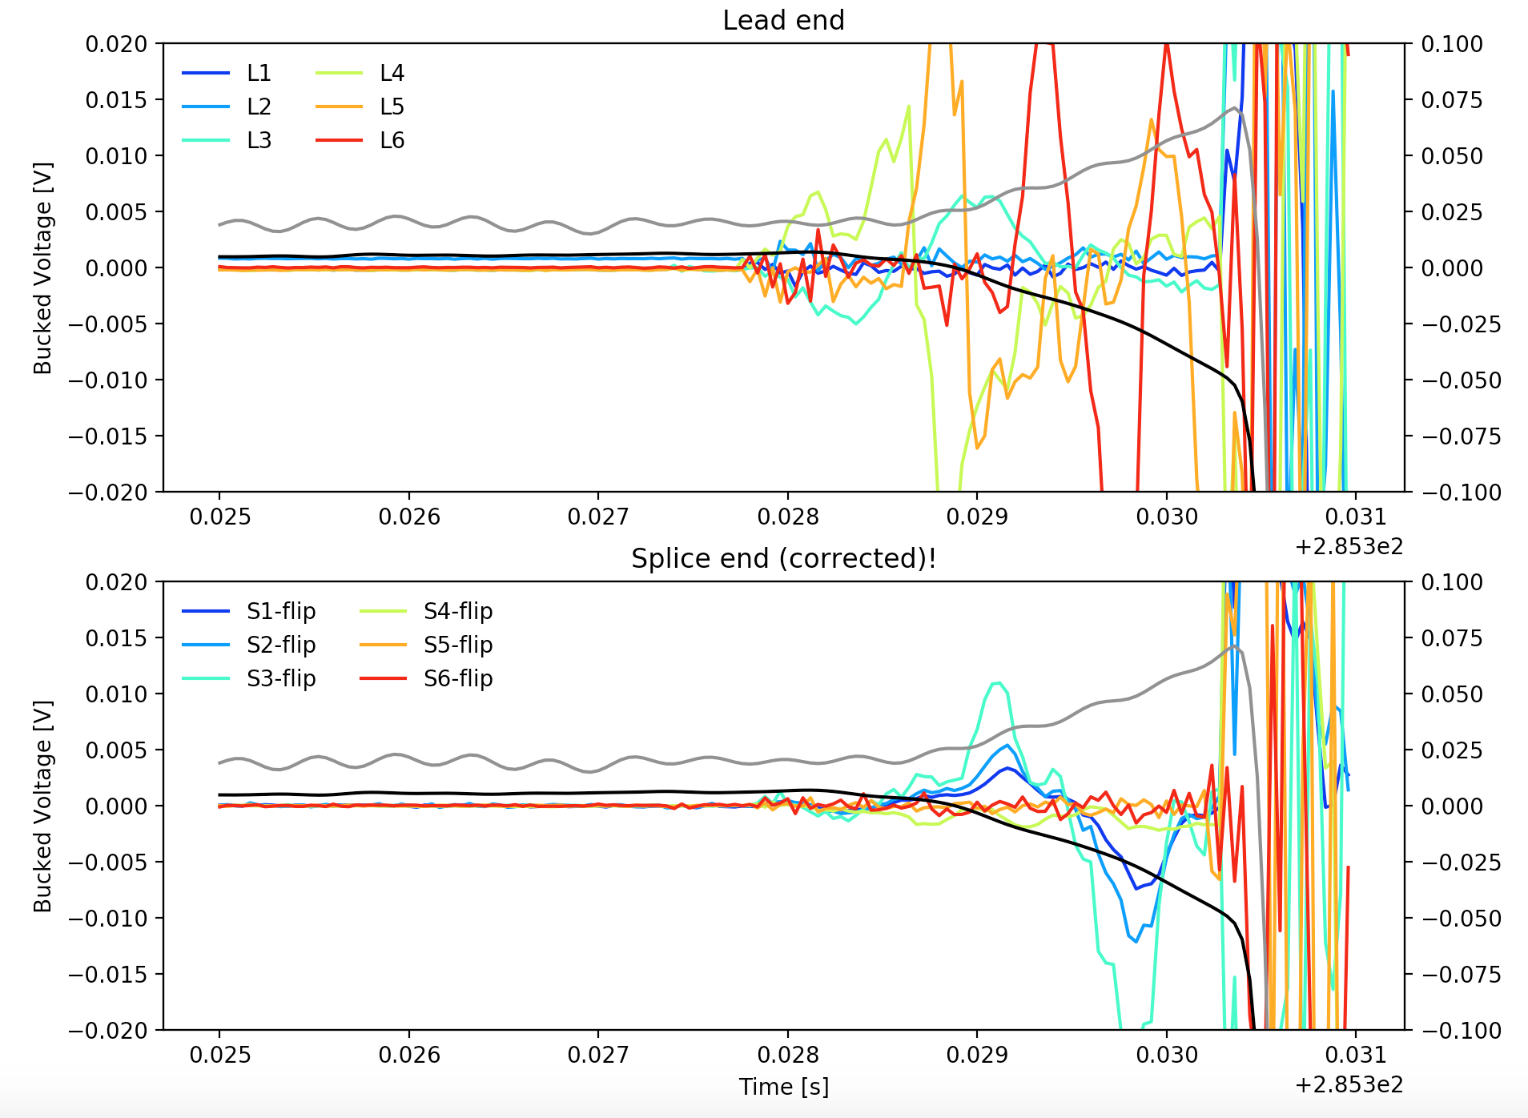
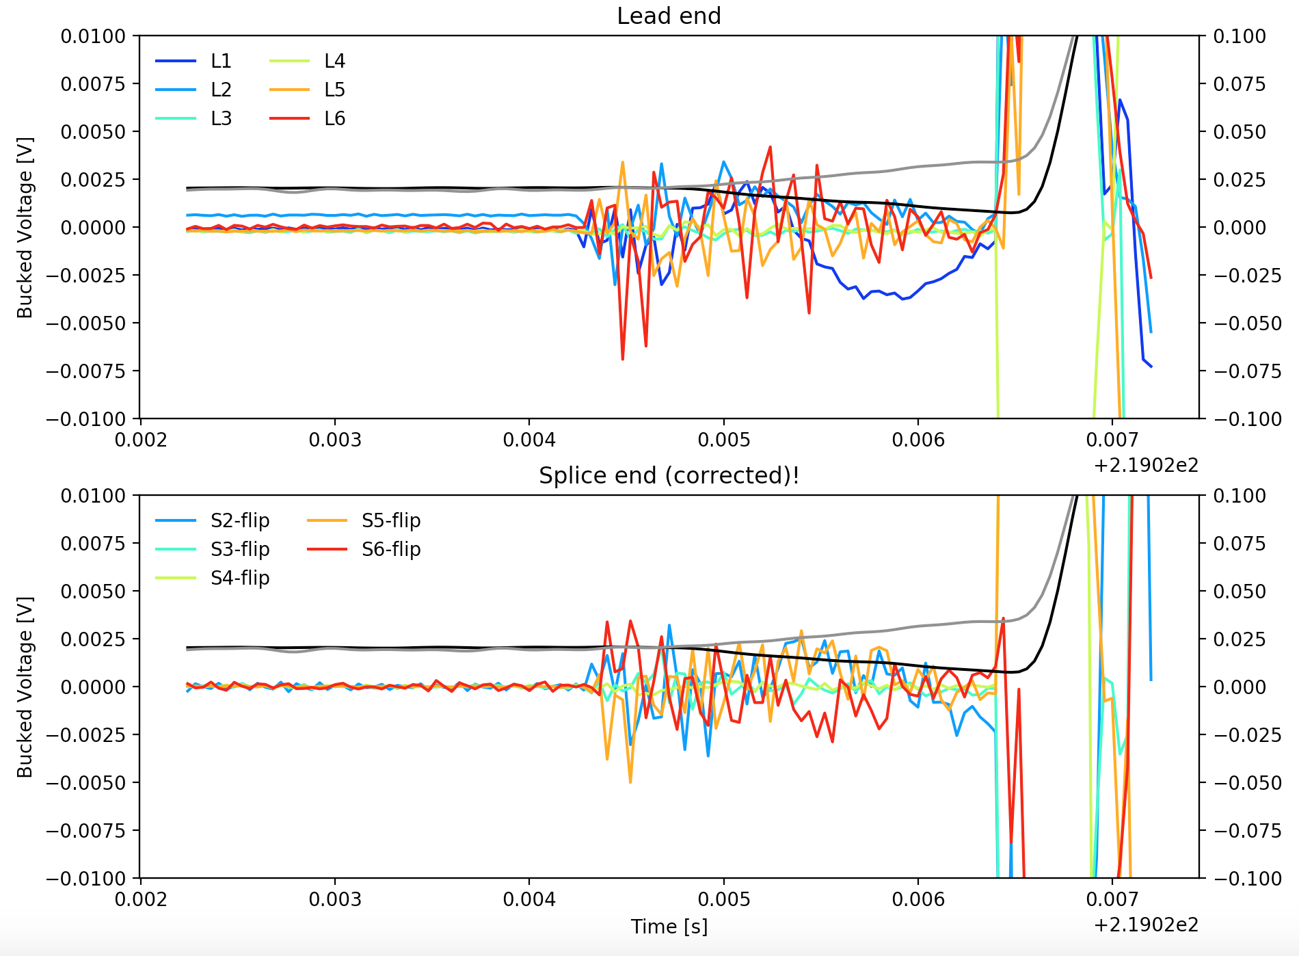
(M7) Quench Antennas – Recent Test
Most recent test was sub 4 – “thin spar” mandrel with CTD 701-X
  One early observation is that more quenches in S4 resembled vibrations across all channels (right) compared to what resembles current redistribution (left)
Sub 3 A22
Sub 4 A04

Slide 4
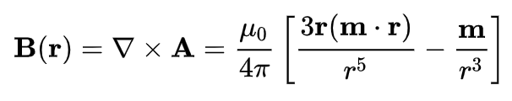
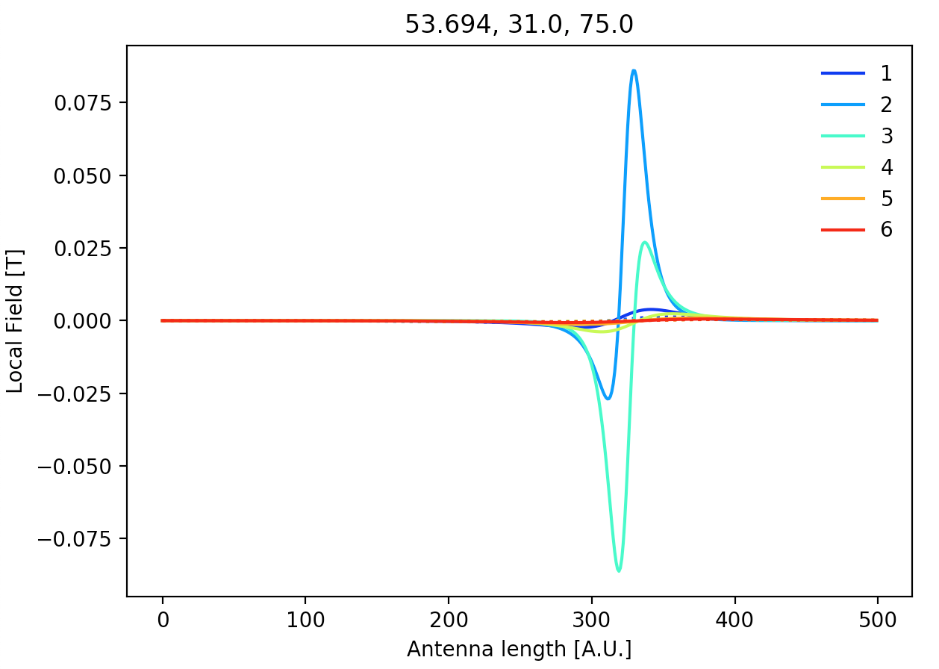
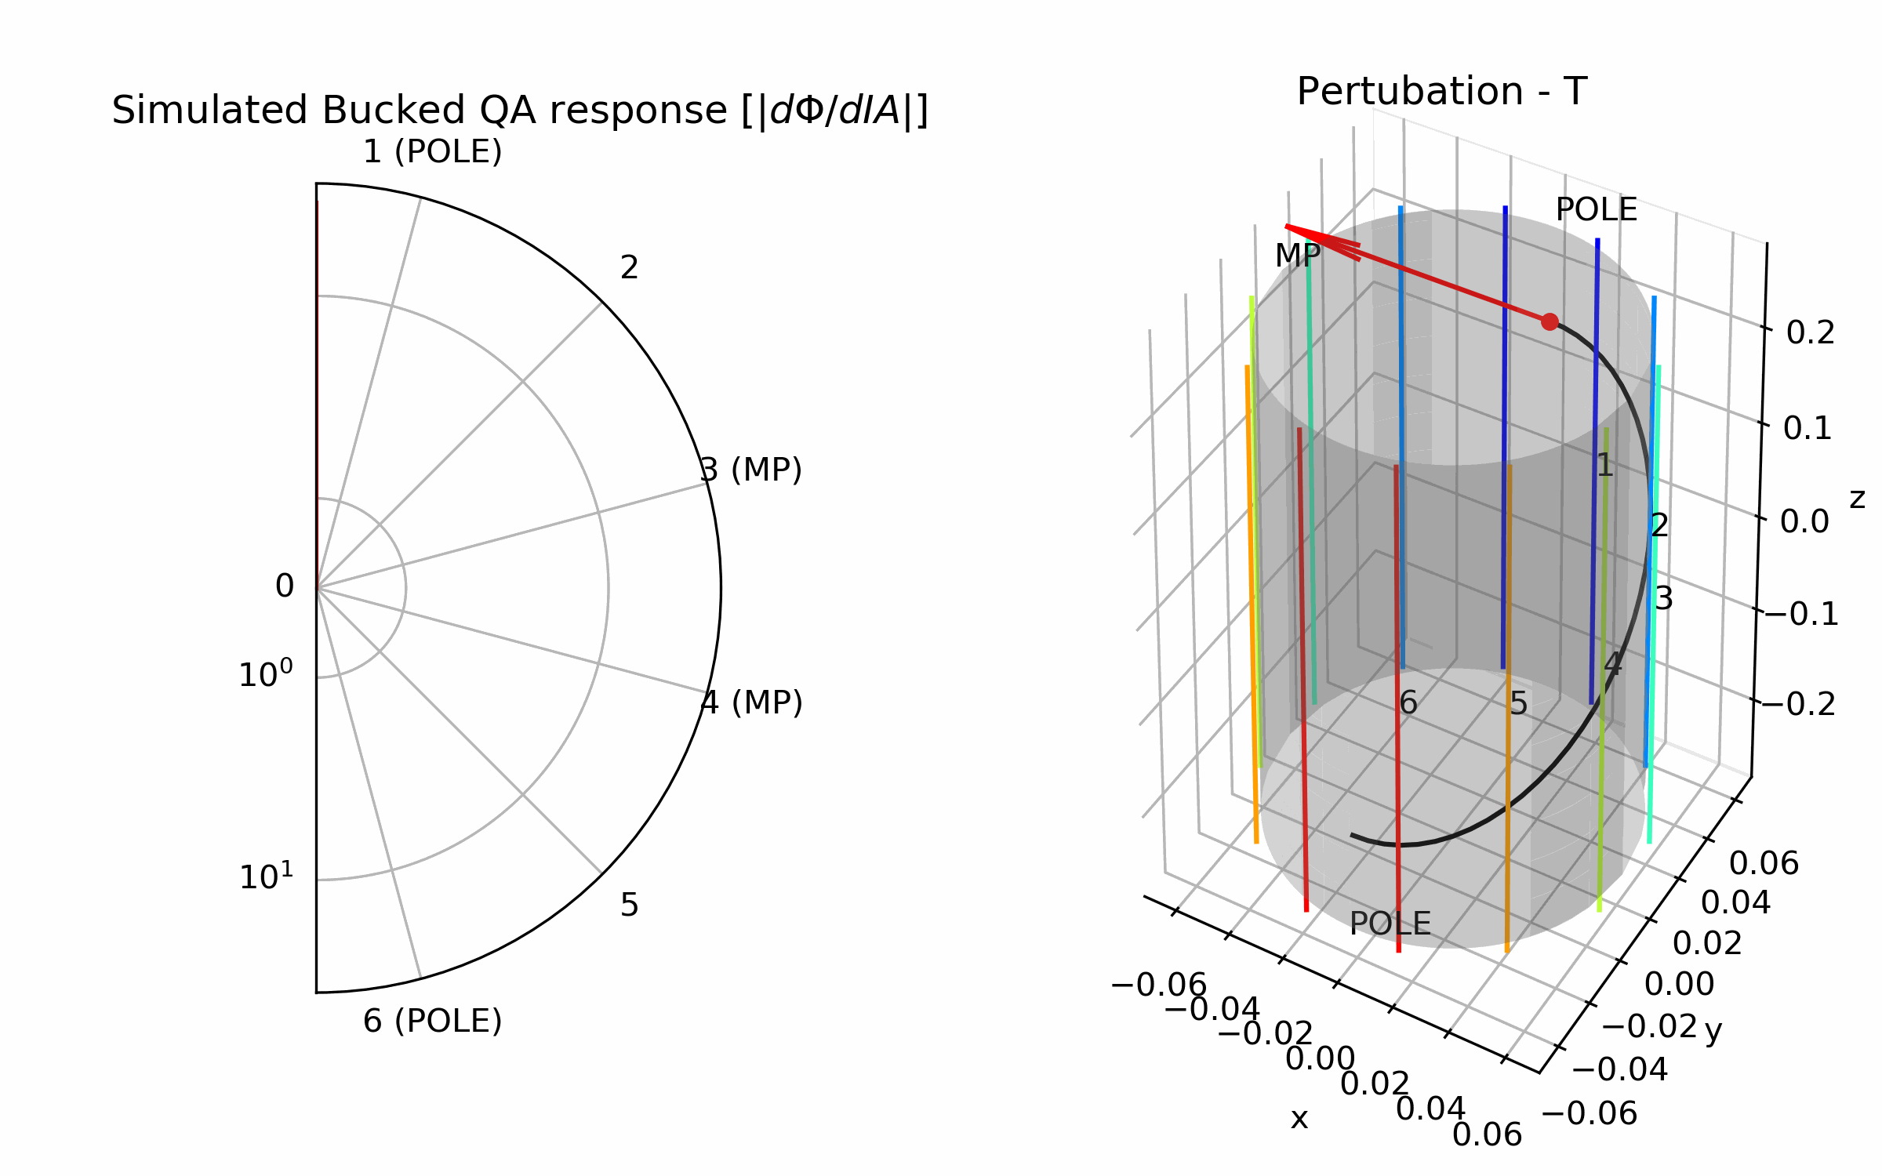
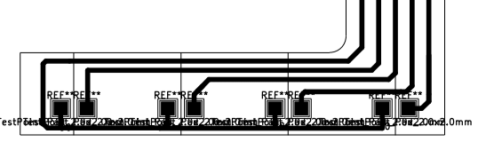
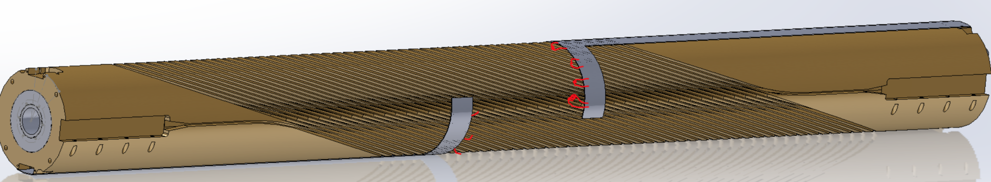
(M7) Quench Antennas – Next Steps
(1) Restart data analysis effort!
(2) Characterize antenna sensitivity to various magnetic moments along CCT path (right)
(3) Implement quench heaters in upcoming subscale to validate quench antennas, initiate well-defined normal zones
  PCB’s ordered, will embed heaters in groove

Slide 5
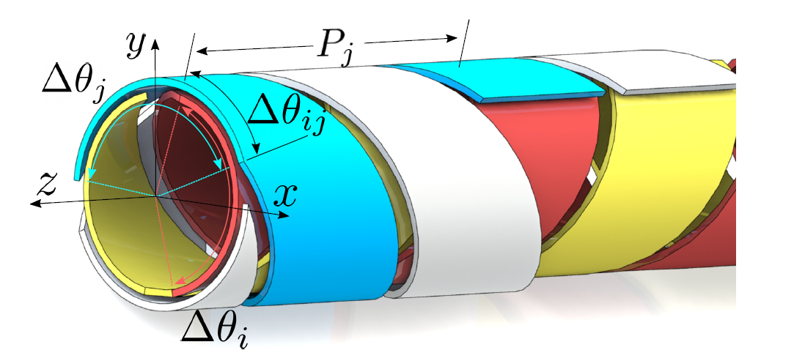
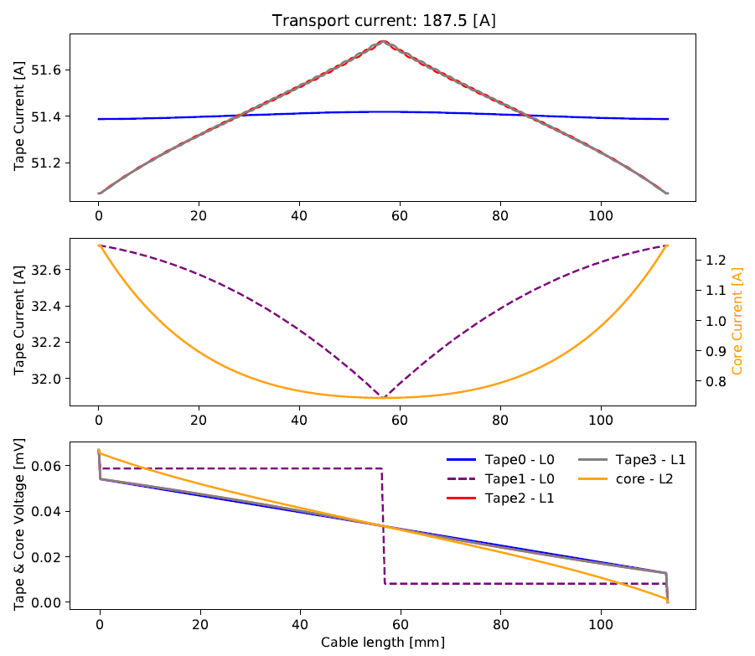
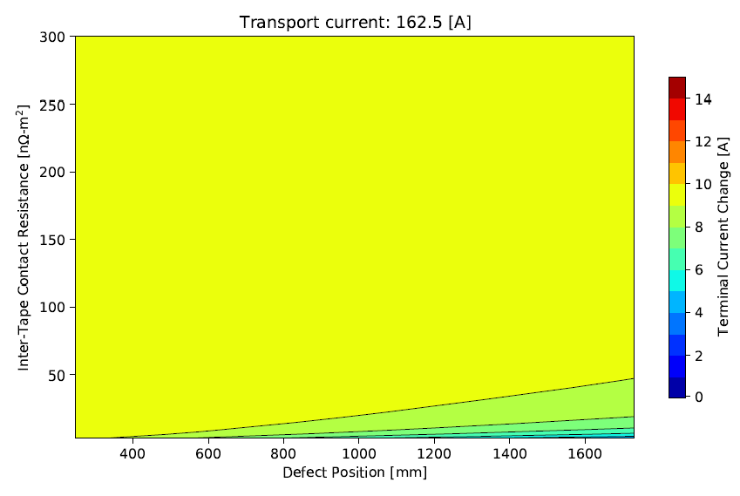
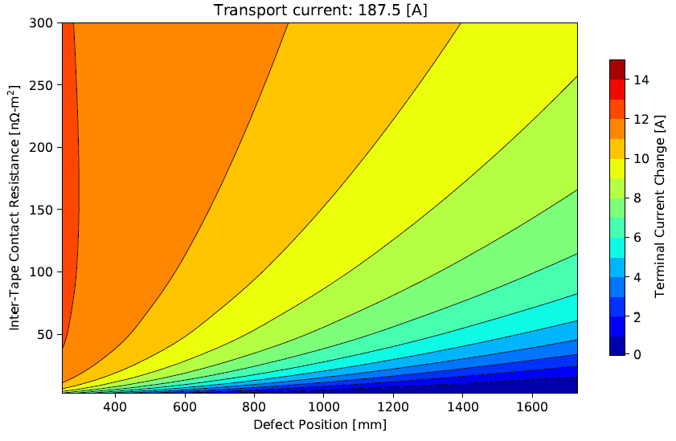
(M4) CORC Network Simulations
Developing CORC current sharing tool (static network model) to guide diagnostics efforts
  ‘’Does current redistribute in the terminal?” - Tool shows that SBIR smart terminal is promising
Current and voltage distributions with point defect in outer-most layer
Magnitude of terminal current redistribution vs. defect length and contact resistance

Slide 6
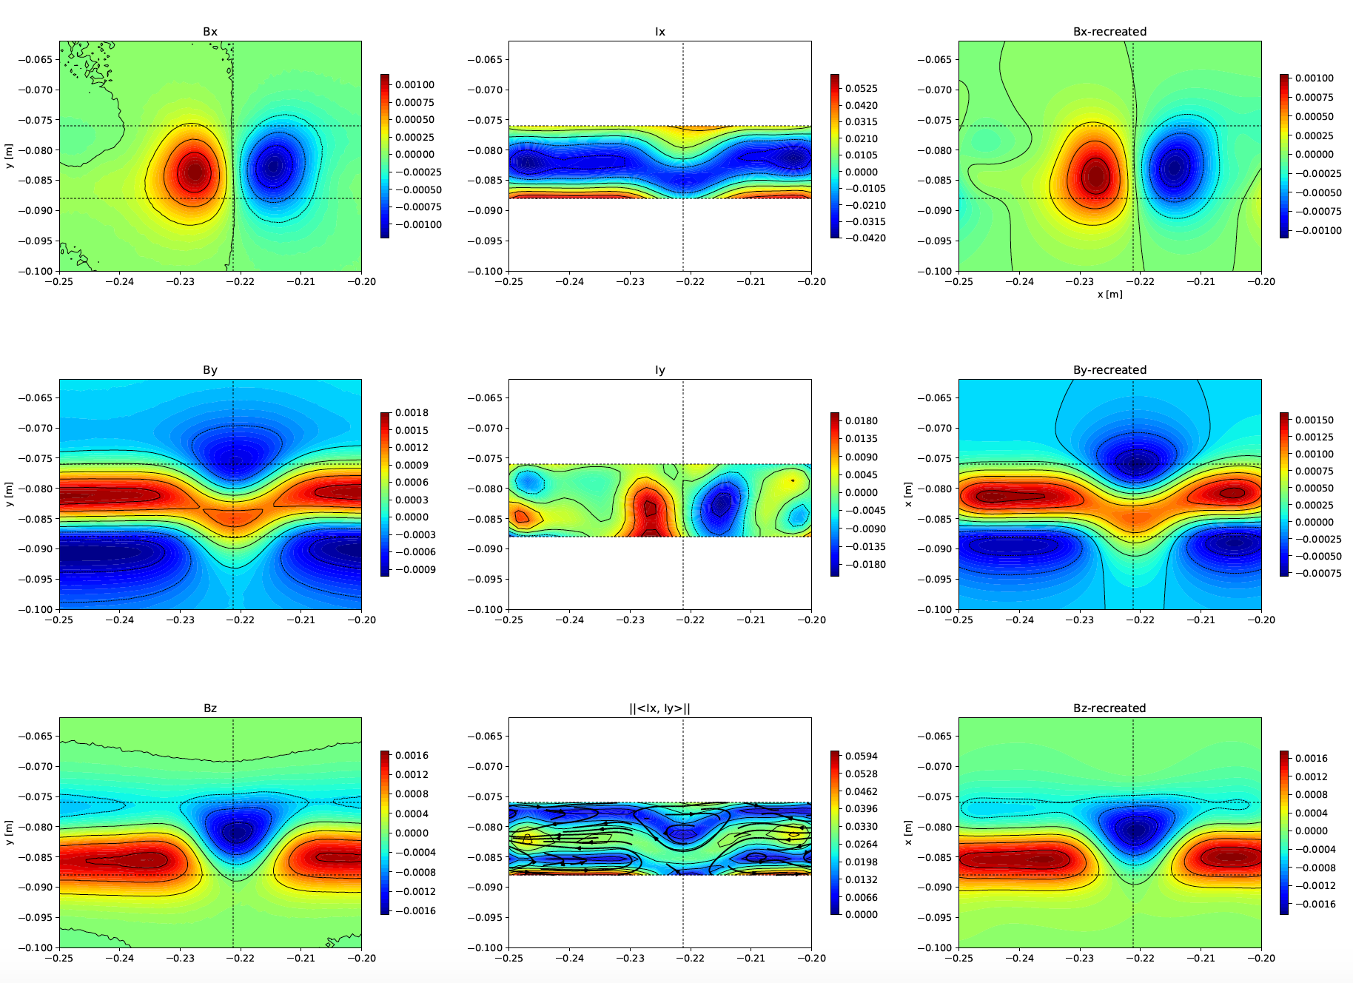
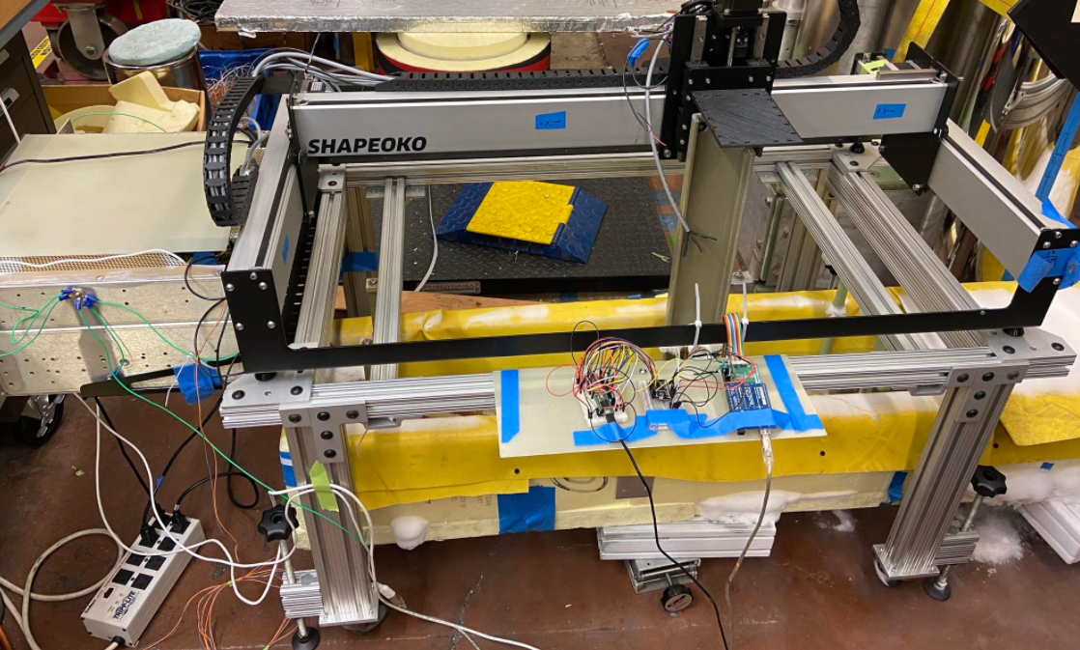
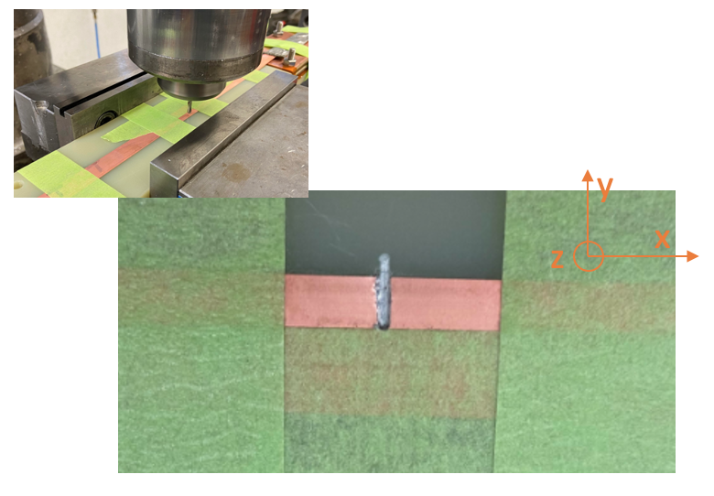
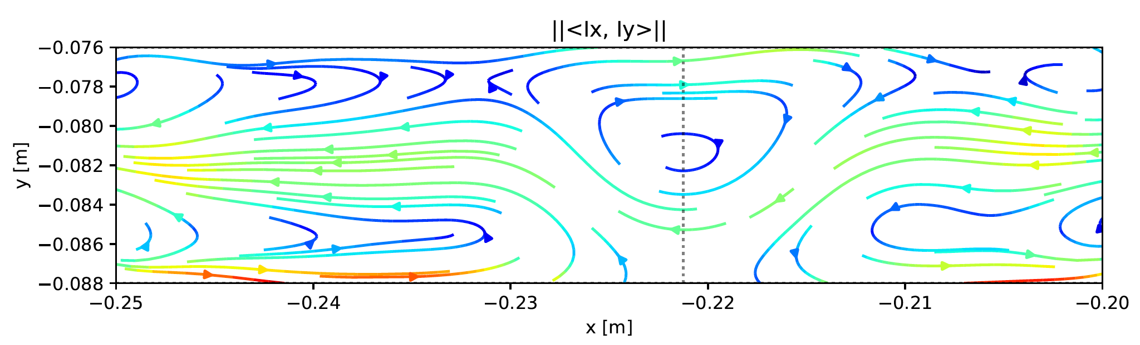
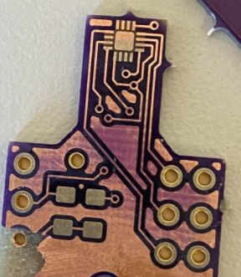
(M4) Scanner
Fields from Recreated Currents
Measured Fields
Recreated Currents
High resolution 3-axis field maps around powered HTS tapes with defects, recreate current distributions
  Step towards objective of improved understanding of current distributions in HTS
  Several engineering challenges recently addressed
Eventual goal is to add “quality control” capabilities that can identify & characterize performance limiting regions in HTS cables (or CCT layers)

