Slide 1
Updated Results for CCT6
Lucas Brouwer
11/02/2021

Slide 2
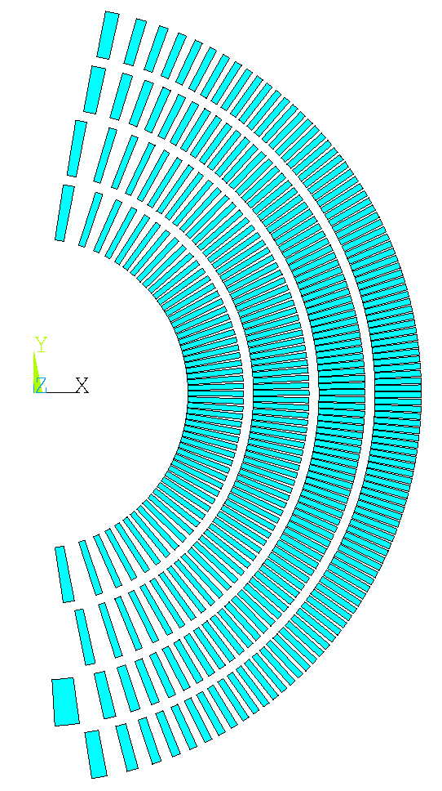
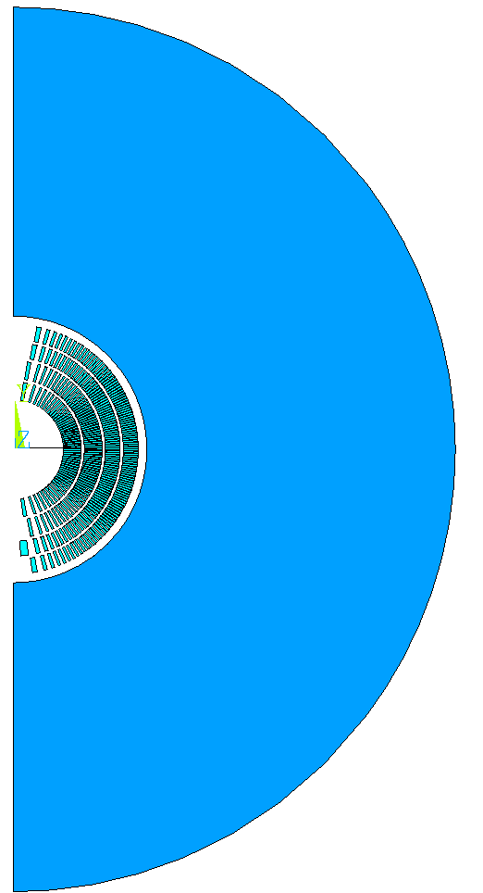
Updated CCT6 model (2D and 3D)
MQXF cable
IR of existing LD1 shell (560 mm)
LD1 cable
10 mm gap
Iron
See “extra” slides at end for cable/channel parameters

Slide 3
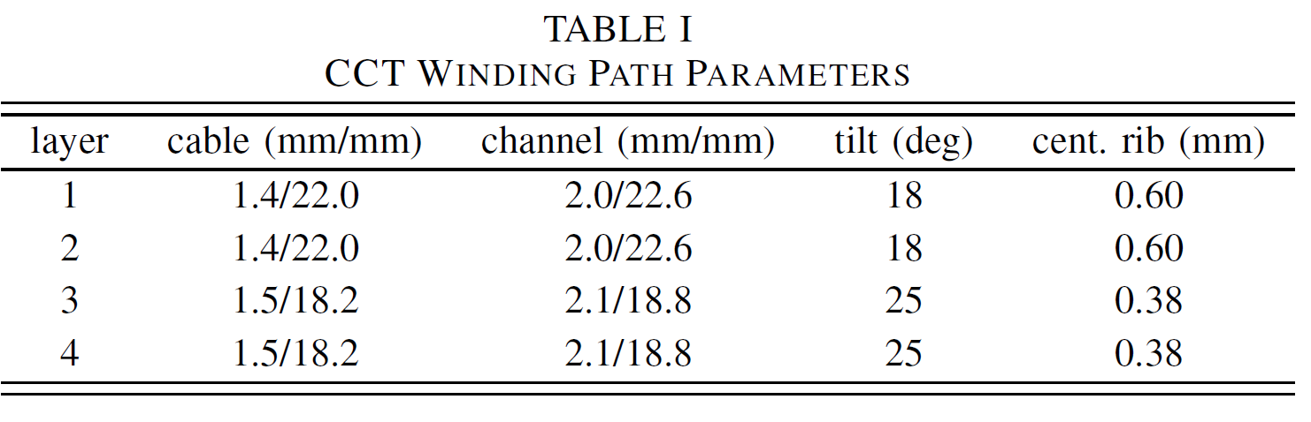
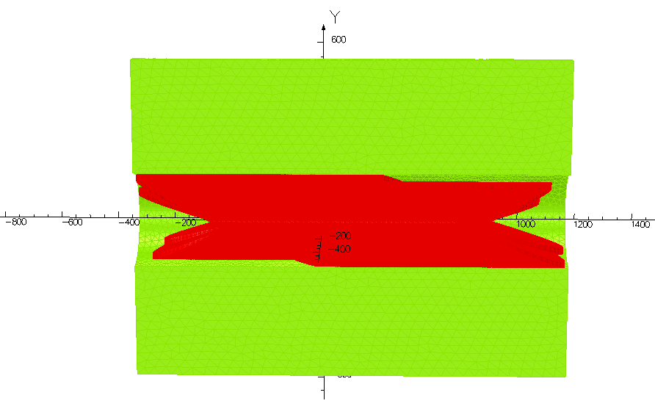
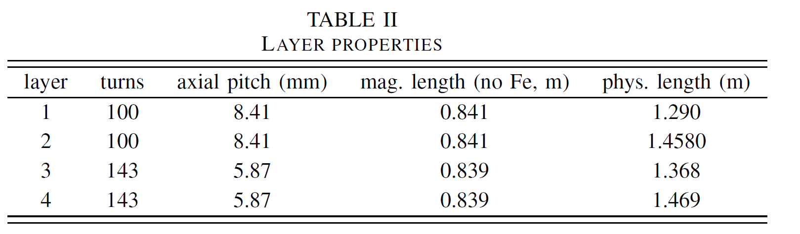
angle in outer layers is increased (keep 1.5 m physical length)
magnetic length of inner and outer layers is matched by turn choice
1.5 m

Slide 4
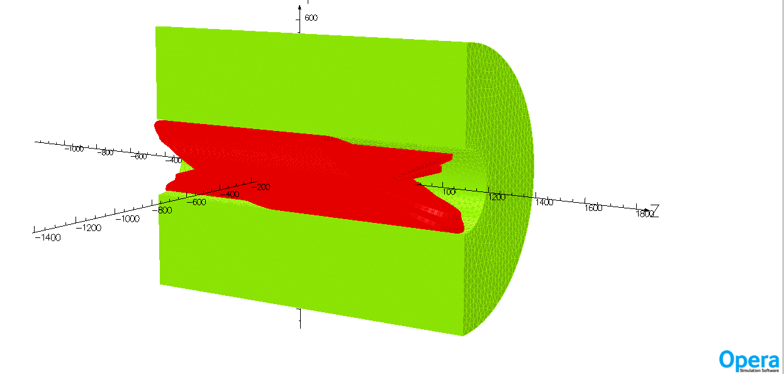
In opera3D, size iron to be the physical length (full 1.5 m)

Slide 5
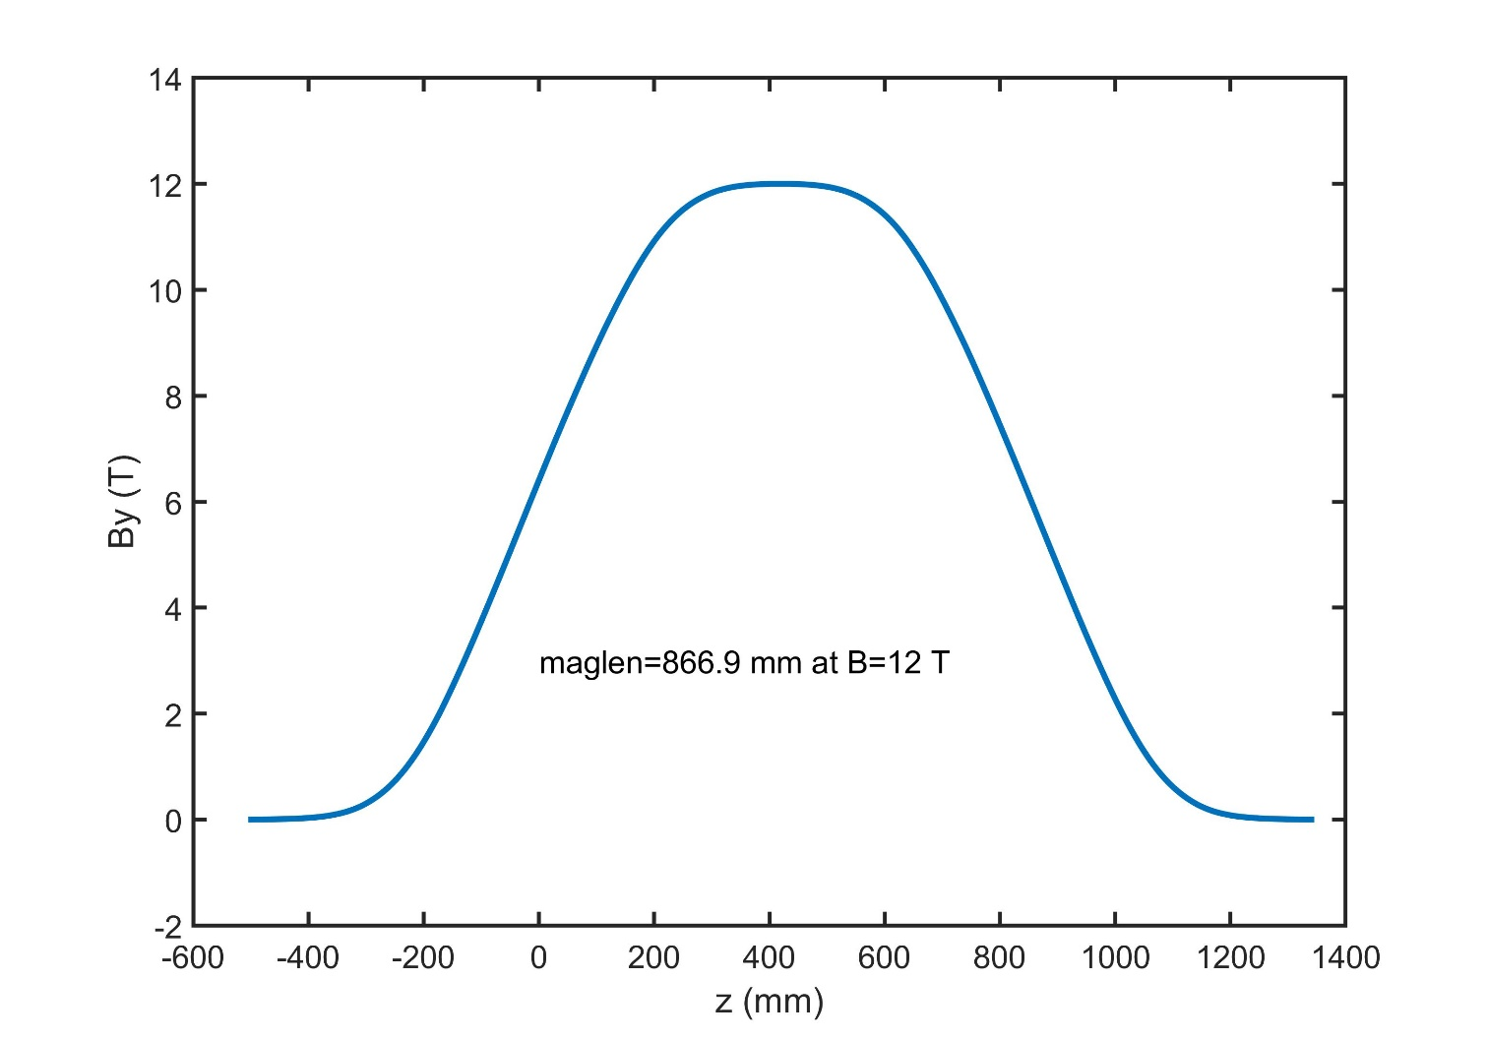
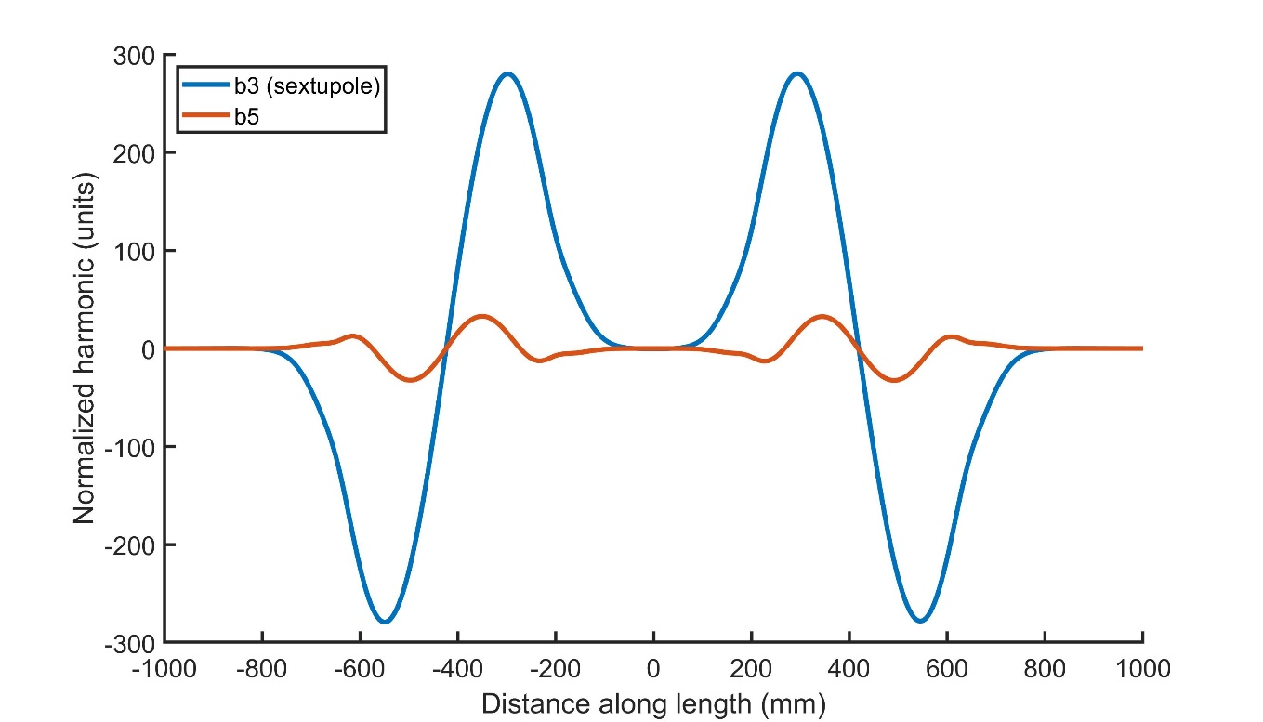
At 12 T (with iron in 3D)
~180 mm with <5 unit

Slide 6
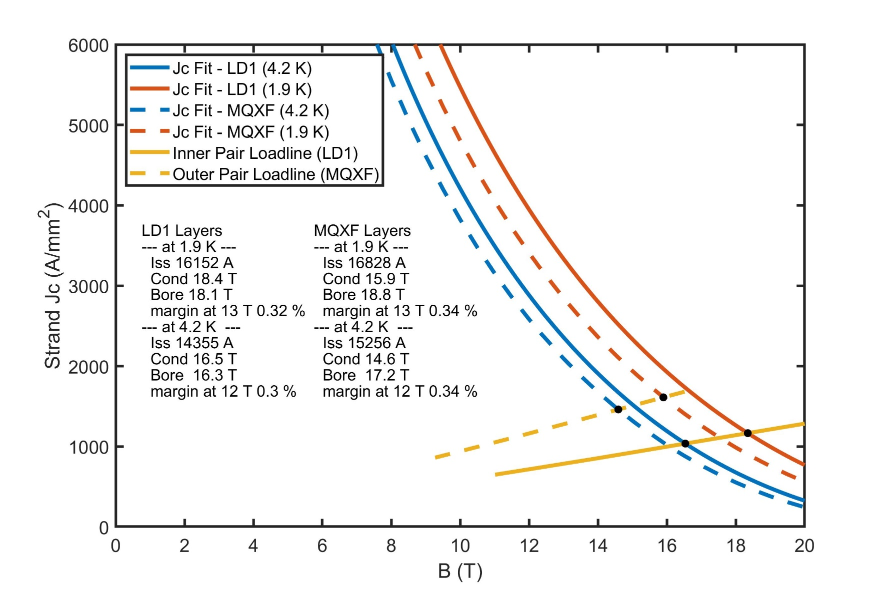
In opera3D, field with iron
I (kA) | By_bore (z=420) | lay1-cond | lay2-cond | lay3-cond | lay4-cond | lay1-rise | lay2-rise | lay3-rise | lay4-rise
11.8 | 13.769 | 13.96 | 13.163 | 11.715 | 10.704 | 1.0139 | 0.9560 | 0.8508 | 0.7774
18 | 19.887 | 20.215 | 19.05 | 16.876 | 15.4 | 1.0165 | 0.9579 | 0.8486 | 0.7744
From Opera3D
 | 4.2 K | 1.9 K
Iss | 14.4 kA | 16.2 kA
Bss_cond | 16.54 T | 18.35 T
Bss_bore | 16.29 T | 18.06 T
30% current margin at 12 T, 4.2 K
32% current margin at 13 T, 1.9 K

Slide 7
Inductance
First rough estimate from 2D ANSYS model = 48 mH/m
Ltot = (48.2 mH/m)*(0.841 m “physical” magnetic length) = 40.5 mH

Slide 8
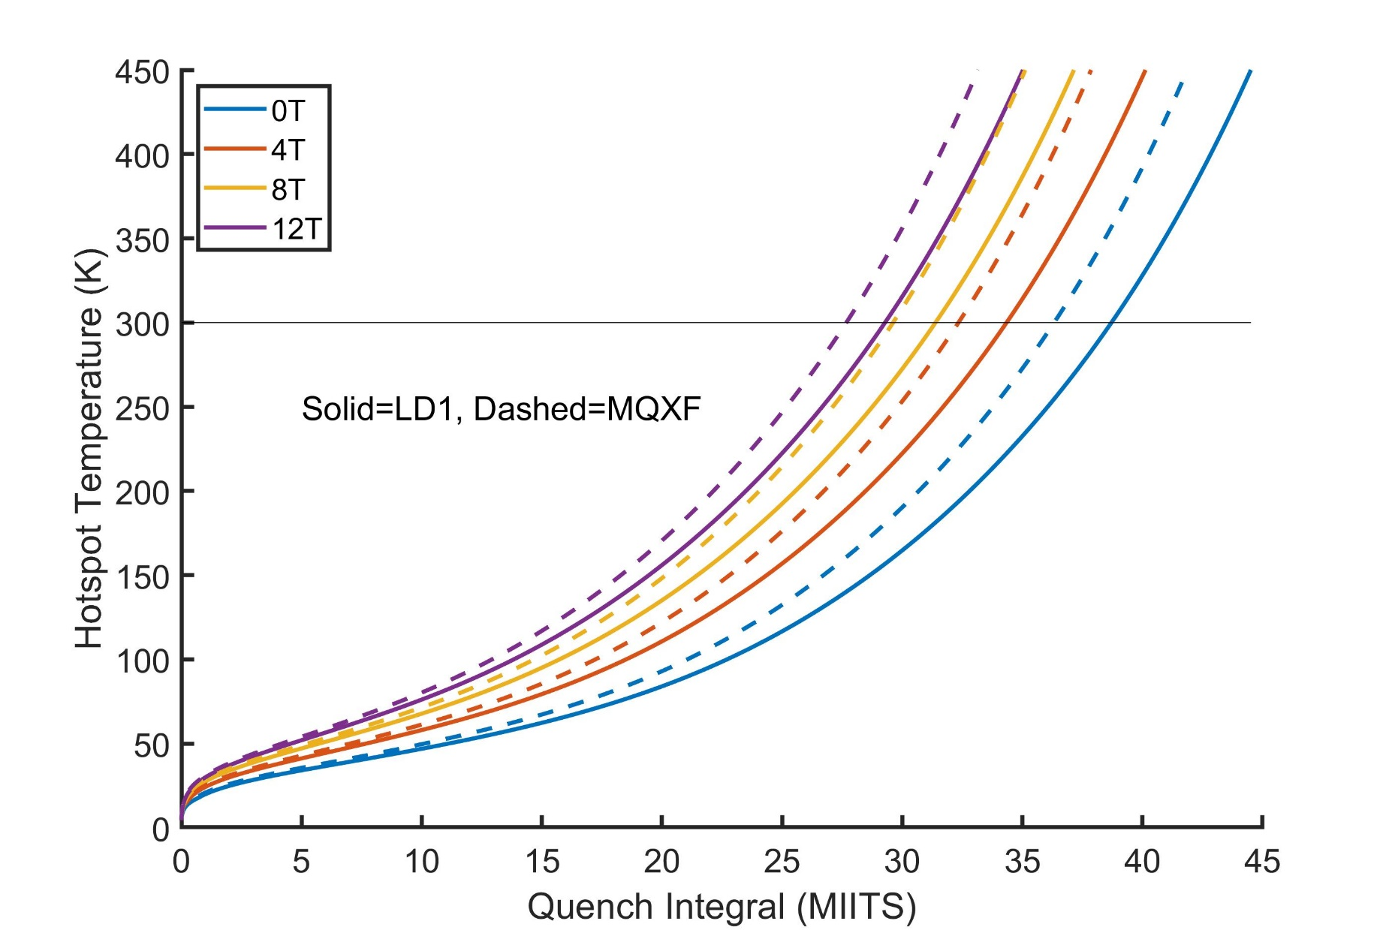
MIITS with RRR=100
as expected, the MQXF cable is limiting (~27 MIITS = 300 K)

Slide 9
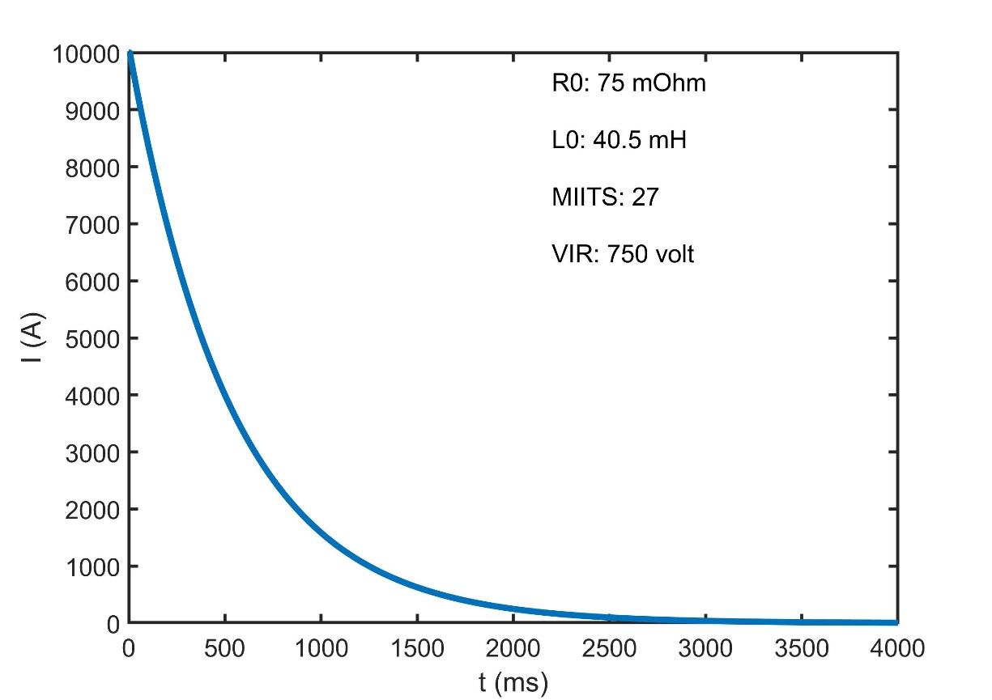
Dump Resistor Protection leads to ~750 V
assume a peak current of 10 kA (~12 T for opera3D)
750 V reaches 27 MIITS (300K) [75 mOhm dump]

Slide 10
Extra slides

Slide 11
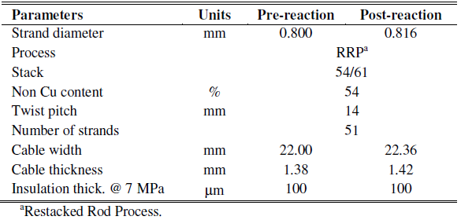
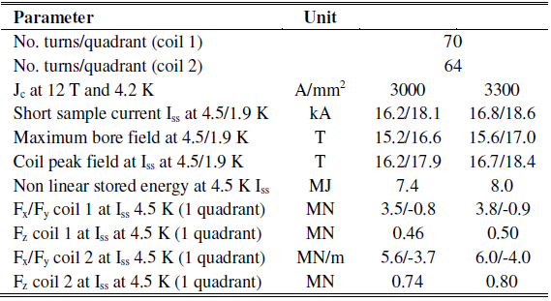
LD1 - Conductor and Cable Assumptions (from Paolo/GianLuca)
The large amount of insulation/space around the cable is the main source of inefficiently (0.3 mm on each side)
strand dia. | 0.8
Cu/Sc | 1.2
strands | 51
Coil Parameters
bw_cable | 22
bw_channel | 22.6
aw_cable | 1.4
aw_channel | 2.0
bw
Ref. P. Ferracin et al., IEEE TASC 22(2), 2012
aw

Slide 12
MQXF - Conductor and Cable Assumptions
The large amount of insulation/space around the cable is the main source of inefficiently (0.3 mm on each side)
strand dia. | 0.85
Cu/Sc | 1.2
strands | 40
bw_cable | 18.2
bw_channel | 18.8
aw_cable | 1.5
aw_channel | 2.1
bw
Keystone removed
aw

