Slide 1
20 T Bi2212/Nb₃Sn Hybrid
Common Coil Design with 15% Margin
Ramesh Gupta
November 2, 2021

Slide 2
20 T HTS/LTS Hybrid Common Coil Design
New hybrid designs for Bi2212 in series with Nb₃Sn having 15%
All design use the Nb₃Sn and Bi2212 Performance as of 9/29/2021
All designs are optimized for a good field quality
Configurations for 4 to 6 layers of main coil (+pole coil)
Space included for an intermediate mechanical structure for stress management (next step - optimize with proper analysis)

Slide 3
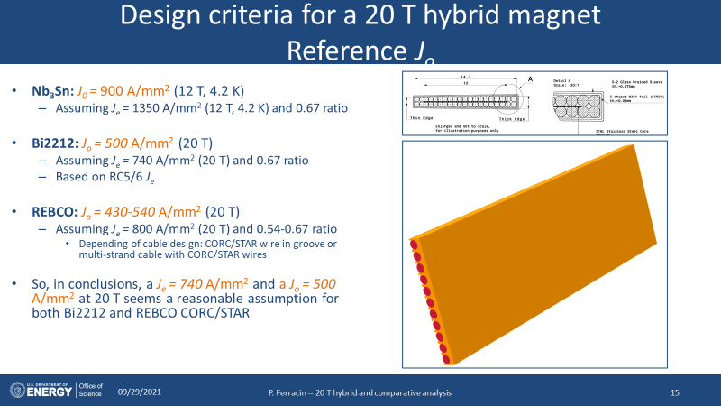
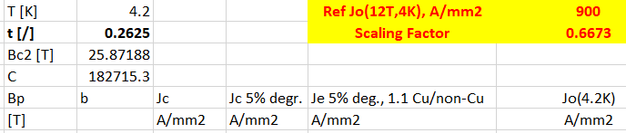

Performance Assumptions of Nb₃Sn & Bi2212
Nb₃Sn
Nb₃Sn
Bi2212
Bi2212

Slide 4
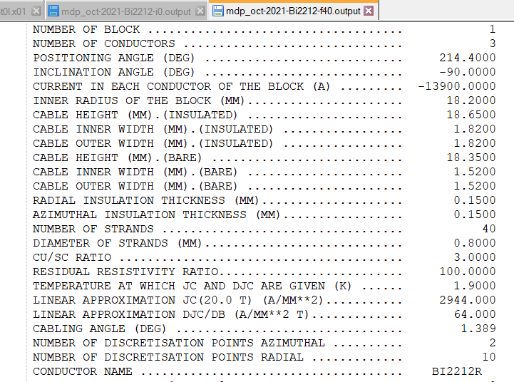
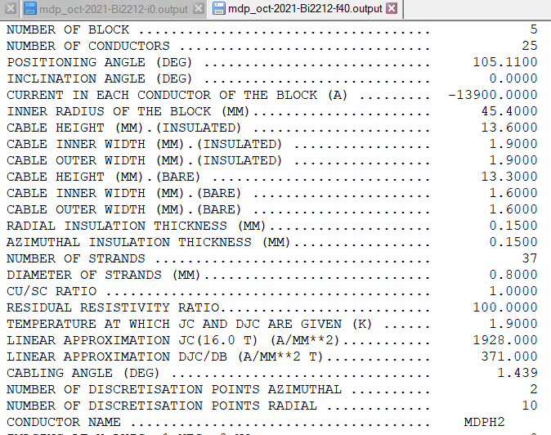
Conductor Used
HTS - Bi2212
LTS - Nb₃Sn

Slide 5
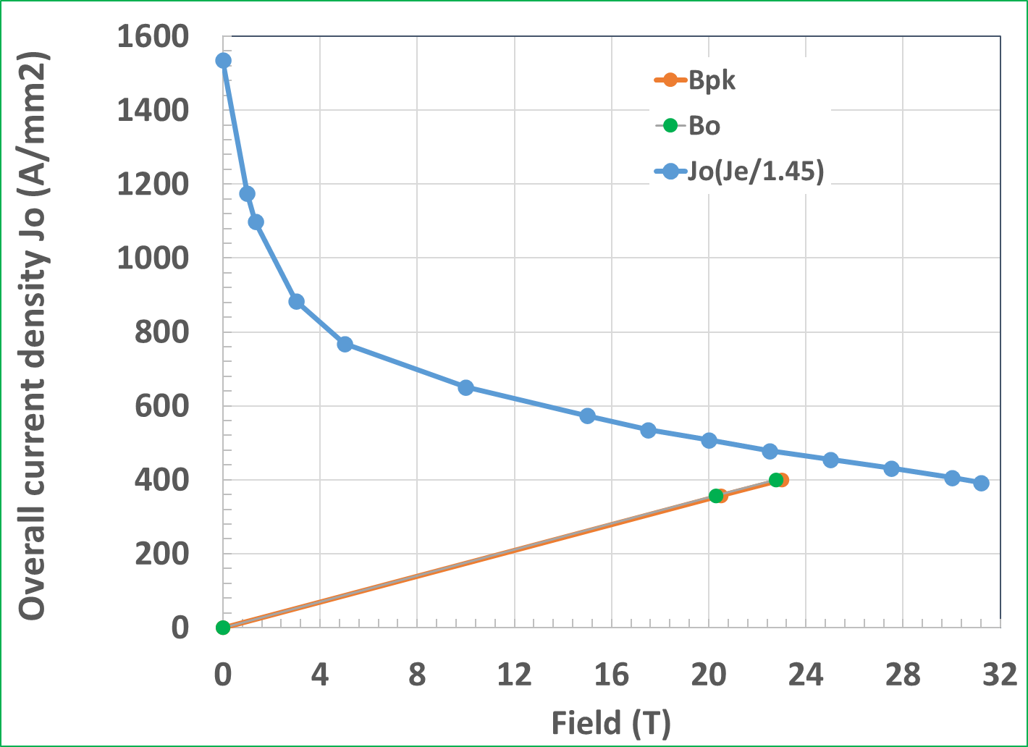
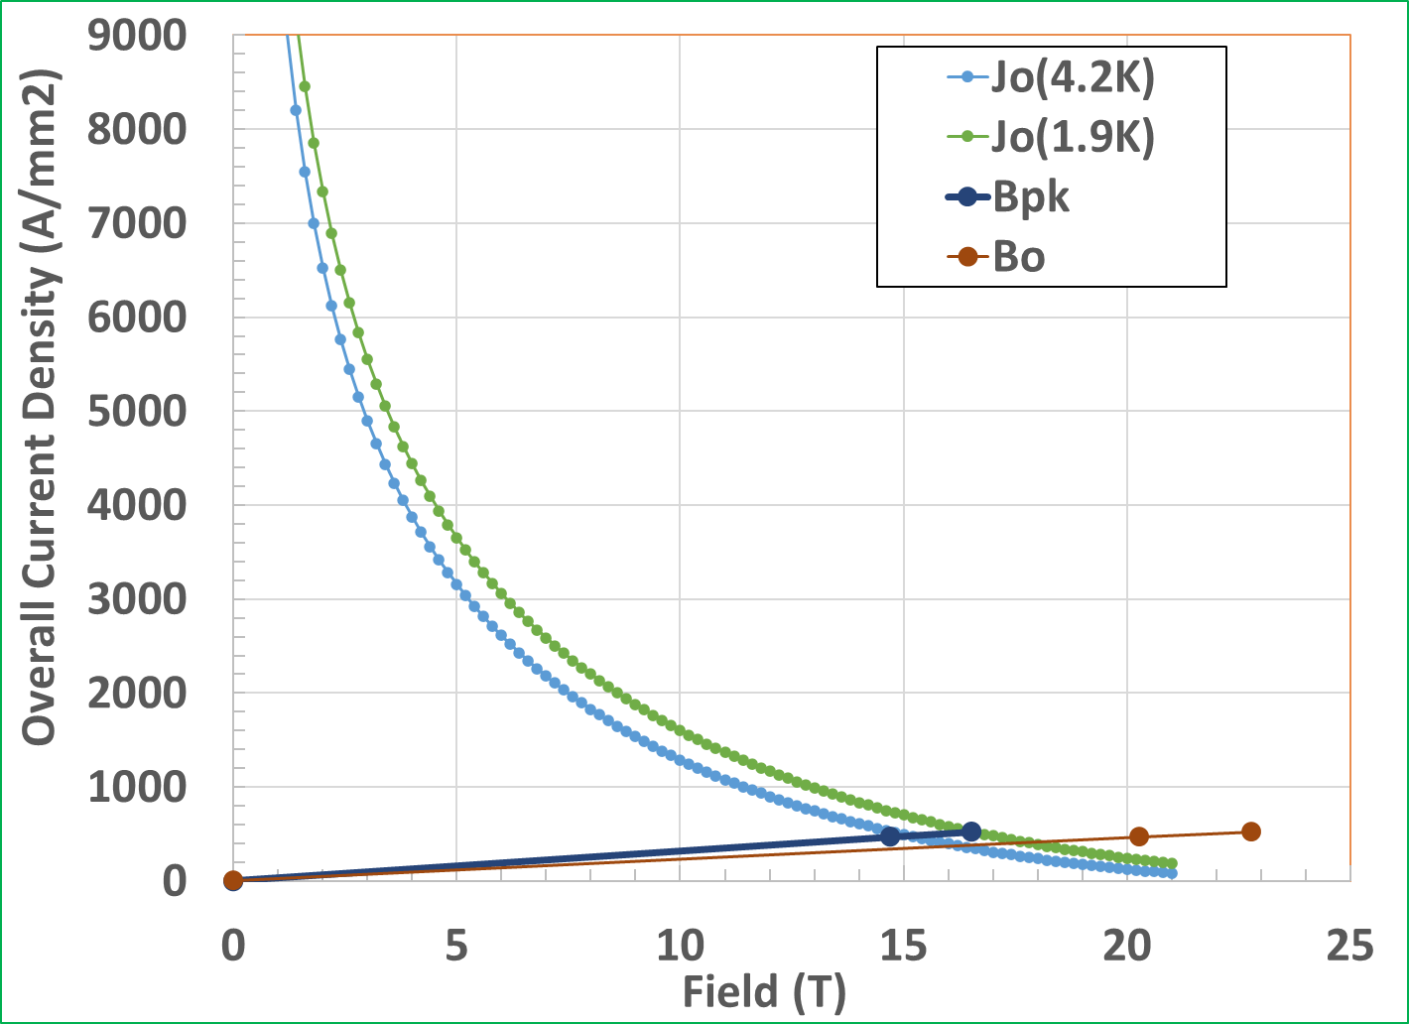
September 2021 Design with New Jo
Mismatched Margins (new designs have matched margins – 15% over 20 T)
Bi2212
Nb₃Sn

Slide 6
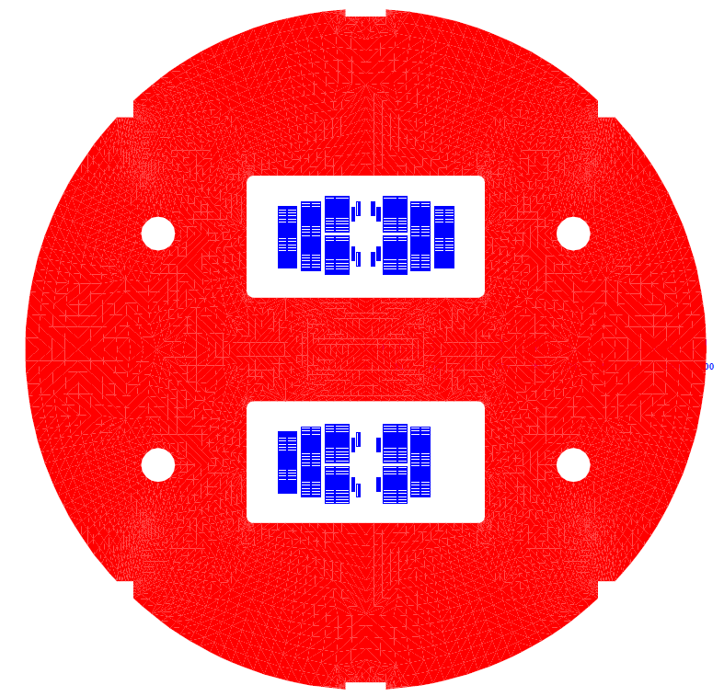
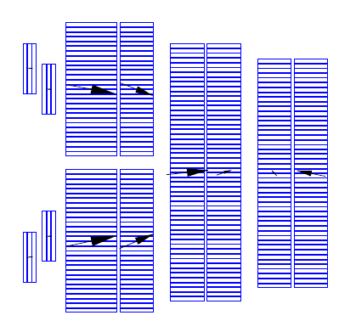
50 mm, 20 T Bi2212/Nb₃Sn Common Coil
Several configurations with matched margin (15%) examined
Structure
One quadrant
(half of one side of the coils)
Full Model
Bi2212
1 Layer of Bi2212
(+pole coils)
3 to 5 Layers of Nb₃Sn
15% margin
20 T at ~14 kA
Space for structure (size to be iterated)
Nb₃Sn
Nb₃Sn
Bi2212
Nb₃Sn

Slide 7
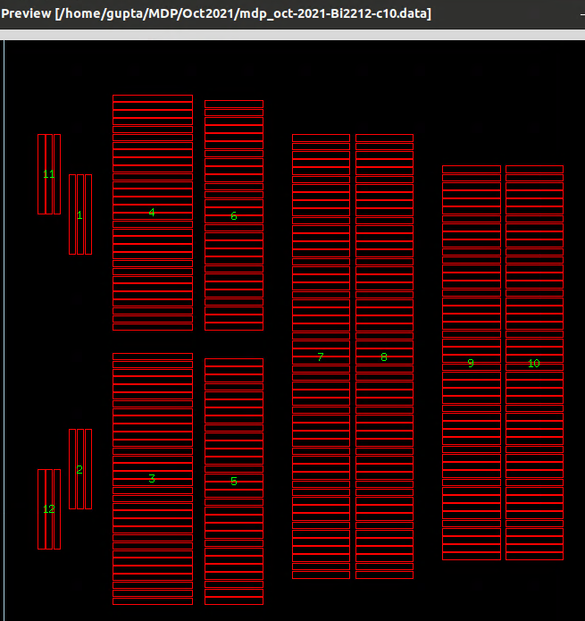
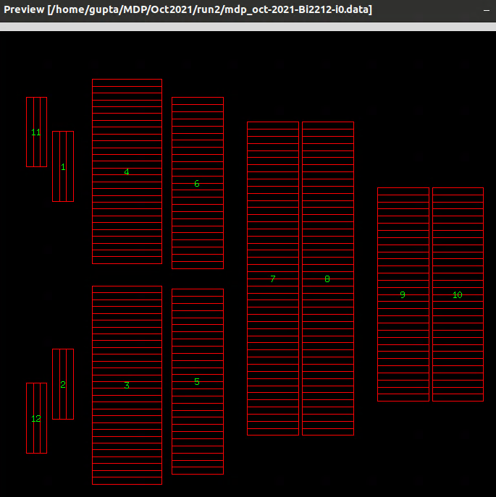
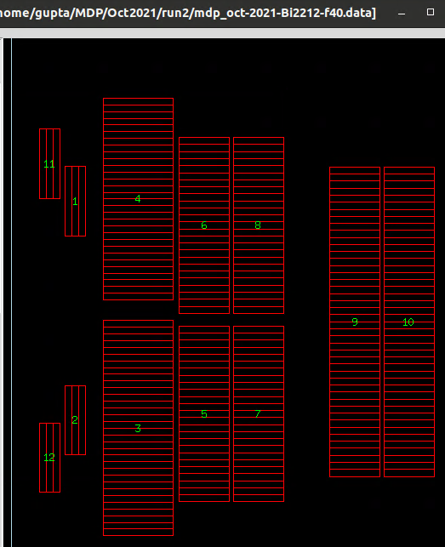
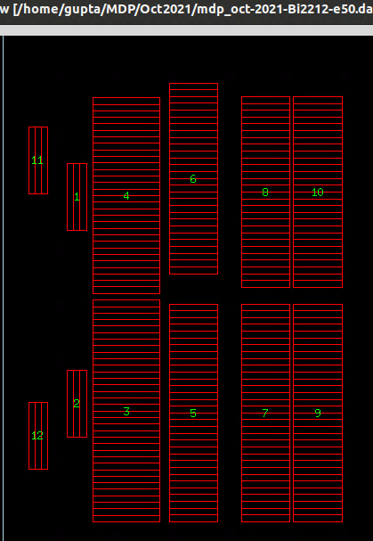
Configurations Examined for Nb₃Sn/Bi2212 Hybrids
New configurations (October 2021) with matched margins
(Number of turns gets reduced, in some cases number of layers as well)
Configuration of September 2021
(mismatched margins with new J₀)
No. of turns: 336
One layer of Bi2212
+Five layers of Nb₃Sn
One layer of Bi2212
+Five layers of Nb₃Sn
One layer of Bi2212
+Four layers of Nb₃Sn
One layer of Bi2212
+Three layers of Nb₃Sn
All configurations have 1 layer of Bi2212 main coils and 6 turns of Bi2212 in pole coils

Slide 8
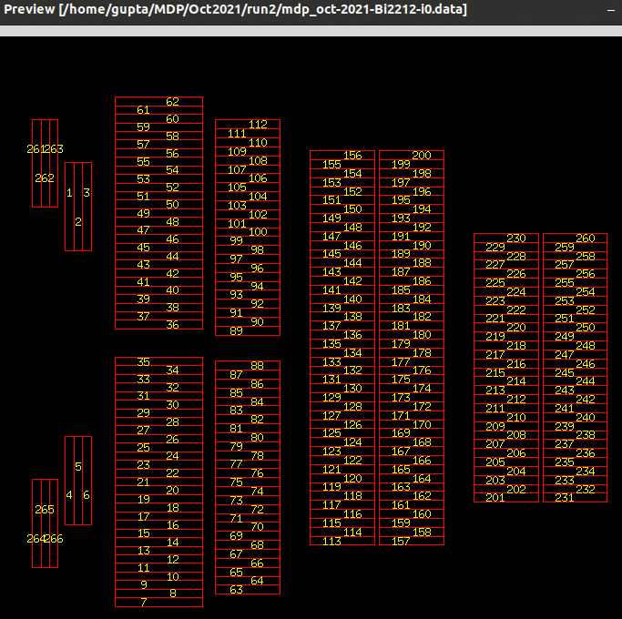
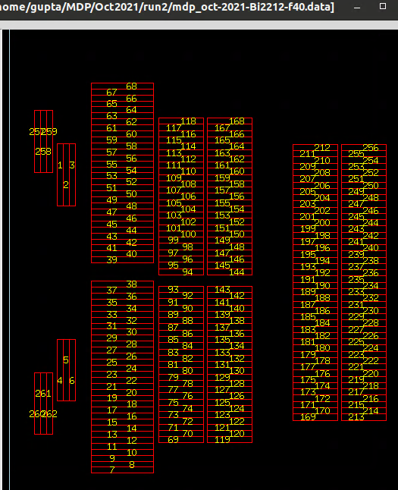
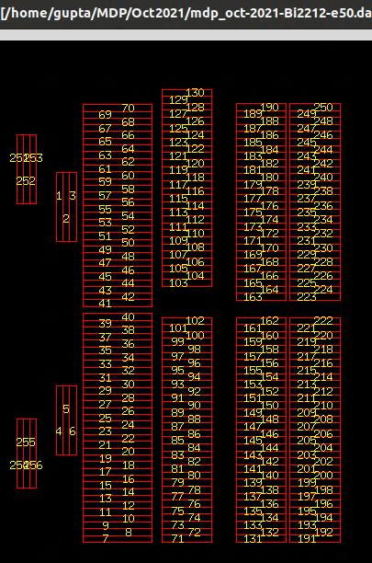
Configurations Examined for Nb₃Sn/Bi2212 Hybrids
New configurations (October 2021) with matched margins
(Total number of turns gets reduced from 336, see also number of layers too)
Total No. of turns: 272
Total No. of turns: 268
Total No. of turns: 262
No. of turns of Bi2212 per aperture = 74
No. of turns of Nb₃Sn in 5 layers = 198
# of turns of Bi2212 per aperture = 80
# of turns of Nb₃Sn in 4 layers = 188
# of turns of Bi2212 per aperture = 82
# of turns of Nb₃Sn in 3 layers = 180

Slide 9
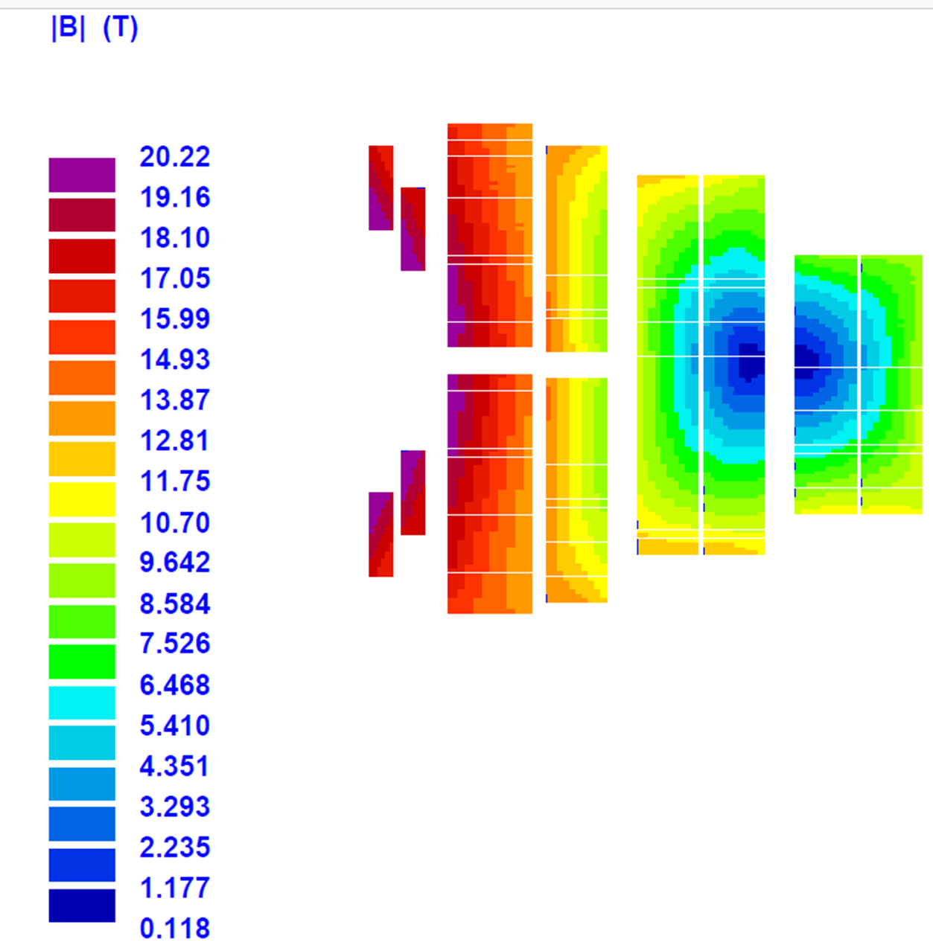
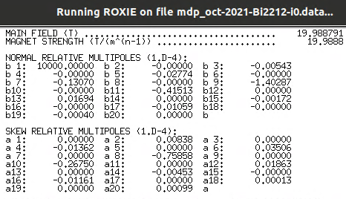
October 2021 Design #1
(6 layers in main coil)

Slide 10
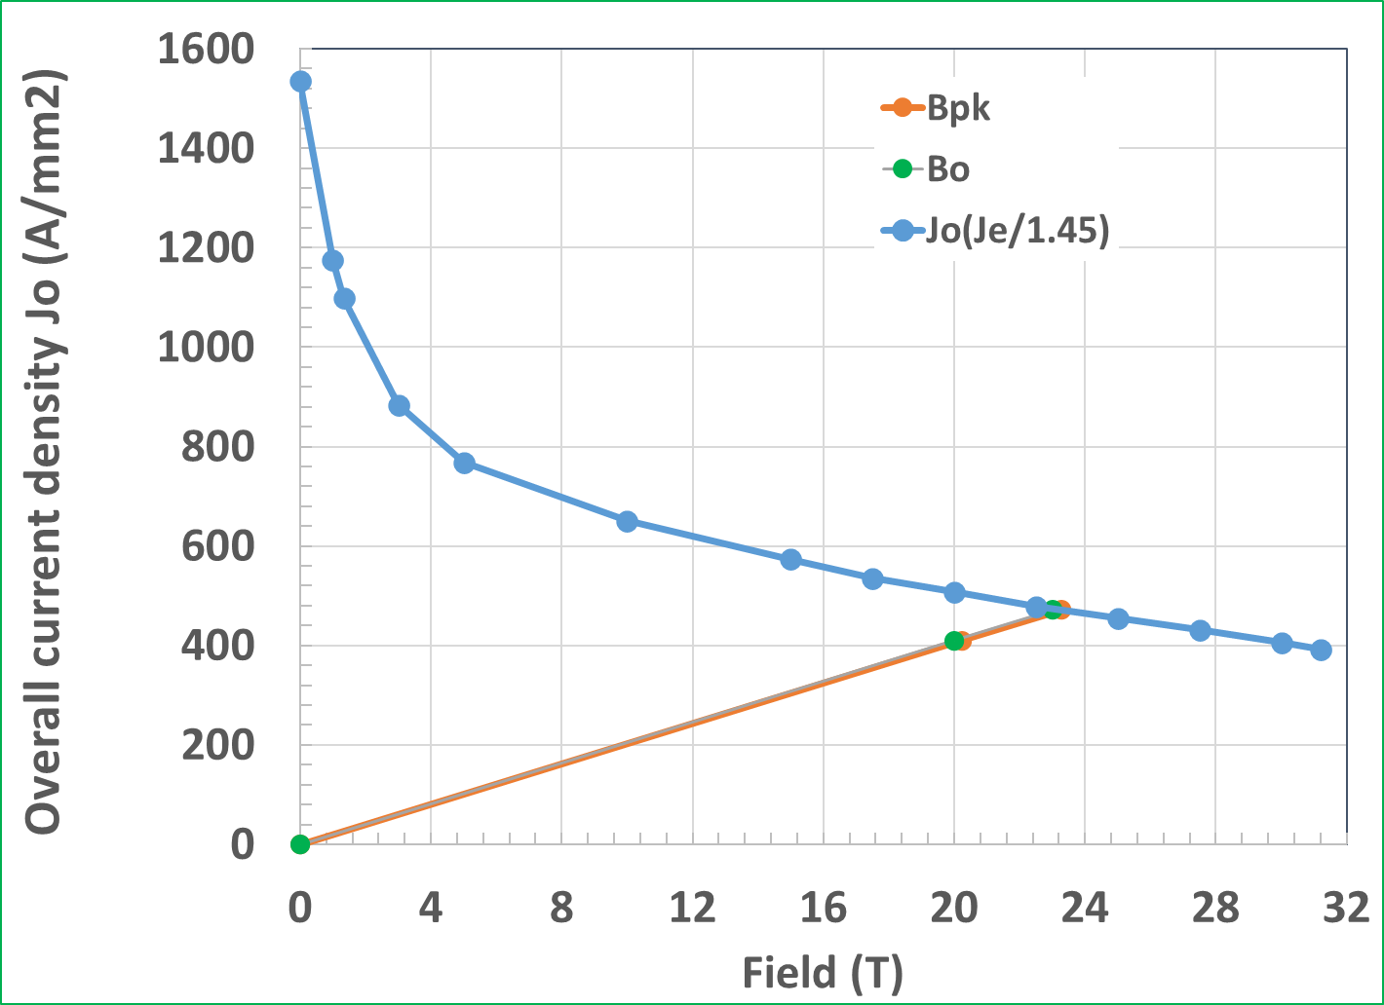
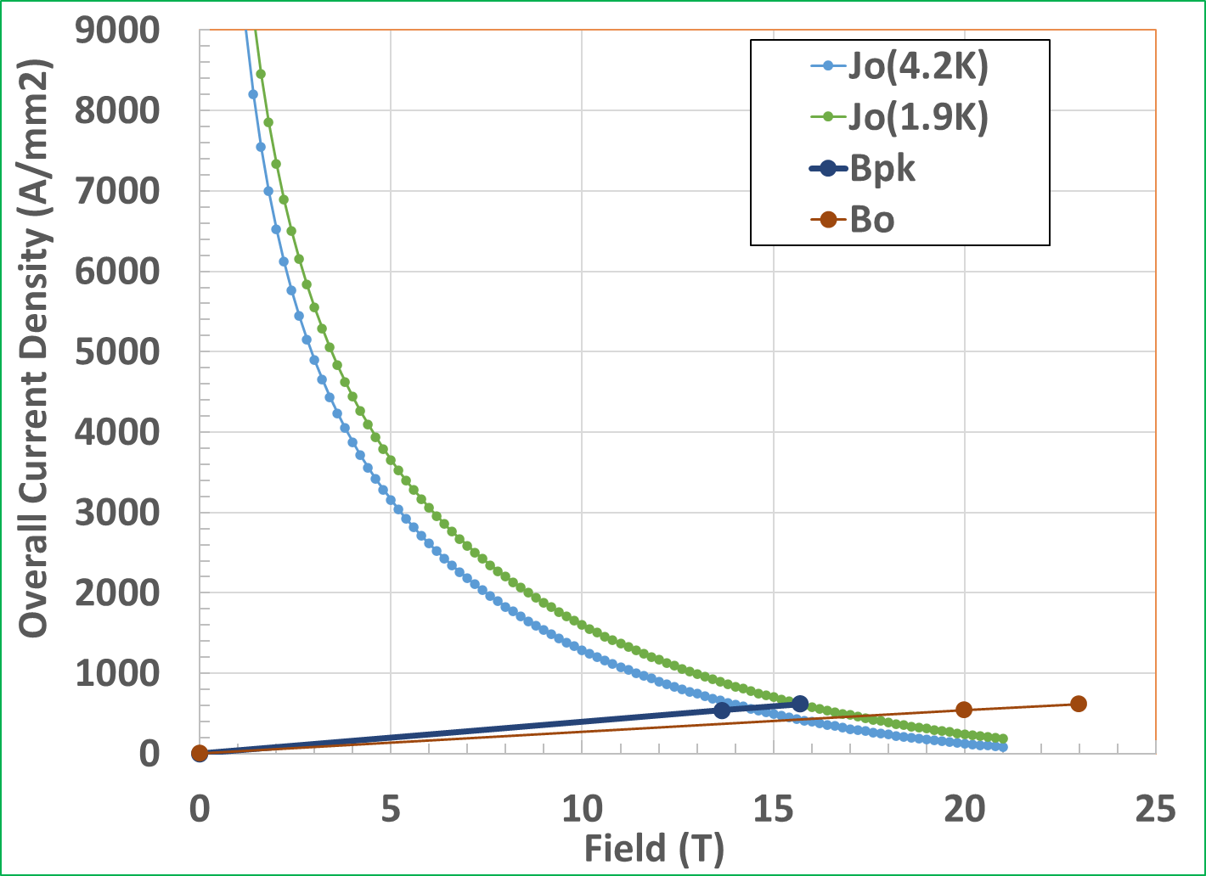
October 2021 Design #1
(margins for 6 layers in main coil)
New designs have matched margins – 15% over 20 T – in both Bi2212 and Nb₃Sn coils for the reference J_{o}
Bi2212
Nb₃Sn

Slide 11
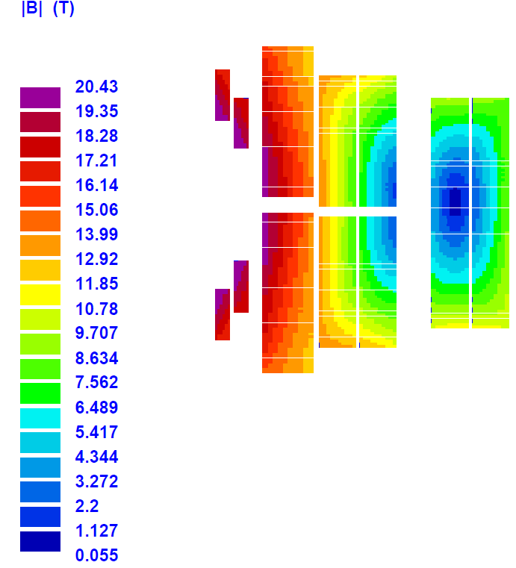
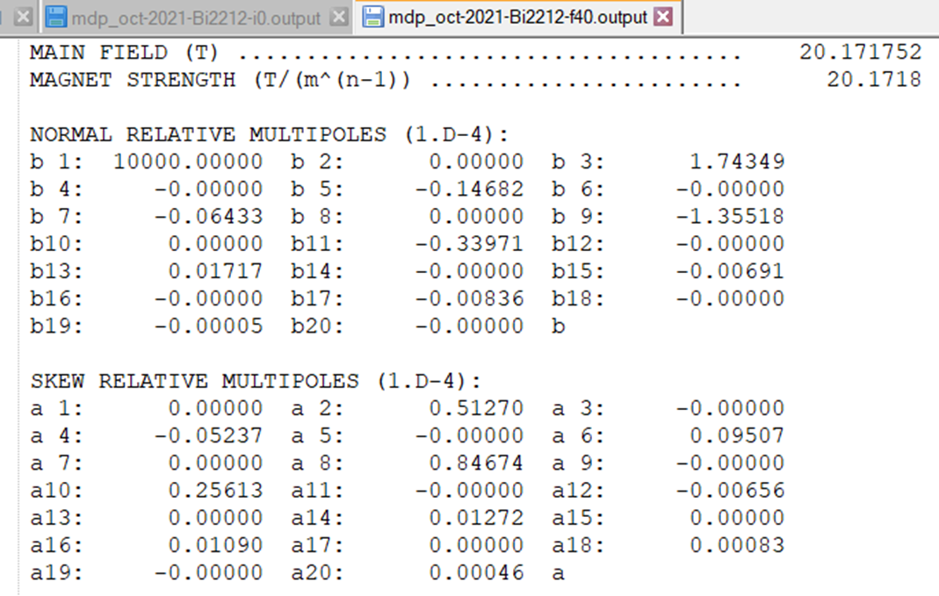
October 2021 Design #2
(5 layers in main coil)

Slide 12


October 2021 Design #1
(margins for 5 layers in main coil)
New designs have matched margins – 15% over 20 T – in both Bi2212 and Nb₃Sn coils for the reference J_{o}
Bi2212
Nb₃Sn

Slide 13
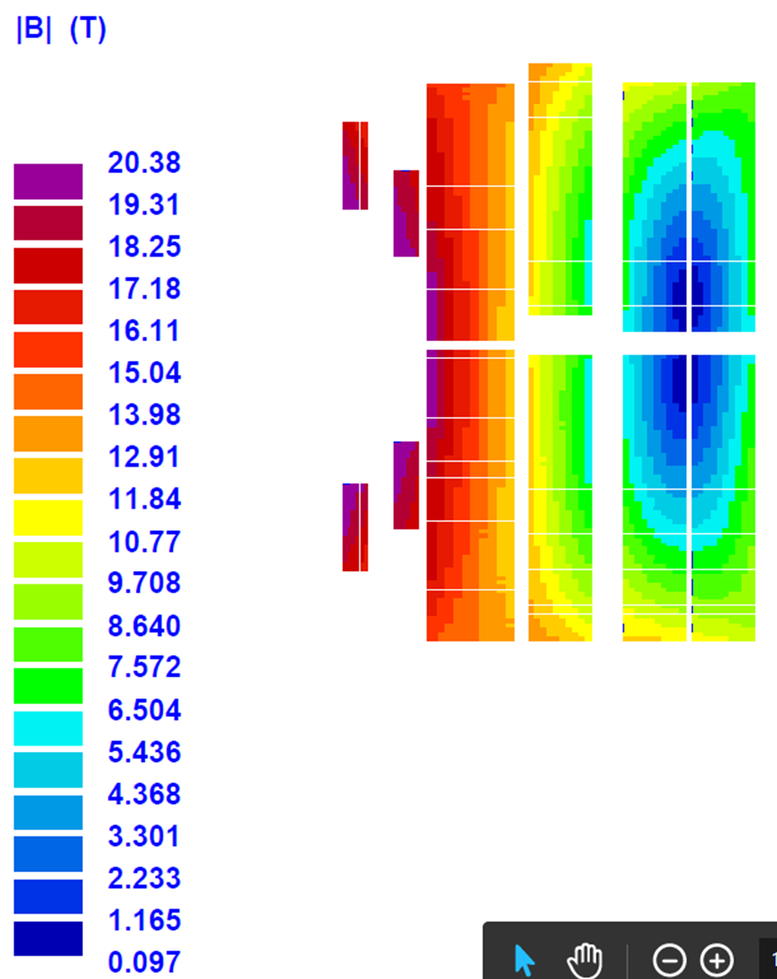
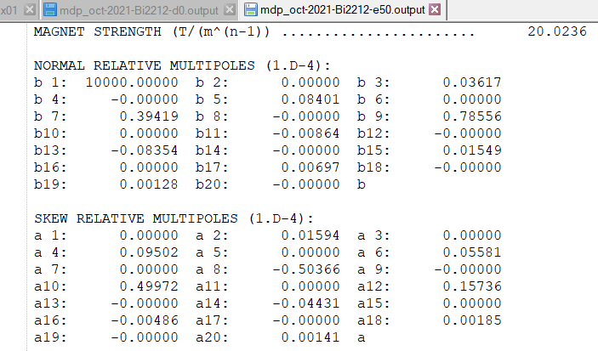
October 2021 Design #3
(4 layers in main coil)

Slide 14
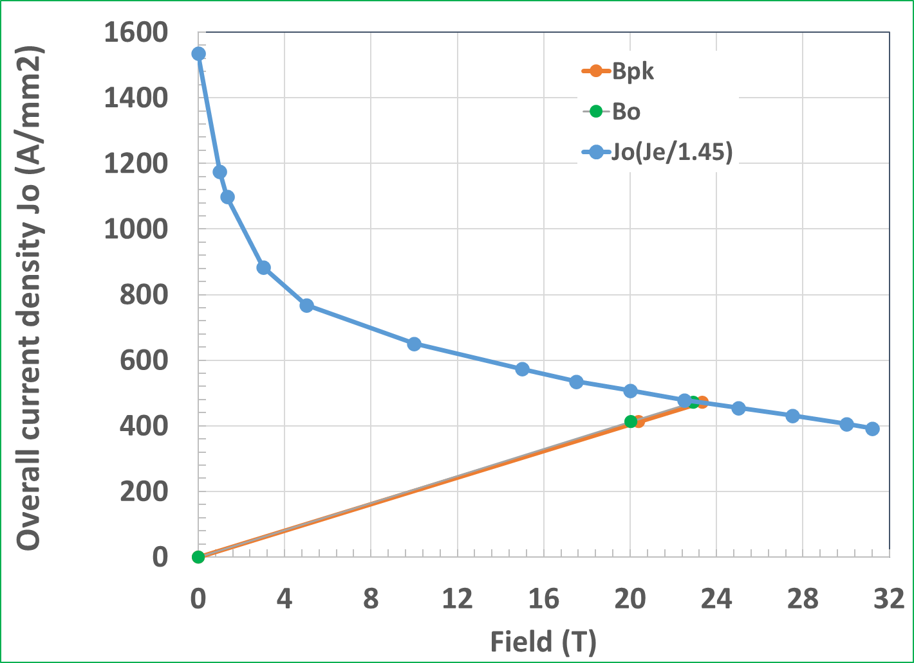

October 2021 Design #3
(margins for 4 layers in main coil)
New designs have matched margins – 15% over 20 T – in both Bi2212 and Nb₃Sn coils for the reference J_{o}
Bi2212
Nb₃Sn

Slide 15
Summary
Three hybrid configurations optimized for Bi2212 in series with Nb₃Sn having 15% margin for the reference J₀ (J_{overall})
They are ranging from 4 to 6 layers in main coil (+pole coil)
All designs are optimized for a good field quality as well
Common coil design is well suited for the very high field hybrid dipoles and seems to be more efficient than other designs. They also seem to need lower number of layers and less conductor
Space included for an intermediate mechanical structure for stress management (next step - optimize with proper analysis)

Slide 16
Old slides from the last presentation in September 2021

Slide 17
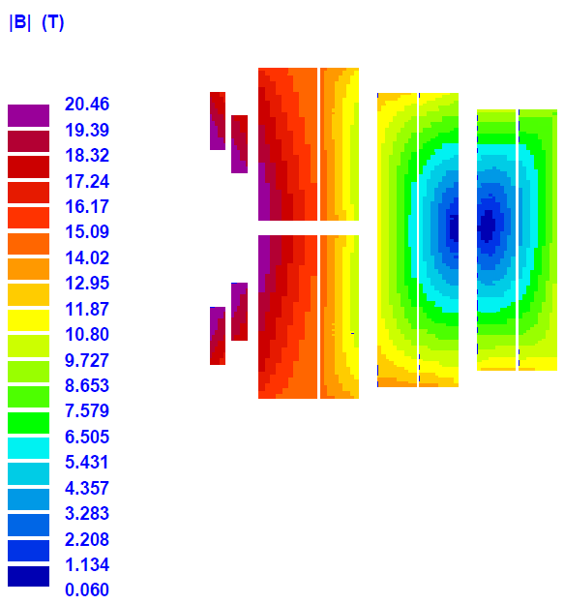
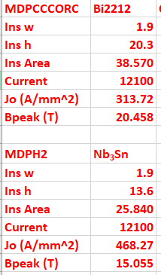
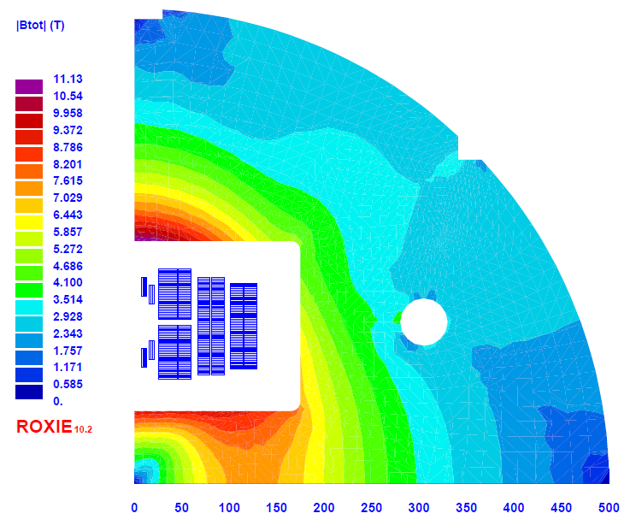
50 mm, 20 T Common Coil Bi2212/Nb₃Sn Hybrid Design
(Design Presented last time - September 2021)
HTS
LTS
LTS
LTS
B₀=20.03 T
Peak Enhancement
~2.2%
(low peak field enhancement)

Slide 18
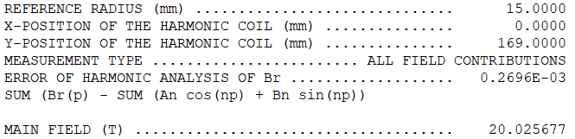
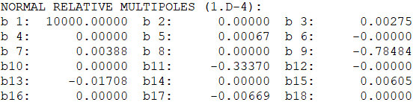
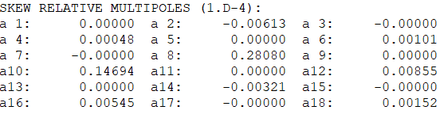
Field Quality in 20 T Common Coil Bi2212/Nb₃Sn Hybrid Design (last September 2021 design)
All harmonics <10⁻⁴ (normal and skew)

Slide 19
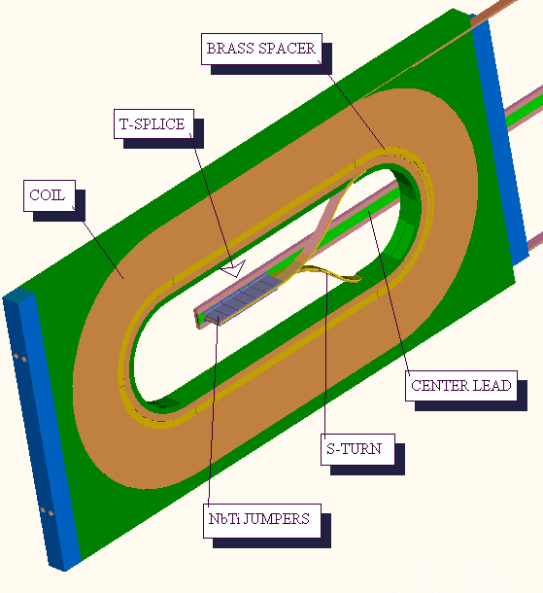
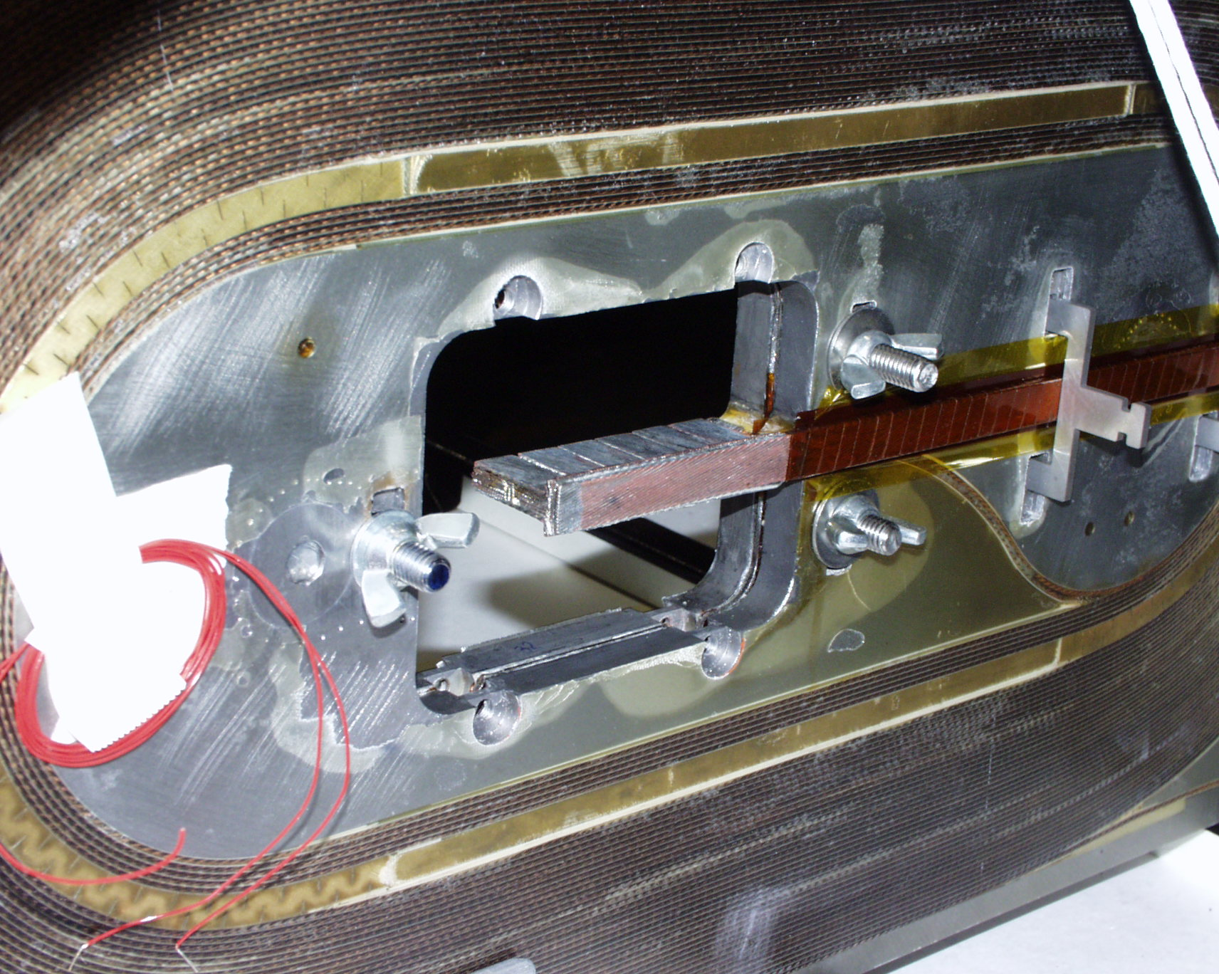
Splices in Common Coil Design
(between two single layer coil)
In common coil design, splice (even between two types of coils), can be easily made in the middle of the coil where the field is very low
Perpendicular Nb-Ti splice in the low field region of BNL common coil dipole DCC017
Bi2212
Nb₃Sn

Slide 20
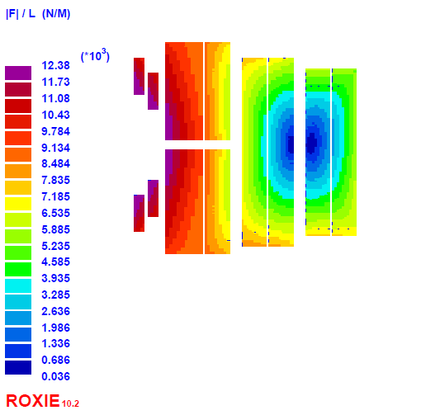
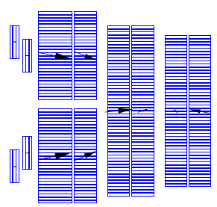
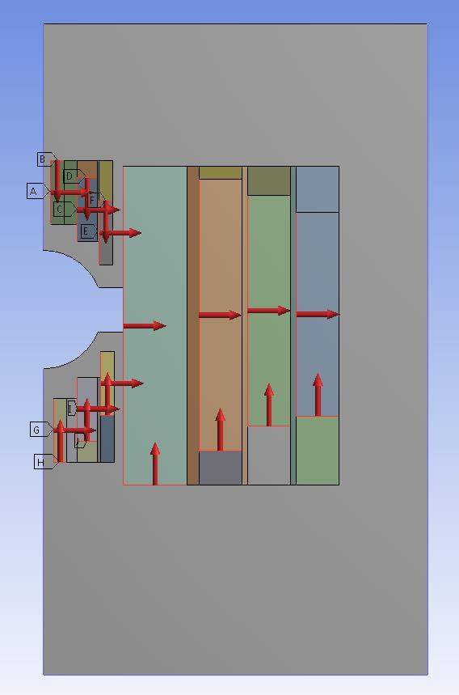
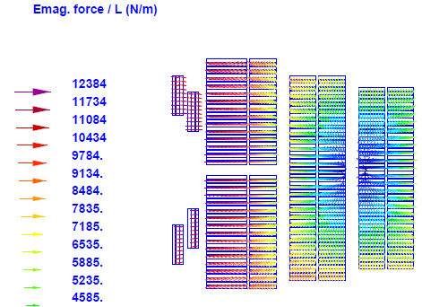

Lorentz Forces @20 T in Bi2212/Nb₃Sn Hybrid
Concept used in the earlier 16 T design for securing pole blocks

Slide 21
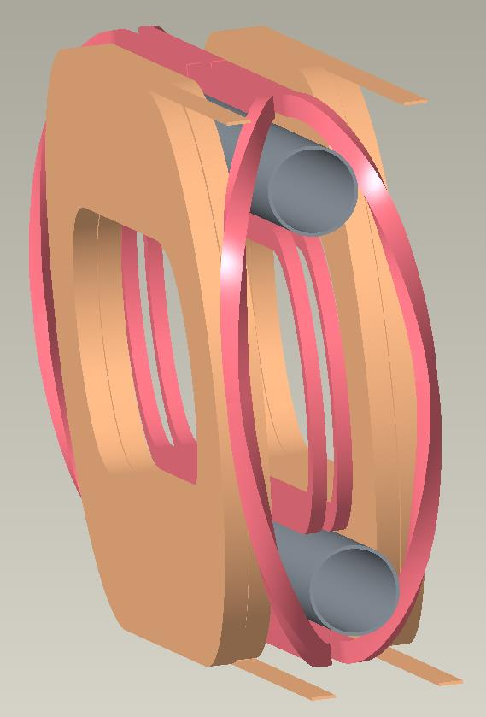
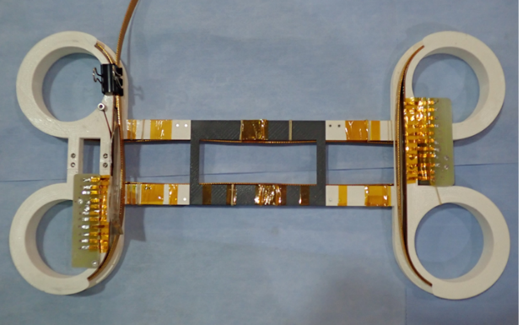
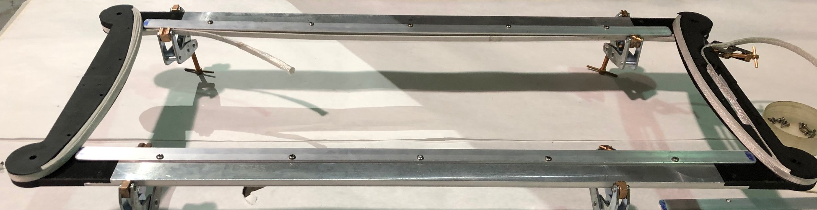
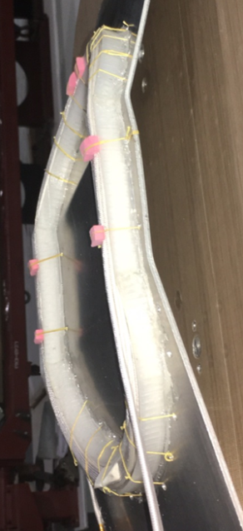
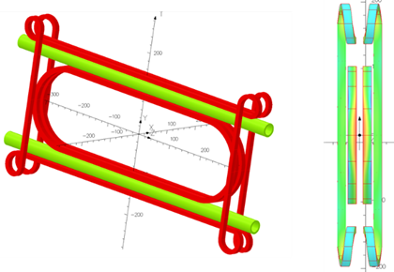
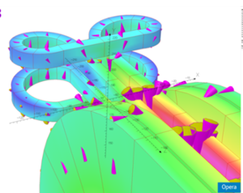
A Few Possible Layout of Away Pole Coils Clearing Bore (others shown elsewhere)
Practice & Tested Coils
CORC coil can be bent first away and then up/down

Slide 22
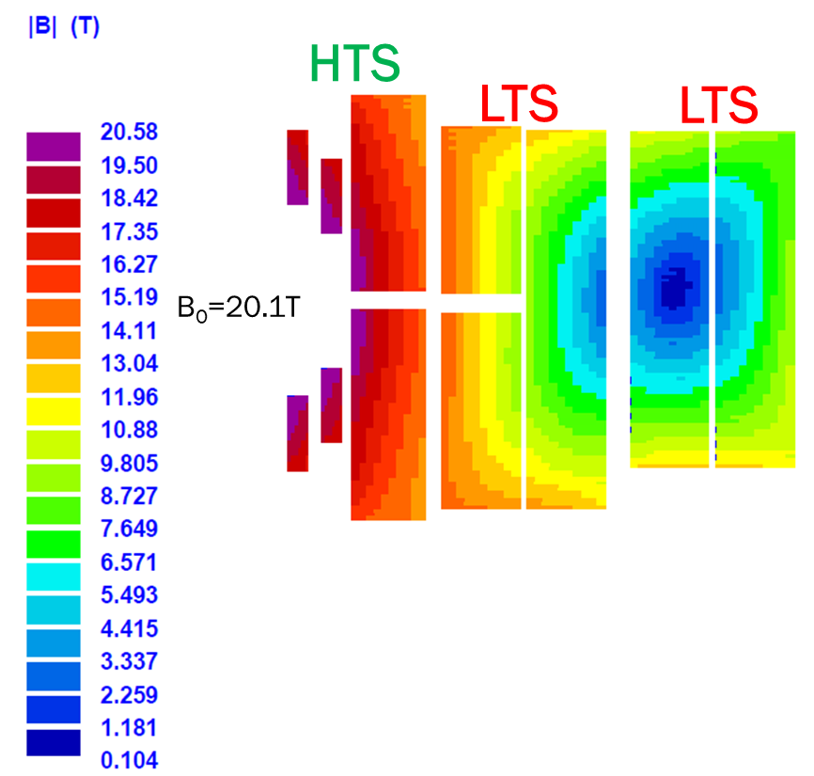
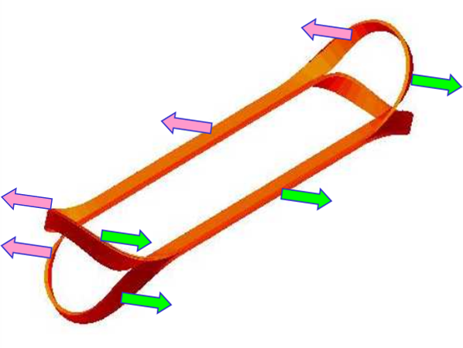
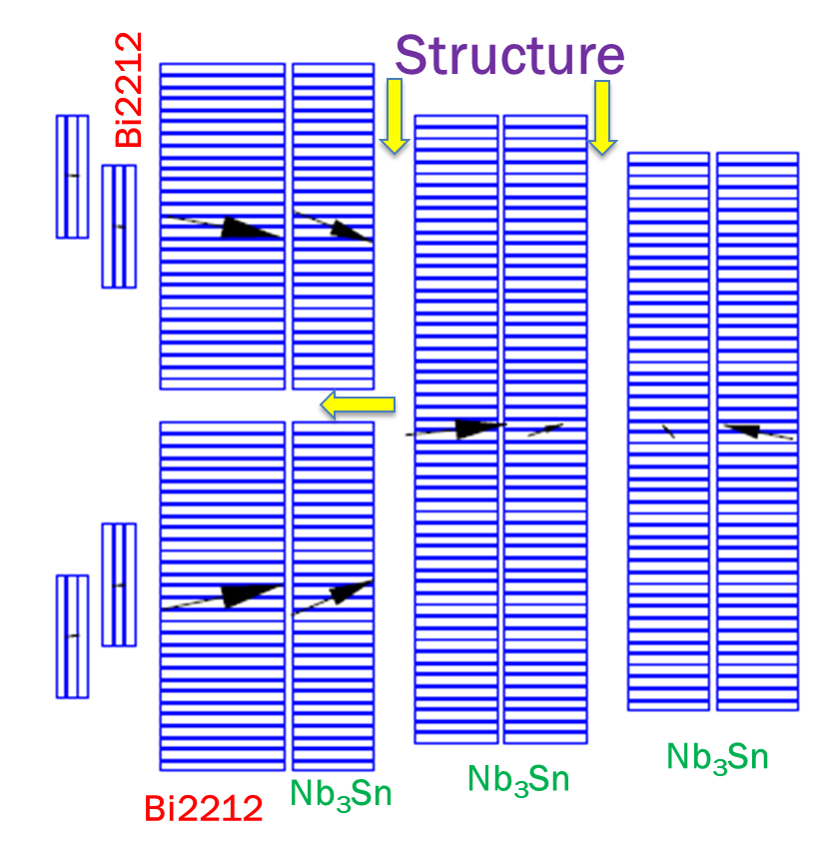
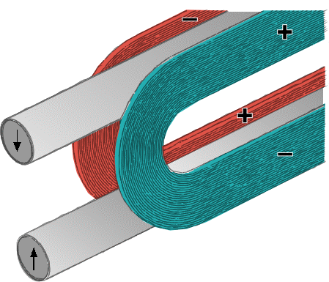
Key Benefits of the Common Coil Design for HTS/LTS High Field Hybrid Dipoles
Natural segmentation between HTS and LTS (and different cables)
Easier tuning between HTS & LTS
Coil layers move as a module without causing strain at ends (BNL common coil had 200 μm)
Intermediate space for stress management structure. It can be easily adjusted, even at the late stage of the magnet construction
B_{pk}=13.6 T
B_{pk}=20.6 T
B_{pk}=16.5 T

