Slide 1
Materials Naming Scheme
Ian Pong (ipong@lbl.gov)
Lawrence Berkeley National Laboratory

Slide 2
Outline
Naming Scheme documents
  E.g. for MDP, AUP, TFD
Introduction
Billet
Spool
Sample
Cable
Software and hardware setup

Slide 3
Introduction
ITER TF: 19 coils, but 500 t of strand, >10,000 billets
LHC MB: 1232 magnets, 1,300 t of strand, ~6,000 billets
AUP MQXFA: 4 inner triplets, ~10 t of strand, ~250 billets
Many more spools
A lot more samples
Need an effective naming scheme to identify each one

Slide 4
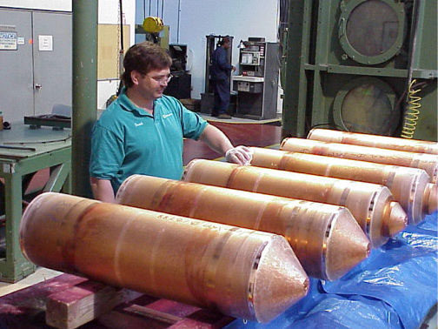
Billet
Defines the architecture and design
Our Naming Scheme starts here
But pedigree is kept also
  Mono
  Subelement
  Dopant
  Etc.
Image from Encyclopaedia of Materials: Science and Technology, Elsevier 2003

Slide 5
Spool
A billet during processing may suffer breakages or may be intentionally cut to remove defects
Typical production: from a single piece to ~10 pieces
Production unit
  May have different history
Piece length unit (a.k.a. piece)
  Same history

Slide 6
Point/Tail
Every piece has two ends
Identifying the ends also helps identify
the direction

Slide 7
Code

Slide 8
Project Code
Project code is a unique one-letter code.
  ‘B’ is to be used for US MDP LTS
  ‘Y’ is to be used for US MDP HTS
The following letters are reserved for other projects:
  ‘A’ is actively used for CERN’s HiLumi LHC
  ‘C’ was used before 2016 for US CDP and is now actively used for CERN’s FCC
  ‘H’ is reserved for CERN’s High Field Magnet (HFM) program
  ‘P’ is actively used for LARP/US HL-LHC AUP
  ‘W’ is for other projects, including TFD

Slide 9
Supplier Code
Supplier code is a unique one letter code that identifies the strand suppliers who have been offered contracts from either CERN or US HL-LHC AUP.
  ‘O’ is for Bruker OST

Slide 10
Rough Diameter
Rough diameter is the strand diameter in tenth parts of millimeter and truncated (not rounded) to tenth part of millimeter.
  Example: 12 for 1.20 mm up to 1.29 mm, 08 for 0.80 mm up to 0.89 mm.

Slide 11
Material Code
Material code is a unique one letter code for the primary superconducting material in strand ID. For US MDP, the following codes may be expected:
  ‘B’ for Bi-2212
  ‘D’ for Bi-2223
  ‘M’ for MgB₂
  ‘S’ for Nb₃Sn
  ‘T’ for Nb-Ti
  ‘Y’ for YBCO or REBCO

Slide 12
Billet Number
A five-digit number is given to uniquely identify material of one billet. The number shall be padded by leading zeroes if necessary, e.g. ‘00293’.
For Bi-2212 and other powder metallurgy billets that are identified by the package date instead of a serial number, the date in YYMMDD format will be modified to 5 digits by translating the month into a single letter
  ‘A’ for January, ‘B’ for February, and so on and so forth.
  E.g. PMM 200424 (billet packaged on 2020 04 24) will be identified as 20D24.

Slide 13
Coating and Annealing Code
Coating code is a unique one letter code for coating metal or coating absence designation in the strand ID. The selection of letter also designates the presence of an annealed condition.
  ‘U’ for un-annealed and un-coated strands
  ‘A’ for annealed and un-coated strands
  ‘C’ for Cr plating, regardless of the plating process (e.g. Cr-III or Cr-VI)
  ‘N’ for Ni plating

Slide 14
Code (Billet and Spool)

Slide 15
Point/Tail and Use Code

Slide 16
Point/Tail Code
The location shall be the letter ‘P’, ‘X’, ‘Y’, or ‘T’ denoting the billet location where the piece was cut
  P - sample cut from the point extremity of the billet
  T - sample cut from the tail extremity of the billet
  X - sample cut from the point side of a piece in the billet, but not from the point extremity of the billet
  Y - sample cut from the tail side of a piece in the billet, but not from the tail extremity of the billet

Slide 17
Use Code
A letter designating the disposition of the sample.
  E.g., the supplier cuts 3 lengths at the same time from a strand production unit for QC. This requires an identifier to assist in routing and to avoid handling errors due to identical names (due to the same strand spool) if this letter was absent
  ‘A’ - Archive length intended for storage
  ‘V’ - Verification use and QC
  ‘S’ - Supplier use on round wires, including supplier sub-contractors
  ‘O’ - Other purpose, such as university R&D, facility qualification, etc.
  ‘W’ - Witness samples

Slide 18
Sample Sequence
The sample sequence is a 2-digit number to facilitate routing when multiple pieces are cut.
The recommendation is to use an incremental first digit (e.g. “10”, “20”, etc.) when cut directly from a spool where the number of cuts should be recorded, and to use an incremental second digit (e.g. “11”, “12”, “21”, “22”, etc.) for subsequent cuts off those pieces.
For further details, see Naming Scheme document

Slide 19
Cable

Slide 20
Cable
Project Code – same as billet/spool
Cable Code – defined by cabling team
Strand Supplier Code – same as billet/spool
Cable Manufacturer Code
  ‘C’ – CERN
  ‘F’ – FNAL
  ‘L’ – LBNL
Cable Map Number – assigned by cabler manufacturer

Slide 21
Cable Production Unit
Multiple runs are possible from a single map.
Startup runs are numbered (1, 2, 3…)
Production runs are identified by incremental letters (A, B, C…)
At LBNL, we typically identify the point/tail as well as the top and bottom sides as PT/PB/TT/TB

Slide 22
100 m Code
The length of the cable piece produced during production is recorded in the cable identifier.
The 100 m code is a letter
  ‘A’ - a piece starting at 0 to 99 m, ‘B’ - 100-199 m, …, ‘J’ for 1000-1099 m, etc.
The cable pieces are identified by the position of the point-end cut, truncated to the closest 100 m

Slide 23
Fork ID or 1 m Code
This code is a two-digit number, identifying the cable position to the nearest metre, in combination with the 100m Code above
  E.g. a cable sample piece cut at 265 m from the cable point will receive the digits ‘65’ for this code, along with the letter ‘C’ for 200-299 m
For extracted strand sample pieces, these digits identify the fork position number on the planetary cabling machine that corresponds to the particular strand
  Note that the fork position number may not correspond to the strand position in the cable, e.g. if a 40-strand cable is made from a cabling machine with 60 forks

Slide 24
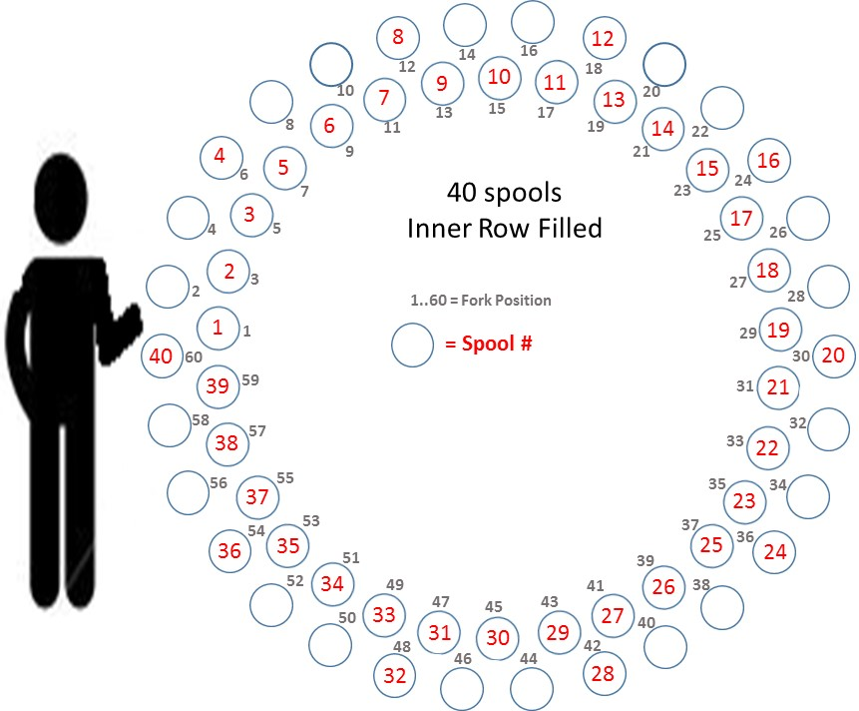
Fork Position versus Strand Number Example
MQXFA Cable

Slide 25
State of Cable/Strand Code
The state of cable code identifies the cable state as follows:
  ‘A’ - bare cable
  ‘B’ - cable with braided insulation
  ‘T’ - cable with wound tape insulation
For strands identified with cables, the state of strand code identifier becomes:
  ‘E’ - extracted strand
  ‘V’ - virgin strand, e.g. excess attached to the cable at the end of the run
  ‘S’ - stainless steel core

Slide 26
Extracted and Virgin Strands
An extracted strand’s detail (e.g. manufacturer, material, billet number etc.) will be identified via the cable map, and should be represented using the cable code in the form of A99AA9999AA99E where E stands for extracted strands. We typically also provide the spool ID.
A virgin strand attached to the cable at the end of the cabling run can be identified in the form of A99AA9999AA99V, as well as AA99A99999A99A. We typically also provide both.

Slide 27
Cable

Slide 28
Test Samples

Slide 29
Lab Code
This list applies to 3 characters in the identifier: the Preparation Lab, the HT Lab, and the Test Lab.
  Note that pre-HT operations, such as mounting a wire under tension onto a barrel, is considered to be part of the sample preparation operation, whereas post-HT operation, such as soldering voltage taps on I_{C} barrel samples, is part of the sample testing operation. Information relevant to any operation stage shall be logged on travelers or the strand database.

Slide 30
Sample ID

Slide 31
HT Furnace Code
Prior to any heat treatment, this identifier shall be ‘U’ or omitted to indicate an unreacted state.
When designated for HT, a letter or digit shall be assigned by the lab performing the HT to identify the corresponding furnace. A furnace identifiers list (‘lookup table’) is to be managed by each lab independently for primarily internal use.

Slide 32
HT Start Date
The HT start date is a string of digits in the format YYMMDD. Prior to any heat treatment, these characters shall be ‘000000’ or omitted.
It is not expected that a furnace will run more than one heat treatment in a day, and therefore the HT Code should be unique by design. If a laboratory is to record its heat treatment internally by serial number instead of date, it is responsible for maintaining a cross-reference list

Slide 33
HT Pull-out Identifier
Prior to any heat treatment, this identifier shall be ‘U’ or omitted. When it is necessary to pull a specimen from the furnace before the full reaction heat treatment has completed, pull-outs can be identified by a sequence of letters that denote time-temperature coordinates along a particular profile, e.g. ‘A’, ‘B’, ‘C’, etc.

Slide 34
Test Facility Info
If a lab has multiple facilities, e.g. different magnets for IC testing, they shall be identified.
A list of test facilities (including subcontractors’) is to be managed by each lab independently for primarily internal use

Slide 35
Thermal Cycle Number
Prior to any testing, this identifier shall be ‘0’ or omitted.
Samples can be tested multiple times. Since cycling between room temperature and cryogenic temperature may impart strain to the sample. Tests that are conducted at cryogenic temperature shall record the number of thermal cycles in this location, starting with ‘0’ for a sample prior to testing.
It is not anticipated that a typical test sample or coil will undergo more than 9 thermal cycles.
For RRR reference wires, use the letter ‘R’ instead of a number

Slide 36
Test Samples

Slide 37
Example 1: BO08S14451A01U
This represents a US MDP strand made by BOST, rough diameter 0.8 mm (say, 0.85 mm), material Nb₃Sn, billet number 14451, strand production unit ‘A’ (this billet might have processed without breakages), Piece Number ‘01’ (this strand production unit might have processed without cuts), un-annealed and un-coated as originally manufactured.

Slide 38
Example 2: B14OL1234BB70A
This is a cable sample of US MDP cable type ‘B14’ (design parameters to be found in the US MDP Approved Cable Codes) made from OST strands cabled at LBNL (‘OL’), LBNL Cable Map 1234, from cable production unit ‘B’, where the point end of the sample was cut at the 170th m = ‘B70’ from the point end of the cable production unit ‘B’. It is a bare cable (‘A’). Note that there is no information about the length of this sample in the ID

Slide 39
Example 3: B21OL1357AA23E
This is a length of extracted strand corresponding to fork #23 on the cabling machine from a cable sample of US MDP cable type ‘B21’ (design parameters to be found in the US MDP Approved Cable Codes) made from OST strands cabled at LBNL (‘OL’), LBNL Cable Map 1357, cable production unit ‘A’, where the sample point end was cut within the first 99 m (‘A’) of the cable. Note that ‘A23’ does NOT denote the position 23 meters from the cable point.

Slide 40
Example 4: BO08S14451A02U.XO11-LVLD130531AU00
a short sample taken from the same strand production unit described above but a different piece number (here ‘02’). The test sample was taken from the point end of the strand piece (‘X’, but not ‘P’ because it is not the point end of the billet), with the use designated as other (‘O’, not for supplier or verification activities and not from archive length). It is a straight sample for volumetric or geometric analyses (‘V’) prepared at LBNL, heat treated at LBNL in their furnace D in 2013 on May 31st, and taken out of the furnace at the 1st quench position, not intended for tests or not yet tested.

Slide 41
Example 5: PO08S14451A01U.YV10 …
Consider the same virgin wire spool described above, that for verification of results, a length long enough for three I_{C} barrels was cut from the tail end (PO08S14451A01U.YV10 which is to become .YV11, .YV12, .YV13) and wound on a stainless steel mandrel (i.e. prepared) at LBNL and heat treated at BNL in furnace A in 2013 on May 31st.
Suppose that after HT, the third sample in this block (.YV13) is to undergo a round-robin IC test (test ID = ‘I’), first at BNL test station ‘A’, then at CERN using test station ‘D’, next at LBNL test station ‘A’, and finally back at BNL test station ‘A’. The Prep-HT-Test ID’s that would be used at BNL, CERN, LBNL, and again BNL would be, respectively (PO08S14451A01U.YV13-): LIBA130531ABA1, LIBA130531ACD2, LIBA130531ALA3, LIBA130531ABA4. Here, the 14th character tracks the number of thermal cycles

Slide 42
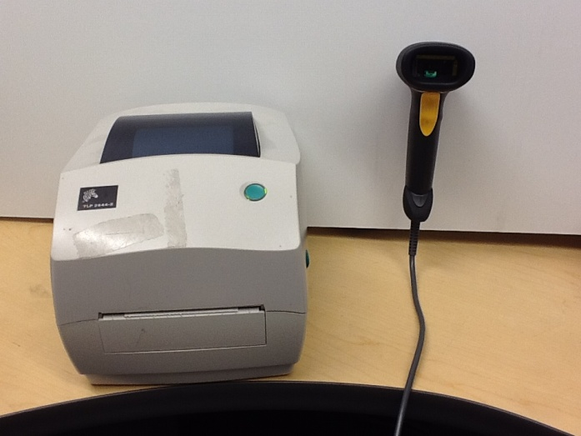
Software and Hardware Setup
Symbol LS2208 barcode scanner (or a similar reader capable of reading Code 39 barcodes)
ZDesigner TLP 2844-Z label printer or similar
Microsoft Excel 2010 (or newer version)
Connectcode Barcode Font package- fonts available at http://www.barcoderesource.com/excelbarcodefont.shtml
Ability to read .xlsm files
Zdesigner TLP 2844-Z Label Printer (left) and
Symbol LS2008 Barcode Scanner (right)

