Slide 1
Training Reduction
MDP Meeting
November 10, 2021
Emanuela Barzi¹, Maxim Marchevsky² , Stoyan Stoynev¹, Xingchen Xu¹
US Magnet Development Program
¹Fermi National Accelerator Laboratory
²Lawrence Berkeley National Laboratory
US Magnet Development Program

Slide 2
Training reduction roadmap
(as presented in 2020)
 |  |  |  |  |  |  |  |  |  |  |  |  |  |  |  |  | High-Cp R&D
 |  |  |  |  |  |  |  |  |  |  |  |  |  |  |  |  | Cable/stack training R&D
 |  |  |  |  |  |  |  |  |  |  |  |  |  |  |  |  | QCD R&D
 |  |  |  |  |  |  |  |  |  |  |  |  |  |  |  |  | Vibrational R&D
2019
2020
2021
2022
2023
Q4
Q1 Q2 Q3 Q4
Q1 Q2 Q3 Q4
Q1 Q2 Q3 Q4
Q1 Q2 Q3 Q4
High-Cp wire concept development
Cable studies on
high-Cp wire
High-Cp applications
to coils
High-Cp cable
development and tests
High-Cp wire and tape optimization
Strand and cable
FEM simulations
Cable device and
sample development
Device fabrication and sample testing
Quench Current-boosting Device (QCD) development and tests on small models
QCD larger magnet
studies and tests
CCT magnet tests
Ultrasonic pulsing
Vibrational tests development
In red border lines – independent funding

Slide 3
Official training reduction roadmap
Roadmap as in the official document:
https://science.osti.gov/-/media/hep/pdf/Reports/2020/USMDP-2020-Plan-Update-web.pdf

Slide 4
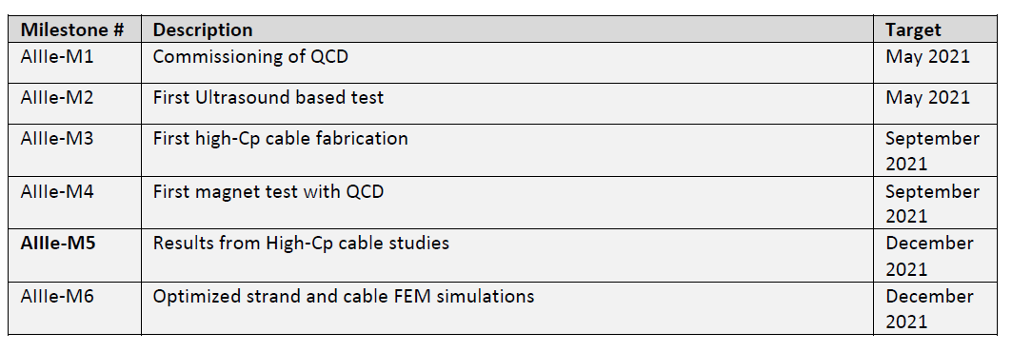
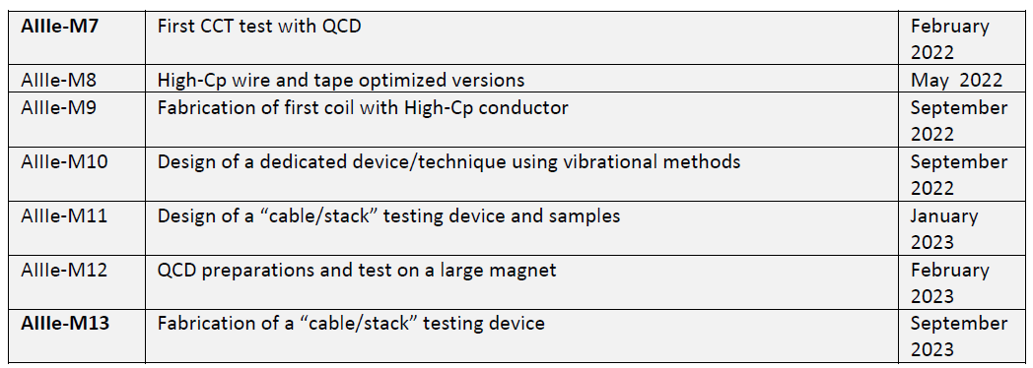
Milestones
QCD: Under completion, test expected in February 2021
Ultrasonics: no SC magnet tests in FY21, we are
preparing for tests in FY22
High-Cp : Wire/cable tests performed with high-Cp
wrapped tape,
high-Cp wires with improved properties
fabricated, test with cables in 2022
FEM simulations in 2022
Overall, we are running with 6-12 months delay due to
multiple factors.
Some studies may be hard to get to in a timely manner.
https://science.osti.gov/-/media/hep/pdf/Reports/2020/USMDP-2020-Plan-Update-web.pdf

Slide 5
Future milestones
We may want to plan for a second “mirror”
magnet test first, as originally envisioned;
in any case FY22 is difficult for testing
Not expected till the end of 2022
It requires resources to develop and a
dedicated team, we could set up a team in FY22

Slide 6
Spare

