Slide 1
Updates on Material Studies
S. Krave, A. Haight, T. Shen, J. L. Rudeiros
8 December 2021
US Magnet Development Program

Slide 2
Outline
General Materials Goals from MDP Plan
Updates On CTD/FNAL/LBNL Collaboration
Other updates from FNAL
Updates from LNBL

Slide 3
Goals of the working group
Work to develop processes and materials to enable high performance magnet designs
  Evaluate resin systems for standard processing parameters
    Viscosity, mixing processes, curing etc…
Applicable Driving Technical Questions:
  How do magnet materials directly affect magnet training and performance?
  How can magnet materials be designed to facilitate improved magnet performance?
  Can improved processes lead to more cost effective and robust magnet designs?

Slide 4

Composite Technology Development, Inc.
A world-leader in advanced material systems and solutions for challenging environments
Radiation-Tolerant, Thermally Conductive Resin Systems for High Energy Physics Magnets
SBIR Grant No. DE-SC0018701
Andrea Haight and Tengming Shen
September 28, 2021

Slide 5

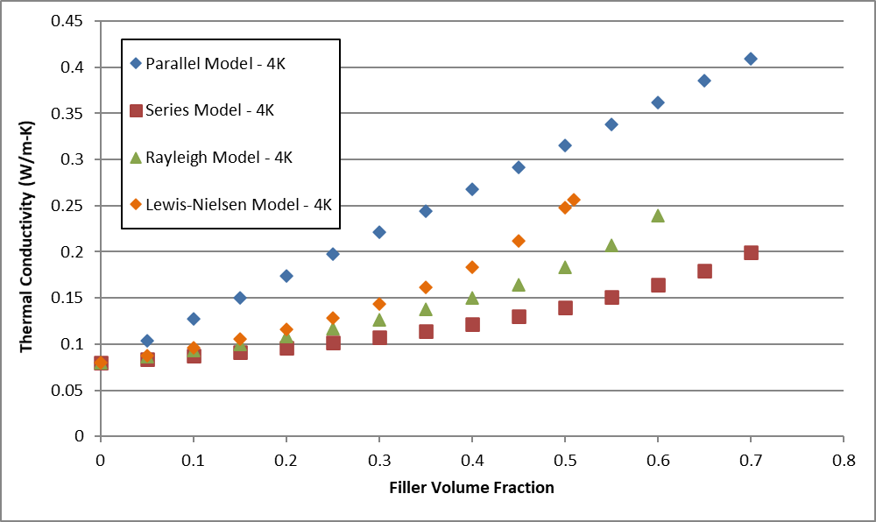
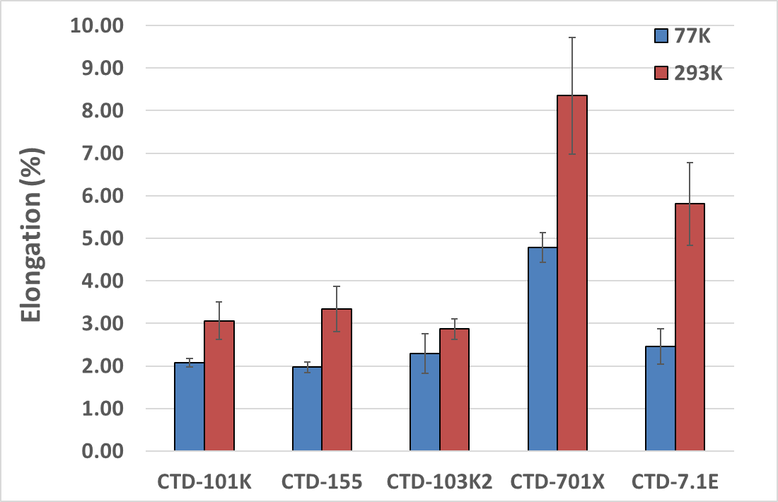



  Program Goal:
  Address long magnet training cycles through insulation optimization
Formulation & evaluation of thermally conductive insulation
Formulation & evaluation of high strain insulation
Optimization of high strain and thermally conductive insulation options
Stack testing for screening options
Subscale CCT magnet fabrication & testing

Slide 6
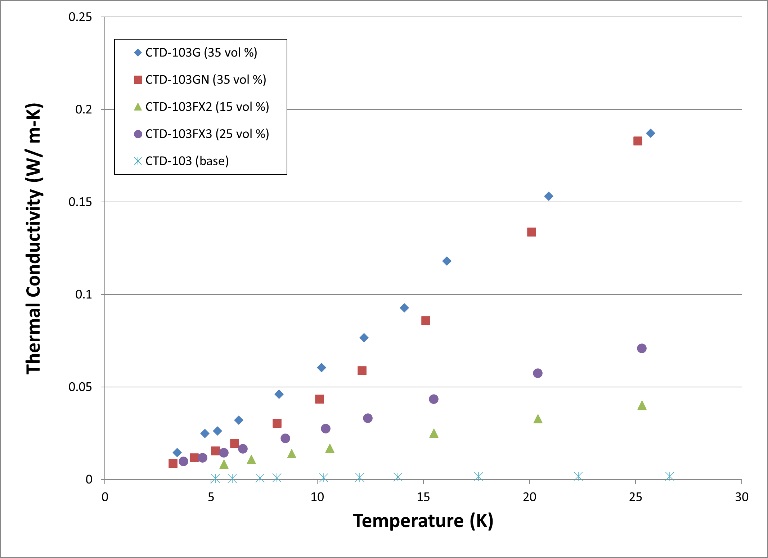
Thermally Conductive Resins
Fillers selected based on published
cryogenic thermal conductivity data
from NIST, CERN
Modeling used to identify target
volume fraction, typically 30 – 40 vol %
Nanoscale materials for potential
property enhancement and to retain
processability
Tested from 4K to 298K
Phase I data shown from 4K to 30K

Slide 7
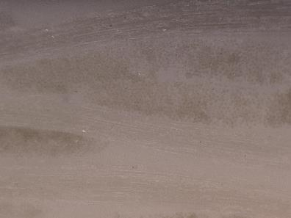
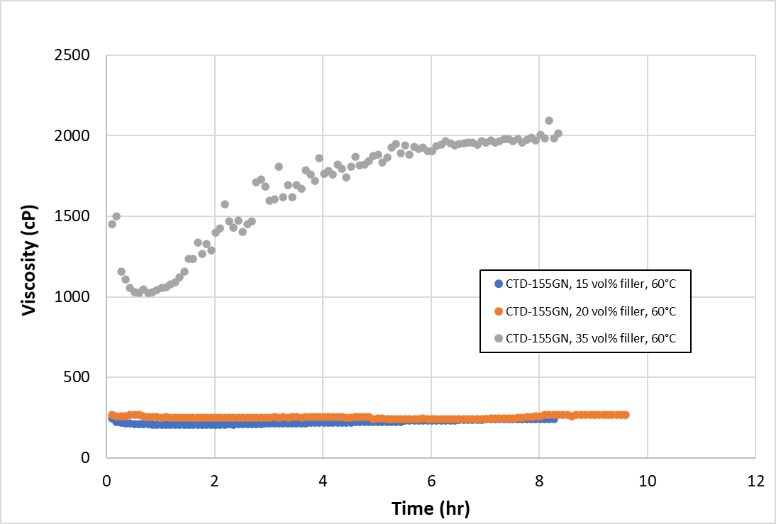
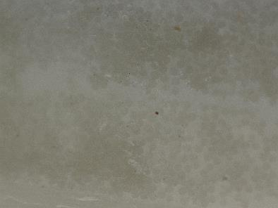
CTD-155GN Evaluation
Most promising Phase I filler added
to CTD-155 (a toughened resin)
  35 vol % system viscosity too
  high for VPI processing
  Reduced particle loading level
  to 20 vol % to manage viscosity
κ = 0.4 W/m-K at 90K
400x
400x
S2 glass laminates fabricated
with this resin
    No particle filtering
    Uniform appearance through
    the laminate
1000x
1000x

Slide 8
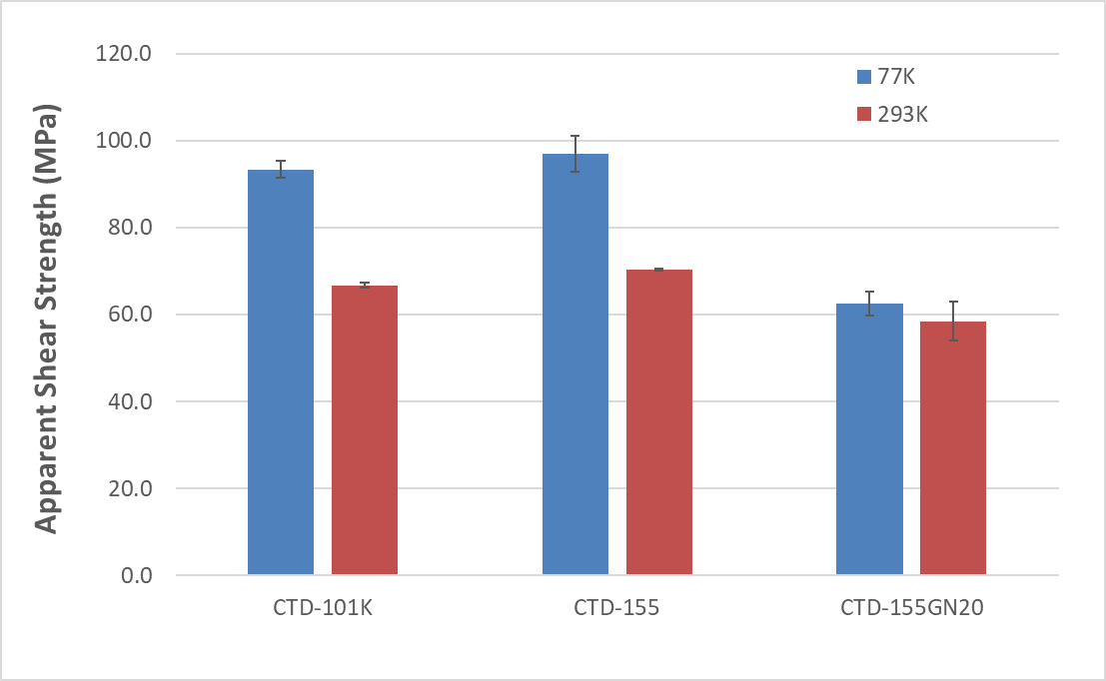
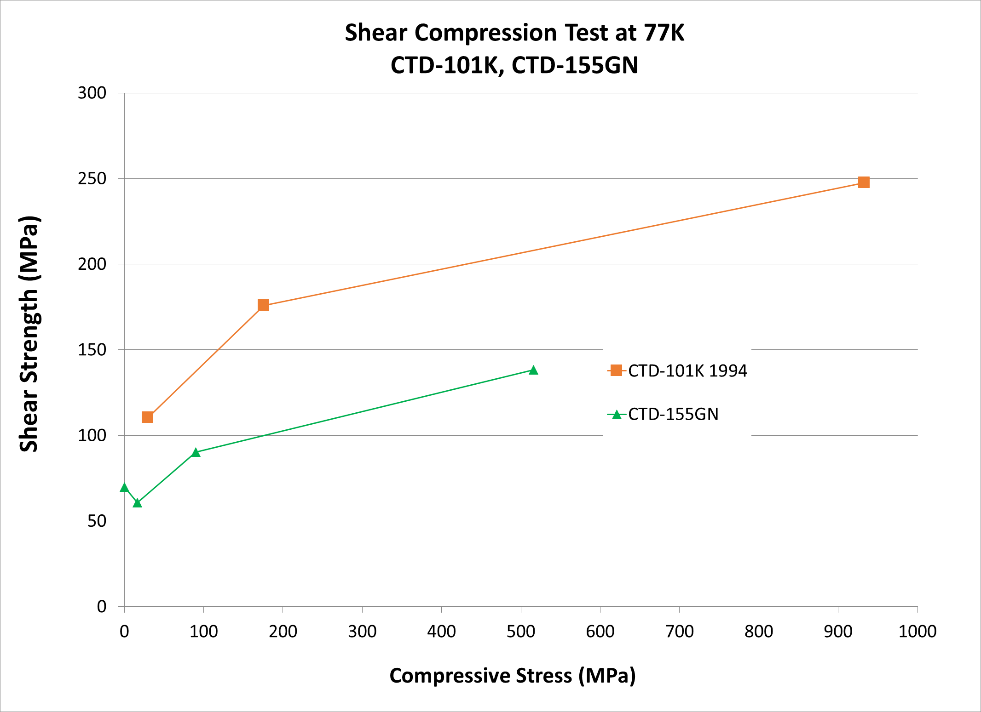
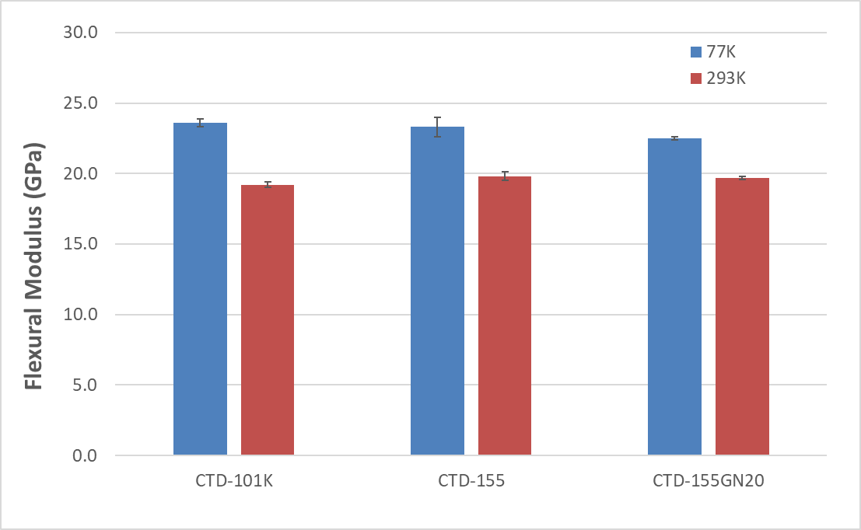
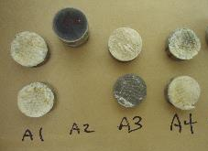
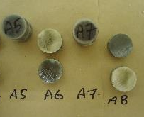
Mechanical Properties
CTD-155GN showed a larger fraction of adhesive failures

Slide 9
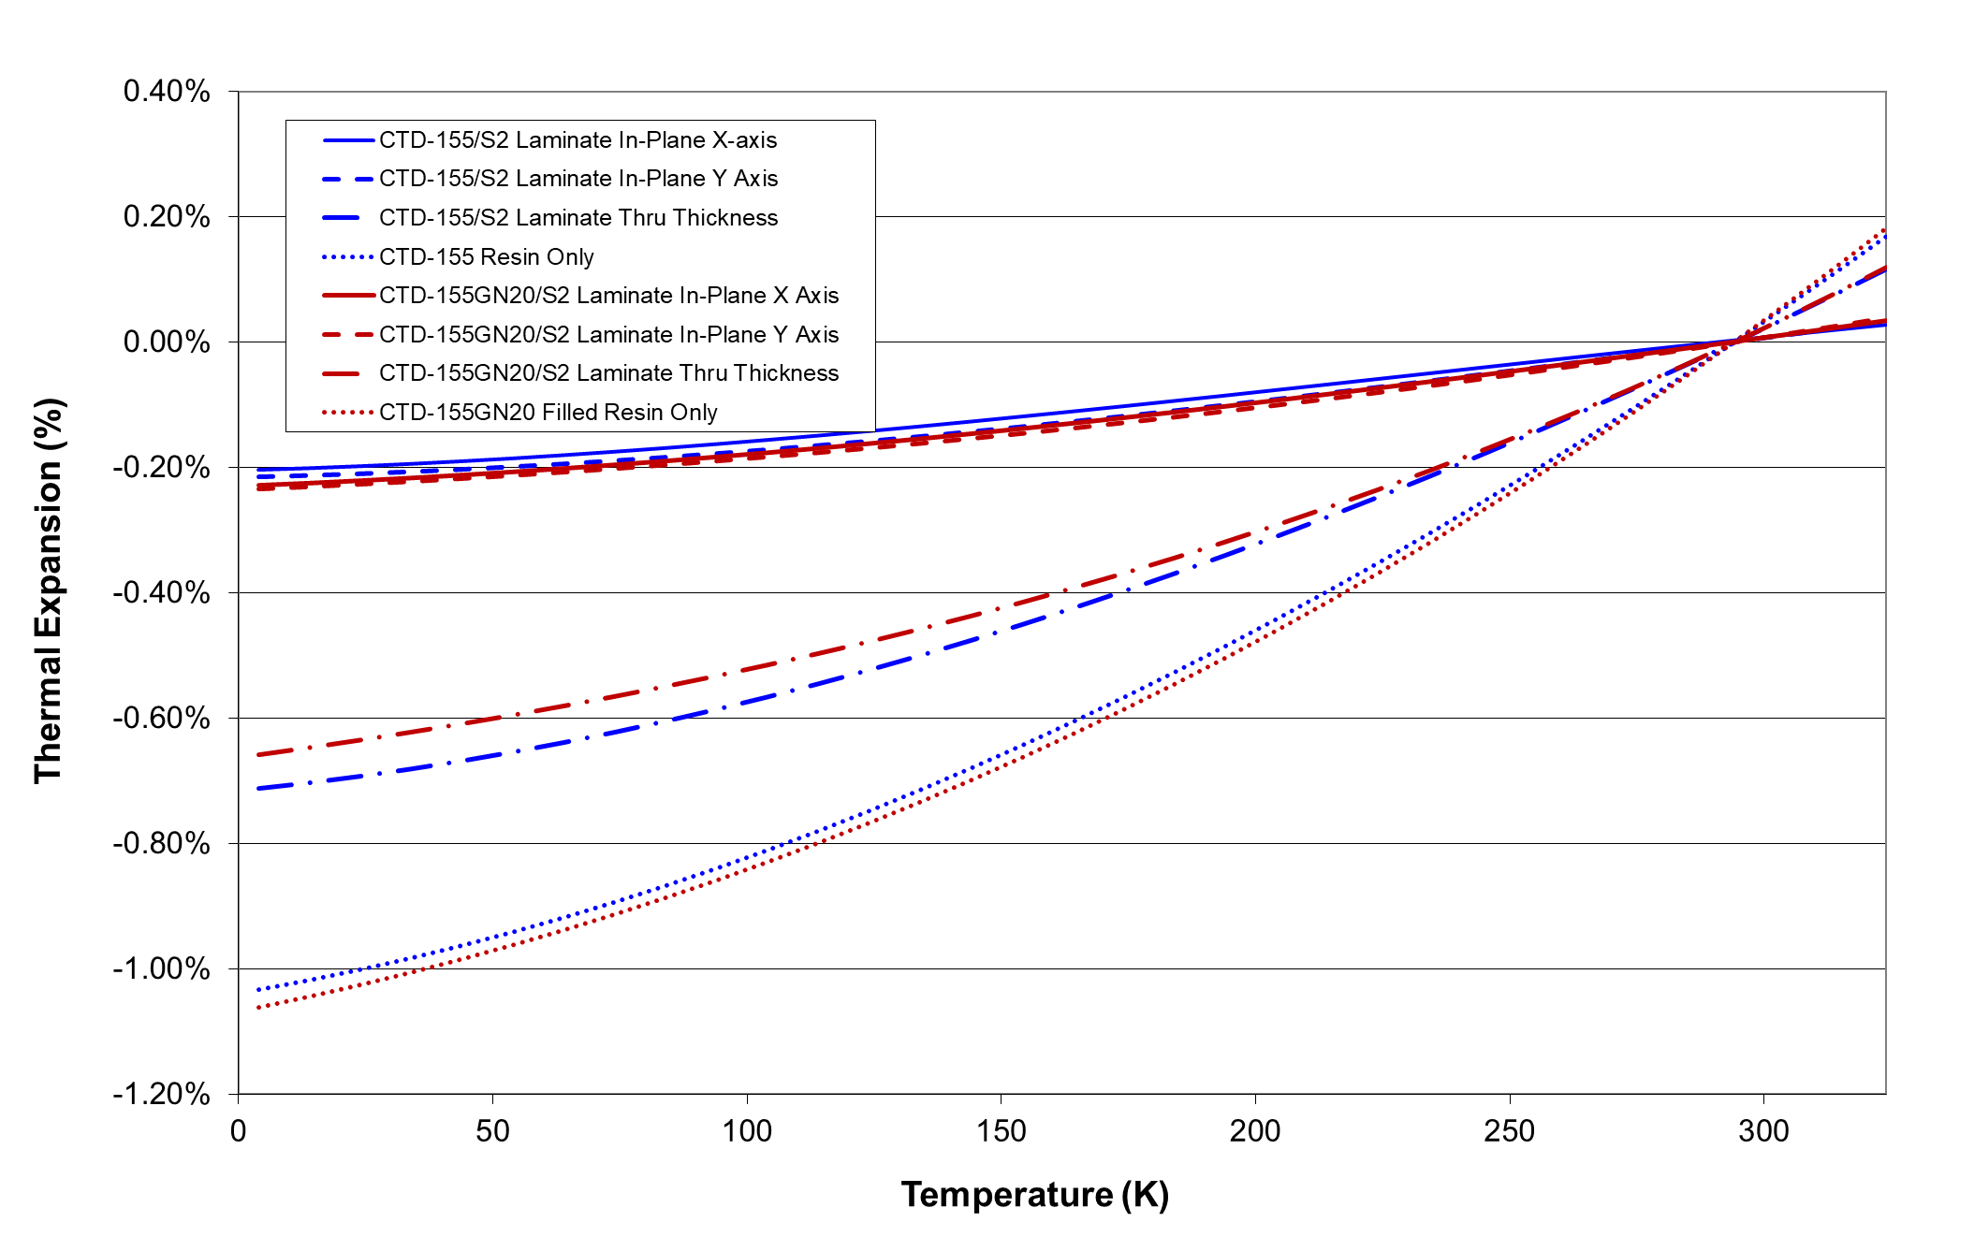
Thermal Expansion

Slide 10
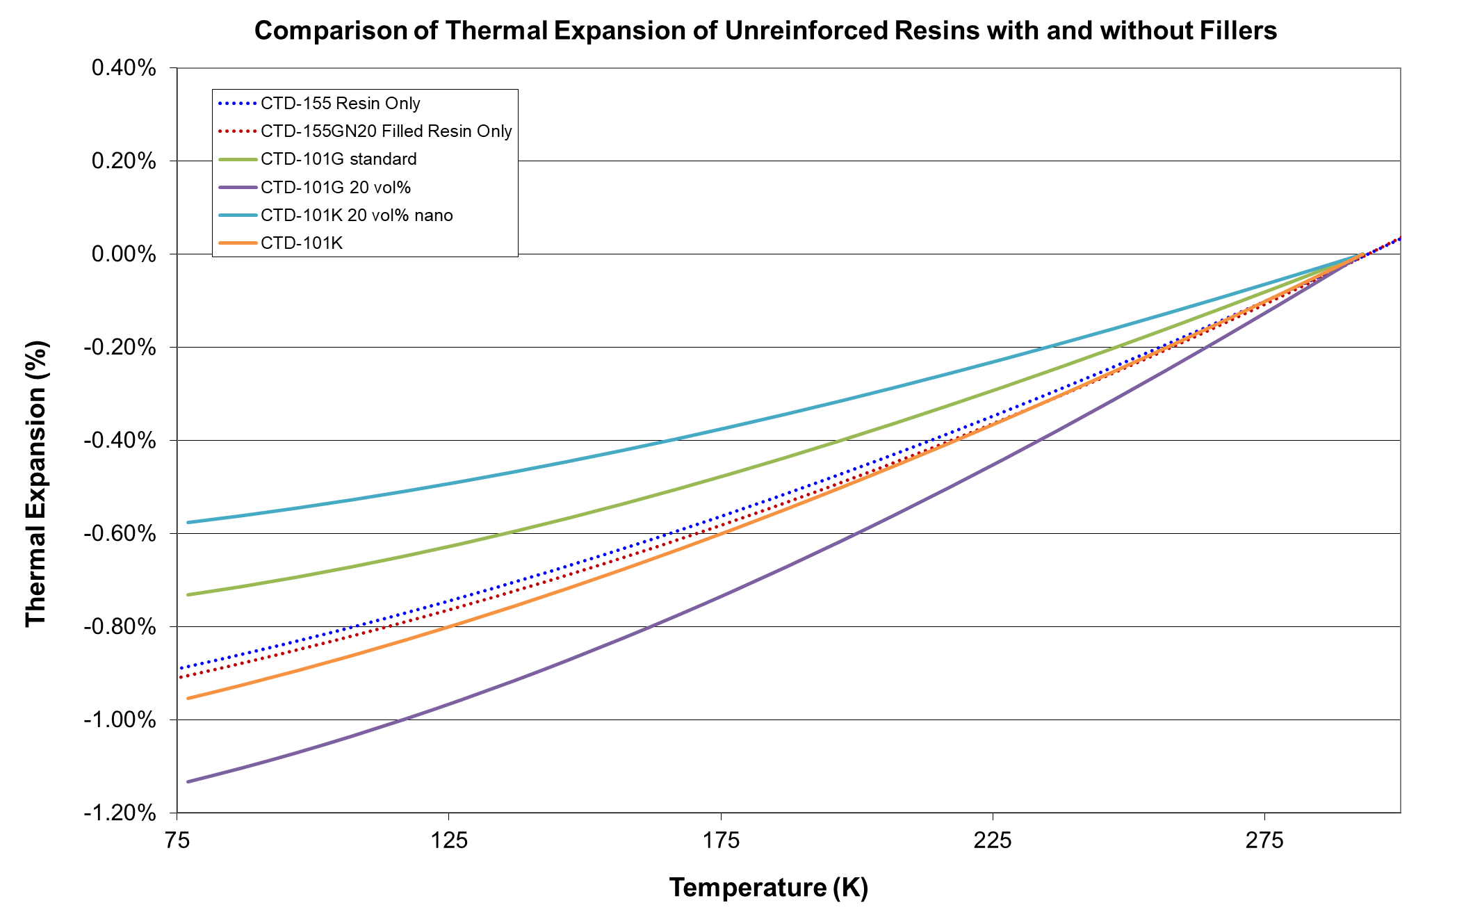
Thermal Expansion – Particle Size & Loading

Slide 11
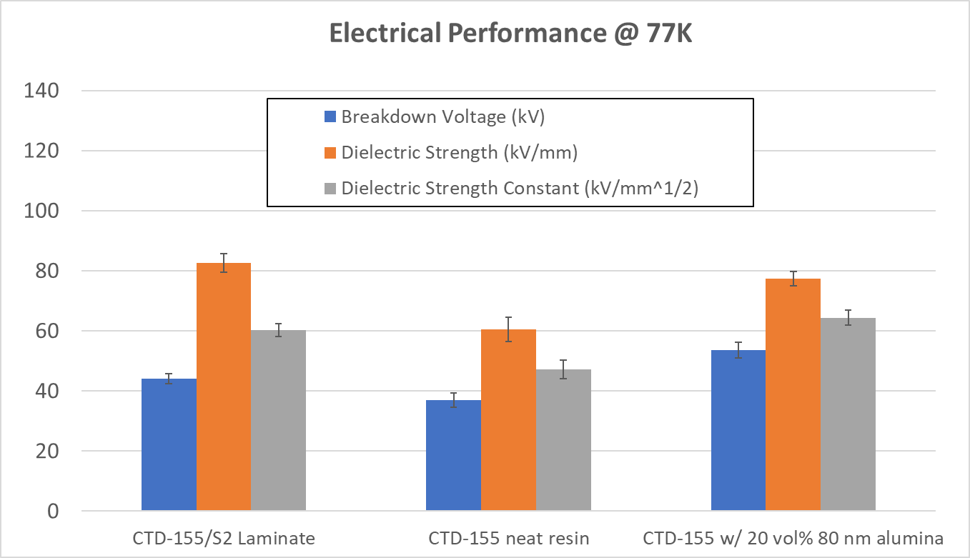
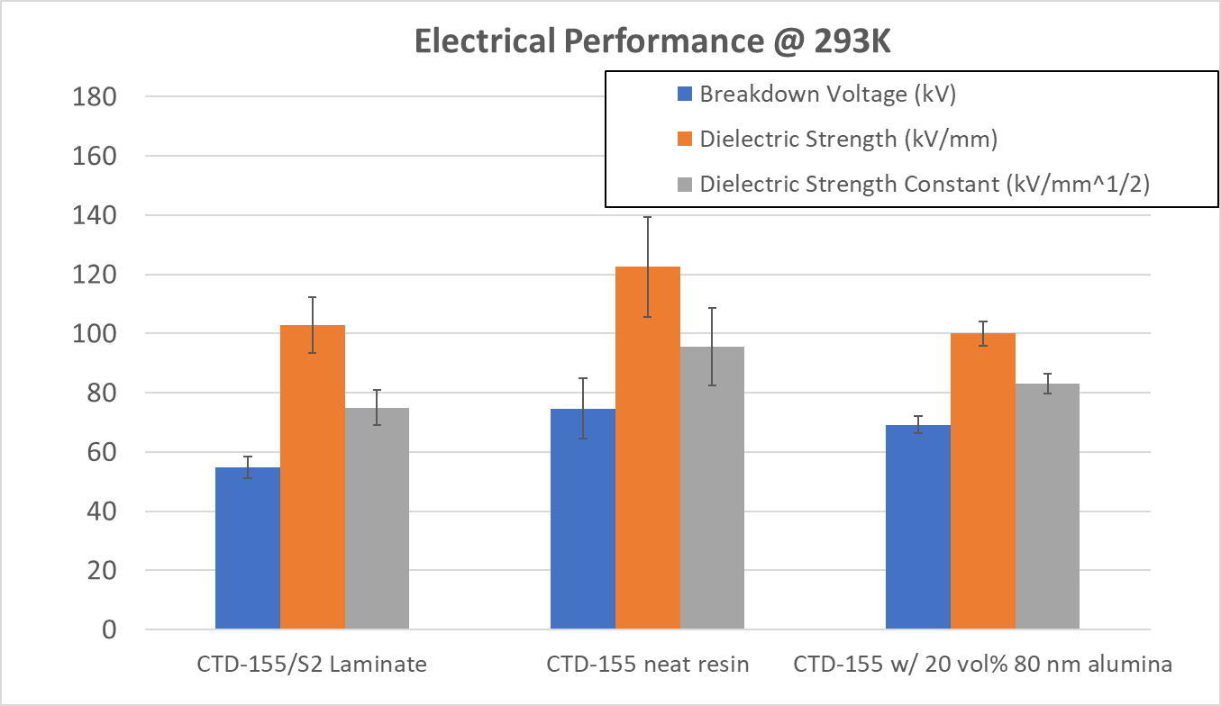
Electrical Properties
Modeling at MIT indicated that there was a potential concern with breakdown initiating at particle boundaries resulting in lower electrical performance
Testing at CTD shows that the particles have no significant effect on electrical performance

Slide 12
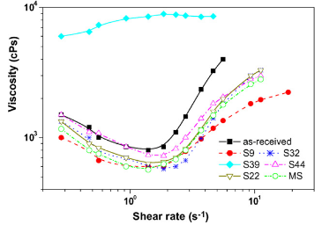
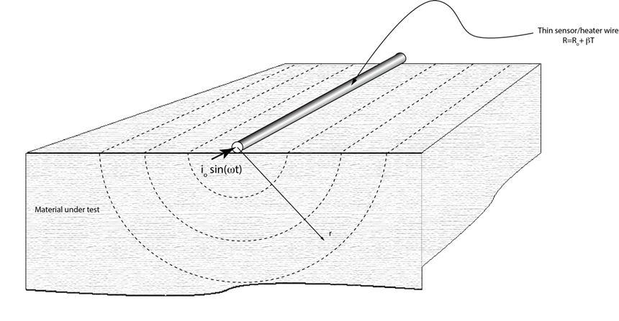
Other Thermally Conductive Resins
Focusing on Filler 3 from Phase I
  Higher thermal conductivity than Filler 1
  Additional synergistic possibilities when blended
  with Filler 1
Particles were surface modified for improved
dispersion, treatment also shown to
lower viscosity
Thermal conductivity evaluated at MIT using
3ω method
  Joule heating in the wire →
  oscillatory heating that is
  dissipated to surrounding material
    Amplitude of temperature oscillations
    in wire used to infer thermal conductivity
E.-S. Lee et al. / Colloids and Surfaces A: Physicochem. Eng. Aspects 316 (2008) 95–103

Slide 13
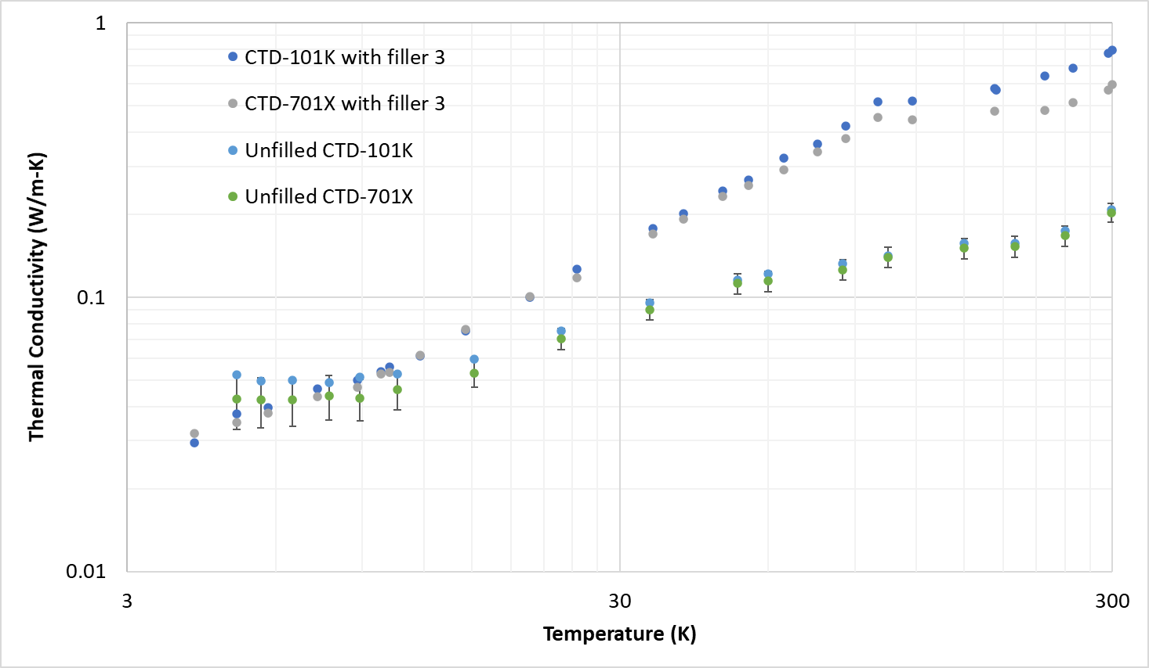
Early Results
Increased particle loading to 30 vol%
  HEP Phase I material was not processable: paste at 25 vol% filler
  These systems were pourable at 30 vol % filler
  κ improved by factor of 2 or better at temperatures above 10K relative to HEP Phase I program results

Slide 14

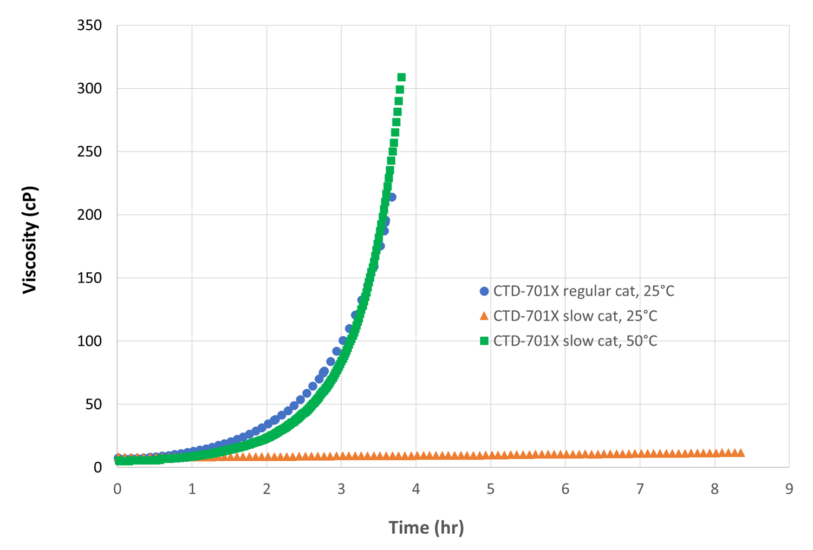
Toughened Resin Systems
Name | Description | T_{g}, °C (tan δ) | Viscosity @ 60°C (cP)
 |  |  | Initial | 7 hours
CTD-101K | Baseline anhydride-cured epoxy resin | 150 (avg QA) | 70 | 100
CTD-103K2 | Long pot life 2-part formulation similar to CTD-101K | 141 | 61 | 61.5 (4.5 hr)
CTD-103LT | Lightly toughened version of CTD-103K2 | 126 | 24 | 71
CTD-155 | Anhydride-cured epoxy resin with reactive rubber toughener | 147 | 125 | 127
CTD-701X | Extremely low viscosity, tough polyolefin resin system | 131 | 25 (@ 25°C) | 70 (90 min, 25°C)
CTD-7.1E | Low viscosity, toughened amine-cured epoxy resin | 72 | 225 | Approx. 2 hr
Initial CTD-701X
formulation
showed rapid
viscosity increase
at 2hr (25°C)
Catalyst change
allowed a significant
increase in potlife
– heat required to
initiate cure

Slide 15
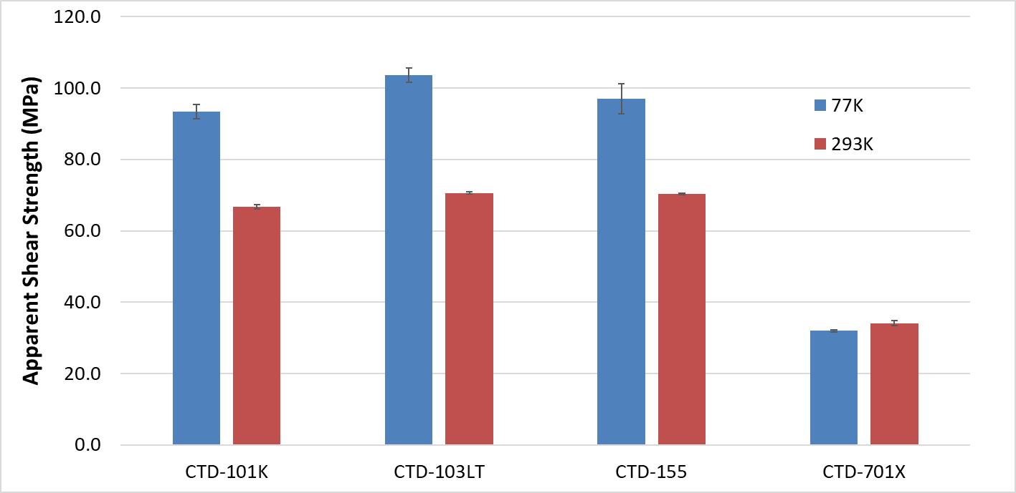
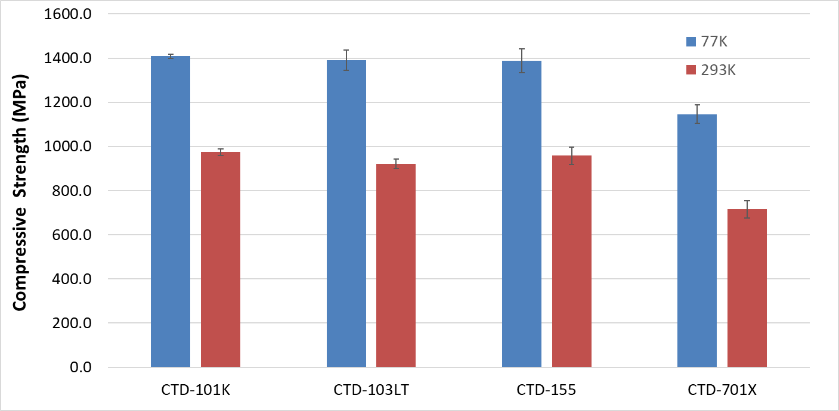
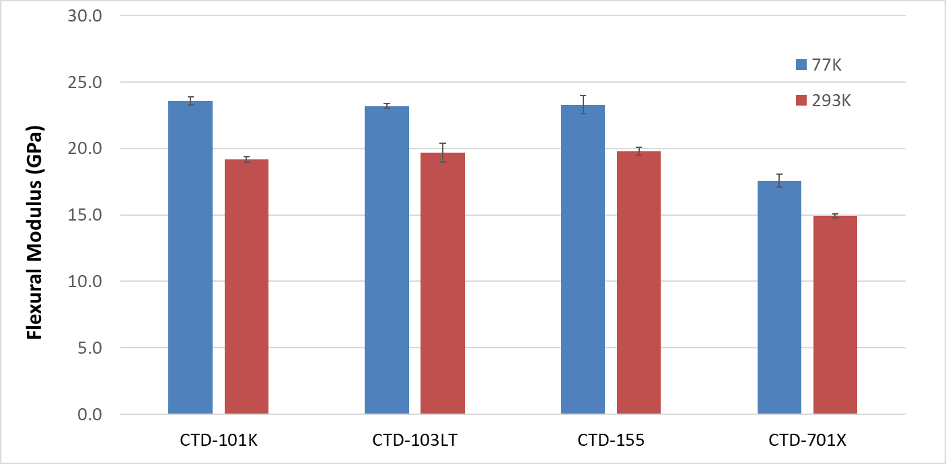
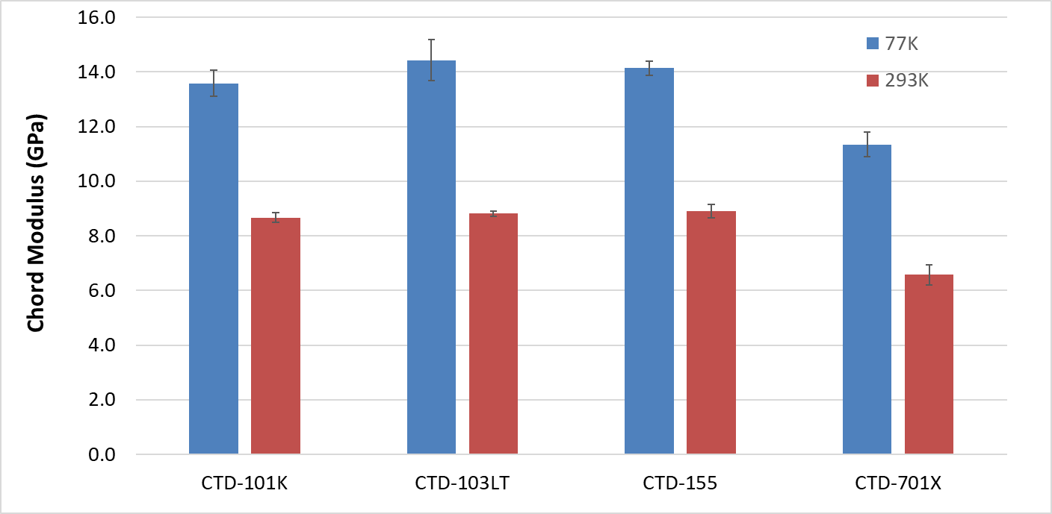
Mechanical Property Summary
6781 style S2 glass reinforcement, V_{f} ~ 50%

Slide 16
CCT Sub4 Magnet 4K Test Summary
Work was supported by the US. Department of Energy, Office of Science, Office of High Energy Physics
under a phase II SBIR award with the Composite Technology Development, Inc., led by Andrea Haight, LBNL, led by Tengming Shen, and Fermilab, led by Steve Krave. Work at LBNL was partially supported by the US. Department of Energy, Office of Science, Office of High Energy Physics through the U.S. Magnet Development Program.
Thanks LBNL colleagues who involved in the design, construction, and test of this magnet. Jose Luis Rudeiros, Diego Arbelaez, Tim Bogdanof, Laura Garcia Fajardo, Geonseok Lee, Mark Krutulis, Elizabeth Lee, Maxim Marchevsky, Max Maruszewski, Cory Myers, Robert Memmo, Jim Swanson, Jordan Taylor, Reed Teyber, Marcos Turqueti, Lucas Brouwer, Shlomo Caspi, Marius Junchno, Paolo Ferracin, Ian Pong, Soren Prestemon

Slide 17
Executive Summary
CTD-101K and NHMFL Mix 61 have been two primary epoxy resins used for constructing superconducting accelerator magnets.
A non-epoxy, high toughness, potentially radiation hard resin CTD-701x was developed in a collaboration between Composite Technology Development, Inc. (CTD), Fermilab and LBNL, and first applied in the LBNL’s subscale Nb₃Sn CCT magnet.
4K magnet testing was performed in August 2021 at LBNL. Good quench behavior was obtained with improved understanding of quench locations and driving mechanisms.
The resin looks a promising system to pursue

Slide 18
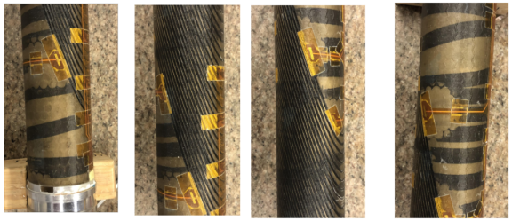
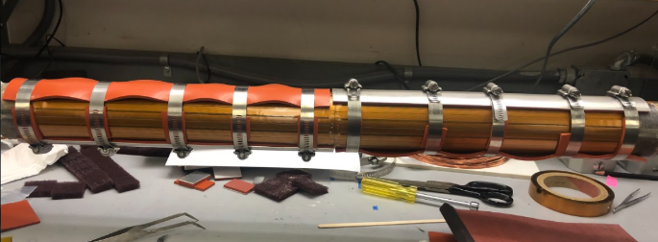
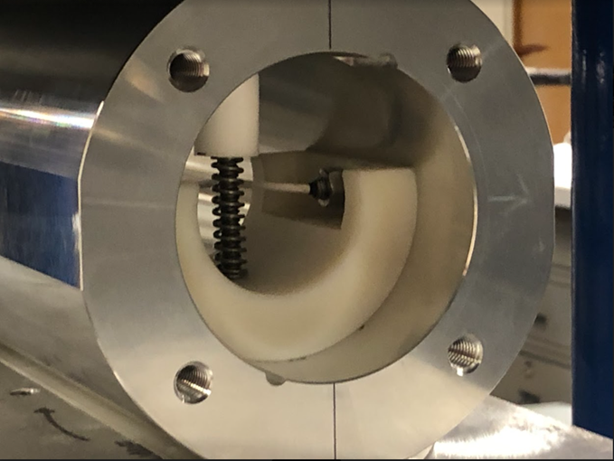
Subscale CCT
L1E after impregnation
CTD-701X
L2D and L1E impregnated, some process changes for L1E to reduce voids
Quench antenna mounting
Shell Press

Slide 19
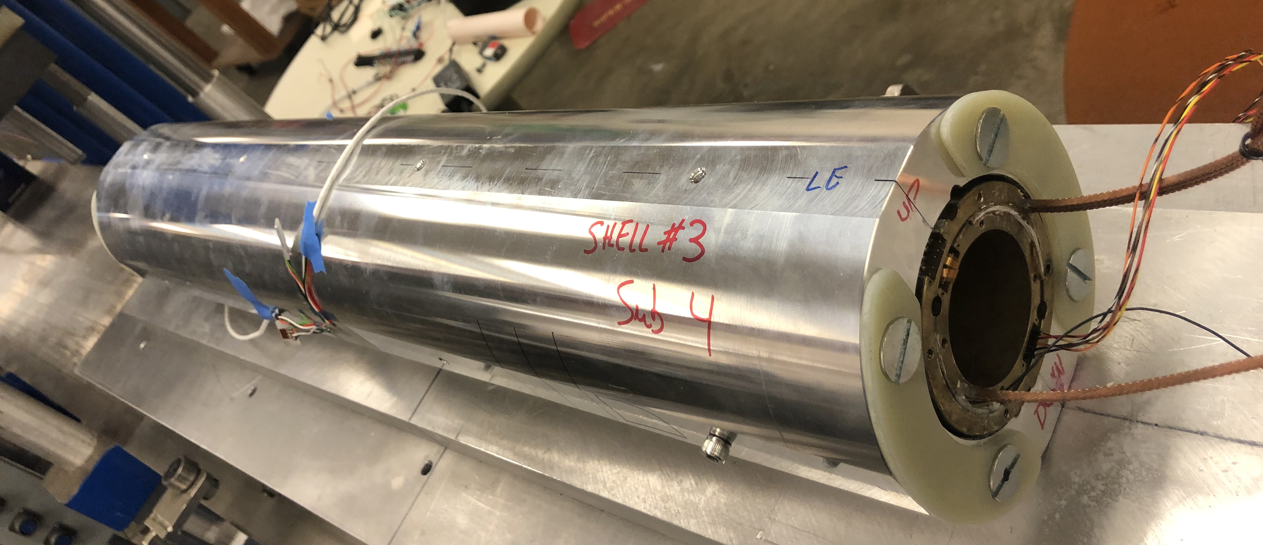
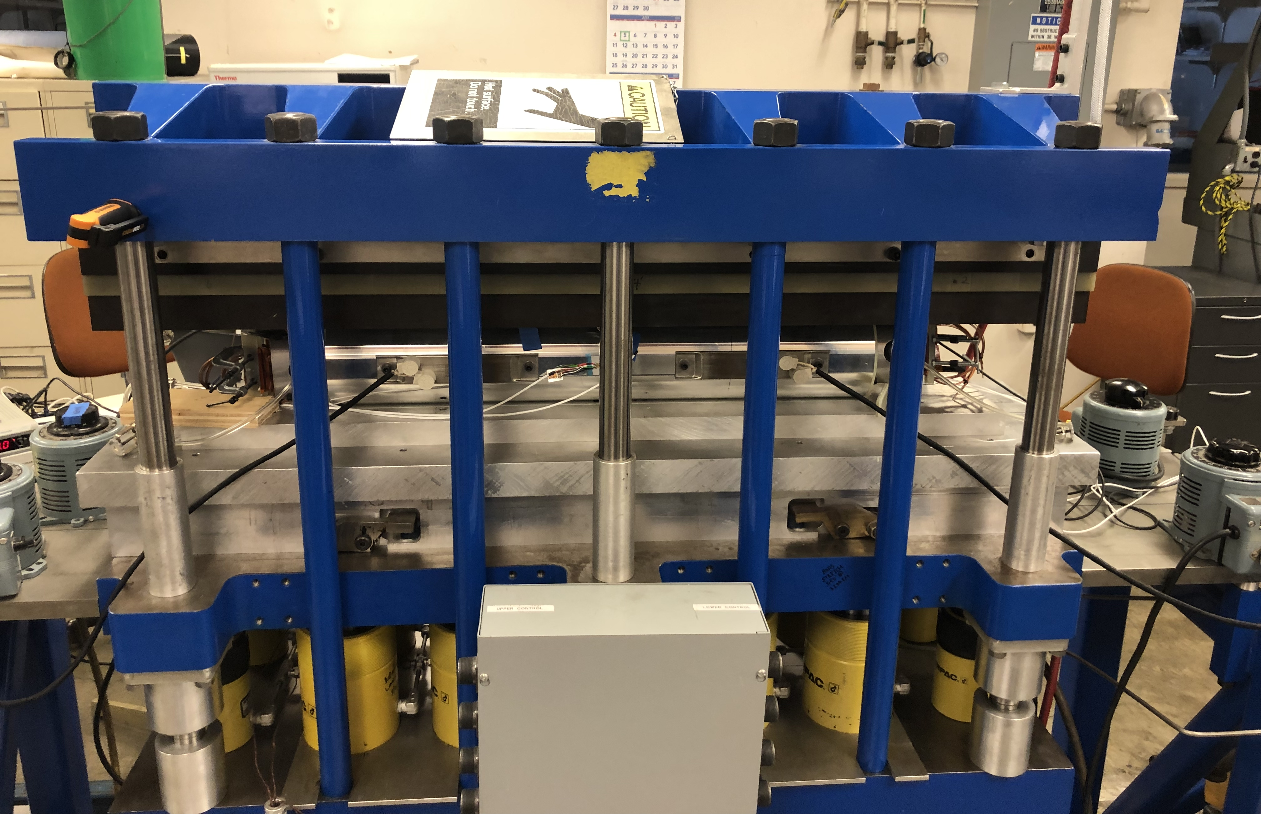
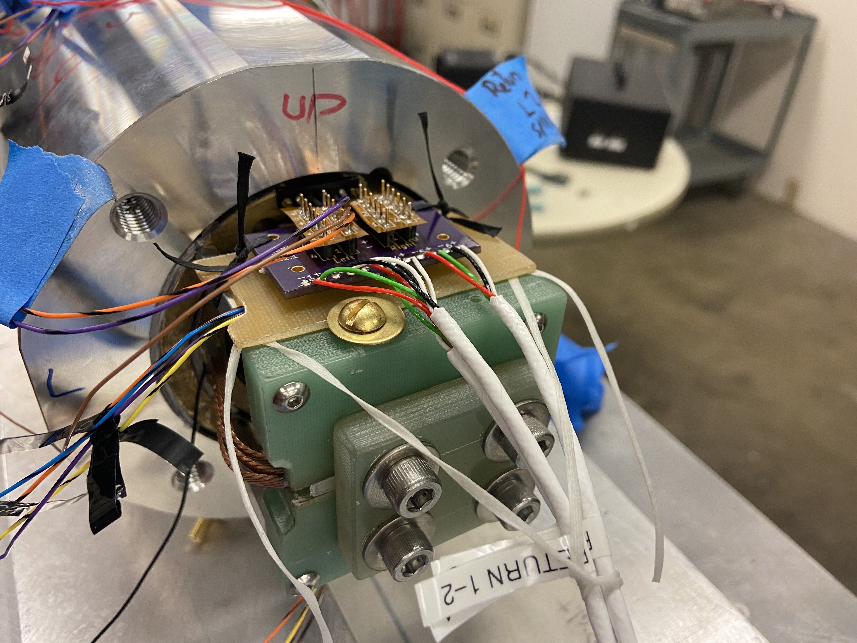
Magnet Construction (Assembly and Test Phase)
Magnet being assembled under press
Magnet out of press
Magnet Return End before test

Slide 20
Quench training curves – CCT sub2/sub3/sub4

Slide 21
Quench training curves – CCT sub2/sub3/sub4/
sub2+TC/sub3+TC

Slide 22
Summary and outlook
More tests and analysis incoming for sub4 including thermal cycle quench tests, microscopy thereafter
CTD-701x is not removing all quench trainings. That is not what we advertise it for – there is potential for a significant reduction of training cycles
Overall, sub4 has training that is as good as, if not better than, those of sub2 and sub3, despite imperfect impregnation of the outer layer coil
NHMFL Mix 61 is an amine-cured system known to have lower radiation resistance
  As a highly crosslinked polyolefin system CTD-701x has potential for higher radiation resistance
  Irradiation at MIT is expected to be completed in the next few weeks with mechanical testing to follow
701x is an interesting system to work with for superconducting magnets and to bring into the commercial market

Slide 23
Additional Topics from FNAL

Slide 24
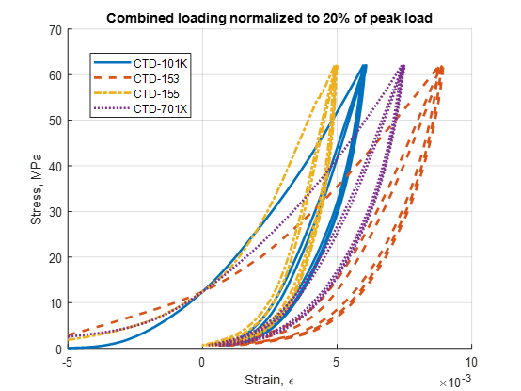
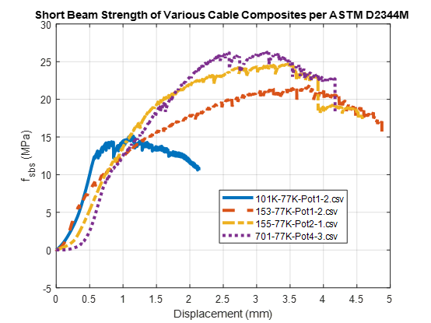
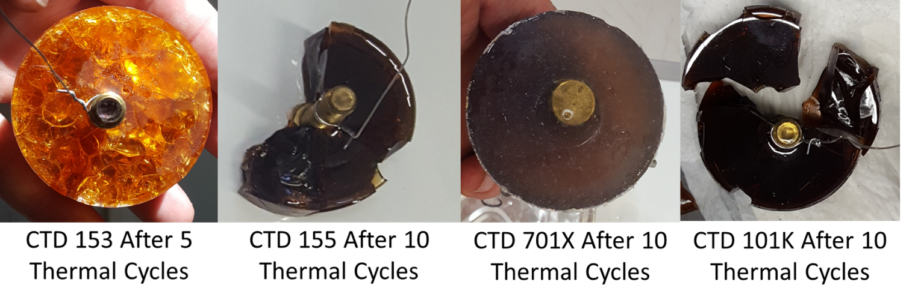
Measurements in collaboration with CTD
We have measured a handful of candidate resins in collaboration with CTD
CTD 155 and 153, toughened epoxy resins
CTD 701 Thermoset polyolefin, extremely tough
This information helped to feed into selecting 155 as a primary base for the filled resin tests above
Although the unusual thermal shock performance and lack of audible cracking, along with general toughness and extreme elongation of the 701 system were unusual enough to warrant interest in building a magnet with it.

Slide 25
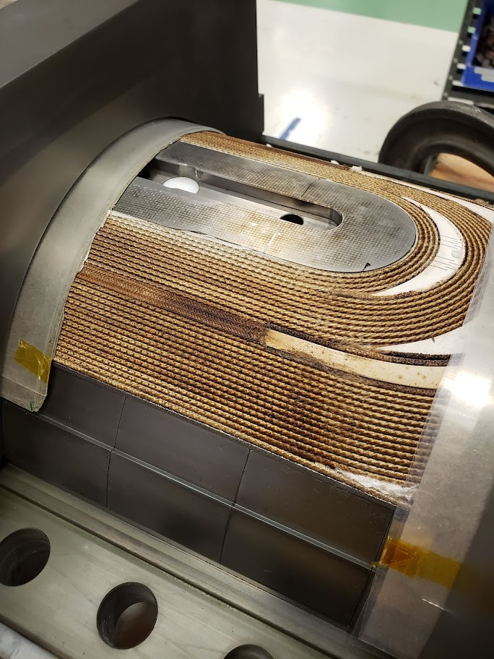
Beginnings of interface Investigation
Traditionally not much attention is paid to the inputs into a system, cable is insulated and wound without much management of surfaces.
Contaminants are assumed to go away during reaction
  This is not the case.
Reaction residues remain on the cable these likely include
  Decomposed siloxane coupling agent
  Decomposed cable lubrication
  Other decomposed sizings
  Ceramic binder
    More silica/silicone ceramic compounds
      Contain carbon in raw state, goal is pyrolysis

Slide 26
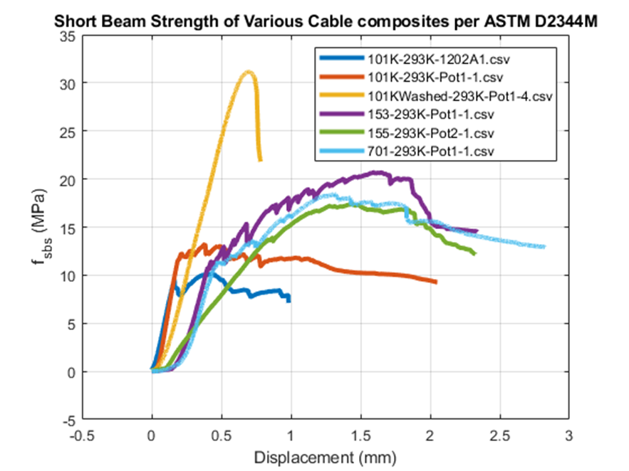
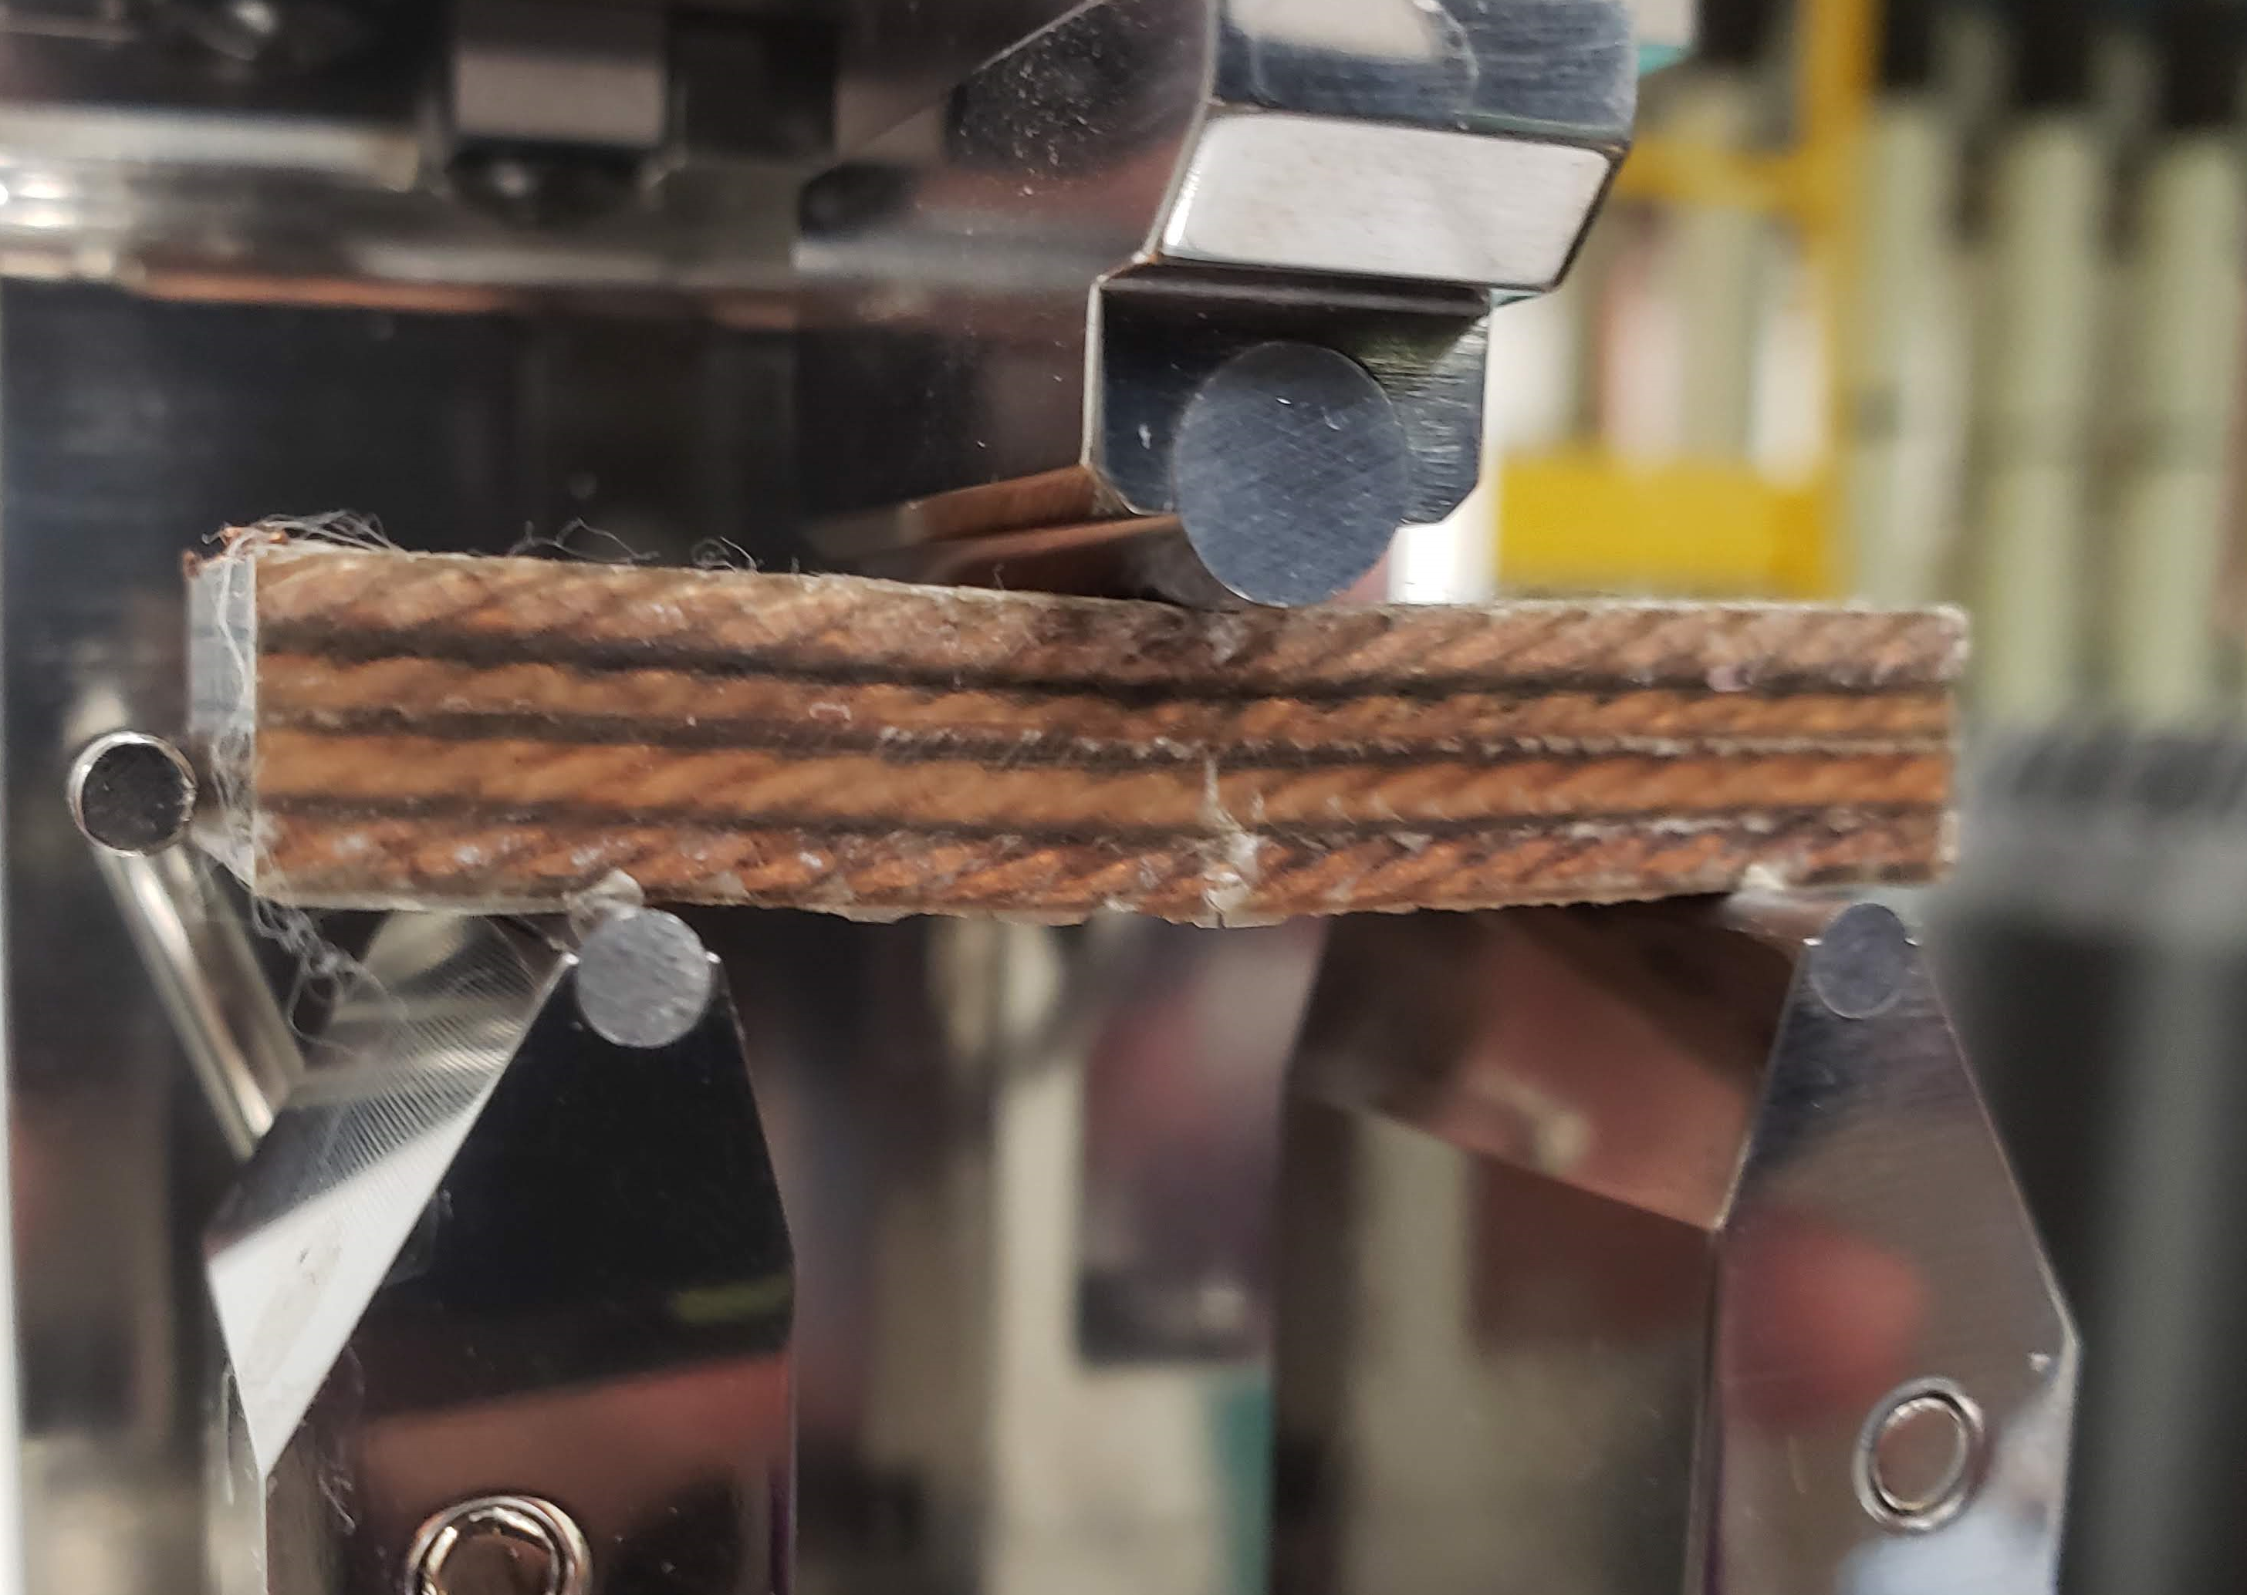
1st Pass at washing cable before reaction
Cleaning process:
Cable and insulation ultrasonic cleaned in 2% Citranox solution at 50°C for 15 minutes.
Isopropyl Alcohol rinse
  Displaces water and fast to evaporate, reduce further oxidation
Air dry
Followed by react in argon, impregnate as usual.
Results from 1st set of testing
Stacks were very well adhered, a set of shims was missing mold release and was extremely difficult to remove
Short Beam Testing revealed no shear failure, though peal load was ~3x the standard 101k sample
No audible cracking until failure, unlike all other tests besides 701
Note crack on bottom of stack. Failure is tensile from bending. Conductor fractured.

Slide 27
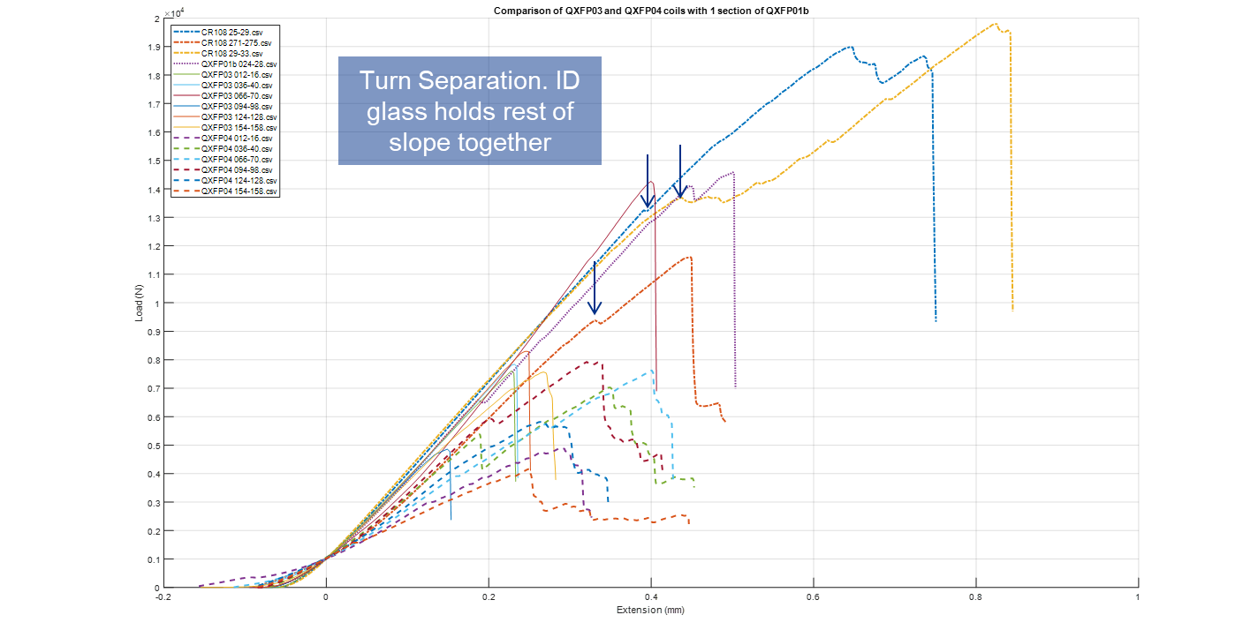

Slide 28
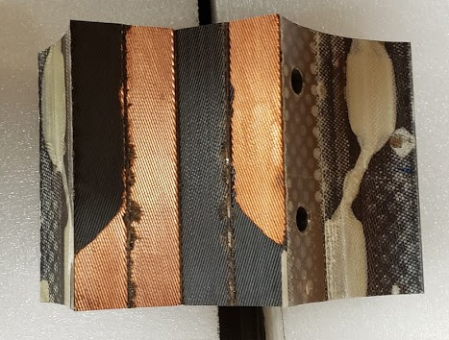
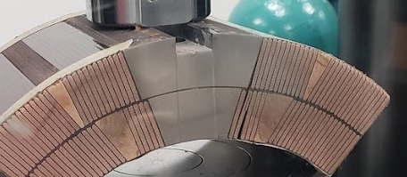
Coil Cross Section Testing
Single sample as a low strength outlier
Delaminated between cable insulation and cable
  Typical with all FNAL coils
More along the lines of a cohesive failure, but still mostly adhesive
  “Preferred” failure mode as typically indicated good bonding and system performance.
Failure between turns
Slight discoloration found on weak coil

Slide 29
Stats from above data have been collected
Failure load is not correlated with TG
Stiffness is not correlated with Tg
Max load has positive correlation to Stiffness

Slide 30
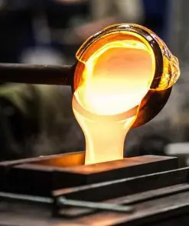
Ongoing Interfaces
Interface investigation is ongoing, partly under SBIR with CTD for managing resin coupling through recipe modification. Goals:
Improve material performance in real-world baseline process (no washing)
Improve ultimate achievable performance in system with controlled inputs (Washed Cable)
Potentially investigate release agents as well
No adhesion, no ability to store energy

Slide 31
Work at LBNL
LBNL has been busy with work utilizing the 701 resin system, reported above
  In addition, more thermal shock testing using the bolt technique has been completed

Slide 32
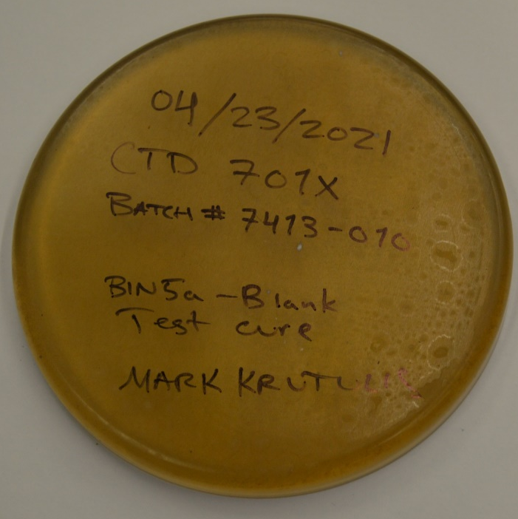
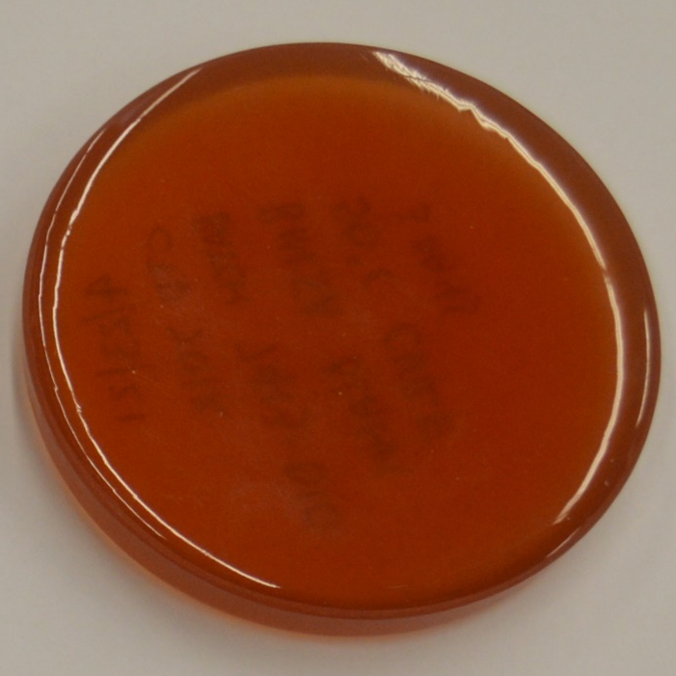
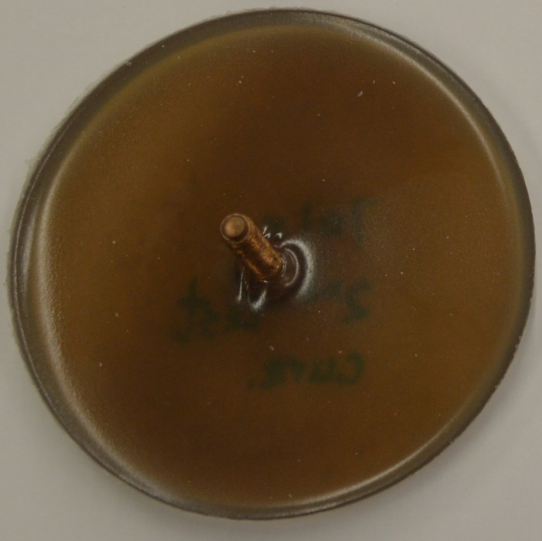

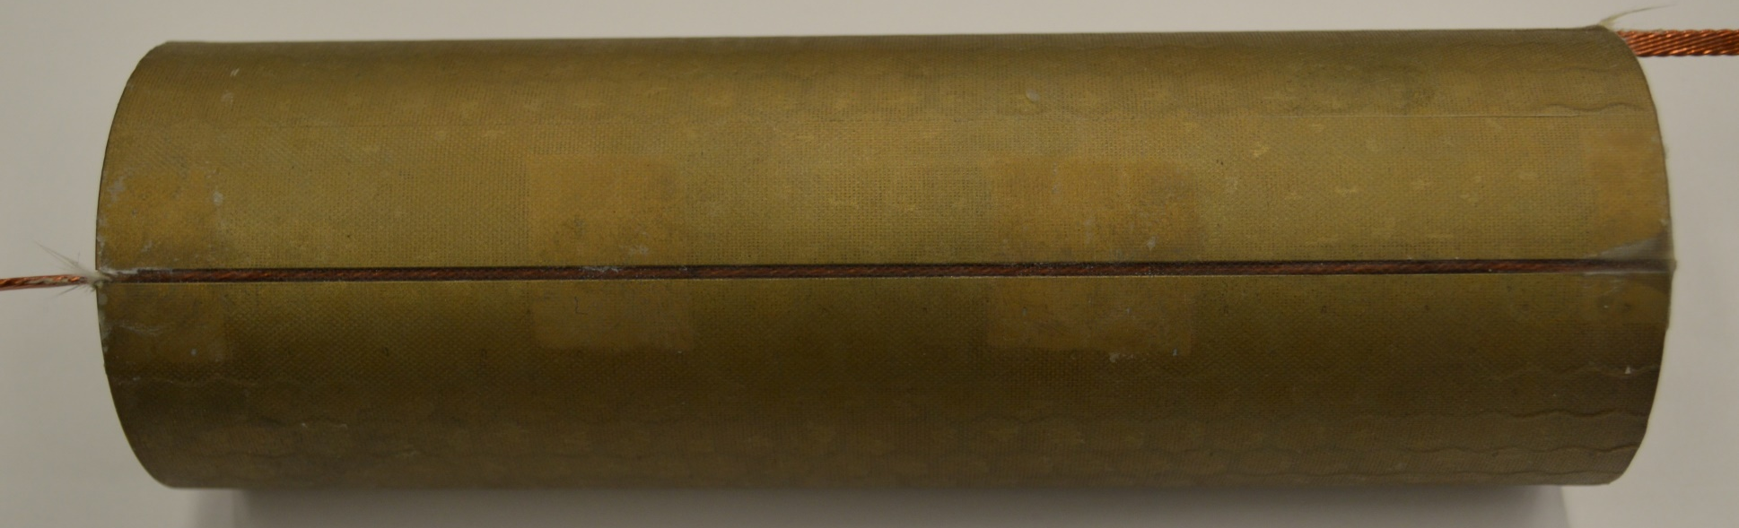
Thermal shock cycle #0
a
b
c
d
a, c, d, e Standard curing cycle
b Cured at 50 °C
TS note:
c, d came from the TestCure0216_2021.
The rest came from
701xTestCureWBIN5dummy.
e

Slide 33
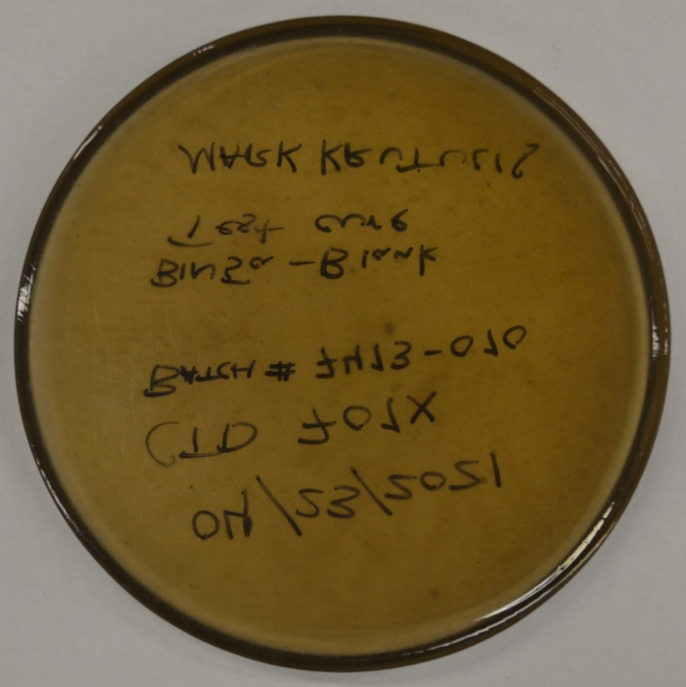
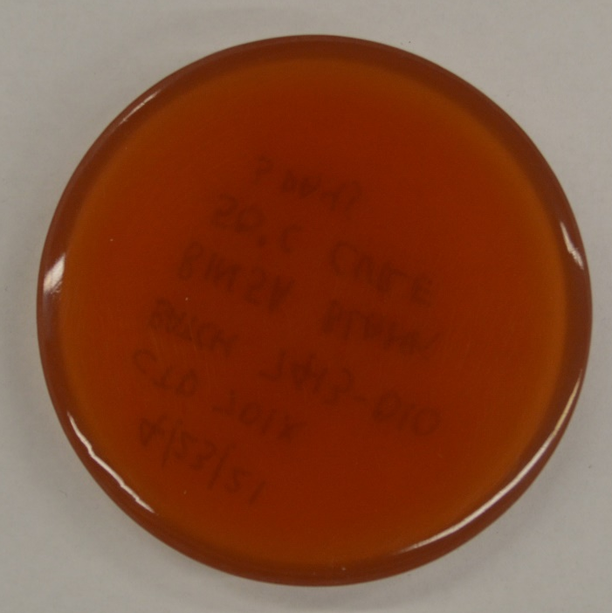
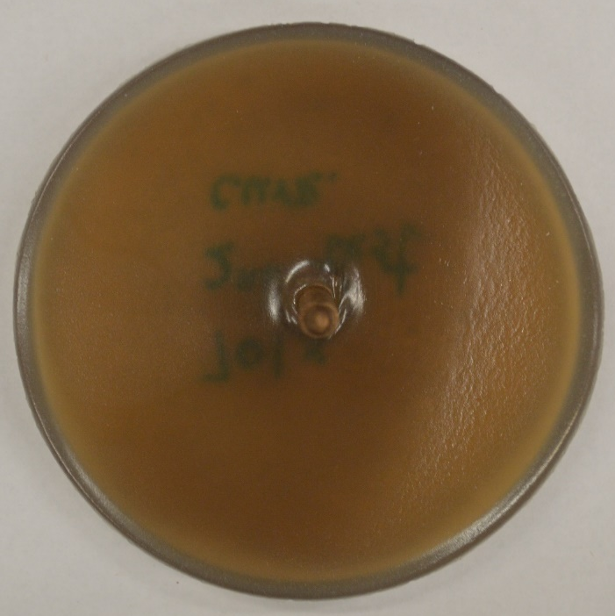
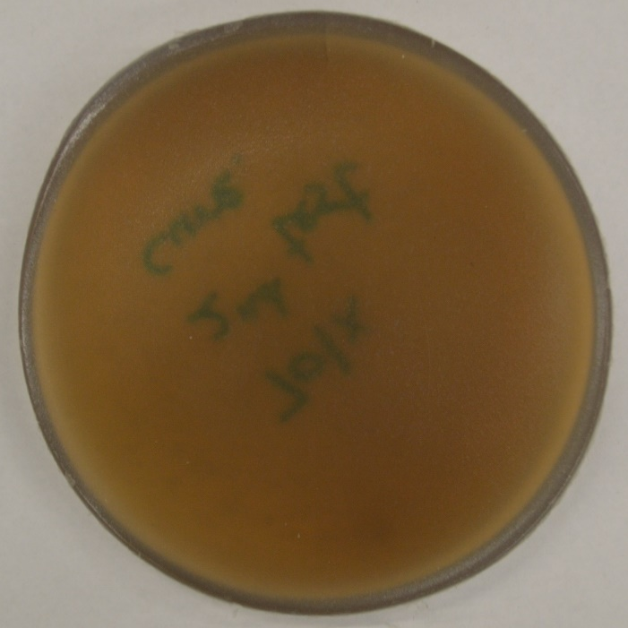
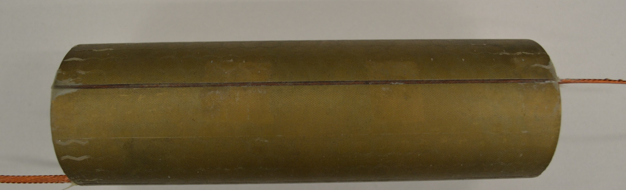
Thermal shock cycle #10
a
b
c
d
a, c, d, e Standard curing cycle
b Cured at 50 °C
Over 10 samples and 100 total thermal cycles including FNAL data, only 1 crack has been observed
e

Slide 34
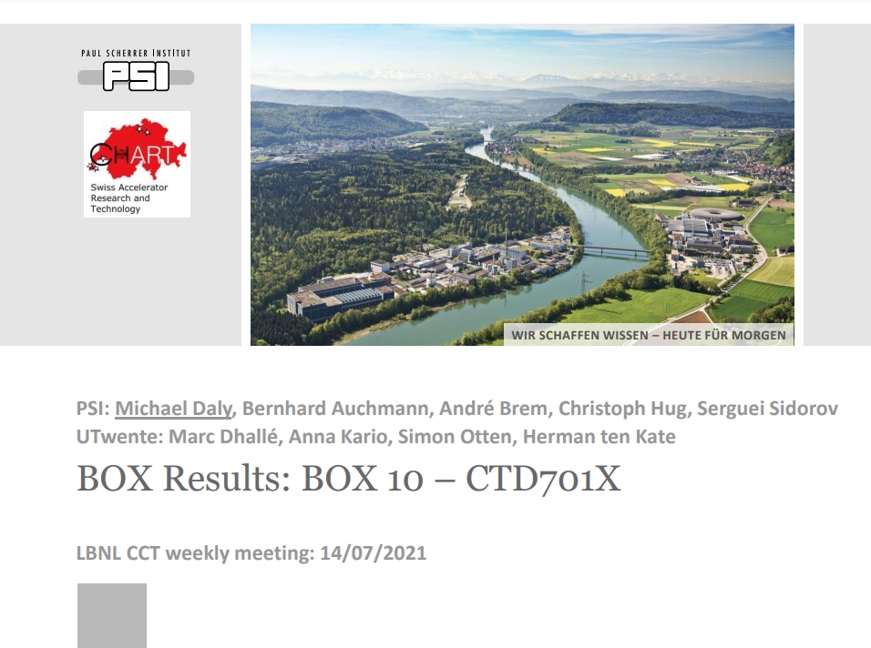

Slide 35
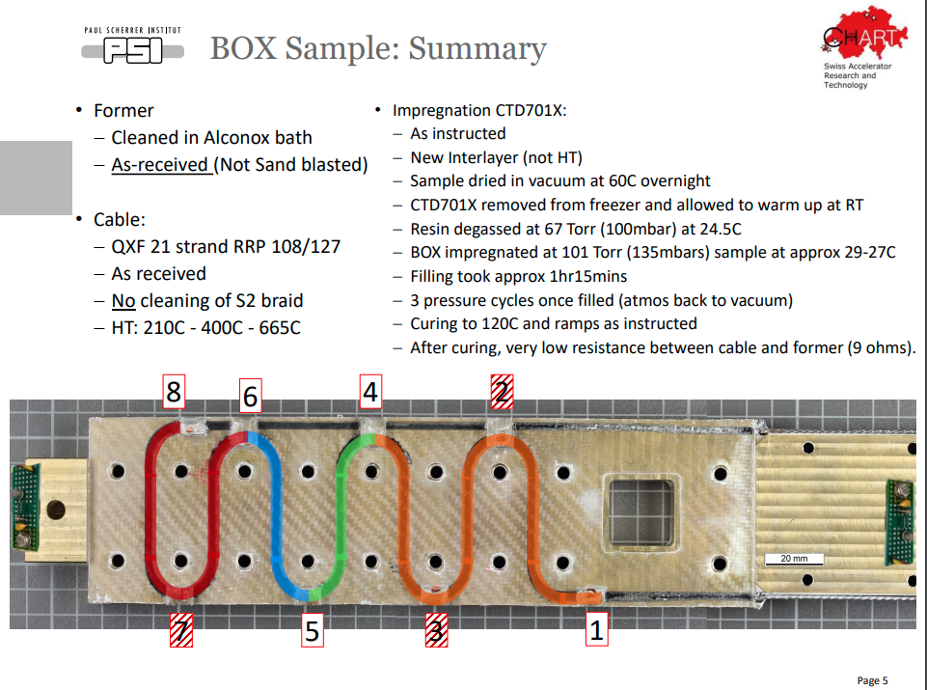

Slide 36


Slide 37


Slide 38
Conclusions and next steps
Continue work on Interfacial modification and testing
Continue Testing on Bin 5

