Slide 1
Introduction to Superconducting Undulators
D. Arbelaez, S. Myers, X. Wang, M. Turqueti, H. Pan, E. Rochepault, T. Ki, S. Myers, T. Seyler, M. Morsch, R. Oort, D. Dietderich, L. Brouwer, M. Marchevky, M. Leitner, R. Schlueter, S. Prestemon,…

Slide 2
Outline
Development of light sources
The motivation and introduction of wigglers/undulators
Basic concept of a superconducting undulator
Material selection
Technical issues
Potential impact to facility capabilities
Status
Future direction

Slide 3
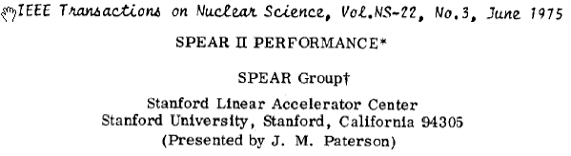
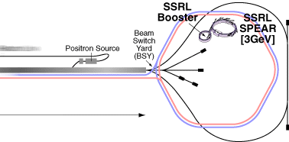

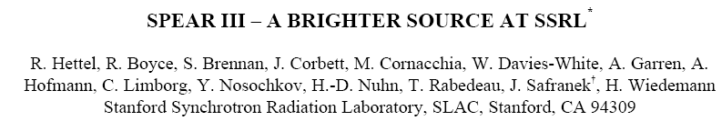
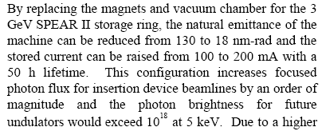
Insertion devices as Synchrotron Radiation Sources
1943: Synchrotron invented by Oliphant
1945: Vekslar, McMillen invent the synchrocyclotron and Betatron
1947: synch. rad. observed at 70Mev GE synchrotron
1949: Wilson et al. first stored beam in a synchrotron
1952: Courant and Snyder develop strong focusing; already patented by Christofilos!
1959: CERN PS operational
1960: Brookhaven AGS operational
1972: Spear completed (leads to J/Psi discovery,…)
The first storage rings were designed for high-energy physics
  As energy of electrons was increased, energy was observed to be lost in the form of radiation – synchrotron radiation
  Key limitation to modern HEP accelerators (one of the motivators for proton rings, and the need to switch to linear colliders for leptons…)
“2nd generation” sources were rings devoted to SR generation, essentially using the bend magnets as sources (examples: NSLS, ANKA, Spear II, …)
“…
“
1990: SPEAR is used exclusively for SR production
IEEE 1998
“…
…“

Slide 4
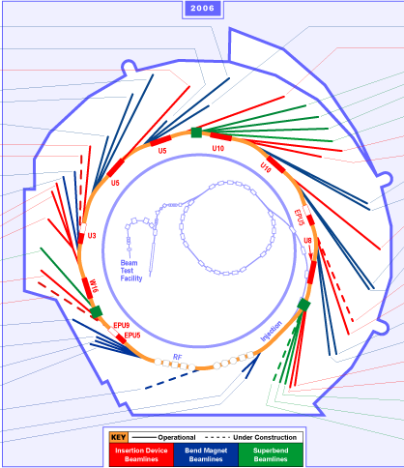
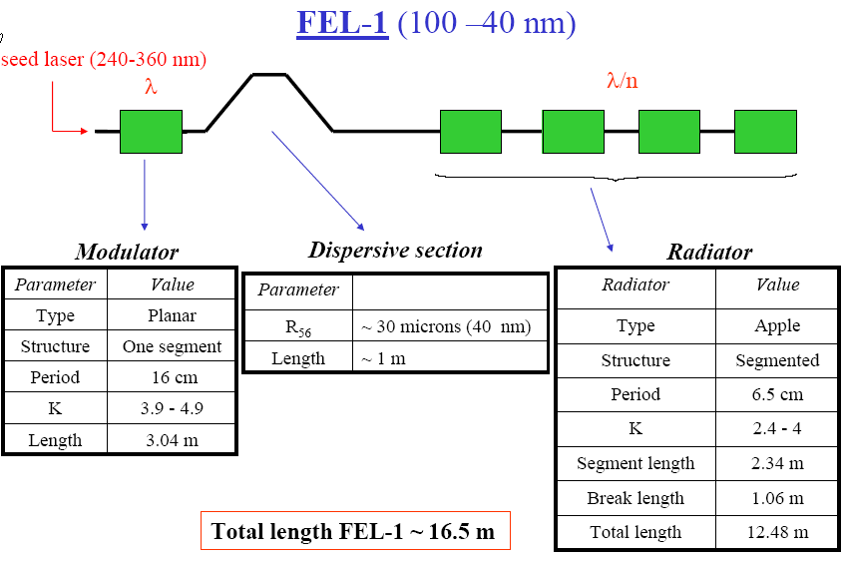
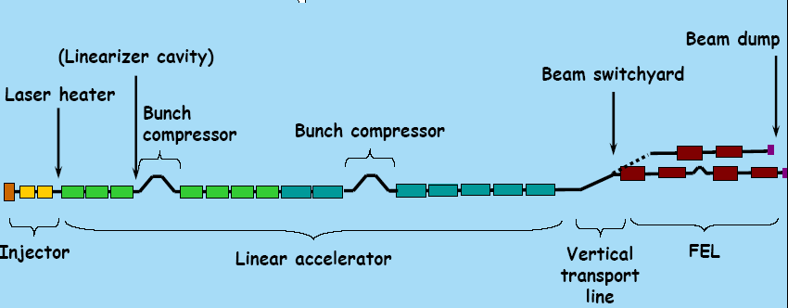
Dedicated SR sources
ALS
“3rd generation” sources designed for use of special magnetic systems, “insertion devices”, (ID’s), into the straight sections of storage rings to generate specific radiation properties tailored to the beamline science needs. (Examples: ALS, Spear III, APS, ESRF,…)
  Accelerator physics: - ID’s should not impact the stored beam – want scalability, ability to exchange devices, etc
  Scientific users: - ID’s tailored to science need, e.g. flux or brightness over a given energy range, polarization control, etc.
Note: almost all 2nd generation rings now incorporate ID’s to enhance their science capabilities
“4th generation” sources are currently being built – FEL’s & ERL’s. (examples: LCLS, DESY XFEL, Fermi at Elettra, 4GLS …)
  Electron bunch passage through “Insertion device” generates synchrotron radiation, which in turn modulates the electron bunch energy; cycle can be repeated down to a final ID section that “radiates” the resulting micro-bunched beam coherently
Example: Fermi@Elettra workshop 2005: J. Corlett, G. De Ninno

Slide 5
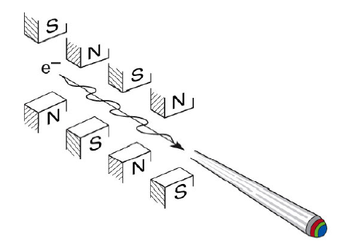
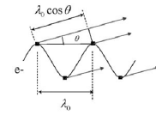
Undulator and Wiggler characteristics:
Field properties
These are magnetic devices generating fields transverse to the passing charged particles, usually designed to be inserted into a ring to generate synchrotron radiation
  Fields can be “planar”, helical, or variable
  Planar devices exhibit vertical focusing
  There is always some coupling of device to beam-physics
Fields are characterized by oscillation period and field strength
  Strength parameter K distinguishes radiation properties
Brian Kincaid, JAP 1977;
See R. Schlueter, Res. Memo 88-57, LLNL 1988 for wiggler field harmonics and focusing

Slide 6
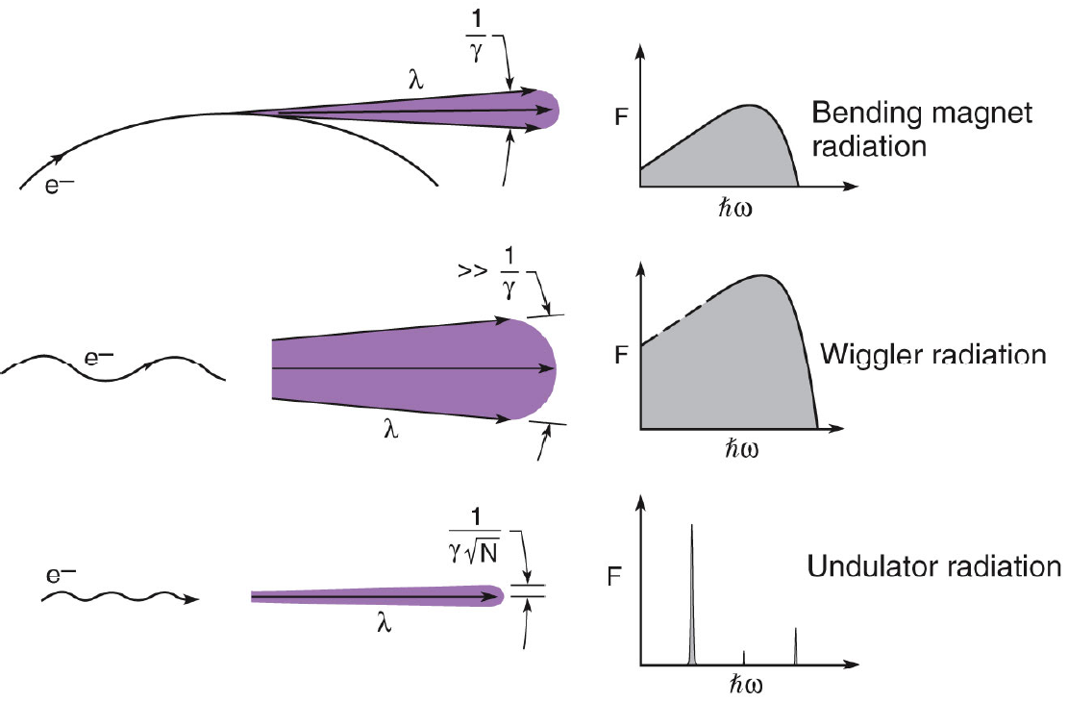
Undulator and Wiggler characteristics: Radiation properties
From David Attwood,
Introduction to Synchrotron Radiation
Continuous spectrum characterized by
ε_{c} = critical energy
ε_{c}(keV) = 0.665 B(T)E²(GeV)
Higher field results in higher critical energy, more power
0.95 E² [GeV]
ε₁ (keV) =
K²
λ_{u} [cm] (1 + )
2
Quasi-monochromatic spectrum with peaks at lower energy than a wiggler
Higher field for same period results in larger spectral range,
or performance can be leveraged to increase brightness

Slide 7
Example applications
Synchrotron radiation sources for soft / hard x-rays
  Large number of lights sources worldwide (and quickly growing!)
  Number of free electron laser projects underway
  Figure of merit is typically brightness (ph./s/mm²/mr²/0.1%bw)
  Higher performance yields higher brightness and/or increased spectral range, or access to higher energy photons
Damping rings
  Emittance is reduced proportional to synchrotron radiation power
  Figure of merit is SR source power => wigglers
  Higher field yields higher power: P~B²
Positron source for ILC
  Positrons generated from pair-production
  Polarized positrons from circular pol. radiation
  Figure of merit is photon flux
  Higher performance yields higher positron production, shorter undulator length
Helical undulator

Slide 8
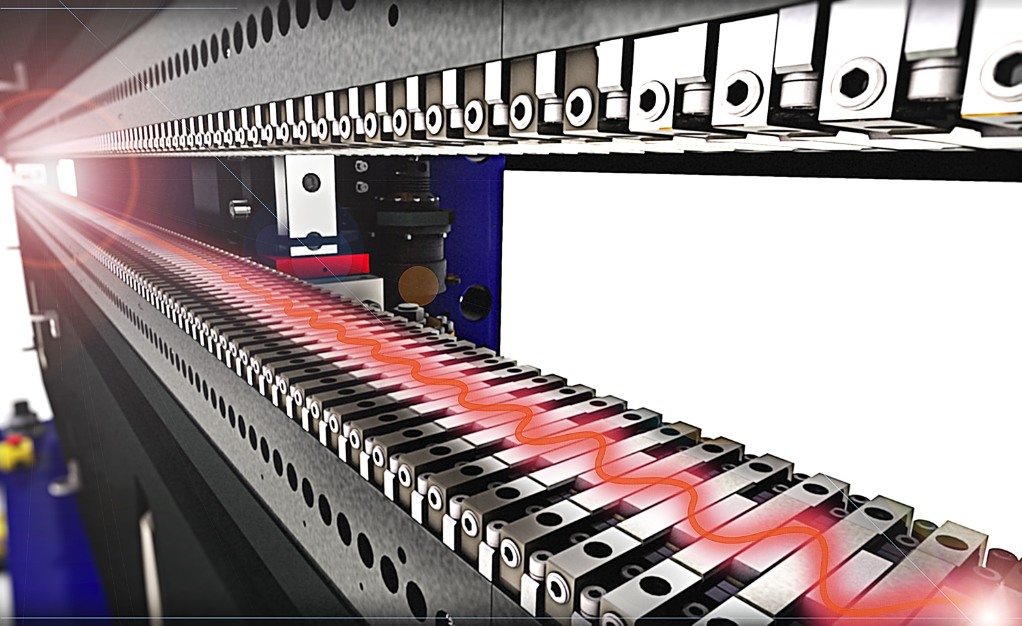
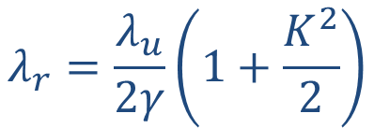
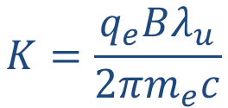
Undulators Are Used To Produce High Brightness Synchrotron Radiation
Most undulators in operation around the world use permanent magnet (PM) technology
Magnetic field strength is used to tune the photon wavelength
  Adjust gap in PM undulator
  Adjust current in superconducting undulator
First Harmonic Radiation
$$λ_{r}=\frac{λ_{u}}{2γ}\left(1+\frac{K^{2}}{2}\right)$$
$$K=\frac{q_{e}Bλ_{u}}{2πm_{e}c}$$
LCLS-II Soft X-Ray Undulator
LCLS-II Soft X-Ray Undulator

Slide 9






Electron beam energy and photon energy and tunability impacted by technology
Undulator characteristics and beam energy yield photon wavelength
Coupled problem:
  Typically want tunability
  Sometimes want polarization control
Undulator technology
Linac / e-beam
  For future FELs, different FEL lines will focus on different spectral ranges, with different timing, synchronization etc. needs
Cryogenics+linac and Undulator lines are dominant cost drivers

Slide 10

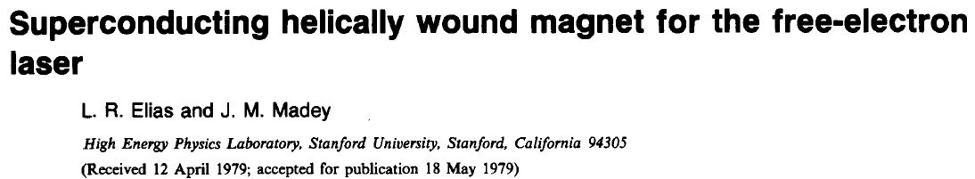
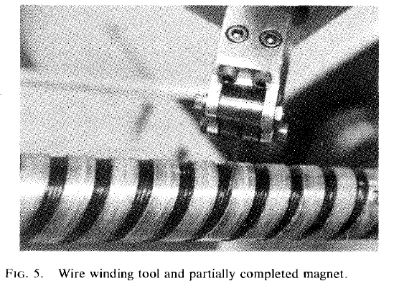
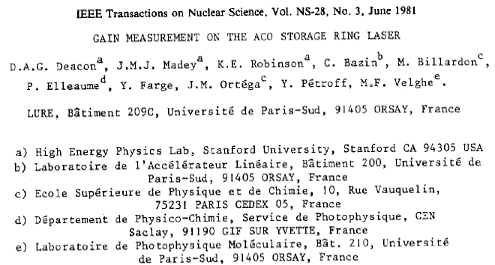
A brief review of the historical role of superconducting insertion devices
Ancient history
The first undulators proposed were superconducting
  1975, undulator for FEL experiment at HEPL, Stanford
  1979, undulator on ACO
  1979, 3.5T wiggler for VEPP
Rev. Sci. Instr., 1979

Slide 11
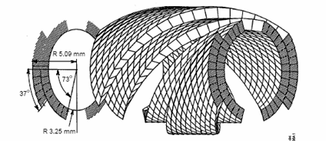
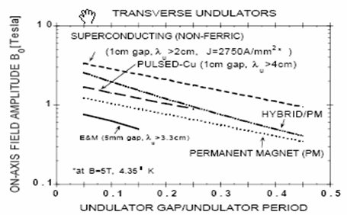
LBNL-SLAC Helical Undulator Design – considered early in the development of the LCLS
Shell-type cross-section geometry
Motivated by LCLS design studies
Specialized optimization code available
LBNL Publications:
S. Caspi, "Magnetic Field Components in a Sinusoidally Varying Helical Wiggler. LBL-35928 July, 1994
S. Caspi, "Stored Energy in a Helical Undulator", LBL SC-MAG-474, 1994.
S. Caspi, "Magnetic Field Components in a Helical Dipole Wiggler with Thick Windings", LBL, 1994
S. Caspi, "A Superconducting Helical Undulator for Short Wavelength FELs", LBL Report SC-MAG-475, 1994.
S. Caspi, R. Schlueter, R. Tatchyn, "High Field Strong Focusing Undulator Designs for X-ray Linac Coherent Light Source (LCLS) Applications". SLAC-Pub 95-6885. PAC 1995.
S. Caspi and C. Taylor , “An experimental superconducting helical undulator”, NIMA Volume 375, 1996
R. Tatchyn, et al, “R&D toward a linac coherent light source (LCLS) at SLAC”, NIMA, Vol. 375, 1996.

Slide 12
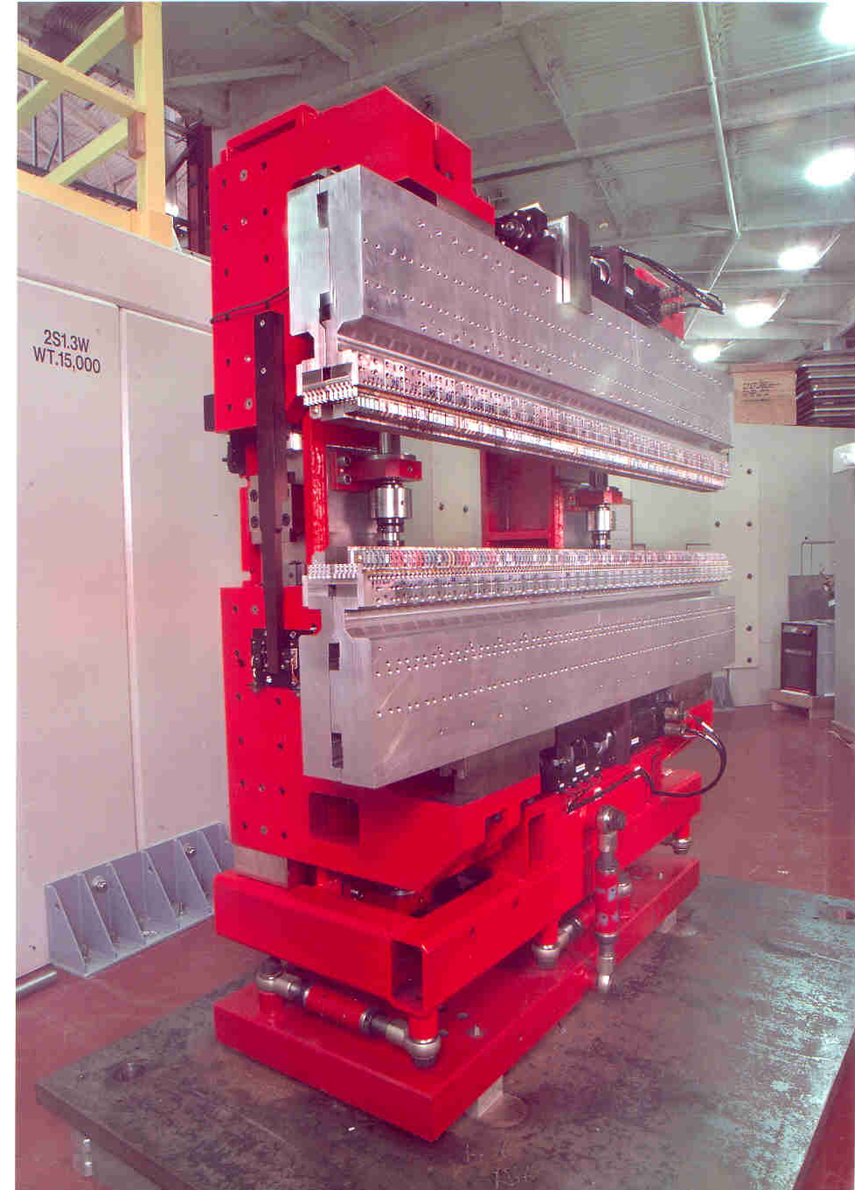
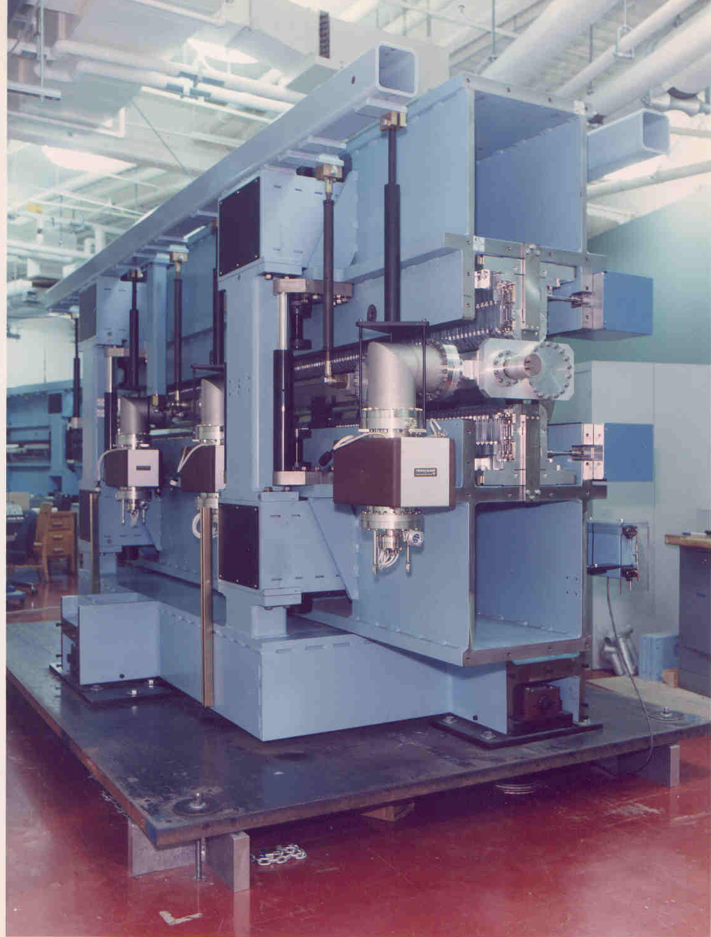
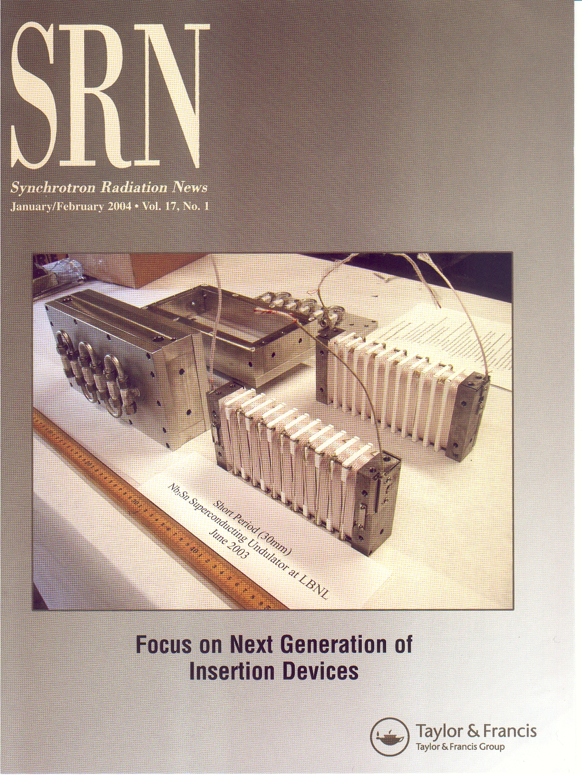
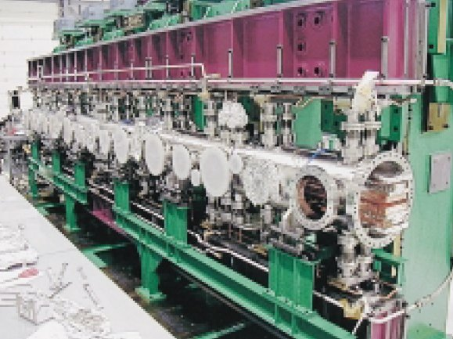
Undulator evolution
ALS EPU50 (1998)
Pure permanent magnet technology, Elliptically polarizing capability
ALS U50 (1993)
Hybrid permanent magnet technology
ALS SCU (200?)
Nb₃Sn superconducting undulator
Spring8 IVUN (2000)
Small gap In-vacuum device

Slide 13
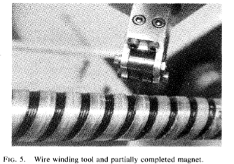
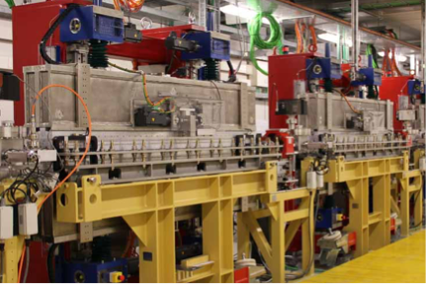
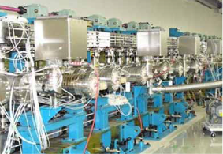
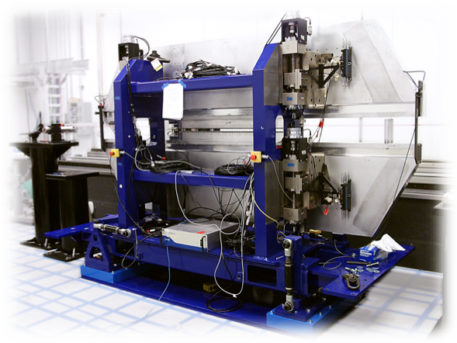
A variety of technologies exist to produce undulating fields, with permanent magnet systems serving as the workhorse
Superconducting bifilar,
Stanford, circa 1977
PM hybrid, fixed gap,
LCLS, Slac
PM EPU,
Fermi, Trieste
IVID
XFEL SPring8
PM hybrid, variable gap,
LCLS-II, Slac

Slide 14
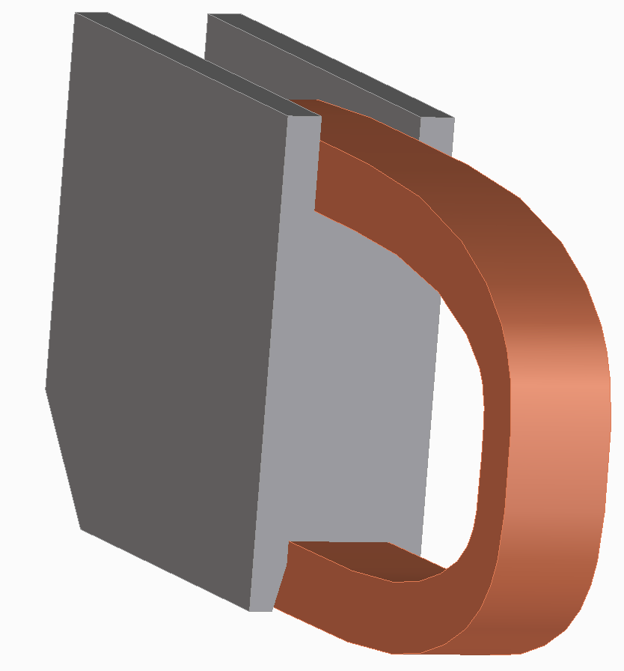
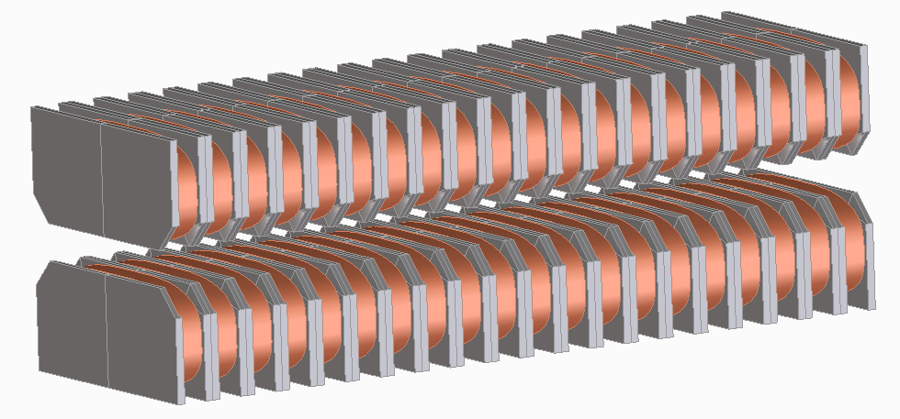
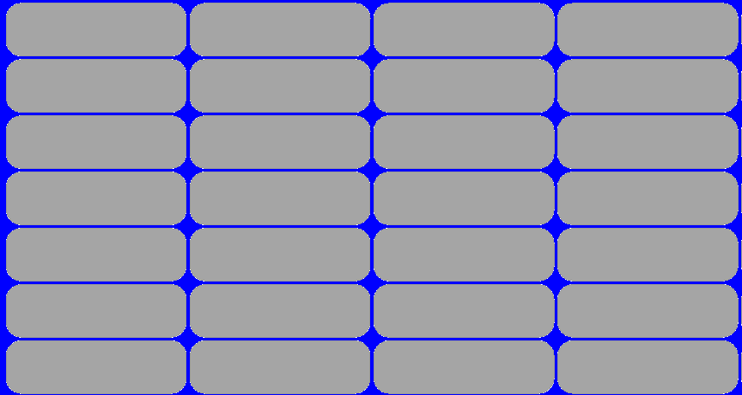
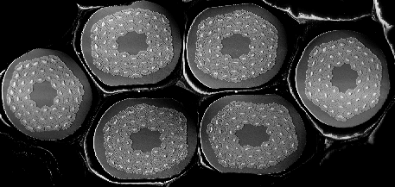
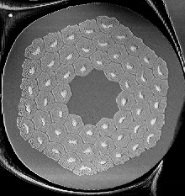
Superconducting undulators – general approach
Yoke
Coil
Electron beam
Nb₃Sn cable, made of 6 wires
Ic (6T,4.2K) ~ 510A, 52% Cu
~40μm diameter
0.48mm diameter

Slide 15
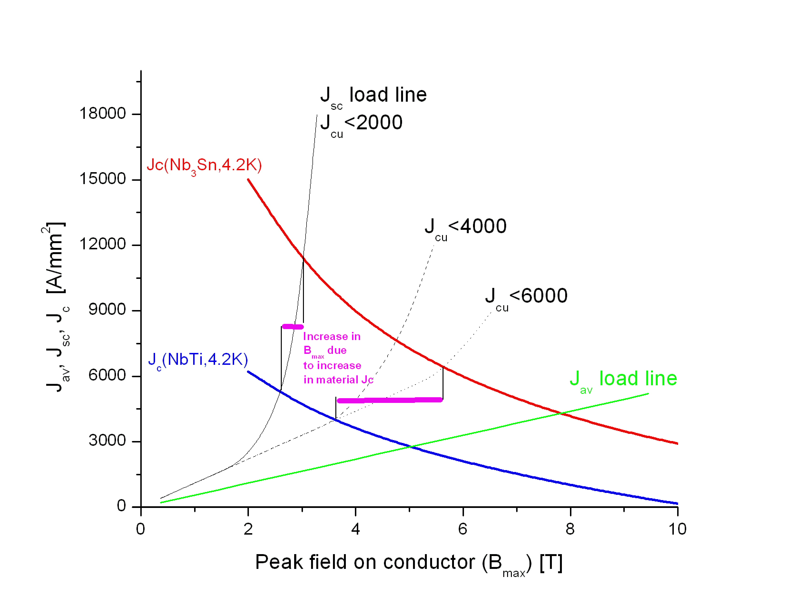
Performance considerations
Motivation for Nb3Sn SCU’s
Motivation for SCU’s
  Promises the best performance, in terms of spectral range and brightness, compared to competing technologies (PM, PM hybrid, Cryo-PM, …)
Motivation for Nb₃Sn
  Low stored energy in magnetic system
    “break free” from J_{cu} protection limitation
  Take advantage of high Jc, low Cu fraction in Nb₃Sn
  “High” T_{c} (~18K) of Nb₃Sn provides temperature margin for operation with uncertain/varying thermal loads
  => LBNL pioneered the use of Nb₃Sn for SCU’s
Nb3Sn superconducting undulator performance curves
Assume Asc/Atot=24%, Jc(4.2K,6T)=6200A/mm²
FEL
SR

Slide 16
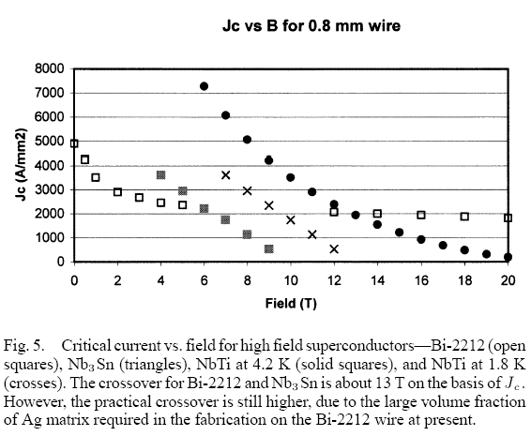
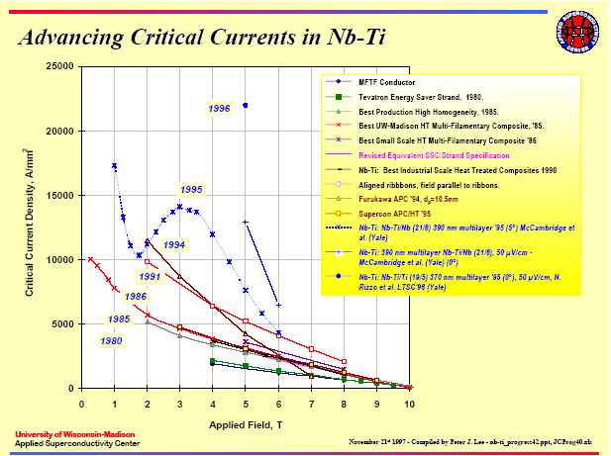
Low-temperature superconductors of interest (circa 2003):
NbTi with Artificial Pinning (APC), Nb₃Sn
Arno Godeke,
personal communication
M. Wilson,
Cockcroft Institue, 2006
Nb₃Sn
R. Scanlan and D. Dietderich
IEEE Trans. Applied Supercond., Vol. 13, No 2, June 2003
NbTi
Magnetic field (Tesla)

Slide 17
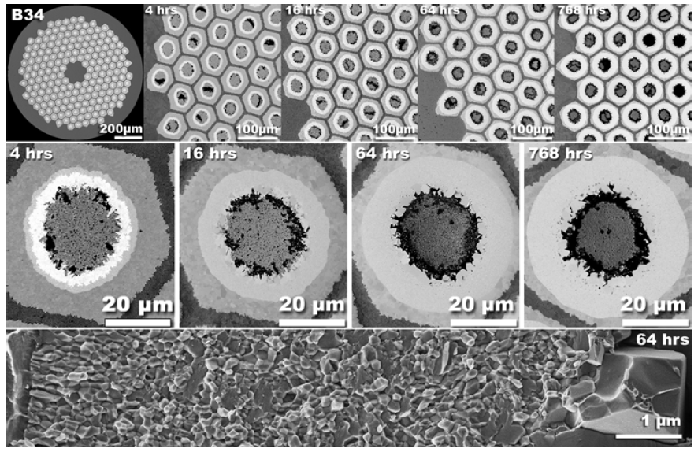
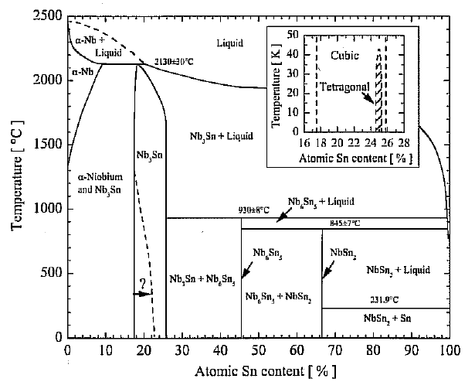
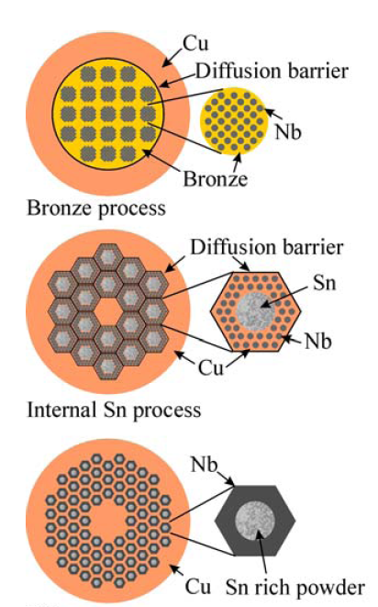
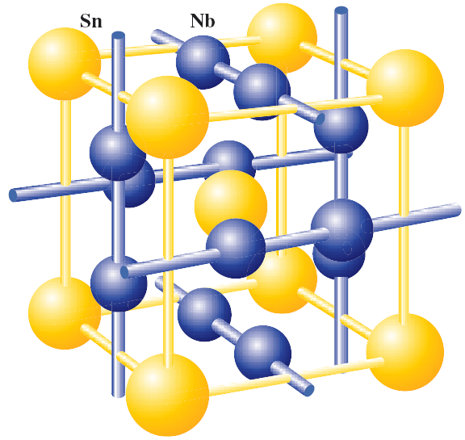
Nb₃Sn superconductors
These are intermetallic compounds, in an A15 structure; A15 is a brittle crystal structure
Requires a fabrication process providing the appropriate composition and A15 development
Process must not jeopardize quality of stabilizer in conductor (typically Cu)
Requires heat treatment to ~650C
=> Have significant impact on magnet design and fabrication!
See Thesis of
Arno Godeke
for an excellent
review of Nb₃Sn
(source of these plots)

Slide 18
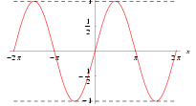
Technical issues with superconducting ID’s
“Low” peak conductor fields => high current densities
  Low-field instability issues
  Quench protection must accommodate extremely high Cu current densities
  Small conductor size required for reasonable currents => poor fill factor
Cryogenic issues
  Beam-based heating
    Image-currents
    Synchrotron radiation
    Other…
  Traditional loads (conduction and thermal radiation)
Phase-correction
  May need active correction due to dual regime (saturated and unsaturated poles)
    Application-dependent
Magnet measurement system
  Must work with cold magnet
  Need integral measurements for beam displacement and steering determination
  Need Hall-probe data with sufficient accuracy for phase-error determination
See “Workshop on Superconducting Undulators & Wigglers”, ESRF
http://www.esrf.fr/Acelerators/Conferences/ID_Workshop
EM wavefronts must be in phase: distance traveled by electron
between consecutive accelerations should be constant
α
Steering
e⁻
Displacement

Slide 19
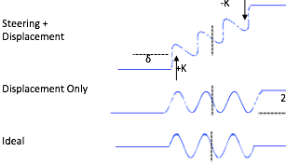
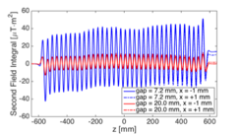

Improvements in field quality from detailed understanding of error sources and optimized tuning
Undulator field quality dictates electron trajectory wander and phase advance
Evaluate all error sources:
  Amplitudes and distributions
  Dependence on field strength
Identify reliable correction methodology

Slide 20
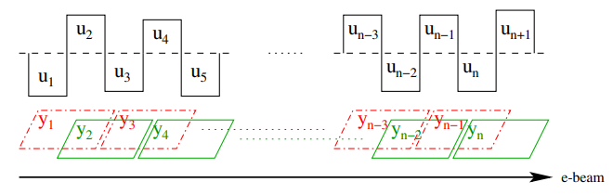
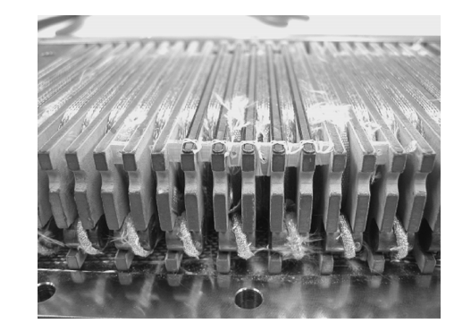
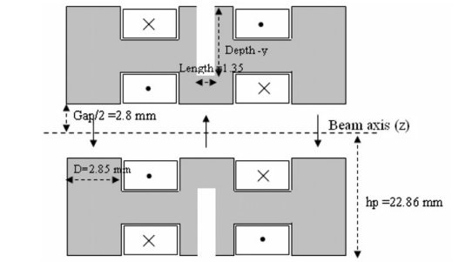
Several Local Field Correction Methods Have Been Proposed And Tested
Induction shimming (demonstrated on short undulator)
Addition of iron pieces in core pockets
Small coil loops around poles
Current loops on vacuum chamber using HTS tape
Heater switch concept
  Single drive current
  Switches can be used to turn correction loops on / off along the undulator length
Induction Shimming Concept
D. Wollman et al., Phys. Rev. AB. 12, 040702 (2009)
Wire Loops Around the Poles
Additional Iron Pieces Concept
S. Prestemon et al., IEEE TRANS. APPL. SUPERCOND., VOL. 15, NO. 2, JUNE 2005
S Chunjarean et al., Supercond. Sci. Technol. 24 (2011) 055013

Slide 21
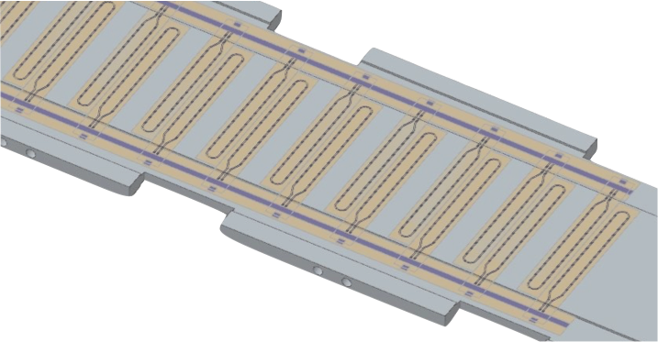


Tuning of superconducting undulators using active correction techniques
Concept of in-situ tuning of undulators
  Selectable correction locations
  Corrections at all locations have the same strength
  Strength can be varied with a single power supply as a function of the undulator field strength

Slide 22
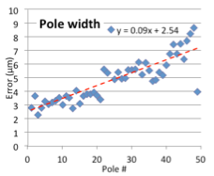
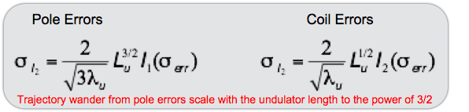
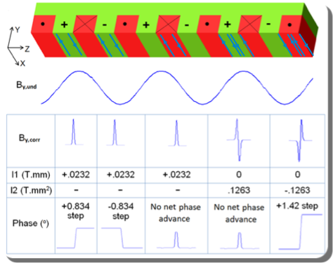
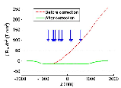
SCU tuning can accommodate typical manufacturing errors with a single active circuit
Example:
3.3m device, yielding 331 poles
period 20mm, magnetic gap 7.5mm
Rochepault et al., TAS 2014

Slide 23
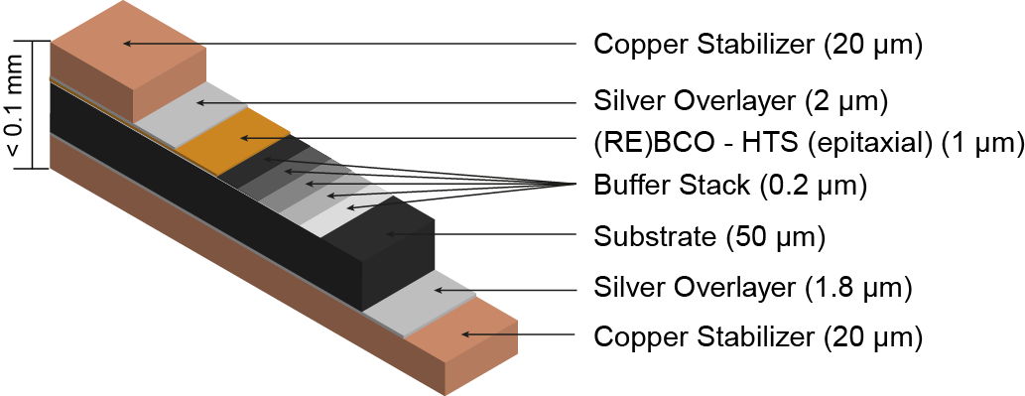





Switch-Based Tuning Concept enables correction of local field errors that impact trajectory and phase
One superconducting path - with heater
One resistive path (low resistance)
When heater is on the superconducting path becomes resistive (high resistance)
Heaters ON
Heaters OFF
Current
Superconducting path
Resistive
solder joint
(low resistance)

Slide 24





Current path can be made via lithography on YBCO Tapes
Commercial tape from SuperPower Inc.
Masks designed for photolithography process
Chemical etching removes Copper, Silver, and YBCO layers where desired
Solderable thin film heaters developed for efficient and reliable fabrication
Laser cutting is used to separate joint section

Slide 25


Corrector Fabrication
Process to adhere correctors to the vacuum chamber was developed (correctors and glue take up 0.2 mm of excess thickness)

Slide 26

Cryogenic design options
Can use liquid cryogens or cryocoolers
  Liquid cryogen approach requires liquifier + distribution system or user refills
  Cryocoolers require low heat load and (traditionally) incur temperature gradients through conduction path and impose vibrations from GM cryocooler
    Limits operating current due to current-lead heat load (despite HTS leads; typical limit is <1kA)
    Solution: heat pipe approach (C. Taylor; M. Green)
Need to know the heat loads under all operating regimes
M. Green, Supercond. Sci. Tech.16, 2003
M. Green et al, Adv. in Cryogenic Eng., Vol. 49
Vacuum chamber and magnet can be thermally linked; magnet and chamber operate at 4.2-8K
Vacuum chamber and magnet can be thermally isolated; chamber operates at intermediate temperature (30-60K); magnet is held at 4.2K
Yoke
Δg_{v}
Δw
Vacuum chamber
4.2-12K
20-60K
Aggressive spacings:
Δw~0.75mm
Δg_{v}~1mm

Slide 27
Beam heating
(Extreme anomalous skin effect; heating no longer a function of RRR or of frequency)
Source: Intro to Solid State Physics, 5th edition, C. Kittel
Podobedov, B., Workshop on Superconducting Undulators and Wigglers, ESRF, July 2003
Eric Wallen, Workshop on Superconducting Undulators and Wigglers, ESRF, July 2003
Caspers, F., Morvillo, M., Ruggiero, F. and Tan, J., LHC Project Report 307, CERN, August 1999

Slide 28

Beam heating impact on performance
In synchrotron rings, image current heating impacts design
In FEL’s, low duty-factor typically implies low image currents
  → Other heating sources will dominate
Yoke
Δw
Δg_{v}
Vacuum chamber
Cold, extreme anomalous skin effect regime:
ALS: ~ 2 W/m
LCLS: ~ 3.e-4 W/m
4.2-12K
20-60K
Cold bore model
Intermediate intercept model
Ref: Boris Podobedov, Workshop on Superconducting
Undulators and Wigglers, ESRF, June, 2003

Slide 29


Nb₃Sn Undulators Have Challenging Quench Protection Requirements Due to High Current Density
The Nb₃Sn undulator operates at extremely high current densities in the wire (during quench J_{Cu} > 5000 A/mm²)
Hot spot temperature is a function of integral of current squared
Fast detection time and current decay are necessary to protect the Nb₃Sn undulator
Hot Spot Temperature
Magnet Protection Requirement
RRR=200
Safe Area
[A²s]

Slide 30

Quench Protection is a major issue for Nb₃Sn SCUs due to the high current density of the wire
Quench Simulation Results
The Nb₃Sn undulator operates at extremely high current densities in the wire (nearly a factor of two greater than NbTi)
Hot spot temperature scales with current squared
Fast detection time and current decay are necessary to protect the Nb₃Sn undulator
Modeling developments for US MDP:
Example CCT
Normalized Current
time [ms]
  Advanced multi-physics simulation methods are being developed as part of the US MDP using custom elements in Ansys
External circuit coupling
Eddy current in structure & in conductor
Simulations predict “Quench-Back” behavior and are in good agreement with measurement Results

Slide 31








Progress on Technology front - Modeling capabilities continue to be developed that have broad applicability to superconducting magnet technology
Brouwer, LBNL
Auchmann, PSI/CERN
Advanced multi-physics coupling using custom elements on clusters

Slide 32

Quench Protection System Layout
Quench Protection system uses state of the art electronic components
  Precision isolation amplifiers (Allow high voltage signals)
  IGBT solid state switches (fast switching)
  Dump resistor (fast decay)
Dump resistor value is chosen for fast decay but voltage must also be kept at reasonable values
QP Inputs
QP System Layout

Slide 33






Numerical Simulation Of Quench Behavior
Advanced multi-physics simulation methods are being developed as part of the US Magnet Development Program using custom elements in Ansys (L. Brower)
  External circuit coupling
  Eddy current in structure
  Eddy currents in conductor (inter-filament coupling loss model)
Simulations predict “Quench-Back” behavior and are in good agreement with measurement Results
Inter Filament Coupling Currents
Quench Simulation Results
Simulations allow for characterization novel QP components
Varistor VI Response
Normalized Current
Brouwer et al., SUST 2019
time [ms]

Slide 34
Calculated performance curves for NbTi conductors

Slide 35
Calculated performance curves for Nb₃Sn conductors

Slide 36


Competing technologies
Permanent magnet devices (pure and hybrid, in-vacuum) are mature and formidable technologies – far exceeding performance of resistive magnet devices
Spring-8 pioneered, ESRF doing R&D on cryogenically cooled versions of in-vacuum PM devices
  Br increases ~10% from 300K to 100K
  Coercivity increases 500% from 300K to 100K!
  Significant field increase by switching to new material
Kitamura, EPAC 2004
Issues:
  Demagnetization during bakeout
    120C bakeout untenable due to low coercivity
  Phase errors during cooldown
    temperature gradients
    Differential expansion of materials
  Possibility of radiation damage
    little radiation damage information at cryogenic temperatures

Slide 37



Superconducting Undulator Motivation
Advantages of an SCU:
Higher magnetic fields allow superior FEL performance.
No permanent-magnetic material to be damaged by radiation → longer life & smaller gaps.
Lower vacuum pressure → limits gas scattering.
Smaller footprint & simpler K-control than typical, massive adjustable-gap PMU.
Easily oriented for vertical polarization*.
Untapped FEL performance advantage…
…but SCU’s need practical development…
* Vertical polarization allows efficient x-ray transport in horizontal deflections

Slide 38

SCU’s Provide Much Higher Fields than PMUs
SCU → much higher field for given period and gap
Nb₃Sn
LCLS-II SCU
NbTi
In-Vac. PMU
PMU
LCLS-II PMU:
λ_{u} = 26 mm
B_{pk} = 1.0 T
g_{m} = 7.3 mm
5-mm vac. gap for all (7.3-mm mag. gap)
In-Vac → same vac. gap (5.3-mm mag. gap)

Slide 39

SCU Advantage – LCLS-II
SCU Can Extend LCLS-II HXR Spectral Range
Nb₃Sn
(18 mm)
e⁻ energy | 4.0 | GeV
Min. x-ray energy | 1.5 | keV
Emittance | 0.4 | μm
Energy spread | 0.5 | MeV
Peak current | 1 | kA
Mean beta | 16 | m
Bunch charge | 0.1 | nC
Max. und. length | 145 | m
Beam rate | 300 | kHz
Full magnetic gap | 7.3 | mm
Safety factor | 20 | %
NbTi
(20 mm)
PMU
(26 mm)
baseline

Slide 40

Planar vs. Helical FEL
e⁻ energy | 4.0 | GeV
Min. x-ray energy | 1.4 | keV
Emittance | 0.4 | μm
Energy spread | 0.5 | MeV
Peak current | 1 | kA
Mean beta | 16 | m
Bunch charge | 0.1 | nC
Max. und. length | 145 | m
Full magnetic gap | 7.2 | mm
Safety factor | 20 | %
Magnetic full gap (or helical inner diam.) = 7.2 mm

Slide 41


“TW-FEL” with SCU & Cu-Linac (LCLS-II)
Step-wise tapered undulators (20%)
1.6 TW (4 keV) →
4 GeV (1 MHz)
3-15 GeV (120 Hz)
1.5-m segment length allows fine taper → maximize peak power
Und. tech. | Nb₃Sn | -
Vac. full gap | 4 | mm
Photon energy | 4 | keV
e⁻ Energy | 6.6 | GeV
Emittance | 0.4 | μm
Peak current | 4 | kA
Self-seeding monochromator
C. Emma, C. Pellegrini, Z. Huang

Slide 42
Relevance to ILC Design
Use same load-line data, apply same Nb₃Sn conductor as LBNL prototype
  Cross section close match (~4x4mm² vs 15.90mm² for LBNL prototype)
  Assume 39 turns of φ=0.48mm
Reasonable operating point at 700A => 3.07 T on coil, 1.37 T on-axis, K=1.78
This performance can be used to reduce period increase positron production
*1000A/mm2 J_{av} converted to current for comparison; actual conductor operated at 226A
1.4 T
0.8 T

Slide 43
History of Nb₃Sn for SCUs at LBNL
Initially proposed the use of Nb₃Sn for SCUs in late 2001: first effort funded by LDRD in FY2002, with follow-on funding in FY2003 (6-period prototypes, λ=30mm)
Nb₃Sn SCU single yoke R&D funded by ANL 2005-2006 (6 period, λ=14.8mm)
LBNL support for FEL development 2011-2013 included development of Nb₃Sn SCUs; investment in winding and testing infrastructure
2016: ANL/LBNL/SLAC collaboration
  Resulted in first 1.5m, λ=19mm Nb₃Sn SCU prototype
  Magnetic measurements in ANL cryostat
  Current limited by one coil at ANL, coil was replaced and retested at LBL to meet the operating current requirement
  Development of novel in-situ field correction system for superconducting undulators
  Development of fast quench protection system for Nb₃Sn undulators

Slide 44



Undulator Layout
Undulator period = 19.0 mm, gap = 8.0 mm, B_{eff} = 1.86 T
Single wire winding with winding direction reversals
  0.6 mm diameter wire
  60 μm thick s-glass braid insulation-=Wire turns around at the end of the pole
Nb₃Sn to NbTi joints at the end of the undulator
RRP Wire
Basic SCU Layout
o
x
o
x
o
x
o
Joint Section
x
o
x
o
x
o
x
Electron Beam
Single Wire Winding
x
o
x
o
x
o
x
o
x
o
x
o
x
o
decoupled
end corrector

Slide 45





Undulator components

Slide 46

Coil Optimization
Find optimal number of turns per layer and total layers necessary to meet peak field requirement (1.86 T @ λ = 19.0 mm, g = 8.0 mm)
Wire diameter = 0.6 mm, insulation thickness = 60 μm
5 layers is sufficient to operate at 80 % of load line margin
Modest gains margin can be obtained by adding more layers
Load Line Margin
Load Line Comparison
Optimizing ratio of coil width to pole thickness
Critical Current
Number of turns per layer
On-Axis Field
Number of turns per layer
Peak Conductor Field
Number of layers

Slide 47

End Designs and Non-Ideal Effects
End design leads to zero angle and displacement at ends with ideal infinite permeability material
Saturation of the undulator core and poles leads to non-ideal effects
  Pole saturation changes the local kick strength
  Pole and core saturation leads to non-ideal global effects
No Core Saturation near end
Variation in Pole Saturation
Flux through the end
2D calculations are shown to demonstrate the principles
For accurate results 3D calculation must be used

Slide 48


Global Field Effects
Even # of poles, Odd # of coils
On-Axis Field Profile
B
cw
cw
z
ccw
ccw
Odd # of poles, Even # of coils
On-Axis Field Profile
cw
ccw
B
z
ccw
cw
Number of turns are chosen to cancel these effects in an ideal case
Global field effects are present due to saturation

Slide 49

Global Field Correction
Coils are wound in first and last pocket of each core
Produces a global correction + local kick
Strength is chosen to cancel only global field error
Effect of end corrector
global field
local kicks
Main coil 1/8 of nominal size (red)
odd# of poles
corrector coil (orange)

Slide 50

Local End Kick Correction
Magnetically decoupled from main undulator core
Produces only local kicks
Field clamps are used to minimize stray field
Compact design (fits under splice joint in Nb₃Sn device)
Effect of end corrector
no global field
local kicks
odd# of poles

Slide 51

Conductor Selection and Heat Treatment
Keys for conductor stability
  Small subelement size
  Low resistivity Copper matrix (high RRR) for stability and quench protection
132/169 Rod and Restack Process (RRP) internal tin strand with 0.6 mm diameter selected
Heat treatment is tailored for specific application
Short Sample Measurement Results
RRP Nb3Sn Strands
SCU Operating Current
Typical Nb₃Sn application > 10T

Slide 52



Undulator Coil Fabrication: Magnet Core
Mandrel is machined from a single piece of steel
Tight fabrication tolerances were met by the vendor
CMM inspection of the magnet cores was done at various steps to verify the quality of the parts
Worked with a plasma spray vendor to develop the coating process to protect against high potential to the magnet core during a quench

Slide 53




Undulator Assembly (Cooling System)
Copper plates in contact with undulator poles (Indium interface)
Copper plates are split in order to reduce the effect of thermal contraction mismatch between materials
Thermal links are used to transfer heat from the plates to the LHe pipe

Slide 54


Final Undulator Assembly
Undulator Assembly at LBNL
Lead Connection and LHe Tank Assembly at ANL

Slide 55

Coil Test Results (Training)
Training is due to energy release that causes coil to quench (sources may include epoxy cracking, interface debonding, conductor motion, …)
Vastly different training behavior seen between different coils
Non-uniform impregnation temperature suspected as a source of training
Individual Coil Quench Training

Slide 56


Full Undulator Test Demonstrates That Current Target Can Be Achieved
One undulator core limited achievable current at ANL test
Reached design field current after replacing low performing undulator half
Undulator Test Results after Coil Replacement

Slide 57



Coil Test Results (Magnet Protection)
Quench protection system was successfully applied to the full length coils
550 mΩ resistor was selected (max. voltage = 430 V) to keep hot spot temperature below ~ 300 K
Voltage Detection
Decay Time
Quench Integral
~ 300 K
Quenchback

Slide 58




Magnetic Measurement Results
Hall probe measurements performed at 500 A with coupled end corrector at 2.5 A
De-coupled end corrector is not energized (second field integral corrected numerically)
Later measurements verified that the sensitivity and strength of the de-coupled end correctors is sufficient to meet the first and second field integral specifications
Magnetic Field
Second Field Integral
Field Integral
Phase Error

Slide 59


YBCO Field Corrector Demonstration
The YBCO correction network was powered to 100 A
All correctors were functioning
Correction locations and strength (only on one side of the gap) were limited which limited the amount of phase error correction
Phase Error
Corrector Response
correctors restricted to these areas

Slide 60






Design concept for FEL SCU module was developed by SLAC/ANL/LBNL
Cryostat concept (Leitner, LBNL)
Quadrupole Magnet
End corrector
Phase shifter+end correction
Cryostat concept (Fuerst, ANL)

Slide 61





Bifilar undulators are intriguing for some applications due to efficiency of photon production and intrinsic monochromatic radiation
Bifilar helical approaches yield excellent performance:
  applicable for “short” periods, λ>~10 (7?) mm, gap>~3-5mm
  wire dimensions, bend radii, and insulation issues
Well-known technology (e.g. Stanford FEL Group, 1970’s), but not “mature”
  most effective modulator for FEL
Need to consider seed-laser polarization
Investigated for positron source production
NbTi (Europe), Nb₃Sn (Argonne – modest to-date)
D. Arbelaez, S. Caspi
S. Caspi, PAC 1995

Slide 62



A very different approach may be viable for small-gap, short period undulator that leverages the ‘tape” architecture of YBCO
Material (YBCO) is in the form of a “tape”
  ~1 micron YBCO layer carries the current
  does not scale: benefit drops with increased thickness
Critical temperature ~100K
Consider stacked YBCO tapes
  Use micro-machining or lithography to produce
    highly reproducible periodicity
    low labor cost
  stacked tapes operate in series
    joints at ends
    20-30 tapes sufficient
    large tolerance to stack errors
First introduced at PAC09
Issues to consider;
    Shielding device from synchrotron radiation
Image current impact due to narrow gap
Beam dynamics / image current interaction with superconductor
Current at edges largely cancels layer-to-layer; result is “clean” transverse current flow
Soren Prestemon, LBNL, Oct. 23-25, 2008

Slide 63



Performance curves (calculated) for the HTS short period technology compared to PM and hybrid devices suggest regimes of strength
Issues considered:
  Width of current path - assumed ~1mm laser cuts separating “turns”
  Finite-length of straight sections – 83% retained for g=2mm, 12mm wide tape
  Gap-period region of strength – most promising in g<3mm, λ<10mm regime
HTS: 2-2.2mm gap
Helical: 3-3.2mm gap, 2kA/mm²
IVID PM: 2-2.2mm gap
Significant improvement in REBCO conductor performance since these calculations were made:
Thicker REBCO layer
Reduced substrate
Zr doping,…
HTS low Cu
HTS baseline
Hybrid PM
Pure PM
Helical
Gap=2, 3mm
HTS concept
Hybrid
PM
EPU
Gap=2mm for all cases
0.5-1mm laser cuts
Assumed Br=1.35 for PM and hybrid devices
Data shown for HTS assumes J=2x10⁵A/mm², independent of field
  for B>~1.5T, scaling needs to be modified to include J(B) relation
Soren Prestemon, LBNL, Oct. 23-25, 2008

Slide 64

A perspective on undulator technology development
“Tabletop” FELs
Development of new undulator technologies requires…
  New ideas and novel thinking that challenge the status-quo
  An understanding of the hurdles involved
  Infrastructure/expertise for development
  A testbed for trials and feedback
  And management/funding support
tape micro-undulator
Fixed polarization
HTS tape undulator
SCU: Planar, helical
???
Cryogenic in-vac. hybrid
Hybrid
SC-EPU
Performance
Variable polarization
PM EPU
Time

Slide 65

SCU R&D Plan for LCLS-II (circa 2014)
Started in Feb. 2014
ANL…
  Build 2-m test cryostat (existing design)
  Build & test 1.5-m long NbTi prototype und. (λ_{u} ≈ 21 mm)
LBNL…
  Build & test 1.5-m long Nb₃Sn prototype und. (λ_{u} ≈ 19 mm)
  Develop measurement & tuning schemes (test-cryostat)
Both Labs…
  Develop field measurement and correction techniques
  Demonstrate predicted field, field quality, end corrections, and cold-mass integration into cryostat
Goal: Deliver 2 fully functional, 1.5-m long, SCU prototypes meeting LCLS-II HXU spec’s (by July 2015)

Slide 66


2 Prototype 1.5-m Superconducting Undulators
LBNL – Nb₃Sn
ANL - NbTi
Identical stainless-steel support frames allow swapping magnets into cryostat

Slide 67
SCU Cryo-Module Concept
alignment
quad
undulator
segments (3)
phase
shifters (3)
focusing
quad
BPM
1.5 m
beam
direction
15 cm
15 cm
70 cm
x & y position
control
x & y position
control
5.5 m
Three 1.5-m long undulator segments in one 5.5-m cryostat
Short segments (1.5 m) easier to fabricate, measure, tune, and taper
Each segment independently powered to allow optimized TW-taper
Ancillary components needed (cold-BPM, cold-phase shifters, cold-quads)
Cryogenics system design
Magnet alignment critical (300 K → 4 K) – needs plan/demo
Beam-based alignment as final correction using motorized pads
Need to build and test one 5.5-m FEL-cryomodule (as FEL building block)

Slide 68

SCU System Concept
0.7-m cold breaks
2-m long segments (+quad+BPM+PS)
λ_{u} = 20 mm, Vacuum gap = 5 mm
5-m cryostats
500-W cryo-plant at 4 K
Joel Fuerst, ANL

Slide 69
Selective R&D as Low-Cost Initiatives
Low-cost items (to kick-start the effort) include:
Cold Phase Shifter (3/CM) – 200k$
Cold Quadrupole Magnet (2/CM) – 240k$
Cold Cavity BPM (1/CM) – not costed
Alignment Development (using existing cryostat) – 510k$
Develop Conceptual Design for FEL-cryomodule – 700k$
SLAC might provide “M&S” and ANL/LBNL might provide “effort” *.
However, this is incremental R&D – SCU’s will not be “shovel-ready” until SCU cryo-module is built and tested.
* Cost estimates available for most items.

Slide 70

Motivation
SCU’s can provide the best performance characteristics for X-ray facilities
  High-field, short-period devices provide spectral range with shortest FEL footprint, lowest beam energy
  Fine trajectory and phase-shake correction provides requisite field quality and access to harmonics
SCU design is focused on performance and cost
  Anticipate lower fabrication costs versus competing technologies
  Anticipate faster commissioning time / undulator section
Need to clearly demonstrate technology for applications to storage rings and FEL’s
SCU → much higher field for given period and gap
Nb₃Sn
NbTi
LCLS-II SCU
In-Vac. PMU
PMU
LCLS-II PMU:
λ_{u} = 26 mm
B_{pk} = 1.0 T
g_{m} = 7.3 mm
P. Emma, FEL2014

Slide 71

Superconductor options
SC-Undulators need high JE to be competitive with PM technology:
  Low temperature superconductors:
    NbTi and Nb3Sn
  High temperature superconductor YBCO is nearly there, at 4.2K (not at 77K)
[1] A. Devred, “Practical low-temperature superconductors for electromagnets”, CERN-2004-006, 2006.
[2] “LHC design report v.1: the main LHC ring”, CERN-2004-003-v-1, 2004.

Slide 72



Conductor options
Have used 0.48mm diameter OST MJR
Working with OST to investigate RRP 217 strand
  Dia: 0.6mm, Deff: 30 microns, RRR: ~50-100?,
  Jc: ~2000-2400?, Cu:SC: 1.1:1
Working with SupraMagnetics, Inc on PIT

Slide 73

Beam steering considerations
Ideal condition consists of…
  Beam arrival on axis
    parallel to nominal path (NP), and with no offset
  Undulator entry results in electron transverse oscillation about NP
  Periodic section results in identical transverse oscillations
  Beam exit results in beam on NP (parallel, no offset)

Slide 74
End Design options and selection
Want zero net displacement and steering due to the ends
Even or Odd number of poles
  Even – zero net steering, non-zero net displacement
  Odd – zero net displacement, non-zero net steering
Even number of poles
Odd number of poles
-K
Steering + Displacement
+K
+K
δ
+K
Displacement Only
2δ
+δ
-δ
Ideal

Slide 75


End design optimization
Odd poles/even coils
Binomial expansion pattern
  Poles: 0, +1/4, -3/4, +1, -1,… (scalar potentials)
  Coils: +1/8, -4/8, +7/8, -1, +1,…
7 x 8 turns/pocket:
  Turns/coil: 7, 28, 49, 56, 56,…
Yoke
+1/8 -1/2 +7/8 -1
Poles
Coils
This expansion yields “perfect” beam trajectory (ideally)

Slide 76

Permeability effects
Non-ideal effects due to finite permeability and differential saturation of end poles
  End kick is dependent on the undulator field
  Dipole field is generated by unbalanced yoke field
x
x
x
Second Field Integral
Curvature due to dipole field
x
1
2
x
x
End Kick
x
x
x
End Kick
x
x
x
(A different type of signature occurs for even-pole scenario)

Slide 77



End correctors for compensation:
Correction of distributed dipole
Wound on top of the main coil in the remaining pocket on each end
Adds both a dipole and end kicks

Slide 78


End correctors for compensation:
Correction of end kicks
Wound in a separate yoke on each end
Decoupled from the main yoke
  adds only end kicks

Slide 79


Tuning for internal trajectory and phase errors
Concept of in-situ tuning of undulators
  Selectable correction locations
  Corrections at all locations have the same strength
  Strength can be varied with a single power supply as a function of the undulator field strength
Once correction locations and current calibration are known, hardwire with final system

Slide 80


Pole Errors
Field error is maximum at the center of the pole (even function)
  Produces a net kick
  Displacement grows linearly with distance
  Pole height error scales as δh/g where g is the gap
  Pole length error scales as δl/l (very sensitive since l is the smallest dimension)
Pole
h
l
Magnetic Field Error
Second Field Integral Error
On-Axis field = 2.2 T
100 μm errors
100 μm errors
K = 0.19 T-mm
K = 0.047 T-mm
K

Slide 81


Coil Errors
Field error is zero at the center of the coil (odd function)
  Produces no net kick
  Displacement does not grow with distance
  Produces a phase error
Coil
d
w
Magnetic Field Error
Second Field Integral Error
δ = 0.94 T-mm²
100 μm errors
δ = 0.21 T-mm²
100 μm errors
On-Axis field = 2.2 T

Slide 82



Scaling of Trajectory and Phase Errors (random)
Trajectory and phase error scaling with respect to fabrication tolerances
RMS value of second integral error
RMS value of phase shake
I2 [μT•m²]
Phase shake [º]
LCLS-II requirement
σ [μm]
σ [μm]

Slide 83
Switch-Based Tuning Concept
One superconducting path - with heater
One resistive path (low resistance)
When heater is on the superconducting path becomes resistive (high resistance)
Heaters
Heaters ON
Resistive path
(high resistance)
Current
Superconducting
path
Resistive
solder joint
(low resistance)
4/21/14

Slide 84


Current path via lithography on YBCO Tapes
Commercial tape from SuperPower Inc.
Masks designed for photolithography process
Chemical etching used to remove Copper, Silver, and YBCO layers where desired

Slide 85

Possible tuning layouts
Example:
I_{corr} = 50 A
Max operating field

Slide 86


Full Length Layout Concept
Correctors are placed on both sides of the vacuum chamber
Top and bottom correctors are used together
Drive current on each side of the vacuum chamber
  Allows for loops with positive and negative orientation
  Return current line is directly below the drive current
4/21/14

Slide 87

Correction Configurations
Various configurations allow for:
  Increase and decrease in the phase error without introducing a net kick
  Positive and negative net kicks without net changes in the phase
  Individual correctors give both a kick and phase change
Net phase increase
No net kick
Net phase decrease
No net kick
Net kick
No net phase change
4/21/14

Slide 88



Example implementation (virtual)
Assumes
  random errors based on measured σ from 0.5m prototype
  3.3m device, yielding 331 poles
  period 20mm, magnetic gap 7.5mm
Rochepault,et al. (2014). IEEE Trans. Appl. Supercond, 24(3)
Average number of correctors needed vs σerr

Slide 89






Pulsed wire measurements complement Hall-probe systems
Dispersion correction algorithm provides high-accuracy
End-damping allows averaging with wire in vacuum
System has been successfully used on PM EPU’s
Arbelaez, et al. (2013). NIMS A, 716, 62–70.

Slide 90
Conclusions
Superconducting undulators promise significant performance improvement over PM devices for soft and hard X-ray light sources - both storage rings and FELs
Field quality requirements can be met through…
  Appropriate end design
  Tight fabrication tolerances
  Active field tuning mechanisms
Hall probe measurements can be complemented by fast and accurate pulsed-wire measurements for trajectory and phase determination

Slide 91
EXTRA slides

Slide 92


Strength of single-loop corrections
Corrector strength approximately varies linearly with corrector current
For a given current the corrector strength varies with the undulator field strength due to saturation of the poles

Slide 93







Sensitivity to longitudinal position
Misalignment from
  fabrication
  differential thermal contraction
By
I1
I2
Phase
advance

Slide 94
Brightness plots for devices based on different technologies with fixed period = 14mm.
Beam Parameters:
I=0.5A
βx/y=13.65 / 2.25m
εx/y=6.3 / 0.03nm
0.06 disp. in x
Energy spread not included
Nb₃Sn superconductor, 24% superconductor in coilpack cross-section, 90% of Jc;
CIVID devices are hybrids

Slide 95
Brightness plots for devices based on different technologies, with fixed K=2
(the device period is defined by the technology) to provide harmonic overlap.
Beam Parameters:
I=0.5A
βx/y=13.65 / 2.25m
εx/y=6.3 / 0.03nm
0.06 disp. in x
Energy spread not included
Nb₃Sn superconductor, 24% superconductor in coilpack cross-section, 90% of Jc;
CIVID devices are hybrids

Slide 96
Brightness plots for devices based on different technologies
Device periods are defined to yield ε₁=800eV
Beam Parameters:
I=0.5A
βx/y=13.65 / 2.25m
εx/y=6.3 / 0.03nm
0.06 disp. in x
Energy spread not included
Nb₃Sn superconductor, 24% superconductor in coilpack cross-section, 90% of Jc; cold bore;
CIVID devices are hybrids

Slide 97


Polarization control
Generating variable linear polarization
A coil as shown generates antisymmetric B_{x} and B_{y} field profiles in z about the coil. The fields are largely on a plane of angle ψ that is a function of the coil gap and x-offset.
A series of such coils in z, separated by λ/2 with alternating current directions, generates B_{x}(z) and B_{y}(z) fields that are periodic with equal phase shift.
I
y
B_{x,y}
x
Beam
ψ
z
Beam

Slide 98
Polarization control
Generating variable linear polarization
Consider a 4-quadrant array of such coil-series.
  If I_{C}=-I_{A}, Coils A and C generate additive –fields.
  Set I_{C}=-I_{A,} I_{D}=-I_{B}; Independent control of I_{A} and I_{B} provides full linear polarization control.
For I_{A}=I_{B}=I_{C}=I_{D}:
I_{B}
I_{A}
ψ
Beam
I_{C}
I_{D}
B_{A}
Independent control of I_{A} and I_{B} provides variable linear polarization control
- If I_{A}=I_{B}, vertical field, horizontal polarization
- If I_{A}=-I_{B}, horizontal field, vertical polarization

Slide 99

Polarization control
Generating variable elliptic polarization
Add a second 4-quadrant array of such coil-series, offset in z by λ/4 (coil series α and β)
With the following constraints the eight currents are reduced to four independent degrees of freedom:
B
A
The α and β fields are 90° phase shifted, providing full elliptic polarization control via
C
D

Slide 100
With some switching… enhanced spectral range
Full polarization control
Separating the coils in the α (and β) circuit into two groupings allows for period-halving:
Period-halved
linear polarization control
(variable linear, no elliptic)
Going further… separating the coils in the α1 (and α2, β1, β2) circuit into two groupings allows for period doubling:
Period-doubled
full polarization control
(Full polarization control)
NOTE: Two power supplies (A, B) needed for linear polarization control; four needed for full
(linear+elliptic) polarization control; switching network could provide access to the above regimes

Slide 101


A conceptual design for the LBNL SC-EPU with minimal joints
Cryocooled using heat-pipe approach
Performance limited by AC losses (dB/dt-induced heating) of coil
Period halving/doubling requires “switchyard” – superconducting switch needs to be demonstrated

Slide 102
Spectral range and Brightness of example SC-EPU λ=28mm device and PM-EPU λ=32mm
Beam Parameters:
I=0.5A
βx/y=13.65 / 2.25m
εx/y=6.3 / 0.03nm
0.06 disp. in x
Energy spread not included
λ linear polarization
λ
Circular
2λ
Limited by aperture
2λ linear polarization

Slide 103
Undulators Are Used To Produce High Brightness Synchrotron Radiation
Most undulators in operation around the world use permanent magnet (PM) technology
Magnetic field strength is used to tune the photon wavelength
  Adjust gap in PM undulator
  Adjust current in superconducting undulator
First Harmonic Radiation
$$λ_{r}=\frac{λ_{u}}{2γ}\left(1+\frac{K^{2}}{2}\right)$$
$$K=\frac{q_{e}Bλ_{u}}{2πm_{e}c}$$
LCLS-II Soft X-Ray Undulator
LCLS-II Soft X-Ray Undulator

Slide 104


Superconducting Undulators Lead To Undulator Higher Field Strength Over A Large Range of Period Lengths
Undulators with high field strength lead to larger photon energy tuning range
Higher photon energy can be obtained (for a given electron beam energy) with higher performing undulator technology by using shorter period device
For a fixed photon energy range a shorter undulator line is required with higher performing undulator technology
There are several NbTi undulator now in operation at the Advance Photon Source in ANL and at ANKA in Karlsruhe
Comparison of Undulator Technologies
LCLS-II SCU R&D Program
Lower limit on photon energy is fixed
6 mm vacuum gap assumed
P. Emma et al., Proceedings of FEL2014

Slide 105

Nb₃Sn Has Significant Performance Advantages For SCUs
Higher Critical Current Density than NbTi (5T,4.5K)
  Translates into potentially ~30% higher field
Higher Critical Temperature than NbTi (18K vs 9.5K)
  Translates into reduced temp. sensitivity / more temp. “margin”
Nb₃Sn requires high temperature heat treatment (~650 °C) and becomes brittle after this reaction (wind and react process)
Load Line Comparison
Temperature Margin Comparison
Critical Surface
80%
Average Current Density [A/mm²]
Average Current Density [A/mm²]
T = 4.2 K
Magnetic Field [T]
Temperature [K]
Peak field on conductor

Slide 106




Undulator Coil Fabrication: Winding
Computer controlled winding machine is used
1.6 km of wire are used for a single core (~ 8000 turns)
Wire braid insulation trials were performed to develop a thin and robust insulating layer on the wire
Increasing braid angle (with respect to wire axis)
0.71 mm
Final braid insulation

Slide 107




Undulator Coil Fabrication: Heat Treatment
Wind and react process
Large furnace at LBNL can accommodate these coils
Coils are compressed in steel tooling
Heat treatment performed in Ar atmosphere at 650 degrees for 50 hours (total cycle time is ~ 7 days)

Slide 108


Undulator Coil Fabrication: Epoxy Impregnation
Coils are transferred to impregnation tooling
Solder joints are made at the ends to flexible NbTi lead cables
Instrumentation wires are installed in the coils
Impregnation process is carried out

Slide 109


Coil Testing
Magnet test facility at LBNL used to test individual coils for transport current
Quench protection system was implemented to protect the full length coils

Slide 110


Use of Acoustic Sensors For Determining Quench Locations
Mechanical disturbances (conductor motion, epoxy cracking, …) are a major source of quenching in superconducting magnets
Acoustic sensors are placed along the length of the undulator
Location of signal initiation is determined by the time it takes for the signal to reach the various sensors
Courtesy of M. Marchevsky

Slide 111

Quench Localization
Top
S4
S1
S5
S3
Bottom
Courtesy of M. Marchevsky

Slide 112
Local Field Correction Methods

Slide 113
Magnetic Measurements Performed at Argonne National Laboratory

Slide 114



Concept For Integrated System For FELs
Needs to include BPMs, phase shifters, and quadrupoles
Alignment strategy is required (need to reference cold components)
Conceptual design was developed at LBNL using a segmented cryostat design (M. Leitner)
  3 x 1.5 m undulator segments
  Cryogenic posts allow for length change during cooldown along the undulator length and provide rigidity in other directions
  Phase shifters are included between each undulator segment
  Includes cold focusing quadrupole and smaller alignment quadrupole
Phase
Shifter
Focusing Quad
Cold
BPM
~50 K SHIELD AND BEAMIPE
4.5 K COLDMASS
RT Strongback
Cryogenic Support Posts
Undulator Coil Structure
Bottom Thermal Shield Plate
Alignment
Quad

Slide 115
Conclusions and Status of Nb₃Sn Superconducting Undulator R&D
Demonstrated the feasibility of “full length” Nb₃Sn superconducting undulators at LBNL
  Developed fabrication and processing techniques for Nb₃Sn undulators (Wire and core insulation, Winding, reaction, epoxy impregnation)
Developed quench protection system for high current density undulators
Functionality of the YBCO field corrector system was demonstrated
Currently ANL is leading effort to install and operate two Nb₃Sn undulators at APS
  Effort led by ANL in collaboration with FNAL (conductor and heat treatment optimization) and LBNL (quench protection)
Areas of interest for future facilities
  Helical SCUs
  Polarization control with SCUs
  Use of other materials to further increase on axis field (REBCO is main candidate at this point)

