Slide 1
CCT6 coil with contact elements and utility structure
Mariusz Juchno
2022-01-11

Slide 2
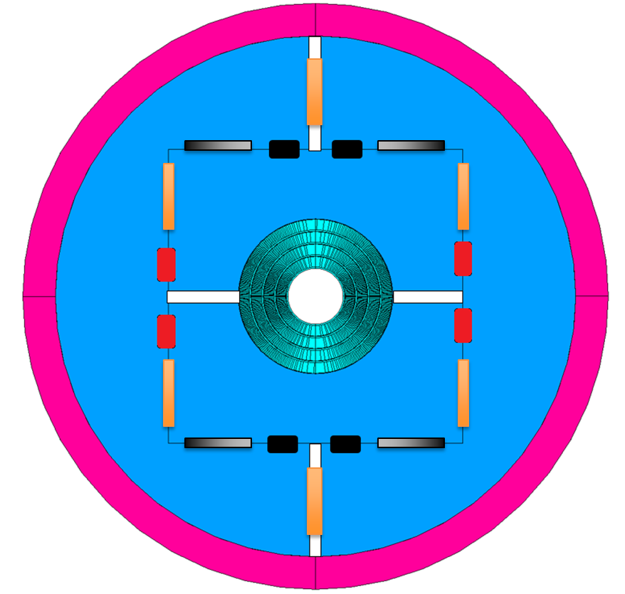
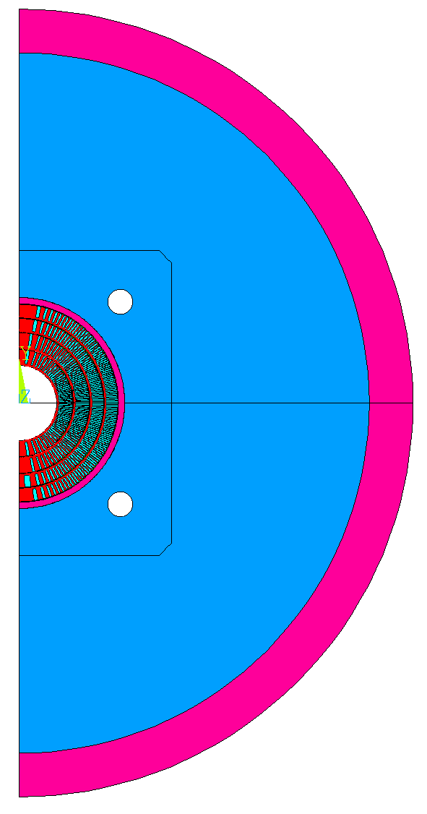
Model geometry
Schematic view with exaggerated gaps
ANSYS geometry

Slide 3
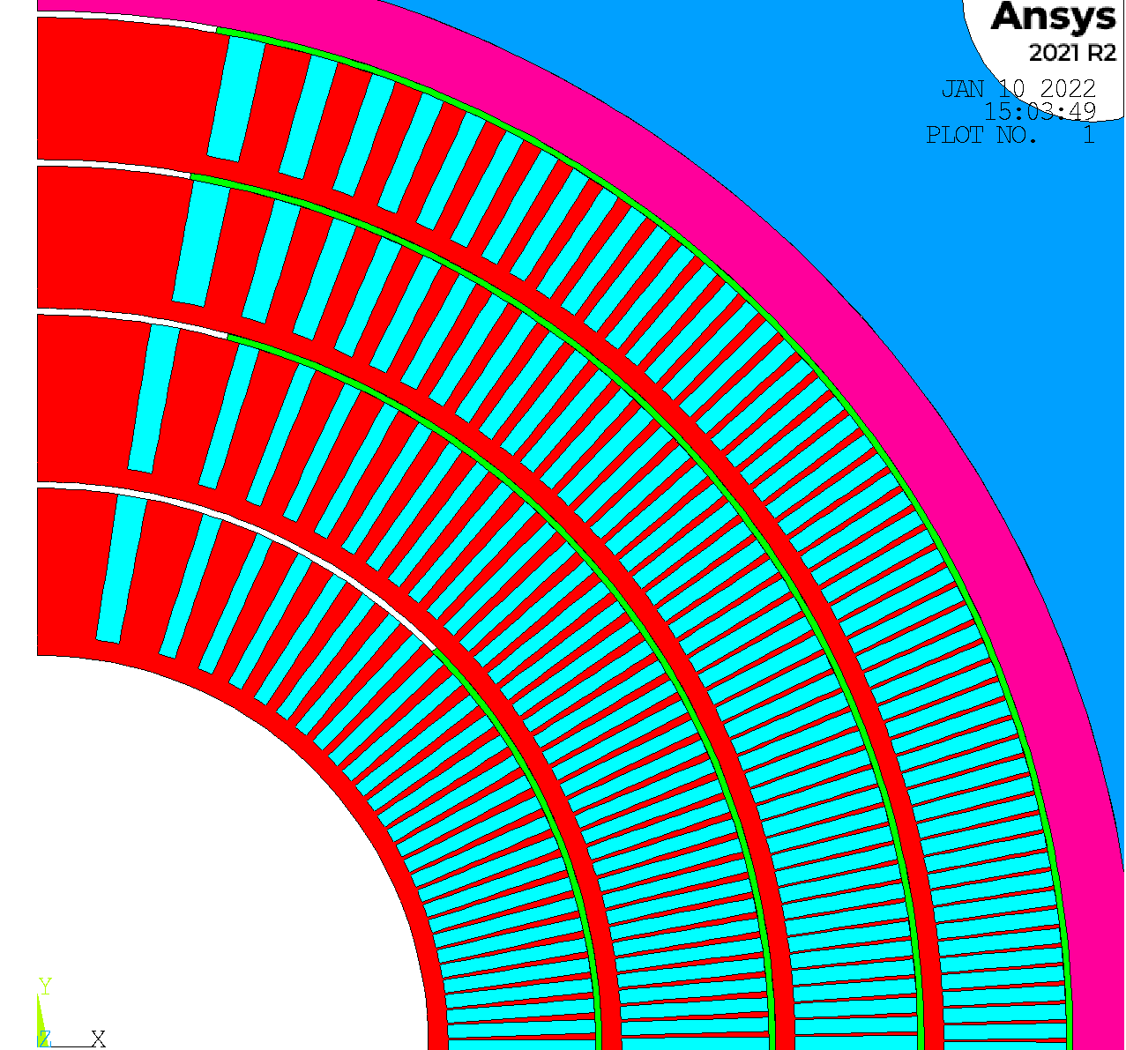
Contact elements between conductor and mandrel
Goal – simulating fully bonded and fully de-bonded case
Interlayer shim angle (optimization ongoing)
Current angles (deg)
45, 75, 80, 80
Early indication: the closer to 90 deg the better
Radial coupling on the layer ID prevents convergence problems
Details in backup
Minor stress artifacts
between layers
azimuthal
azimuthal
radial

Slide 4
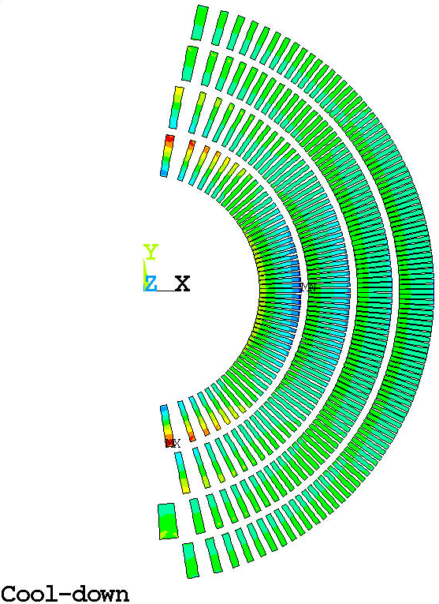
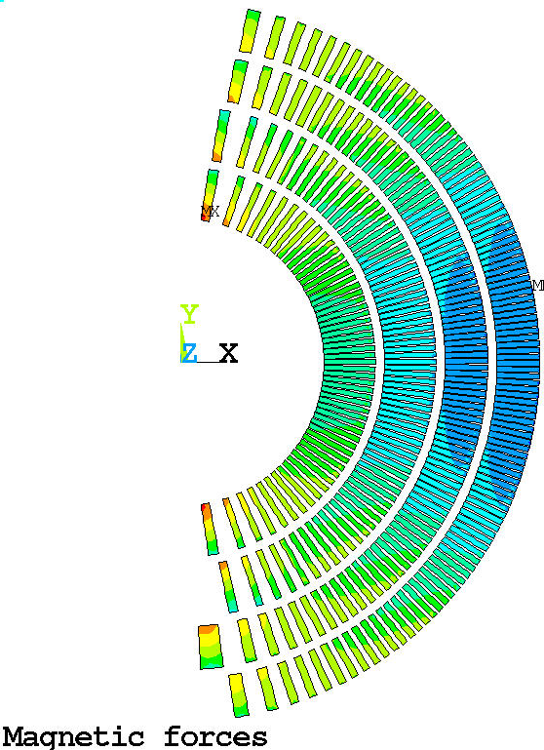
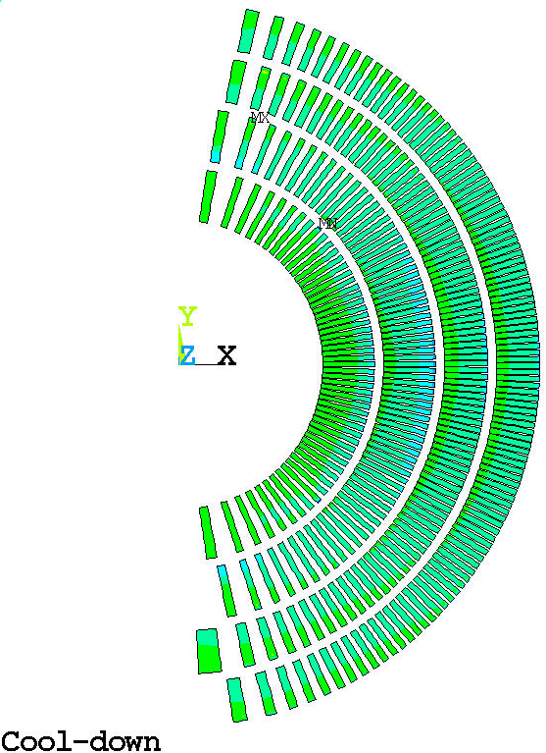
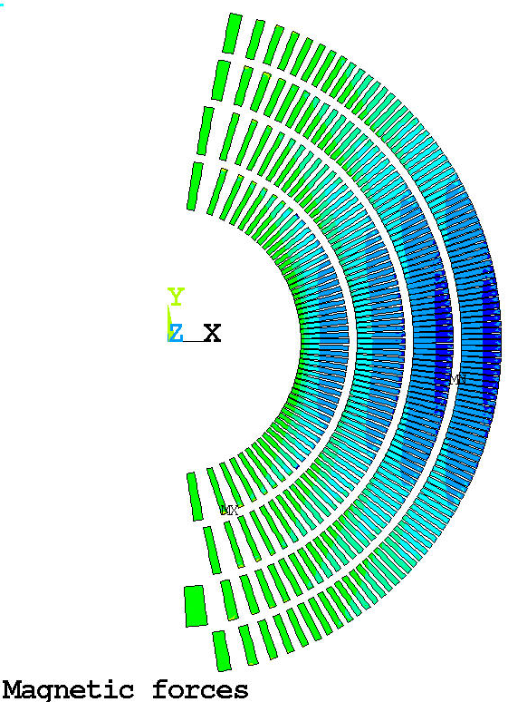
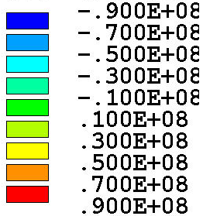




Azimuthal Stress
Bonded contacts
Standard contacts
+10/-50 MPa?
+10/-100 MPa?

Slide 5
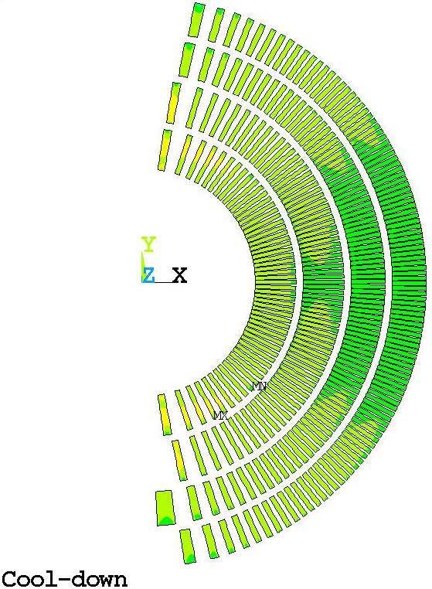
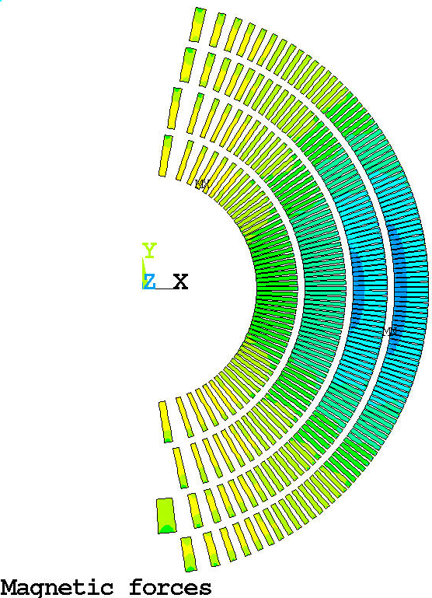
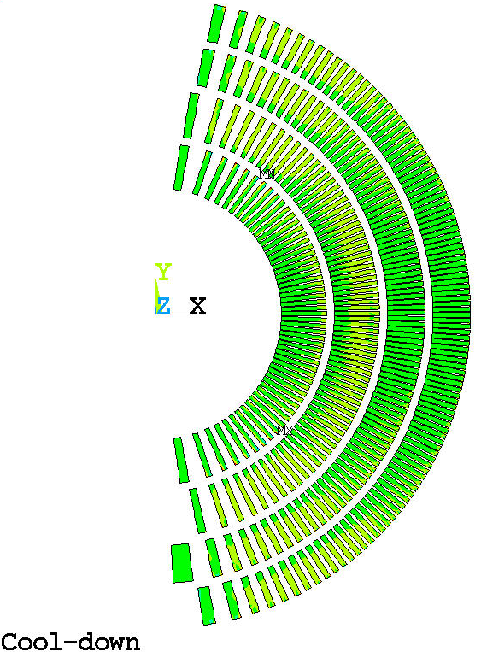
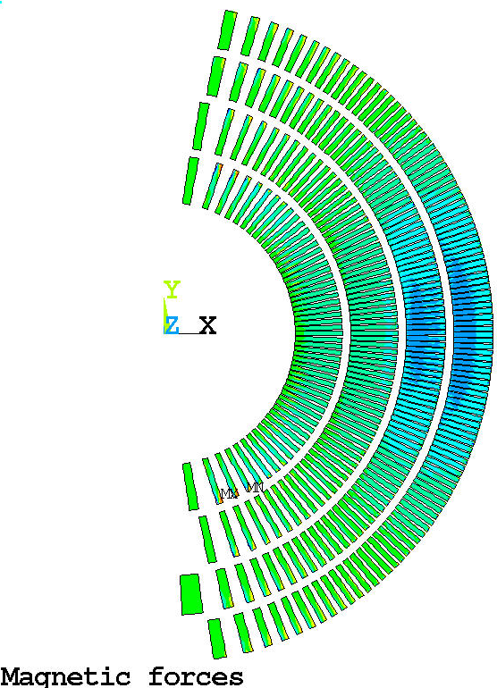




Radial Stress
Bonded contacts
Standard contacts
+60/-10 MPa?
+50/-70 MPa?
+30/-10 MPa?
+10/-70 MPa?
Stress artifacts due to coupling

Slide 6
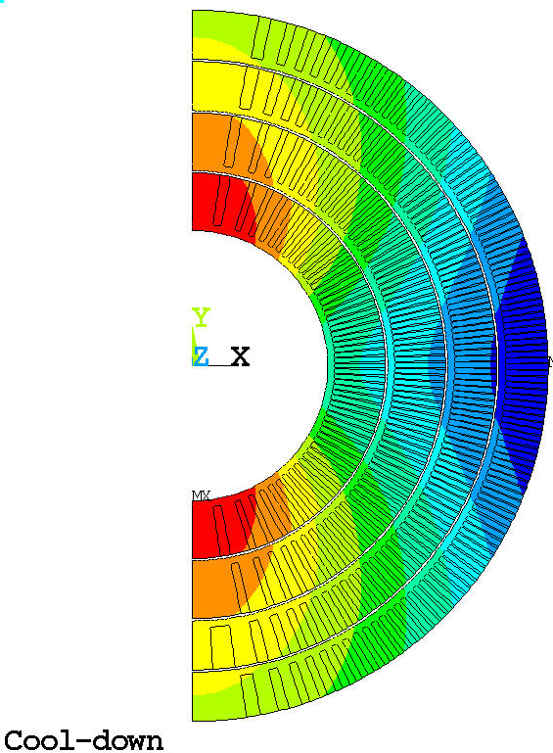
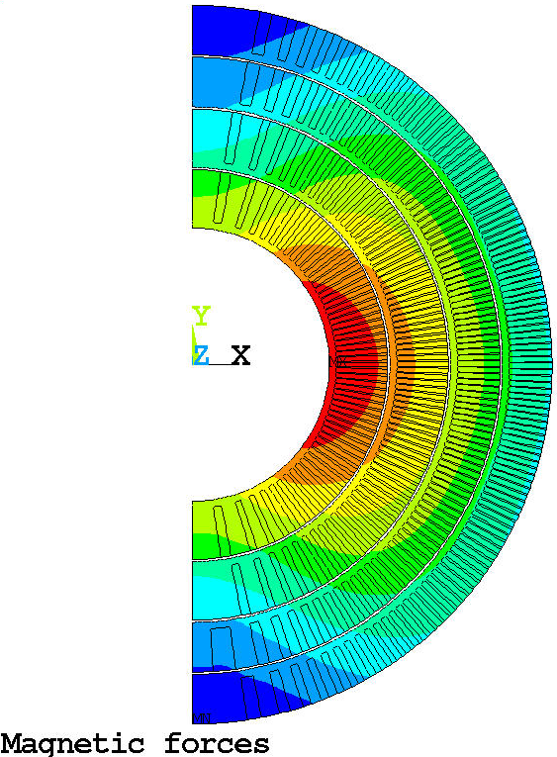
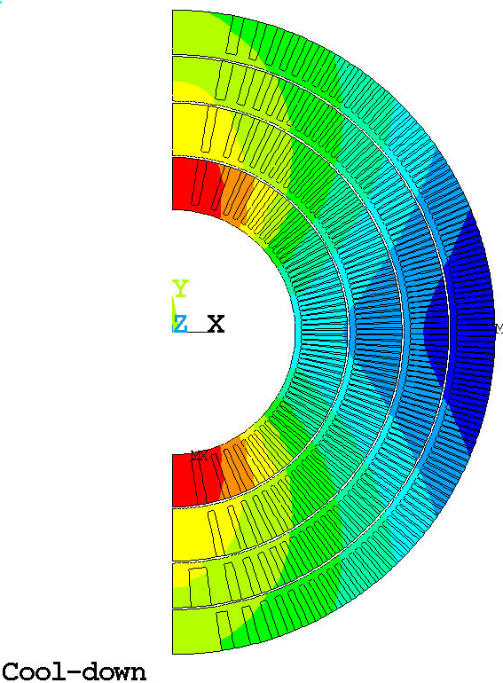
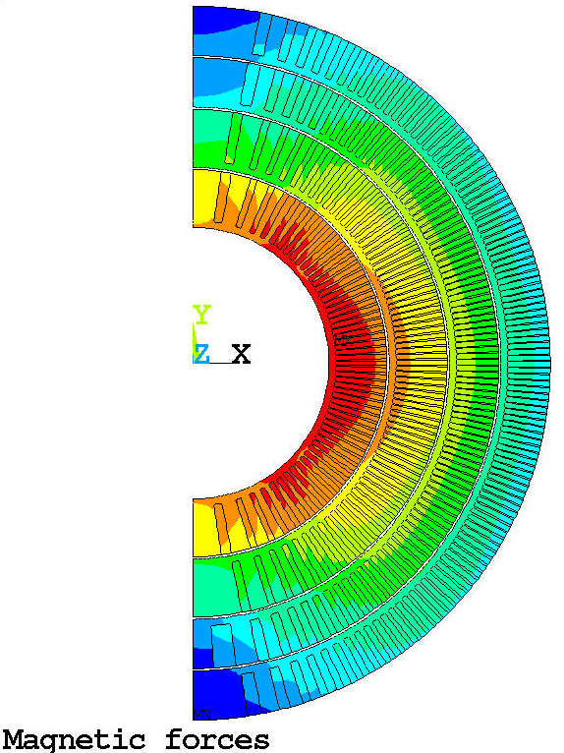
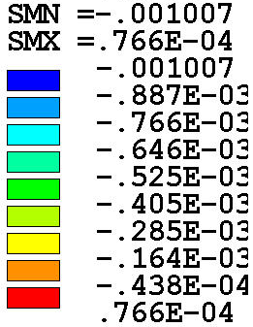
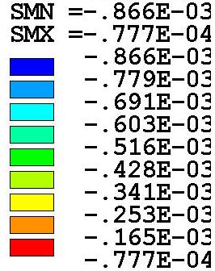
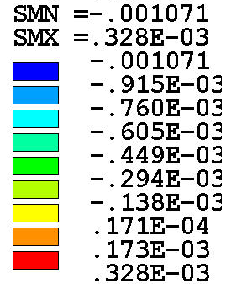
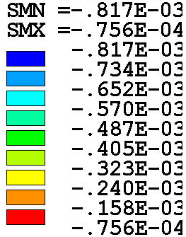
Radial displacement (wrt undeformed RT geom.)
Bonded contacts
Standard contacts
-866 um
-817 um
+328 um
+77 um
-1007 um
Underestimated L1 mandrel rigidly and 45deg shim
-1071 um
-77 um
-76 um

Slide 7
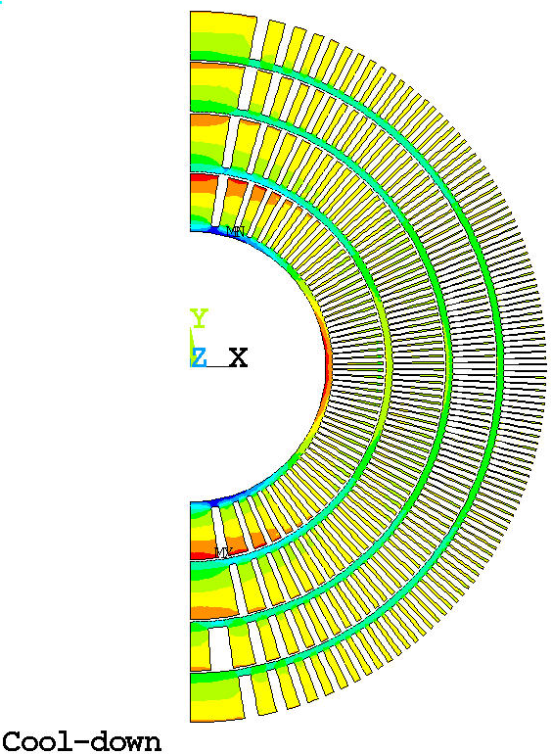
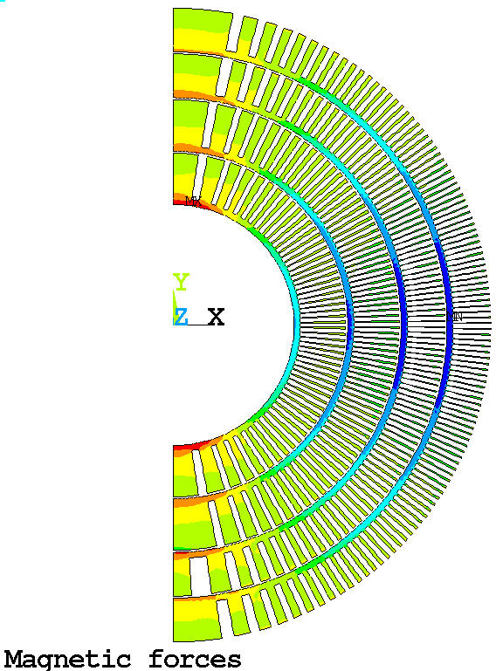
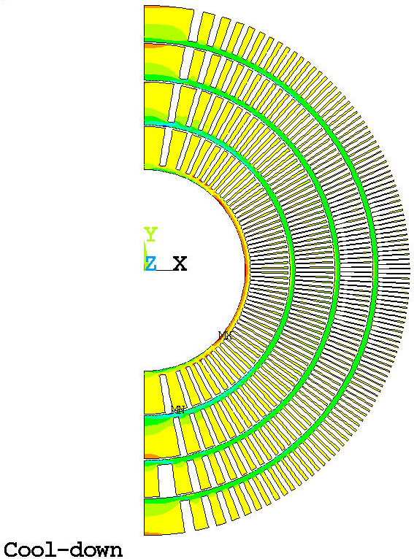
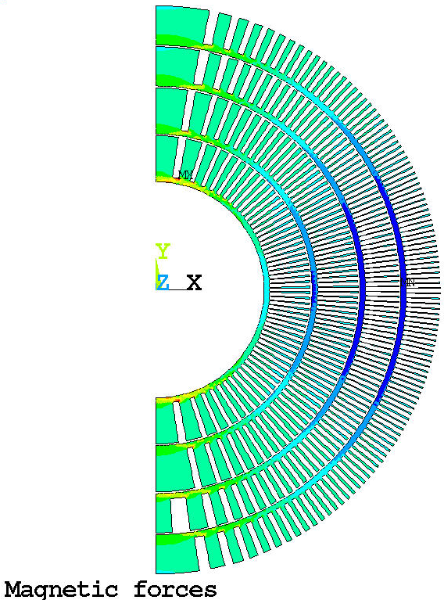
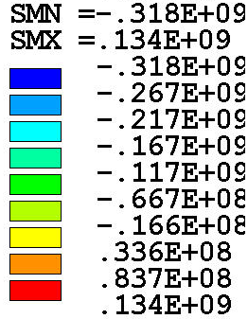
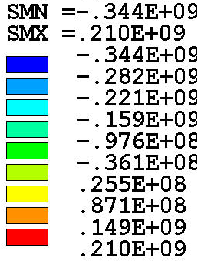
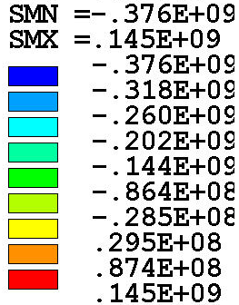
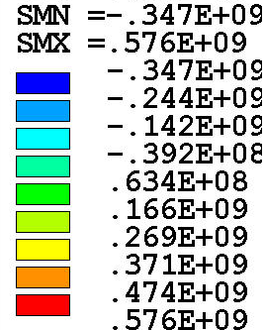
Mandrel stress (azimuthal)
Bonded contacts
Standard contacts
Underestimated mandrel rigidity in 2D 3D analysis needed

Slide 8
Mandrel stress (azimuthal, shims angle, bonded only)
Bonded contacts
Shim analysis in progress
Current shims
Angles (deg) 45, 75, 80, 80
Stress (MPa) CD -318/+134, MF -344/+210
Best case
Angles (deg) 90 in all layers
Stress (MPa) CD -301/+98, MF -325/+243

Slide 9
BACKUP

Slide 10
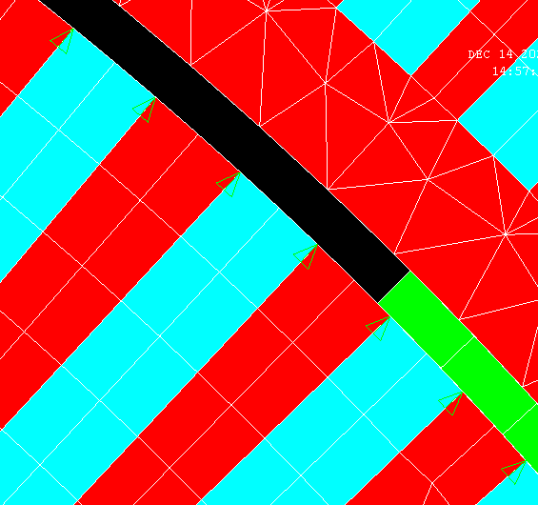
Alternative method of constraining the conductor motion
Shim geometry +/- angle
Shim material G10
No fake shim to constrain conductor motion
Conductor and rib node are coupled on the layer OD
Nodes CSYS rotated to cylindrical with NROTAT
ONLY UR is coupled (UX for a CSYS 1 oriented node)
All conductors except pole-turn have 2 nodes (pole-turn conductor only 1)

