Slide 1
Test summary for strands used in CCT3 and CCT4
MDP Meeting
4/19/2017
D. Dietderich, D. Arbelaez, H. Higley, A. Lin, I. Pong, X. Wang

Slide 2
Strand and Cable Parameters
Strand 13695, RRP 54/61
Production year 2010
Cable 1063, 2 pass cable
April 24, 2015

Slide 3
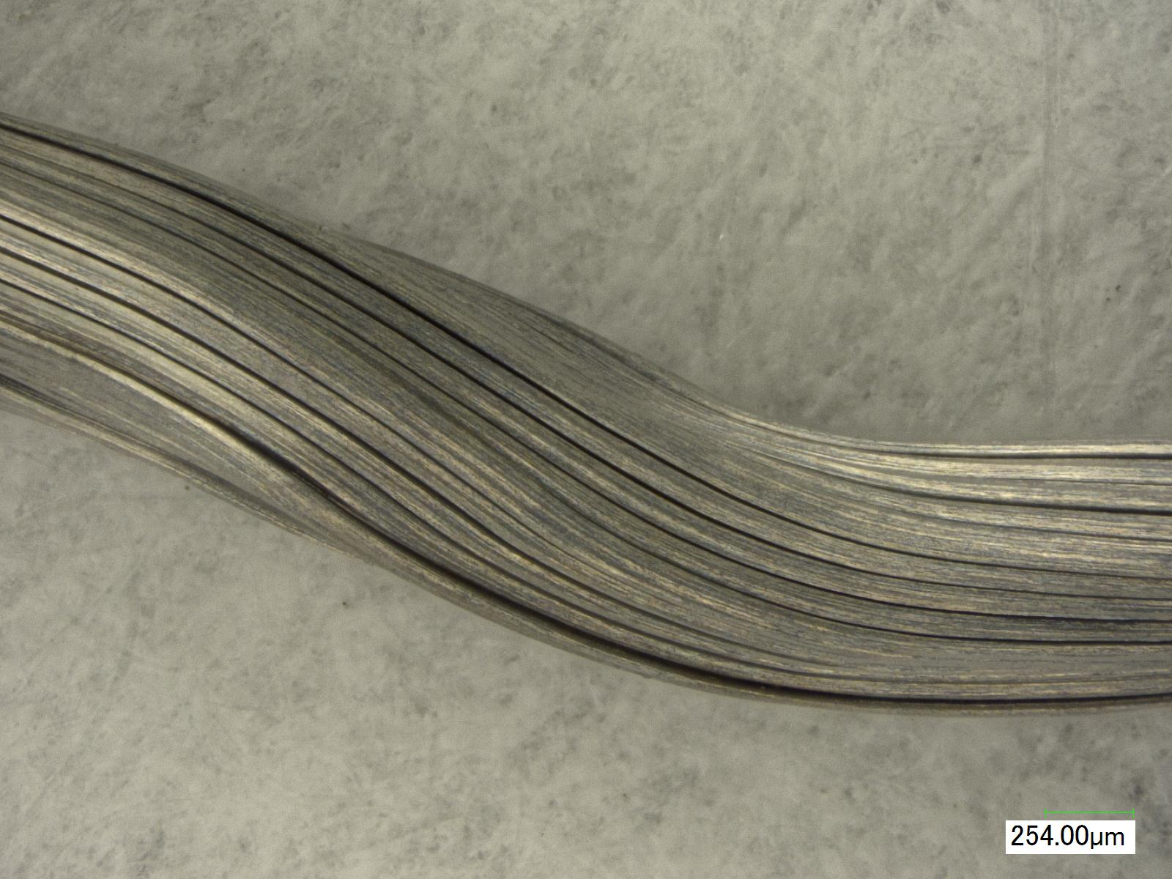
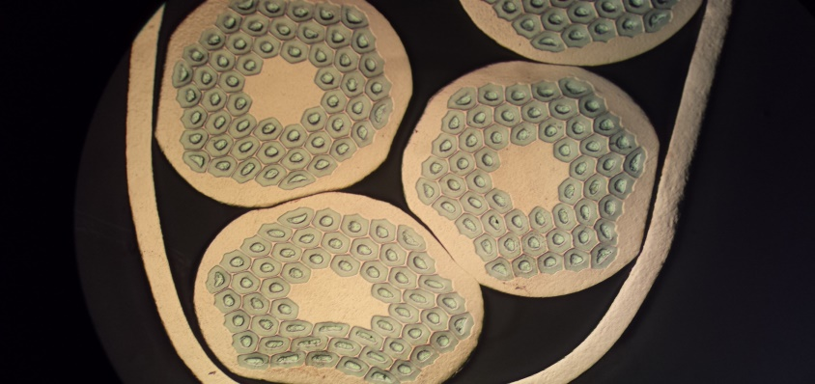
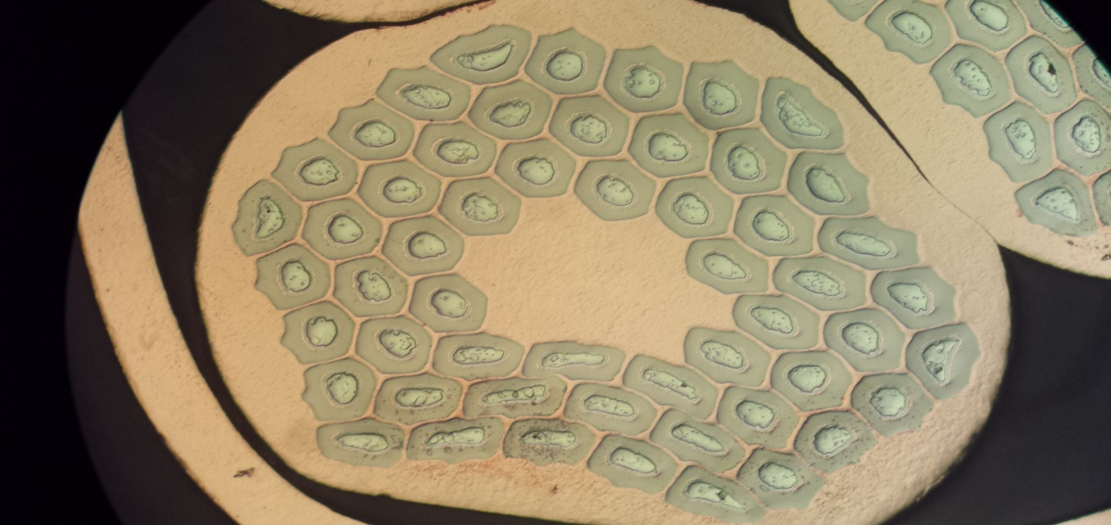
Metallography of cable 1063
Etched after HT

Slide 4
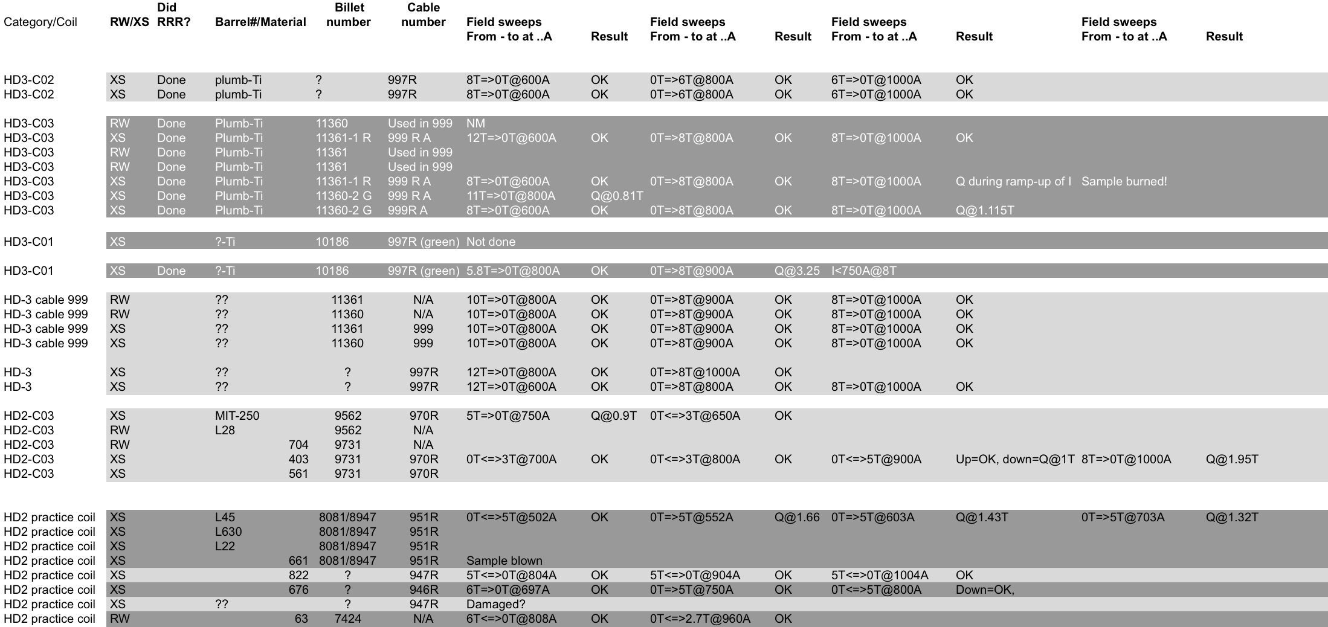
LBL HD Magnet Strand Results:
RRP 54/61, 0.80 mm diameter, ~50% Cu
RRP 60/61

Slide 5
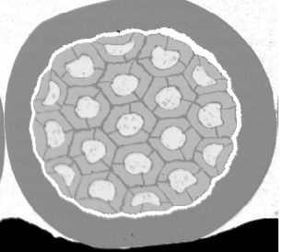
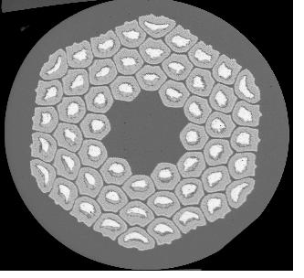
MJR 54/61:
Stability Current for vs. RRR of wire
MJR & RRP
Internal Tin

Slide 6
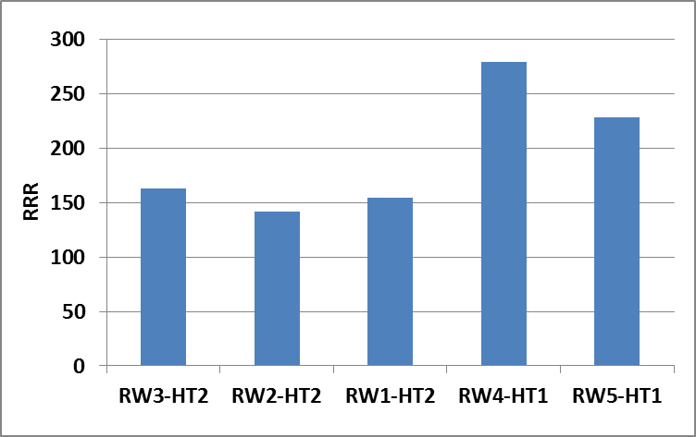
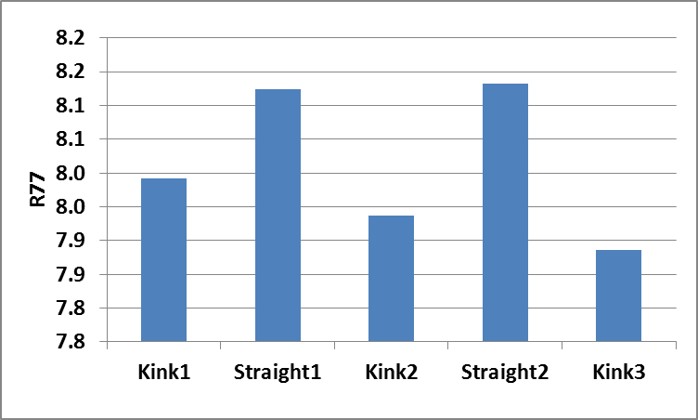
RRR data
CCT3 Witness Round wire RRR
77 K data for the extracted strand
High temperature step: 650-660C for 48 hrs

Slide 7
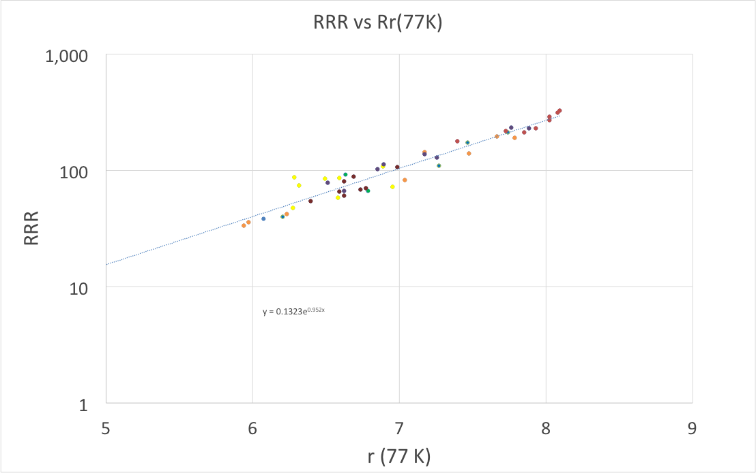
Relation between RRR vs. Rr (77 K)

Slide 8
Extracted strands preparation
Nb₃Sn RRP 54/61
      0.8 mm diameter before heat treatment,
      non-Cu fraction 54%
Samples extracted from cable #1063
  Extracted wires straightened before being wound on to Ti-alloy barrels
Different heat treatments dates:
      Peak temperature of 650-660 C for 48 hrs.
After soldering wires to barrels the samples were cleaned with soap solution in ultrasonic bath
Stycast or solder flux was applied to secure the wires to the barrels
Voltage taps were installed on to wires after the Stycast was applied and cured.

Slide 9
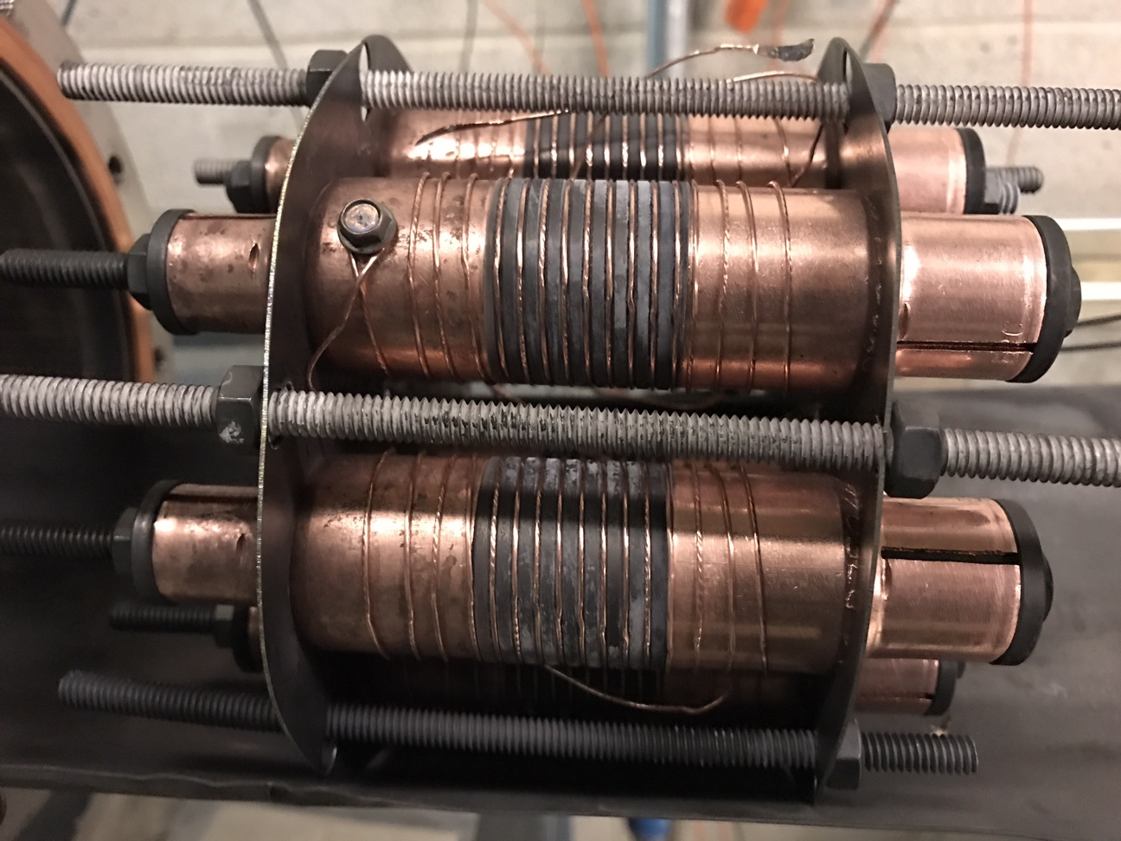
Typical heat treatment rack with samples installed
Andy Lin

Slide 10
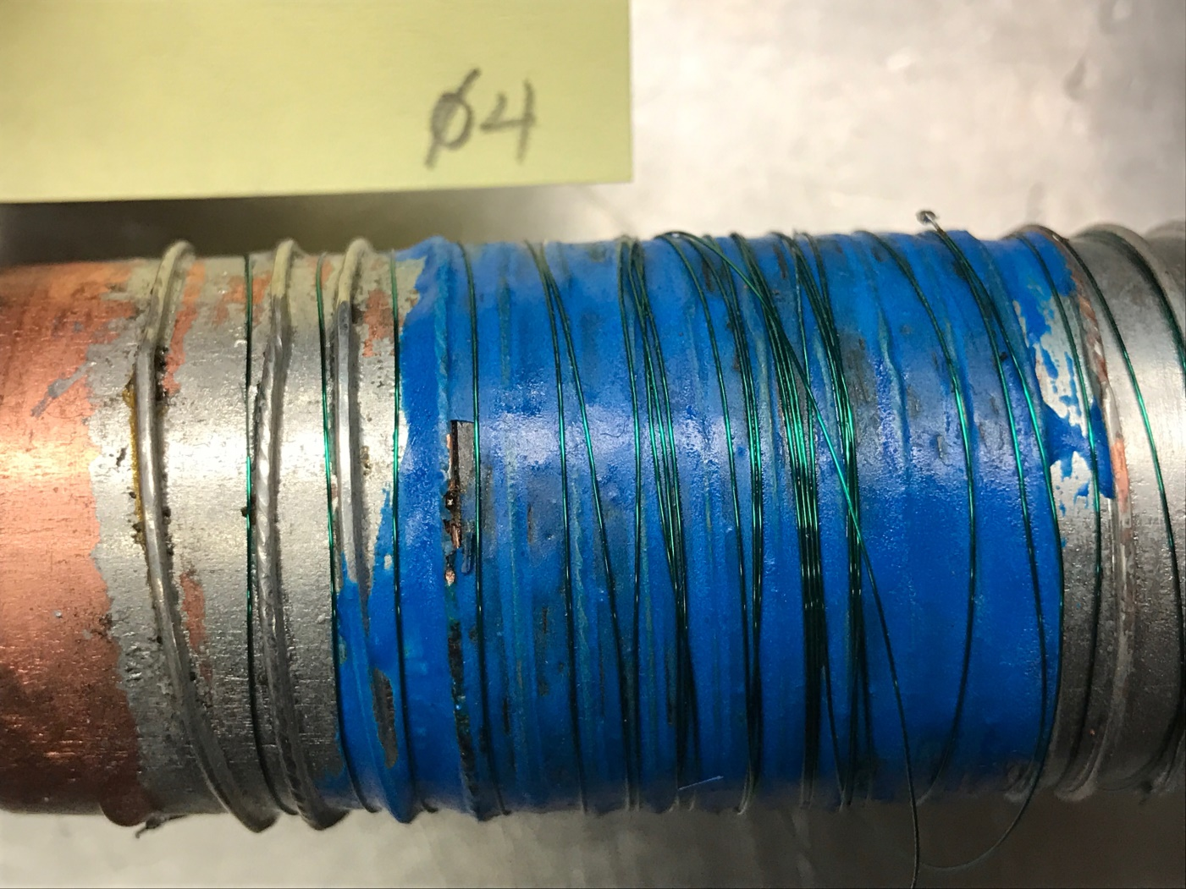
Sample 4 – second one burned up at the bell/barrel transition

Slide 11
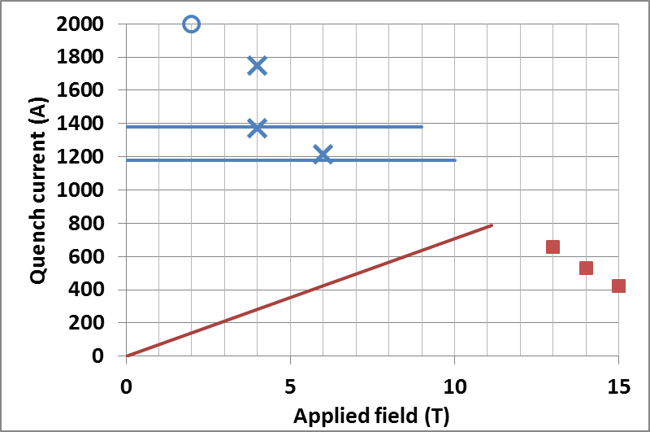
Round Strand: Stable at 1200 A and below from ramps from 0 to 10 T
Strands in cable 1063
PS limit
quench current
I and B range for the sweep
I_{c}(4.2K)
conductor load line

Slide 12
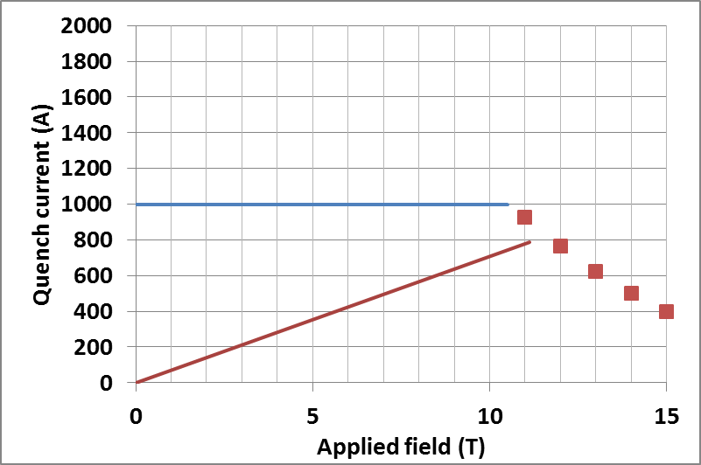
Extracted Strand HT’ed with CCT3: Stable at 1000 A from 0 to 10 T
Extracted strand From cable 1063
No field sweeps done above 1,000 A

Slide 13
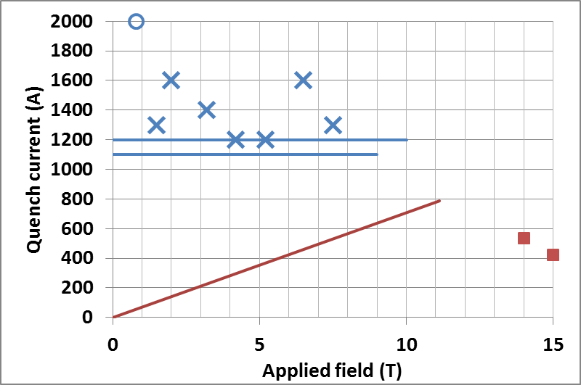
Extracted Strand: Stable below 1200 A from 0 to 10 T
Extracted strand From cable 1063
PS limit
quench current
I and B range for the sweep
conductor load line
I_{c} (4.2 K)
Quench current was measured by increasing the current during the down ramp of the magnetic field
Conductor load line was calculated by L. Brouwer considering the iron

