Slide 1

Nuclear data uncertainties and its impact on design margins and advanced reactor licensing
Workshop on Applied Nuclear Data Activities (WANDA)
Timothy J Drzewiecki
Reactor Systems Engineer
U.S. Nuclear Regulatory Commission
Office of Nuclear Reactor Regulation
February 28 – March 4, 2022

Slide 2

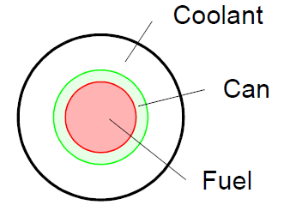
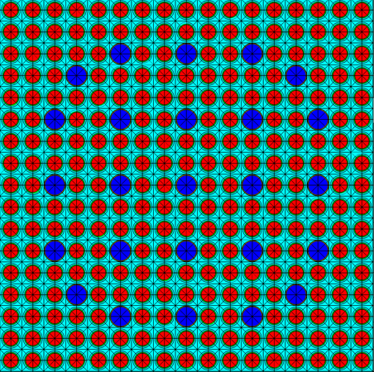
Commercial Light Water Reactor Approach to Reactor Physics/Nuclear Design
Data
(e.g., ENDF/B-VII.1)
  Start with simplified geometry and detailed energy group structure, End with simplified group structure and 3D geometry
  Apply biases and uncertainties to calculated quantities of interest (QOIs):
    Reactivity balance
    Shutdown margin
    Feedback coefficients
    Power distribution
Cross Section Processing
(e.g., AMPX, NJOY)
Output: 100s of energy groups
1-D Pin Cell
(e.g., SCALE, CASMO)
Output: 20-100 energy groups
2-D Assembly
(e.g., SCALE, CASMO)
Output: 2-4 Energy Groups,
Cross Section and Discontinuity Factors
3-D Whole Core Simulator
(e.g., PARCS, SIMULATE)
Emphasized during safety review
Notes:
7 technical branches involved in the review of this TR.

Slide 3
Impact of Data Uncertainty
QOIs verified via (1) startup physics testing, and (2) surveillance requirements
Uncertainties in nuclear data/physics modeling has the potential to adversely impact reactor operation
Notes:
7 technical branches involved in the review of this TR.

Slide 4
Design Margin
(Shutdown Margin)
Available Margin
Margin for Prediction Uncertainty (e.g., nuclear data)
Shutdown Capacity
Margin for Malfunctions (e.g., control rod fails to insert)
Required Shutdown Margin
Notes:
7 technical branches involved in the review of this TR.

Slide 5
NUREG/CR-7289
ORNL/TM-2021/2002
ADAMS Accession No. ML21349A369
Oak Ridge National Laboratory (ORNL)
  F. Bostelmann
  G. Ilas
  C. Celik
  A.M. Holcomb
  W.A. Wieselquist
Notes:
7 technical branches involved in the review of this TR.

Slide 6
Approach
4 Phases:
  Phase 1 and 2: Identify and assess key data impacting reactivity in non-LWRs based on literature review
  Phase 3: Identify relevant benchmarks
  Phase 4: Assess the impact of nuclear data uncertainty through propagation to key QOIs
    Sensitivity and uncertainty analysis (performed using SCALE 6.3)
ADAMS Accession Nos. ML20274A052 and ML21125A256
Notes:
7 technical branches involved in the review of this TR.

Slide 7
Technologies Considered
Notes:
7 technical branches involved in the review of this TR.

Slide 8
Sensitivity and Uncertainty Analysis
Reactor technology | Selected benchmarkª | Type
High Temperature Gas Reactor | HTR-10 | Experiment
Fluoride Salt Cooled High Temperature Reactor | UC Berkeley Mark1 PB‑FHR | Computational benchmark
Graphite-moderated Molten Salt Reactor | MSRE | Experiment
Heat Pipe Microreactor (metal-fueled) | INL Megapower Design A^{b} | Computational benchmark
Sodium Cooled Fast Reactor (metal and oxide fueled) | EBR-II ABR-1000 | Experiment Computational benchmark
ª Although Fast Spectrum Molten Salt Reactors were identified as a relevant reactor concept, a concept with details sufficient for modeling could not be found in the open literature. ^{b} The original design contains oxide fuel. However, for this project, metal fuel was assumed.
Notes:
7 technical branches involved in the review of this TR.

Slide 9
Results and Key Nuclear Data
(Subset of results from HTR-10 benchmark)
Nominal Results
Nominal Reactivity Impacts for QOIs
Notes:
7 technical branches involved in the review of this TR.

Slide 10
Results and Key Nuclear Data
(Subset of results from HTR-10 benchmark)
Sensitivity Analysis Results
Key Nuclear Data Impacting Pebble Graphite Temperature Feedback
Notes:
7 technical branches involved in the review of this TR.

Slide 11
Results and Key Nuclear Data
(Subset of results from HTR-10 benchmark)
Uncertainty Analysis Results
Uncertainty in QOIs due to nuclear data
Notes:
7 technical branches involved in the review of this TR.

Slide 12
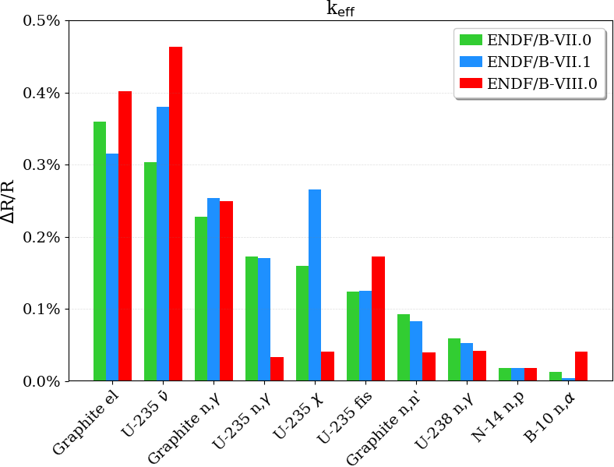
Results and Key Nuclear Data
(Subset of results from HTR-10 benchmark)
Uncertainty Analysis Results
Top Nuclear Data Contributors to Multiplication Factor Uncertainty
Notes:
7 technical branches involved in the review of this TR.

Slide 13
Notes:
7 technical branches involved in the review of this TR.

Slide 14
Conclusions
Major data gaps from the libraries:
  Thermal scattering kernel for molten salts
  Uncertainty for thermal scattering (e.g., graphite)
  Uncertainty for angular scattering in fast spectrum reactors
In general, the most important reactions were shown to be:
  Neutron multiplicity, fission and radiative capture cross sections of fissile isotopes (e.g., U-235)
  Radiative capture cross sections of fertile isotopes (e.g., U-238)
Other significant contributors:
  Capture cross sections of fission products*
  Capture cross sections of neutron absorbing material (e.g., Gd or B)
  Scattering reactions with the coolant and structural materials for fast spectrum systems
For Molten Salt Reactors, in particular, additional neutron capture reactions such as (n,p) and (n,t) for salt components (e.g., Li and Cl) are significant contributors to the reactivity balance.
* Results of study with respect to depletion/burnup are limited due to (1) unavailability of benchmarks and relevant data, and (2) capability not currently available to fully propagate uncertainty in depletion analyses.
Notes:
7 technical branches involved in the review of this TR.

Slide 15
Conclusions
Calculated uncertainty in reactivity balance due to nuclear data is generally greater than what is used in LWR nuclear design.
Large uncertainties that are not considered relevant in LWRs studies were found to be significant for several advanced reactor systems:
  All fast spectrum systems impacted by larger uncertainties in U-238 inelastic scattering and U-235 radiative capture at higher energies
  A large uncertainty in the Li-7 capture cross section causes larger uncertainty in all QOIs for systems that use lithium as part of a salt coolant.
No performance differences observed between the different libraries (i.e., ENDF/B-VII.0, ENDF/B-VII.1, and ENDF/B-VIII.0)
  One exception being ENDF/B-VII.1 and ENDF/B-III.0 perform better for high temperature gas reactors because of the adjusted carbon capture cross section.
NUREG/CR-7289 provides useful insight regarding nuclear design margins to accommodate gaps and uncertainty in the nuclear data.
Notes:
7 technical branches involved in the review of this TR.

Slide 16
Adjustments?
Use of integral experiments to adjust data can significantly reduce uncertainty (increase available margin)
  Also permits adjustment and uncertainty reduction for responses where measurements may not be available.
Notes:
7 technical branches involved in the review of this TR.

