Slide 1
Radiation Transport for Spacecraft Design (with Emphasis on Nuclear Data)
Insoo Jun. Insoo.Jun@jpl.nasa.gov
Jet Propulsion Laboratory, California Institute of Technology
March 1, 2022
Presented at Workshop for Applied Nuclear Data Activities (WANDA 2022)
Copyright 2022 California Institute of Technology. Government sponsorship acknowledged.

Slide 2
Disclaimer
The opinion presented in this talk is solely mine based on my experience at JPL.
Other experts in the fields and at other institutes may have different opinions and preferences on their choice of the code(s) for their problems.

Slide 3
Topics
Sources of the Natural Space Radiation
Space Radiation-Induced Effects
Usage Cases of Radiation Transport Codes for Spacecraft Design
Frequently-Asked-Questions

Slide 4
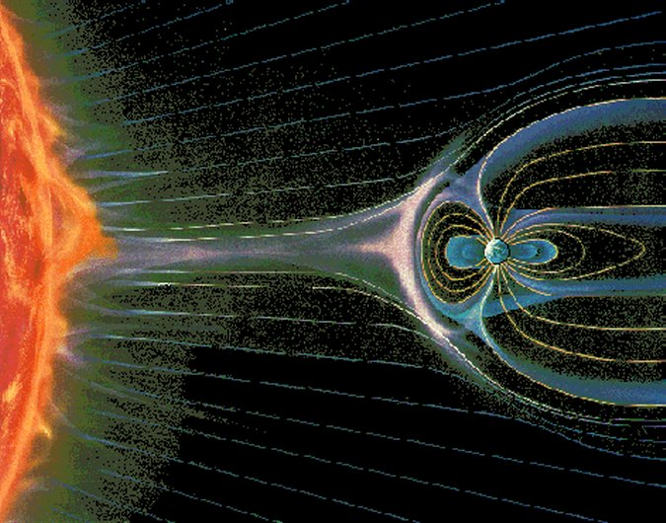
The Space Radiation Environment
Interplanetary Space: Galactic Cosmic Rays
Sun
Solar Wind
Solar Energetic Particles (SEP):Protons and Heavier ions
Trapped Particles
CHARGED PARTICLES

Slide 5
SUMMARY: Radiation Environment
 | Solar Wind | SEP | GCR | Trapped
Characteristics | Constant background | Sporadic, stochastic | Cosmic background | Planetary magnetic field
Main Species | Electron/ion plasma | Protons and heavy ions | Protons and heavy ions | Electrons and protons
Energy | ~eV (up to 2500 km/s with ~400 km/s average) | Up to few 100’s MeV | > 1 GeV | Varies
Solar Cycle Dependence | Higher in solar max | Higher in solar max | Lower in solar max | Varies
Spatial (Heliocentric) | ~1/r² | ~1/r² | ~10% increase/AU | Varies
Models |  | JPL model; ESP; SAPPHIRE; etc. | CREME96; Badwah-O’Neill; etc. | AP9/AE9/IRENE; etc.
Which environment is important depends on where the mission is going for how long and what devices you are using!!

Slide 6
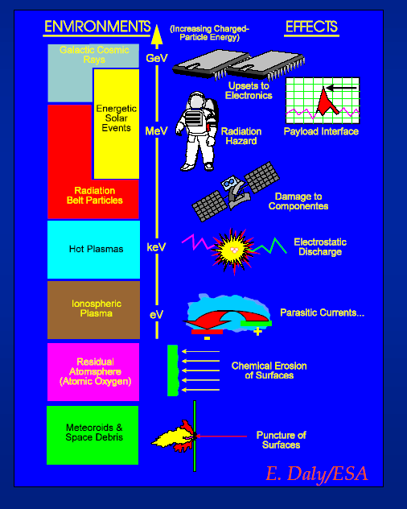
Overview: Radiation and Effects
Total Ionizing Dose (TID)
Displacement Damage Dose (DDD)
Single Event Effects (SEE)
Radiation induced noise in scientific sensors/detectors
Charging
Radiation effects on astronauts

Slide 7
Dose or energy deposition is (almost) everything for radiation effects
Total
Energy Loss
Material
Radiation
=
Ionization
Total Ionizing Dose (TID)
LET
Primarily due to interactions with atomic electrons
+
Displacement
Displacement Damage Dose (DDD)
NIEL
Nuclear interactions could be important
Single Event Effect (SEE) is a special case of TID where even a single particle can generate a lot of electron – hole pairs (i.e., ionization) sufficient to change device property --> Particles with high LET values

Slide 8
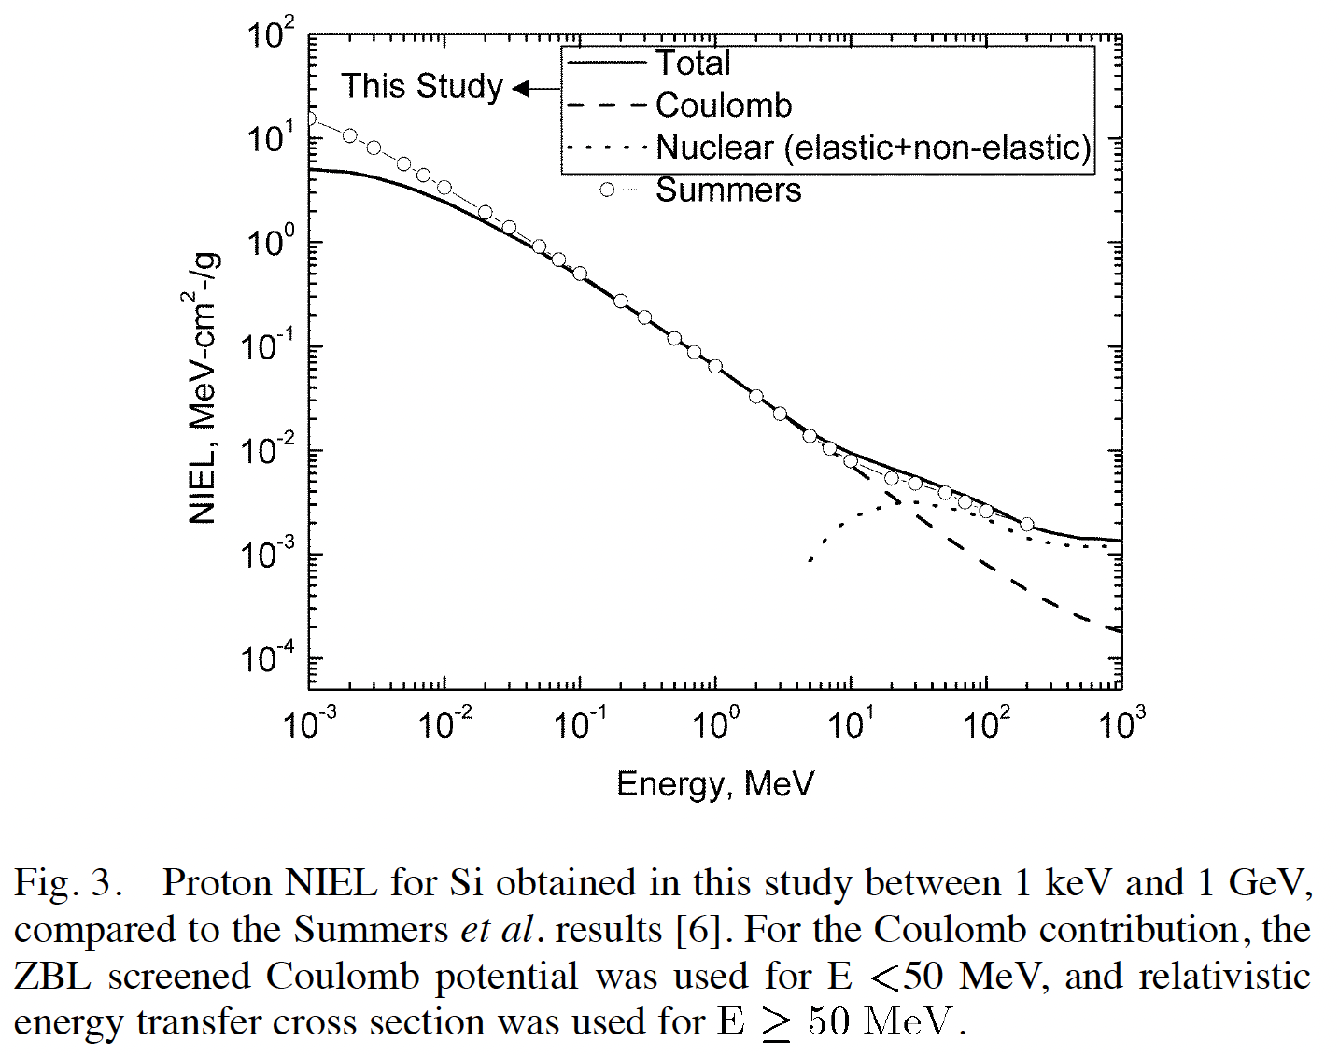
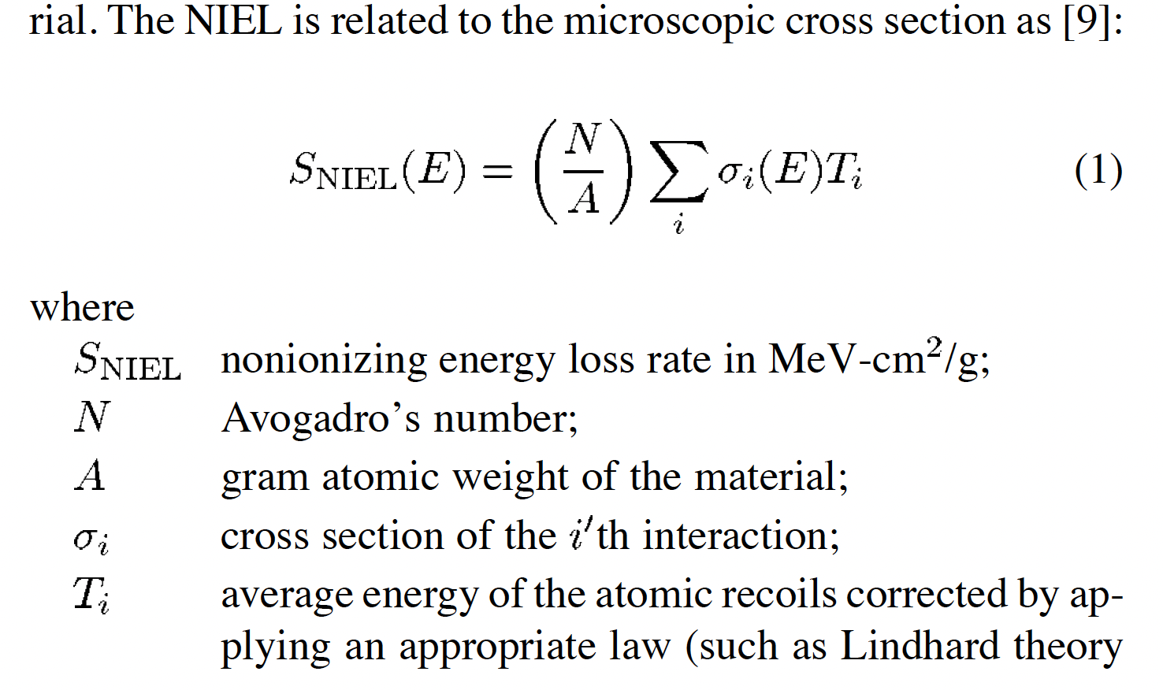
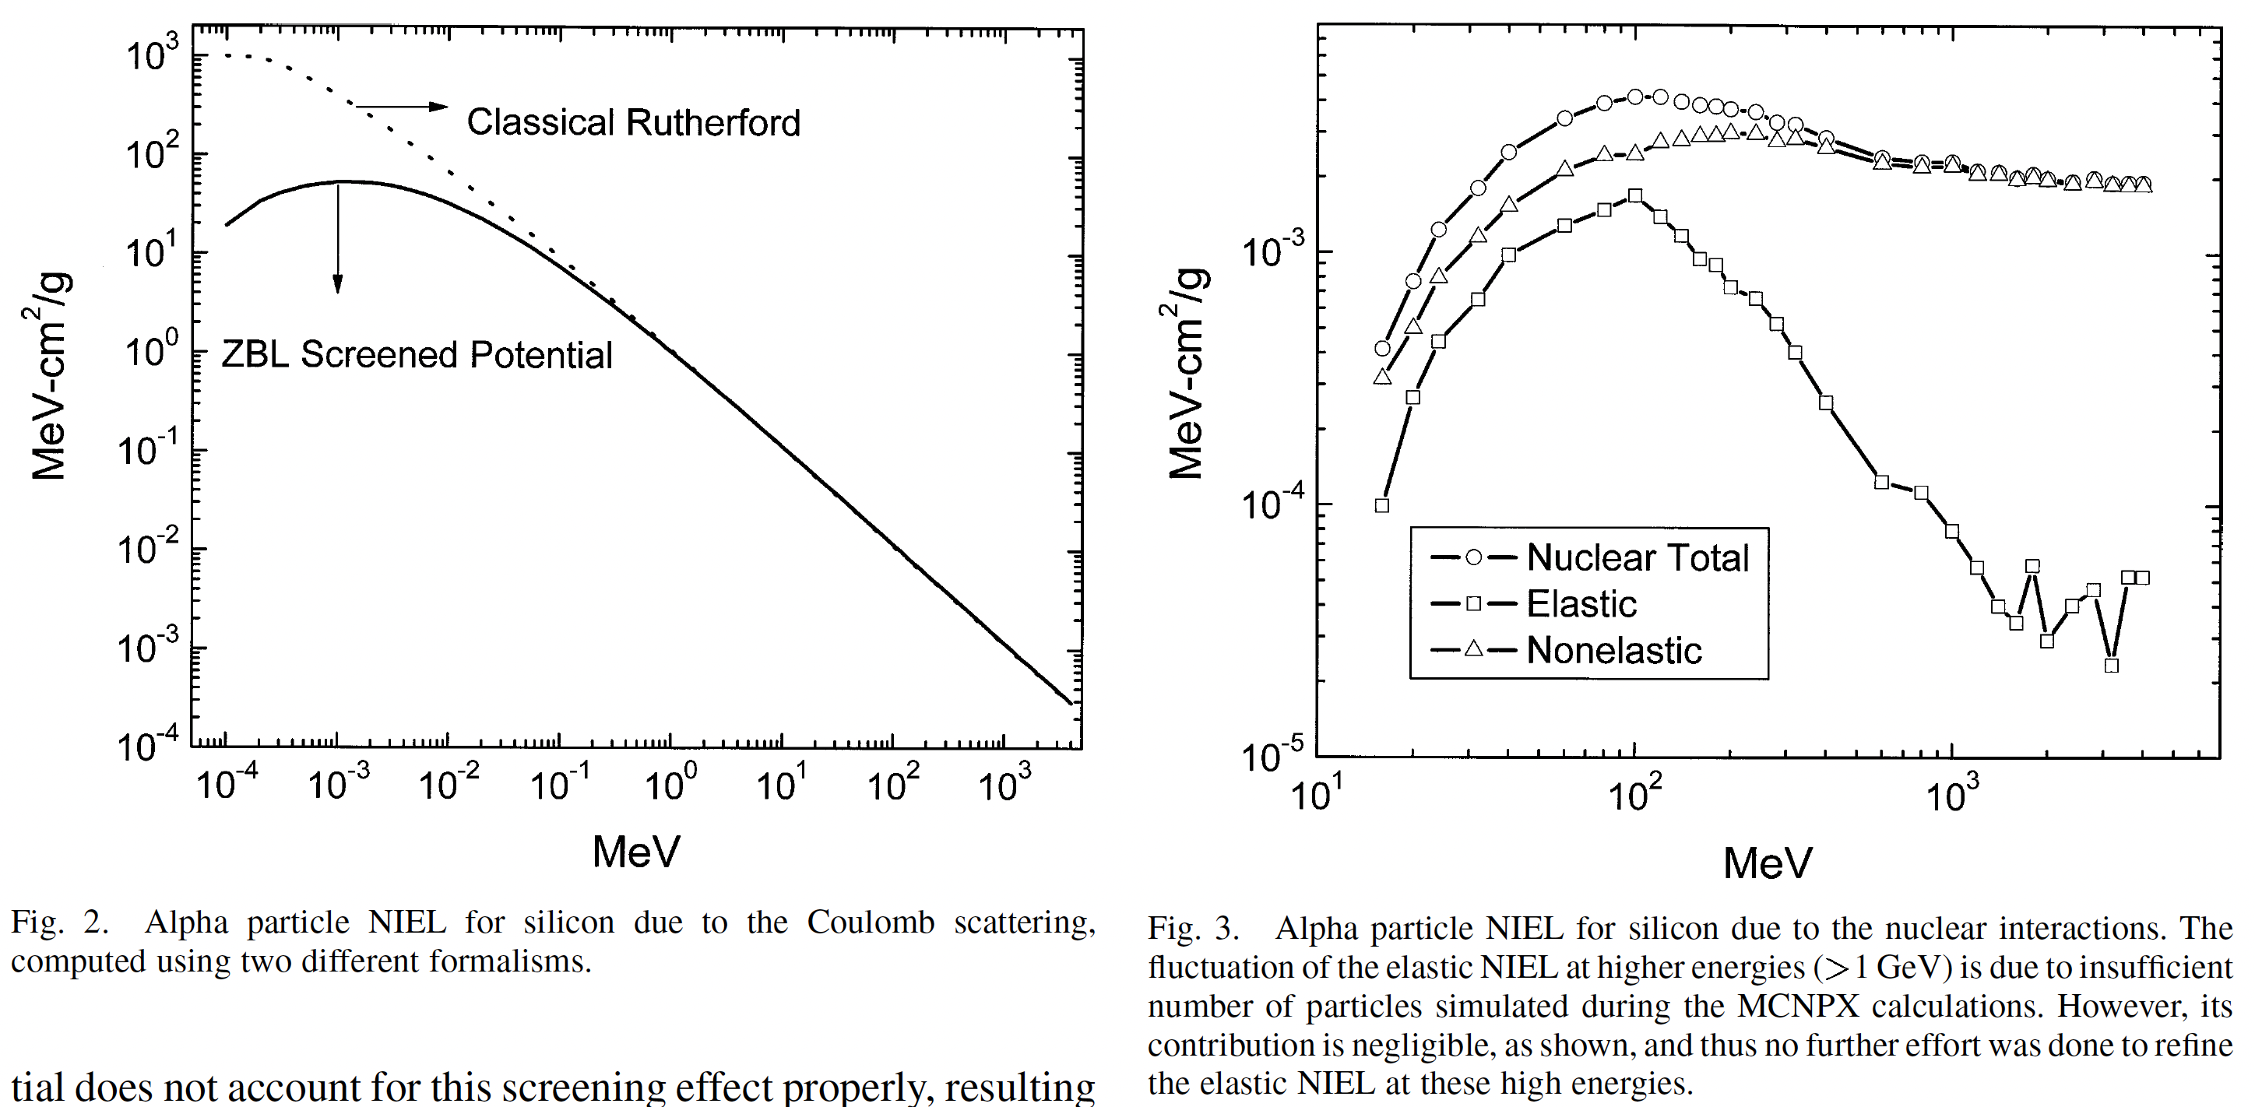
Jun et al. (TNS, 2003)
Jun (TNS, 2002)
Jun et al. (TNS, 2004)

Slide 9
Usage Cases of Transport Codes and Nuclear/Atomic Data (*)
(*) Other codes available: FLUKA, PHITS, HZETRN, etc.
Effects | Particles | Codes | Comments
TID (DDD) | Electrons and Protons | NOVICE, FASTRAD, MCNP, Geant4, SRIM | Particle transport through shielding materials and energy deposition. See B. Jun et al. (2020) for a comparison study for several codes
SEE | Protons and Heavier Ion | CREME96 | Only aluminum shielding and silicon target. See Reed et al. (2013) for a code survey study for SEE
Detector Simulations | Electrons and Protons | MCNP, Geant4 | Response function (e.g., Geometric Factor). Noise background (e.g., for CCD, MCP, etc.)
Charging | Electrons | TIGER (ITS), MCNP, Grant4 | Particle transport through shielding materials and charge deposition.
In all of these codes, the relevant nuclear/atomic interaction data are used for particle transport through shielding/target materials: scattering, absorption, range, LET/stopping power, etc.

Slide 10
General Notes
The uncertainties of the environment models are still considered as a larger contributor to the overall TID/DDD evaluation uncertainty, compared to uncertainty associated particle transport.
Need for improving transport codes and associated nuclear data has not been a critical issue for TID/DDD evaluation.
Radiation Design Factor (or Margin) is used to cover these uncertainties in TID/DDD evaluation.
For spacecraft electronics TID/DDD, secondary neutrons are typically considered not important.
For TID and DDD design for spacecraft electronics, the contribution from proton nuclear reactions may be not that important.
For SEE, CREME96 (or CREME-MC or MRED) has been widely used for typical SEE evaluation.

Slide 11
Typical Frequently-Asked-Questions
Extremely high energy (up to ~100 MeV) electron environment (e.g., Europa Clipper Mission)
Contribution of secondary particles to radiation effects
Bremsstrahlung
Neutrons from photo nuclear reactions
Validity (or accuracy) of radiation transport codes: Contribution to the assigned design margin
Shielding effectiveness for HZE GCR particles
Secondary particle production cross sections
For small feature, new technology devices

Slide 12
Radiation Effect New Trend?
Highly sensitive science missions even in relatively benign radiation environment:
WFIRST – Detection of Exoplanets (noise level of single electron)
Athena – high resolution imaging and spectroscopic X-ray observatory); very low background required
LISA – Gravitational wave mission; sensitivity to displacement of ~5x10⁻¹¹ m
Testing will be a challenge
Accurate and reliable radiation transport tools with the relevant nuclear data would be desired for various particle interaction physics: Cerenkov, fluorescence, Bremsstrahlung, activation, etc.

Slide 13
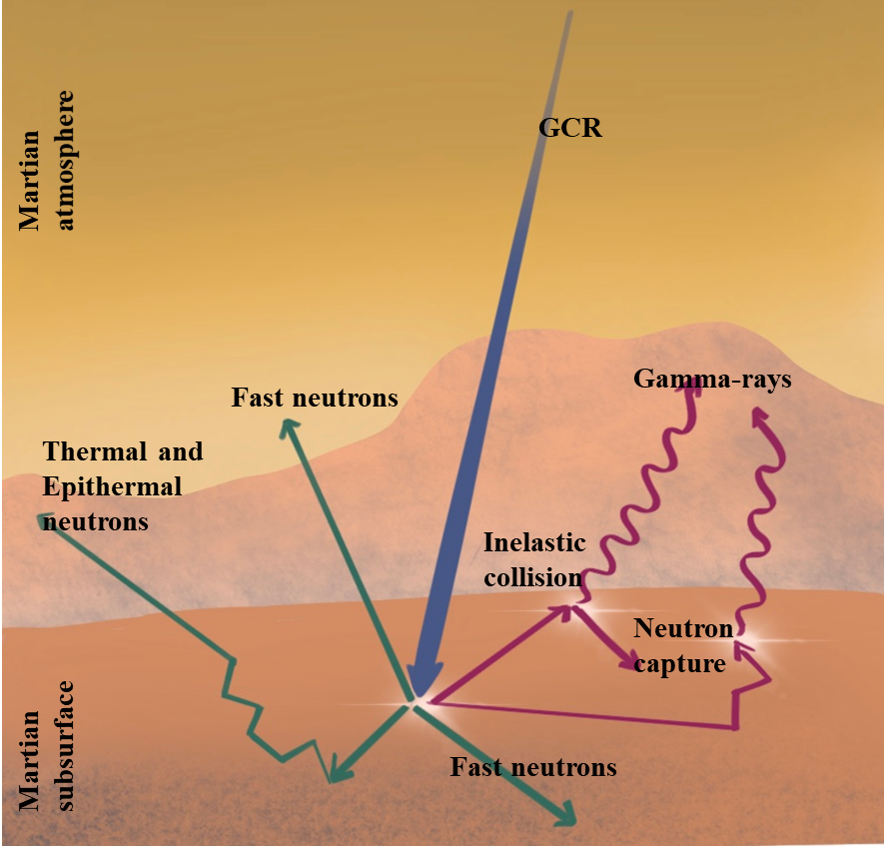
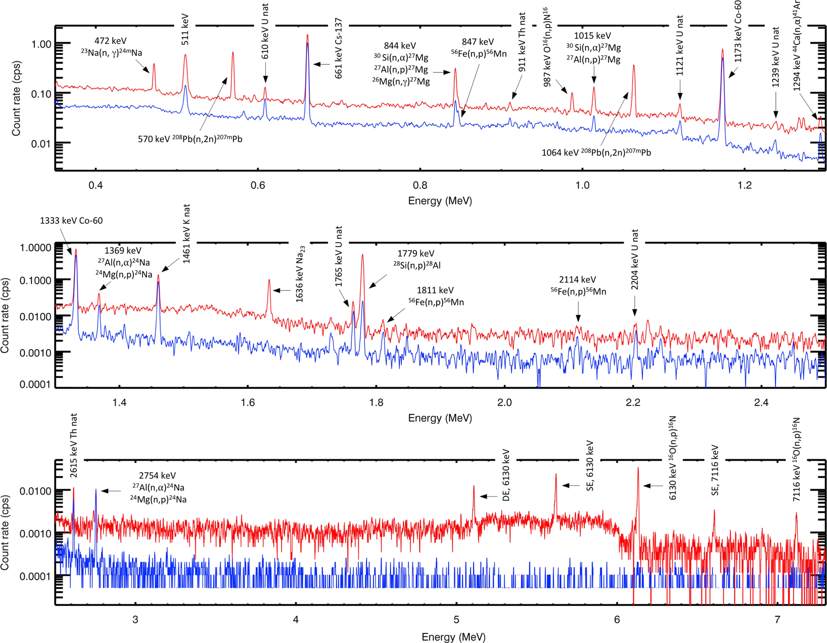
Nuclear Planetology
Litvak et al. (NIMA, 2016)
GCR interactions with planetary bodies
Secondary neutron generation
Gamma-ray producing neutron reactions
Capture reaction XS
Inelastic reaction XS
Induced activation reaction XS
Measured gamma ray spectrum from capture reactions and activation products during neutron pulses

Slide 14
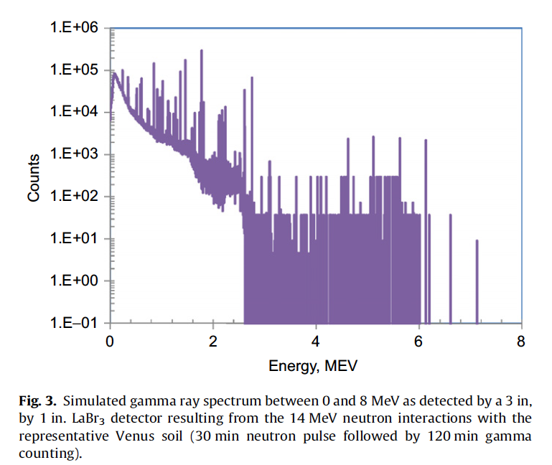
Nuclear Planetology
Jun et al., (NIMA, 2011)
GCR interactions with planetary bodies
Secondary neutron generation
Gamma-ray producing neutron reactions
Capture reaction XS
Inelastic reaction XS
Induced activation reaction XS
Gamma ray spectrum from activation products after neutron pulses
For the need for improving inelastic reaction cross sections -- See Talk by Patrick Peplowski on Wed.

Slide 15
Thank you.
Questions?

