Slide 1
Nuclear Data for High Energy Ion Interactions and Secondary Particle Production Applications: Semiconductors
Robert Reed
Vanderbilt University
Nashville, TN
Mar 1st, 2022
Support provided in part by NASA, DTRA, DoE, and others

Slide 2
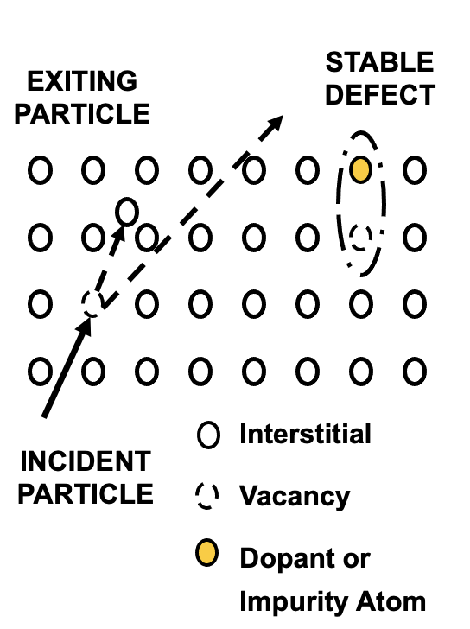
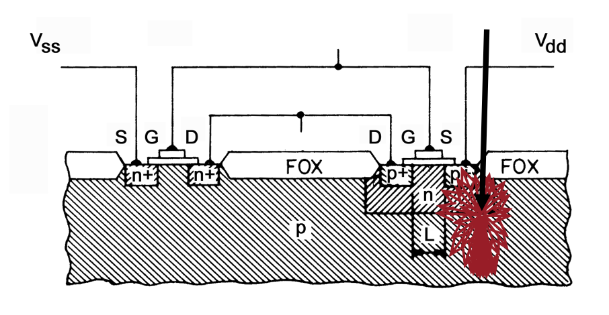
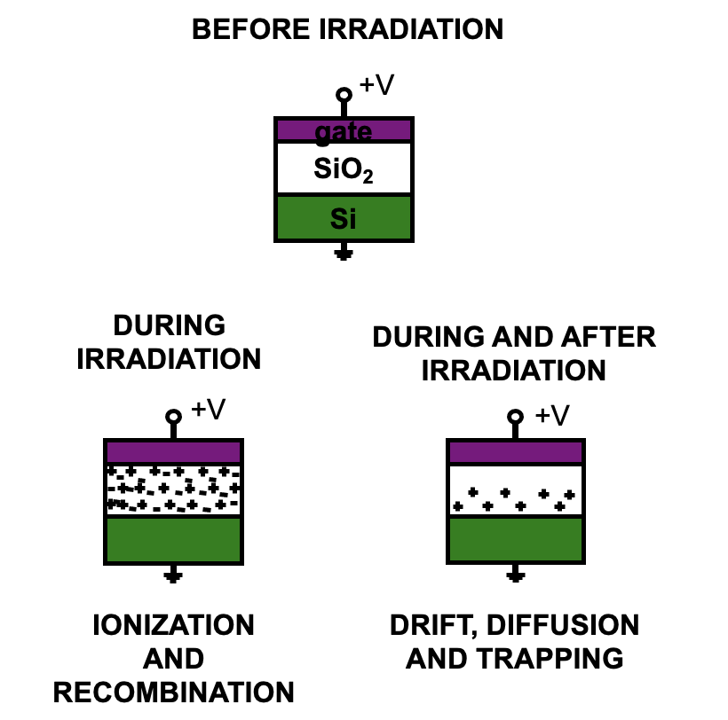
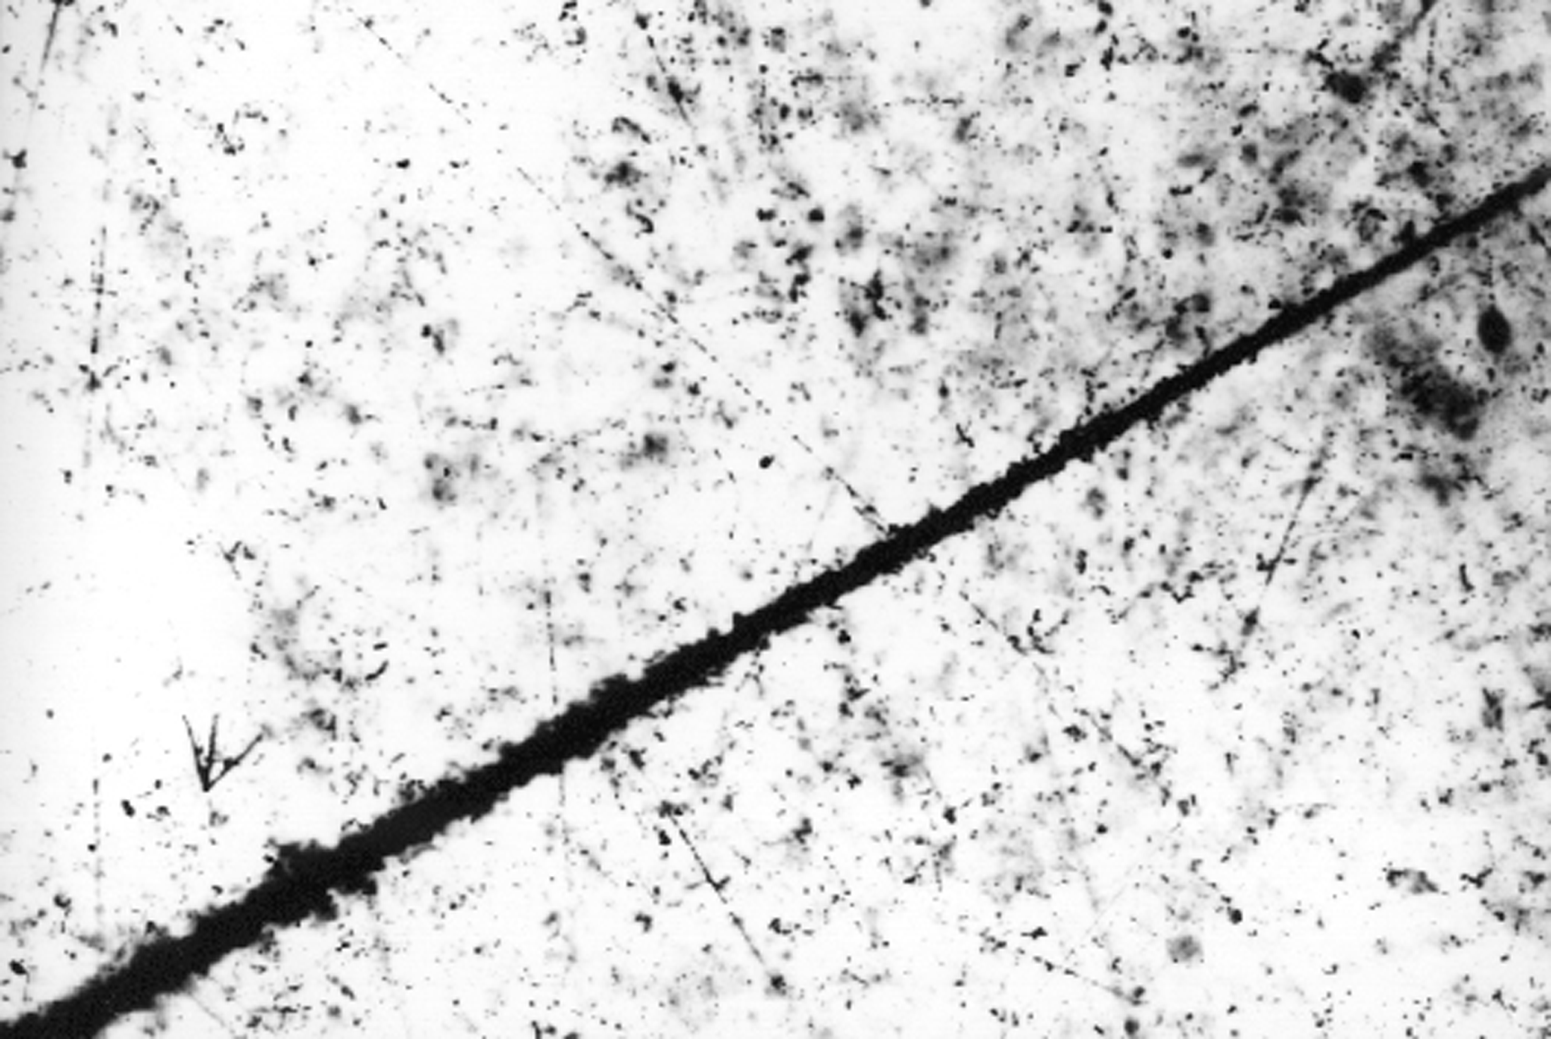
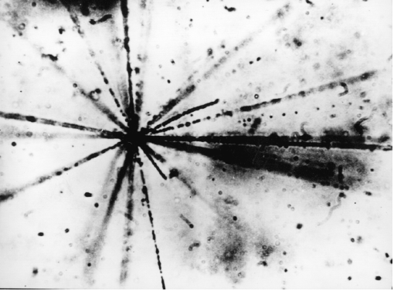
Basic Mechanism for Radiation-Induced Effects on Semiconductors
Displacement Damage (DD)
Single Event Effects (SEE)
Total Ionizing Dose (TID)
J.L. Leray, Notes from 1999 IEEE Nuclear and Space Radiation Effects Conference Short Course
P.W. Marshall and C.J. Marshall, Notes from 1999 IEEE Nuclear and Space Radiation Effects Conference Short Course
P.J McNulty, Notes from 1990 IEEE Nuclear and Space Radiation Effects Conference Short Course

Slide 3
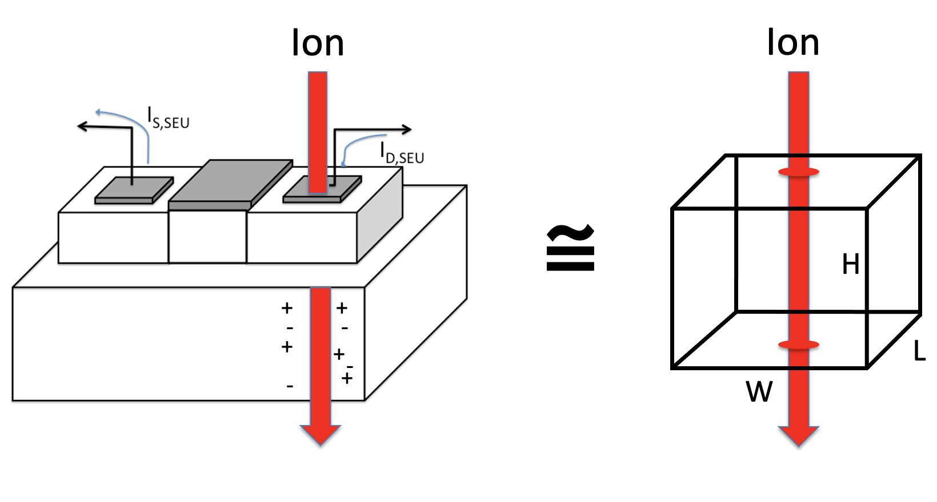
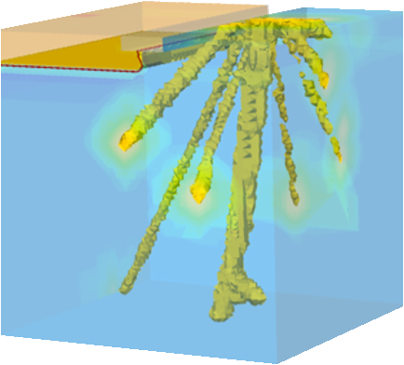
Radiation Transport Modeling for SEEs in Semiconductors Devices and Circuits
Range-energy tables:
Primary Ion
Trajectory
Requires Monte Carlo Modeling
Active
Silicon

Slide 4
Monte Carlo Method Using High Performance Computing

Slide 5
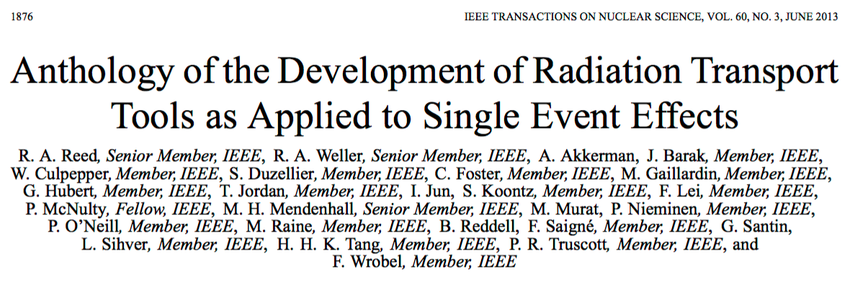
Monte Carlo Method Using High Performance Computing
Aix-Marseille University and CNRS, Marseille, France
CEA, Arpajon, France.
French Aerospace Laboratory (ONERA), Toulouse, France
STMicroelectronics, Crolles, France
Université Montpellier II, France
Soreq NRC, Israel
ESA-ESTEC, Noordwijk, The Netherlands
Chalmers University of Technology, Gothenburg, Sweden
Kallisto Consultancy Ltd., Guildford, United Kingdom
RadMod Research Ltd., Surrey, United Kingdom
Clemson University, Clemson, SC, USA
E.M.P. Consultants, Gaithersburg, MD, USA
IBM, Yorktown Heights, NY, USA
Jet Propulsion Laboratory Pasadena, CA, USA
NASA Johnson Space Center, Houston, TX, USA
Vanderbilt University, Nashville, TN, USA

Slide 6
VU Code: Monte Carlo Radiative Energy Deposition (MRED)
Integrates the physics processes associated with the Geant4 toolkit with Fortran codes:
CEM03 (protons) and LAQGSM, both nuclear physics codes
PENELOPE 2008, an electron transport code
MRED was designed and written by Robert A. Weller and Marcus H. Mendenhall
MRED development as an engineering tool was frozen 2015

Slide 7
Process Details – MRED
Kevin Warren, Ph.D. Dissertation, Vanderbilt, 2010

Slide 8
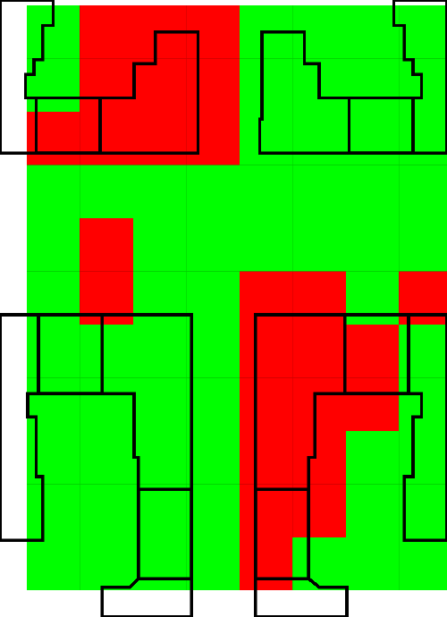
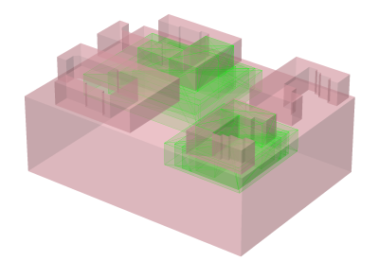
Defining Sensitive Volumes
TCAD Derived Locations
Simple Sensitive Volume not appropriate
Substrate
Sensitive
Volume(s)
Keven Warren, Ph.D. Dissertation, Vanderbilt, 2010

Slide 9
Results
Calibration with Heavy Ion
Prediction of Proton Response
Keven Warren, Ph.D. Dissertation, Vanderbilt, 2010

Slide 10
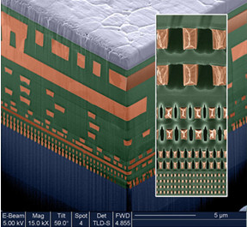
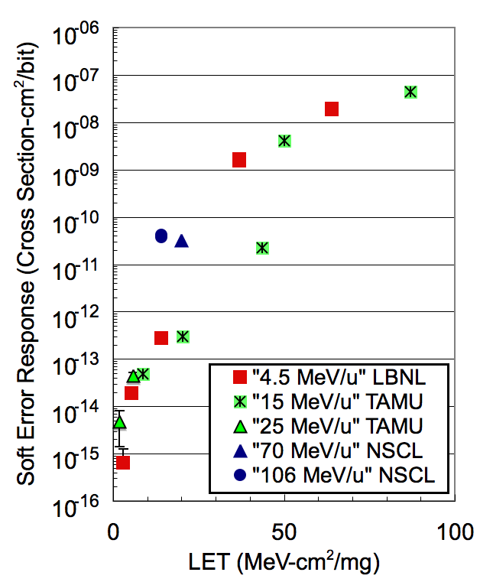
Complex Material Systems
Experimental evidence for this effect on a CMOS SRAM
http://images.dailytech.com/nimage/4621_21476.jpg
Ion-Ion nuclear reactions in non-silicon material near the sensitive volume contribute to the soft error response
To date, this is only important for radiation harden circuits
IEEE Trans. Nucl. Sci. : Warren et al. 2005, Dodd et al., 2007, Reed et al. 2007

Slide 11
Observed and Predicted SEU Rate for a RAD-HARD SRAM
SRAM used on NASA MESSENGER spacecraft
Observed Average SEU Rate:
1x10⁻⁹ Events/Bit/Day
Vendor predicted rate using CREME96:
2x10⁻¹² Events/Bit/Day
Classical Method nearly a factor 500 lower than observed rate
MRED-based predictions bound problem
Reed, IEEE Trans. Nucl. Sci., 2007

Slide 12
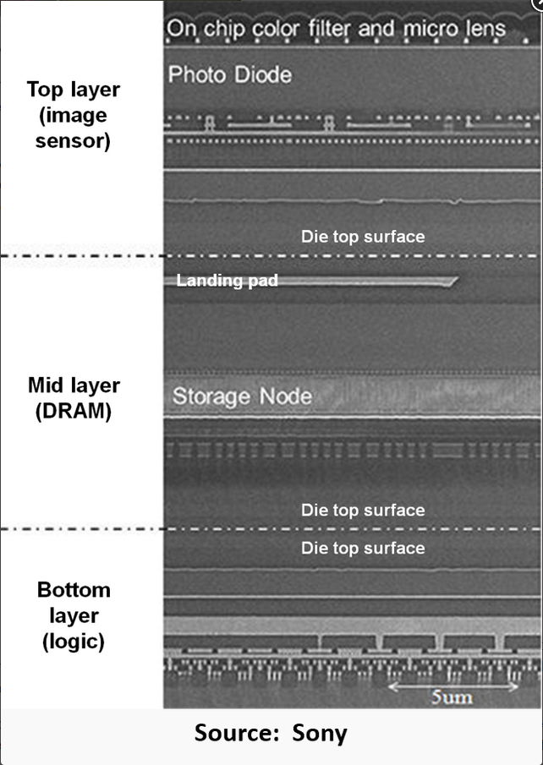
Gaps:
Complex systems
Nuclear Reactions
Is nuclear data sufficient to cover all relevant materials used in IC manufacturing?
Are models sufficient to capture reaction product distributions?
Species, angle, and energy
Fission products for certain materials not defined in models (see talk by Tom Turflinger 10:10 am on Mar 3rd)
High-Energy Heavy Ion Test Facility !!!
https://en.wikipedia.org/wiki/Demosaicing.
Often the gap in knowledge is associated with the microelectronic device response to an irradiation

