Slide 1

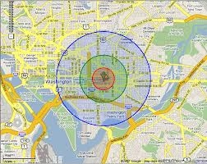
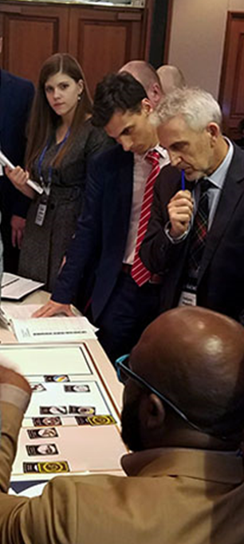

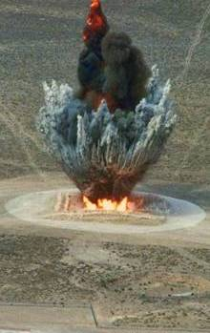
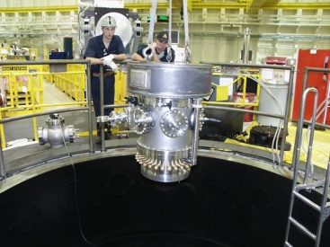
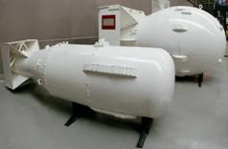
Nuclear Data role in Nuclear Forensics
UNCLASSIFIED
Timothy Ashenfelter, PhD
Sr. Program Manager, Office of Nuclear Forensics
28Feb 2022

Slide 2
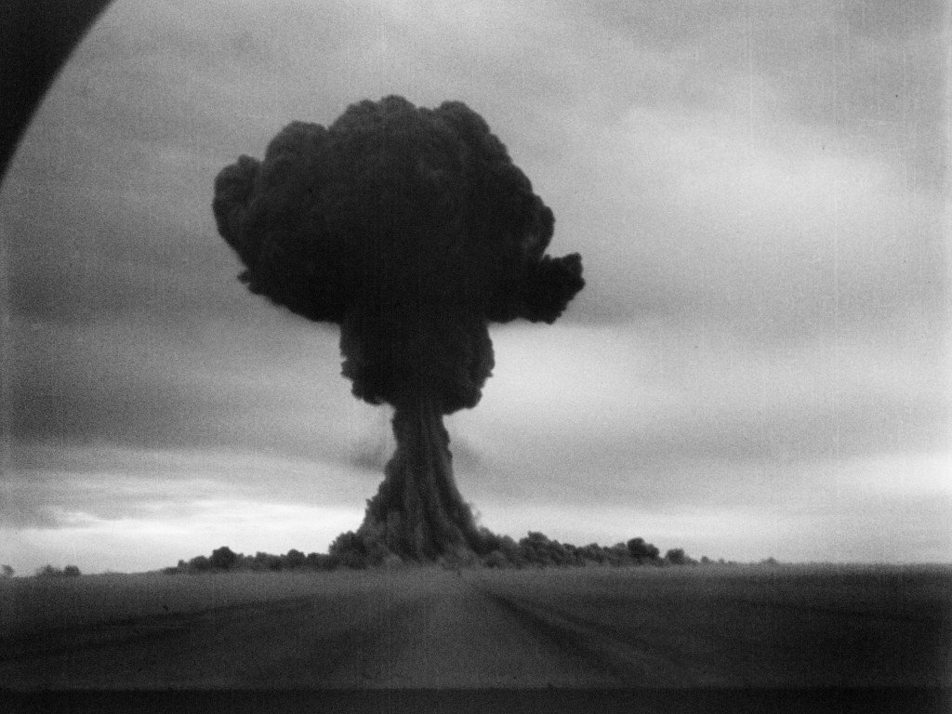
Origins of Nuclear Forensics Mission
UNCLASSIFIED
First soviet detonation (Joe-1) 29Aug 1949
flew air filters to confirm nuclear detonation
Initial capability built upon the test monitoring and treaty verification purposes
Nuclear Forensics was first formalized in early 1990s at the end of the cold war in response to increased nuclear material trafficking
Figure 1 referenced from https://www.sipri.org/publications/2014/eu-non-proliferation-papers/nuclear-trafficking-issues-black-sea-region
https://www-pub.iaea.org/MTCD/Publications/PDF/SupplementaryMaterials/P1706/Plenary_Session_1A.pdf
Referenced from https://nsarchive.gwu.edu/

Slide 3

Where are we Today?
UNCLASSIFIED
https://www.nf-itwg.org/newsletters/ITWG_Update_no_10.pdf
International cooperation to reduce risks/threats
  Builds upon Global Nuclear Detection Architecture
Interdisciplinary national capability at state-of-art laboratory facilities
  Rigorous & defensible processes
  Teamwork in physics, engineering, chemistry, and data science
Interagency coordination between Intelligence, lab, and Law enforcement

Slide 4
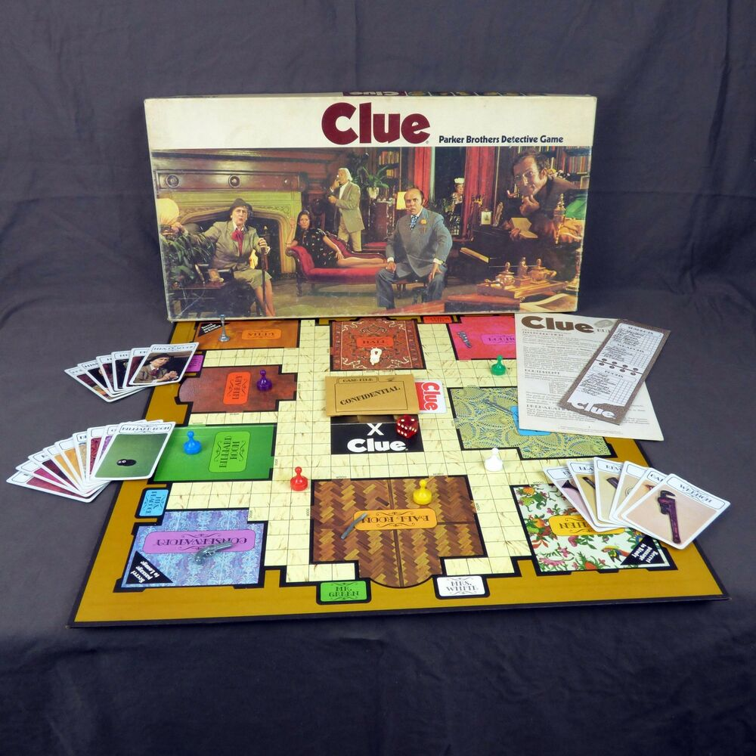
Primary Forensics Goals
UNCLASSIFIED
  Investigation to support prosecution
    Material is the sensor
    Where has this material been or how was it processed last?
    Nuclear material as the most unique and most specialized evidence
  Attribution to counter nuclear state support of terrorism
    Who designed this or who made this material?
    Supports intelligence from likely threat vectors
    Nuclear Data key link between material signature & source
  Deterrence of Nuclear capable states
    Includes “unattributed nuclear events”
    The Evolving Missions of Technical Nuclear Forensics by Tilden & Boyd (https://nationalinterest.org/feature/evolving-missions-technical-nuclear-forensics-189058)
    Capability supports nuclear accountability through willful or negligent proliferation
UNCLASSIFIED

Slide 5
Role of Nuclear Data Measurements
UNCLASSIFIED
Accuracy | How close a method measures ground truth and accounts for systematic effects
Precision | How consistent and repeatable it measures and accounts for statistical uncertainty
Timeliness | How quickly measurements, analyses, and actionable info is shared
Robustness | How broad is the range of scenarios, conditions, or material properties for a given method or signature
Discriminating Power | How well a signature distinguishes between different competing hypotheses to its history or provenance
Provides benchmark data
Criticality experiments simulate key processes
Reduce Uncertainty
Increase Discriminating Power of key isotopic Signatures
Exercise radiochemical and nondestructive techniques together

Slide 6
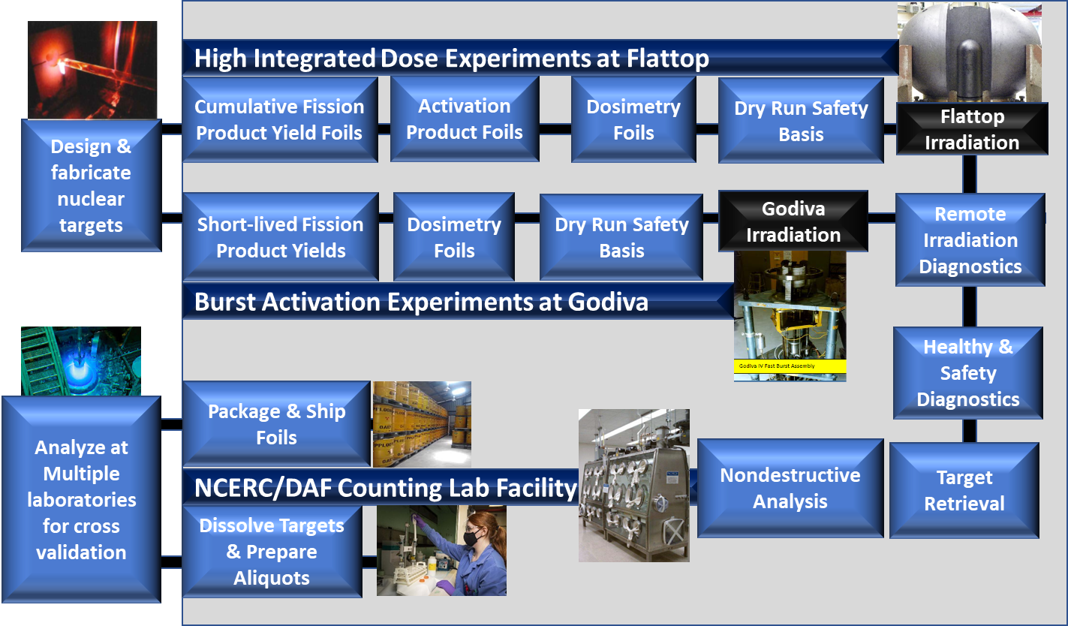
Example Nuclear Data Experiments
UNCLASSIFIED

Slide 7
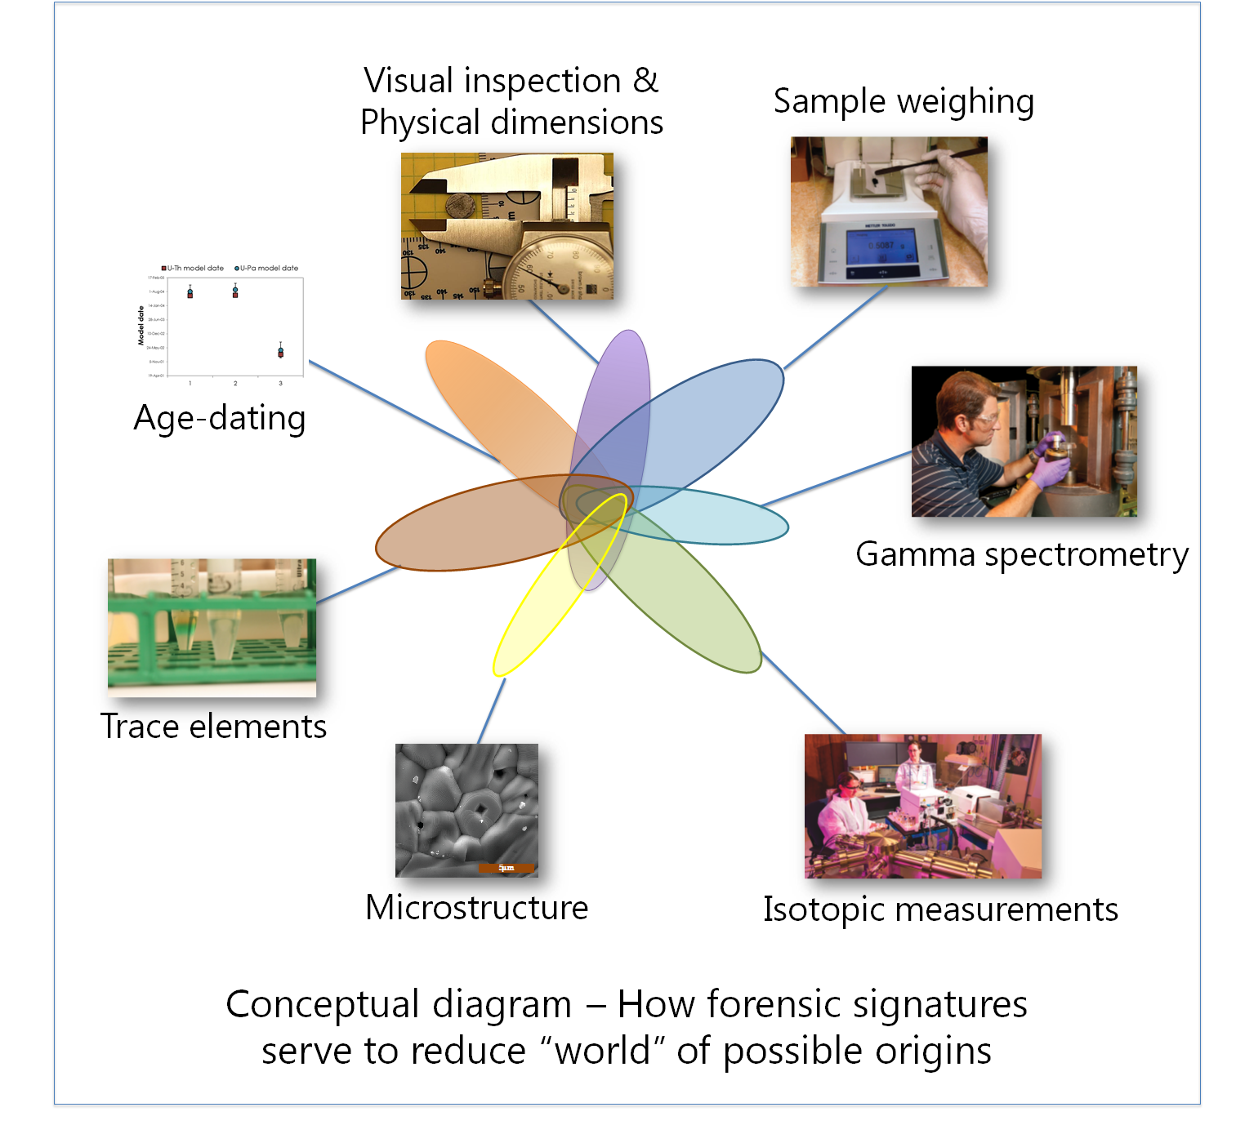
General nuclear data needs
Produce priority trace actinide targets
  photofission or other irradiation techniques to produce short-lived isotopes or mixed targets
  Development of isotopic spikes and reference materials
Advanced instrumentation to measure correlated emissions, improved timing response, and capture total fissions
Minimize uncertainties through contextual measurements
Benchmark nuclear data evaluation tools
Refine models of fuel cycle steps, device, or nuclear debris decay reactions
Emerging importance of atomic data
http://www.nuclear-forensics.org/technical-capabilities.php

Slide 8
Key takeaways
Interdisciplinary science of nuclear forensics maximizes information extraction following target irradiations
Reinforces value of radiochemistry and ensuing mass spec. measurements to complement gamma/beta/alpha analysis
Nuclear data central to intersection of models and measurements to discriminate competing hypotheses
Nuclear data gaps or high uncertainty can limit discriminating power
Thank you!

