Slide 1

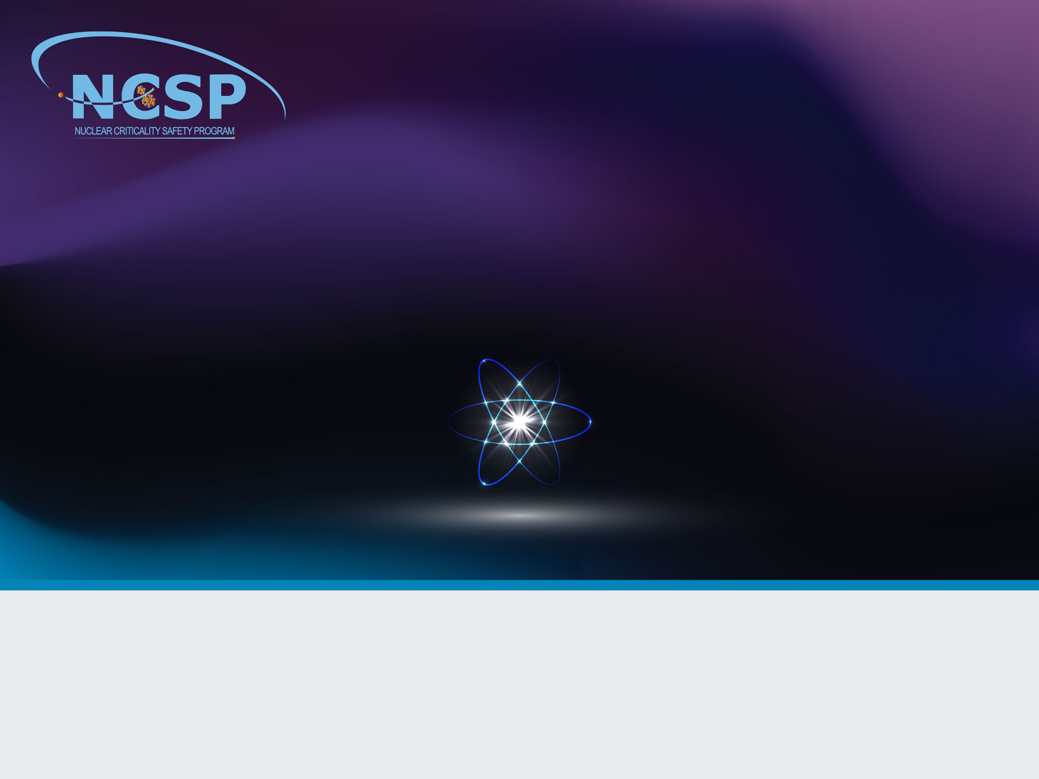
Overview of the NCSP Nuclear Data Program
WANDA-2022 Workshop
Presented by:
Douglas G. Bowen, Ph.D.
NCSP Execution Manager
Section Head, Nuclear Criticality, Radiation Transport, and Safety
Oak Ridge National Laboratory

Slide 2
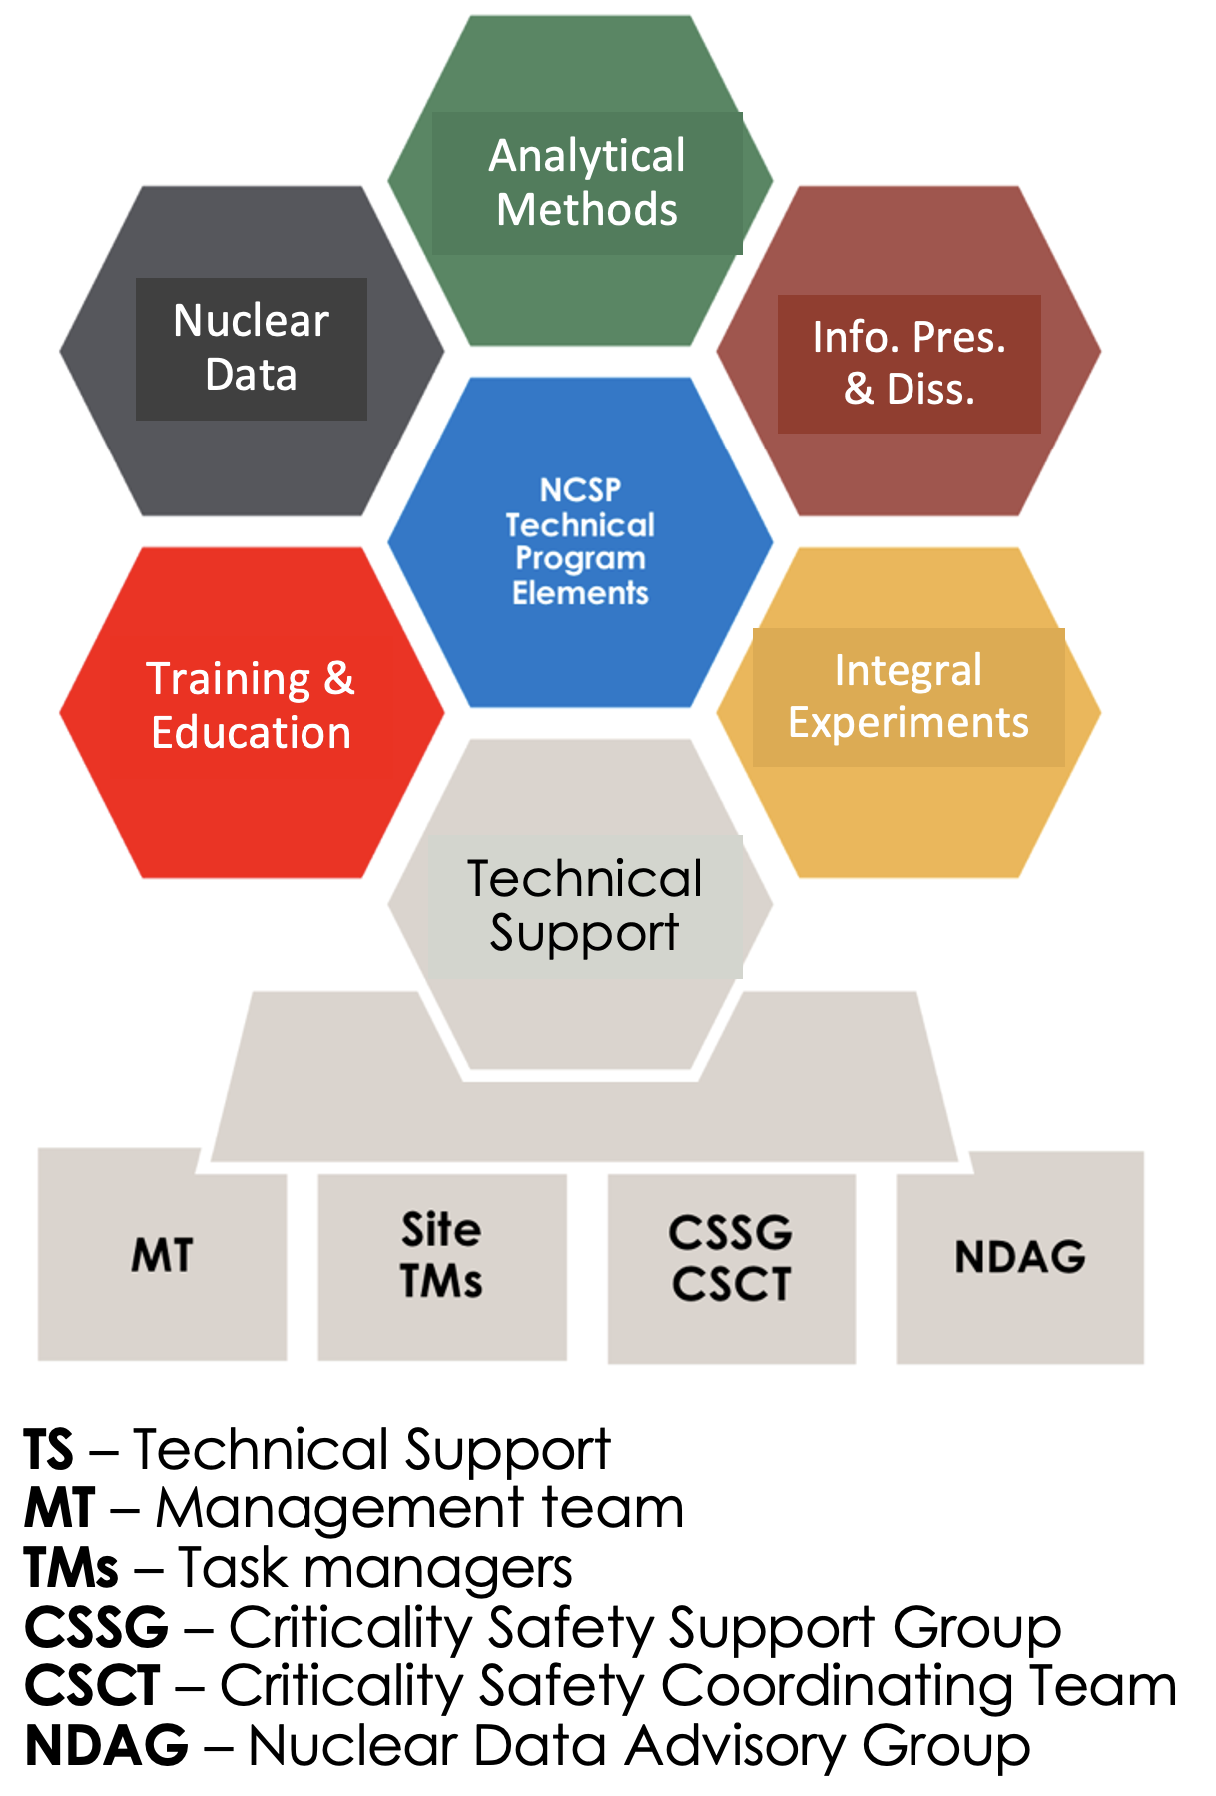
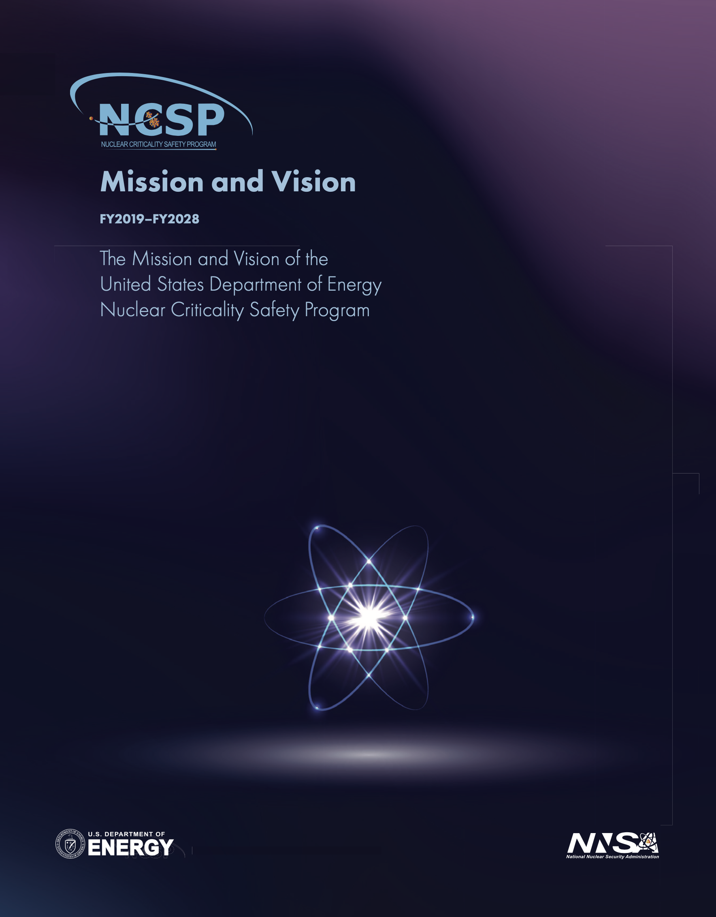
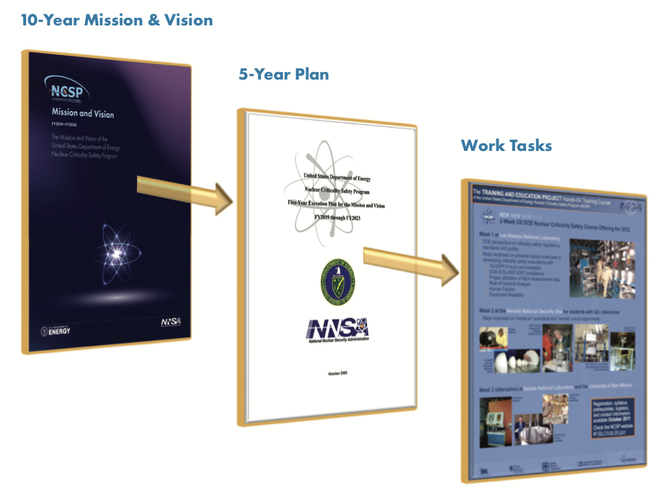

Background / History–Mission Vision–Organization
Early history
NCSP 5-year plan
NCSP organization
Defense Nuclear Facilities Safety Board (DNFSB) Recommendations:
  93-2 (3/23/1993): Need for a general-purpose critical experiment capability that will ensure safety in handling and storage of fissionable material.
  97-2 (5/19/1997): Need for improved criticality safety practices and programs to alleviate potential adverse impacts on safety and productivity of DOE operations.
DOE Implementation Plan for 93-2 and 97-2 recommendations resulted in establishment of the US NCSP
Mission
Provide sustainable expert leadership, direction and the technical infrastructure necessary to develop, maintain, and disseminate the essential technical tools, training, and data required to support safe, efficient fissionable material operations within DOE.
Vision
  Continually improving, adaptable, and transparent program that communicates and collaborates globally to incorporate technology, practices, and programs to be responsive to the essential technical needs of those responsible for developing, implementing, and maintaining nuclear criticality safety.

Slide 3
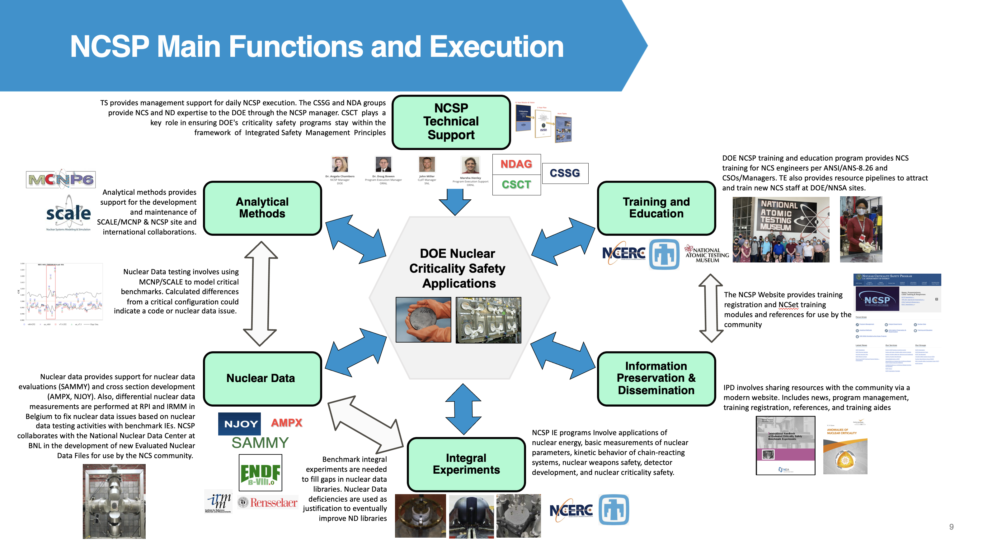

Slide 4




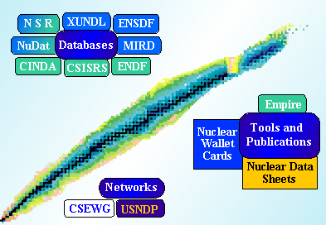
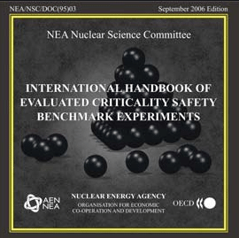
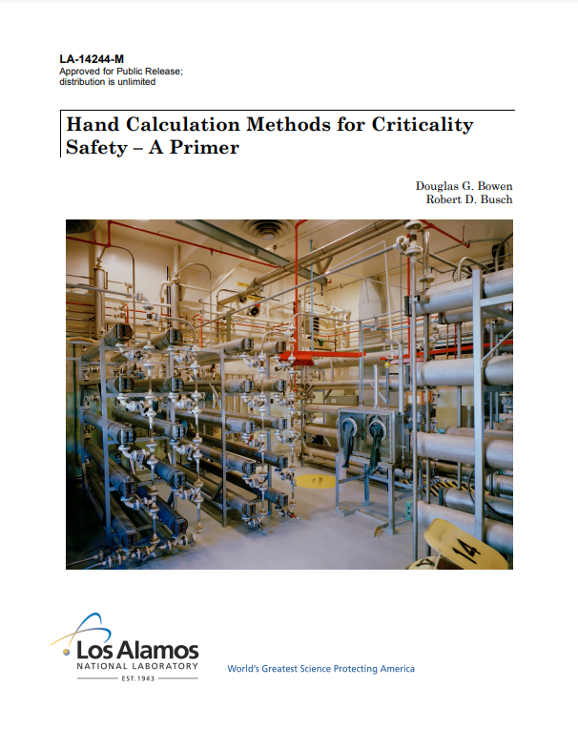
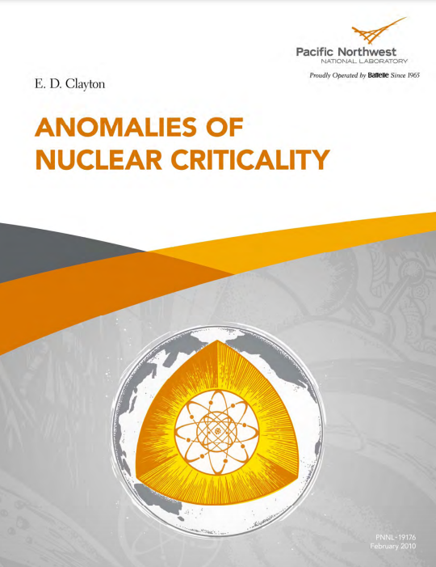
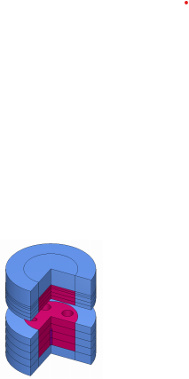

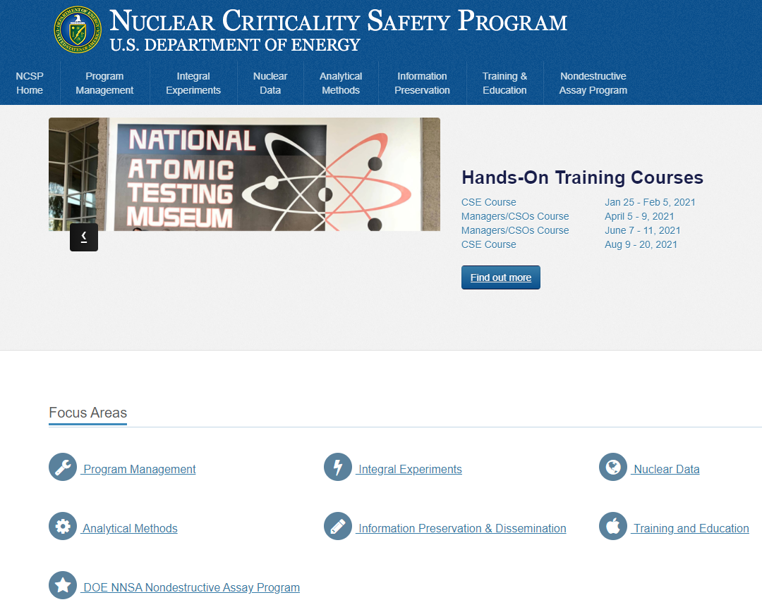
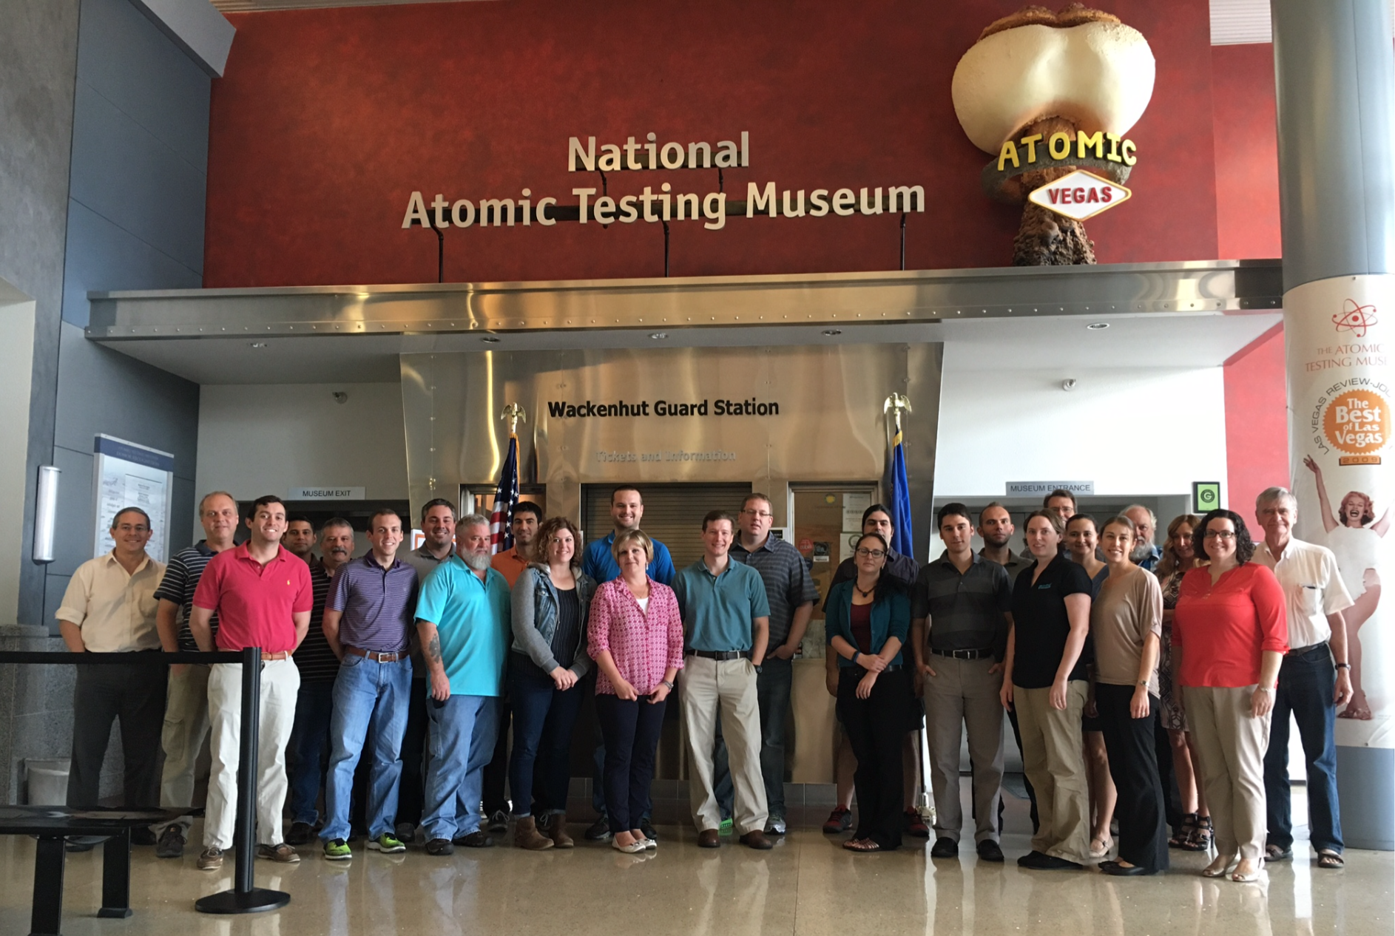
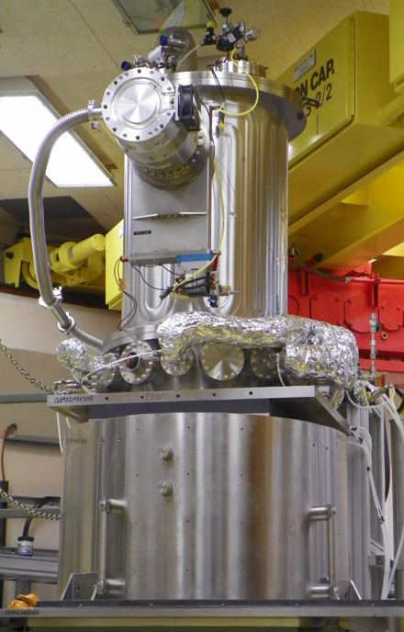
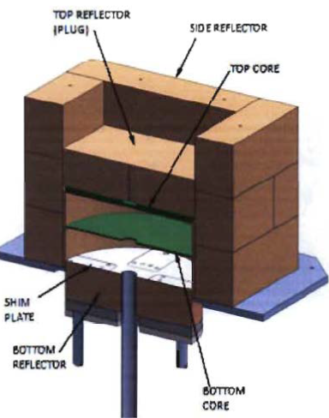
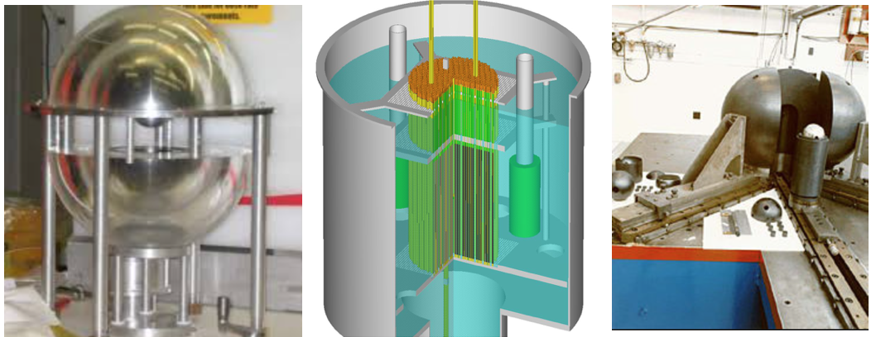

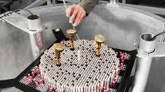
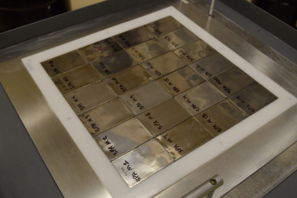

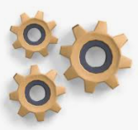
Technical Program Element Activities
AMPX
AM
ICSBEP
GELINA
NCS Handbooks & Reports
ND
IPD
SAMMY
NCSPGoals
NCSP Website
https://ncsp.llnl.gov
TE
IE
TS
Succession Planning
NDA
Program
Program Execution

Slide 5


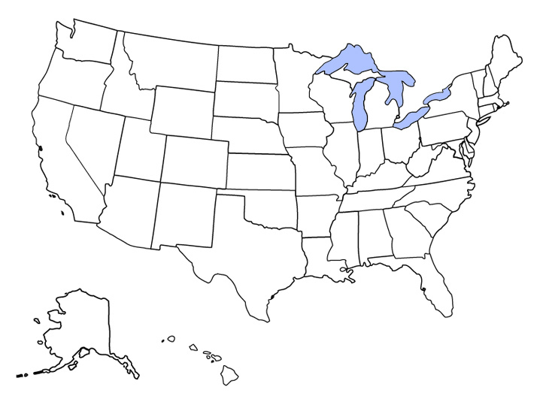






























Current NCSP Work Sites

Slide 6
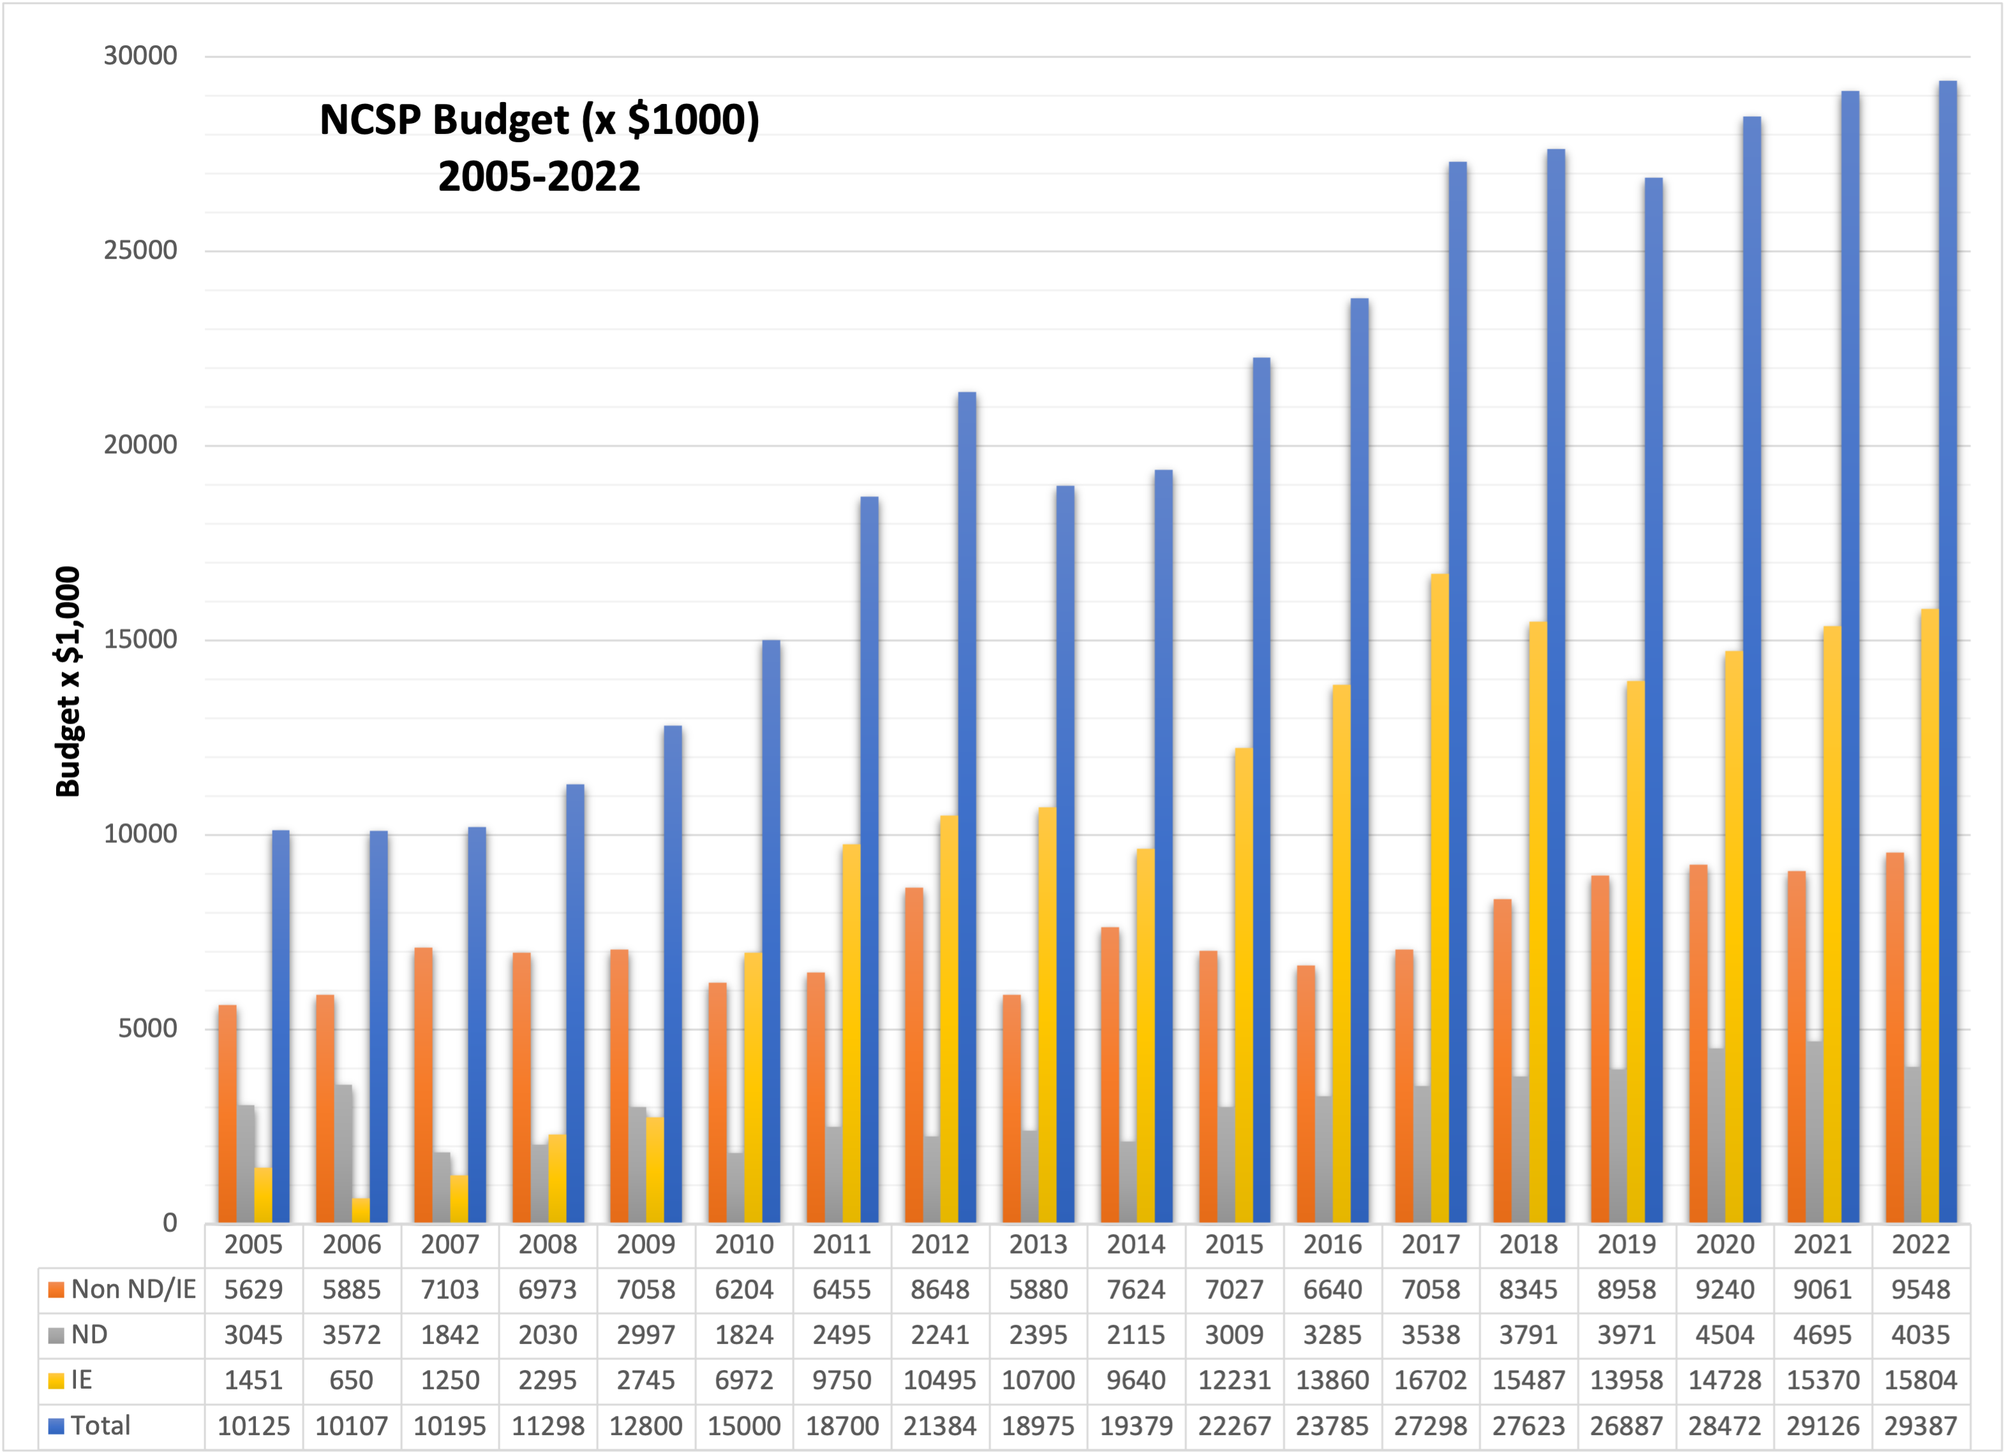
NCSP Nuclear Data and Integral Experiment Budget (>2005)

Slide 7
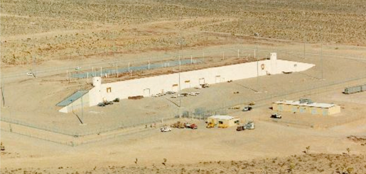
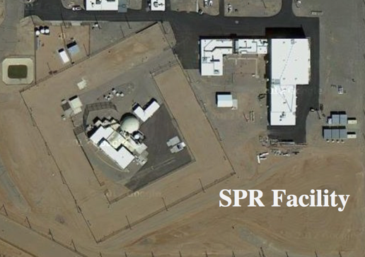
NCSP Integral Experiments
NCSP integral measurements are performed at
  Sandia National Laboratories (SNL) and
  National Criticality Experiments Research Center (NCERC), currently operated by Los Alamos National Laboratory
    NCERC is located at the Nevada National Security Site (NNSS) inside the Device Assembly Facility (DAF)
Types of experiments that can be performed
  Subcritical
    Rocky Flats shells, BeRP ball, Np-237 sphere, TACS shells, etc.
  Critical/Delayed Supercritical
    NCERC: Planet, Comet, Godiva IV, Flattop
    Sandia: Sandia Pulse Reactor critical assembly (2 fuel types, currently)
  Prompt Supercritical
    NCERC: Godiva IV (< 300 deg. C pulse)
DAF/NCERC
SNL/TA-V/SPR Facility
Delayed Critical Regime
k_{eff}=1+𝛽
k_{eff}
Subcritical Regime
Prompt Supercritical Regime
K_{eff}<1.0
k_{eff}=1

Slide 8
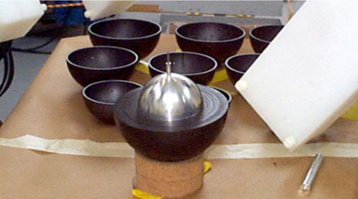
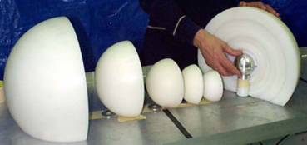
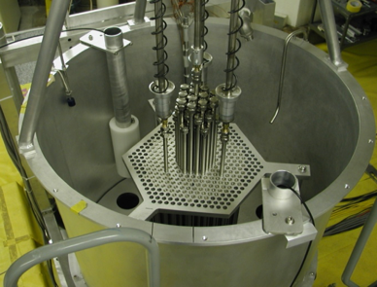
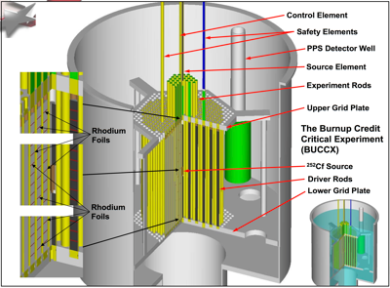
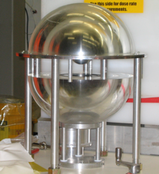
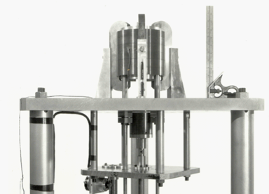
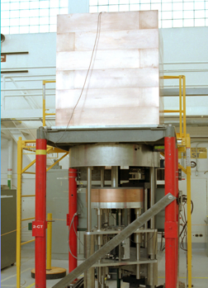
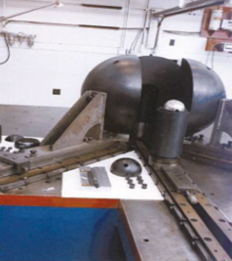
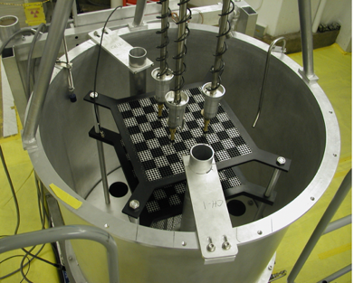
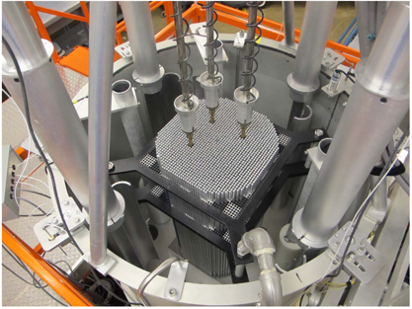
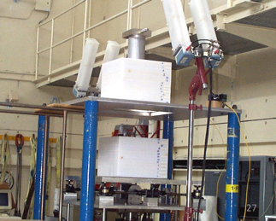
NCSP Critical Assemblies
Sandia National Laboratory
NCERC/DAF
SNL – BUCCX – U(4.31)/Fission Product Experiments
NCERC – Np-237 Sphere
NCERC – BeRP Ball
NCERC – TACS
NCERC – Godiva IV
NCERC – Flattop
SNL – 7uPCX – U(6.9) UO₂ rods
NCERC – Planet
NCERC – Comet

Slide 9

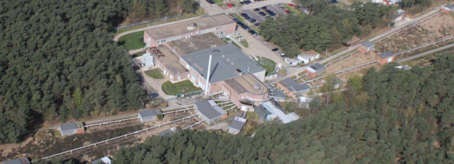

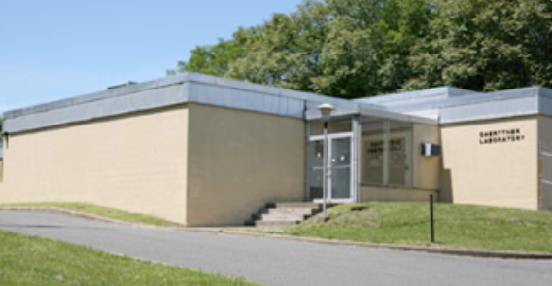
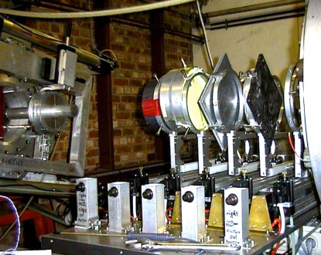
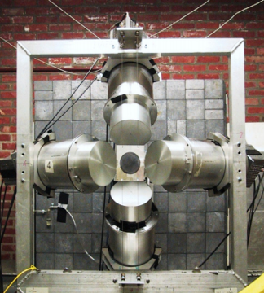
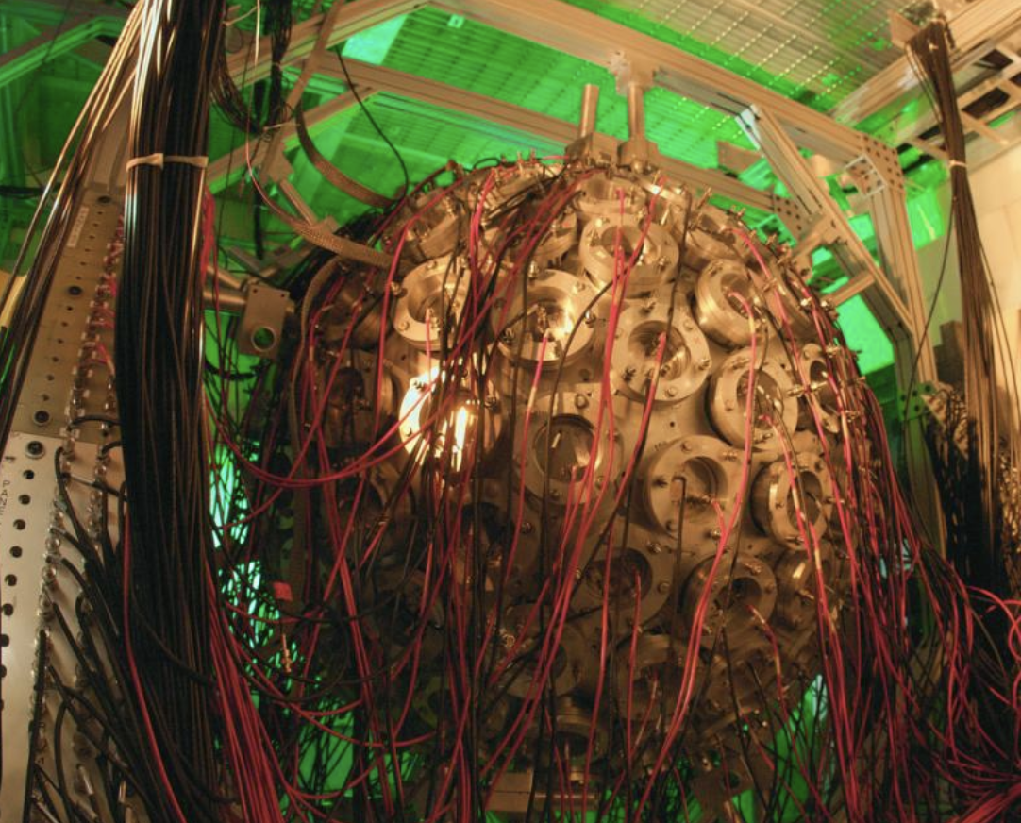

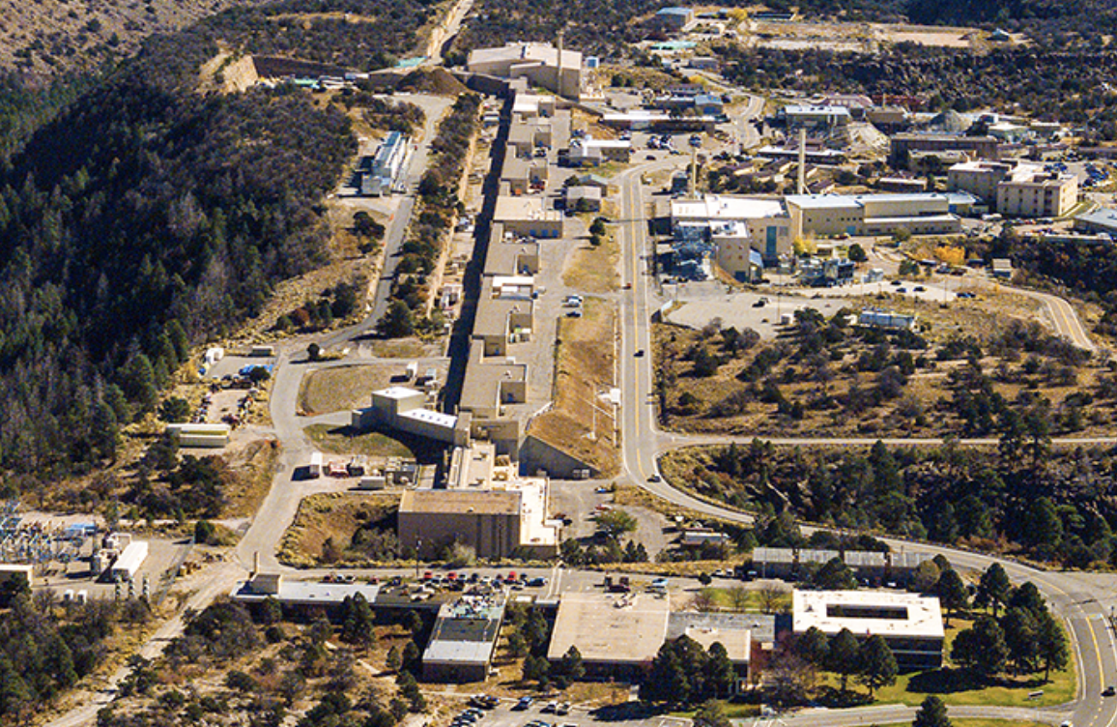
NCSP Differential Experiments
JRC-Geel (GELINA)
NCSP differential nuclear data measurements are performed at
  JRC-Geel GELINA Facility (Geel, Belgium)
  RPI LINAC (Troy, NY)
  LANL (Los Alamos, NM) LANSCE/Lujan Neutron Scattering Center
RPI LINAC
LANL LANSCE
GELINA
GELINA
LANL - DANCE
Photos referenced from:
https://ec.europa.eu/jrc/en/research-facility/linear-electron-accelerator-facility
http://www.linac.rpi.edu/public_html/accelerator.html

Slide 10
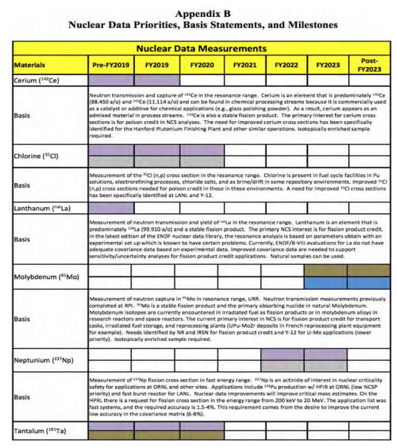
Nuclear Data Measurements &
Evaluation Work for NCSP
Objective: Provide measured and evaluated thermal, resonance, unresolved resonance, and fast region cross section data to address the priority NCSP nuclear data needs
Vision: Addresses multiple Nuclear Data 5- and 10-year goals and attributes identified in the NCSP Vision
Final product: Rigorous ENDF/B evaluations produced from cross section measurements and analyses.
Measurement work effort focused on NCSP priorities by NCSP Nuclear Data Advisory Group (NDAG)
NCSP 5-year plan provides a listing of Nuclear Data measurement and evaluation priorities for the program
DOWNLOAD: https://ncsp.llnl.gov/sites/ncsp/files/2021-10/fy22-26_ncsp_five-year_execution_plan.pdf

Slide 11
NCSP Evaluation Priorities – FY22 NCSP 5-Year Plan
(Appendix . B)
Be-9 |  | HF |  | Polystyrene |  | U-233
LANL |  | LLNL/NCSU |  | LLNL/NCSU |  | IRSN
Beryllium Carbide |  | Hf-176, Hf-177, Hf-178, Hf-179, Hf-180 |  | Pu-238, Pu-240, Pu-241, Pu-242 |  | LANL
LLNL/NCSU |  | ORNL |  | LANL |  | ORNL
Beryllium Hydride |  | La |  | Pu-239 |  | U-234
LLNL/NCSU |  | ORNL |  | IRSN |  | LANL
CaH2 |  | Li-6 |  | LANL |  | U-235
LLNL/NCSU |  | LANL |  | ORNL |  | LANL
Ce |  | Lithium-7 Deuteride |  | Pu-240 |  | U-236
ORNL |  | LLNL/NCSU |  | LANL |  | LANL
Cu-63, Cu-65 |  | Lithium-7 Hydride |  | Reactor Grade Graphite (20% Porosity) |  | U-238
LANL |  | LLNL/NCSU |  | LLNL/NCSU |  | BNL
ORNL |  | N-14 |  | Rh-103 |  | LANL
Fe-54, Fe-56, Fe-57 |  | ORNL |  | IRSN |  | Uranium metal
BNL |  | O-16 |  | NNL |  | LLNL/NCSU
IRSN |  | LANL |  | ORNL |  | V-51
ORNL |  | Paraffin |  | Sr-88 |  | ORNL
Fe-56 |  | LLNL/NCSU |  | ORNL |  | Zirconium Hydride
BNL |  | Pb-204, Pb-206, Pb-207, Pb-208 |  | Ta |  | LLNL/NCSU
IRSN |  | BNL |  | LANL |  | Zr-90, Zr-91, Zr-92, Zr-94, Zr-96
ORNL |  | IRSN |  | NNL |  | BNL
H2O |  | NNL |  | ORNL
LLNL/NCSU |  | ORNL
 |  | RPI

Slide 12
NCSP Evaluation Priorities – FY22 NCSP 5-Year Plan
(Appendix B)
Fe-54 |  | Pu-240
IRSN |  | LANL
RPI |  | LLNL
Mo-95 |  | U-233
IRSN |  | LANL
LANL |  | V-51
NNL |  | ORNL
RPI |  | Zr-90, Zr-91, Zr-92, Zr-94, Zr-96
Polystyrene |  | ORNL
ORNL |  | Polyethylene
RPI |  | RPI
Pu-239 |  | Yttrium Hydride
IRSN |  | RPI
LANL

Slide 13
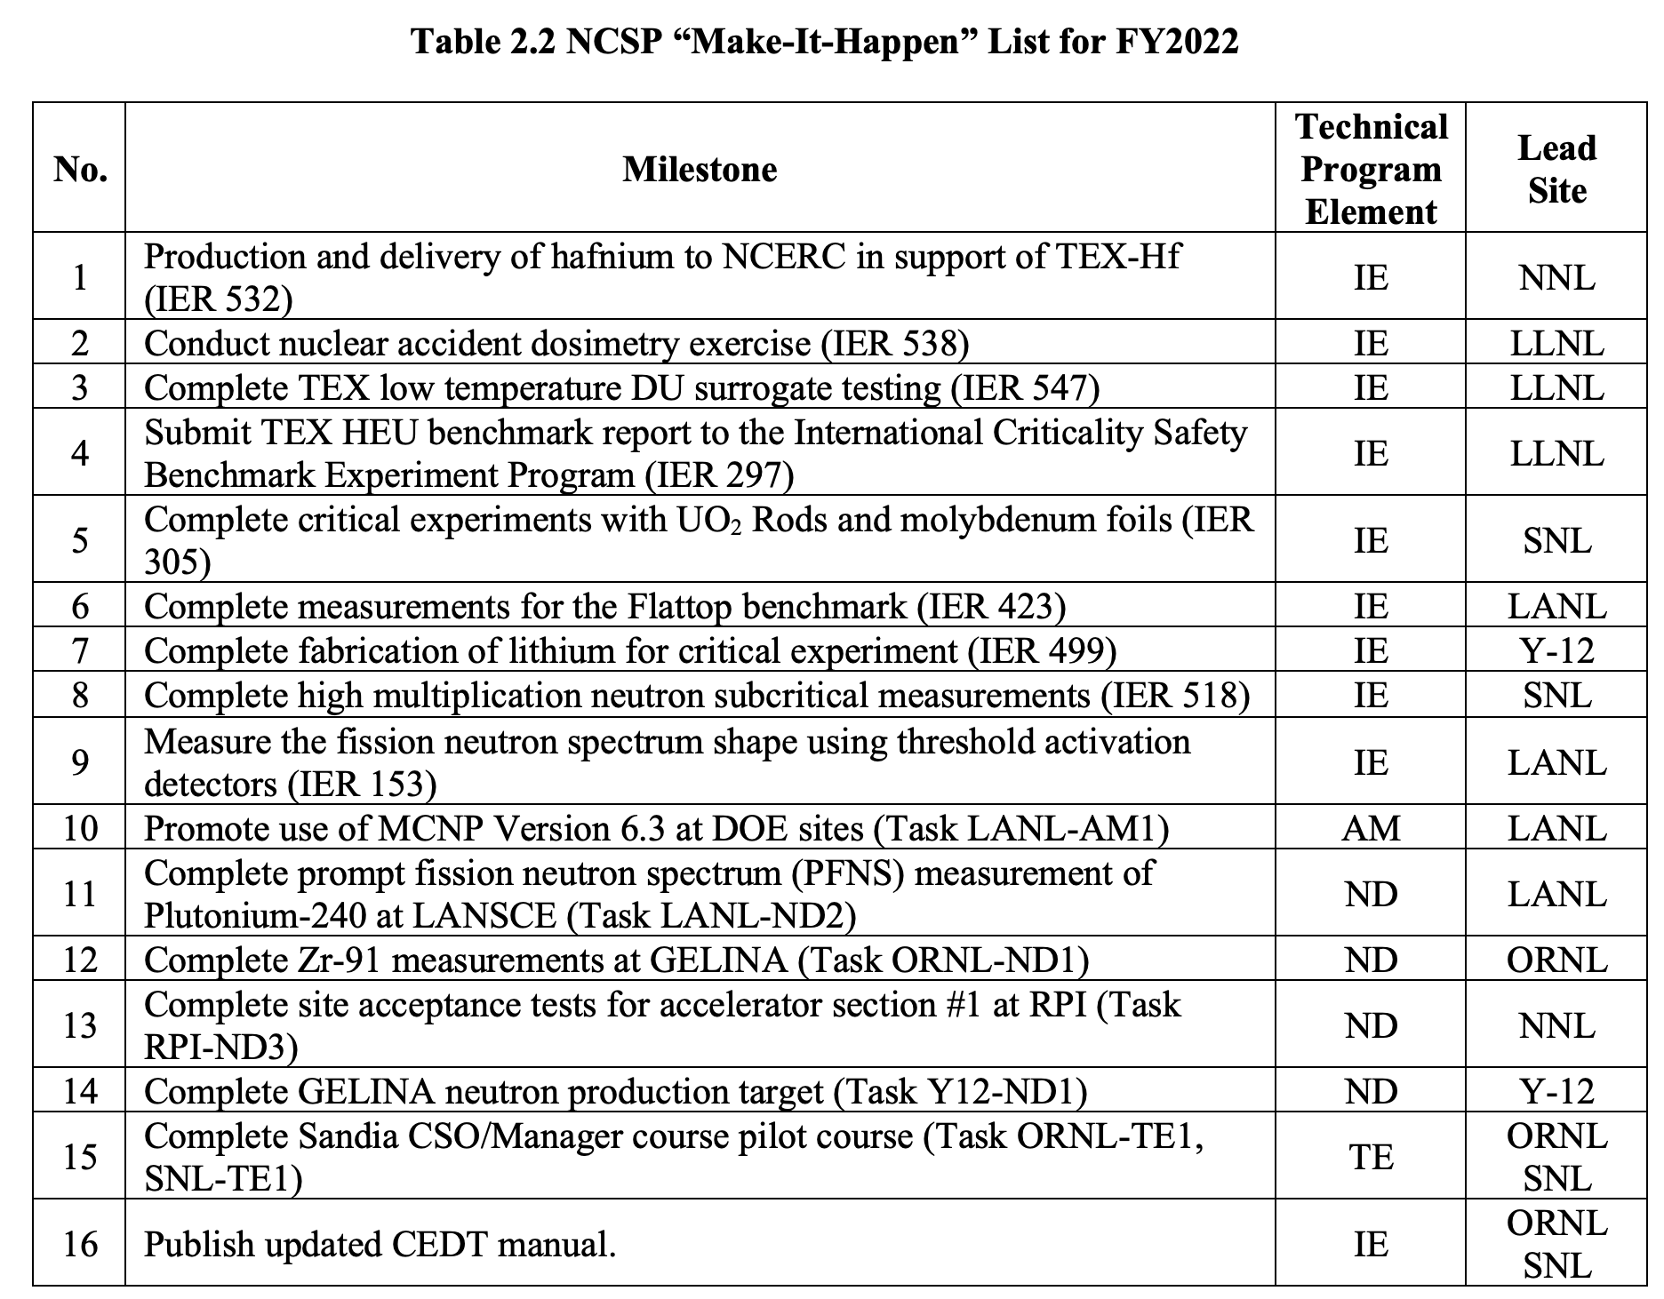
NCSP ”Make It Happen List”

Slide 14
NCSP ”Make It Happen List”

Slide 15
NCSP Cross-Cutting Nuclear Data Work
NCSP Nuclear Data work items support many different programs
  Improvements to U-235, U-238, and Pu-239 are cross-cutting for virtually all programs
  U-233, Pu-240, Np-237 of interest to NNSA (NA-10 & NA-20), DOE-NE, NCSP international collaborators, and the NRC
  Pb and Fe are cross cutting for virtually all programs
  Cl-35 cross cutting for NNSA NA-10 (electrorefining, Pu aqueous chloride processing) and DOE-NE/NRC (molten chloride salt reactors) where there a significant uncertainties associated with the (n,p) reaction. Needs for repository situations (DOE-EM/WIPP)
  Zr & Hf of interest to NNSA NA-30 (NR)
  Ta cross cutting with NNSA NA-10 for pit production
  HF Thermal Scattering Law work cross cutting with NNSA (NA-10, NA-20), DOE-NE, NRC and being done to resolve a historical discrepancies impacting NCS for facility processing with UF6
Notes:
Slide 6, this is probably where you want to discuss cross-cutting nuclear data work. A clarification on the slide, the Cl-35 measurement is for the (n,p) reaction not (n,gamma).
The cross cutting ND work I would suggest mentioning is as follows:
Any improvement to U-235, U-238, Pu-239 are cross cutting for virtually all programs.
U-233, Pu-240, Np-237 of interest to NA10, NA20, NE, NRC
Pb and Fe are cross cutting for virtually all programs
Cl-35 cross cutting for NA10 (electrorefining) and NE/NRC (molten chloride salt reactors) where there a significant uncertainties associated with the (n,p) reaction.
Zr & Hf of interest to NR
Ta cross cutting with NA10 for pit production
HF TSL cross cutting with NA10, NA20, NE, NRC and being done to resolve a historical discrepancy impacting NCS for facility processing UF6

Slide 16
NCSP Benefits/Successes
NCSP support of each major ENDF/B library release supports reduced bias in eigenvalue (k_{eff}) computations to support nuclear criticality safety limit development
NCSP Integral experiments at NCERC and Sandia are funded by the NCSP to ”keep the doors open” and to provide new critical benchmarks for NCS purposes
  NCSP 5-year plan defines the experiments funded for the year
  The NCERC also supports work for a variety of programs and organizations
NCSP performs differential measurements at RPI, LANL (LANSCE), and GELINA (Geel, Belgium)
  GELINA is available via collaboration between DOE/NNSA NA-20 and Euratom (JRC-Geel)
  Y-12 recently completed a DU neutron depletion target for NCSP use
NCSP funds all aspects of the nuclear data pipeline to support the NCS community
  Supporting process operations with hands-on operations with fissionable material
NCSP supports university proposals for our human resource pipeline – many success stories here
Notes:
Slide 6, this is probably where you want to discuss cross-cutting nuclear data work. A clarification on the slide, the Cl-35 measurement is for the (n,p) reaction not (n,gamma).
The cross cutting ND work I would suggest mentioning is as follows:
Any improvement to U-235, U-238, Pu-239 are cross cutting for virtually all programs.
U-233, Pu-240, Np-237 of interest to NA10, NA20, NE, NRC
Pb and Fe are cross cutting for virtually all programs
Cl-35 cross cutting for NA10 (electrorefining) and NE/NRC (molten chloride salt reactors) where there a significant uncertainties associated with the (n,p) reaction.
Zr & Hf of interest to NR
Ta cross cutting with NA10 for pit production
HF TSL cross cutting with NA10, NA20, NE, NRC and being done to resolve a historical discrepancy impacting NCS for facility processing UF6

Slide 17
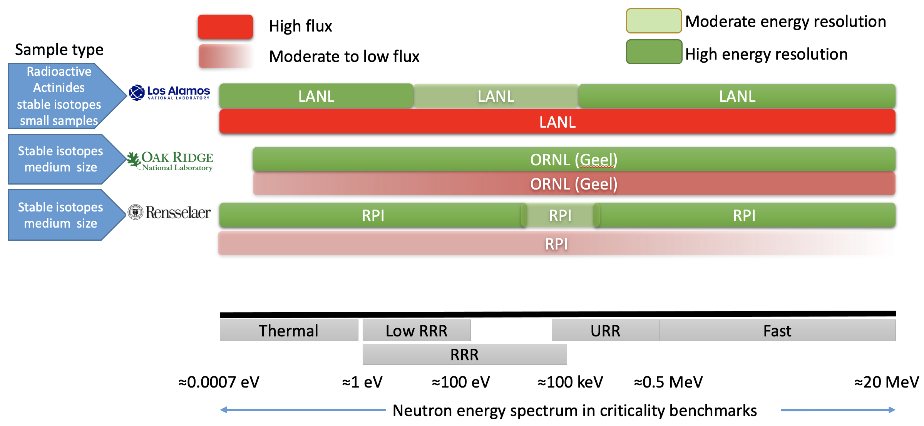
Current NCSP capabilities for (n,γ), (n,tot) and (n,f) measurements

Slide 18
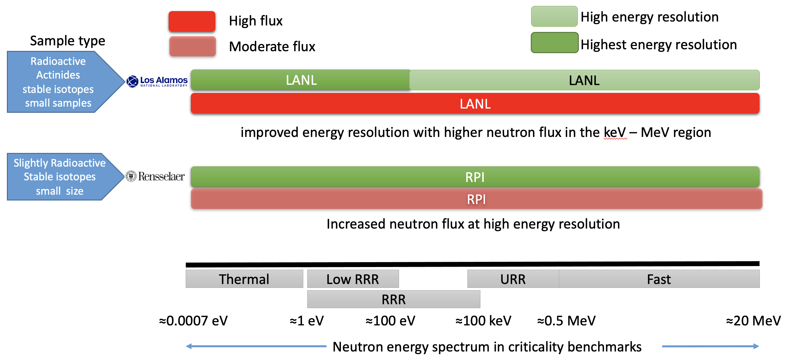
Future NCSP capabilities for (n,γ), (n,tot) and (n,f) measurements

Slide 19

Questions

