Slide 1

Perspectives from DOE Nuclear Physics
WANDA Meeting
March 1, 2022

Slide 2
Good Morning WANDA 2022 !

Slide 3
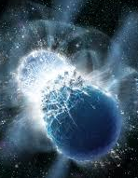
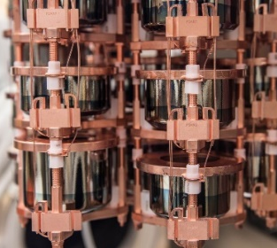
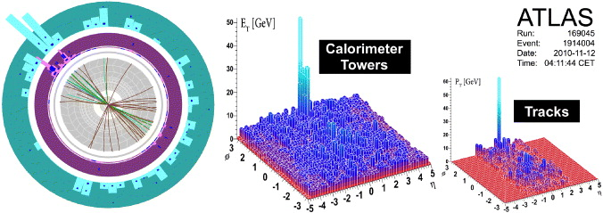
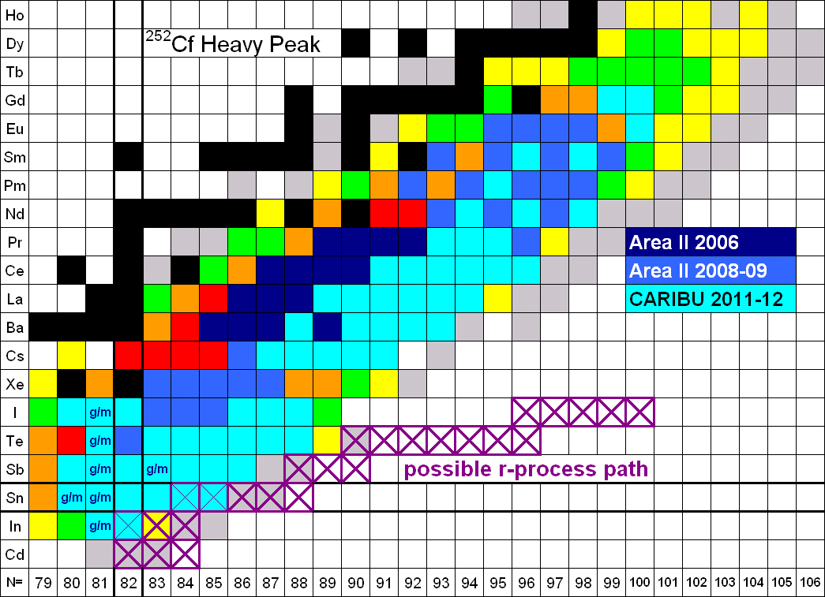
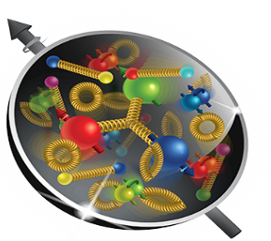
Nuclear Physics
Discovering, exploring, and understanding all forms of nuclear matter
      Understanding why matter takes on the specific forms observed in nature and how that knowledge can benefit energy, commerce, medicine, and national security, by discovering:
  How mass is created from energy in the interior of the proton using the future Electron-Ion Collider?
  What are the properties of the novel quark-gluon plasma discovered at RHIC?
  What is the mechanism underlying the confinement of quarks and gluons via CEBAF and RHIC?
  The search for new exotic particles and anomalous violations of nature’s symmetries at CEBAF
  The limits of nuclear existence? How are heavy elements made in the cosmos via FRIB and ATLAS?
  Is the neutrino its own anti-particle? Do the neutron’s precise properties point to new physics?
  The nature of the strong force in many-body systems via SciDAC?
  Advanced Nuclear Data for Space, Energy, and Research (ANDSER).

Slide 4
Summary of 2022 President’s Request Changes Relative to FY 2021 Enacted
FY 2021 Enacted | FY 2022 President’s Request
Core Research reduced 3.75% from FY20 Enacted (including COL, this is a 5.6% cut from constant effort in FY20). New ECA awards are made. | Core research in Medium Energy, Heavy Ions, and Theory is increased by 12% from FY21 Enacted. (After accounting for COL, this represents a ~10% increase over FY21 Enacted,.) The Fundamental Symmetries and Nuclear Structure and Nuclear Astrophysics portfolios are increased by 15% over FY21 Enacted.
LHC M&O commitments are met. | LHC M&O commitments are met.
FRIB Research flat with FY2020 and below the planned level. | FRIB Research is increased, but still below the planned level.
nEDM supported below planned profile. | nEDM supported significantly below planned profile, possibly impacting schedule.
SciDAC commitment are met. | SciDAC funding is increased to support SciDAC-5 (+$600k).
Nuclear Data slightly increased over FY20 Enacted. | Nuclear Data increased $3.5M from FY21 Enacted to support the expansion of experimental efforts.
Accelerator R&D subject to the 3.75% research reduction. | Accelerator R&D increased ~$1M over FY21 Enacted level.
QIS at $9.5M. | QIS increased to $10.5M.
NP ML/AI Initiative begins with $4M. | AI/ML Initiative support flat with FY21 Enacted ($4M).

Slide 5
General Outlook
The budget uncertainty continues.
We need to stay focused and continue to deliver important outcomes for the nation.
Delivering exciting discoveries, important scientific knowledge, technological advances, and workforce training is what we do.
We need to keep up the good work!

Slide 6
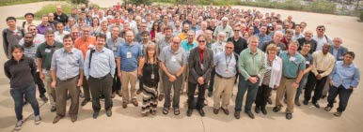
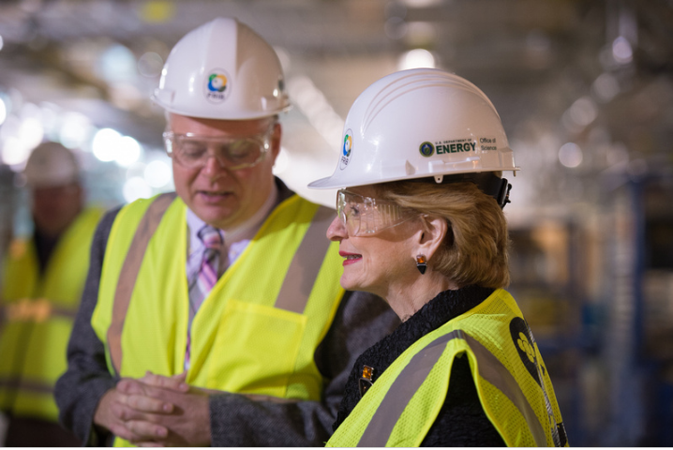
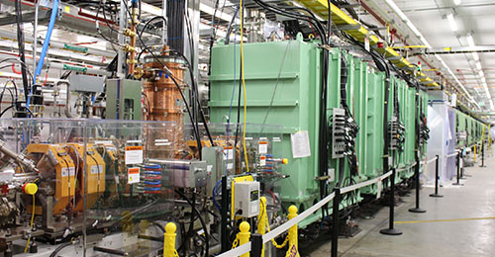
The Fourth, Newest Microscope: Facility for Rare Isotope Beams (FRIB)
FRIB issued a call for proposals to its 1500 member user group.
82 proposals received from 130 institutions in 30 countries requesting 9,784 hours of beam time
FRIB Program Advisory Committee Meeting held in May 2021.
First science in
spring of 2022
RHIC
FRIB
World Leadership in Nuclear Structure & Nuclear Astrophysics Research

Slide 7
Observation
FRIB (and other projects) will provide a torrent of important new, nuclear data
FRIB provides a fertile ground for testing innovative ideas and trying out new models for improved data capture and creation (AI, embedded ND staff, Comprehensive Data Capture, etc.)

Slide 8
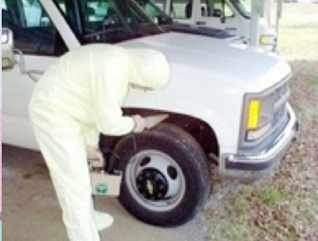
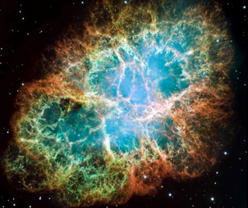
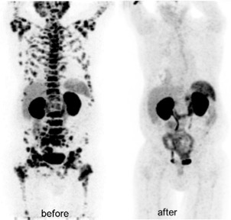
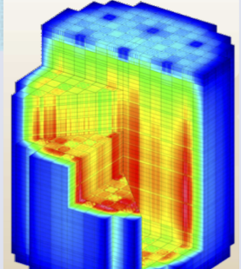
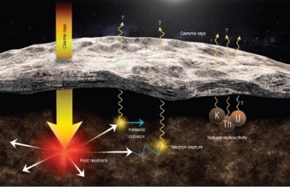
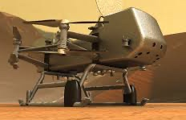
Many types of nuclear data are “crosscutting” to numerous applications
New & Traditional Frontiers Requiring Accurate Nuclear Data
Nonproliferation
Astrophysics
Materials Damage
Nuclear Data
Medicine
Energy
Elemental ID in Space Exploration
Gamma-rays
Cosmic rays
Fast neutrons
Natural
Radioactivity
Nuclear Data Interagency Working Group (NDIAWG) has published 4 FOAs
Notes:
Replace figures as appropriate

Slide 9

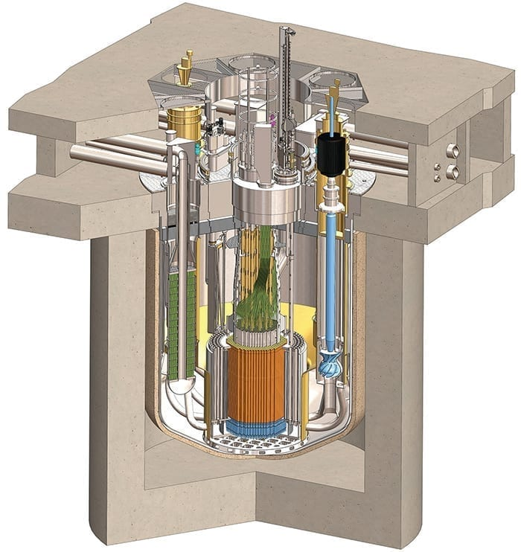
Next generation reactors use faster neutrons, different fuels, and coolants to achieve greater safety and modularity
Nuclear Data In Support of Clean Energy Goals
$$neutron$$
$$multiplication$$
$$factor$$
Terrapower
$$Thermal$$
$$fision$$
$$factor$$
$$Thermal$$
$$Non−leakage$$
$$factor$$
$$Fast$$
$$Non−leakage$$
$$factor$$
$$Thermal$$
$$utilization$$
$$factor$$
$$Resonance$$
$$escape$$
$$factor$$
$$Fast$$
$$fission$$
$$factor$$
Kairos FHR
Non-existent or uncertain Nuclear Data needs to be redressed for new materials and fuels in order to correctly understand/model the neutronics in new designs at a high level of confidence
MCFR (Cl)
TRISO Pebble Fuel (U,C,Si)
Molten Salt Coolant
(Flibe)
https://nucleardata.berkeley.edu
SMR (Na)

Slide 10
Nuclear Data & Space Nuclear Propulsion
Presented to: Workshop on Applied Nuclear Data Activities (WANDA) 2021
Space Technology Mission Directorate
Technology Demonstration Mission Program
Space Nuclear Propulsion Project
Kelsa Palomares, AMA Inc. | January 25, 2020

Slide 11
Other Items in the News
FY2022 Nuclear Data FOA in preparation
NNDC is now designated as an SC PuRE Data Resource
  https://www.energy.gov/science/office-science-pure-data-resources
NNDC has pioneered a new working relationship with some publishers to integrate NNDC data vetting as part of the peer review process to help ensure at the end of the day there is a single curated version of accurate data in everyone’s library
Discussing a charge to the Nuclear Science Advisory Committee (NSAC) to examine Opportunities and Challenges in Nuclear Data Research, Tool Creation Curation Advancement, and Workforce Stewardship.
New connections to other agencies/offices continue to be established (e.g. High energy Fe fragmentation measurement at RHIC planned for NASA).
Contemplating a potential new capability for “Rapid Response Nuclear Data”
Under Secretary for Science and Energy confirmed

Slide 12
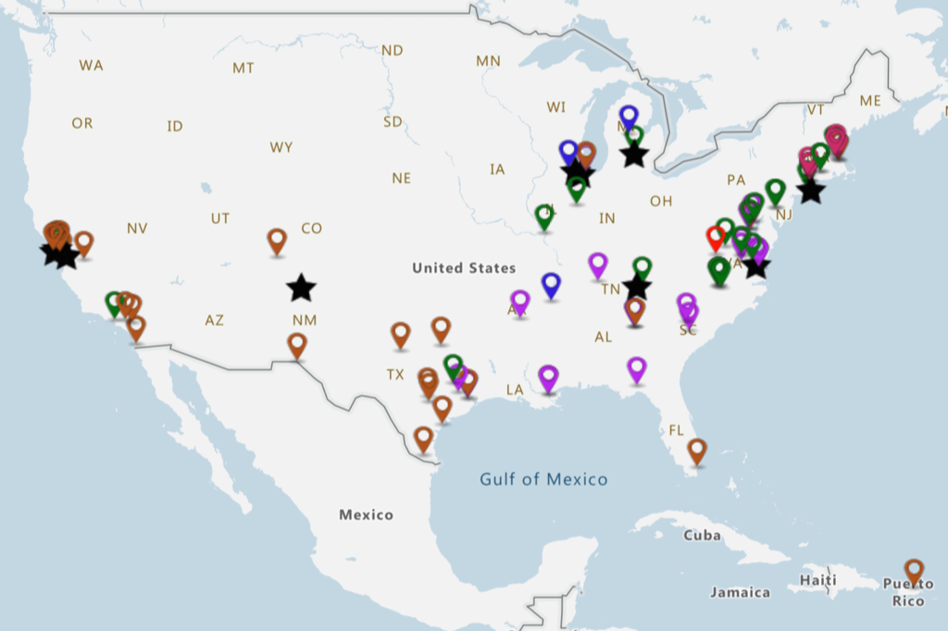


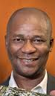
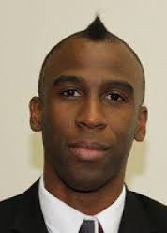
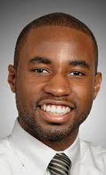






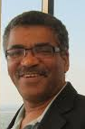
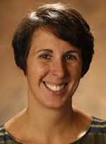

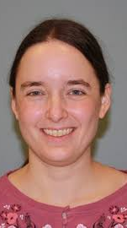
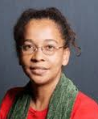
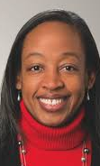

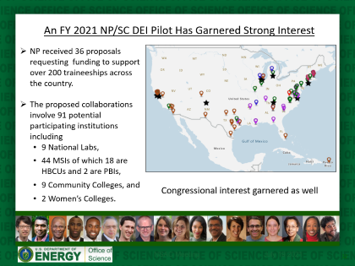

Continued Progress on Diversity, Equity, Inclusion a Strong Priority
NP received 36 proposals requesting funding to support 110 traineeships across the country.
The proposed collaborations involve 91 potential participating institutions including
  9 National Labs,
  44 MSIs of which 18 are HBCUs and 2 are PBIs,
  9 Community Colleges, and
  2 Women’s Colleges.
Congressional interest garnered as well
Traineeships thus far 40% Hispanic, 40% African American, 5% White, 5% Other
FRIB

