Slide 1
Nuclear Data Working Group Catherine Romano Chair, Nuclear Data Working Group
cathy.romano@ib3global.com
WANDA2022
February 28 – March 4, 2022

Slide 2
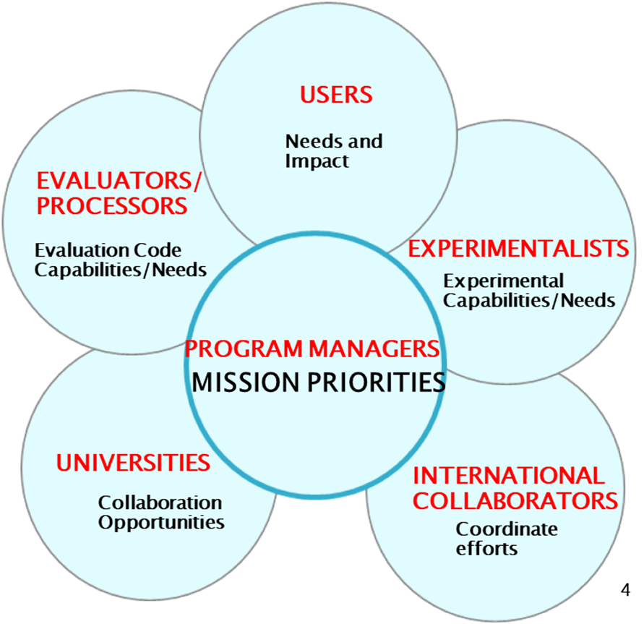
NDWG MISSION STATEMENT
The goal of the Nuclear Data Working Group (NDWG) is to facilitate communication, collaboration, coordination and prioritization of nuclear data efforts across multiple program offices, the national laboratories, universities, and industry.
NDWG was founded in 2015 to identify cross-cutting nuclear data needs
WANDA workshops are the mechanism used to obtain community consensus and to promote outreach

Slide 3
PARTNERS | NDWG Member | Organization
DOE/SC/Nuclear Physics | Lee Bernstein Catherine Romano | LBNL IB3 Global Solutions
NNSA/DNN R&D/PD/NA-22 | Fredrik Tovesson | ANL
NNSA/DNN R&D/Forensics | Todd Bredeweg Jason Harke | LANL LLNL
NNSA/DNN R&D/SNDD | Ron Soltz David Gerts | LLNL LANL
NNSA/NCSP/NA-511 | Mike Zerkle Marco Pigni | NNL ORNL
NNSA/NR/NA-30 | Mike Zerkle Tim Trumbull | NNL NNL
NNSA/Defense Prog./NA-113 | Jo Ressler Shea Mosby | LLNL LANL
NNSA/Defense Prog./NA-114 | Nathan Gibson Robert Casperson | LANL LLNL
DOE/Nuclear Energy | Matthew Jesse Javier Ortensi | ORNL INL
NRC | Will Wieselquist | ORNL
NNSA/Office of Nuclear Forensics/NA-83 | Corey Keith Chris Krenn | LANL LLNL
DOE/SC/Isotope Office | Etienne Vermeulen | LANL
NNSA/Emergency Response/NA-82 | John Koglin Pete Jaegers | LLNL LANL
NIST | Brian Zimmerman | NIST
US Nuclear Data Program | Dave Brown | BNL
NNSA/Nuclear Safeguards and Security/NA-24 | Young Ham | Tech Advisor
Missile Defense Agency/Rad Hardness | Courtney Matzkind | MDA
The NDWG has 50 Members
Representing 17 Programs
and 10 Labs
LAB | NDWG Member
ANL | Filip Kondev
ANL | Guy Savard
BNL | Alejandro Sonzogni
INL | Sebastian Schunert
LANL | Mark Chadwick
LANL | Robert Little
LBNL | Brian Quiter
LBNL | Bethany Goldblum
LLNL | Michael Buchoff
LLNL | Tim Rose
ORNL | Susan Hogle
ORNL | Mike Dion
PNNL | Stephanie Lyons
PNNL | Bruce Pierson
SNL | Pat Griffin
SNL | Phil Dreike
SRNL | Kalee Fenker
SRNL | Chris McGrath
AT LARGE MEMBERS | Bruce Pierson
Jim Koster | LANL
Patrick Talou | LANL
John Engle | Univ. WISC
Teresa Bailey | LLNL
Morgan White | LANL

Slide 4
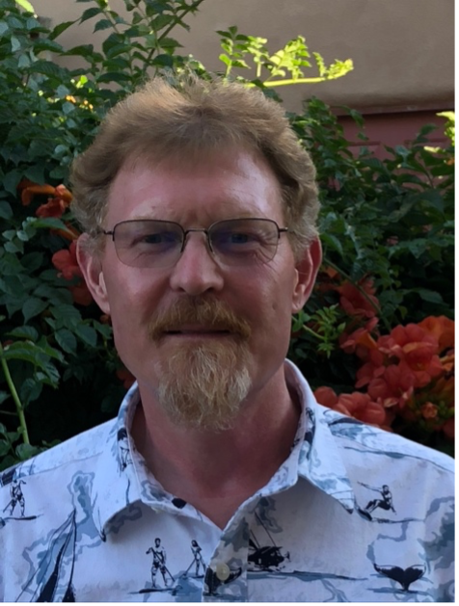
New NDWG Vice Chair!
Todd Bredeweg
Research scientist and the nuclear chemistry team leader at Los Alamos National Laboratory.
Member of NDWG since 2015

Slide 5
NDWG Webpage
Intended to be the mechanism of communication between ND community, ND users and program offices.
https://www.nndc.bnl.gov/ndwg/

Slide 6
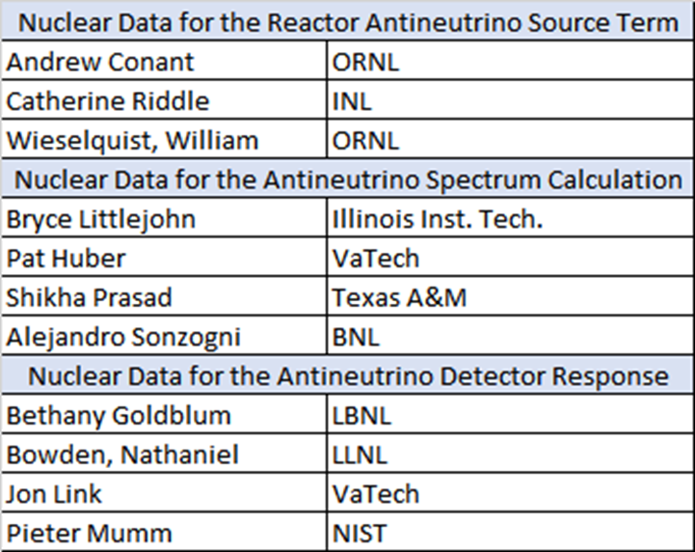
Workshop on Nuclear Data for Reactor Antineutrino Measurements: WoNDRAM
NDWG mini workshop
June 21 - 24, 2021
183 Registrants
Goals: Address nuclear data to:
Understand the reactor anomaly
Enable reactor monitoring using antineutrinos
https://www.nndc.bnl.gov/ndwg/workshops.html
https://arxiv.org/abs/2202.08241

Slide 7
WANDA2021 Report/Journal Paper
Current Nuclear Data Needs for Applications
Karolina Kolos¹, Vladimir Sobes², Ramona Vogt^{1,3}, Catherine E. Romano⁴, Michael S. Smith⁵, Lee A. Bernstein^{6,7}, David A. Brown⁸, Mary T. Burkey⁹, Yaron Danon¹⁰, Mohamed A. Elsawi^{11,12}, Bethany L. Goldblum^{6,7}, Lawrence H. Heilbronn², Susan L. Hogle¹³, Jesson Hutchinson¹⁴, Ben Loer¹⁵, Elizabeth A. McCutchan⁷, Matthew R. Mumpower¹⁶, Ellen M. O’Brien¹⁷, Catherine Percher¹⁸, Patrick N. Peplowski¹⁹, Jennifer J. Ressler⁹, Nicolas Schunck¹, Nicholas W. Thompson¹⁴, Andrew S. Voyles^{6,7}, William Wieselquist²⁰, Michael Zerkle²¹
To be the first perspective piece published in Physical Review Research! (upon final acceptance)
Thank you to Ramona Vogt, Michael Smith and Kay Kolos who spent many hours working with the editors and preparing the document.
Thank you to LLNL for paying for open access!

Slide 8
Past Workshop Topics That Have Been Funded
 | NDNCA (2015) Cross-cutting recommendations |  |  | WANDA2019 Topics
 | Dosimetry Standards |  |  | Nuclear Data for Isotope Production | x
 | Fission | x |  | Safeguards | x
 | Decay Data and g-Branching Ratios | x |  | Materials Damage
 | Neutron Transport Covariance Reduction |  |  | Nuclear Data for Nuclear Energy | x
 | Expanded Integral Validation |  |  | (n,x) Reactions | x
 | Antineutrinos from Reactors | x |  | Atomic Data, NRF Data
 | NDEM (2016) Cross-cutting Recommendations |  |  | WANDA2020 Topics
 | Improving the Pipeline infrastructure | x |  | Covariance/Uncertainty/Sensitivity/Validation
 | Improved Covariance Data |  |  | Nuclear Data for Isotope Production and Targetry Needs | x
 | Inelastic Scattering on actinides | x |  | Machine Learning/AI
 | Capture gamma spectra | x |  | Detector Models, Atomic Data and Stopping Powers
 | Improved Fission yields | x |  | Scattering, Transport and Shielding | x
 | Target Production to Support Nuclear Data Experiments | x |  | Neutron induced gammas and gamma decay | x
 | NDREW (2018) Topics |  |  | WANDA2021 Topics
 | Uncertainty, Sensitivity, and Covariance |  |  | Advanced Computing for Nuclear Data
 | Neutron Capture and Associated Spectra | x |  | Predictive Codes for Isotope Production
 | Fission I, Independent and Cumulative Yields | x |  | Expanded Benchmarks and Validation for Nuclear Data
 | Gamma-Induced Reactions | x |  | Nuclear Data for Space Applications
 | Inelastic Neutron Scattering and Associated Spectra | x |  | Nuclear Data for Advanced Reactors and Security
 | Fission II, Prompt Gammas and Neutrons | x |  | The Human Pipeline for Nuclear Data
 | (α,n) Reactions | x
 | Targets, Facilities and Detector Systems | x
 | Fission III, Decay Data | x
 | Development of Benchmark Exercises
 | Data Processing & Transport Code Needs
 | Actinide Cross Sections | x

Slide 9
Over $44M of nuclear data projects funded through the NDIAWG FOA since FY18
START | TITLE | LEAD LAB | Collaborators | PI
FY18 | Novel Approach for Improving Antineutrino Spectra Predictions for Nonproliferation Applications | ANL |  | Kondev, Filip
FY18 | Improving the Nuclear Data on Fission Product Decays at CARIBU | ANL |  | Savard, Guy
FY19 | Independent Fission Product Yields from 0.5 to 20 MeV | LANL |  | Winkelbauer, Jack
FY19 | Energy Dependent Fission Product Yields | LLNL | LANL, TUNL | Tonchev, Anton
FY19 | Measurements of Independent Fission Product Yields | LANL | LLNL | Duke, Dana
FY19 | Beta-strength function, reactor decay heat, and anti-neutrino properties from total absorption spectroscopy of fission fragments | ORNL | BNL | Rykaczewski, Krzysztof
FY19 | Integral Measurements of Independent and Cumulative Fission Product Yields Supporting Nuclear Forensics and Other Applications | LANL | LLNL, PNNL, NNSS | Bredeweg, Todd
FY19 | Evaluation of Energy Dependent Fission Product Yields | LANL | BNL, LBNL, PNNL, LLNL | Kawano, Toshihiko
 | Improving the double-differential 238U(n,n’g) cross section using neutron-gamma coincidences | LBNL |  | Bernstein, Lee
FY20 | Scoping Study of the Impact of (alpha,n) Reactions and Yields of Nonproliferation Applications | ORNL |  | Romano, Catherine
FY20 | Assessment of Nuclear Data Needs for Neutron Active Interrogation | ORNL |  | McConchie, Seth
FY20 | Fission product yield measurements using 252Cf spontaneous fission and neutron-induced fission on actinide targets at CARIBU | ANL |  | Savard, Guy
FY20 | Modernization and Optimization of the Evaluated Nuclear Structure Data File | BNL |  | McCutchan, Elizabeth
 | 238U(p,xn) and 235U(d,xn) 235-237Np Nuclear Reaction Cross Sections Relevant to the Production of 236gNp | LBNL |  | Bernstein, Lee
FY21 | Neutron Scattering Cross Sections: (n,n'), (n,n'g), and (n,g) Measurements | USNA |  | Vanhoy, Jeff
 | State-of-the-art Gamma-ray Spectroscopy to Enhance the ENSDF | BNL |  | McCutchan, Elizabeth
FY22 | Gamma Rays Induced by Neutrons | BNL | LLNL, LBNL/UCB | Brown, Dave
FY22 | White-source neutron-gamma coincidence measurements of gamma production cross sections at LANSCE | LANL |  | Kelly, Keegan
FY22 | Evaluation of Gamma-ray Production | LANL | LLNL, Notre Dame, NC State | Kawano, Toshihiko

Slide 10
Charge to WANDA2022 Participants
Participate!
Your contribution is critical to gain an understanding of global nuclear data priorities and potential solutions.
Share your thoughts
Ask questions
Add to the chat
Review the written session summaries

Slide 11
Thank You!
WANDA2022 Chairs: Kay Kolos and Bruce Pierson
WANDA2022 Session Chairs: Jon Batchelder, John Despotopulos, Hye-Young Lee, Greg Severin, Ken LaBel, Michael Smith, Ramona Vogt, Lawrence Heilbronn, Nolan Hertel, Tony Slaba, Bret Beck, Calvin Howell, Toshihiko Kawano, Cameron Miller, Lee Bernstein, Pat Griffin, Michael Kruse, Thomas Turflinger, Denise Neudecker, Amanda Lewis, Robert Casperson
The Rapporteurs: Catherine Apgar, Athena Marenco, Preston Awedisean, Tyler Nagel, Naser Burahmah, Joey Gordon, Robert Jacob, Jack Silano, Anton Tonchev, Chad Lani, Cheng Soren, Maksat Kuatbek, Katelyn Cook, Ali Dreyfuss, Daniel Siefman
Lisa Felker, logistics support
Keith Jankowski and Tim Hallman
The NDIAWG
All of you!

