Slide 1
⁴He Stopping Cross Sections:
(α,n) Yields for Nuclear Applications
Stephen Croft¹ and Andrea Favalli²
¹Lancaster University, UK; ²EC, JRC, Ispra, IT
WANDA 2022 Workshop for Applied Nuclear Data Activities
Feb. 28 – Mar. 1, 2022
Session: Stopping Power, Energy Deposition, and Dose
Notes:
Hello!

Slide 2
Outline
Observation
Relative α-particle stopping cross sections in the MeV region for compounds are not as well known as TT IOA (α,n) yield curves can be measured.
Plausible Y_{αn} goal: 1-2% absolute and much better relatively.
(α,n)-reactions
Safeguards NDA Example
Role of Stopping Data
Application Requirements
Ideas to Improve the situation
Notes:
TT IOA = thick-target integrated over angle
NDA = nondestructive assay
!!!We need to confirm the SP XS mixing rule and so why not do it by measuring what we are directly interested in!!!
This serves both purposes and produces data that is immediately useful to applications.
TT IOA yields ‘can’ be measured to about 1.6% absolutely and much better relatively, BUT discrepancies are typically >> bigger!!

Slide 3
Widespread Interest in (α,n)
Nuclear Reaction Theory
Astrophysics
Low Level Background
Isotope Production
Stray Dose
  Accelerator
  Cancer therapy – ²²⁵Ac and ²²⁷Th
Ubiquitous Source Term
  Nuisance &/or Signal across the nuclear fuel cycle & Special Nuclear Material (SNM)
  Nondestructive Assay (NDA)
Alan Leatham next to the Harwell neutron detector.
Source:
David West and Chris Sherwood,
ANE 9(1982)551
Notes:
Our interest is in the low energy, MeV, regime, for the most part

Slide 4
Safety, Security, and Safeguards:
Rest on accurate physical measurements
Interrogating sources e.g. Am/Li
  Broughton et al. NIM A1001(2022)165243
Special Nuclear Materials e.g. separated PuO₂, generate both (α,n) and (SF,n)
(α,n)/(α,xγ) Impurity Characterization
Spent Nuclear Fuel source terms
Waste forms e.g. glass
(Enriched) UF₆ verification
  Product & Process Holdup
Uranium Cylinder Assay System (UCAS) at the Rokkasho Enrichment Plant with a 48Y Cylinder
Source: Miller et al., NSE 176(2014)98
Notes:
For the AmLi: see also D.P. Broughton, M.S. Grund, G. Renha, S. Croft, A. Favalli,
Sensitivity of the active neutron coincidence collar response during simulated and experimental fresh fuel assay,
Nuclear Instruments and Methods in Physics Research Section A: Accelerators, Spectrometers, Detectors and Associated Equipment,
Volume 1001, (2021)165243.

Slide 5
Nuclear and Atomic Data Needs
Physics Based Nondestructive Assay (NDA)
  Design and Optimization of measurement systems
  Characterization and calibration
  Correction factors (to reference conditions)
  Interference corrections
  Inversion
(α,n) Needs
  See: Romano et al., WANDA 2021
  Li-K, yields & spectra, for α’s up to about 8 MeV
  Evaluations, Partial XS’s, Codes, Benchmarks etc.
  Stopping powers not well understood
    Application specific measurements are required
For Illustration see also:
DP Broughton, S Croft, C Romano, and A Favalli
Sensitivity of the simulations of passive neutron emission from UF₆ cylinders to the uncertainties in both ¹⁹F(α,n) energy spectrum and thick target yield of ²³⁴U in UF₆
Nuclear Instruments and Methods in Physics Research A1009(2021)165485 (8pp).
Notes:
All light elements … TT IOA spectra ±2% aspirational goal based on a ‘reasonable’ metrological expectation.
Ex. F
‘Easy’ in sense F-19 is 100% abundant, but between threshold (2.3635 MeV) and 4.76 MeV (U-234) the g.s. and 7 excited state in Na-22 are involved.
Max. emission energy from U-234 F(alpha,n) is about 2.41 MeV.
Even the total XS is very poorly known … data sets need adjustment by 15% of more to match.

Slide 6
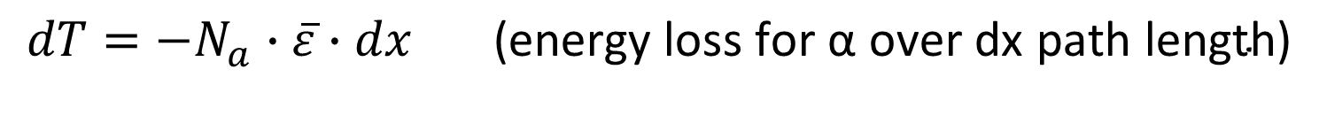
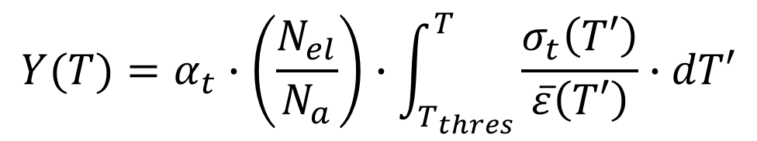
The Usual Equations:
Atomically Mixed (Homogeneous)
Continuous Slowing Down Approximation (CSDA)
The definitions of stopping power cross section, and reaction cross section
$$dT=−N_{a}∙\overline{ε}∙dx \text{(}\text{energy} \text{loss} \text{for} \text{α} \text{over} \text{dx} \text{path} \text{length}\text{)}$$
$dY=+N_{t}∙σ_{t}∙dx$ (prob. of reaction for α over dx path length)
are combined to give the yield equation:
$$Y(T)=α_{t}∙\left(\frac{N_{el}}{N_{a}}\right)∙\int_{T_{thres}}^{T}{\frac{σ_{t}\left(T′\right)}{\overline{ε}\left(T′\right)}}∙dT′$$
Notes:
Energy loss is a stochastic process but fluctuations/straggling is a minor influence.
We must integrate over the path-length (not projected range) from the initial alpha energy to threshold (or until the particle stops).
If we use alpha-n xs in mb/atom, stopping xs in E-15eV.cm^2/atom, and integrate in MeV then we get Yield/E6 alphas, which is also a traditional unit.
Most alphas slow down and stop without interacting and so we neglect the small loss of number as the energy decreases.
The incremental yield depends on the reciprocal of the average atomic stopping cross section of the compound.
Bias in the SP XS therefore affects the yield estimate made from the microscopic alpha-n XS directly
and also how we scale between materials.
At each step the intensity of the emitted spectrum is also affected … but perhaps not strongly.
Homogeneous also means random in this case … crystalline effects are being ignored in our energy range of interest.
Bragg-Kleeman additivity (independent atoms) is assumed but we don’t know how accurate this is.
SRIM and other data bases don’t have good guidance on the uncertainty in SP XS’s.
Direct yield measurements are one way to confirm scaling rules
The n-production XS should be independent of compound
Using the same equipment eliminates most systematic bias.

Slide 7
Usual Equations cont.
Units of Y: 10⁻⁶ n/α
If we use the (α,n) cross section in mb/atom, stopping power cross sections in 10⁻¹⁵eV.cm²/atom, and integrate over kinetic energy in MeV one gets the Yield in units of neutrons per 10⁶ α-particles, which is also a traditional unit in this application domain
Notes:
It’s easy to be six orders of magnitude out unless you take care.
Lot’s of papers often aren’t a clear as they might be!

Slide 8
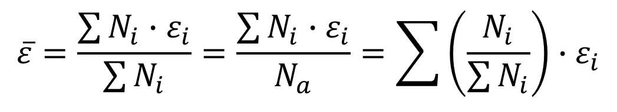
Usual Equations cont.
Bragg-Kleeman additivity is always assumed
$$\overline{ε}=\frac{\sum{N_{i}∙ε_{i}}}{\sum{N_{i}}}=\frac{\sum{N_{i}∙ε_{i}}}{N_{a}}=\sum{\left(\frac{N_{i}}{\sum{N_{i}}}\right)∙ε_{i}}$$
Notes:
BKA is the assumption that the atoms act independently.
In practice chemical binding and other effects such as crystalline and channeling are present.

Slide 9
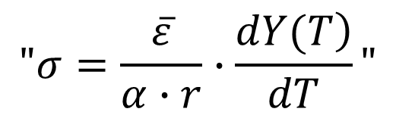
Usual Equations cont.
From the thick target integrated over angle (TT IOA) yield curve we can extract interval averaged cross sections which should be independent of how they were obtained
$$"σ=\frac{\overline{ε}}{α∙r}∙\frac{\left.dY(T\right)}{dT}"$$
Notes:
i.e. we can use the fact that the nuclear data is fixed by nature as a transfer standard

Slide 10
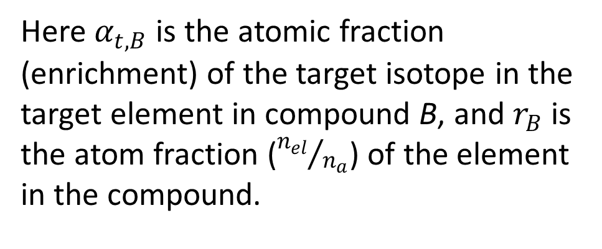
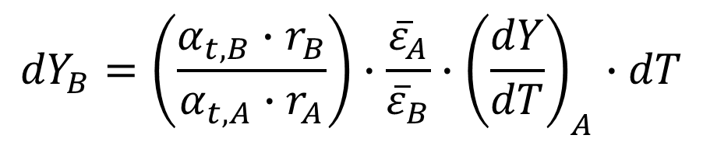
Usual Equations cont.
… and forms the usual scaling rule between media (compounds)
$${dY}_{B}=\left(\frac{α_{t,B}∙r_{B}}{α_{t,A}∙r_{A}}\right)∙\frac{{\overline{ε}}_{A}}{{\overline{ε}}_{B}}∙{\left(\frac{dY}{dT}\right)}_{A}∙dT$$
Here $α_{t,B}$ is the atomic fraction (enrichment) of the target isotope in the target element in compound B, and $r_{B}$ is the atom fraction (${n_{el}}/{n_{a}}$) of the element in the compound.

Slide 11
Historical F-Targets
Gas: ¹⁹F(α,n)²²Na and ⁴He(¹⁹F,n)²²Na
Solid: CaF₂, ZnF₂, SrF₂, LaF₃, PbF₂
Required: UF₆, PuF₄, UO₂F₂:2.5H₂O … etc.
Fluorine is ubiquitous in the fuel cycle, in rocks etc.
Enriched UF₆ is a special case of interest.
¹⁹F is 100% abundant.
For natural feed maximum alpha-energy is form ²³⁴U & is only 4.775MeV
Notes:
Accelerator targets / Radioactive Materials

Slide 12
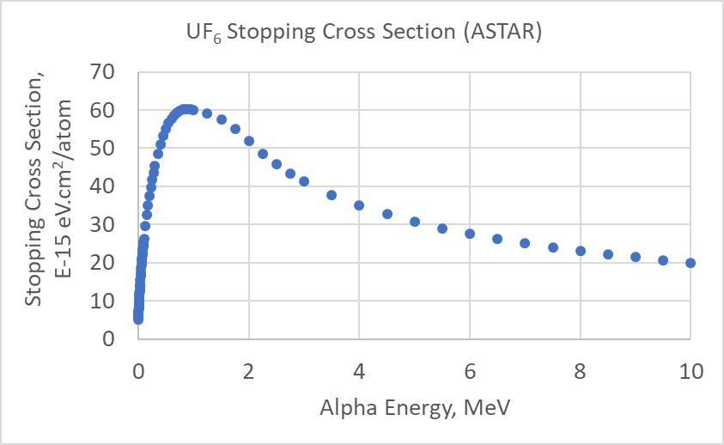
Illustration: SP XS
Shape
Scale
  3.5-5.5 MeV
Source: NIST ASTAR; SRIM-2013

Slide 13
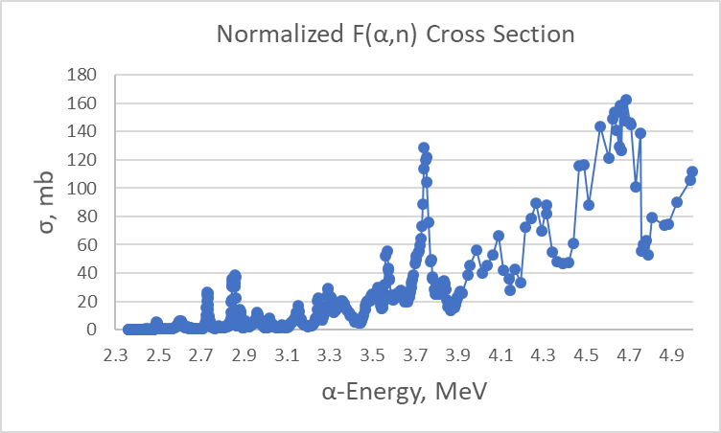
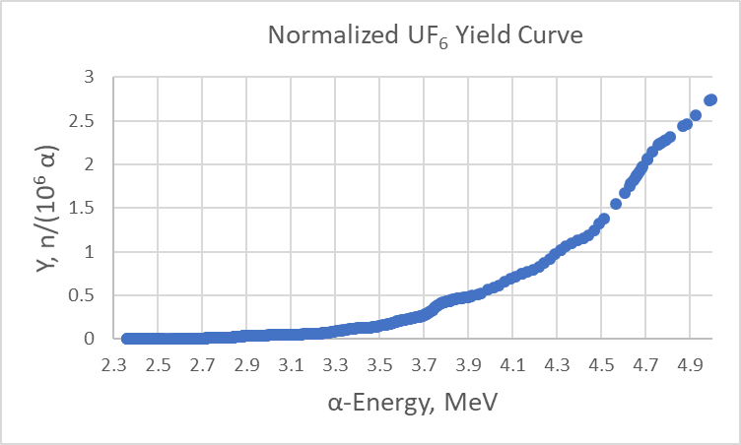
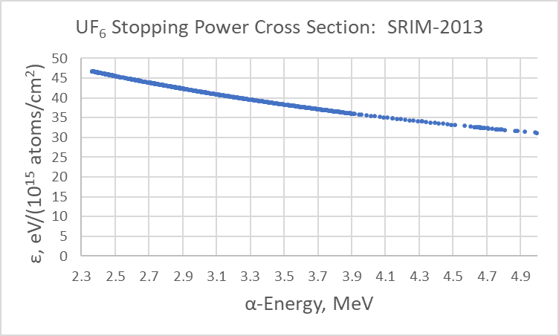
UF₆ case
Source Materials: Croft et al. INMM-2018; Croft et al. NIM A954(2020)161608; Broughton et al. NIM A1009(2021)165485 (extends to 10 MeV)
Notes:
Normalization: Interim – 510 n/s/g U-234 in UF6.

Slide 14
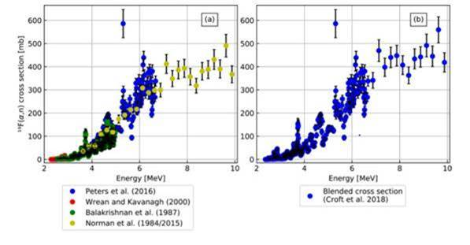
For Completeness
Across the nuclear fuel cycle an upper energy of 10 MeV is reasonable
From: Broughton et al. NIM A1009(2021)165485)
Notes:
In some ways collecting data at higher energies is easier because the cross section is smoother and the yield is much stronger.
And it can still be very useful in normalizing different experiments.
The astrophysics community are often more interested in the low energy region.

Slide 15
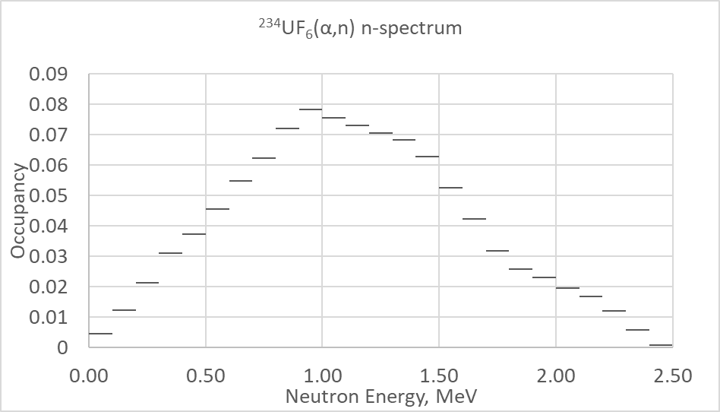
UF₆ case again – Spectra
Determine Instrument Response
Two body kinematics is used to generate the neutron emission energy and the spectrum comes from the integral. The shape of the SPXS matters, not the scale.
Notes:
Source: Fanspec - J&L'83 - includes eff weighting & yield est for U isotopes and SOURCES.xlsx
In brief a special version of SOURCES-4C was created in ORIGEN by Ian Gauld at ORNL.
The stopping power cross sections for F and U were replaced by a SRIM-2013.
The F (alpha,n) cross section was replaced by the 'blended’ XS on the previous slide.
The decay data and branching ratios and all other details were NOT altered.
Experiments tend to fill in the low energy region.
They are not available by isotope which is why we don’t show, for example, Jacobs and Liskien for comparison, here.

Slide 16
Where have workers taken stopping data from?
SRIM-2013 – good book, flexible, and very accessible
NIST ASTAR – limited coverage
MCNP (transport code)
CaSP, Grande & Schiwietz (see PRA 58(1998)3796; NIM B153(1999)1; NIM B164(2000)203)
LaRC (Modified Ziegler) – Tai et al., Langley RC, NASA TP3644(1997)
ALPHN, Salmon & Hermann, ORNL-TM-12239(1992)
Janni (scale p-data for speed and z_{eff}) Part I compounds; Part II (elements). ADNDT(1982)
Ziegler, 1977
SPAR – Armstrong and Chandler NIM 113(1973)313
Northcliffe & Schilling, 1970
Williamson et al. CEA-R-3042(1966)
Whaling, 1958
Notes:
Note NIST ASTAR requires interpolation
SP XS for solid-F from Teflon or CaF2 etc.
Code to code comparisons don’t tell the full uncertainty story
You can tell in part from the organization the energy, ion and target domains of interest

Slide 17
Frustrations
Huge literature – and early reports hard to find
  Paul & Schinner NIM B179(2001)299 – assembling a database is a life's work
No consensus on ‘best values’
No meaningful uncertainty guidance
Limited guidance on compound effects
No α-SPXS tables for the transuranics (e.g. Pu & Am)
Transforming (α,n) yields between compounds incurs an uncertainty comparable to the measurement accuracy
Notes:
I tried to get all the references used by Bichsel one time and failed. A lot of the early reports are hard to find.
Helmut Paul and Hans Bichsel work and critical comments are always worth reading but the question is how to take what they say and use it.
Lack of open data for transuranics is surprising given it is an interesting physics problem and because of stockpile stewardship program.
I have seen some limited data on UPu oxide and carbide but the quality of the data and use of fitting functions don’t allow UO2 vs. PuO2 or UC vs PuC comparisons to be made.

Slide 18
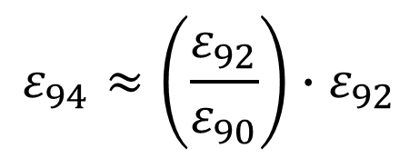

Ad Hoc Electronic SP scaling with atomic number Z>92
Ex.: Plutonium
In the MeV regime both approaches agree to a small fraction of a %
$$ε_{94}≈\left(\frac{ε_{92}}{ε_{90}}\right)∙ε_{92}$$
$$ε_{94}≈ε_{92}+\left(ε_{92}−ε_{90}\right)$$
Notes:
For the electronic component Z-scaling suggests itself,
and for the transuranic elements scaling off Th and U seems the strongest experimental basis.
In the 2-6 MeV range the difference and proportionate formula agree to better than 0.1 %.
Note the SRIM book explains how nuclear stopping can be estimated. It matters at the lower energies. And can be readily estimated for targets of different isotopics. Its why at a given speed the SP of He-3 is not the same as for He-4.

Slide 19
SP XS Methods
Energy deposition in a gas
Energy loss by transmission
Backscatter (double transmission)
Direct (α,n) and (α,xγ), & associated activity
Availability
Uniformity
Stoichiometry
See for ex.: Fontana et al. SP Measurements with the TOF Technique at UT, Knoxville
with material sciences group at ORNL
NIM B366(2016)104-116
Relative Measurements using
the Same Equipment
Minimizes Systematic Bias
Notes:
Some thin target measurements estimate the layer thickness using alpha SP XS and RBS off the substrate.

Slide 20
Experimental study of ³⁷Cl(α,n)⁴⁰K reaction
In collaboration with Argonne National Laboratory (experiment lead by Daniel Santiago-Gonzales).
Requested 2 days of ATLAS beam time with MUSIC (Multi-Sampling Ionizing Chamber) active-target gas-filled detector.
α in the energy range (lab frame) 4.4-7.8 MeV.
Reverse kinematics.
Goal: ³⁷Cl(α,n)⁴⁰K Cross section and stopping power of ³⁷Cl ions in ⁴He gas.
Notes:
According to Mohr (European Physics Journal 2015) “surprisingly, no experimental data are available in EXFOR for the 37Cl(alpha,n=40K and 37Cl(a,p)40Ar reactions”.
A key feature of the experiment is that you measure what you need (i.e. energy loss) and can get data at several energies at once.

Slide 21
Conclusions
Every point of frustrations is an opportunity
There is plenty of scope to improve the situation
Within reach of various facilities
e.g. before Stephen left ORNL he had discussed with Sacit M Cetiner
how Sacit’s new ion TOF spectrometer design could be used for SP XS measurements
e.g. ATLAS/MUSIC
e.g. integral measurements on compounds
Relative measurements on relevant materials can really add value
Direct neutron detection
Reaction γ-ray detection
Associated Activity (¹⁹F(α,n)²²Na: 2.60 y, 1.275 MeV 99.94%)
Notes:
Absolute TT IOA accuracy of 1-2% should be possible and relative measurements should be a small fraction of this,
Representing a stringent test on the mixing rule.

