Slide 1
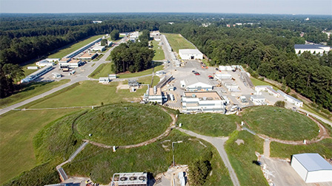
Data Needs for Particle Therapy
Cynthia Keppel
Thomas Jefferson National Accelerator Facility
WANDA
March 2022

Slide 2
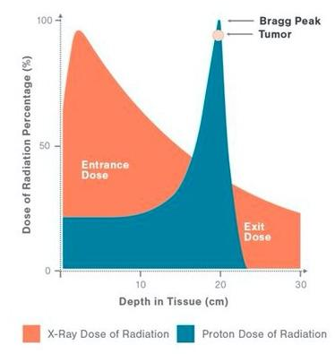
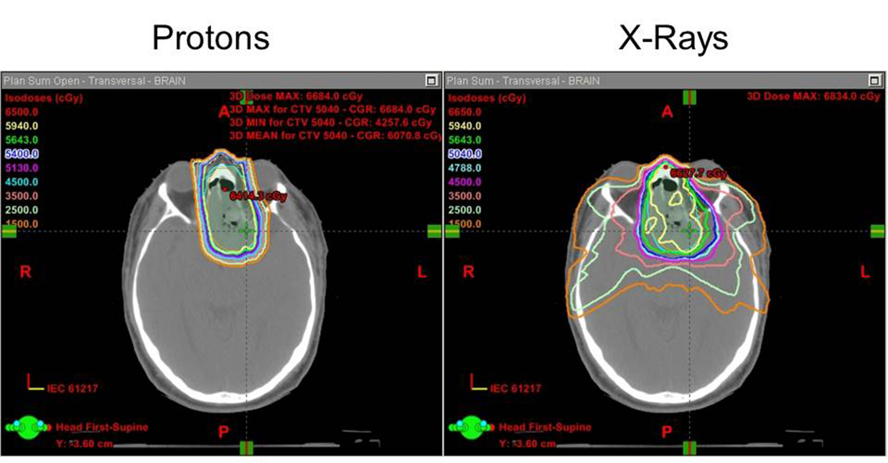
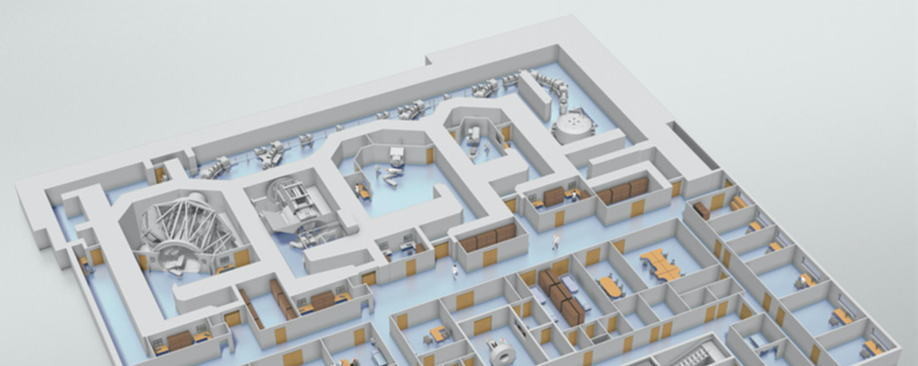
Proton/Ion Therapy for Cancer Treatment
Radiotherapy with a particle accelerator allows oncologists to design fine-tuned three-dimensional cancer treatment plans.
Fundamental nuclear physics: Bragg peak determines proton energy loss = dose to patient
Enables higher precision localized treatment
Associated with fewer side effects due to reduced stray radiation outside the tumor region
Nuclear physics technology to enable this includes simulation, beam transport, acceleration, dose monitoring, and more….

Slide 3
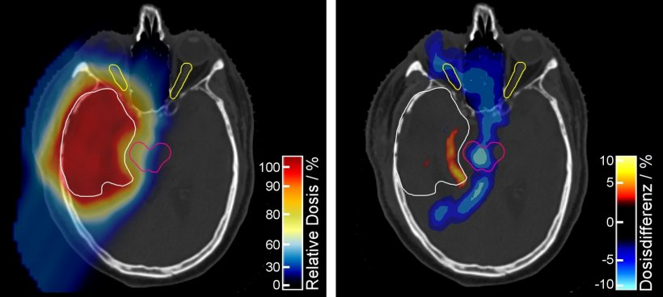
Proton/Ion Radiation Therapy – Range Uncertainties
The range in tissue is associated with considerable uncertainties caused by:
Imaging
Patient setup
Beam delivery
Dose calculation
Safety margins typical 3.5% of range 1 + 1.5mm², up to ~12mm used
Reducing the uncertainties would allow a reduction of the treatment volume, allowing a better utilization of the advantages of protons.
Dual energy CT for planning (Dresden/Heidelberg): saves brain tissue, optic nerves, brain stem – also higher dose delivered to target area

Slide 4
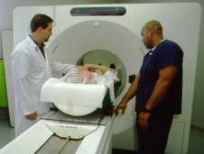
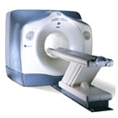
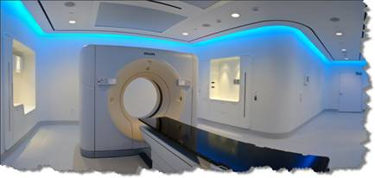
(MRI or PET or..)/CT scans are performed for simulation treatment planning.
The CT images provide the treatment information for tumor location and geometry, surrounding anatomy, and tissue density.
The CT images are used to:
simulate passage of the particle beam
requires physics calibration, convert Hounsfield units to stopping power
- design the radiation therapy plan
- check alignment of patient during treatment

Slide 5
Simulation Calibration
Calculated values sometimes chosen over physically measured results
Could improve:
Tissue types and variation
Rigorous uncertainty evaluation
Distance from CT center effect
Standardization
Schnell et al., Oklahoma (typical example)

Slide 6
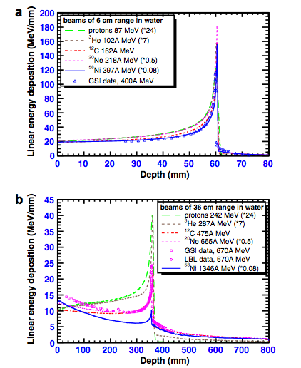
(Carbon) Ion Therapy
Heavier particles have a higher RBE, making them more effective at treating tumors with an anoxic core
At high energies, nuclear fragmentation plays increasing role with heavier ions - secondary particle tail
RBE higher for proximal dose as well
But, are effects from proximal dose same as from primary beam?
Also combined along path as energy is lost, increasing

Slide 7
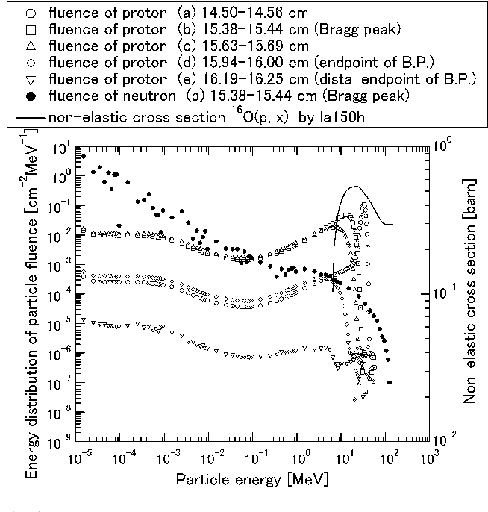
Proton Therapy dose beyond Bragg peak - neutrons
Neutrons continue beyond Bragg peak
Higher RBE, how do they contribute to RBE (energy dependence?)
Production across total beam delivery
Basically only simulation studies
Incorporate into treatment planning?
Matsuzaki et al., Radiol. Phys. Technol., 2010 Jan., 3(1) 84

Slide 8
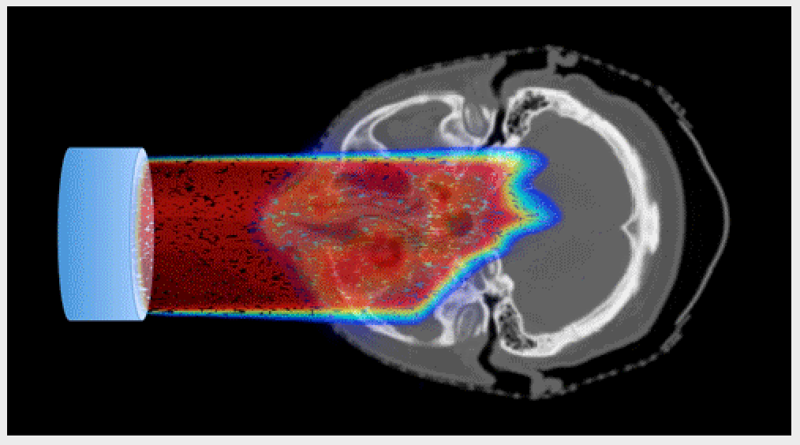
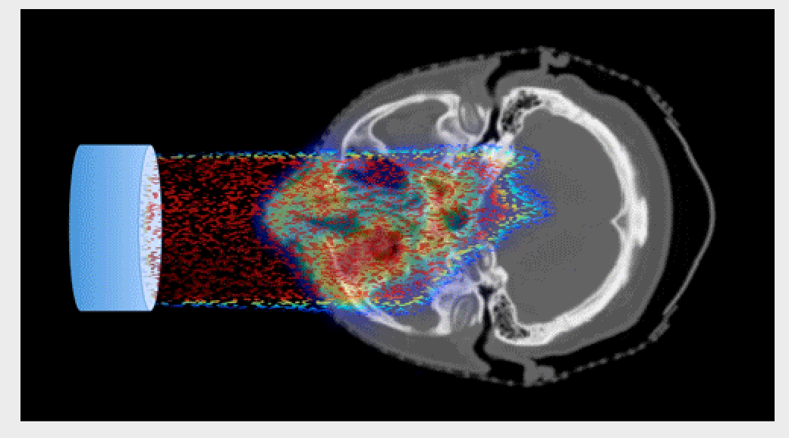
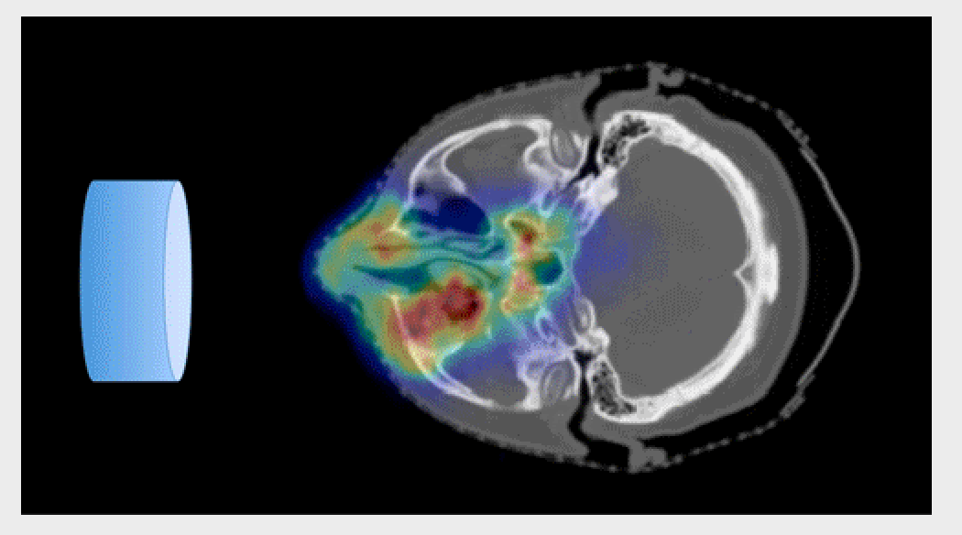
Dose Delivery Verification and Planning
In vivo range verification fist step (PET imaging, prompt gamma,..)
On board, full dose validation in the future?
Use for adaptive planning?
Treatment beam delivery
Intensity depends on:
Beam luminosity (known)
Abundance of element (patient specific)
Type of tissue
Rate of Excitation and Emission
Rate of decay – leverage this?
Excitement of C, O, N,…

Slide 9
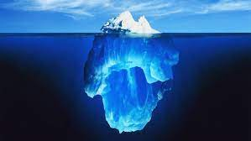
Summary: Just touched on a couple areas…
Improved data and/or data modeling could improve treatment planning
Reduce range uncertainty
Improved stopping power calibration
Include secondary production (and associated dose/RBE)
Facilitate range verification now
Full dose image reconstruction In future
Adaptive planning

