Slide 1
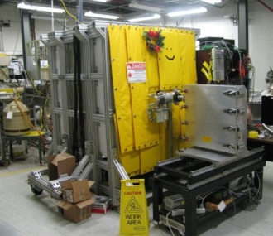
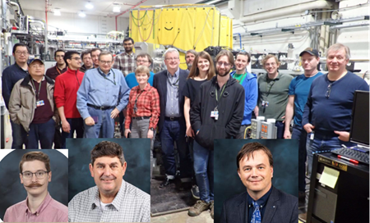


Beta-strength function, reactor decay heat and anti-neutrino properties from total absorption spectroscopy of fission fragments
Krzysztof P. Rykaczewski (Physics Division ORNL)
4-year project, from Nov. 2018, funded by
the DOE Nuclear Data Program following FOA LAB 18-1903
ORNL effort $ 1314 K
Oak Ridge
Argonne
This FOA 18-1903 project focused on new studies with ORNL’s
Modular Total Absorption Spectrometer (MTAS) at the ANL’s CARIBU facility
providing well separated beams of ²⁵²Cf fission fragments.
Evaluated data → NNDC at BNL
Many important contributors: ANL, UTK, LSU, Warsaw, TN Tech, LLNL ..
WANDA 2022, March 4th, 2022

Slide 2
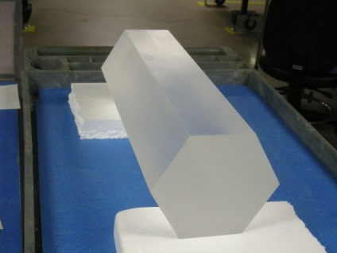
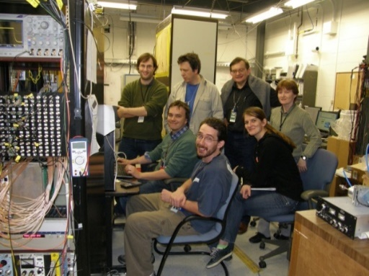
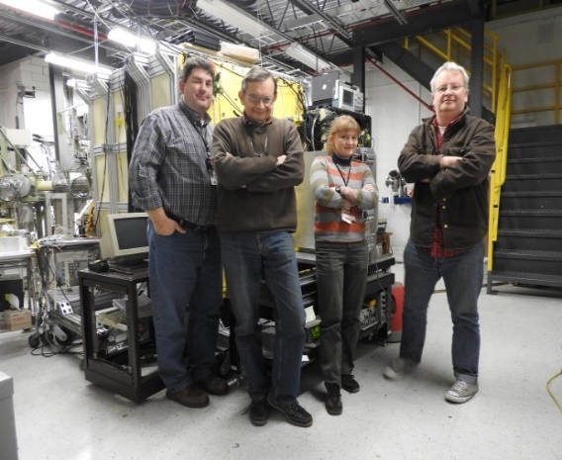
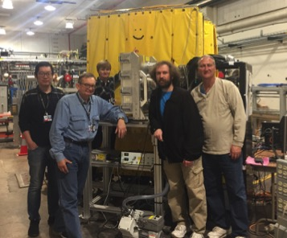




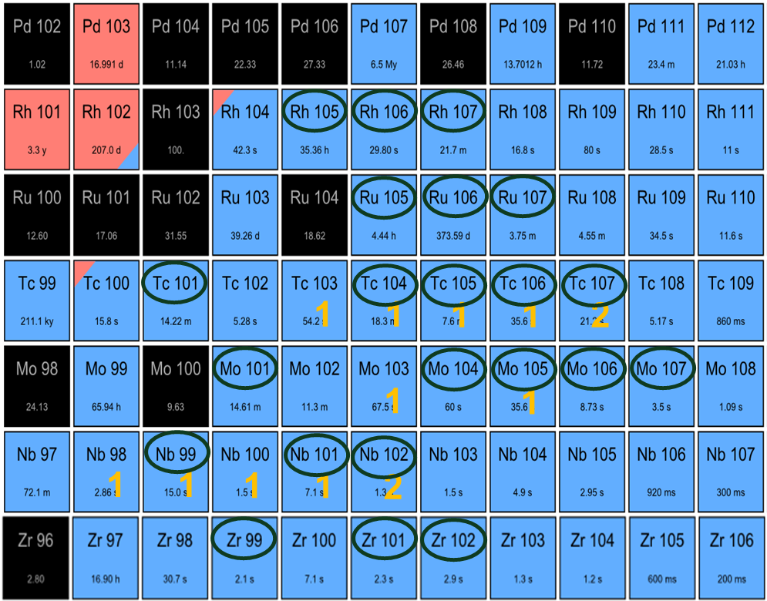
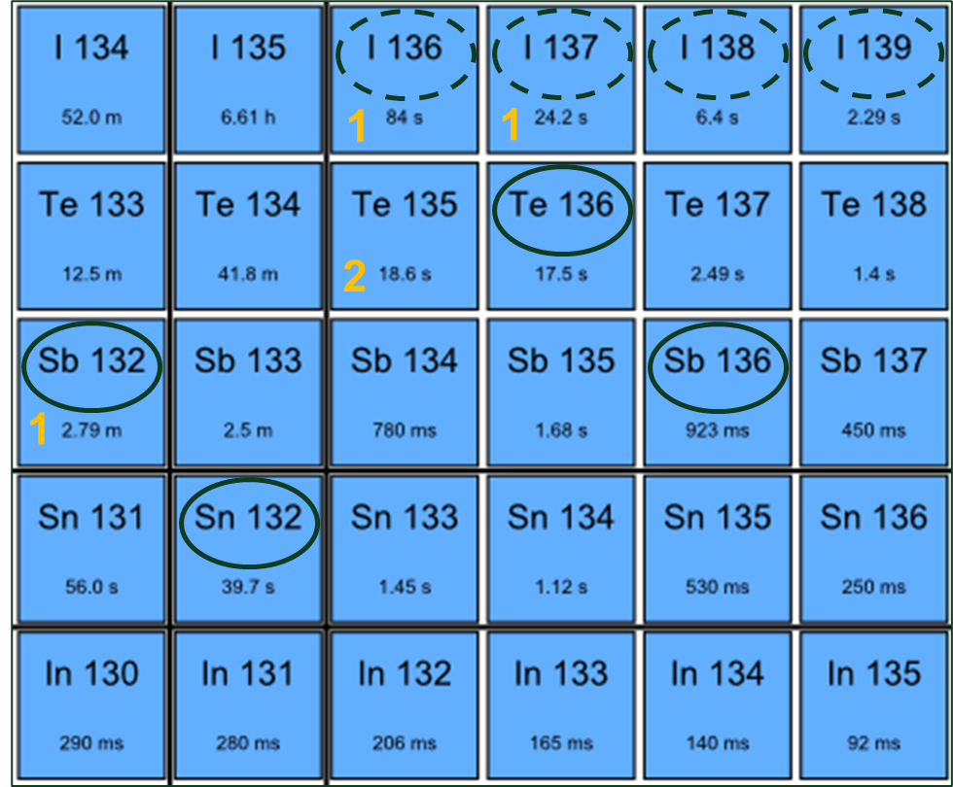
MTAS at ORNL’s HRIBF and ANL’s CARIBU
St. Gobain (OH)
ORNL HRIBF
ANL CARIBU
FRIB FDSi
2020-2021
2010
2011
2012
2016
2019
Black ovals indicate
27 nuclei studied with
MTAS at ANL’s CARIBU.
Several radio-activities
were selected using
MRTOF device.
Nine nuclei of high priority
for reactor decay heat
and
reactor anti-neutrinos.
ANL proposals: KR et al.,
Rasco et al.,
WANDA 2022

Slide 3
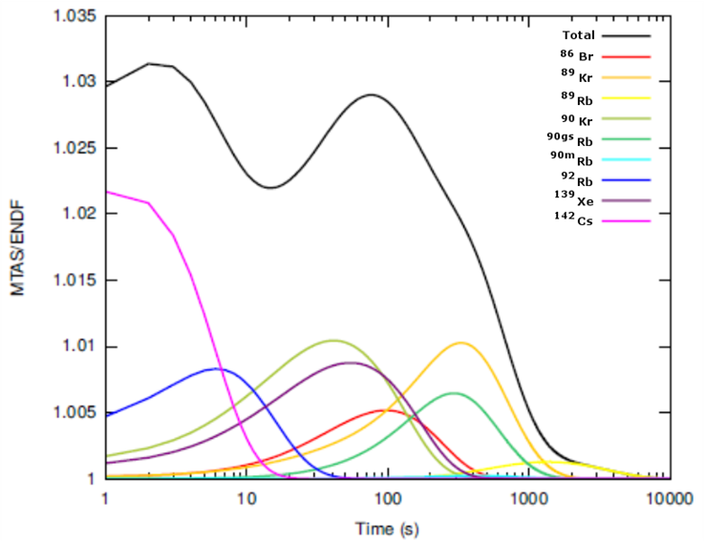
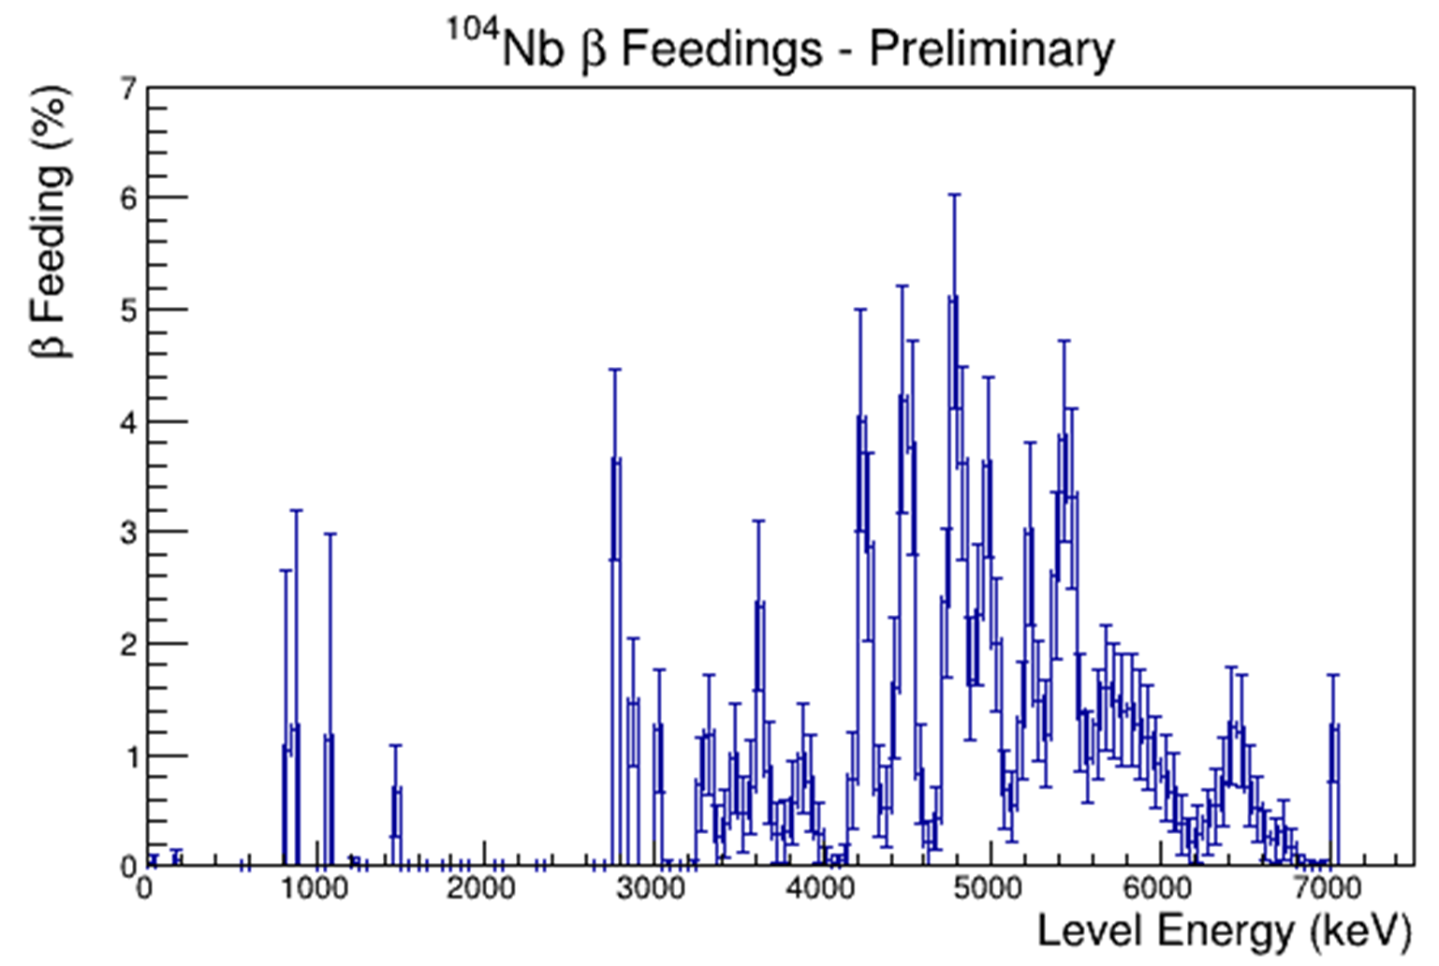
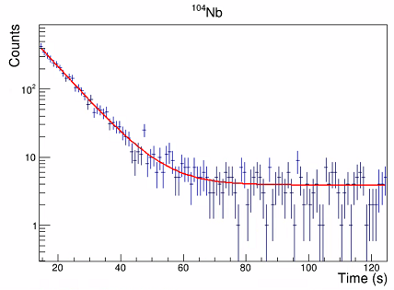
Reactor decay heat and MTAS data - ¹⁰⁴Nb decay, Y_{cum}=1.5% (²⁴¹Pu)
Ryan Lorek (NNDC), APS April 2021- ¹⁰⁴Nb the 3rd most important nucleus to be restudied with TAS method
Earlier results from ⁸⁶Br to ¹⁴²Cs
¹⁰⁴Nb β-decay, Q_{β}=8.5 MeV,
¹⁰⁴Nb half-life
ENSDF/ENDF
known β-fed levels
MTAS
new β-fed levels
T_{1/2}=5.9(3) s
~ 3% increase of γ-radiation
in decay heat release in the power reactor
MTAS derived β-feeding pattern in ¹⁰⁴Nb decay
Few levels listed in ENSDF, no decay scheme.
Decay heat value increased by ~ 60% from
ENDF calculated value of 3.1 MeV
to MTAS experimental result 4.9 MeV.
¹⁰⁴Nb half-life was corrected
from listed 4.9(4) s to 5.9(3) s.
Ground state spin of (1+) revised through
the absence of gs (1+) – gs (0+) β-feeding.
Fijalkowska et al., PRL 119, 052503, 2017
Rasco et al., PRL 117, 092501, 2016
FOA-funded Alex Laminack, DNP 2021, and to be submitted
WANDA 2022

Slide 4
¹⁰⁷Tc decay, Y_{cum}(²⁴¹Pu) = 5%, priority “2”
Reactor Decay Heat:
ENSDF ~ 0.8 MeV
(ENDF ~ 0.5 MeV)
MTAS ~ 2.1 MeV
¹⁰⁷Tc
ENSDF
MTAS
P. Shuai et al, 2022, (in preparation)
WANDA 2022

Slide 5
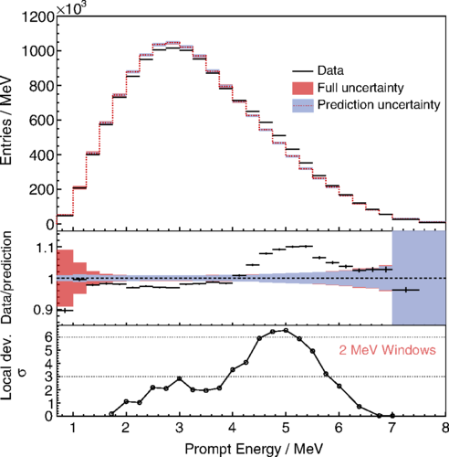
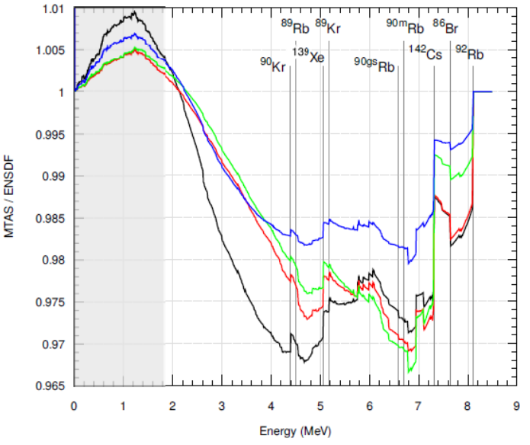
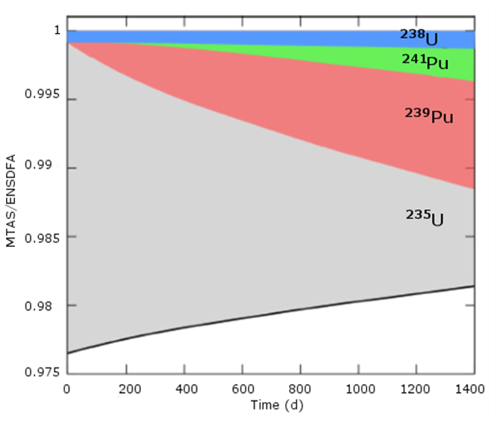
Reactor anti-neutrino interactions and earlier MTAS data
MTAS vs ENSDF
Daya-Bay 2019
~ 5% deficit of overall reactor anti-neutrino interactions (RA anomaly) and an over 6-σ excess of high energy anti-neutrinos (bump) as compared to the reference flux from Huber-Mueller 2011 modelling.
The 2%-3% reduction of the number of anti-neutrino interactions with matter
in nuclear fuel components:
²³⁵U (black), ²³⁸U (blue), ²³⁹Pu (red), and ²⁴¹Pu (green).
Total relative change (solid black line) in the expected number of anti-neutrino interactions with the detector matter (MTAS/ENSDF) as
a function of the reactor operation time
after refueling (burnup profile).
Fijalkowska et al., PRL 119, 052503, 2017
Rasco et al., PRL 117, 092501, 2016
Adey et al., PRL 123, 111801, 2019
WANDA 2022

Slide 6
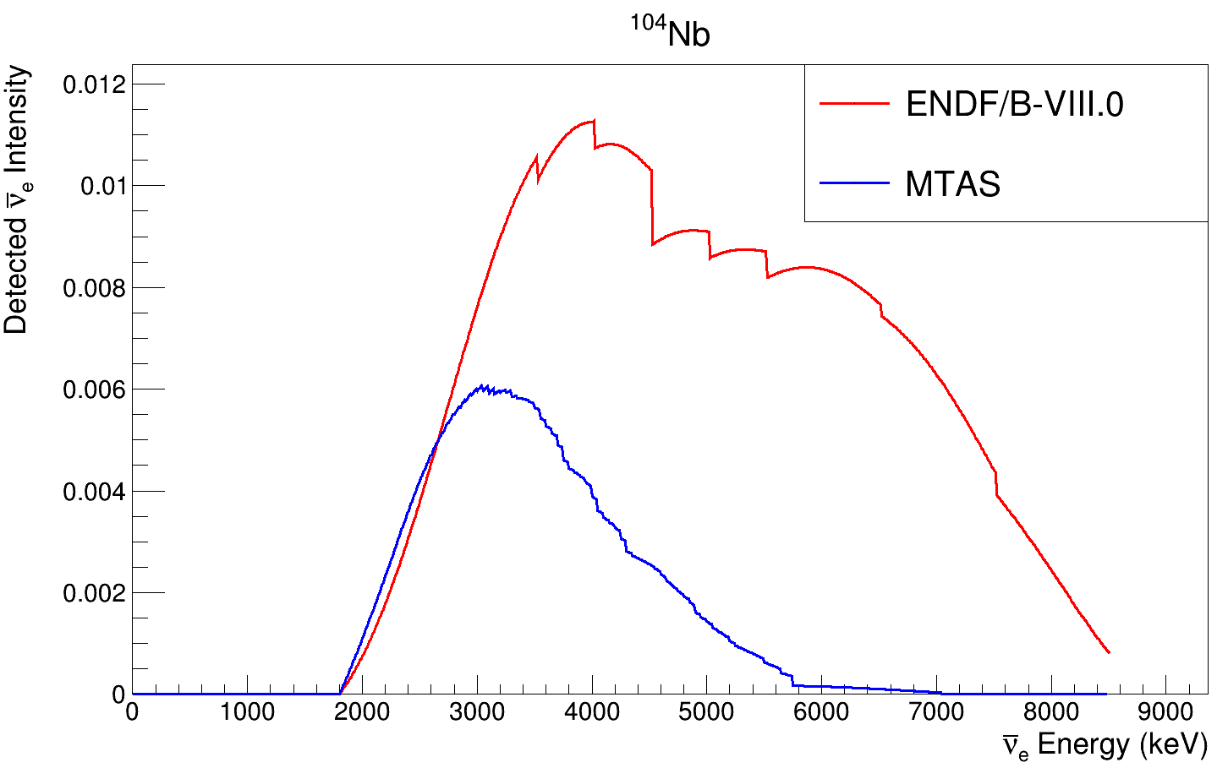
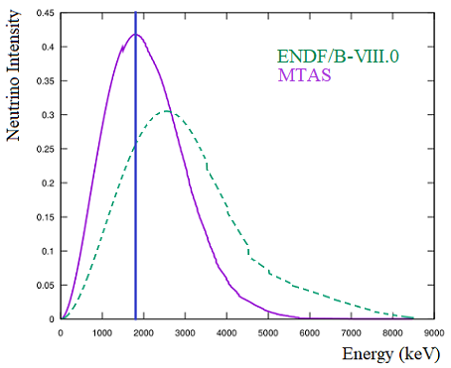
Reactor anti-neutrinos from ¹⁰⁴Nb decay (ANL’s CARIBU/FOA)
¹⁰⁴Nb β-decay ENSDF/ENDF vs MTAS
Anti-neutrino spectra ¹⁰⁴Nb β-decay
¹⁰⁴Nb anti-neutrino - proton interactions
known β-fed levels
MTAS
new β-fed levels
ν+ p →n + e⁺
78%↓
New β-feeding distribution
¹⁰⁴Nb→¹⁰⁴Tc
Note a shift of anti-neutrino spectra
towards lower energies
Reduction of the interacting ν-flux
lowers RA anomaly and increases “bump”
Alex Laminack, Charlie Rasco, Ola Fijałkowska et al., 2022 (preliminary)
WANDA 2022

Slide 7
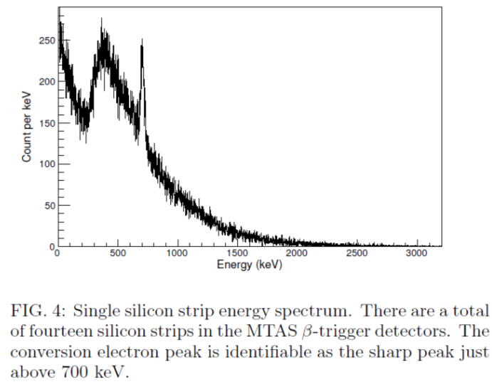
⁹⁸Nb, Y_{cum}~ 6% for ²³⁵U and ²³⁹Pu
MTAS results not always reduce reactor anti-neutrino anomaly and increase the high energy bump
“Deciphering ⁹⁸Nb β Decay with MTAS”, Rasco et al., → submitted to Phys. Rev. C
⁹⁸Nb
1⁺
Q_{β}=4.6 MeV
⁹⁸Nb
2.61
7 β-fed levels
0+, 1+, 2+
MTAS:
20%
2⁺
0.79
20%
0⁺
0.74
E0
61%
57%
0⁺
0
Decay heat down by ~ 50 keV
High energy antineutrinos
in ⁹⁸Nb decay up by 8 %
(lowers the “bump”)
E0 monoenergetic electrons
recorded by segmented silicons
inside MTAS
WANDA 2022

Slide 8
⁸⁸Rb →⁸⁸Kr →⁸⁸Sr decays
“Determination of β -Decay Feeding Patterns of ⁸⁸Rb and ⁸⁸Kr Using MTAS”
P. Shuai et al, → submitted to Phys. Rev. C
The shape of FFU 2- → 0+ β-transition studied with MTAS
MTAS results
⁸⁸Rb
2⁻
Q_{β}=5.3 MeV
4.85 MeV
FFU shape
allowed shape
β-fed levels
from 1+ to 3-
2⁺
1.8 MeV
78%
0⁺
0
⁸⁸Kr
Well separated and intense
First Forbidden Unique
gs→gs β-transition
MTAS simulated response
to gs-gs β-transition
WANDA 2022

Slide 9
Summary
- Measurements of 27 β-decays of refractory elements isotopes with MTAS at CARIBU (ANL) were enabled by FOA funding.
- We are “on budget”, funds are used now to support a third year of Laminack’s post-doc assignment (includes 3 months beyond the FOA end-date 10/30/22)
Large increase of γ-decay heat and related decrease of anti-neutrino energies observed for most decays, but not for all studied decays !
First attempt to distinguish/verify the character of β-transition, with FFU vs allowed shape.
MTAS moved to FRIB/FDSi, to perform “discovery experiments” (4 accepted experiments)
We propose the shape factors for energy spectra of individual beta transitions will be measured with a novel beta-energy detector inside MTAS. This is “the last most important frontier” in the reactor antineutrino spectra analysis, see the conclusions of IAEA2019, WANDA 2020-21, Snowmass 2021, WoNDRAM 2021 meetings.
WoNDRAM 2021 recommendation:
Perform electron spectra measurements for the largest fission product contributors to the total
antineutrino spectrum, to quantify the effect of sub-dominant corrections to the spectrum shape.
WANDA 2022

Slide 10
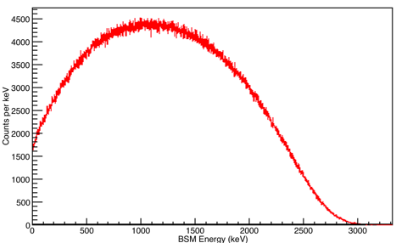
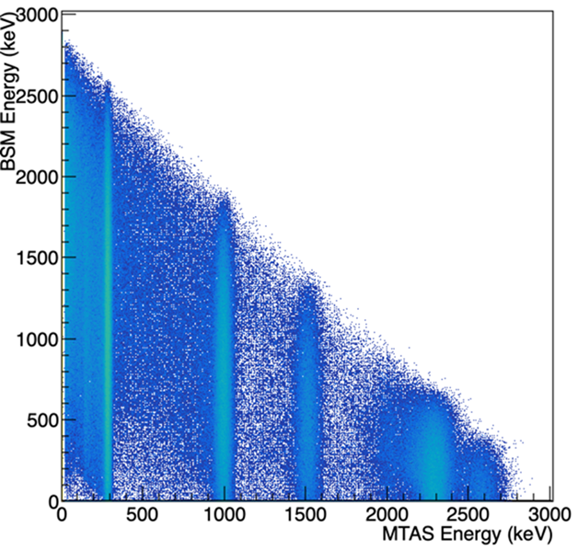
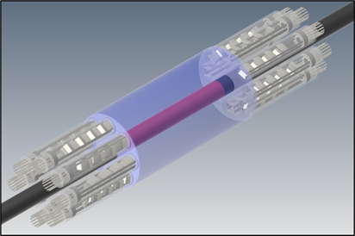
The final frontier for MTAS studies of reactor anti-neutrino properties.
Analysis of beta decay properties depends on the character of beta transition, is it allowed or first forbidden non-unique/unique. The first forbidden transitions are abundant in the decay of reactor made fission products. Individual shape factors for beta energy spectra are planned to be measured using a novel phoswich Beta Spectrum Module (BSM) in coincidence with over 98% efficient MTAS.
5/2+
MTAS-veto’ed β-spectrum
gs→gs β-transition
3/2+
Simulations
B.C. Rasco
1/2+
⁹³Y^{gs}→⁹³Zr^{gs}
1/2⁻ → 5/2⁺
first forbidden unique
90% β-transition
BSM
BSM energy
versus MTAS energy
for ⁹³Y (I^{π} = 1/2⁻) decay
We will select a particular beta transition by gating on the β-fed level energy detected in MTAS using pure Caribu beams selected with a help of MRTOF (application by Rasco et al., for FOA 2440).
Ruland, Febbraro, Rasco, King …. demonstration beam time by Rasco et al approved at ANL
WANDA 2022

Slide 11
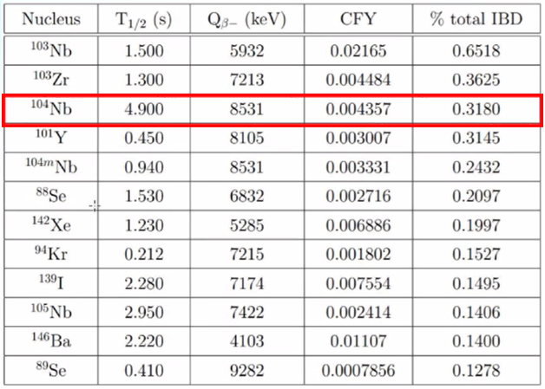
Importance of ¹⁰⁴Nb
Alex Laminack DNP 2021
12 most important thermal neutron-induced fission products of ²³⁵U with little or no experimental data
Ryan Lorek(NNDC) , APS April Meeting 2021
WANDA 2022

